Slide 1



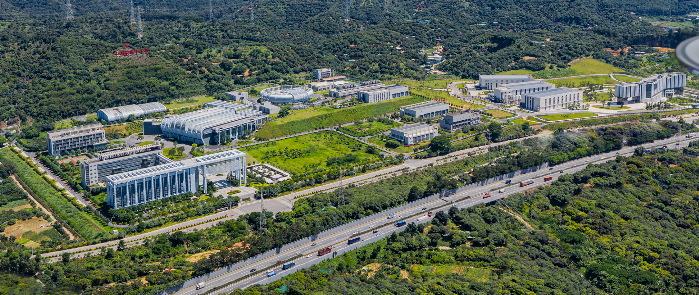
The first time-of-flight thermal and cold neutron test beamline based on a spallation neutron source in China
― Neutron Technology Development Station (NTDS)
Ping Wang
NTDS Team
wangping@ihep.ac.cn

Slide 2
Outline
Overview
Design
Installation and commissioning
Summary

Slide 3
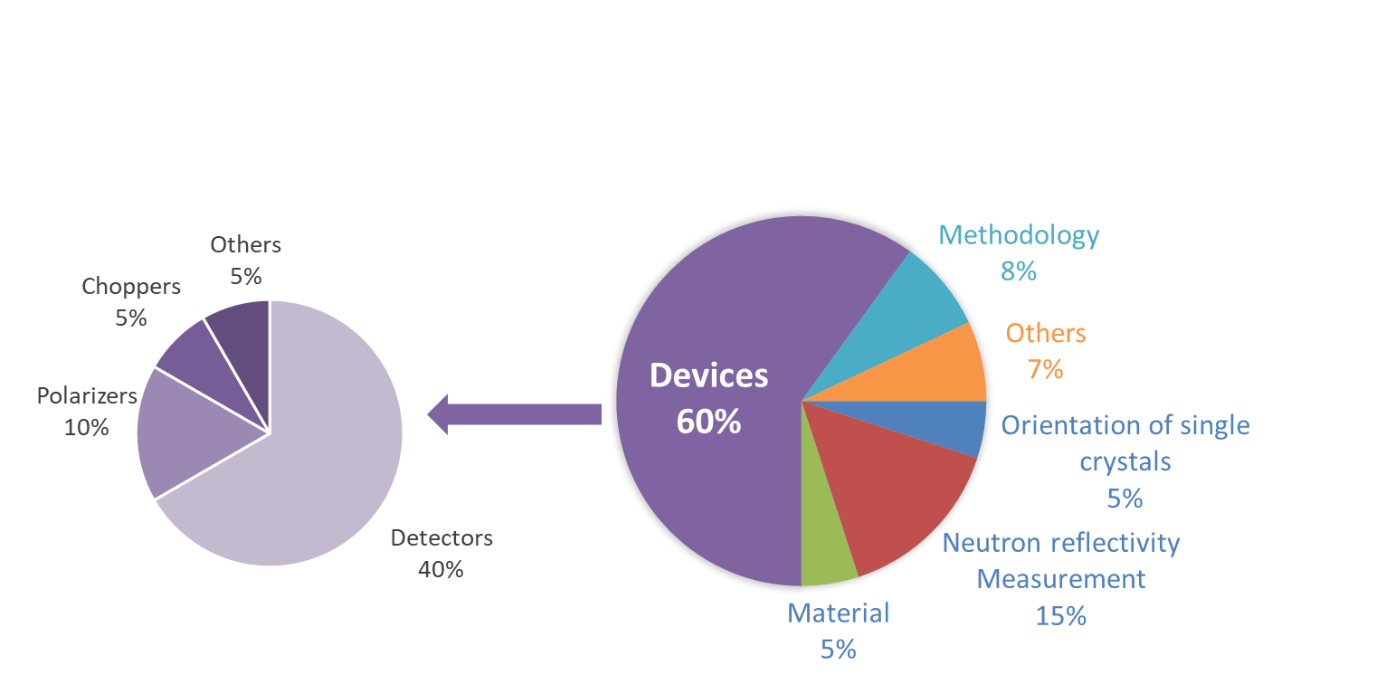
1 Overview
Requirements of a new beamline for China spallation neutron source (CSNS)
1. Numerous neutron device’s neutron beam testing tasks of the CSNS II project
2. Serve as a key platform to advance neutron technology development (such as materials, devices, methodologies, and metrology) for CSNS
Application classification
Beam time allocation
5000 Hours/Year

Slide 4
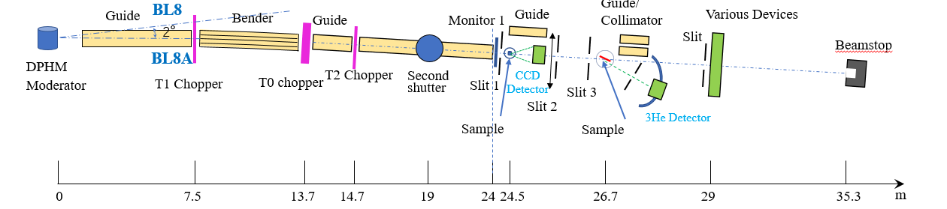
1.1 Design highlights
1. Versatile functions: three terminals
2. Lower background: Bender + T0 chopper, long flight path
3. Higher beamtime utilization efficiency: automatic technology
Wavelength: 0.5~20 Å (0.2~300 meV)
Bandwidth of TOF: 5.4 Å
Beam Size: 25mm(W) × 50mm(H)
Terminal 2
Neutron reflectivity
Terminal 3 Multi-function
Terminal 1
Single-crystal orientation

Slide 5
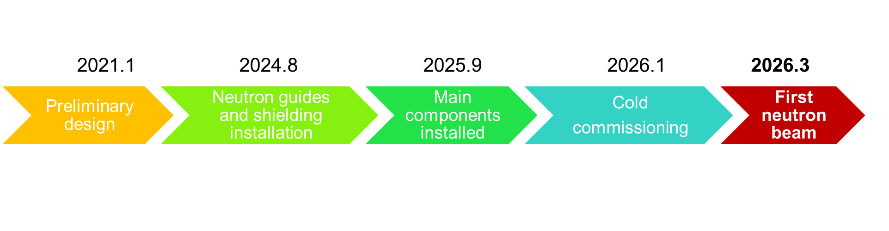
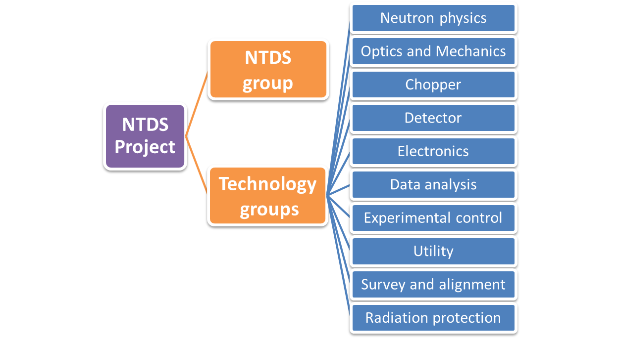
1.2 Schedule and organization

Slide 6
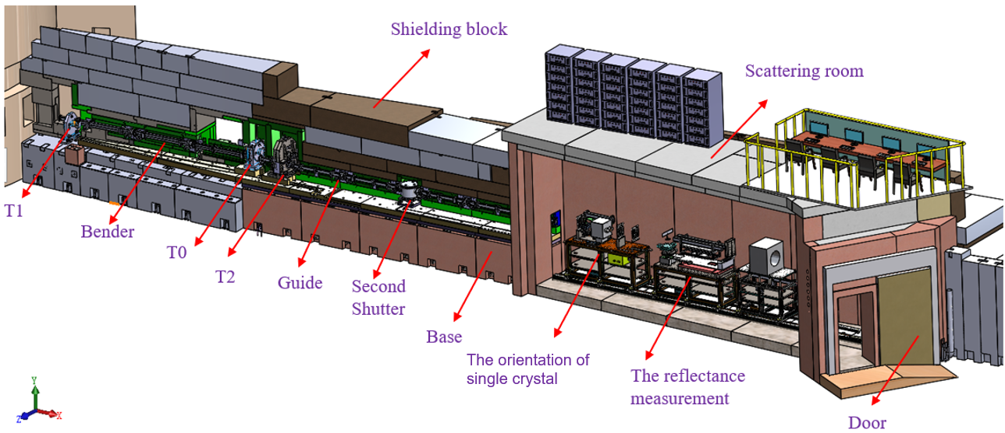

2 Design
Main components:
Choppers: 3 sets T0+Single disk T1+Double disk T2
Supermirror neutron guide Bender+ Straight
Second shutter
Neutron slits: 4 sets
Single-crystal orientation terminal Rotating sample stage, CCD Detector
The reflectivity terminal Rotating sample stage, 8mm 3He Detector
Shielding：Carbon steel, Boron-containing polyethylene, Concrete

Slide 7
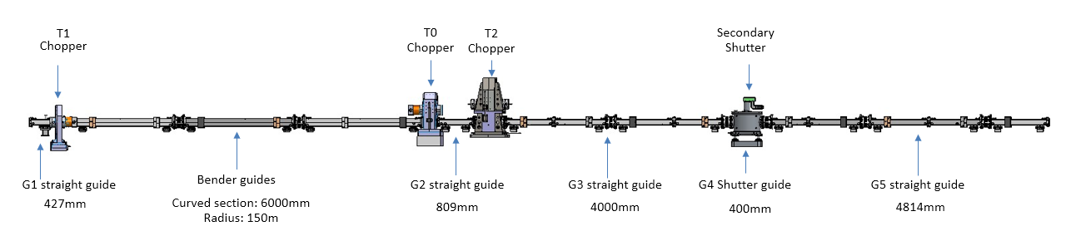
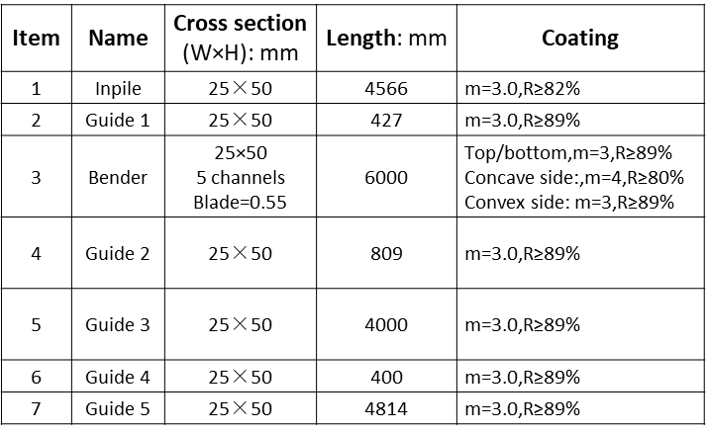
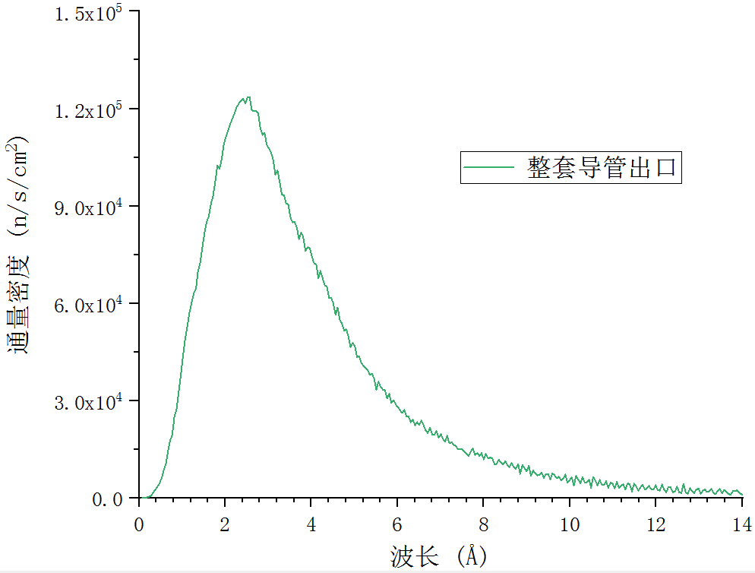
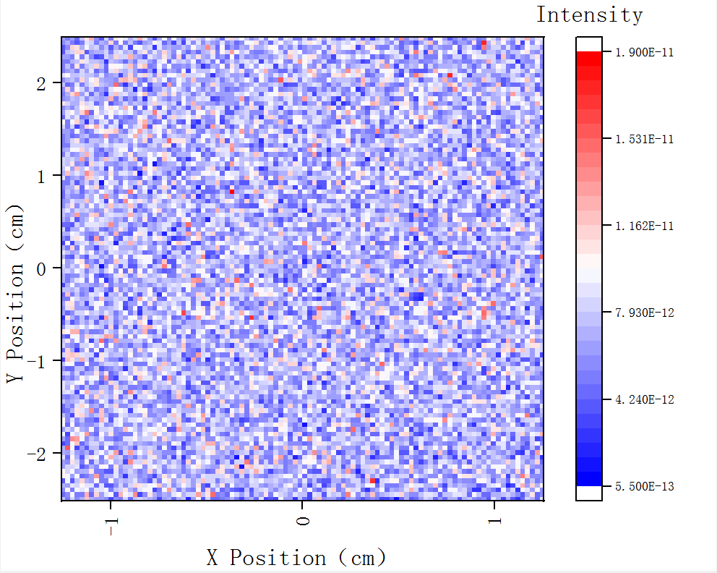
2.1 Neutron guide system
Bender: to separate from Beam line 8 and remove fast neutrons and gamma rays background
Straight guide: to efficiently transport neutrons
Beam
Neutron wavelength spectrum on guide exit
Neutron spacial homogeneity
Flux
Wavelength

Slide 8
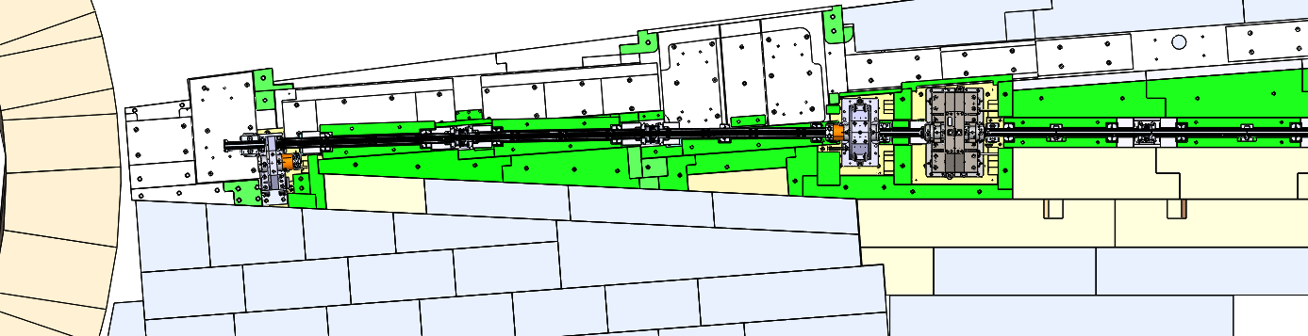
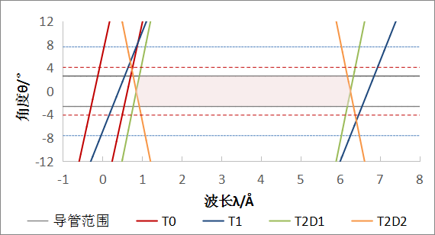
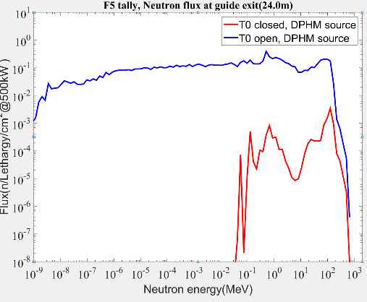
2.2 Neutron chopper system
T2(14.7m): to select the desired bandwidth neutrons
T1(7.5m): to reduce frame overlap background
T0(13.7m): to block the prompt high energy particles
Neutron chopping time and space diagram
The prompt fast neutron background is suppressed by two orders of magnitude
Bandwidth (5.4Å)
Degree
Wavelength (Å)

Slide 9
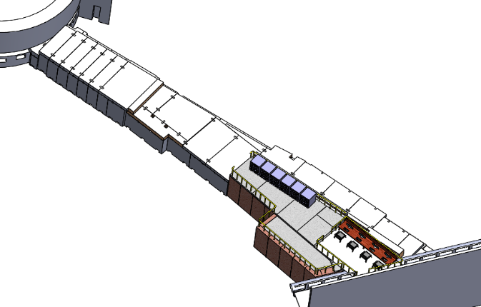
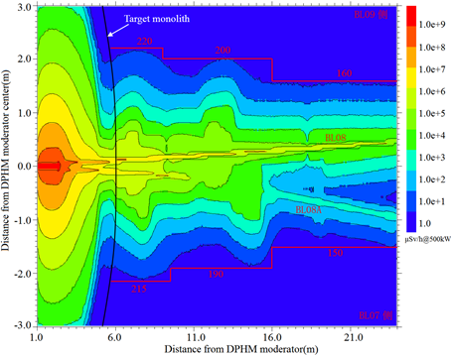
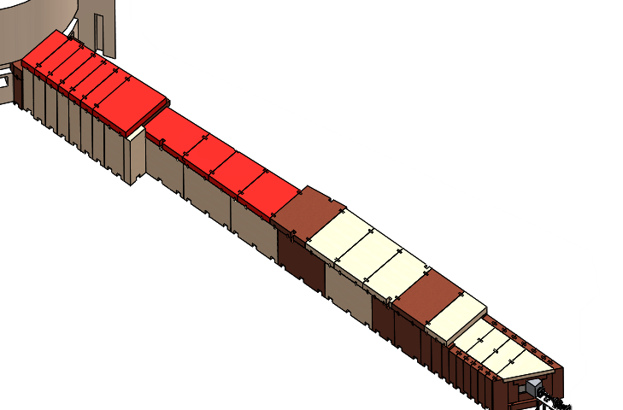
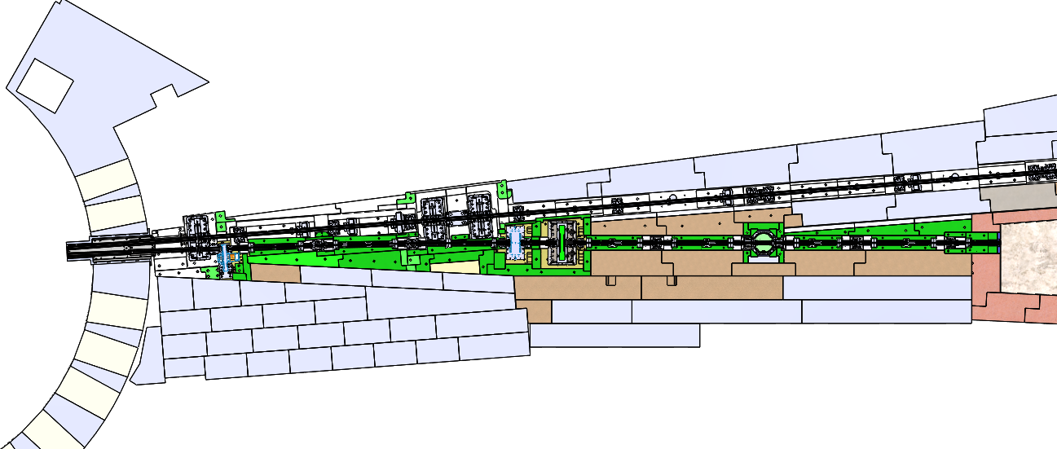
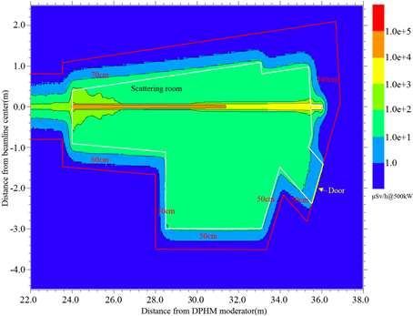
2.3 Shielding
Reconstruction based on the BL8 shielding
Neutron shielding calculations
The dose rate is less than 2.5 μSv/h@500kW
Now

Slide 10
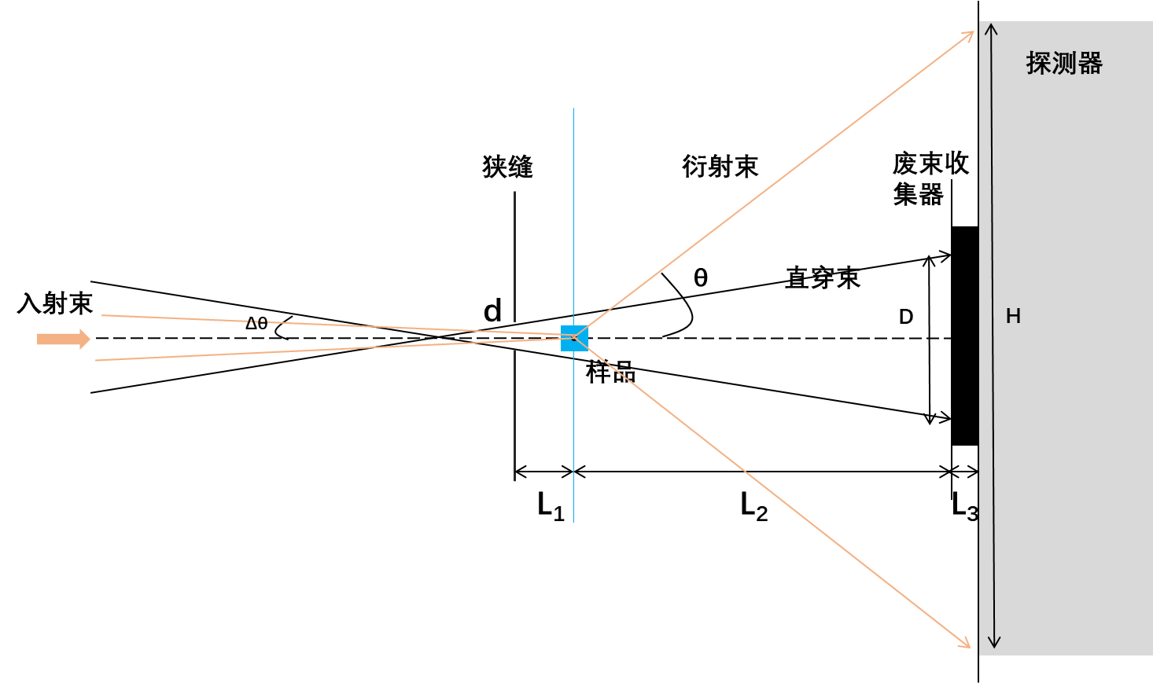
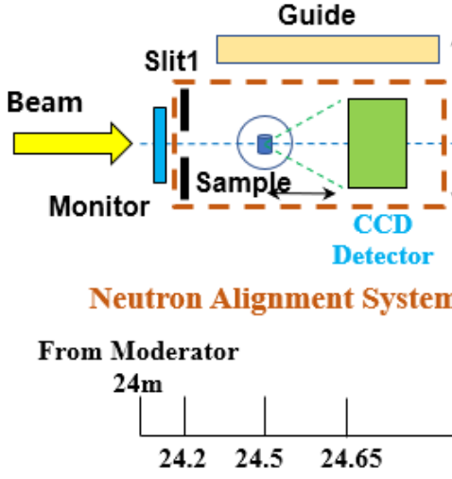
2.4 Terminal 1: Single-crystal orientation
Requirements from instruments
Specific inverted lattice faces and directions
Quickly check the quality of single crystal samples
Limited by the detectors, can not be carried out on the spectrometer
By Yuhua Ma
Beam stop
Slit
Scattering beam
Detector
Incident beam
Sample
Neutron wavelength and bandwidth: 0.85~6.25Å，5.4 Å
Beam size: 0.1×0.1mm²~25×50mm²
Alignment precision: <0.5°
Sample size: ≥ 0.5mm³
Detector: CCD camera (200×200mm²),0.2mm each pixel
Neutron flux at sample: 7.3×10⁶n/s/cm²@160kW

Slide 11
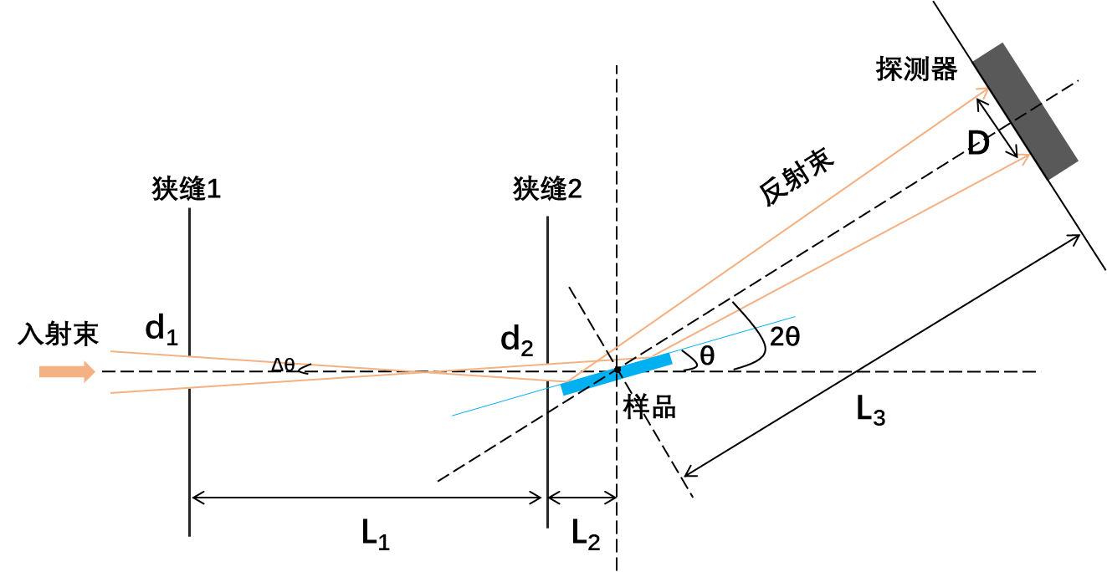
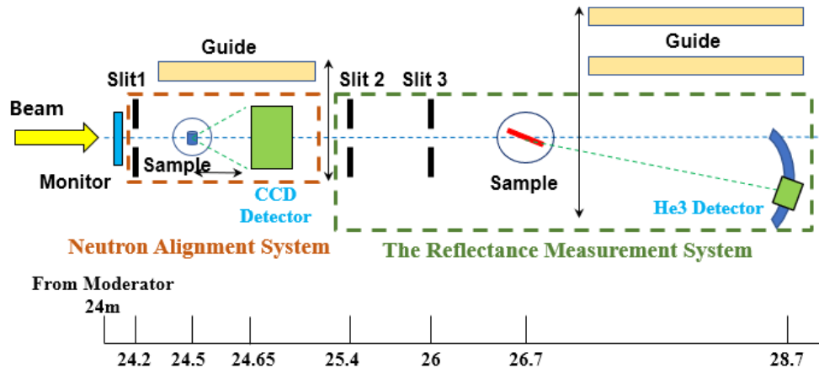
2.5 Terminal 2: Neutron reflectivity
Testing platform for neutron supermirror development of neutron optics
By Qing Zhang
Reflecting beam
Slit1
Slit2
Detector
Incident beam
Sample
Neutron wavelength and bandwidth: 0.85~6.25Å，5.4 Å
Beam size: 0.1×0.1mm²~25×50mm²
Q range: 0.005~0.22Å⁻¹（m=0.2~10）
Best Resolution Q/Q：~1%
Detector: 4*He3 tube,8mm×300mm
Neutron flux at sample: 3.8×10⁶n/s/cm2@160kW

Slide 12
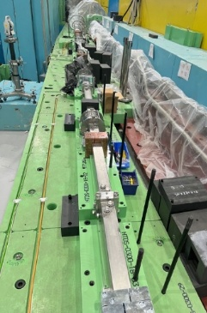
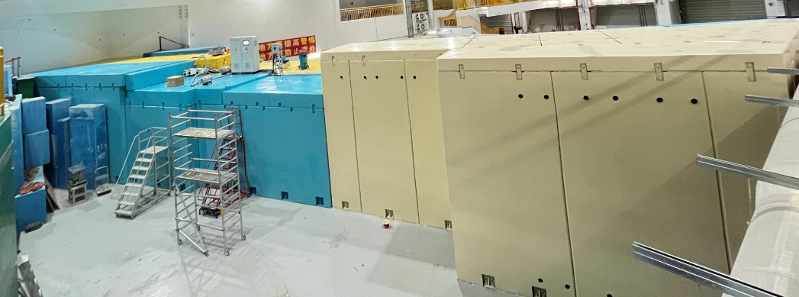
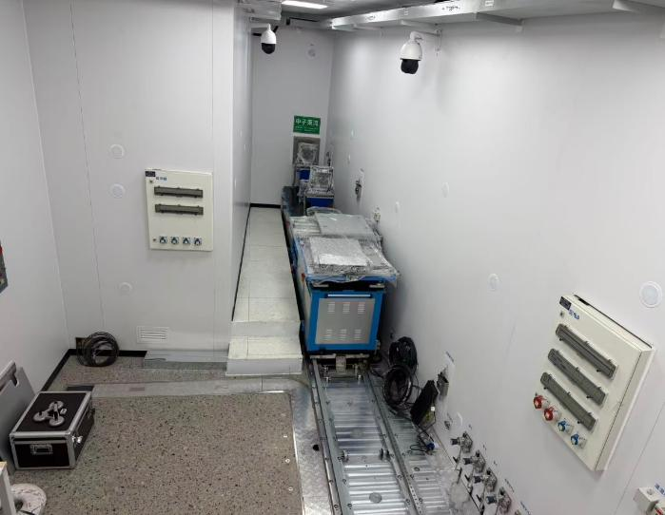
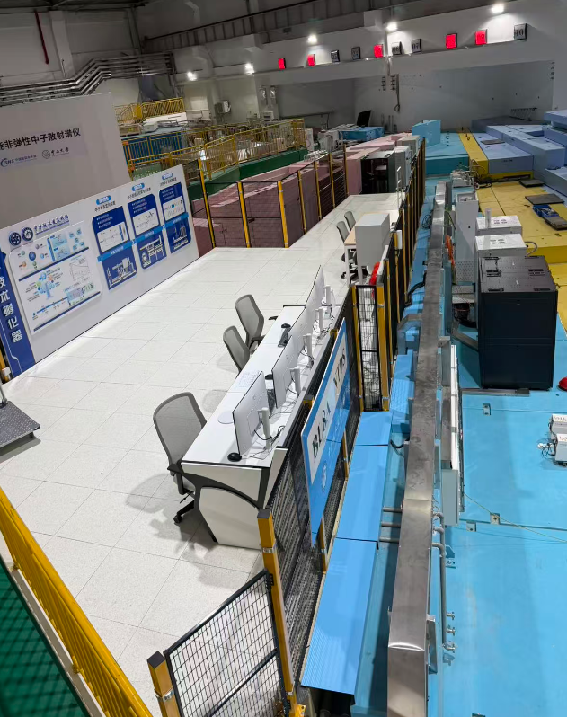
3 Installation and Commissioning
The neutron guides and shielding were installed in Sep. 2024
Neutron Guide
Shielding
Other components (choppers, second shutter, reflectivity terminal, etc. ) were installed in Oct. 2025
Test Station
Operation area

Slide 13
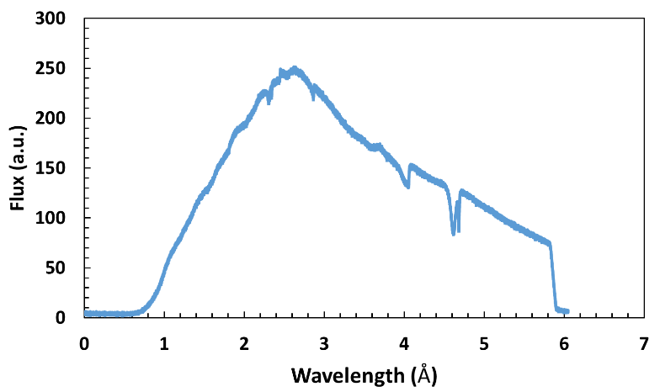
3.1 The first neutron beam
NTDS successfully achieved its first neutron beam on March 5, 2026
The neutron flux: 4.2×10⁶ n/(cm²*s) at 0.5 ~ 5.9 Å by choppers

Slide 14
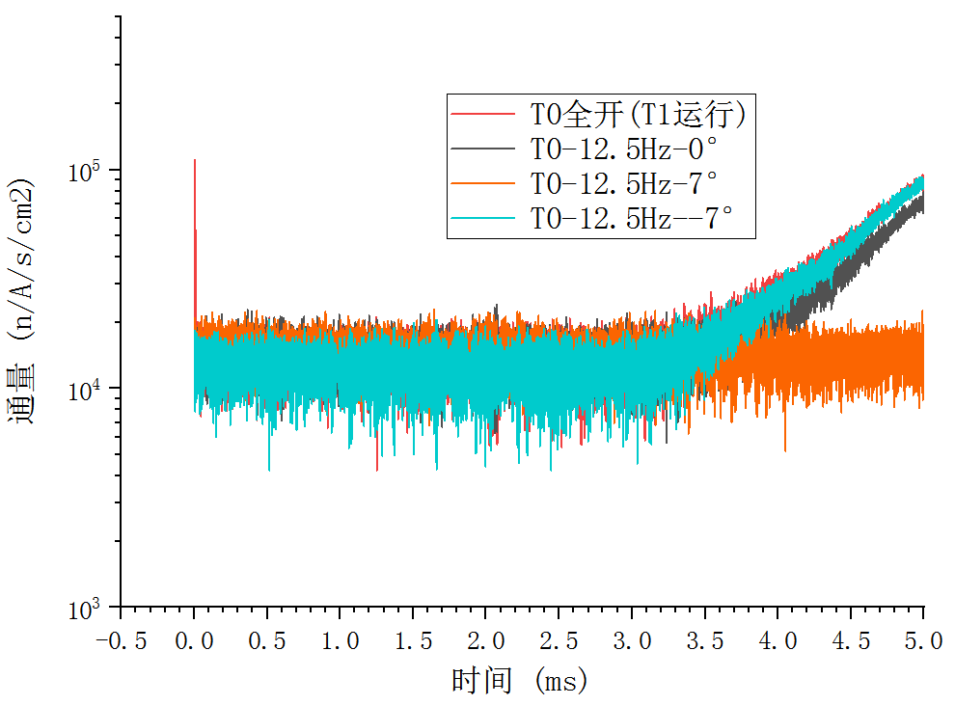
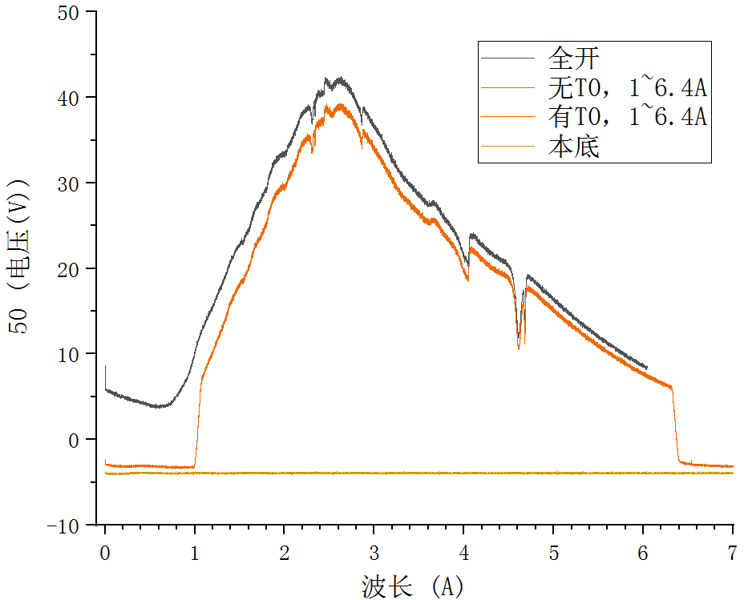
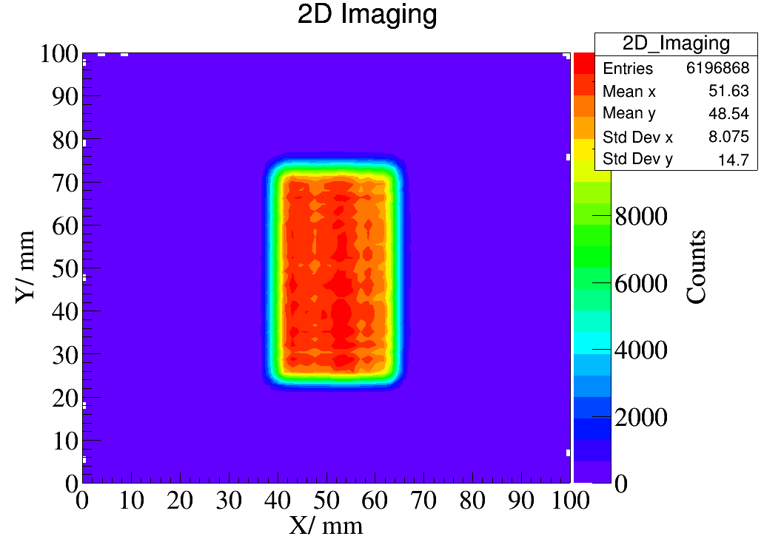
3.2 Neutron beam performance
Comparison of overlapping neutron wavelength frames by bandwidth choppers
High energy particles were suppressed by T0 chopper
Beam spatial distribution by the neutron beam monitor
Flux
Flux
1~6.4Å
Time (ms)
Wavelength (Å)

Slide 15
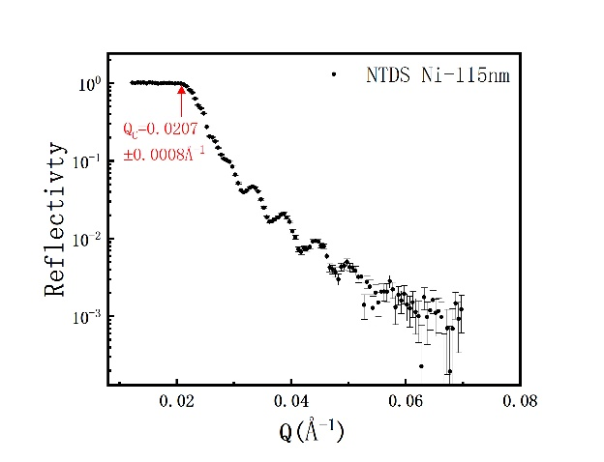
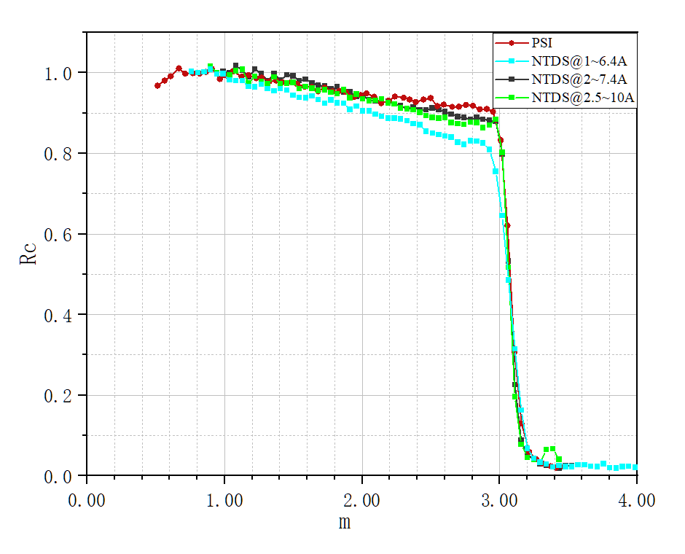
3.3 Neutron reflectivity commissioning
Standard nickel film sample
Standard m=3 supermirror sample
The difference between the experimental and theoretical Qc values is 5% due to the thin film density being lower than that of the bulk material
It seems better to use a large angle of reflection with long wavelength neutrons for better consistency in the reflectivity data, and the commissioning is still going on

Slide 16
4. Summary
NTDS has completed most of its project construction tasks, and it is the first beamline to achieve neutrons in the CSNS II project
NTDS is on commissioning and operation, which will strongly support the numerous neutron beam testing tasks of the CSNS II project
NTDS will play an important role for the neutron technology development of CSNS in the future

Slide 17
Thanks for your attention!

