Slide 2
Helium Leaks with Radiological Content: Detection Challenges
Contamination Alarm for Target (CAT)
PRESENTED BY Atefeh Sadeghzadeh

Slide 3
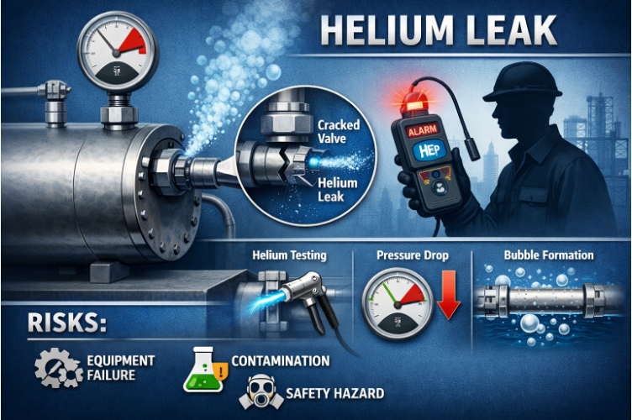
What is the Problem

Slide 4
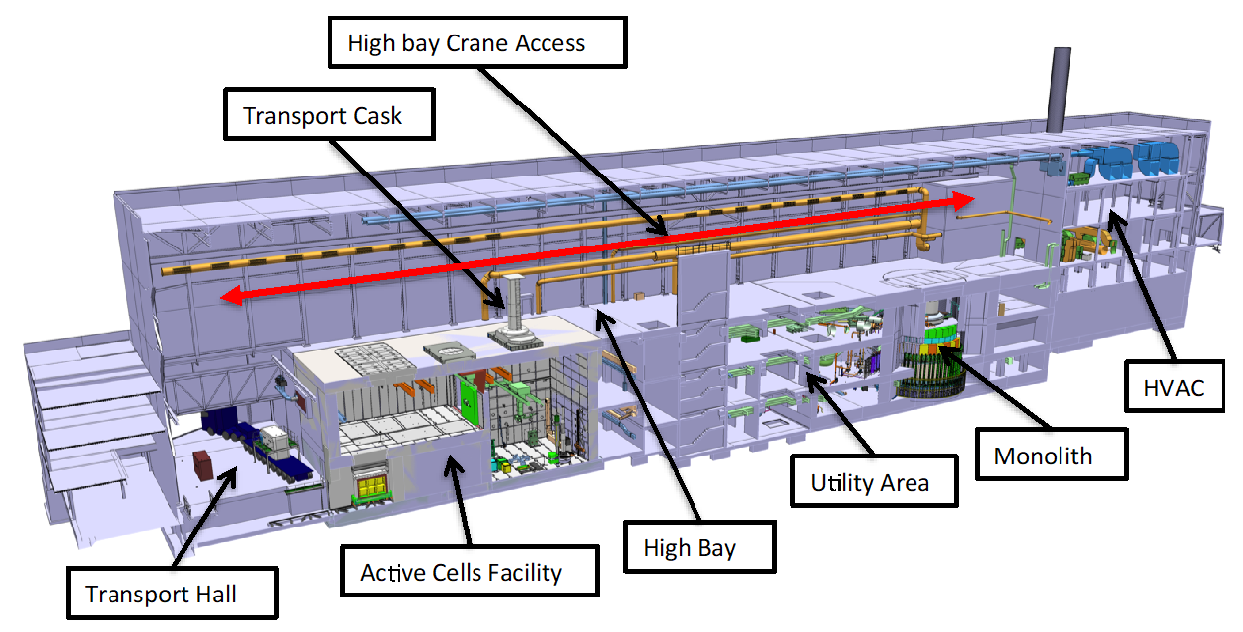
Contamination Alarm for Target= CAT
Background of accident analyses that define the requirement to have a CAT
The Worker Evacuation System (CAT) has been identified as a system performing a Worker Radiation Safety Function (WRSF) in the accident analyses:
AA3W– loss of confinement of radioactive helium in the D02 building

Slide 5
CAT
Why is the CAT needed?
AA# | Inventory | Without CAT |  |  | With CAT
 |  | Exposure time | Dose – Room 1 | Dose – adjacent areas | Exposure time | Dose – Room 1 | Dose – adjacent areas
3W | Helium | 4 h | ≤ 298 mSv | ≤ 155 mSv | 10 min | <14 mSv | ≤ 3 mSv
Worst-case scenario for 5MW operations
During Production mode
Full system rupture – worker in the same room as the rupture
Worker unaware -> long exposure time
Reduction in exposure time → reduction in dose to worker from the accidents

Slide 6
System Functional Requirements

Slide 7
CAT Requirements
Functional requirements – helium leakage event
CAT shall detect the helium leakage event and initiate an alarm to evacuate the target utility area in the D02 building
CAT shall have PFD = 10⁻² per demand
CAT design shall be fail-safe where applicable
CAT design shall aim for high availability

Slide 8
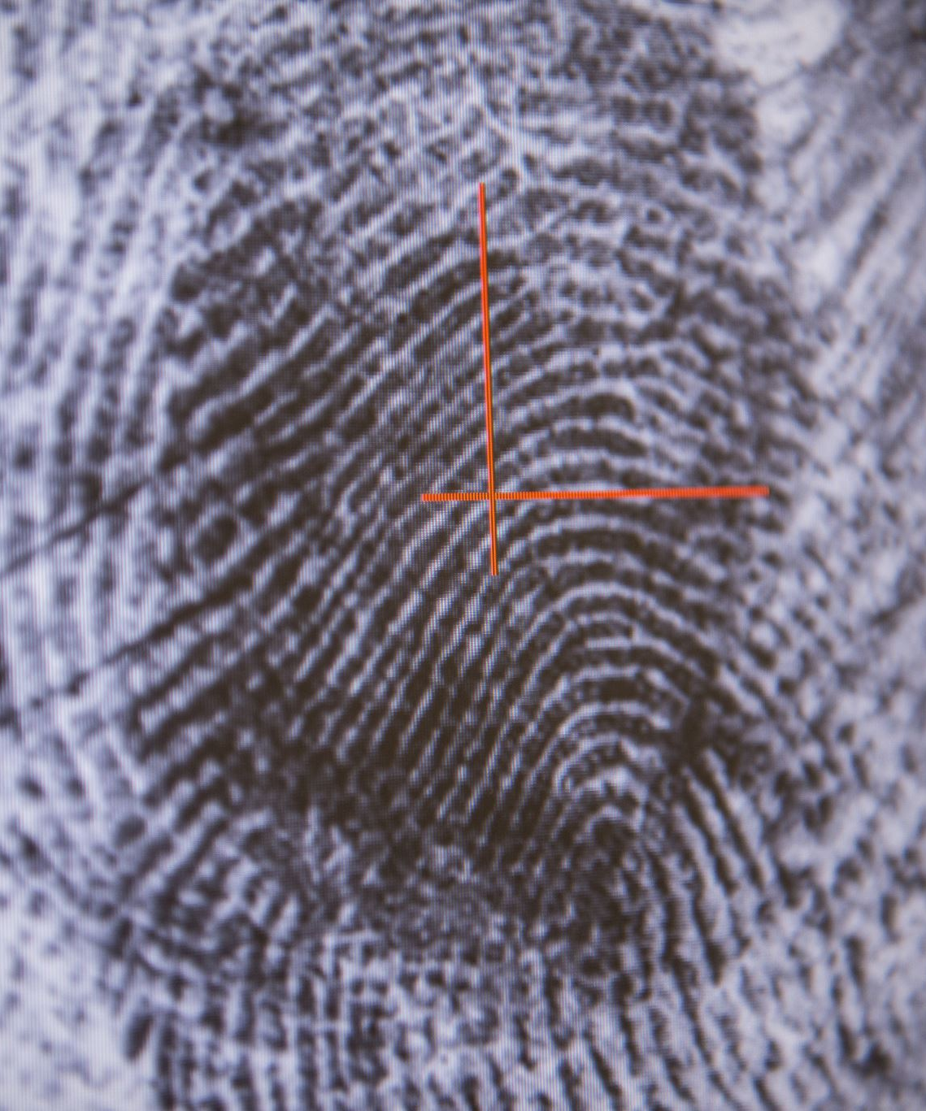
What to Detect (detection threshold)

Slide 9
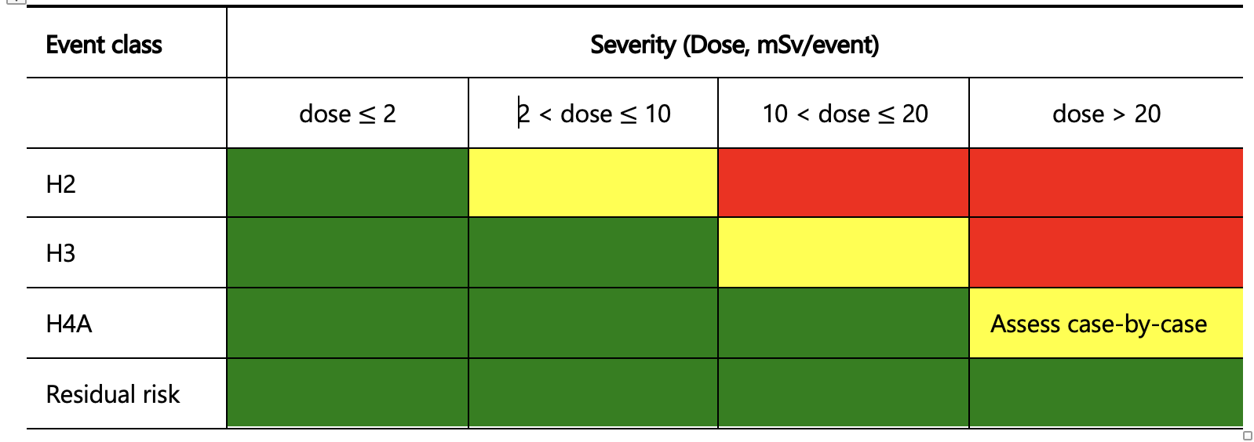
Detection Threshold
Helium concentration limits
 | Units | Event
Dose to worker | [mSv] | 10
Exposure time | [hr] | 4
Helium leak rate | [g/hr] | 1500
Helium concentration | [ppm] | 1800
Normal Operation (H1)
ESS dose limit = 20 mSv/year
ESS dose constraint = 2 mSv/year
ESS Event Risk Assessment Criteria Matrix
Tolerable range (yellow) facilitates ALARA during design

Slide 10
Detection Options and Challenges

Slide 11
The three options
CAT Detection
The three options retained for further assessment:
Option 1: helium leak detection
Option 2: helium process change
Option 3: radiation detection

Slide 12
Detection Option 1: Helium Leak detection

Slide 13
Option 1: helium leak detection
The main Helium Leak Detection (HDL) methods are the following:
Mass spectrometer,
Thermal conductivity,
Resonant acoustic sensor,
Ultrasonic acoustic sensor: does not provide quantitative data,
Non-IR laser detector: very specific academic applications, e.g. UV lasers
Gas chromatography (coupled with MS or TCD).

Slide 14
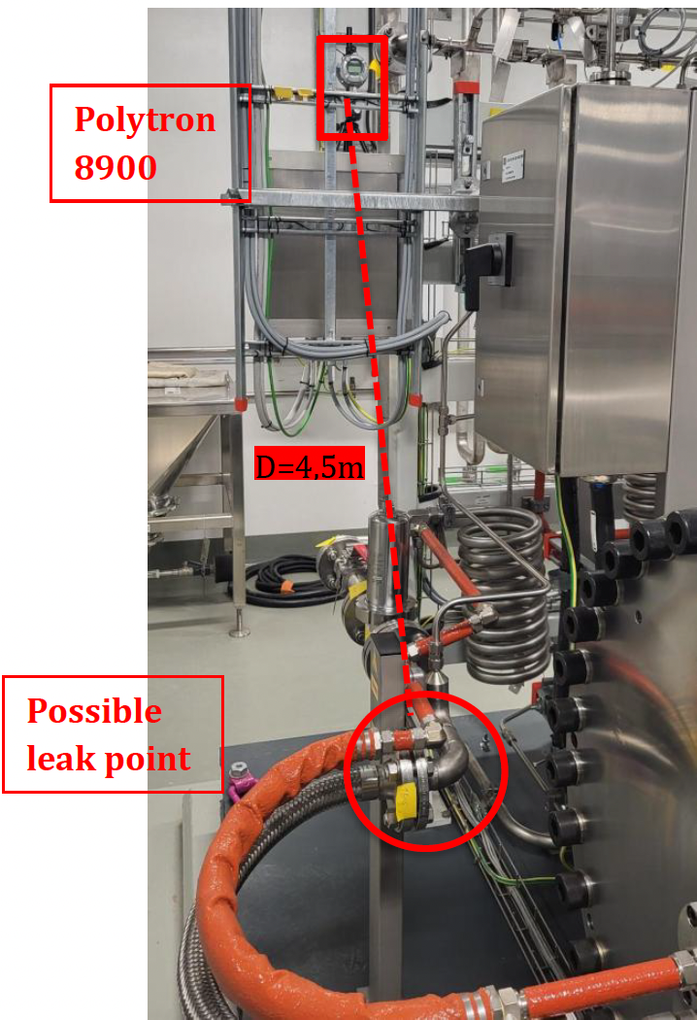
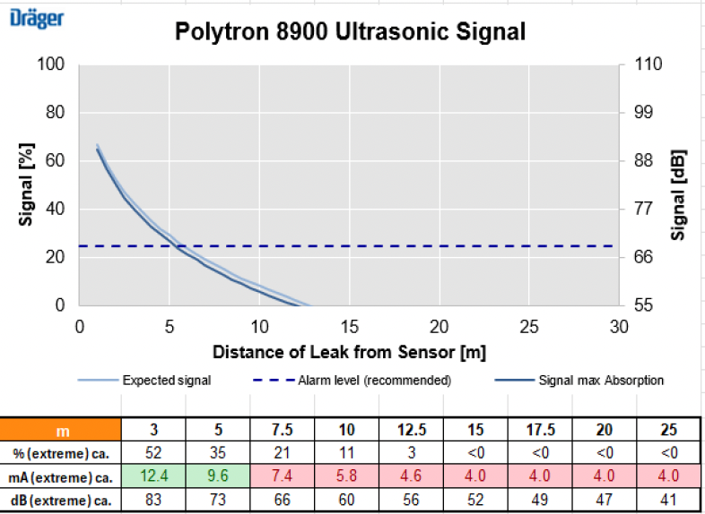
Option 1: helium leak detection
Ultrasonic Leak detectors
Ultrasonic acoustic detectors work by sensing sound in the ultrasonic range.
Measurements were planned to map the ultrasonic spectrum during normal operation

Slide 15
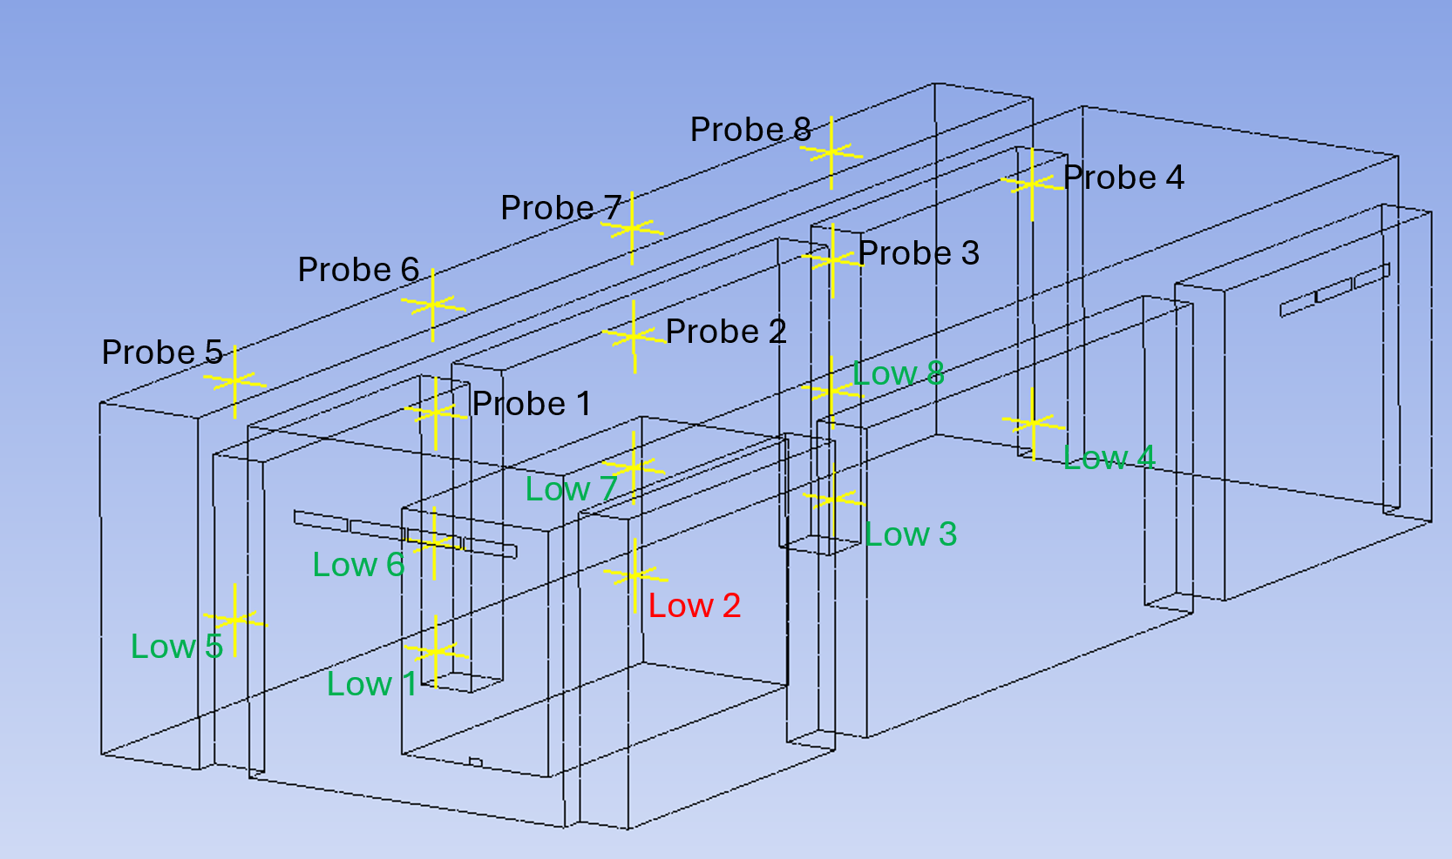
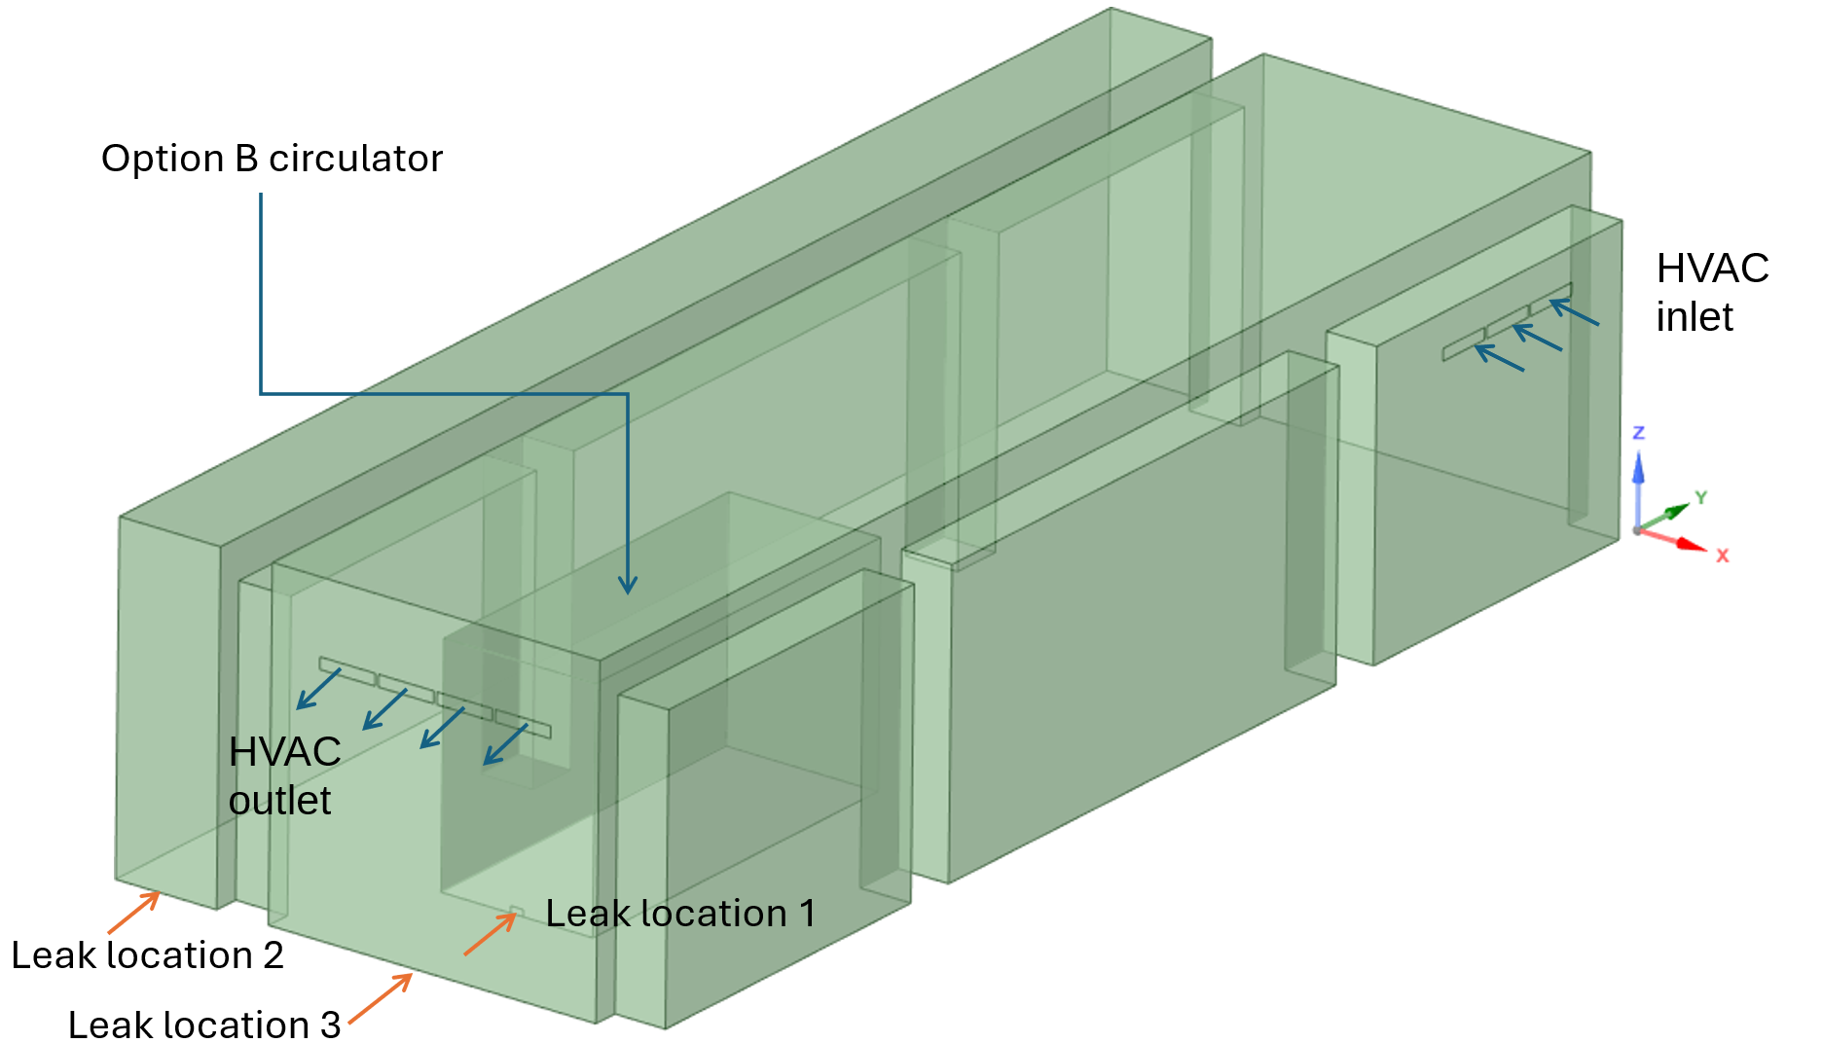
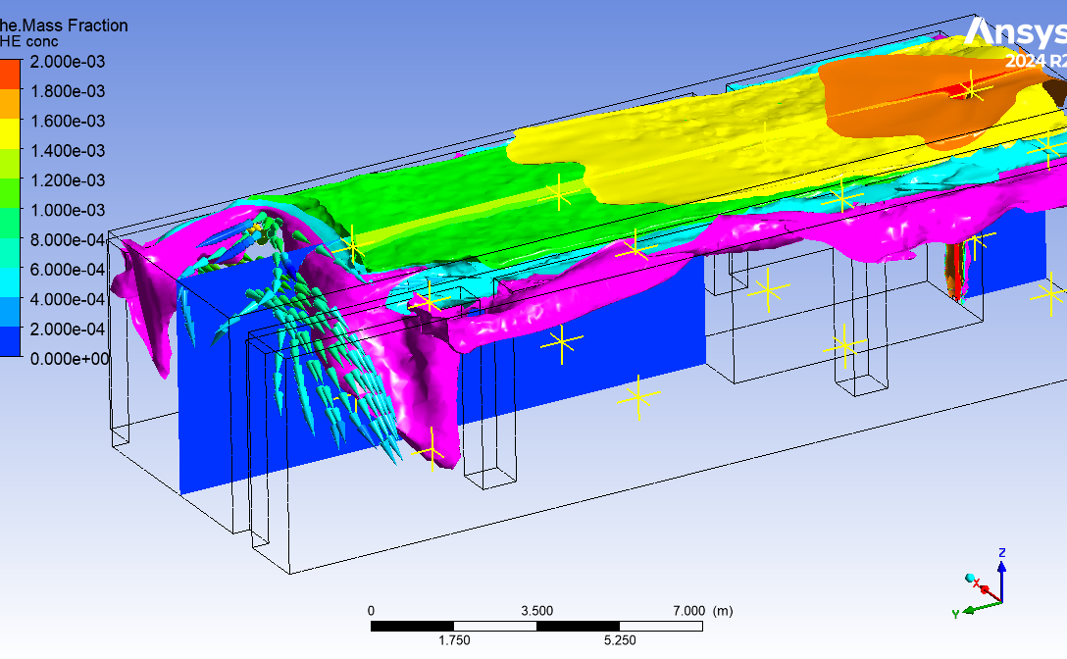
Option 1: helium leak detection
CFD analysis
The leak rate of helium has been given as 1.5 kg/h.
HVAC flow interacting with the Helium, pink represents a concentration of 175ppm.
Provided by Jonathan Moberg

Slide 16
Option 1: helium leak detection
Characteristics of helium leak detection
The helium loop is pressurised, therefore detection of a leak flowing out from the helium piping is the applicable method.
Key considerations include:
Rooms volume and geometry
Potential release paths in the event of pipe ruptureare
The detector could be in a room with a favourable radiation environment (low class area) during Production mode, which
improves equipment accessibility
facilitate maintenance on the detection equipment.
Sensing lines should be installed to
extract air from the sampling points
These points should be located near the ceiling of relevant rooms, where helium is likely to accumulate
Notes:
Major considerations are the size of rooms concerned, and the likely release paths from a pipe break.
The detector could be located in a room with a relatively low dose that is accessible for maintenance, and to minimise exposure to radiation. Sensing lines would be installed to transfer air from the sampling points located close to the ceilings of the relevant rooms, to a multistream valve at the inlet of the QMS.

Slide 17
Option 1: helium leak detection
Resonant acoustic sensors
Resonant acoustic sensors are based on measurements of the speed of sound. This detection technique consists in measuring differences in the speed of sound due to different gas mixtures, as sound travels within a resonant cavity.
An increase in helium concentrations of the order of 100 ppm could therefore be detectable.
Notes:
Given the large difference in the speed of sound in air (343 m.s⁻¹) versus helium (1008 m.s⁻¹), this technique is sensitive to changes in air density resulting from changes in helium concentrations in air.
The claimed resolution in measuring the speed of sound is of the order of 0.001 m.s⁻¹.

Slide 18
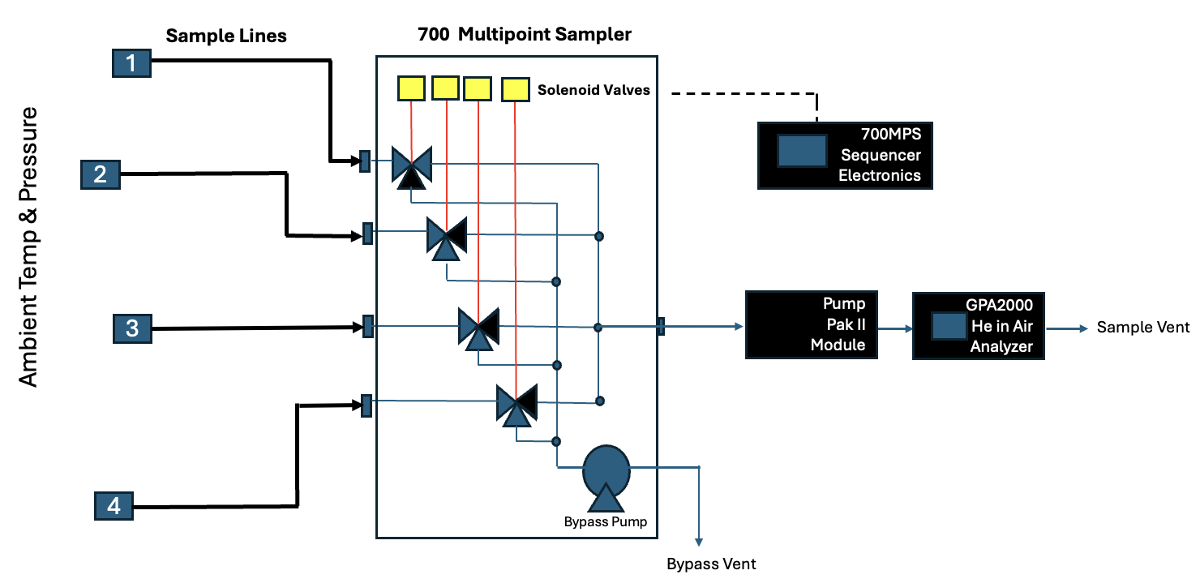
Option 1: helium leak detection
GPA2000

Slide 19
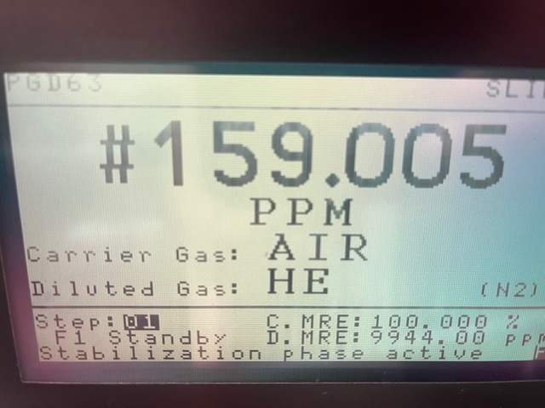
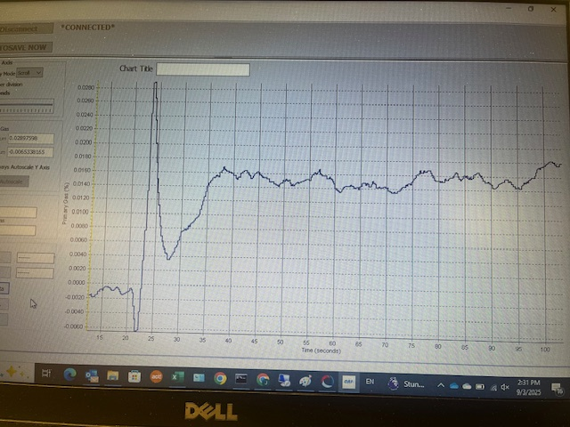
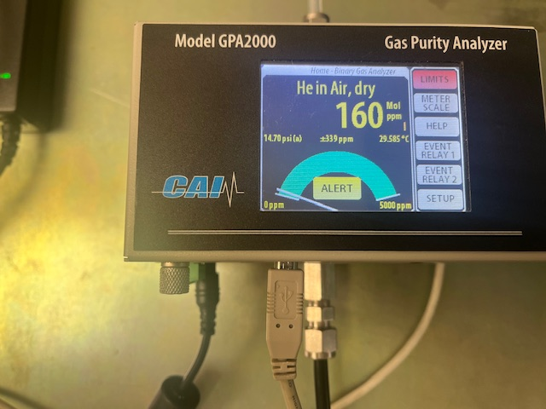

GPA2000 Stability Performance @ 159ppm He in Air
Stability Performance at 159ppm He in Air Mix
Captured GPA2000 Reading = 160ppm

Slide 20
Option 1: helium leak detection
CAT helium leak detection Challenges
Advantages
The helium leak detection system could provide an early indication of an abnormal leak
The helium leak detection system would be independent of all other systems
Limitations
The helium leak detection system for ESS would have to be adapted from existing commercial systems that are designed for environments that are much more controlled
One big unknown is the dispersion behaviour of the helium from the leak point to the detection system inlet which will most likely be located close to the ceiling.

Slide 21
Detection Option 2: Helium process change

Slide 22
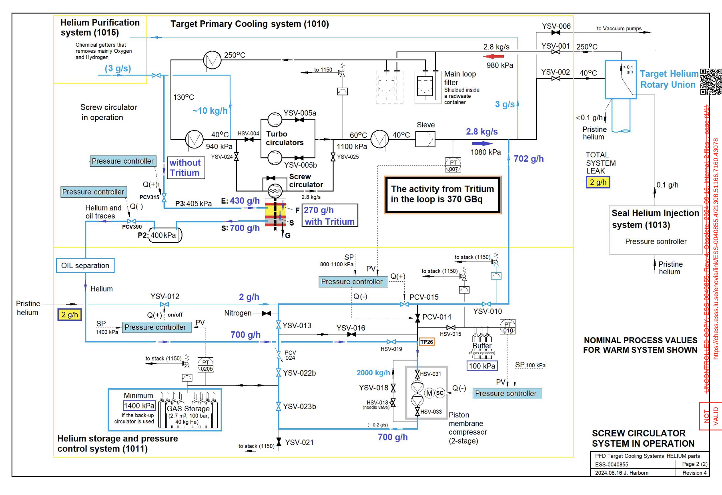
Option 2: helium process change
TPCS – Target Primary (helium) Cooling System
Provided by Jaroslaw Fydrych

Slide 23
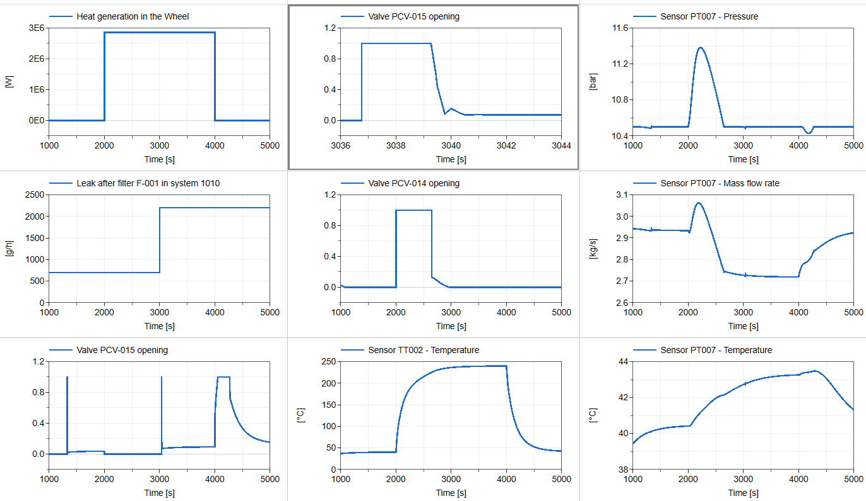
Option 2: helium process change
PCV-015 - valve on helium resupply line to TPCS
The simulation takes about 1000 seconds to stabilize, so the plots start there.
At start: no beam, “normal” leak of 700 g/h
At 2000 s: full beam power
At 3000 s: an extra leak of 1500 g/h (total 2200 g/h)
At 4000 s: beam trip
Provided by Emil Lundh
Time

Slide 24
Option 2: helium process change
CAT helium process detection challenges
Advantages
The detection method is based around existing equipment from system 1010.
Process parameters are already planned to be logged, providing historical data that can be studied to derive trip limits.
Limitations
Normal Leak out of the system (700 g/h into oil) is comparable to lower bound of the the accident leak rate
Beam on/off changes the pressure of the Helium and affects operation of the PCV-015
Safety rating of equipment

Slide 25
Detection Option 3: Radiation detection

Slide 26
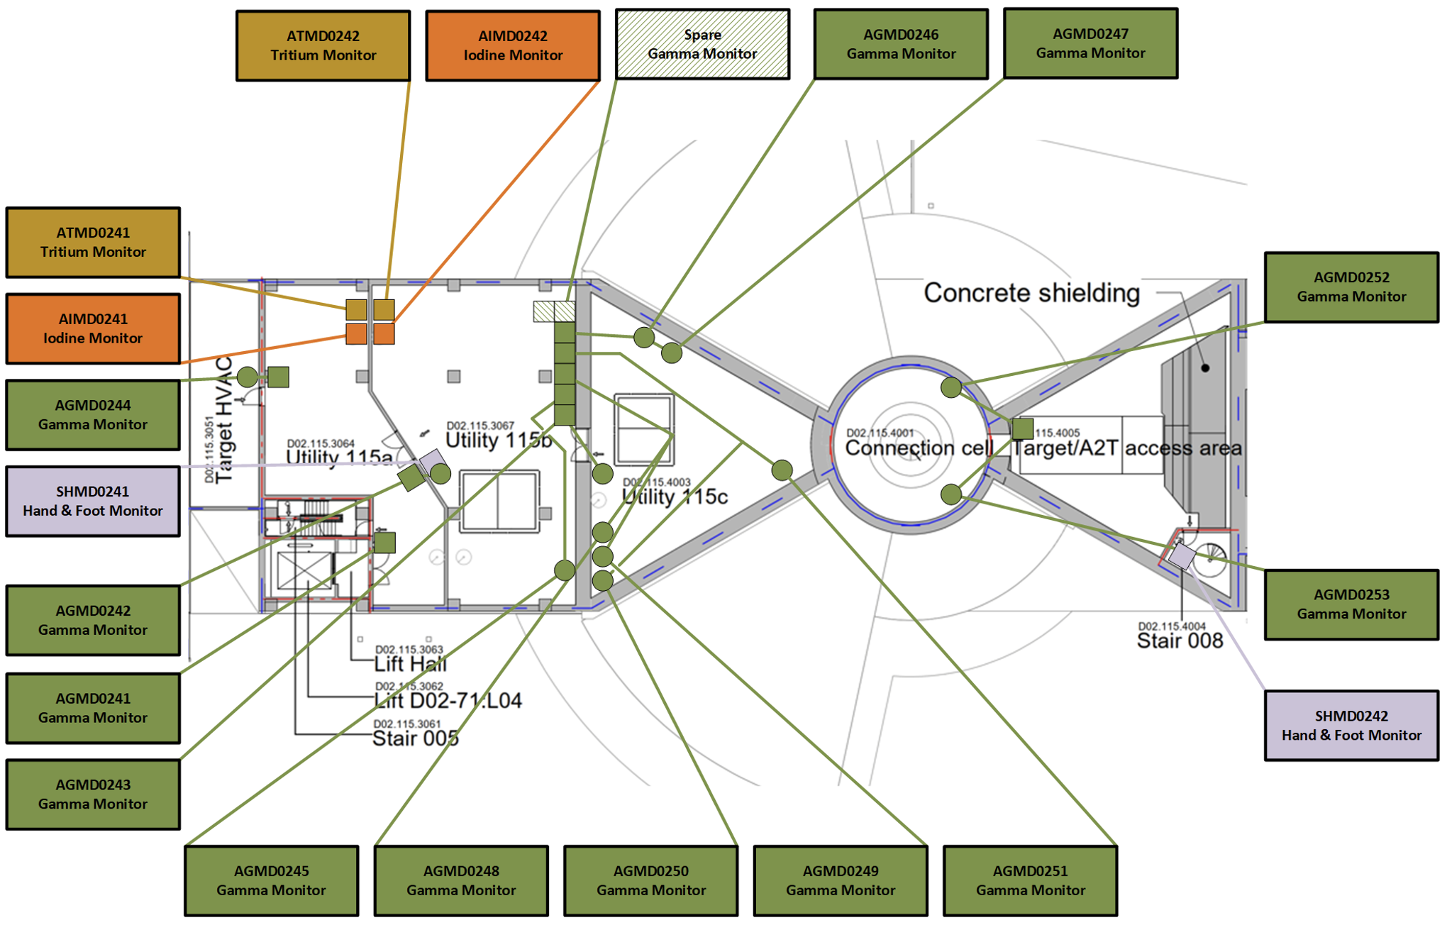
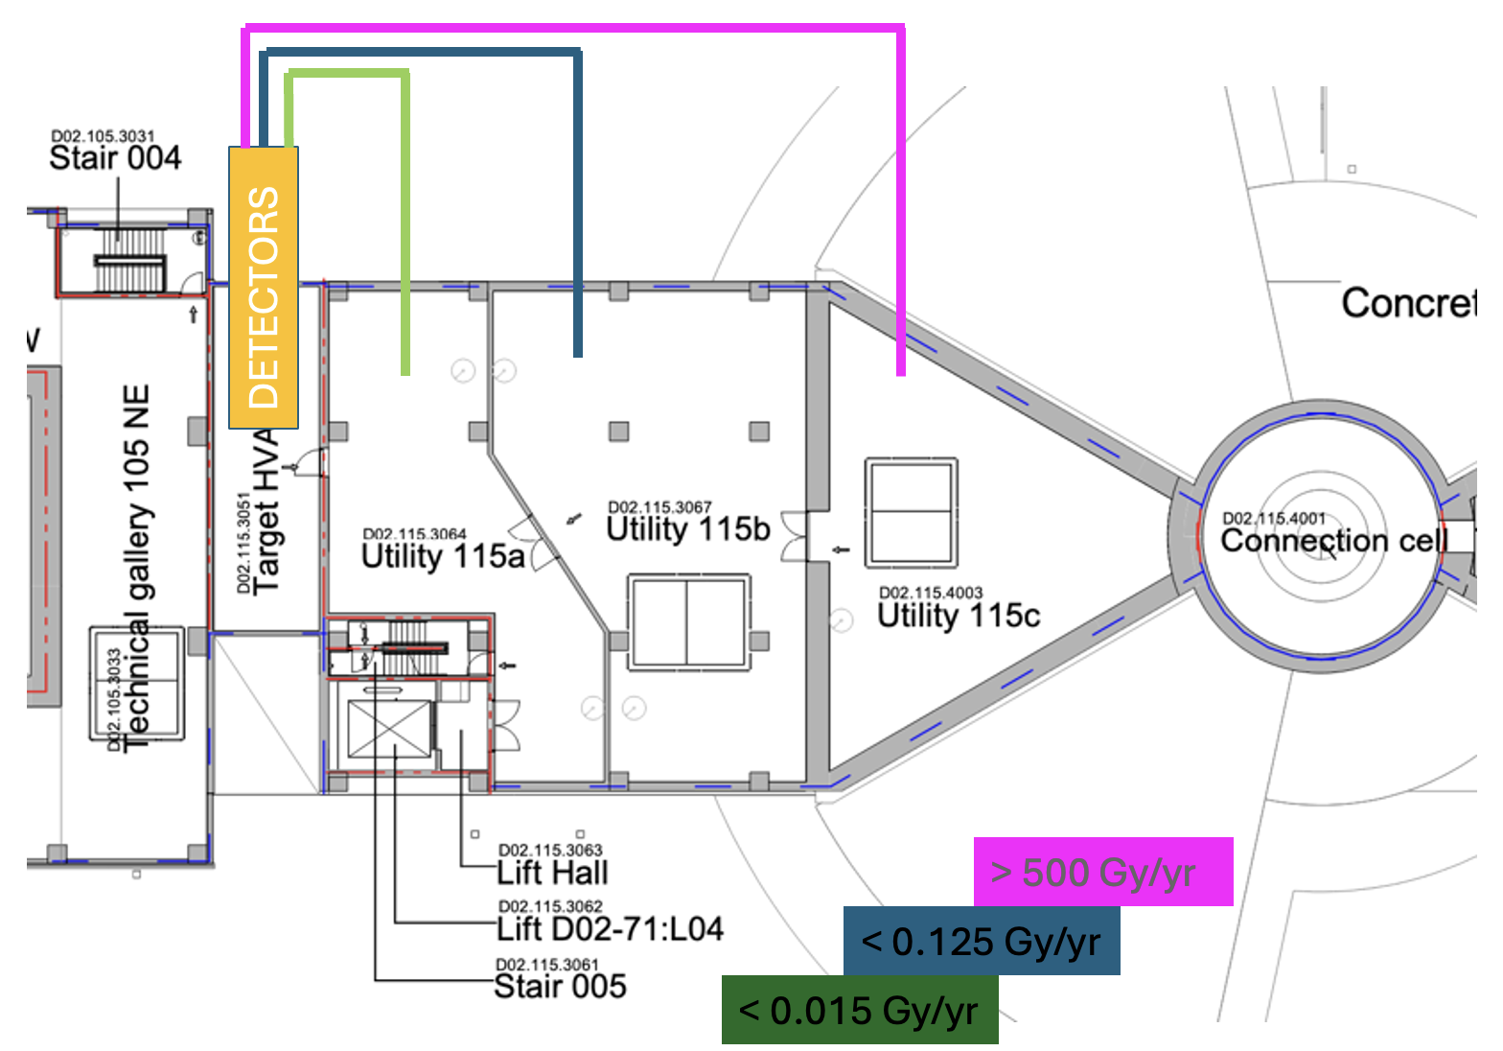
Radiation systems in the TUB
Types of radiation monitoring systems in relevant rooms
the Radiation Protection (RP) system specific to area monitoring for classification and detection of radiological abnormalities,
the radiation supervision system for process operations,
the CAT system to evacuate workers in accident scenarios, may include specific radiation detectors, maintained by RP.
CAT detection
RP
monitoring

Slide 27
CAT: Detecting Radiation
Accidental release of helium in the Neutron Factory utility block
CAT continuous radiation monitoring could include tritium, iodine, and noble gases*
(*noble gases do not contribute to the inhalation dose to workers)
Element | Main isotope | Activity [Bq/m³] | Inhalation Dose – 4h [mSv] | Other significant isotopes
Hydrogen | Tritium (H-3 gas) | 1.7E8 | 0.001 | -
Iodine | I-125 | 4.3E6 | 102 | I-117 → I-128
Xenon | Xe-125 | 4.3E6 | 0 | Xe-120 → Xe-127
Krypton | Kr-79 | 1.3E6 | 0 | Kr-76 → Kr-90
Argon | Ar-43 | 4.0E5 | 0 | Ar-37 → Ar-44
Neon | Ne-24 | 8.6E5 | 0 | -
Example detector options
Tritium: M-Ionix 2: 2 kBq/m³ → 2 GBq/m³
I-125: Ultra Energy SmartMCA: 3.7 Bq/m³ → 0.37 MBq/m³
Provided by Etam Noah

Slide 28
Pros & Cons
CAT radiation detection challenges
Advantages
Radiation detection is directly related to the radiation hazard.
Experience exists at ESS on deployment and use of a variety of radiation detectors.
Limitations
Radiation spectrum is unknown. Radiation consequences of an accidental release of helium are based on simulations.
Normal operation backgrounds must be discriminated against, to identify and alarm on accidental helium leak rates.
Provided by Etam Noah

Slide 29
Thanks for listening, Questions?

