Slide 1



ICANS XXV
Recovery From a Sticky
Position
Presenter - Dan Coates
ISIS Target Design Group
Group Leader – Ste Gallimore
Notes:
The abstract pattern can be removed or repositioned if required. Be careful to ‘Send to Back’ so that it does not obscure any important information.

Slide 2
Agenda
1 Isis target stations
.
2 The failure
3 Tooling design
4 Preparation
5 The task
6 The cause & future
Notes:
To replace photo with one of your own. 1) Send the geometric shape overlay to the back – Right-Click > Send to Back > Send to Back. 2) Replace image – use the guides provided to correctly position it. 3) Send your image to the back so that the geometric overlay re-appears over the image. Please remove or amend the image credit if you are using a different image to the one provided.

Slide 3
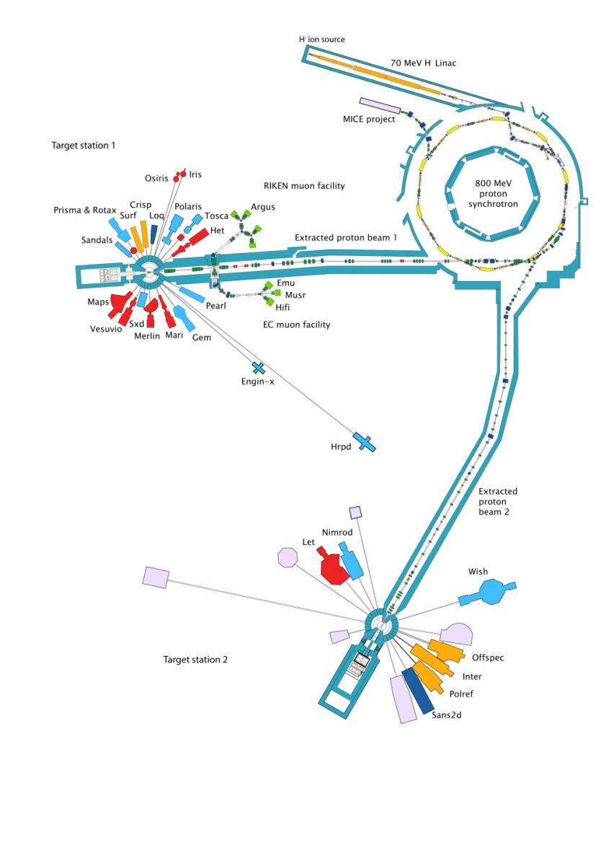
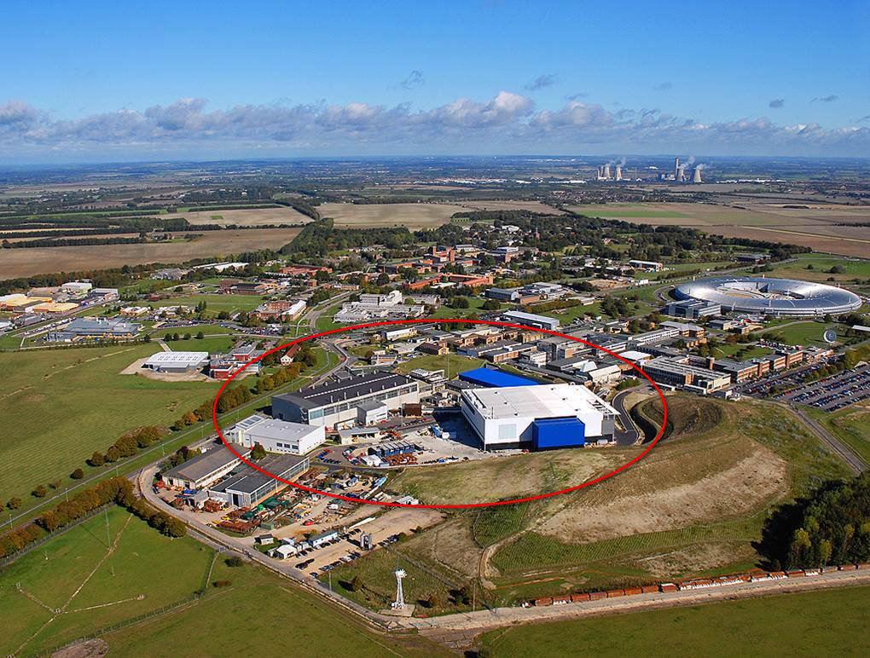
ISIS SPALLATION SOURCE
800MeV – 50Hz
160µA - 40Hz
ISIS FACILITY
40µA – 10Hz

Slide 4
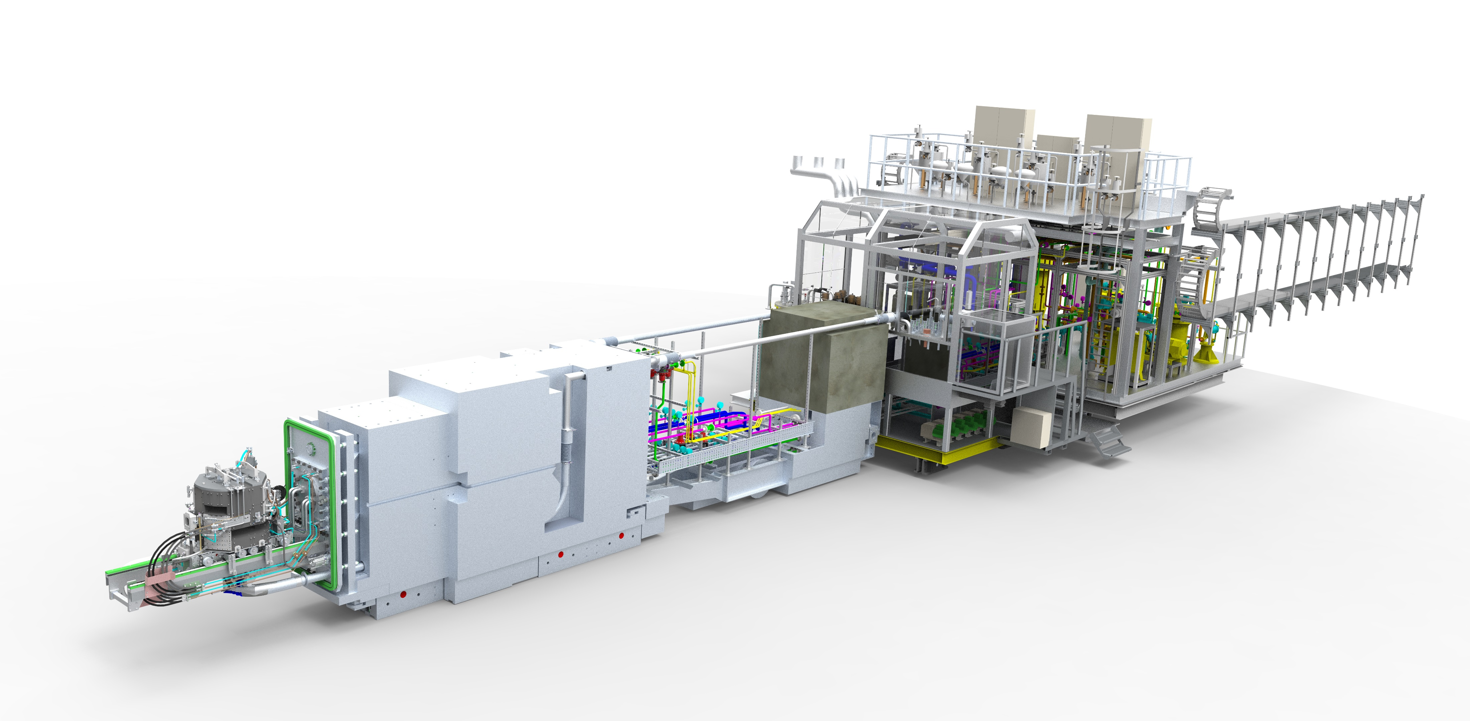
TARGET STATION 1 TROLLEY LAYOUT
SHIELD GAP, USED FOR TRANSPORTING COMPONENTS INTO REMOTE HANDLING CELL
REAR SHIELD PLUG
FORWARD SHIELD PLUG
TARGET, REFLECTOR, AND MODERATORS (TRAM)
THIS IS THE AREA THAT IS THE FOCUS OF THIS PRESENTATION.
CRYO TROLLEY, H2 & CH4 COLD BOXES
WATER SERVICES
40 years old
Low Millage, travels 30m, 3x per year, Total 3.6Km, (2.25 miles).
No service history, All retired.
300 tons
Trolley designed for regular methane moderator replacement (2 per year)
Company that supplied the bogies, ceased trading in the late 80’s
Driven from the tail by a chain, gearbox and motor.
VOID VESSEL DOOR & INFLATABLE SEAL
ISIS Target Station 2 is of a similar layout!

Slide 5
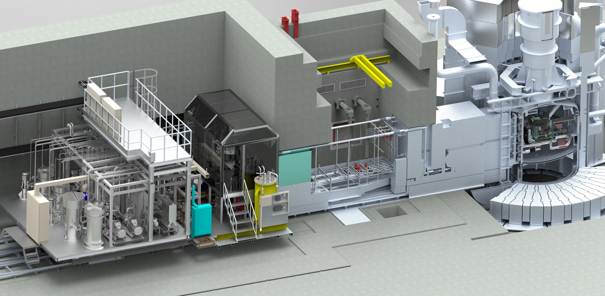
ISIS TARGET STATION 1 SECTION
TARGET STATION MONOLITH
REMOTE HANDLING CELL
TARGET SERVICES AREA
TROLLEY MOVEMENT
VOID VESSEL, He ATMOSPHERE
WASTE ROUTE, 1M X 1M TRAP DOOR TO TUNNEL
ISIS Target Station 2 is of a similar layout, but with a retractable void vessel!

Slide 6
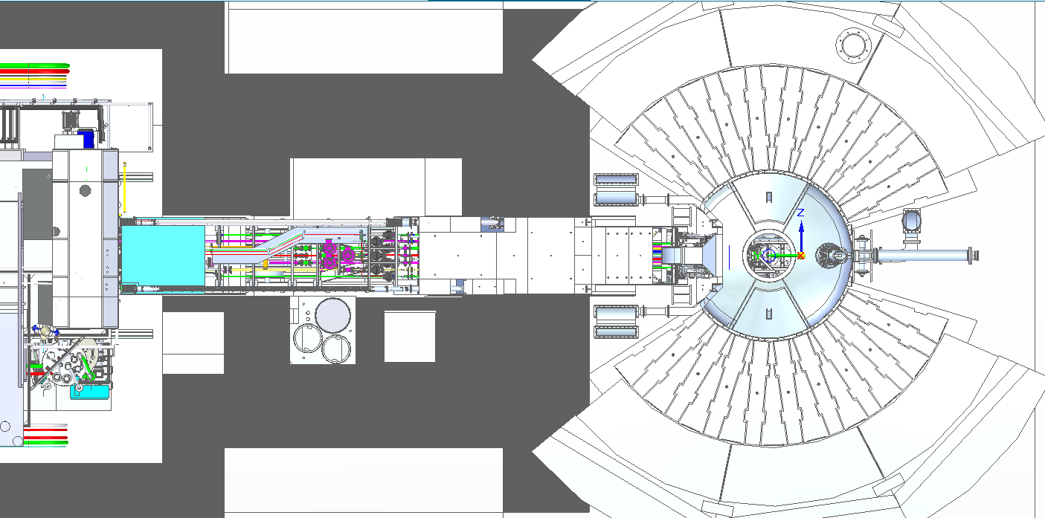
Target trolley gets stuck
1st July 2025
Location of
Collision
TROLLEY
DRIVE
DIRECTION
Target Station
Tunnel
Distance stuck
From home
Remote Handing Cell
Target Station

Slide 7
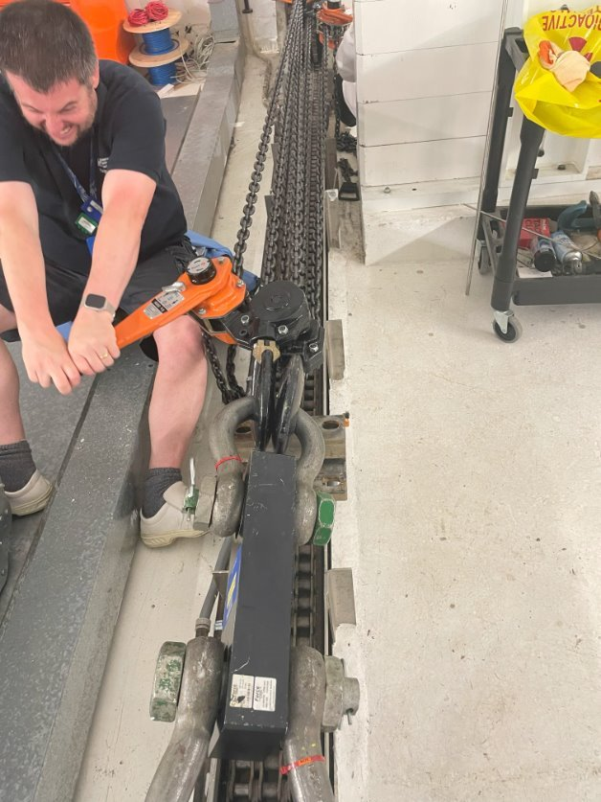
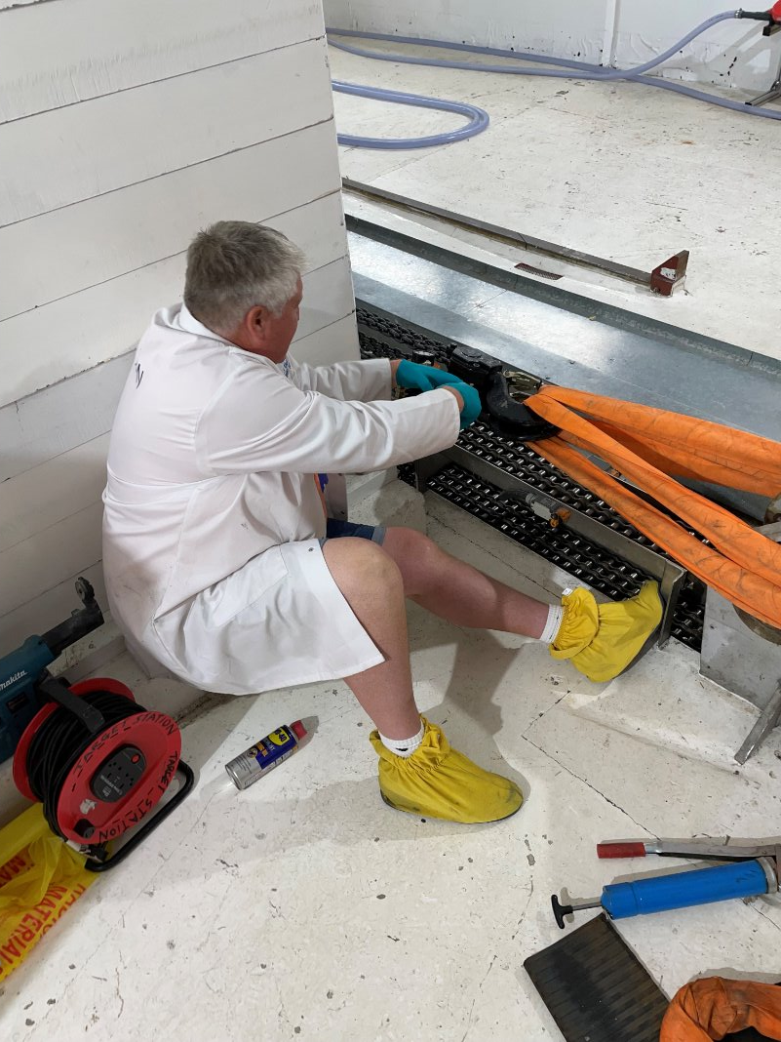
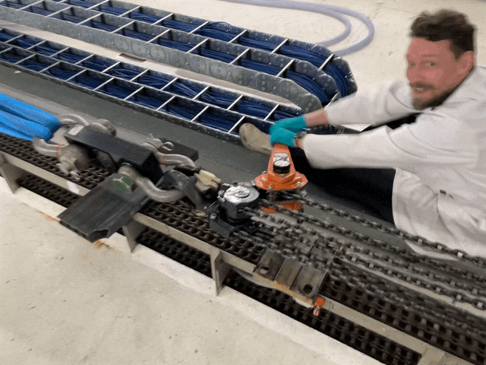
Target trolley recovery
Trolley 1.5m from fully forward
Trolley stuck
Trolley drive overload trips, chain jumps.
14 tons to move trolley
2 hours to get trolley fully back

Slide 8
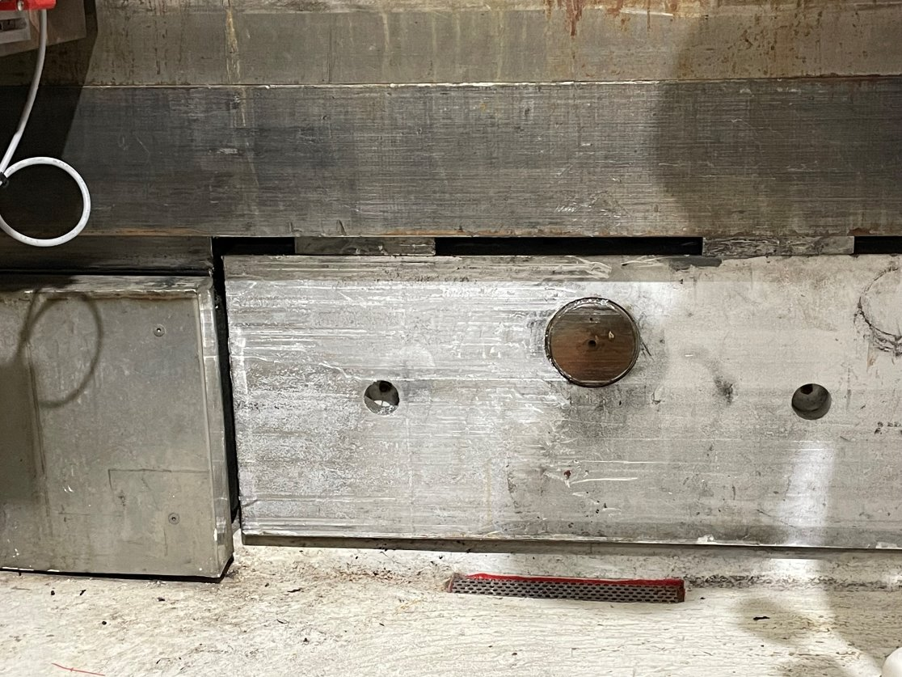
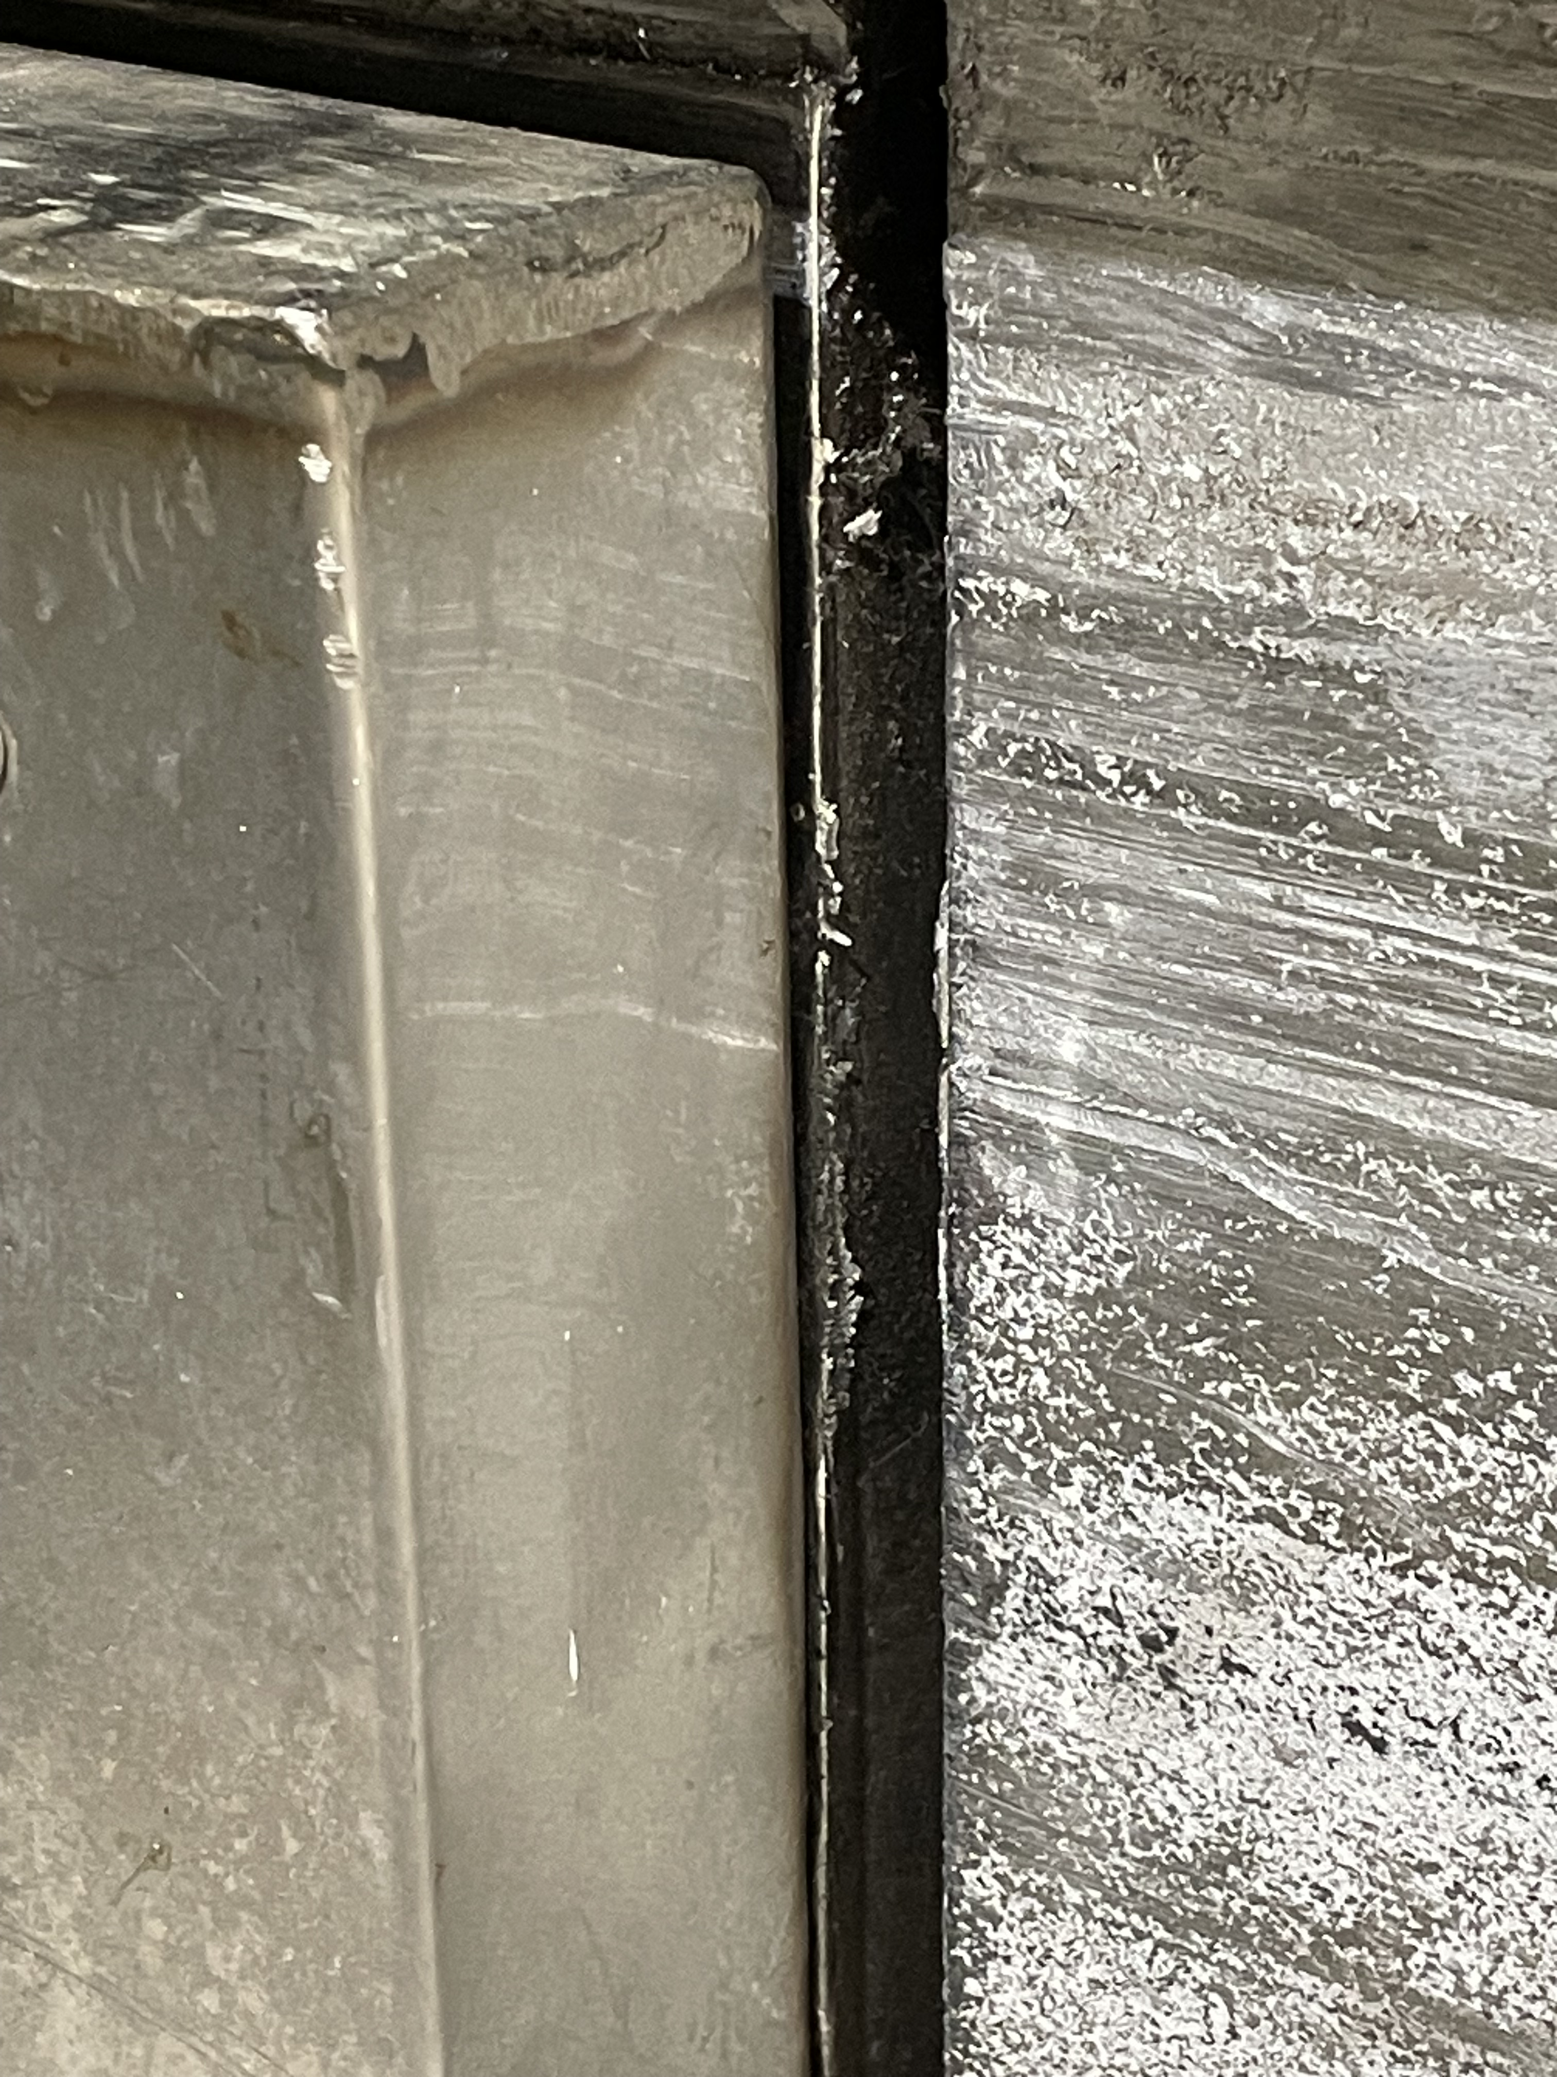
Damage spotted
North side Hudson trolley
New rubbing marks
Swarf
Missing paint

Slide 9
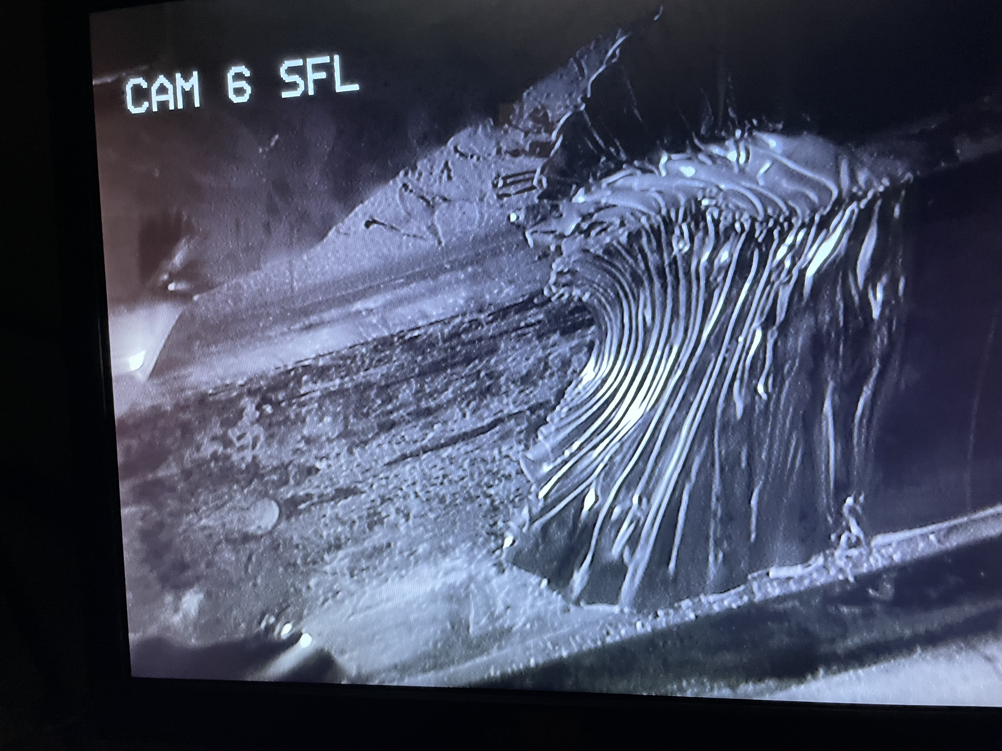
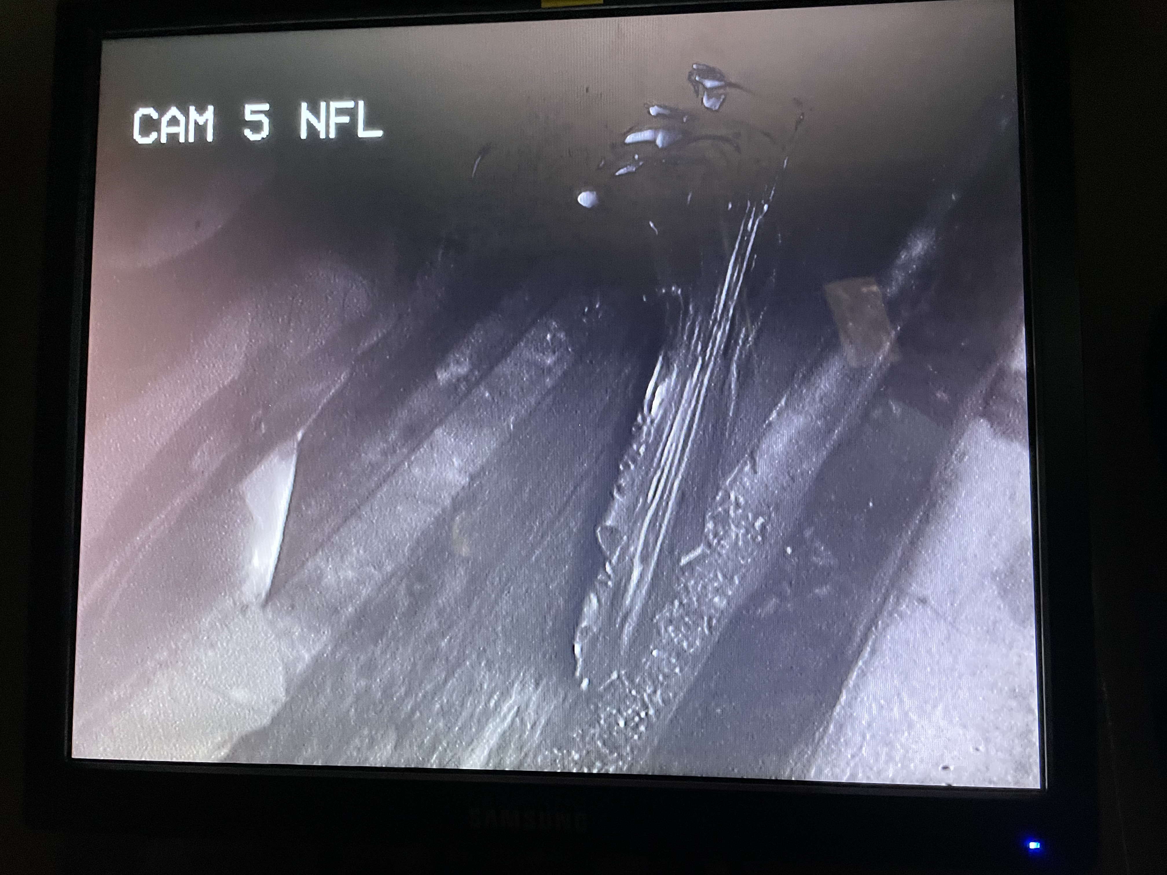
Damage to forward tunnel cladding
North side Hudson trolley
New rubbing marks
Swarf

Slide 10
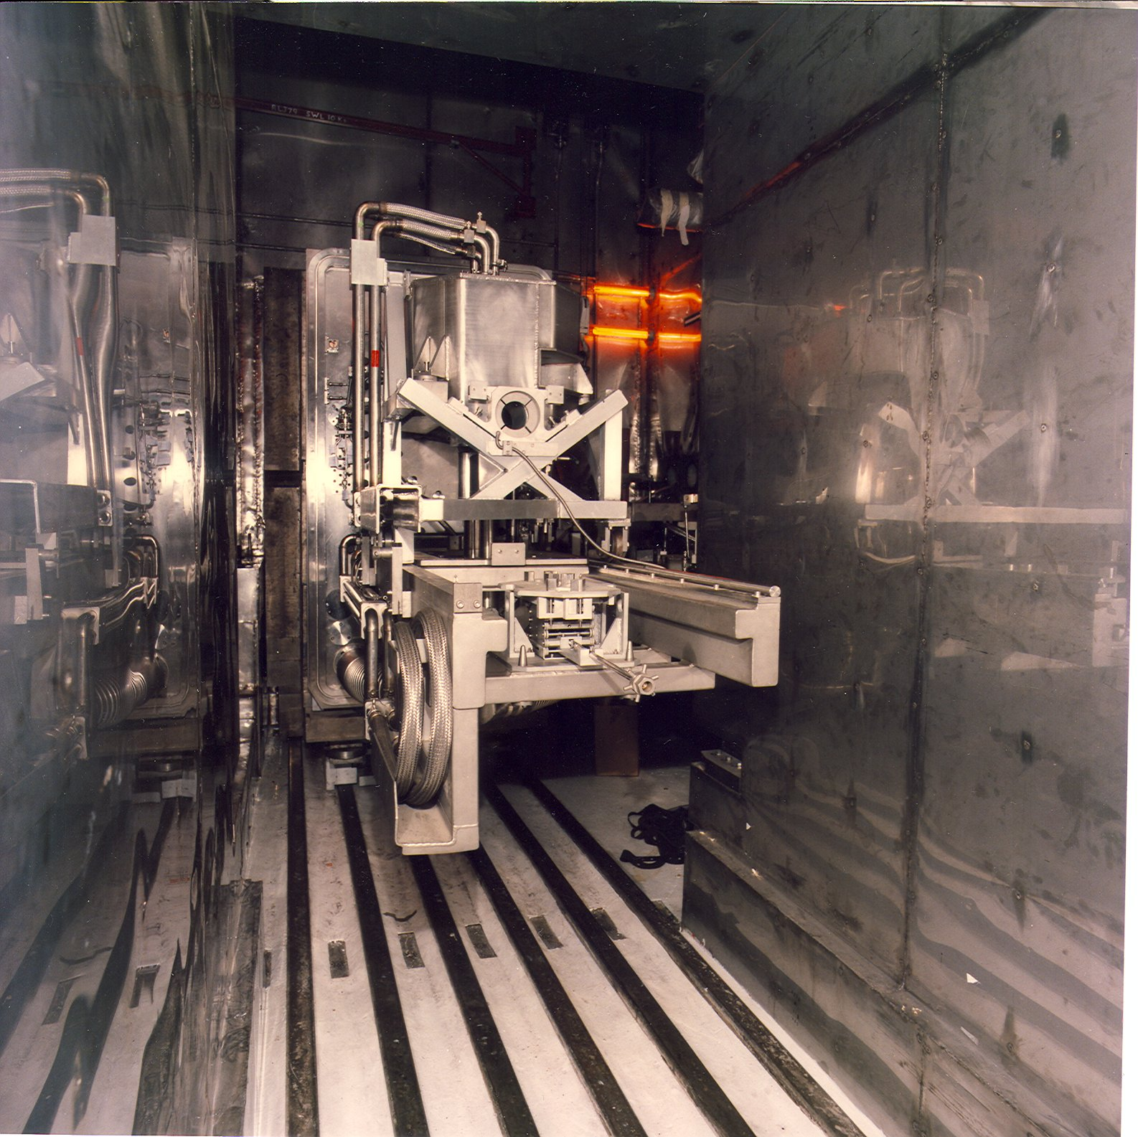
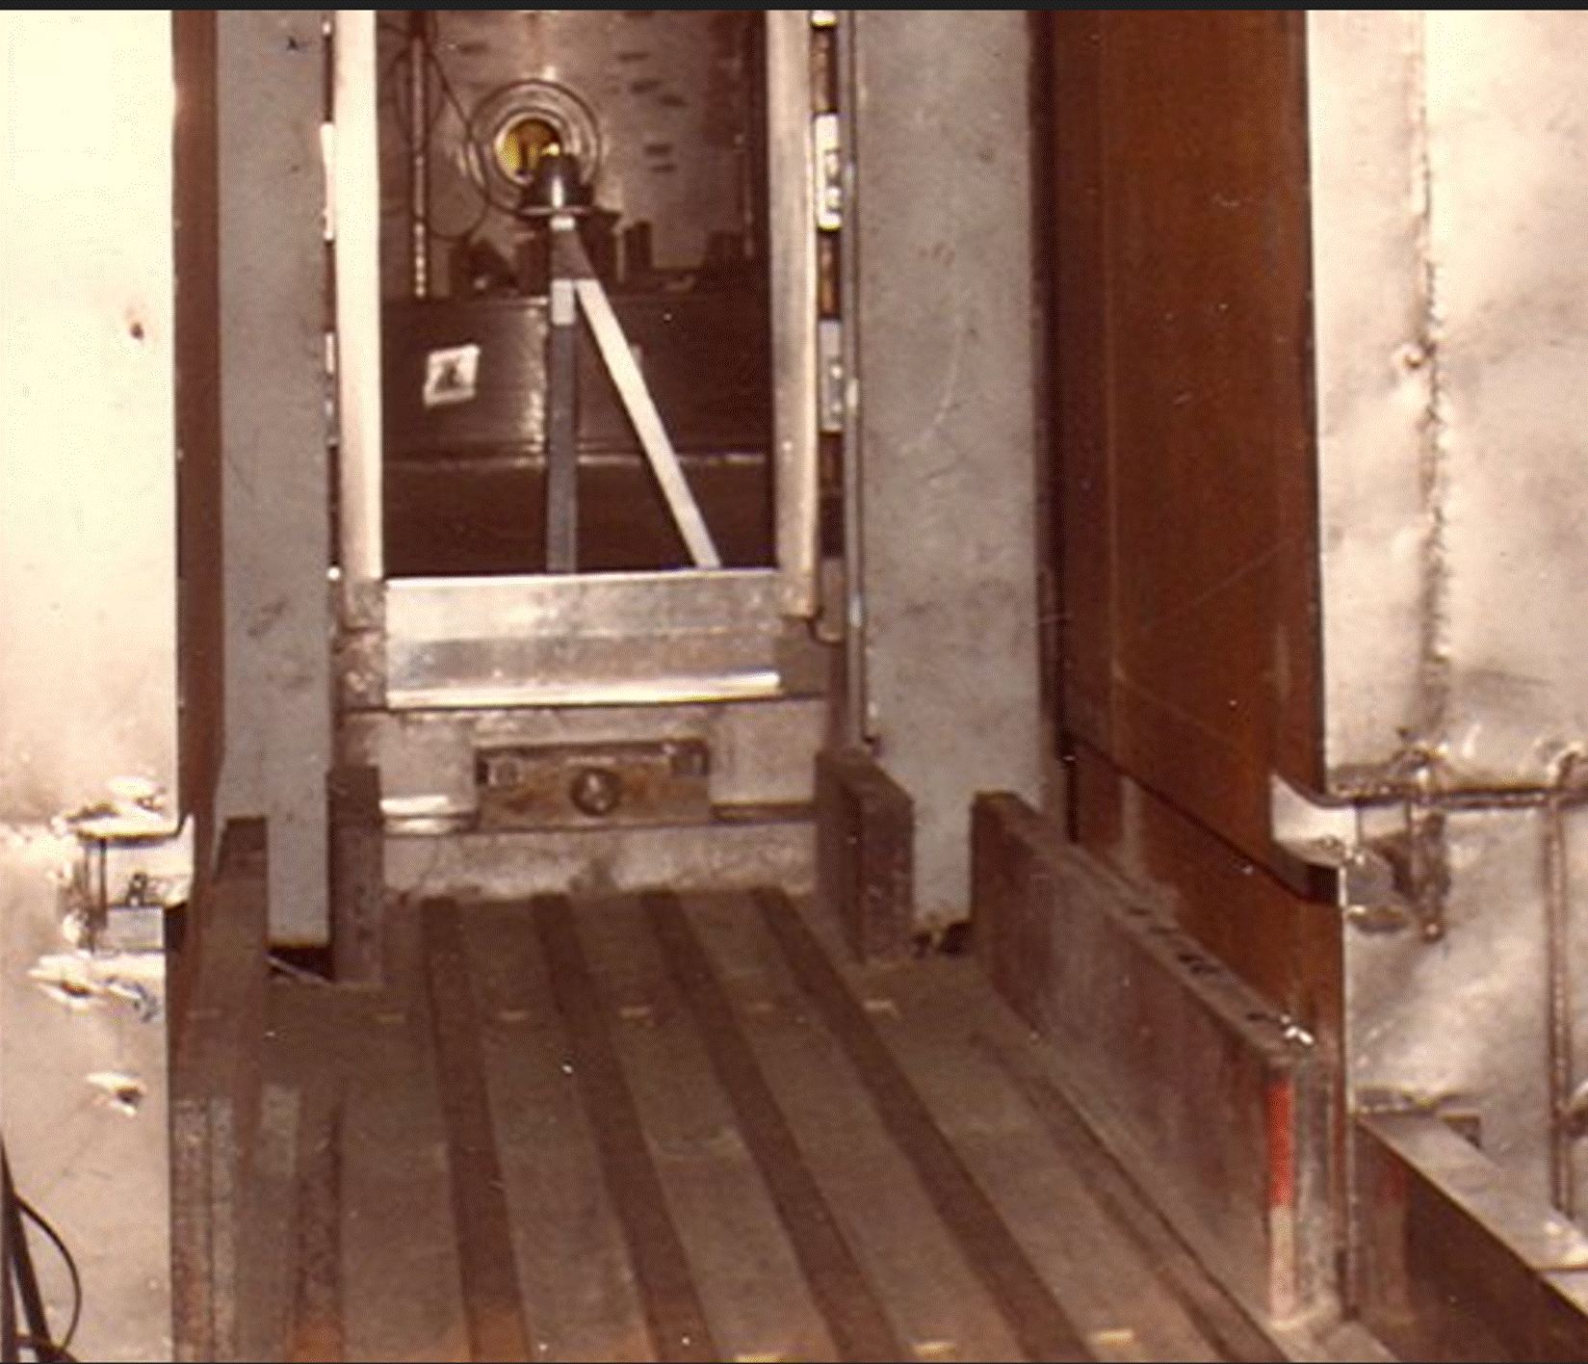
Inside the TSA
Target station tunnel looking towards
the remote handling cell
Target station tunnel looking towards
the void vessel

Slide 11
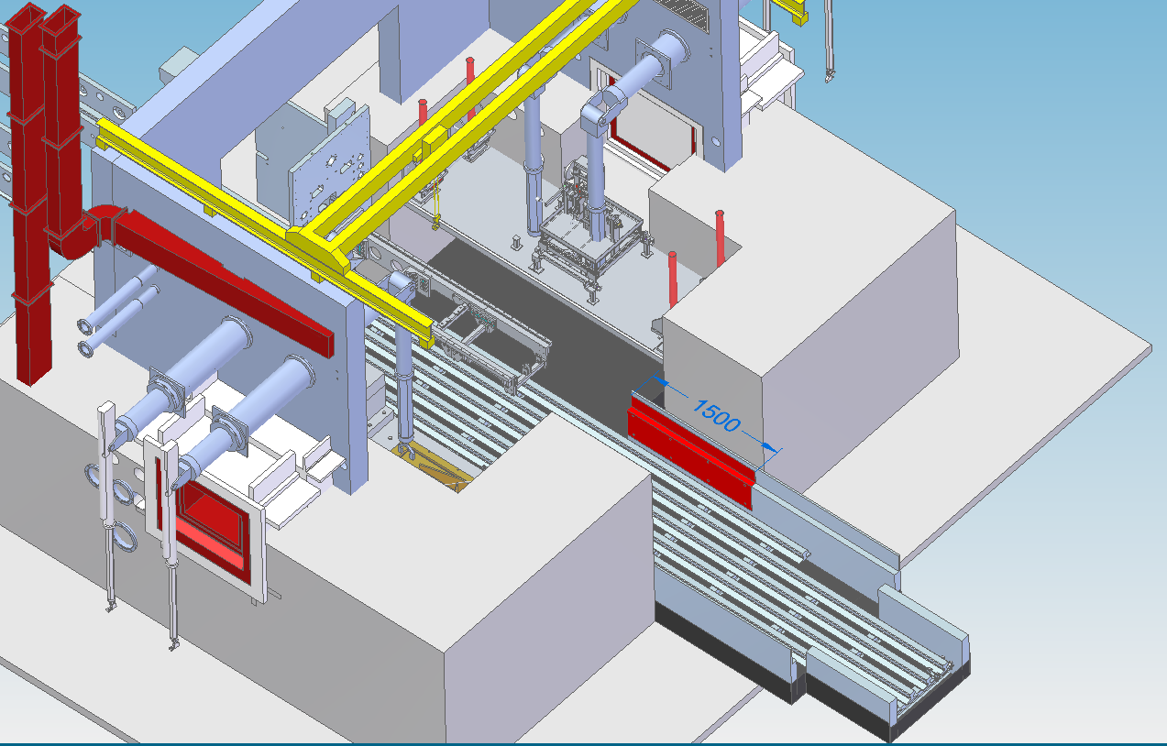
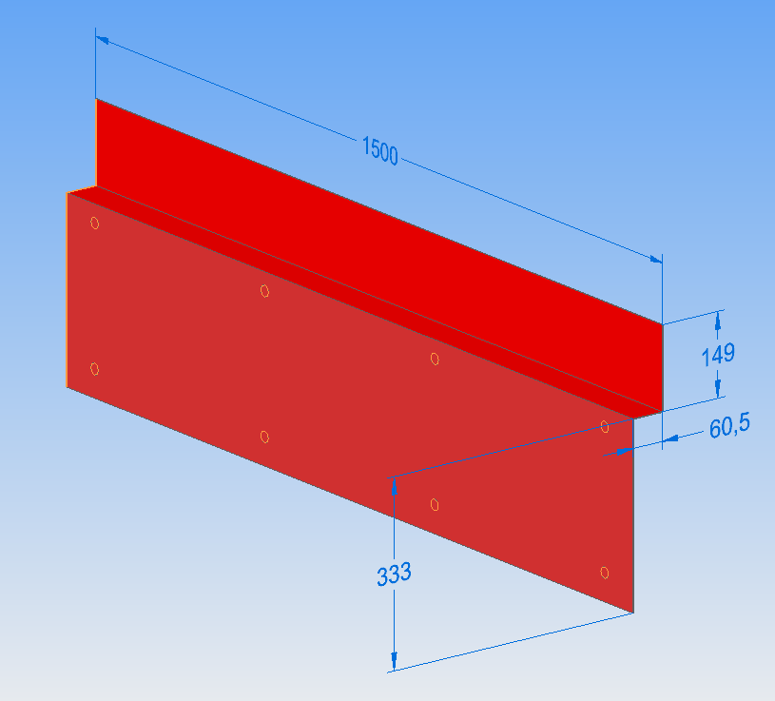
Location of the damaged cladding
Location of the damage is within the tunnel to the target station.
No visibility.
Poor lighting.
Out of reach of the manipulators.
No crane coverage.
1mm thick stainless cladding.
Stud welded to wall, number and location of ?
Challenging cut profile. Corners!

Slide 12
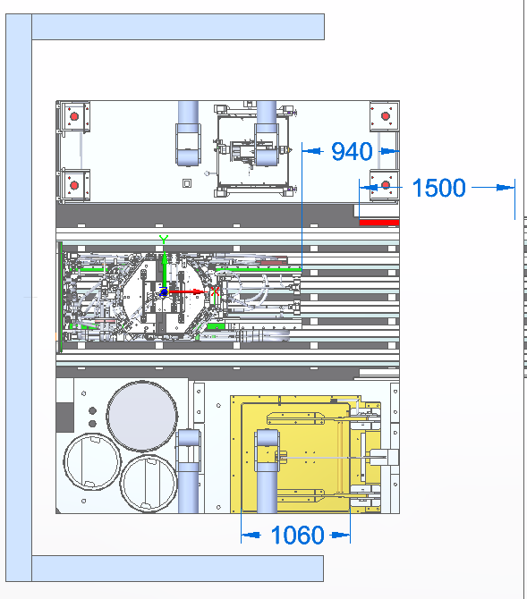
Remote handling cell limits
The Remote Handling Cell is for operational maintenance. It is not used for PIE. Radioactivity must be kept low for personnel entry.
However, we have done:-
Drilling & Tapping.
Bandsaw cutting of old TRaM frame.
Cropping of moderators.
All these tasks were carried out within reach of the crane and manipulators.
The removal of the cladding would need to be carried out remotely with the TRaM assembly occupying the cell. Personnel access not permitted with the Tram in the cell.
Only a small area with 1T crane coverage available to assemble kit to reach 1.5m down the tunnel.
Can only use two of the four manipulator arms, TRaM obstructs two of the arms.
Position of the TRaM
Space to assemble tooling
Damaged Cladding
Limit of manipulator reach
Target storage well
Cell entry trap door

Slide 13
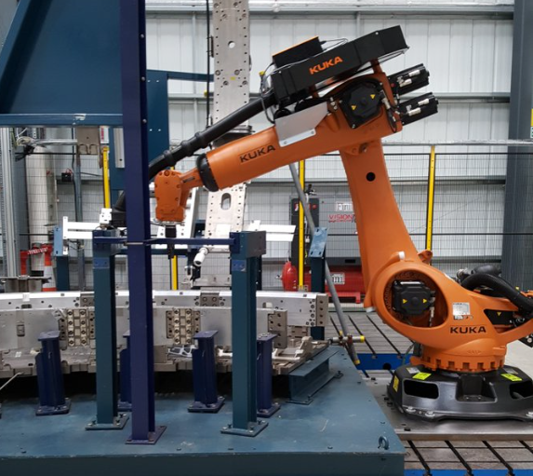
Cladding removal design considerations
Borrow a robotic arm from an external active handling supplier? - Tight time frame, difficult to
decontaminate and release back to supplier.
Plasma Cutting & Laser cutting? No spark arresting on the ventilation system.
Cutting by nibbler? - gap between cladding and wall unknown.
Remaining option was to cut cladding by grinding.
Grinder types, power, wheel sizes, wheel material types, carbide cutting / grinding wheel / diamond wheels.
Tool holding, positioning, changing wheels.
Control, how were we going to move into position, remote control, control via manipulators, motor drives?
Location, build a frame to mount tooling, use the existing rails?
Concerns, with gyro effects from grinder, wheel failure, vibration, dragging the trolley and tool wear. Mock up & trials to prove the design and procedures.
Access, Tooling to fit through to 1m x 1m hatch!.

Slide 14
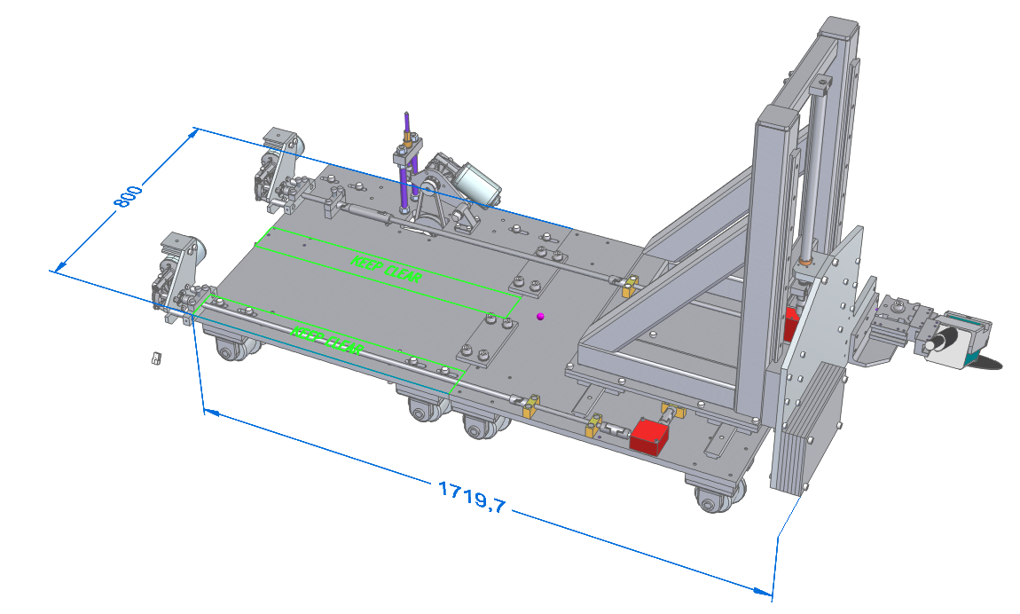
Cutting trolley design
Cutting trolley
Consisting of 2 trolley units to mount on the existing cell rails.
Each trolley is shipped in and coupled within the cell.
Utilising readily available off the shelf components, leadscrews, bearings, universal joints, motors, vee belt, angle grinders, slideways, and quick- change tool post.
PWM DC motor drive, fine control, maintains torque.
Multiple angle grinders prepared. 4”, 9”. Different wheel types. Arranged in various orientation.
Rear drive trolley
Remote traverse 24V DC motors.
Lathe, Quick change tool post
Trolley drive 24V DC motor.
Angle Grinder

Slide 15
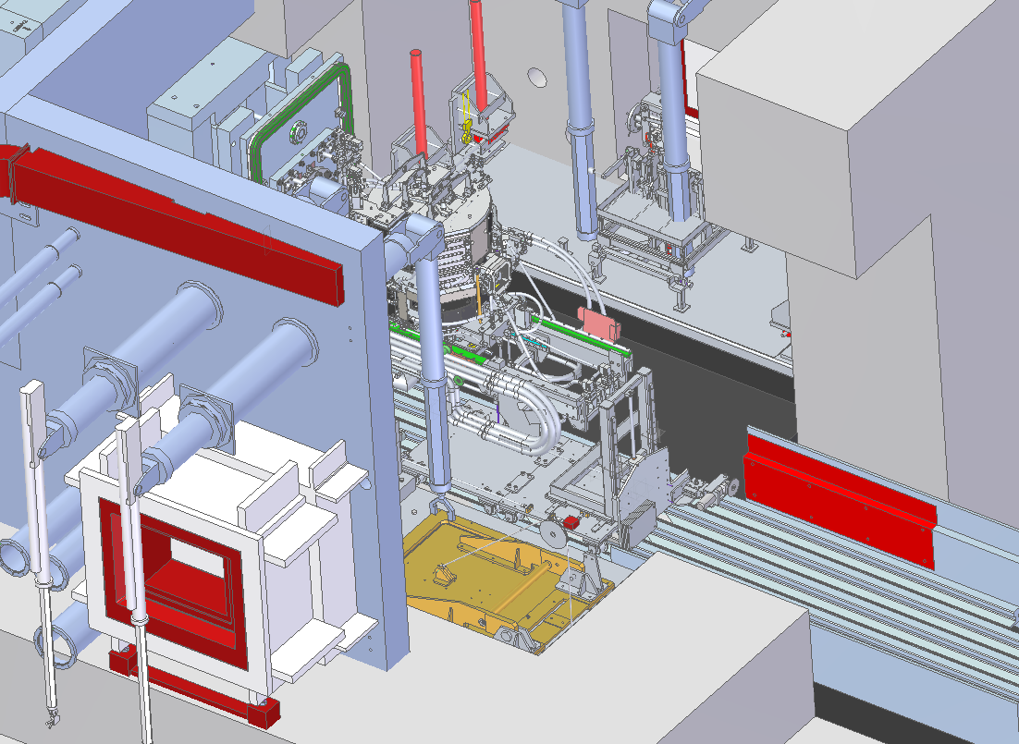
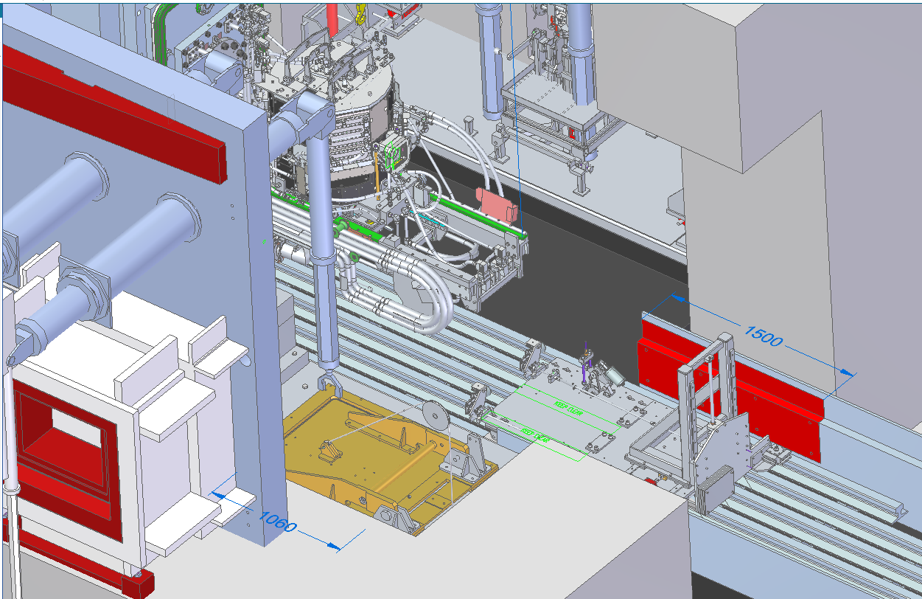
Cutting trolley design
Cutting range
Trolley in the retracted position to provide access for tool changes and assembly.
Trolley in the forward position to cut beyond the damaged area maintaining control access to manipulators

Slide 16
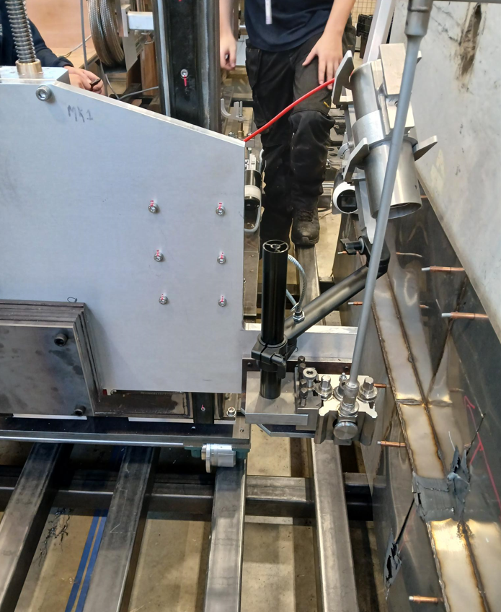
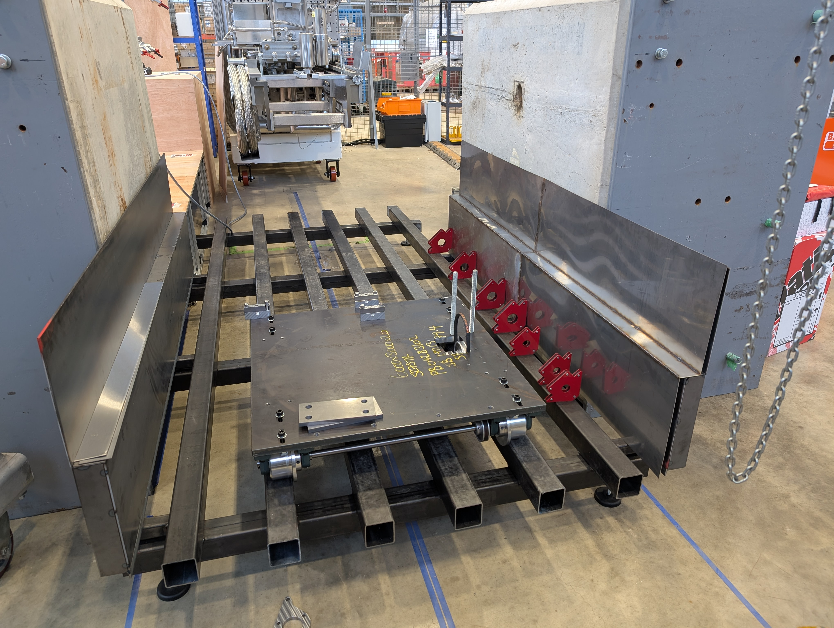
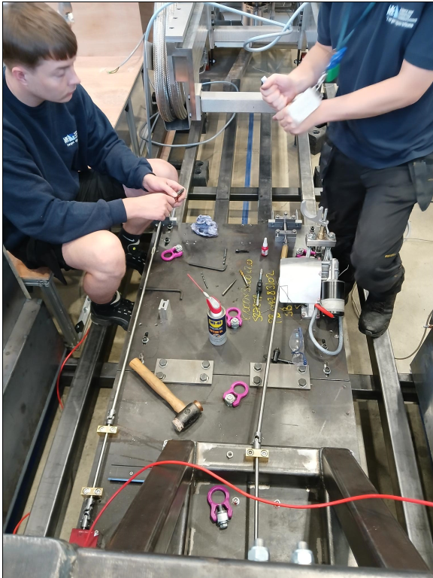
Mock ups and testing
As the components arrived, they were assembled and tested.
Modifications carried out to improve reliability, performance, and for easier remote handling to reduce loading on the manipulators.

Slide 17
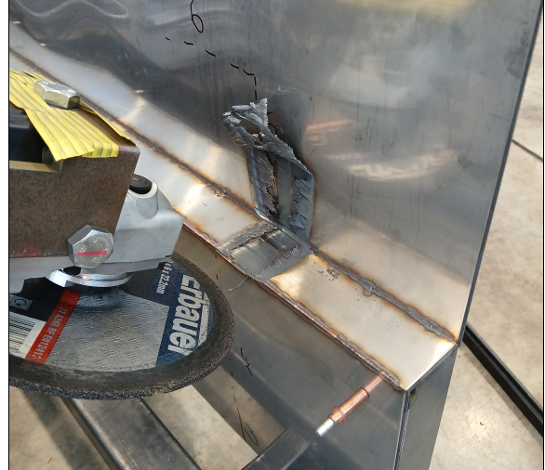
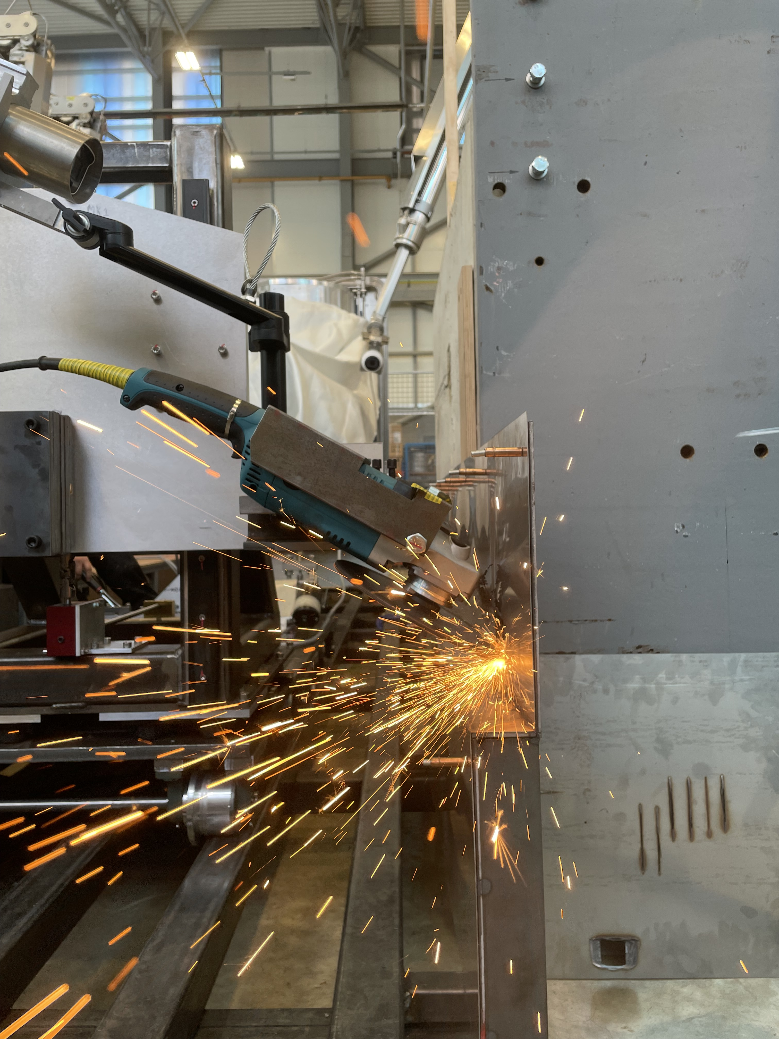
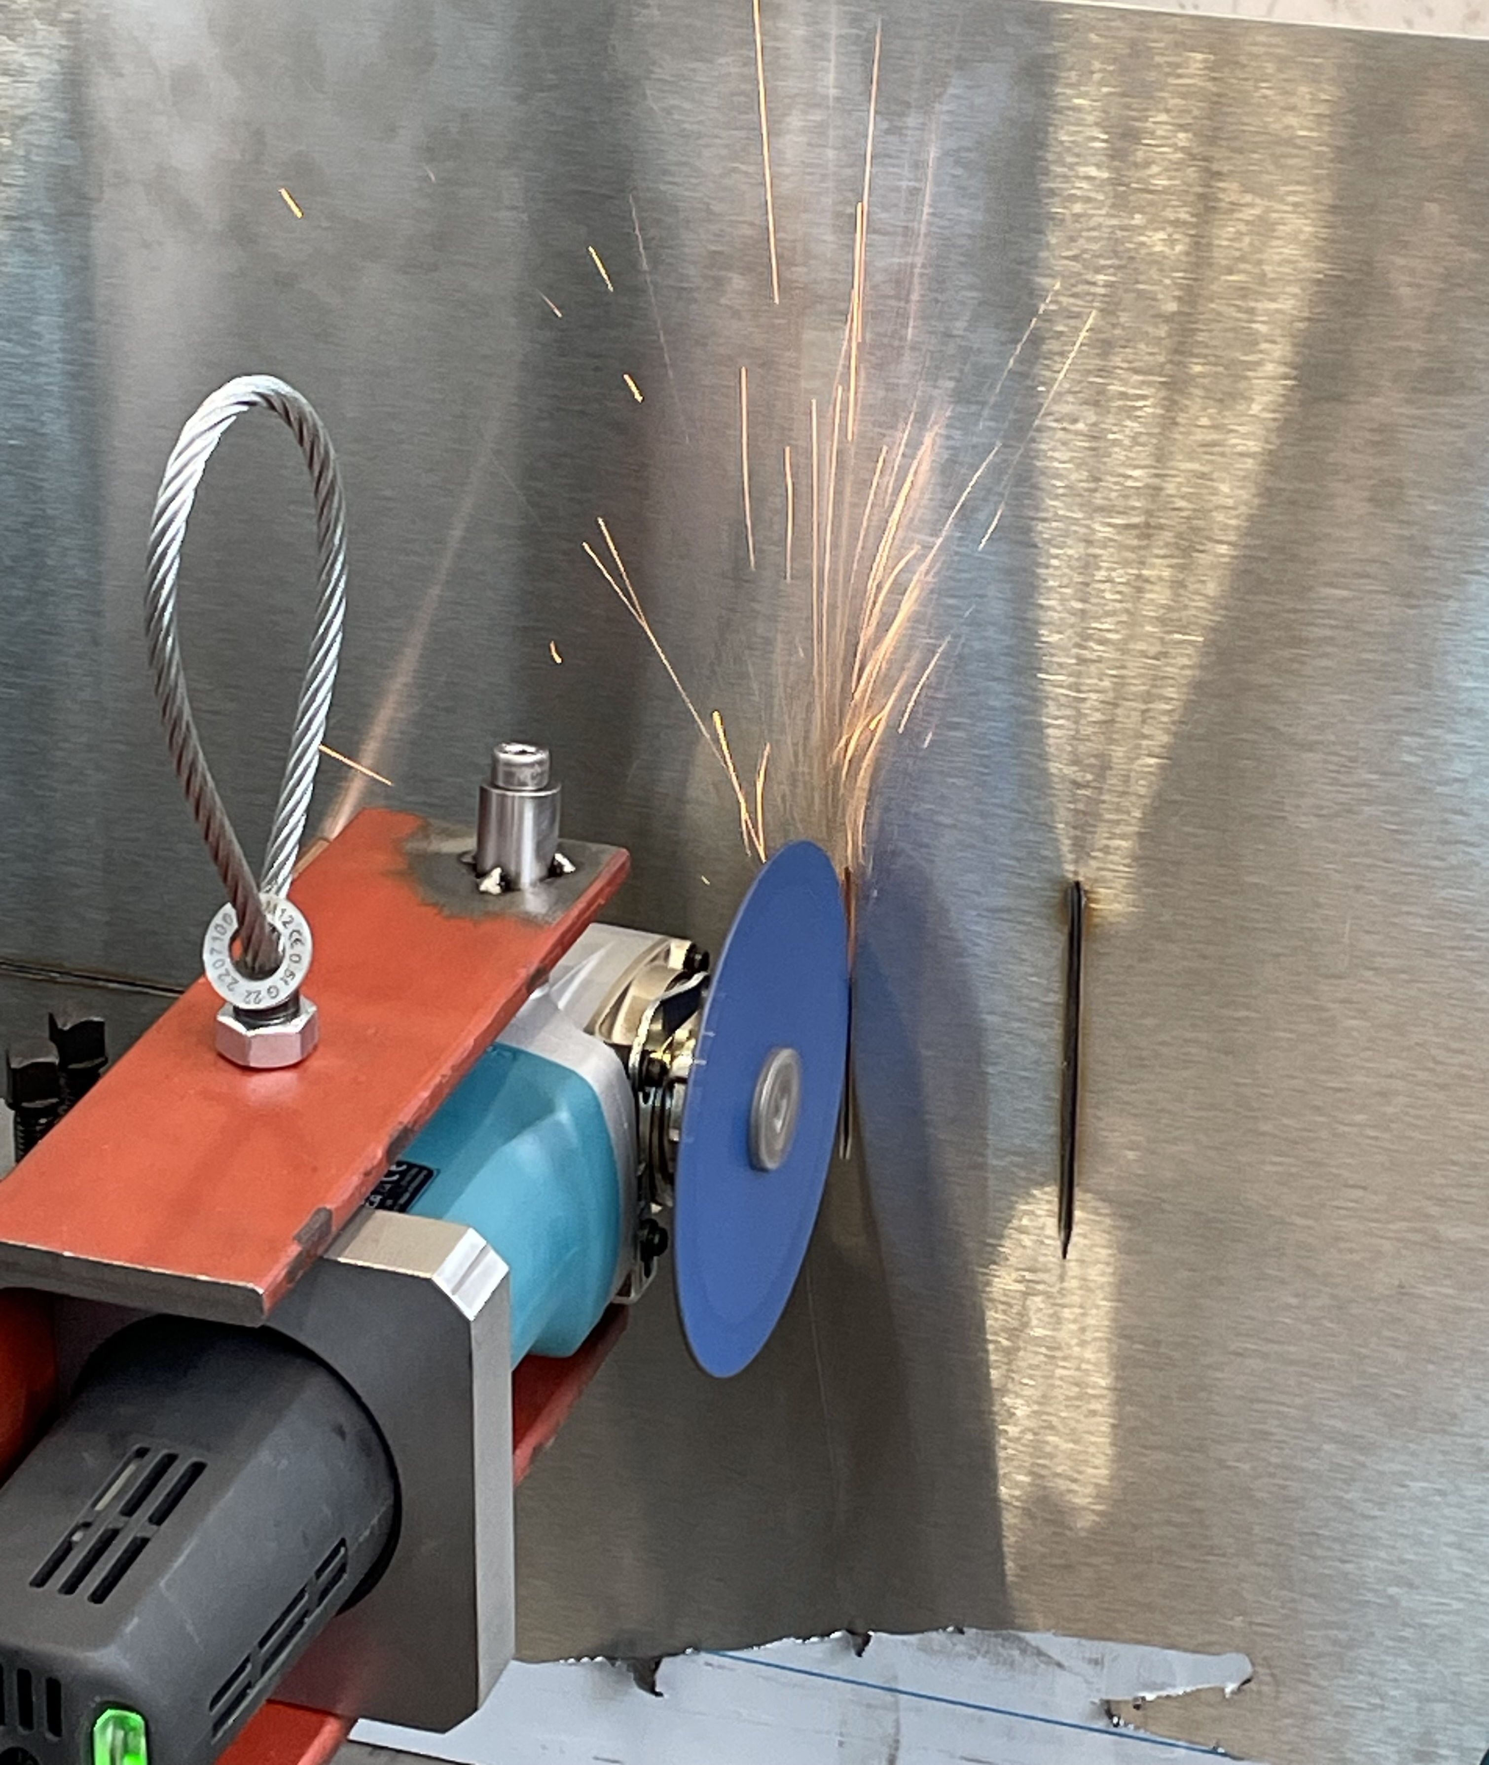
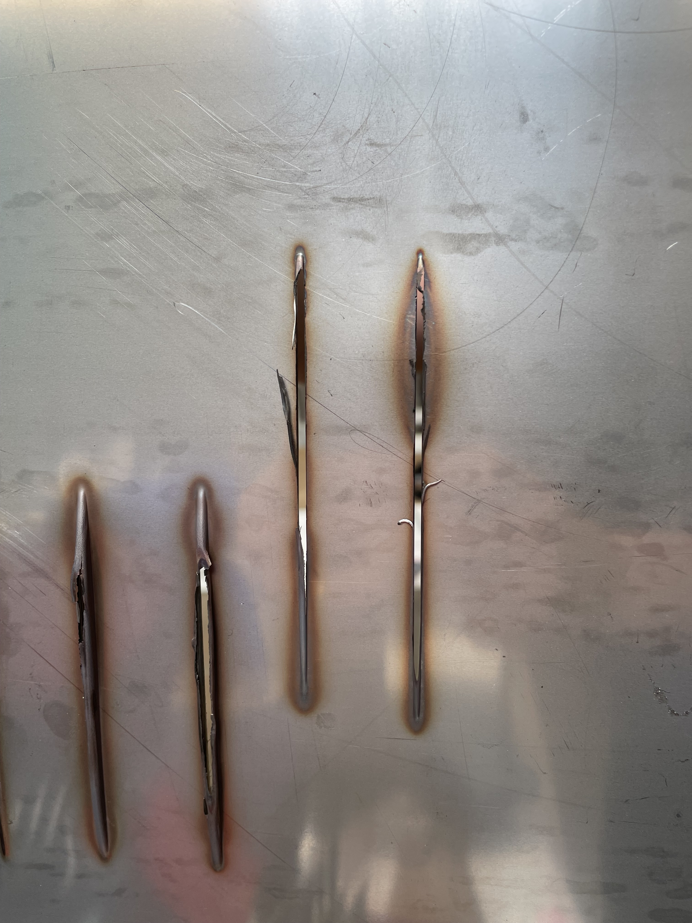
Test cuts
Deciding on grinder sizes
Testing discs

Slide 18
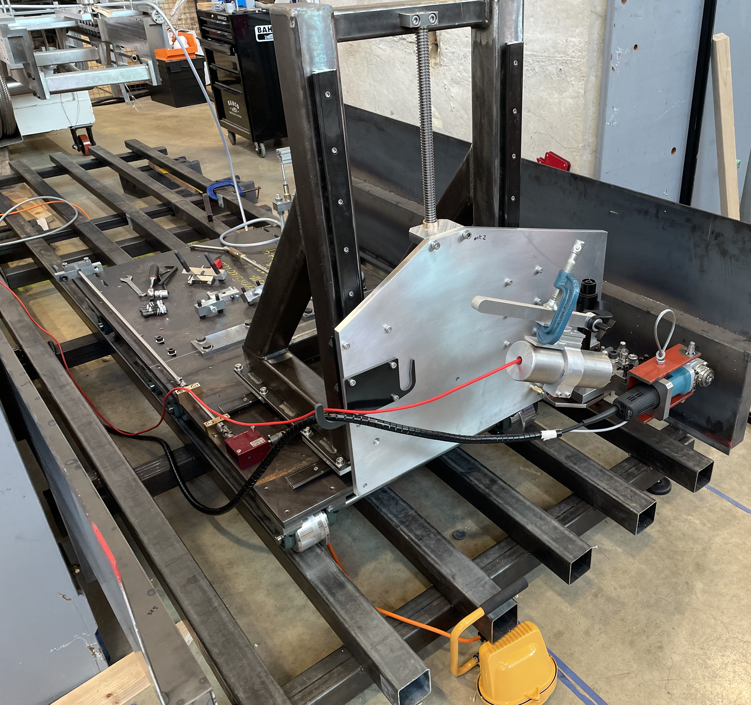
Proven final design
Rear trolley
Front trolley
3 x grinders - vertical, horizontal & tilted.
Camera holder
Grinder power supply
& controls
Produce procedures for installation and cutting
Gained confidence that we can carry out the repair

Slide 19
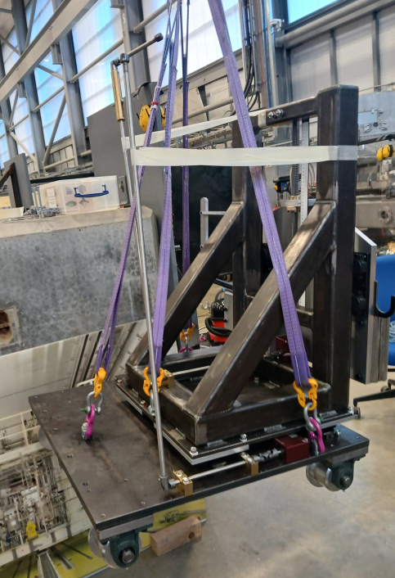
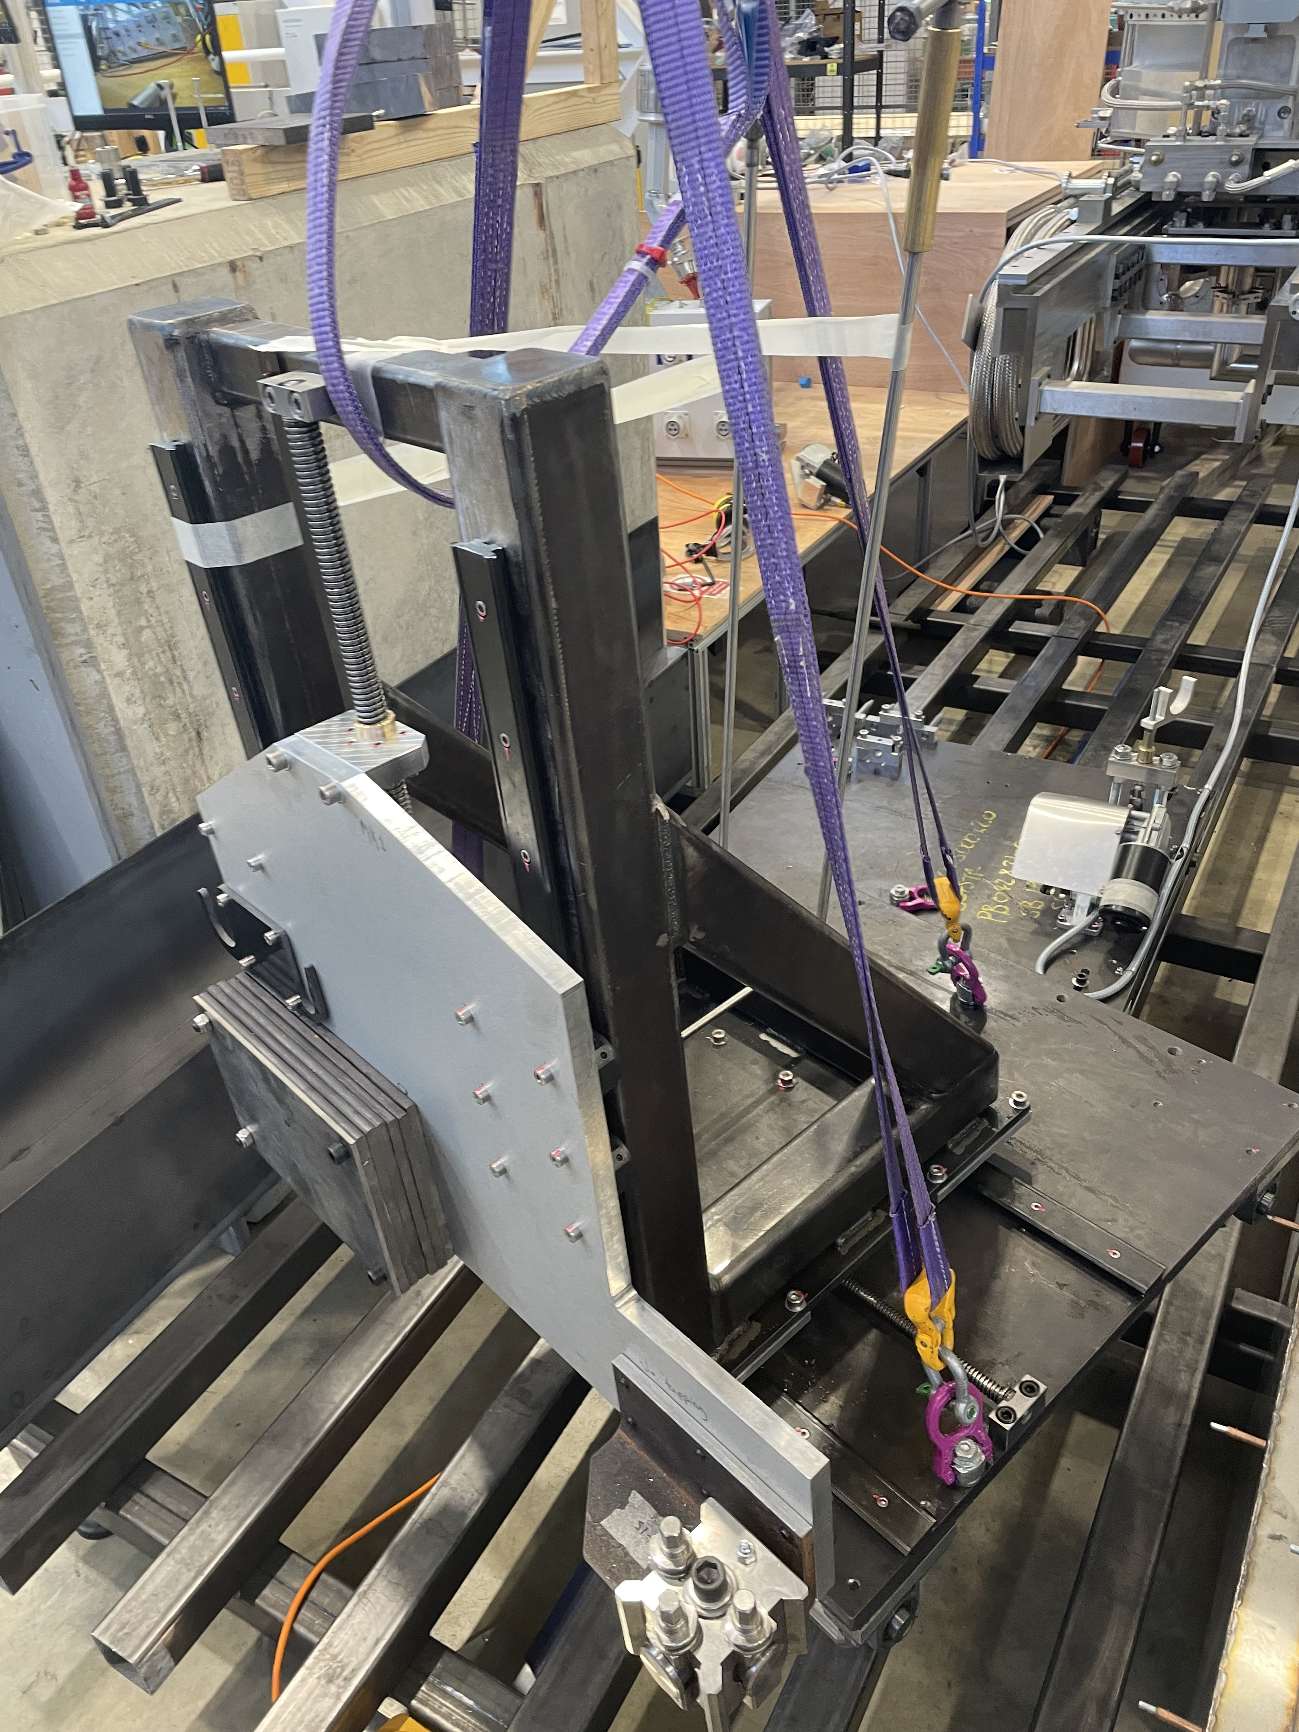
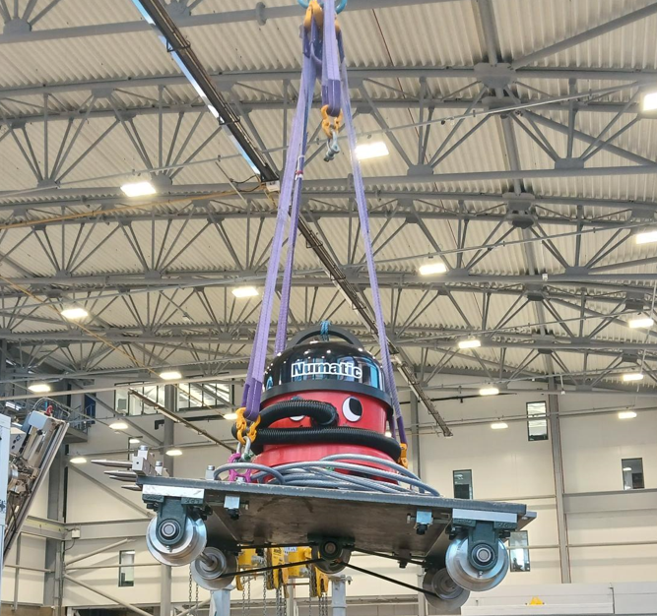
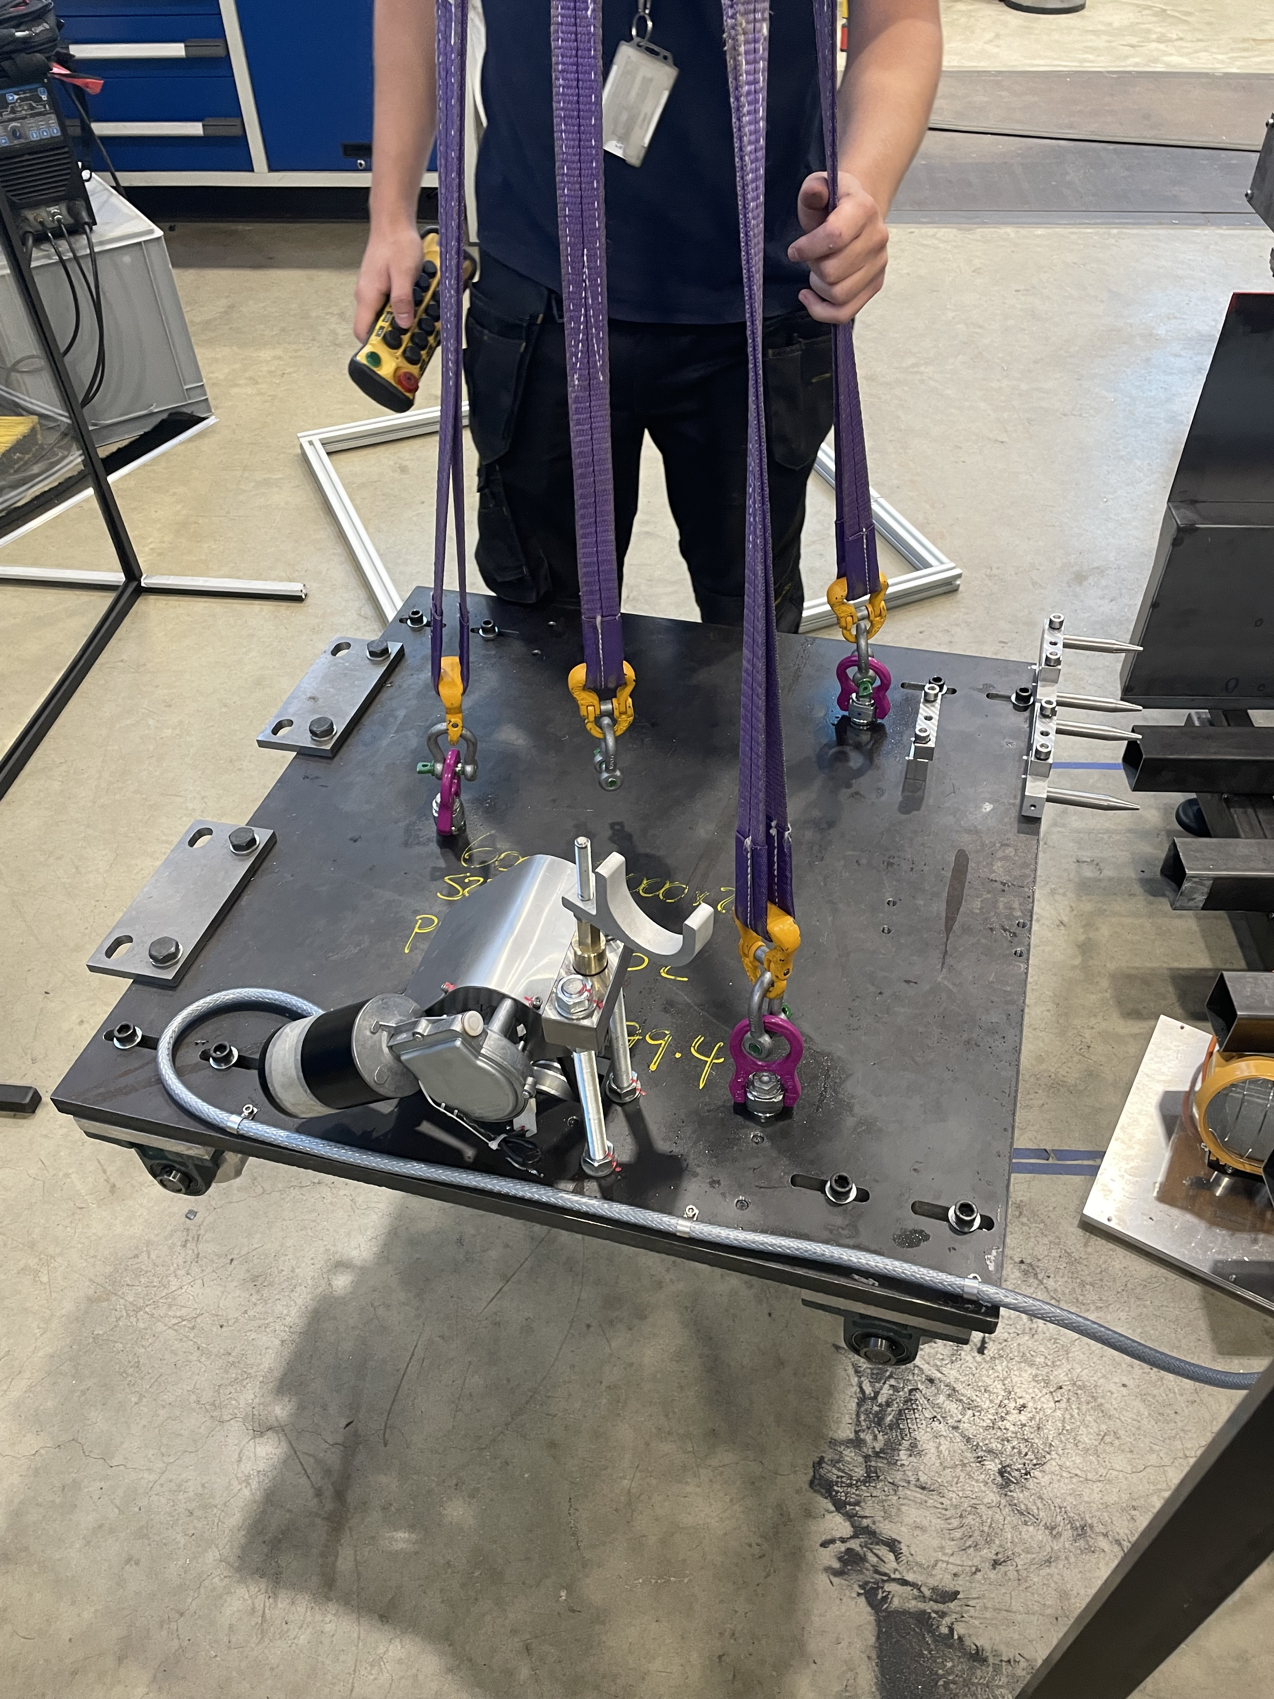
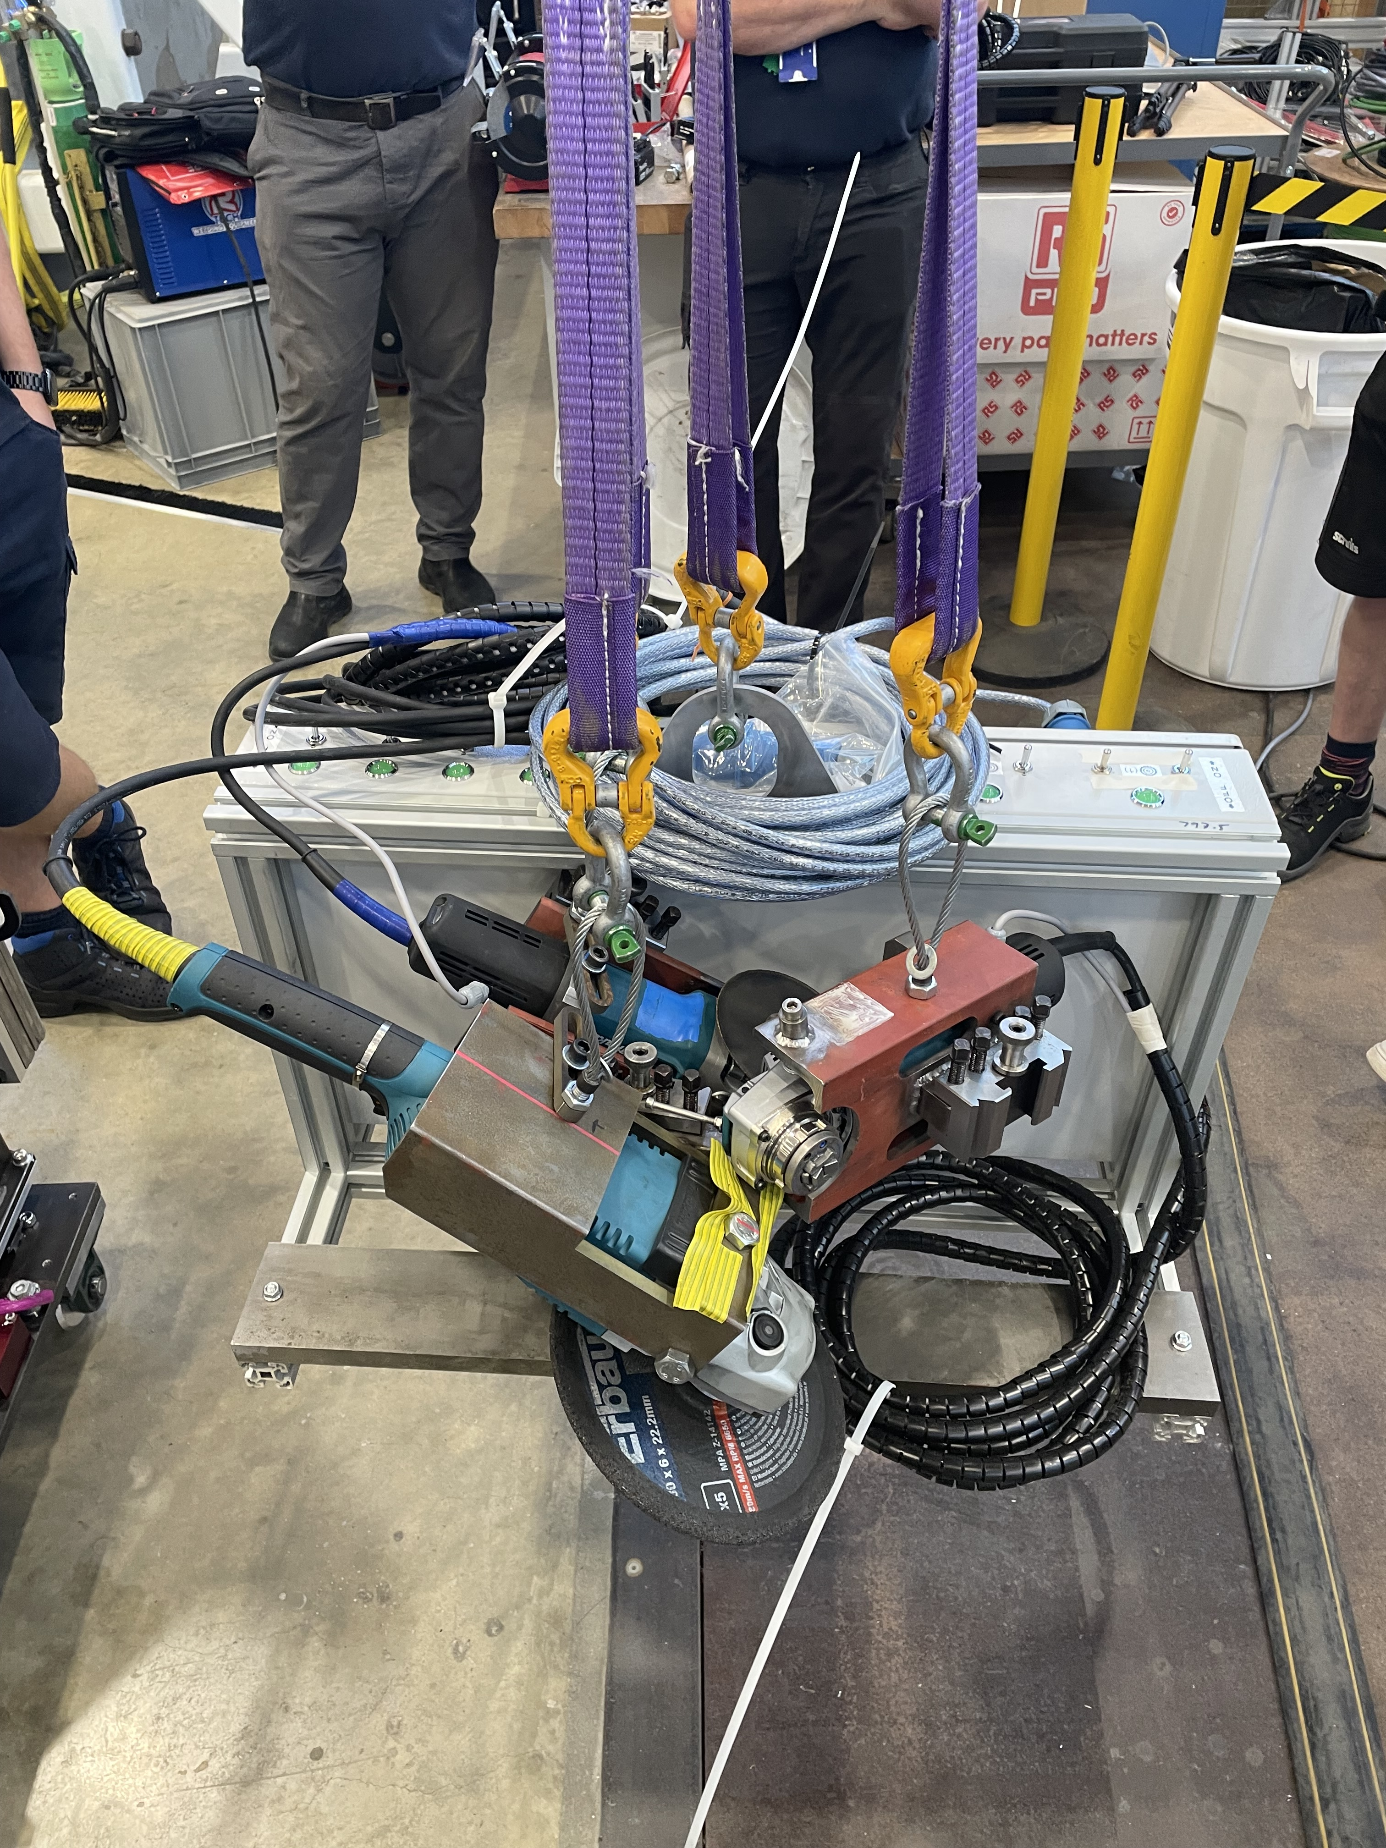
The kit is prepared for posting
Into the remote handling cell
Robot split into 5 packages
3 x Units remotely craned into RHC
1 x TSA, trolley motor power supply
1 x manipulator rooms, remote traverse motor power supply.
Henry hitches a lift

Slide 20
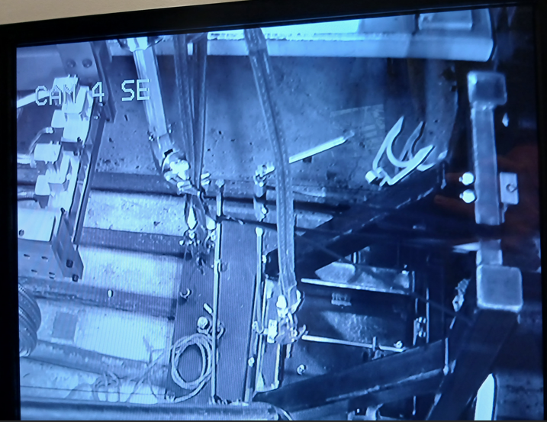
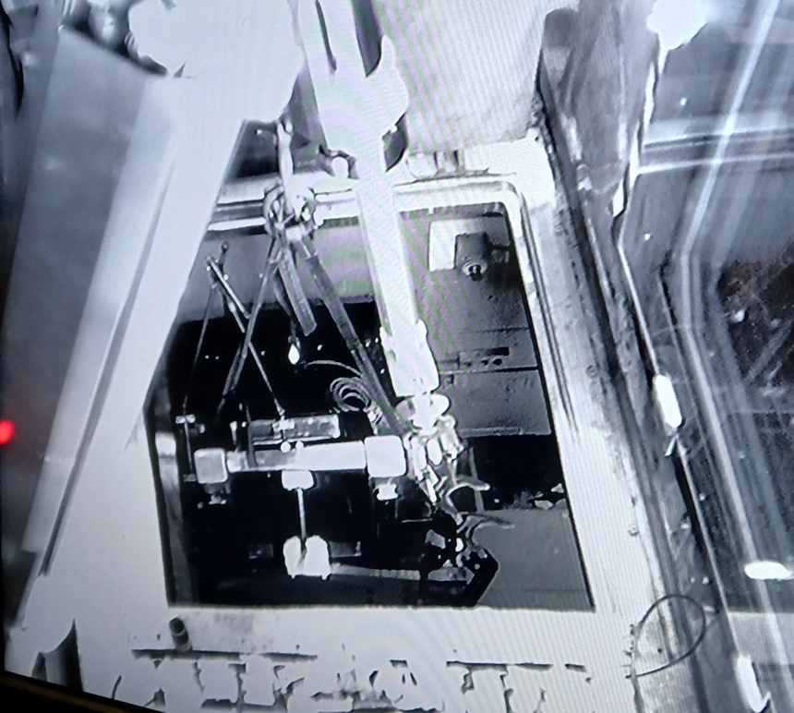
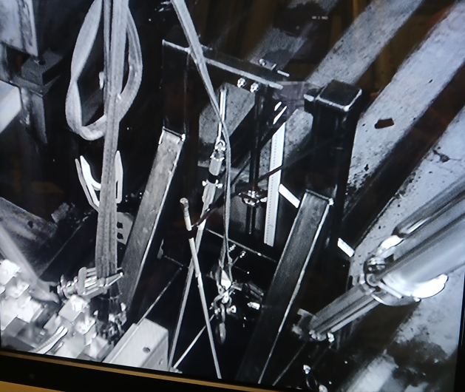
Equipment posted into the cell and assembled
A week of transferring equipment into the remote handling cell.
Assembly of trolleys
Feeding through cables.

Slide 21
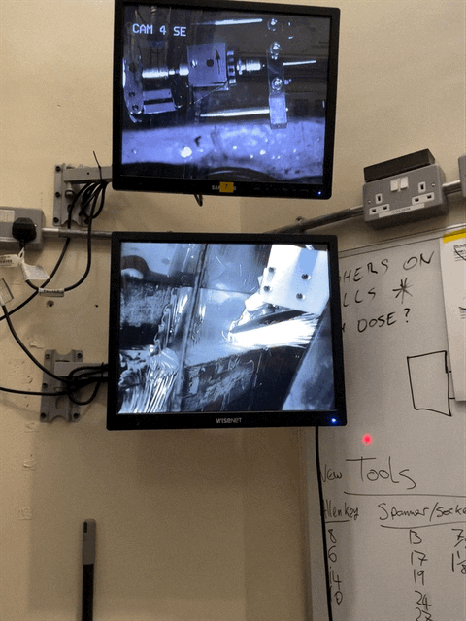
Cutting begins
Took 7 people to operate the robot
Based in three different room
First 3 cuts – 9" grinder
Cuts 4 and 5 – 5" vertical grinder
Cut 6 – 5" horizontal grinder

Slide 22
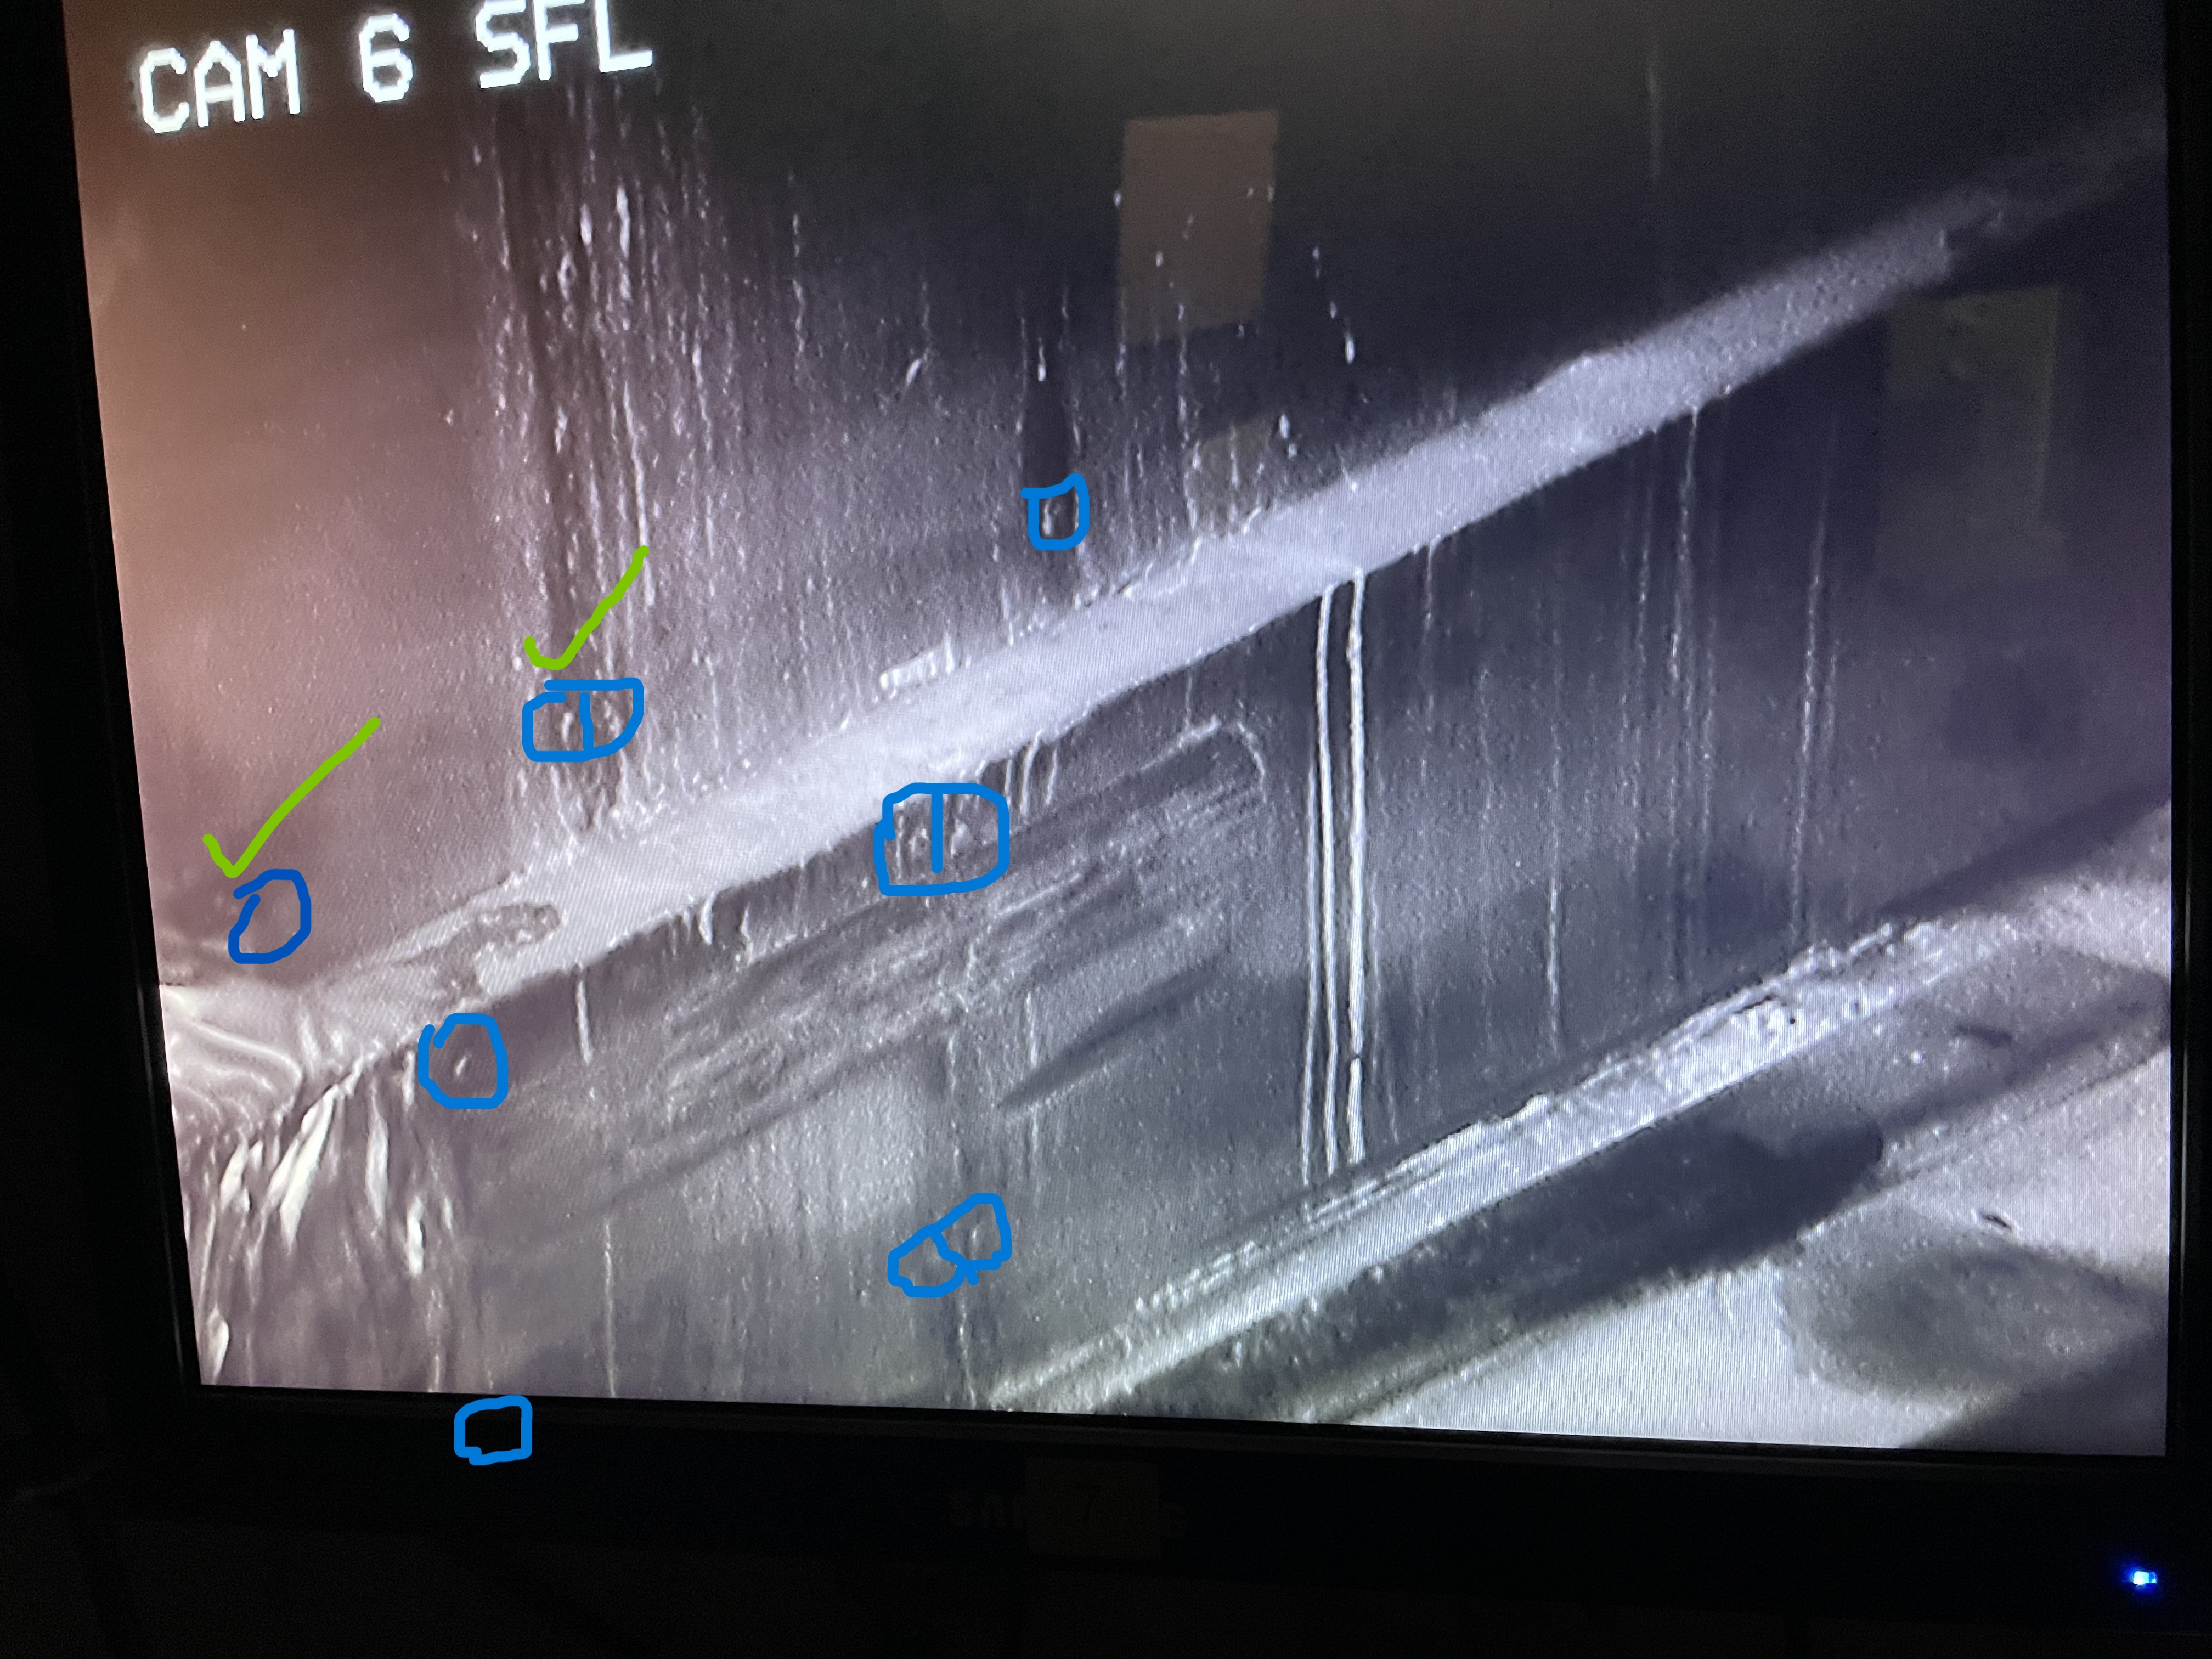
The unknown & frustration
Unable to practice due to lack of information on how the stainless was mounted to the wall.
Guessing the location of the studs.

Slide 23
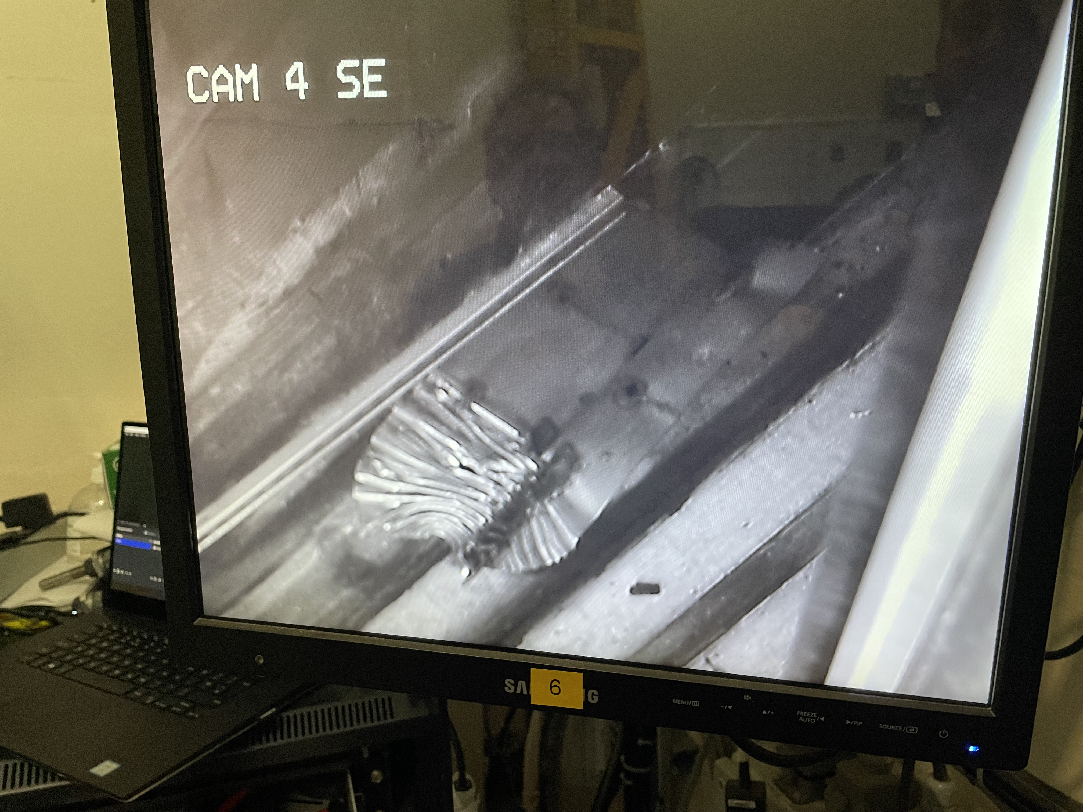
It’s free!
Modified pry bar
(Extended by 3m with crane loop)
Lots more grinding
After a week of cutting & prying, Success!
The target trolley was able to be driven forward.
Rescheduled user cycle was able to begin on time.
The design, mock ups, and repair was completed within a 2 month window.

Slide 24
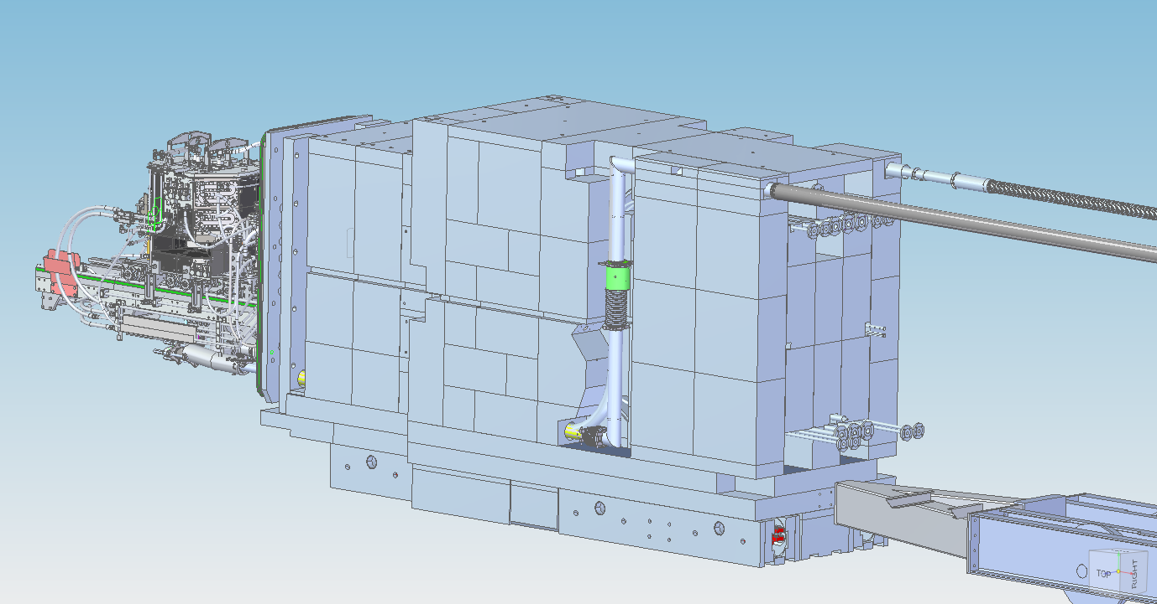
Cause of the collision?
The target trolley has a history of getting stuck. There was a collision in 2010. Solved by correcting a tilt.
It always seem to occur on the northside.
Building subsidence.
120T trolley bogie wear.
Trolley being pushed from a single central point causing skew.
Trolley bogie X4
Single point push pivot

Slide 25
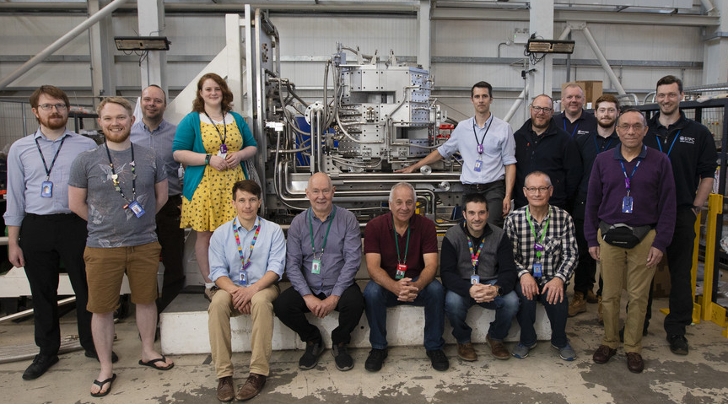
A team effort!
This difficult task that was completed within a very tight time frame. This was only possible due to the dedication of technical staff with various skill set contributing their efforts by reprioritising their work.

Slide 26

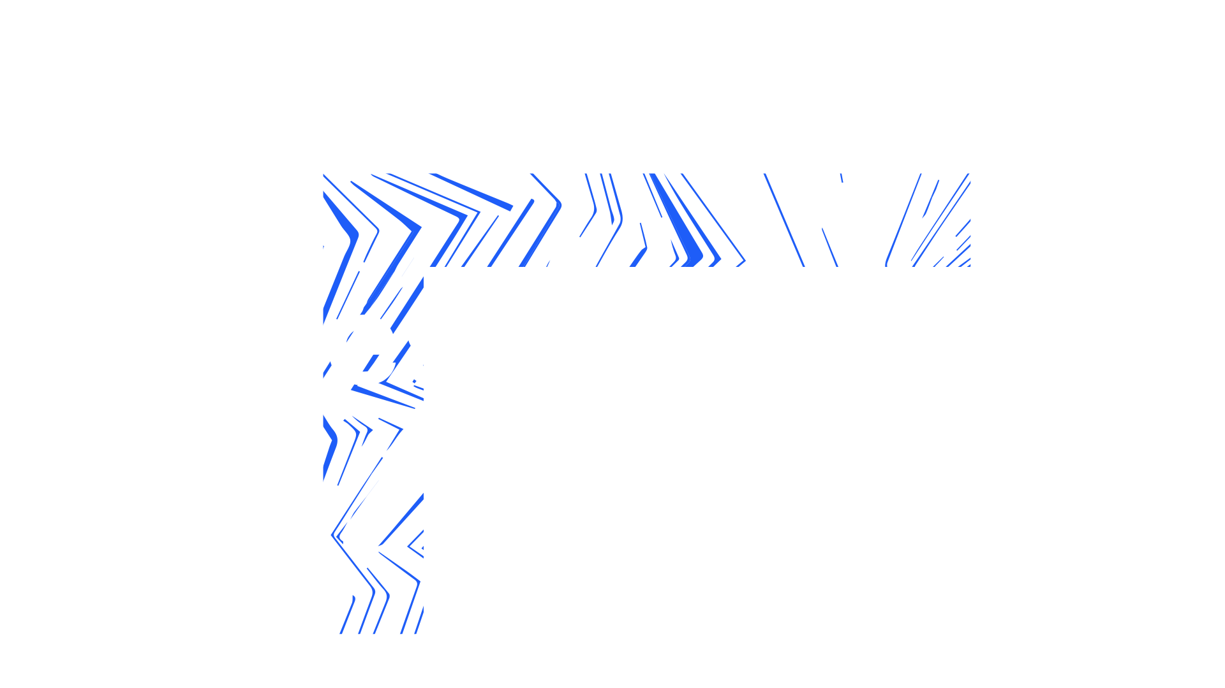

Daniel.coates@stfc.ac.uk
Notes:
The abstract pattern can be removed or repositioned if required. Be careful to ‘Send to Back’ so that it does not obscure any important information.

