Slide 2
Freezing of the Moderator Reflector Plug 1 (MRP-I) at ESS
April 2026
PRESENTED BY Marc Kickulies (ESS) & Yannick Beßler (FZJ)

Slide 3
Content
Requirements
MRP-I engineering design
Freezing experiment & numerical analyse
MRP-I commissioning incident
Hypothesis
Conclusion

Slide 4
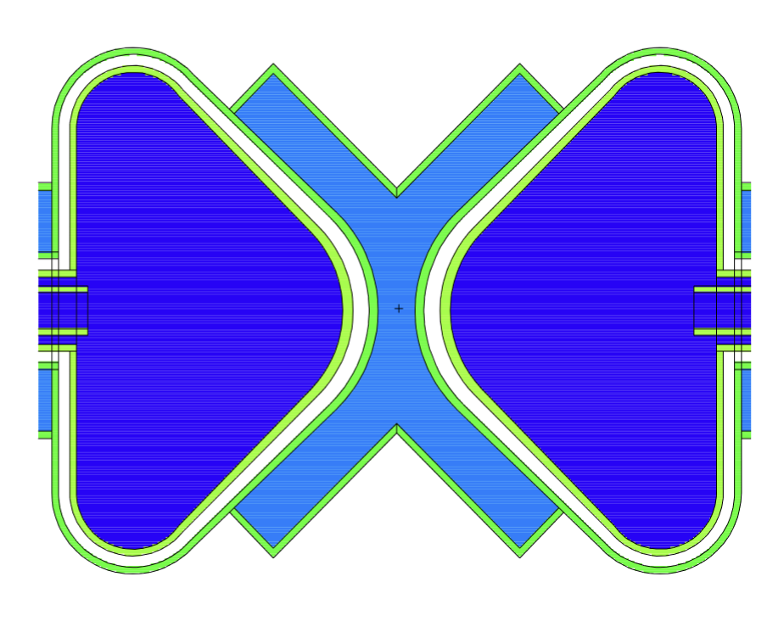
Requirements
Optimised for Maximal Neutronic Performance
at 5 MW Proton Beam Operation
Reflect and moderate fast neutrons from the target to thermal and cold neutrons suitable for the Neutron Scattering Systems
Position the moderators
Enable handling of active components
Shielding and avoidance of streaming
Cooling the radiation heat in liquids and solid metal bodies
Butterfly (BF) 2
Moderator

Slide 5
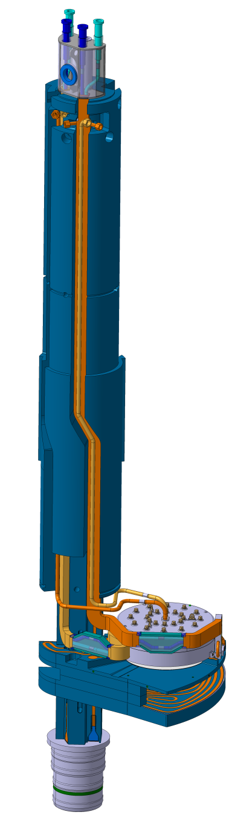
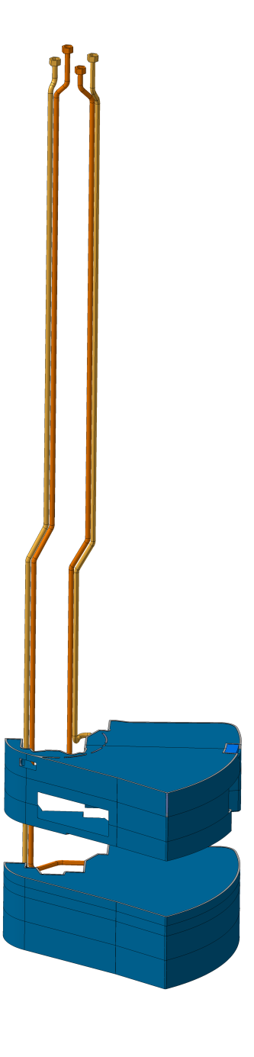
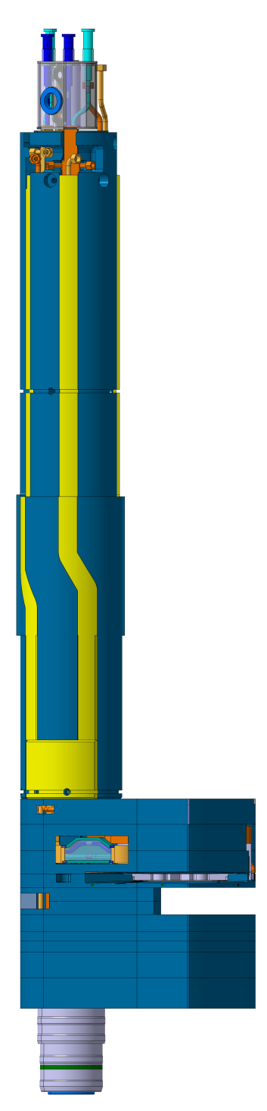
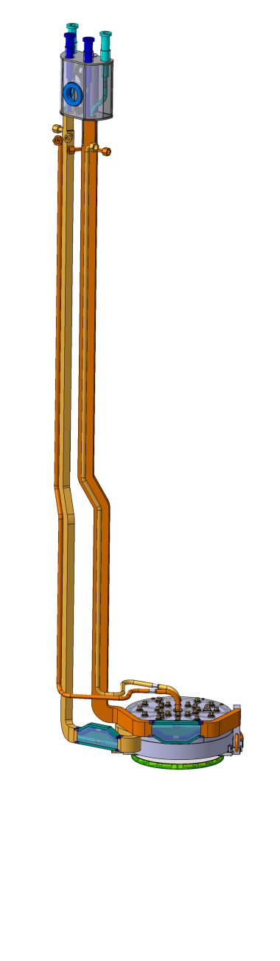
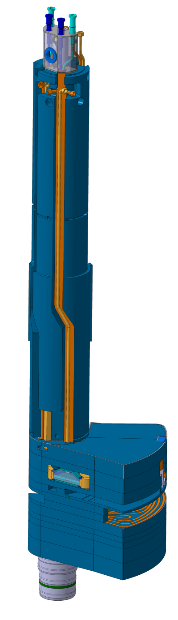
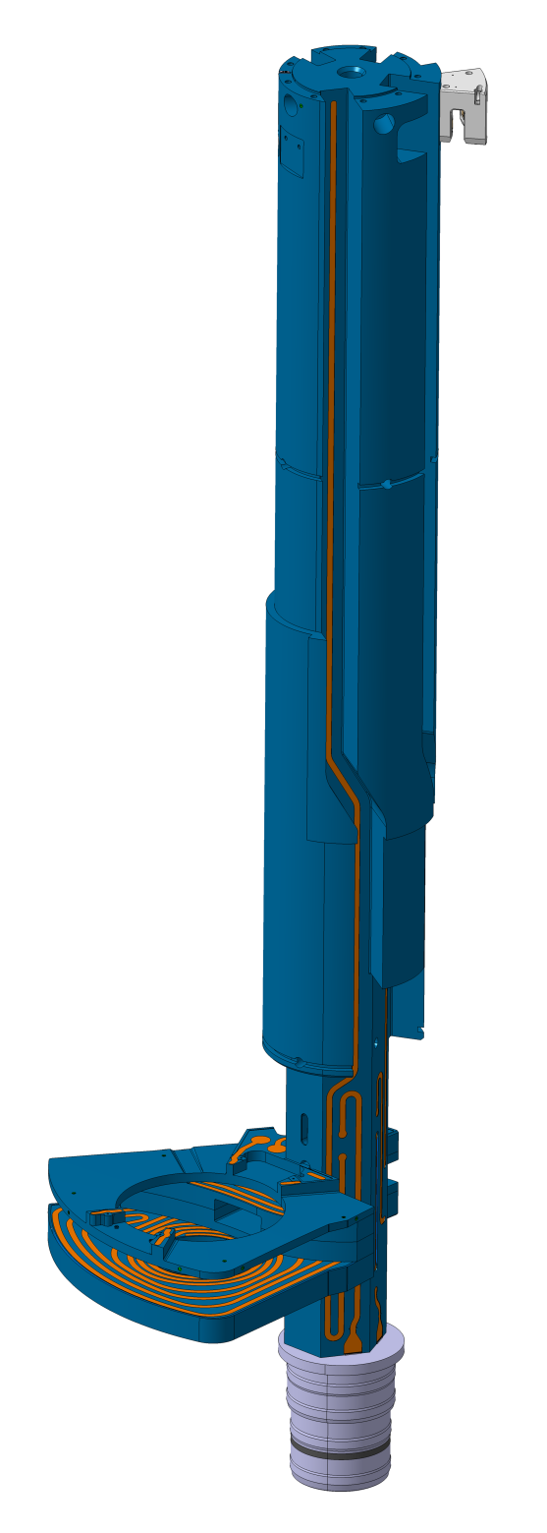
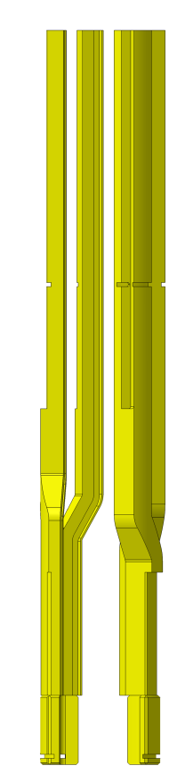
Engineering design of MRP-I
Overview
Back fillers
MRP support structure
Moderator & Reflector Unit
Outer reflector
Final assembly

Slide 6
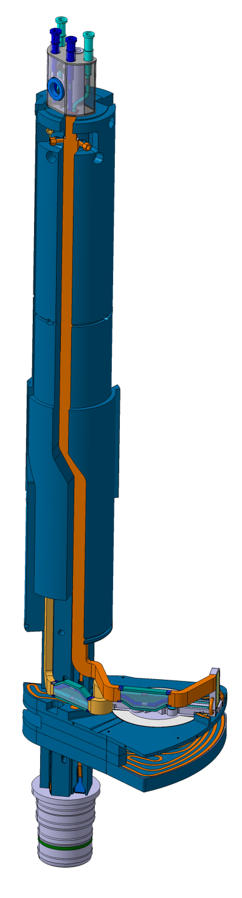
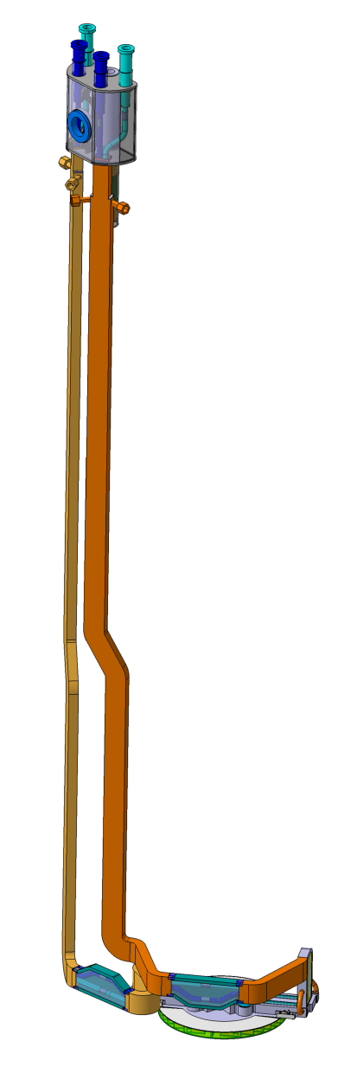
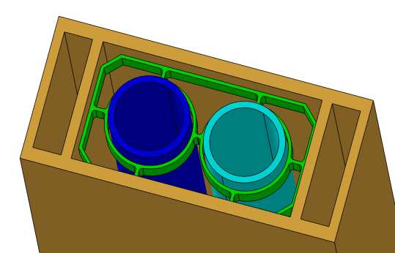
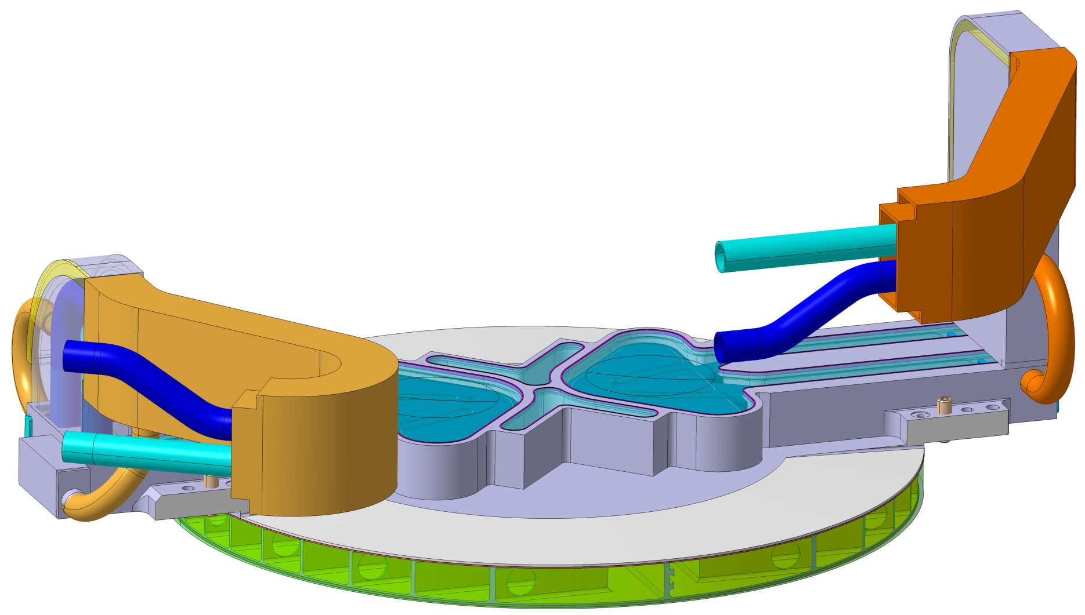
Engineering design of MRP-I
Moderator Unit
LH2 In-/Outlet
Thermal Moderator water loop 1
Vacuum pump port
Spacer
Thermal Moderator water In-/Outlet (loop 1+2)
Thermal Moderator water loop 2
Three chamber profile (water + vacuum + water)
LH2 pipes
Vacuum chamber
Thermal Moderator (water)
Cold Moderators (hydrogen)
Pre-Moderator (water)

Slide 7
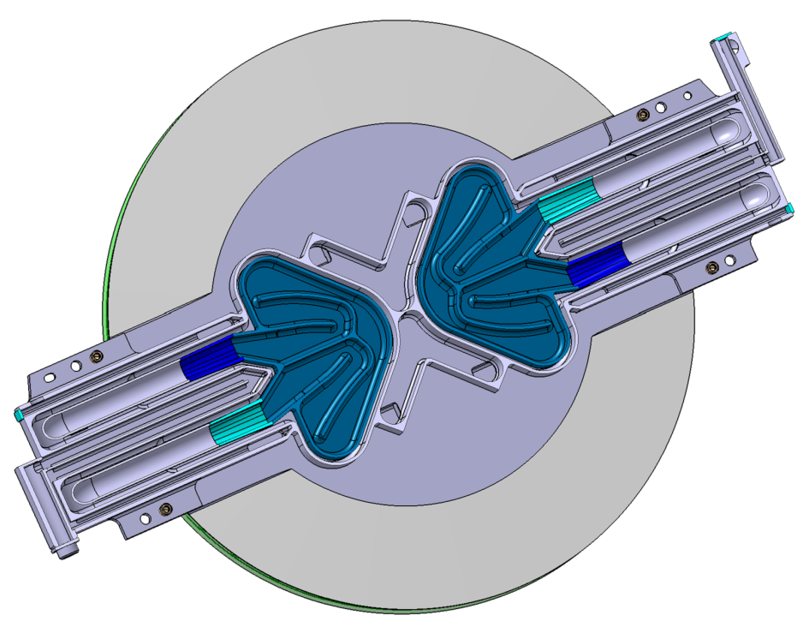
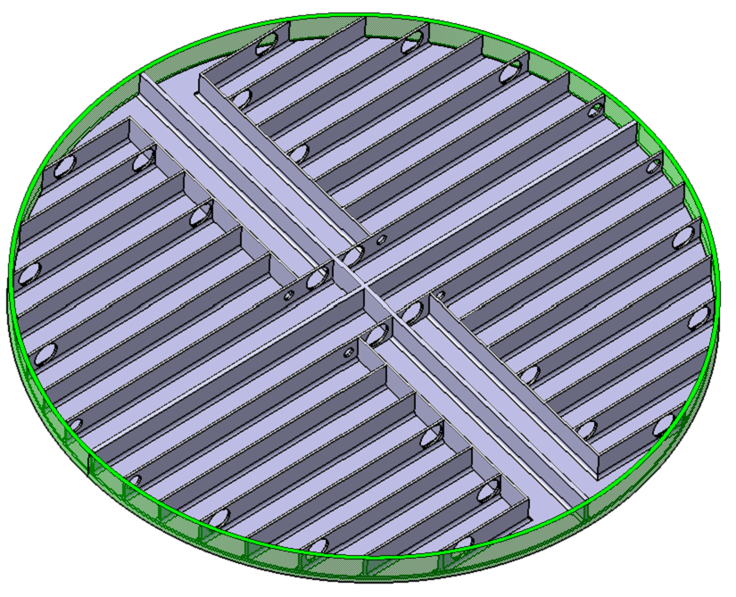
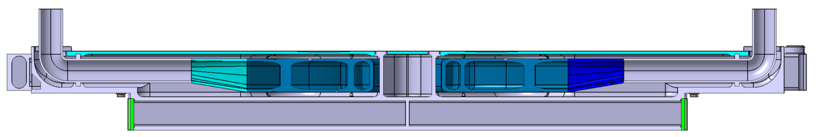
Engineering design of MRP-I
Freezing Risk
Cold Moderator (LH2 @20K)
Pre-Moderator
Water flow
1
2
3
2
1
4
3
4
Water channels/
water section
Thermal Moderator
Water jacket
Water-cooled reck
Cold moderator
Vacuum gap: 5 mm
46
90
30
Ø 600

Slide 8
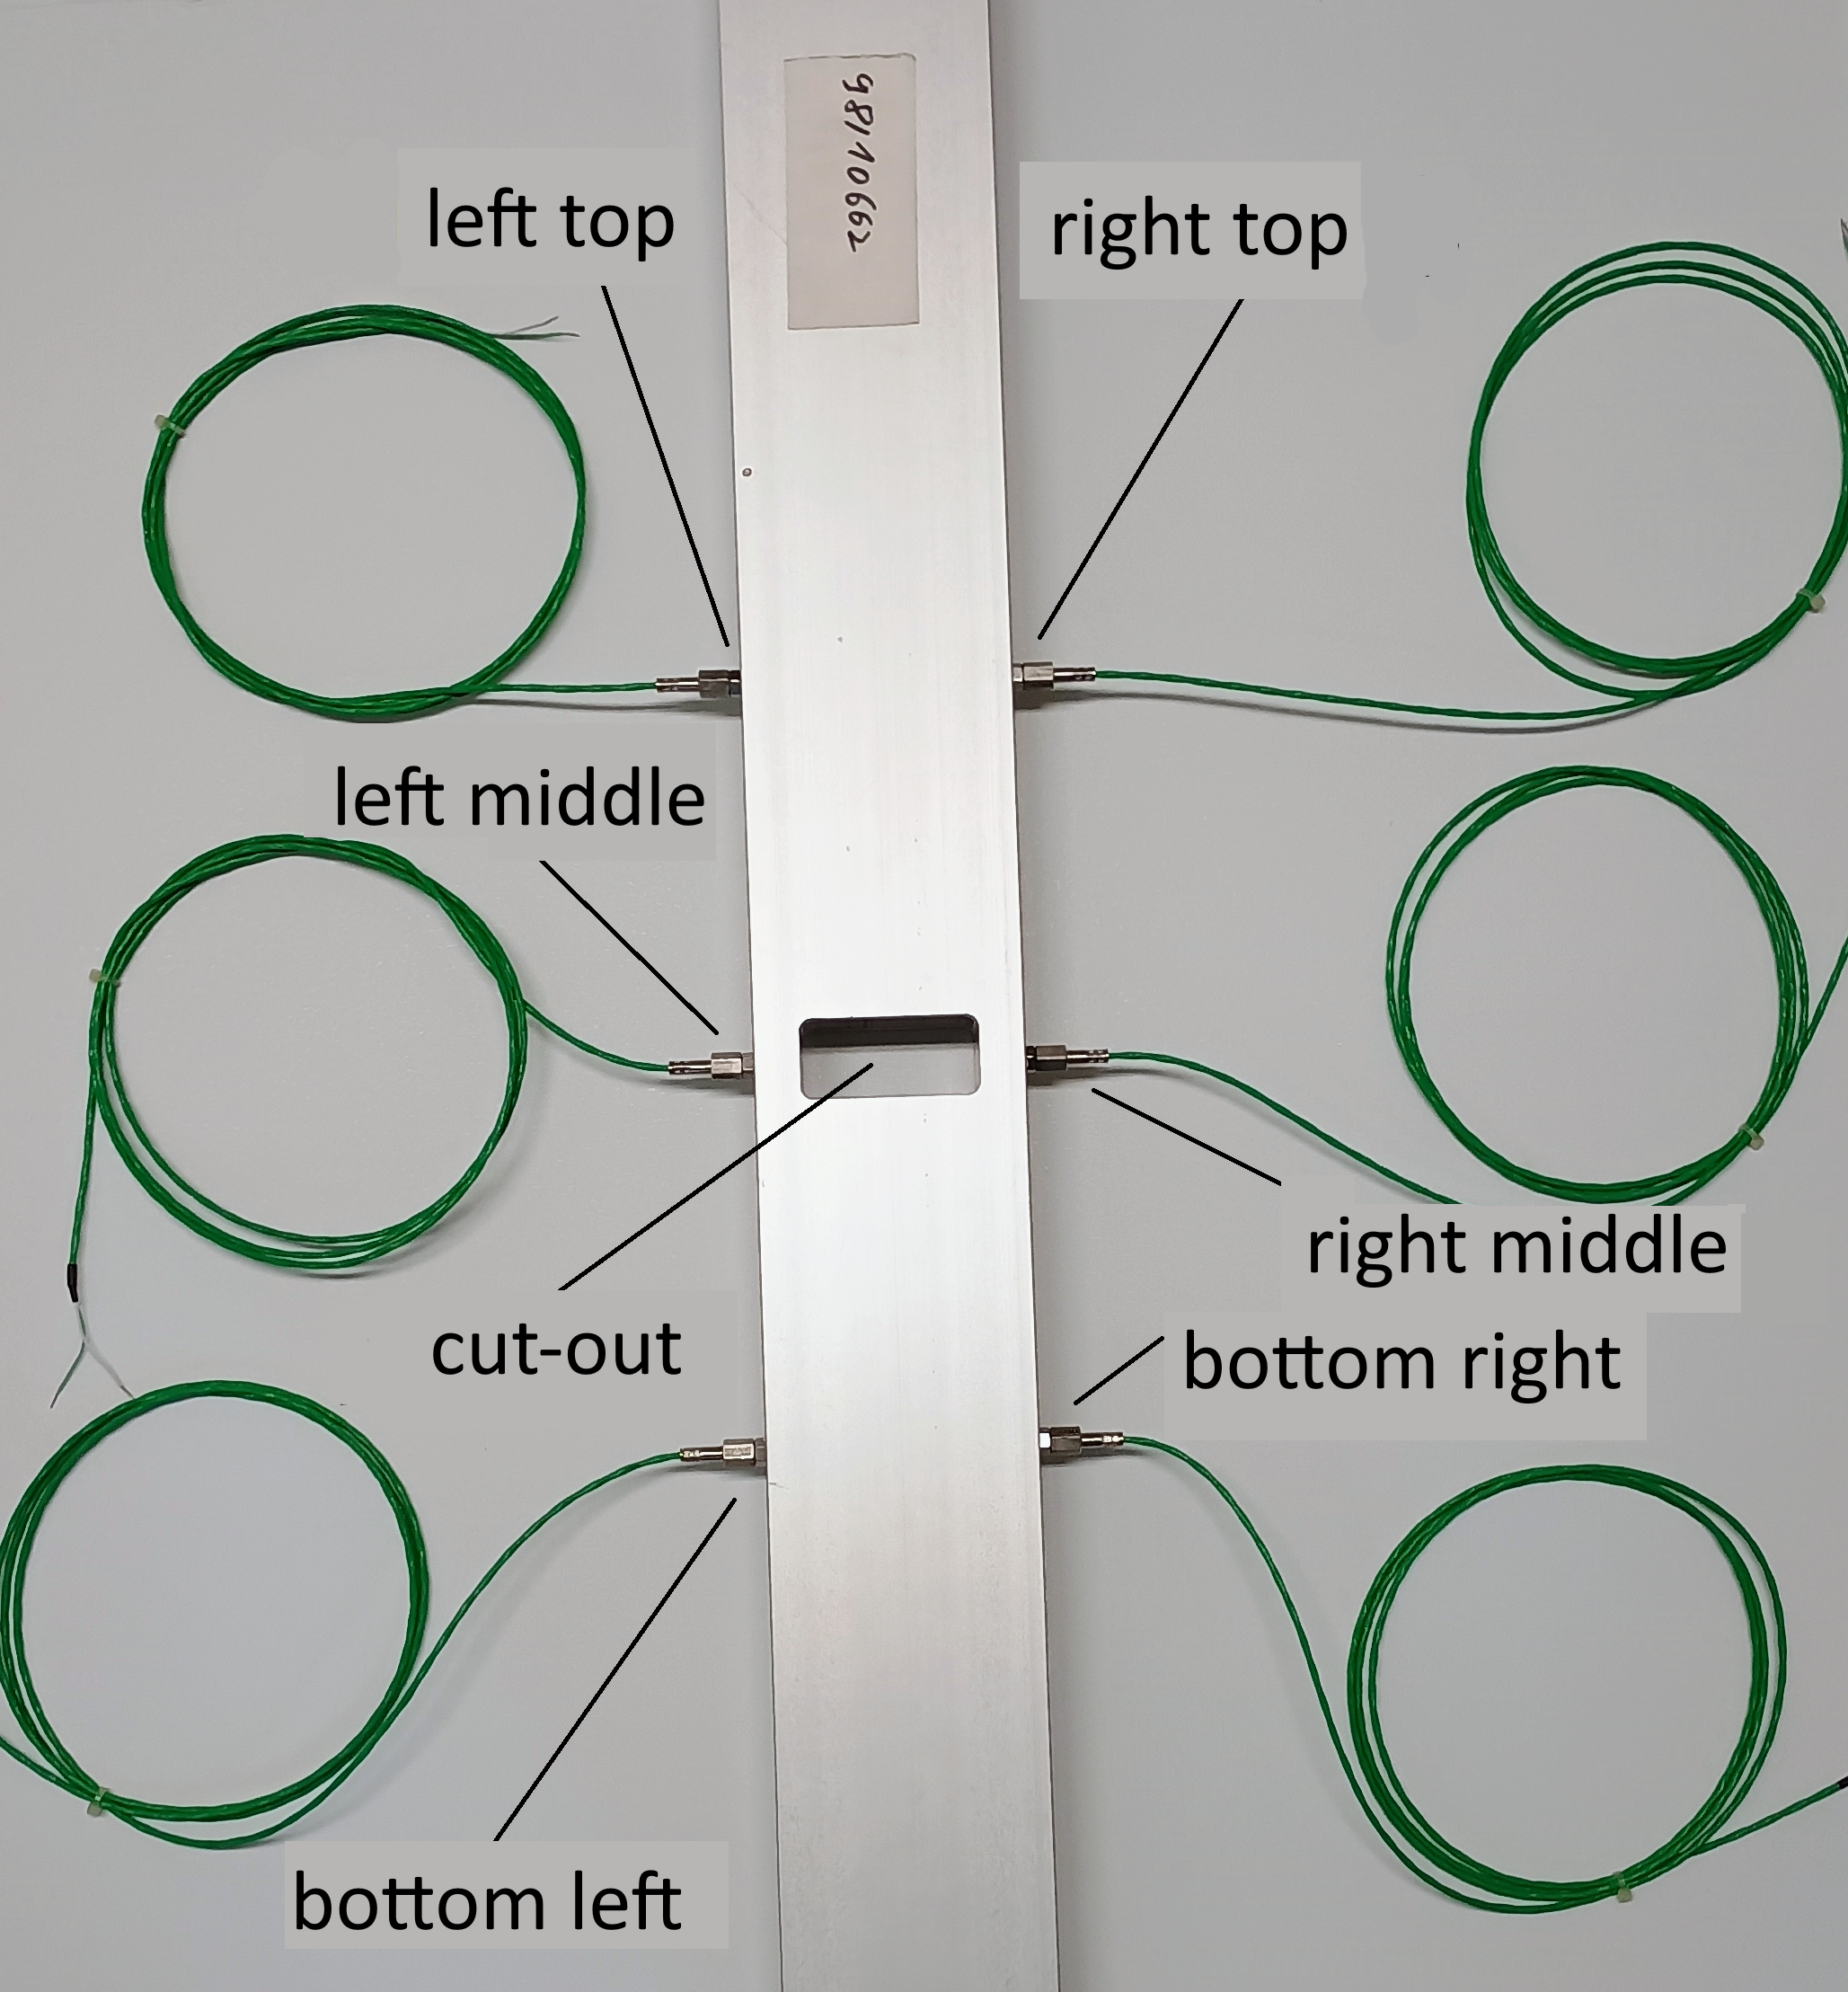
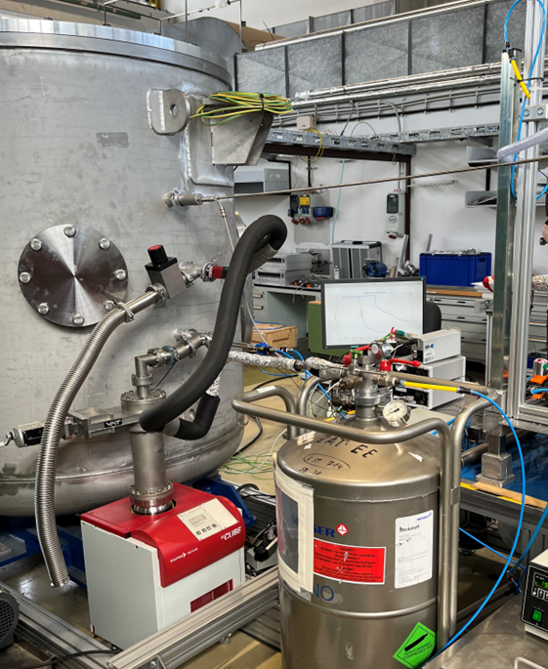
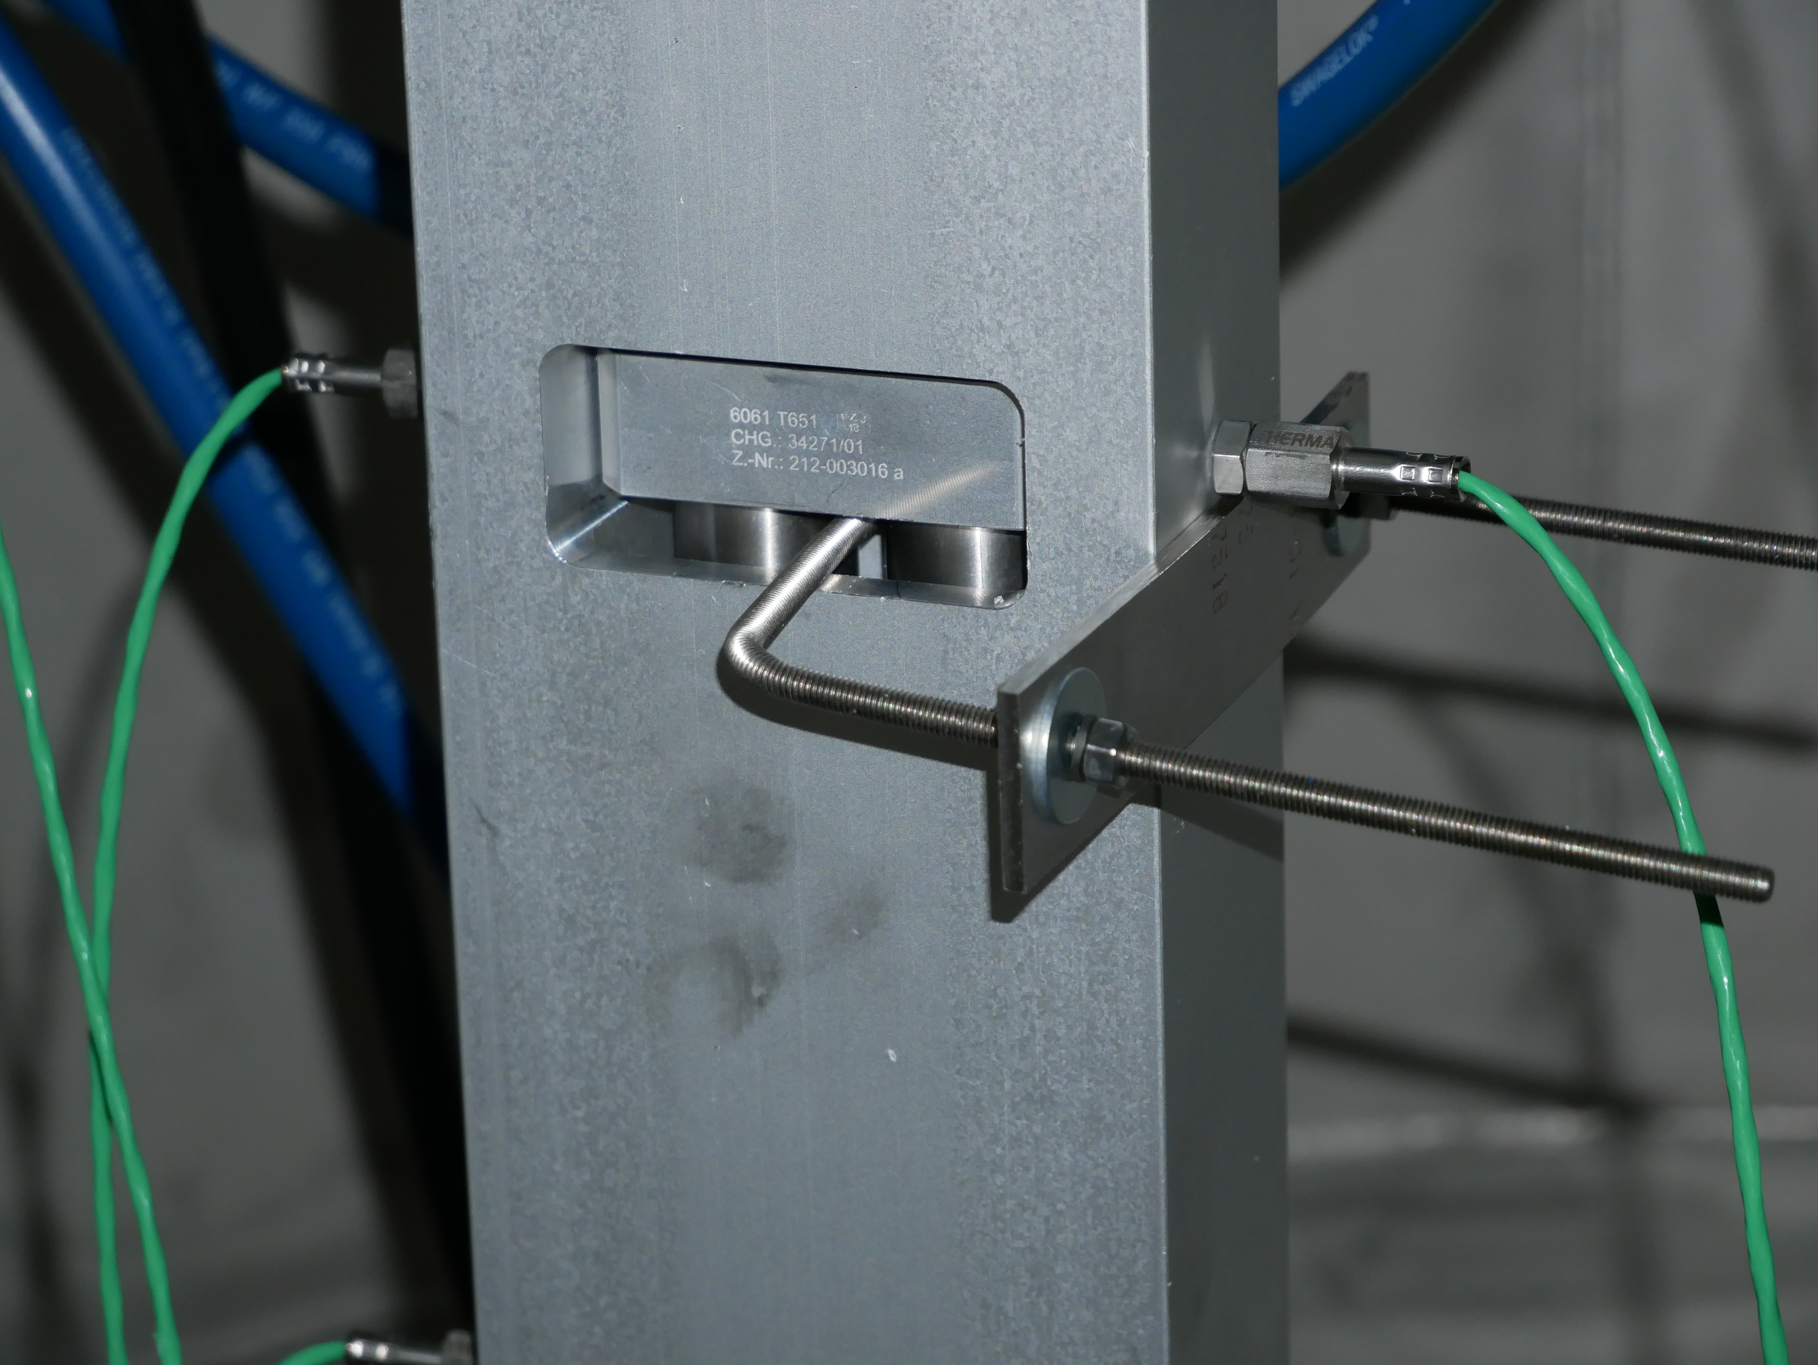
Freezing Experiment
Overview
Water pockets
Temperature monitoring
Clamping mechanism to press cold pipe against spacer
Vacuum chamber for the experiment
Pipes filled with LN2
Three chamber profile with cutout for spacer

Slide 9
Freezing Experiment
Results
 | Temperature [°C]
time [min] | right middle | left middle
3 | 16.7 | 18.4
5 | 15.8 | 17.8
15 | 12.7 | 14.1
30 | 6.2 | 8.9
Temperatures measured inside the profiles after the water circuit was repeatedly interrupted
The freezing point was reached 46 min after the pump was switched off (middle right chamber)

Slide 10
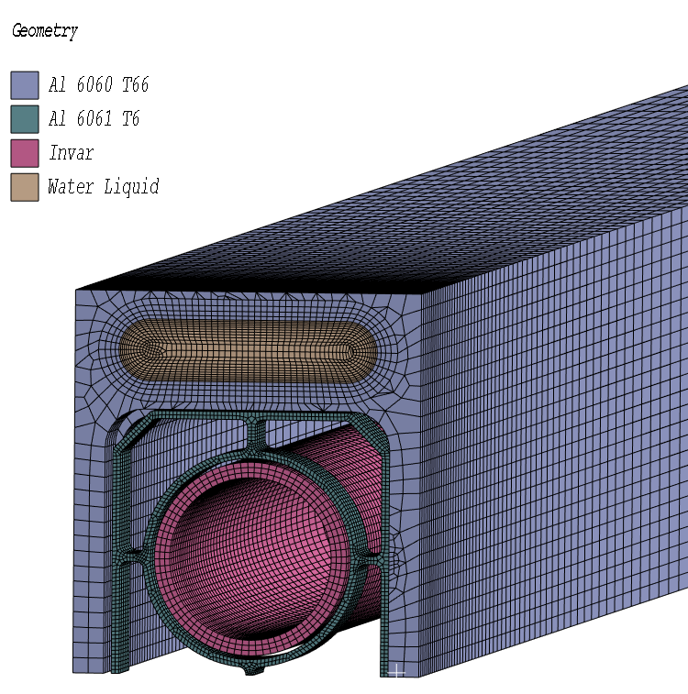
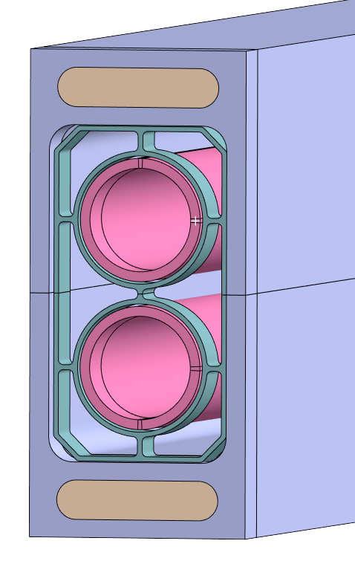
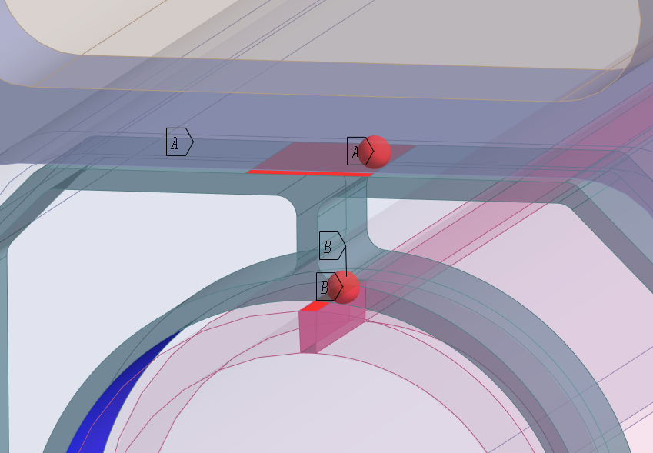
Freezing Simulation
Overview
water
Two contact situations were considered:
A) flat contact between spacer and vacuum jacket
B) cylindrical contact between invar pipes and spacer
→A contact force of 500 N, which was conservatively estimated from analyses results
water
Main heat fluxes from the water channels through the spacer and to the hydrogen pipes were considered
(pipes pressed to the right and top/bottom!)
water
hydrogen pipe
vacuum jacket
spacer

Slide 11
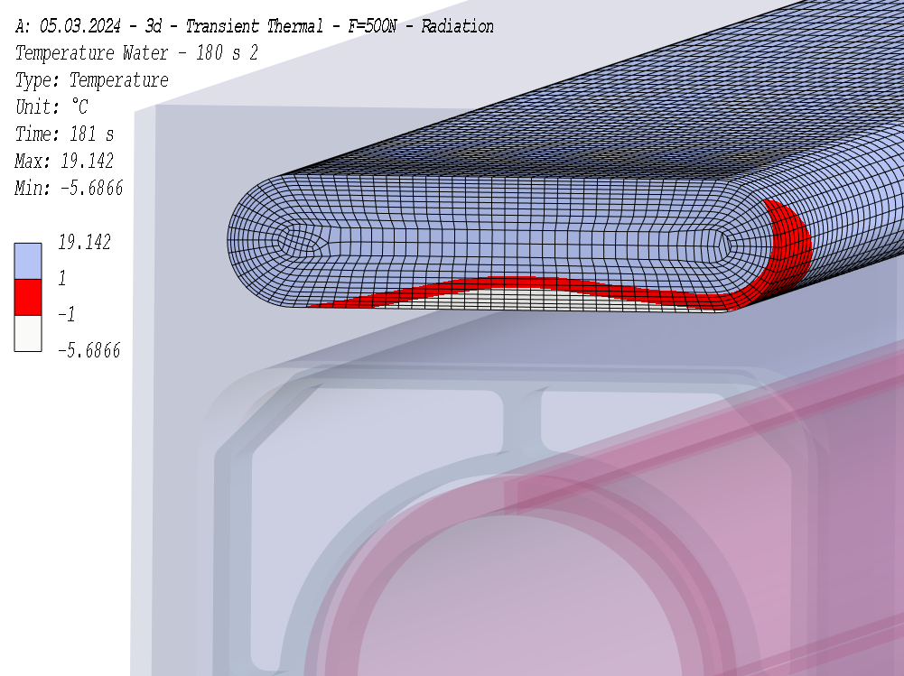
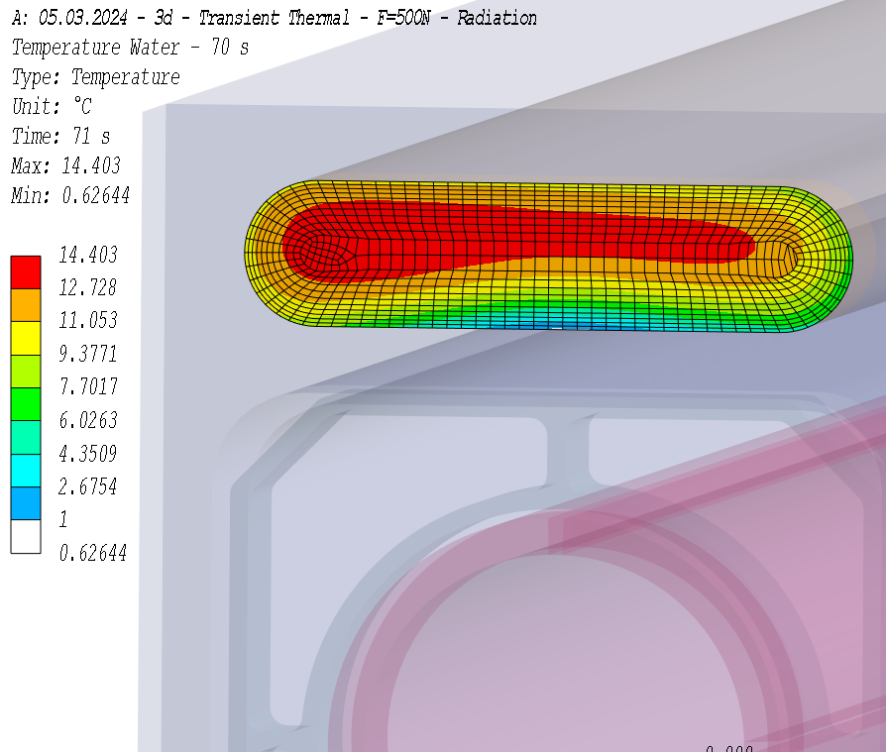
Freezing Simulation
Results
The total heat flux from the hydrogen pipes to the circulating coolant water is about 190 W for one complete spacer.
The ice layer in the water channel after 180 s is shown in the upper right-hand figure.
The cross-section available for the water flow after 180 s is sufficient in this case to avoid blocking or high pressure drop after starting the standby pump.
Freezing at the channel wall will locally start at about 70 s after pump failure (cf. lower right-hand figure).
It will take about 548 s till the cross section of the water channel is completely frozen.
start of freezing at channel wall

Slide 12
Freezing Experiment & Simulation
Conclusion
Experiment (2024-11):
The freezing point was reached about 46 min after the pump was switched off
However, these results are not conservative enough, as nitrogen was used instead of hydrogen (approximately 50K higher temperature) and the contact force was probably too low!
Simulation (2024-03):
The freezing point was reached about 9 min after the pump was switched off
However, these results are too conservative, as they assumed full contact, the contact force was probably overestimated, and no natural convection is considered!
It can therefore be assumed that the freezing occurs under real condition in between!
9 min<t_{F}<46 min
This is in good agreement with the two incidents at ESS in October and November 2025.

Slide 13
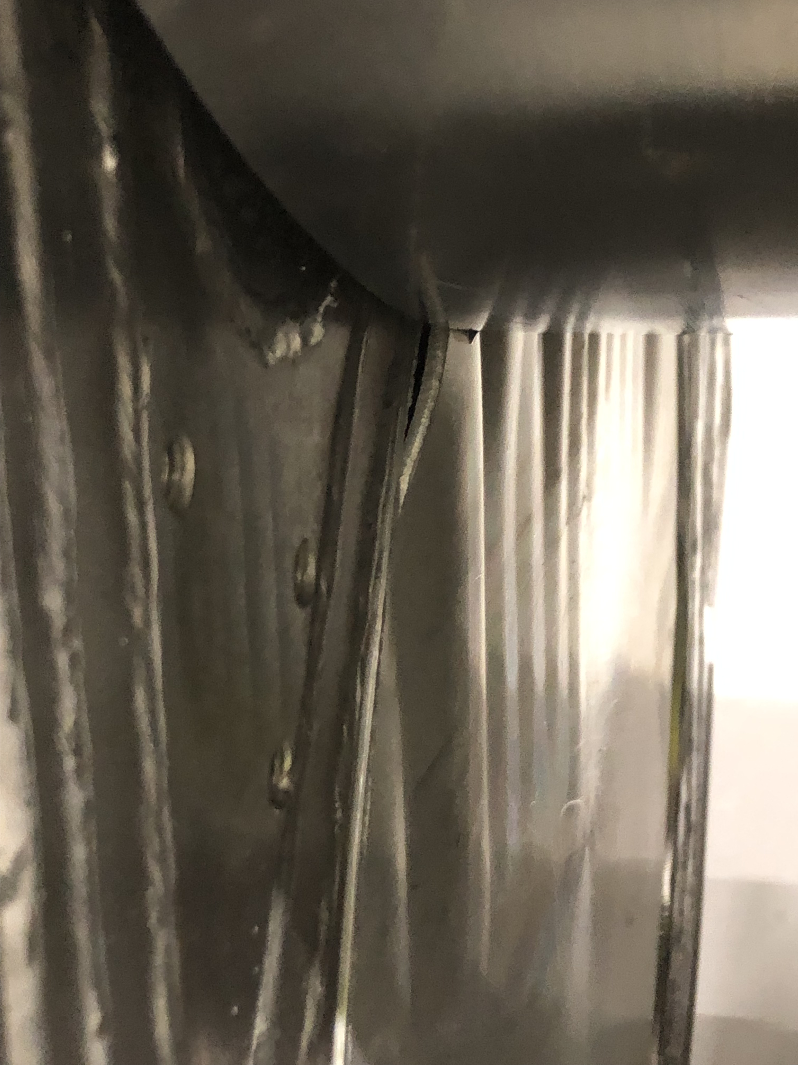
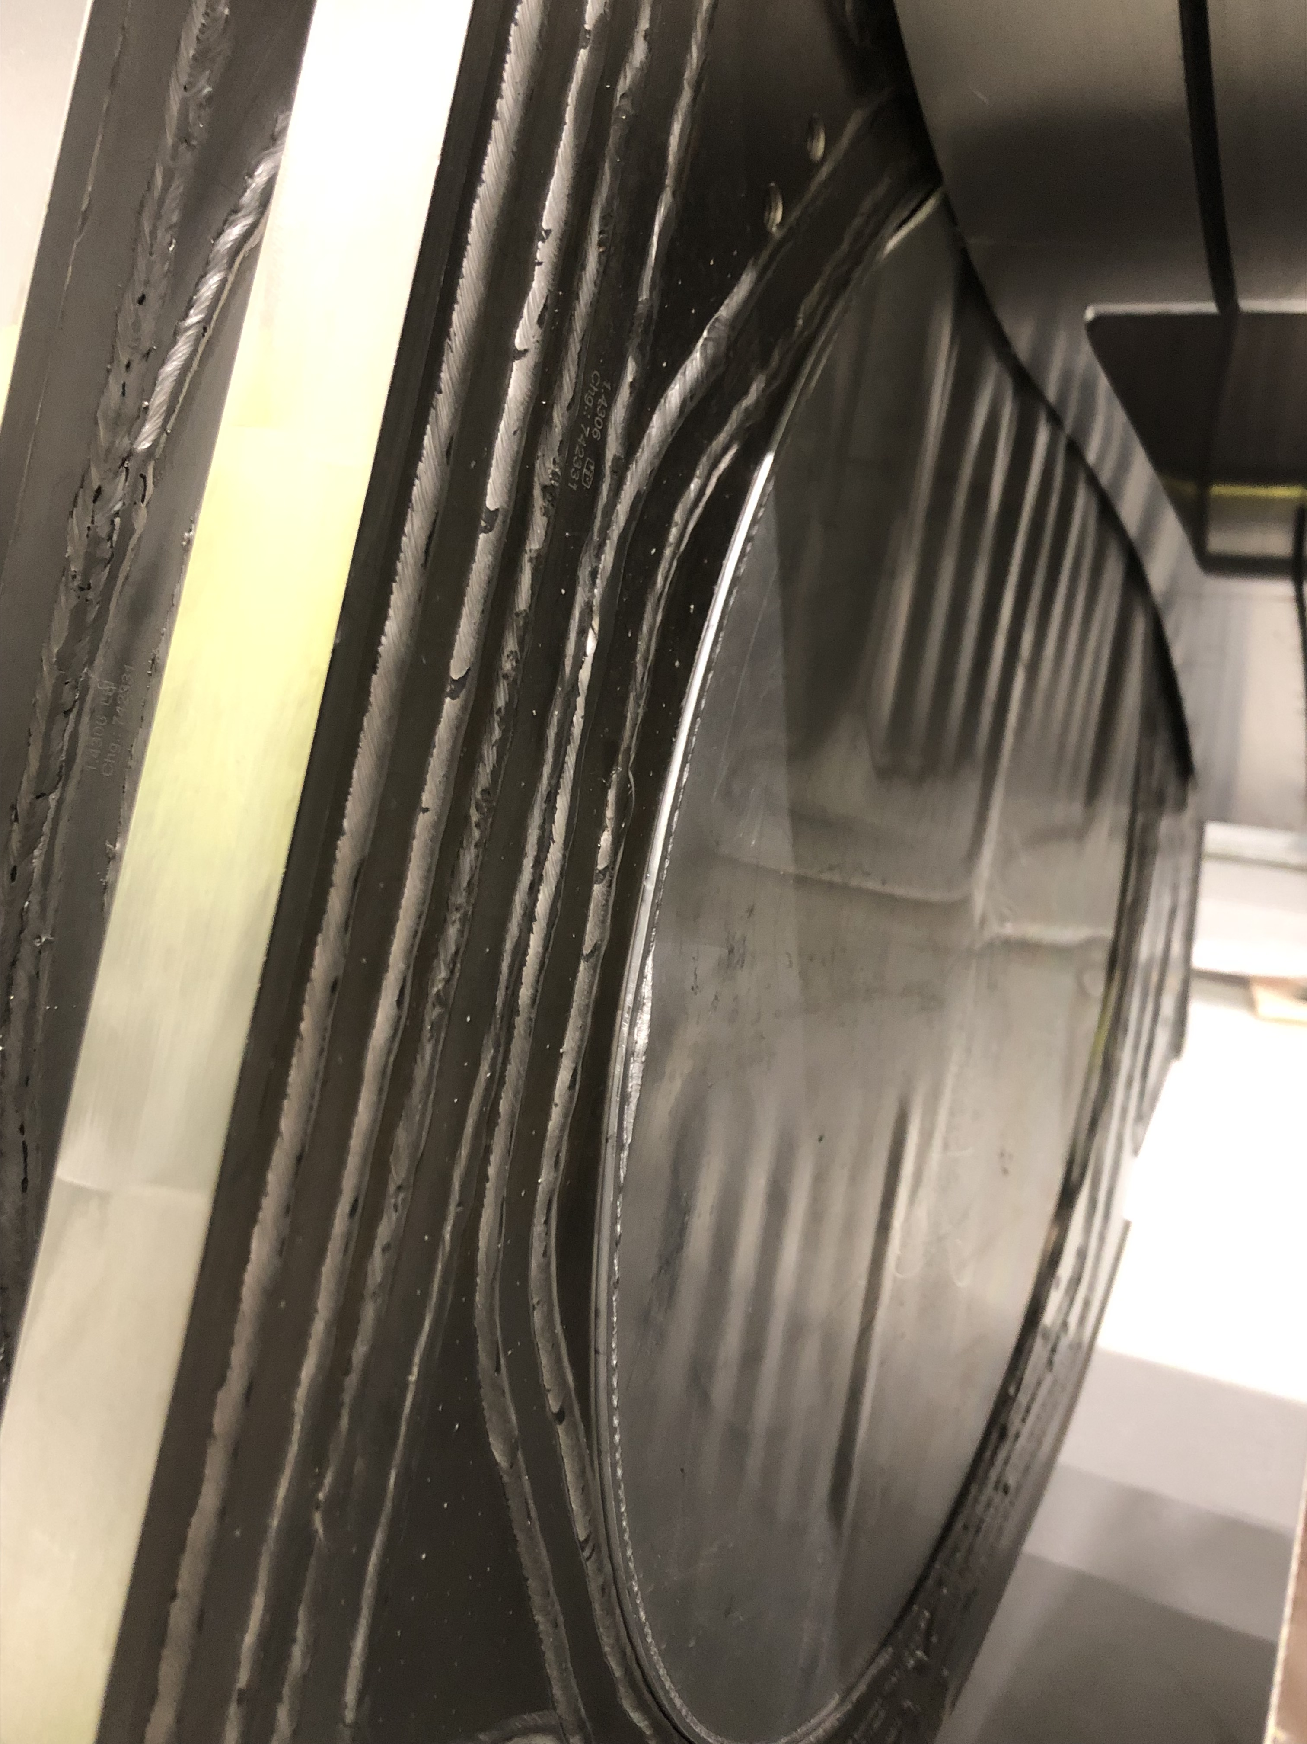
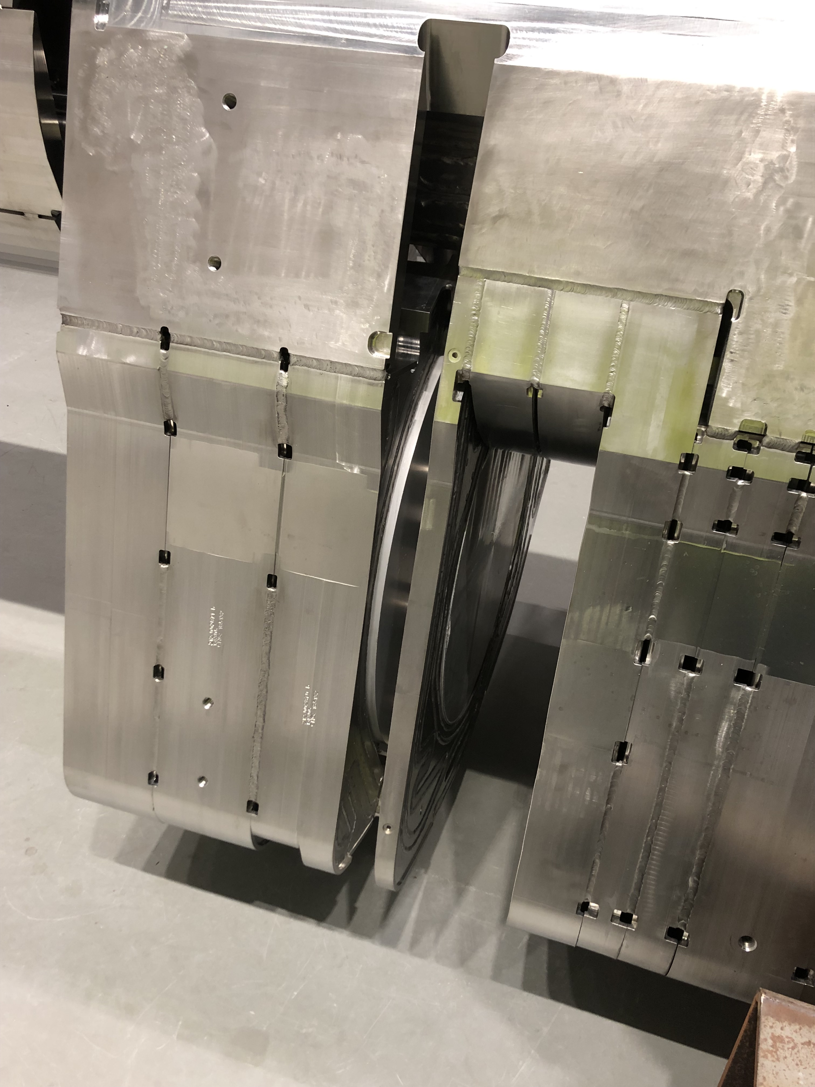
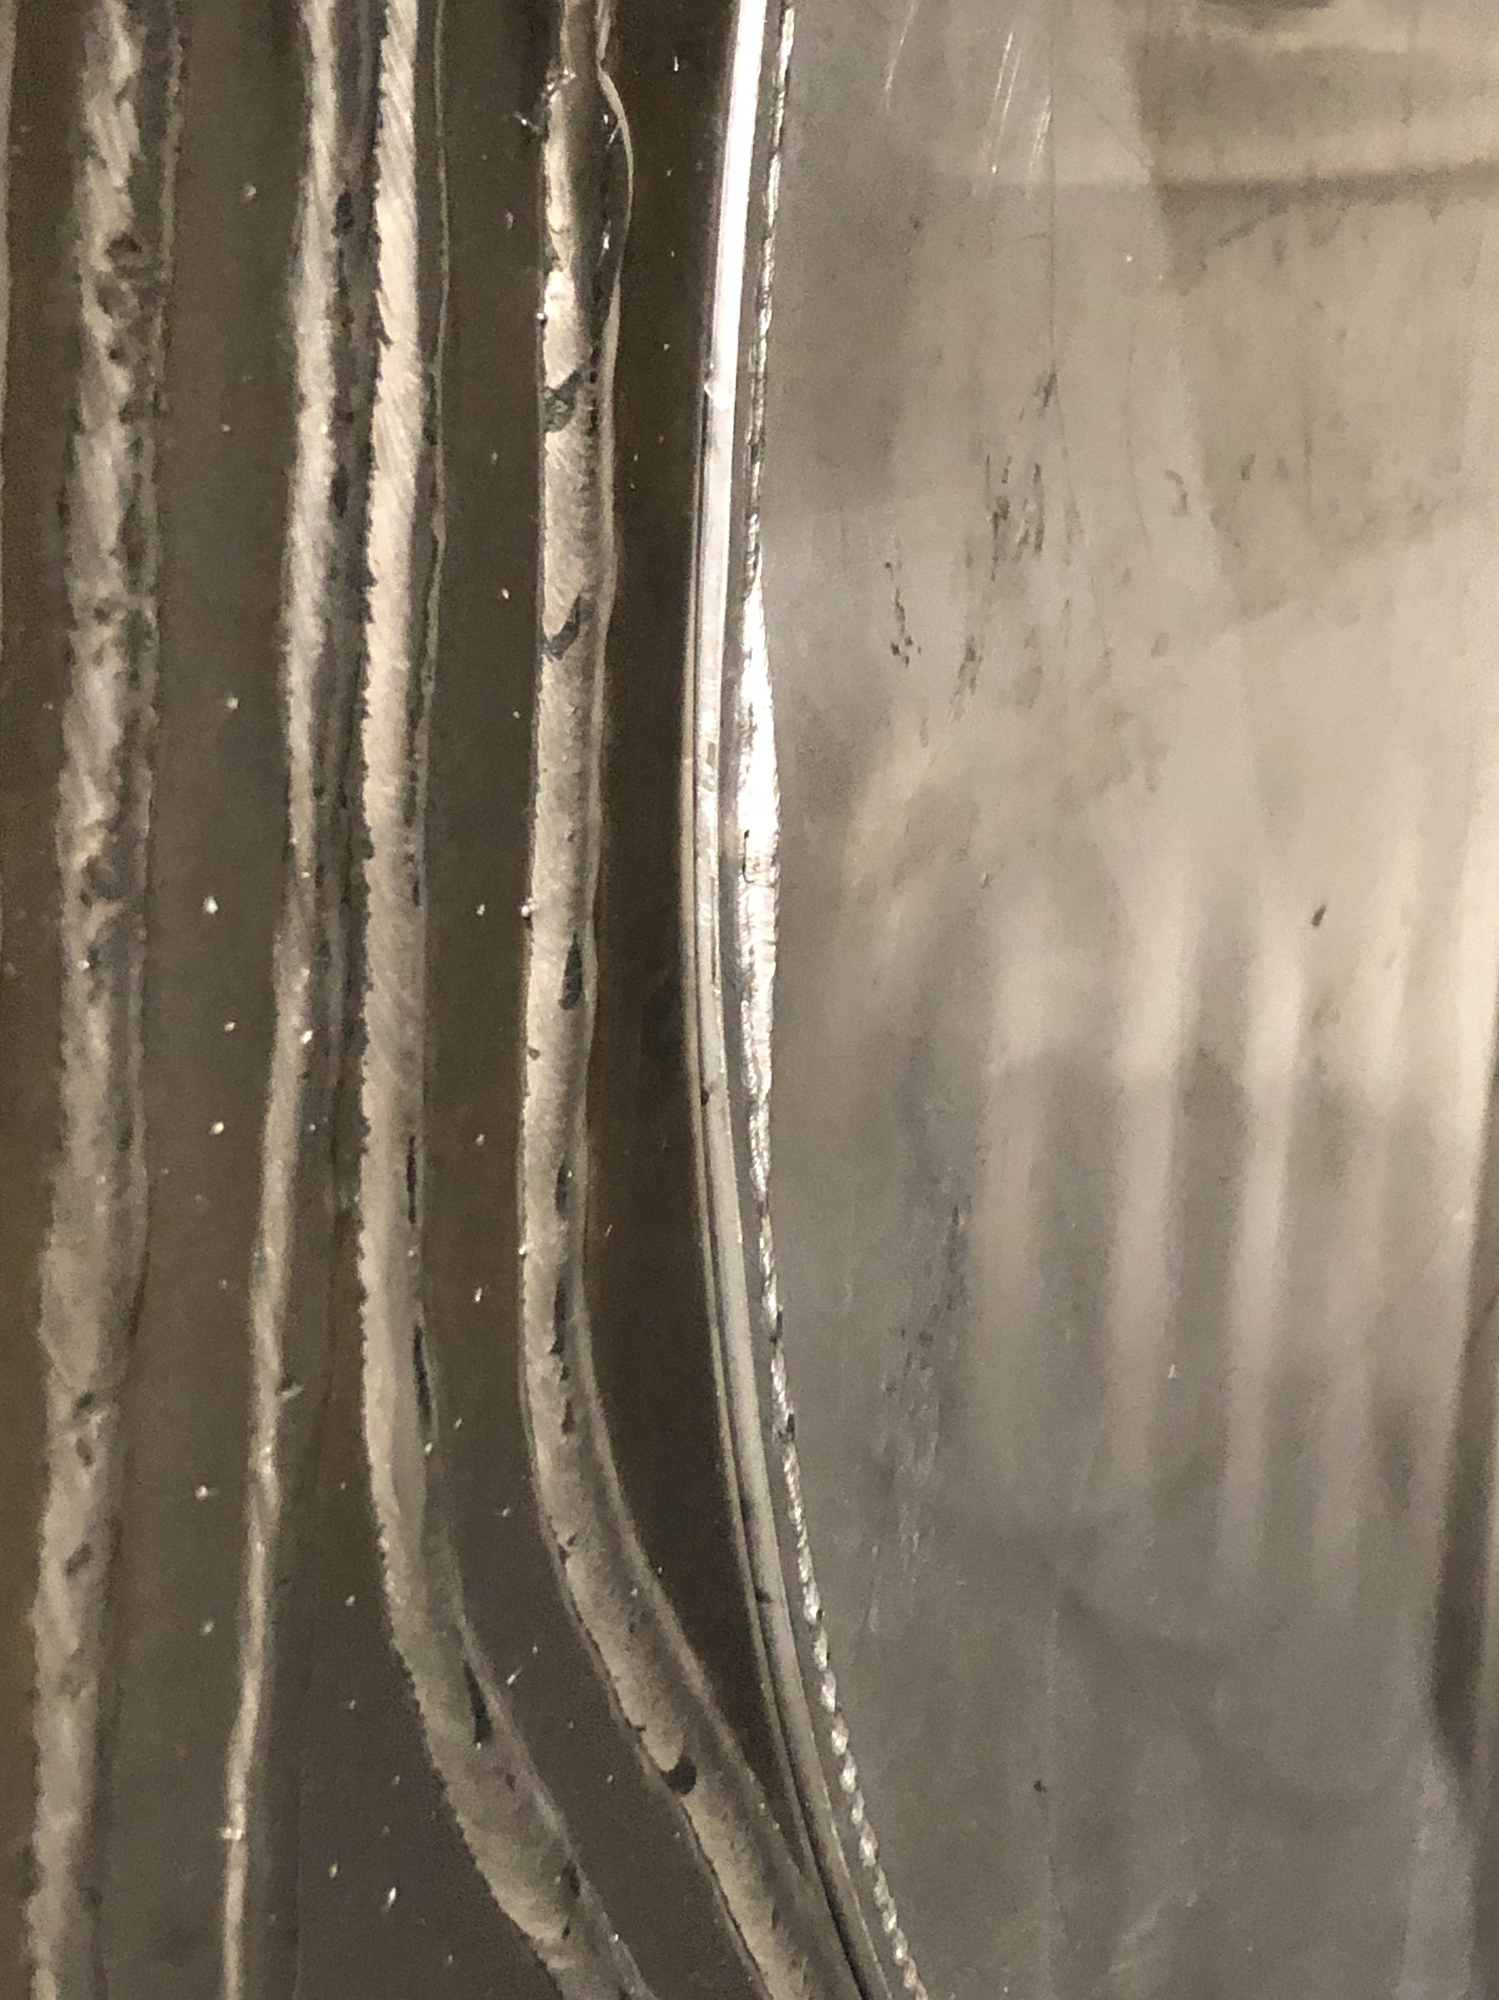
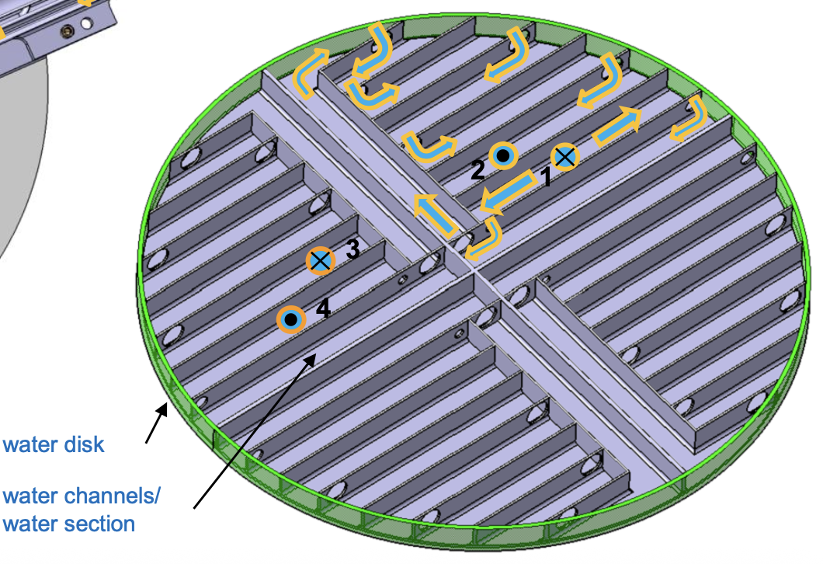
MRP-I commissioning incident
Incident 25th Nov. 2025
Pictures of damages 5th Dec. 2025

Slide 14
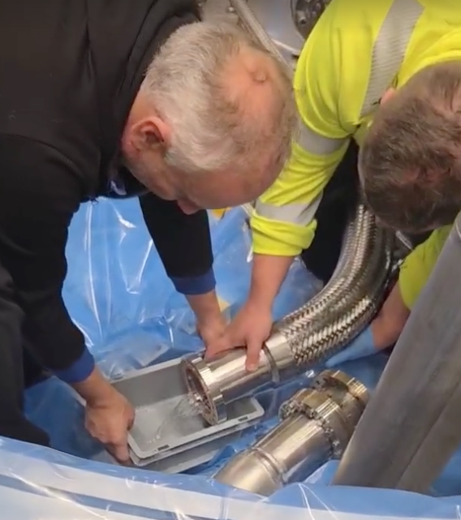
MRP-I commissioning incident
Water in isolation vacuum of MRP-I

Slide 15
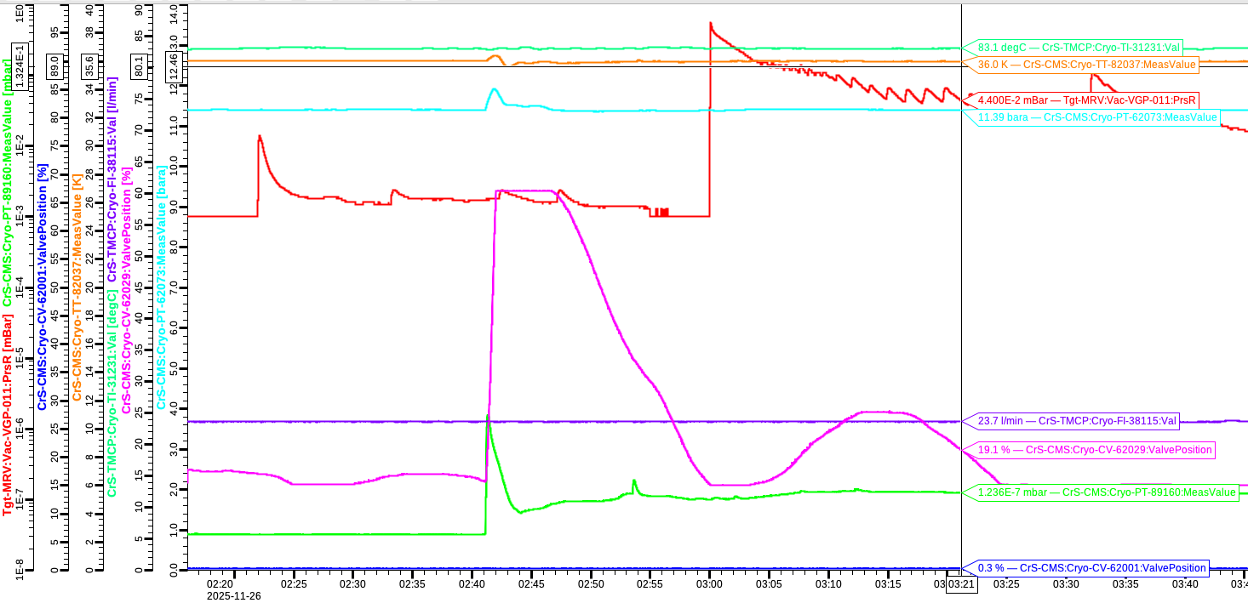
MRP-I commissioning incident
Vacuum Events
3:00 Large Leak into Monolith Vacuum
Vacuum Pump Stop
2:20 Leak into Monolith Vacuum
23:55 Voltage Dip
23:55 Cooling Pump Trips
~01:00 Unsuccessful Start Cooling Pump because of ice plug blockage
2:20; 2:40; 3:00: Vacuum Events
2:40 Leak into Hydrogen Isolation Vacuum

Slide 16
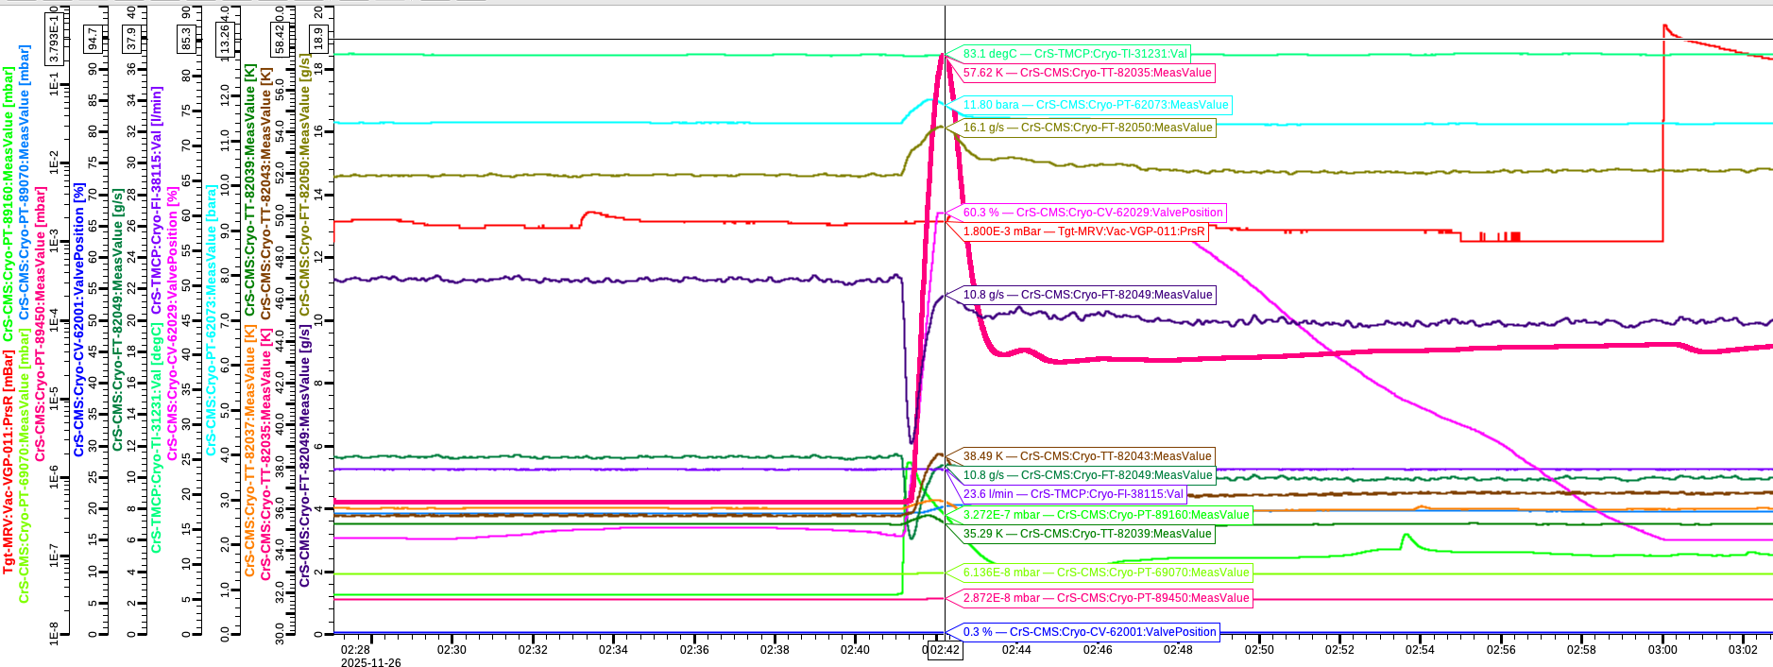
MRP-I commissioning incident
Hydrogen Temperature Event
One of the Hydrogen Pipe Temperature Increase from 36K to 57K
during Leak into Hydrogen Isolation Vacuum (2:40)

Slide 17
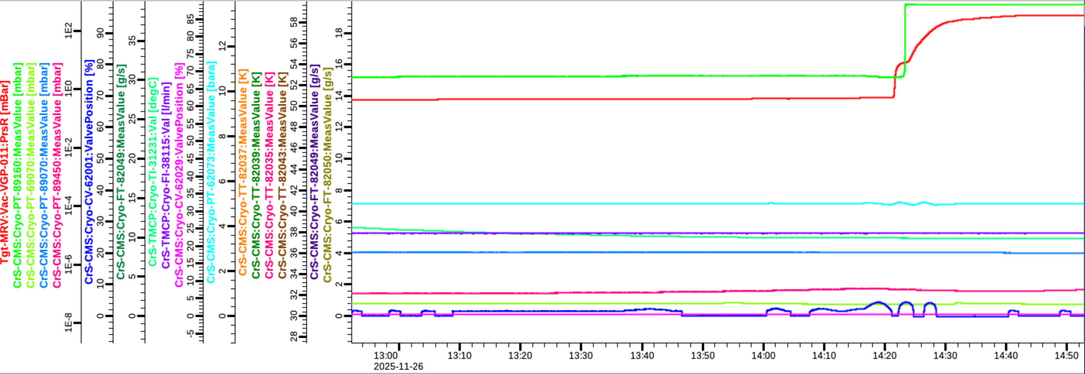
MRP-I commissioning incident
Water piping connection to Monolith and Isolation Vacuum
N2 Flushing of Water Channels gives Indication in both Vacuum Spaces

Slide 18
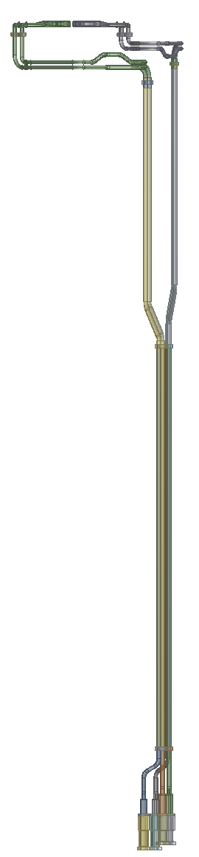
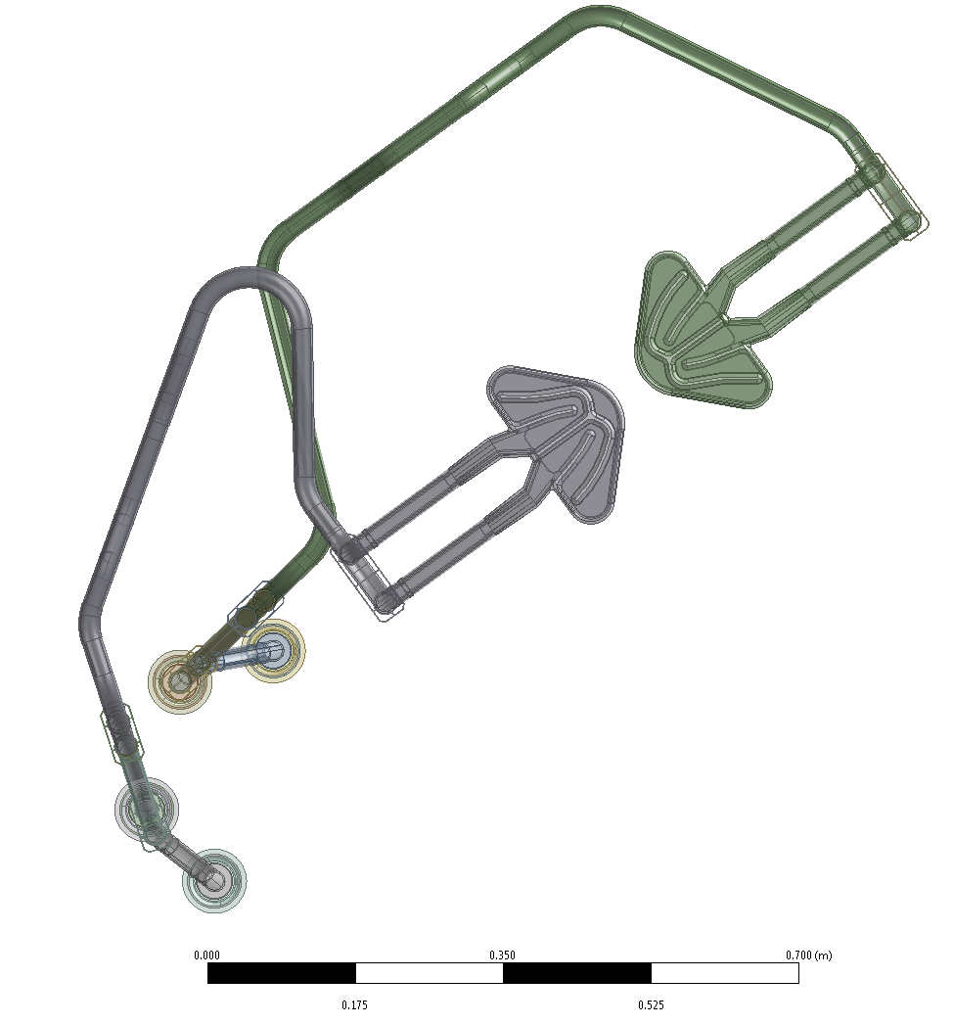
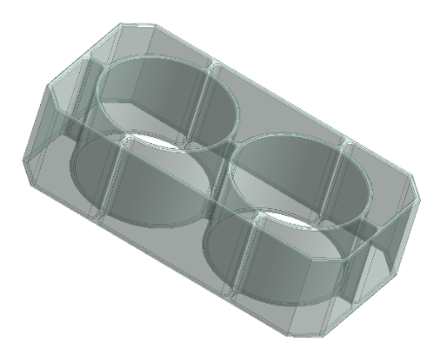
Hypothesis
Preliminary result
Stainless steel
Invar
Freezing starts, by heat conduction, through the spacers/contact areas.
Thermal radiation would also lead to freezing, but it would take longer.
It can be assumed that after this long period of time all water channels in the vicinity of the spacers (shown in red) were completely frozen.
This resulted in a volume of water that was enclosed and could no longer expand along the cooling channel while freezing.
The expansion of the water upon freezing then caused the thin-walled, rigid aluminum structure to burst at different locations.
Invar
Al

Slide 19
MRP1 back in Jülich for Analysis
MRP-I was send back to FZJ on April 26 for a detailed damage assessment, with the goal:
Identifying damaged areas (including hidden damages).
Comparison with numerical simulations.
Transfer of results for the new MRP design.
Possible design improvements to delay the unavoidable freezing risk.
Reusability verification of parts of the MRP-I (e.g., Beryllium)
Determination of the minimum required water mass flow rate for passive cooling
….

Slide 20
Conclusion
We cannot design away the risk of freezing
But we can introduce mitigations:
Start redundant pump
Connect pump motors to UPS and diesel backup
Implement additional emergency pump
Supply water from high tank by gravity

Slide 21
Finish presentation

