Slide 2
Is the Juice Worth the Squeeze?
Cost–Value Trade-offs in Engineering Review Processes
ICANS XXV
PRESENTED BY Iñigo Alonso and Lena Bystedt

Slide 3
Introduction
Introduction
Background
Methodology
Empirical Observations
Discussion
Conclusion
Role and Intent of Engineering Reviews
Large-scale engineering projects rely on formal review processes across lifecycle phases, where reviews act as decision gates: structured checkpoints linking technical evidence to governance decisions.
Intended value*:
increase in system maturity is within the defined threshold;
the project deliverables satisfy the business case;
the resources are sufficient to for the stage and subsequent stages;
unresolved issues that need to be addressed in that stage are addressed; and
overall risk for proceeding forward in the system life cycle is acceptable.
But reviews require substantial effort (e.g. documentation production, coordination across stakeholders, etc.) and can have severe schedule impact.
* Walden D D, Shortell T M, Roedler G J, Delicado B A, Mornas O, Yew-Seng Y and Endler D 2023 INCOSE Systems Engineering Handbook (Hoboken, NJ: Wiley)
Notes:
Engineering reviews are formal mechanisms used to support decisions across a project lifecycle. They act as decision gates, meaning progress depends on demonstrated system maturity.
Their intended value is threefold: improve decision quality, reduce risk, and detect issues early. Conceptually, they bridge technical knowledge and governance authority.
Reviews are designed to ensure that decisions are informed, justified, and risk-aware

Slide 4
Reviews in Theory vs Practice
Introduction
Background
Methodology
Empirical Observations
Discussion
Conclusion
Engineering Reviews in Complex Projects
In theory:
Decisions are driven by technical evidence
Strong linkage between review outputs and governance decisions
Aim to improve:
Decision quality
Risk reduction
Early defect detection
In practice:
Decisions influenced mainly by:
Schedule pressure
Resource constraints
Organisational incentives
Is the value generated worth the resources invested?
Notes:
In practice, reviews require significant effort in documentation, coordination, and participation. However, decisions are often driven by schedule pressure or prior commitments rather than review outputs.
This creates a cost–value tension. The critical issue is whether the effort invested translates into real impact.
The paper argues that effectiveness depends on how tightly reviews are linked to decision authority. If this link is weak, reviews risk becoming procedural rather than impactful.

Slide 5
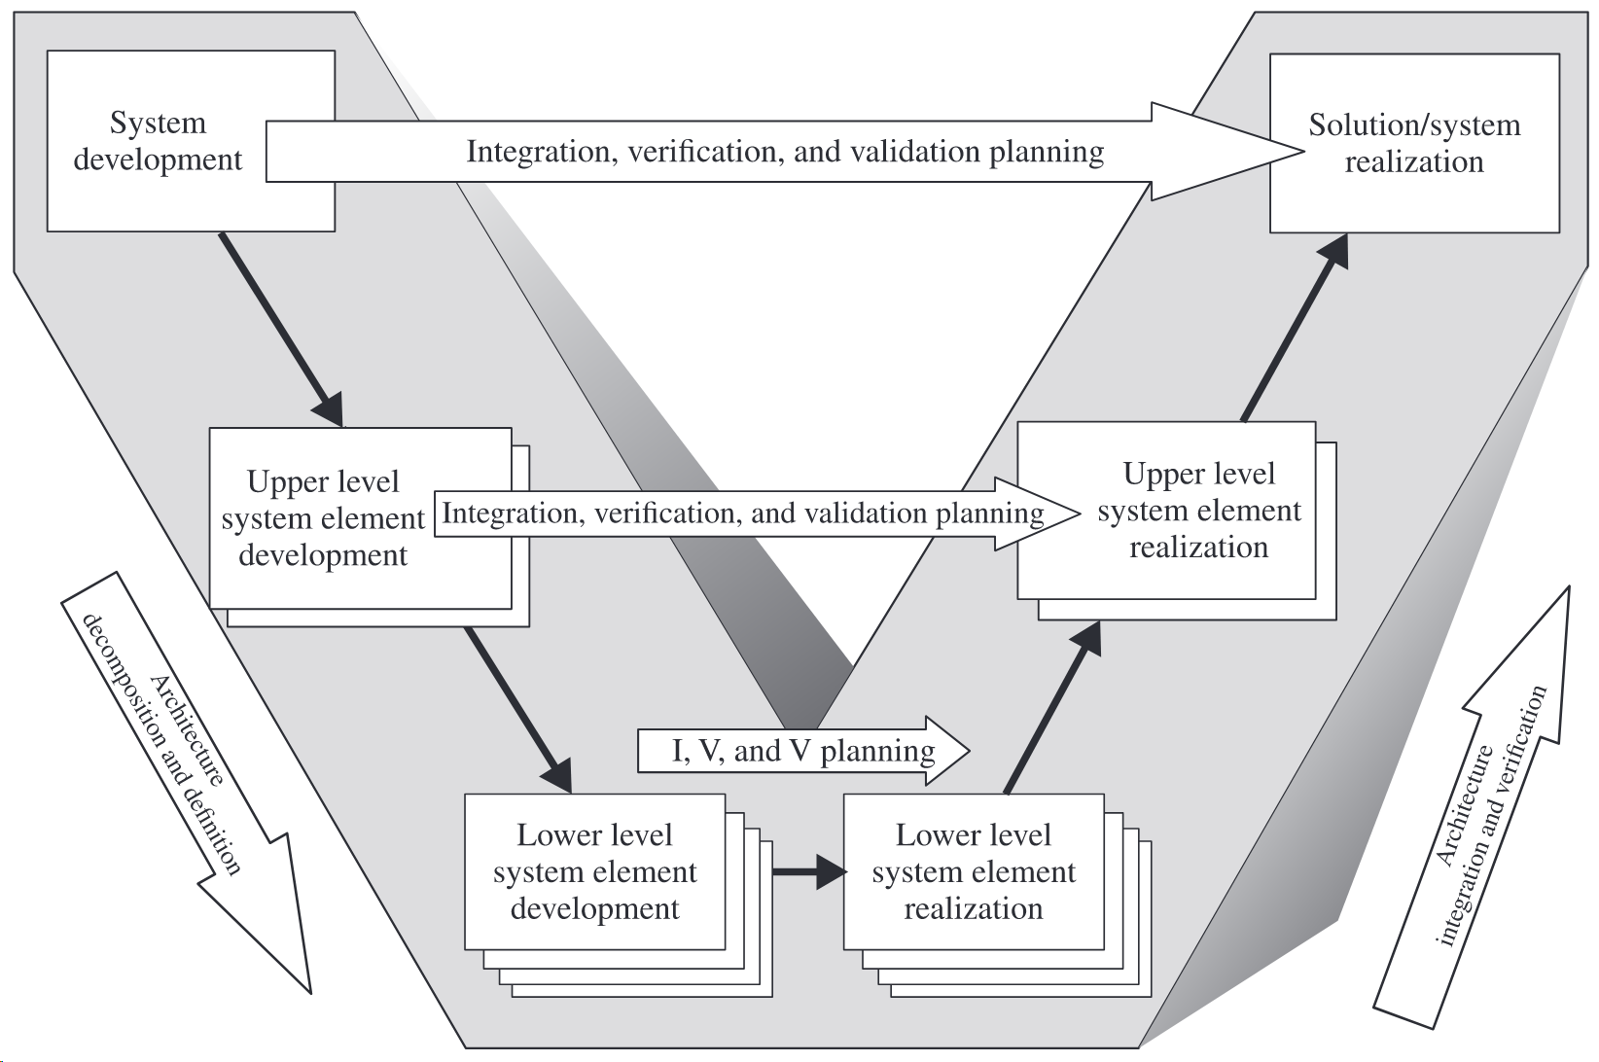
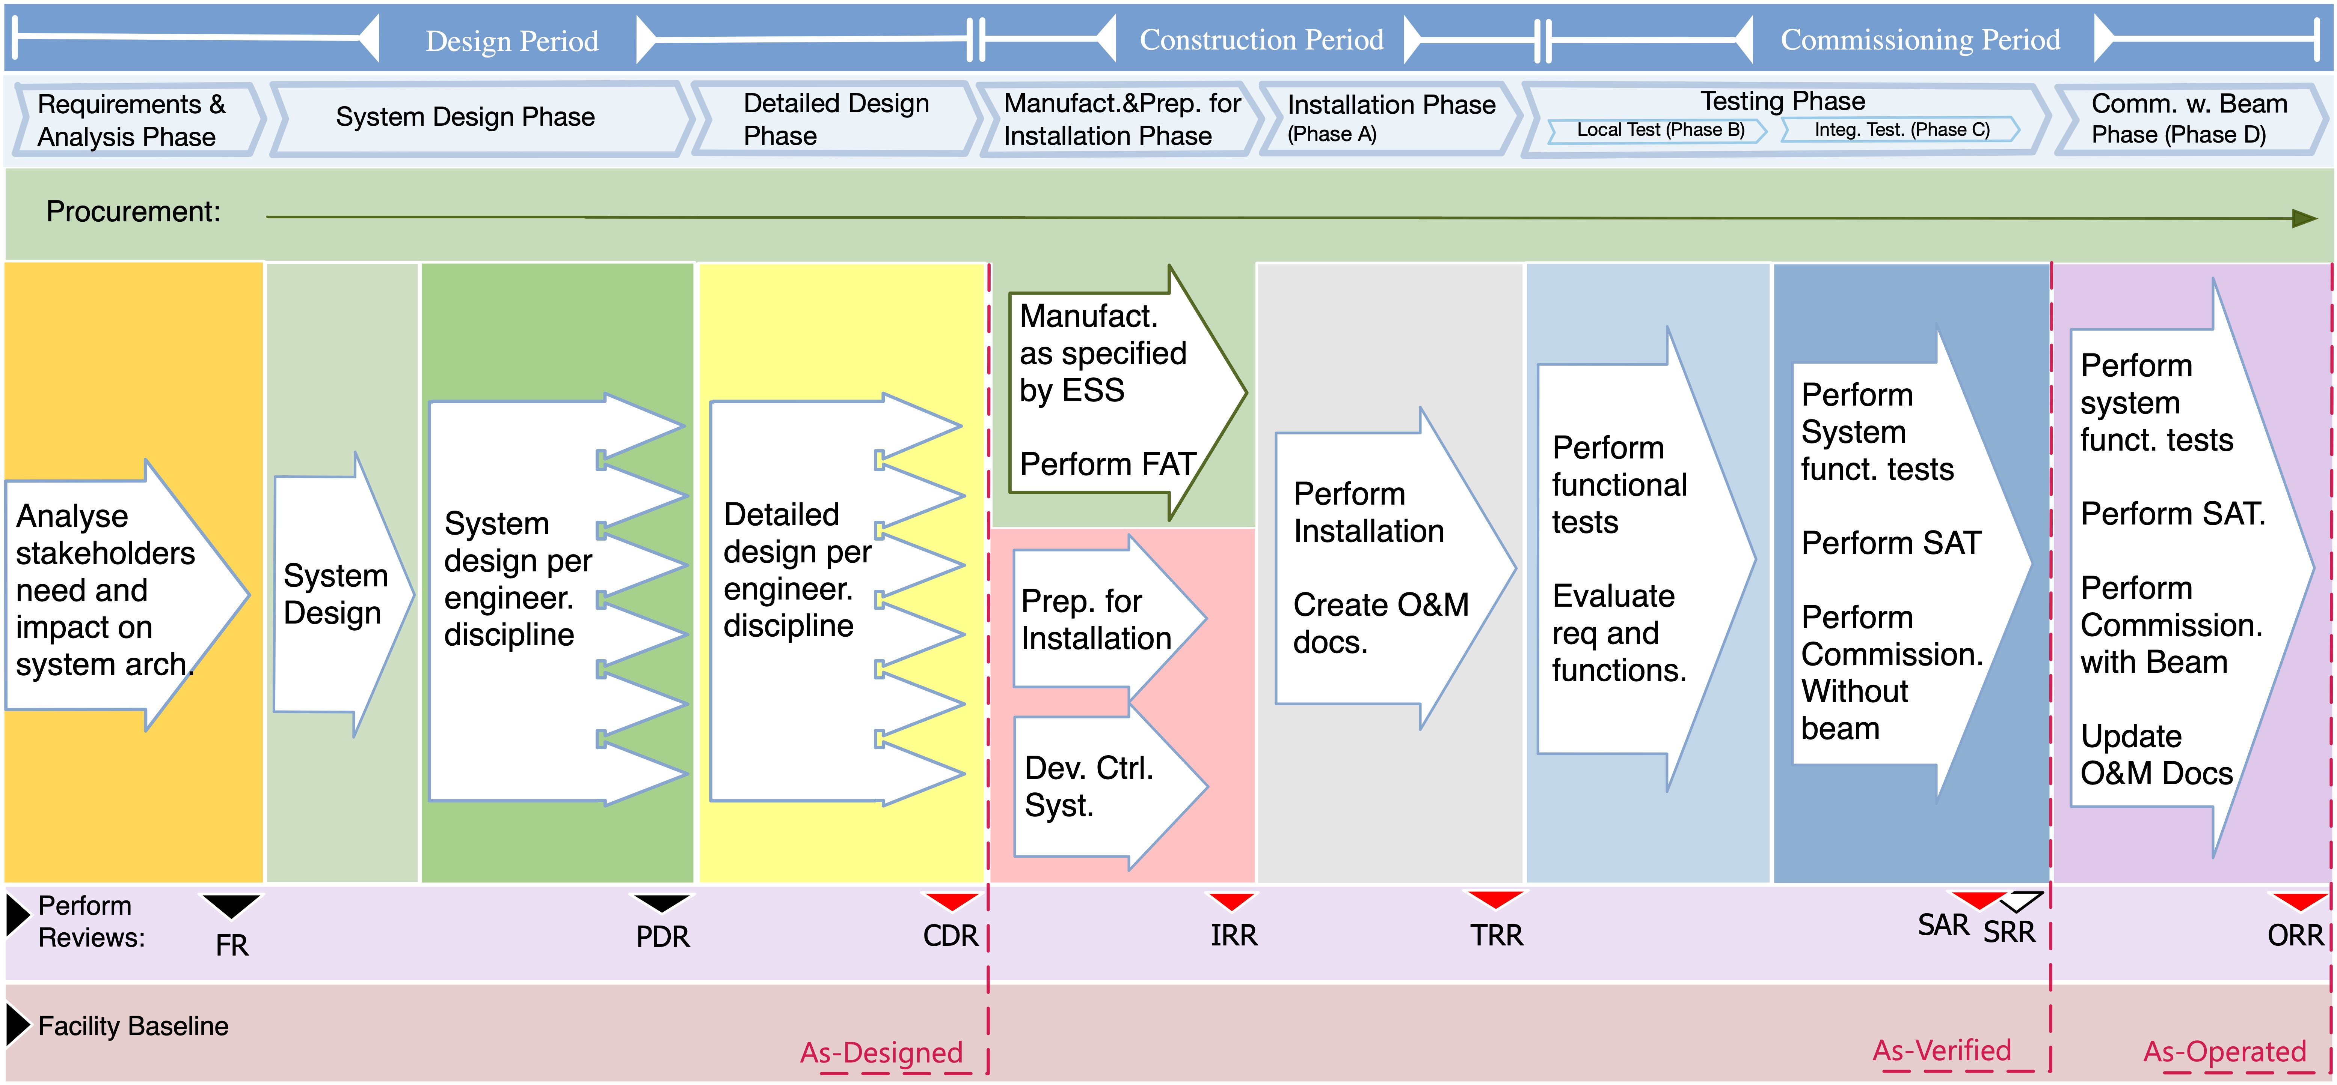
Engineering Process at ESS
Introduction
Background
Methodology
Empirical Observations
Discussion
Conclusion
SAR
PDR
CDR
TRR
IRR
* Walden D D, Shortell T M, Roedler G J, Delicado B A, Mornas O, Yew-Seng Y and Endler D 2023 INCOSE Systems Engineering Handbook (Hoboken, NJ: Wiley)
Notes:
Short giving an overview of the build up
Can this be related to the V-model? Not explicitly done in EHB, but would be lovely to see. We can just maybe throw it across, or just embed into the talk.
Should we at some point somewhere throw in SAR process maturity? The development it went through, or maybe just keep what we learned from that – in recommendations for practitioners.

Slide 6
Evaluating Cost–Value Trade-offs
Introduction
Background
Methodology
Empirical Observations
Discussion
Conclusion
Research Design and Analytical Approach
Research strategy:
Embedded case study at the European Spallation Source ERIC
Focus on engineering tollgate and acceptance reviews
Mixed-methods approach:
Quantitative: review volume, effort, participants, outputs
Qualitative: lessons learned and stakeholder feedback
Data sources:
Review records, documentation, attendance logs
Findings, actions, and issue tracking systems
Milestones and planning data
Analytical logic:
Characterise review activity and effort
Compare inputs vs outputs (effort–outcome relationship)
Identify structural patterns affecting value
The method links effort → outputs → impact to assess whether reviews create real value

Slide 7
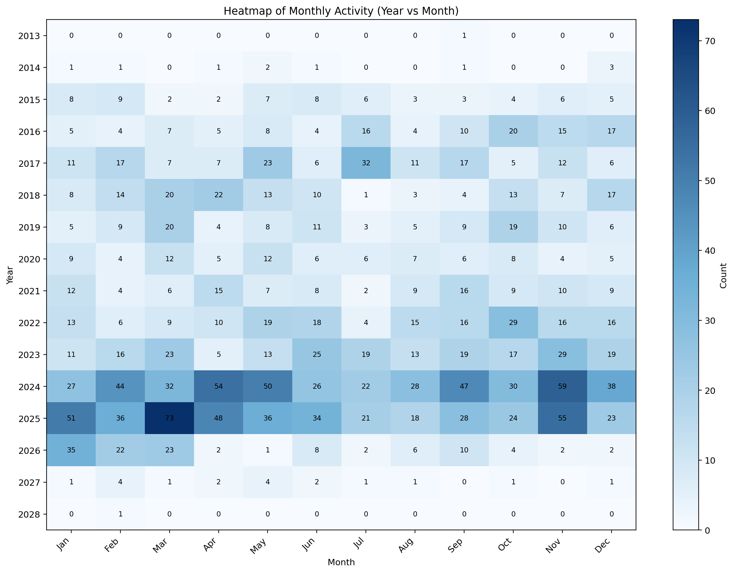
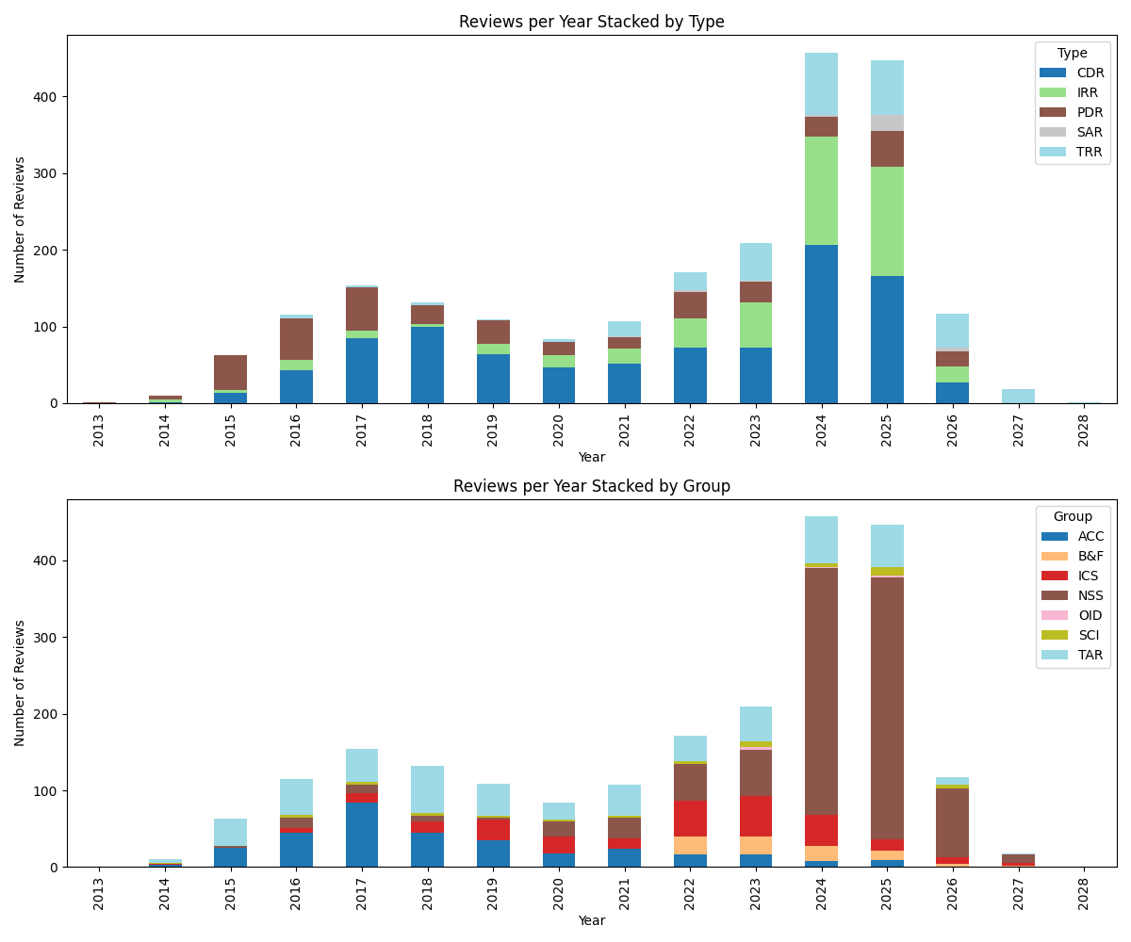
All Technical Reviews distribution
Introduction
Background
Methodology
Empirical Observations
Discussion
Conclusion
Over time and by type and division
Total 2195 Avg/y 137.2
PDR 406 TRR 325
CDR 949 SAR 32
IRR 483
Notes:
Excel exports from Primavera
PDR: 406
CDR: 949
IRR: 483
TRR: 325
SAR: 32
Or separate into
Bars (count) per type and per sub-division
PDR, CDR, IRR, TRR, SAR, (SRR)
And then put it onto a time line with lines to show the frequency/density approaching major tollgate (SAR5,SRR5,SP,BA,RBOT,BOT)
Can have two slides on that
For every slide to describe what we see, what pattern right?

Slide 8
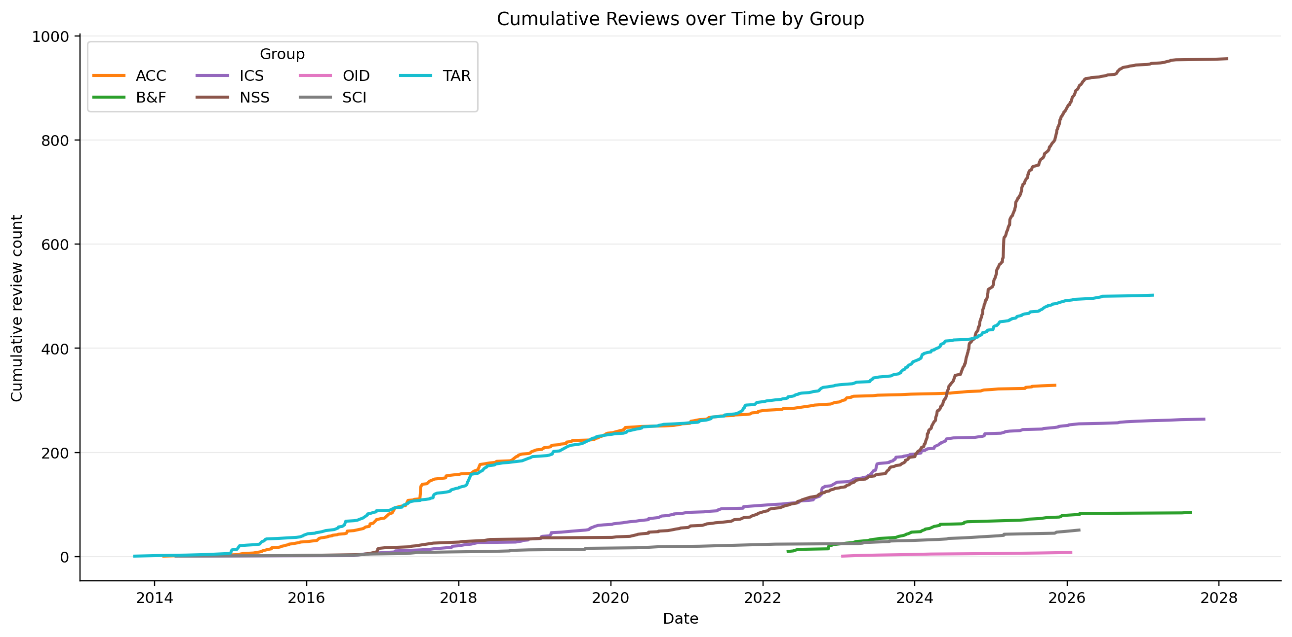
All Technical Reviews distribution
Introduction
Background
Methodology
Empirical Observations
Discussion
Conclusion
Over time and by type and sub-project
Notes:
Excel exports from Primavera
PDR: 406
CDR: 949
IRR: 483
TRR: 325
SAR: 32
Or separate into
Bars (count) per type and per sub-division
PDR, CDR, IRR, TRR, SAR, (SRR)
And then put it onto a time line with lines to show the frequency/density approaching major tollgate (SAR5,SRR5,SP,BA,RBOT,BOT)
Can have two slides on that
For every slide to describe what we see, what pattern right?

Slide 9
System Acceptance Reviews across facility
Introduction
Background
Methodology
Empirical Observations
Discussion
Conclusion
Review density increase approaching major milestones
Review activity was clustered in time rather than evenly distributed.
Peak density reached
5 reviews in 2 weeks
8 in 4 weeks, and
12 in 8 weeks,
with the strongest compression occurring in November–December 2025 ahead of SAR5, SRR5, and the March 2026 Beam On Target (BOT) commissioning milestone.
Milestone markers reflect the October 2025 schedule baseline; some review dates later shifted following the facility event.
SAR5
SRR5
BOT
Notes:
[LENA]

Slide 10
System Acceptance Review actions across the facility
Introduction
Background
Methodology
Empirical Observations
Discussion
Conclusion
A compressed review sequence produced a steep increase in actions ahead of BoT
SAR5
SRR5
BOT
*The majority of identified actions had already accumulated before the plotted key milestones in early 2026.
Review-generated actions increased sharply during the main autumn 2025 review period.
Most reviews were dominated by actions due before BoT, but some produced substantial post-BoT action volumes.
Action generation was uneven, with a few high-output reviews driving much of the cumulative increase.
The cumulative identified action count reached 1,173.

Slide 11
System Acceptance Reviews across the facility
Introduction
Background
Methodology
Empirical Observations
Discussion
Conclusion
Action output as a proxy for review value
Division | Reviews | Total actions* | Committee participations | Actions per committee participation | Share before BoT
TGT | 6 | 360 | 50 | 7.20 | 89.7%
NSS | 10 | 373 | 81 | 4.60 | 63.0%
ESS | 3 | 347 | 29 | 11.97 | 44.4%
ICS | 1 | 37 | 10 | 3.70 | 64.9%
ACC | 1 | 56 | 12 | 4.67 | 82.1%
Actions per committee participation is used here as a proxy indicator of review output relative to committee input.
A committee participation means one committee member taking part in one review event. If the same person sits on five reviews, that counts as five committee participations, not one.
*Action counts are based on SAR report actions. Later Jira follow-up counts are not directly equivalent, since some report actions were split into multiple tickets and additional actions were added after the reviews.
21 SAR reviews generated 1173 actions and 193 committee participations
For every committee participation in a review, 6.08 actions were generated on average.
Target reviews show 7.20 actions per committee participation, above the overall average of 6.08.
Target reviews were also more front-loaded toward BoT, with 89.7% of actions due before BoT.
ESS reviews (Cross Cutting SAR, Soft SAR) reviews show the highest action density at 11.97 actions per committee participation, whereas ICS is the lowest at 3.70.
Notes:
Recommendations to be acted upon by the project, recommendations generate actions.
General formula
Actions per committee participation = Total actions / Committee participations
Example: Target
Total actions = 360
Committee participations = 50
Calculation: 360 / 50 = 7.20
So: Target generated 7.20 actions per committee participation.
Was the low-output review low because the system was already mature, or because the review produced little useful follow-up?
A lower value for actions per committee participation does not necessarily indicate lower value. It may reflect either a more mature system with fewer remaining issues, or a review that generated less observable follow-up output. Likewise, a higher value may indicate either stronger issue identification or lower system maturity.

Slide 12
Committee composition and participation concentration
Introduction
Background
Methodology
Empirical Observations
Discussion
Conclusion
Committee review-event participations across 21 SAR reviews, grouped by functional role and seniority level
Notes:
Left figure: Shows the distribution of counted committee review-event participations by functional role. Management and radiation safety/protection account for the largest shares, followed by quality/compliance and occupational health and safety. This indicates that review committees relied heavily on governance, safety, and compliance-related functions, alongside technical specialists.
Right figure:
Committee participation was dominated by leads/managers, followed by heads/directors and engineers/specialists. This suggests that reviews relied strongly on personnel with coordination, decision-making, and oversight responsibilities, rather than being composed mainly of technical specialists alone.

Slide 13
Committee participation load across SAR reviews
Introduction
Background
Methodology
Empirical Observations
Discussion
Conclusion
Participation across 21 reviews held March 2025 – March 2026
14 of 55 individuals (~25%) accounted for 65.8% of all committee participations across 21 SAR reviews.
The top 9 individuals already accounted for 50.8% of all participations.
One individual attended 19 of 21 reviews, while the median individual attended only 2.
25 individuals participated in only one review each, together accounting for just ~13% of participations.
The committee burden was not only substantial in hours, but also concentrated in people.
The concentration is not driven by one single discipline. Leadership roles dominate overall participation, but the repeated load is also clearly carried by specialist functions central to safety, quality/compliance, and commissioning. This indicates a repeated need for the same cross-functional competencies.
Notes:
The committee burden was not only substantial in hours, but also concentrated in people.
The same people were repeatedly reused across reviews, suggesting that review capacity depended on a relatively small core of recurring members.
This concentration mirrors the committee composition slide: leadership roles dominate overall participation, but the repeated load is also clearly carried by specialist functions central to safety, quality/compliance, and commissioning.
Committee participation was highly concentrated: 14 of 55 individuals — about 25% — accounted for 65.8% of all 193 committee review-event participations across 21 SAR reviews.
A small recurring core carried much of the review load: the top 9 individuals already accounted for 50.8% of all committee participations.
The concentration is not driven by one single discipline: the most frequently recurring members come from Quality / Compliance, OHS, Commissioning, Radiation Safety / Protection, Controls / ICS, and Coordination, indicating a repeated need for the same cross-functional competencies.
The participation profile is strongly skewed: one individual attended 19 of 21 reviews, while the median individual attended only 2 reviews.
A long tail coexists with the core group: 25 individuals participated in only one review each, and together accounted for only about 13% of all participations.

Slide 14
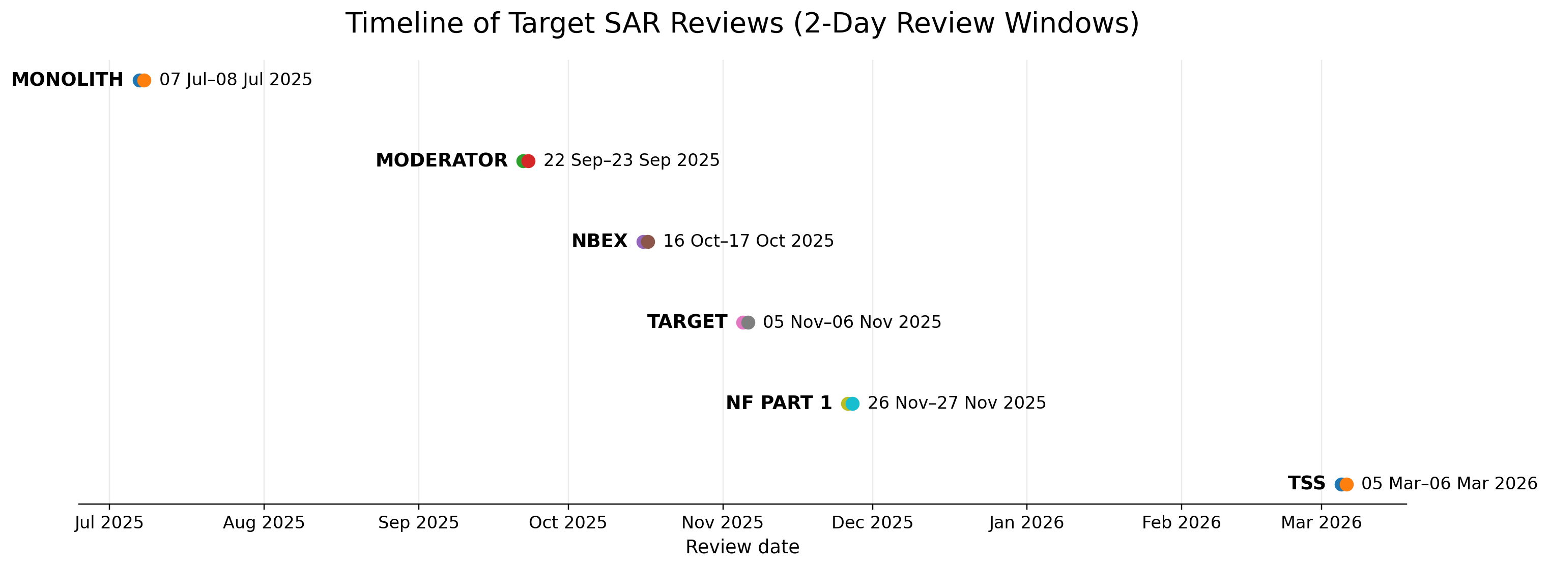
Target SAR Reviews Timeline
Introduction
Background
Methodology
Empirical Observations
Discussion
Conclusion
Sequence of Target group SARs from Monolith to TSS, July 2025 to March 2026
Most Target SARs were conducted within a five-month window, illustrating a tightly compressed review sequence ahead of later BoT-related milestones. Target reviews proceeded in parallel with other SAR reviews across ESS.
Notes:
Coincides with peak slide.
Reviews for group of systems.

Slide 15
Target review meetings: measured meeting effort
Introduction
Background
Methodology
Empirical Observations
Discussion
Conclusion
Duration, participation and attendance cost (excl. preparation and follow-up work)
Review | Open session (hours) | Closed Session (hours) | Complete meeting duration (hours) | All meeting participants | Committee members | Open cost (person-hours) | Closed committee cost (person-hours) | Total review cost (person-hours)
Monolith SAR | 8.67 | 3.50 | 12.17 | 42 | 9 | 364.0 | 31.5 | 395.5
Moderator SAR | 5.58 | 2.67 | 8.25 | 47 | 8 | 262.4 | 21.3 | 283.8
NBEX SAR | 4.92 | 2.67 | 7.58 | 41 | 9 | 201.6 | 24.0 | 225.6
Target SAR | 5.58 | 3.17 | 8.75 | 47 | 8 | 262.4 | 25.3 | 287.8
NF SAR Part 1 | 7.33 | 3.08 | 10.42 | 52 | 9 | 381.3 | 27.8 | 409.1
TSS SAR | 5.50 | 3.00 | 8.50 | 23 | 7 | 126.5 | 21.0 | 147.5
SUM / summary | 37.58 (total) | 18.08 (total) | 55.67 (total) | ~42 (mean) | ~8.3 (mean) | 1598.3 (total) | 150.9 (total) | 1749.2 (total)
Meeting effort across the six Target reviews was substantial: 55.67 meeting hours translated into 1749.2 person-hours of attendance cost.
Participant and committee sizes were broadly consistent across reviews.
Variation in total review cost was therefore driven mainly by differences in meeting duration rather than large differences in attendance size.
NF SAR Part 1 represented the highest measured meeting effort; TSS SAR the lowest.
Notes:
Core formulas
Open session cost (man-hours) = Participants × Open duration (hours)
Closed committee cost (man-hours) = Committee members × Closed duration (hours)
Total review cost (man-hours) = Open session cost + Closed committee cost
Open sessions are costed for all participants; closed sessions are costed only for committee members

Slide 16
Target review meetings: action output relative to measured effort
Introduction
Background
Methodology
Empirical Observations
Discussion
Conclusion
Action-based effort indicators
Review | Actions total | Person-hours per action | Actions per 100 person-hours | Actions per meeting hour
Monolith SAR | 79 | 5.01 | 19.97 | 6.49
Moderator SAR | 54 | 5.26 | 19.03 | 6.55
NBEX SAR | 53 | 4.26 | 23.49 | 6.99
Target SAR | 73 | 3.94 | 25.37 | 8.34
NF SAR Part 1 | 61 | 6.71 | 14.91 | 5.85
TSS SAR | 40 | 3.69 | 27.12 | 4.71
TOTAL / overall | 360* | 4.86 | 20.58 | 6.47
*Action counts are based on SAR report actions. Later Jira follow-up counts are not directly equivalent, since some report actions were split into multiple tickets and additional actions were added after the reviews.
It took 4.86 person-hours of measured meeting effort to generate one action.
For every 100 person-hours of measured meeting effort, 20.58 actions were generated.
For every hour of measured review meeting time, 6.47 actions were generated.
The reviews differed noticeably in output density when actions were related to effort.
By this proxy, TSS SAR and Target SAR were the most output-dense by person-hours, while NF SAR Part 1 was the least.
Notes:
For every hour we spent in review we got 6.47 actions out of it.
Person-hours per action = 1749.2 / 360 = 4.86
Actions per 100 person-hours = (360 / 1749.2) × 100 = 20.58
Actions per meeting hour = 360 / 55.67 = 6.47 (55.67 Complete meeting duration (hours)
Core formulas
Actions total = extracted count of actions for each Target review
Person-hours per action = Total review cost (person-hours) / Actions total
Actions per 100 person-hours = (Actions total / Total review cost (person-hours)) × 100
Actions per review hour = Actions total / Complete meeting duration (hours) Share due before BoT = Due before BoT / Actions total
Share due after BoT = Due after BoT / Actions total

Slide 17
Target review action themes
Introduction
Background
Methodology
Empirical Observations
Discussion
Conclusion
Identified Target review actions grouped by theme and timing relative to Beam on Target (BoT)
Safety/compliance, verification/validation, maintenance/lifecycle support, and nonconformities dominate the Target action profile.
A substantial share of actions had to be resolved before BoT.

Slide 18
Target review action themes
Introduction
Background
Methodology
Empirical Observations
Discussion
Conclusion
Identified Target review actions grouped by theme and shown by current closure status
Action closure varies clearly by theme, rather than progressing evenly across all areas.
Verification/validation and documentation-related themes show comparatively stronger completion, while several other categories retain a more persistent open backlog.
Completion is uneven across themes, indicating different levels of maturity across the action backlog.
Notes:
The amount of work is not even because some issues are to be completed after BoT, and that’s OK if they are open or InProgess.
Relate one example.

Slide 19
Target review action closure status
Introduction
Background
Methodology
Empirical Observations
Discussion
Conclusion
Progression of Target review actions across Target SAR tollgates
Although many actions were closed in the earlier group SARs,
later reviews still generated or retained open items,
suggesting that closure pressure persisted late in the readiness sequence towards major tollgates.
Notes:
The amount of work is not even because some issues are to be completed after BoT, and that’s OK if they are open or InProgess.
Relate one example.

Slide 20
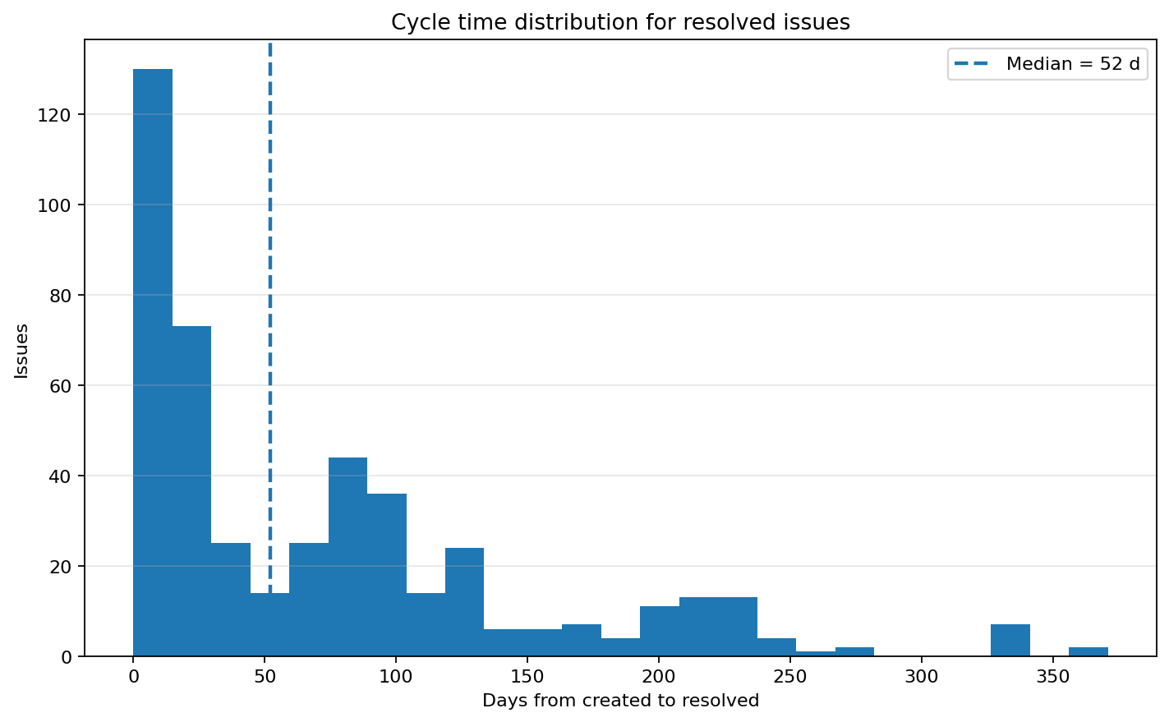
Target action closure dynamics
Introduction
Background
Methodology
Empirical Observations
Discussion
Conclusion
Cycle time distribution for resolved review issues
A median closure time of 52 days indicates that
review actions often remained open well beyond the review event itself,
with a long tail of slower-moving items.

Slide 21
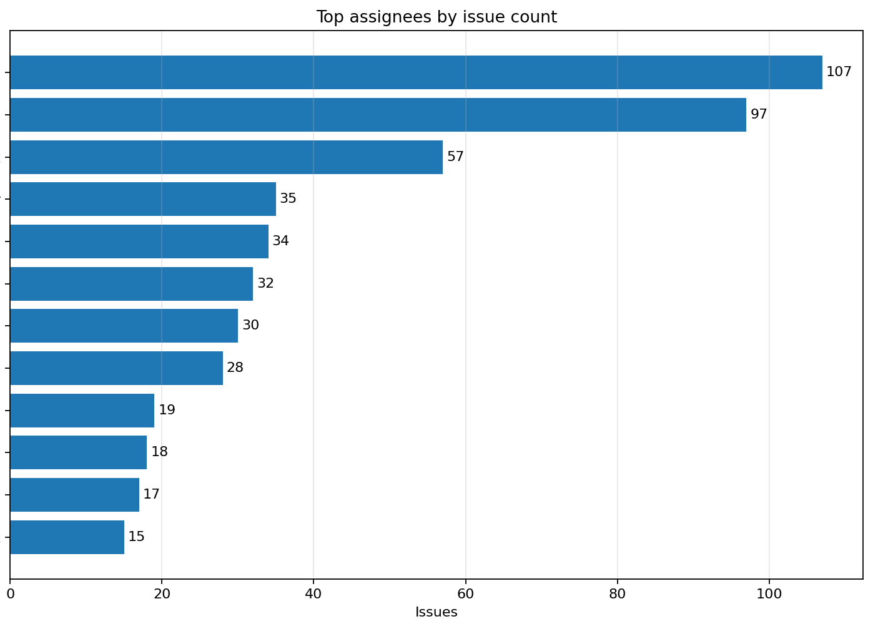
Action assignment concentration
Introduction
Background
Methodology
Empirical Observations
Discussion
Conclusion
Distribution of review issues across the most frequent assignees
Review issue ownership was highly concentrated,
with a small number of assignees accounting for a substantial share of all assigned actions.

Slide 22
ESS SAR in Practice: Signals from the Field
Introduction
Background
Methodology
Empirical Observations
Discussion
Conclusion
Selected Observations (Monolith Group SAR)
Selected observations from the review committee:
“We only used the checklist… the procedure part is mostly for organisers.”
“The checklist is an active hindrance for constructive committee work.”
“A lot of the documentation was missing… presentations were being added during the review.”
“It was impossible to properly address all remaining questions during the meeting.”
Process metrics:
63+ checklist questions (47 baseline + 16 added)
~1 hour delay per 3 hours scheduled (~33% schedule overrun)
Key documents released during the review (baseline, presentations)
Outcome: “Approved with post-SAR actions”
Notes:
Procedure and checklist were revised based on the feedback as it as received, very agile response.

Slide 23
Aligning Reviews with Value
Introduction
Background
Methodology
Empirical Observations
Discussion
Conclusion
When Do Engineering Reviews Deliver Value?
It is necessary to always keep an eye on the costs you are incurring, and to know them you need to measure them.
Reviews demand high effort:
Documentation, coordination, participation
People are busy
And create a wealth of beneficial outputs
Reports, findings, actions…
Incentive to get things done
Decision to proceed
But often show limited impact
Scheduled too late and in parallel with others
Recommendations lack specificity
Technical risk management becomes reactive
Resource planning is essential (e.g., what functions are needed for each review), so you have a balance between continuity in the reviews and overloading individuals.
Arguably the biggest benefit…
Schedule compression reduces the value of the reviews by having less than ideally prepared committees, and less than necessary time to address the actions afterwards.
Notes:
Including the prioritization of actions
Effectiveness depends on alignment of:
Knowledge (review outputs)
Authority (decision-making power)
Timing (while there is time)
Value is not created by more reviews, but by better integration with the engineering and the project management processes

Slide 24
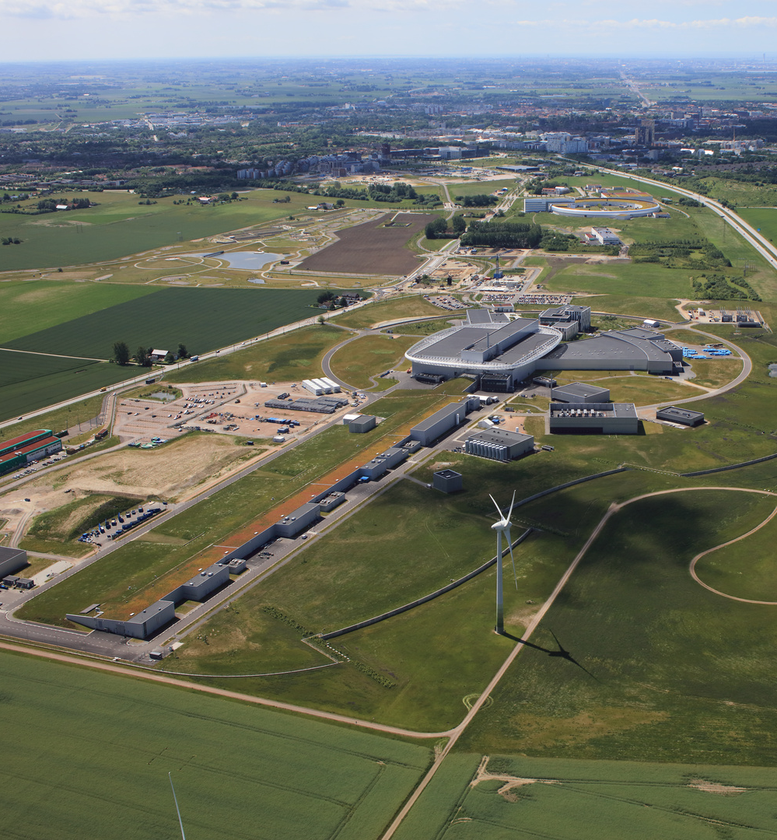
Greenfield Facilities
Introduction
Background
Methodology
Empirical Observations
Discussion
Conclusion
Why more process emerges precisely when understanding is lowest
Constraint taxonomy
Regulatory: what must not be done
Technical: what cannot be done
Institutional: what we choose not to do
Procedural substitution When understanding is weak, organisations replace it with process → documentation becomes a proxy for knowledge and insight
Review pathology Reviews shift from testing insight to demonstrating compliance → defensibility over discovery of the truth
Constraint as comfort Governance expands to reduce anxiety, not to improve decisions
Reviews should reflect understanding. When box-checking replaces it, process becomes the problem.
© Perry Nordeng

Slide 25
Recommendations for Practitioners
Introduction
Background
Methodology
Empirical Observations
Discussion
Conclusion
Designing High-Value Review Processes
Appoint capable people to coordinate the process and empower them
Anchor reviews to a common process and plan
No review without a clear path forward
Culture is what aligns things outside the process
Avoid silos and create cross-functional teams
Enforce accountability
Assign single-point ownership for each action
Link actions to authority, not just responsibility
Shift reviews earlier
Position reviews where design freedom is still high
Maximise ability to influence outcomes and avoid schedule compression
Reduce procedural overload
Prioritise critical insights over documentation volume
Be agile regarding the process development
Focus on understanding
Evaluate whether the system is sufficiently understood, not just compliant
Include reviews for “orphan scope” in your plan
Include Non-Technical concerns and Cross-cutting systems in the process
Communicate and build relationships.
High-value reviews are decision-driven, timely, and accountable, not document-driven

Slide 26


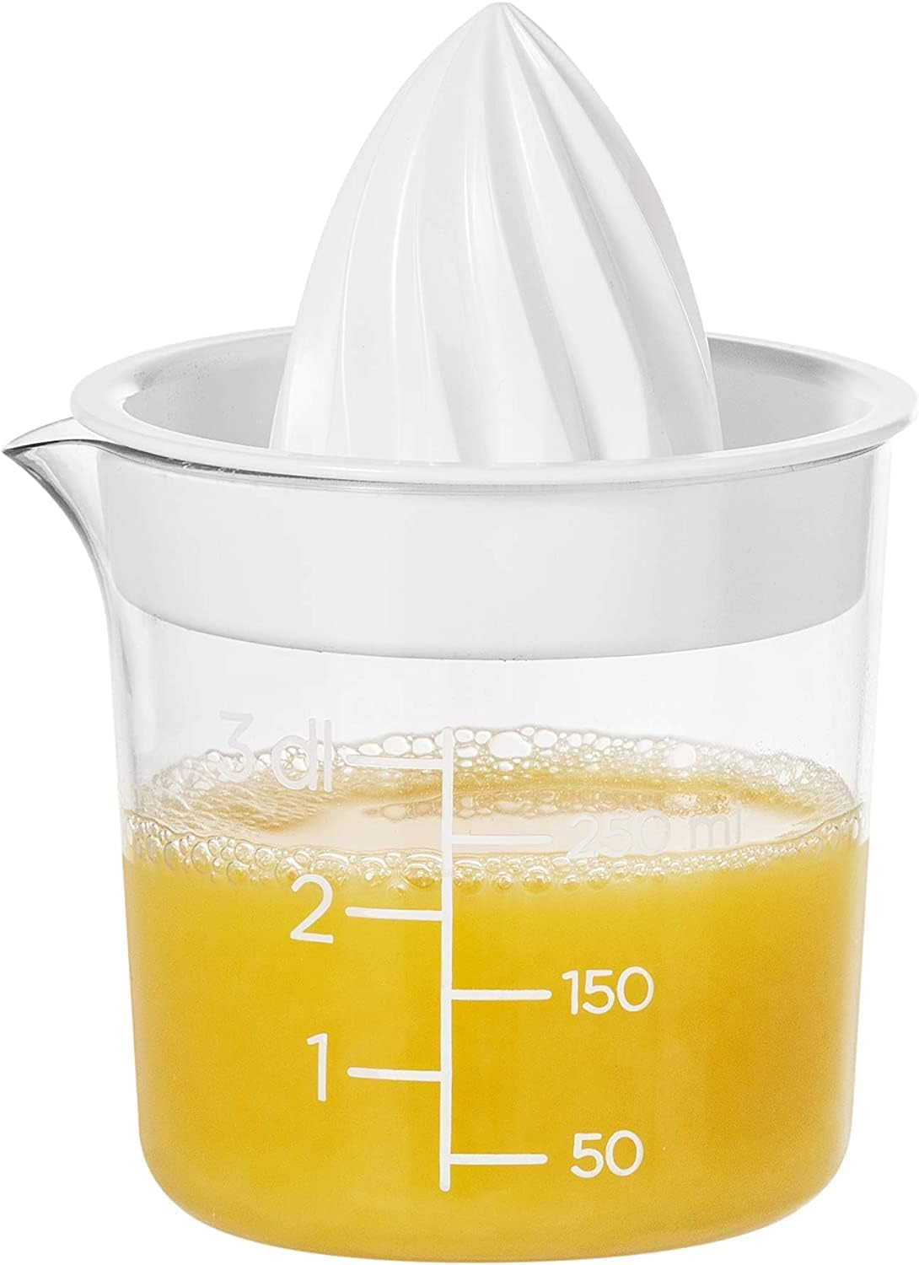
Is the juice worth the squeeze?
Introduction
Background
Methodology
Empirical Observations
Discussion
Conclusion
Yes! But…

Slide 27
For additional insights
We are always happy to discuss reviews!
Lena Bystedt (Miriant AB) lbystedt.pro@gmail.com
linkedin.com/in/lenabystedt
Iñigo Alonso (ESS) inigo.alonso@ess.eu
linkedin.com/in/inigoalonso/

