Slide 1



A New Model for Radioactive Waste Management at ISIS
Christopher McKay
Melissa Collier
ICANS 2026
Notes:
The abstract pattern can be removed or repositioned if required. Be careful to ‘Send to Back’ so that it does not obscure any important information.

Slide 2
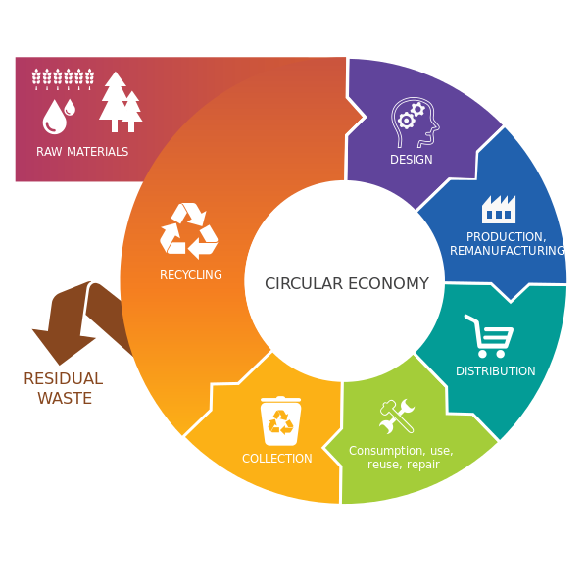
Real Impact of Radioactive Waste
Half of the world’s GHG emissions, and over 90% of global water stress and biodiversity loss events, are due to the extraction and processing of raw materials
Radioactivity breaks the circular economy
COP28 2023
EU Parliament
Notes:
So I've highlighted our waste, but what is the consequence
Quote"…" the a key answer to reducing resource extraction this is the circular economy
The UK Government has set it's greening government commitments – Net Zero, 70% Recyling, 15% waste reduction
Radioactivity breaks the circular economy
In our strictly regulated field, the main impact of solid radioactive waste is not radiological, it is the harm caused by the lost resource. Over the past 5 years radioactive waste represents the majority of waste produced by STFC that cannot be released for recycling.

Slide 3
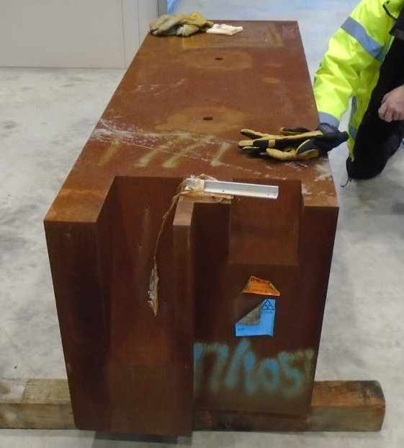
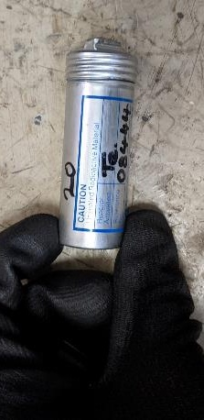
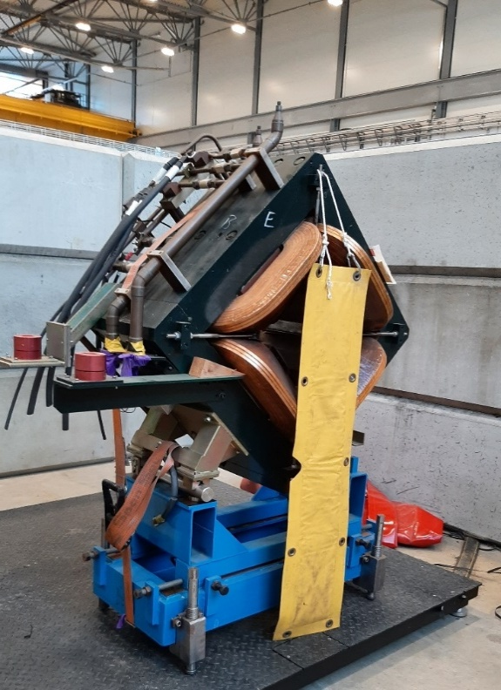
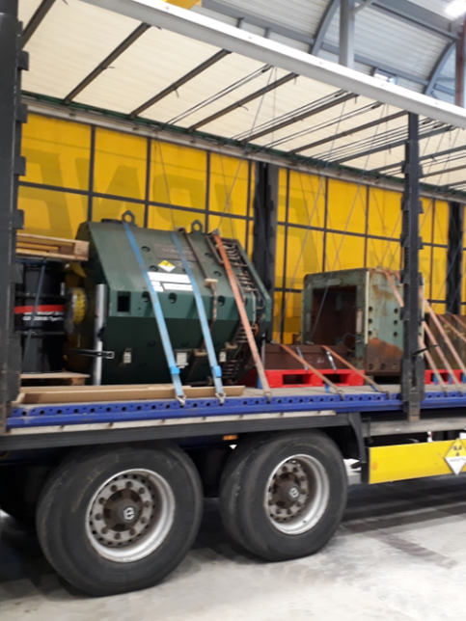
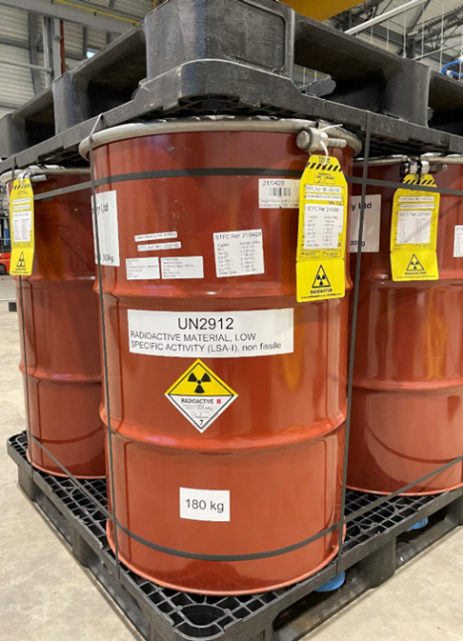
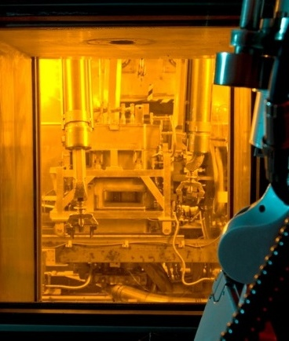
Radioactive Waste
Existing waste on site
1340 te 7PBq
Future operational waste
100 – 200 te/y 4PBq/y
~2000 te 80PBq
Decommissioning waste
~34,000 te 200PBq
Listed activity only includes radionuclides with t1/2>30 days

Slide 4
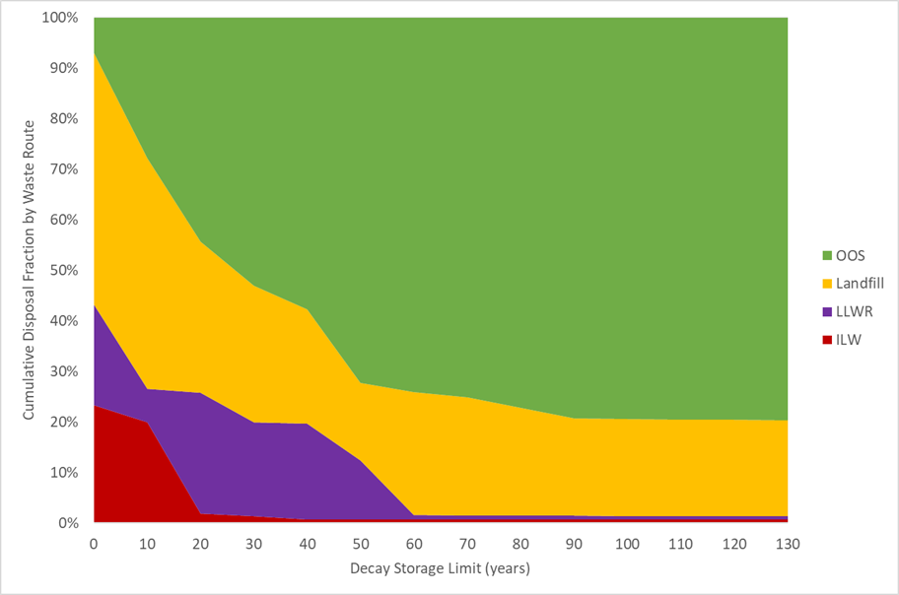
Decay
80% of ISIS radioactive waste can be diverted to conventional recycling
Think of waste as an asset!
Majority of benefit within ~ 60 years
No further benefit beyond 90 years
Our most highly active wastes will remain ILW for thousands of years.
~ 0.5% long-lived ILW
~ 200 tonnes
Graph showing cumulating disposal fractions with decay time for ISIS radioactive waste distribution
White dotted line indicates current accumulation time limits for most metallic categories

Slide 5
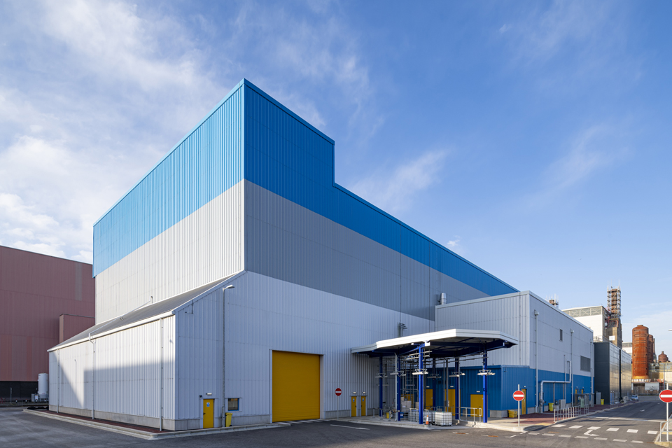
The Problem!
ISIS had evolved into a limit driven management model
Regulatory time limits were driving burial of waste
Rad waste recycling rate of only 36%
Forecast burial of ~21,000 tonnes
Bureaucratic burden of complex limits
39 classes of waste and 149 different limits
Unable to take strategic approach
We were required to transfer our ILW by 2028
Expected costs exceeded £100M
Forecast radioactive waste disposal fraction under previous model
Sellafield Miscellaneous Beta Gamma Waste Store

Slide 6
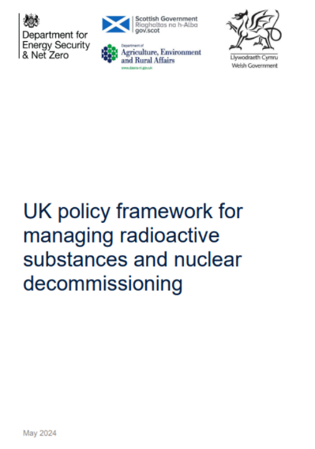
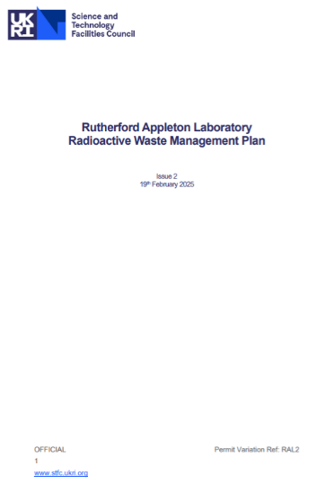
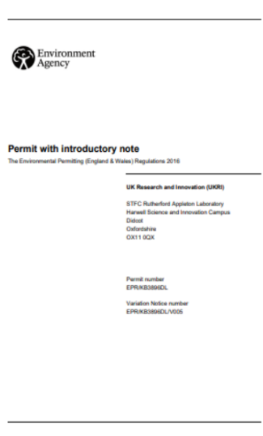
Optimised Waste Management Model
Achieve the best environmental outcomes and public value through the flexibility of individual optimisation rather than the inflexibility of limits
A 2024 waste policy introduced “risk-informed” decision making, allowing flexibility and signaled expanded use of decay storage
Case for a “new way” made via a
Radioactive Waste Management Plan
Regulator assurance allowed key parts to be
implemented in 2024
Granted first of a kind permit in January 2026

Slide 7
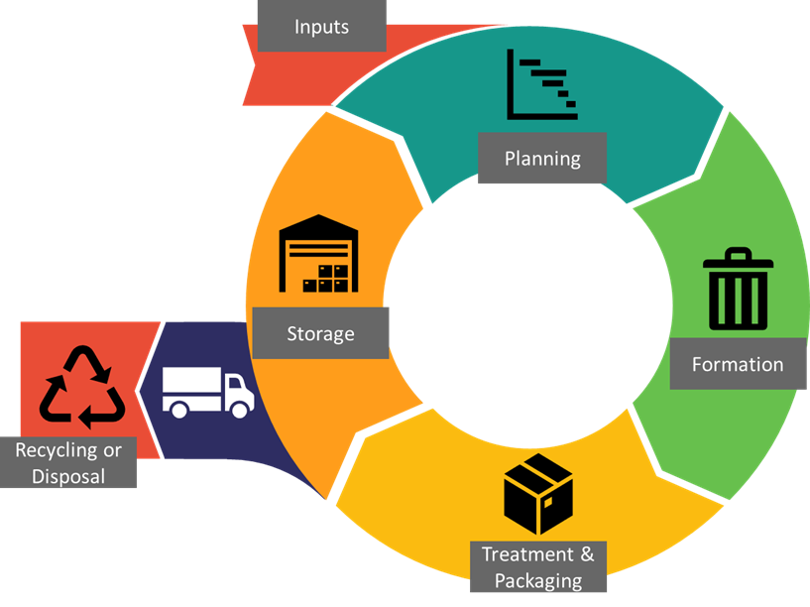
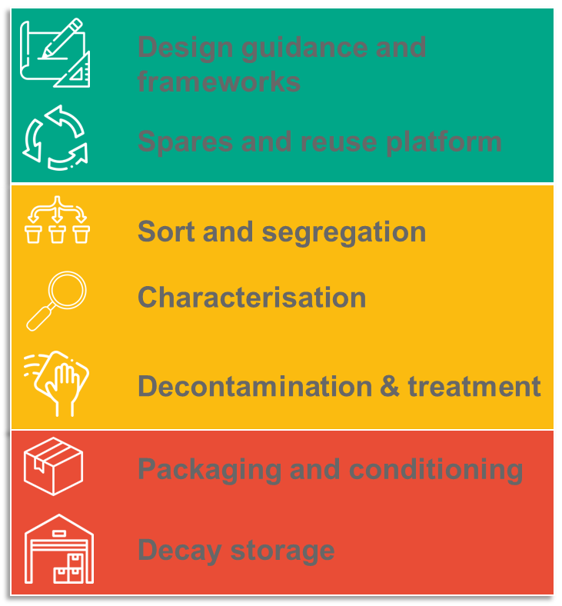
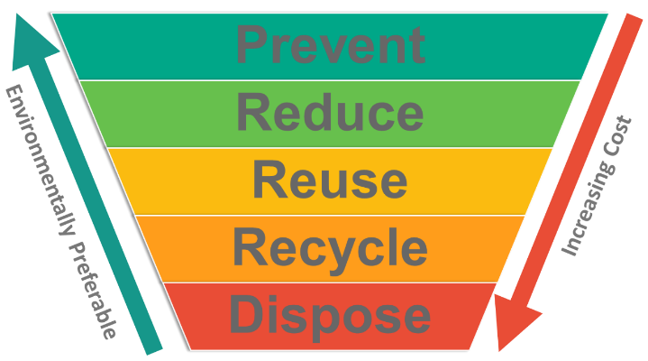
Lifecycle and hierarchies
Lifetime management
Waste Hierarchy
Treatment Hierarchy

Slide 8
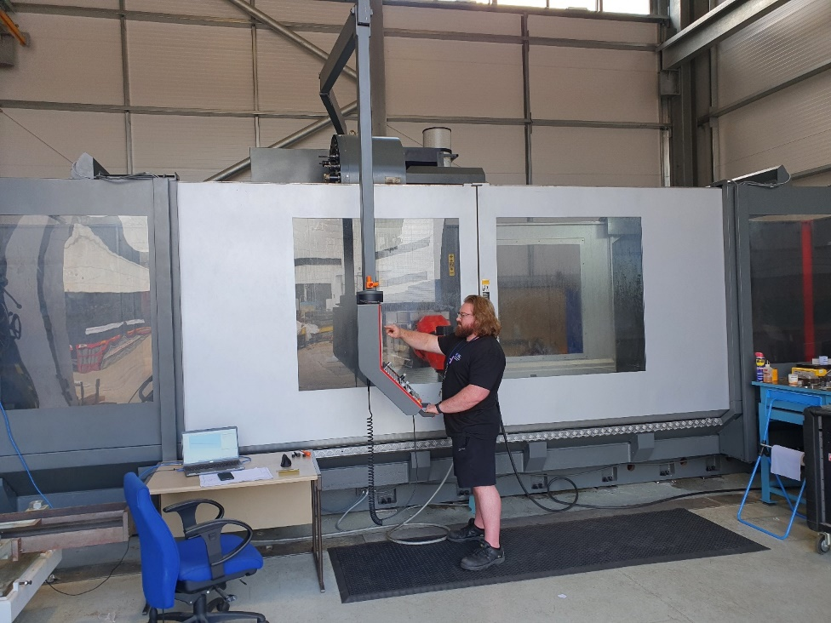
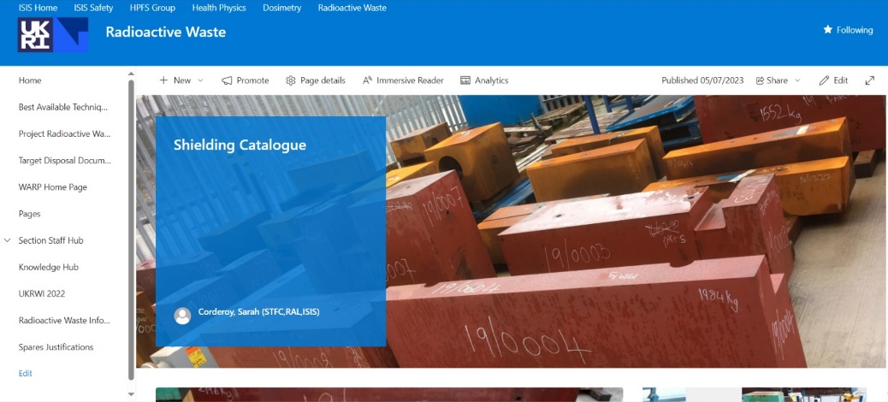
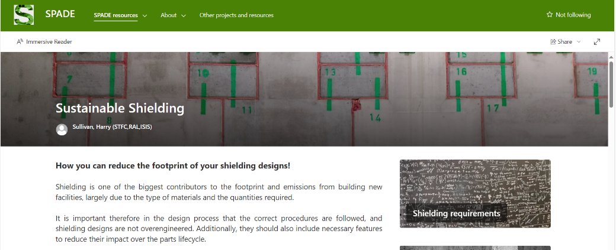
Reuse of Shielding
Reuse framework
In-house active machining capability
Radioactive spares catalogue
Designers Guidance

Slide 9
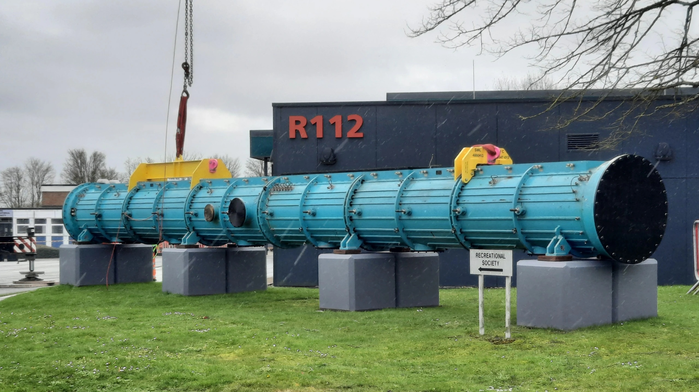
Reuse of ISIS LINAC Tank IV
Originally consigned as radioactive waste
Now preserved as scientific heritage

Slide 10
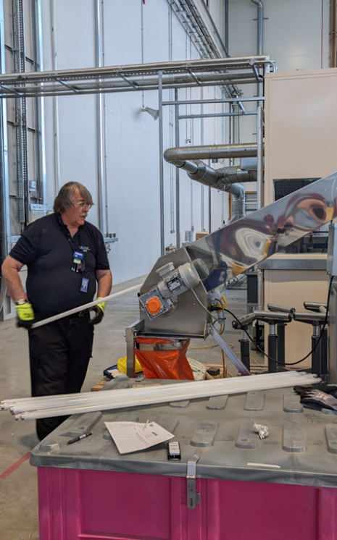
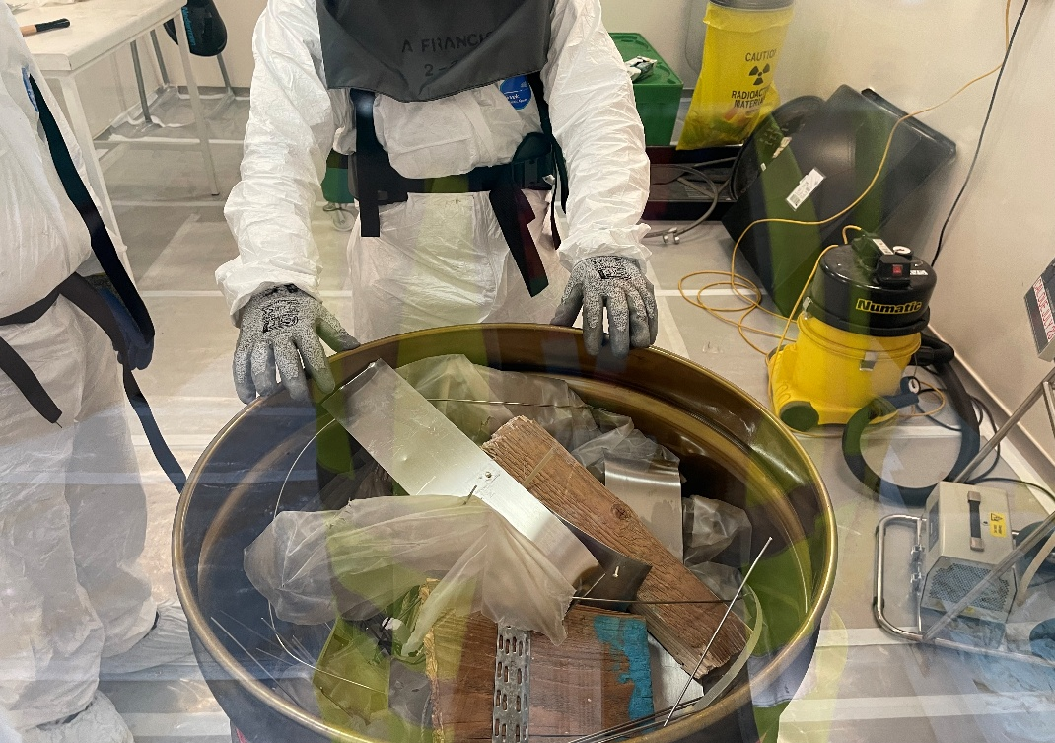
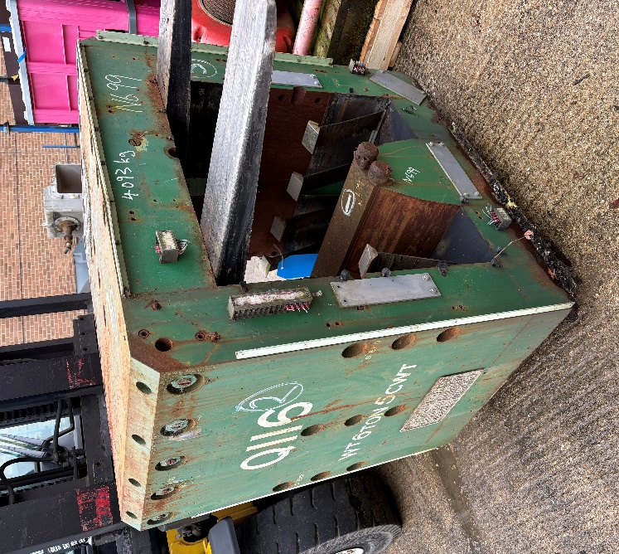
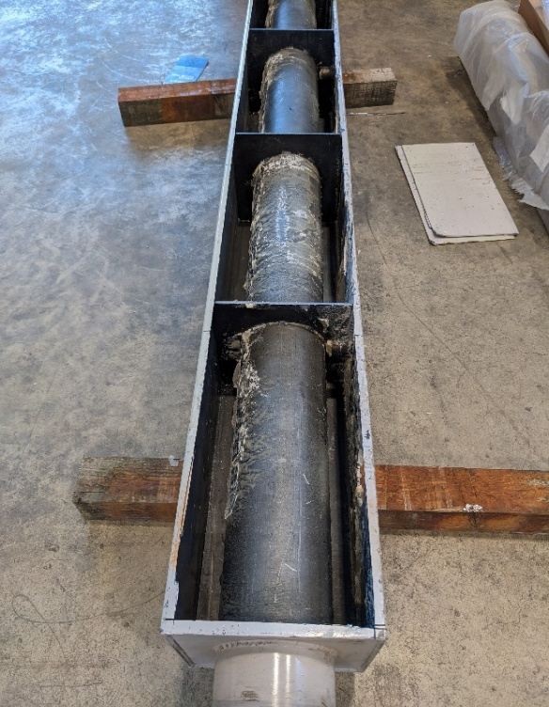
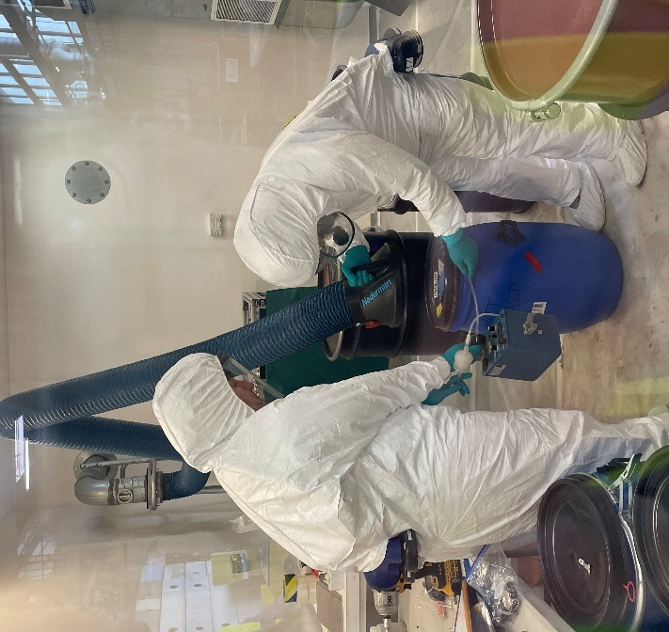
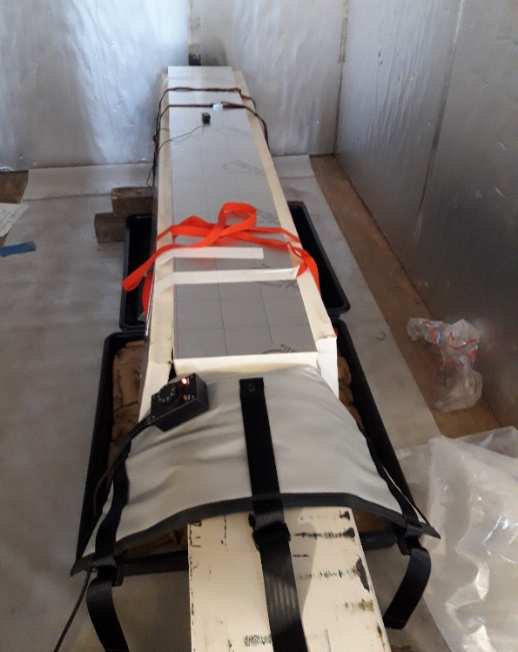
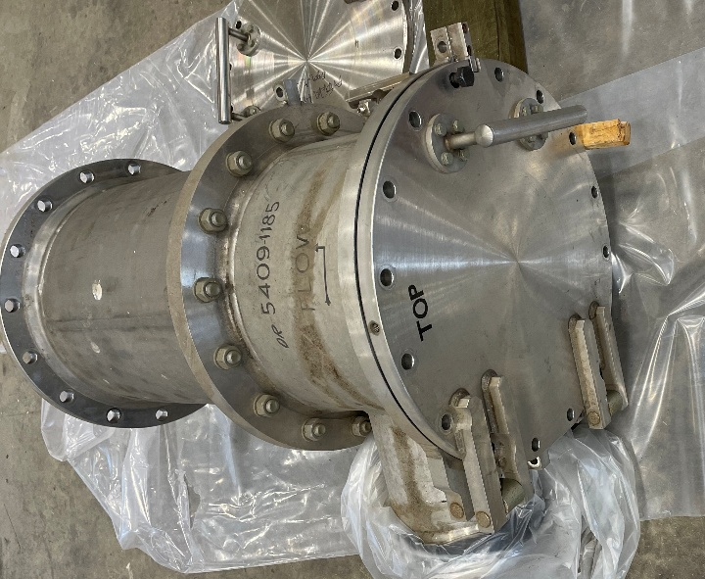
LLWR

Slide 11


Minimise Burden on Future Generations
Core concept to sustainable development is to meet our needs without compromising the ability of future generations to meet their own needs
It is not acceptable to unduly burden future generations with the cost or risks of our radioactive waste.
Presumption Toward Early Solutions
Waste as an Asset for the Future
Solutions sooner rather than later
Don’t leave work to future generations that can be done now
E.g. Upfront characterisation, and treatment
Ensure passive safety
There is indirect harm from loss to circular economy
Waste that can be reused or recycled is a future asset.
Balance future benefit against risks and costs of treatment/storage

Slide 12



Storage Justifications
Waste is held under one of three categories
Buffer Storage
Temporary storage necessary to undertake characterisation, treatment, packaging etc., or to accumulate a sufficient quantity for economic processing or transport.
Decay Storage
Storage to achieve a defined benefit through radioactive decay, such as to allow a specified retrieval or treatment step, or to allow a change in disposal route.
Interim Storage
Storage where there is not currently a treatment or disposal option. i.e. awaiting a national ILW disposal facility

Slide 13
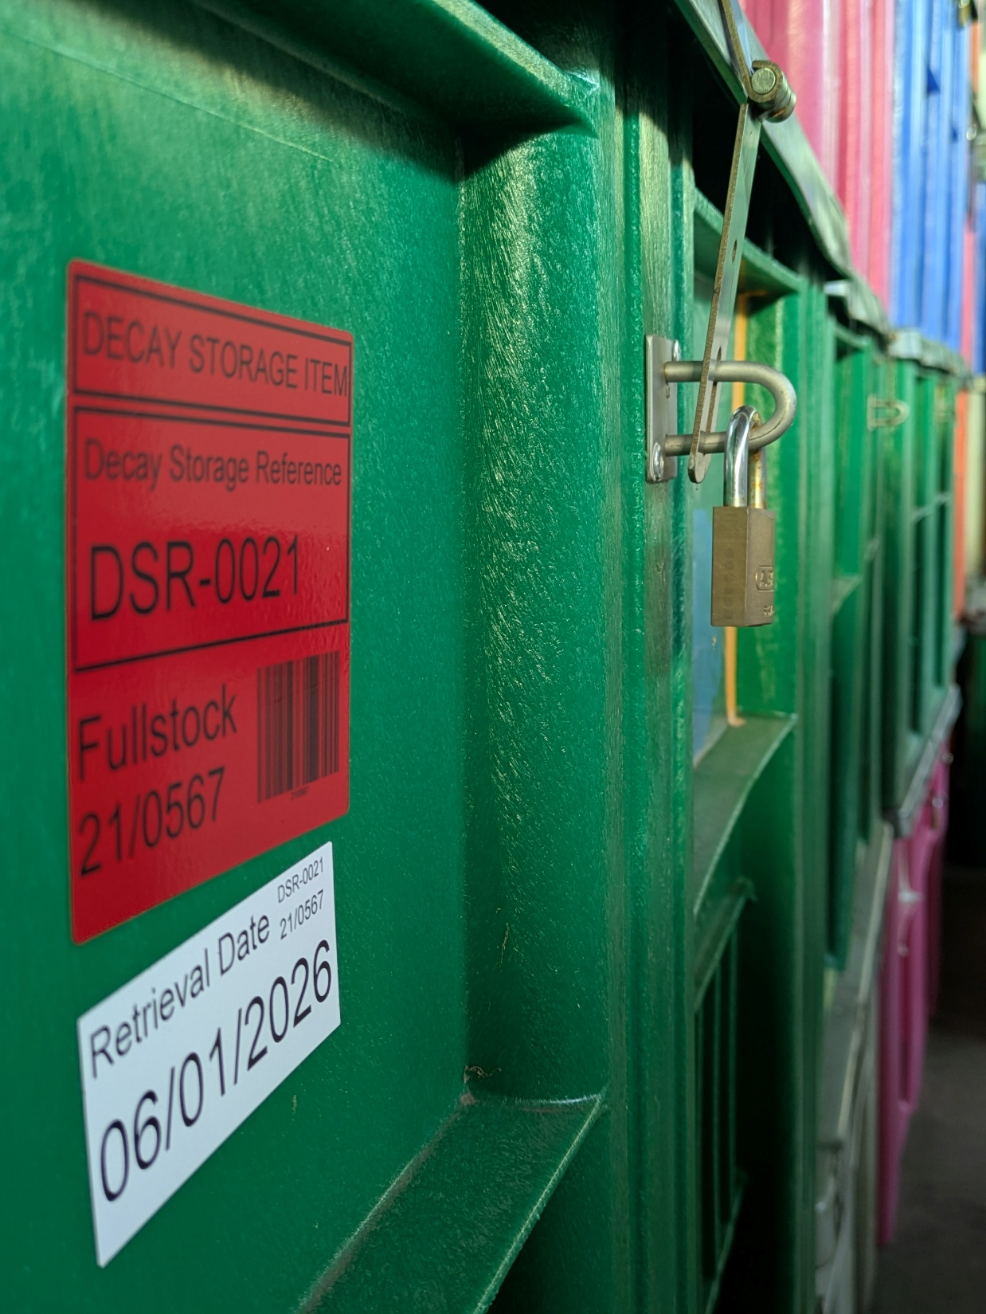
Justification Principles
Decay and Interim storage only allowed:
Individual justification
As part of an overall management plan
As the bottom of the hierarchy
We apply to the following conditions:
Fully characterised
A genuine environmental or safety benefit
Disposal as soon as target condition is met
Storage in a passively stable condition
Storage (were practicable) in a “disposable” condition
Limit to credible period of institutional control (<100 years)

Slide 14













Treatment & Storage Model
Buffer
Buffer Storage
Characterisation
Individual BAT
BAT framework
iterative
Treatment
Segregation
Packaging
Decay Storage
Justification & Review
Reuse
Interim Storage
Transport
Off-Site Treatment
Recycling
Disposal

Slide 15


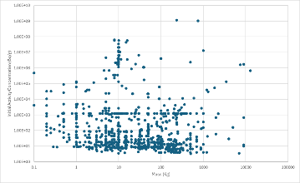


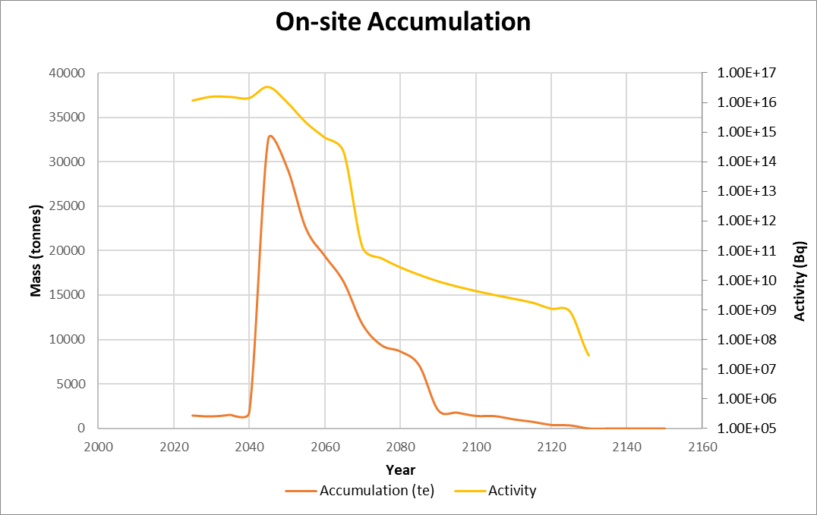
Waste Forecasting
Key requirement to give confidence to our regulators
Monte-Carlo simulation of waste
User defined generation forecasts
Weighted empirical waste distributions
Database of ~8000 waste items
Forecasting allows
Optimisation management models
Testing assumptions & uncertainty
Estimate of future benefit & timelines
Inform future planning
Validation of management strategies
Generation Forecast
Waste Data
Simulated Waste
Simulate Management Models & Assumptions
Iteration &
Recalculation
Verification &
Planning
Inventory & Disposal
Forecasts

Slide 16
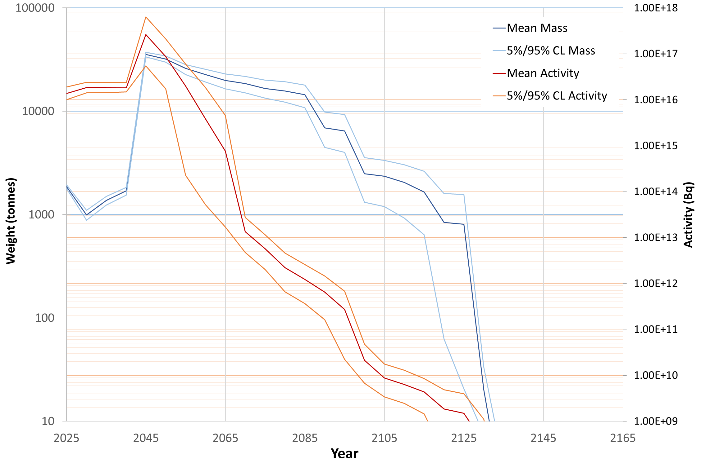
Forecast Waste Inventory
Radioactive Waste Inventory Forecast for ISIS Baseline Scenario
27,000 tonnes of radioactive waste available for recycling
Long-term responsibilities
Peak Accumulation ~ 30,000 tonnes
Last waste leaves ~2130
Explored range of scenarios, such as
Extended ISIS operation
ISIS successor facility
Activity values exclude short-lived radionuclides

Slide 17
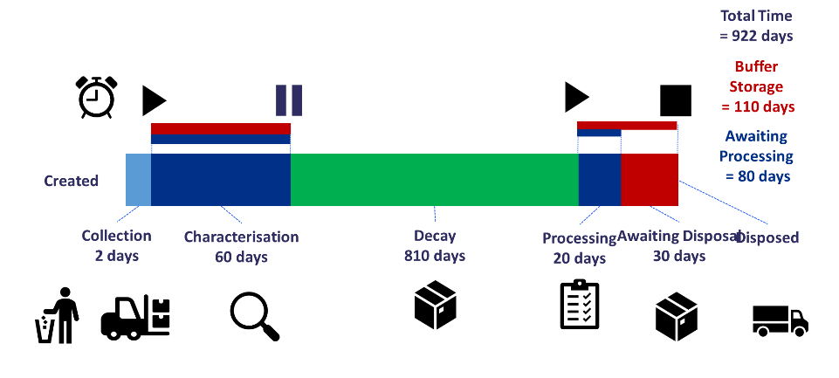
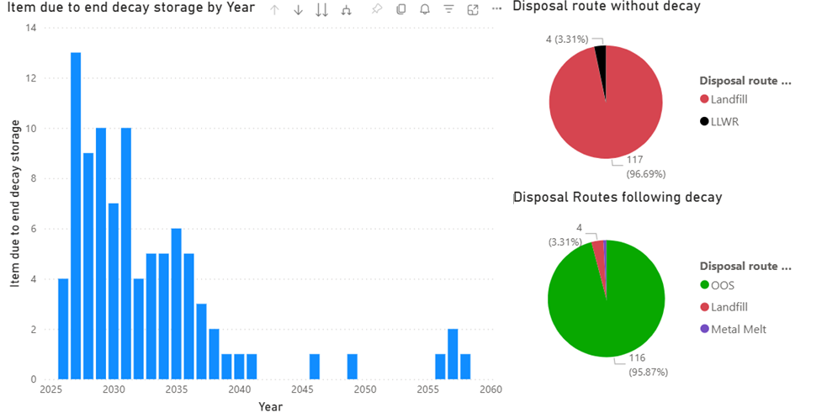
Data Led Assurance
Illustration of waste lifetime tracking
Continuing assurance to regulators is essential
Lifetime tracking of waste, outcomes & benefits
Demonstrates optimisation
Monitor & validate expected benefits of storage
Data is essential for informed decision making
Regulators require us to demonstrate we are:
Minimising time in “Buffer Storage”,
Disposing without delay once disposal conditions met, &
Evolving inventories & disposals match forecasts
Decay Store Benefit Metrics
Automated metrics minimise compliance burden and create transparency
New type of regulation for UK

Slide 18
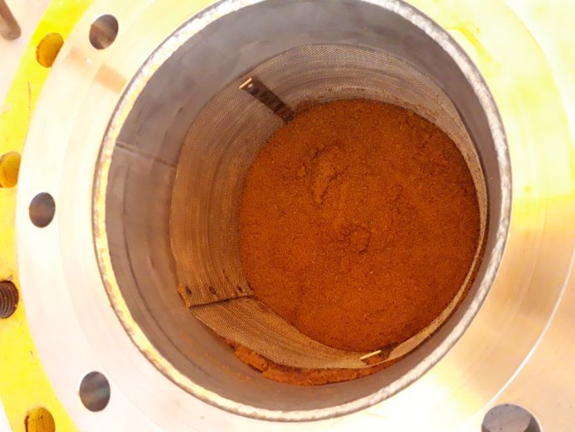
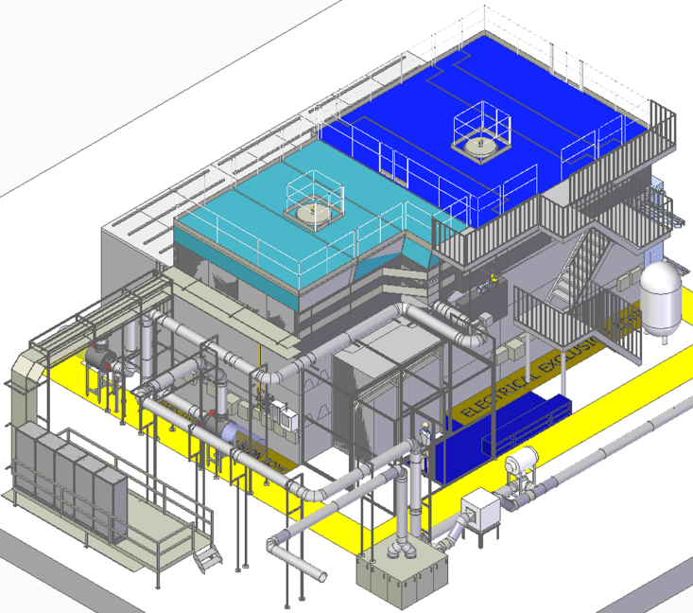
Transition
A problematic waste:
target circuit ion exchange resin
We set target dates to complete transition.
Regulators require on-going assurance
2028
Existing LLW Transition Completed
Problematic Wastes Resolved
Disposability Assessment for ILW Completed
Long-term records management system
2032
Existing long-lived ILW Transition Completed
No further backlog
Waste Remote Handling Facility to enable ILW processing

Slide 19
Summary
New Radioactive Waste Management Model
Focus on optimisation rather than limitation
Fully utilise decay storage as part of a hierarchy
Recycling rates expected to go from 36% to 80%
27,000 tonnes of material over future life of ISIS
Substantial financial savings >£100M by 2028.
Sustainable long-term costs going forward
Establishes a credible and consistent management approach throughout full lifecycle of ISIS
First of a kind for UK
Actual rate achieved since 2024 is ~90%

