Slide 1
The Moderator Test Station at the Spallation Neutron Source
E. B. Iverson, K. C. Johns, A. V. Aleksandrov, A. Coleman, V. Freudenberg, F. X. Gallmeier, B. DeGraff, K. B. Grammer, S. Jolley, R. A. Knudson IV, J. Watkins, D. Willis
Oak Ridge National Laboratory
ICANS-XXV
13-19 April 2026

Slide 2
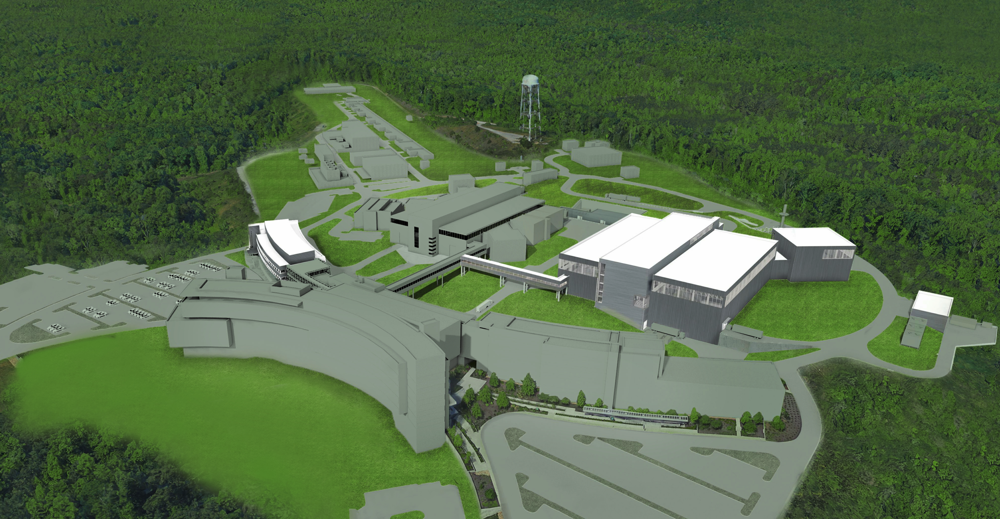
Outline
Moderator Test Station project
Moderator Test Station concept
General description
Target Development
Analyzer Development
Science Case highlights
Operational Plan
Moderator Test Station
First Target Station
Second Target Station
Notes:
In building the MDF at SNS, we do not have to focus on flux as much as we would on a stand-alone facility:
SNS doesn't need another beamline - this is for source technology demonstration - dedicated, single-use optimization
A small source would never begin to compete on flux; just don't worry about it
Prototypical nature is more important than flux anyway

Slide 3
ORNL Moderator Test Station Concept
MTS concept developed to take advantage of the SNS Beam Test Facility and optimize a neutron source to the sole purpose of testing moderator systems and materials, while enabling any moderator testing we ever had trouble performing
SNS RFQ test station (the BTF - 10.1016/j.nima.2019.162826)
2.5 MeV negative hydrogen ions, up to 50 mA peak, up to 60 Hz, up to 1 ms; all fixed
Use a LEBT-style proton chopper; choose from 0.5 to 10 µs proton pulse
Add a target; 3E10 n/s at 75 W from p(⁷Li,n), low primary energy, large beam spot
Provide a large volume space for test moderator
Can't do 10 cm high by 16 cm diameter elsewhere, or reflector-filters, or long tubes, or ...
Wing configuration is prototypical and allows small view of high brightness configurations
Provide for rigorous reproducibility in moderator positioning and orientation
Optimize the facility solely for moderator characterization
Notes:
With the SNS front-end copy that makes up the BTF, we get “forced” into a different source configuration than we might choose if we started from scratch. This changes our optimization process, which at least for exploration purposes offers the chance at significantly different features and gains.

Slide 4
MTS Science Case
We have identified 8-10 moderator concepts for testing
Intermediate temperature moderators (80-240 K) like ammonia, ethane, propane
Directionally-enhanced moderators (10.1016/j.nima.2014.04.047)
Pelletized moderators (10.1016/j.nimb.2013.12.006)
Slush moderators (methane, hydrogen)
Moving moderators (10.1016/j.nima.2020.163562)
High brightness moderators (10.1063/5.0095900)
Very cold neutron source moderators (10.1088/1742-6596/1021/1/012083)
Additionally, there are a wide variety of materials to be tested in conventional monolithic configurations overlapping with some of these concepts

Slide 5
ORNL Moderator Test Station Project
ORNL is developing the Moderator Test Station as an Accelerator Improvement Project, as specific class of DOE project in which funding is taken completely from a single year’s operating budget, so there is a hard cap to the total project cost, but it is all committed from the beginning
Funded for 9M$, with initial contingency >20%
Conceptual Design Review completed 1 April 2024
Preliminary Design Review completed 11 February 2025
Final Design Review scheduled 6 May 2026
Installation expected to begin April 2027
Commissioning expected to begin January 2028
Notes:
With the SNS front-end copy that makes up the BTF, we get “forced” into a different source configuration than we might choose if we started from scratch. This changes our optimization process, which at least for exploration purposes offers the chance at significantly different features and gains.

Slide 6
MTS Science Case - Specifics
Hydrogen moderator performance on SNS FTS doesn’t scale well, losing 20% of the benefit of higher power per MW on proton beam power – we don’t know yet whether this is due to flow maldistribution, entrained gas, stagnation zones, orthohydrogen, or .…
New facilities plan to leverage high-brightness advanced parahydrogen moderator designs
Validating these designs will let us push boundaries a little harder, and know just how well we have to catalyze the hydrogen system to support the desired performance
New Moderator Development
New poisoning / decoupling strategies may extend the lifetime of our inner reflector plug while reducing the penalty arising from burn-up
Intermediate temperature moderators like liquid ammonia or ethane might be a better fit to instruments on the current water moderator, or new instruments in a three-source future
Directionally-enhanced moderators have already been demonstrated to increase brightness into a specific direction (e.g., a guide) by factors, more efficiently using the neutrons we produce
Pelletized moderators offer access to colder materials with higher hydrogen density, better serving high resolution long-wavelength instruments, while minimizing challenges from radiation damage
Notes:
In building the MDF at SNS, we do not have to focus on flux as much as we would on a stand-alone facility:
SNS doesn't need another beamline - this is for source technology demonstration - dedicated, single-use optimization
A small source would never begin to compete on flux; just don't worry about it
Prototypical nature is more important than flux anyway

Slide 7
MTS Typical Moderator Characterization
Energy spectrum; <0.1 meV to >10 eV
Simple time-of-flight measurement, both low-efficiency and high-efficiency in-beam detectors, possibly eventually including single-pulse spectral measurements
Flight path length of ~2.5 m or greater required, short pulse required
Key Performance Parameter: 1E4 n/ster/eV/(Ws) at 2 W required, 6E4 and 75 objective
Energy-dependent brightness across moderator; 1 meV to 1 eV
Pinhole collimation with area detector
Energy-dependent emission time distribution; 0.3 meV to 3 eV
Time-focused crystal analyzers; 0.3 meV to ~3 eV requires two separate analyzer arms, but also makes it practical to check resolution effects
Flight path lengths of ~6 m total, short pulse required
1-5 Angstrom required, 0.3 to 18 Angstrom objective

Slide 8
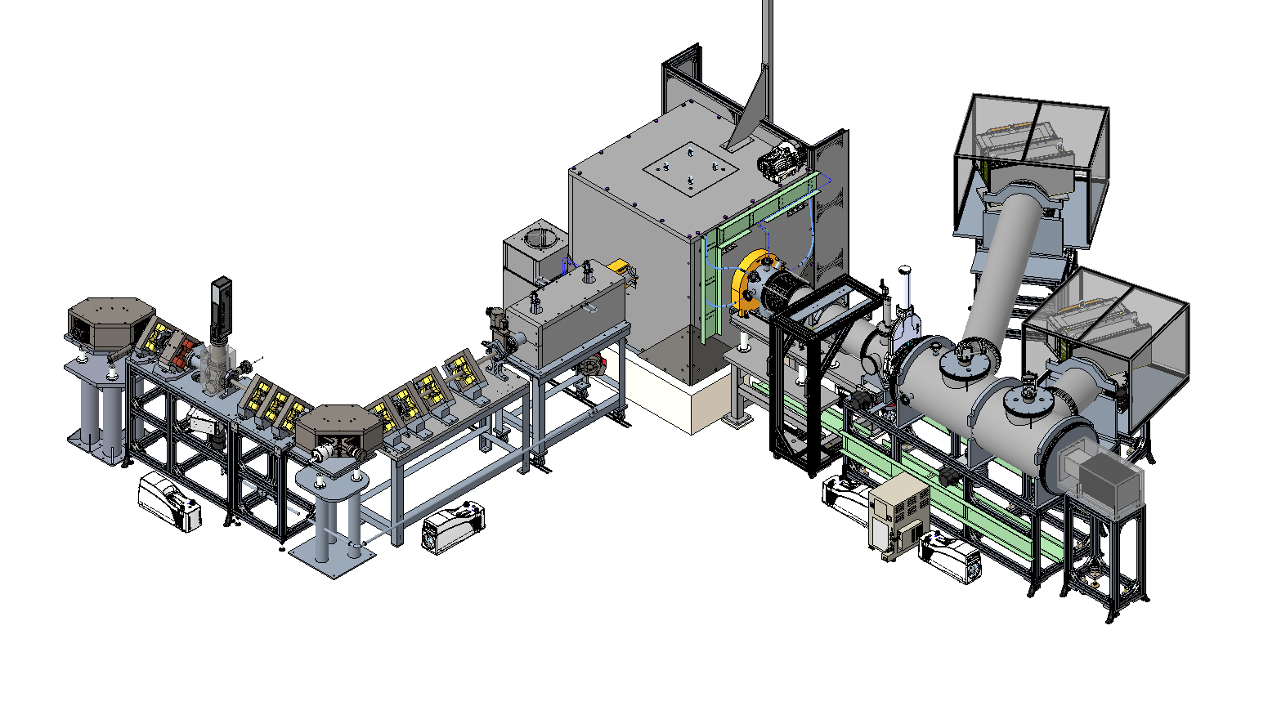
MTS and Proton Beamline Extension
Gas Handling System
Area
Detector
Target and
Shielding Block
Area
Detector
Area
Detector
Neutron Beamline
Beam Stop
Shielding
Mica Analyzer
Proton Beamline
Copper Analyzer
(Future)

Slide 9
MTS Overview: Layout at extended BTF
Relocated BTF Beamstop
MTS Shielding monolith
Walking access to BTF FODO during MTS operation
FODO Extension to BTF
New Bending Magnets and Quads to deliver beam
Current Beam Test Facility

Slide 10
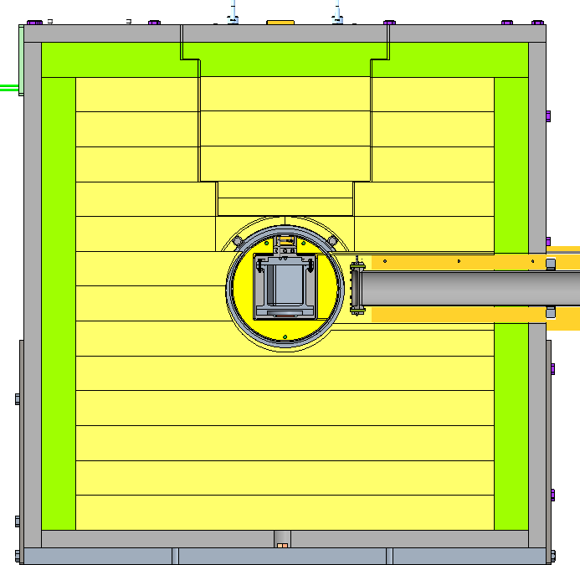
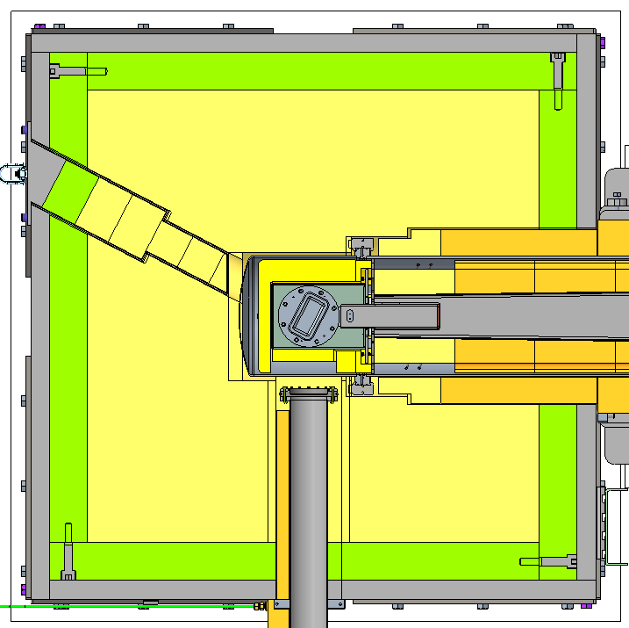
MTS Shielding, Moderator, and Neutron Beamline
1.2 m polyethylene
5 cm borated polyethylene
10 cm lead
p- from
BTF
5 cm steel

Slide 11
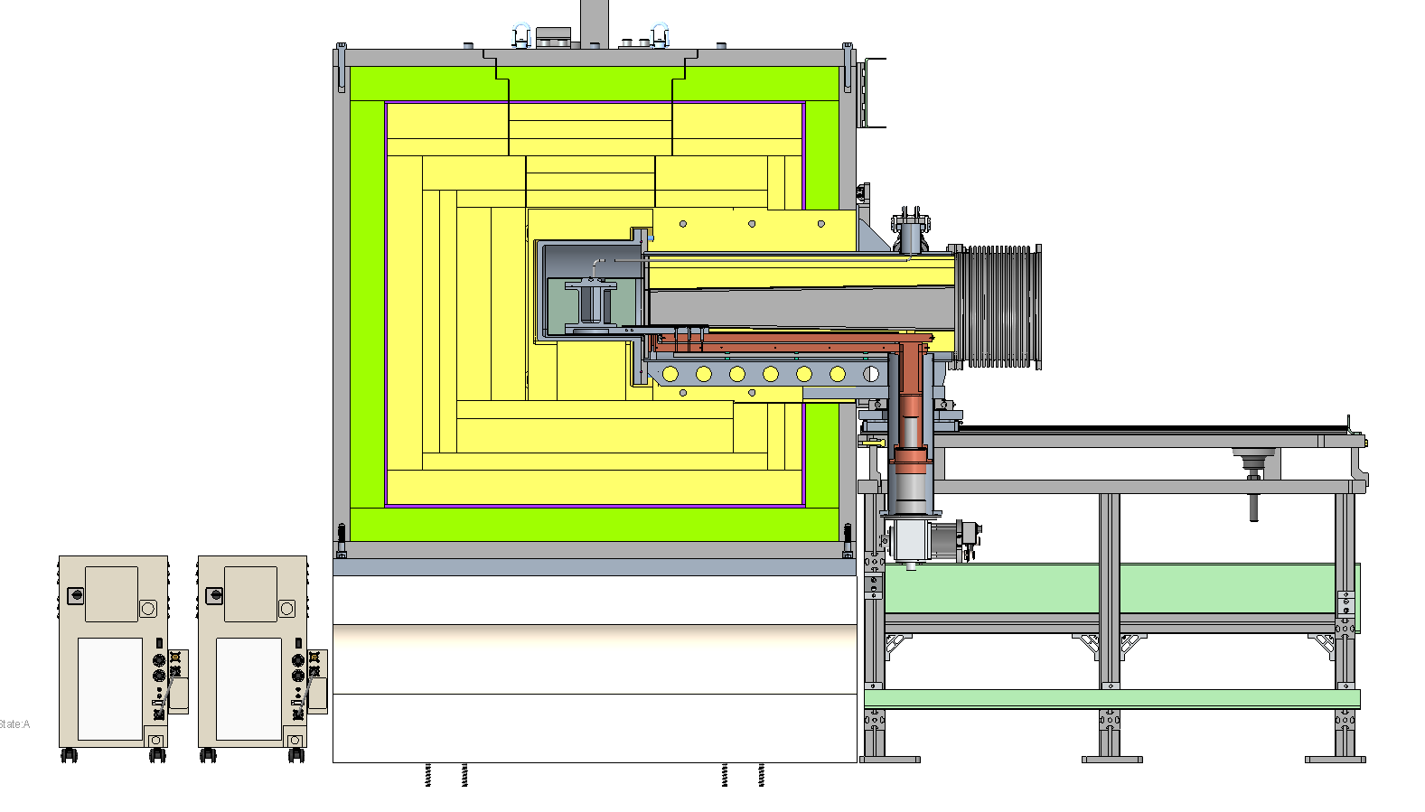
MTS Shielding, Moderator, and Neutron Beamline
Removable cryostat including neutron beamline, moderator services, and shielding, on tracks for reproducible positioning
5 cm steel
10 cm lead
1 cm boron carbide
1.2 m polyethylene
n

Slide 12
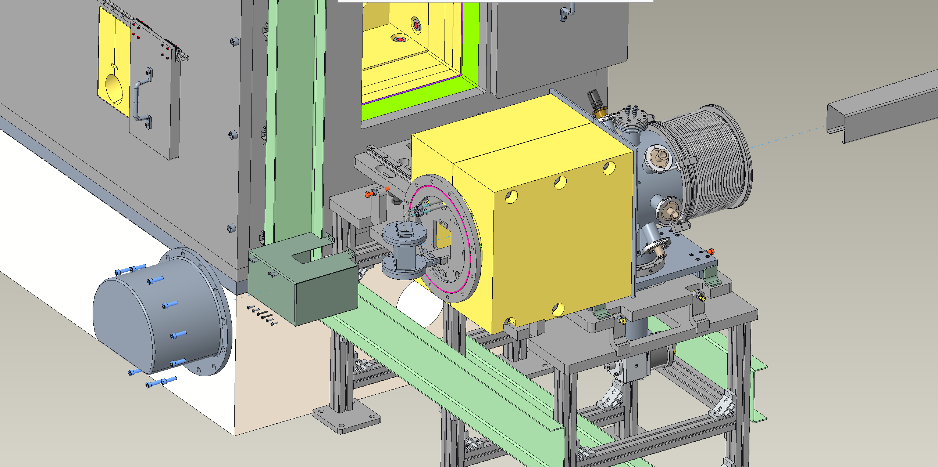
MTS Cryostat
Removable cryostat in withdrawn position allowing direct access to test moderator

Slide 13
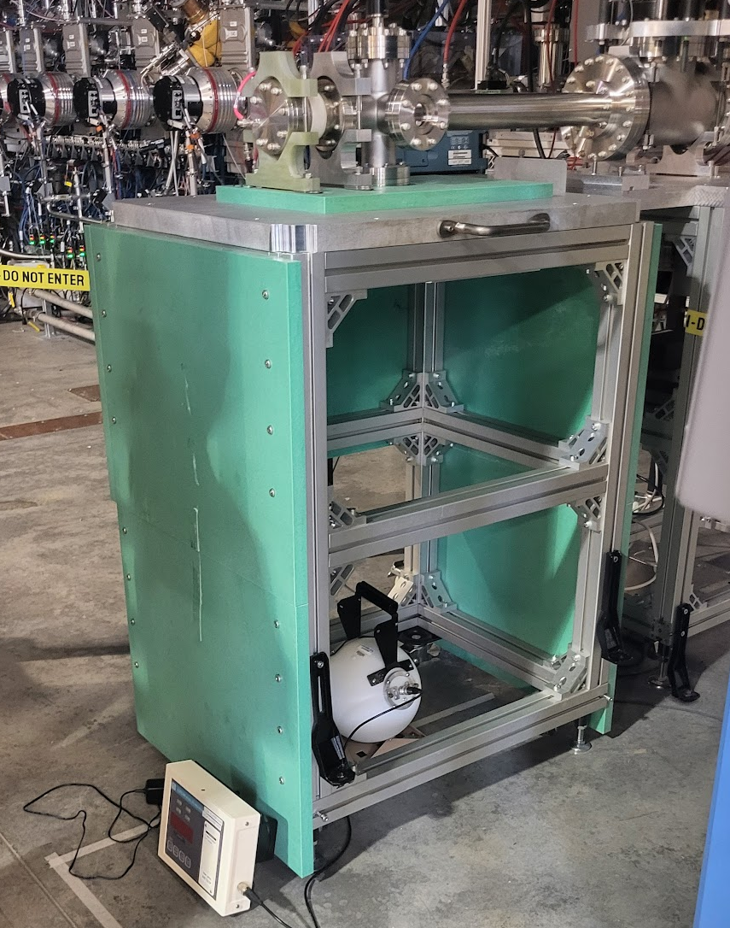
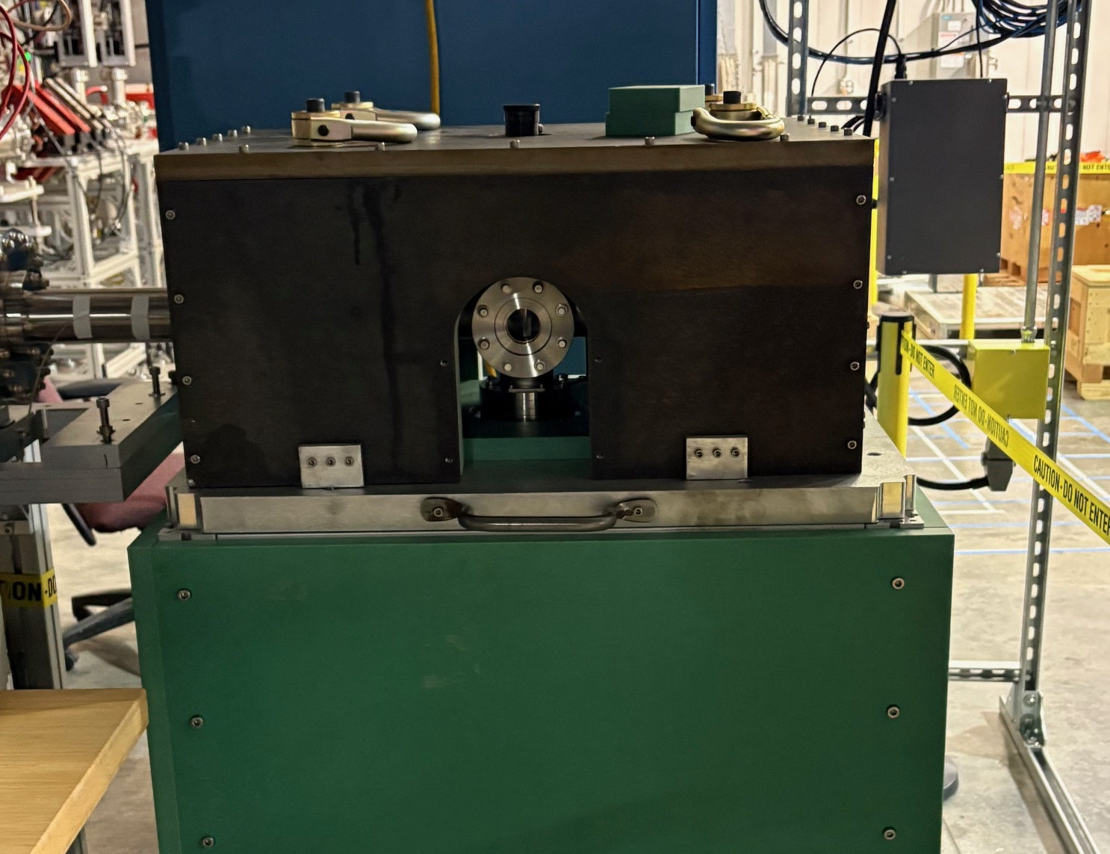
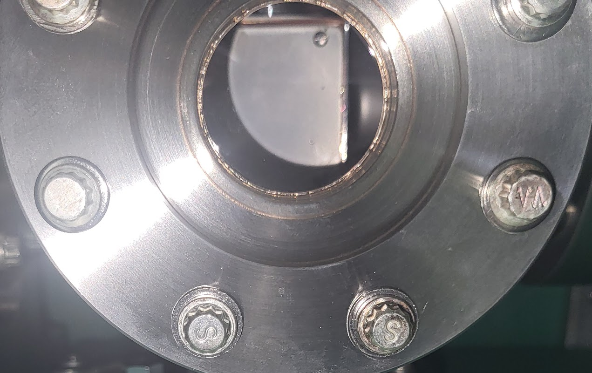
MTS Target Testing at BTF Performed in November
Original concept specified inclined target to spread beam
Low energy elastic scattering at design angle hypothesized to impact target performance – tested at BTF
Same target, inclined at different angles, did show effect. Design orientation lost >50% of neutron intensity

Slide 14
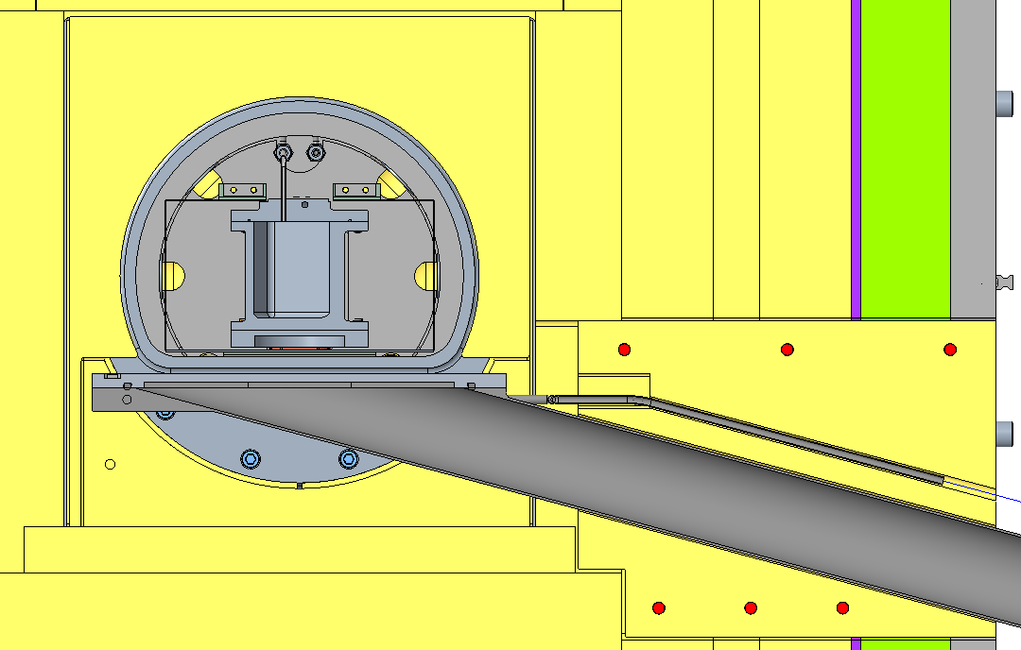
Inclined Targets for Low Energy Ions Suffer Losses
Original concept specified inclined target to spread beam, intended to reduce heating and make a more “prototypical” illumination (i.e., from a stopping length heavy metal target)
Low energy elastic scattering at design angle DOES impact target performance – 2x loss
Target configuration changed to normal incidence, results in additional 3x better coupling
Six times the intensity for an easier proton beam layout and a 70% reduction in target size!

Slide 15
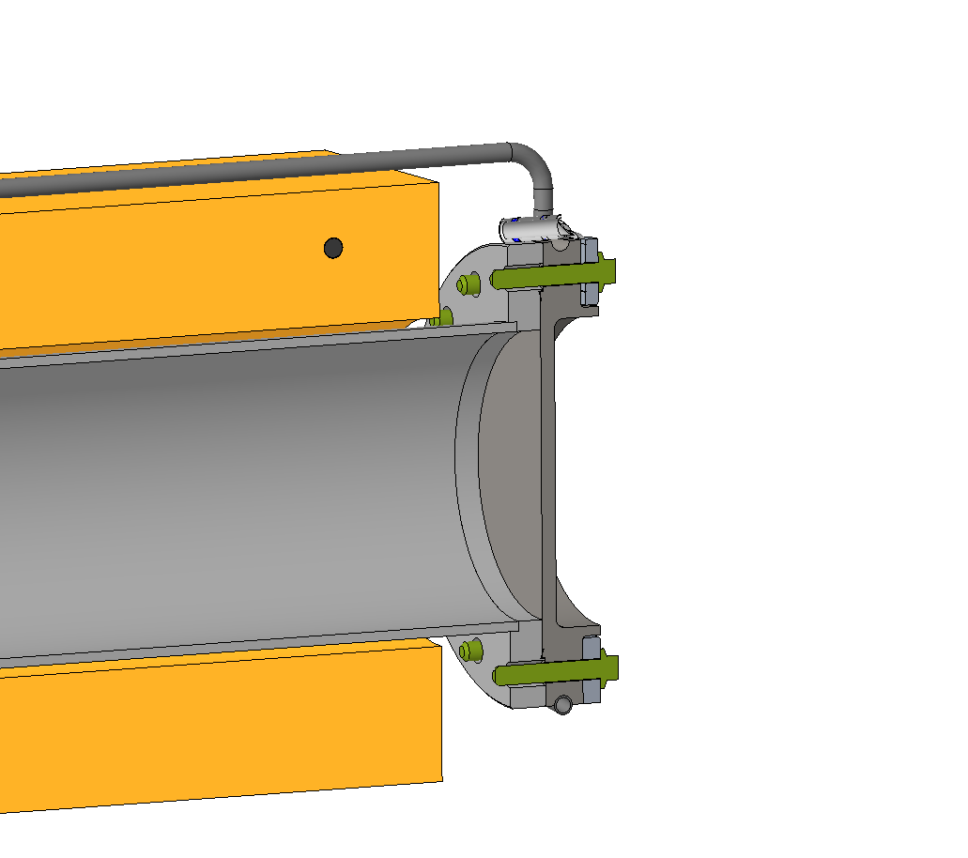
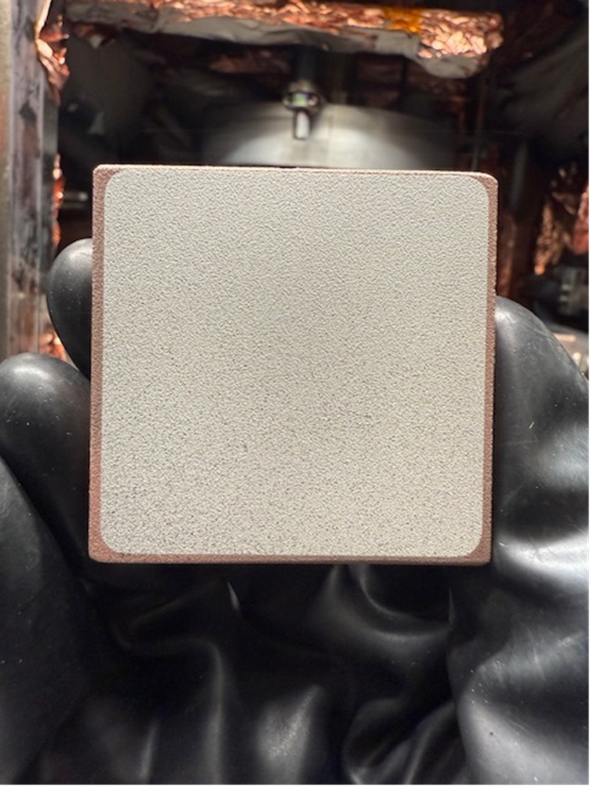
MTS Target Concept Development
Lithium coated directly onto copper flange, edge cooled by water
Titanium encapsulated target allows handling in air.
Layers are applied using physical vapor deposition
Collaborative effort with Energy Storage and Conversion group at ORNL
Copper plate (5 mm)
Lithium target (70 um)
Titanium overcoat (50 nm)
Courtesy: Katie Browning

Slide 16
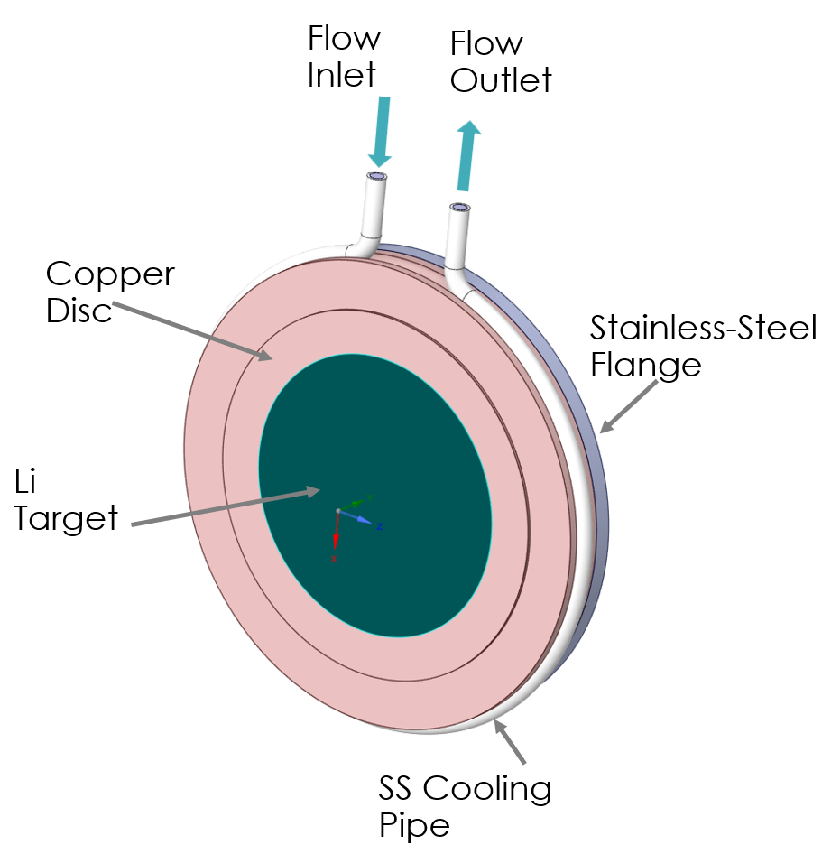
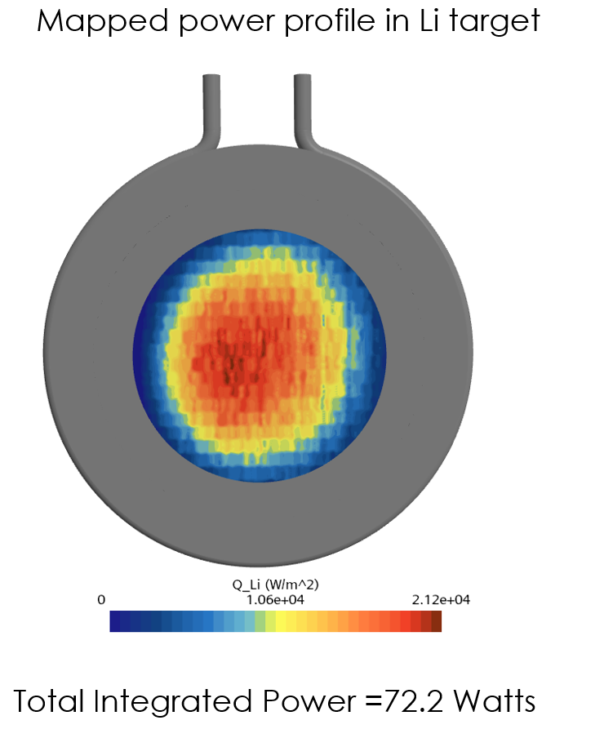
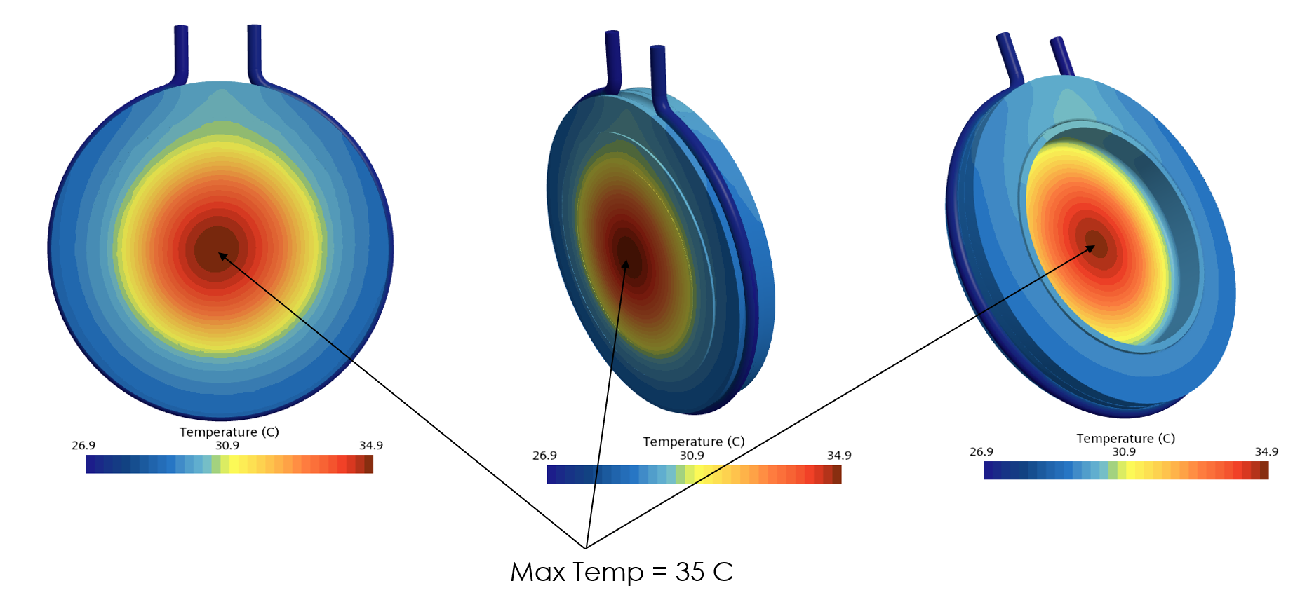
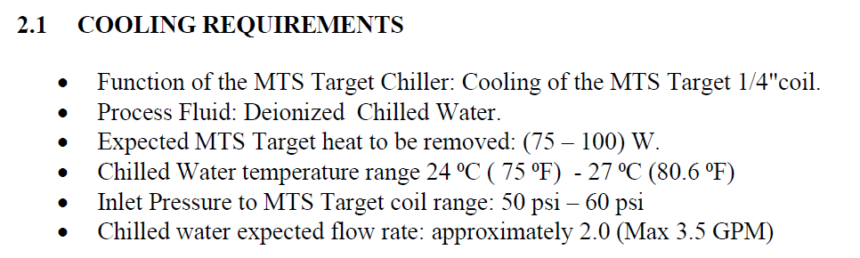
MTS Target Cooling

Slide 17
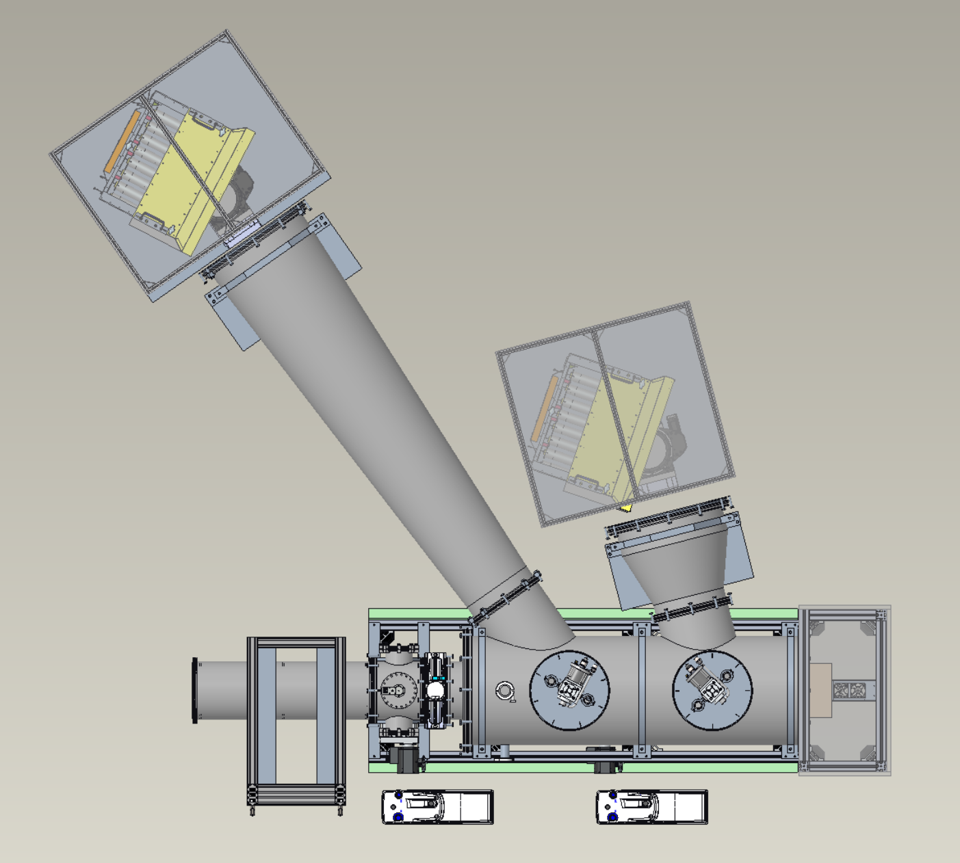
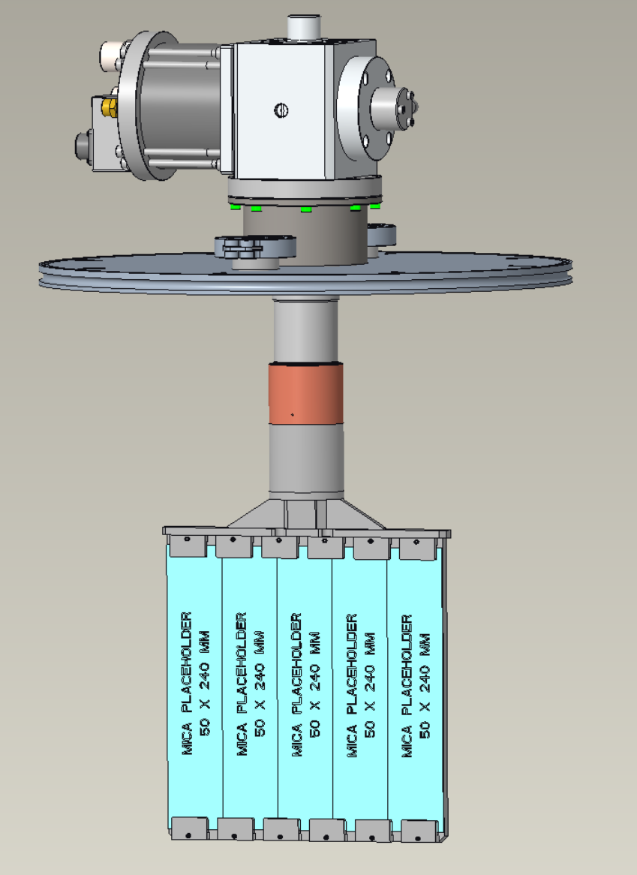
MTS Analyzer Arrays
Mica Permanent frame
Mica will be cooled to 80 degrees Kelvin
Symmetric Crystal (Mica) Analyzer Array
Asymmetric Crystal (Copper) Analyzer Array
(Future upgrade)

Slide 18
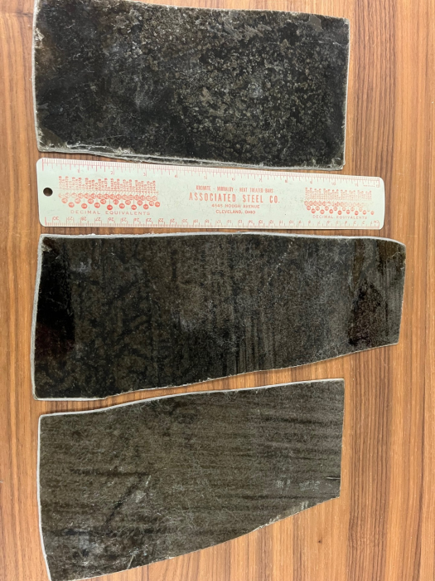
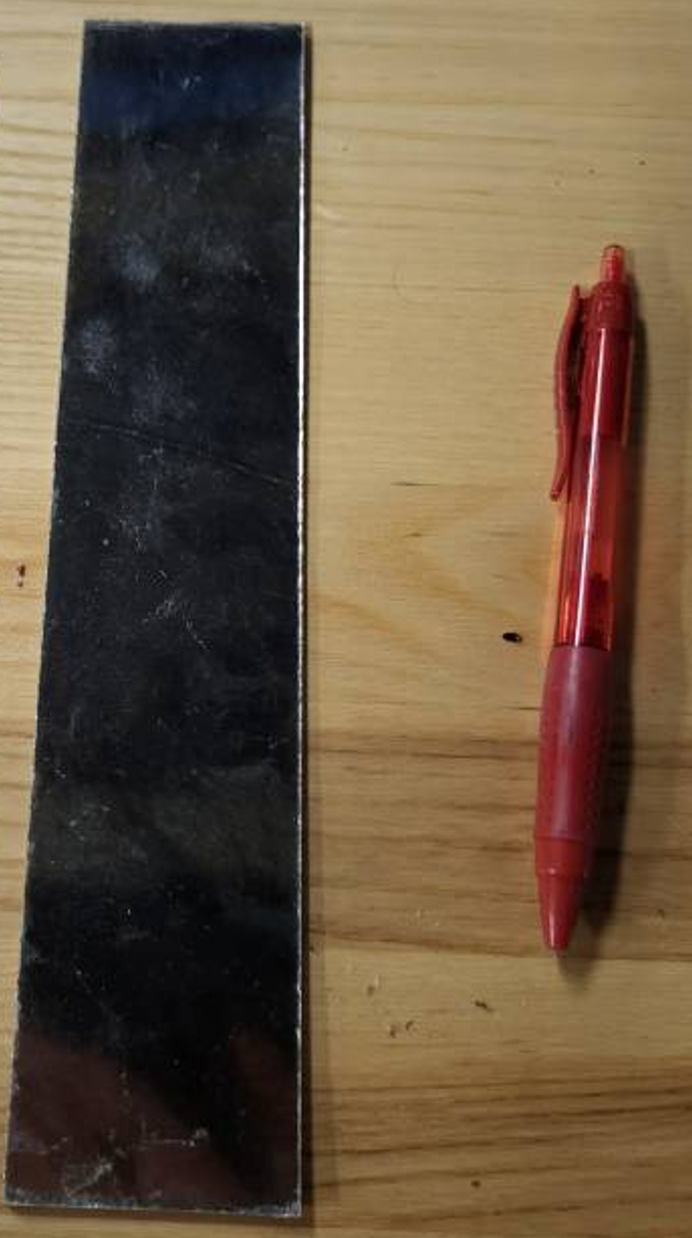
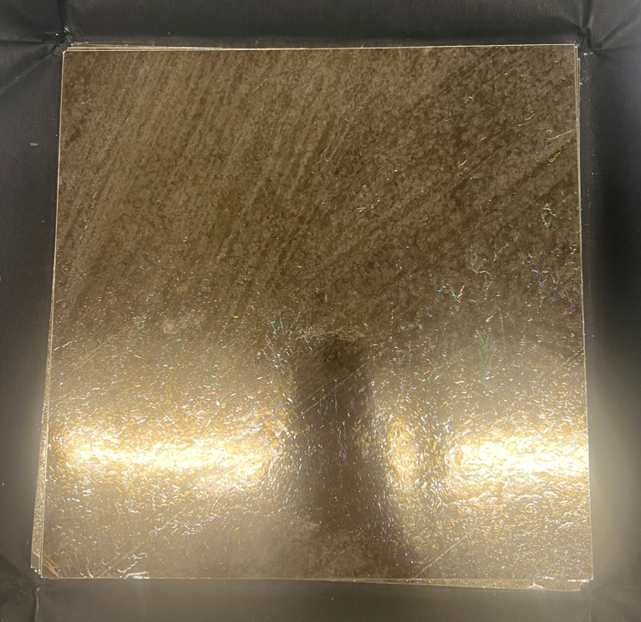
MTS Mica Analyzer
Mica procured from three vendors
Natural phlogopite
Compared to fluorophlogopite, phlogopite has significantly larger mosaic and reflectivity
Asheville Mica Energy Solutions
Mica size: 242 mm x
(varies from 102mm to 127mm)
SPI Supplies
Mica size: 240 mm x 50 mm
USA Mica
Mica size: 240 mm x 240 mm

Slide 19
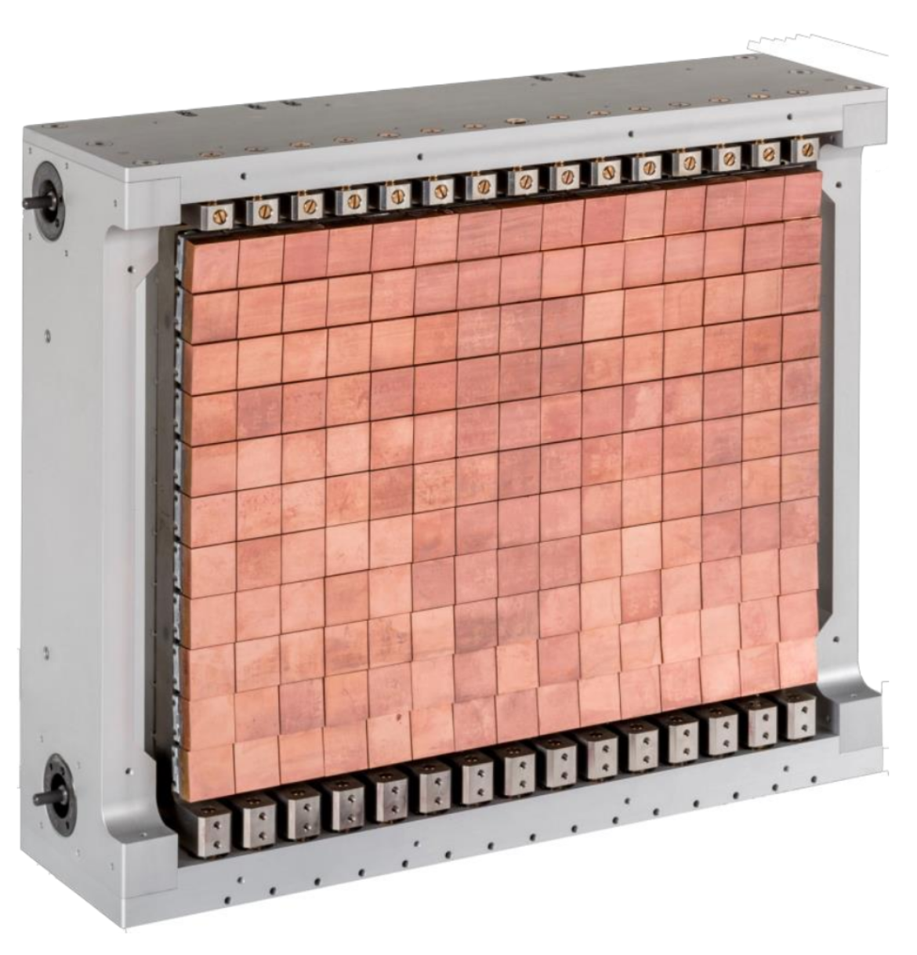
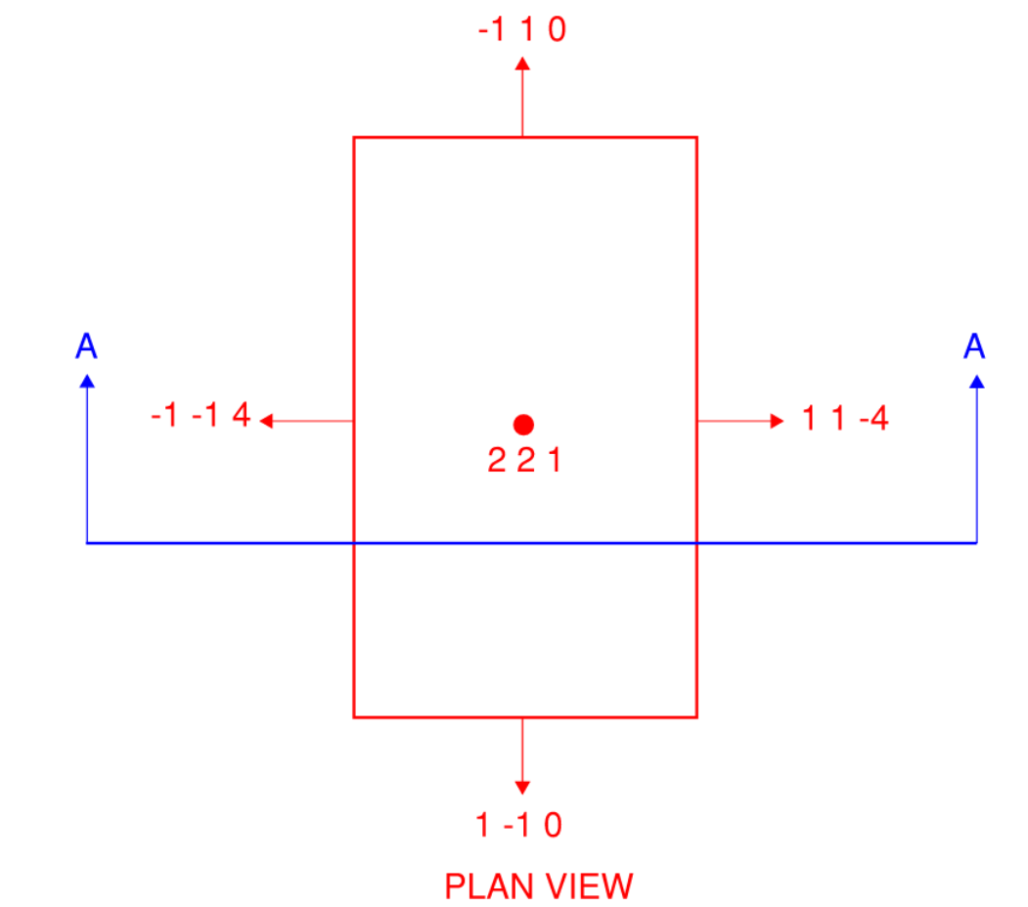
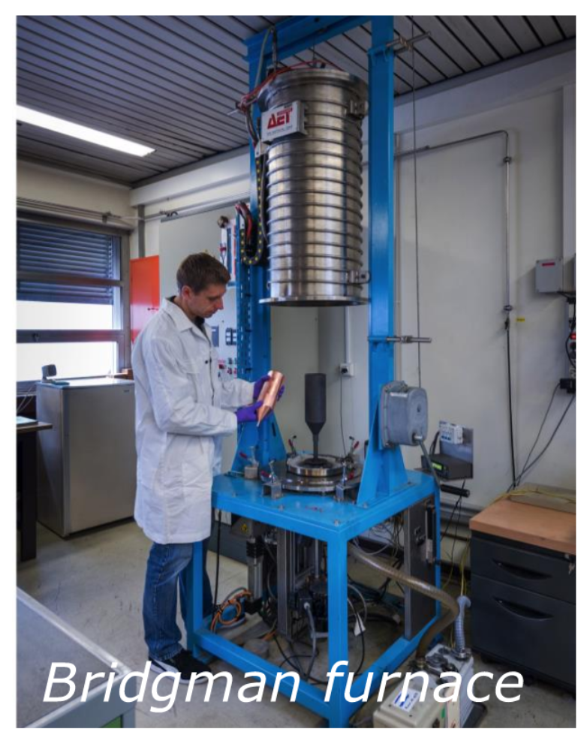
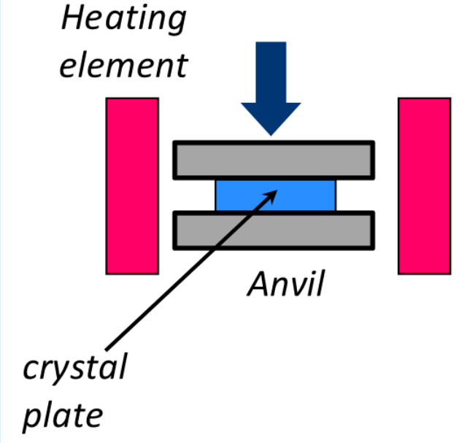
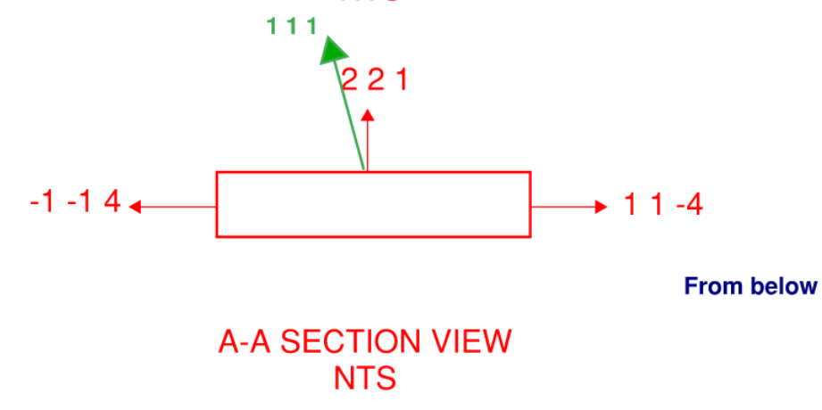
MTS Copper Analyzer (Upgrade)
Photos from Institut Laue-Langevin
On hold due to time / development needed to produce crystals
Anticipate 50 mm by 50 mm by 2 mm 221 oriented copper with 2 degree mosaic

Slide 20
MTS Operational Plans
The MTS will operate for as much as 20 – 25 weeks per year, typically in one- or two-week periods, for system development and moderator testing
The MTS Science Case (ORNL/TM-2024/3583) outlines twelve different moderator concepts and an array of new materials for testing once operational – we will have ample tests to fill the time
Operation of the MTS will require the beam from the BTF. We do not anticipate operating “both” at the same time, but we do anticipate having access to either while the other is running
Running MTS will typically involve much more production level beam than BTF usually uses for accelerator physics and operations studies – 60 Hz continuous operation for several days at a time, totaling as much as 20 to 25 weeks per year
There will be local control, but most accelerator control will be from the Central Control Room
Local and CCR control for the neutron beamline and gas handling system

Slide 21
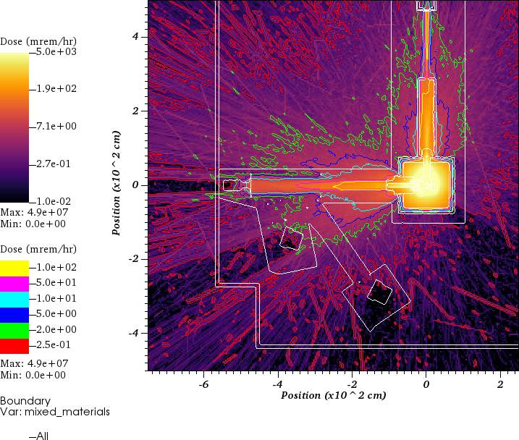
MTS Radiation Safety
Shielding analysis performed on CAD geometry converted to MCNP using GEOUNED and GeomWriter
The current shielding layout limits dose rates outside the fence to less than 2 mrem/hour except for some streaming around the in-beam detector, which will be blocked by the beamstop (not included in this particular calculation)
Dose rates near the neutron beamline and the proton beamline will approach 10 mrem/hour, well within guidelines for the posted radiation area, but will generally not be accessed during operation
BTF FODO line will be under 2 mrem/hour

Slide 22
Summary
The SNS Moderator Test Station will permit characterization of a wide variety of moderator materials and concepts, in a prototypical wing configuration, supporting FTS improvements, the STS concept, and new moderator development
Along the way we'll develop a capability to explore and characterize advanced moderator configurations that exceeds any facility currently available
Targeted optimization will let us improve the measurement time to characterize a moderator at LENS with two orders of magnitude lower primary source intensity (and even lower shielding requirements)
Improved characterization concepts will let us do so over a larger energy range, with more certain and better understood instrument characteristics

