Slide 1


Preliminary neutronic design of the ECHIR beamline at ESS
M. Myllymäki, R. Brenner, E. Brücken, A. Chambon, V. Darakchieva, C. Darve, C.-J. Englund, W. Englund, S. Ghatnekar Nilsson, T. Hildén, M. Jacewicz, P. Kinhult, L.Zanini
ICANS XXV 13-17 April 2026, Malmö, Sweden

Slide 2
Outline
Introduction and motivation
ESS and ECHIR (ESS Chip Irradiation facility) concept
ECHIR design
Preliminary neutronic calculations with MCNP6
Results
Summary

Slide 3
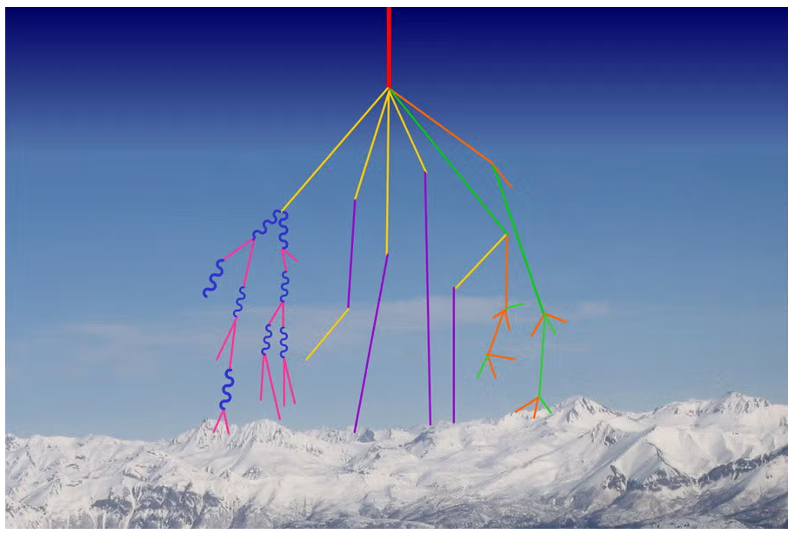
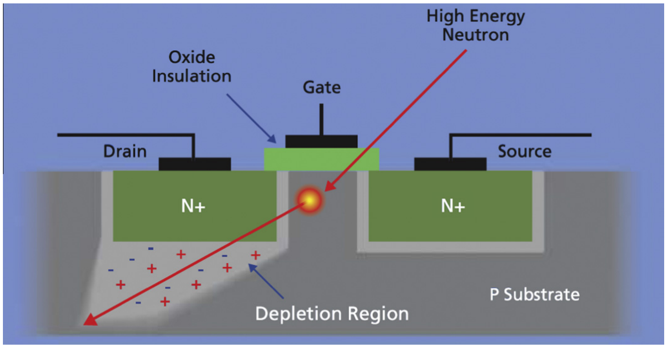
Motivation
Electronics used in sectors such as automotive, aviation, and space industries must be qualified against radiation-induced failures
High-energy atmospheric neutrons may cause radiation-induced degradation (e.g. Single Event Effects (SEE) and displacement damage)
  Potential for severe malfunctions, data corruption, and structural damage
The rate of radiation-induced effects in natural environment is low → accelerated neutron testing is necessary
Currently, ChipIr at ISIS is the only facility in Europe able to provide a suitable energy spectrum for Cosmic Ray (CR) Robustness testing
Top: UCAR Center for Science Education (Gordon & Russell)
Bottom: L. Ciani & M. Catelani, A fault tolerant architecture to avoid the effects of Single Event Upset (SEU) in avionics applications, Measurement 54:256-263, 2014

Slide 4
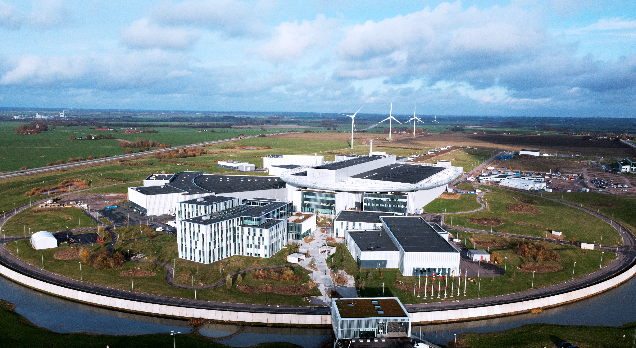
European Spallation Source (ESS) in Lund, Sweden
Neutron production by spallation of 2 GeV protons on tungsten target
Designed operation at 5 MW average beam power
The high-flux and high-energy neutron field provides an ideal environment for CR robustness testing
Image: Mickael Tannus/ESS

Slide 5
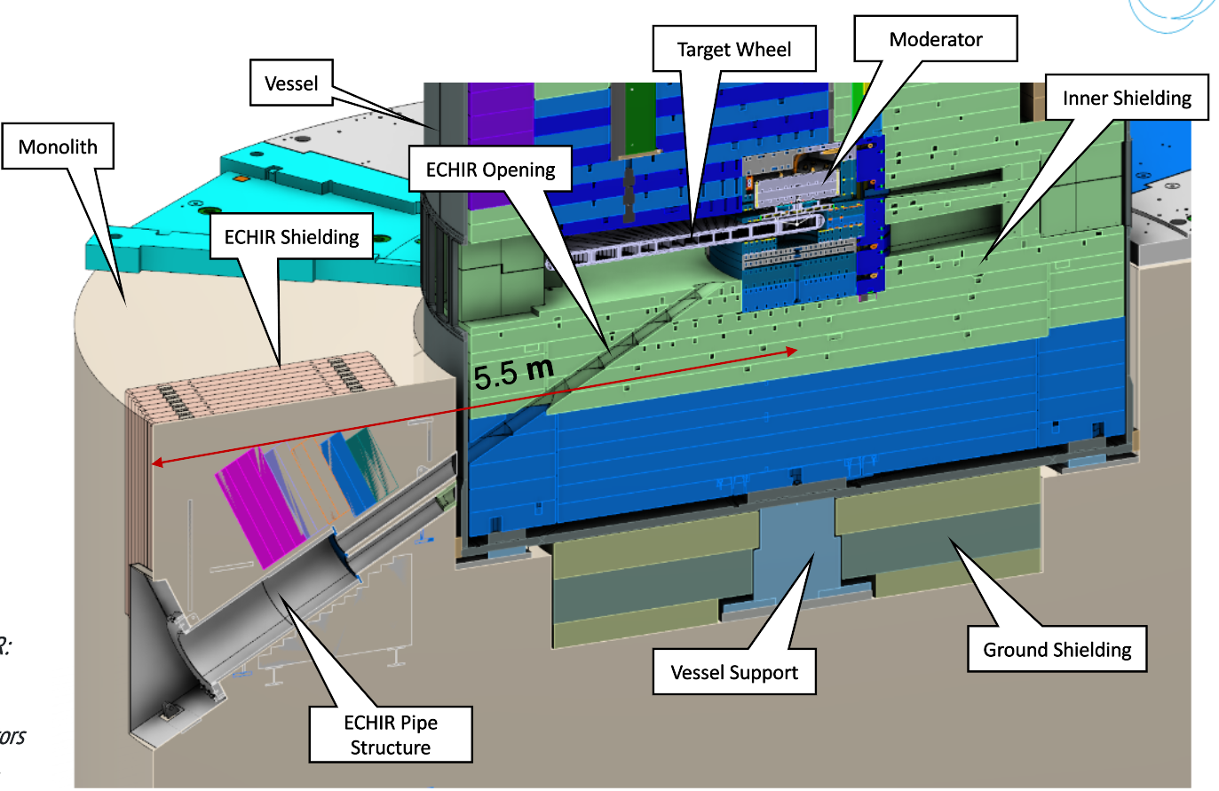
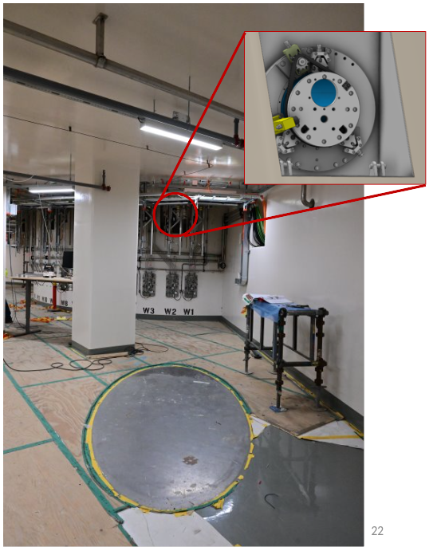
ESS Chip Irradiation facility - ECHIR
The ECHIR beamline has been proposed at ESS for CR testing
  Fast neutron channel and revolver-type shutter already in place
The beamline is in the forward direction w.r.t the proton beam, and tilted 30° downward from the horizontal → this geometry provides the optimal neutron spectrum
Once constructed, ECHIR would be able to deliver atmospheric-like neutron spectrum up to ~1 GeV, reaching a flux of 4.3·10⁷ n/cm²/s (E > 10 MeV) at the sample position

Slide 6
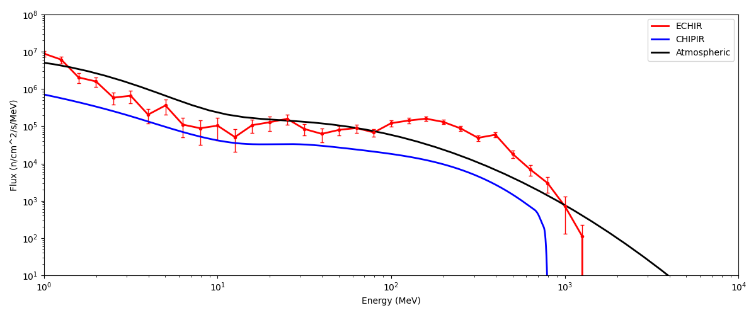
Expected performance of ECHIR
Atmospheric spectrum superimposed and aligned with ECHIR
Expected neutron flux above 10 MeV approximately 10 times higher at the sample position compared to ChipIr

Slide 7
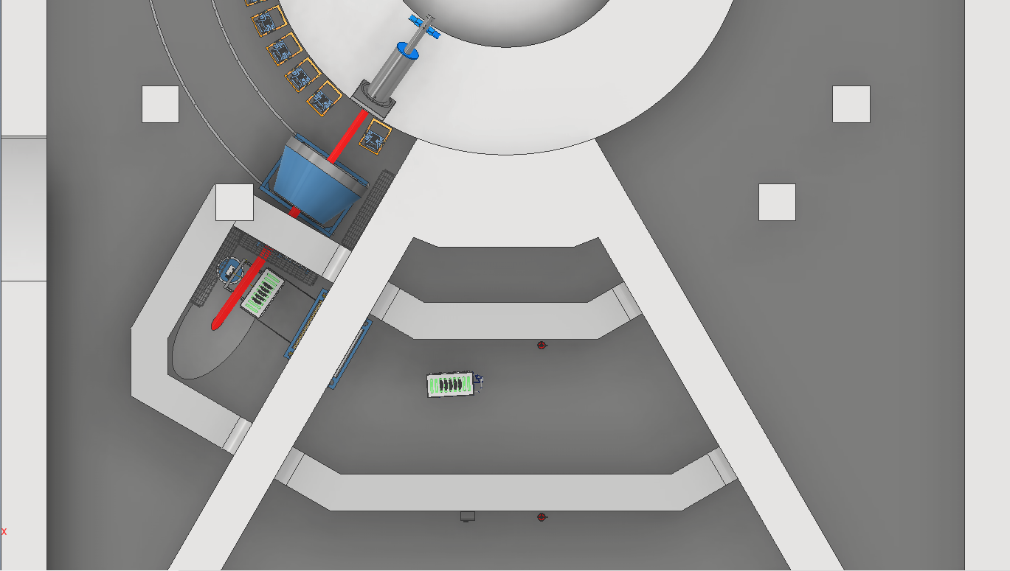
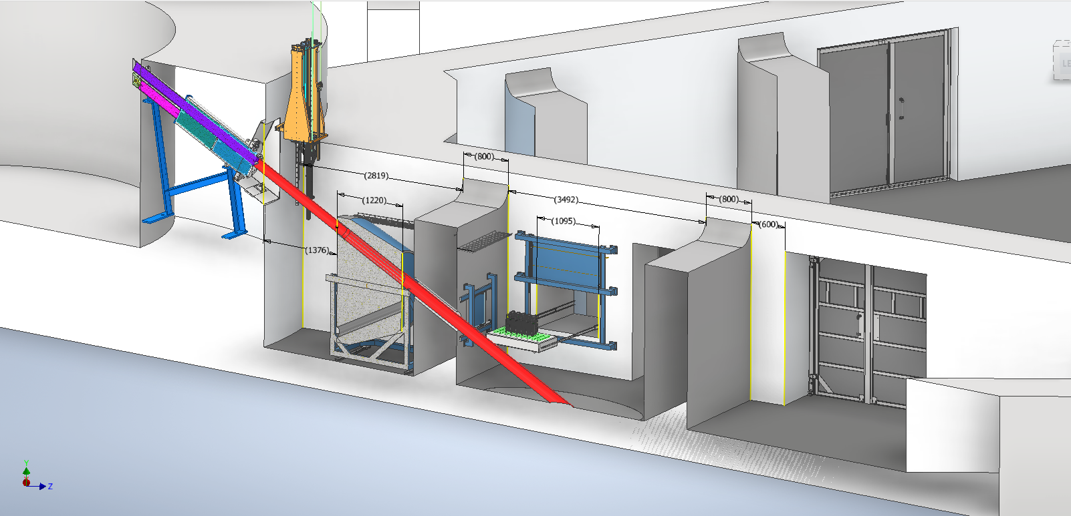
Proposed ECHIR design
Collimation room
Neutron beam is collimated with rotating stainless steel collimation wheel
  Apertures from 5 cm to 20 cm, and fully closed position
ECHIR room
Control room
Samples for testing can be directly installed in the room in safe conditions, or using a remote-handling system
Neutron path
(red line)

Slide 8
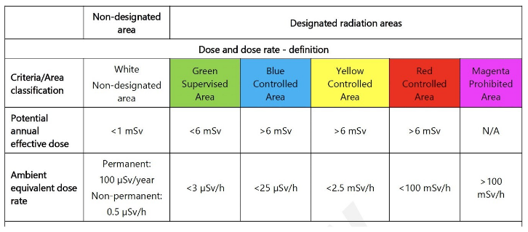
ESS radiation area classifications
Regular instruments at ESS are classified as “green” supervised area, with a dose rate below 3 µSv/h
Preliminary shielding studies have been performed with Monte Carlo simulations
  The goal is to find a shielding configuration that would reduce the dose rate to acceptable level
Collimation room
ECHIR room
Control room

Slide 9
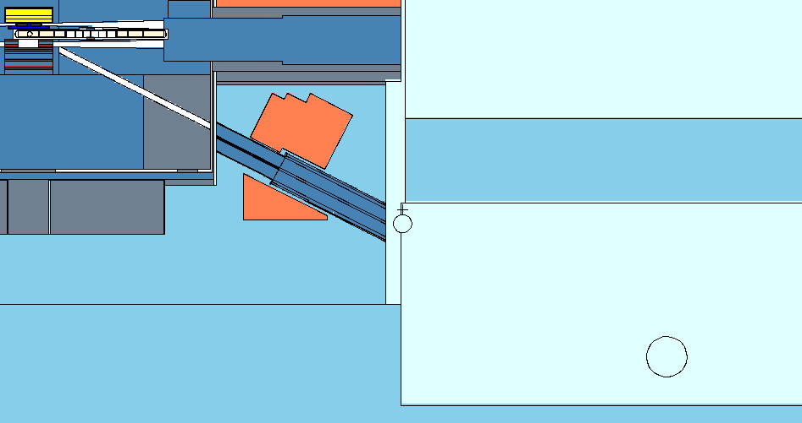
Computational methods: MCNP6.3
Neutronic calculations were performed with Monte Carlo N-Particle transport code (MCNP6.3)
Simulation models 2 GeV protons on tungsten target
  Generated spallation neutron field is transported through the whole beamline geometry
F4-tally and TMESH mesh tally used for dose rate calculations
All results have been normalized by proton current corresponding to 5 MW beam power
MCNP model by A. Takibayev
A.
B.
C.
Target and moderator
Revolver-shutter (closed with stainless steel)
(Empty/unmodified) ECHIR room

Slide 10
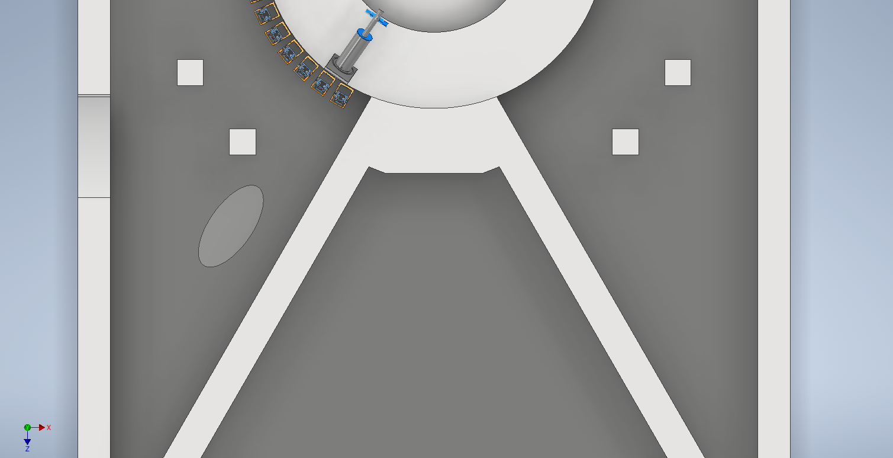
Starting point: empty ECHIR room
 | Dose rate at pos. 1 [mSv/h] | Dose rate at pos. 2 [mSv/h]
Revolver-shutter closed | 3.03 ± 0.38 | 0.34 ± 0.04
Revolver-shutter open | (464 ± 19)·10³ | (99 ± 4)·10³
1.
2.
Dose rate with the neutron path closed is ~1000x too high for green level!

Slide 11
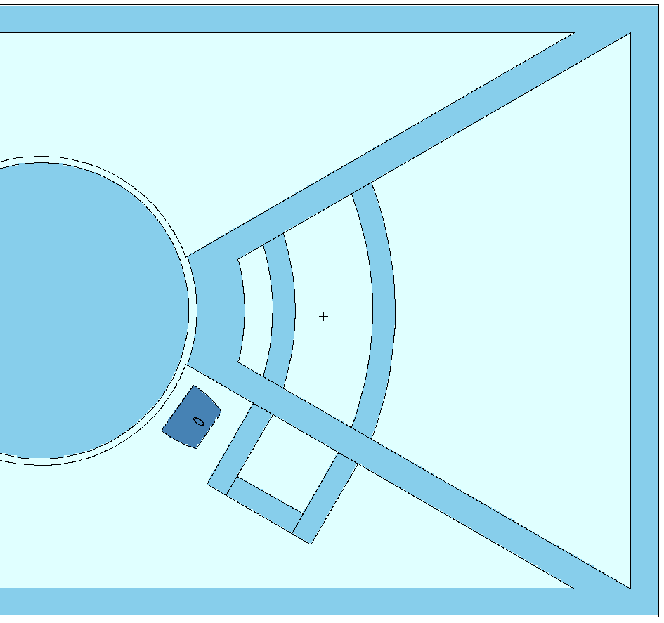
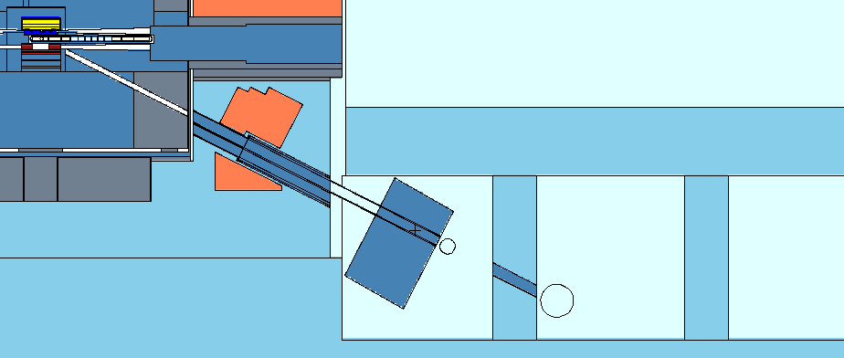
Simulation geometry: ECHIR beamline
Dose rate tallied at four key locations:
Collimation room (exit of the collimator)
ECHIR room (sample position)
Control room
Outside of control room
Control room
Collimation room
3.
4.
1.
2.
ECHIR room
stainless steel
collimator
stainless steel
plug
concrete walls
stainless steel
plug (revolver-shutter closed)
1.
2.

Slide 12
Materials and shielding geometry
Air
Concrete
Stainless steel
Shielding materials used
  Stainless steel (SS316L) (ρ = 7.85 g/cm³)
  Regular concrete (ρ = 2.35 g/cm³)
  Heavy concrete (with MagnaDense) (ρ = 3.8 g/cm³)
Walls marked as ‘X’ or ‘X’ either regular or heavy concrete in the calculations
  All other walls are regular concrete
Walls marked as ‘X’ can additionally be either 80 cm or 120 cm thick
Revolver-shutter closed with stainless steel and collimator in closed position
X
3.
X
4.
1.
2.
X
1.
2.

Slide 13
Impact of the wall material and thickness to the dose rate
Material and thickness | Pos. 2 [µSv/h] (ECHIR room) | Pos. 3 [µSv/h] (Control room) | Pos. 4 [µSv/h]
Regular concrete, 80 cm wall | 19.6 ± 2.5 | 22.8 ± 2.7 | 2.9 ± 0.5
Regular concrete, 120 cm wall | 7.3 ± 0.7 | 9.2 ± 1.6 | 0.8 ± 0.3
Heavy concrete, 80 cm wall | 8.7 ± 0.9 | 11.2 ± 1.8 | 1.2 ± 0.3
Heavy concrete, 120 cm wall | 2.3 ± 0.2 | 5.0 ± 0.8 | 0.3 ± 0.09
X
3.
X
4.
2.
X
Maximum dose rate reduction is achieved with 120 cm of heavy concrete
More shielding needed for the control room to bring dose rate to the green level

Slide 14
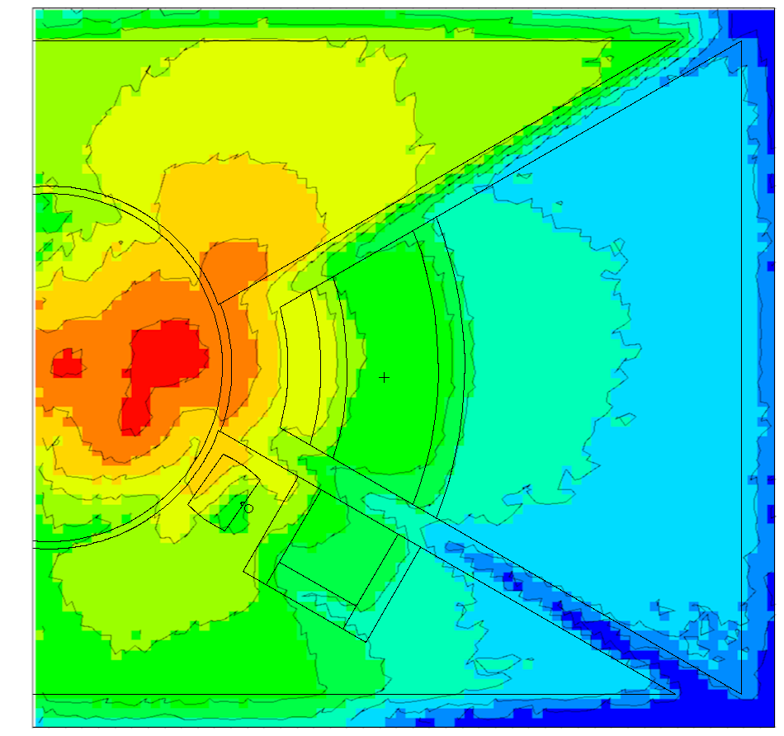
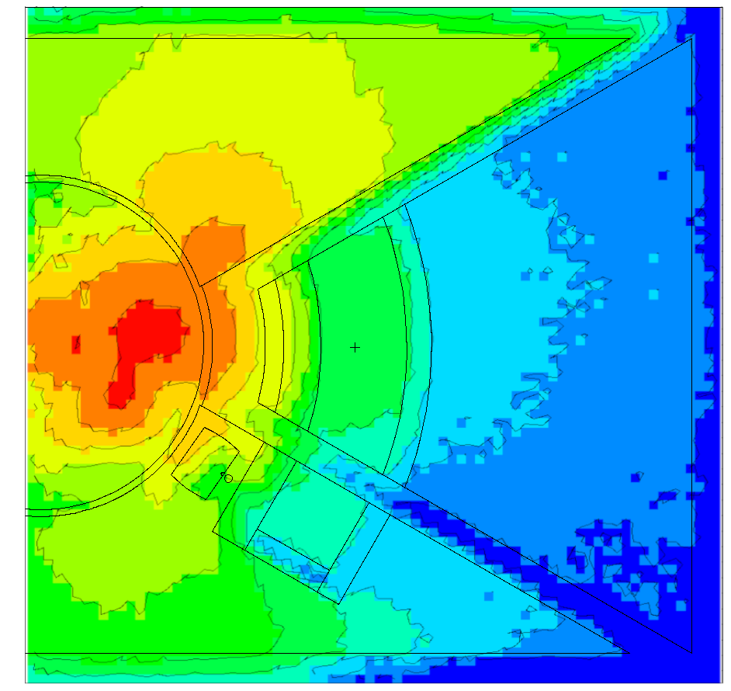
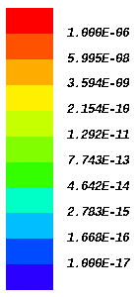
Dose rate maps: the “worst” vs “best” configuration
regular concrete, 80cm walls
µSv/h
heavy concrete, 120cm walls
1.6∙10⁴
4.3∙10³
1.2∙10³
340
94
26
7.2
2.0
0.6
0.16
X
X
3.
3.
1.
X
4.
1.
X
4.
2.
2.
X
X

Slide 15
Summary and next steps
A proposal for a new instrument, ECHIR, at ESS has been submitted
  Significant investment has already been done by ESS with installing a fast neutron channel, additional shielding and a shutter system
Preliminary neutronic calculations have been performed with MCNP6
Future work includes
  Optimizing the design: current configuration close to green level
  Activation study of the materials
  Comparison study: ECHIR in the instrument hall

Slide 16
Thank you!

Slide 17
Backup slides

Slide 18
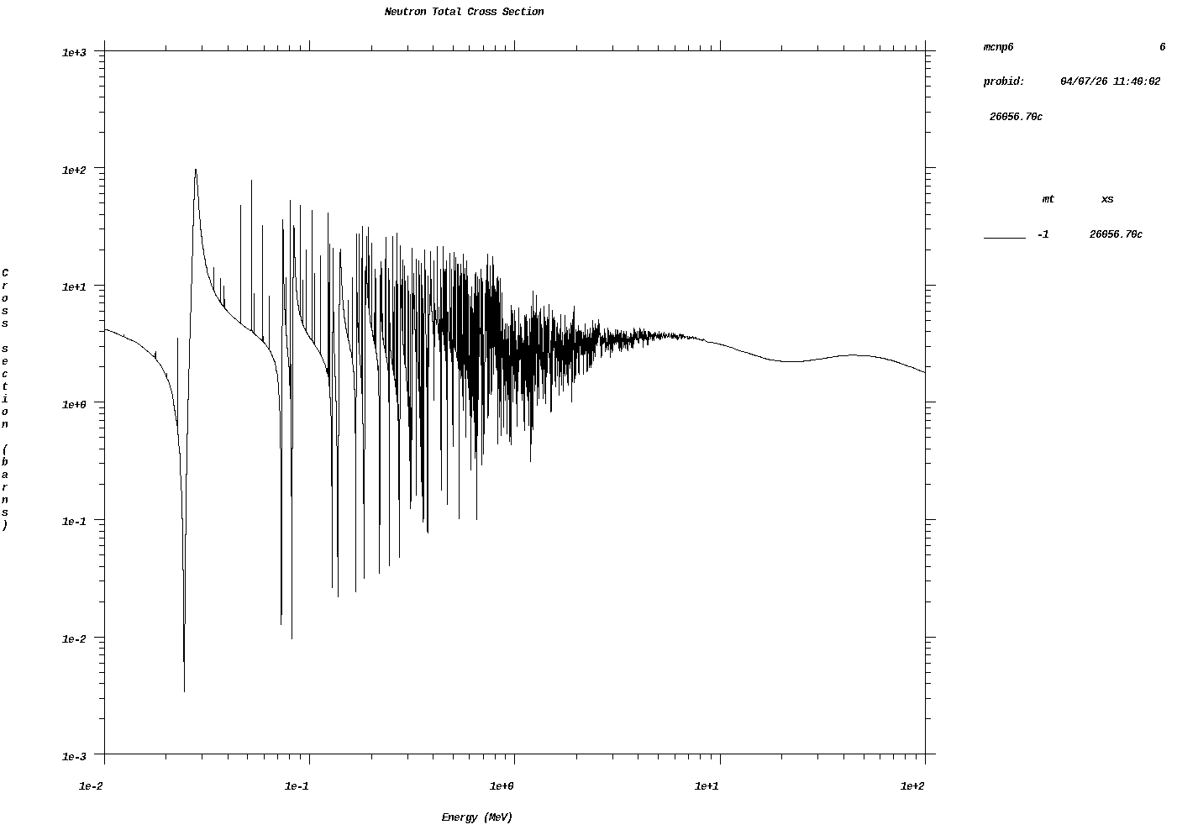
MCNP6: cross section libraries and physics models
Neutron interactions: ENDF70 (.70c)
  Based on ENDF/B-VII.0
Proton interactions: ENDF70PROT (.70h)
  Based on ENDF/B-VII.0
Thermal scattering data: ENDF70SaB
  Based on ENDF/B-VII.0
Outside the data range for the tabulated libraries (up to 150 MeV depending on the element/isotope), the default MCNP6 physics models were used (CEM03.03)

Slide 19
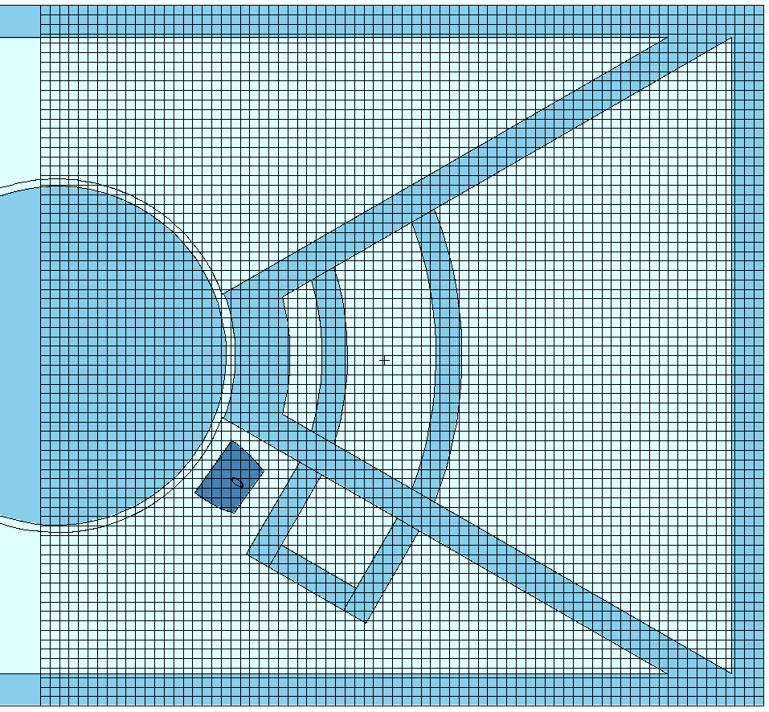
MCNP6: Dose rate tallies
A mesh tally (TMESH) was used to map the dose rates within the ECHIR beamline and surrounding areas
  30x30x30 cm³ voxels
Dose rate was additionally tallied in key locations using the average cell flux tally (type F4)
Flux-to-dose rate conversion factors derived as the maximum of the values reported in ICRP Publication 116: Conversion Coefficients for Radiological Protection Quantities for External Radiation Exposures (2010)
3.
1.
4.
2.

Slide 20
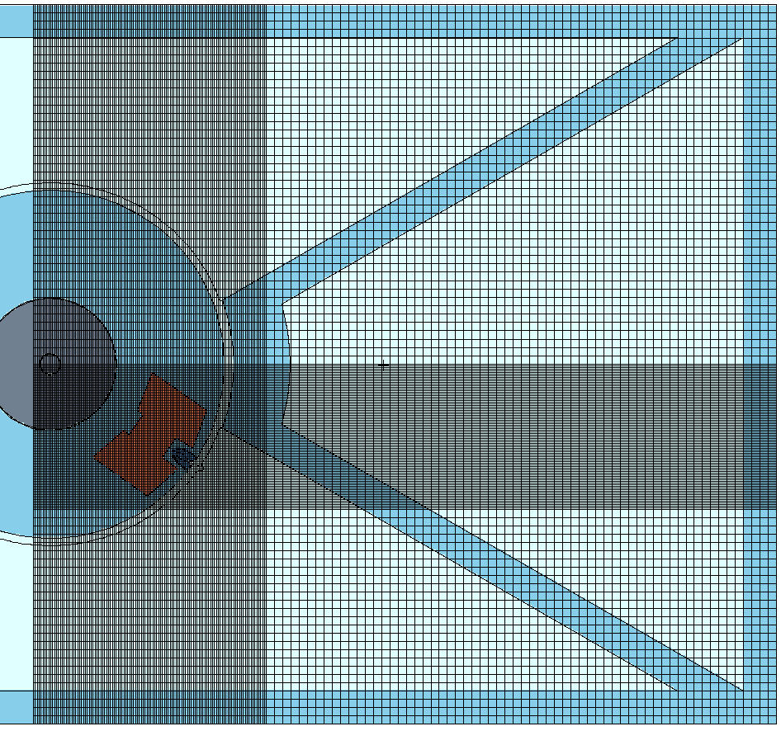
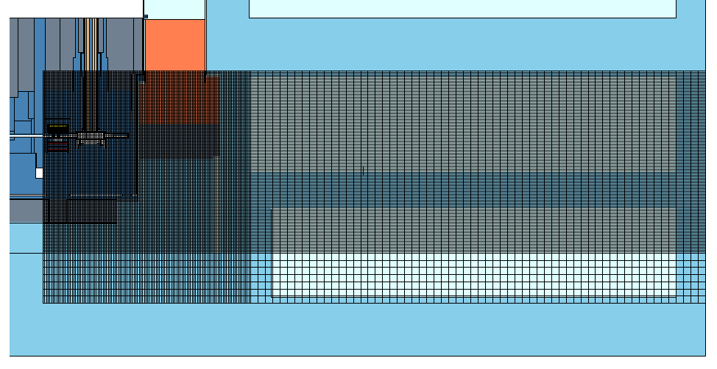
MCNP6: Variance reduction
Variance reduction needed for the simulation results to converge within reasonable timeframe
  Space and energy-dependent weight windows are used to bias particle transport towards important regions
Weight window file generated with Automated Variance Reduction Generator software (ADVANTG)
Weight window mesh covers all essential rooms in the geometry
Adaptive voxel size
  5x5x5 cm³ voxels capture small-scale geometric features
  Larger voxel size in low-complexity regions to optimize memory usage

Slide 21
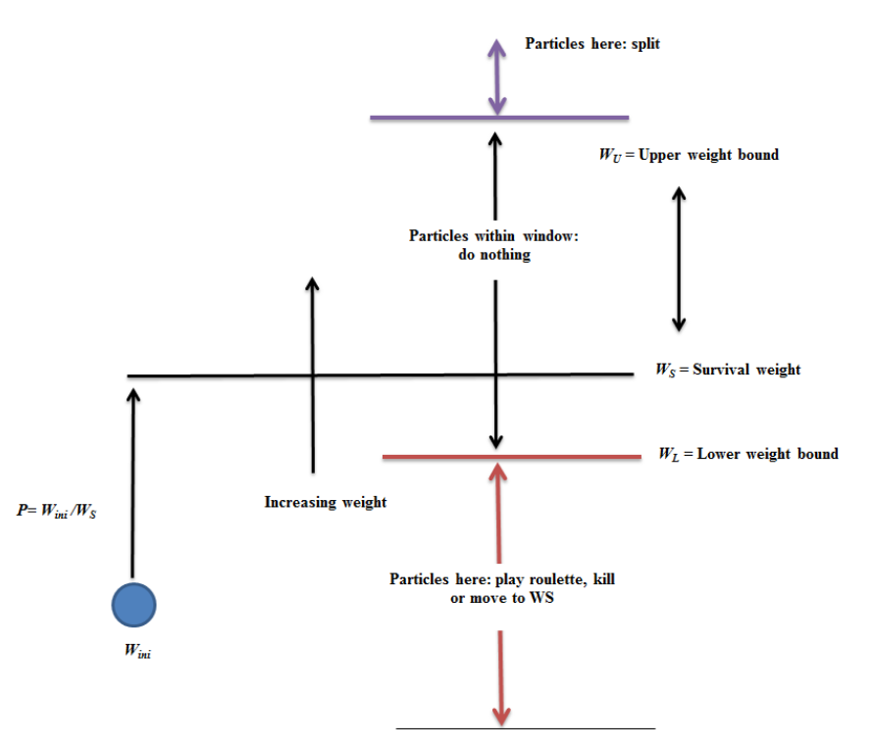
Variance reduction: Weight window technique
Combines splitting and Russian roulette
  If a particle weight above window, the particle is split so that all particles are within the window → population of particles in important regions is increased, giving more statistics
  If a particle weight below window, the particle is either terminated or its weight is increased → computational time is saved by terminating particles in regions of less interest
Saidi, Pooneh & Sadeghi, Mahdi & Tenreiro, Claudio. (2013). Variance Reduction of Monte Carlo Simulation in Nuclear Engineering Field. 10.5772/53384.

Slide 22
MCNP6: regular vs heavy concrete
 | Regular concrete | Heavy concrete
Iron (Fe) | 1.8% | 26.5%
Hydrogen (H) | 7.6% | 13.4%
Oxygen (O) | 54.6% | 53.0%
Silicon (Si) | 10.2% | 4.2%
Calcium (C) | 22.3% | 1.2%
Density [g/cm³] | 2.35 | 3.8

