Slide 1
The FINESSE and the NNBAR program at the ESS
Valentina Santoro, Lund University
on behalf of the FINESSE*/NNBAR Collaboration
FINESSE* evolution of the HIBEAM beamline concept

Slide 2
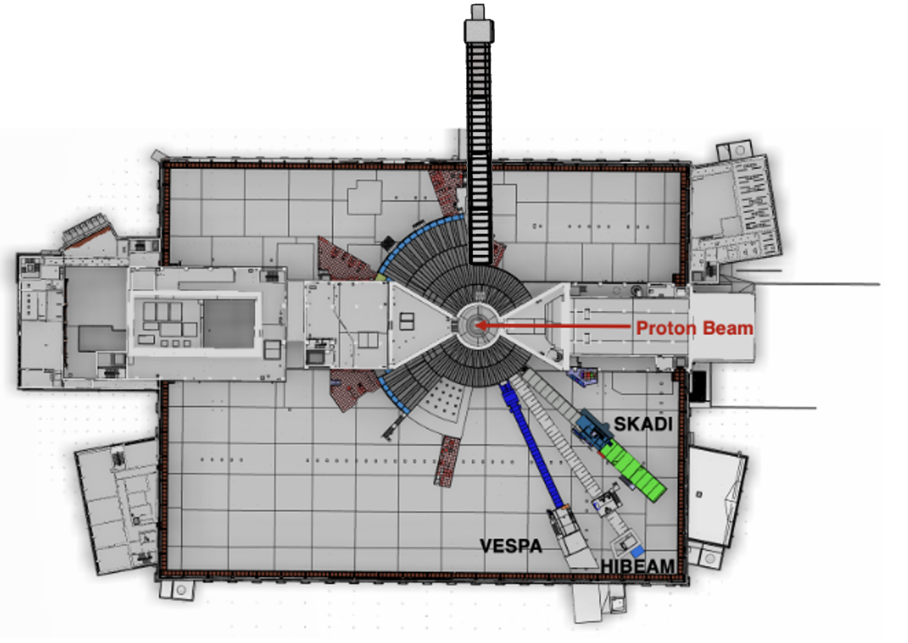
The FINESS/NNBAR program
The FINESSE/NNBAR program is a two-stage program for particle physics at ESS
FINESSE

Slide 3
The FINESS/NNBAR program
The FINESSE/NNBAR program is a two-stage program for particle physics at ESS
FINESSE
FINESSE : ESS fundamental physics beamline

Slide 4
The FINESS/NNBAR program
The FINESSE/NNBAR program is a two-stage program for particle physics at ESS
NNBAR Experiment (>2035): search for n→n̅ oscillations (sensitivity increase of 10³ compared to previous experiments )
FINESSE
FINESSE : ESS fundamental physics beamline

Slide 5
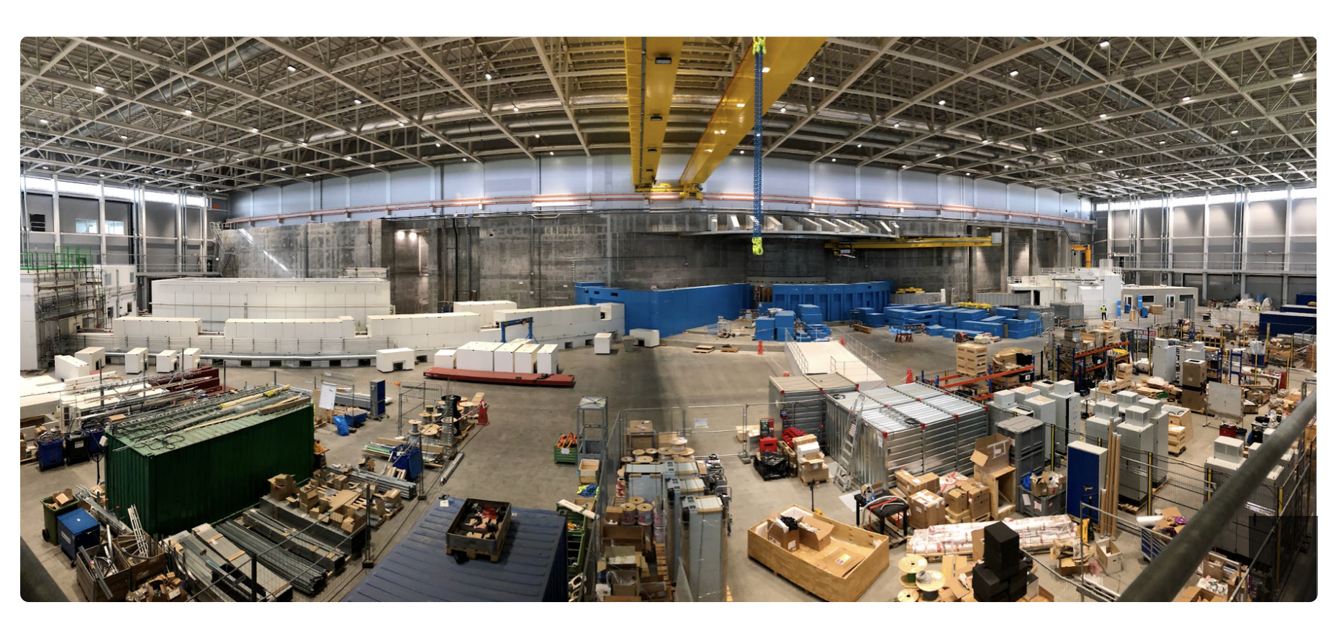
The ESS and future instruments
The ESS is currently constructing 15 scientific instruments
Each instrument is designed to deliver neutron beams for a wide range of experiments across materials science, physics, chemistry, and engineering
Particle physics has been identified as a missing component

Slide 6
The ESS and future instruments
The ESS is currently constructing 15 scientific instruments
Each instrument is designed to deliver neutron beams for a wide range of experiments across materials science, physics, chemistry, and engineering
Particle physics has been identified as a missing component
The ESS has opened a call for new instruments (closed on March 27)
If the proposal is successful, ESS will provide support for the further development of the beamline, including engineering resources.
At a later stage, the instrument could be considered for full construction funding.

Slide 7
The FINESSE Beamline
FINESSE is A Versatile Beamline for Fundamental Interactions with Neutrons at the European Spallation SourcE)
It is a beamline dedicated to particle physics research
It is an Evolution of HIBEAM concept → Extends and generalises the original HIBEAM concept into a unified facility
V Santoro et al 2025 J. Phys. G: Nucl. Part. Phys. 52 040501

Slide 8
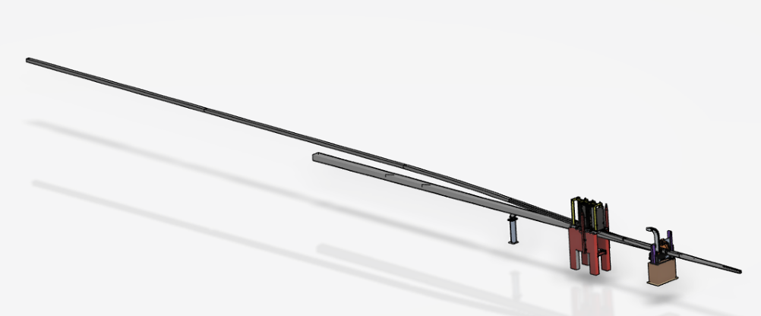
The FINESSE Beamline
FINESSE is A Versatile Beamline for Fundamental Interactions with Neutrons at the European Spallation SourcE)
It is a beamline dedicated to particle physics research
It is an Evolution of HIBEAM concept → Extends and generalises the original HIBEAM concept into a unified facility
V Santoro et al 2025 J. Phys. G: Nucl. Part. Phys. 52 040501
Dual-mode concept (unique feature): the beamline could be run in high-flux mode or low background mode
Exchangeable guide system → Switch between configurations within a single instrument
Low-background
High-flux

Slide 9
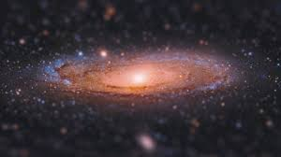
The Science of the FINESSE program
Particle physics is the science seeks to understand the basic principles and interactions that determine how the Universe works, from elementary particles to the largest cosmic structures
Some of the questions that FINESSE is trying to answer are:
Why does the Universe contain matter? After the Big Bang, matter and antimatter should have existed in equal amounts. Yet today the Universe is made almost entirely of matter. Do neutrons sometimes transform into antimatter?
What is dark matter? The unknown component making up ~85% of matter in the Universe

Slide 10
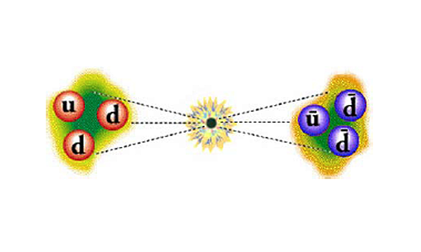
The Science of the FINESSE program
Particle physics is the science seeks to understand the basic principles and interactions that determine how the Universe works, from elementary particles to the largest cosmic structures
Some of the questions that FINESSE is trying to answer are:
Why does the Universe contain matter? After the Big Bang, matter and antimatter should have existed in equal amounts. Yet today the Universe is made almost entirely of matter. Do neutrons sometimes transform into antimatter?
What is dark matter? The unknown component making up ~85% of matter in the Universe
$$n→\overline{n}$$

Slide 11
The Science of the FINESSE program
Particle physics is the science seeks to understand the basic principles and interactions that determine how the Universe works, from elementary particles to the largest cosmic structures
Some of the questions that FINESSE is trying to answer are:
Why does the Universe contain matter? After the Big Bang, matter and antimatter should have existed in equal amounts. Yet today the Universe is made almost entirely of matter. Do neutrons sometimes transform into antimatter?
What is dark matter? The unknown component making up ~85% of matter in the Universe
$$n→\overline{n}$$

Slide 12
The Science of the FINESSE program
Particle physics is the science seeks to understand the basic principles and interactions that determine how the Universe works, from elementary particles to the largest cosmic structures
Some of the questions that FINESSE is trying to answer are:
Why does the Universe contain matter? After the Big Bang, matter and antimatter should have existed in equal amounts. Yet today the Universe is made almost entirely of matter. Do neutrons sometimes transform into antimatter?
What is dark matter? The unknown component making up ~85% of matter in the Universe
$$n→\overline{n}$$
ESS search complementary and competitive to search performed at CERN. The neutron is a neutral, stable, quantum probes. Extremely sensitive to tiny effects and rare processes

Slide 13
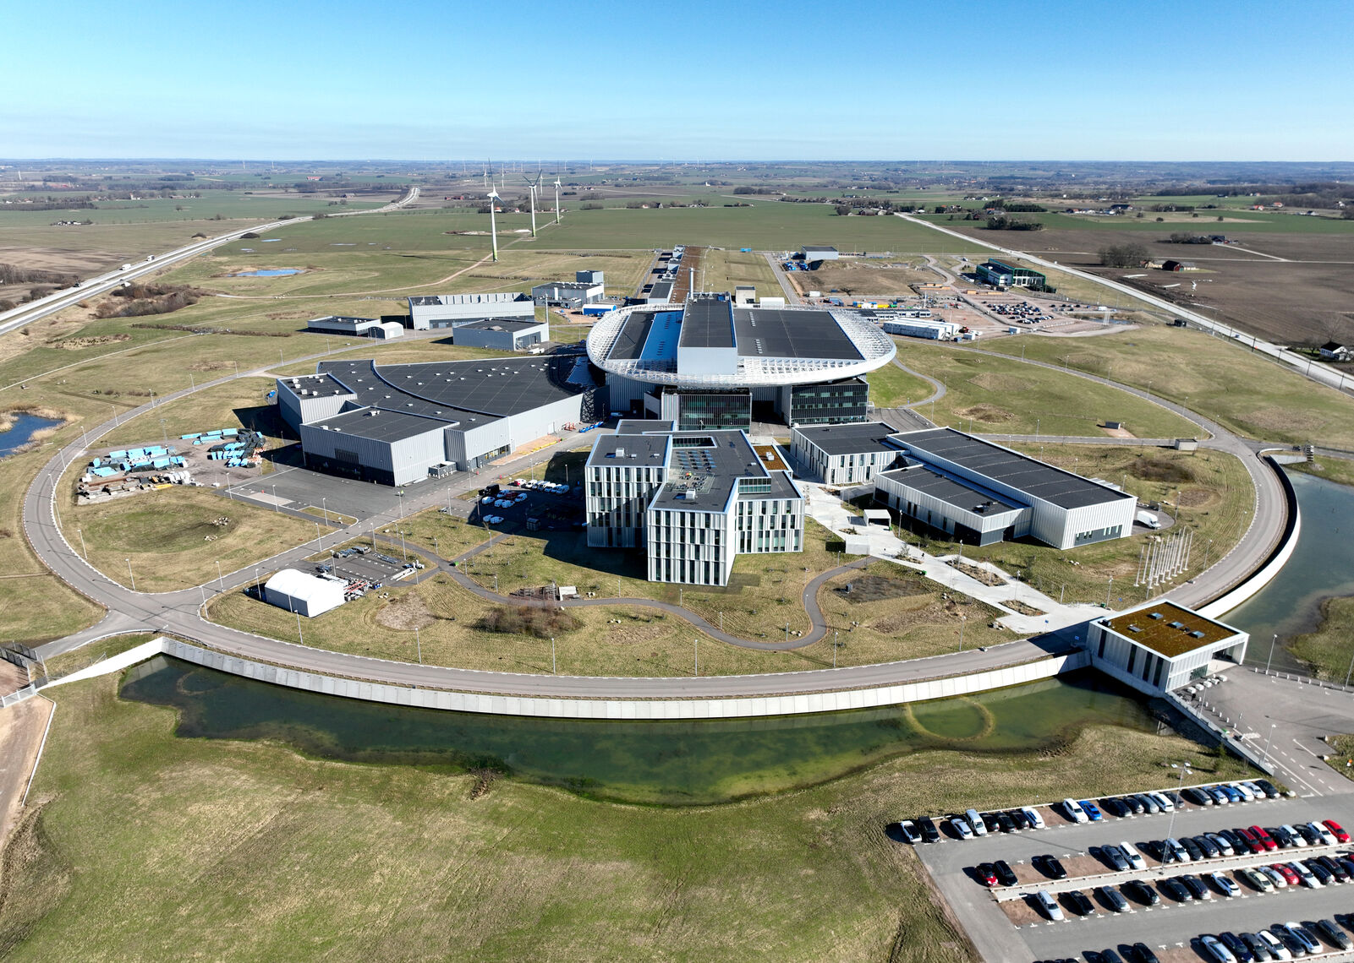
Why ESS?
The European Spallation Source will produce the most intense neutron beams in the world, making it the ideal place to search for extremely rare phenomena
Unique pulse structure
Time-of-flight information
Control of neutron energy and background
Enables precision + background rejection

Slide 14
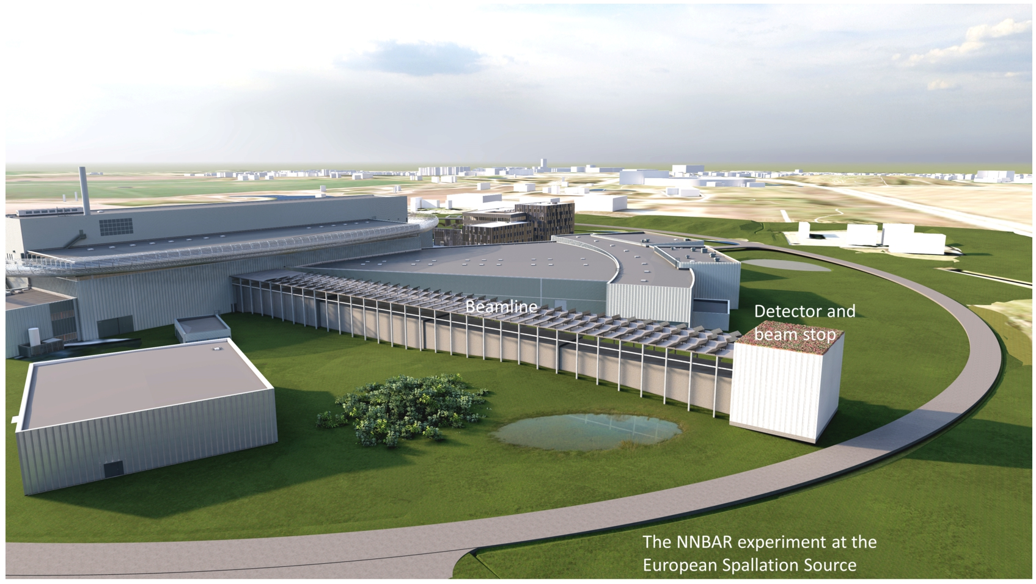
Why ESS?
The European Spallation Source will produce the most intense neutron beams in the world, making it the ideal place to search for extremely rare phenomena
Unique pulse structure
Time-of-flight information
Control of neutron energy and background
Enables precision + background rejection
Large-scale infrastructure
Long beamlines (tens of meters)
Large experimental areas
Ideal for long flight-path experiments

Slide 15
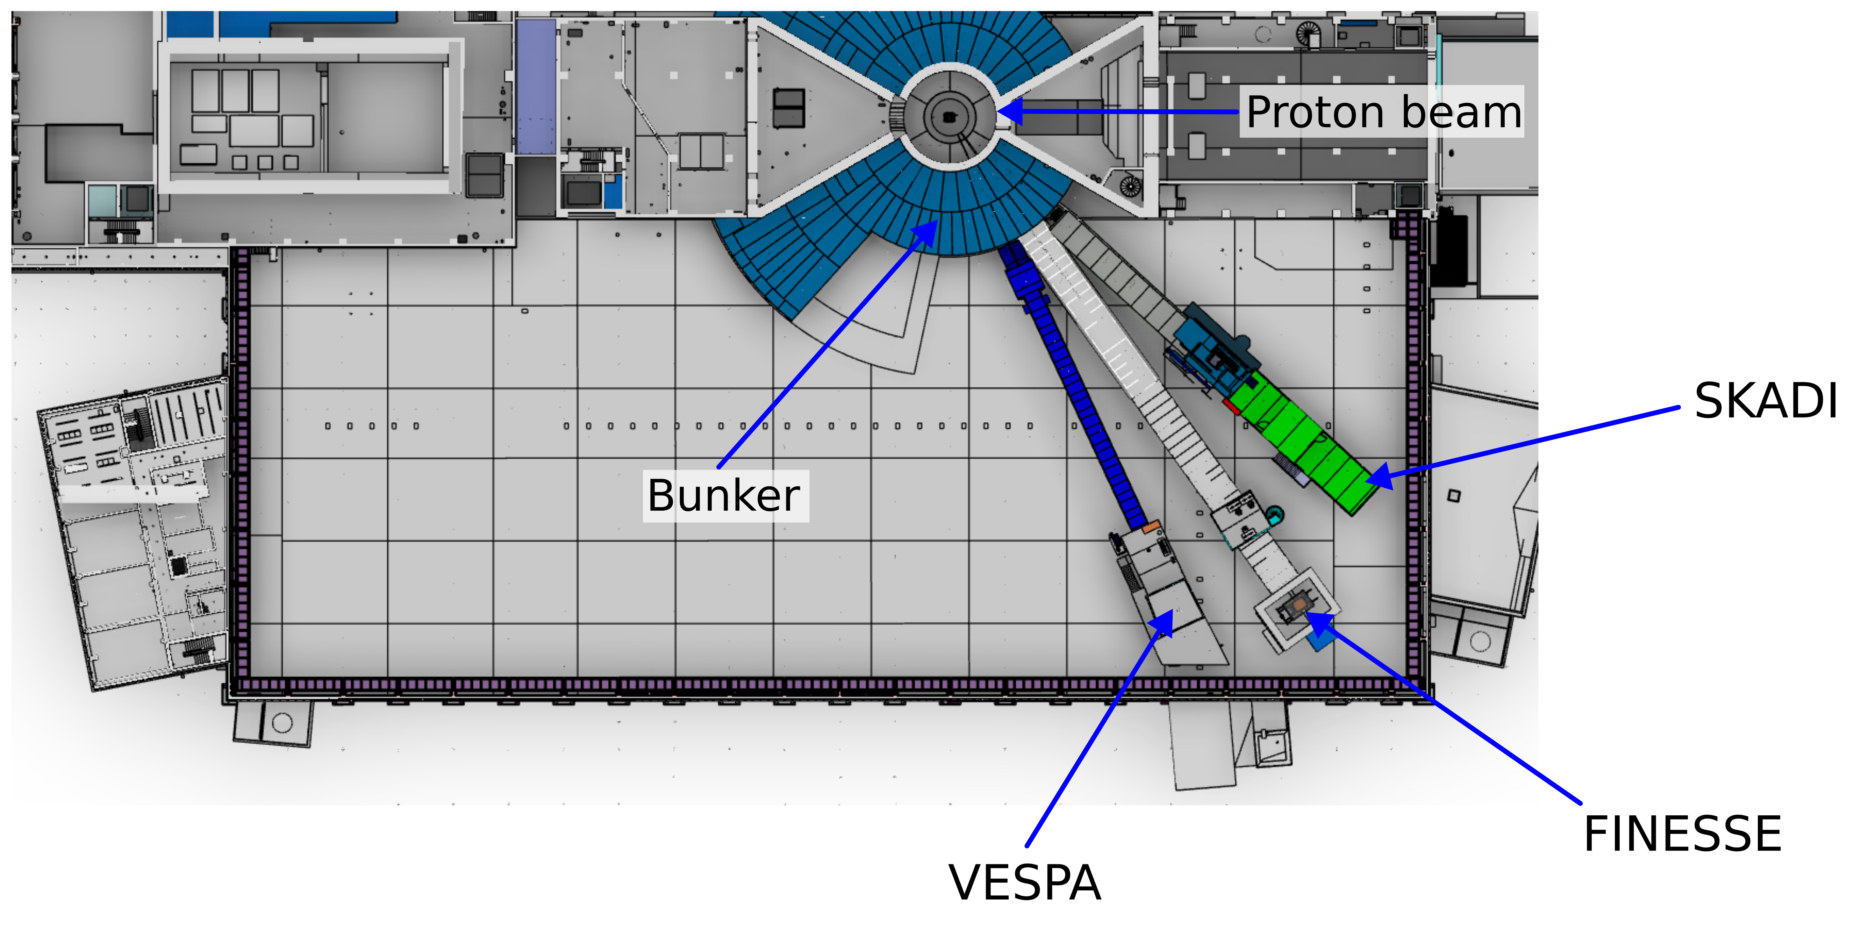
ESS Instruments Layout (I)
Proposed location of the FINESSE Beamline. ESS East Sector Beamport E5

Slide 16
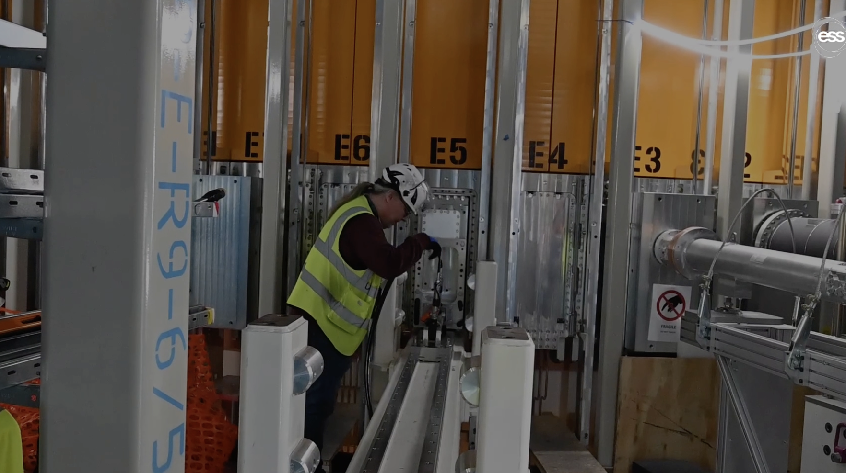
ESS Instruments Layout (II)
The E5 beam port has been opened with a monolith insert, i.e. a neutron extraction system installed last year.

Slide 17
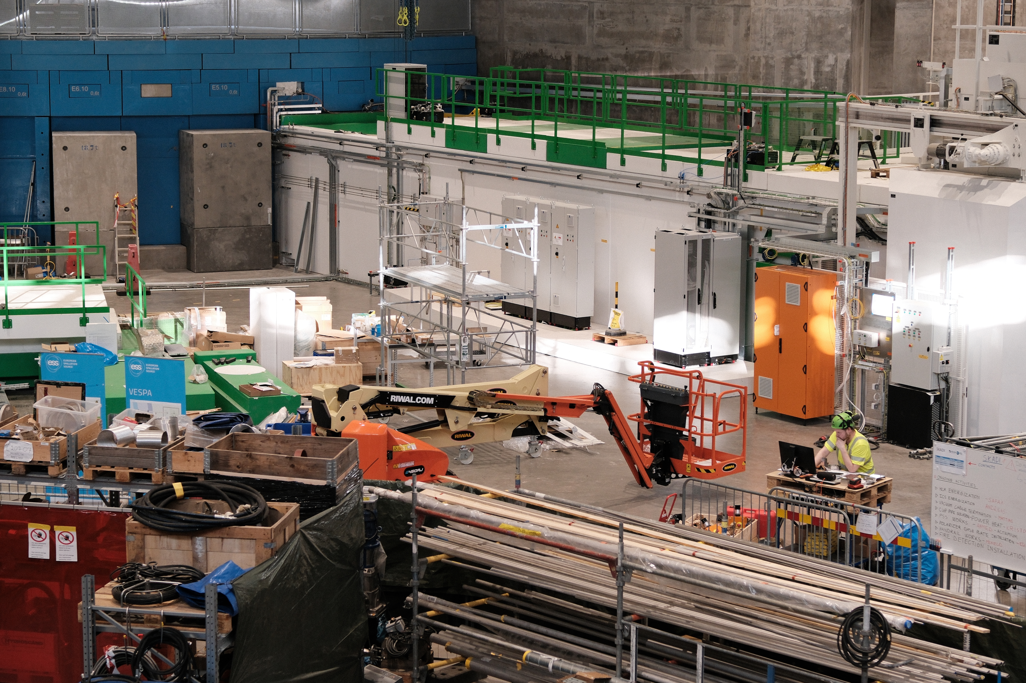
ESS Instruments Layout (II)
The E5 beam port has been opened with a monolith insert, i.e. a neutron extraction system installed last year.

Slide 18
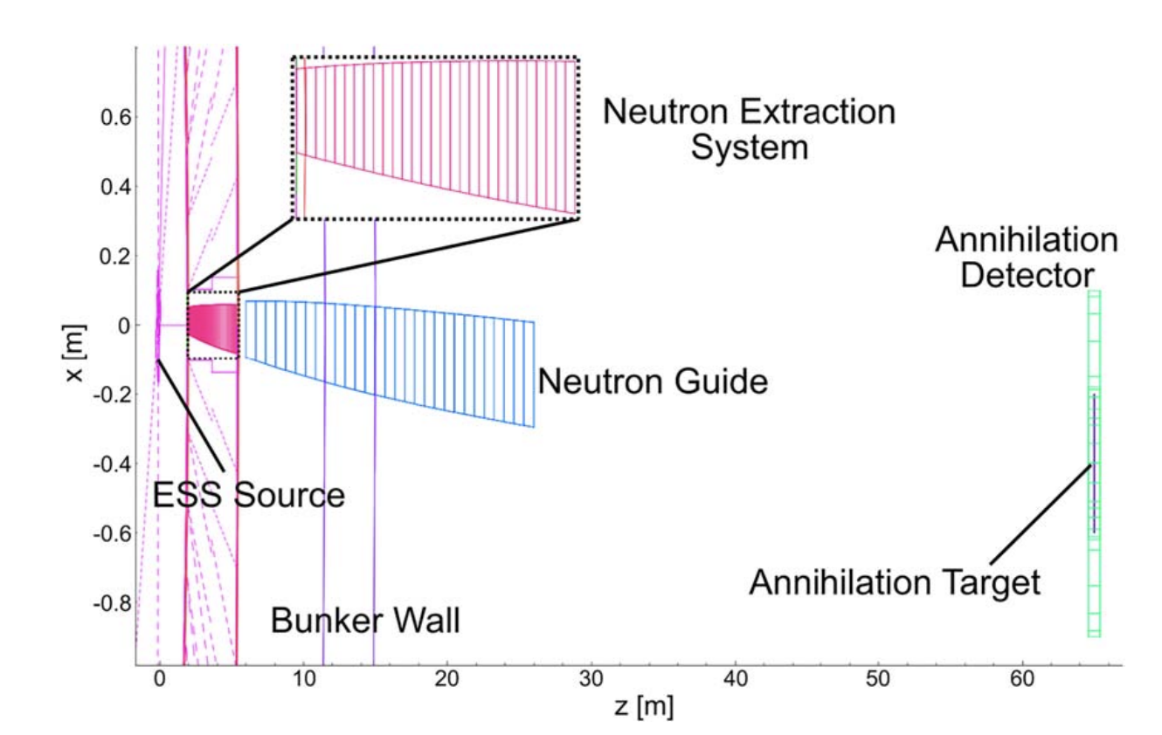
FINESSE Beamline Concept (I)
One instrument, two regime
High-Intensity Mode
Maximizes neutron flux. For experiments limited by statistics More neutrons → better sensitivity
Elliptical guide with direct line-of-sight to the moderator
Low-Background Mode
Minimizes unwanted signals and noise
For experiments that require a clean signal → higher precision.
Double-bender design removing line-of-sight twice

Slide 19
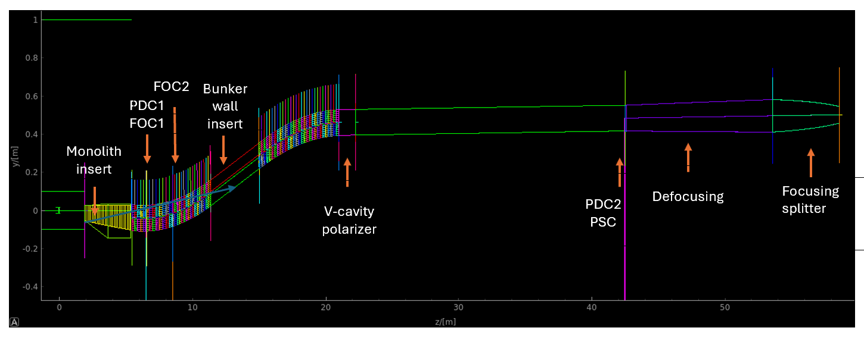
FINESSE Beamline Concept (I)
One instrument, two regime
High-Intensity Mode
Maximizes neutron flux. For experiments limited by statistics More neutrons → better sensitivity
Elliptical guide with direct line-of-sight to the moderator
Low-Background Mode
Minimizes unwanted signals and noise
For experiments that require a clean signal → higher precision.
Double-bender design removing line-of-sight twice

Slide 20
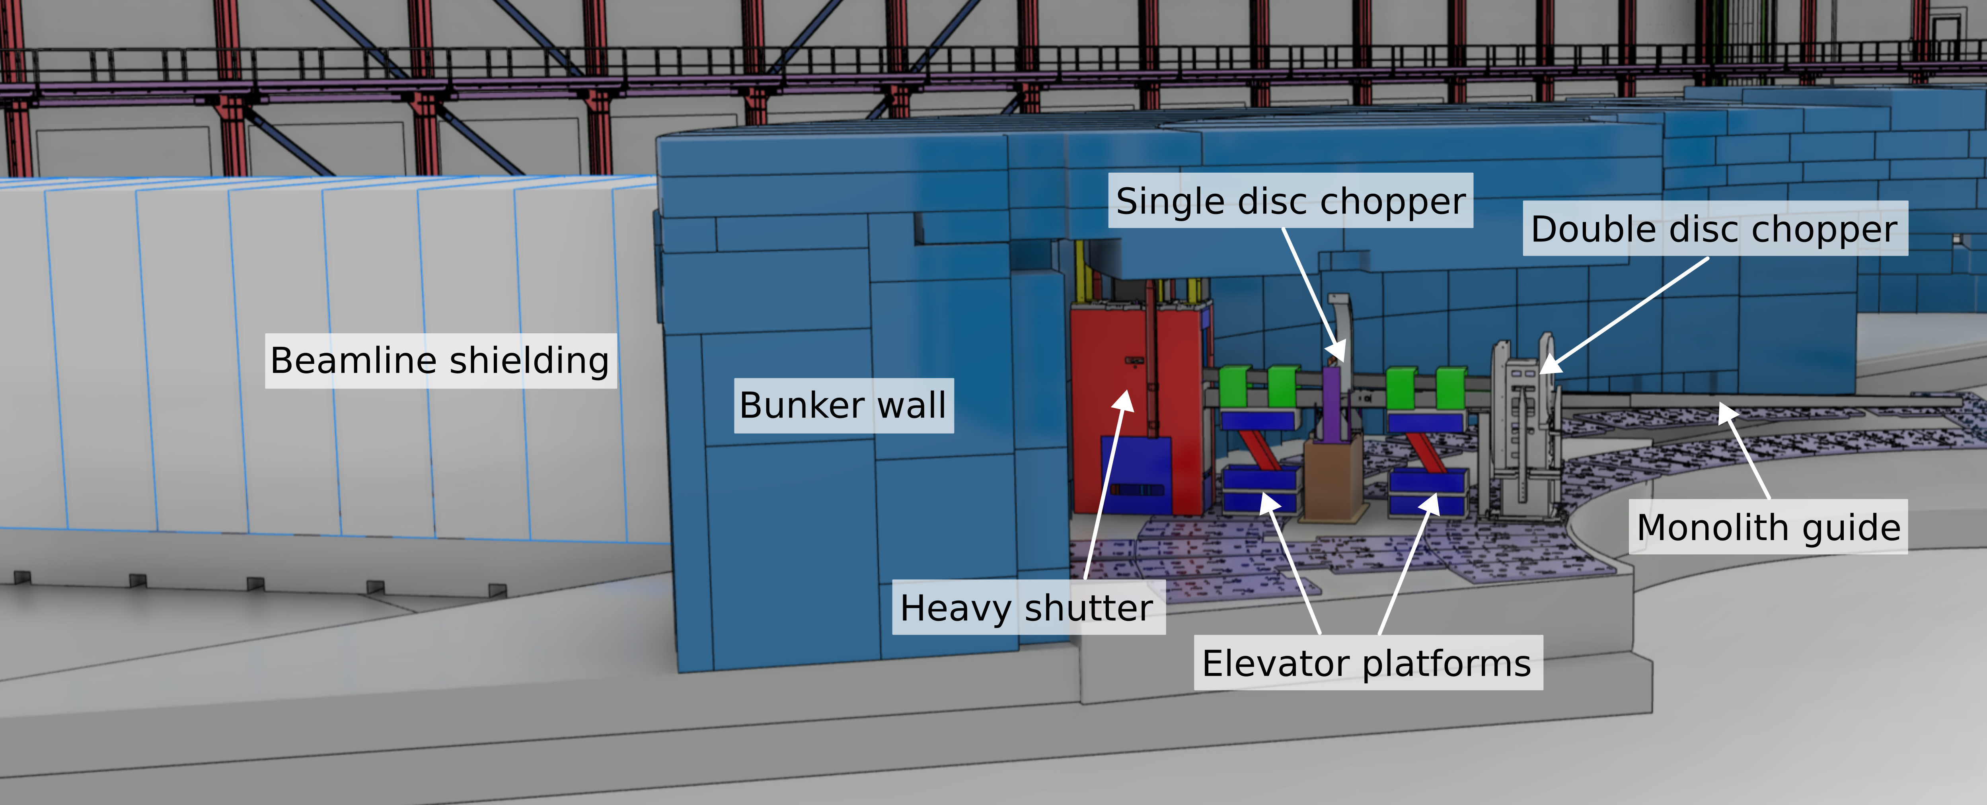
FINESSE Beamline Concept (II)
The key idea: a switchable neutron guide
The beamline contains two alternative guide paths → only one is active at a time

Slide 21
FINESSE Beamline Concept (II)
The key idea: a switchable neutron guide
The beamline contains two alternative guide paths → only one is active at a time
The switch is done by exchanging a short guide section inside the ESS bunker
Possible technologies:
Sliding system (rails)
Elevator platform
Manual replacement during shutdown

Slide 22
FINESSE Beamline Concept (II)
The key idea: a switchable neutron guide
The beamline contains two alternative guide paths → only one is active at a time
The switch is done by exchanging a short guide section inside the ESS bunker
Possible technologies:
Sliding system (rails)
Elevator platform
Manual replacement during shutdown
All are standard technologies in neutron facilities

Slide 23
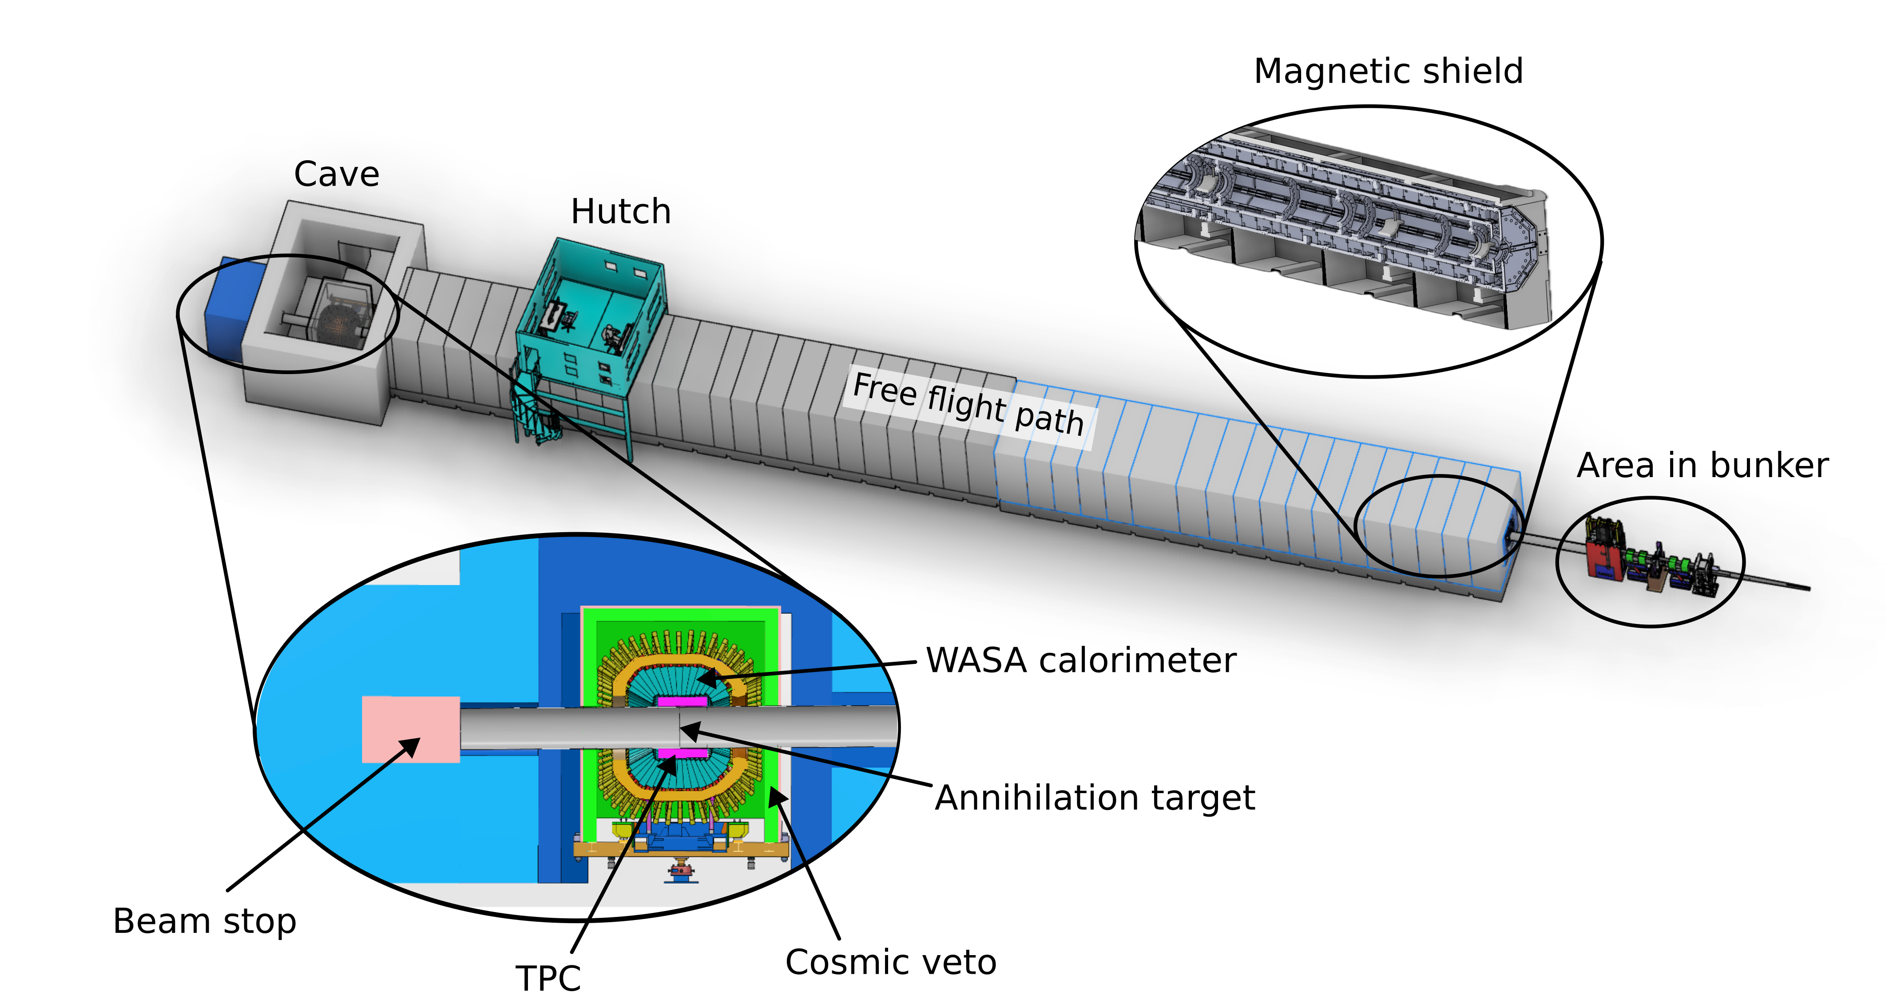
The FINESSE High-Flux Program
The FINESSE high flux program was previously called HIBEAM

Slide 24
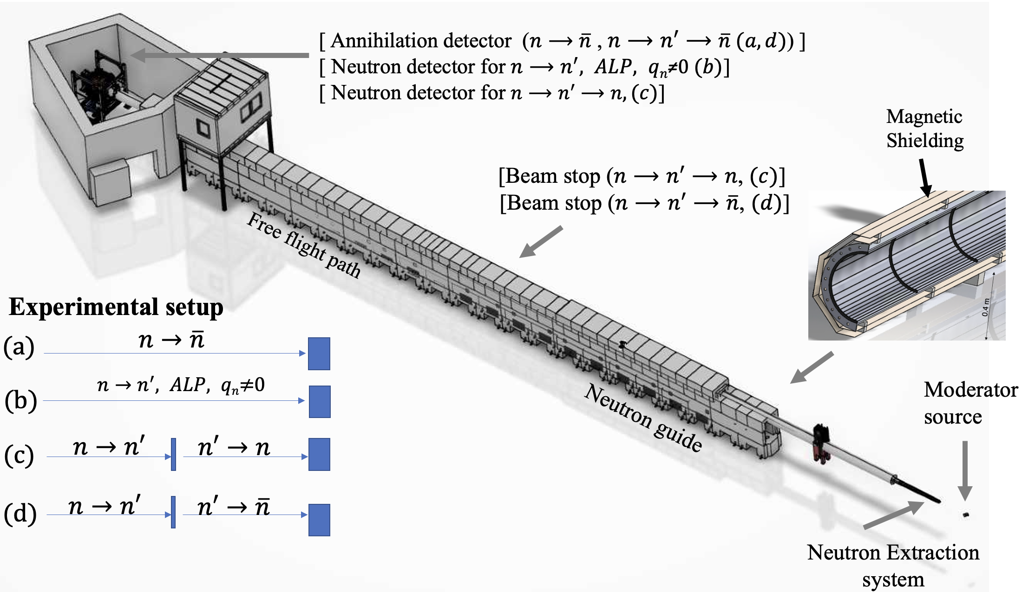
FINESSE searches “High-flux-mode” (I)
V Santoro et al 2025 J. Phys. G: Nucl. Part. Phys. 52 040501
Key Examples for the high flux mode:
Neutron to antineutron oscillations
Neutron to sterile neutron oscillations
Search for Axion-like-particle
Search for non-zero neutron electric charge,
Search for rare neutron decay, neutron capture

Slide 25
FINESSE searches “High-flux-mode” (I)
V Santoro et al 2025 J. Phys. G: Nucl. Part. Phys. 52 040501
Key Examples for the high flux mode:
Neutron to antineutron oscillations
Neutron to sterile neutron oscillations
Search for Axion-like-particle
Search for non-zero neutron electric charge,
Search for rare neutron decay, neutron capture
All the proposed searches will need a 50 m magnetic-control beam line.
Beamline able to suppress the magnetic field of the earth but also of precisely scanning the magnetic field

Slide 26
FINESSE searches “High-flux-mode” (I)
V Santoro et al 2025 J. Phys. G: Nucl. Part. Phys. 52 040501
Key Examples for the high flux mode:
Neutron to antineutron oscillations
Neutron to sterile neutron oscillations
Search for Axion-like-particle
Search for non-zero neutron electric charge,
Search for rare neutron decay, neutron capture
All the proposed searches will need a 50 m magnetic-control beam line.
Beamline able to suppress the magnetic field of the earth but also of precisely scanning the magnetic field
Different detectors are needed to detect the neutrons or the antineutron signal

Slide 27
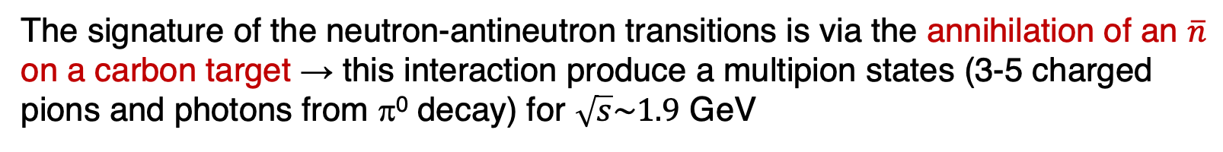
The annihilation detector options
The signature of the neutron-antineutron transitions is via the annihilation of an $\overline{n}$ on a carbon target → this interaction produce a multipion states (3-5 charged pions and photons from π⁰ decay) for $\sqrt{s}\sim 1.9$ GeV

Slide 28
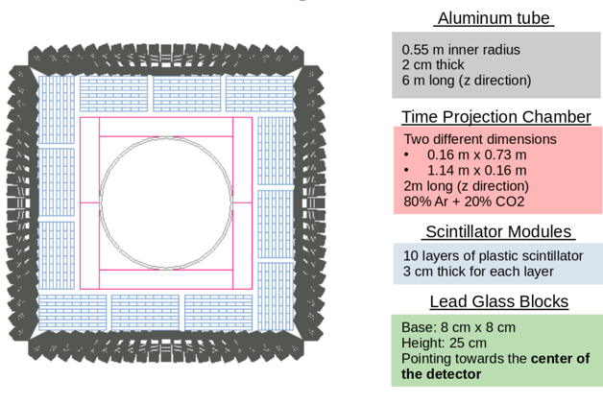
The annihilation detector options
The signature of the neutron-antineutron transitions is via the annihilation of an $\overline{n}$ on a carbon target → this interaction produce a multipion states (3-5 charged pions and photons from π⁰ decay) for $\sqrt{s}\sim 1.9$ GeV
Two Different options:
Scintillator/lead-glass calorimeter
Time Project Chamber
Cosmic veto shield

Slide 29
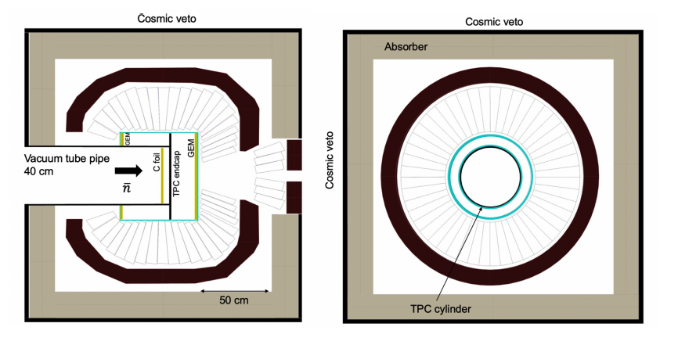
The annihilation detector options
The signature of the neutron-antineutron transitions is via the annihilation of an $\overline{n}$ on a carbon target → this interaction produce a multipion states (3-5 charged pions and photons from π⁰ decay) for $\sqrt{s}\sim 1.9$ GeV
Two Different options:
Scintillator/lead-glass calorimeter
Time Project Chamber
Cosmic veto shield
WASA calorimeter available to FINESSE, 1012 CsI(Na) crystals Uppsala University are co-owners
Time Project Chamber
Cosmic veto shield

Slide 30

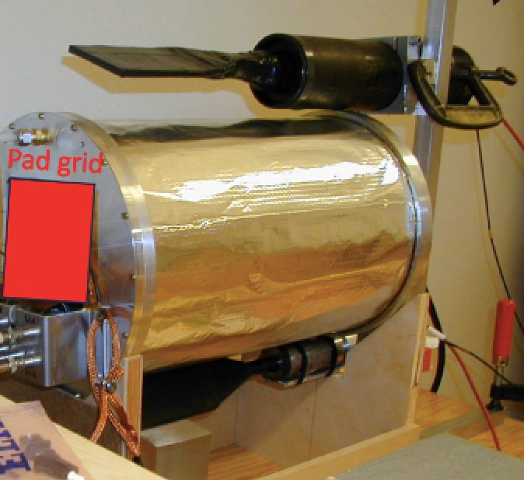
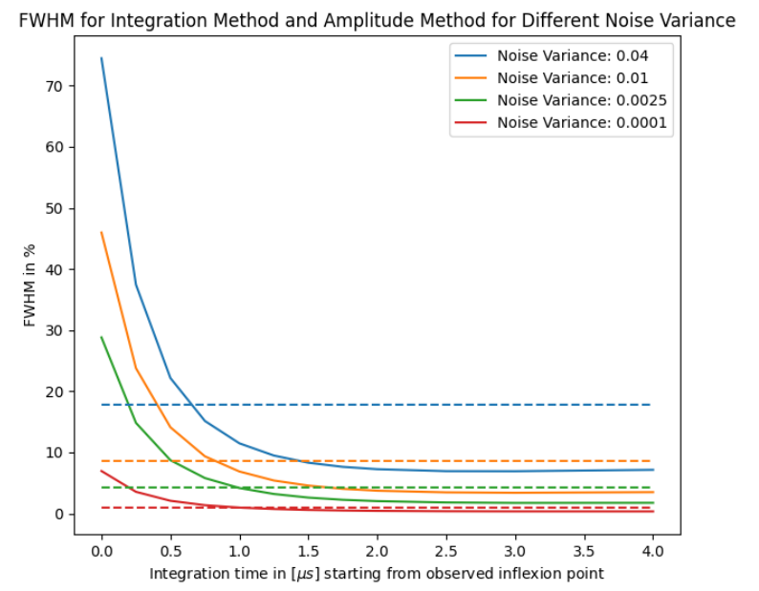
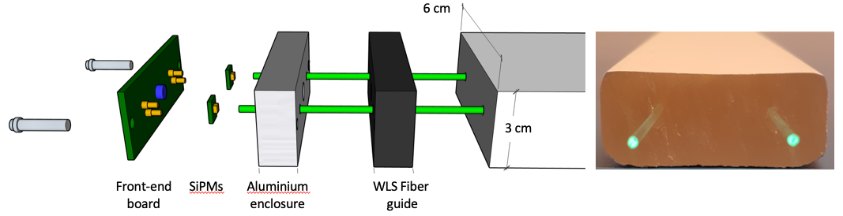
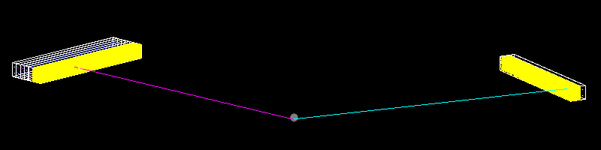
FINESSE Detector Prototypes. Status and Activities
TPC
TPC (LU, UNICAMP, State University of Rio de Janeiro)
Prototype detector operational, tests with cosmic rays ongoing
Tracking algorithm under development
HRD/LEC (SU)
Front-end electronics under development
First pulses measured with self-triggering electronics
Cosmic veto (IFJ PAN)
Test stand for lab tests of different scintillator geometries constructed
WASA (UU)
Light guides of Csi(Tl) crystals refurbished
different FPGA sampling algorithms under investigation
Test experiment has been performed at CCB in Krakow in December 2025
WASA
sampling
algorithms
HRD
CCB simulations

Slide 31
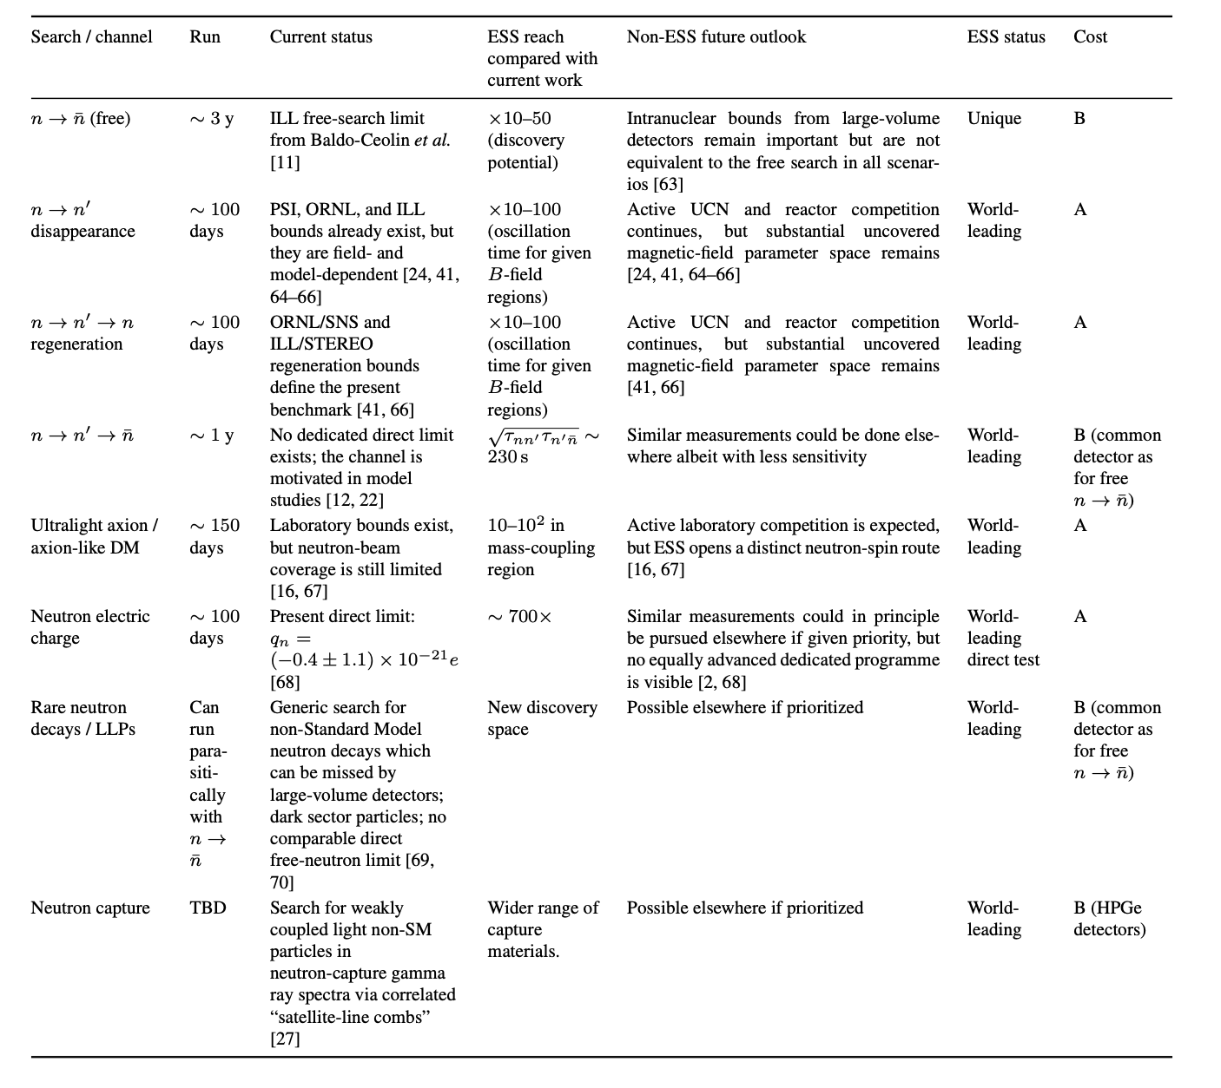
FINESSE searches “High-flux-mode” (II)

Slide 32
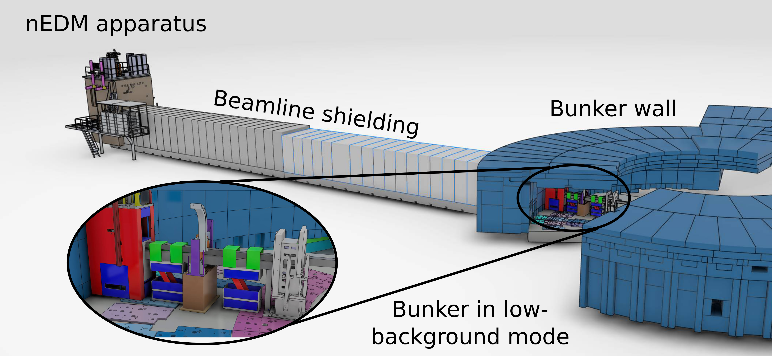
The FINESSE Low-Flux Program

Slide 33
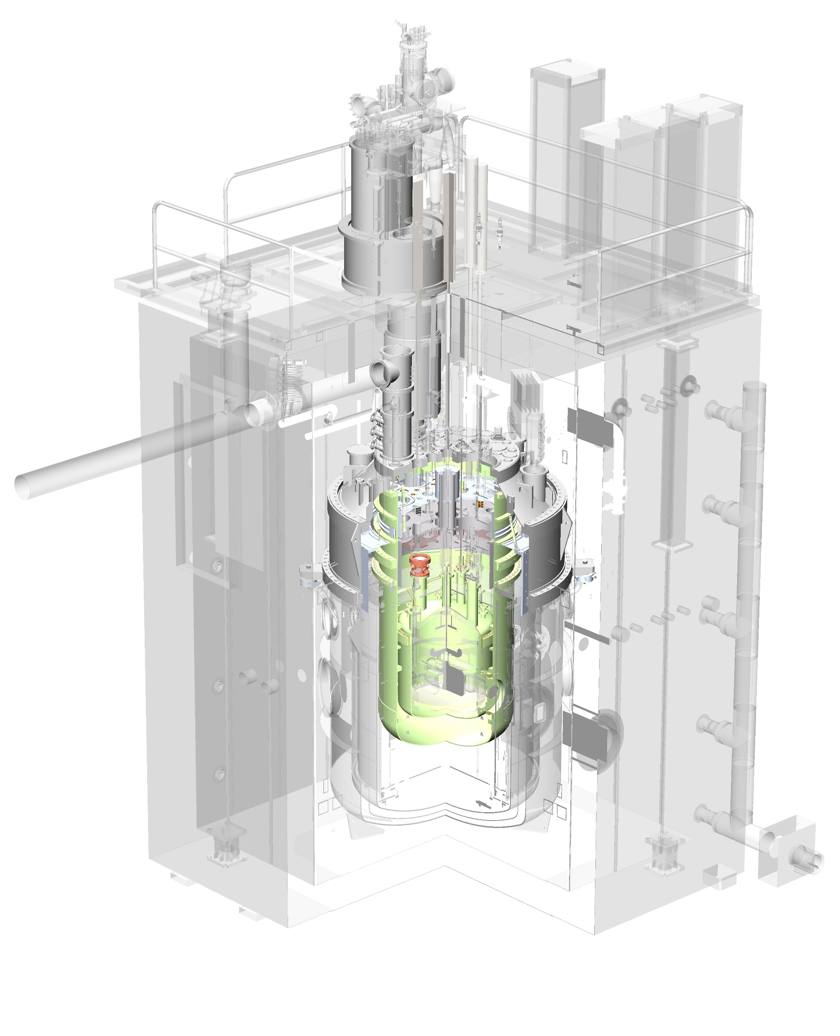
Search for non Electric Dipole Moment of the neutrons
U.S./European Cryogenic Neutron EDM Initiative
A large scale cryogenic experiment to measure the neutron EDM at a sensitivity below 3⋅10⁻²⁸ e⋅cm.
Uses cryogenic techniques to improve all aspects of the experiment
Production of ultra-cold neutrons in situ in superfluid He provides high density in measurement cell
Mostly developed by US Department of Energy and National Science Foundation, but funding terminated in 2023 with construction underway

Slide 34
Search for non Electric Dipole Moment of the neutrons
U.S./European Cryogenic Neutron EDM Initiative
A large scale cryogenic experiment to measure the neutron EDM at a sensitivity below 3⋅10⁻²⁸ e⋅cm.
Uses cryogenic techniques to improve all aspects of the experiment
Production of ultra-cold neutrons in situ in superfluid He provides high density in measurement cell
Mostly developed by US Department of Energy and National Science Foundation, but funding terminated in 2023 with construction underway
New Effort
Planning a sequence of preparatory demonstration measurements at ILL
This experiment could become a flagship measurement for the low-background FINESSE programme, reaching precision beyond current SNS (Oak Ridge) goals

Slide 35
FINESSE searches “Low-flux-mode” (I)
Beyond the search for EDM many different measurements are possible for the low flux mode:
Neutron decay measurements
Tests of fundamental symmetries (e.g. parity violation)
Precision neutron lifetime and correlation measurements

Slide 36
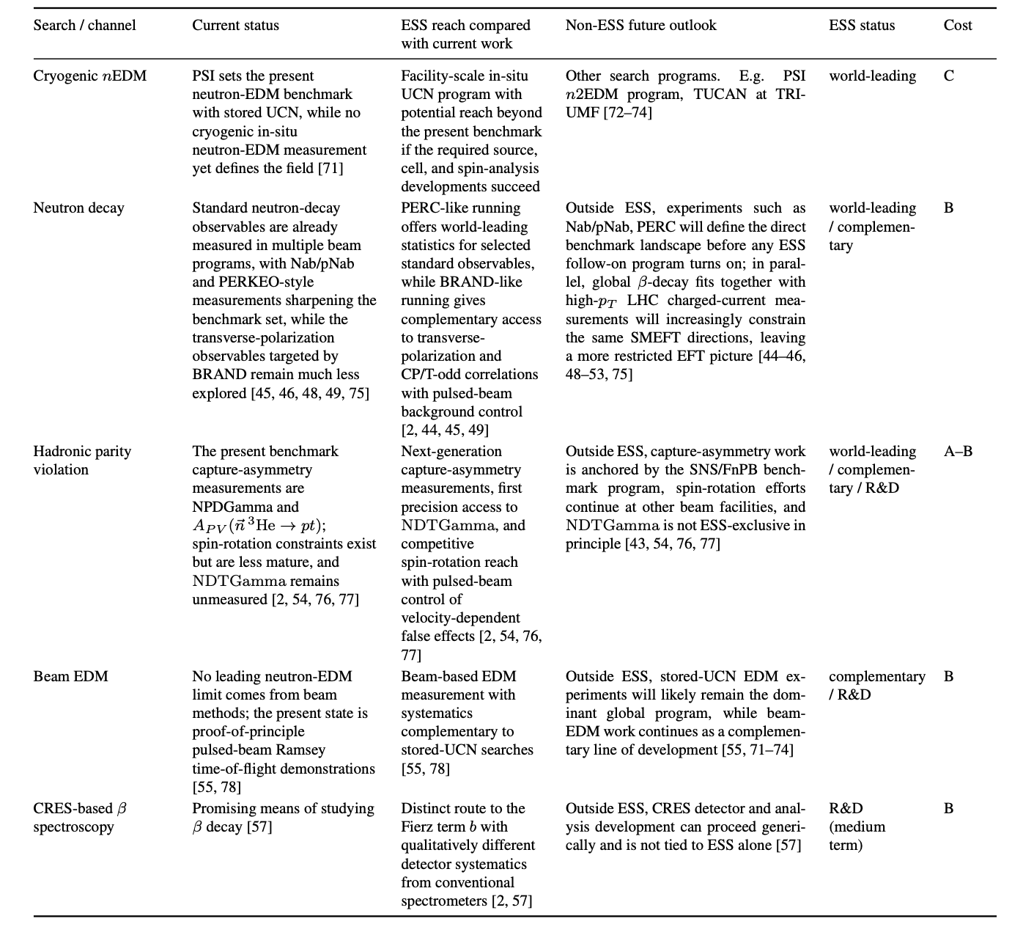
FINESSE searches “Low-flux-mode” (II)

Slide 37
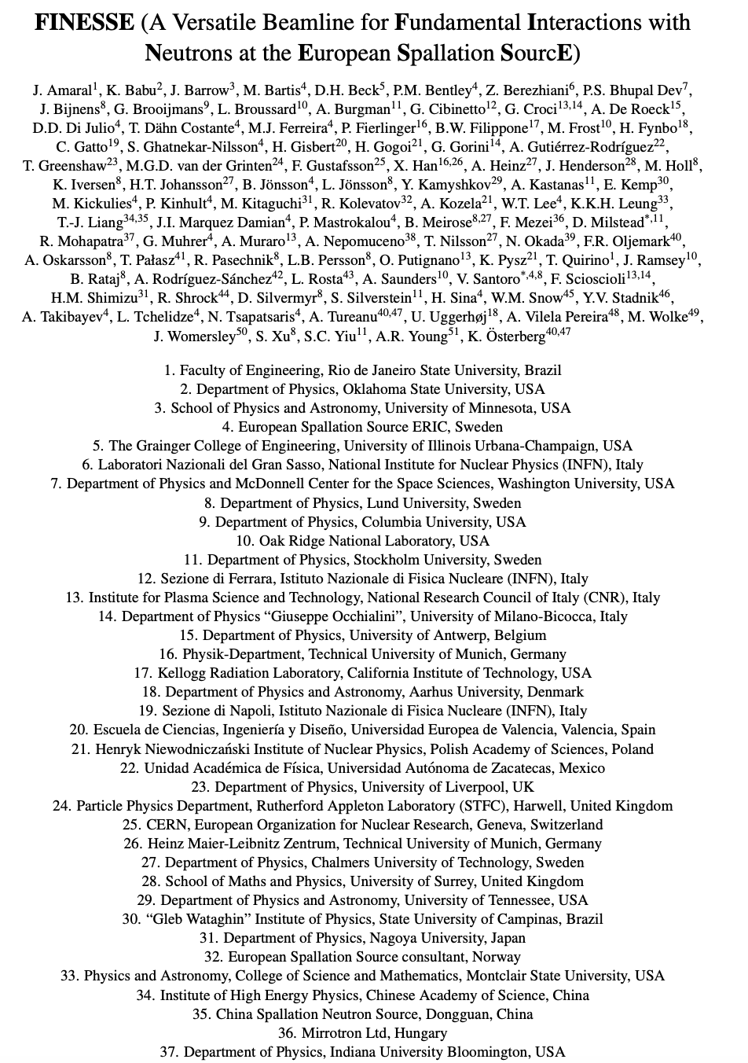
Summary of the FINESSE program
FINESSE: A Discovery Facility at ESS
A 40-year scientific program for fundamental neutron physics
Strong international collaboration (97 signatories, 18 countries)
Unique capabilities
Versatile beamline based on exchangeable guide concept
Covers:
Discovery physics
Precision measurements
Dedicated UCN program

Slide 38
Summary of the FINESSE program
FINESSE: A Discovery Facility at ESS
A 40-year scientific program for fundamental neutron physics
Strong international collaboration (97 signatories, 18 countries)
Unique capabilities
Versatile beamline based on exchangeable guide concept
Covers:
Discovery physics
Precision measurements
Dedicated UCN program

Slide 39
The NNBAR Experiment at the ESS
The observation of neutrons turning into antineutrons would constitute a discovery of fundamental importance for particle physics and cosmology

Slide 40
The NNBAR Experiment at the ESS
The observation of neutrons turning into antineutrons would constitute a discovery of fundamental importance for particle physics and cosmology
Observing a neutron turning into an antineutron would help us understand why the Universe today is made of matter and not antimatter.

Slide 41
The NNBAR Experiment at the ESS
The observation of neutrons turning into antineutrons would constitute a discovery of fundamental importance for particle physics and cosmology
Observing a neutron turning into an antineutron would help us understand why the Universe today is made of matter and not antimatter.
NNBAR will have a sensitivity increase of 10³ compared to previous experiments → Opportunities for such a leap in sensitivity are rare

Slide 42
ESS Instruments Layout
NNBAR Experiment (>2033): search for n→n̅ oscillations (sensitivity increase of 10³ compared to previous experiments )
FINESSE

Slide 43
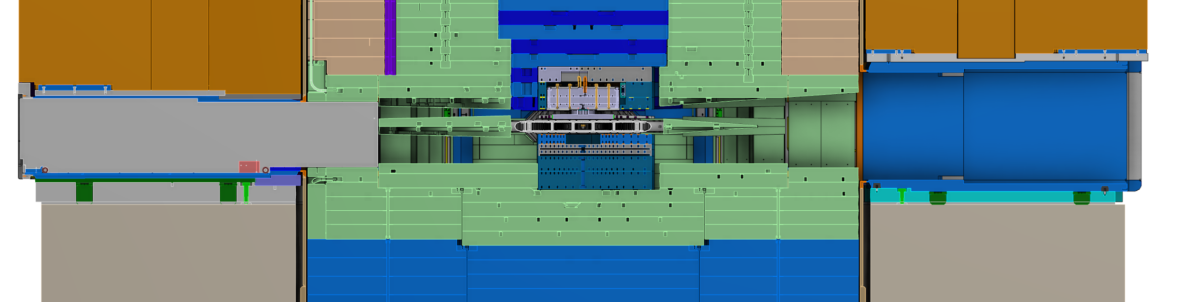
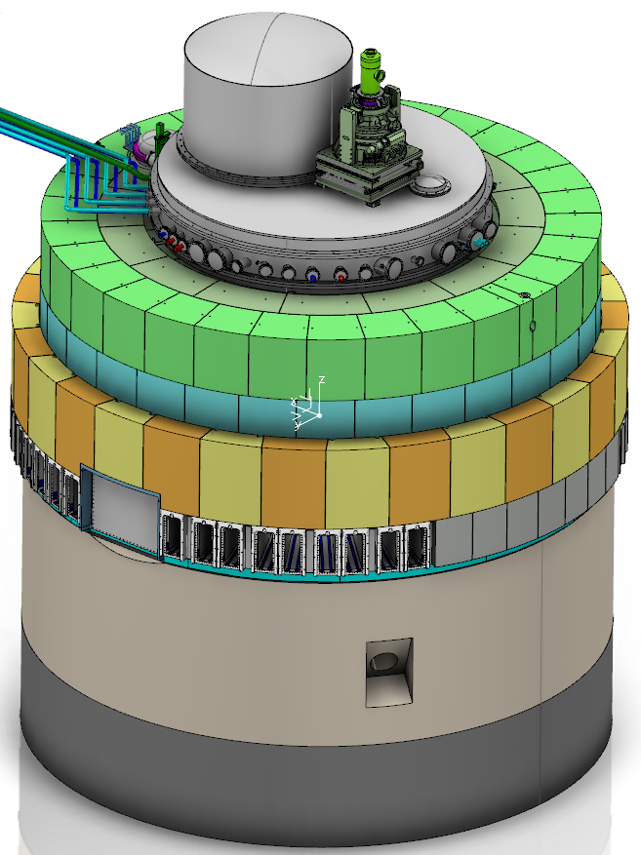
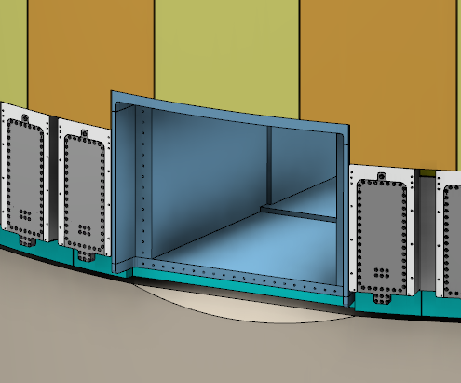
Why NNBAR @ ESS?
A large beam port has been built at ESS for NNBAR to allow for extraction of a high intensity beam to provide sufficient intensity for neutron to antineutron search
ESS Target
NNBAR Large Beam Port
regular beamport
NNBAR Large Beam Port
Standard ESS Beam line
ESS target monolith
(11 m diameter)
43

Slide 44
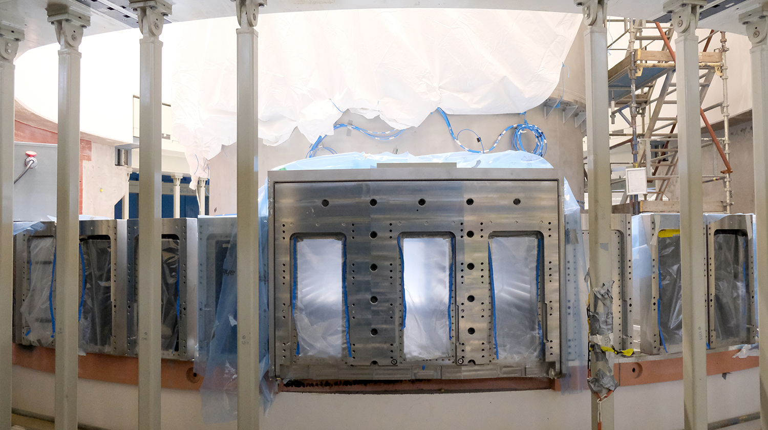
Large Beam Port Installed in the Target Monolith

Slide 45
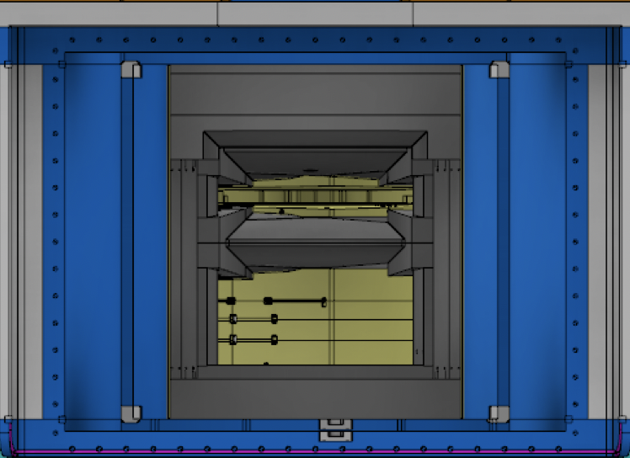
Large Beam Port Installed in the Target Monolith
~ 1m
Upper Moderator
Lower Moderator

Slide 46
Large Beam Port Installed in the Target Monolith
~ 1m
Upper Moderator
Lower Moderator
NNBAR Large Beam Port has been constructed to provide sufficient intensity for $n→\overline{n}$search
It is able to deliver 1.5x10¹⁵ n/s there is no beamline currently available or planned at any other facility that could reach a flux even close to this number

Slide 47
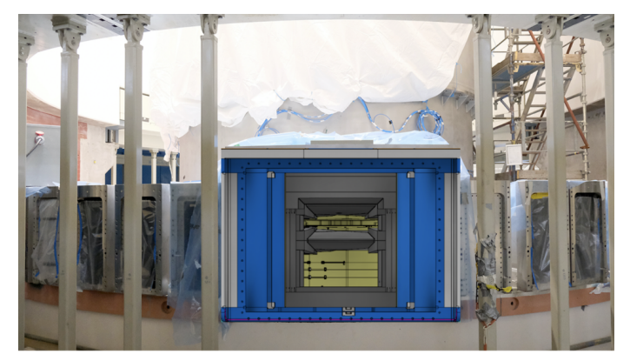
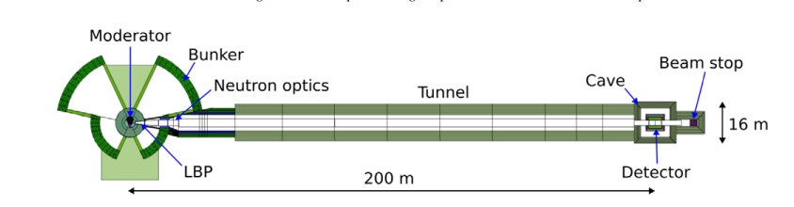
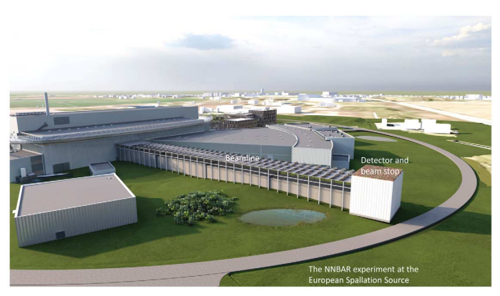
Overview of the NNBAR experiment
Neutrons into the beamline via the Large Beam Port
New LD2 lower moderator (J.Neutron Res. 25 (2024) 3-4, 315-406)
Focusing from nested mirrors.
Propagation in magnetically shielded beamline (<5-10nT, ~200m)
Biological shielding
Annihilation target surrounded by detector to observe antineutrons
Beam dump (B4C, polyethylene, steel and concrete)

Slide 48
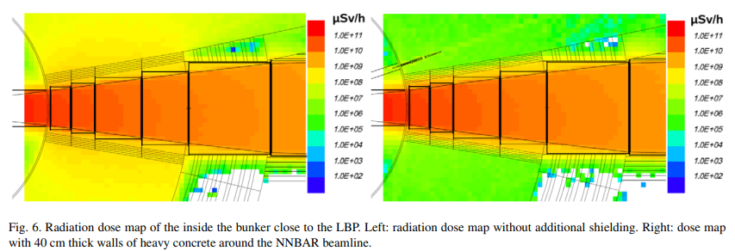
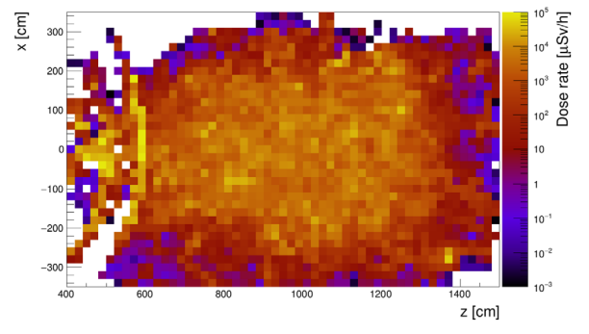
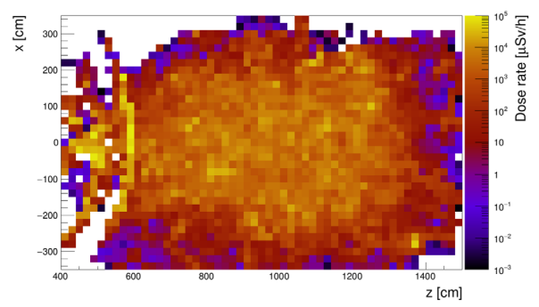
NNBAR beamline simulation in the bunker area
Bunker wall designed with the objective of reducing the radiation dose outside it to a level below the threshold defined with respect to the supervised area at the ESS
Additional shielding for LBP
40cm heavy concrete
3 μSv/h – optimize for 1.5 μSv/h ,
25 μSv/h – optimize for 12.5 μSv/h (roof)

Slide 49
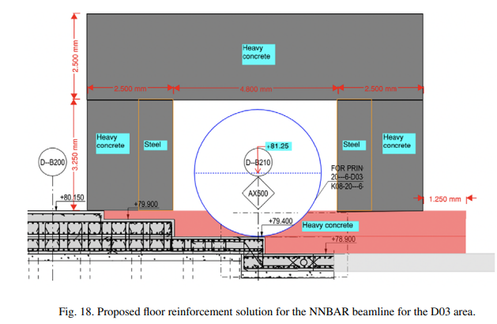
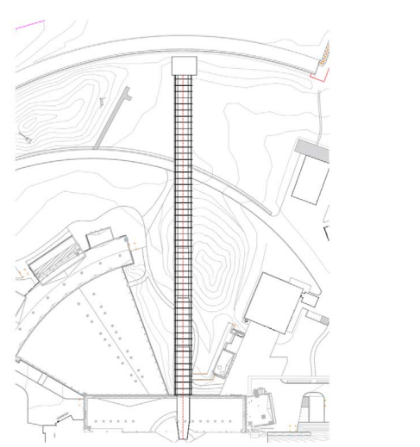
Civil engineering
NNBAR, the ESS Facility Management division and SWECO company.
Steel pillar in bunker moved as part of extra shielding work
Floor-loading support
Distribution slabs
200m optimized/trade off
No conflict between beamline foundation and local utilities/services
Options for detector cave with various options e.g. full weather protection.

Slide 50
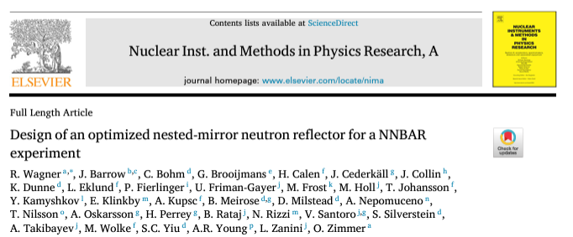
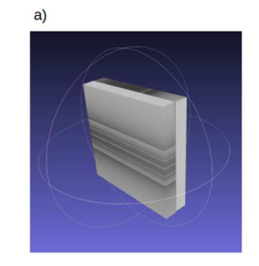
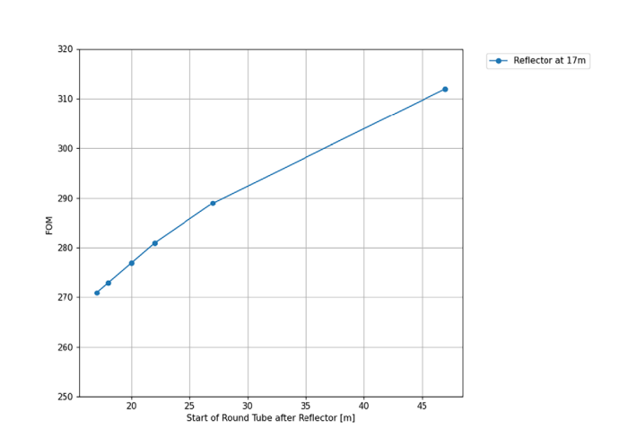
Neutron focusing
Many configurations considered.
Nested mirrors.
Monoplanar reflector at 17 m from the bunker followed by a square-> circular cross section.
300 ILL units per year for P=2MW.

Slide 51
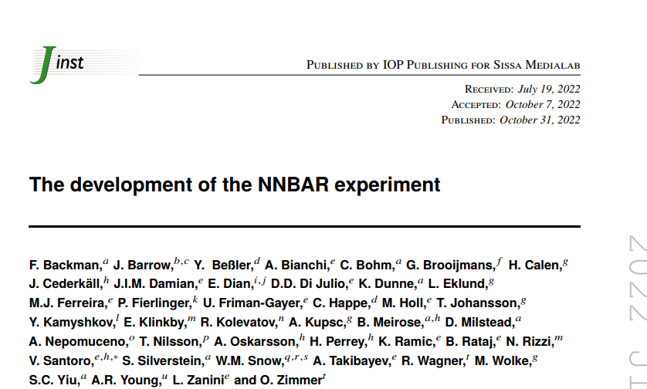
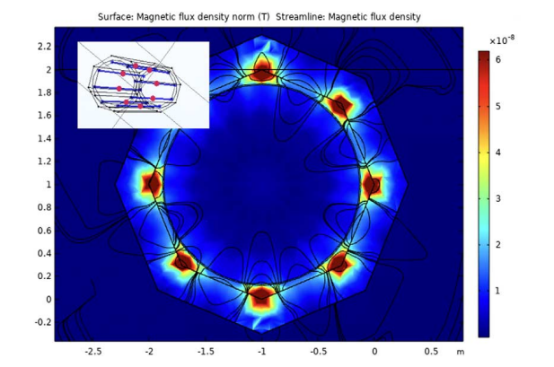
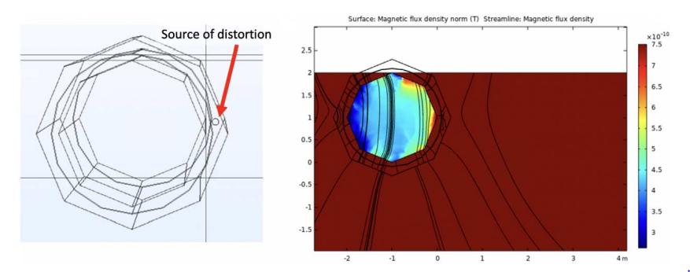
Magnetic shielding
Require <5-10nT for quasi-free condition
Octanol mumetal shield
Static lowering of B-field and field damping up to ~10Hz.
Toroidal coils for magnetic equilibration

Slide 52
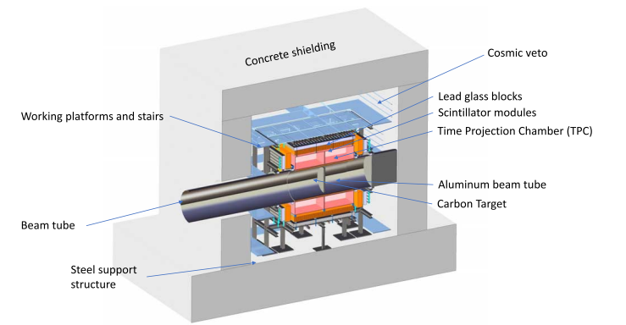
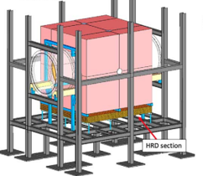
Annihilation detector
~1.8 GeV centre-of-mass energy
3-7 pions
Different designs considered
Lead-glass EM calorimeter
Scintillator (hadronic range)
TPC
Scintillator cosmic veto
Mechanical design (Julich)

Slide 53
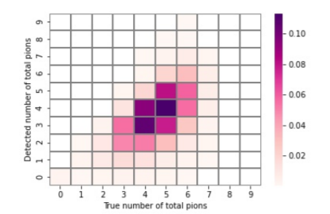
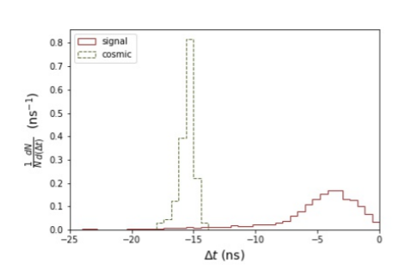




Geant-4 detector simulation
Pion multiplicity
π⁰ mass reconstruction
Event timing
Pion multiplicity
Cosmic
Signal
Invariant mass
Proton/pion separation
Proton
Cosmic
Pion
Signal
Antineutron-nucleon annihilation signature in the detector.
Achieve cosmic rejection for an efficiency >75%
ILL efficiency ~50% .

Slide 54

Backgrounds
Cosmic rays (neutral and charged - dominant at ILL)
Spallation bg -high energy.
Suppressed with timing (5ms)
~MeV-scale neutrons
Low energy photons - from the activation of the target + beamline.
Low energy (~1 MeV) but give pile-up
Considering magnetic field for Compton electrons
Nuclear fragments
Geant4 and MCNP study for different beamline configurations and neutron poisons

Slide 55


Possible NNBAR performance
Three year run at 2MW.
~1100 ILL units in discovery potential.
Pushing up to the PeV scale
Extend ~500 TeV for dimension 9, six quark operator.

Slide 56



Parameterised cost
~80MEuro for baseline radius=1m

Slide 57

















Building FINESSE/NNBAR
Co-spokespersons: G. Brooijmans (Columbia), D. M. (SU)
Lead scientist: Y. Kamyshkov (Tennesee)
Technical Coordinator : Valentina Santoro (ESS, LU)
Prototype coordinator : Matthias Holl (ESS)
Computing and Detector Simulation: Bernhard Meirose (LU,CTH)
Institutions in Sweden, Germany, Poland, Italy, US, Brazil, Australia
Support from Horizon2020 + national funding agencies (~5MEuro over the past five years)

Slide 58
Summary of the FINESSE/NNBAR status
Several activities are currently ongoing, both from the beamline and the detector development FINESSE proposal submitted to the ESS on the 27 of March

Slide 59
Summary of the FINESSE/NNBAR status
Several activities are currently ongoing, both from the beamline and the detector development FINESSE proposal submitted to the ESS on the 27 of March
Our vision is start with the FINESSE program and then transition to the NNBAR experiment

Slide 60
Summary of the FINESSE/NNBAR status
Several activities are currently ongoing, both from the beamline and the detector development FINESSE proposal submitted to the ESS on the 27 of March
Our vision is start with the FINESSE program and then transition to the NNBAR experiment
The FINESSE beamline has the potential to support other experiments for the entire neutron user community, serving the community throughout the entire lifetime of the ESS

Slide 61
Summary of the FINESSE/NNBAR status
Several activities are currently ongoing, both from the beamline and the detector development FINESSE proposal submitted to the ESS on the 27 of March
Our vision is start with the FINESSE program and then transition to the NNBAR experiment
The FINESSE beamline has the potential to support other experiments for the entire neutron user community, serving the community throughout the entire lifetime of the ESS
NNBAR is a natural evolution of the FINESSE program sensitivities improvement of 10³

Slide 62
BACK UP SLIDES

Slide 63

Key Examples from HIBEAM Proposed Searches
Neutron to antineutron oscillations
Neutron to sterile neutron oscillations
Search for Axion-like-particle (two different talks tomorrow)
Search for non-zero neutron electric charge
Search for Electric dipole moment of the neutrons (work-on-going)
Hadronic weak interaction and estimations of sensitivities for neutron decay experiments experiments (work in progress just started )
The HIBEAM ”original program”

Slide 64
Key Examples from HIBEAM Proposed Searches
Neutron to antineutron oscillations
Neutron to sterile neutron oscillations
Search for Axion-like-particle
Search for non-zero neutron electric charge
Search for Electric dipole moment of the neutrons (work-on-going)
Hadronic weak interaction and estimations of sensitivities for neutron decay experiments experiments (work in progress just started )

Slide 65
Key Examples from HIBEAM Proposed Searches
Neutron to antineutron oscillations
Neutron to sterile neutron oscillations
Search for Axion-like-particle (talk tomorrow by Yevgeny Stadnik )
Search for non-zero neutron electric charge
Search for Electric Dipole Moment of the neutrons (work-on-going)
Hadronic weak interaction and estimations of sensitivities for neutron decay experiments (work in progress just started )

Slide 66
Key Examples from HIBEAM Proposed Searches
These searches could be conducted using the same optical system, an elliptical straight guide
Neutron to antineutron oscillations
Neutron to sterile neutron oscillations
Search for Axion-like-particle
Search for non-zero neutron electric charge
Search for Electric Dipole Moment of the neutrons (work-on-going)
Hadronic weak interaction and estimations of sensitivities for neutron decay experiments (work in progress just started )

Slide 67
Key Examples from HIBEAM Proposed Searches
Neutron to antineutron oscillations
Neutron to sterile neutron oscillations
Search for Axion-like-particle
Search for non-zero neutron electric charge
Search for Electric Dipole Moment of the neutrons (work-on-going)
Hadronic weak interaction and estimations of sensitivities for neutron decay experiments (work in progress just started )
These searches require a guide system that lose line of sight from the moderator

Slide 68
Key Examples from HIBEAM Proposed Searches
HIBEAM High-flux-mode
Neutron to antineutron oscillations
Neutron to sterile neutron oscillations
Search for Axion-like-particle
Search for non-zero neutron electric charge
Search for Electric Dipole Moment of the neutrons (work-on-going)
Hadronic weak interaction and estimations of sensitivities for neutron decay experiments (work in progress just started )
HIBEAM Low-background-mode
For this reason, in this talk, we will refer to the initial searches as HIBEAM High-flux-mode and HIBEAM Low-background-mode

Slide 69
HIBEAM searches “High-flux-mode”
All the proposed searches will need a 50 m magnetic-control beam line
Beamline able to suppress the magnetic field of the earth but also of precisely scanning the magnetic field with
step size 0.2 μT between ± 200μT

Slide 70

HIBEAM searches “High-flux-mode”
The signature of the neutron-antineutron transitions is via the annihilation of an $\overline{n}$ on a carbon target
All the searches with the antineutrons as a final state will require an annihilation detector.

Slide 71

HIBEAM searches “High-flux-mode”
For the neutrons to antineutrons oscillations HIBEAM searches can exceed ILL experiment by factor 10 or even more sensitivity depend on detector size and beamline length

Slide 72
HIBEAM searches “High-flux-mode”
For the searches with neutrons as a final state, depending on the experiment, we will require different neutron detectors

Slide 73
HIBEAM searches “High-flux-mode”
The six different experiments will benefit of the same optics system

Slide 74


The HIBEAM high-flux-mode neutron guide
ESS Source
Bunker wall
End of the Neutron guide

Slide 75


$$n→\overline{n}$$

Slide 76
nEDM experiment at the ESS
The nEDM experiment is a large scale cryogenic experiment to measure the neutron EDM at a sensitivity below 3e-28 e-cm.
Mostly developed by US Department of Energy and National Science Foundation, but funding terminated in 2023 with construction underway.
There is now a program to develop further this experiment (see Douglas Beck talk)
ESS Target
NNBAR Large Beam Port
regular beamport
NNBAR Large Beam Port
ESS target monolith
(11 m diameter)

Slide 77
Why NNBAR @ ESS?
A large beam port has been built at ESS for NNBAR to allow for extraction of a high intensity beam to provide sufficient intensity for neutron to antineutron search
ESS Target
NNBAR Large Beam Port
regular beamport
NNBAR Large Beam Port
Standard ESS Beam line
ESS target monolith
(11 m diameter)
77

Slide 78
Large Beam Port Installed in the Target Monolith

Slide 79
Large Beam Port Installed in the Target Monolith
~ 1m
Upper Moderator
Lower Moderator

Slide 80
Large Beam Port Installed in the Target Monolith
~ 1m
Upper Moderator
Lower Moderator
NNBAR Large Beam Port has been constructed to provide sufficient intensity for $n→\overline{n}$search
It is able to deliver 1.5x10¹⁵ n/s there is no beamline currently available or planned at any other facility that could reach a flux even close to this number

Slide 81

The NNBAR Beamline
NNBAR will have a a 200 m long beamline where the neutron will fly free for long distance
NNBAR figure of merit Nt² (N= number of neutron t is the flight time )

Slide 82

The NNBAR experiment (schematic)
n̅
To design the optimal experiment you need to take into account several different aspects:

Slide 83


The NNBAR experiment (schematic)
n̅
Moderator:
It determines the number of cold neutrons
emitted by the source
To design the optimal experiment you need to take into account several different aspects:
Full Engineering design of a high intensity source for NNBAR

Slide 84

The NNBAR experiment (schematic)
n̅
Reflector/Neutron Guide:
How many neutrons you collect, transport and focus in the experiment
We have designed a nested mirror optics system able to achieve the NNBAR expected sensitivity

Slide 85


The NNBAR experiment (schematic)
n̅
Beamline Simulations
Full beamline simulations –> civil engineer project on going to integrate the NNBAR beamline in the ESS facility

Slide 86
NNBAR Status
Conceptual Design Report of the NNBAR experiment have been delivered and published with support by European Commission Santoro, V. et al. ‘HighNESS Conceptual Design Report: Volume II. The NNBAR Experiment.’ 1 Jan. 2023 : 315 – 406
Detector development and design optimization. Design of the NNBAR moderator, optics system, simulations of backgrounds and shielding. Integration in the ESS facility
Address uncertainties in cost of experiment
Next step is to move from CDR to TDR

Slide 87
Back Up

Slide 88
Summary
Neutron oscillations are a key but rarely explored portal for new physics
baryogenesis, BNV physics, dark matter
The ESS is opening a new discovery window
HIBEAM/NNBAR is a multi-stage program to increase sensitivity by ~1000
From prototype development to physics
HIBEAM offers a wide range of applications (neutron oscillations, axions, rare decays etc. ).
The ESS is on our doorstep. The chance to do world class particle physics there shouldn’t be wasted.

Slide 89


Costs
HIBEAM
Can design, build and conduct complete experiments for a Synergy Grant (14MEuro).
Construction cost ~ several millions.
Use available infrastructure and available components.
NNBAR
Construction
~78MEuro

Slide 90
HIBEAM searches “High-flux-mode”
The signature of the neutron-antineutron transitions is via the annihilation of an $\overline{n}$ on a carbon target
All the searches with the antineutrons as a final state will require an annihilation detector.

Slide 91
HIBEAM searches “High-flux-mode”
For the neutrons to antineutrons oscillations HIBEAM searches can exceed ILL experiment by factor 10 or even more sensitivity depend on detector size and beamline length

Slide 92
HIBEAM searches “High-flux-mode”
For the searches with neutrons as a final state, depending on the experiment, we will require different neutron detectors

Slide 93
HIBEAM searches “High-flux-mode”
The six different experiments will benefit of the same optics system

Slide 94
The HIBEAM high-flux-mode neutron guide
ESS Source
Bunker wall
End of the Neutron guide

Slide 95
The HIBEAM Optics simulations for HIBEAM low background configuration

Slide 96


nEDM Guide layout (Options A and B) 95% mean polarization at 9AA
Bender
15Wx13H cm x 6m
10 horizontal channels
Polarizer
15Wx13H cm x 0.5m
26 horizontal channels
PDC
A: 6.5m and 26m
B: 6.5m and 42.5m

Slide 97



Slide 98


nEDM Guide layout (Options C and D) 99.5% mean polarization at 9AA
Benders
15Wx13H cm x 6m
15Wx13H cm x 4m
10/13 horizontal channels
Polarizing bender
15Wx13H cm x 2m
26 horizontal channels
Allows for polarization below 5AA
V-polarizer
15Wx13Hcm x1m
3V-mirrors
Transmits “up” polarization, increases divergence of “down” polarization above 5AA
Straight polarizing guide
15Wx13Hx1m
Absorbs “down” polarizations at long wavelength
Pulse definition choppers (PDCs)
C: 6.5m and 26m
D: 6.5m and 42.5m

Slide 99



Slide 100
FOM in the cells @ 5MW
 | n/s 8.8-9.0AA | n/s total | n/s/cm2/AA@8.9A | n/s/cm2 total
A.10 | 7.7E08 | 2.3E09 | 2.55E07 | 1.5E07
A.5 | 7.3E08 | 2.2E09 | 2.45E07 | 1.5E07
B.10 | 7.3E08 | 1.4E09 | 2.45E07 | 9.3E06
B.5 | 7.0E08 | 1.3E09 | 2.35E07 | 8.7E06
C | 8.3E08 | -- | 2.75E07 | --
D | 8.73E08 | 2.65E9 | 2.91E07 | 1.79E07
E | 8.28E08 | 1.6E09 | 2.82E07 | 1.07E07
F | 9.72E08 | -- | 3.24E07 | --
G | 1.26E09 | -- | 4.20E07 | --
A: C-polarizer, m=3 guides, ANNI original chopper settings, PDC1@6.5m and PDC2@26m Results for 10 and 5 slits in bender 1.
B: C-polarizer, m=3 guides, ANNI original chopper settings, PDC1@6.5m and PDC2@42.5m Results for 10 and 5 slits in bender 1.
C: C-polarizer, no choppers, wavelength restricted to 8.8-9.0AA, open choppers
D: New concept, curved with V-shaped polarizer, PDC1@6.5m and PDC2@26m
E: New concept, curved with V-shaped polarizer, PDC1@6.5m and PDC2@42.5m
F: New concept, curved with V-shaped polarizer, wavelength restricted to 8.8-9.0AA, open choppers
G: Theoretical max, straight guide (slits preserved), V-polarizer, wavelength restricted to 8.8-9.0AA, open choppers
In the options A-F line of sight is lost at 11.5 meters (just before the bunker wall)
Initial optimization indicates that an improvement of at least a factor of three over the ORNL experiment can be achieved

Slide 101






HIBEAM Magnetic shielding status
A key feature of the HIBEAM beamline is the 50-meter magnetic control infrastructure, which enables a wide range of experiments.
Simulations of the magnetics shielding just started with COMSOL, a a 10-meter prototype of the magnetic infrastructure will be constructed as part of a project funded by the Swedish Foundation for Strategic Research.
Notes:
"Performance depending on the bending fractions of the beamline:
If the beamline is bent twice to move out of the line of sight, we can achieve 61% of the original ANNI proposal's performance.
Higher performance, up to 70%, could be achieved if the bending fraction is relaxed.
Simulations and Design Verification:
McStas simulations must be validated with background calculations to estimate the actual background impact.
The ANNI design must also be verified against engineering constraints.

