Slide 2
ICANS XXV
Integrated testing of the Neutron Factory - Planning, testing and Lessons Learned
PRESENTED BY ANTON LUNDMARK & Jaime arriagadA

Slide 3
Agenda
1 Testing of the Neutron Factory
2 Lessons learned
3 Readiness for starting operation with proton beam

Slide 4
1
Testing of the Neutron Factory

Slide 5
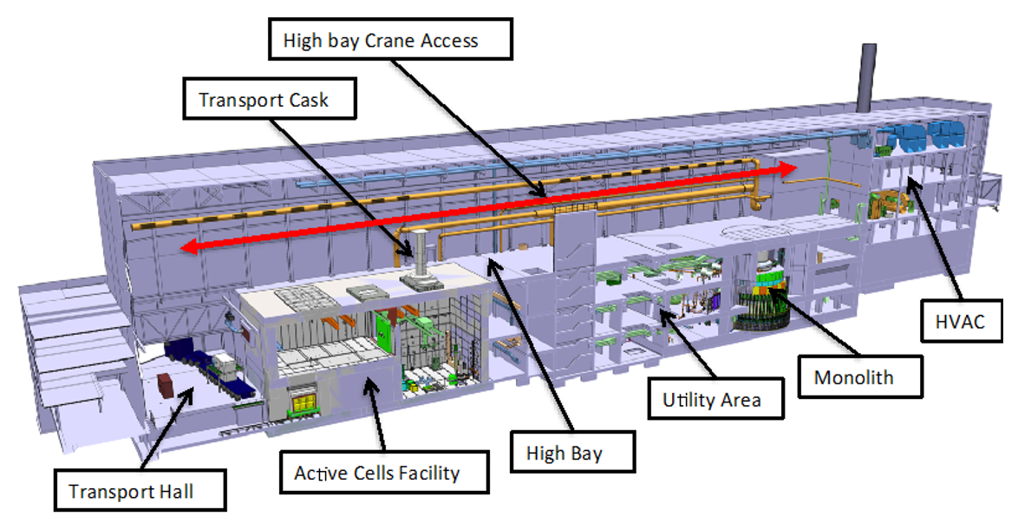
Introduction – Neutron Factory concept
Target Group
The Target station can be divided in the following functional units;
Neutron factory -> divided in groups for commissioning purposes
Maintenance systems; remote handling systems, casks and active cells
HVAC & infrastructure
The neutron factory consists of the systems required for neutron production
Tuning beam dump (1068) is not part of NF as it is part of the accelerator operation
LSS (1172) is not part of NS as it is part of instrument operation
Moderator Group
Monolith Group
NBEX Group
5

Slide 6
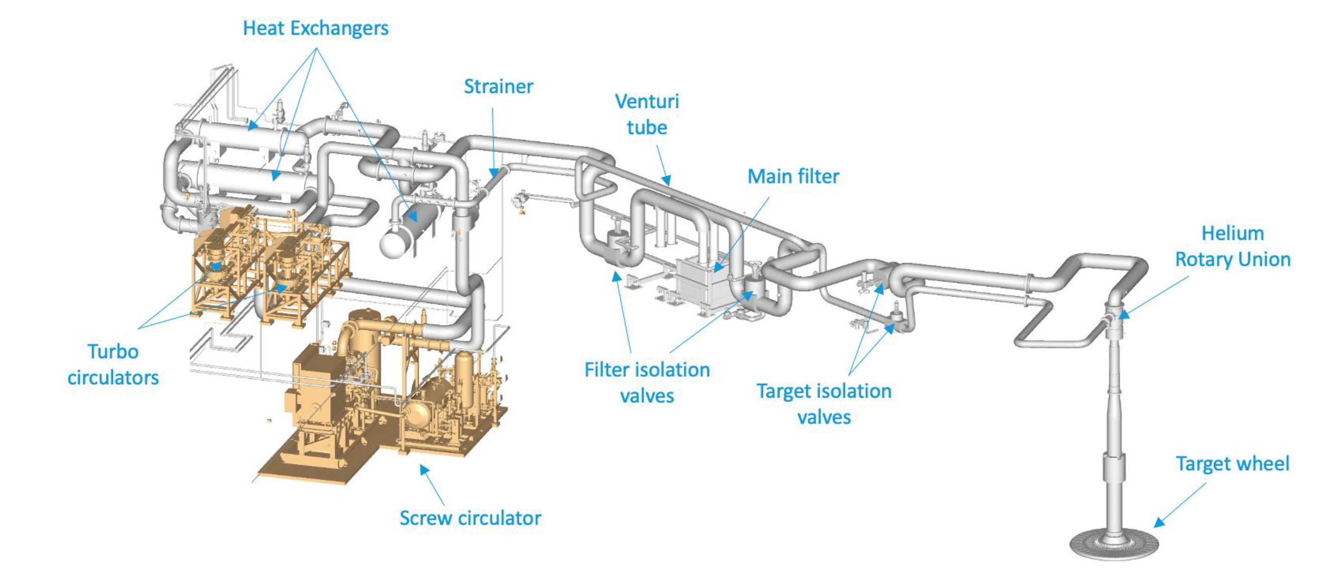
WoW during testing w/o beam - The Target Group testing
TWDS 1000 – Target wheel, Drive & Shaft
HeC 1010 – Target Primary Cooling
HePC 1011 – Press. Ctrl Primary Cooling
HeIn 1013 – Helium Injection
HePu 1015 – Helium Purification
HeWC 1016 - Equipment cooling (circ & compr)
PrHe 1030 – Pristine Helium (filling St)
IAD 1031 – Instrument Air Distribution
DWD 1032 – Deionized Water Distribution
N2D 1033 – Nitrogen Gas Distribution
IWCT 1046 – Target Intermediate Water Cooling
IDrT 1047 – Intermediate Drain Tanks
CDrT 1049 – Contaminated Drain Tanks
TMS 1063 – Target Monitoring System
OffG 1140 – Off-gas extraction
MPRS 1150 – Monolith Pressure Relief System
HCPR 1160 – Helium Cooling Pressure Relief
FM Air: CF Instrument Air Supply
FM DW: FM Deionized Water Supply
FM WC: FM Water Cooling Supply
FM N2: FM Nitrogen Supply
TWDS
1000
A
From CF

Slide 7
WoW during testing w/o beam - The Target Group testing
TWDS 1000 – Target wheel, Drive & Shaft
HeC 1010 – Target Primary Cooling
HePC 1011 – Press. Ctrl Primary Cooling
HeIn 1013 – Helium Injection
HePu 1015 – Helium Purification
HeWC 1016 - Equipment cooling (circ & compr)
PrHe 1030 – Pristine Helium (filling St)
IAD 1031 – Instrument Air Distribution
DWD 1032 – Deionized Water Distribution
N2D 1033 – Nitrogen Gas Distribution
IWCT 1046 – Target Intermediate Water Cooling
IDrT 1047 – Intermediate Drain Tanks
CDrT 1049 – Contaminated Drain Tanks
TMS 1063 – Target Monitoring System
OffG 1140 – Off-gas extraction
MPRS 1150 – Monolith Pressure Relief System
HCPR 1160 – Helium Cooling Pressure Relief
FM Air: CF Instrument Air Supply
FM DW: FM Deionized Water Supply
FM WC: FM Water Cooling Supply
FM N2: FM Nitrogen Supply
IWCT
1046
TWDS
1000
FM WC
HeC
1010
A
From CF

Slide 8
WoW during testing w/o beam - The Target Group testing
TWDS 1000 – Target wheel, Drive & Shaft
HeC 1010 – Target Primary Cooling
HePC 1011 – Press. Ctrl Primary Cooling
HeIn 1013 – Helium Injection
HePu 1015 – Helium Purification
HeWC 1016 - Equipment cooling (circ & compr)
PrHe 1030 – Pristine Helium (filling St)
IAD 1031 – Instrument Air Distribution
DWD 1032 – Deionized Water Distribution
N2D 1033 – Nitrogen Gas Distribution
IWCT 1046 – Target Intermediate Water Cooling
IDrT 1047 – Intermediate Drain Tanks
CDrT 1049 – Contaminated Drain Tanks
TMS 1063 – Target Monitoring System
OffG 1140 – Off-gas extraction
MPRS 1150 – Monolith Pressure Relief System
HCPR 1160 – Helium Cooling Pressure Relief
FM Air: CF Instrument Air Supply
FM DW: FM Deionized Water Supply
FM WC: FM Water Cooling Supply
FM N2: FM Nitrogen Supply
IWCT
1046
TWDS
1000
FM WC
HeC
1010
A
“Option A”
From CF
“Option B”

Slide 9
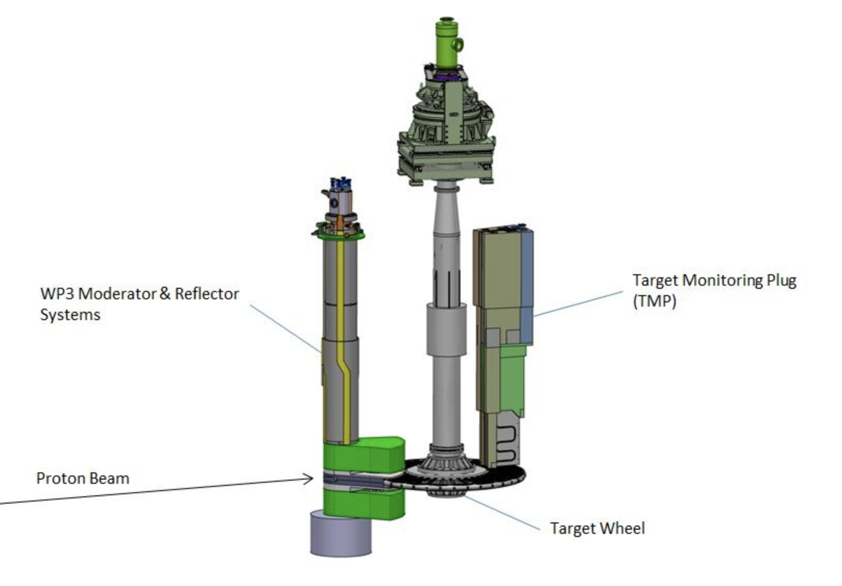
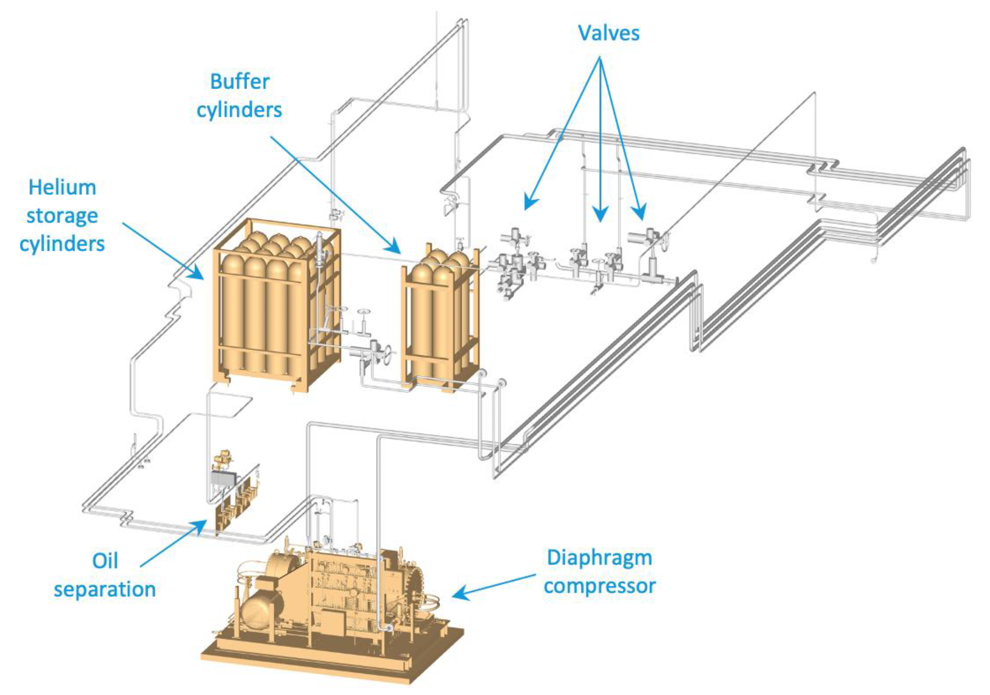
WoW during testing w/o beam - The Target Group testing
TWDS 1000 – Target wheel, Drive & Shaft
HeC 1010 – Target Primary Cooling
HePC 1011 – Press. Ctrl Primary Cooling
HeIn 1013 – Helium Injection
HePu 1015 – Helium Purification
HeWC 1016 - Equipment cooling (circ & compr)
PrHe 1030 – Pristine Helium (filling St)
IAD 1031 – Instrument Air Distribution
DWD 1032 – Deionized Water Distribution
N2D 1033 – Nitrogen Gas Distribution
IWCT 1046 – Target Intermediate Water Cooling
IDrT 1047 – Intermediate Drain Tanks
CDrT 1049 – Contaminated Drain Tanks
TMS 1063 – Target Monitoring System
OffG 1140 – Off-gas extraction
MPRS 1150 – Monolith Pressure Relief System
HCPR 1160 – Helium Cooling Pressure Relief
FM Air: CF Instrument Air Supply
FM DW: FM Deionized Water Supply
FM WC: FM Water Cooling Supply
FM N2: FM Nitrogen Supply
TMS
1063
IWCT
1046
TWDS
1000
FM WC
HeC
1010
A
HeWC
1016
HePC
1011
HePu
1015
HCPR
1160
For H20 PSV
HeIn
1013
From CF
“SERA compressor”

Slide 10
WoW during testing w/o beam - The Target Group testing
TWDS 1000 – Target wheel, Drive & Shaft
HeC 1010 – Target Primary Cooling
HePC 1011 – Press. Ctrl Primary Cooling
HeIn 1013 – Helium Injection
HePu 1015 – Helium Purification
HeWC 1016 - Equipment cooling (circ & compr)
PrHe 1030 – Pristine Helium (filling St)
IAD 1031 – Instrument Air Distribution
DWD 1032 – Deionized Water Distribution
N2D 1033 – Nitrogen Gas Distribution
IWCT 1046 – Target Intermediate Water Cooling
IDrT 1047 – Intermediate Drain Tanks
CDrT 1049 – Contaminated Drain Tanks
TMS 1063 – Target Monitoring System
OffG 1140 – Off-gas extraction
MPRS 1150 – Monolith Pressure Relief System
HCPR 1160 – Helium Cooling Pressure Relief
FM Air: CF Instrument Air Supply
FM DW: FM Deionized Water Supply
FM WC: FM Water Cooling Supply
FM N2: FM Nitrogen Supply
OBSERVATION:
Due to the turbo circulators are not available yet, an “option B” circulator has been
purchased, based on of-the-shell technology (screw compressor). This has imposed new
requirements to the group and the building, among others:
Extra water cooling (system 1016).
Extra room cooling and higher load on HVAC systems.
SERA compressor (system 1011) work continuously off-design.
Higher minimum helium flow required.
New control modules (ICS software).
Extra interlocks and control functions.
Development of extra OPI’s.
More complicated operation State Machine.
More cumbersome operation and manuals.
More maintenance needs.
Worsen work environment conditions (noise, heat).
+ Redundancy => higher availability & reliability.
TMS
1063
IWCT
1046
TWDS
1000
FM WC
HeC
1010
A
HeWC
1016
HePC
1011
HePu
1015
HCPR
1160
For H20 PSV
HeIn
1013
From CF

Slide 11
WoW during testing w/o beam - The Target Group testing
TWDS 1000 – Target wheel, Drive & Shaft
HeC 1010 – Target Primary Cooling
HePC 1011 – Press. Ctrl Primary Cooling
HeIn 1013 – Helium Injection
HePu 1015 – Helium Purification
HeWC 1016 - Equipment cooling (circ & compr)
PrHe 1030 – Pristine Helium (filling St)
IAD 1031 – Instrument Air Distribution
DWD 1032 – Deionized Water Distribution
N2D 1033 – Nitrogen Gas Distribution
IWCT 1046 – Target Intermediate Water Cooling
IDrT 1047 – Intermediate Drain Tanks
CDrT 1049 – Contaminated Drain Tanks
TMS 1063 – Target Monitoring System
OffG 1140 – Off-gas extraction
MPRS 1150 – Monolith Pressure Relief System
HCPR 1160 – Helium Cooling Pressure Relief
FM Air: CF Instrument Air Supply
FM DW: FM Deionized Water Supply
FM WC: FM Water Cooling Supply
FM N2: FM Nitrogen Supply
TARGET GROUP
TMS
1063
Option B
IWCT
1046
TWDS
1000
FM WC
HeC
1010
A
HeWC
1016
HePC
1011
HePu
1015
HCPR
1160
For H20 PSV
HeIn
1013
From CF

Slide 12
WoW during testing w/o beam - The Target Group testing
TWDS 1000 – Target wheel, Drive & Shaft
HeC 1010 – Target Primary Cooling
HePC 1011 – Press. Ctrl Primary Cooling
HeIn 1013 – Helium Injection
HePu 1015 – Helium Purification
HeWC 1016 - Equipment cooling (circ & compr)
PrHe 1030 – Pristine Helium (filling St)
IAD 1031 – Instrument Air Distribution
DWD 1032 – Deionized Water Distribution
N2D 1033 – Nitrogen Gas Distribution
IWCT 1046 – Target Intermediate Water Cooling
IDrT 1047 – Intermediate Drain Tanks
CDrT 1049 – Contaminated Drain Tanks
TMS 1063 – Target Monitoring System
OffG 1140 – Off-gas extraction
MPRS 1150 – Monolith Pressure Relief System
HCPR 1160 – Helium Cooling Pressure Relief
FM Air: CF Instrument Air Supply
FM DW: FM Deionized Water Supply
FM WC: FM Water Cooling Supply
FM N2: FM Nitrogen Supply
SUPPLY SYSTEMS
FM AIR
IAD
1031
TARGET GROUP
TMS
1063
FM DW
DWD 1032
Option B
IWCT
1046
TWDS
1000
A
A
W
A
HeC
1010
A
FM WC
A
N2
HeWC
1016
HePC
1011
N2
He
HePu
1015
FM N2
N2D
1033
HCPR
1160
He
For H20 PSV
HeIn
1013
He
From CF
PrHe
1030

Slide 13
WoW during testing w/o beam - The Target Group testing
TWDS 1000 – Target wheel, Drive & Shaft
HeC 1010 – Target Primary Cooling
HePC 1011 – Press. Ctrl Primary Cooling
HeIn 1013 – Helium Injection
HePu 1015 – Helium Purification
HeWC 1016 - Equipment cooling (circ & compr)
PrHe 1030 – Pristine Helium (filling St)
IAD 1031 – Instrument Air Distribution
DWD 1032 – Deionized Water Distribution
N2D 1033 – Nitrogen Gas Distribution
IWCT 1046 – Target Intermediate Water Cooling
IDrT 1047 – Intermediate Drain Tanks
CDrT 1049 – Contaminated Drain Tanks
TMS 1063 – Target Monitoring System
OffG 1140 – Off-gas extraction
MPRS 1150 – Monolith Pressure Relief System
HCPR 1160 – Helium Cooling Pressure Relief
FM Air: CF Instrument Air Supply
FM DW: FM Deionized Water Supply
FM WC: FM Water Cooling Supply
FM N2: FM Nitrogen Supply
SUPPLY SYSTEMS
FM AIR
IAD
1031
TARGET GROUP
TMS
1063
TARGET GROUP
FM DW
DWD 1032
Option B
IWCT
1046
TWDS
1000
A
A
W
A
HeC
1010
A
FM WC
A
N2
HeWC
1016
HePC
1011
IDrT
1047
N2
He
CDrT 1049
HePu
1015
FM N2
N2D
1033
HCPR
1160
He
OffG
1140
For H20 PSV
HeIn
1013
EXHAUST SYSTEMS
He
From CF
PrHe
1030

Slide 14
WoW during testing w/o beam - The Target Group testing
TWDS
1080
SIT3
TWDS
1080
SIT1
TWDS
1080
SIT2
SUPPLY SYSTEMS
TSS
TWDS 1000 – Target wheel, Drive & Shaft
HeC 1010 – Target Primary Cooling
HePC 1011 – Press. Ctrl Primary Cooling
HeIn 1013 – Helium Injection
HePu 1015 – Helium Purification
HeWC 1016 - Equipment cooling (circ & compr)
PrHe 1030 – Pristine Helium (filling St)
IAD 1031 – Instrument Air Distribution
DWD 1032 – Deionized Water Distribution
N2D 1033 – Nitrogen Gas Distribution
IWCT 1046 – Target Intermediate Water Cooling
IDrT 1047 – Intermediate Drain Tanks
CDrT 1049 – Contaminated Drain Tanks
TMS 1063 – Target Monitoring System
OffG 1140 – Off-gas extraction
MPRS 1150 – Monolith Pressure Relief System
HCPR 1160 – Helium Cooling Pressure Relief
FM Air: CF Instrument Air Supply
FM DW: FM Deionized Water Supply
FM WC: FM Water Cooling Supply
FM N2: FM Nitrogen Supply
FM AIR
IAD
1031
TARGET GROUP
TMS
1063
FM DW
DWD 1032
HeMeas
1017
Option B
IWCT
1046
TWDS
1000
A
W
A
HeC
1010
A
FM WC
A
N2
HeWC
1016
HePC
1011
IDrT
1047
N2
He
CDrT 1049
HePu
1015
FM N2
N2D
1033
HCPR
1160
He
OffG
1140
For H20 PSV
MPRS
1150
HeIn
1013
EXHAUST SYSTEMS
He
For He PSV
From CF
PrHe
1030
* 1150 part of
Monolith Group

Slide 15
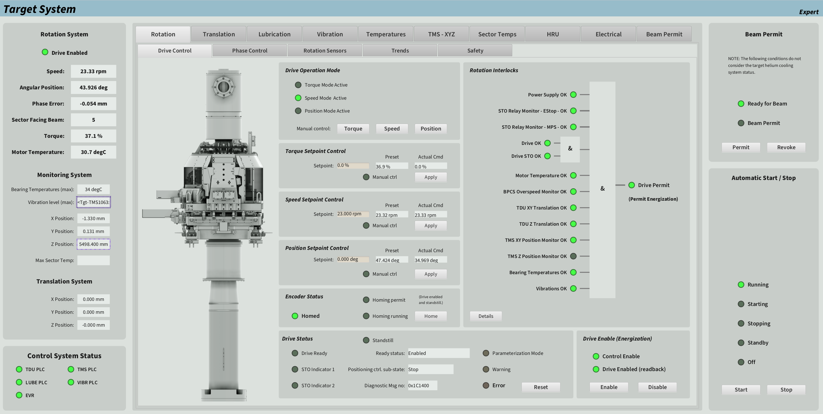
OPI Target System: systems 1000 and 1063

Slide 16
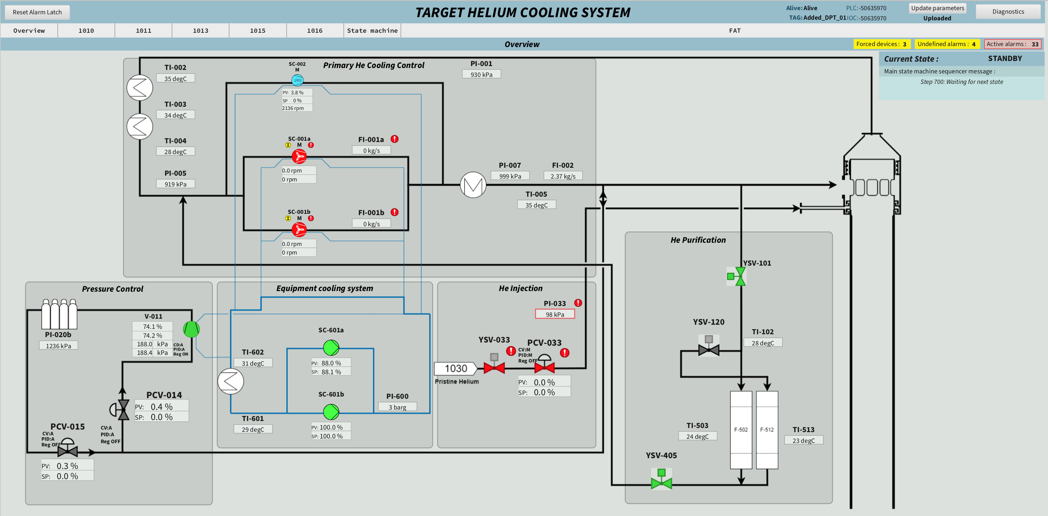
OPI Target Helium cooling system: systems 1010, 1011, 1013, 1015, 1016 (and soon 1017)
1046:W-006
System 1010
Option B
1046:W-007
Option A
1046:W-008
System 1015
System 1011
System 1016
System 1013

Slide 17
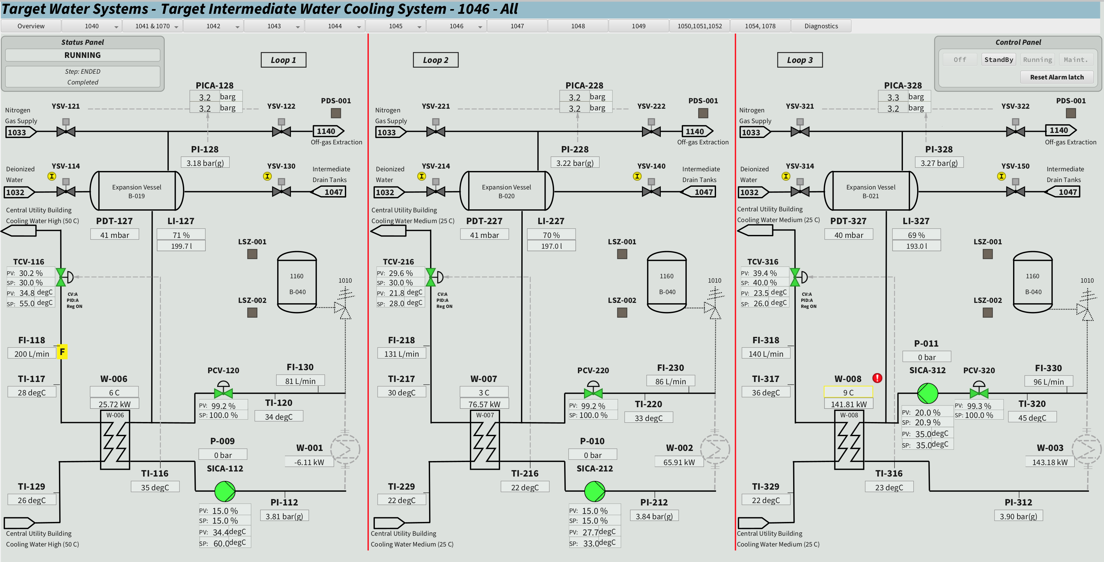
OPI Target Intermediate water-cooling system: system 1046 (3 loops)

Slide 18
Testing status
LOCAL TESTING
NOT TESTED
PREPARATION LOCAL TEST
SOT ONGOING
SOT COMPLETED SYT ONGOING
SOT COMPLETED SYT COMPLETED
LT DONE
SAT ONGOING
SAT COMPLETED
INTEGRATED TESTING
PREPARATION GROUP TEST 1
GROUP TEST 1 ONGOING
GROUP TEST 1 COMPLETED
PREPARATION GROUP TEST 2
GROUP TEST 2
ONGOING
GROUP TEST 2 COMPLETED
GT DONE
NEUTRON FACTORY TESTING
NF ONGOING
NF COMPLETED

Slide 19
NF test plan
Objectives
The NF integrated test primarily serves to:
Verify that all NF systems can be operated together.
It is an opportunity to verify open issues from previous group tests.
It is a “kind of” availability & reliability test, implying 24/7 operation during a prolonged period of time. The purpose here is:
to identify if unplanned stops and trips occur,
assess the NF current availability & reliability levels (without beam on target) compared to ESS global requirements.

Slide 20
NF test plan
* Italic font = NF Operational Mode
* CAPITAL font = State Machine State
Test cases and acceptance criteria
Test | Description | Acceptance criteria
Test 1: Closure of open issues from group tests | This phase of the testing serves the purpose to close open issues from previous tests, e.g. tests that may have not been finalized. Duration: 1 week. | All open issues that can have a negative impact on operation closed.
Test 2: Start-up of the NF | Test of start-up sequence from Maintenance mode to Production mode. The purpose is consolidating the proposed start-up sequence and to test operation procedures and administrative measures for start-up, together with MCR. Duration: 1 week, at least two start-ups performed. | The Neutron Factory started successfully without any trips or significant alarms.
Test 3: Shutdown of the NF | Test of shutdown sequence from Production mode to Maintenance mode. The purpose is to test operation procedures and administrative measures for shutdown, together with MCR. Duration: 1 week, at least two shutdowns performed. | The Neutron Factory successfully shut down and taken to Maintenance mode without any trips or significant alarms. Cooling down mode successfully performed.
Test 4: Long term steady state operation | Test of steady state operation. The purpose is to test that all systems are stable and reliable. Duration: 2 weeks. | The Neutron Factory successfully operated in stable steady state conditions without any significant alarms, during at least 10 consecutives shifts of uninterrupted operation.
Test 5: FAULT initiation | Simulate that one subsystem goes to FAULT an alarm in one subsystem. Verify that other subsystems react as intended. | Subsystems behave as intended according to control systems.

Slide 21
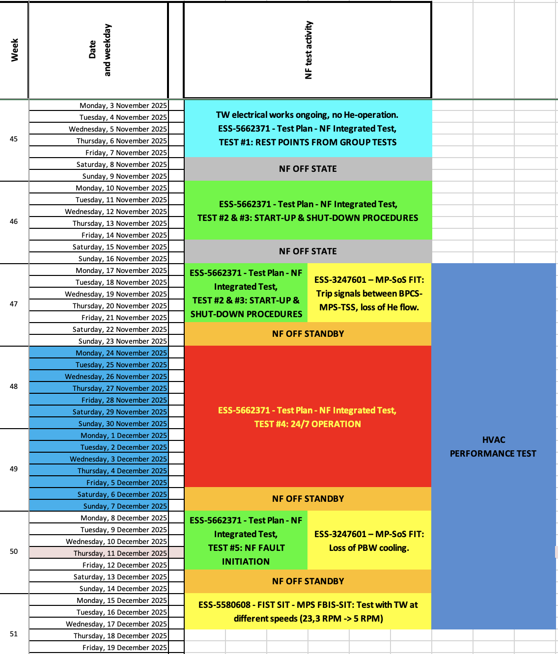
NF test plan
Schedule
W45: cannot operate TW (due to electrical works) and therefore neither He cooling.
Preparations
Rest points from Group tests
W46: start-up/shut-down seq. consolidation
W47 : start-up/shut-down MCR procedures.
MPS FIT.
HVAC performance test
W48: W48+49: 24/7 steady state operation.
HVAC performance test
W50: Fault initiation
MPS FIT
HVAC performance test
W51: FIST-SIT
HVAC Performance test

Slide 22
TARGET GROUP
MODERATOR GROUP
TWDS 1000 – Target wheel, Drive & Shaft
HeC 1010 – Target Primary Cooling
HePC 1011 – Pressure Control Primary Cooling
HeIn 1013 – Helium Injection
HePu 1015 – Helium Purification
1016 – Equip. cooling Tgt cooling circulators & compressor.
InsC 1026 – Neutron Beam Port Insert Cooling
AtOA 1028 – Neutron Beam Optic Assambly Atmosphere
PrHe 1030 – Pristine Helium
IAD 1031 – Instrument Air Distribution
DWD 1032 – Deionized Water Distribution
N2D 1033 – Nitrogen Gas Distribution
RGT 1040 – Radiolysis Gas Treatment
PWCM 1041 –Moderator Primary Water Cooling
PWCR 1042 – Reflector Primary Water Cooling
PWCS 1043 – Shielding & Plugs Primary Water Cooling
IWCL 1044 – Intermediate Water Cooling 15°C
IWCM 1045 – Intermediate Water Cooling 30°C
IWCT 1046 – Target Intermediate Water Cooling
IDrT 1047 – Intermediate Drain Tanks
PDrT 1048 – Primary Drain Tanks
CDrT 1049 – Contaminated Drain Tanks
WPuM 1050 – Water Purification Moderator
WPuR 1051 – Water Purification Reflector
WPuS 1052 – Water Purification Shielding & Plugs
Crs-CMS 1055 – Water Cooling H2 Pump
CWD 1057 – Cooling Water Distribution
Smpl 1059 – Sample Station
IrrM 1061 – Irradiation Module
PBIP 1062 – Proton Beam Instrumentation Plug
TMS 1063 – Target Monitoring System
PBW 1065 – Proton Beam Window
IS 1066 – Inner Shielding
CPMV 1067 – Covers, Penetrations & Monolith Vessel
PBWC 1070 – Proton Beam Window Cooling
PBWP 1076 – Proton Beam Window Port Block & Vessel
MPBP 1098 – Neutron Beam Port Block Package
Crs-CMS 1100 – Cryogenic Moderator System
MRP 1110 – Moderator Reflector Plug
MRRU 1112 – Moderator Reflector Roration Unit
Crs-TMCP 1120 – Target Moderator Cryo Plant
OffG 1140 – Off-gas extraction
MPRS 1150 – Monolith Pressure Relief System
HCPR 1160 – Helium Cooling Pressure Relief
CF Air: CF Instrument Air Supply
CF DW: CF Deionized Water Supply
CF WC: CF Water Cooling Supply
CF N2: CF Nitrogen Supply
D02
TSS
1080
SIT1
TSS
1080
SIT2
TSS
1080
SIT3
TSS
1080
SIT4
WPuM 1050
SpentRes
1054
ResFill
1078
Dry
1058
From CF
CF AIR
IAD
1031
1041
1032
1031
PBWC 1070
1042
1000
1044
CF AIR
IAD
1031
TMS
1063
PWCM
1041
1010
W
A
PBW 1065
1046
CF DW
DWD 1032
1041
N2
CF DW
DWD 1032
1042
1033
RGT
1040
1046
HeMeas
1017
1044
1032
1031
PBIP
1062
1032
1031
1031
1031
N2
CF CWM
CF WC
IWCL
1044
1033
MRP
1110
IWCT
1046
HeC
1010
TWDS
1000
W
A
PDrT 1048
CF CWH
1033
W
A
A
A
Smpl 1059
N2
HeWC
1016
IDrT
1047
IDrT
1047
OffG
1140
1031
IrrM 1061
CDrT 1049
HePC
1011
CDrT 1049
1032
PWCR
1042
N2
He
HePu
1015
1040
1033
W
A
CF N2
N2D
1033
1046
1033
1030
He
CF N2
N2D
1033
1041
N2
HCPR
1160
1042
1011
1030
1100
WPuR 1051
PrHe
1030
1011
MPRS
1150
HeIn
1013
PrHe
1030
CWD
1057
1013
from CF
1100
Crs-CMS (1055)
Crs-CMS (1100)
InsC 1026 – Neutron Beam Port Insert Cooling
PrHe 1030 – Pristine Helium
IAD 1031 – Instrument Air Distribution
OffG 1140 - Off-gas Extraction
1015
OffG
1140
He
1030
H2 fill St:
1107
Crs-TMCP (1120)
N2
H2
He
NBEX GROUP
1100
1033
1107
1030
NBOA NMX
MONOLITH GROUP
NEUTRON
FACTORY
NBOA Beer
SpentRes
1054
ResFill
1078
Dry
1058
IAD
1031
AtOA
1028
CF AIR
IAD
1031
1027
CF AIR
A
1043
He
NBOA C-Spec
1045
Smpl
1059
NBOA Bifrost
1043
WPuS
1052
PBIP
1062
Off-gas
1140
NBOA Miracles
CF DW
DWD 1032
1045
He
1032
1031
1032
1031
InsC
1026
NBOA T-Rex
PWCS
1043
CF WC
IWCM
1045
W
A
TMS
1063
PrHe
1030
NBOA Heimdal
W
A
1033
N2
NBOA Loki
IS
1066
1172
IDrT
1047
LSS
A
PDrT 1048
RGT
1040
1031
PBWP
1076
He
Integration with PSS
NBOA Freia
CDrT 1049
N2
1033
MRV
(1027)
NBOA Odin
A
NBOA Dream
CF N2
N2D
1033
1040
PWCS
1043
InsC
1026
1043
W
A
A
OffG
1140
from FM
N2
He
NBOA Vespa
MPBP
1098
NBOA skadi
from CF
MPRS
1150
CPMV
1067
NBOA Estia

Slide 23
Tuning Beam Dump testing - status
R
1068 – Tuning Beam Dump (TBD)
1069 – Tuning Beam Dump Shielding
MPS
SAR4
SRR4
TBD & Shield
1068_1069
Integr.
Test
BoD
ACC WCS02

Slide 24
Target HVAC testing – status
R
1130 - TS HVAC - Room Environment Monitoring System
1131 - TS HVAC – Air Supply for C1, C2 and C3
1132 - TS HVAC - Air Exhaust from C1 and C2
1133 - TS HVAC - Process Control & Monitoring System
1134 - TS HVAC – Outlet of Exhaust Gases
1135 - TS HVAC – Air supply for C3
1136 - TS HVAC – Air exhaust from C3
1137 - TS HVAC – Air Exhaust from C4
1138 - TS HVAC Heating Water System
1139 - TS HVAC Cooling Water System
Off-gas extraction system
We have good evidence that the HVAC system has enough capacity for the D02 building, both flow and pressure cascade.
Issue in Active Cell, needs correction -> post BOT.
Fire protection system control logic, e.g. fire dampers, is under test now (needs to be tested for building acceptance) -> March ‘26.
Performance test and Stress test -> April ‘26.
HVH / HVC
1138-1139
(Step 2a - SOT)
HVH / HVC
1138-1139
(Step 2b - SyT)
HVEC / HVSA / HVEB
1137-1131b-1136b
(Step 5b - SyT)
RESTPOINTS
NF Test
HVRM
1130
(Step 1a – SOT)
HVSA / HVEA / HVEG / HVEC
1131-1132-1134-1137
(Step 3a & Step 5a - SOT)
HVSA / HVEA / HVEG
1131-1132-1134
(Step 3b - SyT)
HVRM
Final Balancing
(Step 7a)
HVRM
Final Perf Test
(Step 7c)
Integr
Point
HVRM
Stress Test
(Step 7b)
OffG
1140
(Step 6 - LT)
HVSB / HVEB
1135-1136
(Step 4a - SOT)
HVSB / HVEB
1135-1136
(Step 4b - SyT)
Integr
Point
Precondition for operation with H2 in CMS
Fire Dampers system
(OIM)

Slide 25
2
Lessons learned from Test and commissioning of the Neutron Factory

Slide 26
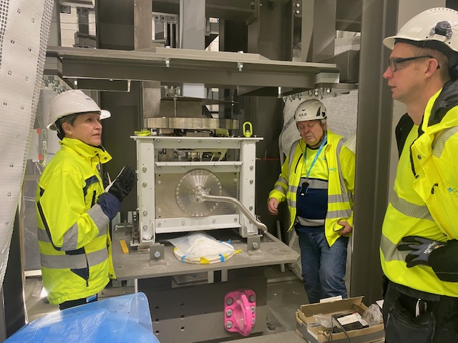
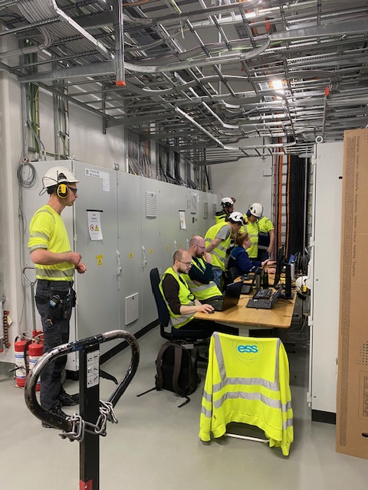
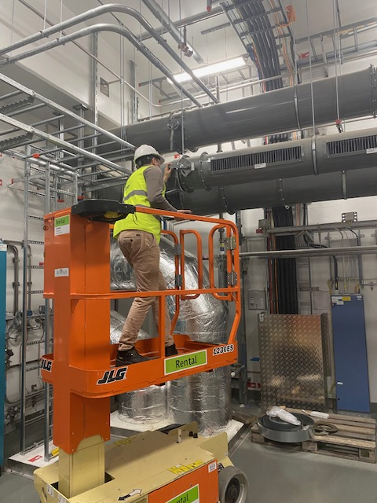
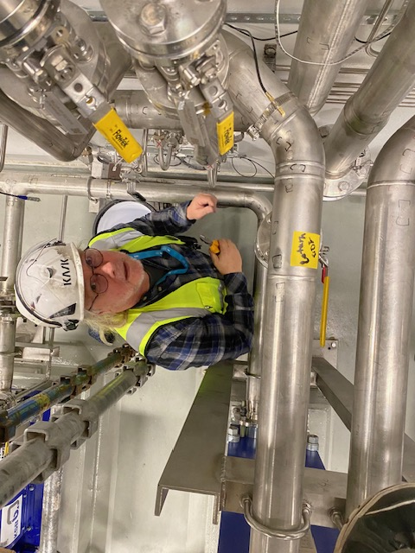
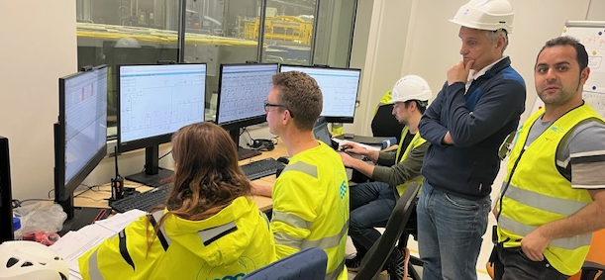
Lessons learned
Helium systems testing team,
start up circulator
HVAC balancing
The people!
PBW at MUTS
Water systems
Running from
local
monitoring
room
System 1016:
Circulator
water cooling,
testing
26
Notes:
RL-OK, My – ändrat document all till everything
Assess your current level of technical mastery for the system(s) you manage.
Share specific examples of how your expertise has helped you identify and resolve challenges or improve system performance.

Slide 27
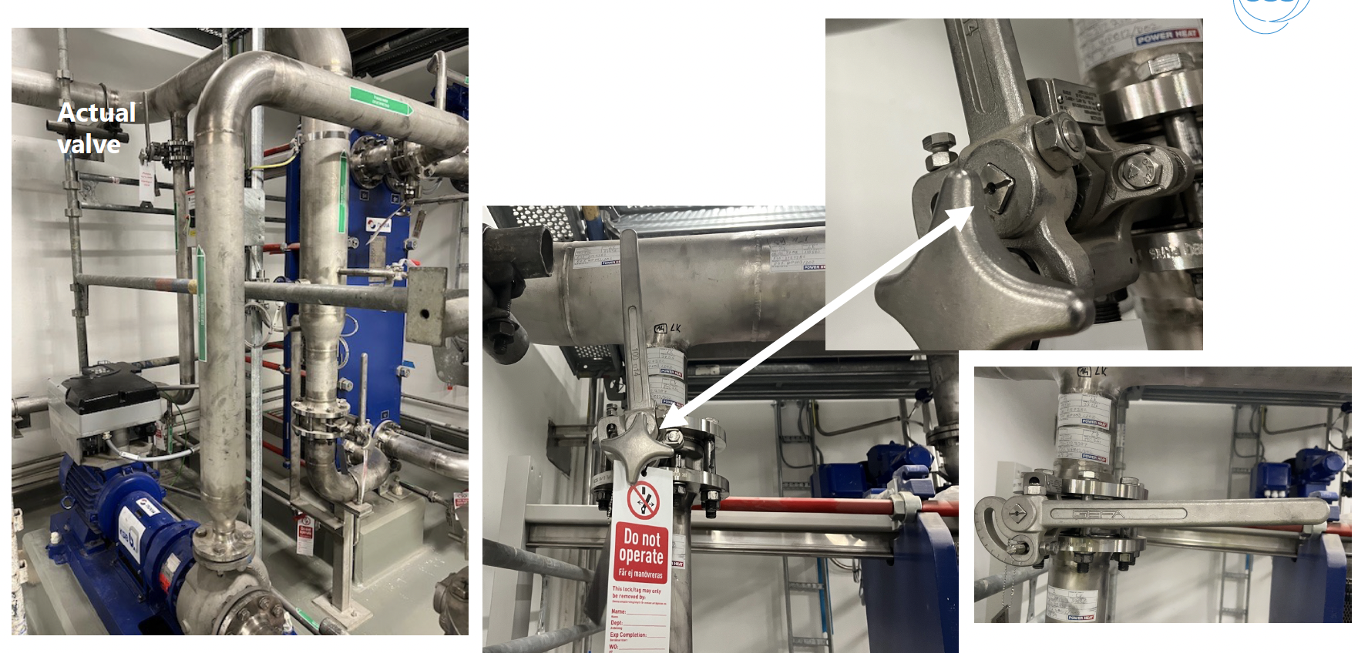
Lessons learned
Can we trust the position of the valve?
Local indication
of the stem
position

Slide 28
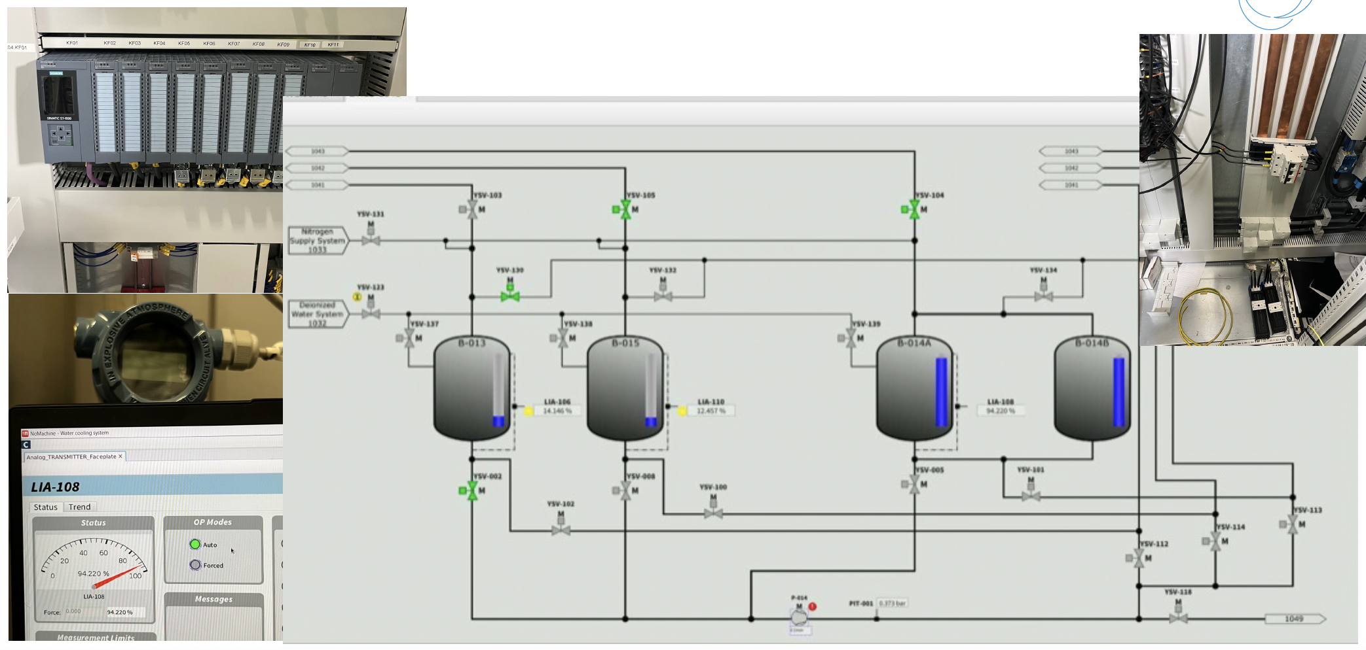
Lessons learned
Everything looks good, but in reality…

Slide 29
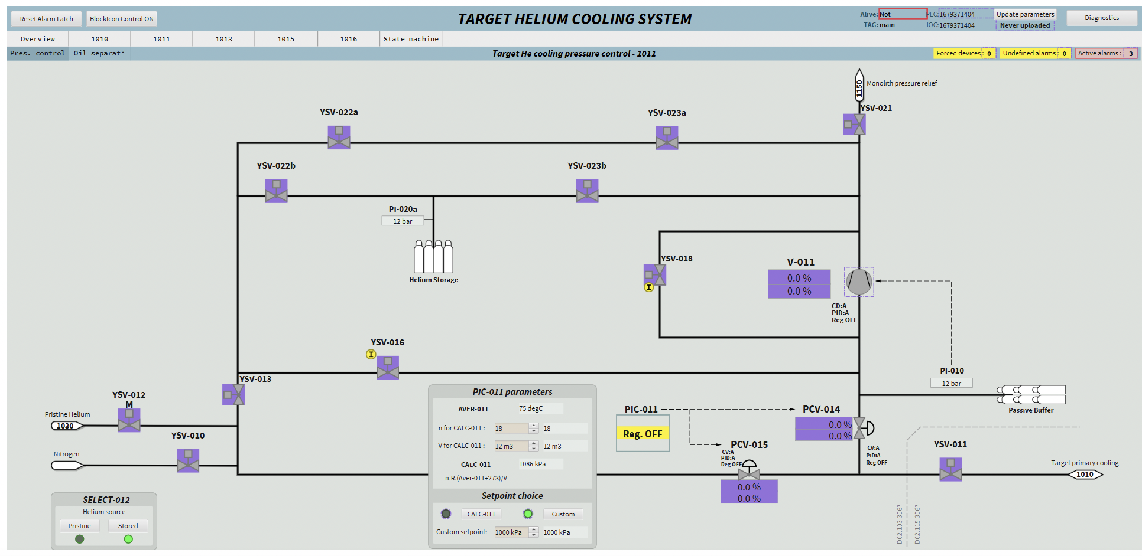
Lessons learned
Now we have a special color code to sign for communication lost (purple)

Slide 30
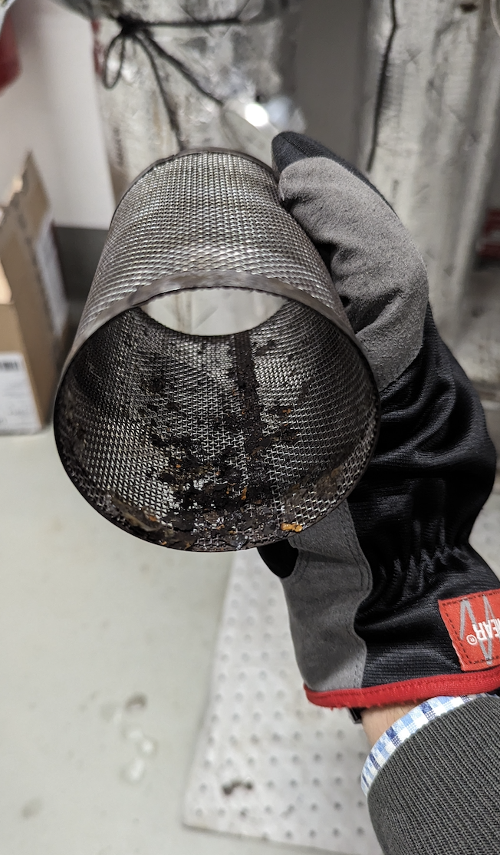
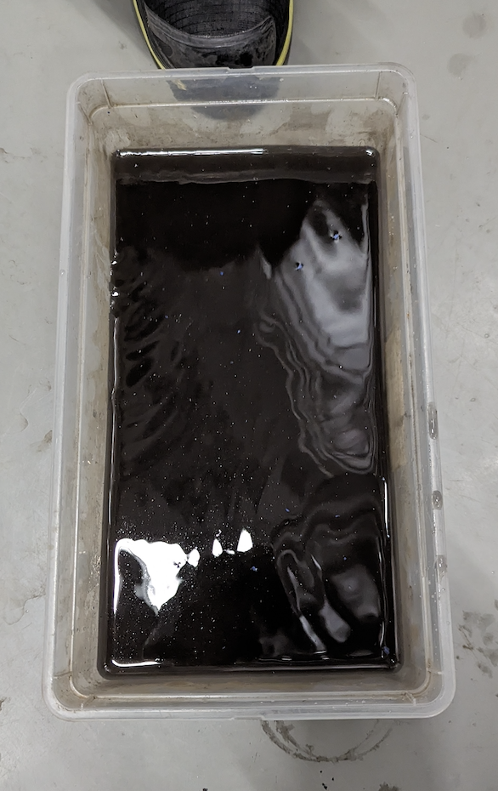
Lessons learned
Cleanliness issues after installation
Water system in the HVAC system.
The system was supposed to be flushed and clean.
We were supposed to be fill with a glycol/water mix, but for practical reasons we decided to start-up with only water.
After 1 day of operation, inspection of filter showed that was not the case.
Now the system is being flushed (again…). Time!
Visual inspections, camera inspections can save time and money.

Slide 31
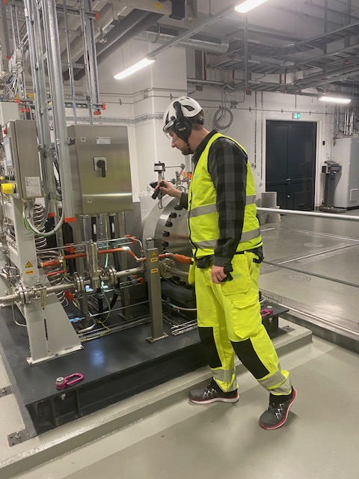
Lessons learned
SERA compressor oil leakage
SERA compressor (support diaphragm compressor for keeping the helium pressure in the main helium cooling circuit to the target wheel).
Broken pipe due to high vibrations and fatigue.
Mitigated by changing process parameters and reinforcing the affected pipe support.
Vibration monitoring of this machine implemented.
More frequent inspections and maintenance than originally recommended by supplier.

Slide 32
Lessons learned
Freezing of the Moderator Reflector Plug 1
(MRP 1) at ESS, by Marc Kickulies
Wed April 15th 9:00 AM in Live 1
MRP damaged
The ESS MRP is a highly integrated component, optimised for maximum brightness performance at 5 MW proton beam power.
The MRP 1 consists of two cold para hydrogen moderators that operates at a temperature of around 17K.
In addition, a thermal- and pre-moderator, a Beryllium reflector, steel frames (or outer reflectors) and steel supporting structures, which cooled with light water at around room temperature.
During commissioning without beam (25th Nov. 2025) cooling water to the MRP stopped due to external circumstances, while the cryogenic parts were at around 35 K. As a result, the water in the thermal- and pre moderator, which is in close vicinity to the cold moderator and the cryogenic supply and return pipes froze. The freezing of the water finally caused sever damages of the MRP 1 beyond the possibility of repair.

Slide 33
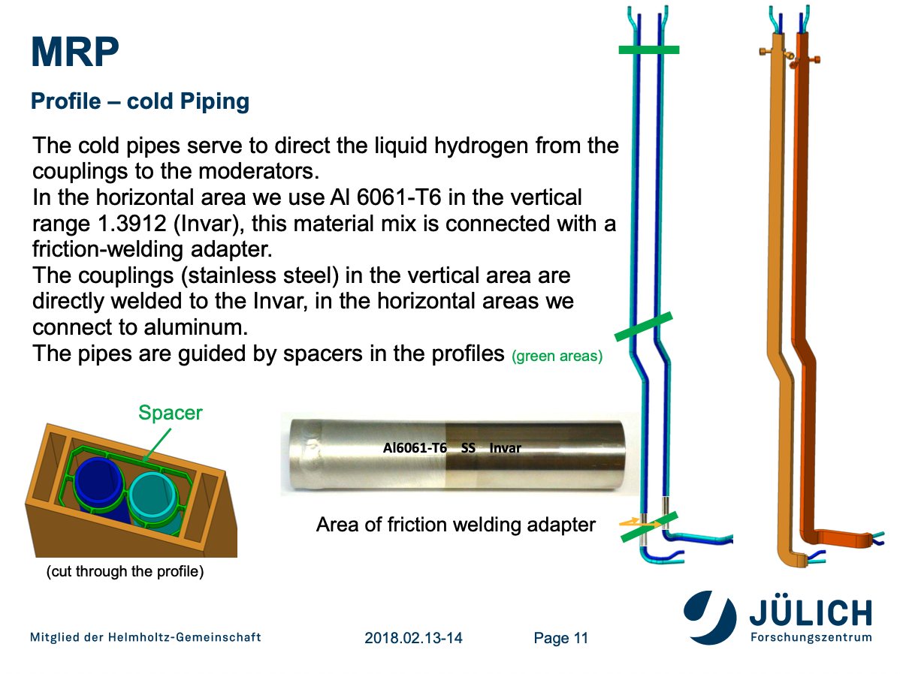
Lessons learned
MRP damaged

Slide 34
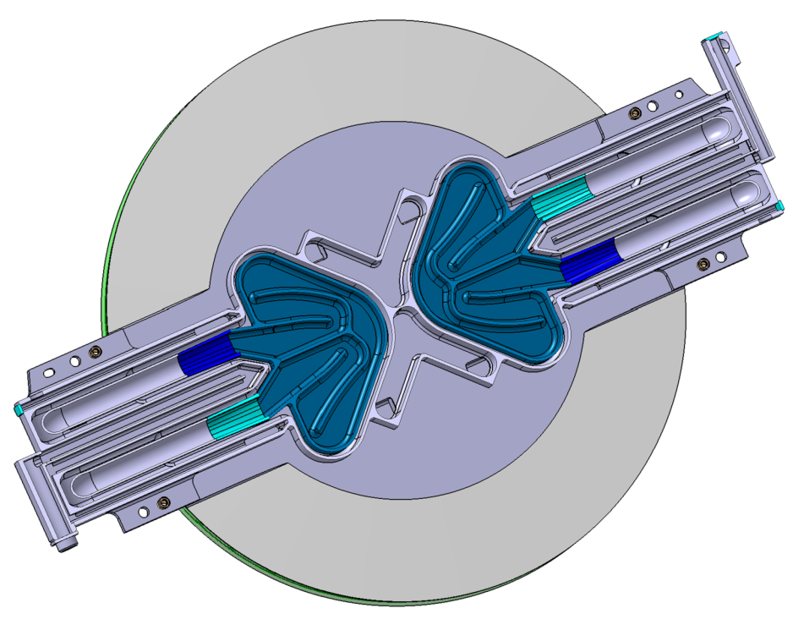
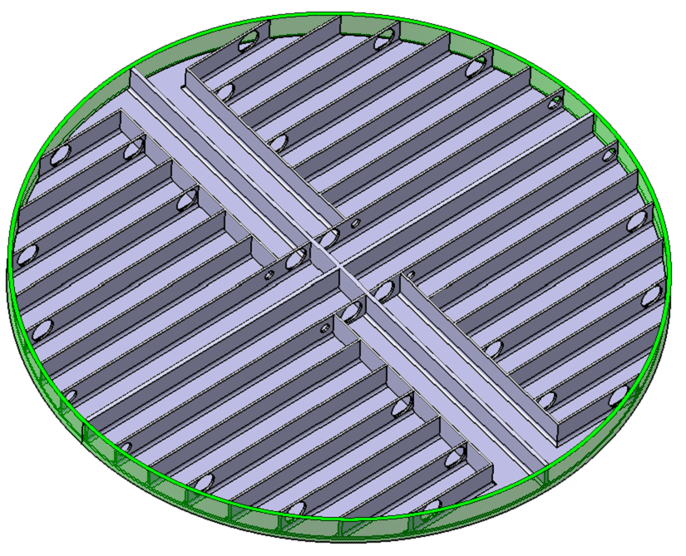
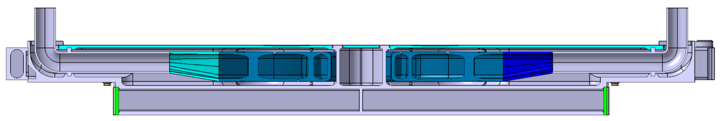
Engineering design of MRP-I
Freezing of the Moderator Reflector Plug 1
(MRP 1) at ESS, by Marc Kickulies
Wed April 15th 9:00 AM in Live 1
Freezing Risk
Cold Moderator (LH2 @20K)
Pre-Moderator
Water flow
1
2
3
2
1
4
3
4
Water channels/
water section
Thermal Moderator
Water jacket
Water-cooled reck
Cold moderator
Vacuum gap: 5 mm
46
90
30
Ø 600

Slide 35
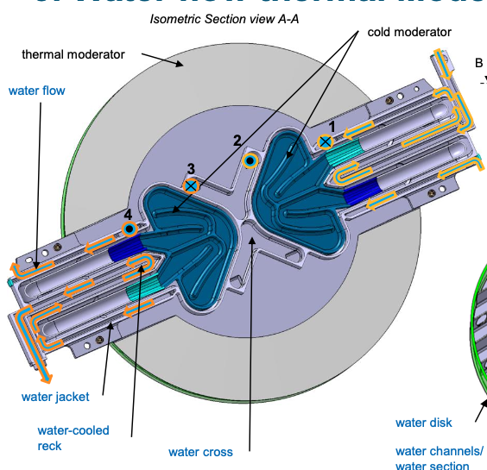
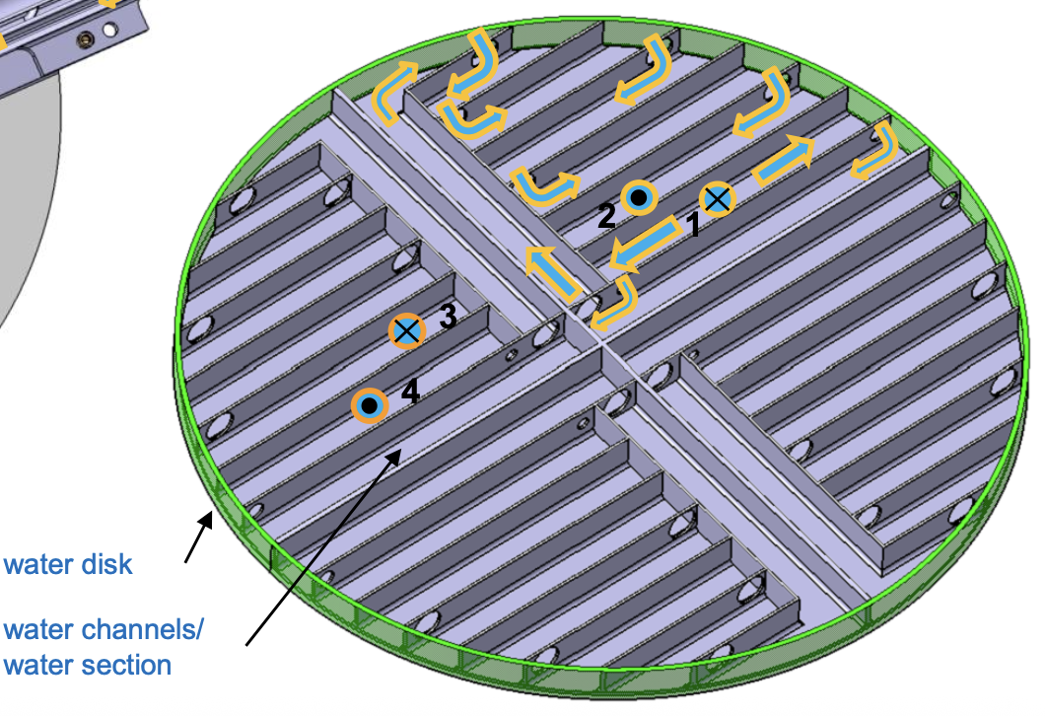
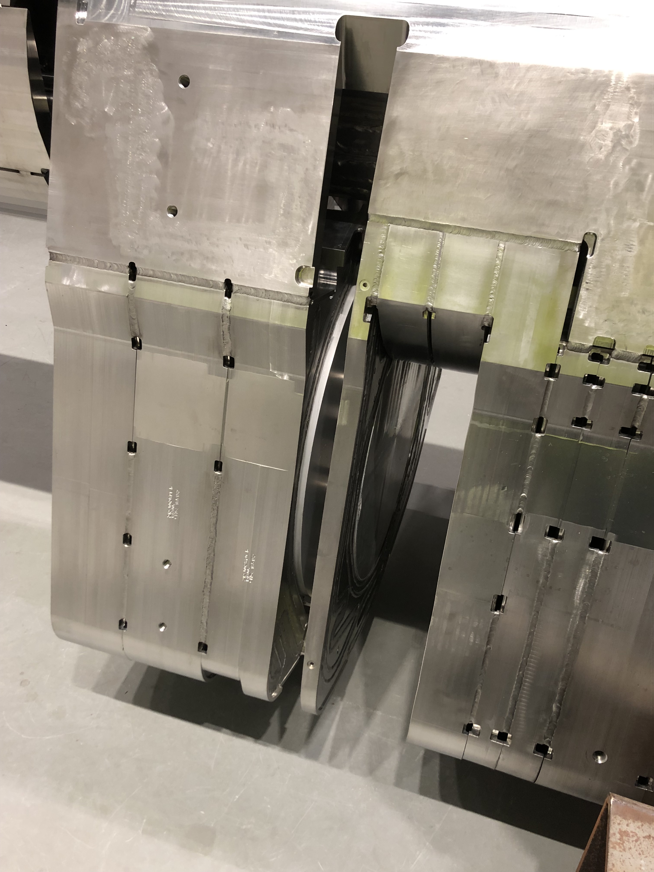
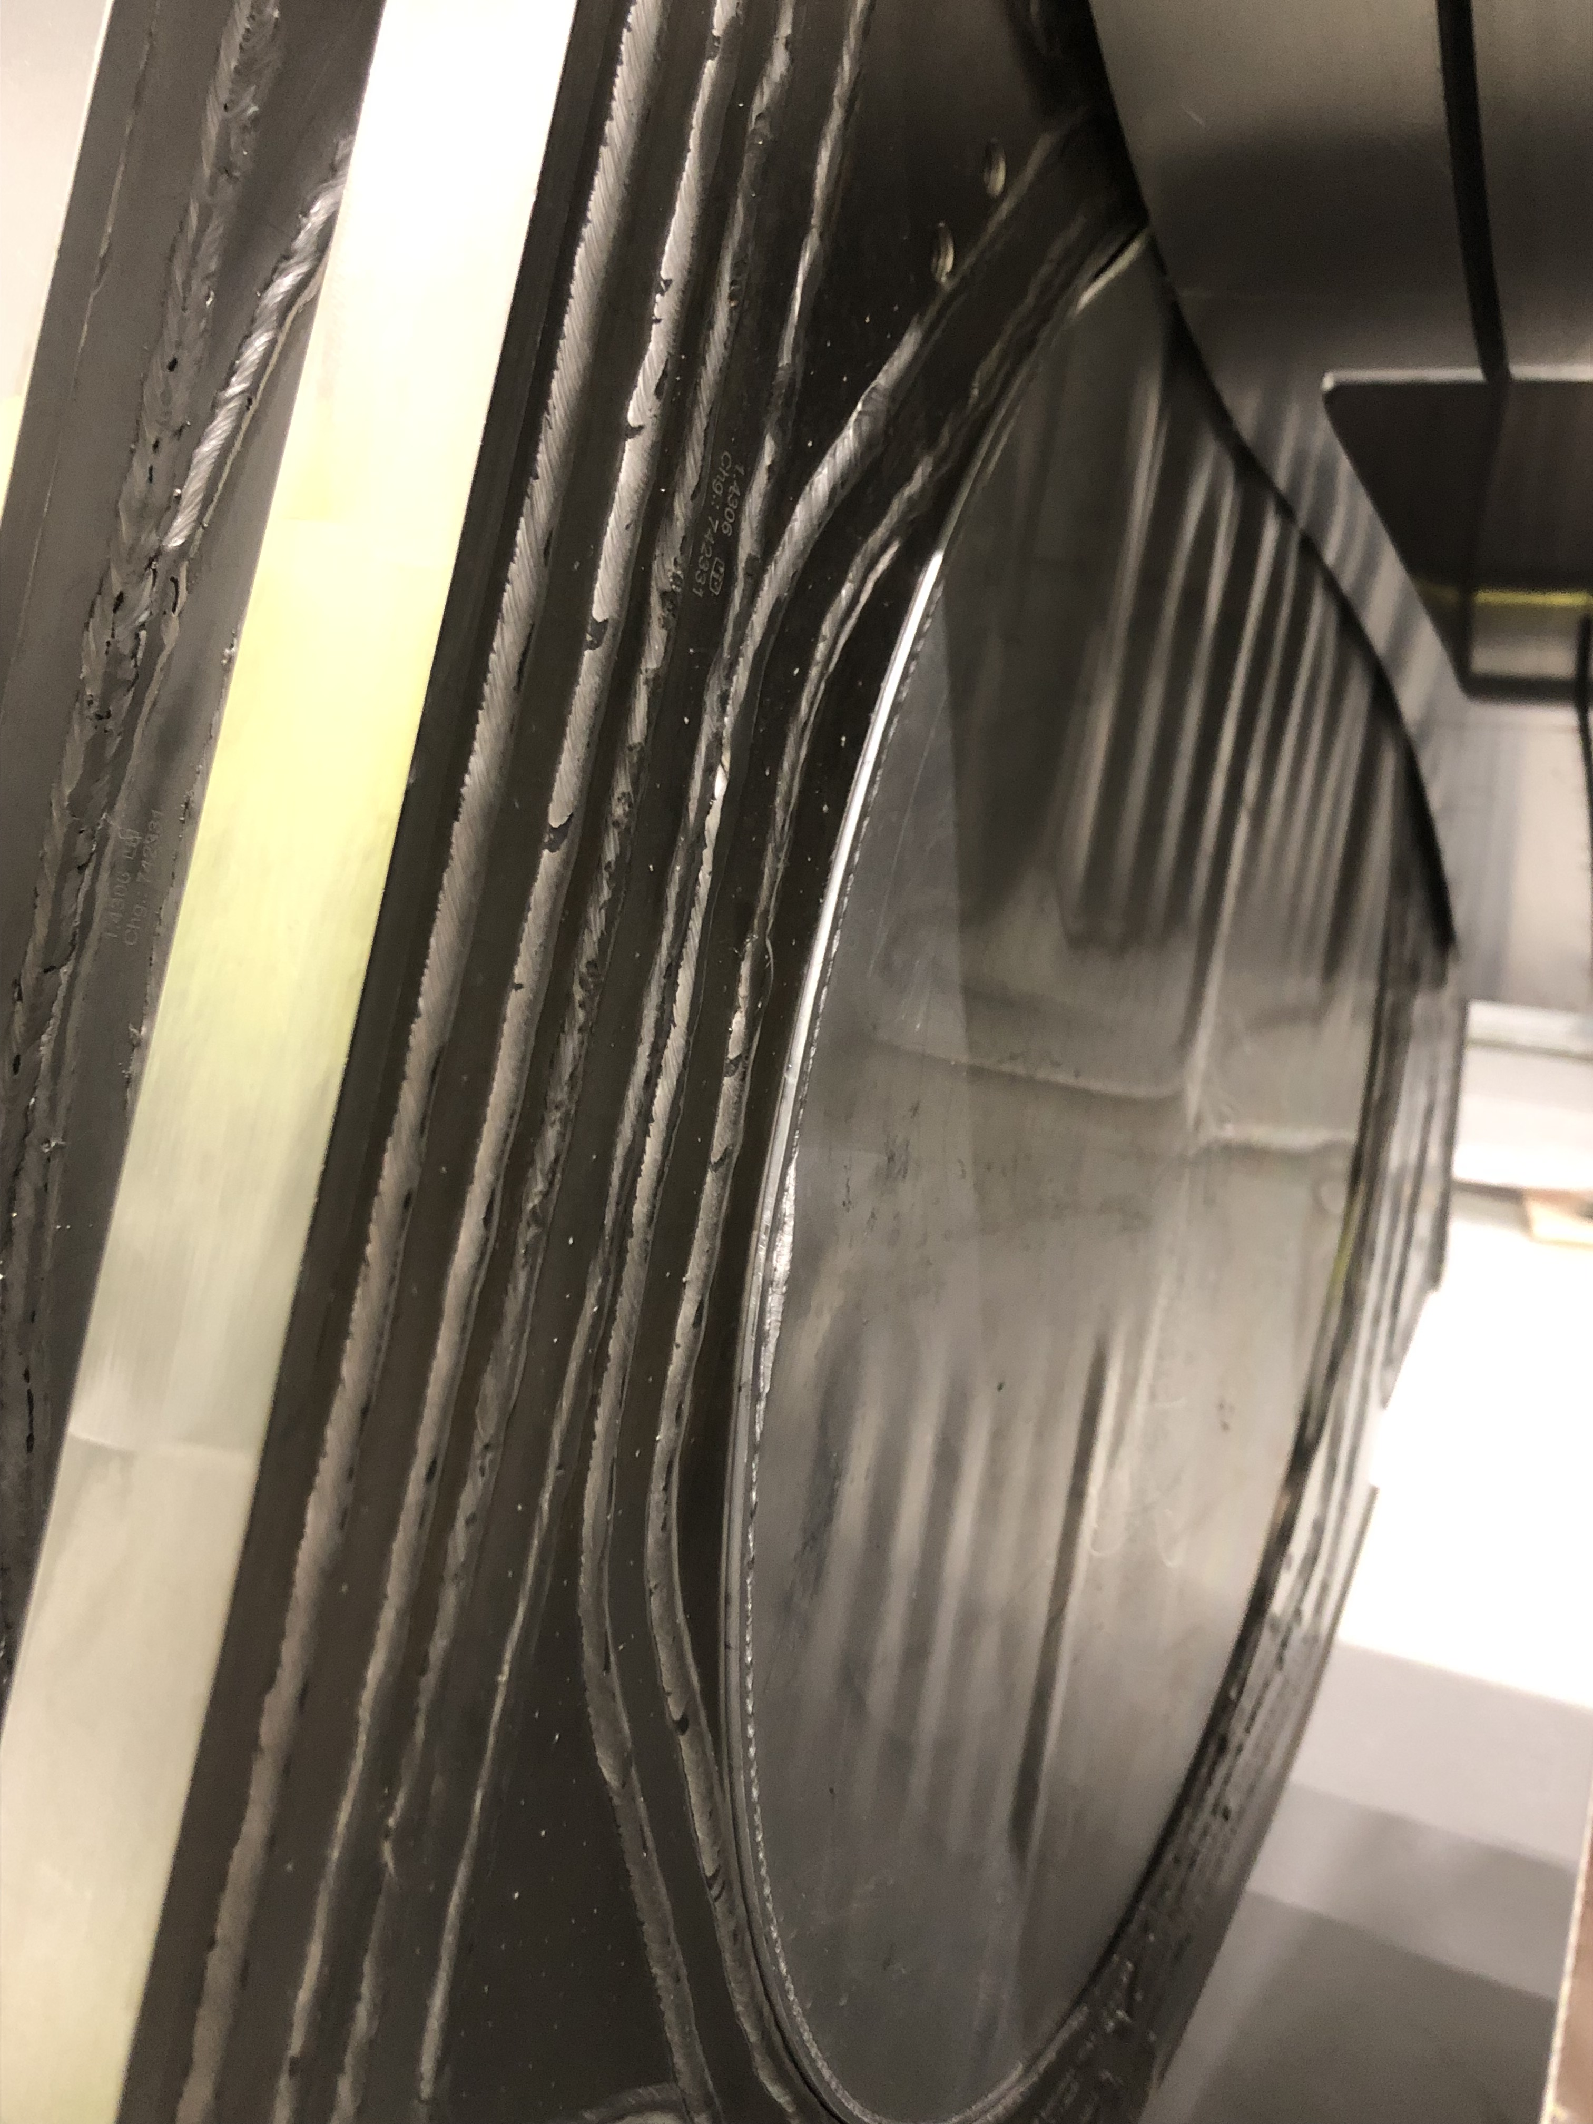
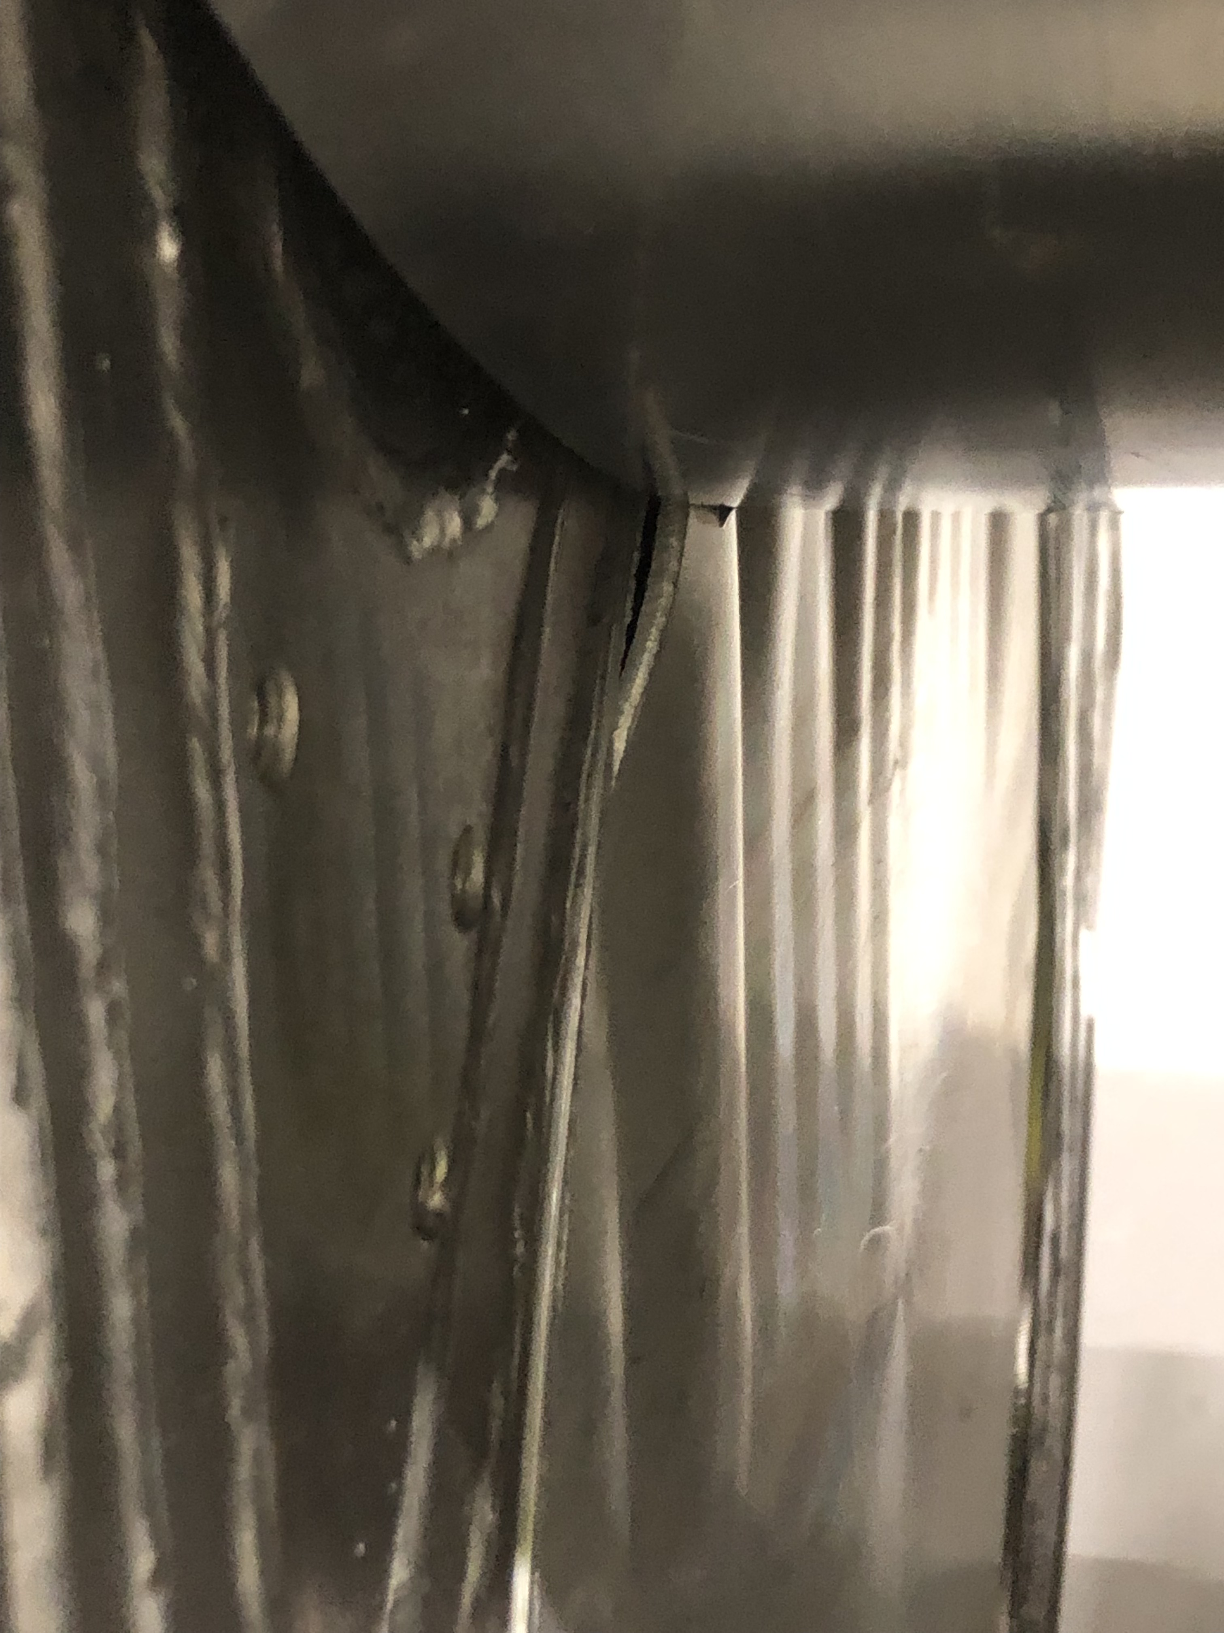
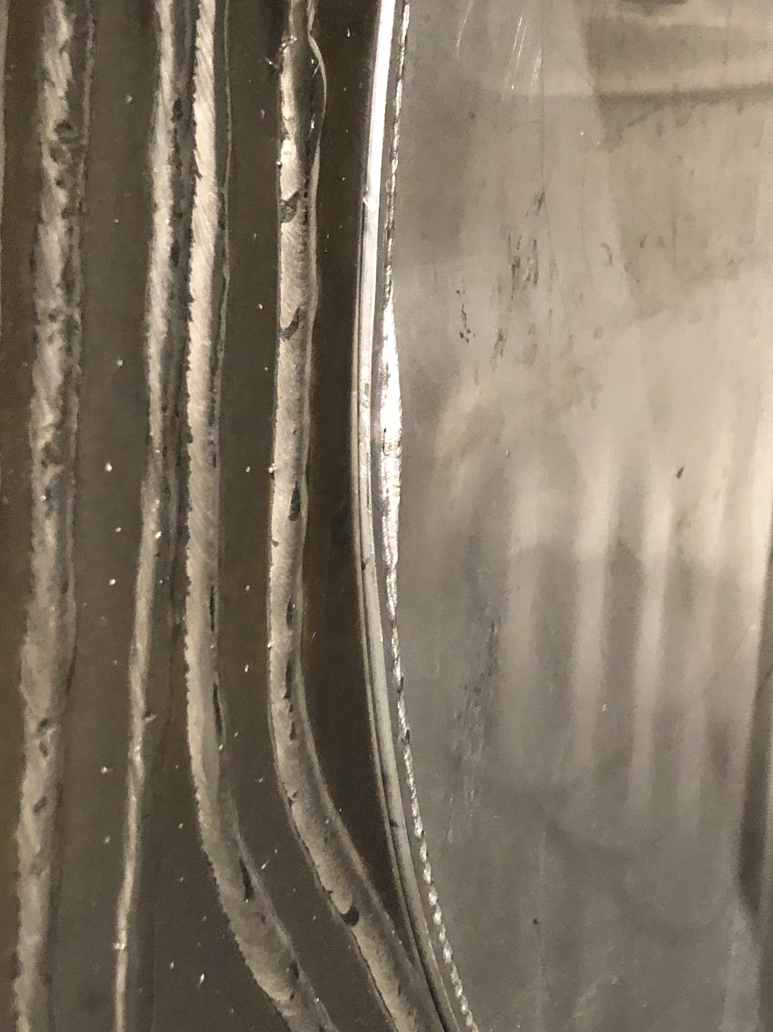

Slide 36
Lessons learned
MRP damaged
RCA executed that pointed out several aspects to be strengthen, both technical and procedural.
Mitigations ongoing to avoid similar incident sin the future:
Start redundant pump
Connect pump motors to UPS and diesel backup
Implement additional emergency pump
Supply water from high tank by gravity
Own lessons learned:
Prioritization of alarms to Main Control Room is of high importance
Integration of information from different systems is important.
E.g, dedicated HMIs for monitoring health of critical components as a whole, not only at sub-system level
Automatize actions that have to be executed in a relatively short time, eliminate the human factor when required.
Spare parts of critical components (or lack of them) has big impact om availability -> mitigate through
prioritization based on availability also
Poster by Larissa Cunico
“Mitigations to the risk of water freezing in MRP”

Slide 37
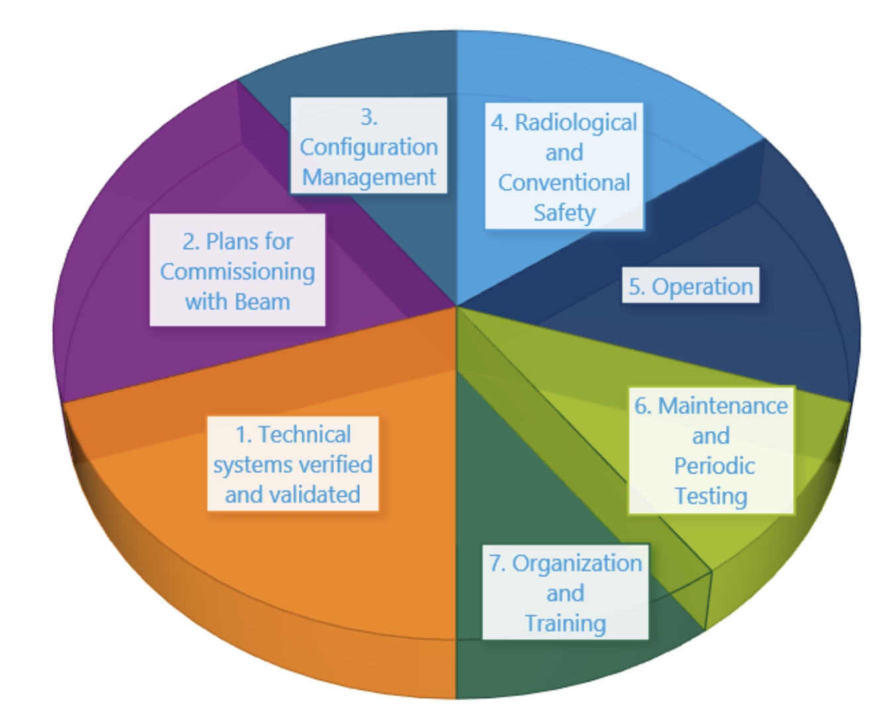
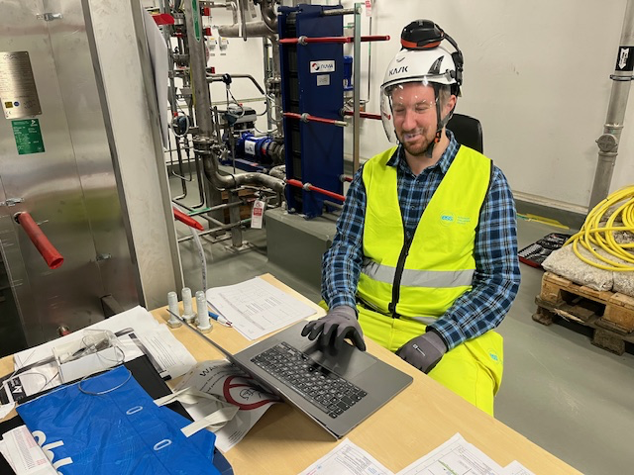
Readiness for operation with p+ beam
Spare slide
On-call preparation together
with ICS for NF test!!!
Procedures are good to have, but most important is to have competent people:
A group of ambitious and dedicated System Owners (SO).
A group of Target technicians is finally in place (5 target + 2 IOM).
Training of these technicians is ongoing mainly through participation in the last stages of commissioning, actual maintenance activities and drills with typical components (e.g. exchange of helium filter, HRU testing, circulator operation, water cooling systems operation, HVAC balancing, etc.).
We have a very experienced group of consultants that have participated in the target commissioning (most are Swedish “nuclear power plant” technicians/engineers) who are “mentoring” our technicians.
37

Slide 38
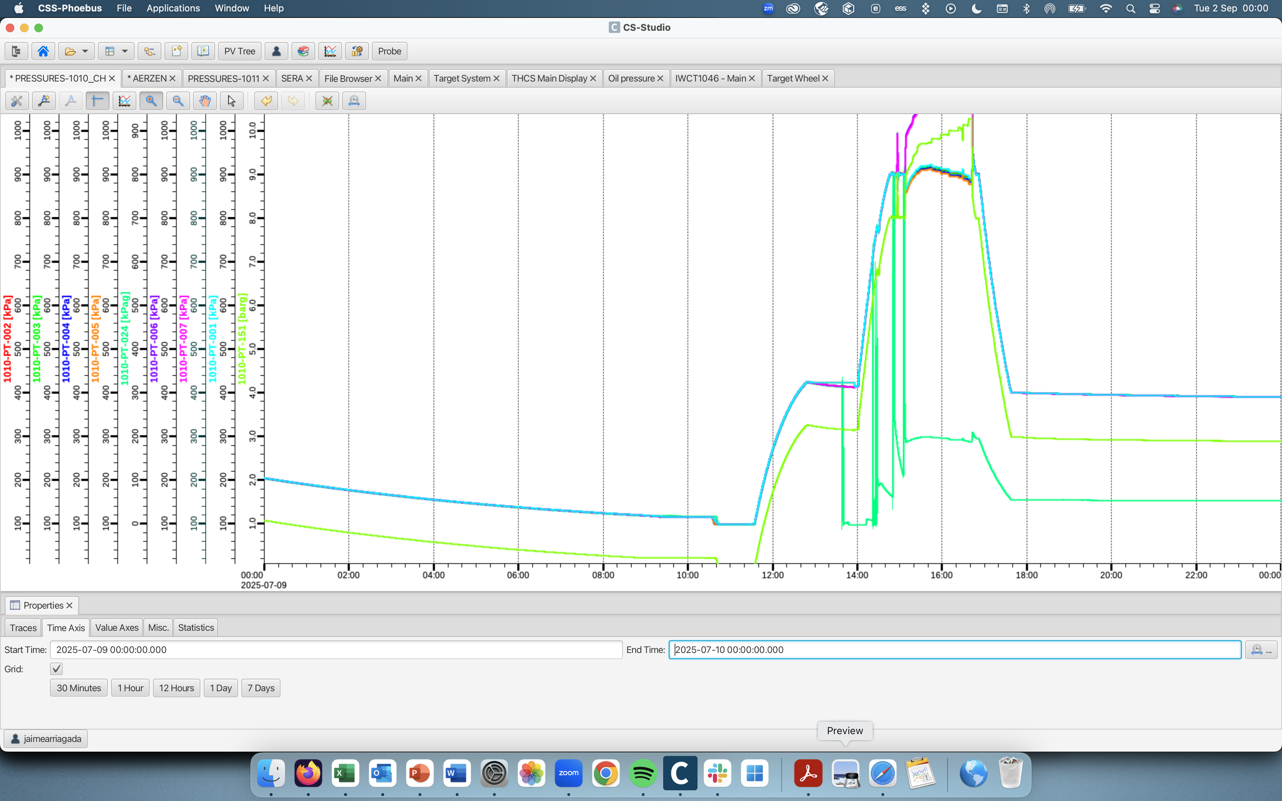
Target commissioning – Helium circulator operation
Spare slide
9th of July, Target helium cooling system
In Bypass mode (w/o Target wheel
Connected).

Slide 39
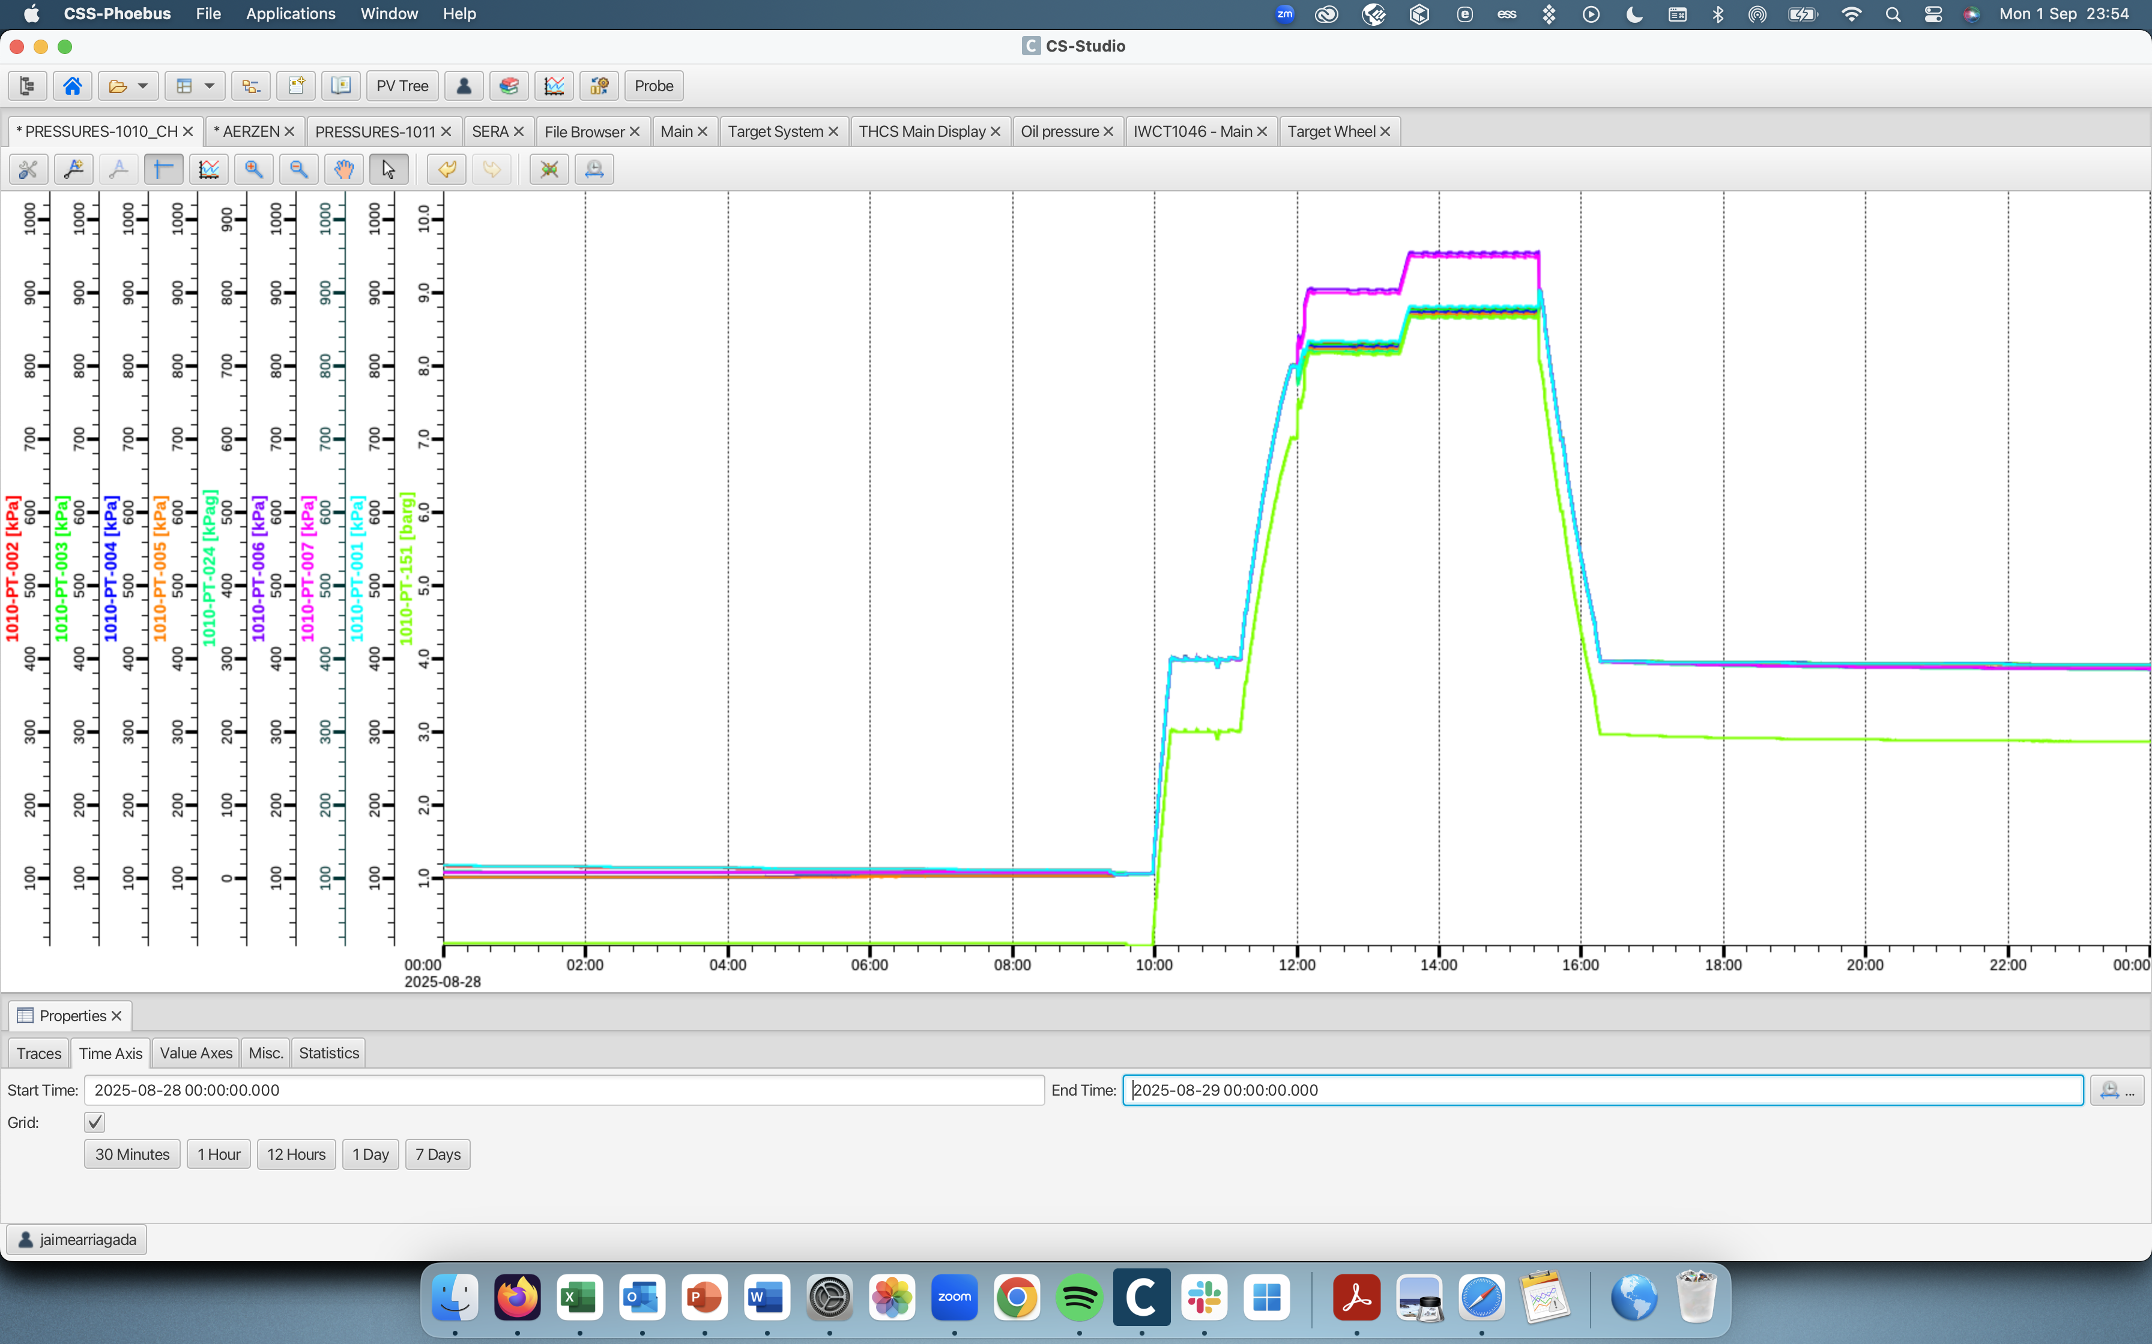
Target commissioning – Helium circulator operation
Spare slide
28th of August, Target helium cooling system
with Target wheel
connected.

Slide 40
Initial operation with p+ beam
Spare slide
We have other important commissioning activities in parallel with the NF commissioning with beam:
Cask commissioning- needed for maintenance and exchanges:
Test and commissioning of all Casks configurations.
Time demanding commissioning.
ACF & remote handling commissioning, related to Waste handling procedures.
Tune-in and final balancing of the nuclear HVAC system in parts of D02 (ACF). Time demanding.
Reliability levels need to be established. Impact on Maintenance strategy, for instance:
Develop a program for Condition Based Maintenance during the first operation years, based on operational data from hot commissioning.
Take advantage of data driven tools, like AI for dynamic modelling, fault diagnostics, fault recognition and expert systems development (support to operators).
Optimize the electricity consumption of the Target systems, etc.
Last, but not least: Finalize and update all the documentation, especially the operational documents.
40

Slide 41
End

