Slide 1
Supporting ESS operations and commissioning with "spallation chemistry"
Monika Hartl, Katrin Michel, Patric Lindqvist Reis, Hossein Sina, Harald Schneider, Nicholas Weisend, Michael Wohlmuther, Günter Muhrer
European Spallation Source Eric
ICANS XXV, Malmö, April 13-17th, 2026

Slide 2
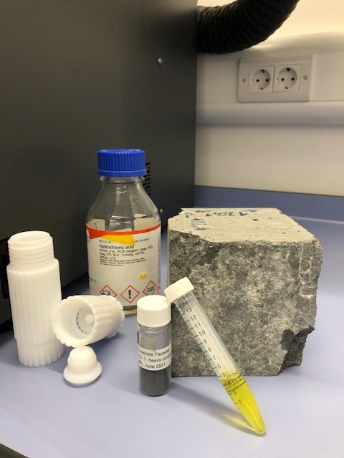
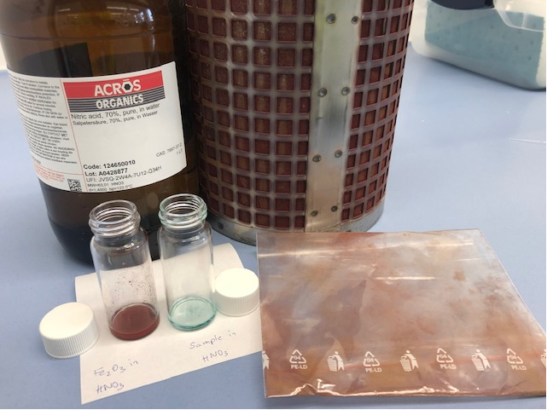
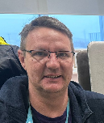
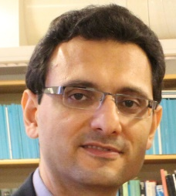

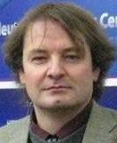

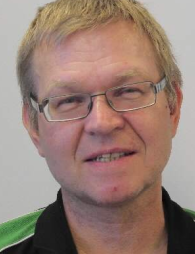


How everything started in 2022
Spallation Chemistry Team
Main Topics in 2022:
(1) Concrete analysis (shielding for accelerator tunnel, bunker):
assuring no unwanted trace elements in the material -> activation
(2) Accelerator water analysis:
huge water body, lots of debris and blocked filters
Shielding material
analysis
SMEs from Spallation Physics Group and the Chemistry and Life Science Group formed 2022-2025 the ESS-wide “Spallation Chemistry Team” collaboration
4 chemists, 2 physicists, 1 material scientist, 1 engineer – 50% of team was experienced from previous spallation/neutron sources with the goal to:
avoid duplicated requests for assistance & measurements
avoid requests asking for a sledgehammer to crack a nut
create searchable knowledge base to be able to understand what is going on
Water and filter
analysis

Slide 3
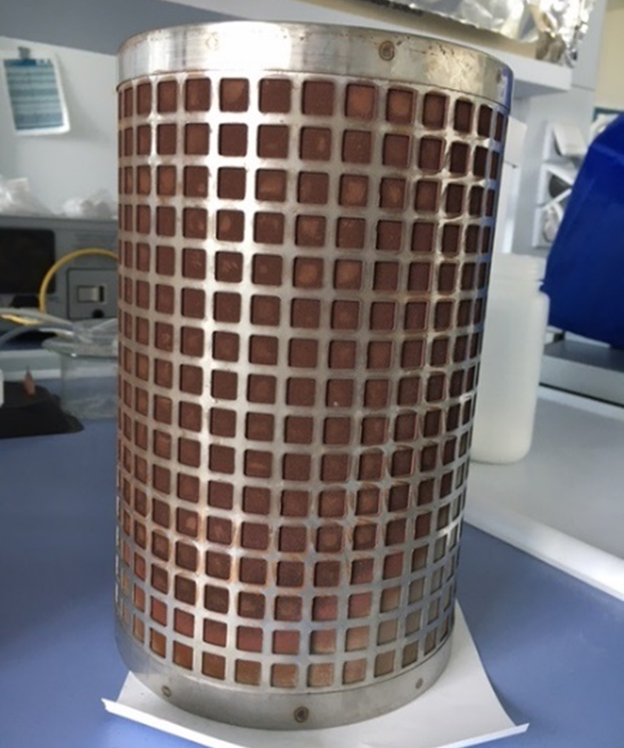
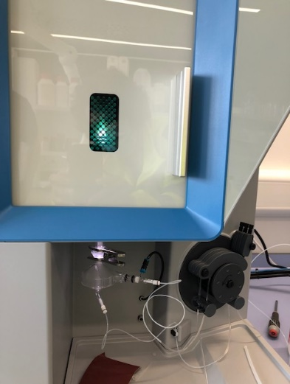
PRESENTED BY Monika Hartl
Part of the Chemistry&Lifescience Support (CLS) group
1
Water chemistry
Cooling water, DI water
Accelerator (klystron, RFQs)/Target
=> pH, conductivity, oxygen content => blocked filters, corrosion

Slide 4
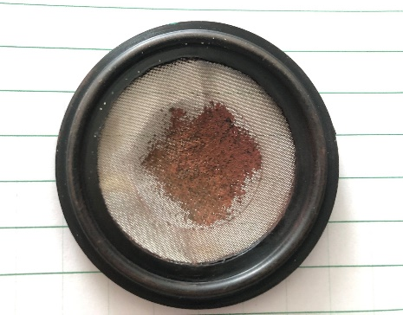
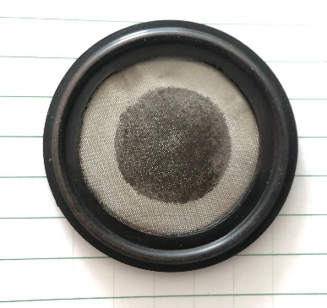
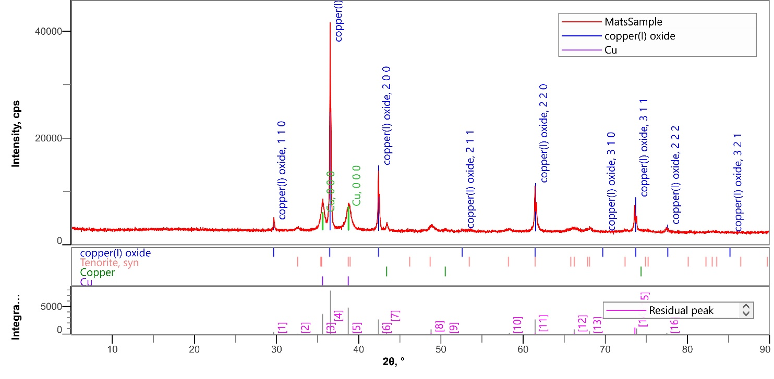
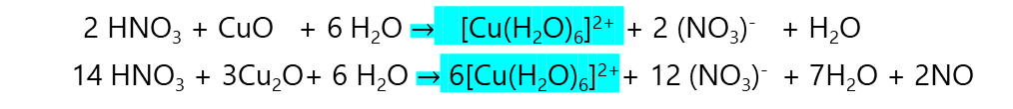
Blocking filters in the accelerator cooling water system
Cooling water system - no heat exchangers between sections
CWH cooling system/Radio frequency power station – frequently blocked filters:
Deposit: Cu(red),Cu₂O(black),CuO(red)
XRD pattern –
phase identification
Upstream: reddish deposit -> downstream: black
HNO₃
Cu
2 HNO₃ + CuO + 6 H₂O $→$ [Cu(H₂O)₆]²⁺ + 2 (NO₃)⁻ + H₂O
14 HNO₃ + 3Cu₂O+ 6 H₂O $→$ 6[Cu(H₂O)₆]²⁺+ 12 (NO₃)⁻ + 7H₂O + 2NO
rust
Crystalline Copper oxide species are blocking the filters

Slide 5
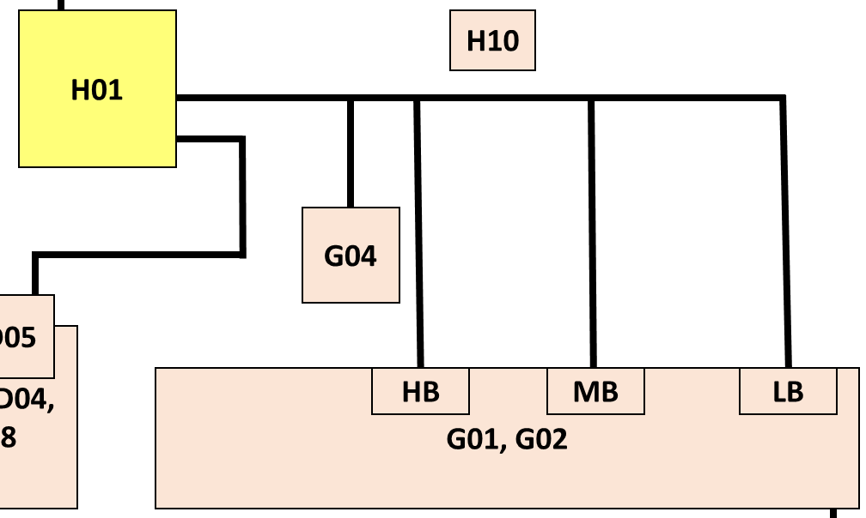
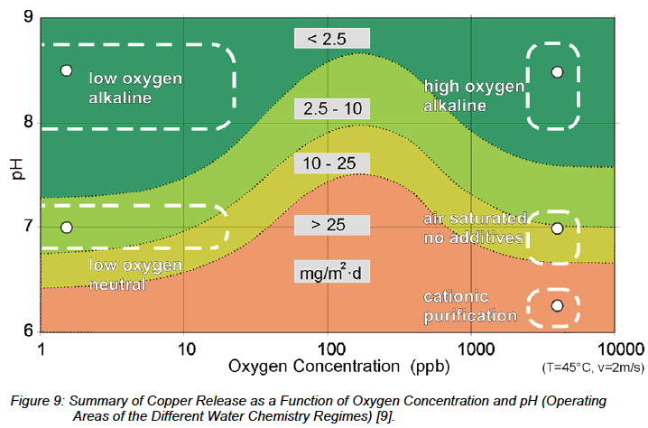
Blocking filters in the accelerator cooling water system
CWH / CWM system (up to summer 2025)
Loop | CWM | CWH
Water temperature | 24-30°C | 45-55°C
Filtration CW mains | 1000 μ
Filtration LB, MB, HB | 100 μ
conductivity | 0.23 μS/cm (5 MΩ)
pH | 6.5-7.5
no heat exchangers between sections (500 m³ water)
Large ion exchanger (bypass) removes Cu⁺, Cu²⁺ (if dissolved in water!)
ICP-OES: limits for Cu-detection 5 ppb
100-500 ppm O₂ in loop
CWH
accelerator
Summary of copper release rates in function of oxygen level and pH. [R.Svoboda, H.G.Seipp: Power Plant Chemistry, 6 (2004) 1, pg 7-142]
=> Need to reduce O2 in water

Slide 6
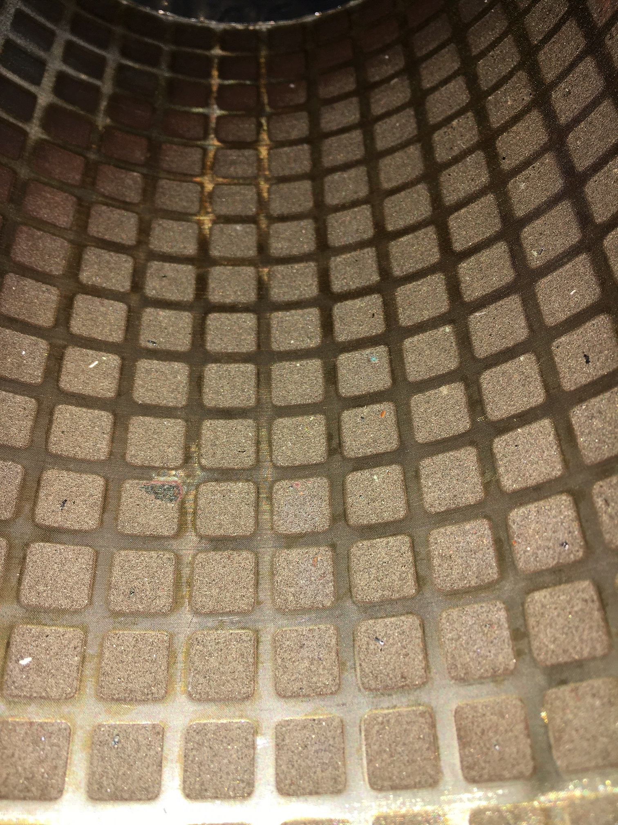

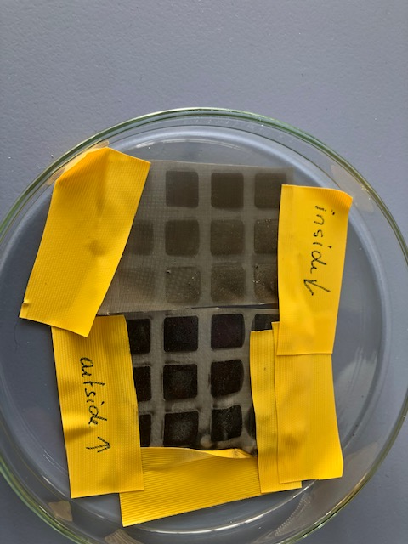

Blocking filters in the accelerator cooling water system
Origin of copper
Why do we find copper oxide downstream instead of upstream?
Is oxygen in the water causing formation of Cu₂O/CuO?
Metallic Cu
Inside of filter
Metallic Cu
Inside of filter – upstream
Outside of filter - downstream
Cu pieces (red) get stuck in the filter (At installation or later? Erosion?)
Over time, Cu pieces in filter are slowly oxidized due to O₂ concentration in the water.
Cu₂O (black) crystallizes on downstream side of filter (less turbulence) first to Cu2O then to CuO (red).
Reddish color
Black color
Are we continuously eroding Cu? Or is it an installation problem?
Less oxygen to not dissolve Cu => no blockage

Slide 7
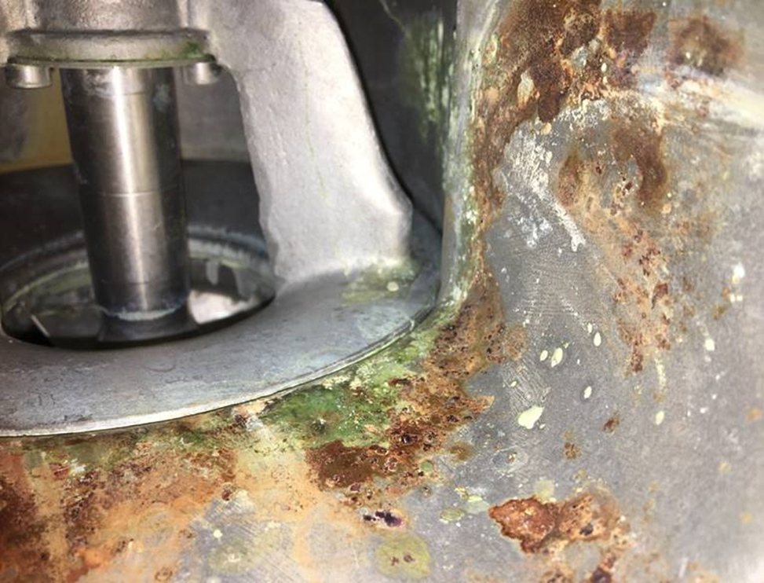
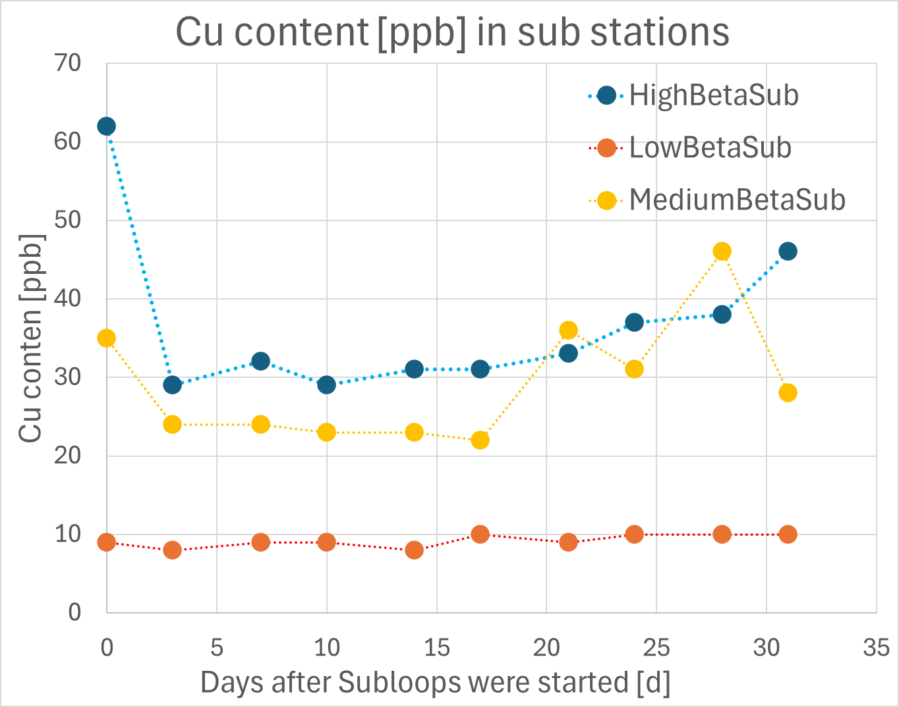
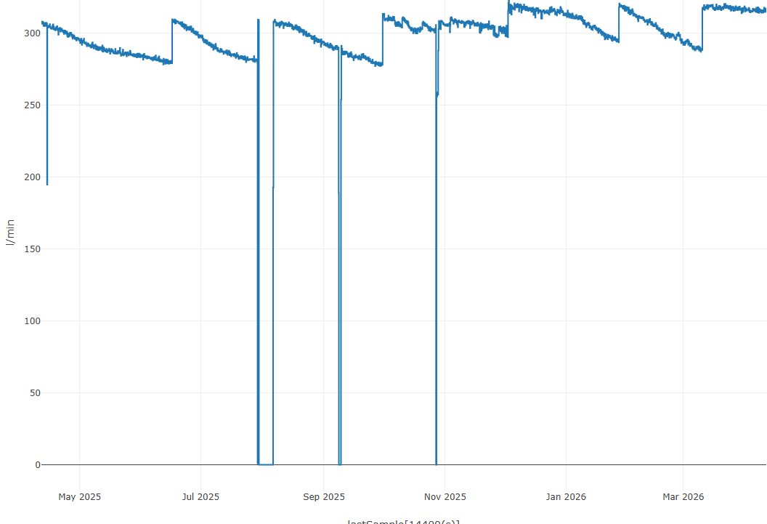
CWH status today
-> Will be needed during operations
Separation of cooling water loops since Oct. 2025: each subsection is separate
Much improved, but still Cu₂O deposits: historical or new?
O₂ dissolved in water monitored and much reduced: continue to eliminate O₂ sources
Adjustment of pH?
Other corrosion (Fe,..)
Water flow
300
250
200
Flow l/min
150
100
50
Ongoing Work:
Rutambhara Yogi
Björn Eldvall
Morten Rostrup Forup Jensen
Walther Borg
Olle Lagerblad
Emmanouil Trachanas
Hadi Sadeghzadeh
Mats Nilson
May
2025
Juli
2025
Sep
2025
Nov
2025
Jan
2026
March
2026
CWH
x
x
x

Slide 8
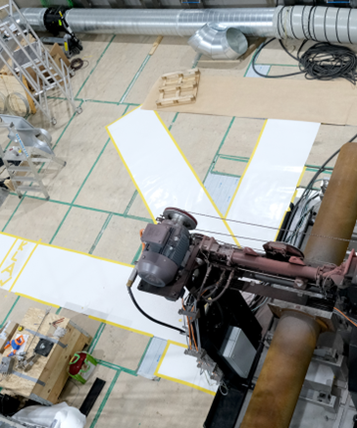
2
Chemical analysis/ quality checks
45 deg
90 deg

Slide 9
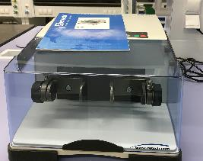
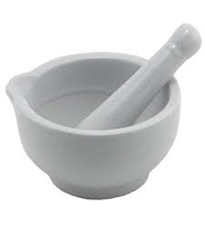
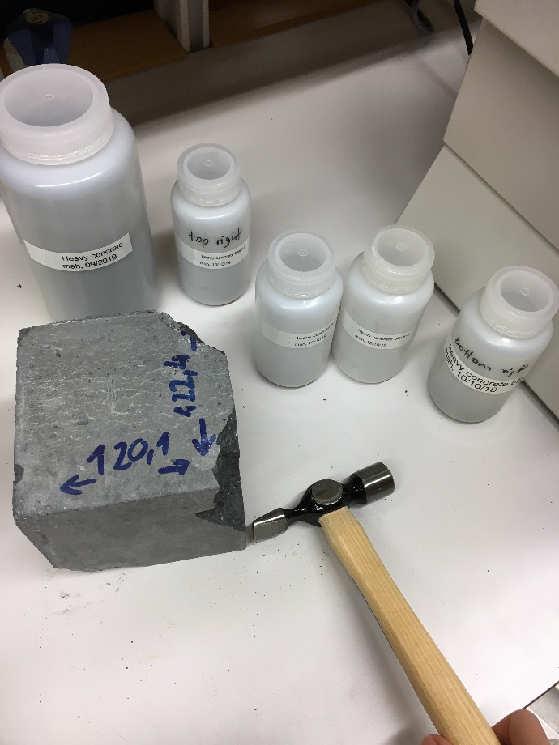
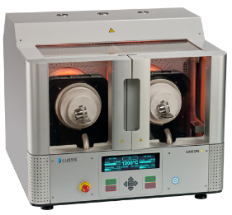
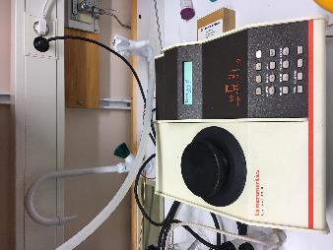
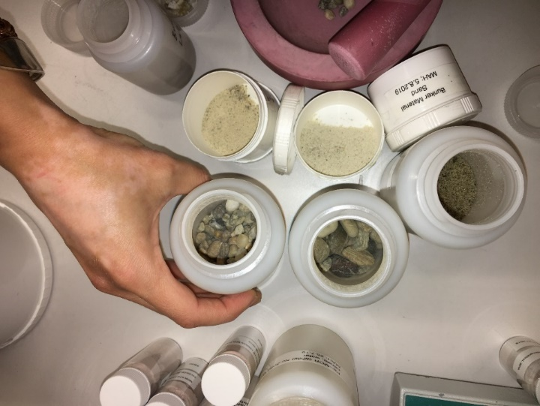
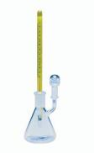
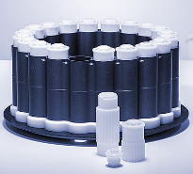
Composition of ESS shielding and construction materials
Materials in the (future) radiation field
Materials should not activate (longterm) isotopes (e.g. Eu, Co,…).
Material composition is important for MCNP calculation.
ESS expertise & equipment has developed:
(1) Sample preparation (ball mill, fusion furnace, microwave)
(2) Density measurements (pygnometer, gas pygnometer)
(3) X-ray fluorescence measurements (XRF) and Laser-induced-breakdown Spectroscopy
(5) ICP-Optical Emission Spectroscopy (ICP-OES)
(6) Scanning Electron Microscopy (SEM)
various materials: beam port inserts, shutters, concrete walls, beam dump,….and lots of quality gate measurements for neutron scattering instruments.
Commercial analysis labs are expensive and often work according to standardized operating procedures – does not always fit the problem.

Slide 10
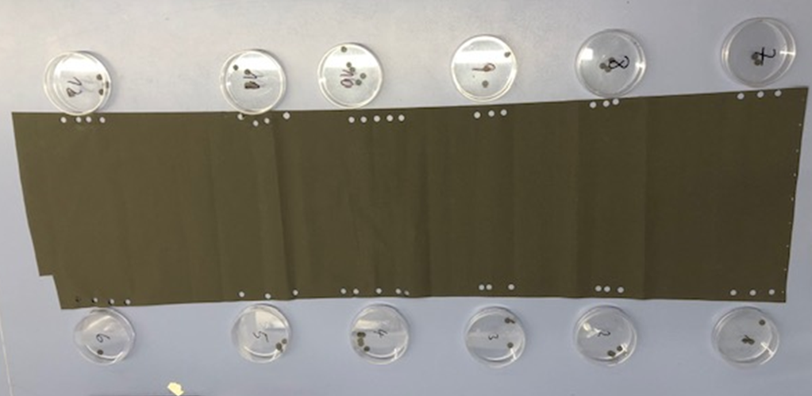
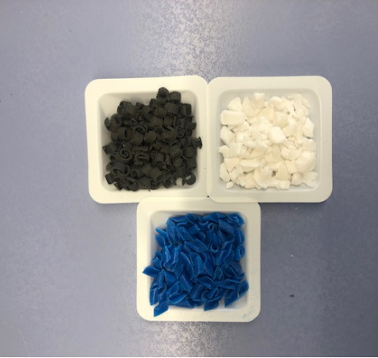
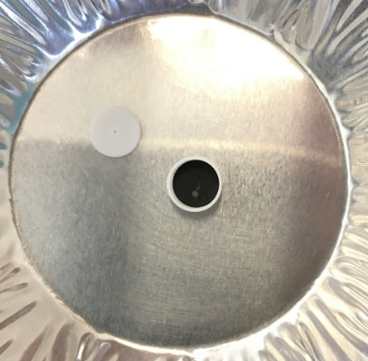
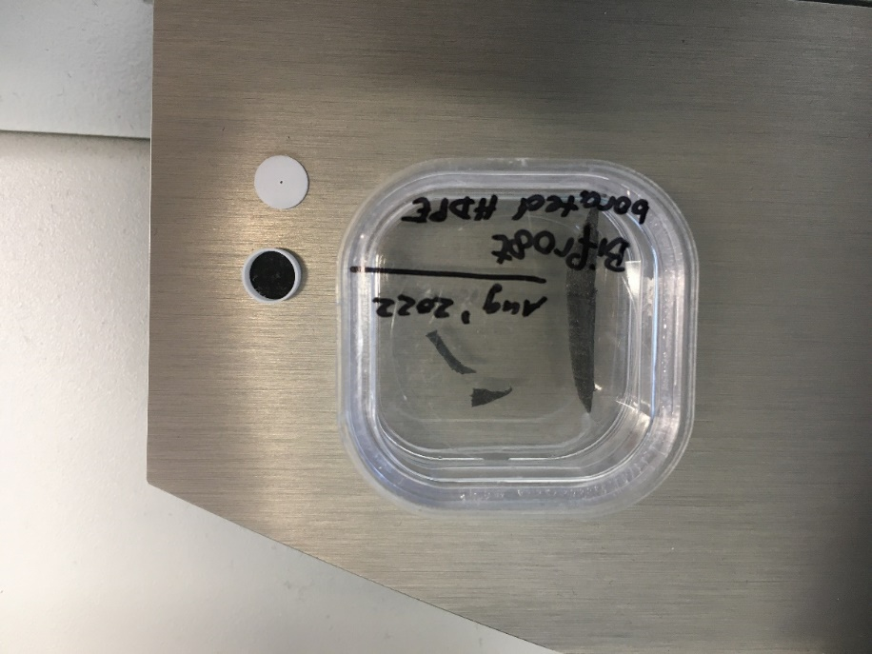
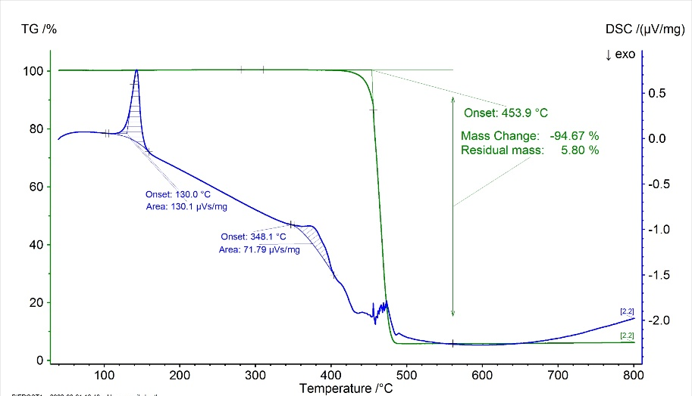
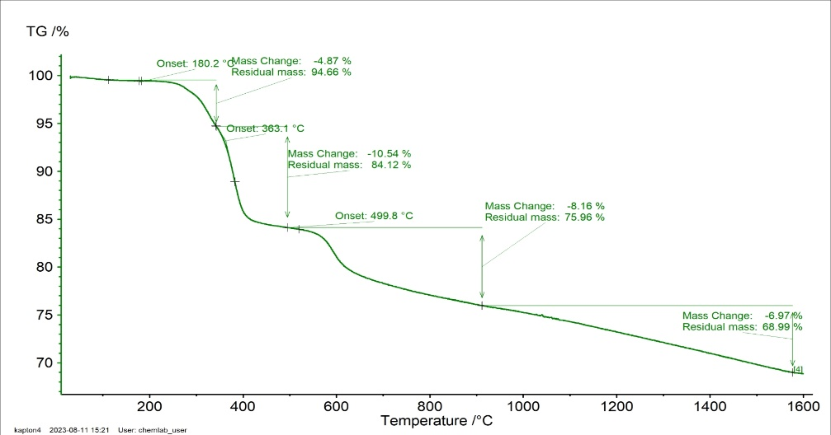
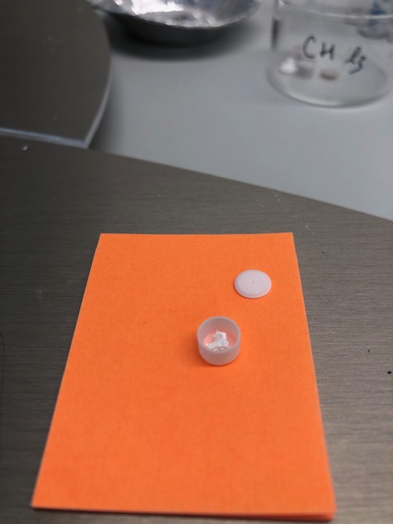
Composition of ESS shielding materials
Boron containing polyethylene / Gd₂O₃ containing kapton
Borated PE (target)
Borated PE for
BIFROST
Gd₂O₃ Collimator for CSPEC
Borated HDPE
for CSPEC
Fernando Yamil Moreira
Rosa Camilleri Lledó
Piotr Slawik
Sara Ghatnekar Nilsson
Weight change upon heating: B₄C or B₂O₃ remains
Phase transition around 100 -150 °C allows differentiation between LDPE and HDPE.
Kaptonsheet not homogenously covered: thickness of Gd₂O₃ layer is 15 µm at the bottom while in the middle and top is >20 µm.

Slide 11
Active Cell – remote diamond wire cutting
Dry cutting trials
Shaft Cutting Station - Moderator Reflector Plug
Super Duplex SS mock-up

Slide 12

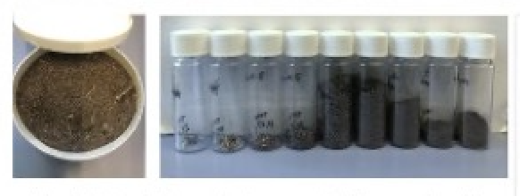
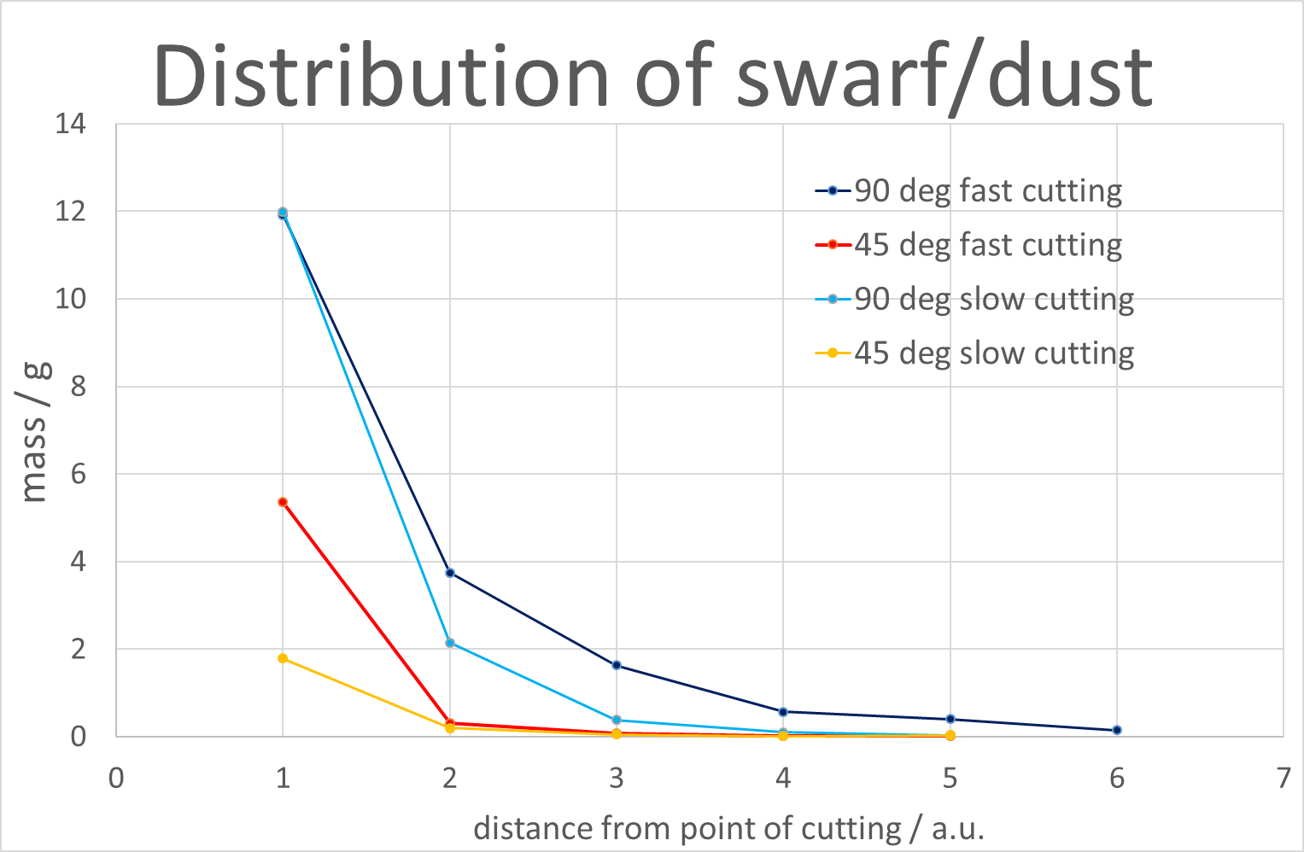
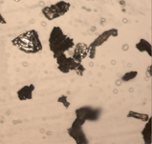
Active Cell – remote diamond wire cutting
Testing dust/swarf distribution before active materials are present
Diamond-string saw used at varying speed.
Various sampling points at different angles
45°
90 °
90 deg
45 deg
Small particle with sharp edges are produced

Slide 13
Active Cell – remote diamond wire cutting (ONGOING)
Dry cutting trials (2022 and 2025)
Shaft Cutting Station - Moderator Reflector Plug
Super Duplex SS mock-up
5hours (2022) => 27 hours of cutting (2025)
More tests coming with ventilation in place
Carwyn Jones,
Magnus Göhran
Gumer Verdu
Amina Chemlal
Donna Tam
Harry Robinson
James Kent
Jonathan Rose
James Davies
William Blyth

Slide 14
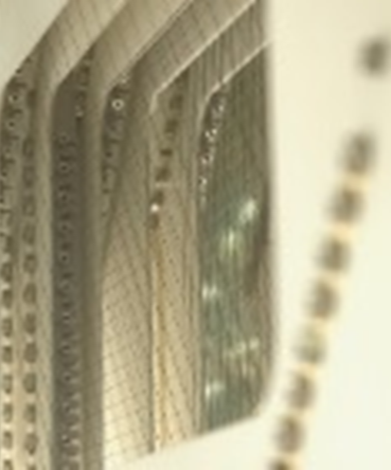
3
Trouble-shooting

Slide 15
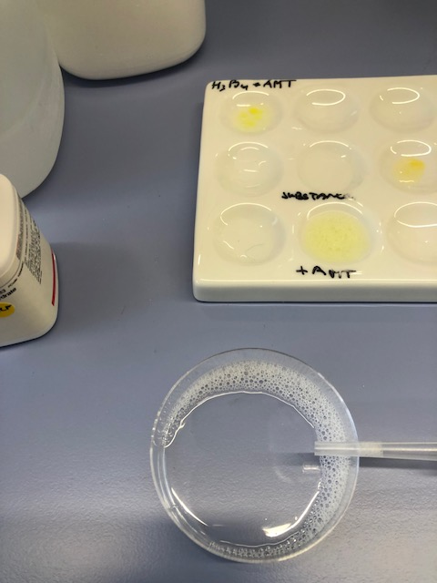
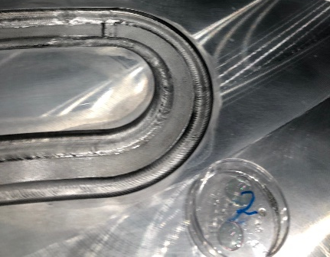
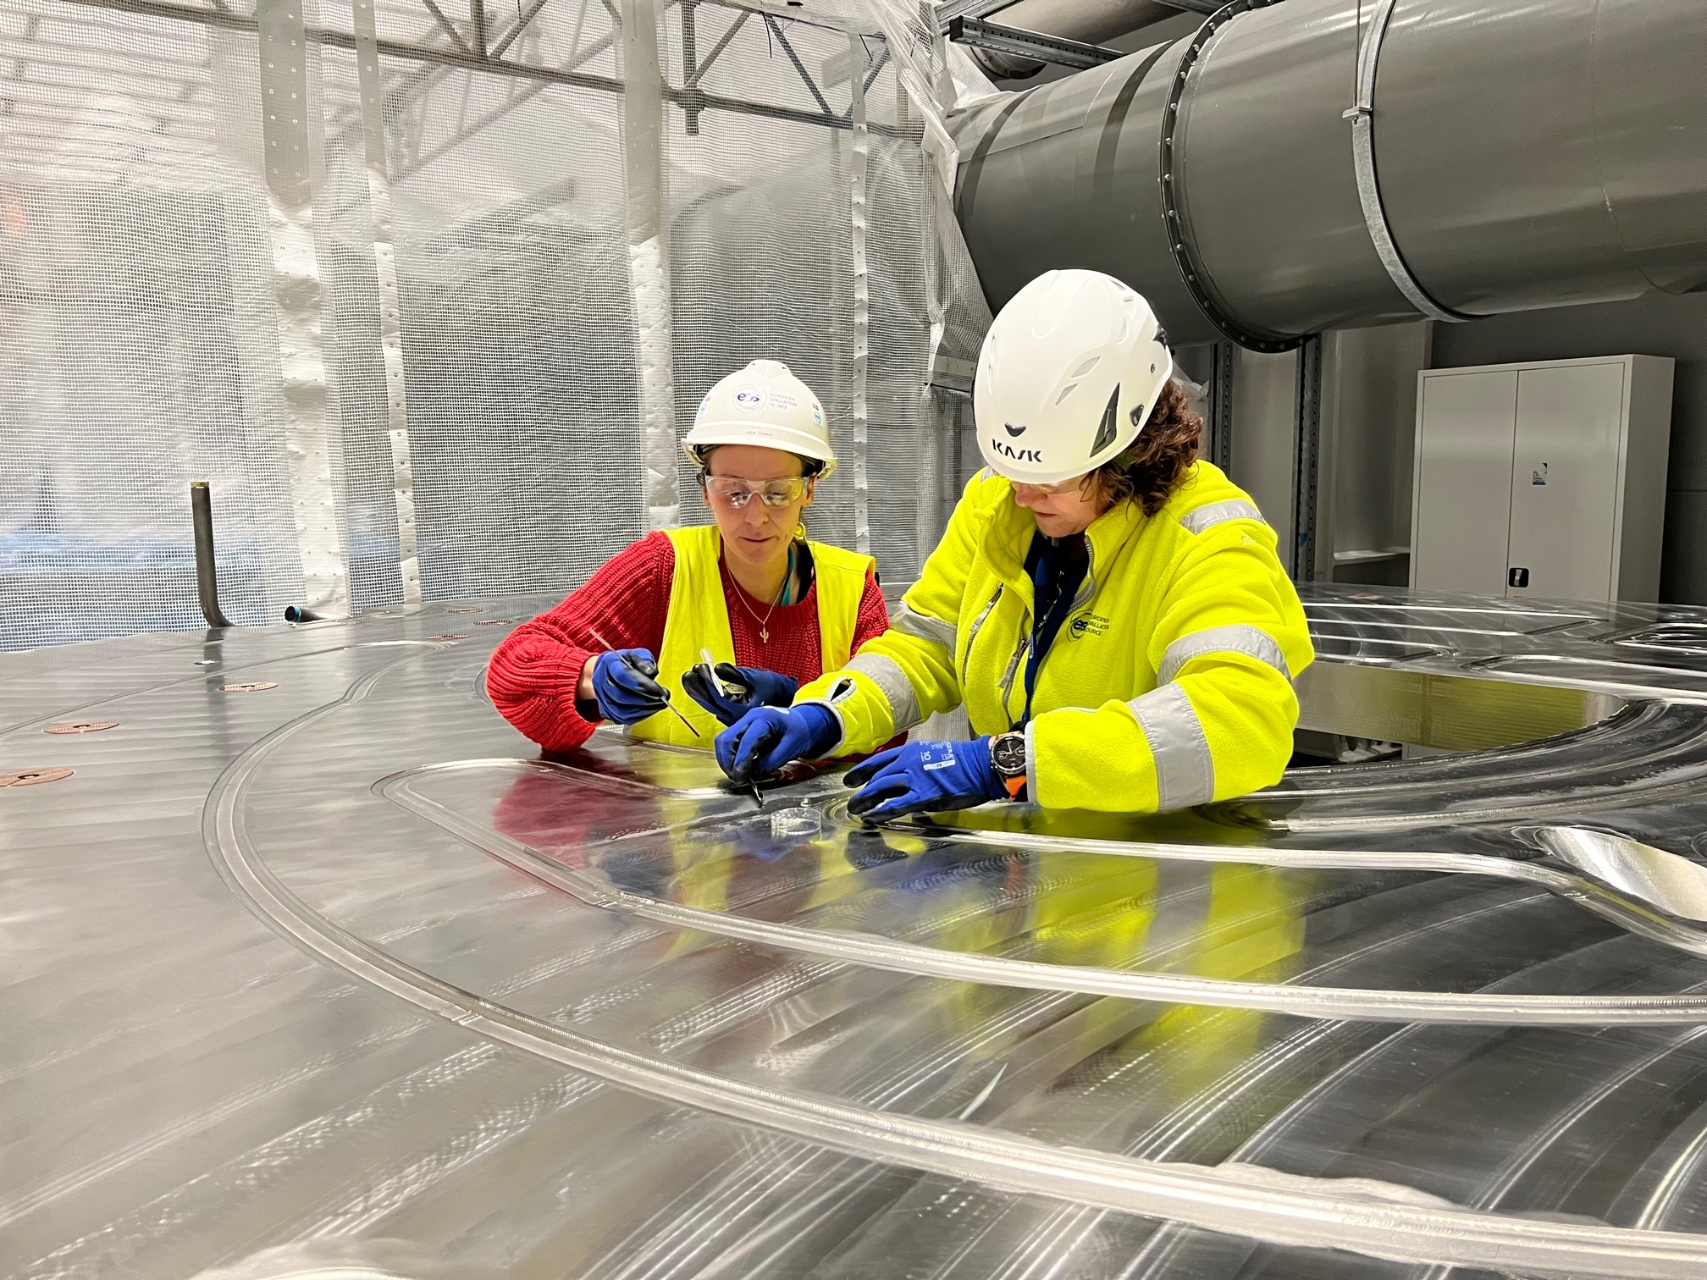
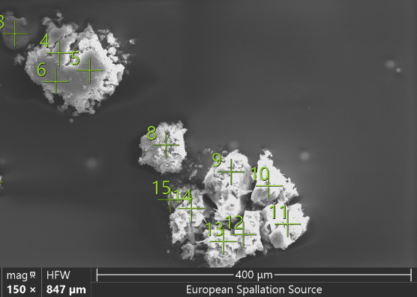
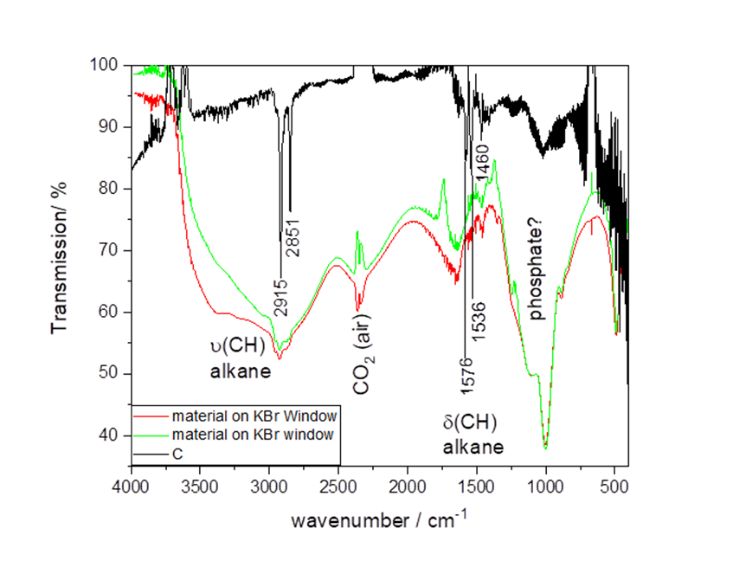
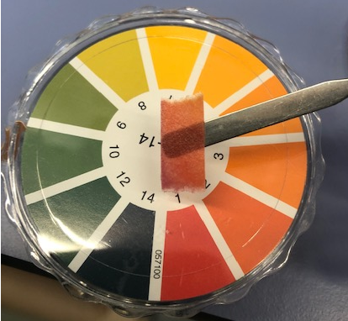
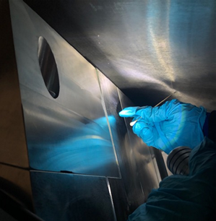
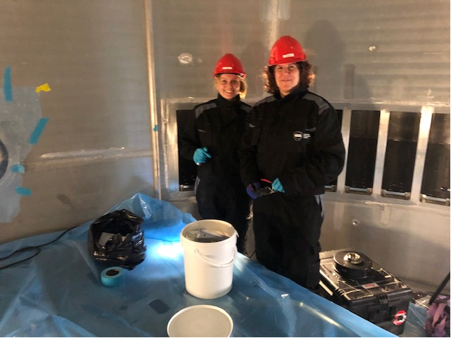
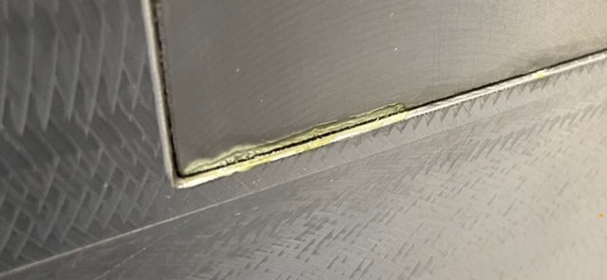
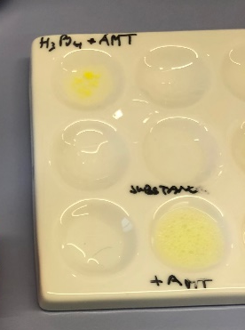
Unknown substances in the wrong places
Krister Blomberg
Mats Segegerup
Alice Corani
Goo on the target area cooling water blocks
(1) Yellow substance found in monolith, beam ports
assumed chemicals: “crack-testing liquid” used for inspection
FTIR not convincing, SEM only light elements found
-
(2) Liquid (yellowish) found on target wheel
When sampling, noticed foaming:
Gave idea to look at cleaning process for the components
Check pH: acidic
Chemical test for
phosphate
-
sample

Slide 16
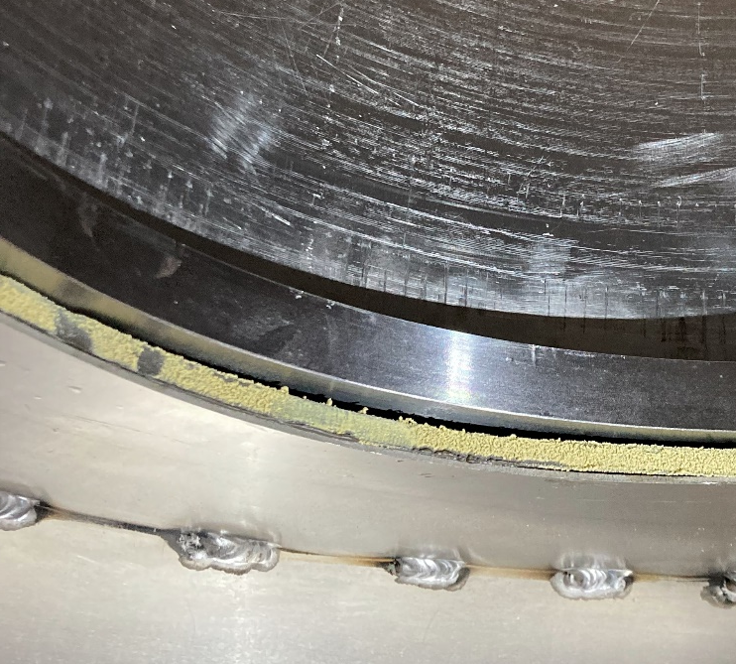






Unknown substances in the wrong places
Dust and debris in accelerator and target
Lead Dust exposure –delay tank bunker
Carbonformation on
tetrodes
Formation of PbO on lead shielding on a klystron.
Transport and storage of unpainted lead bricks in the area of the delay tank bunker for the cooling water => dust containing lead –> method development done.
And a lot of all other kinds of materials in unexpected places
- pump oil, glue, lubricants, graphite/steel shavings,…
Often a simple and quick identification helps solve the issue
and prevent delays.
Alice Corani
OHS group

Slide 17




ESS Project Support – trouble shooting
Wire grid for beam rastering – assembly challenges
Grid
beam on target: beam amplitude, position, edges, projected horizontal and vertical profiles
wires are held by ferrule within a sleeve.
Assembly issue:
components oily – slip of wire does not allow assembly
cleaning of components in lab with hexane - still slipping
Measurements via optical microscope (10x):
123 μm ± 4 (specified was 78 μm)
wire diameter 100 μm
Ferrule in sleeve shows gaps
Wire is not held in place.
Cyrille Thomas
Mateusz Dominiak-Sumila
Antoine Lepine
Rasmus Johansson
Gabriel Calcisca
Ferrule was dimensioned incorrectly

Slide 18




Development Work with Fluids & Source Technologies
Smurf Oil for He-compressor (target cooling)
Test to see if compressor oil is inert to H2 (as a chemical model for tritium):
Properties and main chemical components of the oil seem to be unaffected
Oil composition unknown: Usually Zinc dialkyldithiophosphate (ZDDP) is added as anti-oxidation, anti-wear, and anti-corrosion additive. => forms protective layer on top of steel (FeS) but not confirmed.
Lubricant for He compressor was heated to
1.5x maximum temperature under 2.5 bar H₂.
Lubricant turned blue after 8 weeks.
Other He compressor needs – method
development:
Oil quality check:
rheology/viscosity (Rheometer)
water in oil (Karl-Fisher titration)
metals (ICP-OES)
GC-MS determining (NO !) oil in He gas
Naja de la Cour
Jia-Fei Poon
Jaroslaw Frydrych
Jaime Arriagada

Slide 19

Advantages of having in-house support
….over hiring external analytical support
Commercial analysis labs are expensive and often do not deliver what is needed but what they have been asked for.
ESS stakeholders know what they want but often do not know what analysis/support to ask for.
In-house support understands “spallation source” issues better (experience) and can help more quickly; easy to talk to.
Analysis starts by correct sampling
In-house experts can develop methods to analyze materials as needed and then teach technical staff in the respective groups
Sending activated components outside of ESS might become difficult (or costly).
Chemistry can be fun!
We gladly support you in taking care of things yourself.

Slide 20

Thank you
Spallation Chemistry
2022-2025
ChemistrySpallationTeam@ess.eu

Slide 22

5
Capabilities

Slide 23



Chemistry User Laboratories in E04
Used to support ESS construction and commissioning
Level 100
Life science Lab
Spectroscopy room
Detector lab
X-ray diffraction
Physical Characterization
Cold
room (later)
Level 110
SULF Offices
Basic Chemistry lab
storage
Cutting/ polishing
Motion Control lab
SEM
storage

Slide 24




Radioactive Materials Laboratory
Lab to check (slightly) radioactive components
RML
Exp. halls
Changing
area
Radiation monitor
Test cases:
Testing of oil in He-loop
tensile testing of proton beam window

Slide 25



Phase Characterization/Identification
Powder Diffraction, Optical microscopy, SEM
Leica Optical microscope with indenter and camera
RIGAKU Smartlab SE Powder X-ray machine (Cu tube): sample changer
FEI Environmental Scanning electron microscope (E-SEM):
Owned by Target, operated by Hossein Sina

Slide 26



TG, BET, pycnometry and electrochemistry
Density, thermal decomposition, porosity/surface area, electrochemistry
Netzsch Jupiter STA: DTA/DSC
T=30-1600 °C, sample size 1-30 mg
BET surface area determination
nitrogen
Autolab potentiostat:
cyclic voltammetry
Hg-drop polarography
voltammetry:
Gas pycnometer (helium):
measuring the density of a solid material

Slide 27






Elemental Analysis
Operational: XRF, Fusion furnace, ICP-OES, Digestion Microwave
Microwave digestions instrument:
Up to 20x50 ml Teflon cups, T<100 °C
Automatic fusion machine:
Up to 2 samples;
Pt crucibles, approx. 1200 °C
Elemental Analysis CHNO:
Up to 80 samples;
Ion-coupled-Plasma-Optical Emission Spectroscopy (ICP-OES): ppm/ppb range, up to a few mg
X-ray Fluorescence:
permanent loan from STFC

Slide 28




Spectroscopy equipment
Operational: UV/VIS, FT-IR, RAMAN, DLS
UV/VIS Spectrometer range: 200-850 nm
D₂/W-halogen lamp: 230nm-2.5μm
Dynamic light scattering:
- R= 0.18 nm - 2500 nm
- 300 Da to 1MDa
FT-IR Spectrometer range: 450-4000 cm⁻¹
-ATR for powders
-hATR for liquids
Raman Spectrometer range: 20 - 4000 cm⁻¹ , Transmission and reflectance; can be performed at low temp (cryo – 10K)

Slide 29


Active Cell – remote diamond wire cutting
Testing dust/swarf distribution before active materials are present
Shaft Cutting Station: Diamond-string saw July 2022 – fast, dry cut (5 h), super duplex SS
45 deg
CO₂
90 deg
Large HEPA filter from the air handling units clearly show weigh difference after cutting => what part is debris?

Slide 30







ESS Project Support – trouble shooting
Various small projects
Corroded screw after transport of target wheel shaft
drive from manufacturer
Pin material in failed flow meter: WC (tungsten carbide). Are cracks in surface normal aging?
Rust bloom on screw thread
Slightly damaged galvanized layer
Intact galvanized layer
SEM/EDX: Cl- found
Salty, moist climate caused corrosion
Prolonged exposure during transport on ship
Pin of flowmeter
(oxidation ->H₂WO₄)
SEM/EDX: Shows cracks – logbook showed usage of flow meter that exceeded its specifications.

Slide 31

S
3
Development work

Slide 32




Development work with Beam Diagnostics Group
Flamespray of target wheel - March 2022. Production of 3x 1 kg luminescent powder
Cr-doped Al2O3 (sintered)
Ce-doped YAG
Mixture of both
Cyrille Thomas
Emelie Wiklund
Anton Järild
Shrikant Joshi
Håvard Gjersdal
Stefan Bjoreklund
Magnus Sandburg
Collaboration with SNS to test new materials in the radiation field (on the SNS target).
We can use commercial chemicals. We can optimize the coating. We are independent.

