Slide 2
Derivation of safety trip point for ESS target wheel rotation
- Kazim Raza Syed and Linda Coney, ICANS XXV, 2026
PRESENTED BY Kazim Raza

Slide 3
Agenda
1 Basis for Setpoint Analysis
2 Correlating TW rotation with Beam footprint
3 Calculating Analytical Limit
4 Setting TSS trip limit
5 Summary

Slide 4
1
Basis for Setpoint Analysis

Slide 5
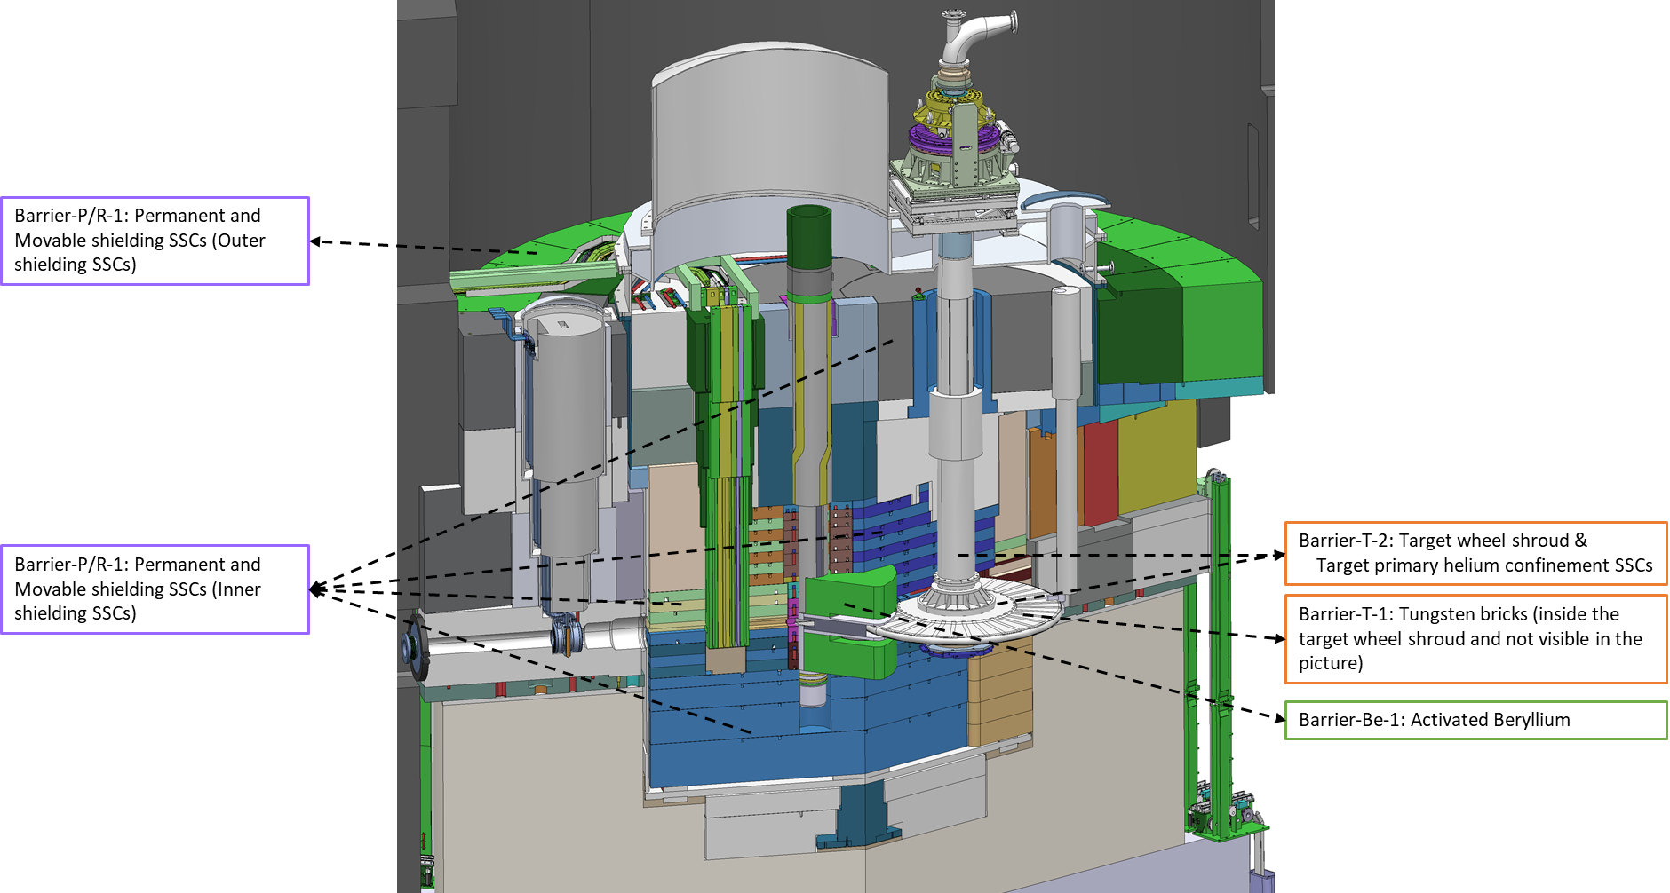
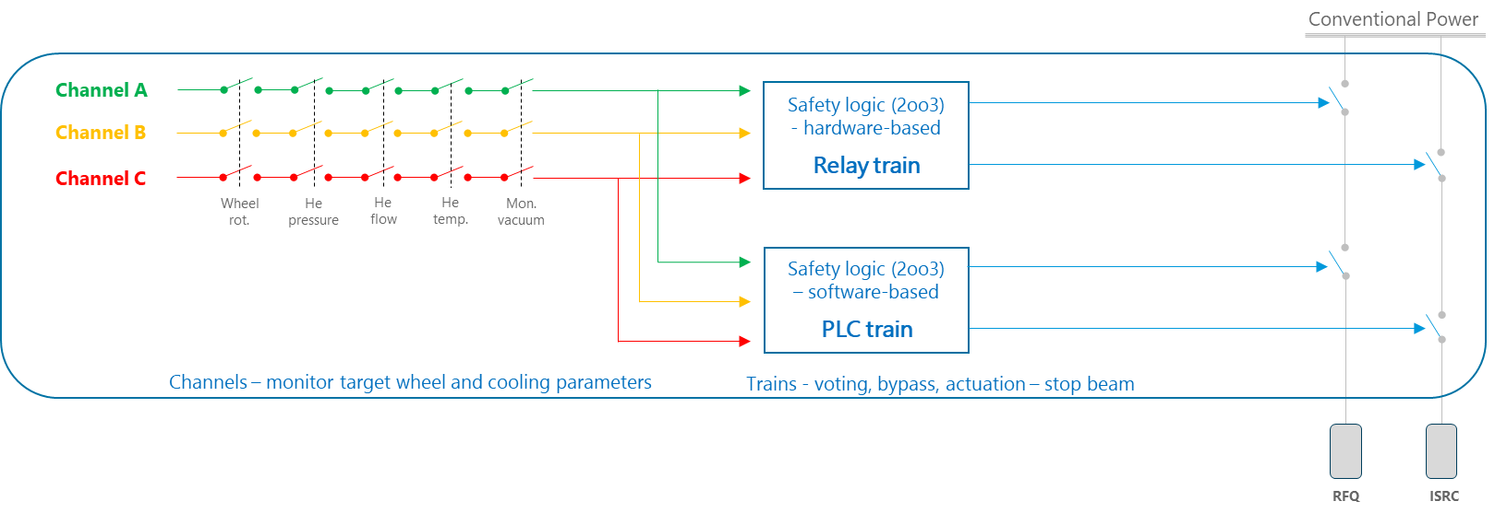
Barriers in NF and Target Safety System
Overview
  Application of 7-step approach on the Target Neutron Factory has resulted in identification of a classified Target Safety System (TSS) acting in the 3rd DID level for public.
  Target wheel rotation speed is identified as one of the parameters to be monitored by TSS for protection of Barrier-T-1 (tungsten bricks).
TSS architecture

Slide 6
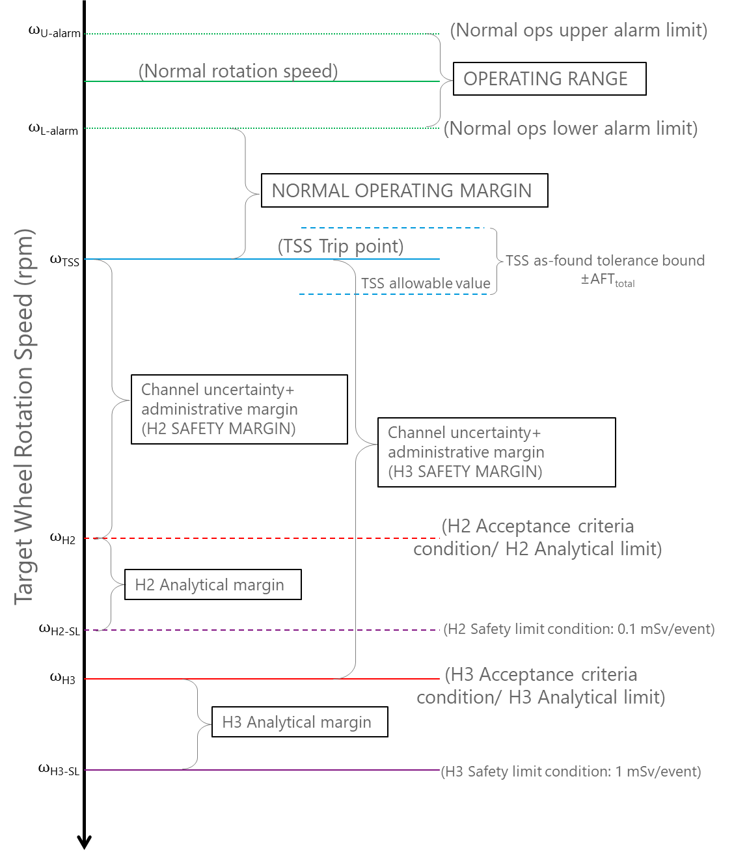
TW rotation setpoint relationship
Connecting to safety case
Class | Event | Frequency (/y) | Dose consequences
H1 | Normal Operation |  | Dose constraint ≤ 0.1 mSv/year
H2 | Anticipated events | F ≥ 10⁻² | Design criteria ≤ 0.1 mSv/event
H3 | Unanticipated events | 10⁻² > F ≥ 10⁻⁴ | Design criteria ≤ 1 mSv/event
H4A | Improbable events | 10⁻⁴ > F ≥ 10⁻⁶ | Design criteria ≤ 20 mSv/event
H4B | H2-H3 events combined with multiple failures | F > 10⁻⁴ | Design criteria ≤ 20 mSv/event
H5 | Highly improbable events | 10⁻⁶ > F ≥ 10⁻⁷ | Design criteria ≤ 100 mSv/event
  AA1 (loss of wheel rotation) and AA3 (loss of coolant) during proton beam on target event are H3 event class.
  Correlating dose criterion to corresponding process parameter is the key requirement.
  Critical to find the balance between normal operating margin and safety margin.

Slide 7
Analytical limit
Acceptance criteria for the barriers
  Tungsten surface temperature shall remain below 500°C for reducing risk of non-adhesive tungsten oxide layer.
  Reference: Y. Lee, 2019, “Requirements for maximum stress and maximum temperature in proton-irradiated tungsten”, ESS internal report.

Slide 8
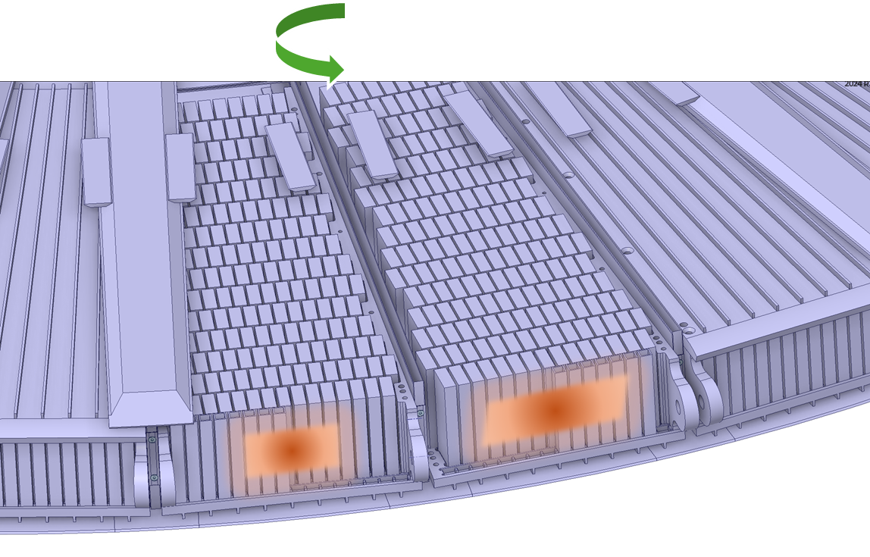
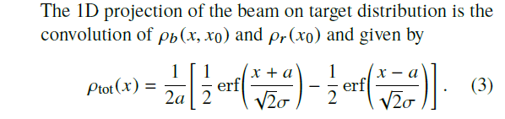
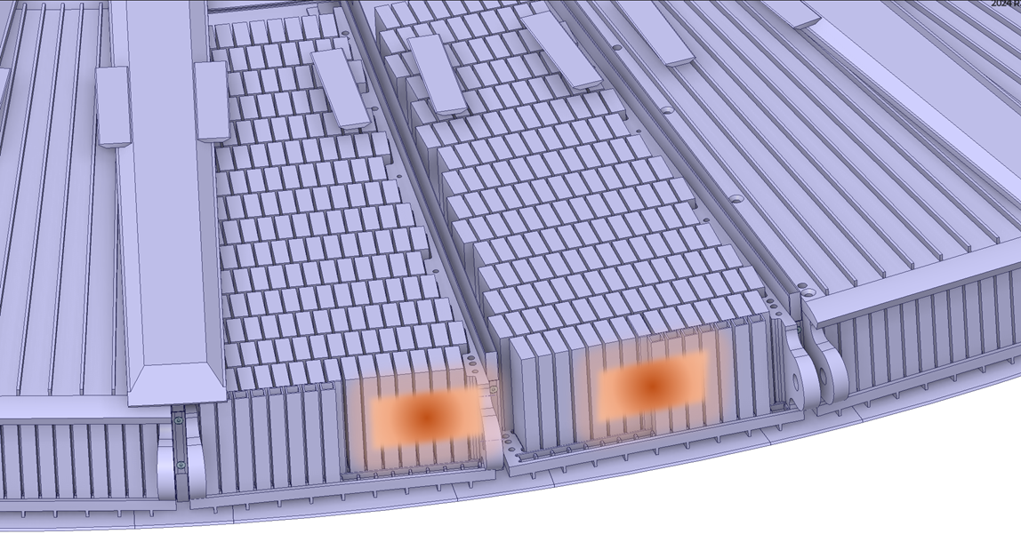
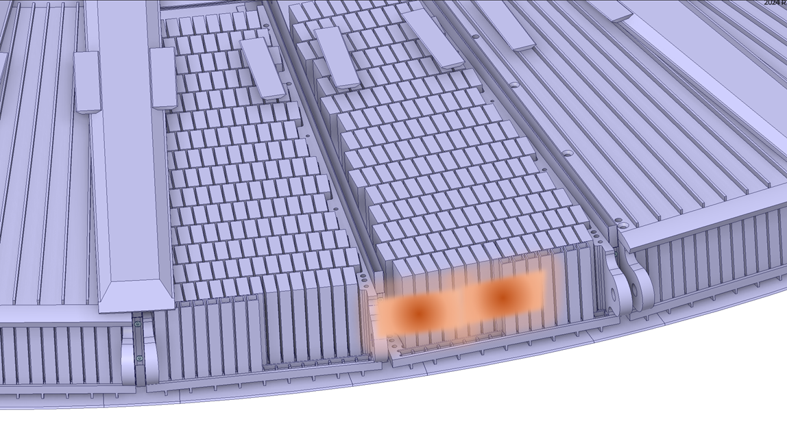
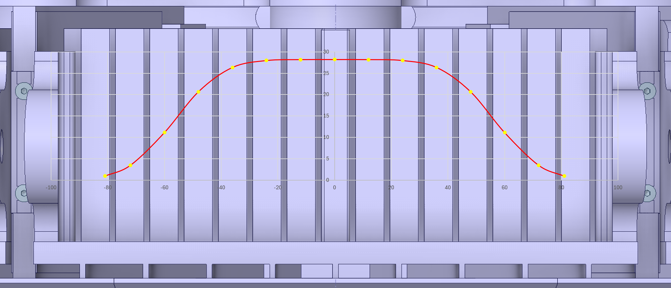
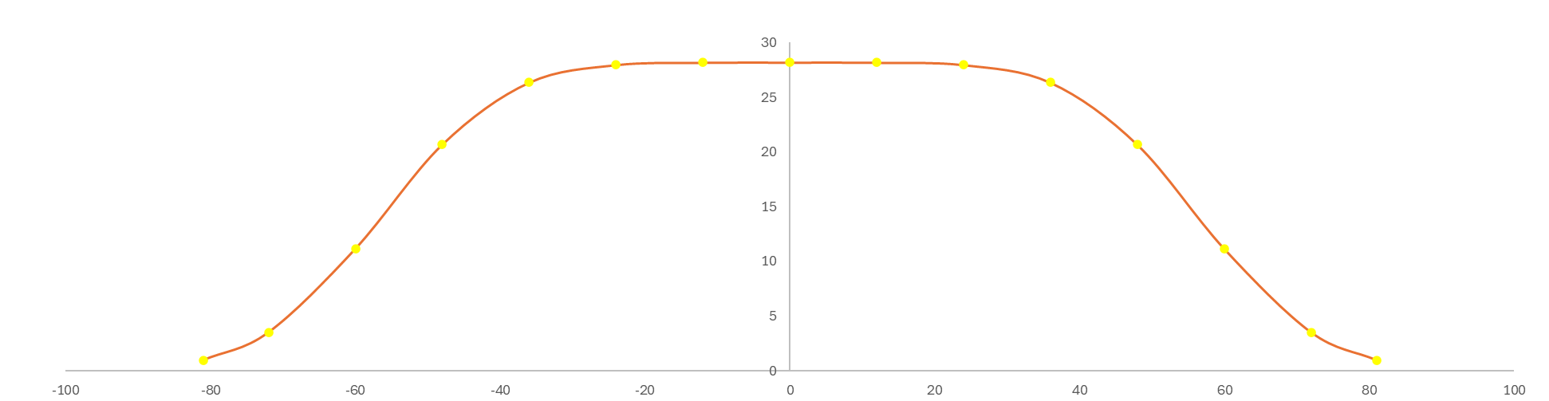
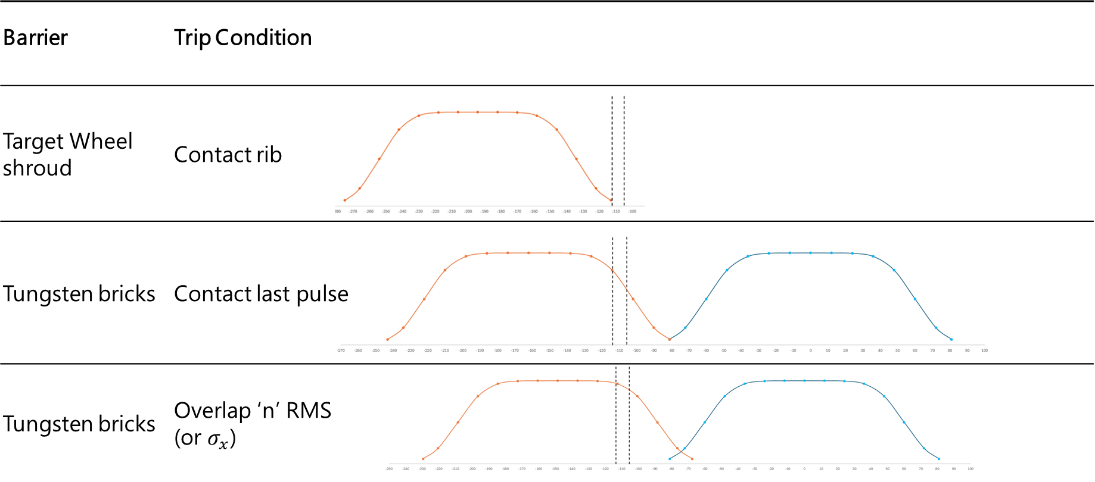
Impact of reduced wheel rotation
Reference: R. Miyamoto and H.D.Thomsen, IPAC 2018, “Parametric study of the beam footprint characteristics on the ESS Target”

Slide 9
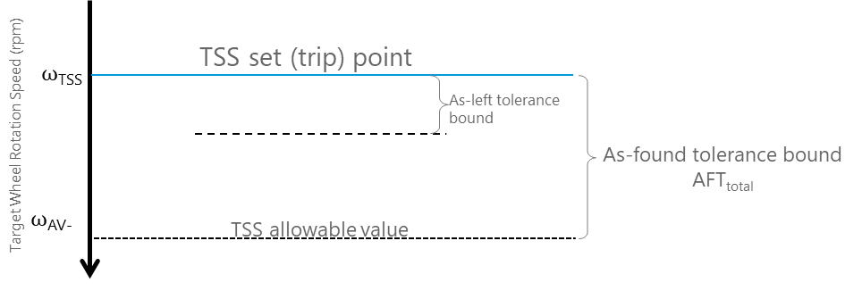
Understanding the terms
Setpoint vs Trip point
Setpoint is the value of the PV at which the channel trip is expected.
  Specific number (deterministic)
  Measure of expected channel behavior
Trip point is the actual value of the PV at which the trip does occur.
  Physical realization of the setpoint
  Random variable
  Measure of channel performance
  Allowable Value is a criterion for surveillance testing.
  Non-compliance implies that the channel performance is degraded. Remedial measures (recalibrate, replace, etc.) are recommended.

Slide 10
2
Correlating TW rotation with beam footprint

Slide 11
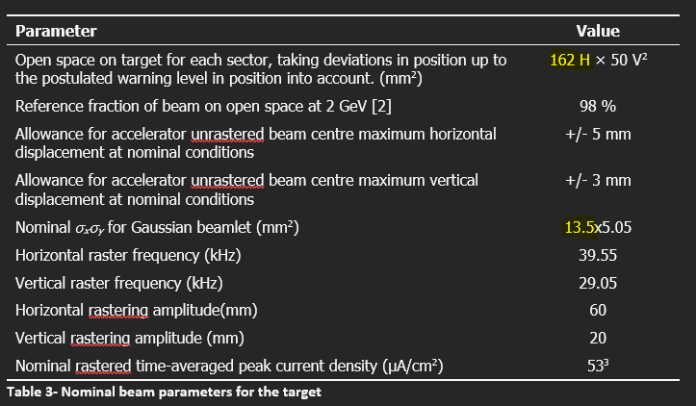
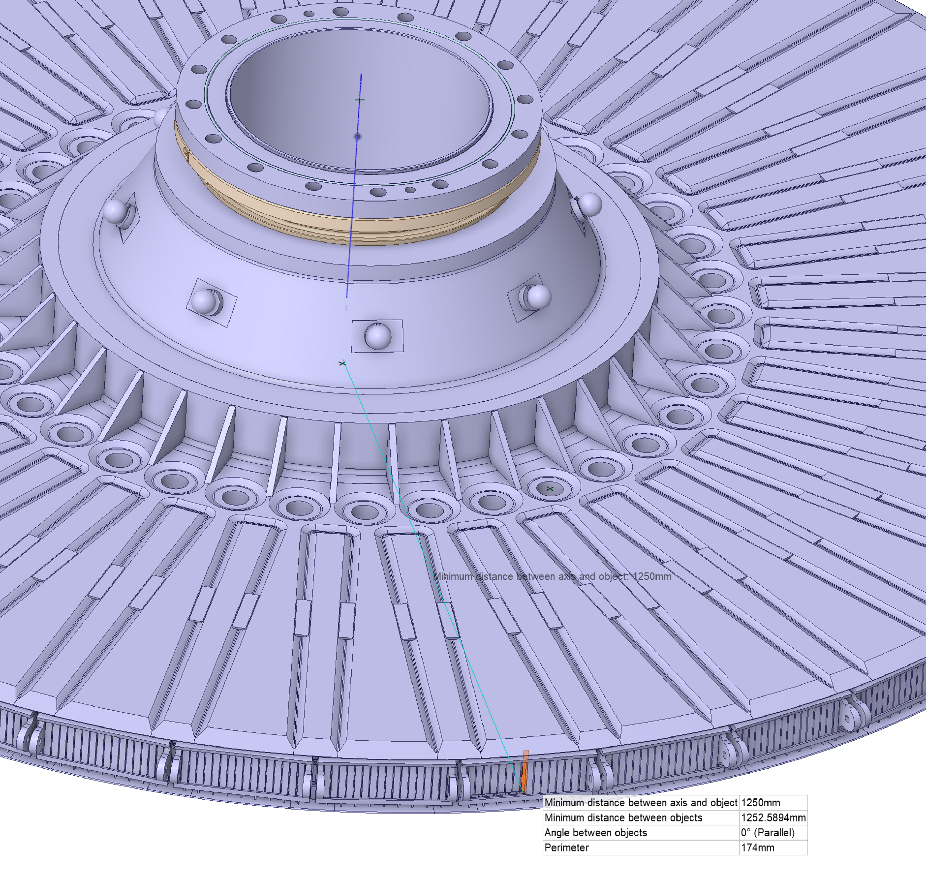
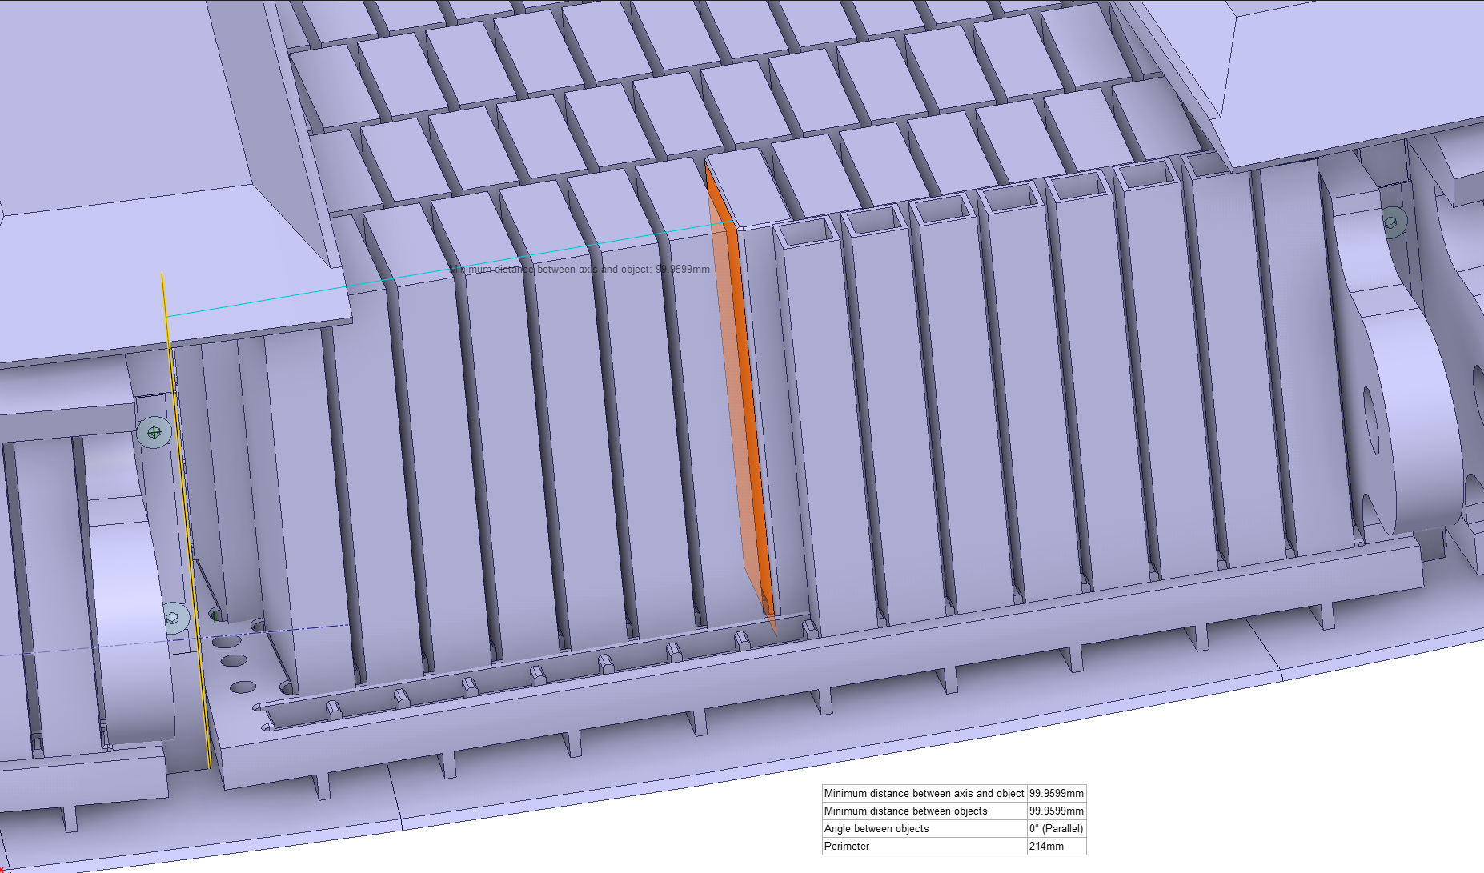
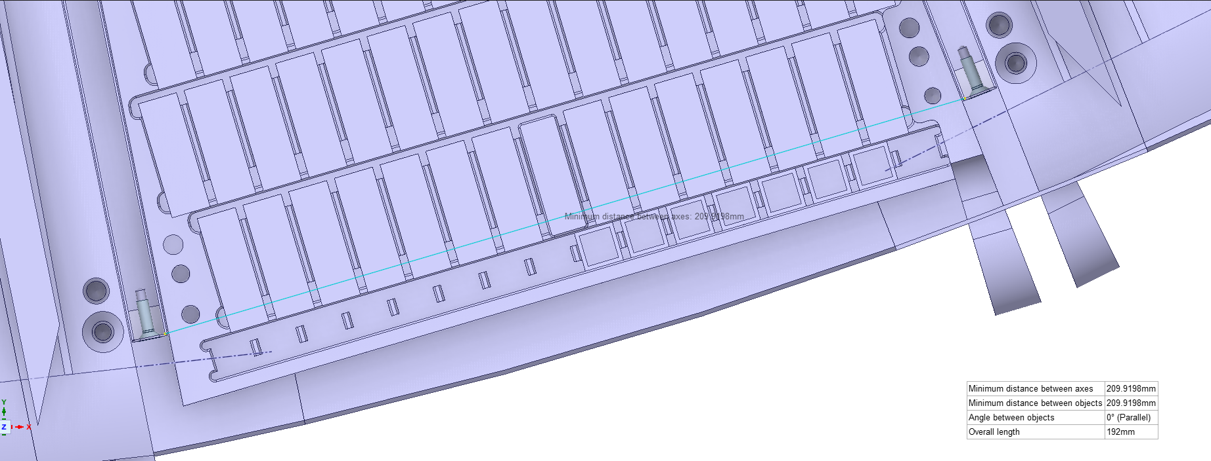
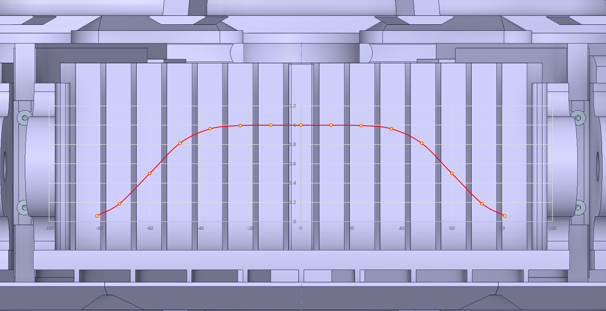
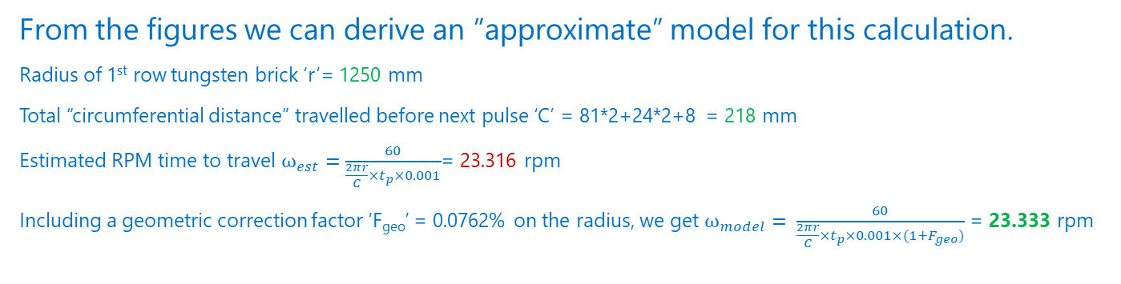
Wheel rotation to beam shift model
Pulse Beam repetition rate = 14 Hz; Number of sectors = 36
Expected Normal operations speed = 23.33 rpm
Time difference between two pulses t_{p}= 71.43 ms
From the figures we can derive an ”approximate” model for this calculation.
Radius of 1st row tungsten brick ‘r’= 1250 mm
Total “circumferential distance” travelled before next pulse ‘C’ = 81*2+24*2+8 = 218 mm
Estimated RPM time to travel ${\text{ω}}_{est}=\frac{60}{\frac{2πr}{C}×t_{p}×0.001}$= 23.316 rpm
Including a geometric correction factor ‘F_{geo}’ = 0.0762% on the radius, we get ${\text{ω}}_{model}= \frac{60}{\frac{2πr}{C}×t_{p}×0.001×(1+F_{geo})}$ = 23.333 rpm

Slide 12
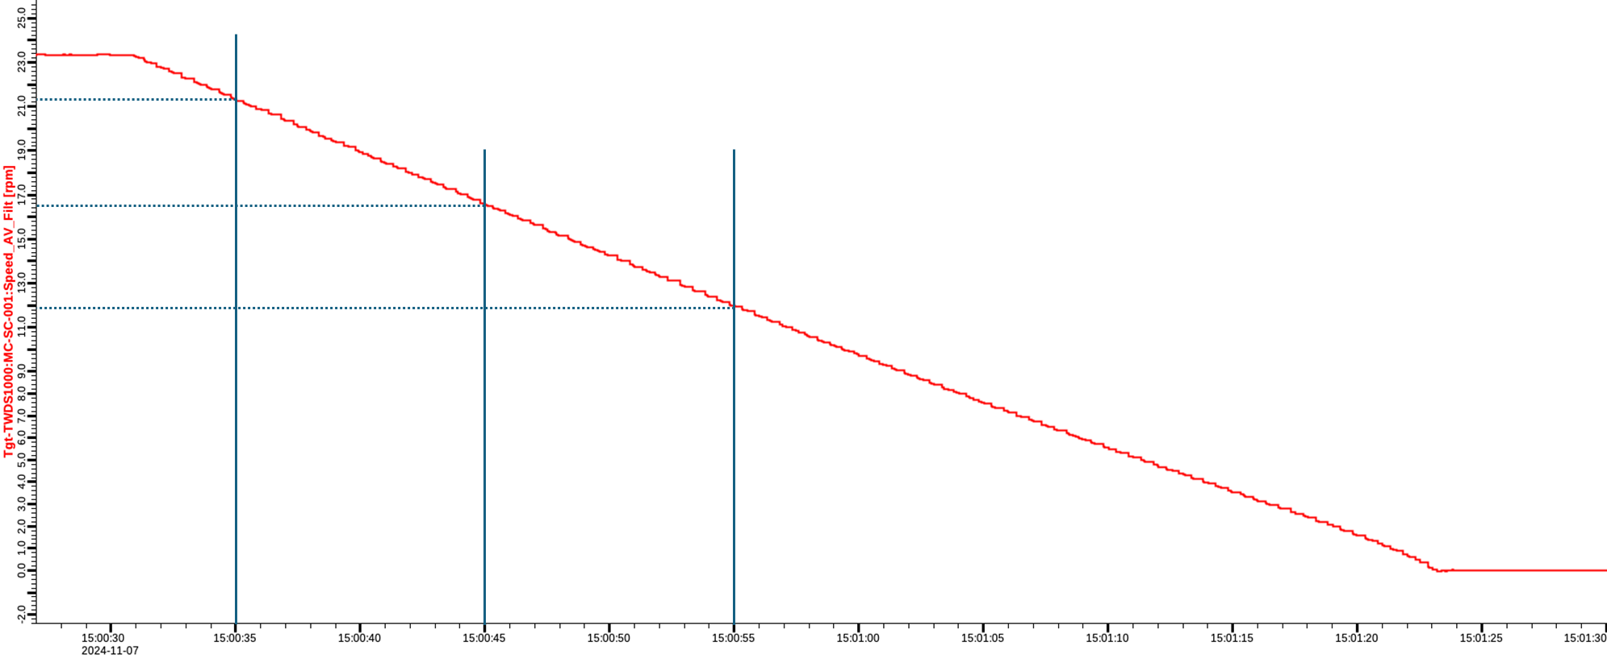
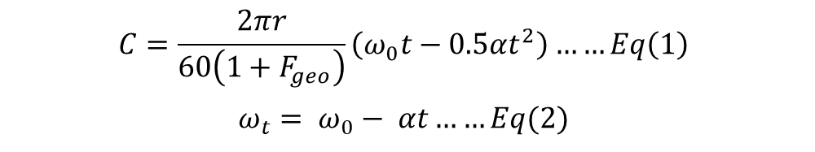
Impact of wheel rotation & TSS on ‘C’
Targe Wheel coast down rate
From experiments on Mock-up and Test stand
Average rpm reduction rate = 0.469 rpm/s (Angular deceleration = 0.0492 rad/s²)
$$C=\frac{2πr}{60\left(1+F_{geo}\right)}\left(ω_{0}t−0.5αt^{2}\right)……Eq\left(1\right)$$
$$ω_{t}= ω_{0}− αt……Eq(2)$$
We can derive the corresponding criteria for trip condition using above model
Trip Condition | Implementation in model
Contact rib | The beam footprint shift exceeds +24 mm
Contact last pulse | The distance between footprints of consecutive pulses reaches zero.
Overlap 1 RMS | The distance between footprints of consecutive pulses reduces below -13.5 mm.
Overlap 2 RMS | The distance between footprints of consecutive pulses reduces below -27 mm.
Overlap 3 RMS | The distance between footprints of consecutive pulses reduces below -40.5 mm.

Slide 13
3
Calculated Analytical Limits

Slide 14
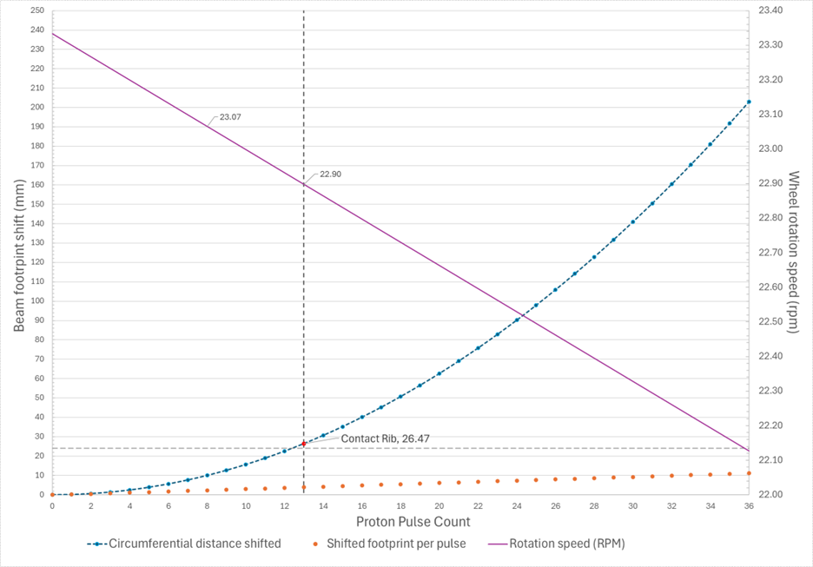
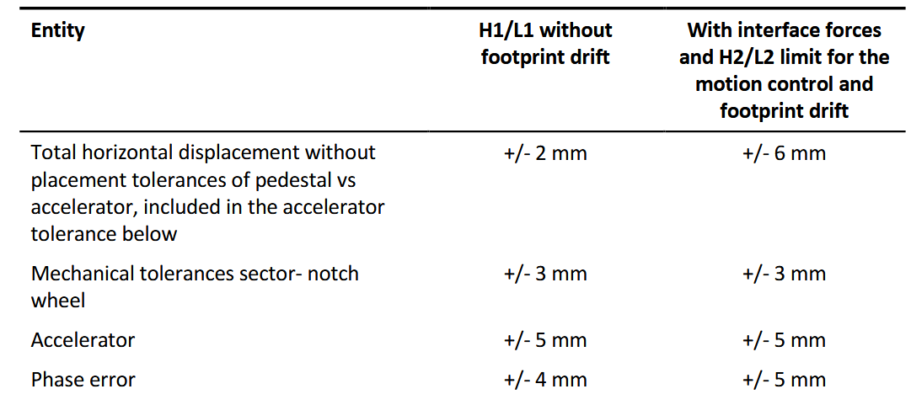
Analytical Limit – Target wheel shroud
Operational Group trip condition – Contact rib
  Kristoffer Sjögreen, “Target wheel, drive and shaft description of operational limits” highlights machine tolerances for the Target Wheel during operation.
  Additional ±13 mm tolerance should be included here, since we are estimating absolute shift of the beam footprint.
  Rib 2nd pulse occurs on the 39th Pulse = 22.03 rpm

Slide 15
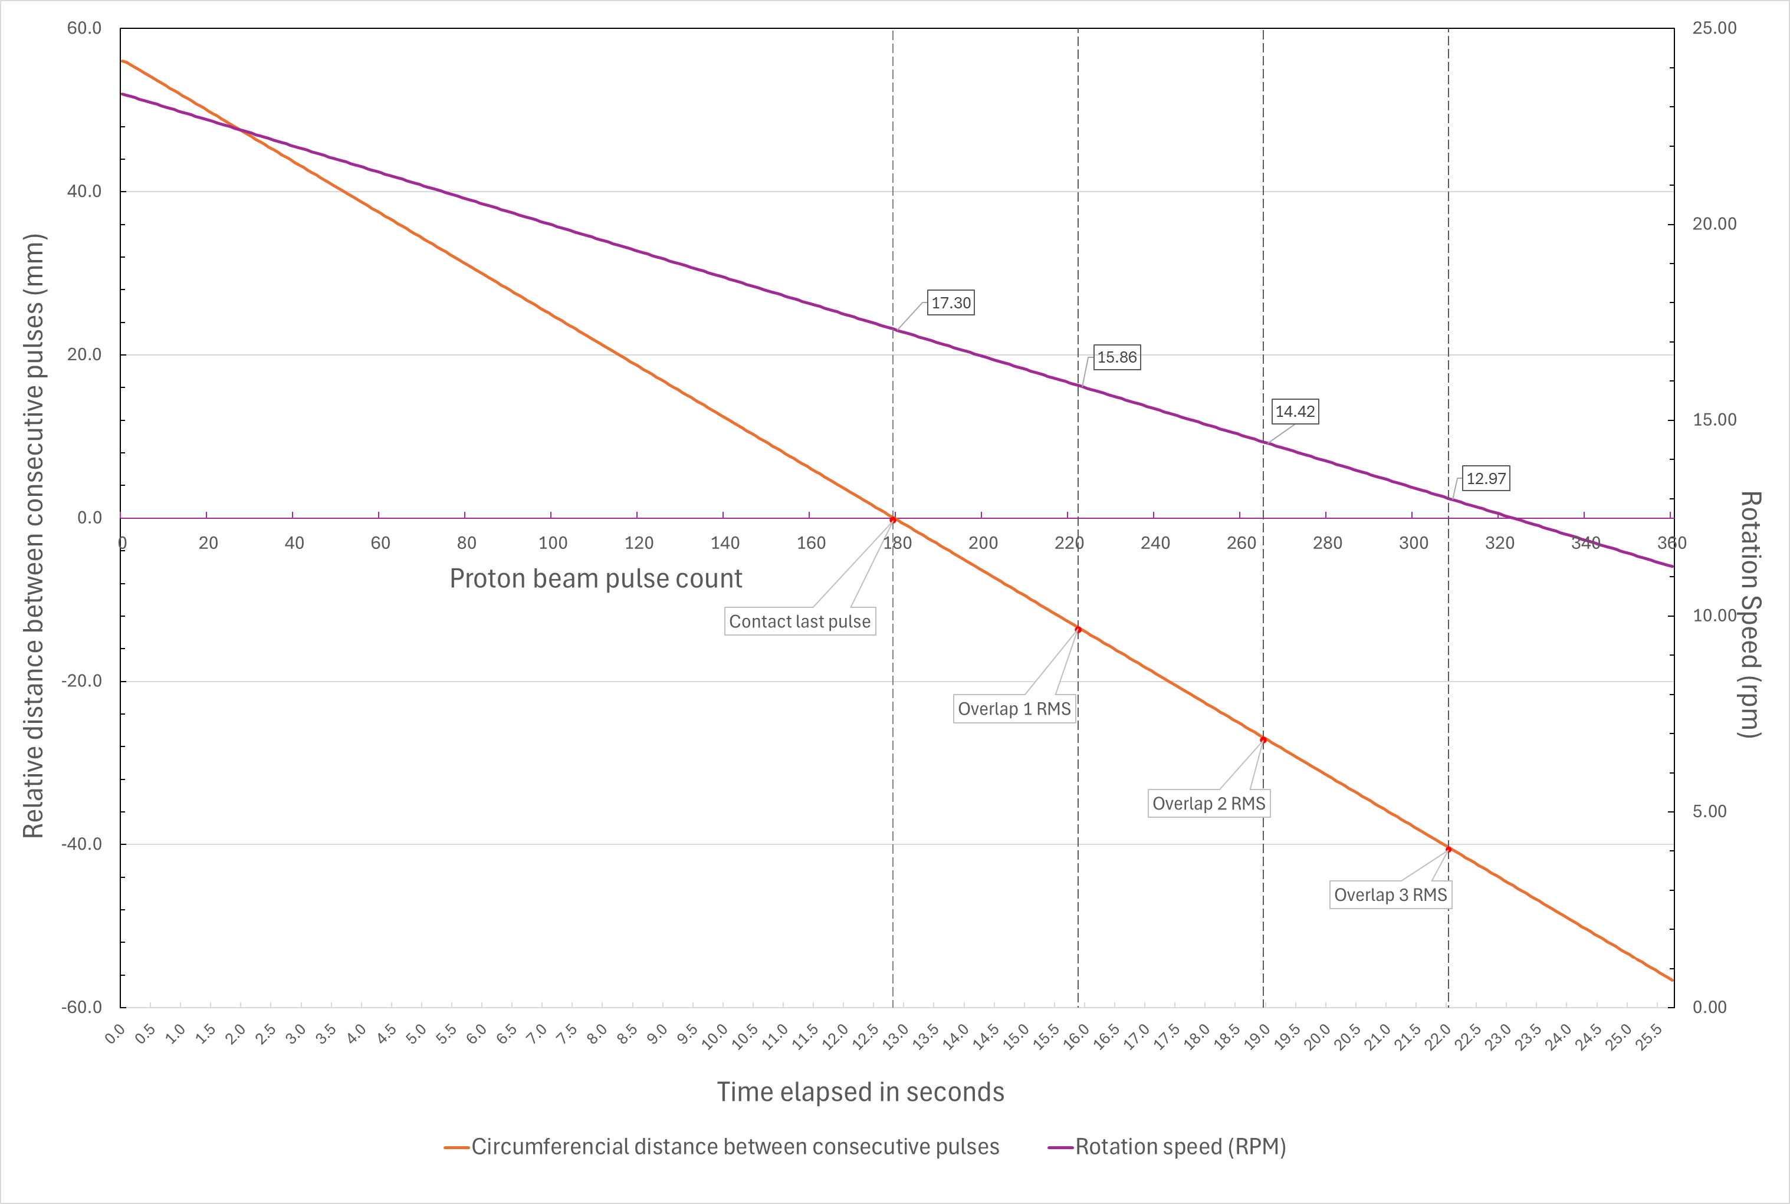
Analytical Limit – Tungsten bricks
TSS trip conditions
  Relative distance (or shift) between two consecutive beam pulses.
  Note: These are the analytical limits and not the final trip points.
    Choice of analytical limit is dependent on the temperature of the tungsten during the event.

Slide 16
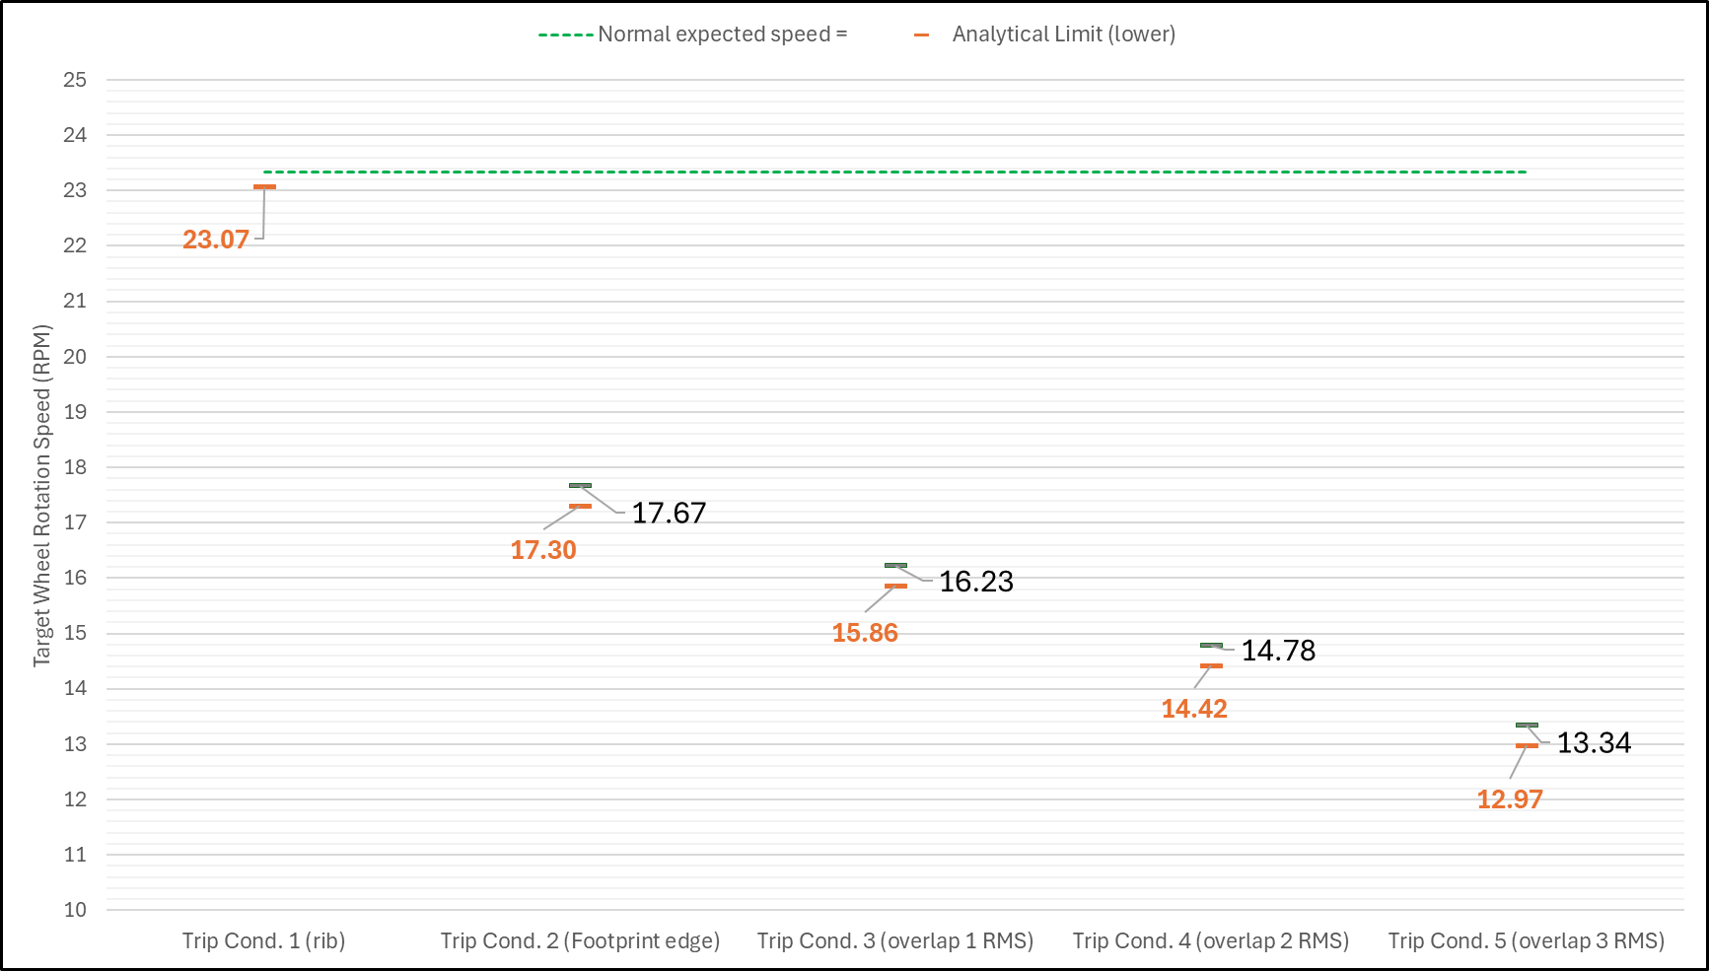
Impact of TSS SIF response time
TSS “SIF Response Time” = 765 ms
O. Jansen, "TSS Site Acceptance Test1 (SAT1) Report“ (ESS Internal report) gives max time of 265 ms for sensor detection.
A. Ponton, "Response time to shut off completely the beam production at the IS and RFQ after TSS contactors have been opened“ (ESS Internal report) gives max time of 500 ms for the actuator.
Analytical Limits are modified to include the TSS SIF response time

Slide 17
4
Setting the TSS trip point

Slide 18
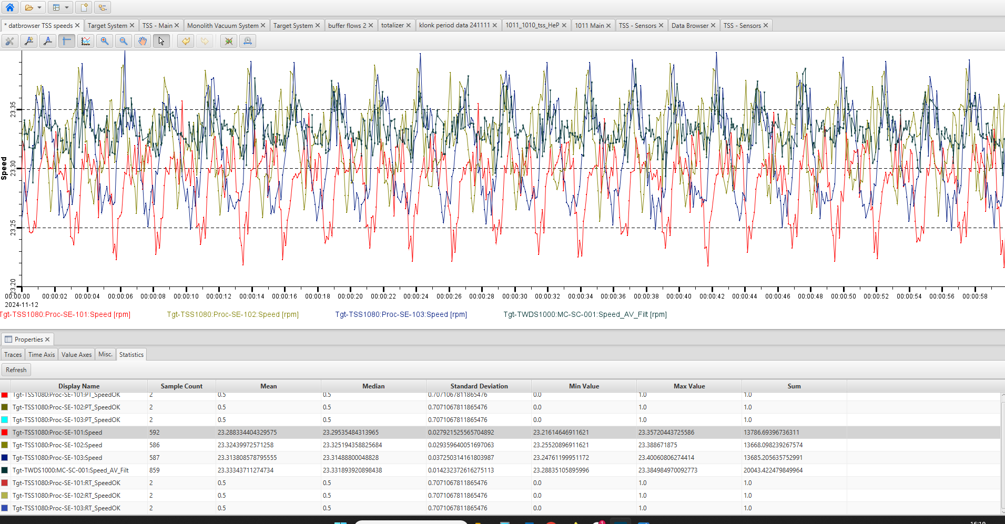
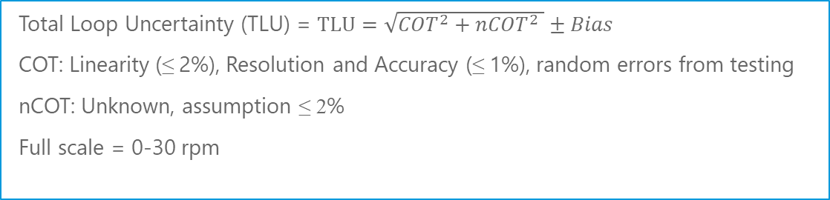
TSS channel uncertainties
Channel uncertainties – Components of Tolerance (COT) and nCOT
  COT – Component of Tolerance are uncertainty components that are addressed in the channel operation tests (surveillance testing).
    Drift over entire test interval
    Test instrument uncertainties
    Setting tolerances
  nCOT – uncertainty components that are not addressed in the channel operation test.
    Devices excluded in the test
    Effects of change in operating environment
  Total Loop Uncertainty (TLU) = $TLU=\sqrt{{COT}^{2}+{nCOT}^{2} }±Bias$
  COT: Linearity (≤ 2%), Resolution and Accuracy (≤ 1%), random errors from testing
  nCOT: Unknown, assumption ≤ 2%
  Full scale = 0-30 rpm

Slide 19
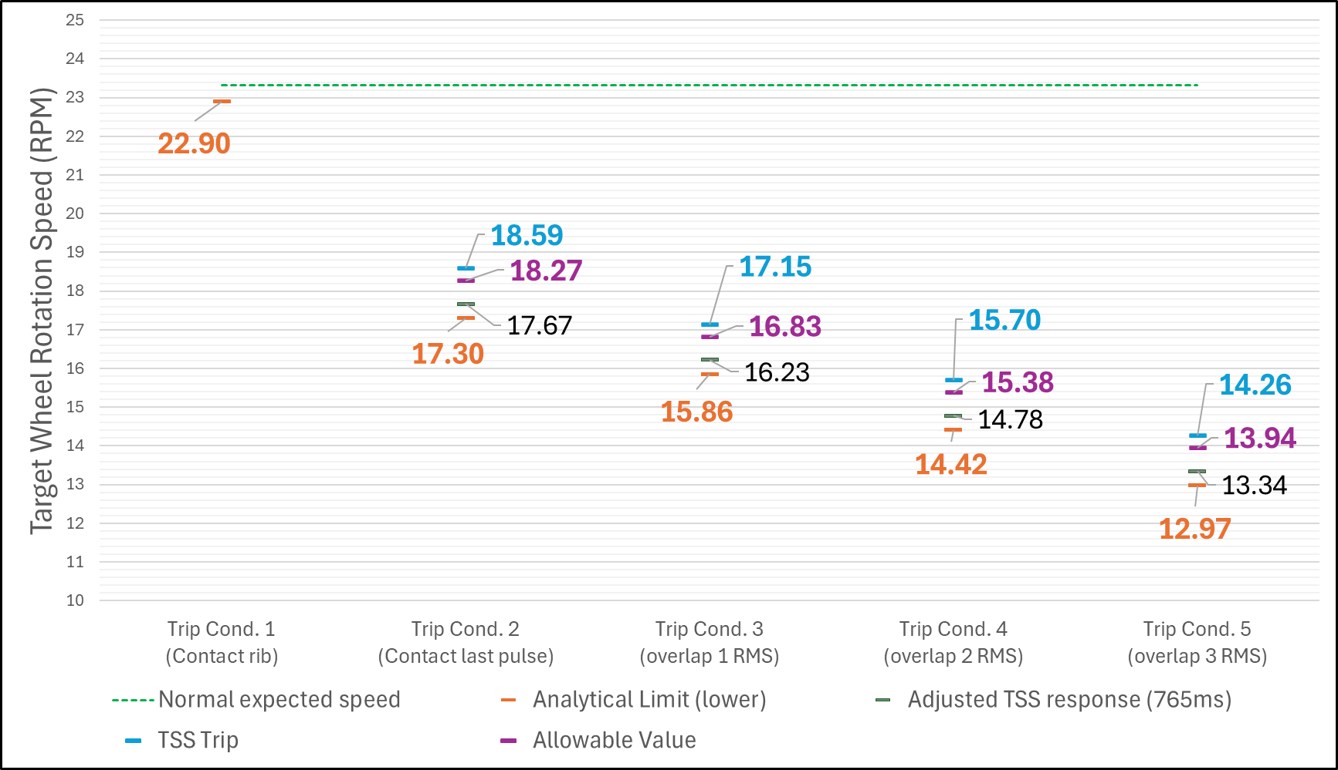
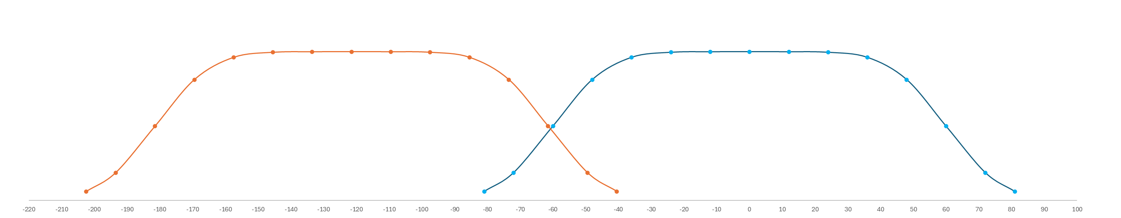
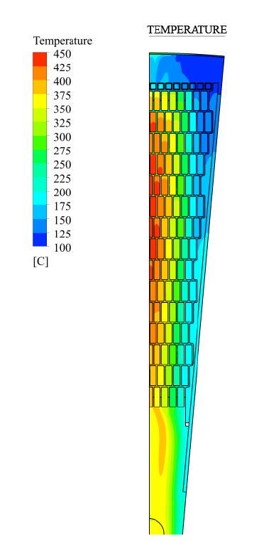
TSS trip points
Estimated from calculated analytical limits
  Trip setpoints are shifted up to include the channel uncertainties.
  Trip condition (analytical limit) with overlap of 3 RMS (or less) is considered for the TSS.
    At 3 RMS overlap, the heat generation in the tungsten brick at the extremes reaches almost similar value as the last pulse.
    CFD calculations from ESS Bilbao, J. Aguilar, 2021 “Design Report Target Vessel” have shown that the peak temperature in the tungsten bricks at the extremes remains below 300°C.

Slide 20
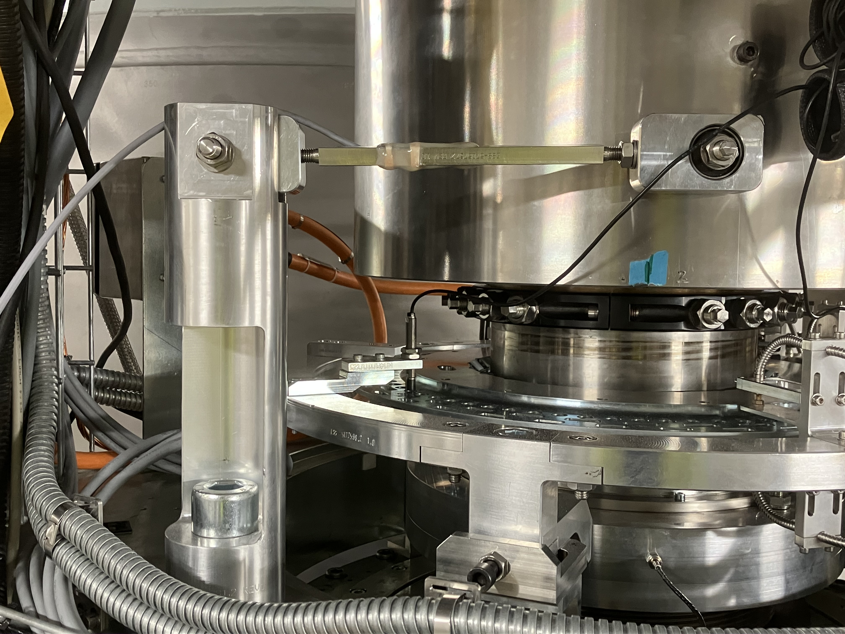
Summary
  In this work, a methodology to connect the ESS NF safety case with the trip points has been developed for the target wheel rotation.
  Results from the on-going commissioning tests of the target systems are included to improve the calculations.
  Although not comprehensive, but we have gained understanding of our safety margins at this stage.
  Future expansion –
    Connect with a standardized thermal model of the tungsten cooling during events.
    Improve assumptions on the uncertainties in the sensor behavior under thermal and high radiation environment
Photo of the notched wheel on top of the target wheel shaft

Slide 21
Thank you for your attention!
“All models are wrong, but some are useful.”— George Box, (1919–2013) British statistician renowned for shaping modern industrial statistics and experimental design

