Slide 1
Scattering Instrument Development and Design Workflows in Neutron Sciences at ORNL
April 16, 2026 | ICANS XXV| Malmö, Sweden
Matthew J. Frost
Neutron Technologies Division

Slide 2
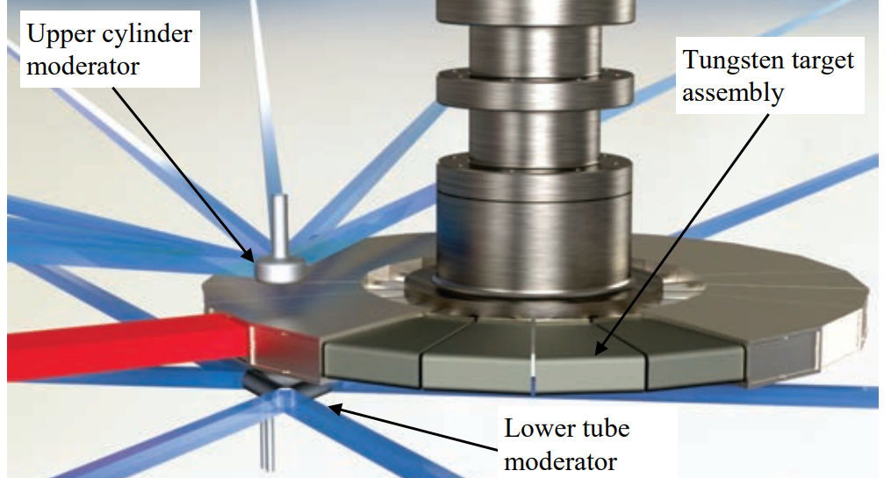
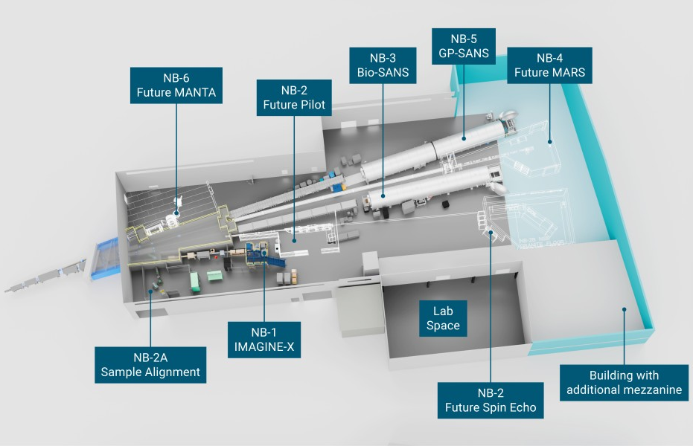
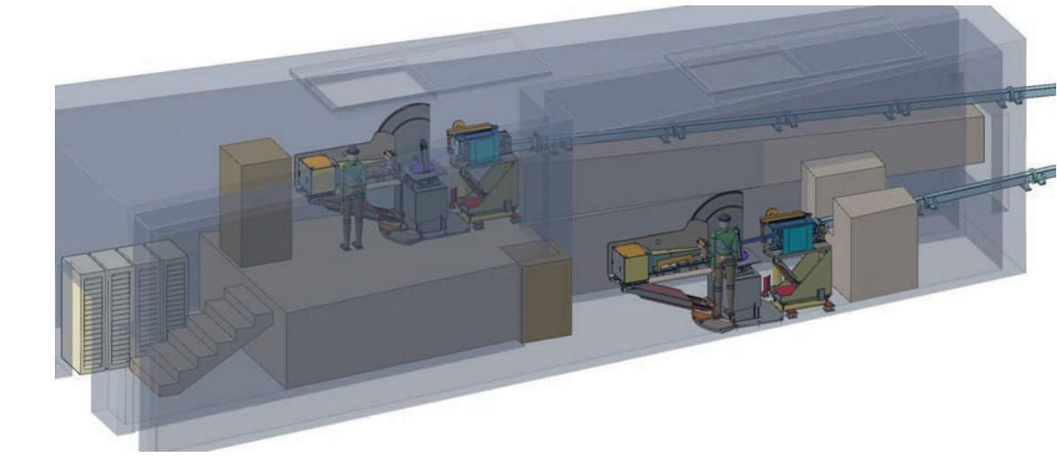
ORNL is On Track to Deploy a Significant Number of Redesigned or New Scattering Instruments in the next 10 years
https://neutrons.ornl.gov/sites/default/files/STS_CDR_Vol1_v2.pdf
https://neutrons.ornl.gov/cgh
Notes:
HBRR Cold Guide Hall: Six leg guide system supporting more than 7 different instruments
STS

Slide 3
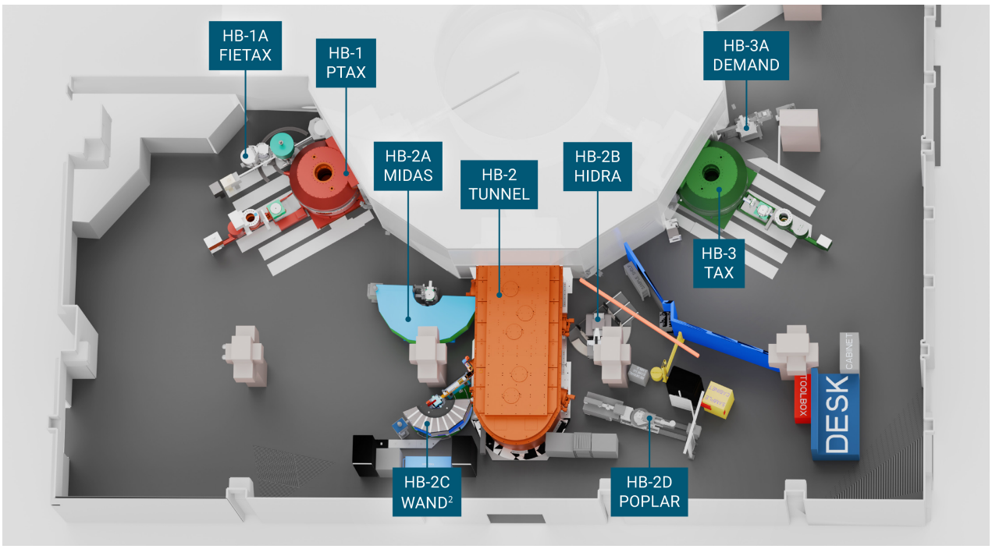
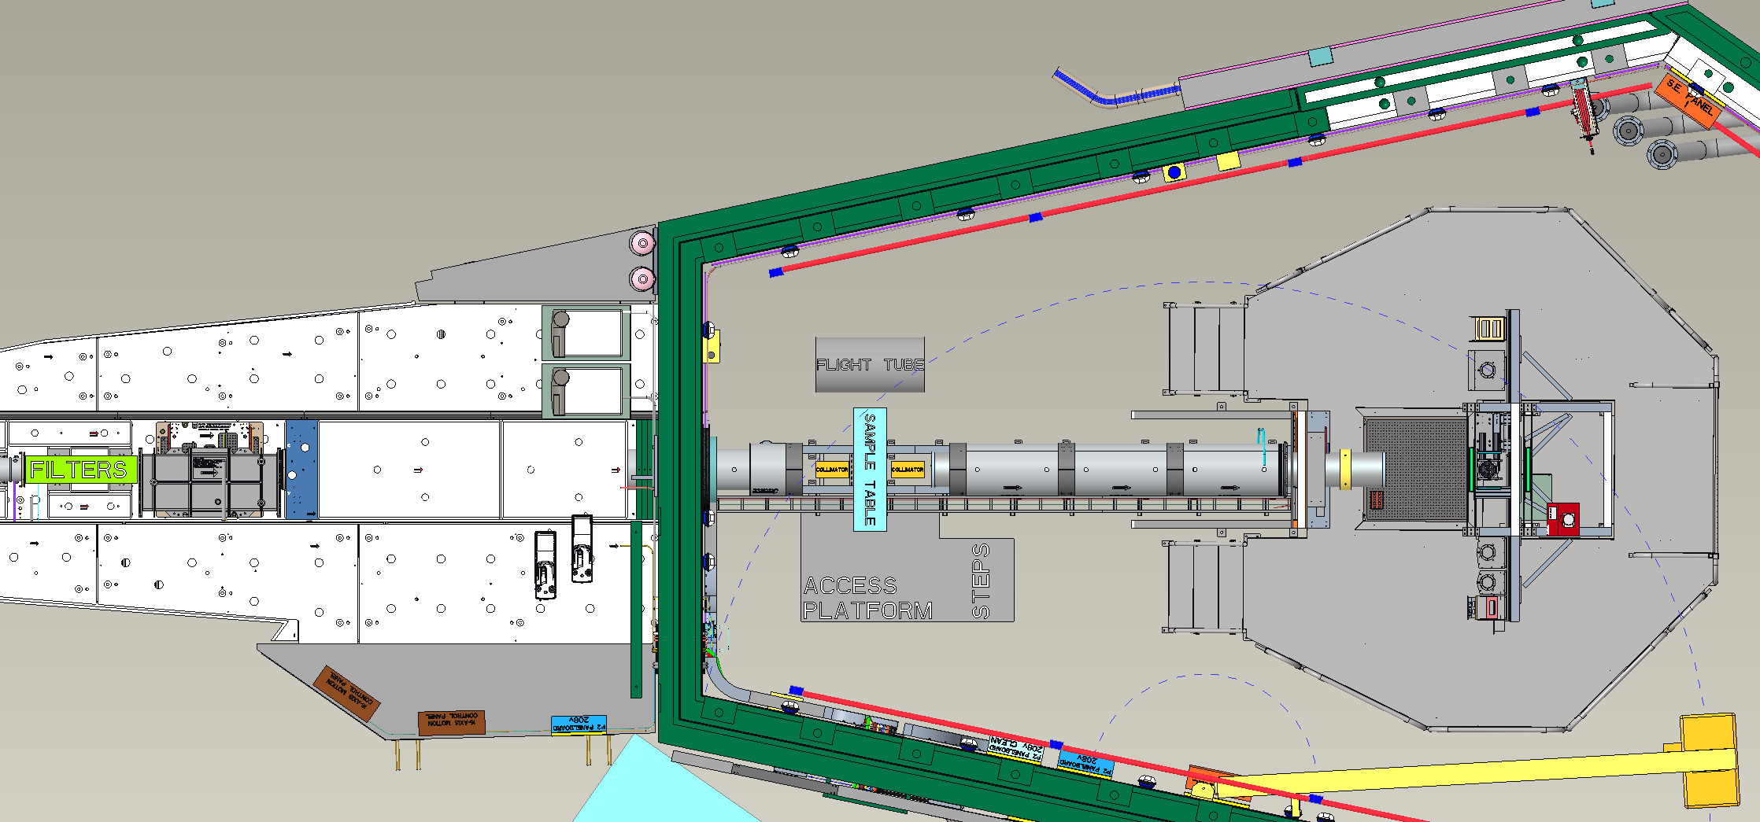
Neutron Sciences Currently Provides Support for Upgrades to Existing Instruments at SNS and HFIR
Proposed 20 meter nuclear cross section station at VENUS
Layout: Matthew Balafas
https://neutrons.ornl.gov/sites/default/files/G021712_HBRR_Flyer_2025-2.pdf
Notes:
HB2 Tunnel Reconfiguration
Imagine X

Slide 4
We Have Developed a Workflow That Enables Efficient and Effective Iteration of Instruments During the Initial Design
CAD/Engineering Tools
Conceptual Design
Science Requirements
Detailed Mechanical Design
Fabrication and Procurement
Optical Design
Shielding Design
Neutron Simulations
Notes:
Experiment Needs
Begin Loop
Simulation
CAD Conversion
Shielding Analysis
Refinement of Mechnical Design
End Loop
Implementation of Practical Features
Confirmation/Refinement of Simulation

Slide 5
Experiment Needs and Science Requirements
Technique (and Staff Personality) Dependent…
User Community, Sample Environment Technology, and Past Instrument Experiences.
Advise Stake Holders on a Measurable Figure of Merit (FOM)
Some weighted metric of instrument resolution and flux on sample over a defined wavelength range.
A living document is developed that provides a common point of communication for expectations of capability amongst all involved.
Clear Goals is the Goal
The result should be this document and with that some crude idea of the instrument layout (sample position, detectors, nominal guide path, beam stop)
Notes:
Sample Size
Divergence
Wavelength Range
Detector Type
Figure of Merit
(Flux, Resolution)

Slide 6
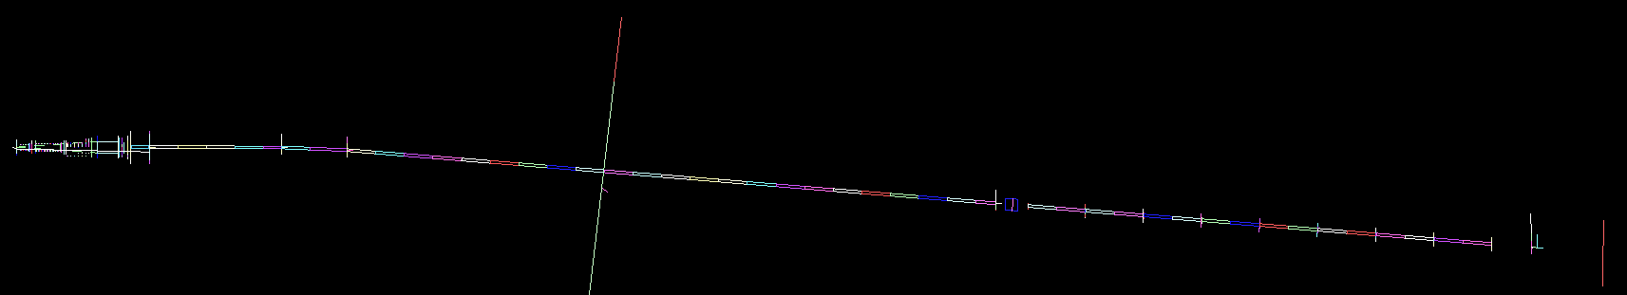
Incident Optical Design and Simulation
Incident Beam Design Pursued with a McStas Simulation
With Experiment Requirements Document in hand, applicable metrics are used to develop a first idealized incident beam optics design.
Notes:
Source Brightness
Nominal sample position and guide plan

Slide 7
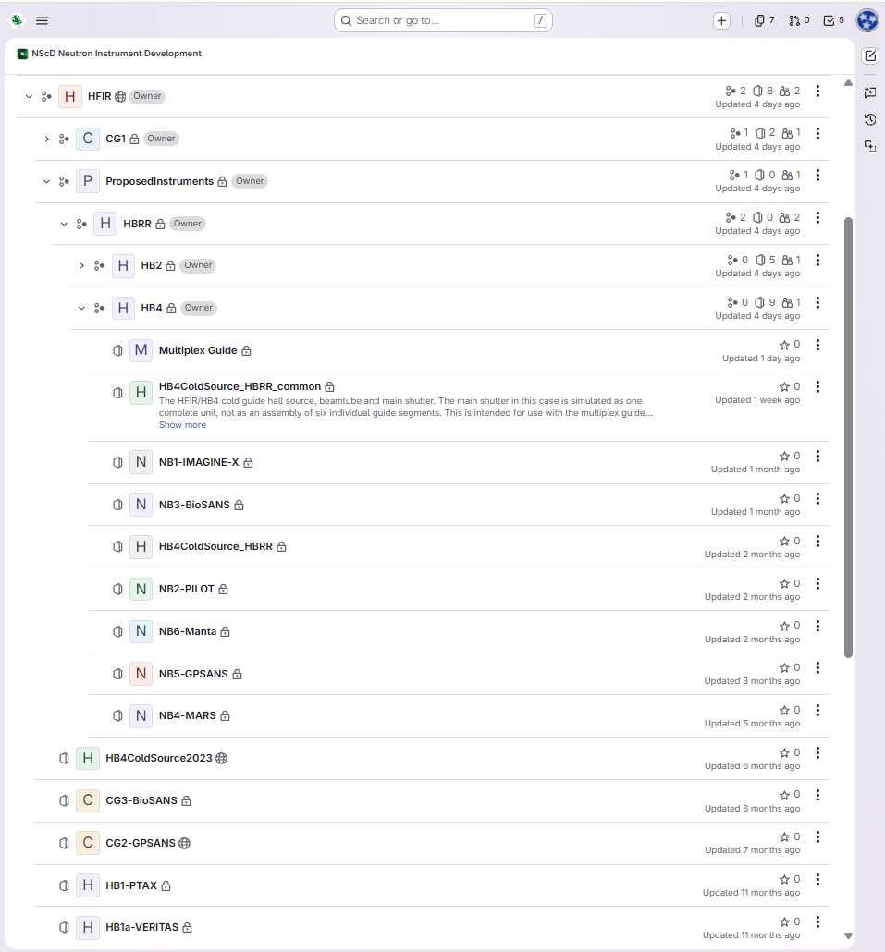
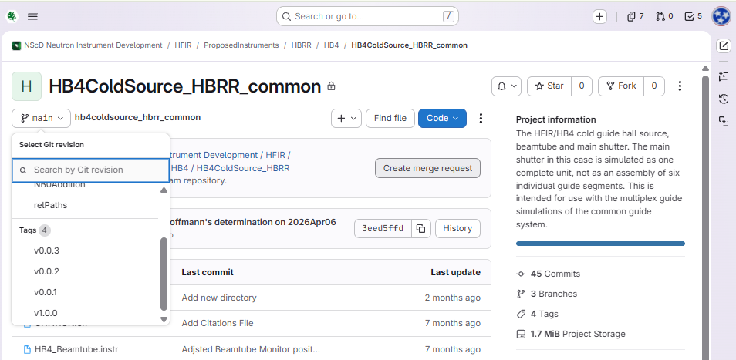
Versioning and Distribution of Results via GitLab Repository

Slide 8
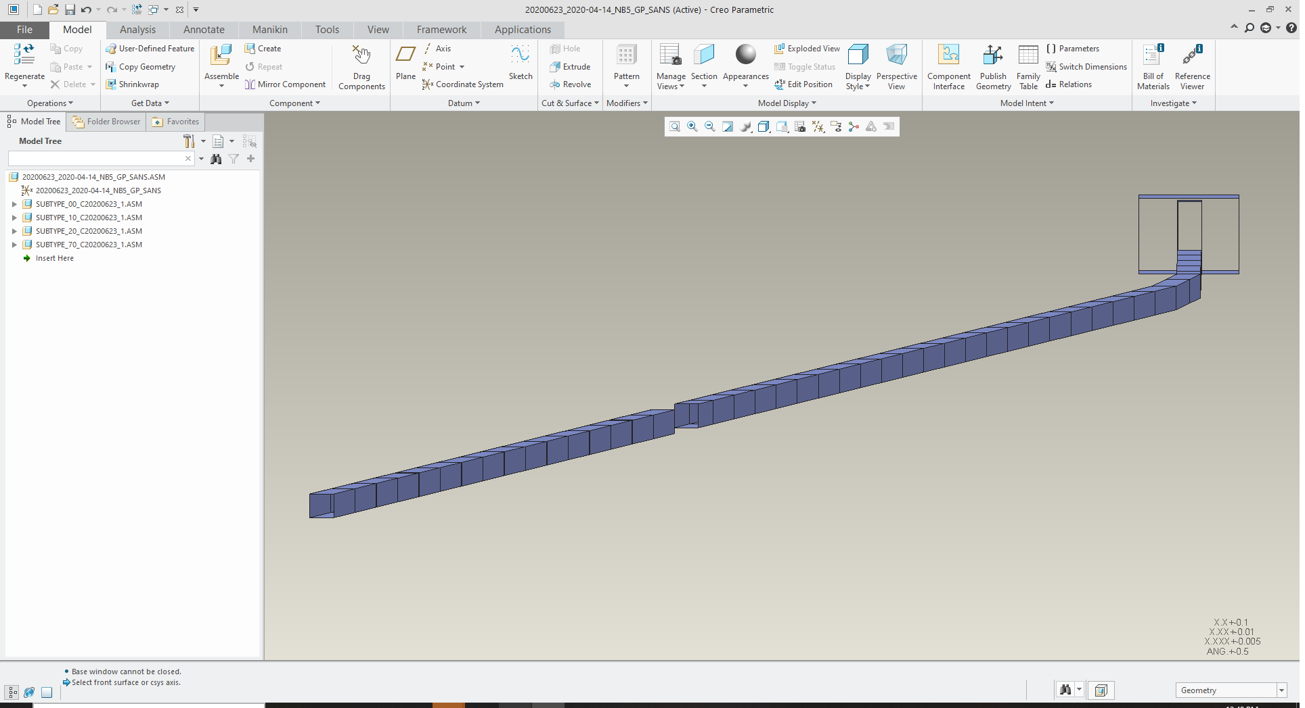

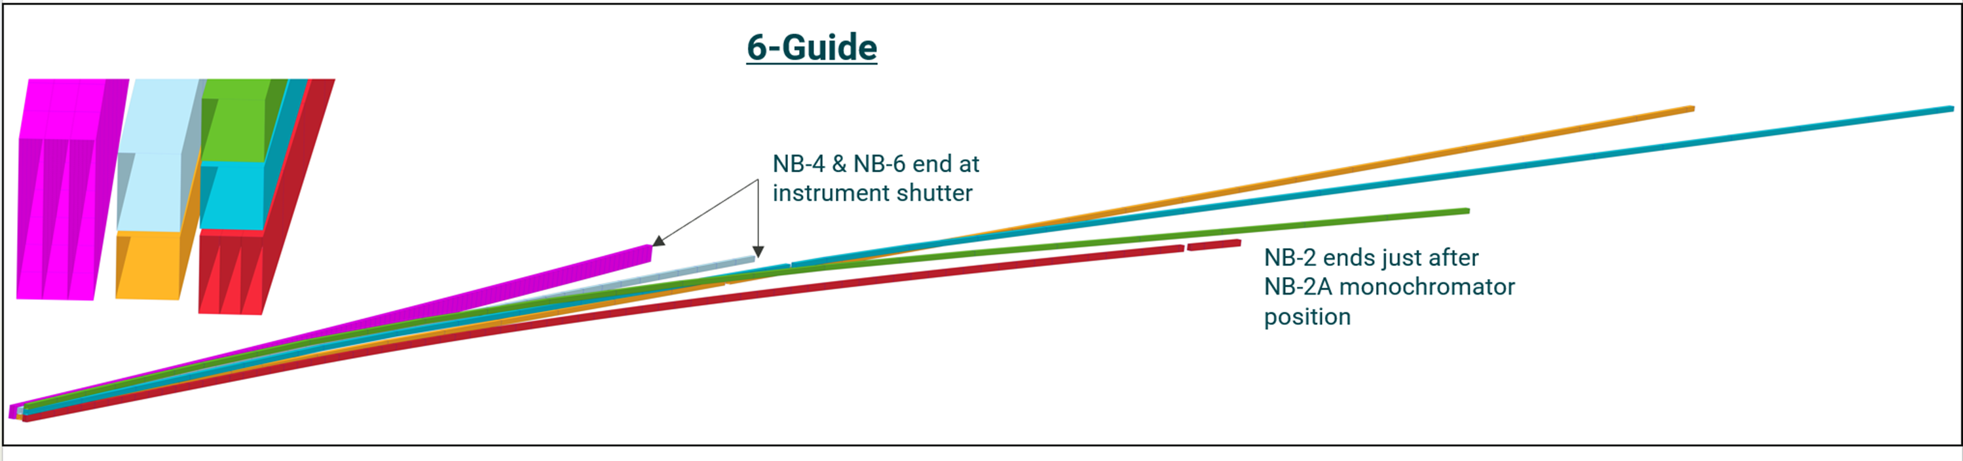
Conversion to CAD – McStas2CAD
Gitlab Repo
https://code.ornl.gov/3xf/mcstas2cad
Like all the best software, always a work in progress.
Written in Python3, uses numpy and scipy
Tested in Linux and MacOS
Main programs are creo_point_cloud.py, McStas2IGES, and arms2STEP.
Other small helper scripts included
Notes:
McStas2CAD with IGES and STEP compatibilties

Slide 9
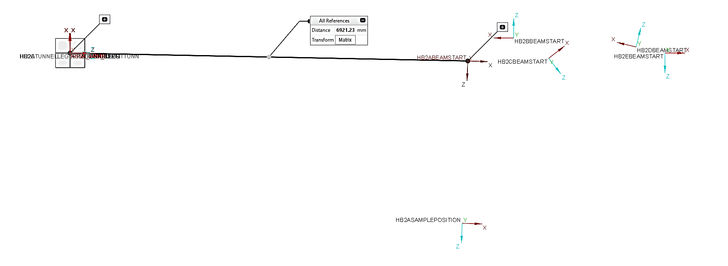
McStas2CAD is Resolving More Components in CAD
ARM component to STEP coordinate system
IGES doesn’t have a CSYS that is resolved in most CAD software

Slide 10
Shielding Analysis – Cold Guide Hall Network
Refined Guide Geometry in McStas with a common coordinate system amongst the instruments permits shielding analysts to develop detailed models of the entire common guide system.
This is enabled by the IGES output format from McStas2CAD conversion and lowers the pain when reissuing these files during the iteration phases.
Notes:
Guide Shapes and Coatings make a difference with regards to what shielding needs to do, especially in close quarters with other instruments.

Slide 11
Refinement of Design in CAD for Feedback into Simulations
Instrument Stakeholders or Design Engineers will occasionally come back with:
“We have to do this thing in order for the whole instrument to work, please move the X to position Y along the instrument and determine performance impact.”
“X is in the procurement phase. The vendor wants to do Y to X, can the design accommodate that?”
Inclusion of Practical Features as the Design Matures
Windows, Apertures, Sample Environments, Misalignment Limits
Scrapers, Guide/Polarizer Substrate, Shutter Locations
All the things that make an instrument work, but are not considered during the initial concept phase
Notes:
“We have to do this thing in order for the whole instrument to work, please move the X to position Y along the insrument”
“X is in the procurement phase. The Vendor wants to do Y to X, can the design accommodate that?”
“We need to design a large vacuum jacket for all of the guides within 10 meters of the source. What are the alignment tolerances?”
Inclusion of practical features as they appear in the design.
Windows
Apertures
Guide/Polarizer Substrate
Alignment Limits
Shutter locations
Scrapers

Slide 12
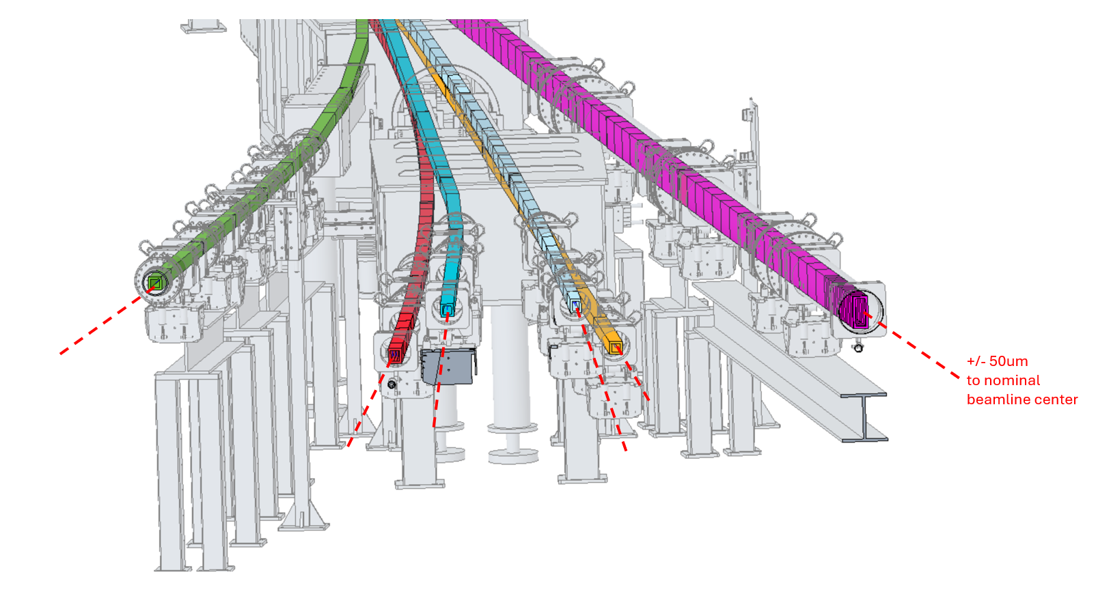
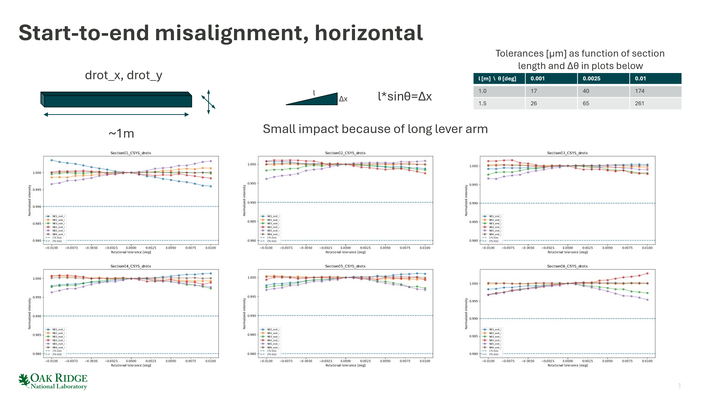
Simulations Answer Questions About Alignment Tolerances
Layout: Thomas Huegle

Slide 13
Measure Result and Refine Simulation
CAD/Engineering Tools
Conceptual Design
Science Requirements
Detailed Mechanical Design
Fabrication and Procurement
Optical Design
Shielding Design
Neutron Simulations

Slide 14
Measure Result and Refine Simulation
CAD/Engineering Tools
Conceptual Design
Science Requirements
Detailed Mechanical Design
Fabrication and Procurement
Optical Design
Shielding Design
Installation
Neutron Simulations
Facility Investment
New Developments
Instrument Characterization
Commissioning
Not a “Workflow”, but a Continuous Refinement of Facility Capability!

Slide 15
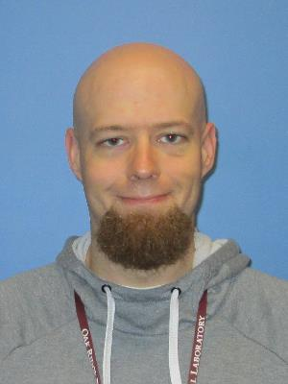
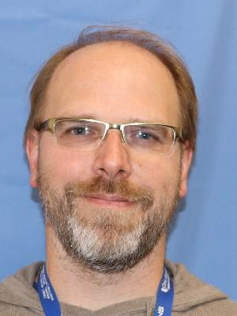
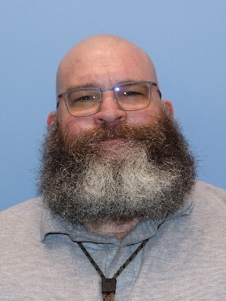
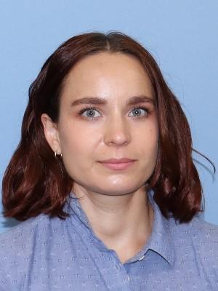
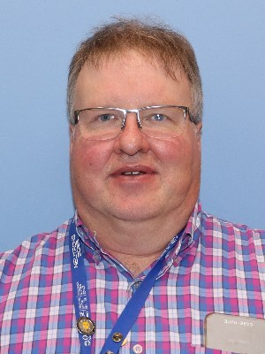
Conclusion/Contributors
We are leveraging a Development and Design Workflow Process that Encourages the Continuous Refinement of Instrument Design and Performance
Suited to large-scale facilities, where suite sizes are such that other instruments can still meet most users’ needs while enhancements are implemented.
Future FTS, STS, HFIR Instruments will use this process, providing stake holders’ confidence in the delivery of the expected instrument performance.
Kyle Grammer, Thomas Huegle, Michael Hoffmann, Stephanie Jolly, Garrett Granroth

