Slide 1
Towards a Comprehensive Digital Twin Framework for the J-PARC Neutron Instrument Suite
ICANS XXV, Malmö, Sweden
Dr. Gabriele Sala - gsala@post.j-parc.jp -
16th April 2026

Slide 2
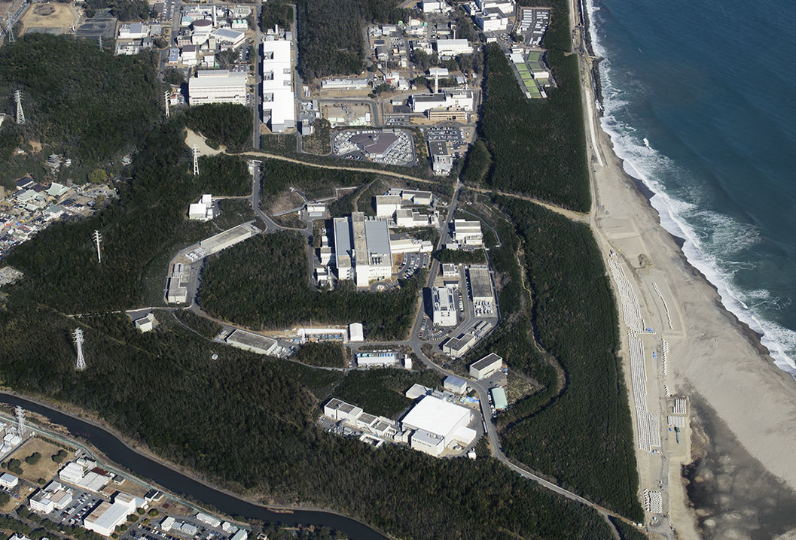

Contents:
Why do we need Virtual Twins at TS1 ?
What can we achieve with them ?
Virtual Twin Instruments at TS1
Spectrometers
Diffractometers
Reflectometers
WANS / SANS
Neutron Imaging
Conclusion

Slide 3




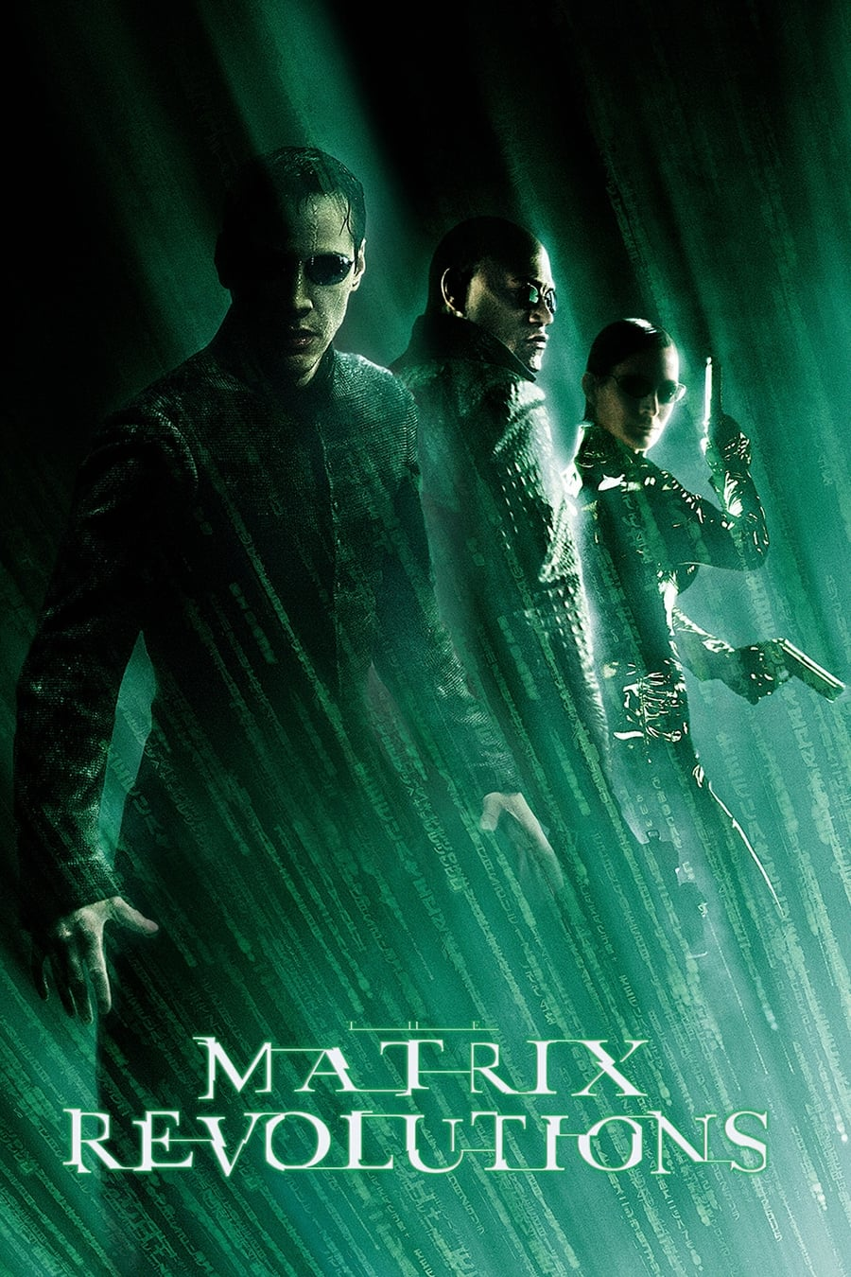

Introduction
What do all these movies have in common? ( Besides amazing CGI )
They ALL show Endless Possibilities in the Virtual Reality World
1999
2003
2003
2010
2025
1982
Notes:
So, this begs the question: Why don’t we construct a virtual neutron scattering facility where we can create, optimize, test and compare our instruments ?
In other words, why do we need a virtual twin ?

Slide 4
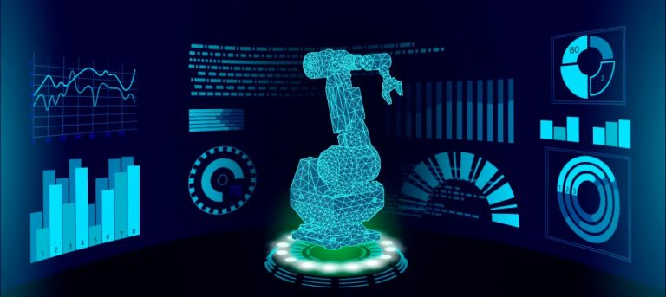
Why do we need a virtual-twin?
Quick debugging of real hardware issues and perform background noise studies.
More complete data analysis including Instrument Resolution.
Didactic tool for new/old users (especially for Neutron School).
World-Wide support from the McStas community.
Easy to code and remarkably useful for Instrument Upgrades.

Slide 5
Current Status of Target Station One (TS1)
Overview of the current TS1
PRELIMINARY RESULTS
MORE SIMULATIONS ARE RUNNING…

Slide 6
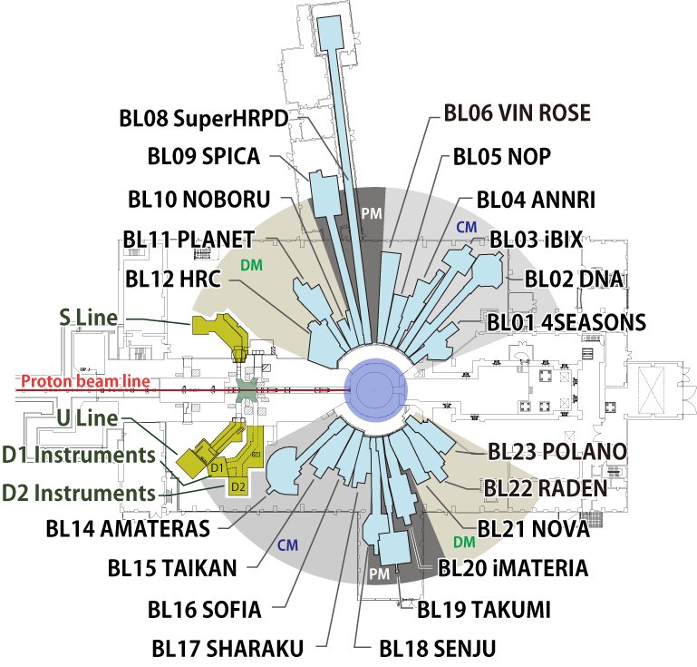
Overview of the Current TS1:
Characteristics:
f_{S} = 25 Hz at ~ 1 MW
Total 23 beam-ports
Total 21 Instruments built
BL07 Empty
BL13 Future Instrument Plans
Notes:
It is only natural that with such a rich and diverse ensemble of instruments, we first want to get a solid baseline to develop future capabilities for TS2.

Slide 7
Overview of the Current TS1:
McStas Instrument Headcount
Instruments that cannot be simulated:
BL04 ANNRI
BL05 NOP
BL06 VIN ROSE
BL10 NOBORU
Instruments that do not belong to MLF:
BL03 iBIX
BL20 iMATERIA
To Do:
BL09 SPICA
BL12 HRC
BL17 SHARAKU
BL20 POLANO
Total of 11 / 15 Instruments
Notes:
Thanks to the help and support of all my colleagues and all engineers who shared all blueprints and info. Current total is 11 out of 15 instrument simulated at different level stage.

Slide 8
Current Status of Monte Carlo Simulations for TS1
Spectrometers
Diffractometers
Reflectometers
WANS / SANS
Neutron Imaging
Notes:
I am very proud of the strong support I received from all the J-PARC divisions: MLF, KEK and CROSS in providing me all the info to build the Monte Carlo Instrument files.

Slide 9
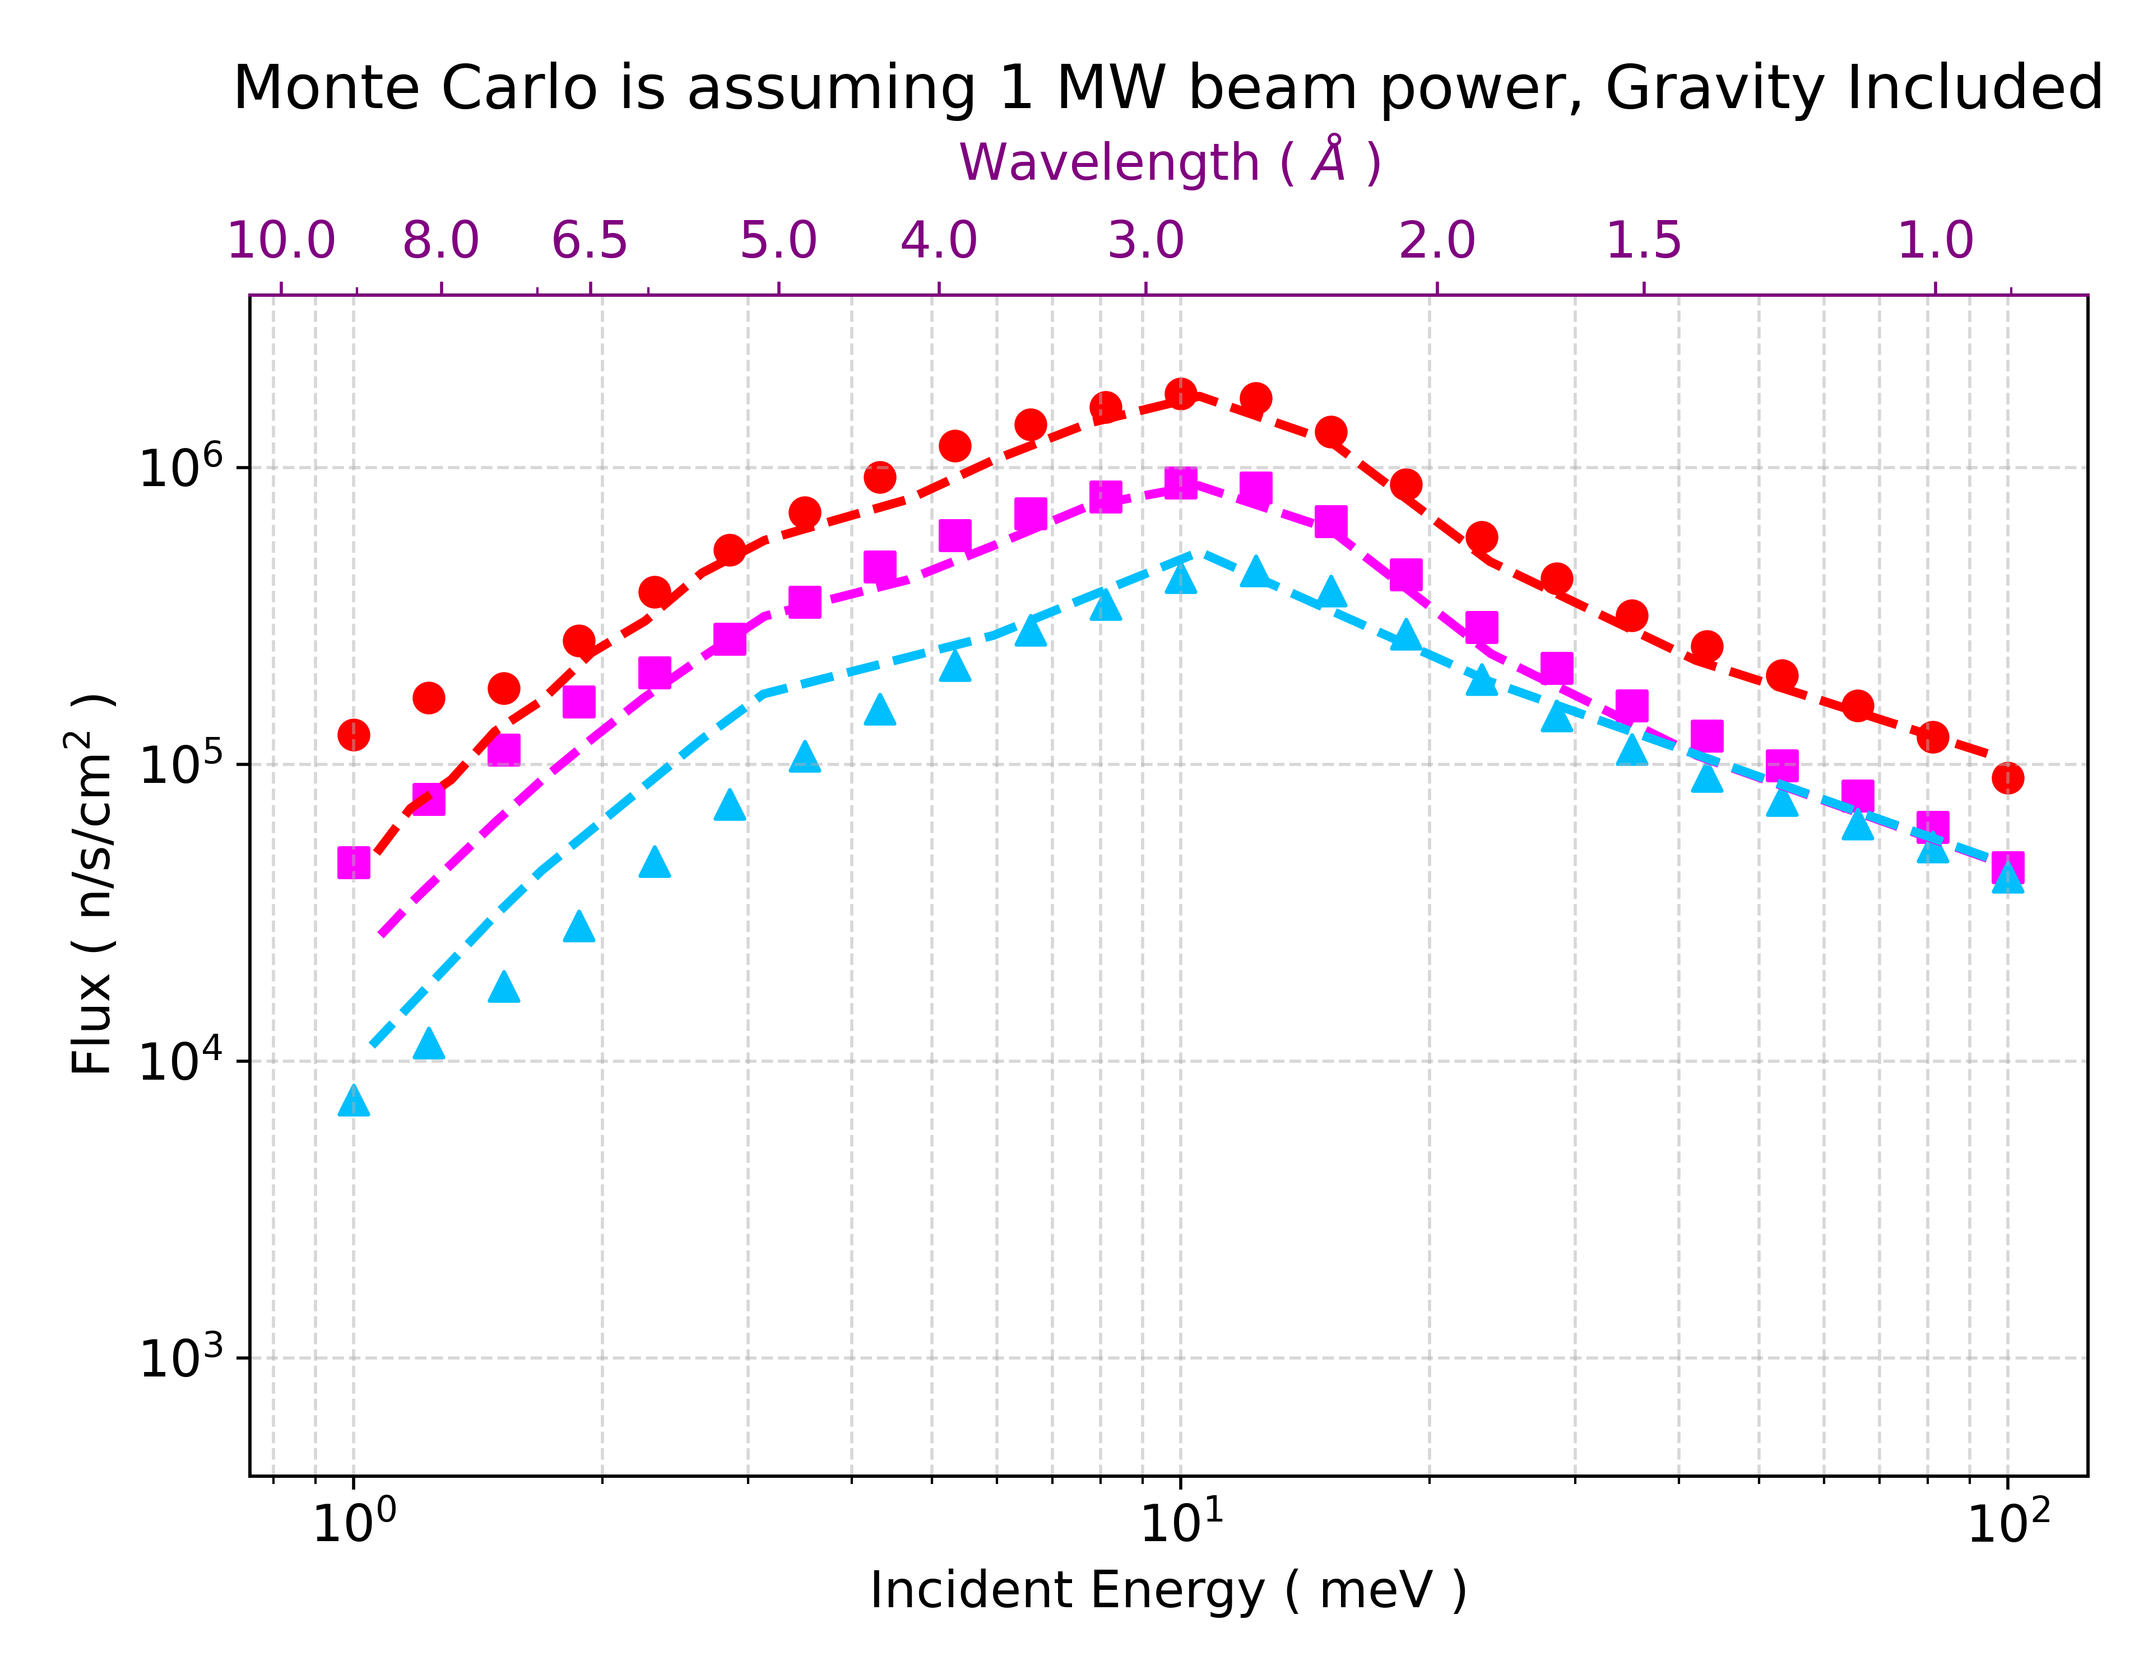
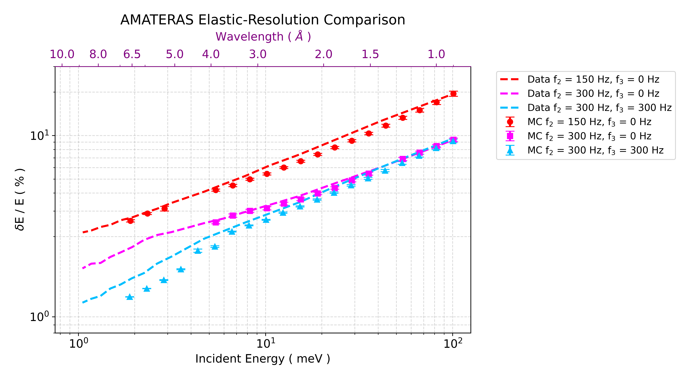
Spectrometers: BL01 / BL02 / BL14
MC Simulations performed on AMATERAS show a remarkable agreement with the measurements.
Flux prediction are within 8% from the real data set, discrepancies due to chopper phases / delays.
Elastic Resolution is within 2-5% from the real data set, discrepancies due to chopper phases / delays.
Powerful tool to refine Chopper settings on the real instrument, analyze leaking energies and potential hardware upgrades.

Slide 10
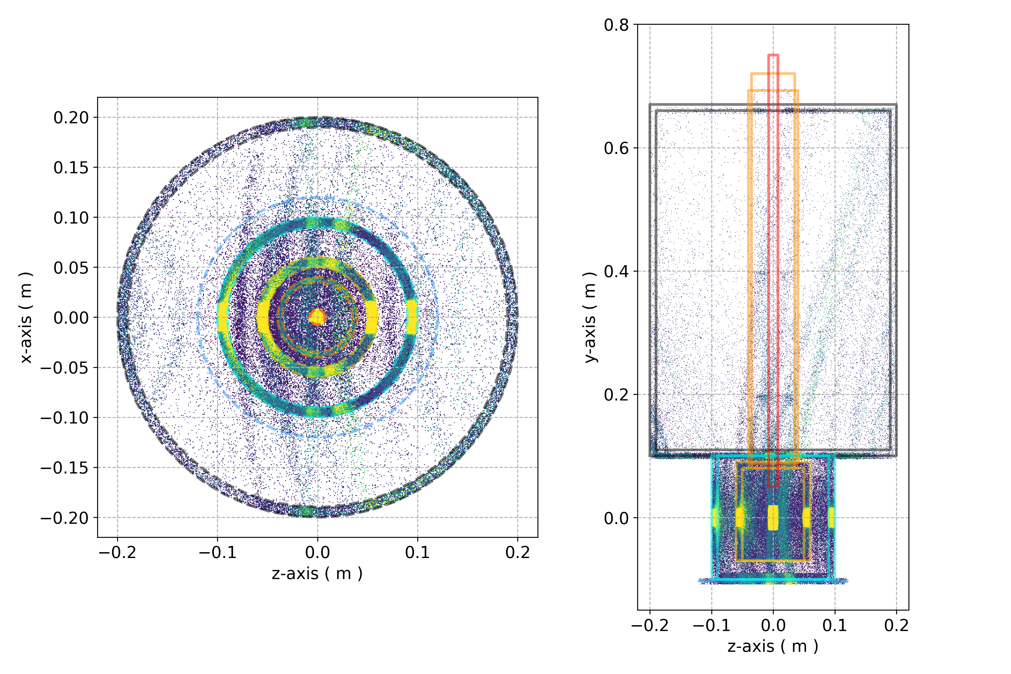
Optimization of Sample Environment → BKG Simulations
Visualizing neutron interactions inside realistic SE:
Reconstruction of the Origin of Artifacts in the data-set
Optimization of BKG shields
Optimization of SE geometry
Multiple-Scattering effects
Optimization of Radial Collimator
Design Better Sample Environments

Slide 11
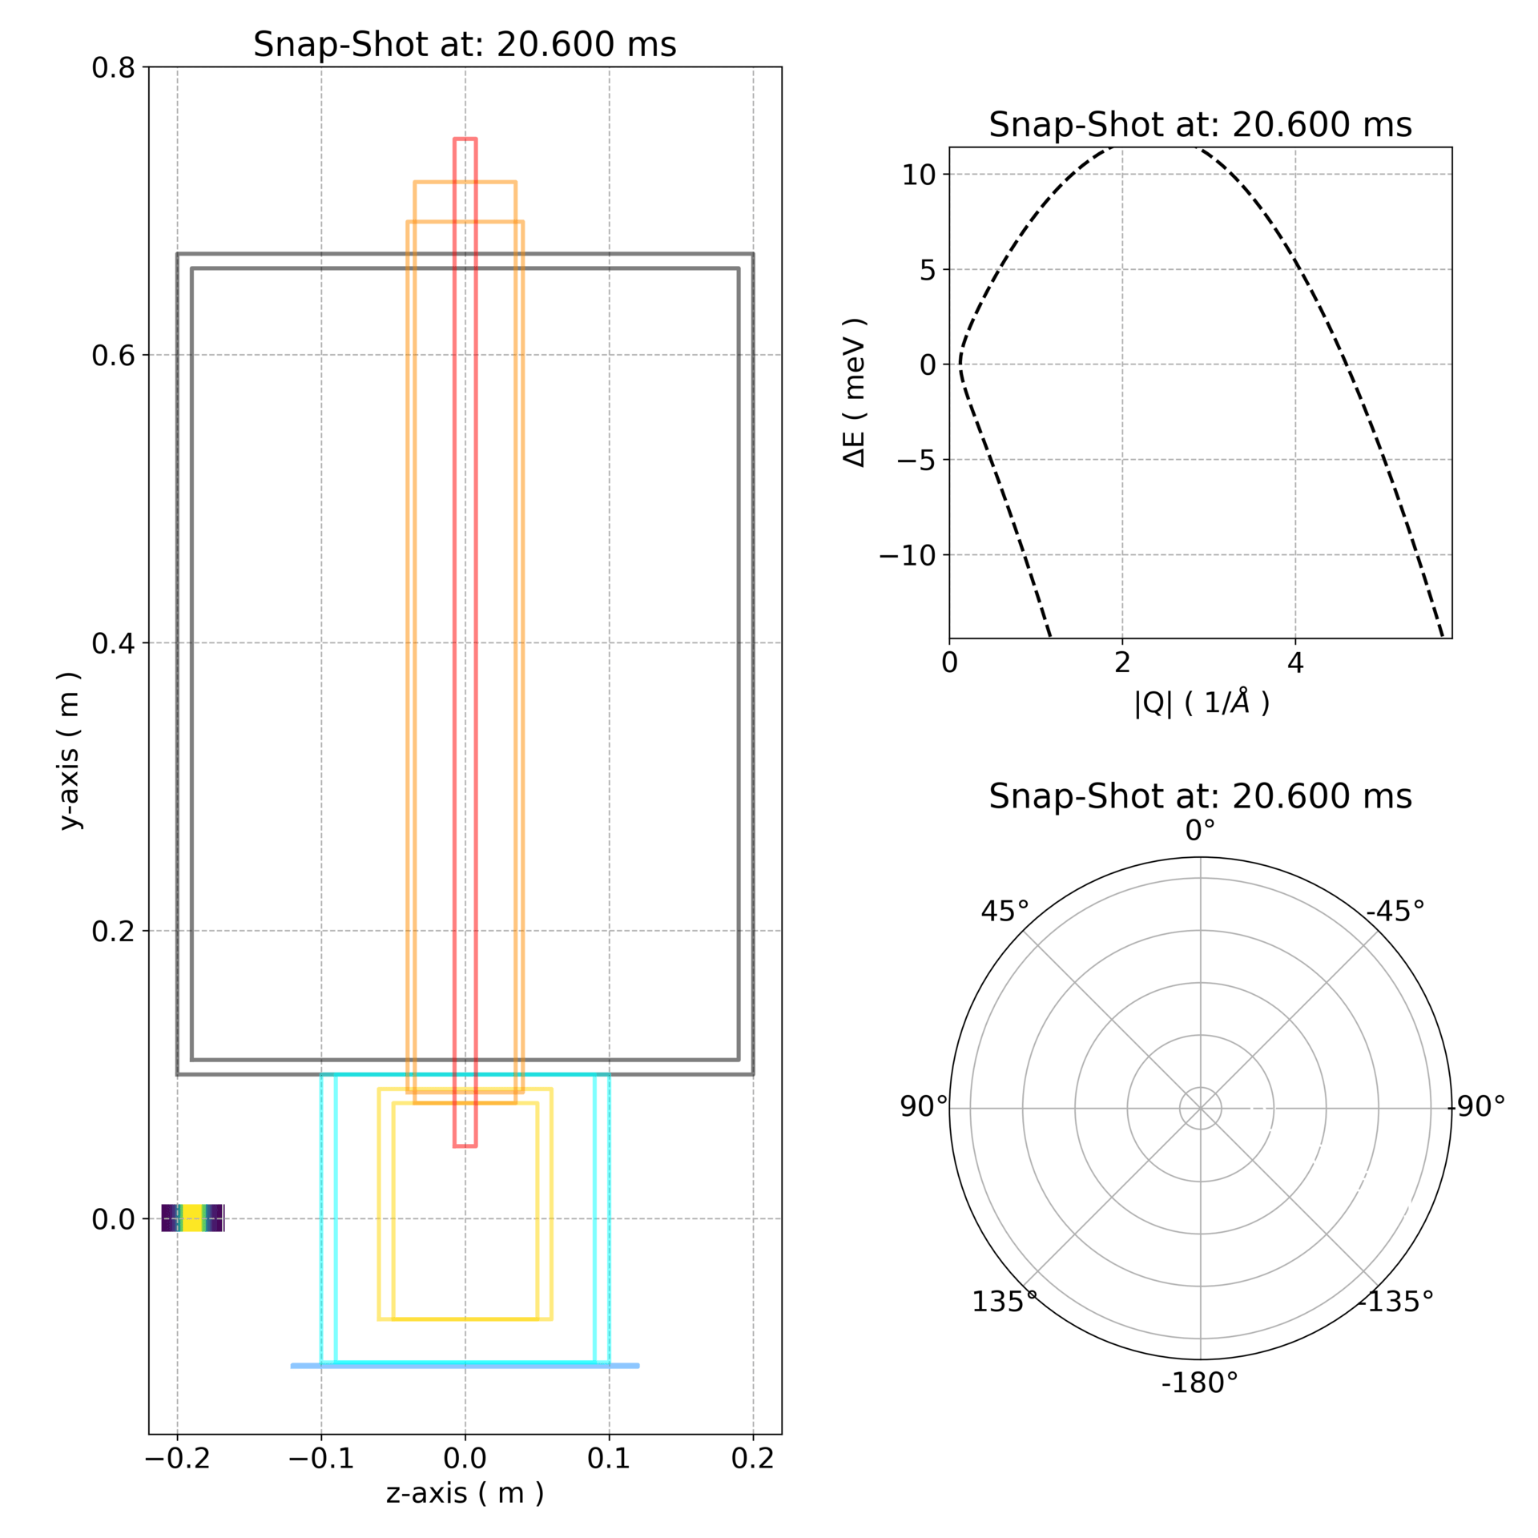

BKG Simulations: No Shields VS Shields
No Shields
Shielded

Slide 12
Diffractometers
SENJU BL18
SuperHRPD BL08 / NOVA BL21
PLANET BL11

Slide 13
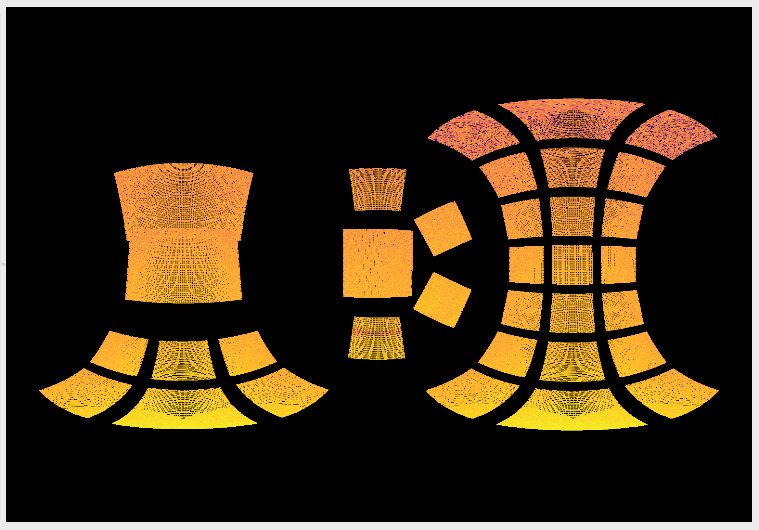
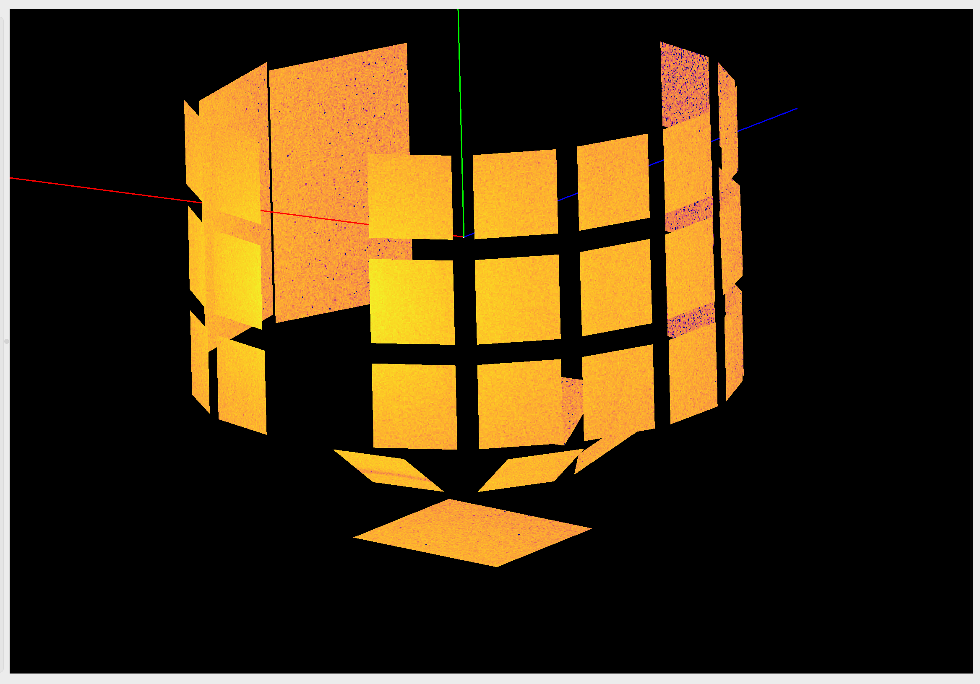
Diffractometers: BL08 / BL11 / BL18 / BL19 / BL21
Spherical-Z view along beam direction
3D-view along beam direction
n⁰
n⁰
Total Pixel: 192512
Measured Scintillator dimensions, pixel size and detector tilts are used to generate the IDF.
**Possibility to add TimePix detectors as further upgrade to McStas.

Slide 14
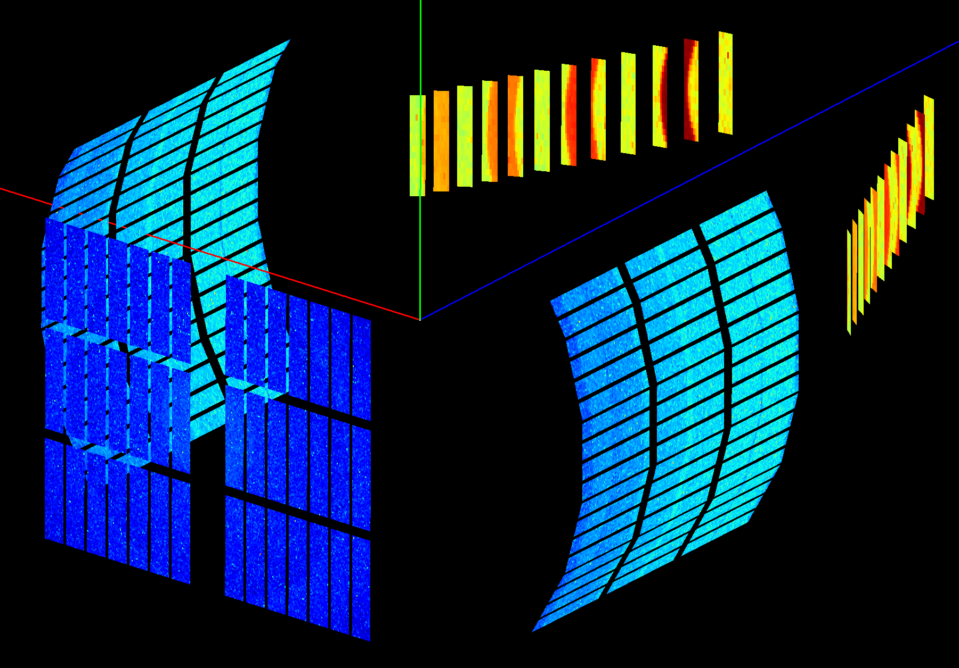
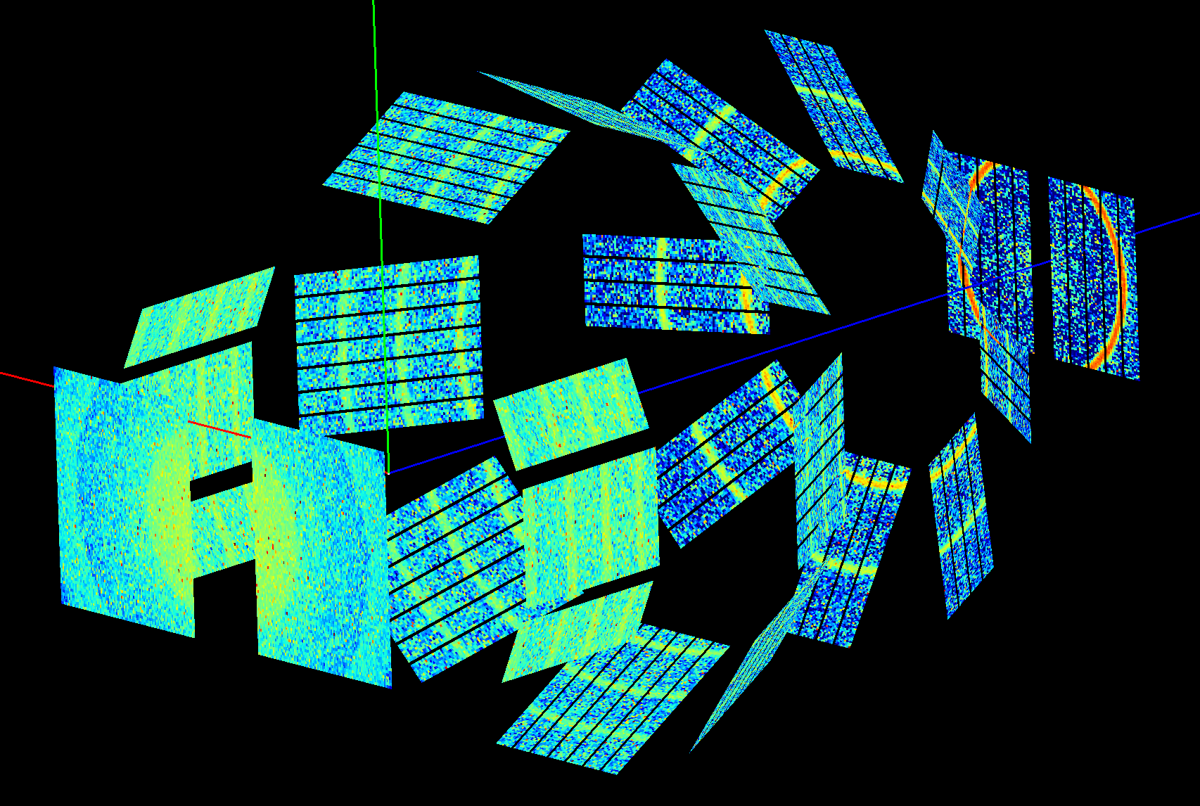
We can handle more Complex Detector Geometries
n⁰
n⁰
BL08 SuperHRPD
BL21 NOVA
³He LPSD geometries are reproduced directly from the blue-prints, including missing detectors.
Orientations (including tilts) matches calibration data (can be used for misalignments).
IDF files can be fully used in Mantid for direct visualizations and Data-Analysis.

Slide 15
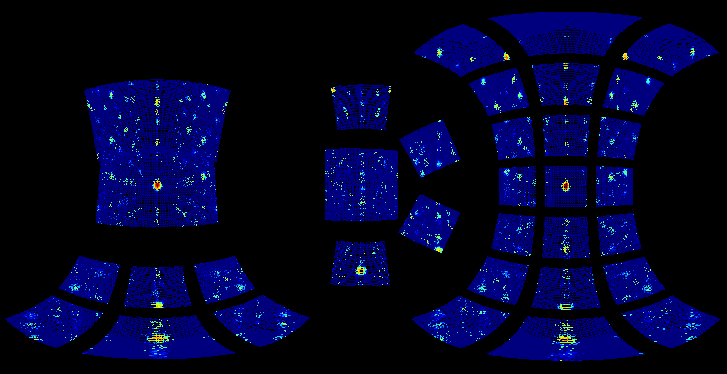
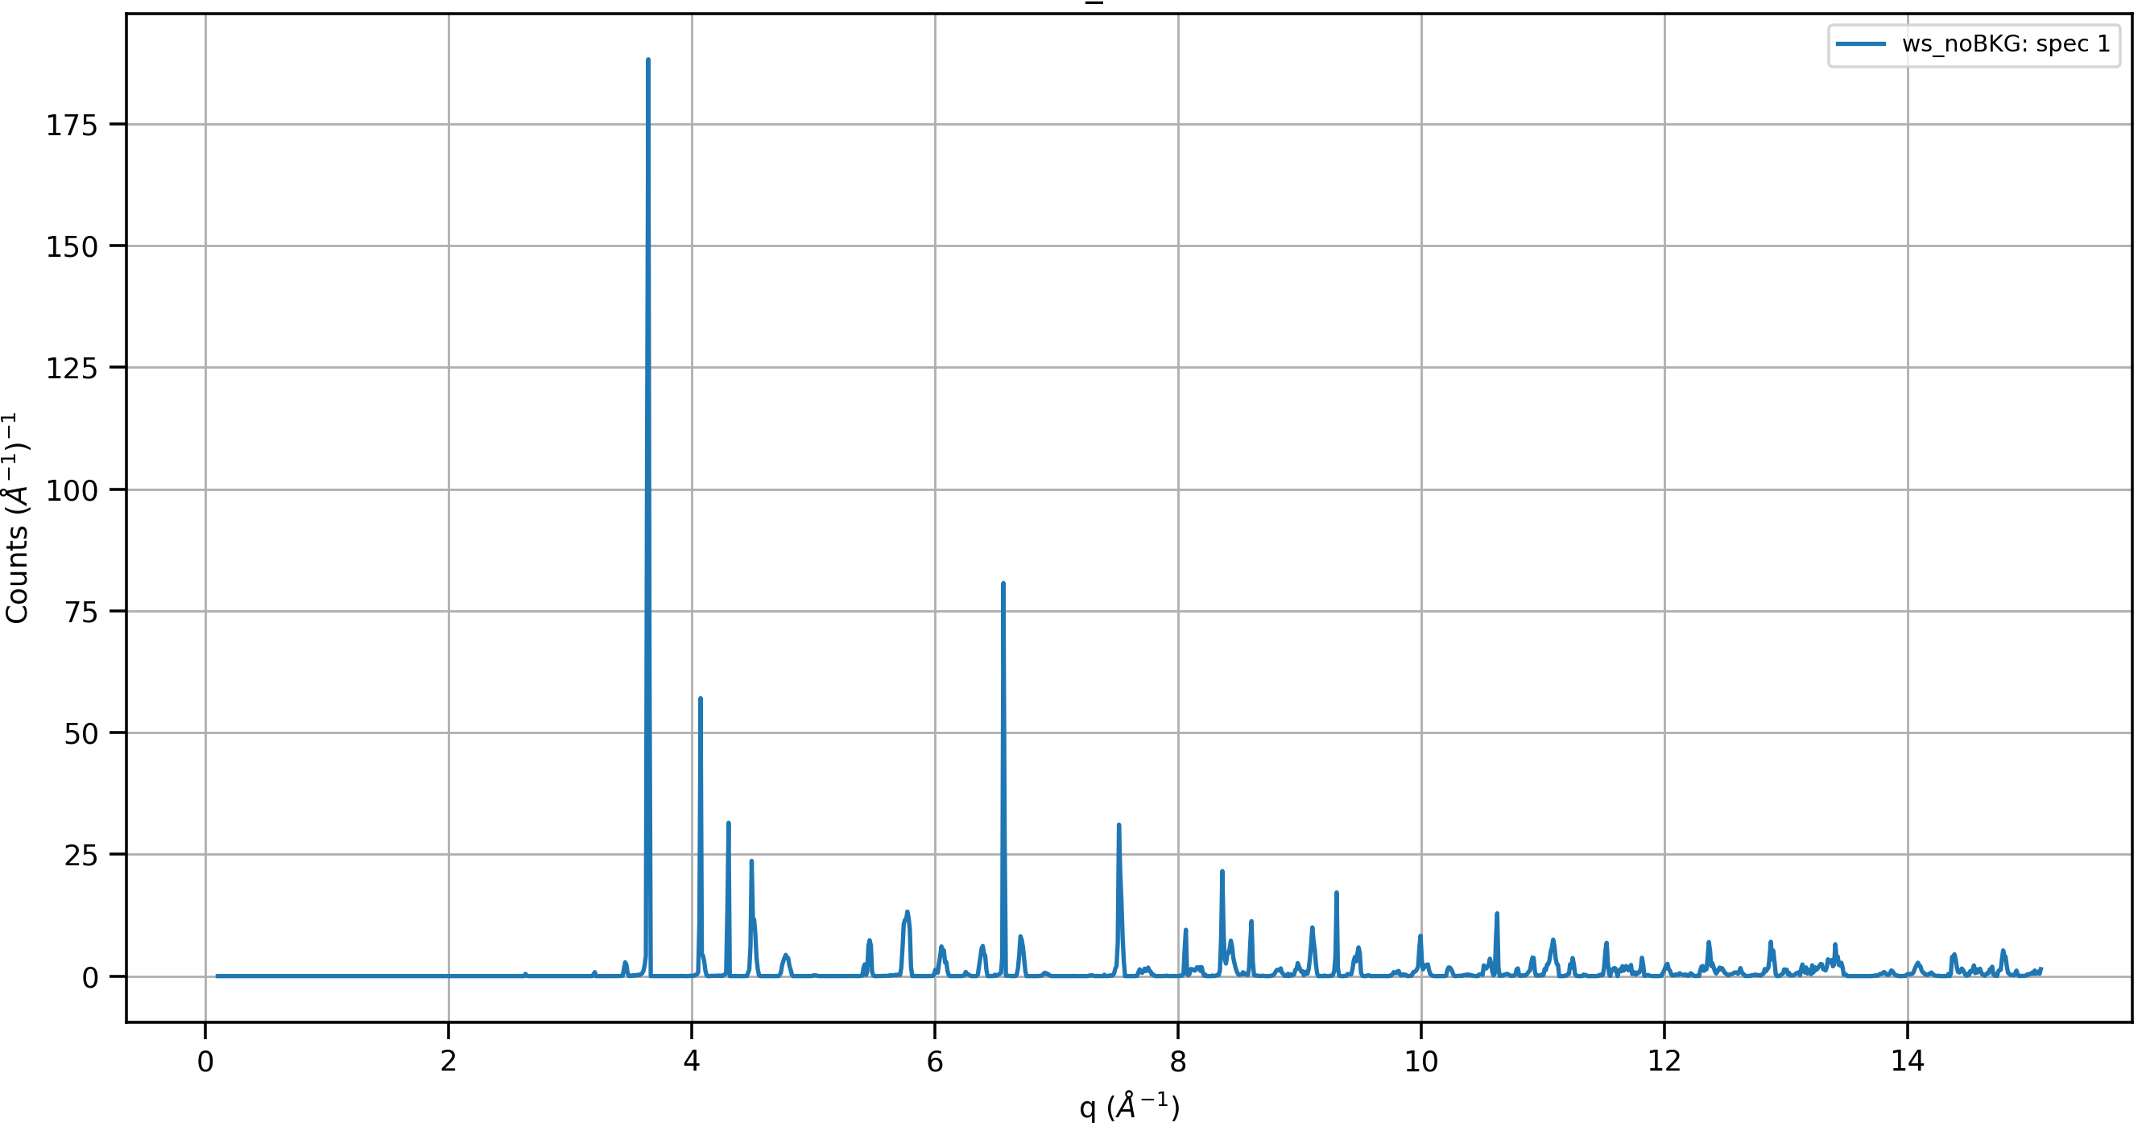
Virtual Experiment and Benchmarking
Single Crystal sample of MnF₂ from figure 10 of SENJU paper
A 2x2x2 mm single crystal MnF₂ (no incoherent scattering or background included).
Peaks have been integrated and converted in Q-space (or d-space).
Simulation can use any .cif file from COD or ICSD, McStas will translate them.
Simulations can be used to refined UB-matrix for further Analysis / Studies.

Slide 16
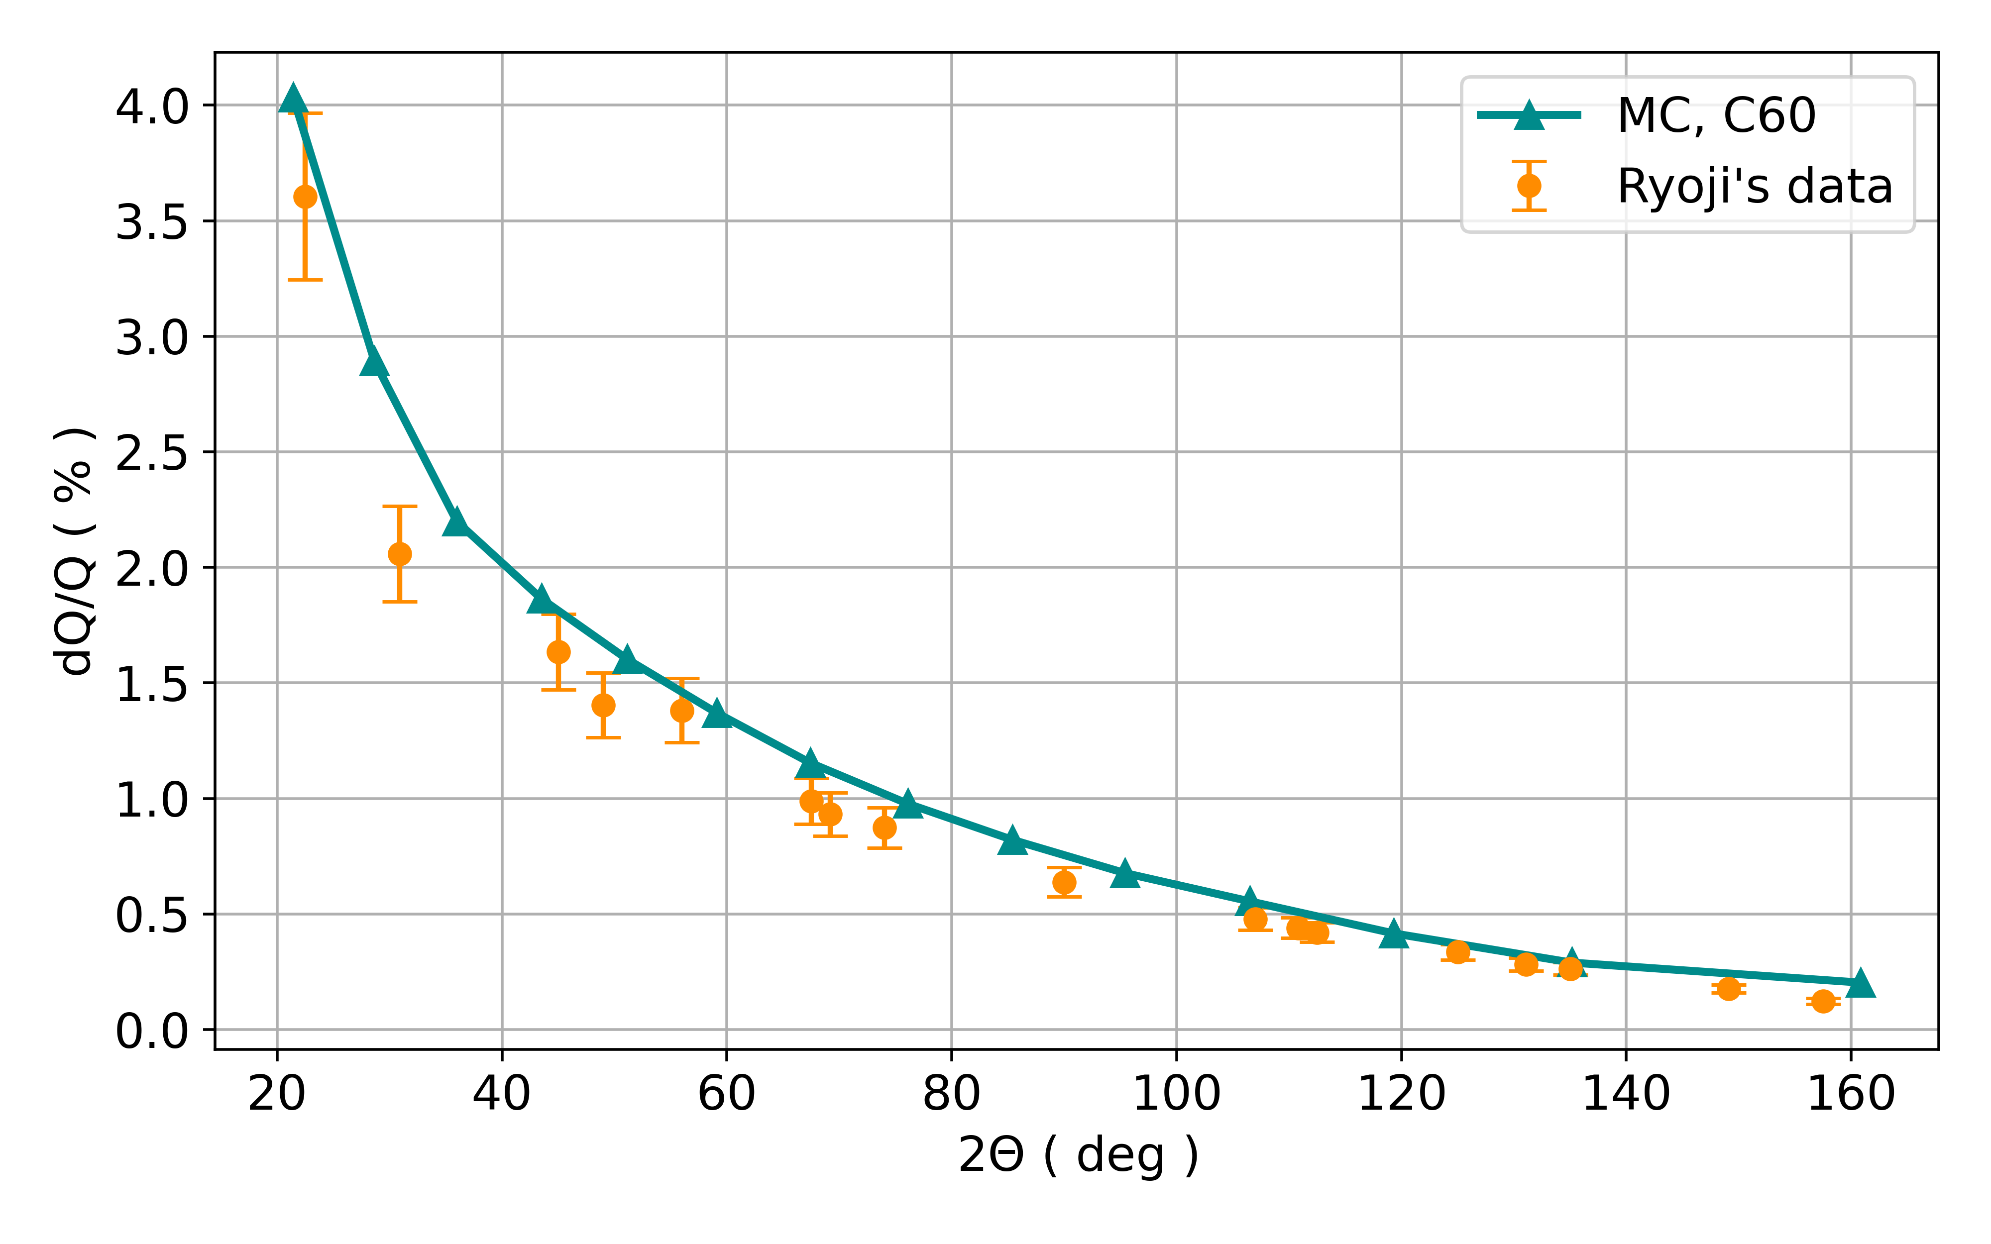
Benchmarking Q-Resolution
Spherical sample of C₆₀ 1 cm diameter with multiples of <111> Bragg peaks.
Data analyzed in MANTID: converted in Q-space and saved with appropriate binning for fitting.
Scipy curve_fit used to fit Gaussian curves to every single Bragg peak.
Calculated FWHM is then plotted as function of angular range and compared to data.
An independent fit to each point is performed using a simple cotangent curve.

Slide 17
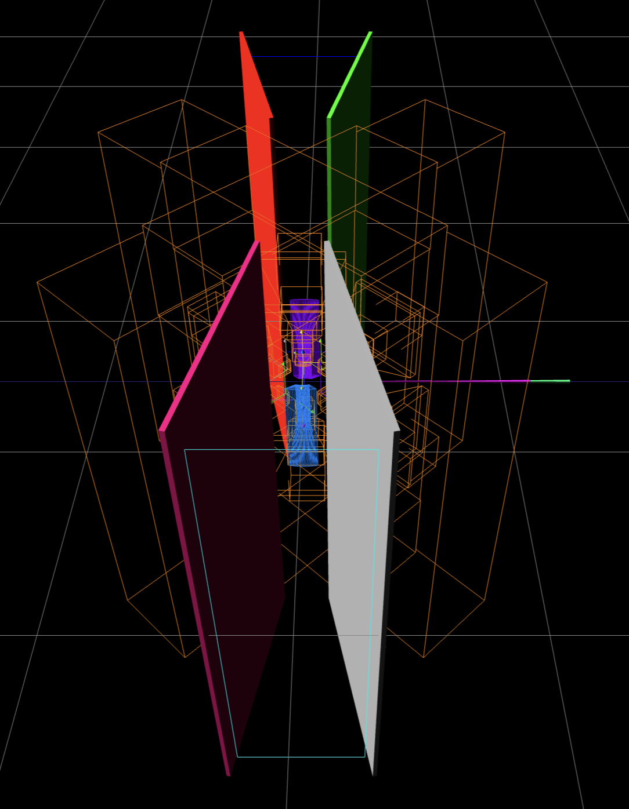
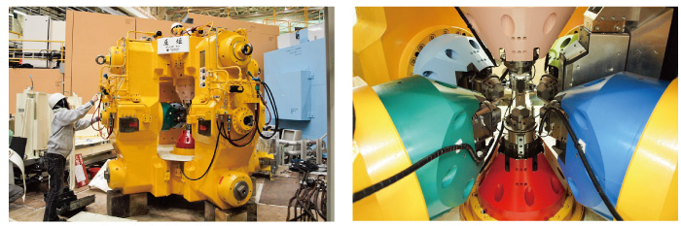
High Pressure System ATSUHIME Real-Model
Number of Union Elements Included: 80
Support Structure-Frame
6 Pistons
WC Heads
Sample Position + Extra SE

Slide 18
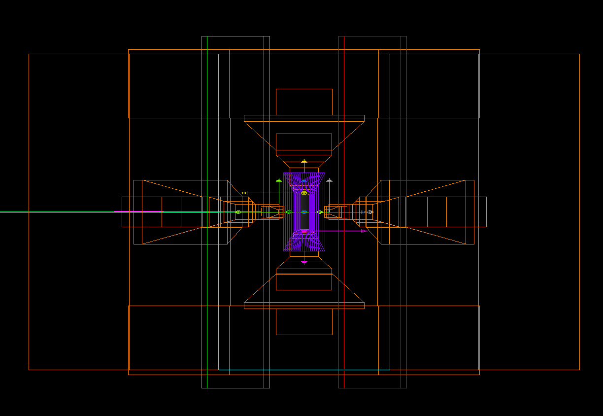
High Pressure System ATSUHIME McStas-Model
High Pressure System generated with 80 Union components:
6 piston tips modelled in WC.
6 pistons can move in/out with same excursion as real ones.
Simplified support structure-frame to avoid anomalies in the simulations.
Each of the three collimators are automatically rendered.
4 absorbing panels included to mimic the real shields.
Detector positions and pixel locations match the real ones.
*Possibility to add extra shields in the simulation for BKG Analysis.
n⁰
Side View

Slide 19
Reflectometers
SOFIA BL16

Slide 20
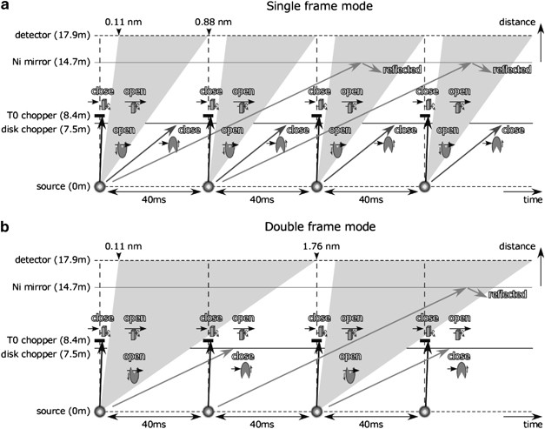
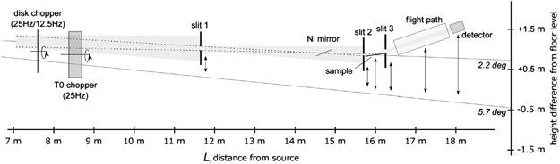
Reflectometer: BL16
Double-Beam-Port
Highly Versatile Neutron optics.
McStas is set up to simulate alternatively both sources with inclinations of -2.2° and -5.7°.
Possibility to use a Single-Frame or Double-Frame mode included.
Currently developing new set of Reflectivity kernels for best Instrument Comparison.
*Polymer Journal 45, 100-108 (2013)

Slide 21
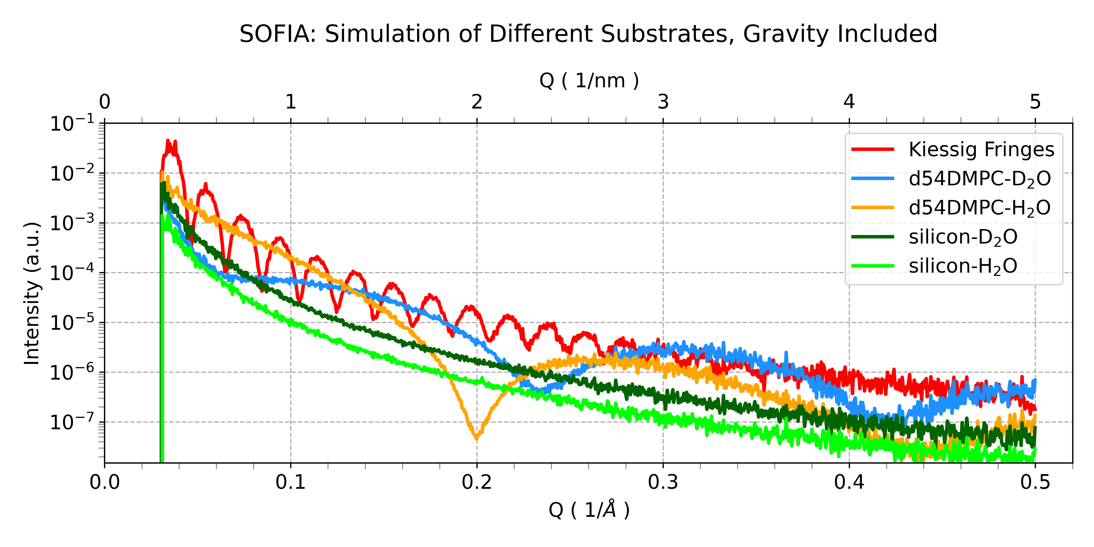
Reflectometer: BL16
Possibility to simulate different “thin-film sample” kernels for reflectometer optimizations.
Analysis of background features, resolution and detector coverage in progress.

Slide 22
WANS / SANS
TAIKAN BL15

Slide 23
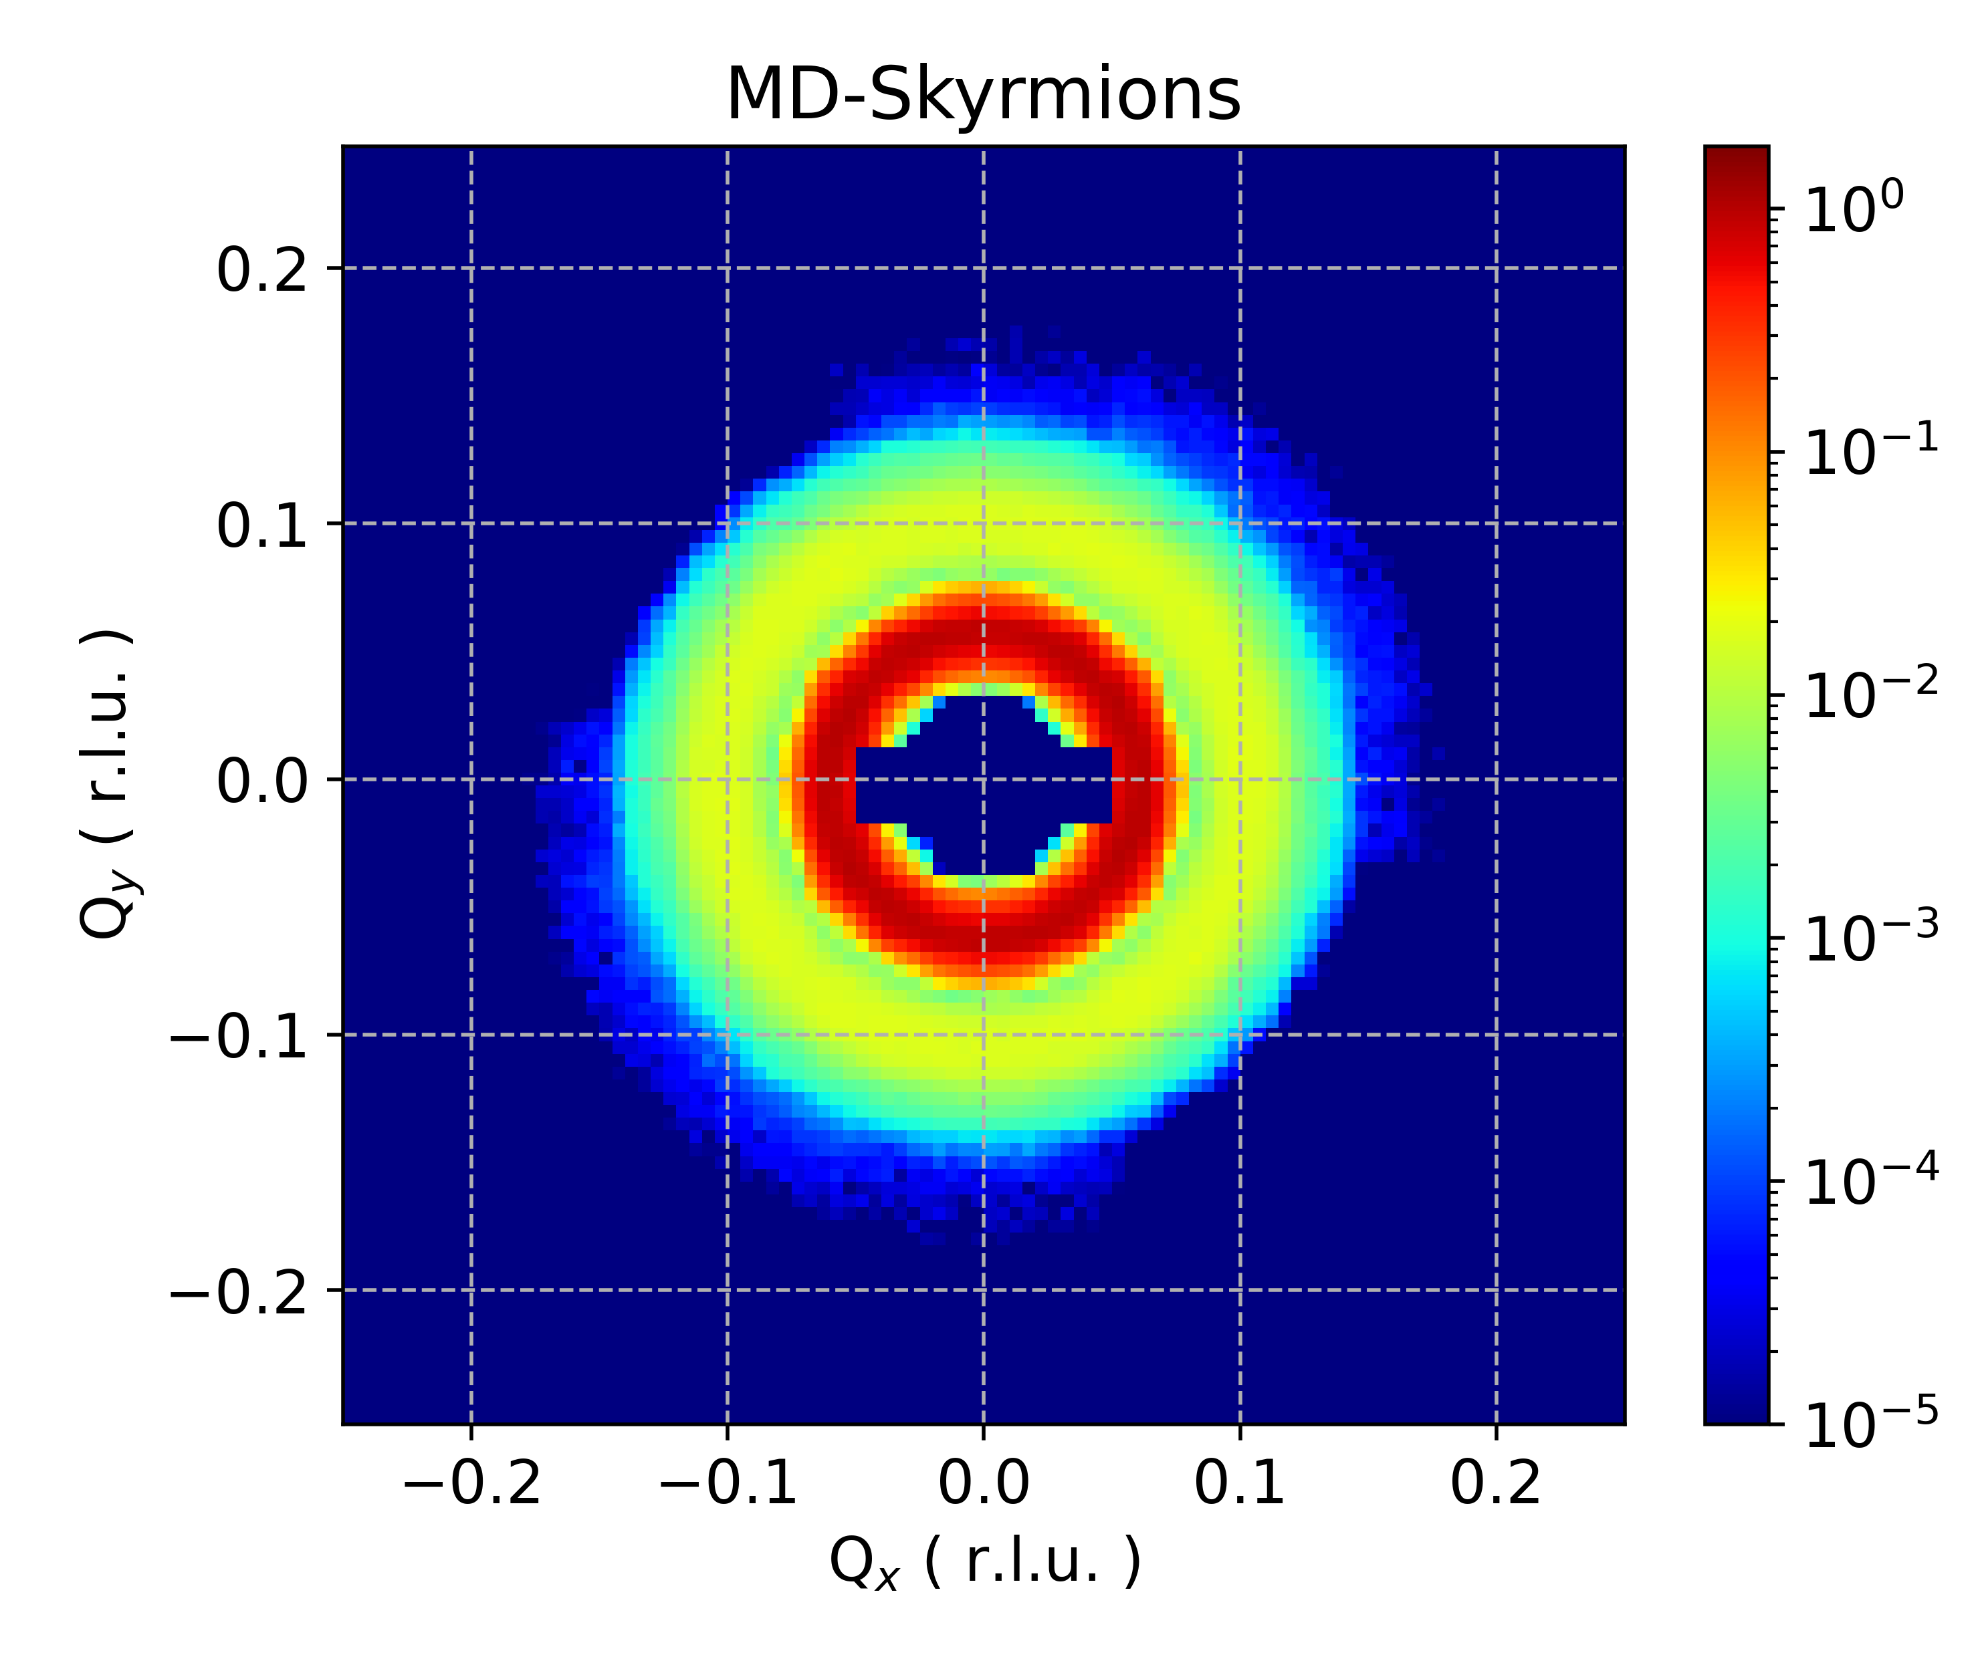
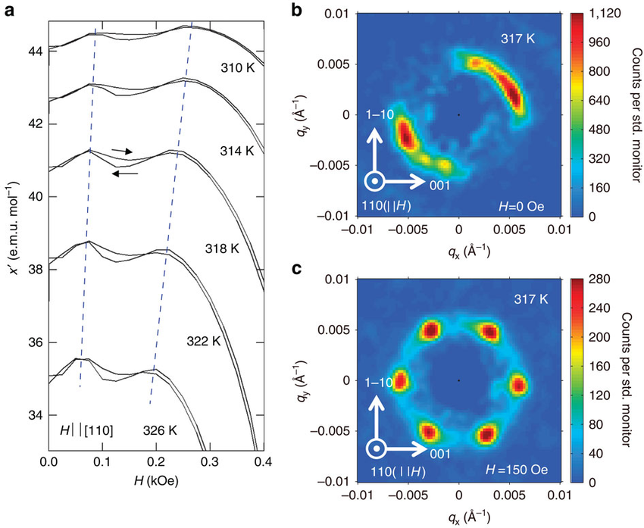
WANS - SANS: BL15
*Nat. Comm. 6, 7638 (2015)
Monte Carlo simulation of a Multi-Domain Skyrmion kernel (model Ref. Nat. Comm. 6, 7638).
A set of Bragg reflections forming 3-concentric rings with 𝜋/3 periodicity have been created and randomly rotated in McStas to produce the Multi-Domain kernel.
Lattice constants were chosen to match TAIKAN lowest-detector-banks.
Simulations saved in Nexus format and data reconstructed / Analyzed directly in Mantid.

Slide 24
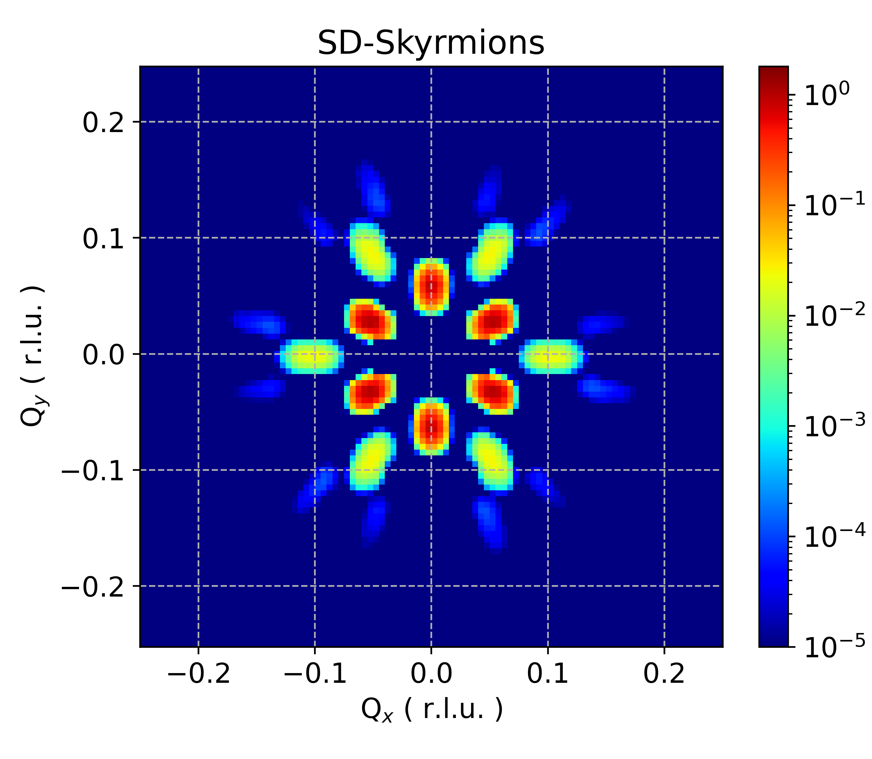
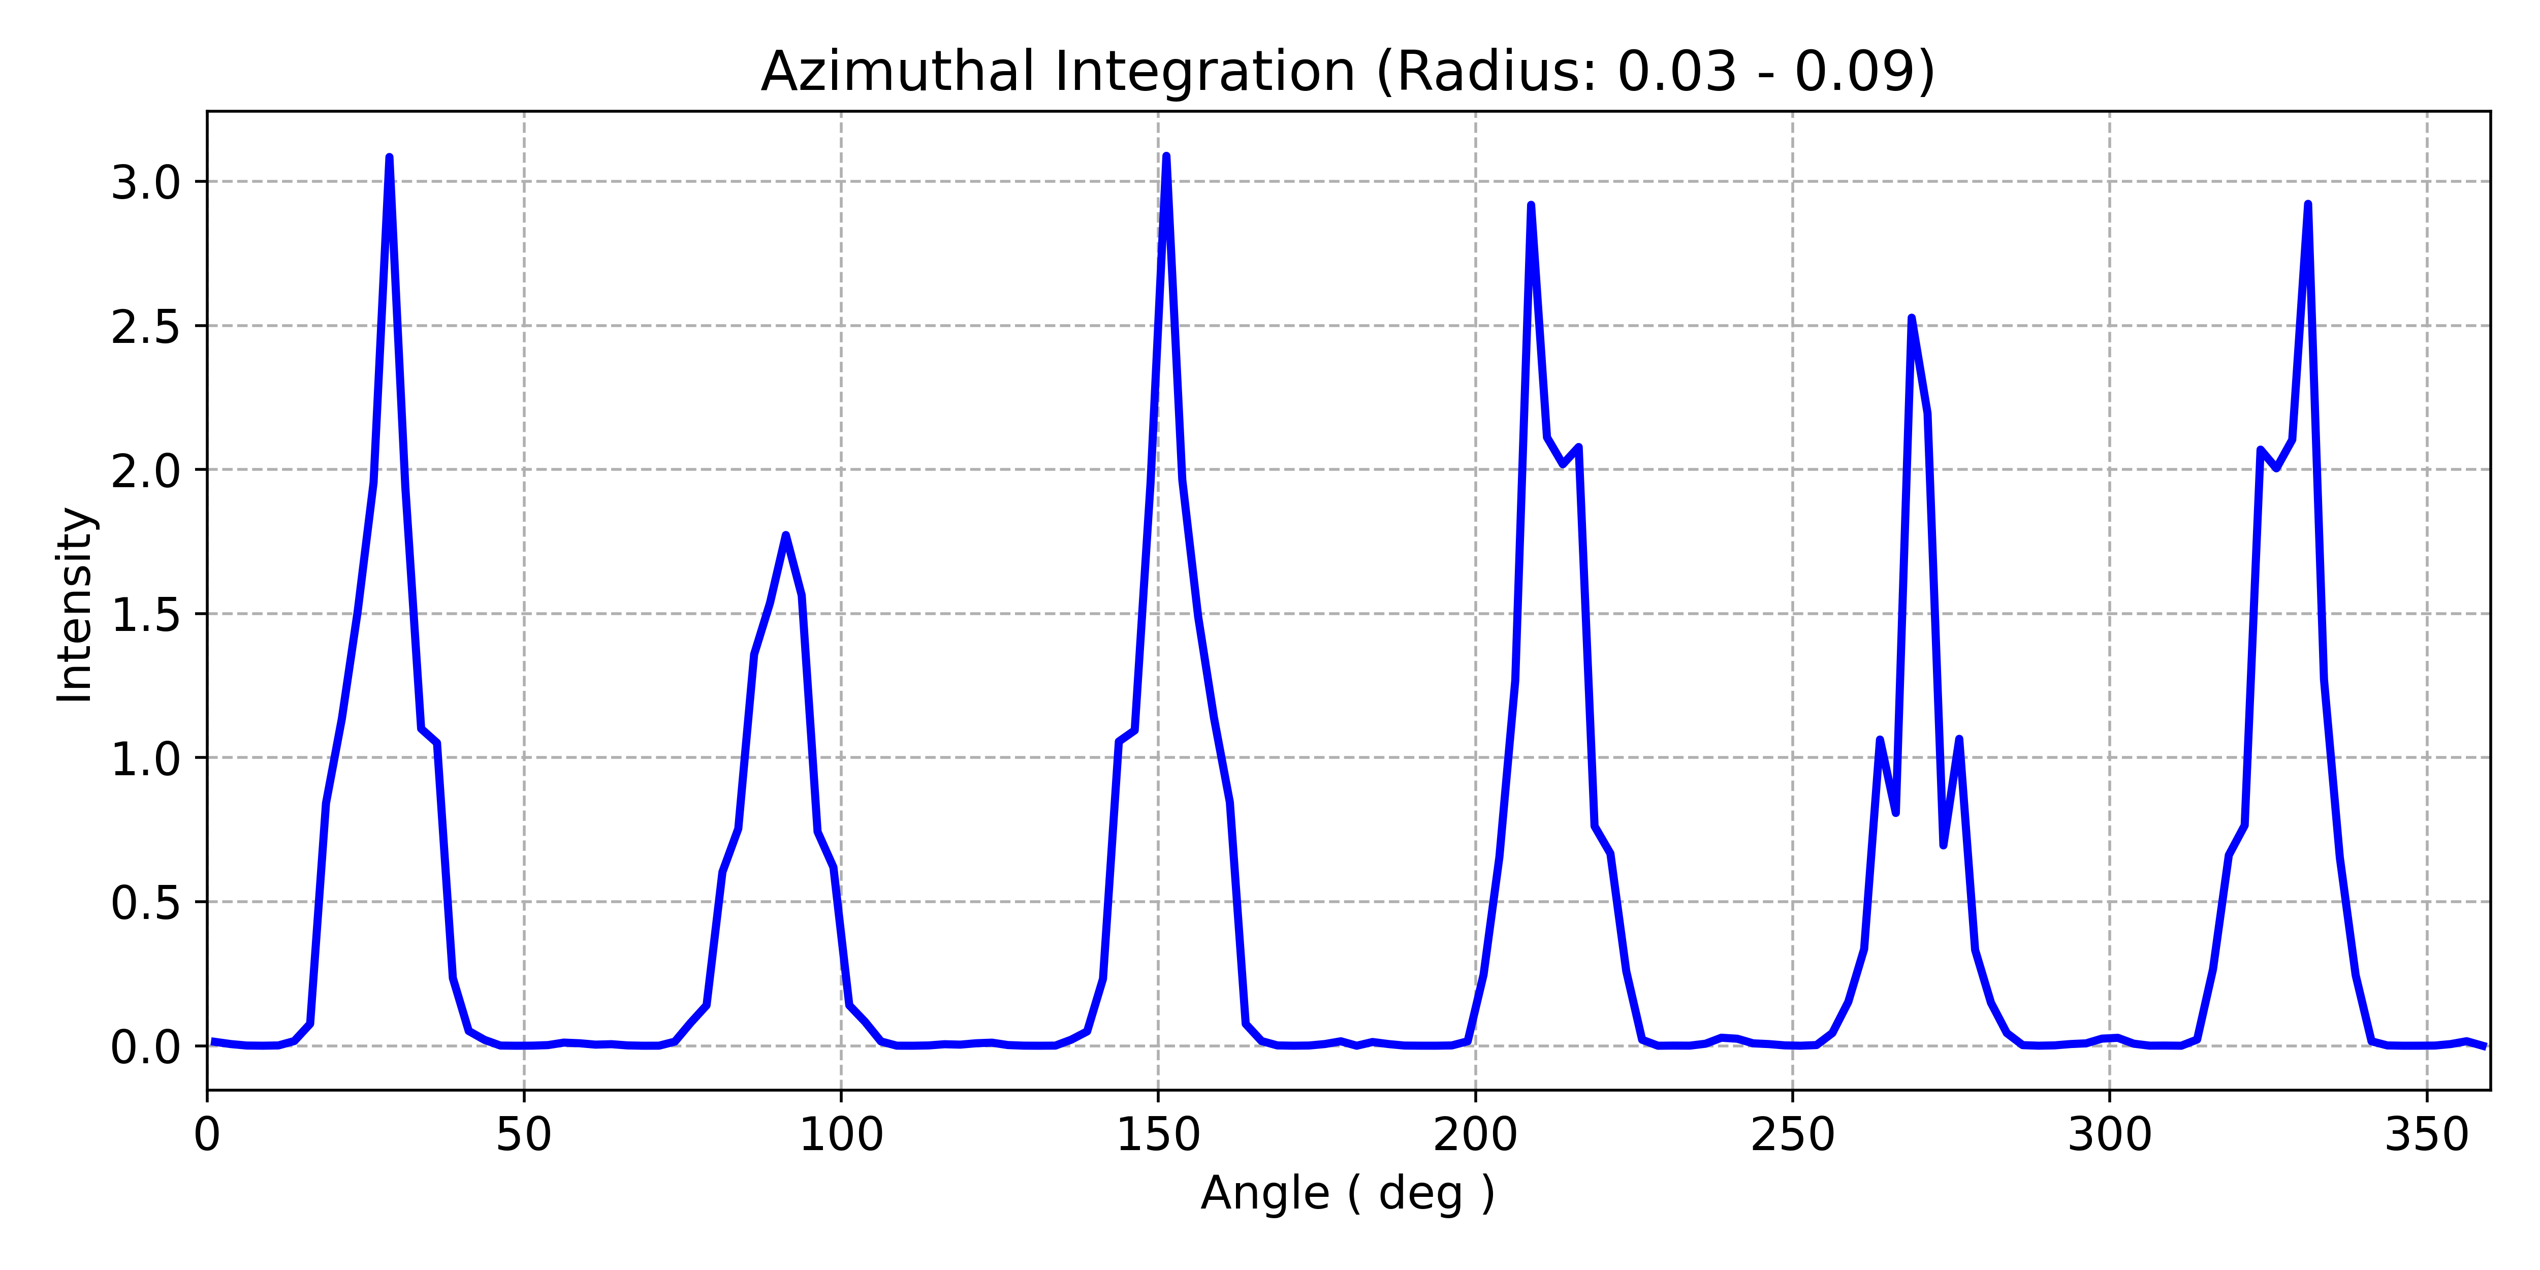
WANS - SANS: BL15
Monte Carlo simulation of a Single-Domain Skyrmion kernel.
A set of Bragg reflections forming 3-order of peaks with 𝜋/3 periodicity have been created in McStas.
Simulations saved in Nexus format and data reconstructed / Analyzed directly in Mantid.
An Annular ring integration can be used to highlight the 6 Bragg peaks angular location in the data set.
*Nat. Comm. 6, 7638 (2015)

Slide 25
Neutron Imaging
RADEN BL22

Slide 26
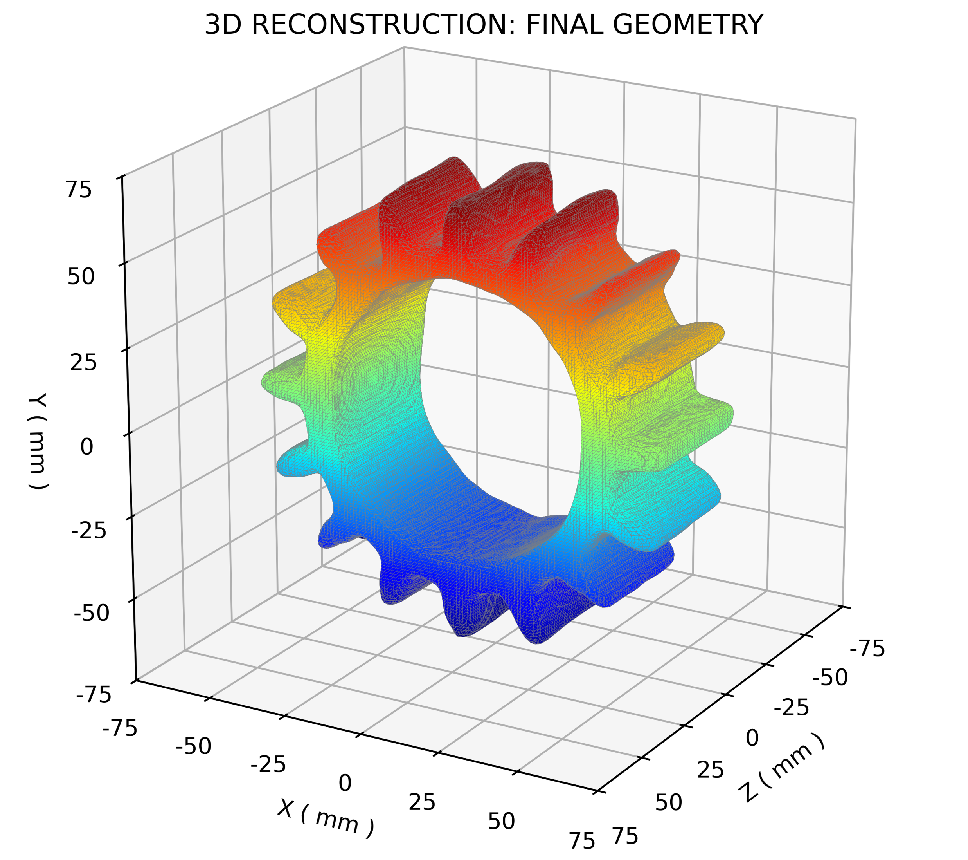

Neutron Imaging: BL22
McStas 16 Teeth-Gear Model
Ti Teeth
Cu Ring
Monte Carlo simulation of a CuTi-Gear assuming 3 ≤ 𝜆 ≤ 6 Å, ratated 0° ≤ ω ≤ 180°, 1° step.
Tomographic Reconstruction uses the SART algorithm and PyVista for 3D-Rendering.
Possibility to simulate Texture and Strain in Material is under evaluation.

Slide 27
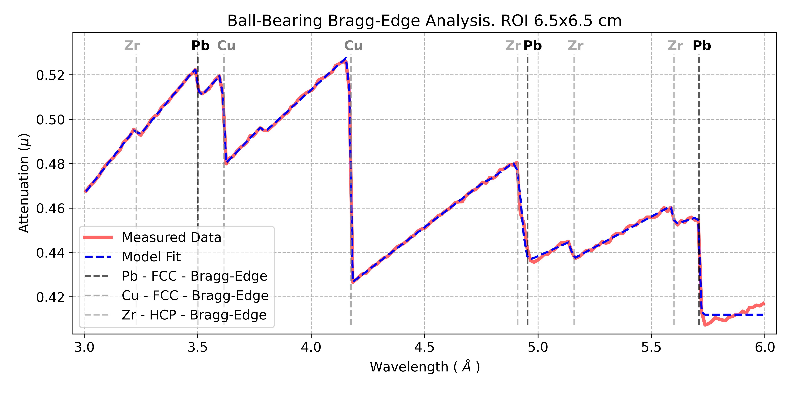
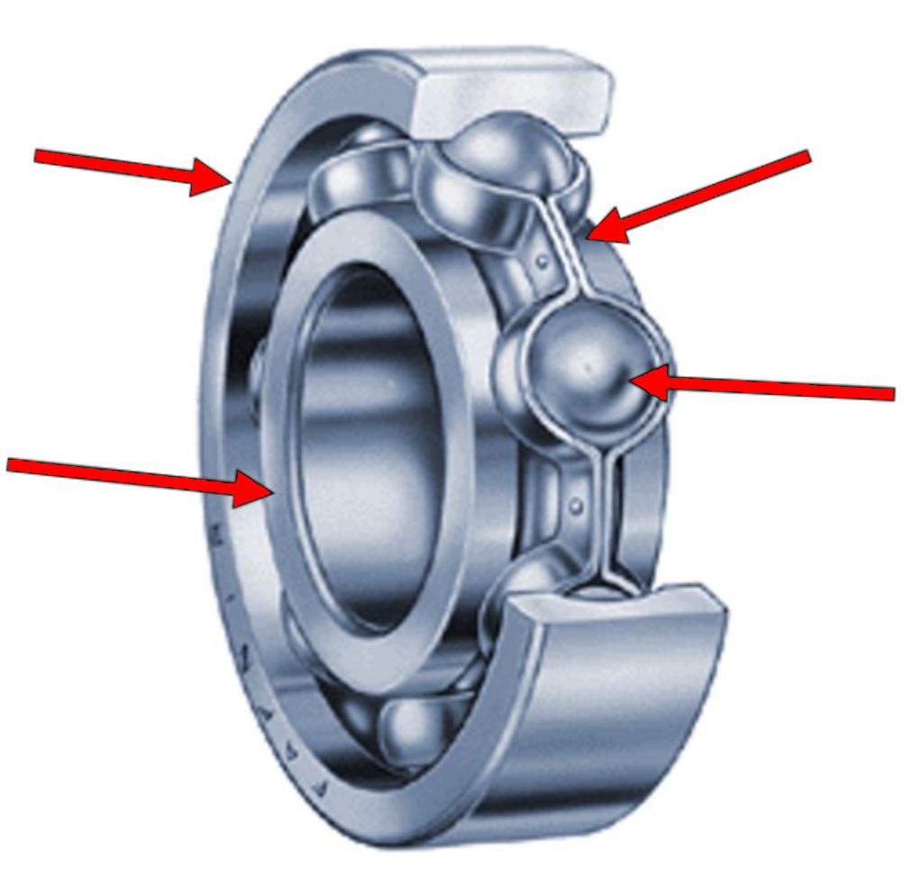
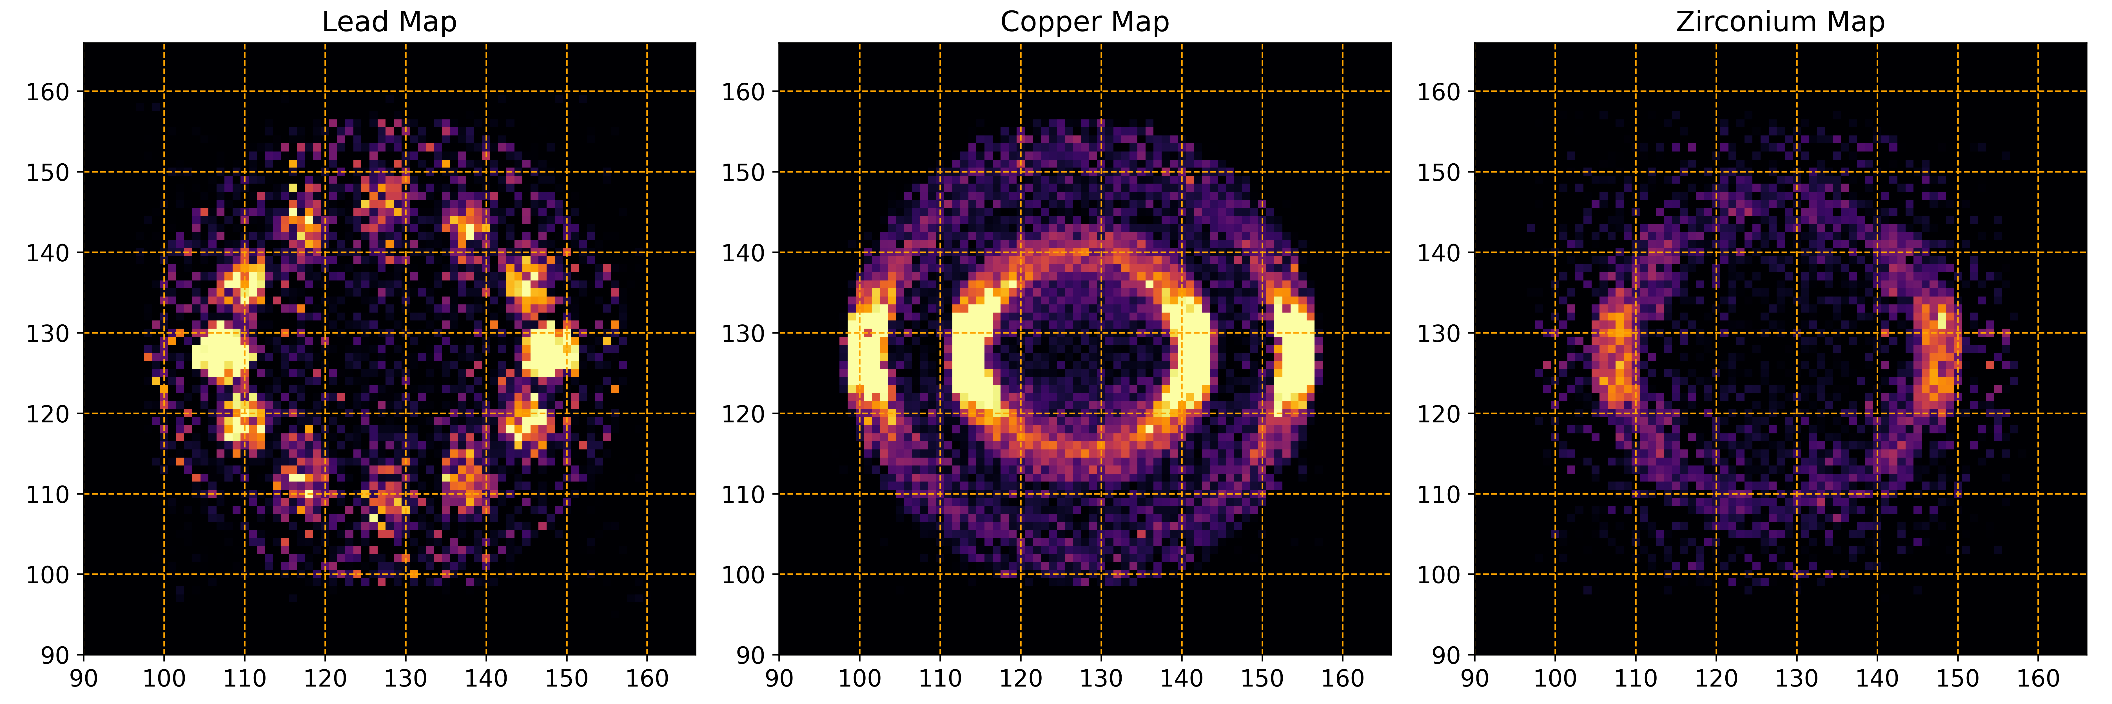
Neutron Imaging: BL22
McStas Ball-Bearing Model
Cu Ring
Zr Cage
Pb Spheres
Cu Ring
MC simulation of a PbCuZr Ball-Bearing assuming 3 ≤ 𝜆 ≤ 6 Å, rotated 0° ≤ ω ≤ 360°, 1° step.
Bragg-Edge Tomography separates the different materials in the kernel.

Slide 28
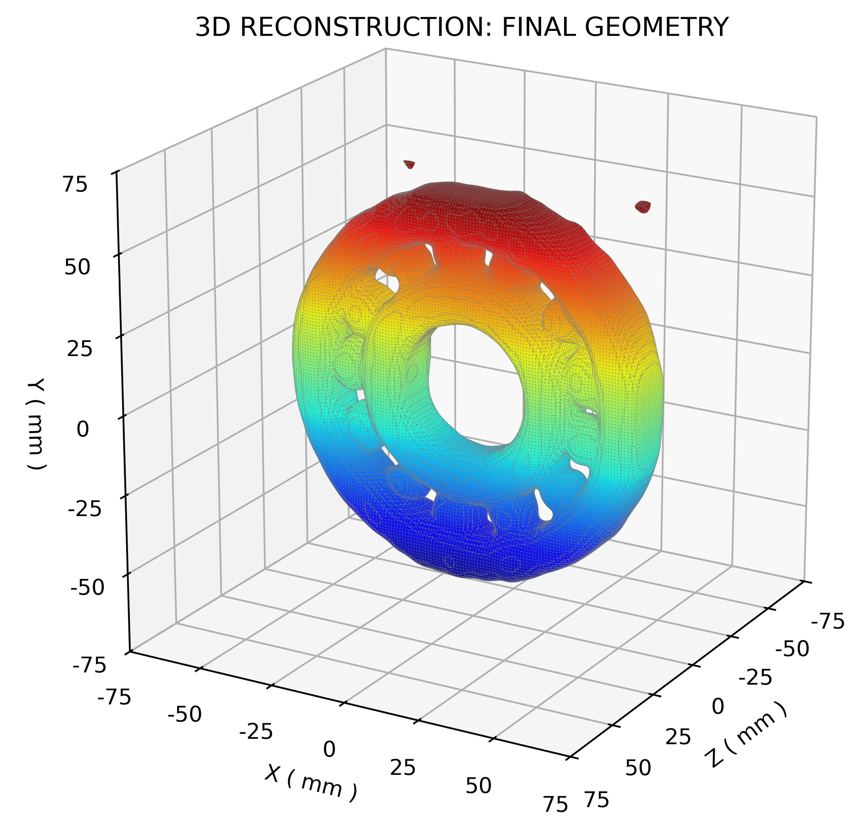
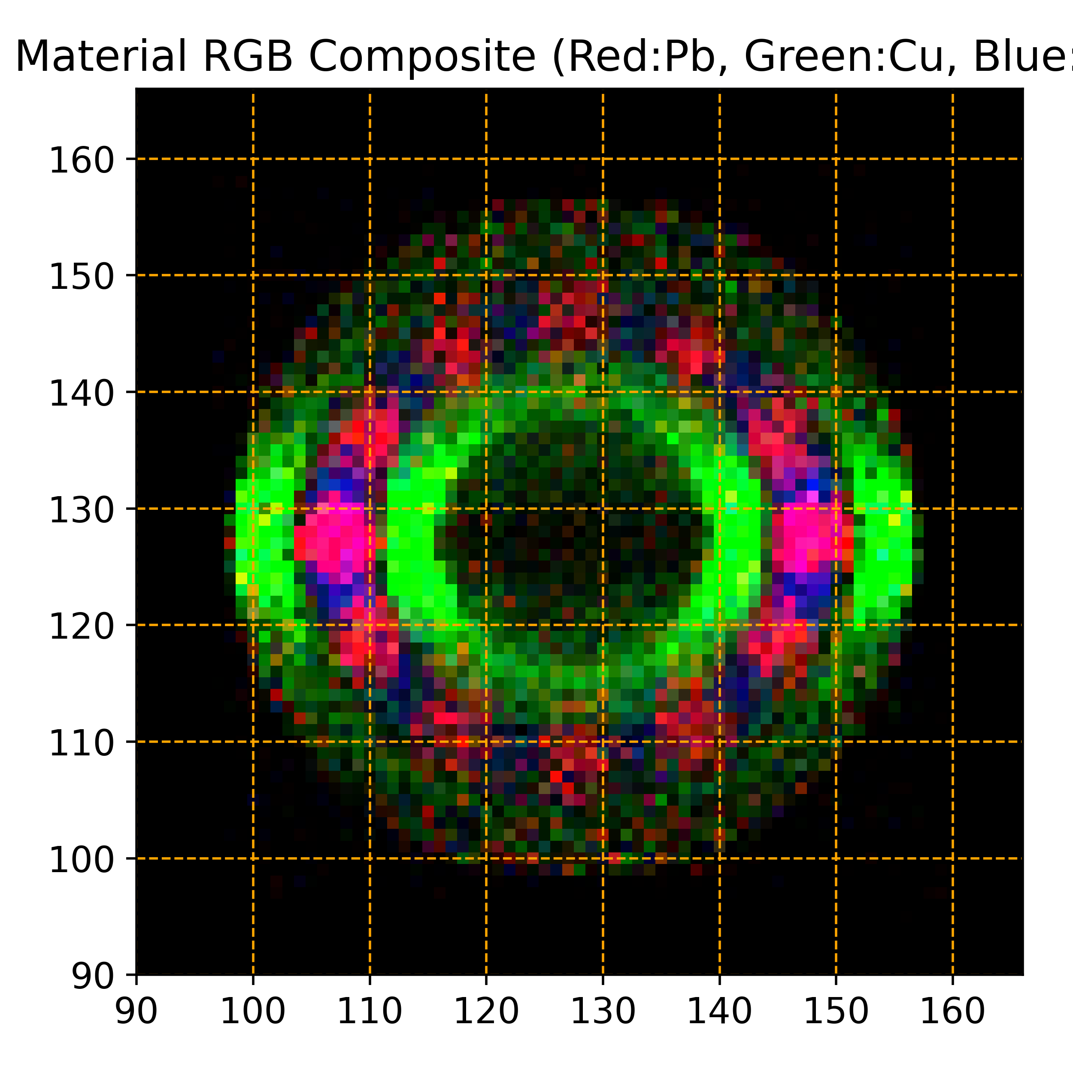
Neutron Imaging: BL22
McStas Ball-Bearing Model

Slide 29
Conclusions and Outlook
Digital Twins are powerful tools to quickly study and resolve Instrument issues.
Can be built directly from blueprints, easily updated and maintained.
User-friendly to code and remarkably useful for Instrument Upgrade, Debugging, Teaching etc.
MC Simulations are strong-reliable baselines to predict Instrument Performance:
Flux and Resolution can be directly compared with real measurements.
Instrument Upgrades can be optimized and verified “a posteriori” after installation.
SE Background can be simulated to optimize shields or study artifacts.
Sample kernels can be tailor-made for any Instrument for optimizations, debugging, studies etc.
New Users can employ these tools as learning/training materials.
All these McStas J-PARC Instruments and SEs will be shared with the world-wide community.
Once a solid base is established for TS1, these Simulations will lay the foundations for the future TS2 Instrument Suite at J-PARC.

Slide 30
お時間をいただきありがとうございました Thank you for your time

