Slide 1
ICANS XXV - 13–17 apr 2026, Clarion Hotel Malmö Live
SORGENTINA
a multipurpose accelerator-driven fusion neutron source
A. Pietropaolo - on behalf of the SORGENTINA project team
ENEA, Nuclear Department, Frascati, Italy
antonino.pietropaolo@enea.it

Slide 2
Overview
Scientific premises
SORGENTINA project
The main components of the so-called thermomechanical demonstrator
Tests
Remarks & Conclusions

Slide 3
Scientific premises Main focus
^{99m}Tc radiotracer for Single Photon Emission Computed Tomography
^{99m}Tc is effective in imaging diagnostics
Short Half-Life: T_{1/2} ~ 6 h
Optimal γ-ray emission: E_{γ} = 140 keV
^{99m}Tc covers about 85% of diagnostic radioisotope market with more than 30 million SPECT procedures per year worldwide.
It is mostly obtained from the β⁻ decay from the parent nuclide ⁹⁹Mo (namely the ‘’ vector’’ because of its long half-life of about 3 days)

Slide 4
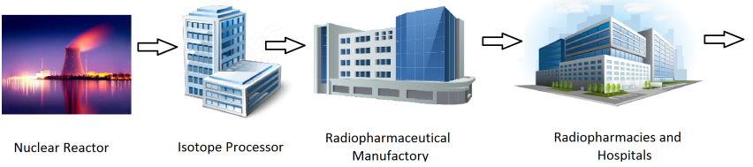
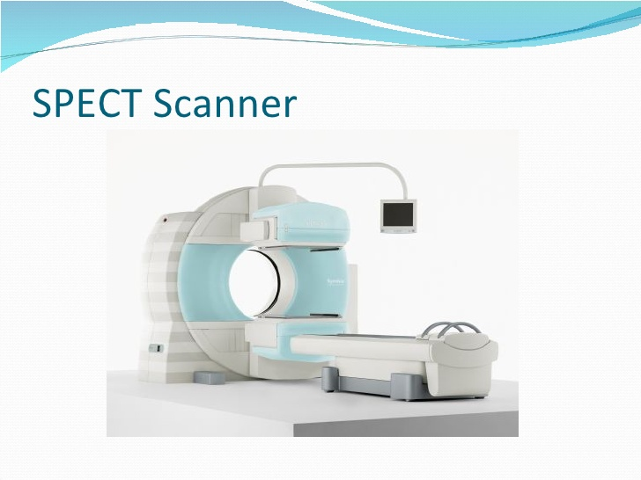
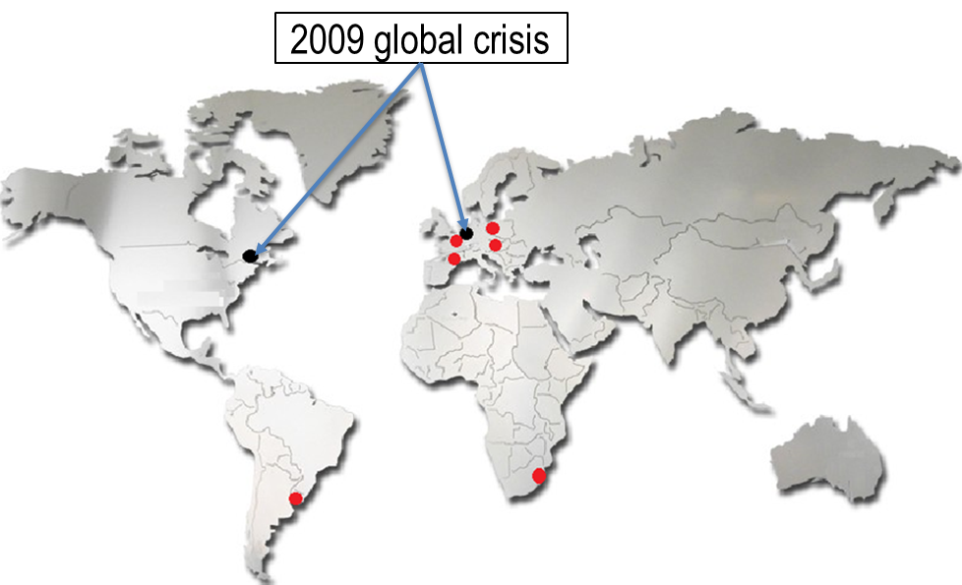
Scientific premises ⁹⁹Mo/^{99m}Tc supply chain – gold standard
Direct fission to ⁹⁹Mo is not very probable
Individual Fission Yield = 1.8E-3%
Cumulative Fission Yield = 6%
⁹⁹Mo is thus produced by the main reaction paths: ²³⁵U + n →²³⁶U → ⁹⁹Zr + ¹³⁴Te + 3n
and
²³⁵U + n → ²³⁶U → ⁹⁹Y + ¹³⁴I + 3n ⁹⁹Zr and ⁹⁹Y then decay by β emission to ⁹⁹Mo.

Slide 5
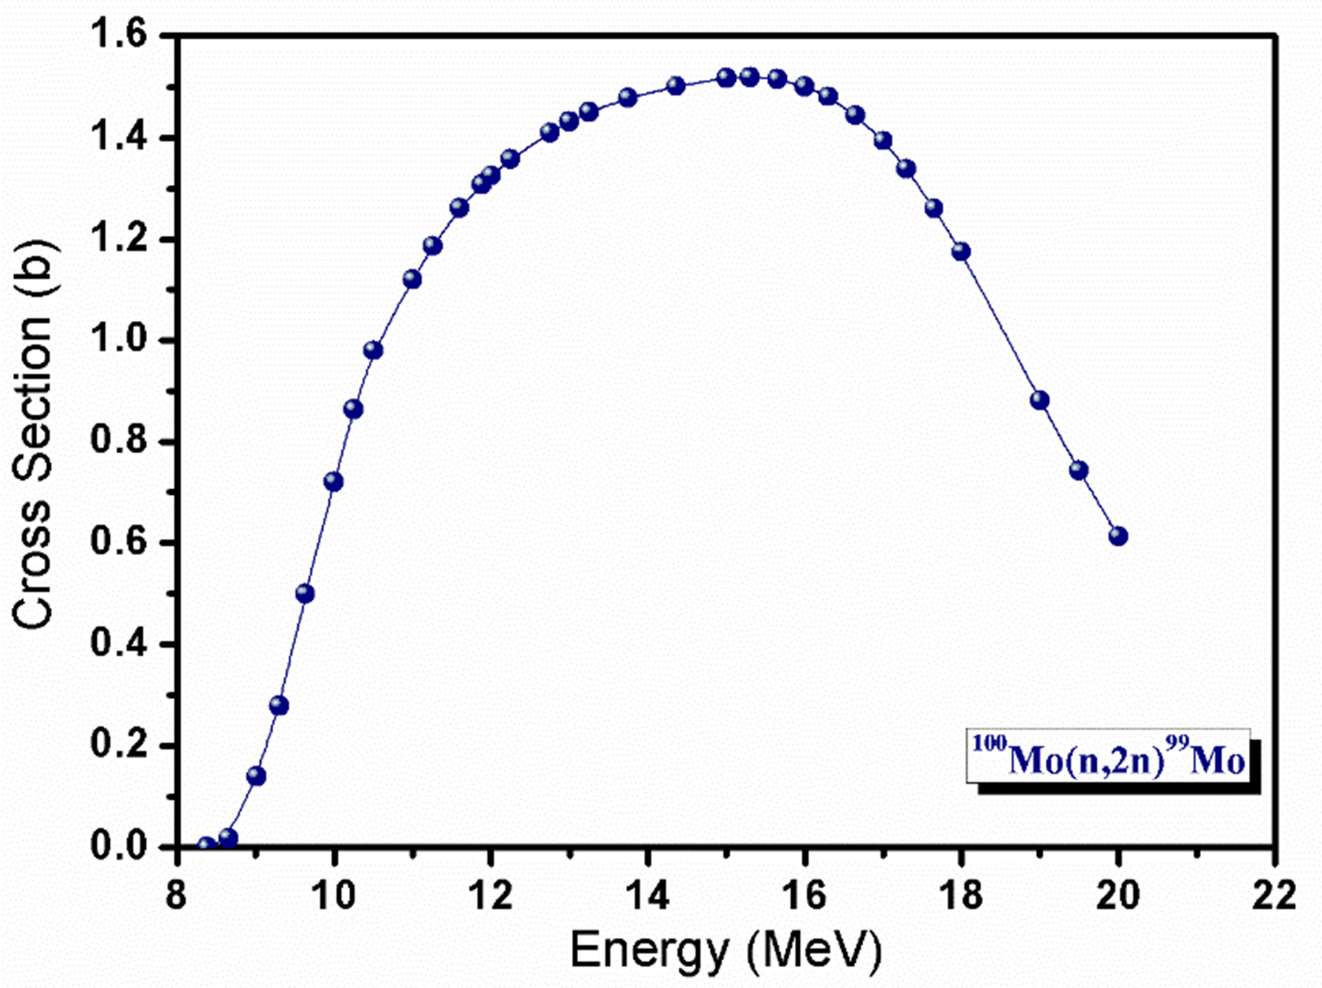
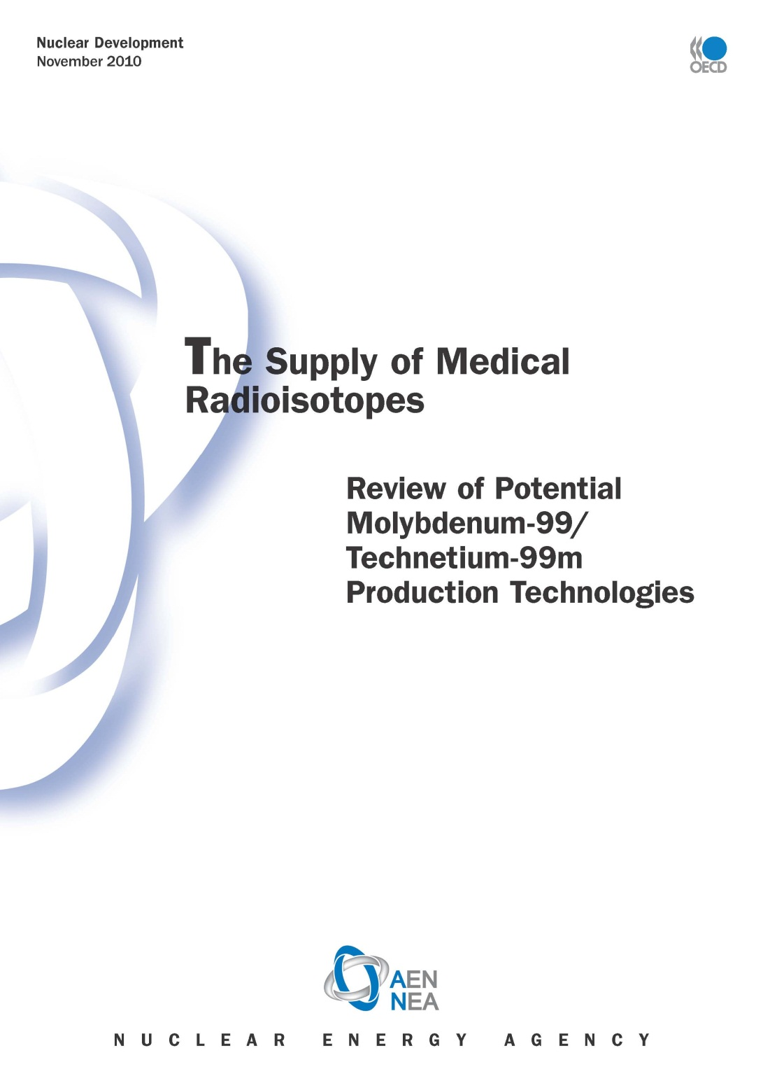
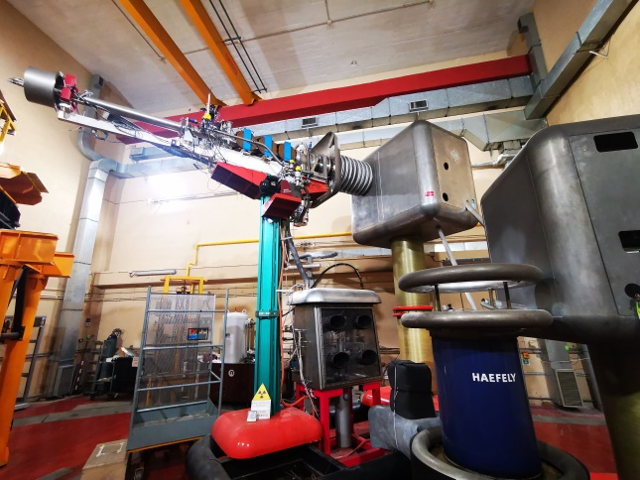
Scientific premises ⁹⁹Mo/^{99m}Tc supply chain – alternative solutions
A series of ^{99m}Tc production methods (direct or by means of ⁹⁹Mo precursor) have been identified as short-, mid- and long-term alternative solutions to the reactor based technique:
Thermal neutrons
⁹⁸Mo(n,γ)⁹⁹Mo
Fast Neutrons
¹⁰⁰Mo(n,2n)⁹⁹Mo
Gamma-ray beam
¹⁰⁰Mo (γ,n)⁹⁹Mo
Accelerated charged-particle beams
⁹⁶Zr(α,n)⁹⁹Mo or ¹⁰⁰Mo(p,2n)^{99m}Tc
In 2015
process tested at
FNG (ENEA-Frascati)
FNG
300 W accelerator-driven
14 MeV fusion neutron source
Y_{n} ~ 5×10¹⁰ s⁻¹
D + T → n + α + 17.1 MeV
E_{n} = 14.1 MeV

Slide 6
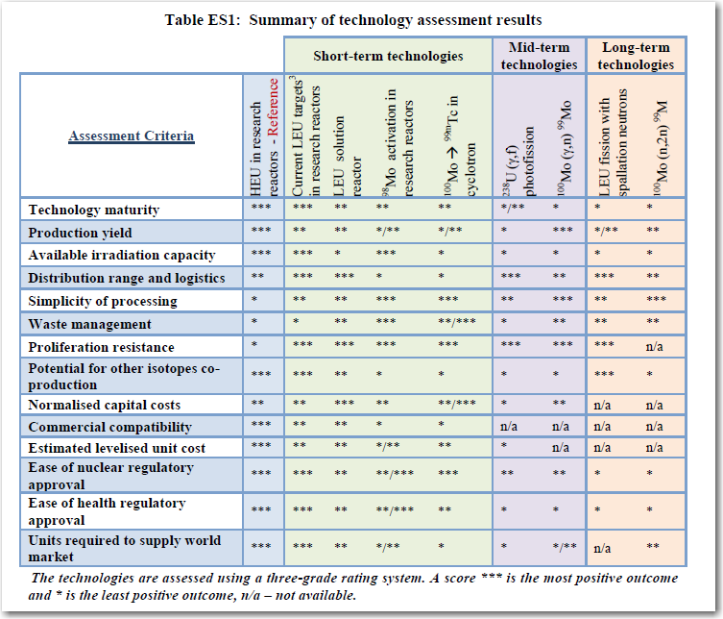
Scientific premises ⁹⁹Mo/^{99m}Tc supply chain – alternative solutions
2017
2025
2035
SORGENTINA

Slide 7

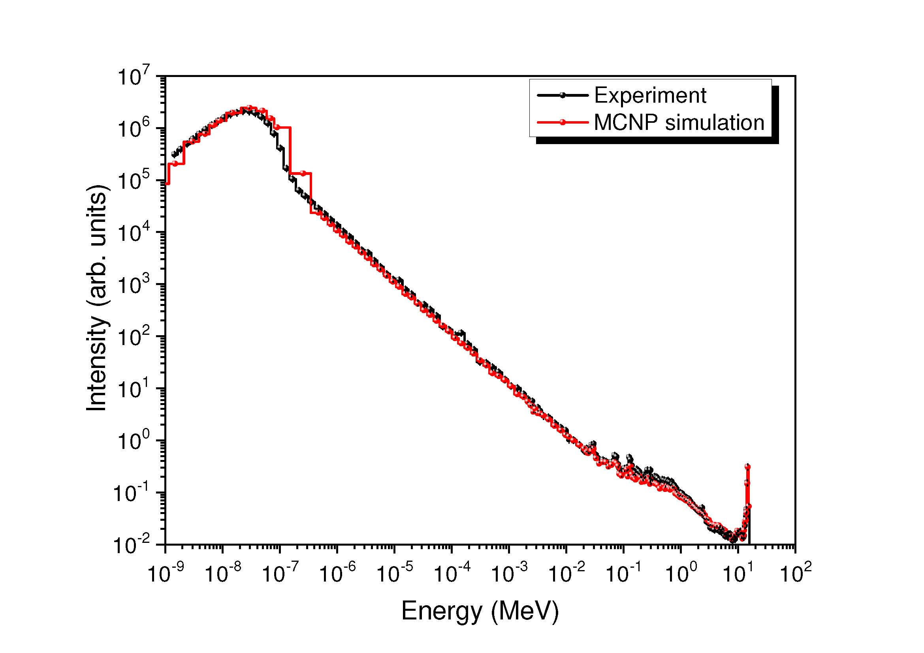
SORGENTINA project Main goal of the project
Design of a 14 MeV fusion neutron source 250 kW power neutron emission rate of about 10¹⁴ s⁻¹;
Production of medical radioisotope (mainly ⁹⁹Mo and ⁶⁴Cu) but also other applications with fast and thermalised neutrons for fusion technology and beyond.
Need to proceed step by step as this is a
first of the kind fusion neutron source
Funding scheme
ENEA 25% RER 75%
Experiments on moderators @ FNG facility
Project started on Jenuary 2020
5 M€
Thermomechanical
Demonstrator

Slide 8
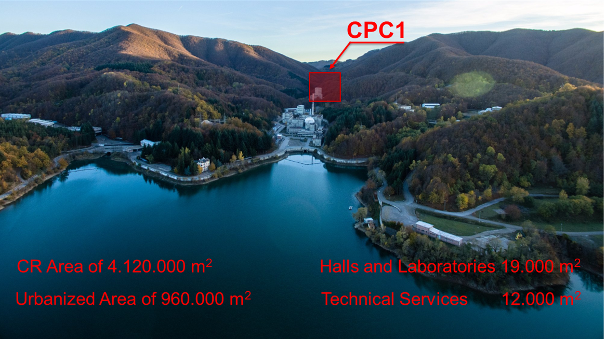
SORGENTINA project location
ENEA Brasimone Research Centre
SORGENTINA Building
Brasimone Lake

Slide 9
SORGENTINA project The main components of the Termomechanical Demonstator (TMD)
ROTATINMG TARGET
2020-2021 (SARS-COV2): design/discussions
2022: call for tender
2023: contract (De Pretto Industries, Italy)
2024: realization
2025: testing (more tests needed)
ION SOURCE & ACCELERATOR
2020-2021 (SARS-COV2): discussions and conceptual design
2022: call for tender and contract (MUONS Inc., US)
2023-2025: realization
2026: testing (ongoing)
330 rpm
condenser
D/T (50/50) plasma chamber
Multiapertures extraction grids
Drift tube
evaporator
Target acts as a heat pipe
Liquid-Vapor phase transition for power exhaust
11

Slide 10
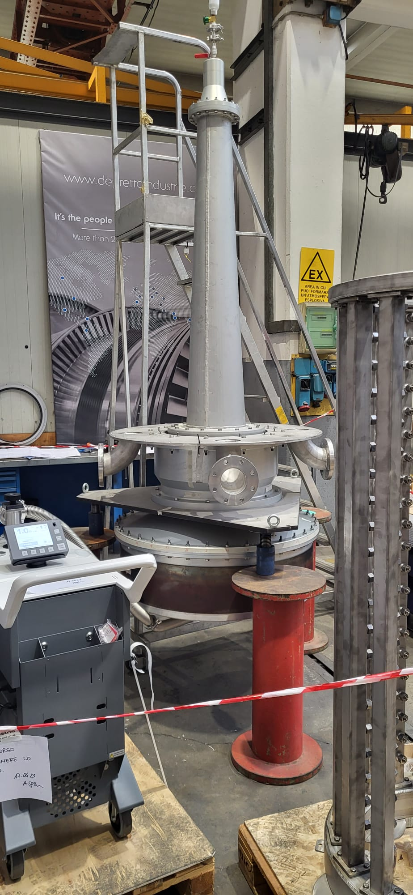
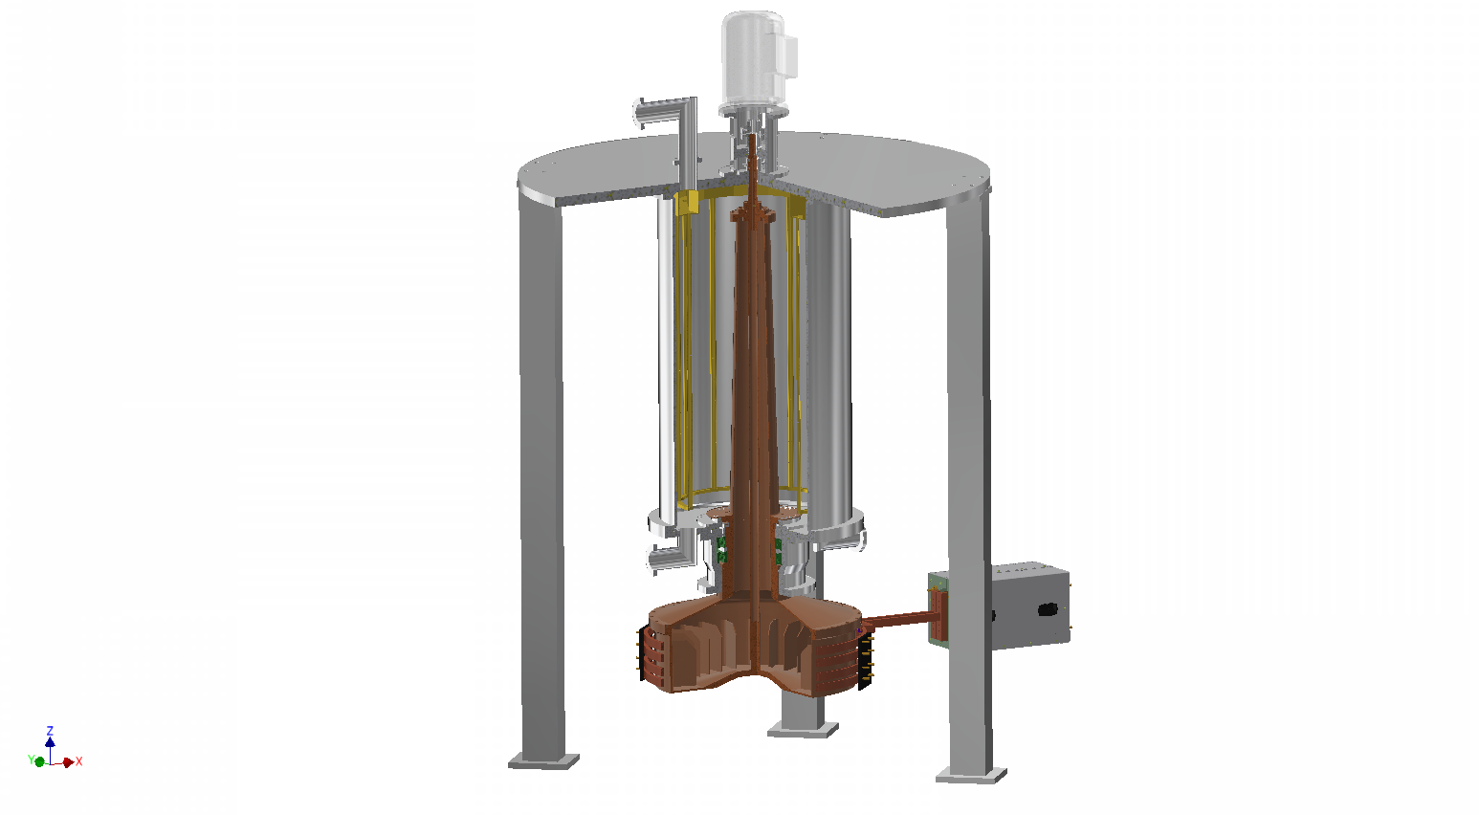
SORGENTINA project The rotating target prototype
What we were thinking about
What we have in our hands
Electric engine
Stator
Spray manifolds
Condenser
Bearings
Rotating target
aluminium
Evaporator
E-M inductor
simulate of the average power from the ion beam distributed by the target rotation
11

Slide 11
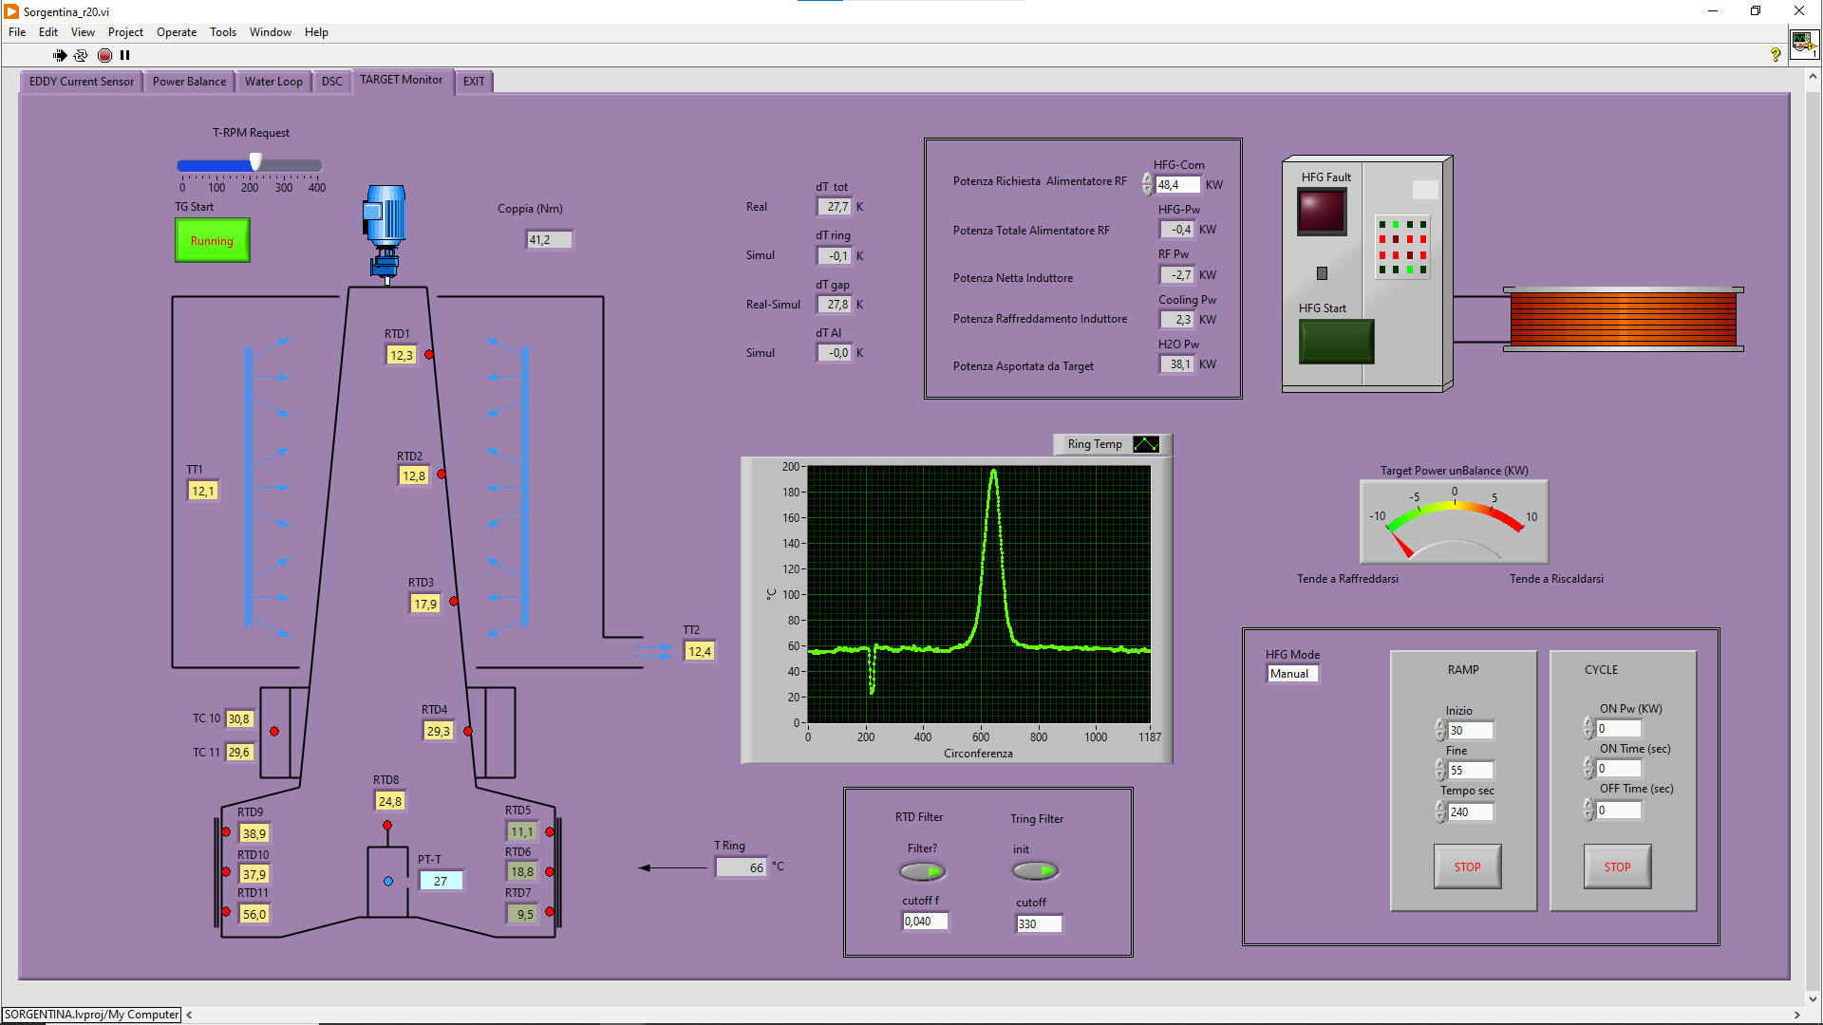
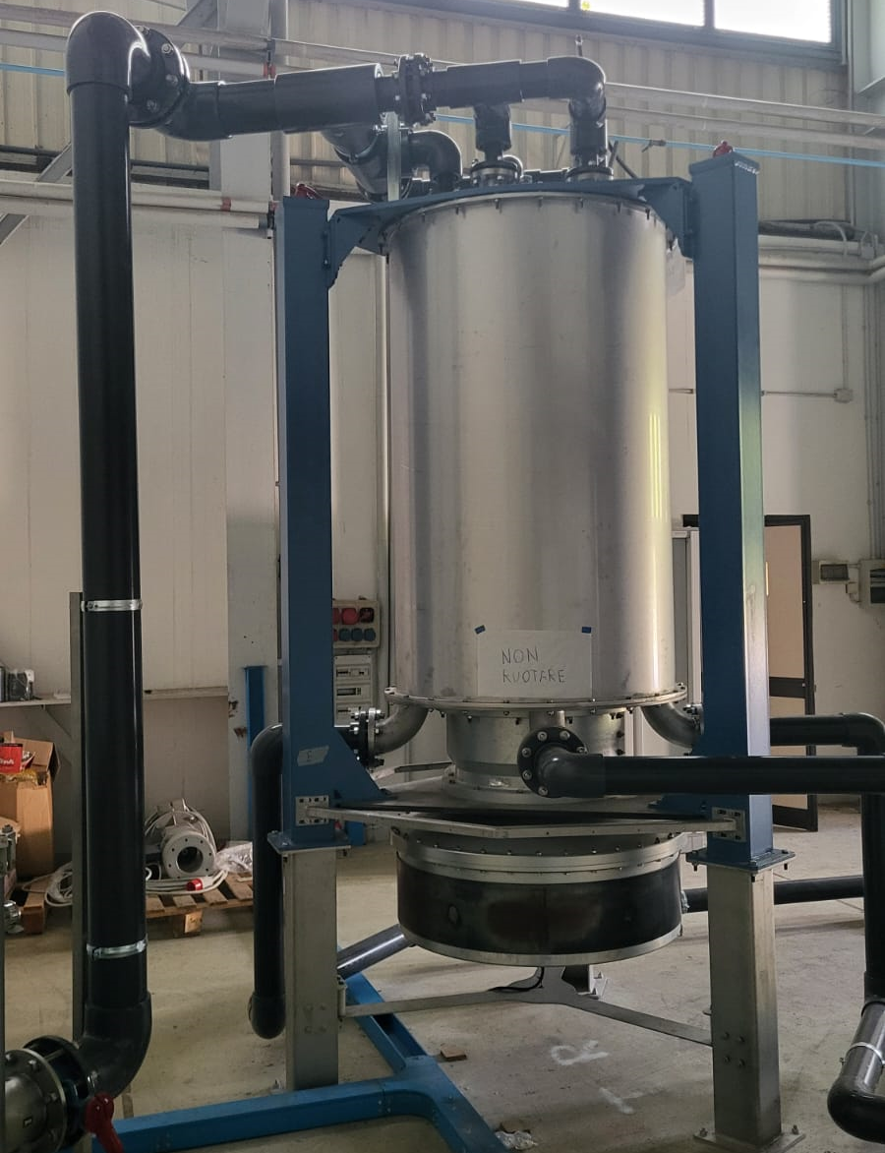
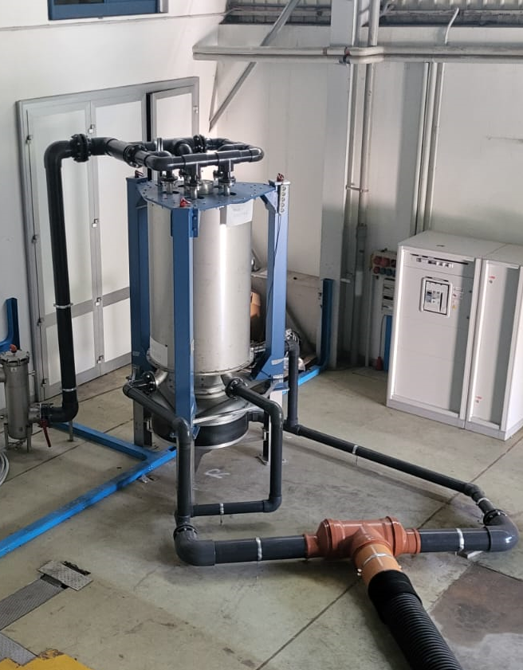
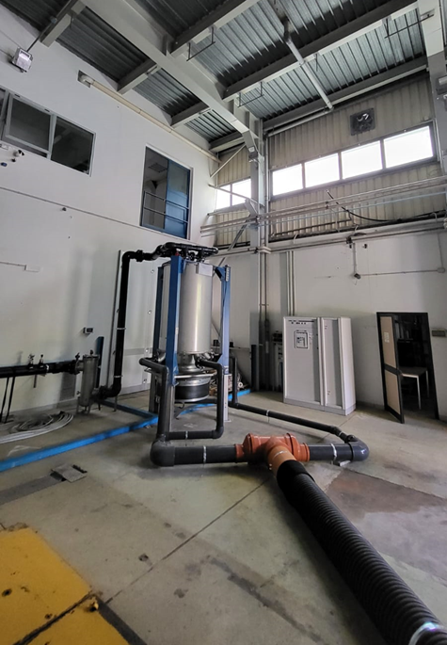

SORGENTINA project The rotating target prototype
Tests with EM inductor limitied @ 50 kW
Mechanical problems
to be solved as soon

Slide 12
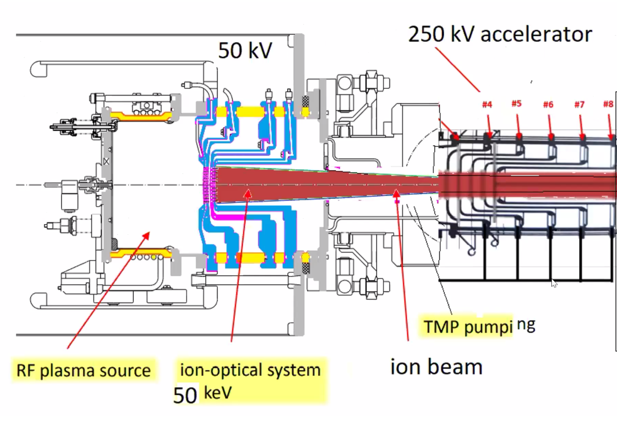


SORGENTINA project The ion source & accelerator
Participants &
Contracting authority
Call for tender
Is there a way to describe what is a
‘’competitive dialogue’’
as a procedure for an international call for tender?
MUONS Inc. US had the contract

Slide 13
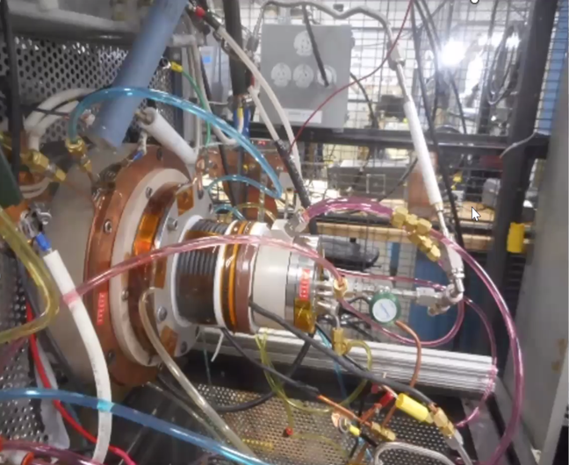
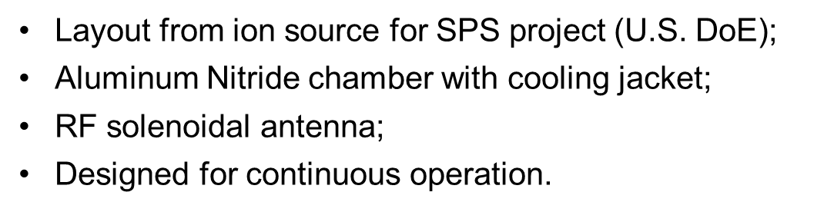


SORGENTINA project The ion source & accelerator
Parameter | Value
Ion energy | 300 keV
Ion current | 830 mA
composition | D+/T+ (50/50)
Beam gemetry rectangular spot | 20 cm - H 8 cm - W
Operation | CW
Hydrogen only for this phase of the project

Slide 14
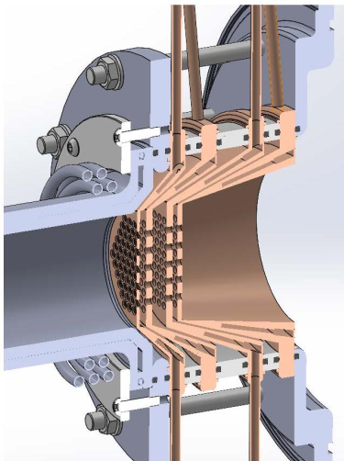
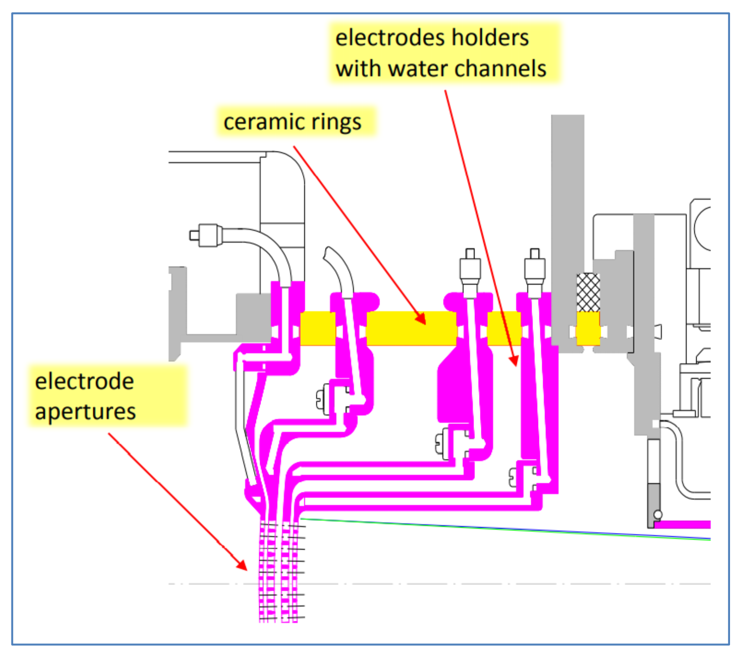
SORGENTINA project The ion source & accelerator
~0.9 A extracted and accelerated up to 50 keV;
91 apertures, 4-mm diameter arranged in a hexagonal pattern inside a diameter of 6 cm;
Electron suppressor grid;
Grids are made in oxygen free copper with a 10 μm layer of Mo;
Water channels are inside the electrode holders.

Slide 15
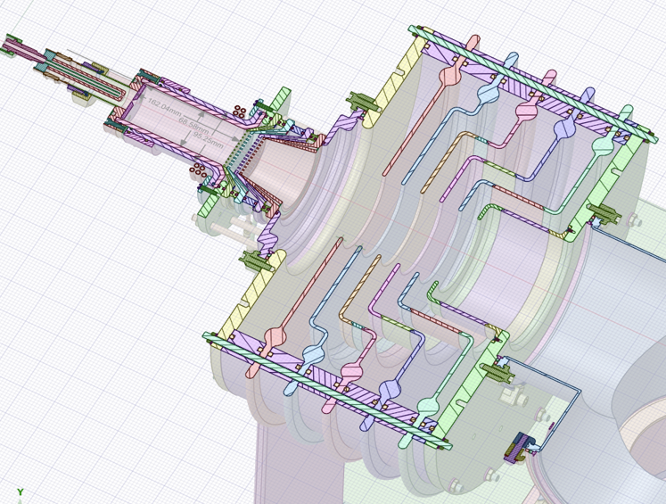
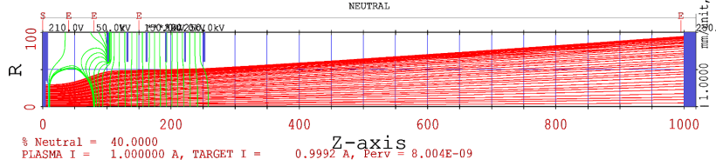
5 electrodes to bring the beam energy from 50 keV to 300 keV;
Ceramic insulators among the electrodes.

Slide 16
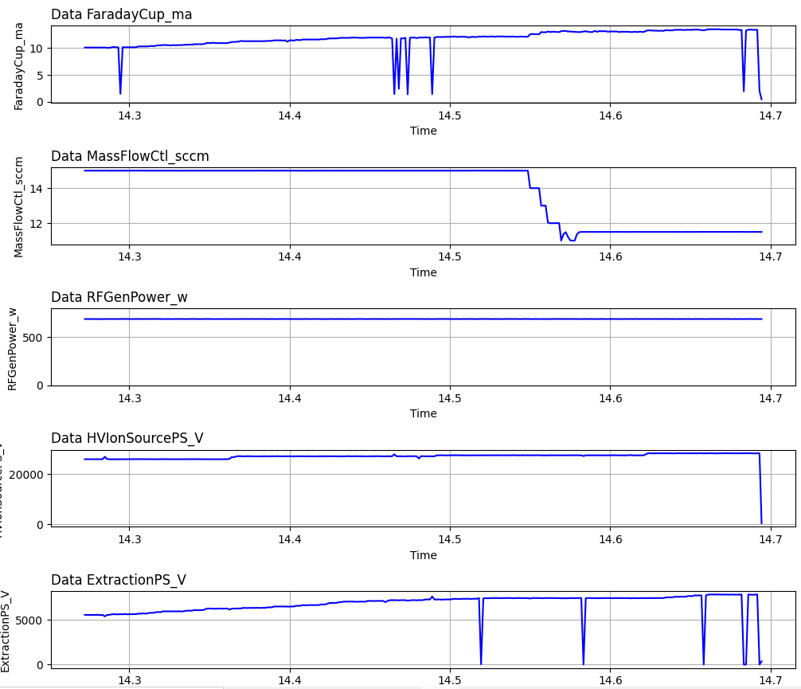
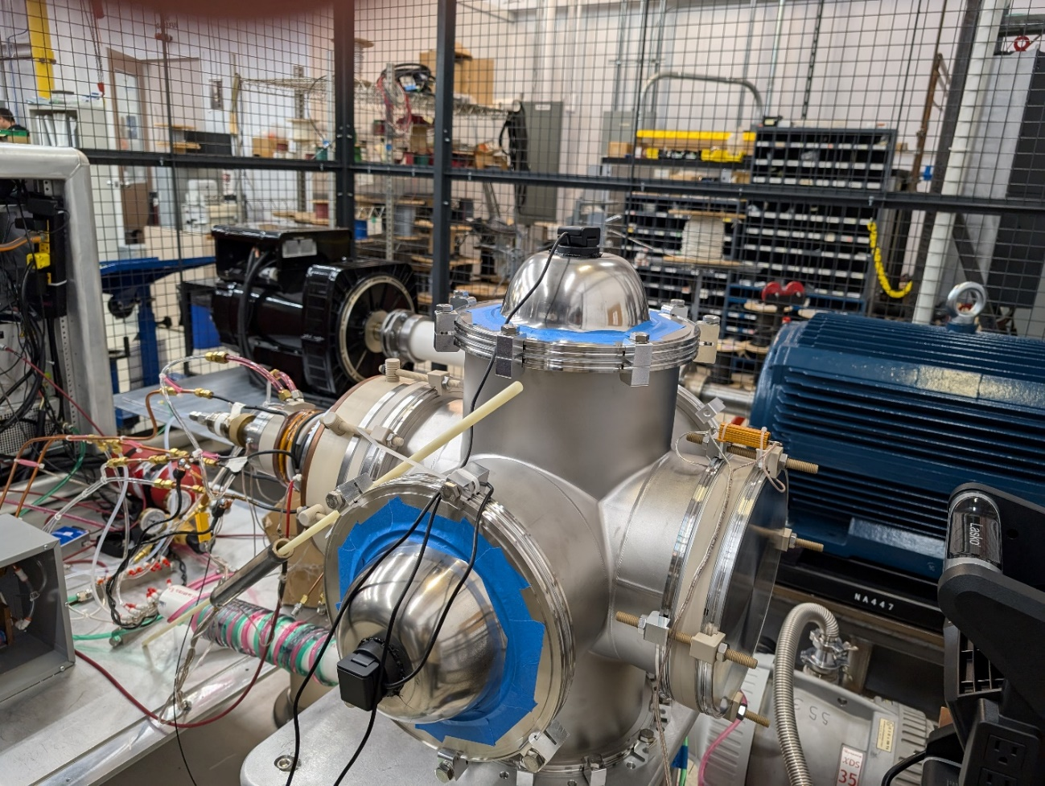
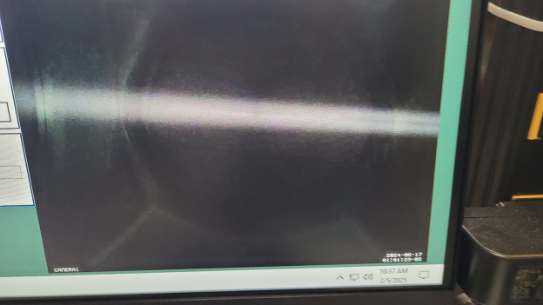
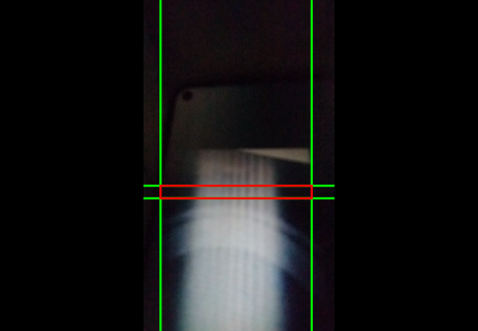
SORGENTINA project The ion source & accelertator: tests at Richarson Lab (US)
Single Aperture beam measurement on September 19th, 2024
H+, 16.7 mA @ 28 kV
More: February 2025, 91-hole grids, 100 mA of H+ extracted @25 kV

Slide 17
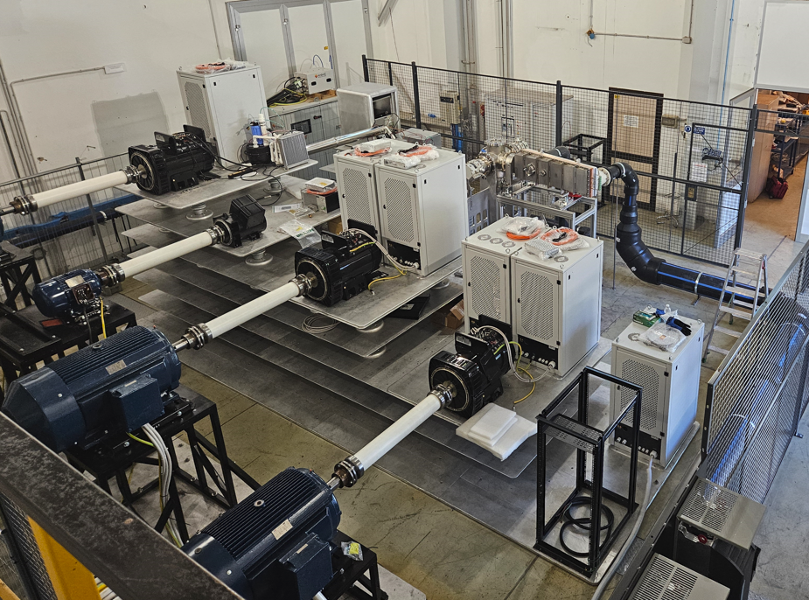
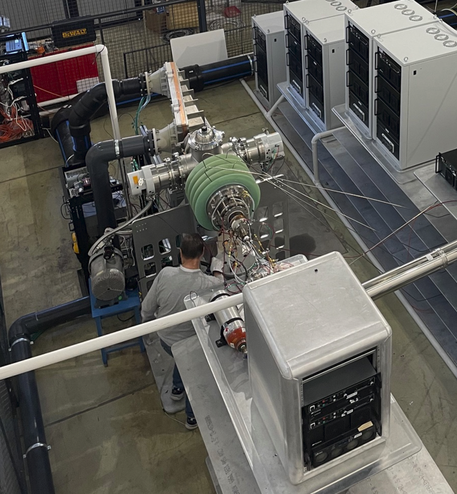
SORGENTINA project Device installation at Brasimone Research Centre
HV decks
Ion beam dump
Ion beam dump
Accelerator
Vacuum, high voltage, control system tests done in Brasimone in February 2026
Full test in H+ @ 250 kW with beam dump @ ENEA Brasimone in May
Ion source
Ion source 300 kV deck
Six 50 kV 900 mA power supplies are in series to get 300 kV;
Individual power taps at ground, 50kV, 100kV, 150kV, 200kV, 250kV, 300 kV;
4 sets of supplies are each powered by an alternator that is driven by an electromotor (3x150 kW, 1x11 kW) using an isolated drive shaft.

Slide 18
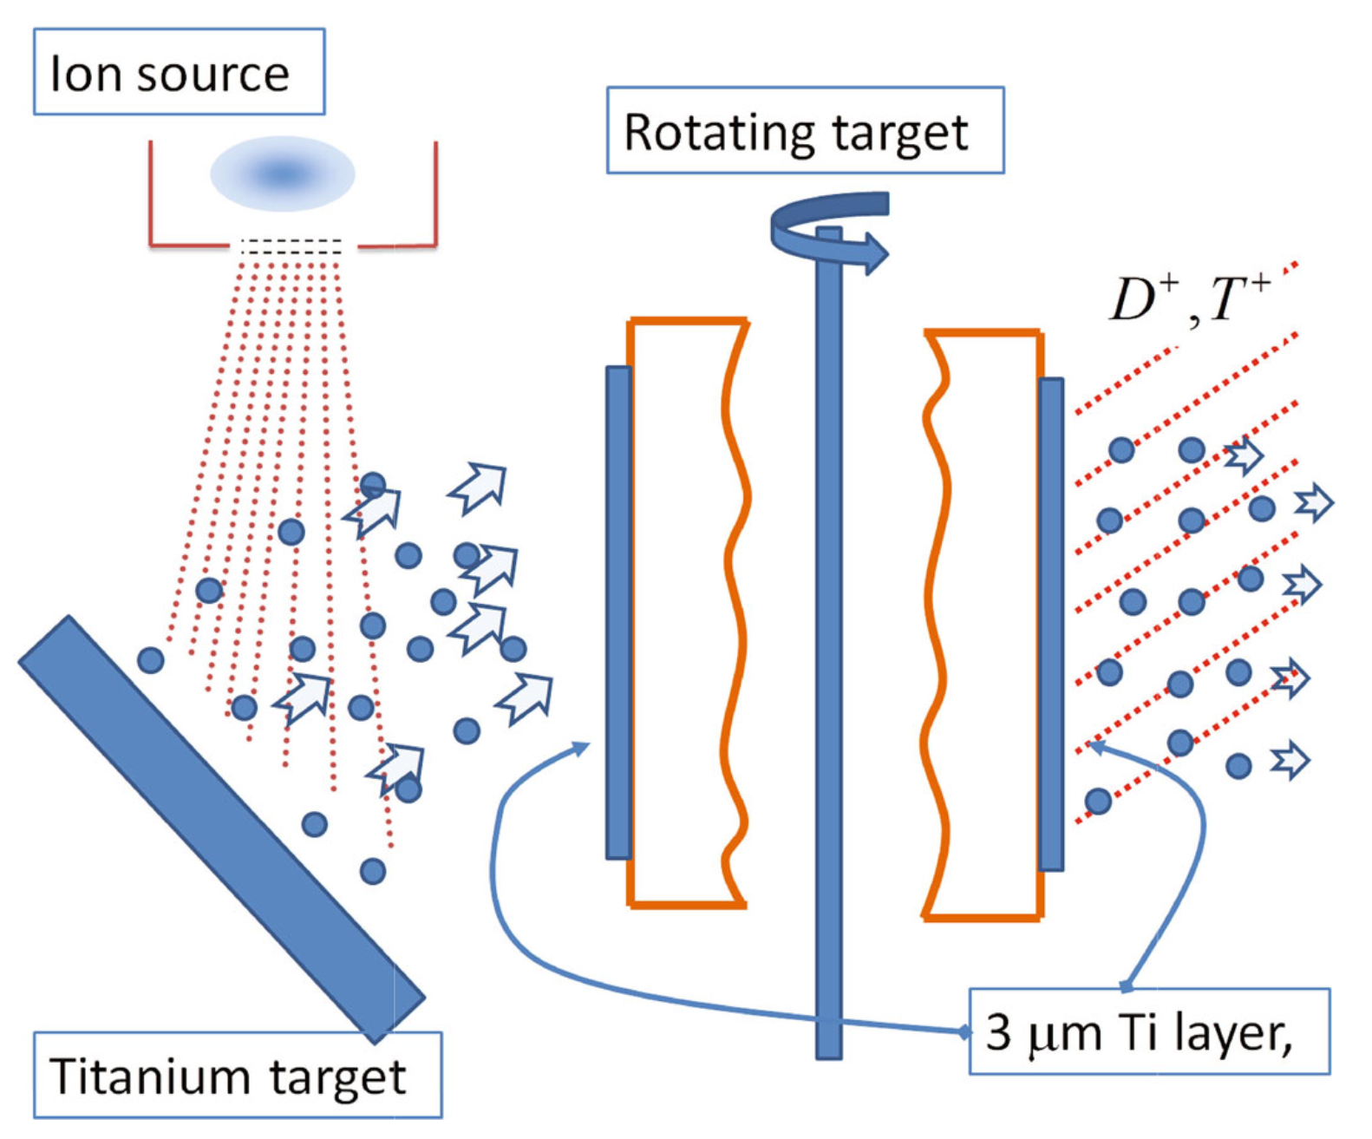
SORGENTINA project Next steps
The TMD phase will end on July 2026 (5 M€ funded). The next steps we need to do are:
Assessment of the primary cooling system using the inductor up to 250 kW power;
Study about rotating sealing systems:
Ferrofluidic
Polymeric
polymeric + ferrofluidic
Joining vacuum chamber hosting the rotating target with the ion source & accelerator
Test in operando of the Ti sputtering system (already tested at laboratory scale in ENEA) to be hosted inside the vacuum chamber housing the rotating target
Titanium for H (then D/T) implantation:
TiD_{x} (1.4 < x < 1.8) as from experimental campaing on FNG

Slide 19
SORGENTINA project
ENEA- RER MoU responsible
Scientific Responsible
Planning and Quaility Manager
The SORGENTINA project team
Nadia Voukelatou, Alessia Santucci, Agostina Orefice, Antonietta Rizzo, Marco Lamberti,
Nicola Fonnesu, Pietro Zito, Ivan Panov Spassovski, Fabio Moro, Davide Flammini, Vincenzo Narcisi,
Valerio Sermenghi, Salvatore Scaglione, Danilo Zola, Danilo Dongiovanni, Nicholas Terranova,
Jean-Francois Ciparisse, Alberto Ubaldini, Camillo Sartorio, Andrea Evangelista, Paolo Del Prete, Pietro Agostini, Demis Santoli, Bruno Mastroianni, Ranieri Marinari, Marco Capogni, Mauro Capone, Alessandro Del Nevo,
Gian Marco Contessa (now ISS), Alessio Del Dotto (now INFN)
Researchers/technicians & adminstrative staff from different ENEA’s Laboratories/Departments
and thus different but synergic competences
About 10 publications about the first activities of the project
We are waiting to finalise all the remaining tests to publish more
TASK-4: Neutronics
TASK-1: Civil works
TASK-5: Tritium
TASK-6: Radiochemistry
TASK-2: Target
Essential for the funded phase
TASK-7: Safety
TASK-3: Accelerator
In the perspective of new funds
TASK-8: Radiation Protection
TASK-9: Titanium facility

Slide 20

SORGENTINA project
Thank you for attention
and possibly see you with more results at ICANS XXVI
…hopefully for the moment

