Slide 1
The High Brilliance Neutron Source (HBS) Project: From Concept to Reality
Paul Zakalek, JCNS, FZJ

Slide 2



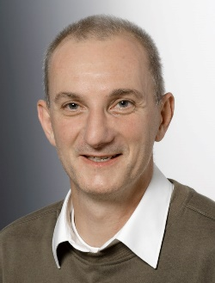
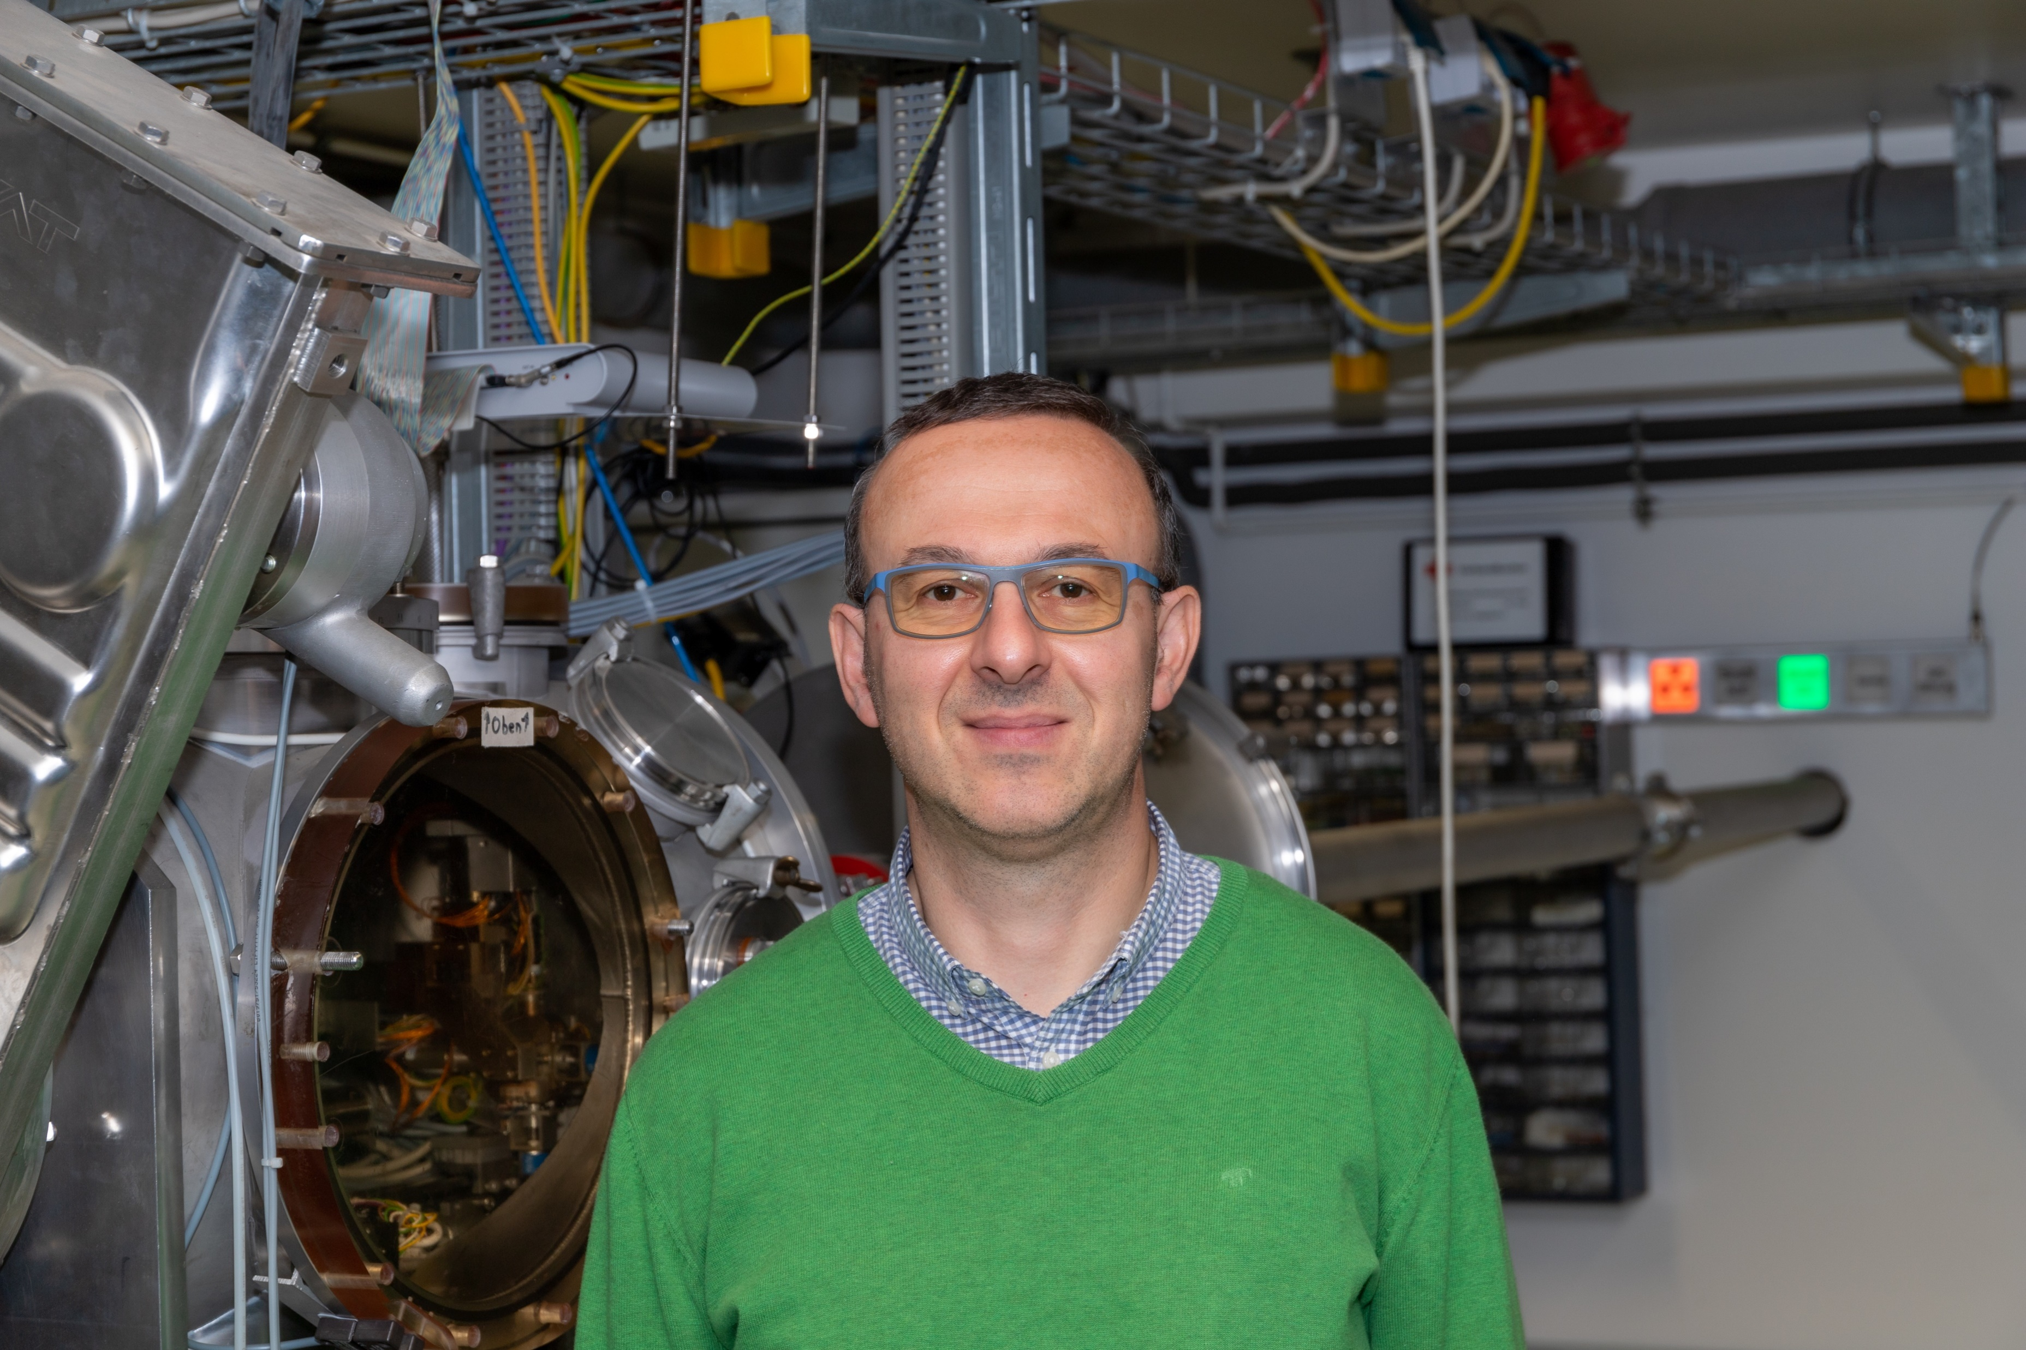




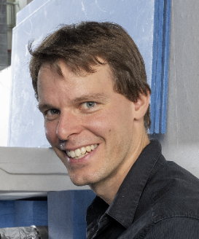

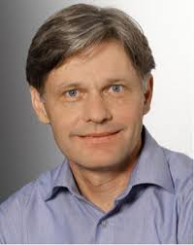





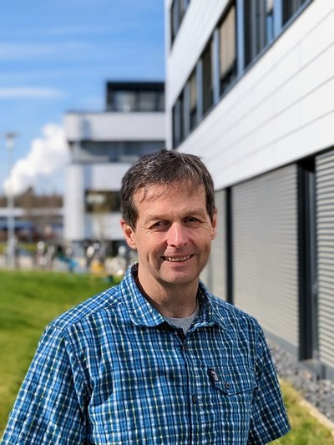

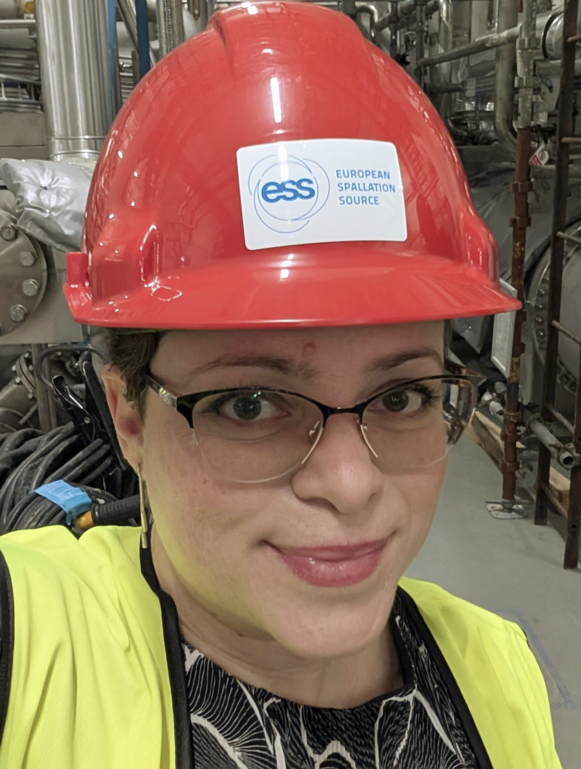



HBS lives due to many people and partners
And many more

Slide 3
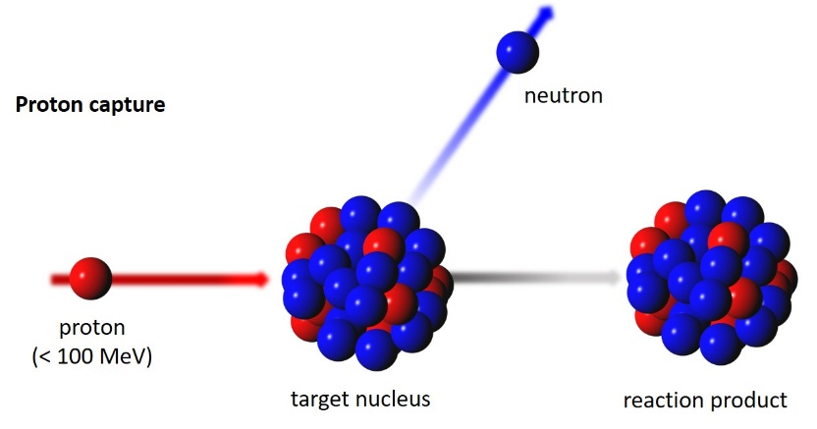
HBS-I: Compact, Efficient, and Sustainable Neutron Production
Low-energy proton capture enables unique selling points
A highly efficient neutron facility
low energy accelerator, small target, compact shielding
Resilient & flexible
modular design, can be adapted to specific requirements
Opportunities for innovation and technology
novel technologies and attractive access schemes
sustainable & accessible
minimizes radioactive waste and requires no nuclear licensing
The Landscape 2000
Proton Capture

Slide 4
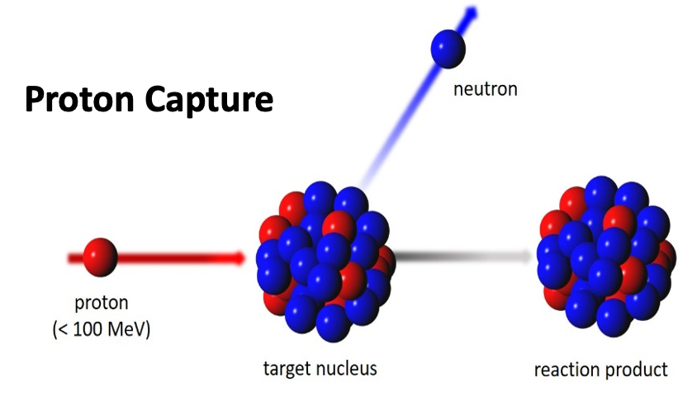
HBS-I Project Milestones: From Vision to Recommendation
Start of HBS Project
2013

Slide 5

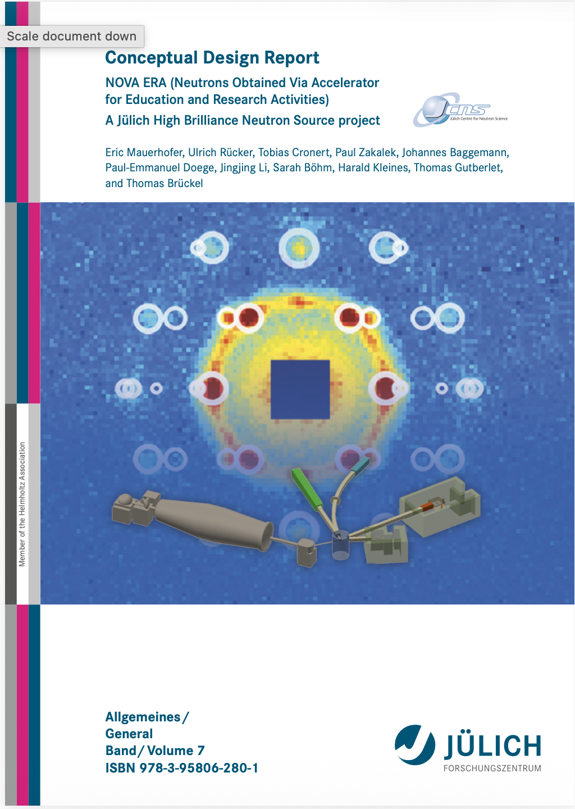
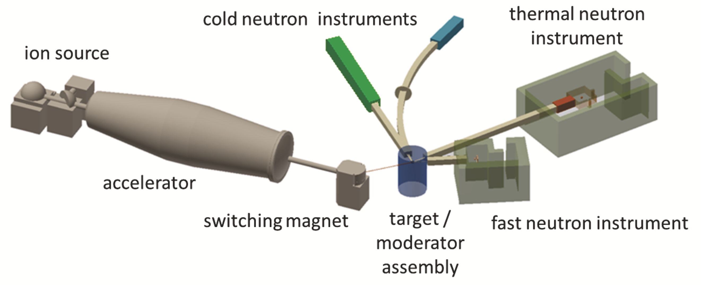
HBS-I Project Milestones: From Vision to Recommendation
Start of HBS Project
CDR Nova Era
2013
2017

Slide 6
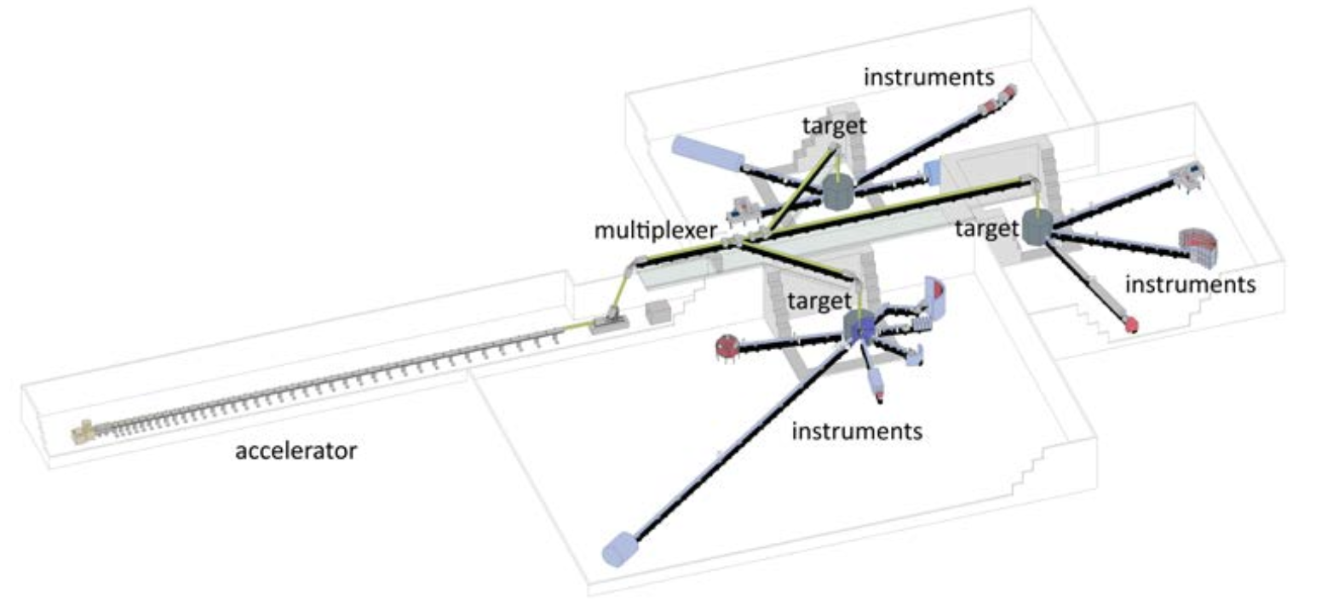
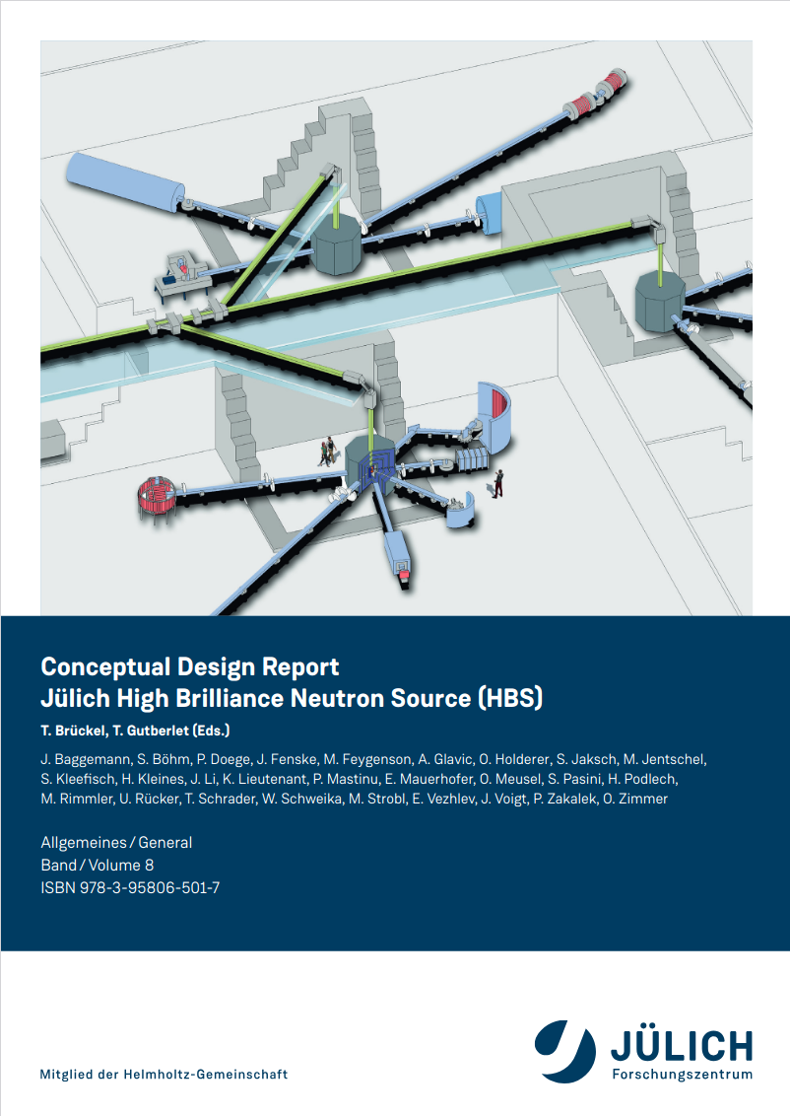
HBS-I Project Milestones: From Vision to Recommendation
Start of HBS Project
CDR Nova Era
CDR
HBS
2013
2017
2020

Slide 7
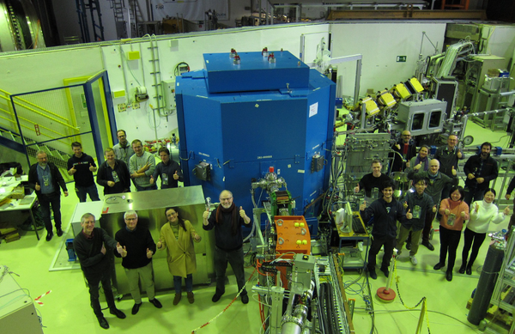
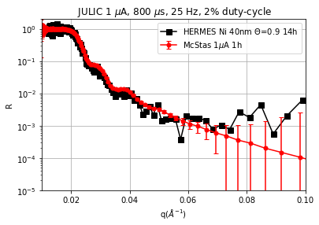
HBS-I Project Milestones: From Vision to Recommendation
Start of HBS Project
CDR Nova Era
CDR
HBS
JULIC Neutron Platform
2013
2017
2020
2022
Contribution from CEA:
Mariano Paulin
Frédéric Ott
Alain Menelle

Slide 8
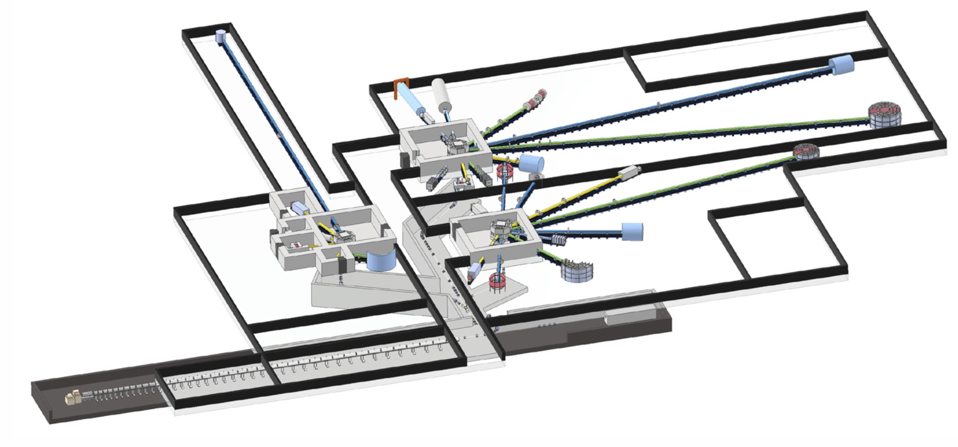
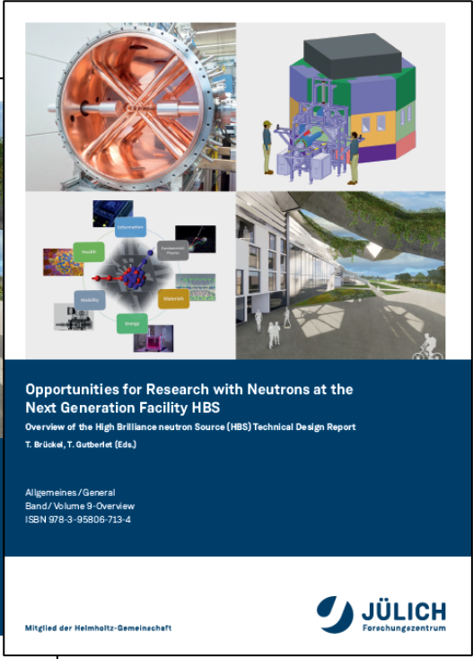
HBS-I Project Milestones: From Vision to Recommendation
Start of HBS Project
CDR Nova Era
CDR
HBS
JULIC Neutron Platform
TDR
HBS
2013
2017
2020
2022
2023

Slide 9
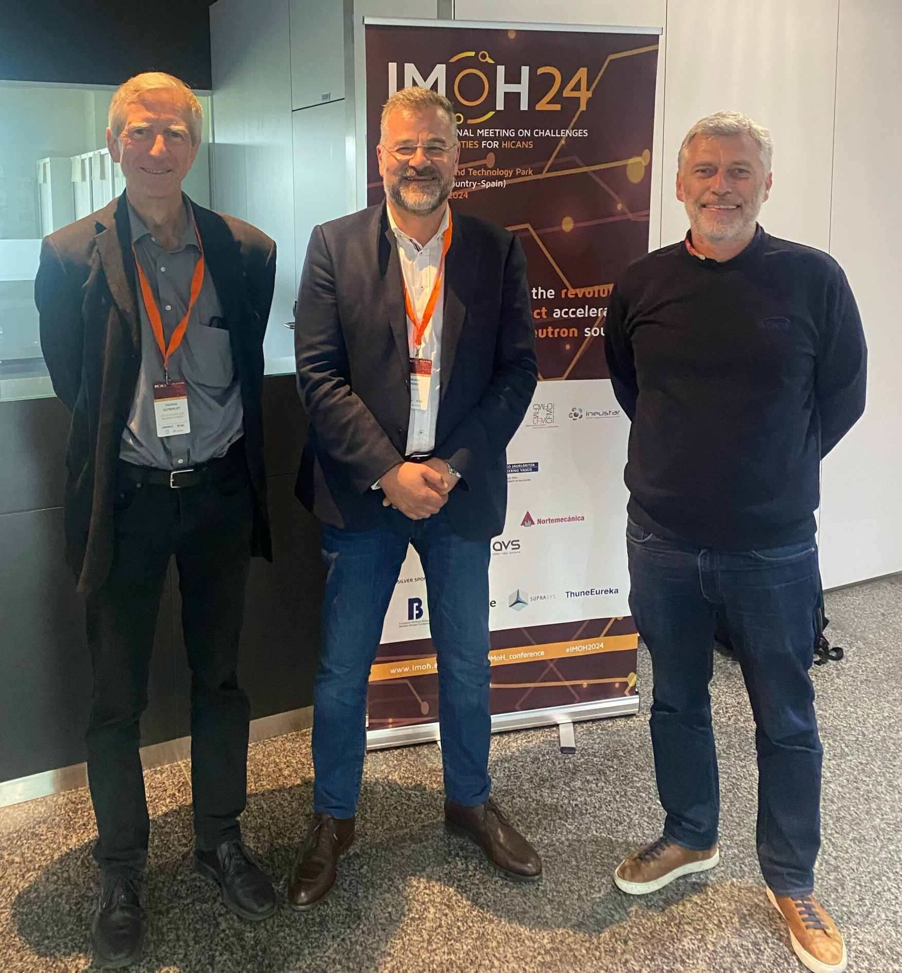
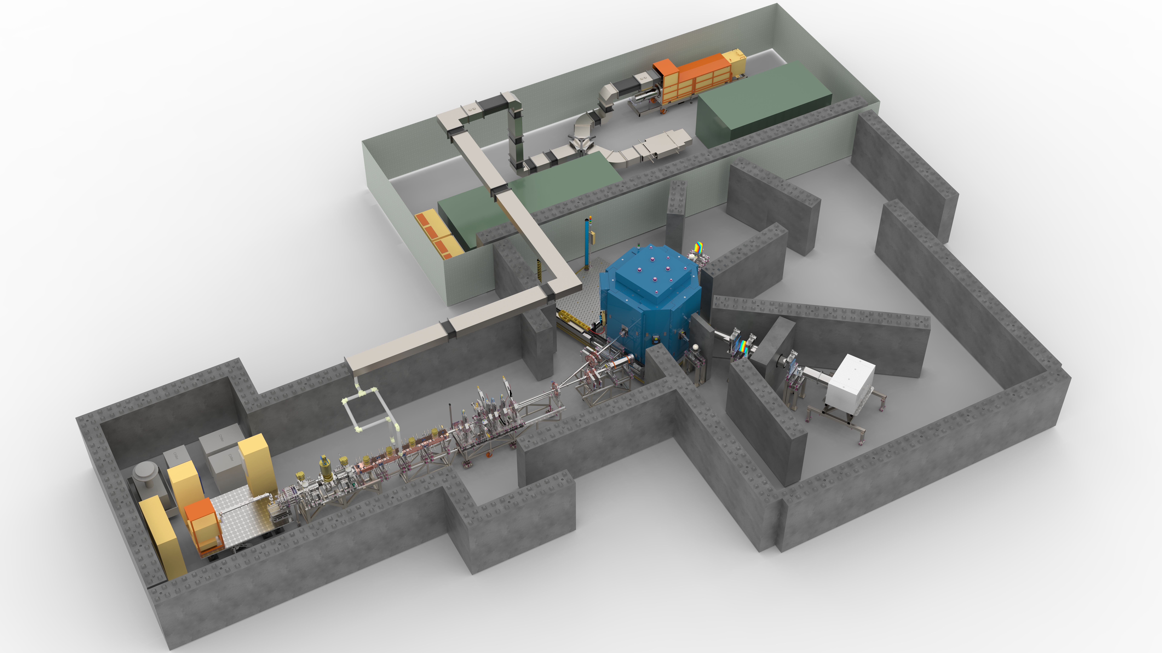
HBS-I Project Milestones: From Vision to Recommendation
Start of HBS Project
CDR Nova Era
CDR
HBS
JULIC Neutron Platform
TDR
HBS
Joint Project
(D, F, S)
2013
2017
2020
2022
2023
2024

Slide 10
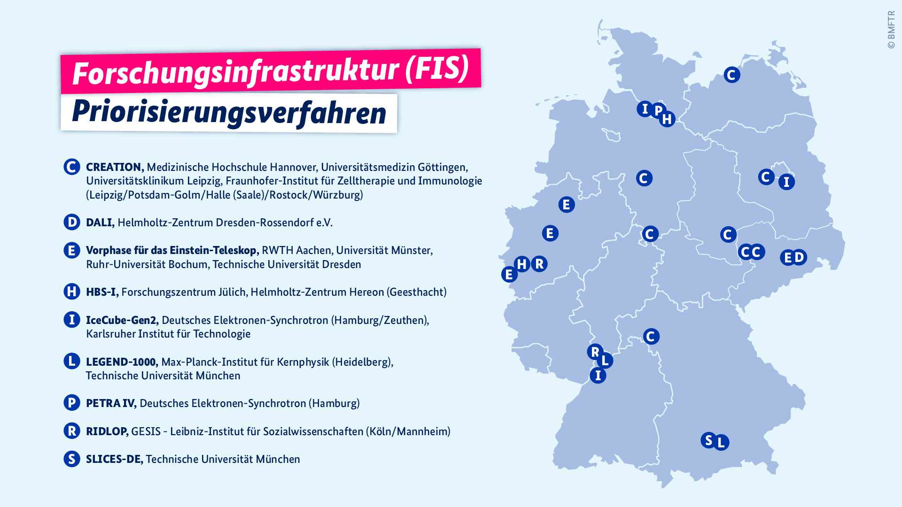
HBS-I Project Milestones: From Vision to Recommendation
Start of HBS Project
CDR Nova Era
CDR
HBS
JULIC Neutron Platform
TDR
HBS
Joint Project
(D, F, S)
HBS-I short listed
Science council recommends
HBS-I
2013
2017
2020
2022
2023
2024
2025
2026

Slide 11
Projects within HBS: Building the Path to HBS-I
JULIC • HiCANS Platform • HBS-I • HBS – A modular, scalable approach to HiCANS
HBS
N-yield: 100% (10¹⁵ n/s)
Energy: 70 MeV
Time: only TDR
Place: -
JULIC Neutron Platform
N-yield: 0.001%
Energy: 45 MeV
Time: 2022 – 2023
Place: Big-Karl lab, IKP
Jülich (Germany)
HiCANS Platform (with ESS Bilbao, LLB Saclay)
N-yield: 0.1%
Energy: 3 MeV
Time: 2027 – 2032
Place: Bilbao (Spain)
HBS-I
N-yield: 10%
Energy: 20 MeV
Time: 2034 – 20XX
Place: COSY-building,
Jülich (Germany)

Slide 12
Projects within HBS: Building the Path to HBS-I
JULIC • HiCANS Platform • HBS-I • HBS – A modular, scalable approach to HiCANS
HBS
N-yield: 100%
Energy: 70 MeV
Time: only TDR
Place: -
JULIC Neutron Platform
N-yield: 0.001%
Energy: 45 MeV
Time: 2022 – 2023
Place: Big-Karl lab, IKP
Jülich (Germany)
HiCANS Platform (with ESS Bilbao, LLB Saclay)
N-yield: 0.1%
Energy: 3 MeV
Time: 2027 – 2032
Place: Bilbao (Spain)
HBS-I
N-yield: 10%
Energy: 20 MeV
Time: 2034 – 20XX
Place: COSY-building,
Jülich (Germany)

Slide 13
Projects within HBS: HBS-I & HiCANS Platform
JULIC • HiCANS Platform • HBS-I • HBS – A modular, scalable approach to HiCANS
HiCANS Platform (with ESS Bilbao, LLB Saclay)
N-yield: 0.1%
Energy: 3 MeV
Time: 2027 – 2032
Place: Bilbao (Spain)
HBS-I
N-yield: 10%
Energy: 20 MeV
Time: 2034 – 20XX
Place: COSY-building,
Jülich (Germany)

Slide 14

The HBS-I Facility
Accelerator
20 MeV
100 mA peak
<20 % duty cycle
20 – 200 Hz
Medical radioisotopes
^{99m}Tc, ¹⁷⁷Lu, ²²⁵Ac, ⁶⁷Cu
Target Station
40 kW
10¹³ n / s
Compact
Diffractometer
Flux: 1.2.10⁵ - 1.10⁶ n/cm²/s
engineering and energy materials, proteins
Neutron Imaging
Flux: 3.10⁴ – 1.2.10⁵ n/cm²/s
Energy devices, soil, plants, cultural heritage
Small-Angle Neutron Scattering (SANS)
Flux: 8.5.10⁵ n/cm²/s
nano- and biomaterials
Neutron Reflectometer
Flux: 5.10⁵ n/cm²/s
magnetic layers, biological membranes
PGNAA
Flux: 3.4.10⁷ n/cm²/s
chemical and isotope analysis

Slide 15
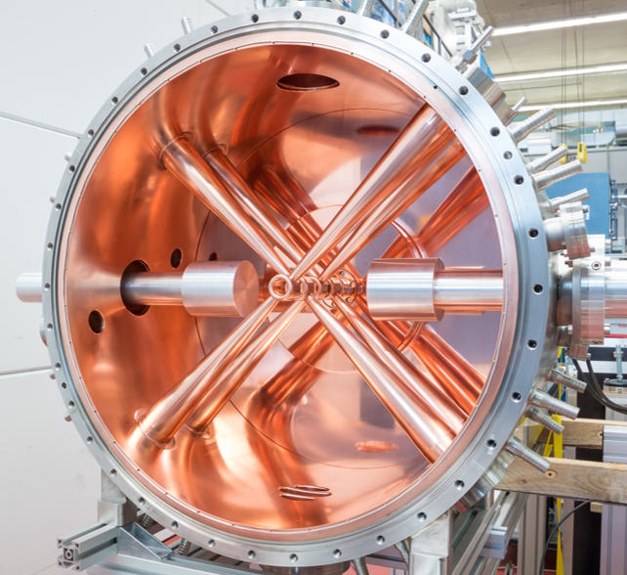
HBS Accelerator
TDR Concept up to 20 MeV
100 mA, 2 20 MeV pulsed proton linac
RFQ
RFQ
ECR ion source
CH cavity
CH cavity
LEBT
MEBT
>100 mA
proton source
175 MHz
(2-4 m, 1.2 -> 2.5 MeV)
normal conducting CH cavities and
quadrupole dublets
(~2.5 m, 2.5 -> 20 MeV)
Seite 15

Slide 16
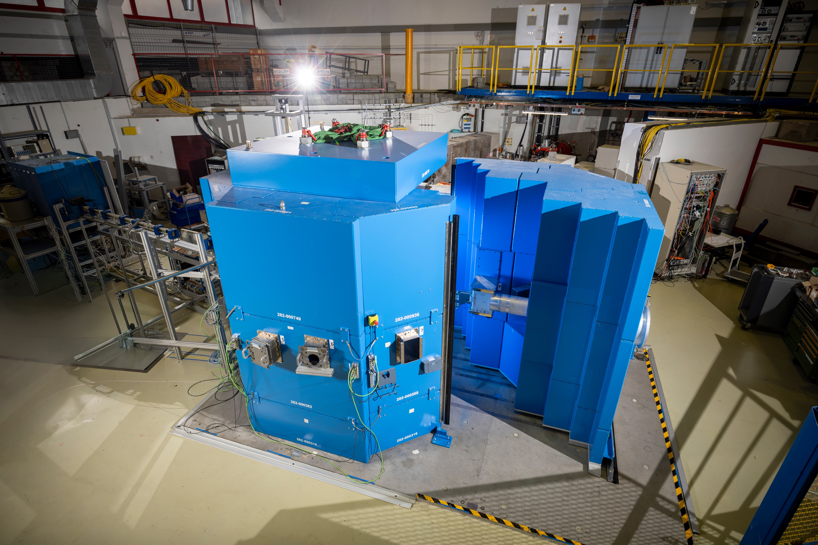
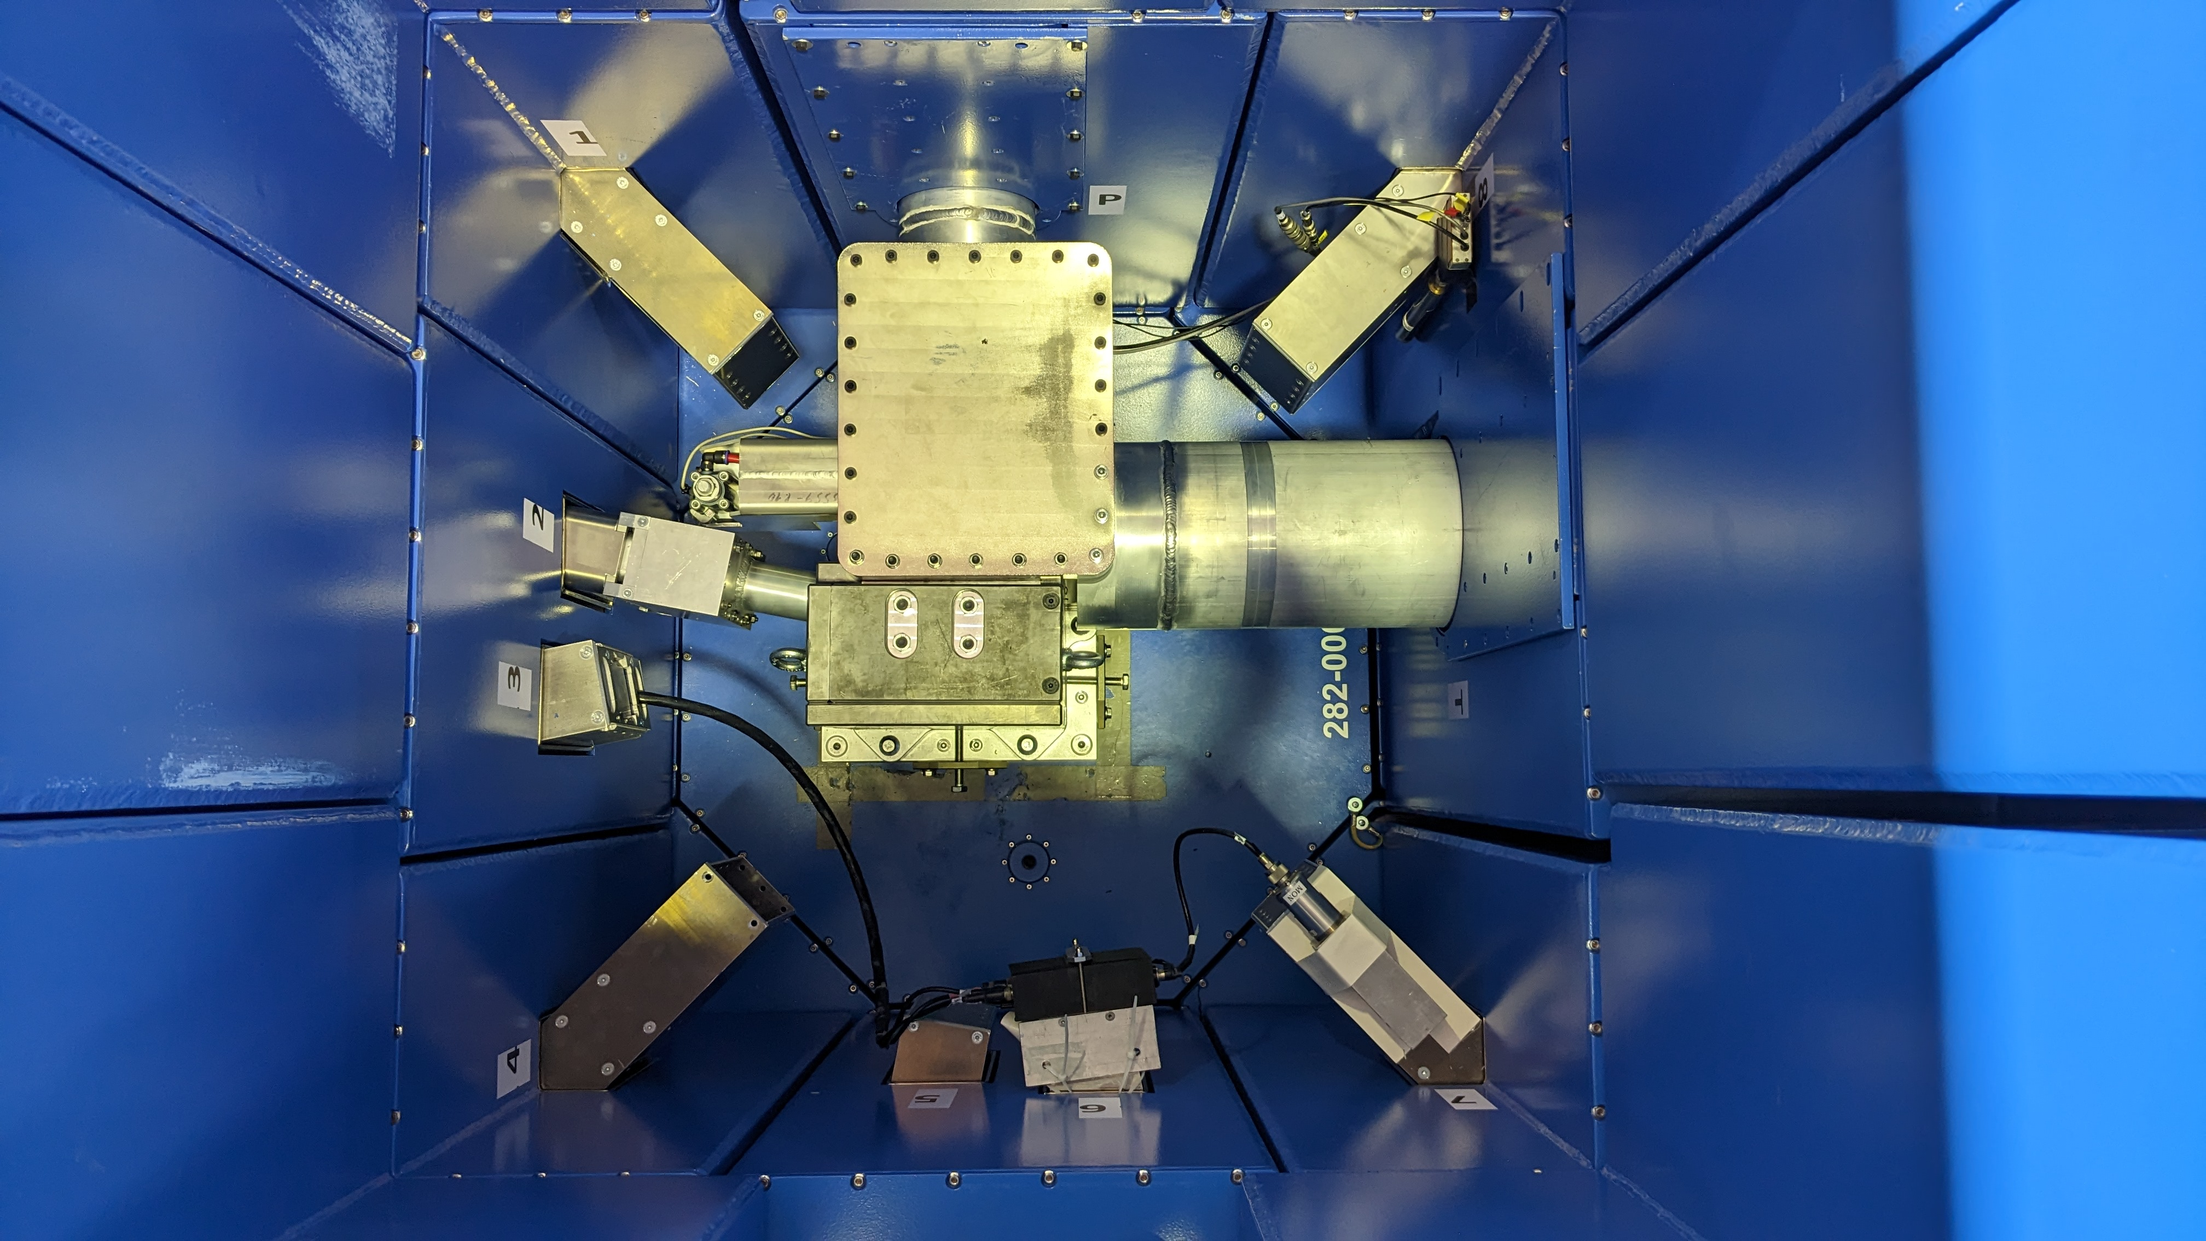
HBS Target Station
Reuse existing target station
Protons
Target
plug
Seite 16

Slide 17
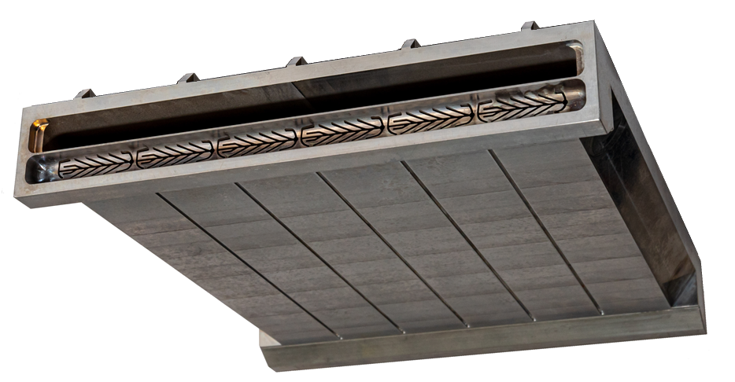
HBS Target
In working process of adapting target to 20 MeV
Tantalum back cover | reinforcement braces
Water coolant
flow direction
out
in
5,8 mm
beam stop (water coolant backflow)
Neutron producing layer with
micro channel coolant structure
112 mm
120 mm
Impinging Proton beam direction
Seite 17

Slide 18
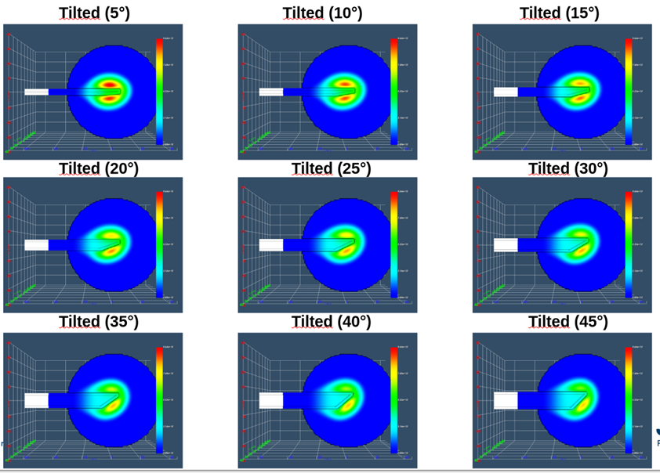
HBS Moderator
Tilted target improves performance and flexibility
Tilted 45°
Tilted 15°
Tilted 5°
Seite 18

Slide 19
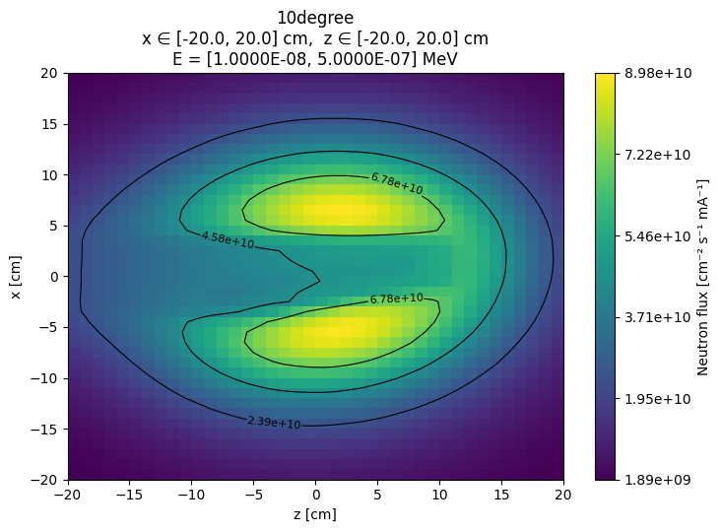




HBS Moderator
Tilted target improves performance and flexibility
Increases flux maximum
Creates two maxima
(for thermal and cold extraction)
Allows straight forward extraction of multiple energies
Increases power density at target
$$I_{up}$$
$$φ_{up}^{max}$$
$$φ_{down}^{max}$$
$$I_{down}$$
Seite 19

Slide 20
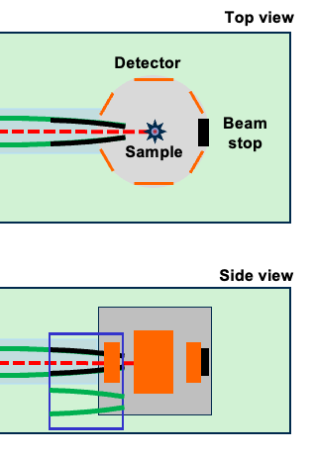
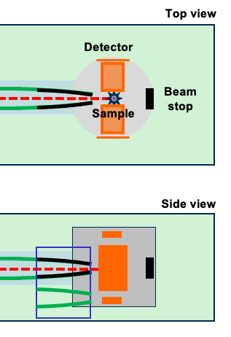
The diffractometer for the HBS-I (60 meter)
Multimodal
Single Crystal Diffraction
Powder Diffraction
Engineering Diffraction
Top view
TMR unit
Bunker wall
Detector
Guide
Beam
stop
Sample
Choppers
2.16 m
29.5 m
56 m
58.2 m
1.54-1.73 m
59 m
Side view
Seite 20

Slide 21
Important Milestones
  Q2 / 2027: Project funding
  Q3 / 2029: COSY decommissioned / building permit revived
  Q2 / 2030: Accelerator bunker prepared
  Q4 / 2032: Accelerator installed
  Q3 / 2033: Commissioning finished
  Q1 / 2034: Operation start
  Q4 / 2053: Operation end
  Q4 / 2056: HBS-I decommissioned
Page 21

Slide 22


HBS Vision
A healthy landscape
of large and small
neutron sources
complementing
each other
The Landscape 2000
Thank you for your attention.

