Slide 1
A Real-Time Ortho-hydrogen Diagnostic for a Liquid Hydrogen Moderator
E. B. Iverson, B. DeGraff, J. Denison, F. X. Gallmeier
Oak Ridge National Laboratory
ICANS-XXV
13-17 April 2026

Slide 2
Outline
Ortho and para hydrogen are neutronically different, it matters, we want minimal ortho, we want to KNOW we have minimal ortho, and it’s both complex and hard….
The SNS PPU project, primarily meant to upgrade the accelerator complex to 1.3 GeV and 2.0 MW, also provided an orthohydrogen converter (catalyst) system and development for a real-time Raman based diagnostic to monitor the orthohydrogen level
SNS FTS moderators were designed to be not particularly sensitive to orthohydrogen fraction, in part because we knew it would be difficult to ensure full equilibration during operation – so we really only needed to get FTS moderators down to about 1% orthofraction, which is still quite a bit off-equilibrium
We tested an immersion probe diagnostic, which worked well enough to confirm that that radiation-induced backconversion prevented full relaxation of the hydrogen and would result in a significant power dependent variation in orthofraction during regular SNS operations
We deployed a “through-the-window” diagnostic on each of the three hydrogen loops in the SNS CMS at the same time as we deployed IONEX based catalyst systems, and all appear to be working exactly as intended
Notes:
In building the MDF at SNS, we do not have to focus on flux as much as we would on a stand-alone facility:
SNS doesn't need another beamline - this is for source technology demonstration - dedicated, single-use optimization
A small source would never begin to compete on flux; just don't worry about it
Prototypical nature is more important than flux anyway

Slide 3
Background
Orthohydrogen and parahydrogen are different
  spin coherence in parahydrogen reduces the cross section by >100x at 1 meV
  equilibrium at 20 K is 0.2% ortho, but that represents 30% of the scattering cross section
  an extra 0.2% changes the cross section by 30%; changing “thickness” from 28 mm to 38
Relaxation is famously slow, taking months to get to 0.2% equilibrium (20K) without catalysts
Kinetics model suggests that SNS power levels, around 0.02 W/cm³, can result in a shift away from 0.2% ortho at equilibrium to as much as 30% ortho, on a bad timescale
Add a catalyst – the system will settle quickly and to a near-equilibrium (low) ortho level which will let us better optimize the moderator performance at a higher level of performance
But how will we know? Is it even needed? Is all this correct or naive conjecture?
  Need a reliable diagnostic for real-time in situ measurements of orthohydrogen fraction in liquid hydrogen moderators under neutron irradiation
Notes:
With the SNS front-end copy that makes up the BTF, we get “forced” into a different source configuration than we might choose if we started from scratch. This changes our optimization process, which at least for exploration purposes offers the chance at significantly different features and gains.

Slide 4
Orthohydrogen Diagnostic Development Overview
Measure ortho-para ratio using in situ Raman spectroscopy
  Direct indication of ortho and para hydrogen levels in liquid flow
Primary design: use cryogenic viewport to view circulating hydrogen with Raman head
  Sapphire windows separating hydrogen volume, insulating vacuum, and optics
  +Strong signal with lowest background - most sensitive measurement
  +Maintain vacuum boundary to monitor for leaks
  -Required demonstration of cryogenic window at pressure
  -Needed physical system modification
Backup design: fiber immersion probe penetrating circulating hydrogen
  Sapphire fiber encased in steel with compression fitting
  +Could deploy in CMS using existing penetrations without significant system modifications
  -Weaker signal with higher background - less sensitive measurement

Slide 5
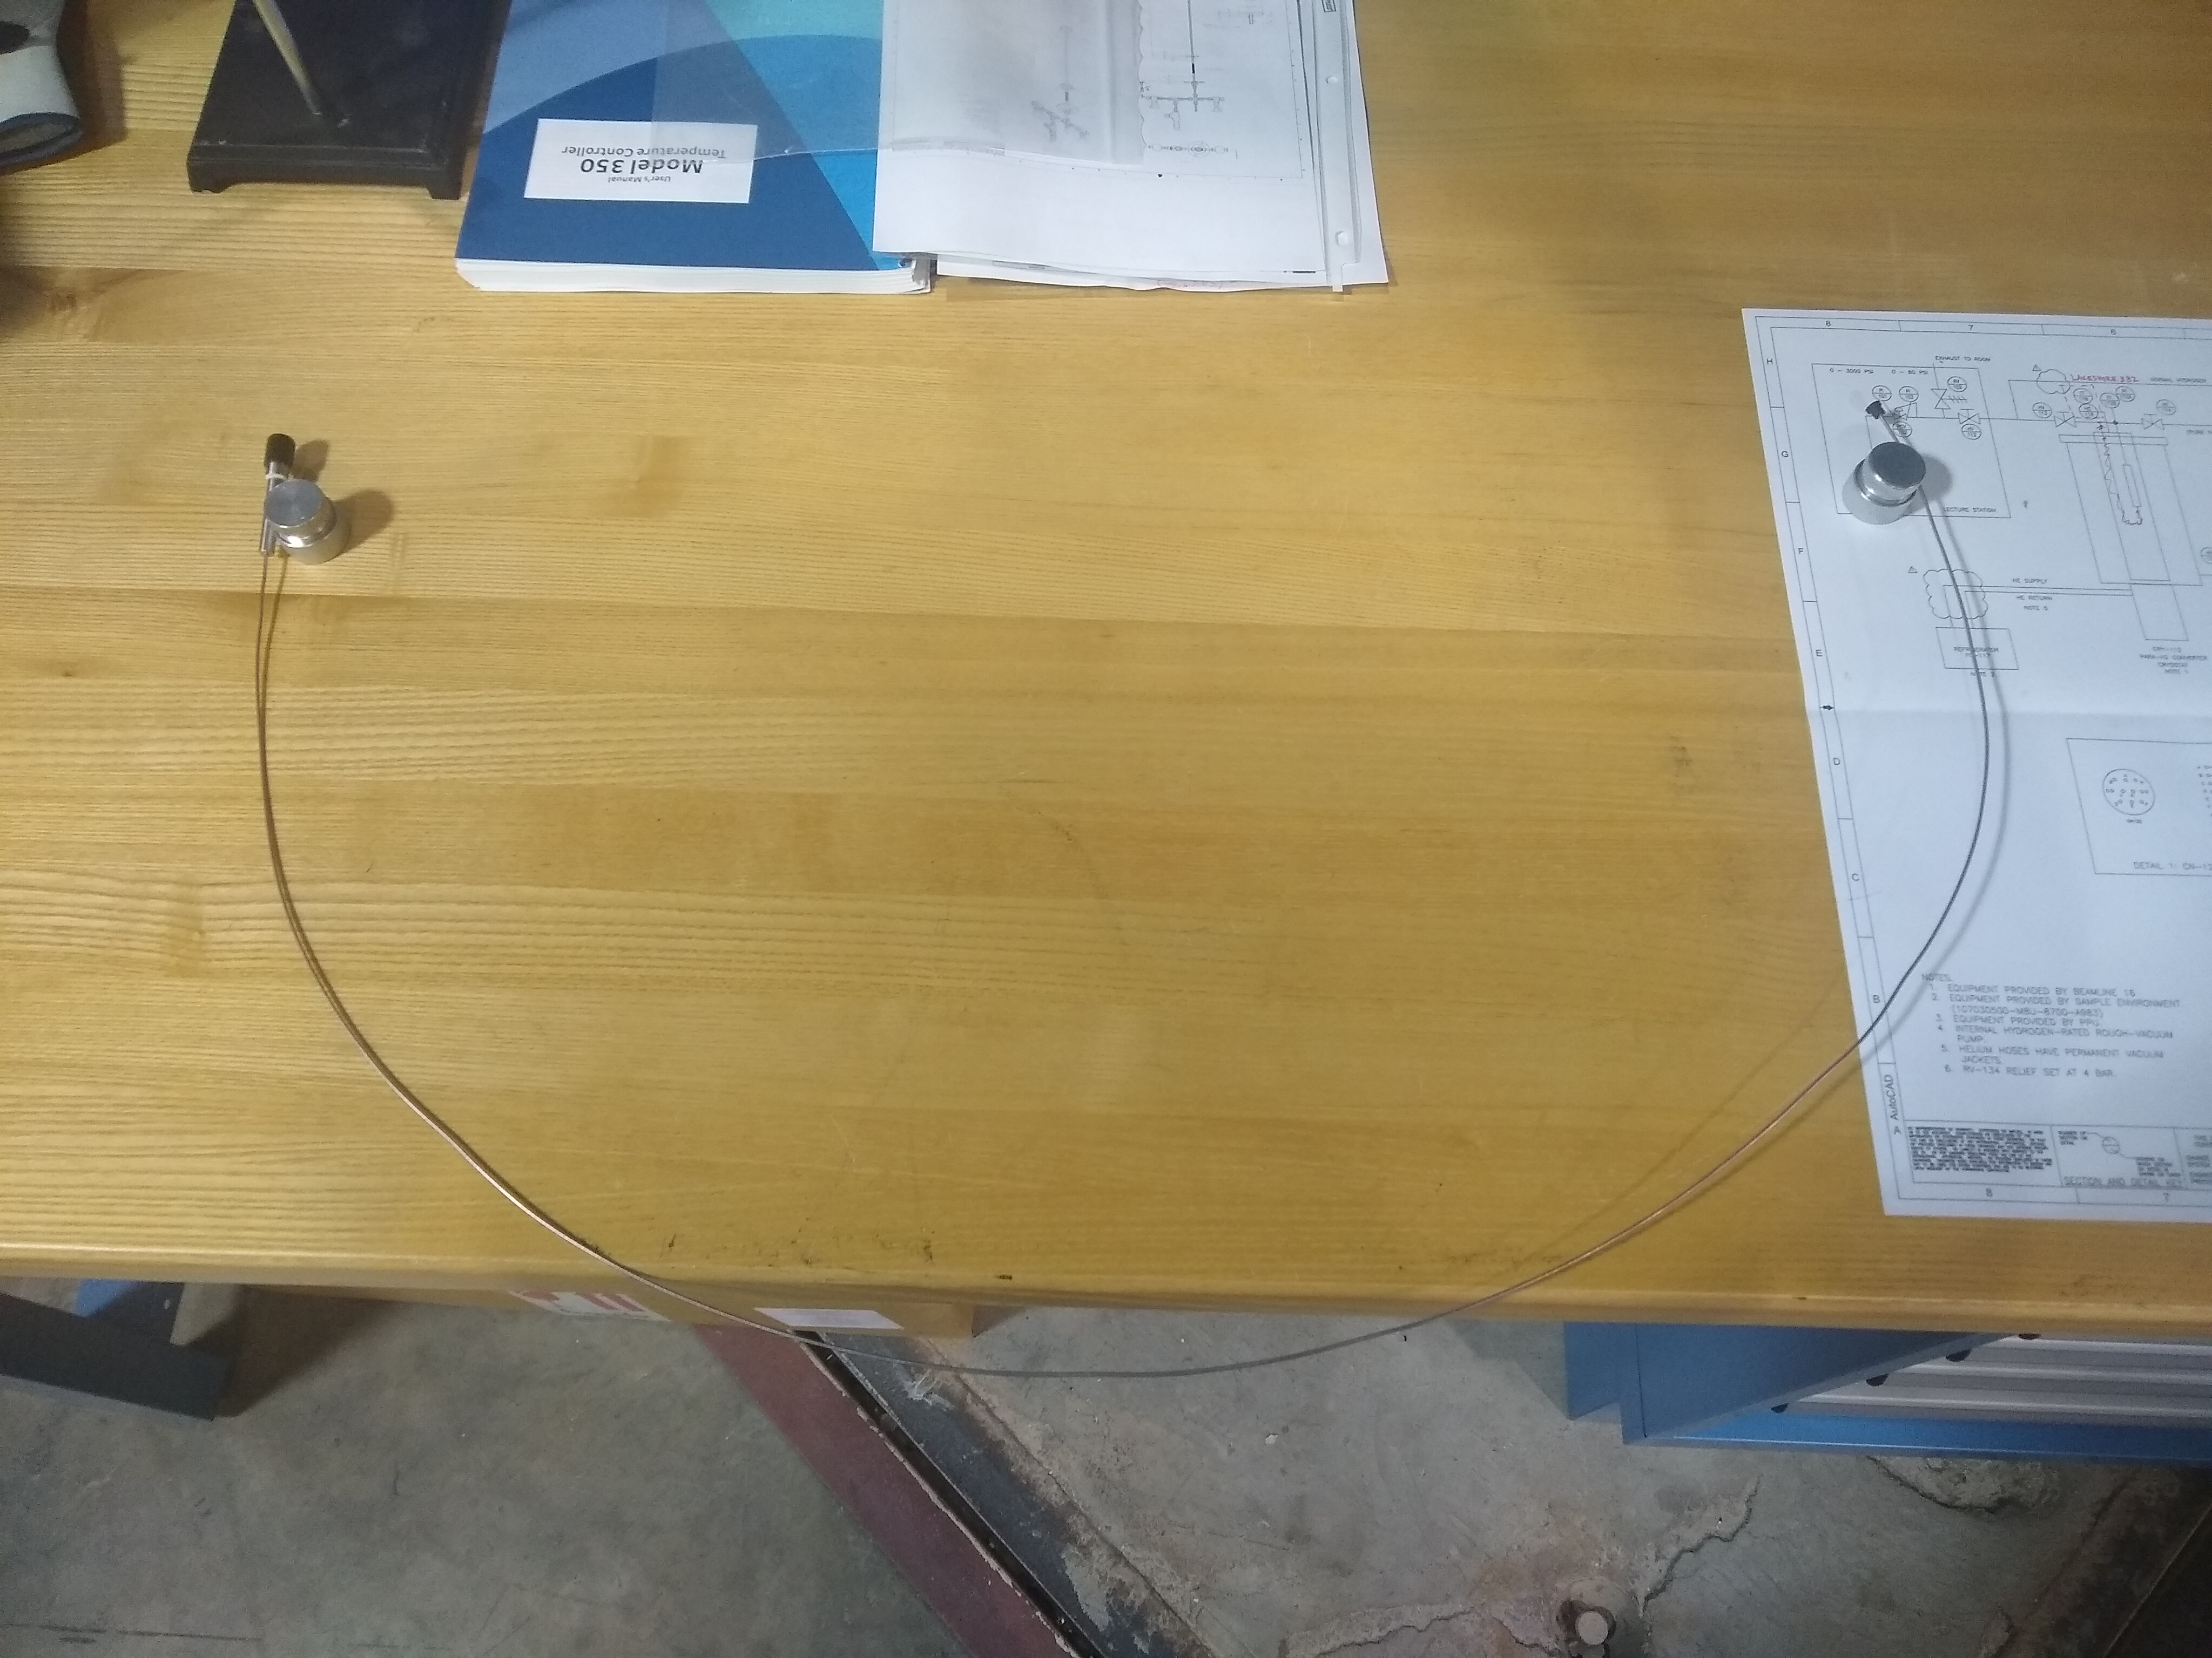
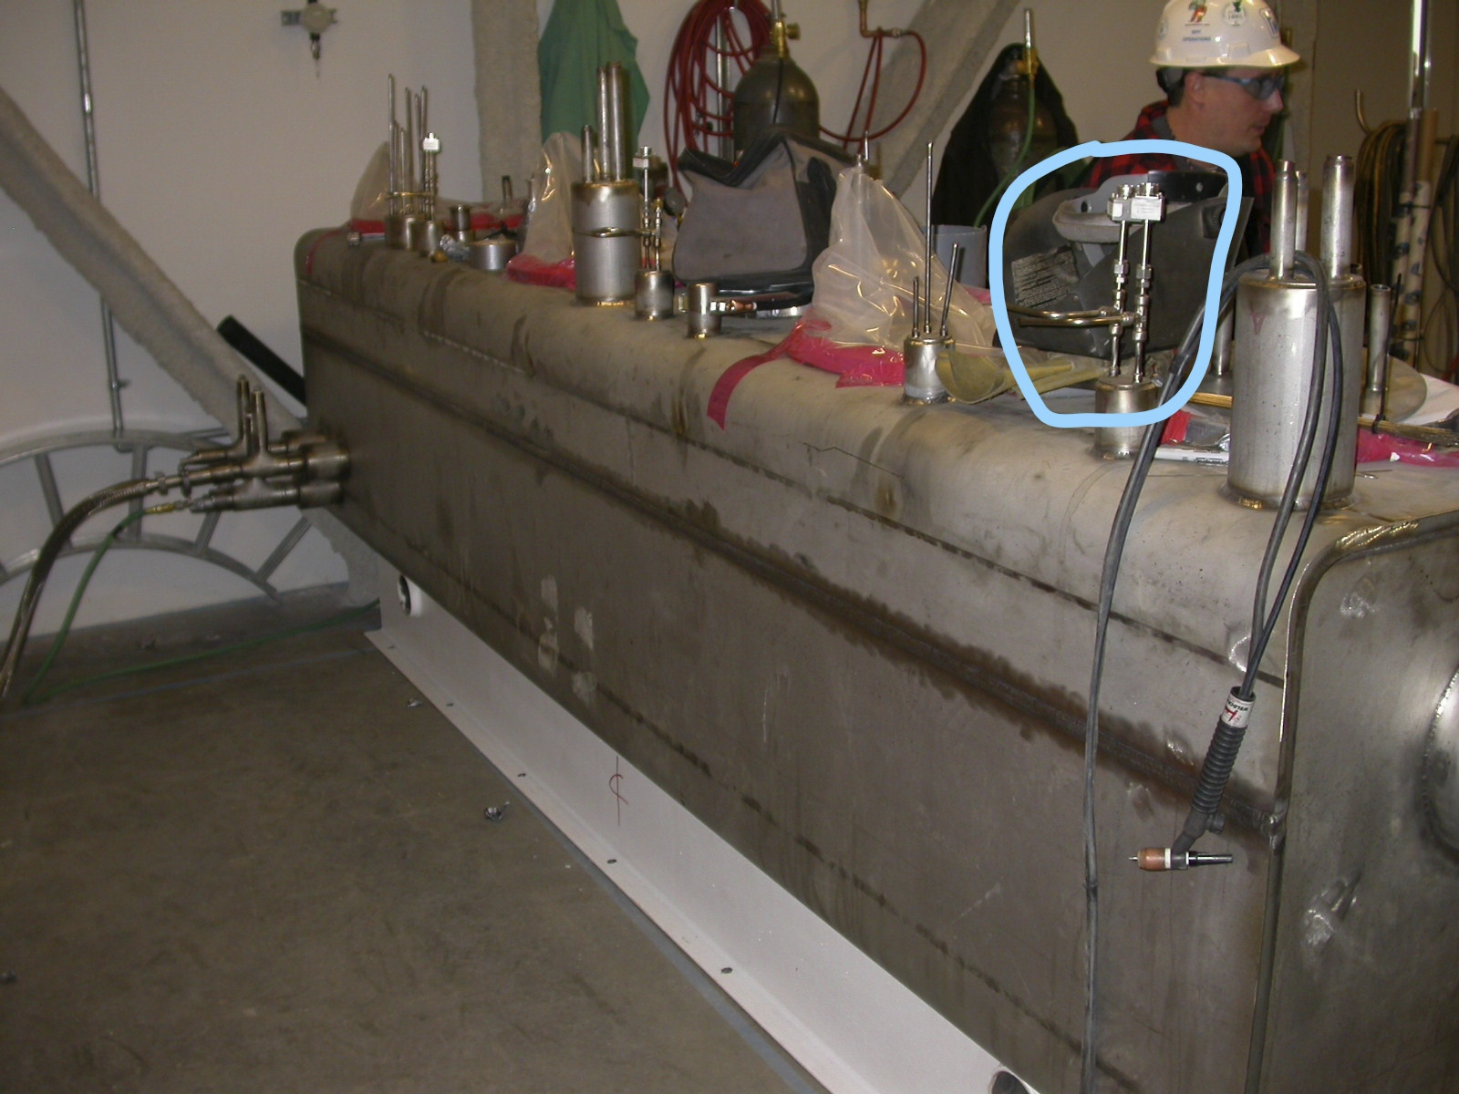
Probe Diagnostic
Commercial Probe, OTS Laser/Spectrometer
50” long, sapphire core, SS jacket, compression mounting
Raman head mounted to fiber
50 mW Laser and spectrometer connected to head
Fiber extends into liquid hydrogen volume replacing redundant thermocouple
`

Slide 6
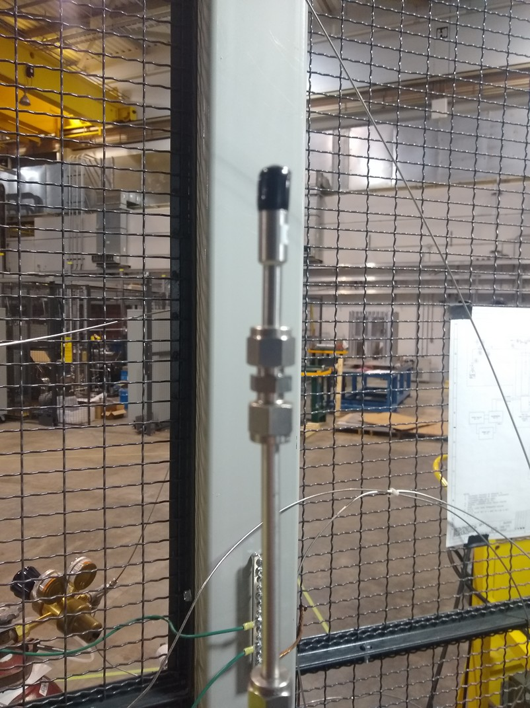
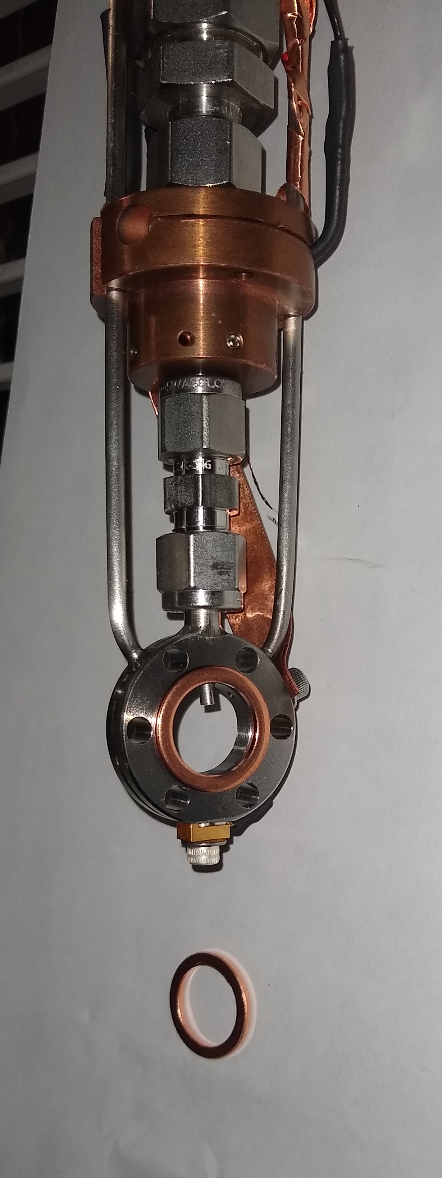
Probe Diagnostic
Testing in Bench-top Apparatus
Mounted at test stand
Fiber probe tip
Liquid hydrogen fill level
Probe tip protrudes into sample cell

Slide 7
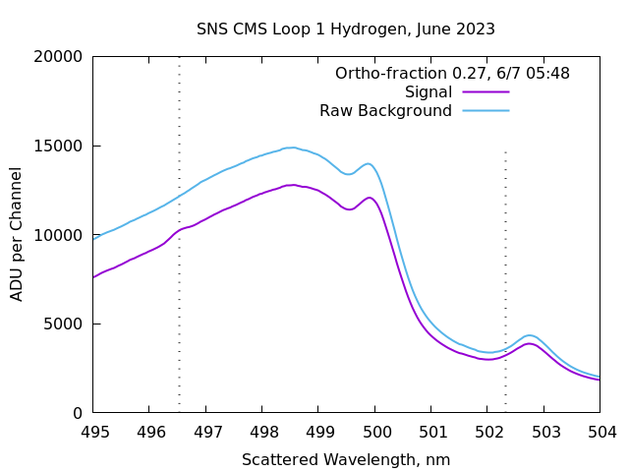
Probe Diagnostic
Spectra in Cold Moderator System
Orthohydrogen
Parahydrogen
Immersion probe tested on bench-top system was installed into existing CMS to test function and get a snapshot at orthohydrogen levels before installation of converter module.
First attempt was in November 2022; fiber broke on insertion and yielded no data
Second attempt in May 2023 successful
Background is high and varies over time

Slide 8
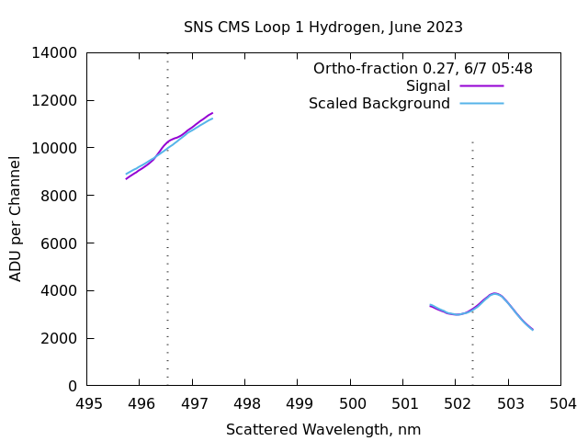
Probe Diagnostic
Spectra in Cold Moderator System – yes, it’s there….
Orthohydrogen
Parahydrogen
Careful treatment of data permits extraction of subtle signal
36 Hours of background measurements taken before hydrogen fill
Best match background is scaled and subtracted from signal to reveal two peaks – one arising from parahydrogen transitions (0-2 state); one from orthohydrogen transitions (1-3)
Peak area ratio gives ortho-para ratio

Slide 9
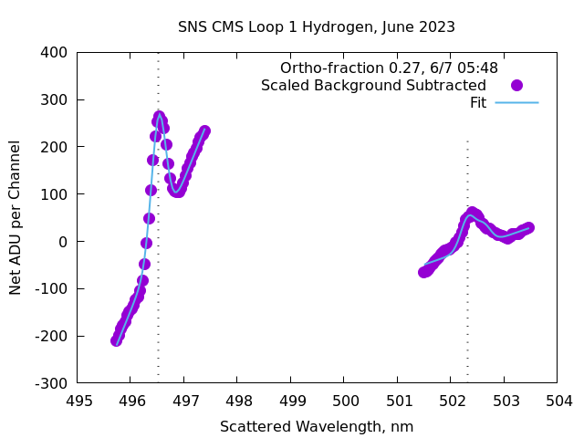
Probe Diagnostic
Spectra in Cold Moderator System – no, REALLY
Orthohydrogen
Parahydrogen
Careful treatment of data permits extraction of subtle signal
36 Hours of background measurements taken before hydrogen fill
Best match background is scaled and subtracted from signal to reveal two peaks – one arising from parahydrogen transitions (0-2 state); one from orthohydrogen transitions (1-3)
Peak area ratio gives ortho-para ratio

Slide 10
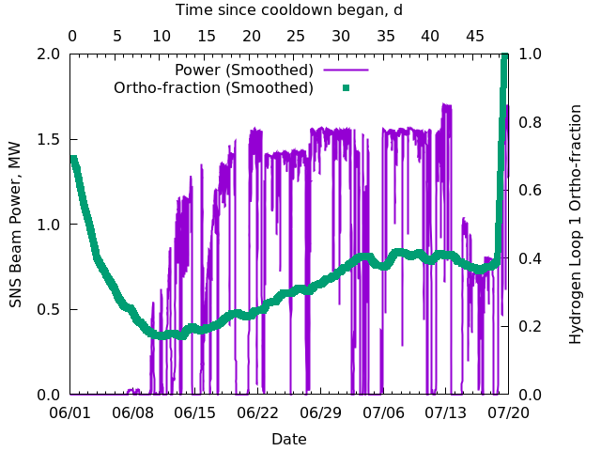
Probe Diagnostic
Operational Results in Cold Moderator System
10 one-second spectra are averaged for display
Every other spectra saved; 39 averaged together for analysis – one every 13 minutes
75% orthohydrogen hours after fill
27-30% after 5 days – consistent with natural relaxation
As soon as beam comes on, orthohydrogen levels climb
Steady state at 1.4-1.7 MW takes 4-5 weeks
Kinetics model confirmed, diagnostic works at >2-5%

Slide 11
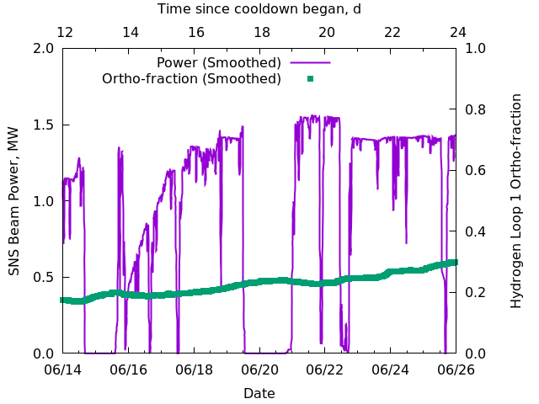
Probe Diagnostic
Operational Results from Power Transient
Orthohydrogen levels respond to beam off periods with lag
Early beam-off periods show continued increase in orthohydrogen levels for around one day before beginning to fall again
Later beam-off periods (once some sort of equilibrium has been achieved?) show faster drop
If we weren’t adding a catalyst, we should not fill so early

Slide 12
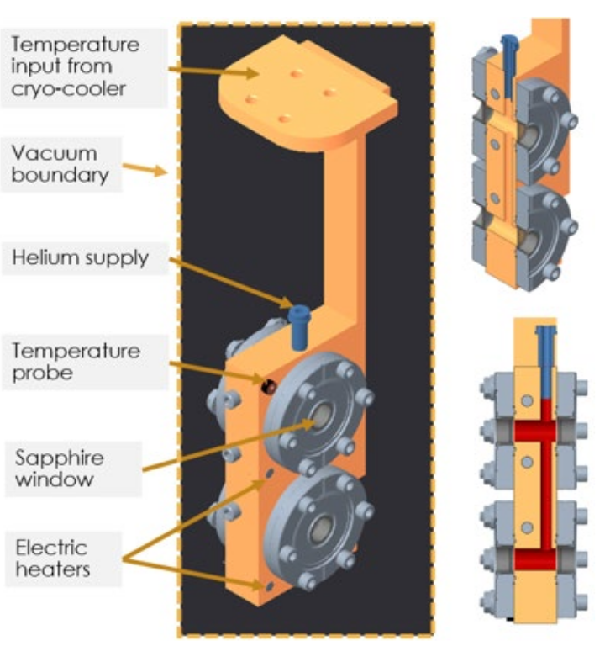
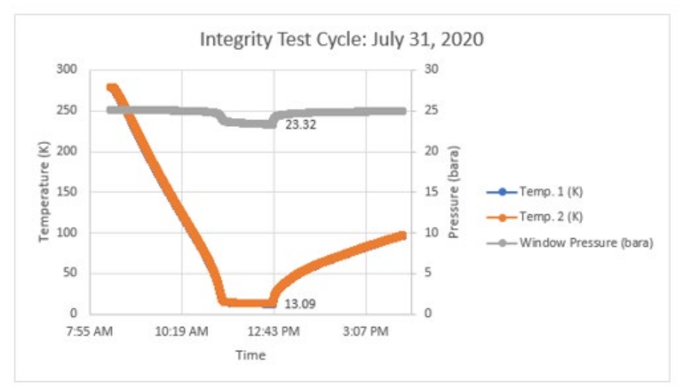
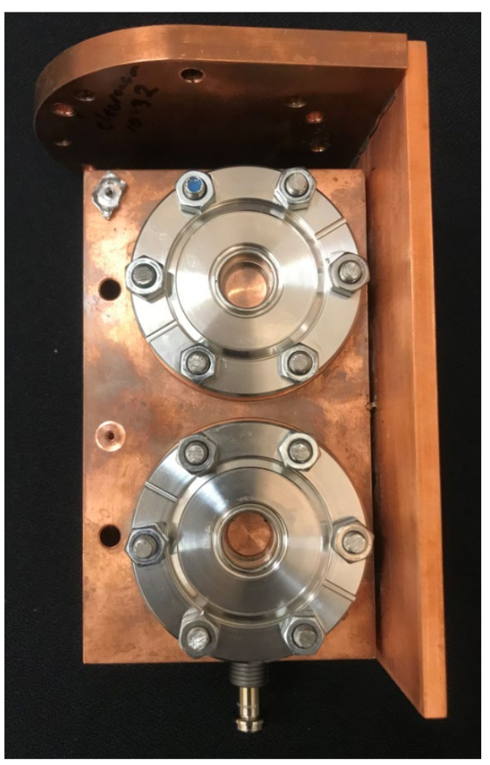
External Window Diagnostic
Window Requirements and Testing
Commercial sapphire windows are available – certified for temperature OR pressure, not both
Needed to verify that windows would not fail at operating condition even after multiple cycles
20 K, 19 bar relief / 14 bar operations, 3-4 cycles per year expected conditions
13 K, 24 bar, 30 cycles needed to demonstrate fitness, 1 day needed per cycle
Tests performed at ORNL’s Pellet Laboratory – success; no leaks after 30 cycles / 4 windows

Slide 13
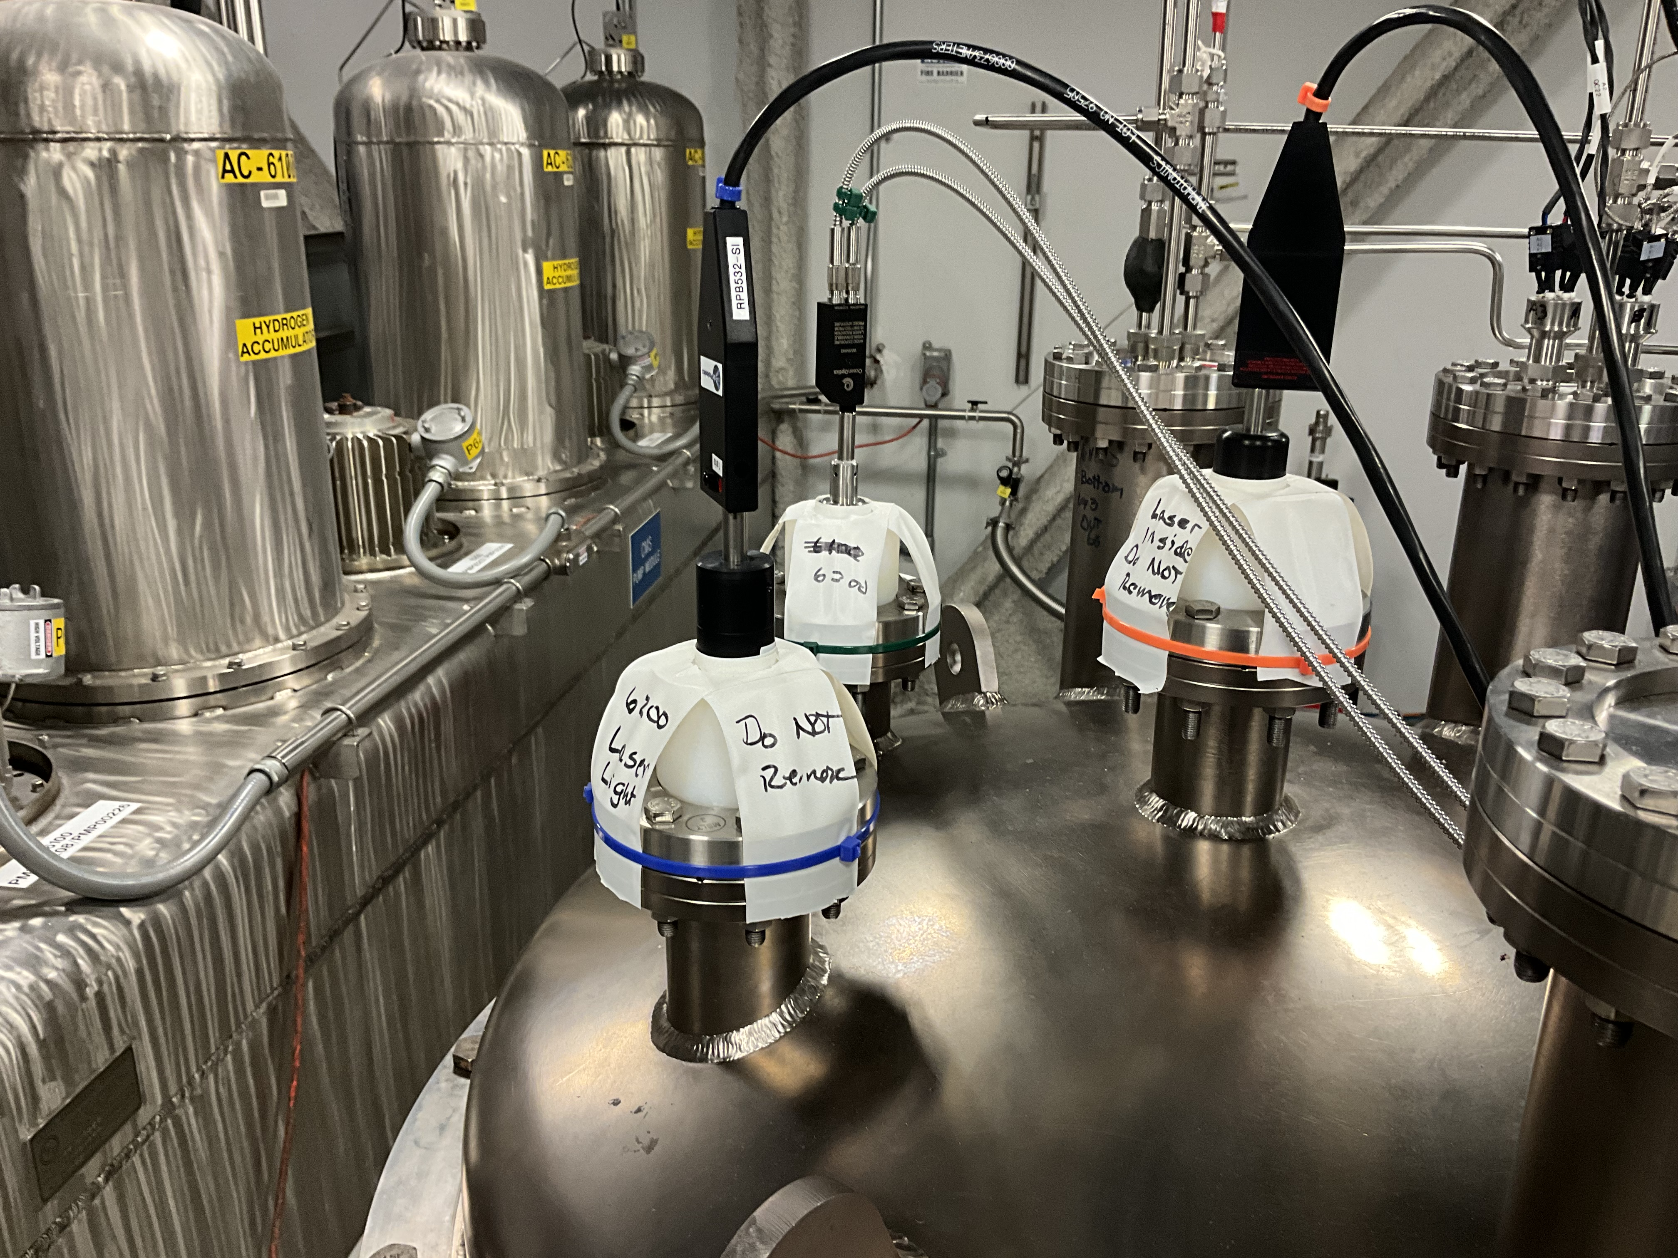
External Window Diagnostic
Raman System Installation
Windows are welded into 100 mm dead legs in the catalyst system, adjacent to external windows
Raman heads with 100 mm working distance probes look into the windows
Each Raman head is coupled to an optical spectrometer, all read by a single computer
Each Raman head is fed by an independent laser (100 mW at 532 nm)

Slide 14
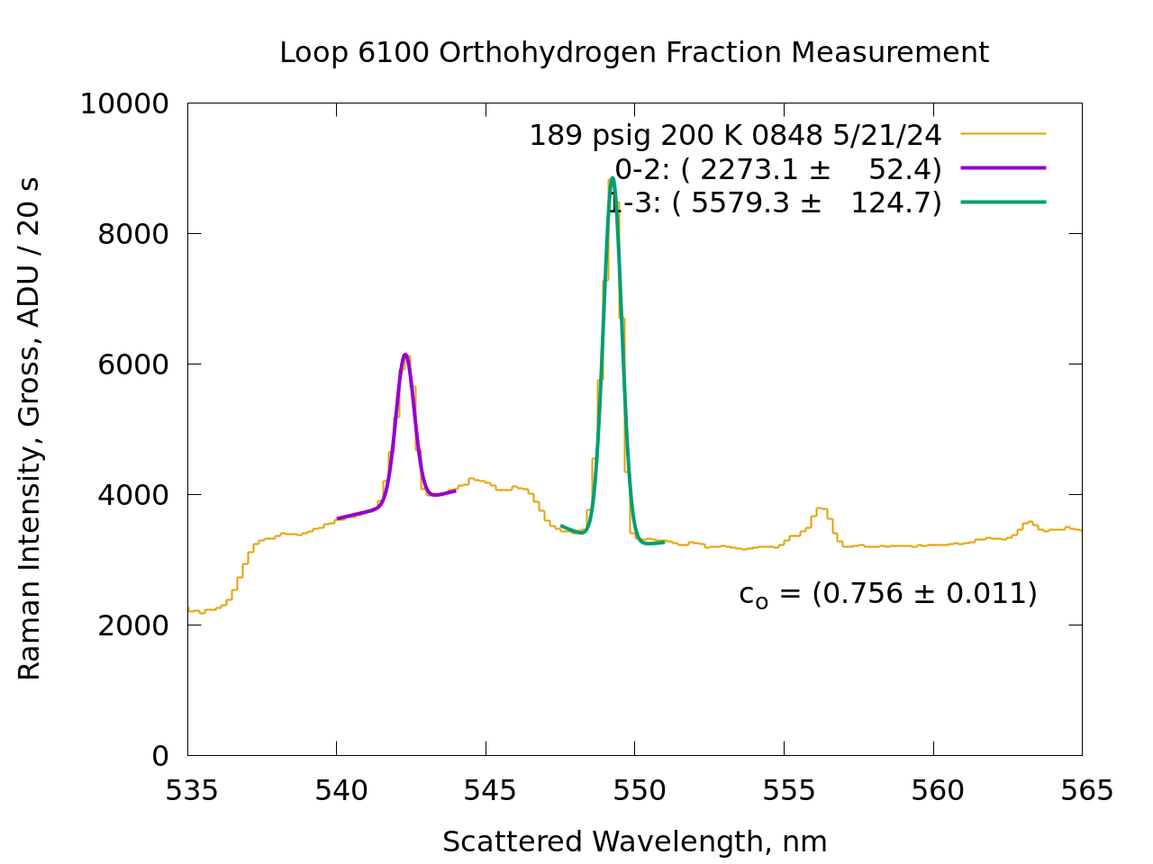
External Window Diagnostic
Room Temperature Spectrum
Recall that very first Raman spectra from the probe installation, where there was significant data processing to see, let alone quantify, the spectrum
When we replace 1200 mm of sapphire with 3 mm of sapphire, the background goes way down and the signal goes way up
Instead of 15 minutes worth of data collection, we need 20 seconds and the peaks are obvious
Plot shows raw spectra, without even dark current subtraction
300 K, 14 bar, < 30% of operating density

Slide 15
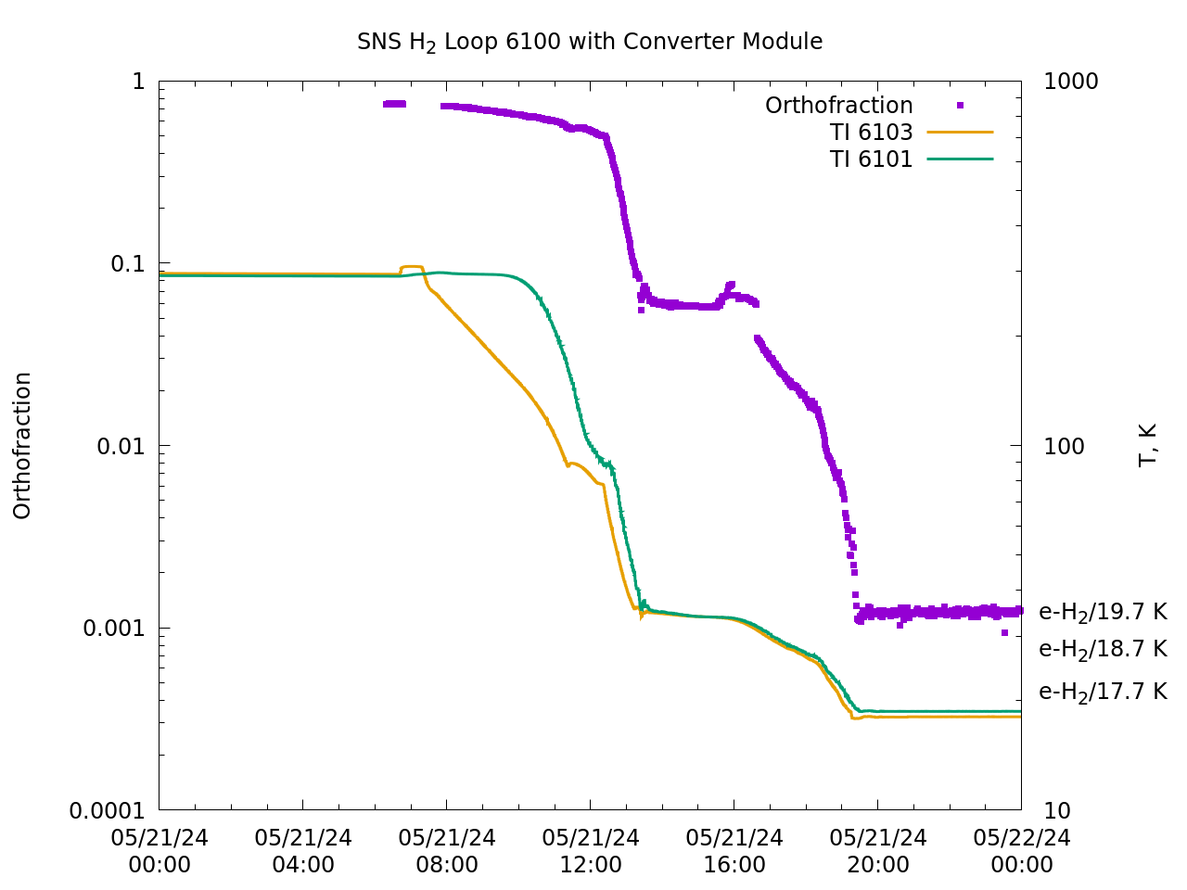
External Window Diagnostic
Calibrate at Room Temperature and Go
Standard filling procedure gives us sufficient time at room temperature to calibrate conversion factor for ratio of relevant peaks to orthofraction
First try, everything “just worked”
Loop 1, Top Upstream Decoupled Hydrogen
Diagnostic indicates that orthofraction falls to equilibrium values corresponding to a temperature within 1 K of thermocouple readout, which is better than we can really trust such a thermocouple
Diagnostic indicates that orthofraction follows temperature within seconds, not months, suggesting that catalyst works well

Slide 16
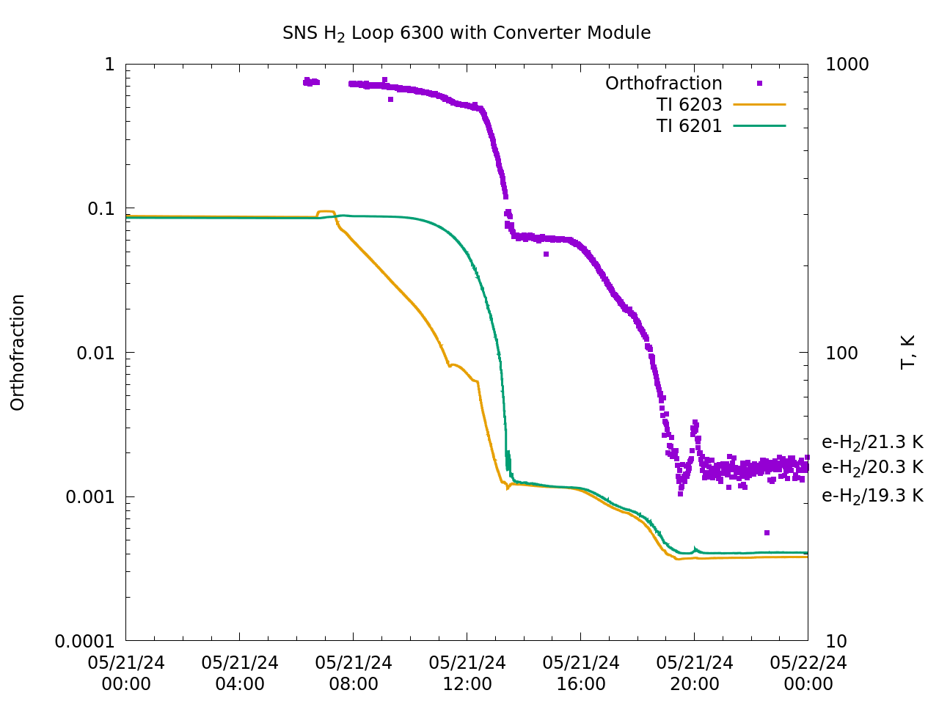
External Window Diagnostic
Comparable Results for Different Loop
Loop 3 (bottom downstream coupled moderator) goes to a slightly different temperature
  Diagnostic sees that
Small temperature hiccup after equilibration
  Diagnostic sees that
Still has a negligible response time
Spectra are recorded here for 1 second, limited by SIGNAL, not background
30 spectra averaged for general periods
5 spectra averaged for closer looks

Slide 17
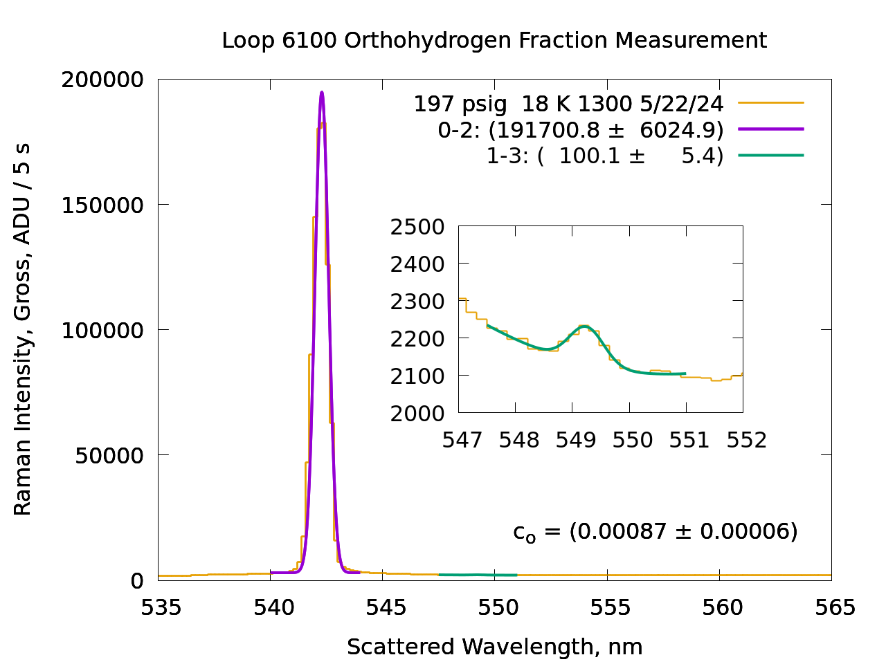
External Window Diagnostic
Challenging Dynamic Range
At room temperature, when the ortho:para ratio is 3:1, peaks are relatively comparable
At operating temperature, para peak is dominant (~2000x) limiting collection time
Ortho peak is still sufficient to see small changes in temperature
May try filtering para peak to improve sensitivity even further, but may not be needed

Slide 18
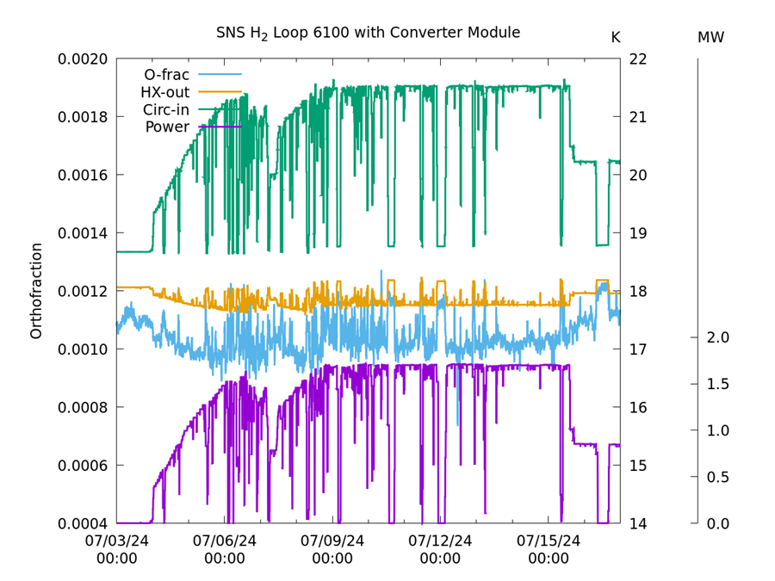
External Window Diagnostic
Challenging Dynamic Range
Minimal response of orthofraction to power transients
Temperature at HX output temperature is adjusted by heater (on the helium side) to offset power changes
Power goes off, HX output temperature goes up by 0.2 degrees, orthofraction goes from 0.0011 to 0.0012
Over 12+ days, going from no power to 1.6 MW, the orthofraction never changed outside of 0.0009 – 0.0012 (the catalyst works just fine), and we can reliably see differences of 0.0001 (the diagnostic works just fine)

Slide 19
Summary
The “through the window” Raman probe works as designed – it can measure the orthohydrogen fraction in a working liquid hydrogen system every few seconds, with straightforward calibration, down to 0.001, with precision of around 0.0001.
The immersion probe system does work – it can measure the orthohydrogen fraction down to some 0.01 to 0.02, which just isn’t good enough for our particular application
The catalyst system deployed is more than sufficient to handle backconversion, and to reduce transient times to seconds
The irradiated hydrogen kinetics model first presented at the Neuss ICANS is largely correct
Resulting SNS hydrogen moderators are reliably stable, and in some ways feature improved absolute performance as well
The orthohydrogen question has been a long-term effort from many different colleagues at many different facilities, and has been the subject of at least 30 ICANS papers since 2000.

Slide 20
Acknowledgments and Thanks
Monika Hartl
Yujiro Ikeda
John Jarmer
Takashi Kamiyama
Yoshiaki Kiyanagi
Guenter Muhrer
Hirotatsu Ogawa
Motoki Ooi
Eric Pitcher
Bernie Reimer
Mike Rowe
Gary Russell
Hiroshi Takada
Hideki Tatsumoto
Makoto Teshigawara
Noboru Watanabe
Dave Baxter
Tim Broome
Torben Brun
Jack Carpenter
Luke Daemen
Brian DeGraff
John Denison
Phil Ferguson
David Freeman
Masatoshi Futukawa
Franz Gallmeier
Masahide Harada

