Slide 1
Development status of the ESS cryogenic moderator system
European Spallation Source (ESS) ERIC, Lund, Sweden
Presented by Theodoros Vasilopoulos

Slide 2
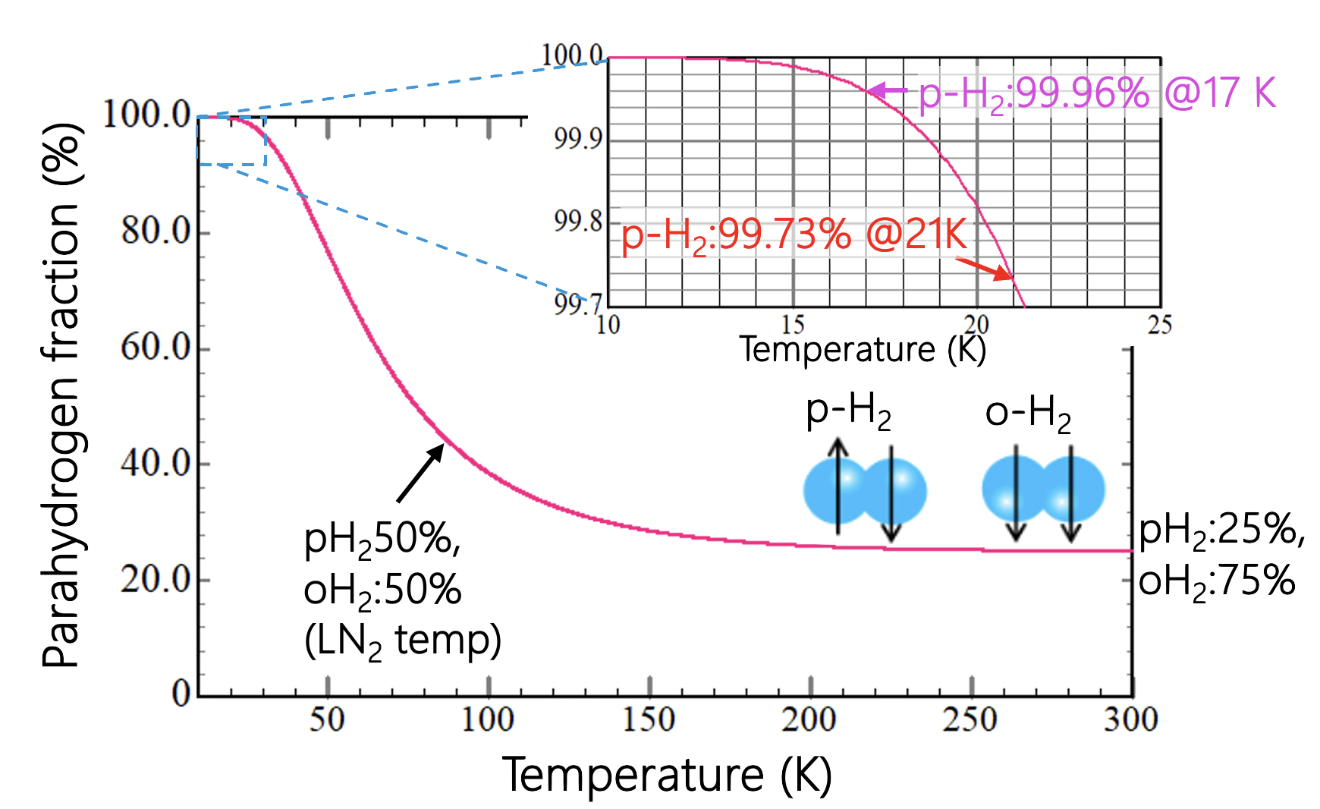
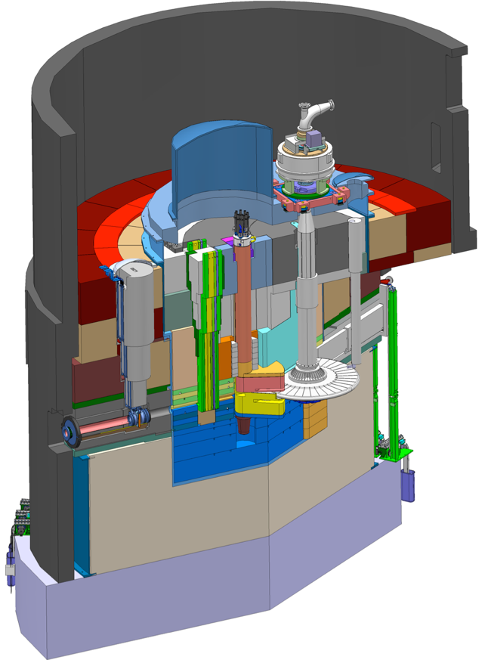
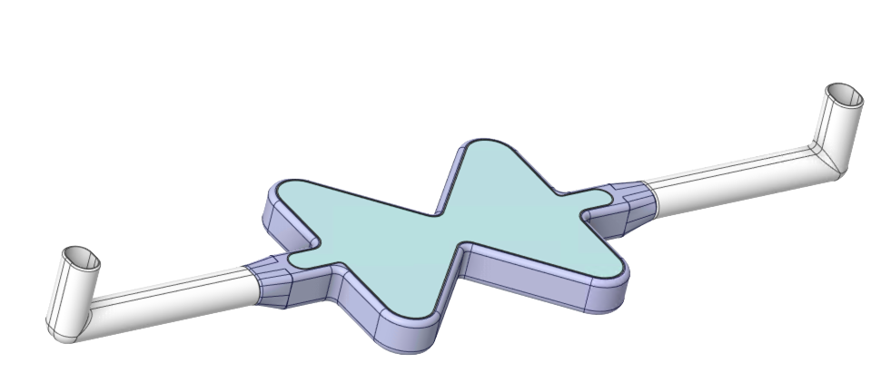
Introduction
ESS hydrogen moderator requirements
ESS European Spallation Source
5 MW beam (2.0 GeV proton, 62.5 mA) at 14 Hz (a pulse length of 2.86 ms.)
- Parahydrogen fraction of more than 99.5%.
- Average temperature rise at each moderator < 3 K.
Two hydrogen moderators
Monolith vessel
Moderator-reflector plug
Q=6.7 kW
Proton beam
Target
17.2 kW
Q=4.0 kW
(3 MW)
Q=10.5 kW
Target wheel
(Tungsten)
5 MW Proton beam
Cryogenic Moderator System (CMS)
- 18 K and 11 bar (Subcooled liquid hydrogen).
- Flow rate to each moderator >250 g/s
- Ortho/para hydrogen convertor (catalyst)
2026-04-15
2

Slide 3
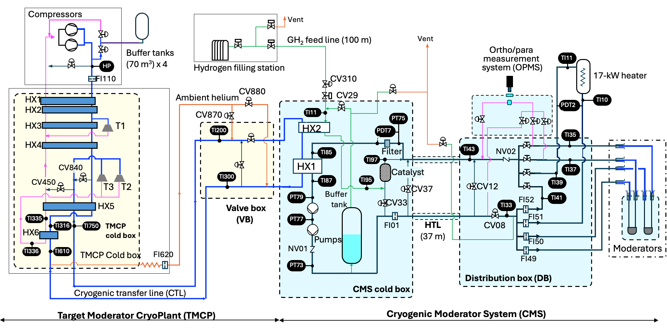
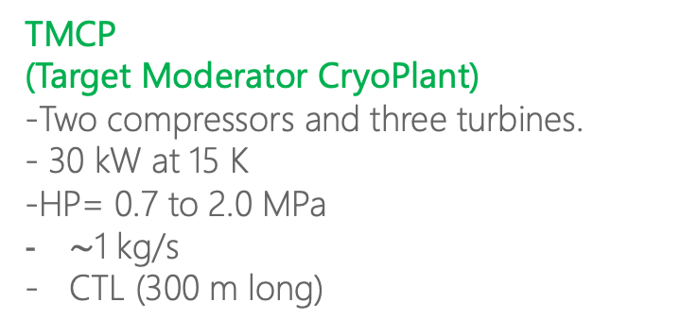
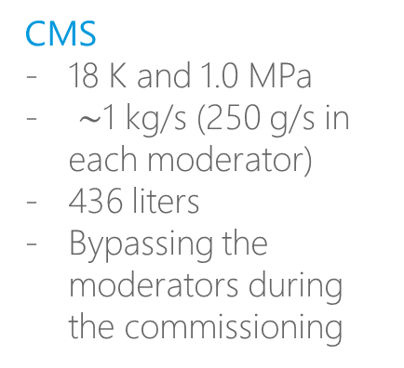
ESS Cryogenic Moderator System (CMS)
TMCP
(Target Moderator CryoPlant)
-Two compressors and three turbines.
- 30 kW at 15 K
-HP= 0.7 to 2.0 MPa
$\sim$1 kg/s
CTL (300 m long)
Accelerator building
Target building
CMS
18 K and 1.0 MPa
$\sim$1 kg/s (250 g/s in each moderator)
436 liters
Bypassing the moderators during the commissioning

Slide 4
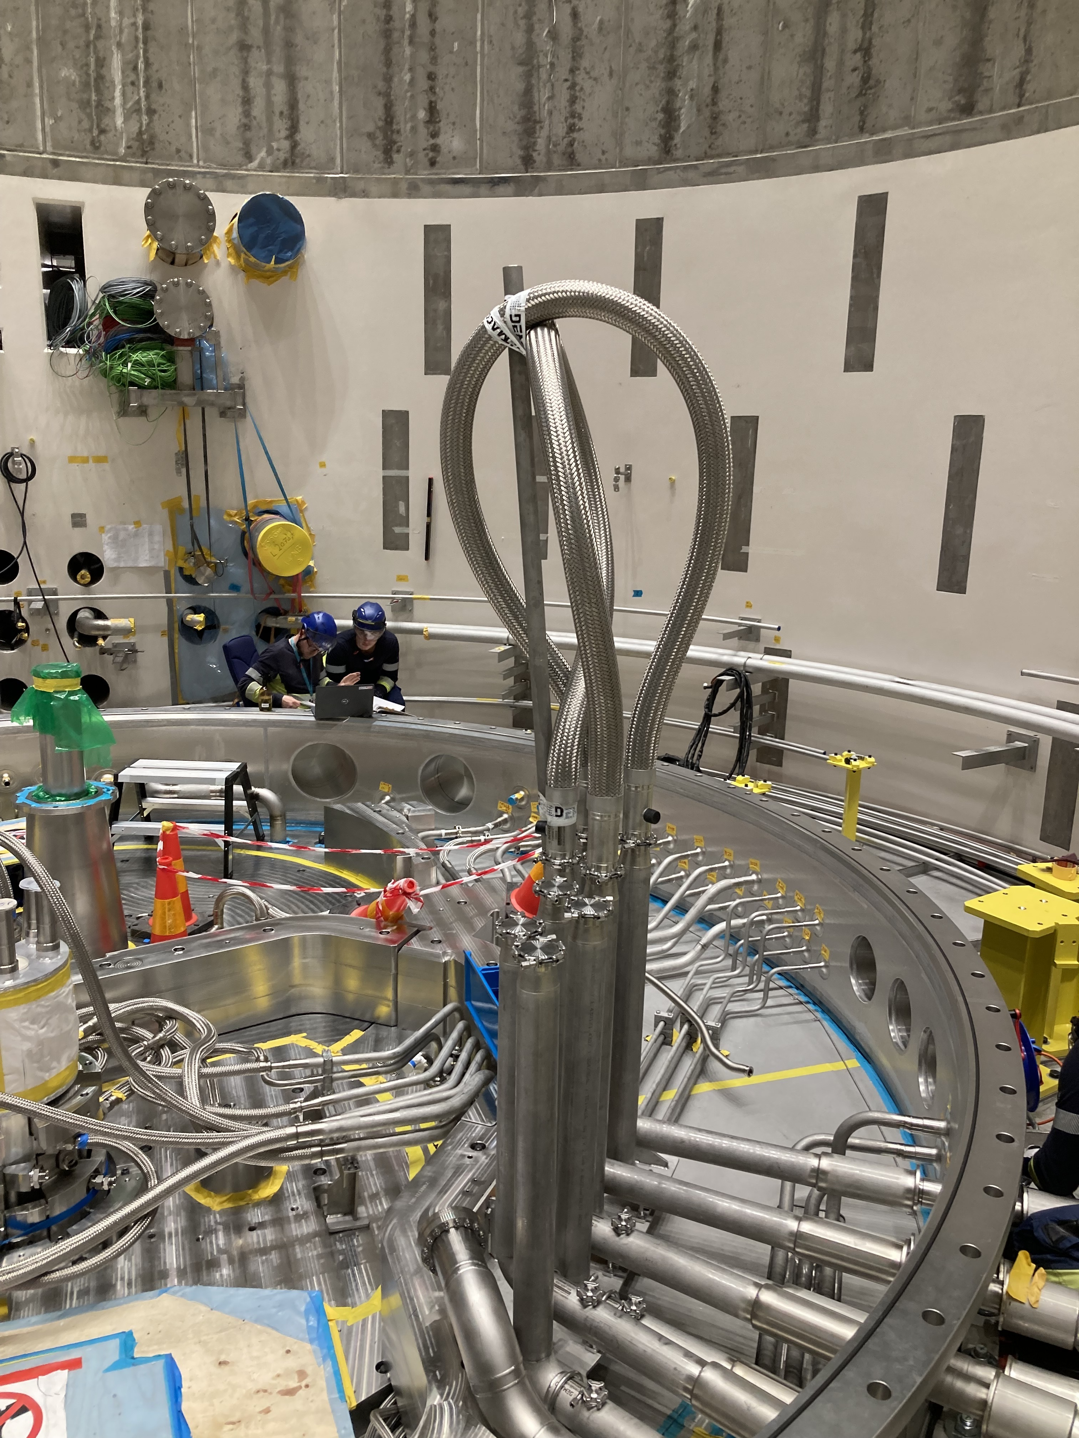
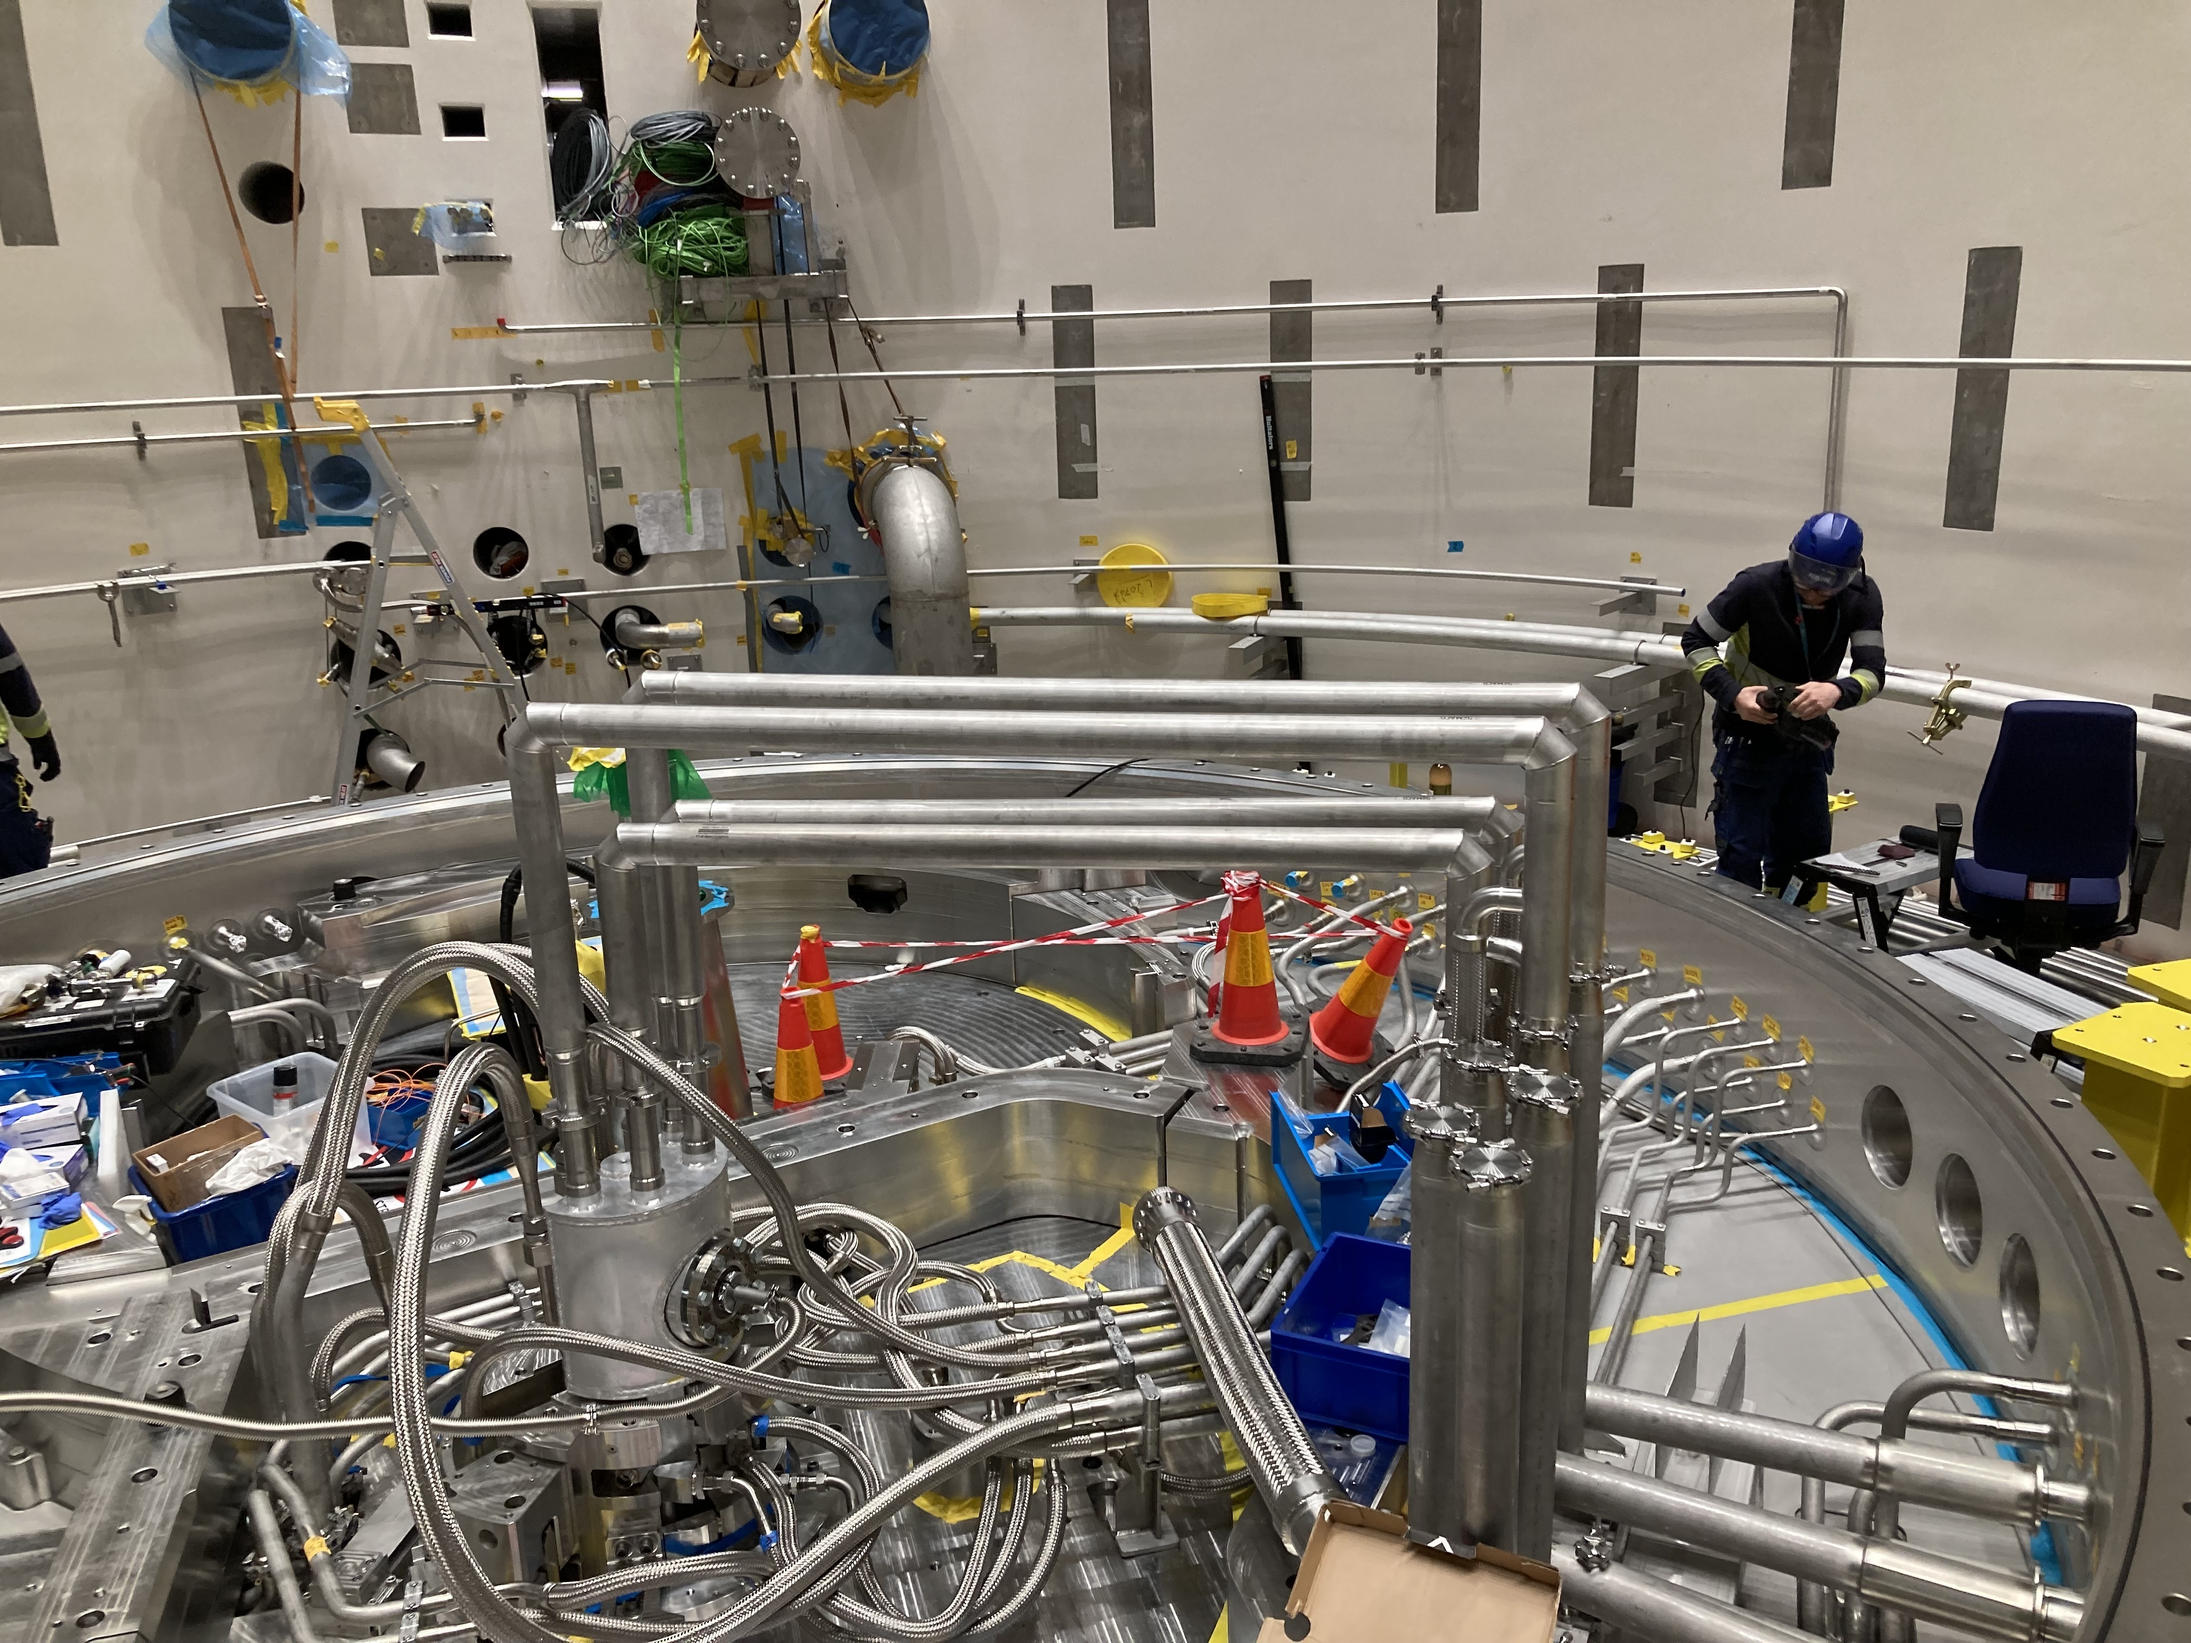
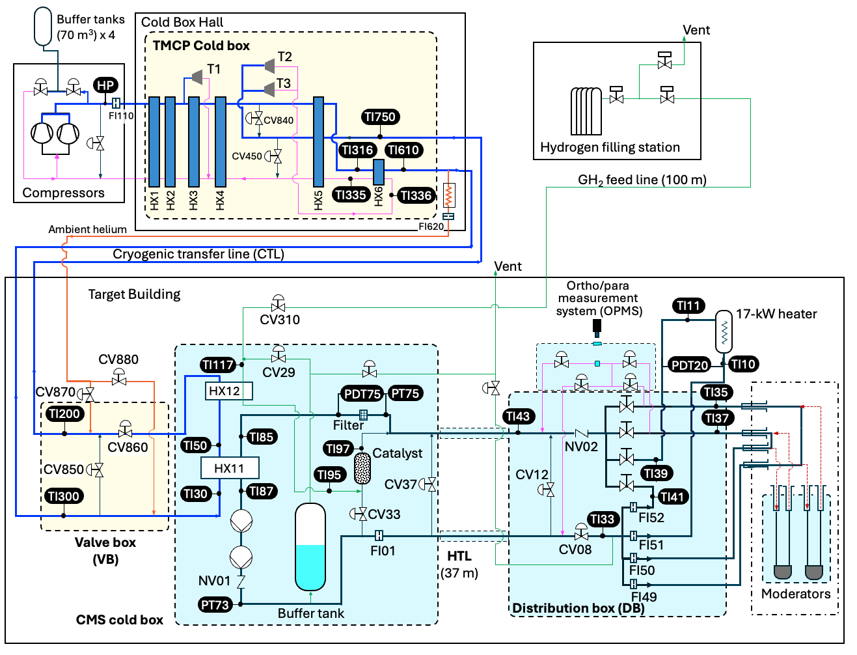
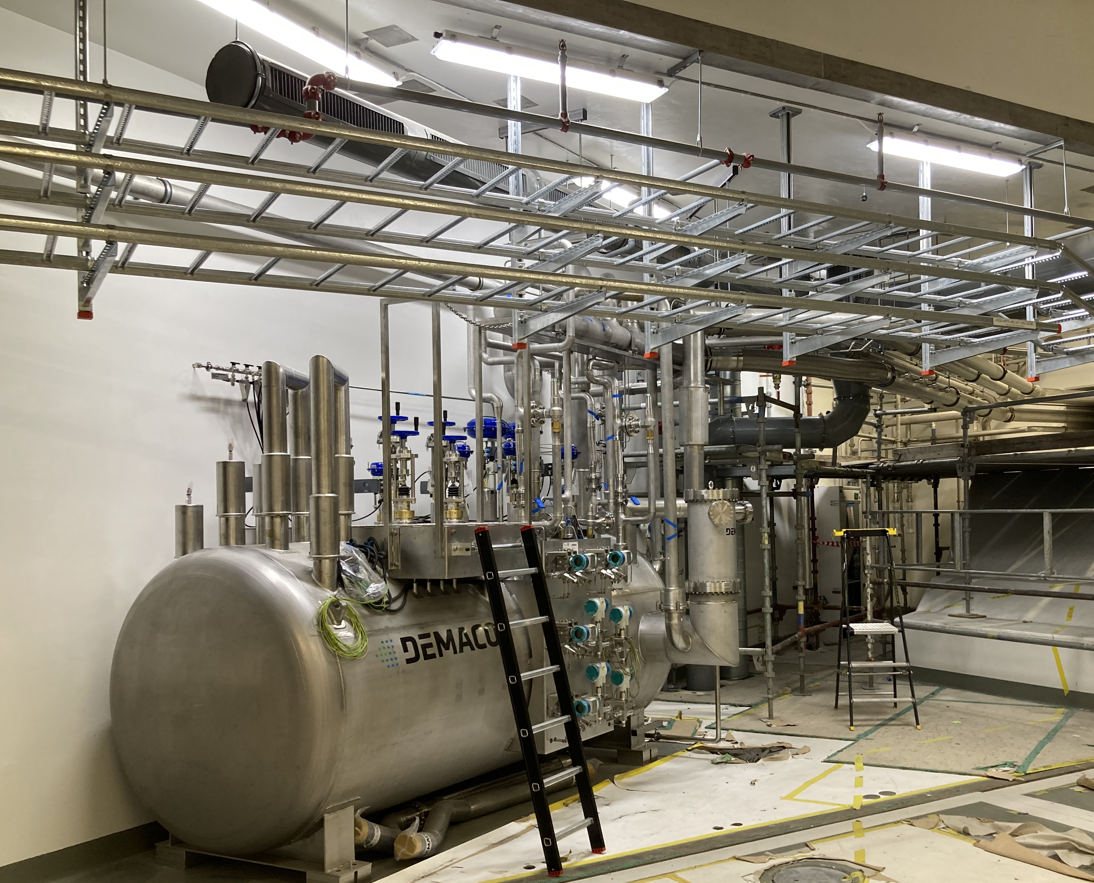
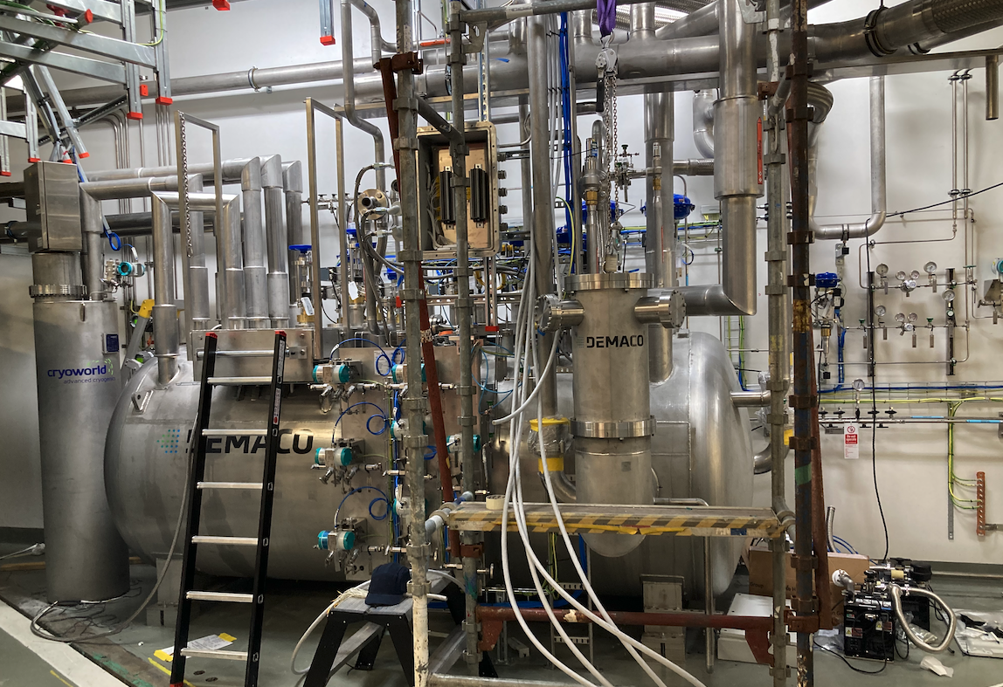
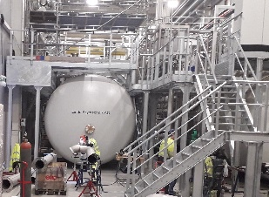
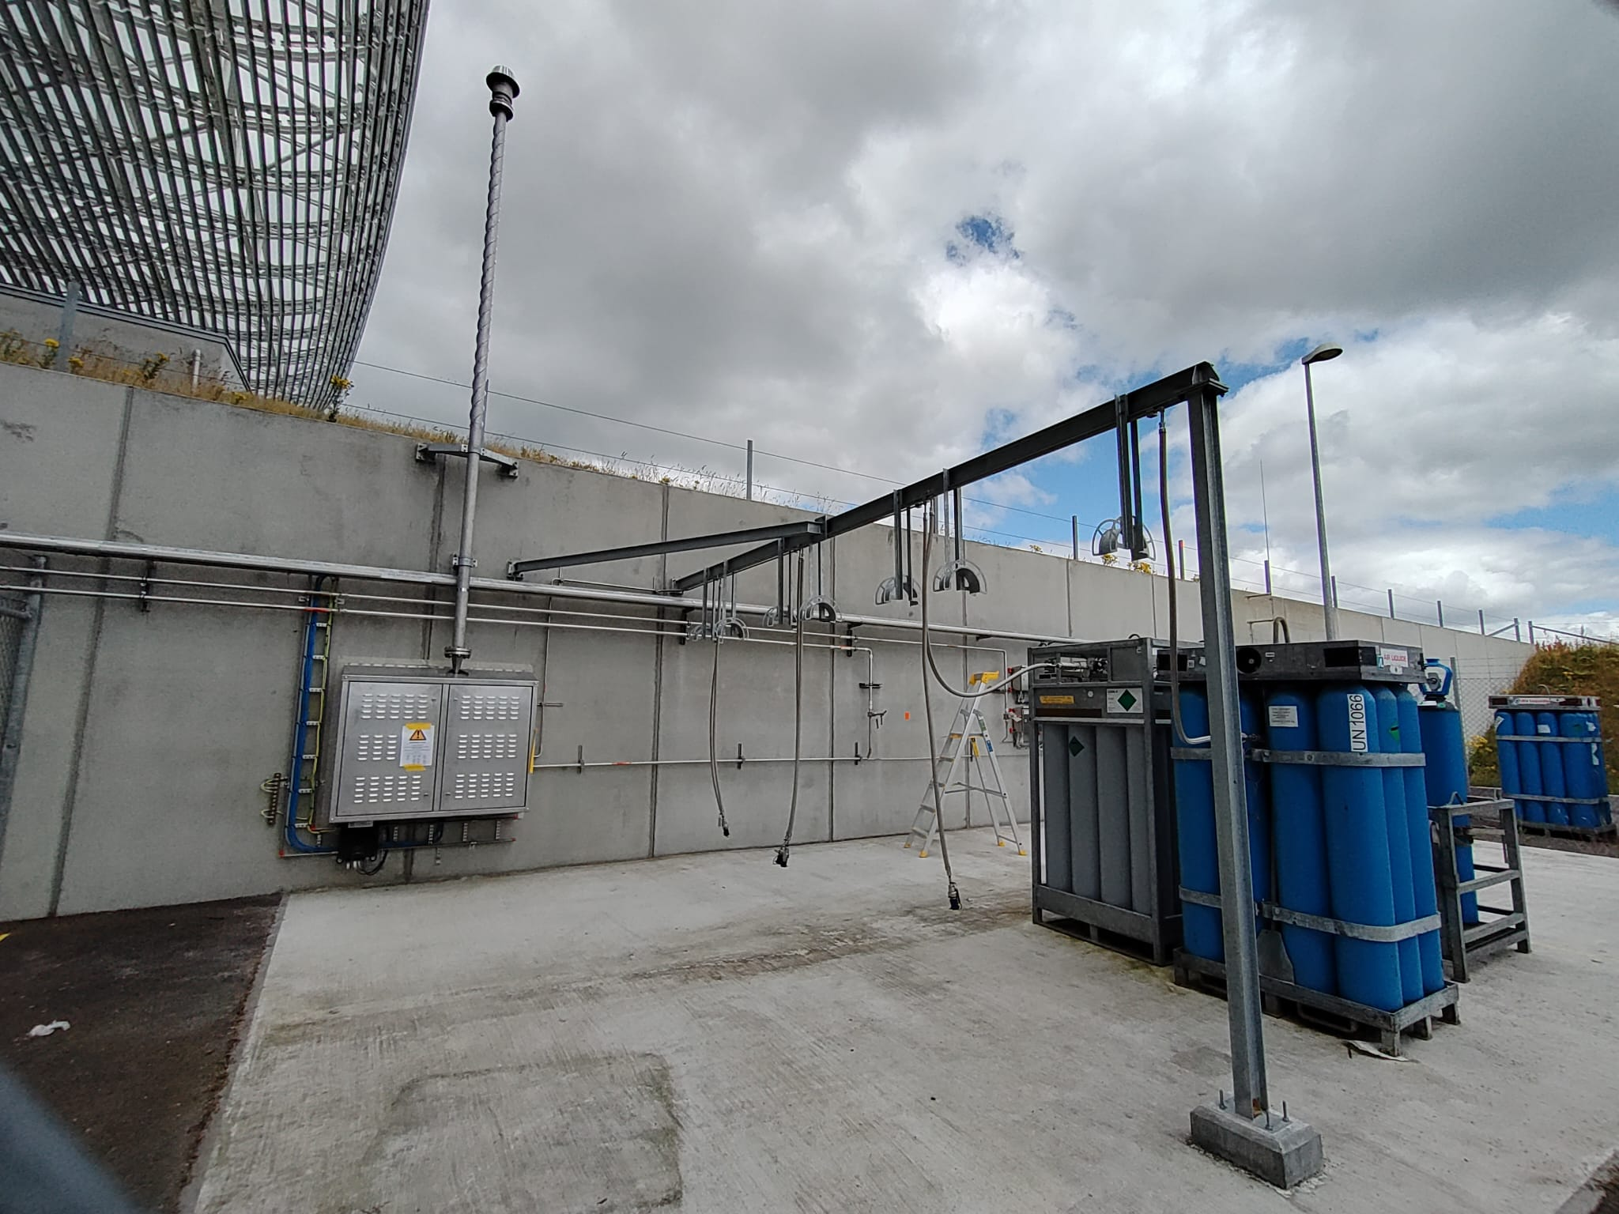
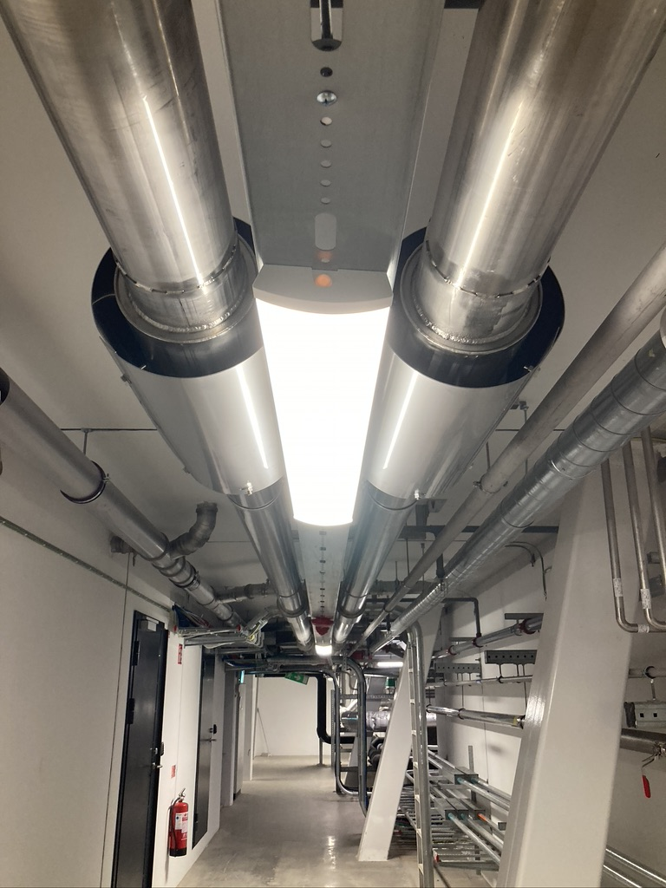
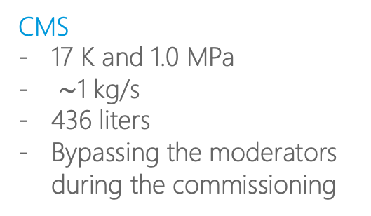
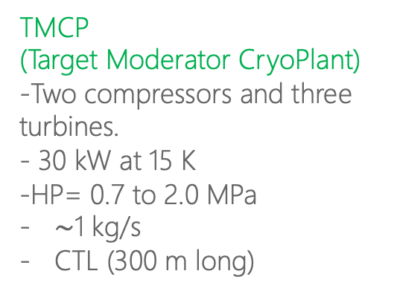
ESS Cryogenic Moderator System (CMS)
Nov., 2021
Bypass lines
TMCP
(Target Moderator CryoPlant)
-Two compressors and three turbines.
- 30 kW at 15 K
-HP= 0.7 to 2.0 MPa
$\sim$1 kg/s
CTL (300 m long)
Jan. 2024
Filling station
CMS DB
Moderator
Vacuum vessel
H2 transfer lines
2019
CMS
17 K and 1.0 MPa
$\sim$1 kg/s
436 liters
Bypassing the moderators during the commissioning
TMCP
valve box
CMS CBX
Feb. 2024
Feb. 2024
2023
2019
Hydrogen filling station
300m CTL
May. 2024
2022

Slide 5
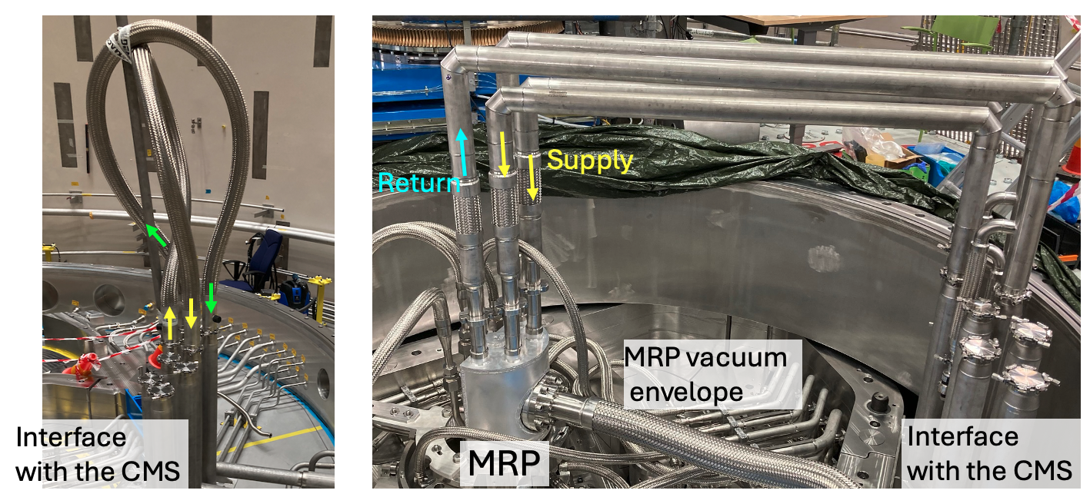
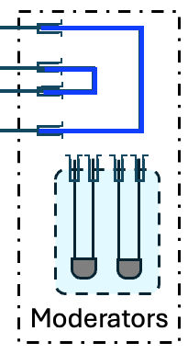
CMS commissioning
Hydrogen operation started since March 2025
TMCP commissioning (without connecting the CMS) completed in December 2022.
CMS installation completed except for OPMS and the heater in January 2024.
- Due to delay of filling station and electrical cabinets.
Phase 1
Jan
Feb
Mar
Apr
May
Jun
Jul
Aug
Sep
Oct
Nov
Dec
Phase 1 (58 days)
Phase 1 (21 days)
Phase 1
(11 days)
2024
Heater and OPMS installed.
ESS water
system trip
Phase 2
2025
Phase 1 (20 days)
Phase 2 (7 days)
Phase 2 (11 days)
Phase 1 (12 days)
Moderators
connected
Phase 2 (25 days)
ESS water system trip due to power glitch
Vacuum pump
failure
2026
Phase 1 (38 days)
Moderator issue
Helium operation
Hydrogen operation
Installation work

Slide 6
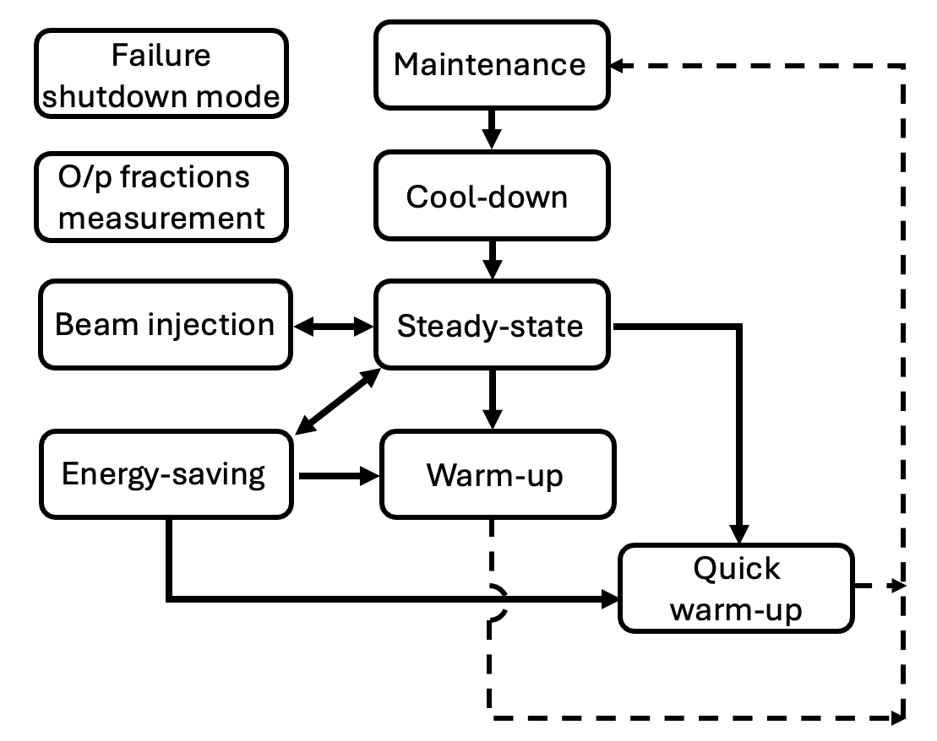
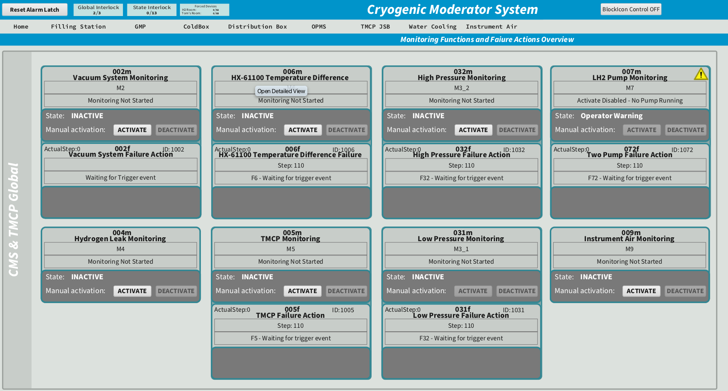
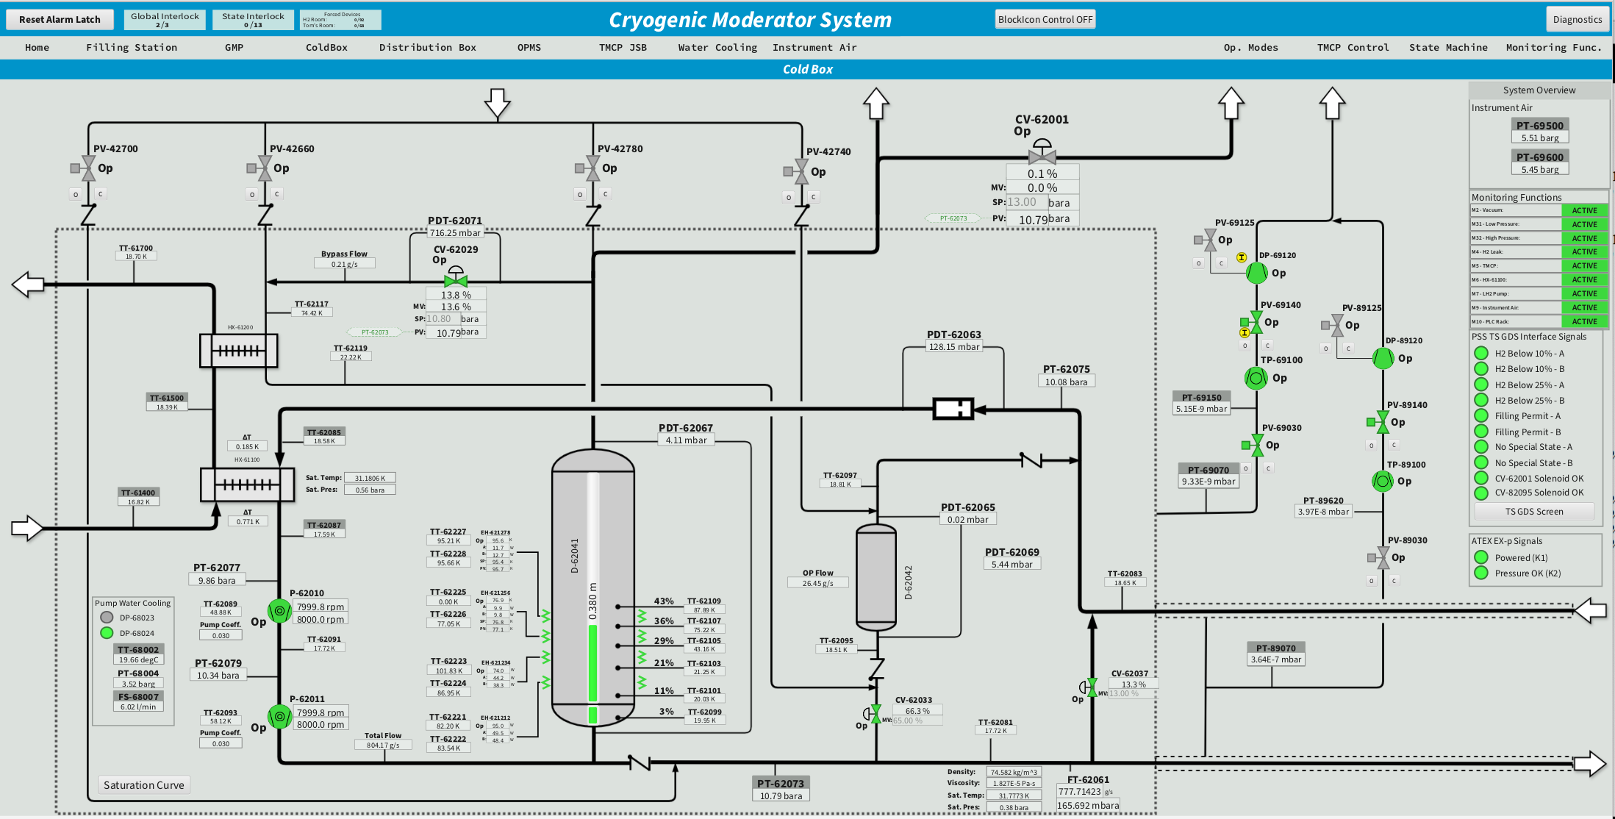
Automated CMS operation scheme
Under development

Slide 7
Pressure fluctuation mitigation and thermal compensation
Why do the CMS consider them?
At SNS: 18 K and1.5 MPa (supercritical pressure)
Heater
HX
Moderator
18 K
He refrigerator
HX
18 K
Proton beam on
Flow control
Pressure rise
due to density increases
(expansion)
+2.5 K
Bellows
(Accumulator)
At J-PARC: 18 K and1.5 MPa (supercritical pressure)
HX
Moderator
Always 21.0 K
Heater
18 K
No impact on He refrigerator
Accumulator
HX
If the heat load cannot be removed via HX,
the rise in supply temperature leads to an additional increase in pressure.
18 K

Slide 8
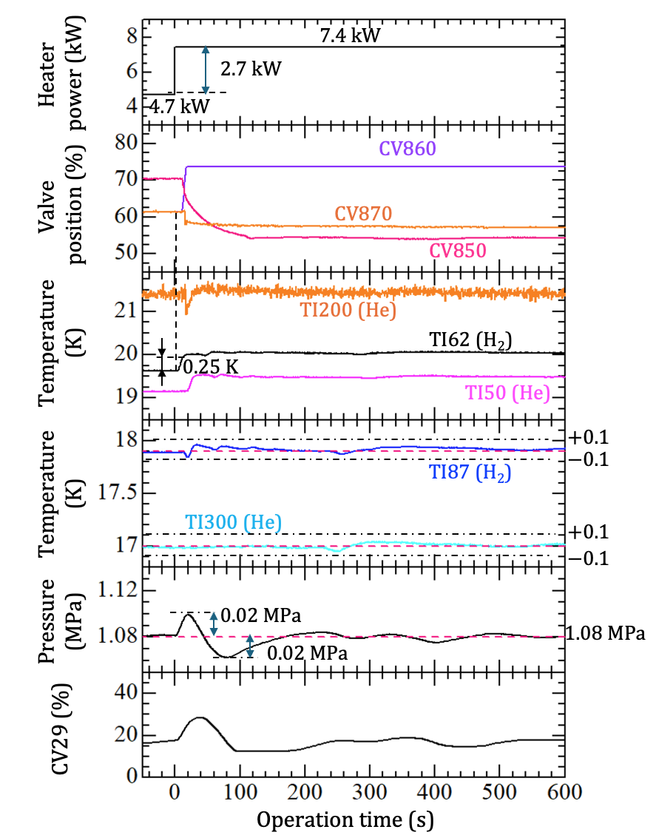

Pressure fluctuation mitigation and thermal compensation
Heater power was rapidly switched between 4.7 kW and 7.4 kW.
-> Simulating 2-MW proton beam operation.
In that case, at ESS…….
CV870
Ambient He gas
TI62
CV860
TI200 21.5 K
CV29
CV850
$$∆P$$
HX
TI87 18 K
TI300 17.0 K
- Thermal compenstation
Flow control by He refrigerator
+ CV870 (Return temperature:21.5 K
- Pressure rise mitigation
Buffer tank + CV29 + Recondenstation

Slide 9
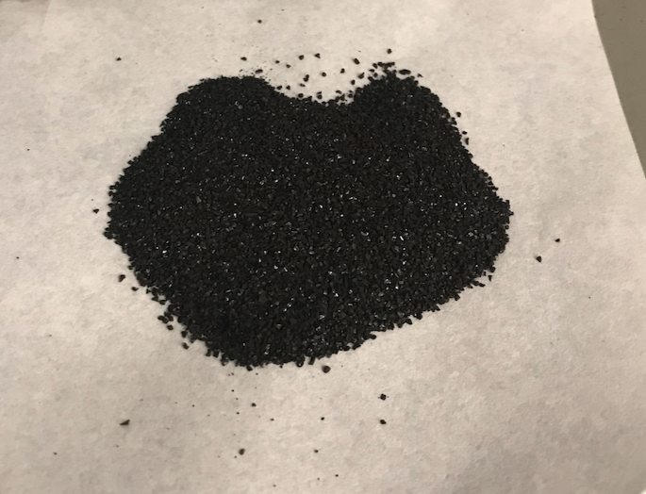
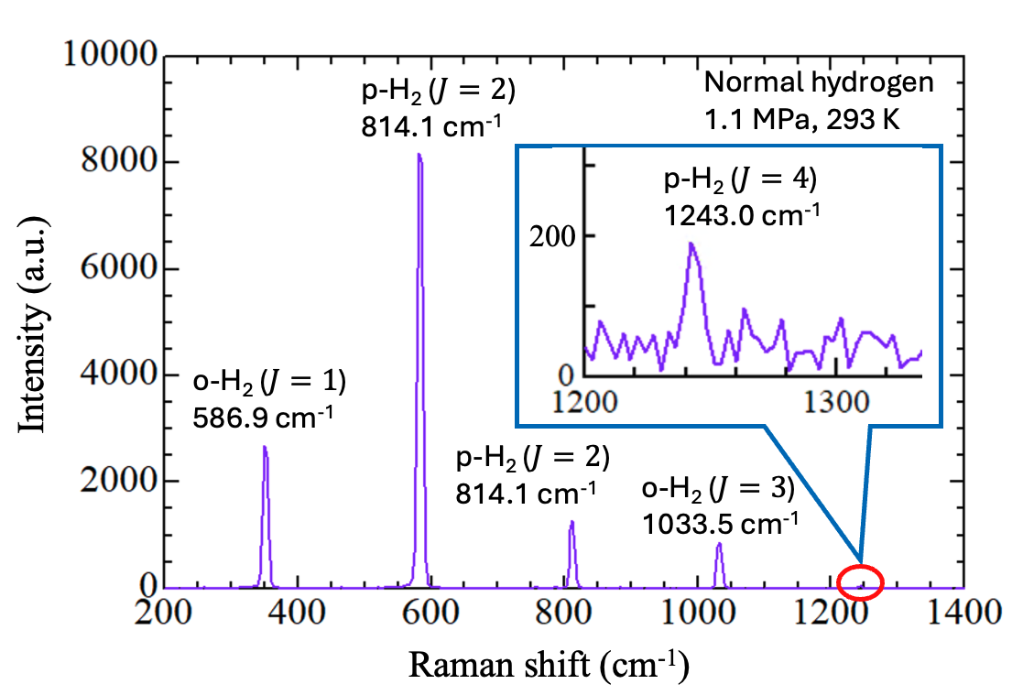
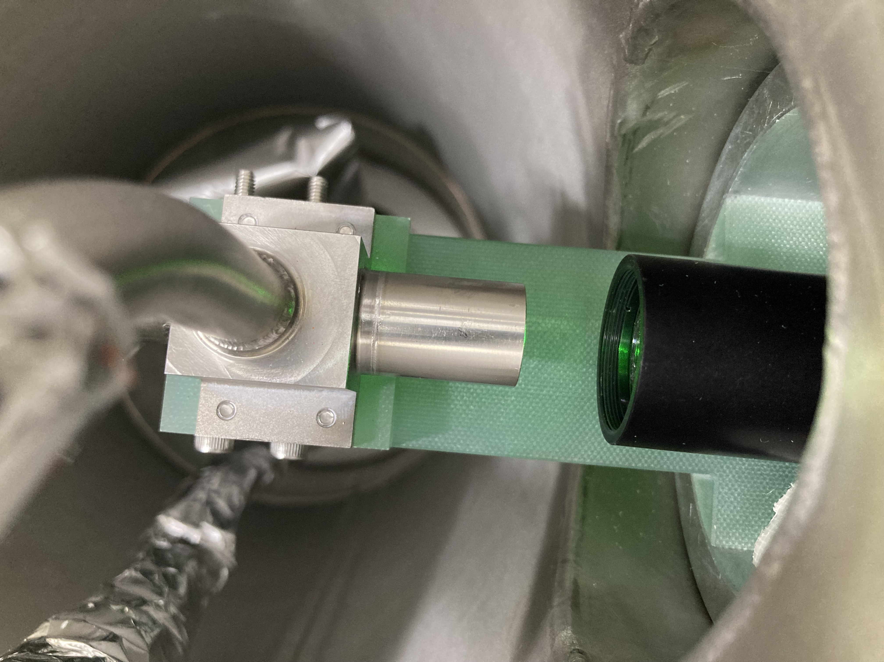
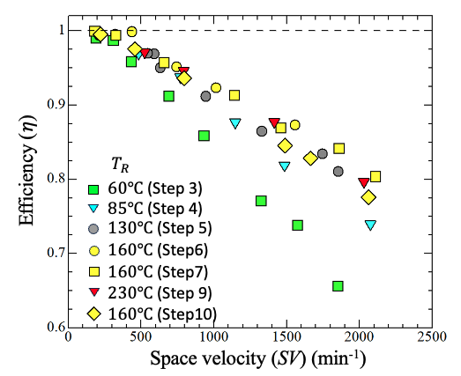
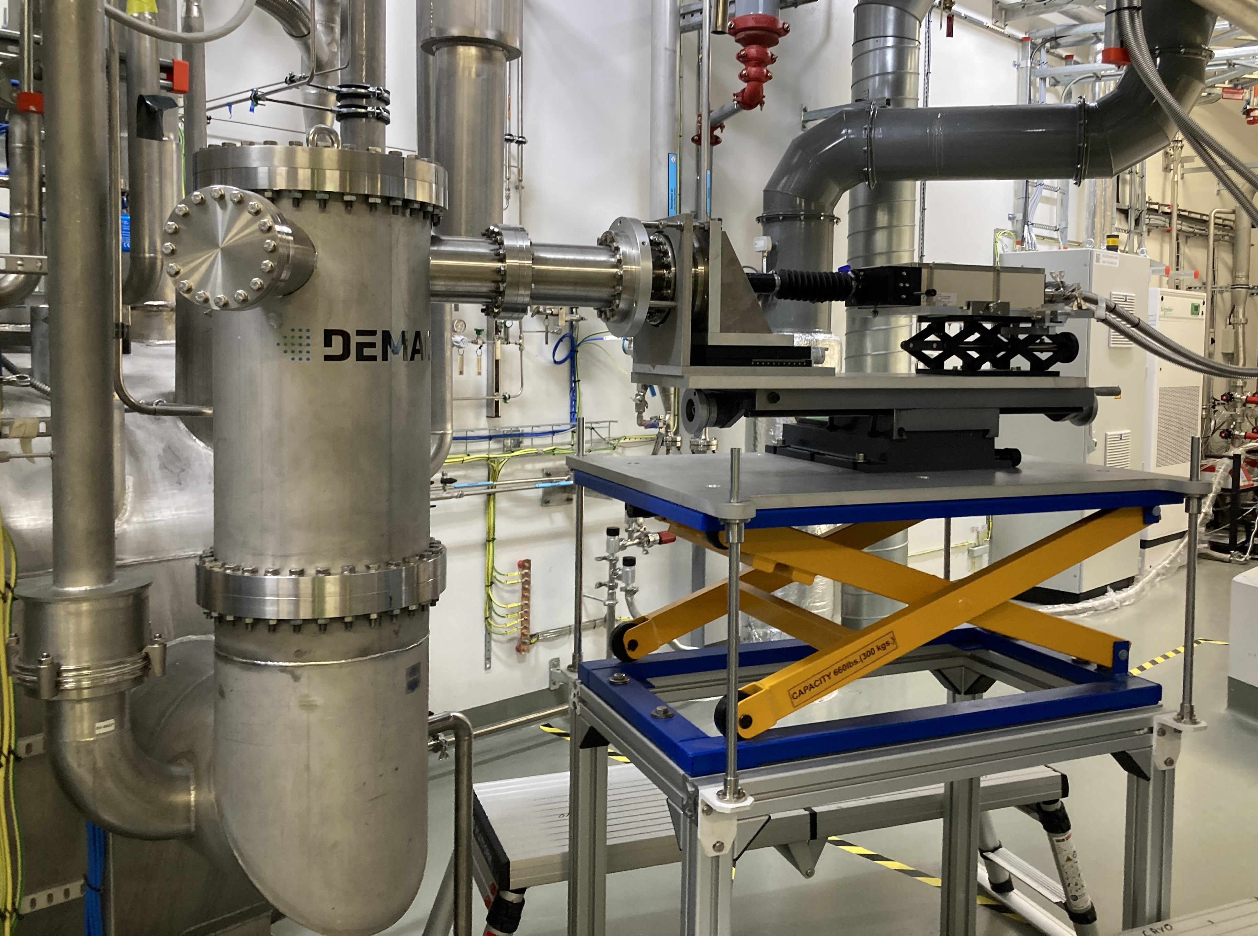

O/p H₂ catalyst and in situ measurement by Raman spectroscopy
Parahydrogen fraction > 99.5%
Ortho/parahydrogen catalyst
In-situ ortho/parahydrogen ratio measurement system
- IONEX® Type OP
- Investigation of the adequate activation temperature
Measurement results of conversion efficiency at LN₂ temperature.
Activation temperature =160$℃$
(Tatsumoto et al. 2025 Cryogenics 150 104106)
Catalyst activation and filling are planned for summer 2026.

Slide 10
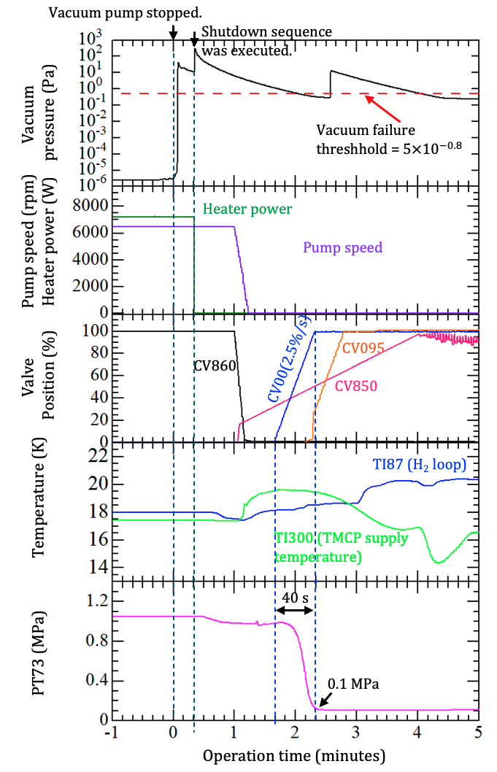
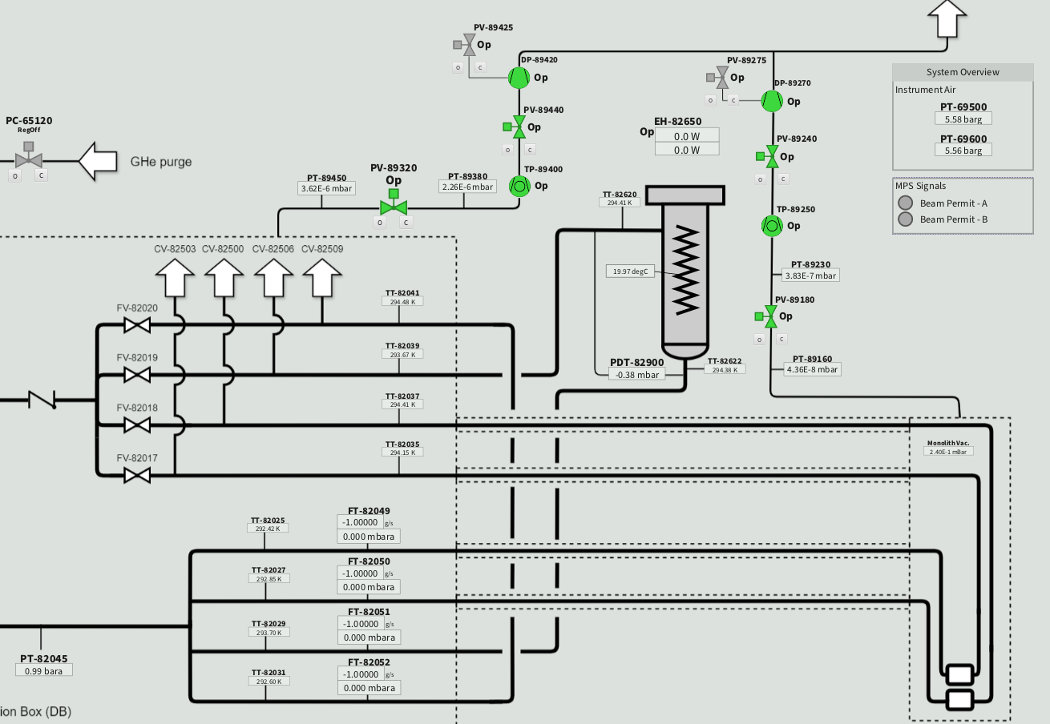
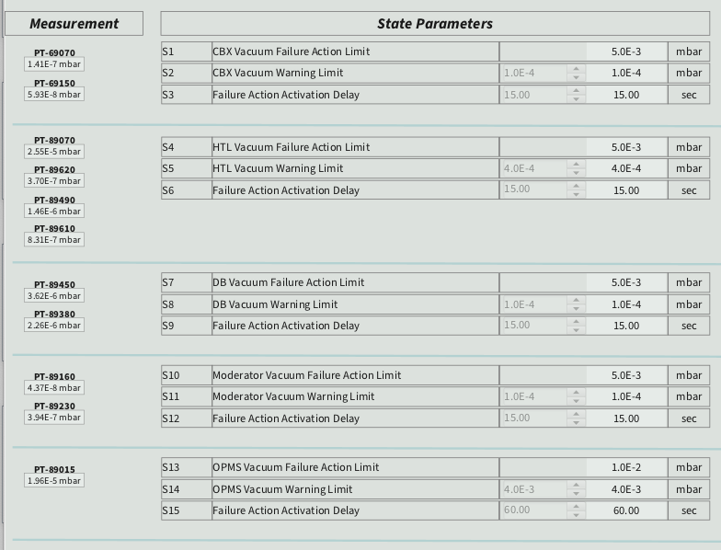
Automatic CMS shutdown triggered by failure
Vacuum pump stopped, on November 26, 2025

Slide 11
Conclusions
Prior to hydrogen operation, preliminary CMS commissioning has been conducted using helium in 2024, and the first hydrogen cooldown was successfully completed in March 2025 without catalyst filling.
CMS is currently operated in semi-automatic mode, and ongoing performance tests aim to optimize operating conditions and establish procedures for automated control.
Dynamic heat load tests demonstrated that the buffer tank effectively suppress pressure fluctuations, and that the TMCP valve box compensated for heat load variations as designed.
During hydrogen operation at 18 K, a primary vacuum pump failure occurred, and the CMS shutdown sequence executed as designed, ensuring a safe and controlled system shutdown.
Preparations for the first beam-on-target operation are steadily progressing.

Slide 12
Finish presentation Thank you for your attention

