Slide 1
ISIS Neutron and Muon Source - Solid Methane Moderator Commissioning
Mark Telkman, Paul Morgan
ICANS XXV, Malmö, Sweden
16/04/2026

Slide 2
Summary
What is the ISIS Solid Methane Moderator?
New heat exchanger type with gadolinium poisoning foil
New design(s) and expectations
Commissioning tests – 2 moderators, June 2025 to now
Results
Conclusions(?)
Notes:
In this presentation, I will describe:
What does the methane moderator look like
The new heat exchanger designs and inclusion of the gadolinium foil
New design and expectations
Commissioning tests performed and their results
Any conclusions we have found from the last 4 user cycles.

Slide 3
Terminology
HEX = Heat exchanger
DMOD = Decoupled Moderator
Mk1 = original heat exchanger (pre DMOD 040)
Mk2 = first new heat exchanger (used in DMOD 040)
Mk3 = second new heat exchanger (used in DMOD 041)
Charge = methane mass
Charge change = process of refilling volume with new methane
Notes:
Go through terminology

Slide 4
Solid Methane Moderators
3.5x more efficient than hydrogen moderators, but operationally challenging due to burp pressures and deterioration
Operating at ISIS since 2008
  The first moderators failed
  Recombination process of hydrogen and methane radicals in temperatures 30-90K now better understood
  Design settled in 2011, 35 bar design limit with charge cycle lasting 17-19 hours
Notes:
Why do we use solid methane at ISIS:
They provide a higher density of hydrogen atoms, combined with CH4 molecules able to provide efficient scattering of neutrons. This means that solid methane is 3.5x more efficient at converting fast neutrons to cold neutrons than hydrogen.
We have been using solid methane moderators at ISIS since 2008:
The first moderators failed, despite being operated at temperatures above the known “spontaneous recombination” level reported at other facilities.
Methane under neutron irradiation breaks down into hydrogen and methane radicals (CH3), but unable to recombine in “cold” conditions. These defects are close to each other when below 20K, and a spontaneous pressure release occurs
As it turns out, there is a secondary recombination of hydrogen and irradiated methane radicals above 30K that was not known about.
Thanks to efforts of various members across ISIS, this process is now better understood, and we can operate for 17-19hours of beam time before having to perform a charge change.

Slide 5
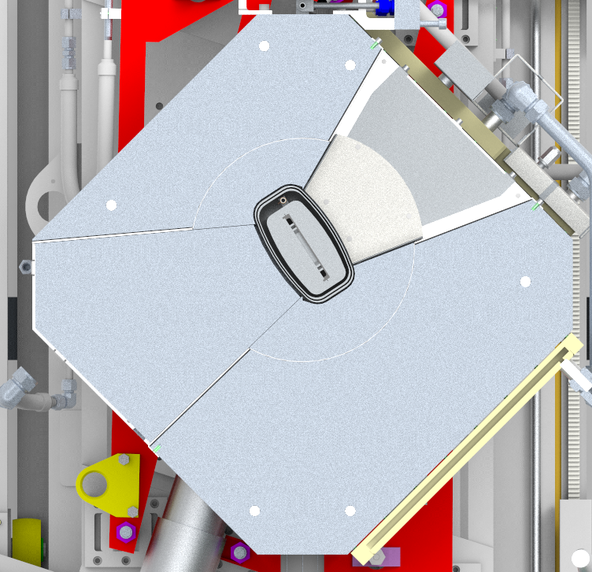
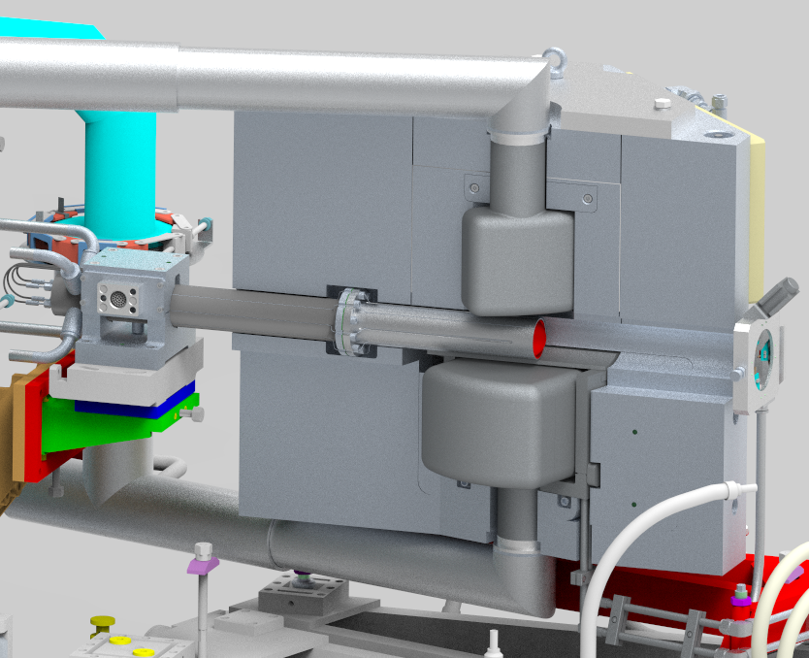
Future WiSH-2 Instrument (2032)
Solid Methane (40-60K)
Cadmium decoupler
Operational WiSH Instrument
Notes:
The layout of Target Station two is shown here – solid methane moderator above the target, with one current beamline in operation and a further addition coming as part of the ISIS Endeavour programme. The methane moderator at ISIS is unique and is crucial for ISIS science.

Slide 6


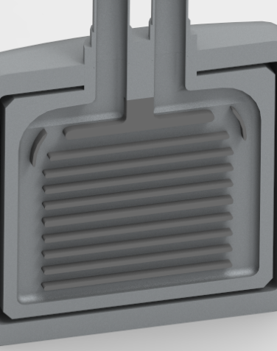
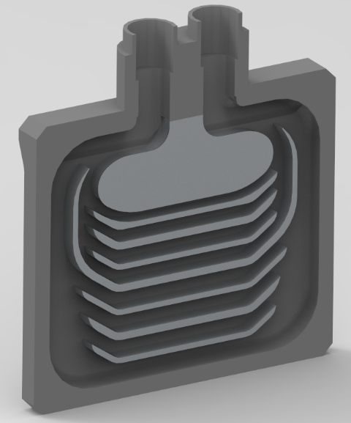
New Design
Tube to plate heat exchanger
Different flow rate (lower pressure drop)
Decrease in methane volume (200g to 160g)
Introduction of gadolinium poisoning foil
Aluminium foam not brazed
Aluminium foam (1199)-solid methane matrix
Mk1 Heat Exchanger
(DMOD 001-039)
Mk2 Heat Exchanger
(DMOD 040)
Mk3 Heat Exchanger
(DMOD 041)
Notes:
The design in use since 2011 has been a pipe heat exchanger/sink inside a 10 mm thick aluminium shell. Aluminium foam is then used inside the methane space to improve heat exchange.
The new design to include a gadolinium poisoning foil required a flat base to mount on to, so a plate heat exchanger design was put in place. There are two versions of this as shown here. The plate heat exchangers are designed to have a lower pressure drop and therefore a higher flow rate. This would help to regain some cooling lost by switching to a less conductive aluminium, whilst also improving the temperature gradient across the moderator.
A major change has been to remove the brazing between the foam and heat exchanger – very difficult to braze 5XXX series aluminium.

Slide 7
Aluminium 5083-O Heat Exchanger
Internal design pressure = 5 bar
External design pressure = 35 bar
Al-foam (1199, 10% density) and solid methane
Aluminium 5083-O shell
Design pressure = 35 bar
Gadolinium Foil (50 µm, Al-5251 sandwich)
Thermocouple location
Notes:
In summary:
New heat exchanger has an internal design pressure of 5 bar and external limit of 35 bar.
Al-5083 used for both the outer shell and the heat exchanger.
Aluminium foam continue to be used to improve cooling efficiency and is compressed on to the surface of the heat exchanger.
The gadolinium foil is 50 microns thick and is sandwiched between two thin plates of aluminium 5251.

Slide 8
What was Expected?
A slightly worse starting temperature but slower deterioration?
Similar pressure release at charge change warm up?
Less flux, sharper resolution
See next slide…
Warming of irradiated solid methane leads to pressure release
Less methane in new design, but unsure on its impact
Much smaller available methane volume
Thinner volume in viewing angle
Notes:
What was expected in the new design?
A worse starting temperature but slower deterioration? See next slide
Difficult to determine whether a smaller amount of methane means a lower pressure release – number of defects and recombination events may not change. Best to assume that it is now lower
Less flux because there is less methane volume in total and the foil effectively splits the moderator in half. This however will mean better resolution.

Slide 9
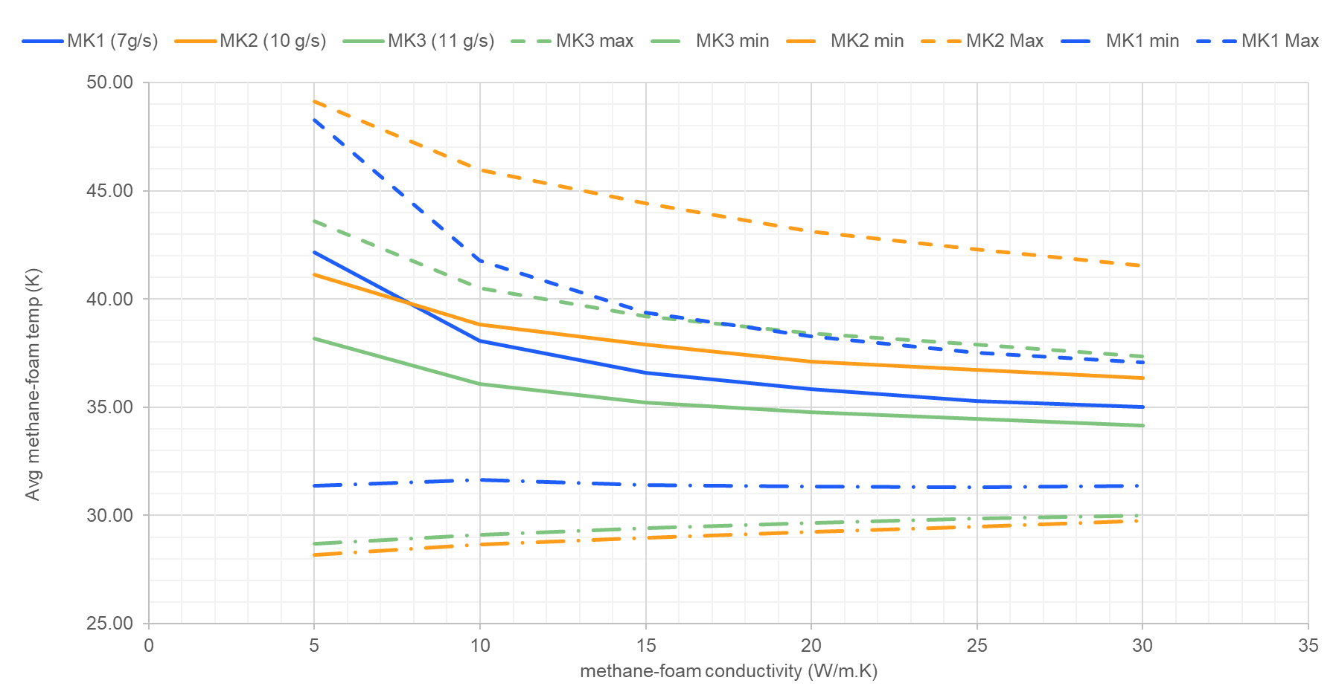
Temperature increase predictions
Compared Mk1, Mk2, and Mk3 at their designed flow rates
Varying bulk thermal conductivity of methane and aluminium foam conductivity
  “simulate” potential deterioration mechanism
Helium inlet T = 25 K
Notes:
Comparisons of the three designs:
All 3 designs (1 old, two new) modelled at their designed flow rates.
The methane and aluminium foam bulk conductivity is changed to simulate a deteriorating moderator. Different temperatures measured in the methane (average, max, min).
Mk1 in blue, original, best temperature distribution for a high thermal conductivity.
However, as the moderator deteriorates, potentially via a worsening bulk thermal conductivity in the methane space, The Mk1 design deteriorates quicker.
Mk3 (green) will be better than Mk2 (orange), both in average temperature and distribution.
This modelling assumes all parts are in perfect contact with each other

Slide 10
Planned tests for two new moderators
Positioning of foil
Pressure measurements at increasing time intervals
Flux measurements at different helium temperatures
Deriving an “efficiency” of heat exchanger, compare to previous design
Coldbox optimisation – increase mass flow rate to reduce temperature
Monitor the deterioration rate
Impact of poisoning foil
Ensure moderator does not fail
Notes:
To monitor the performance of the new design and determine it suitability for future use, six areas were highlighted for focus:
Positioning of the foil via neutron imaging
Incrementally increasing the run time for each methane charge
Measure the impact of the poisoning foil on flux and resolution
Take measurements of flux count across different wavelengths for different helium inlet temperatures. This is to derive a sort of efficiency for the heat exchanger that can be compared to other designs.
Increasing the flow rate through the heat exchanger by closing a bypass valve on the helium circuit and increasing the inlet pressure to the turboexpander.
Monitoring the performance/temperature deterioration over time

Slide 11
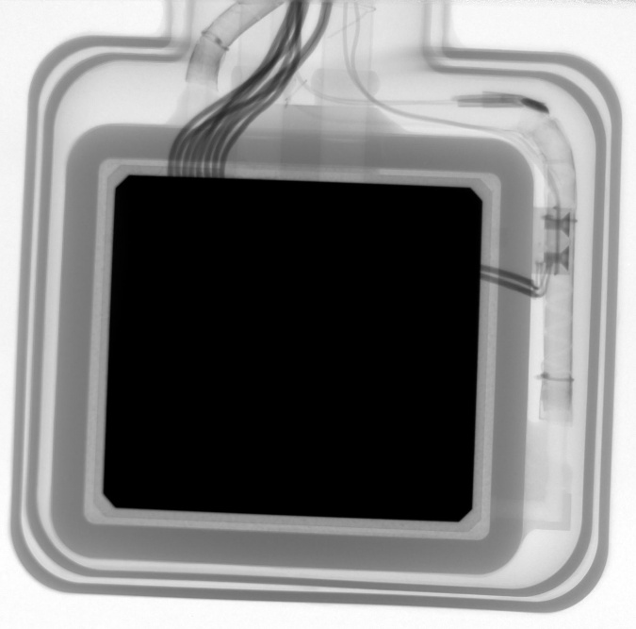
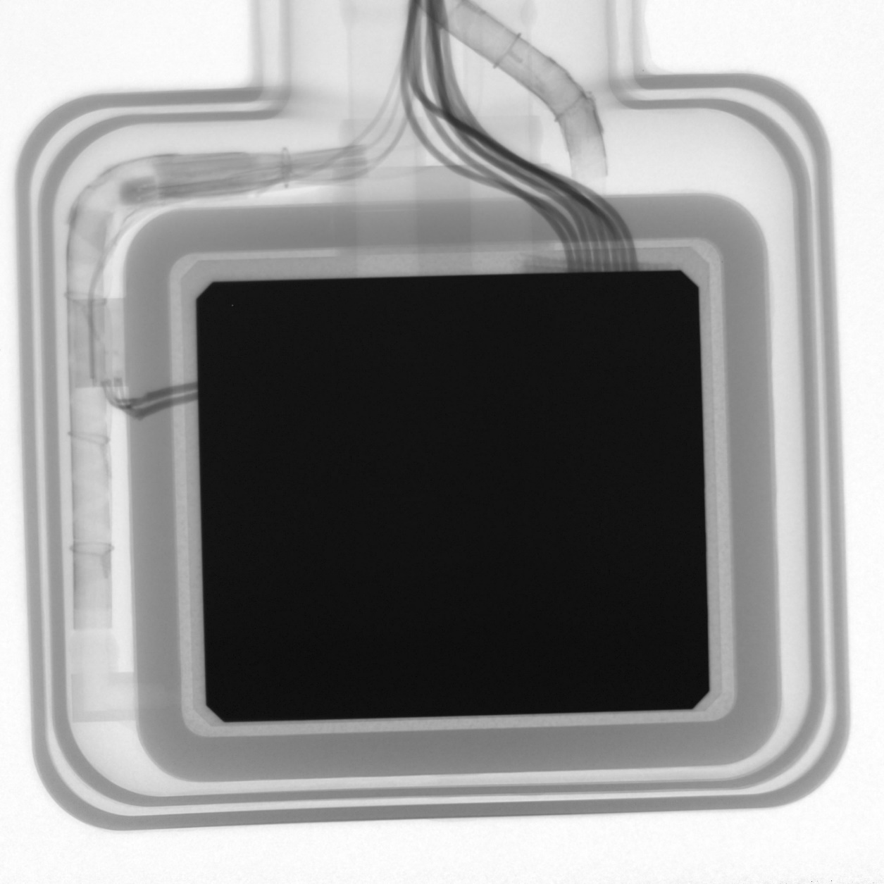
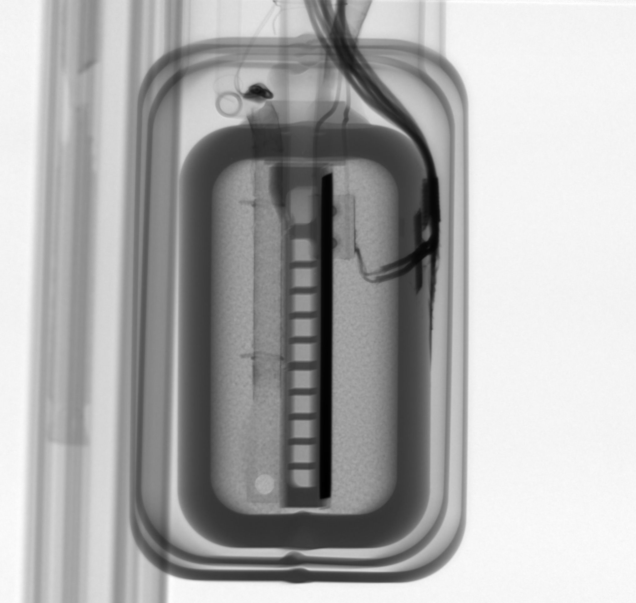
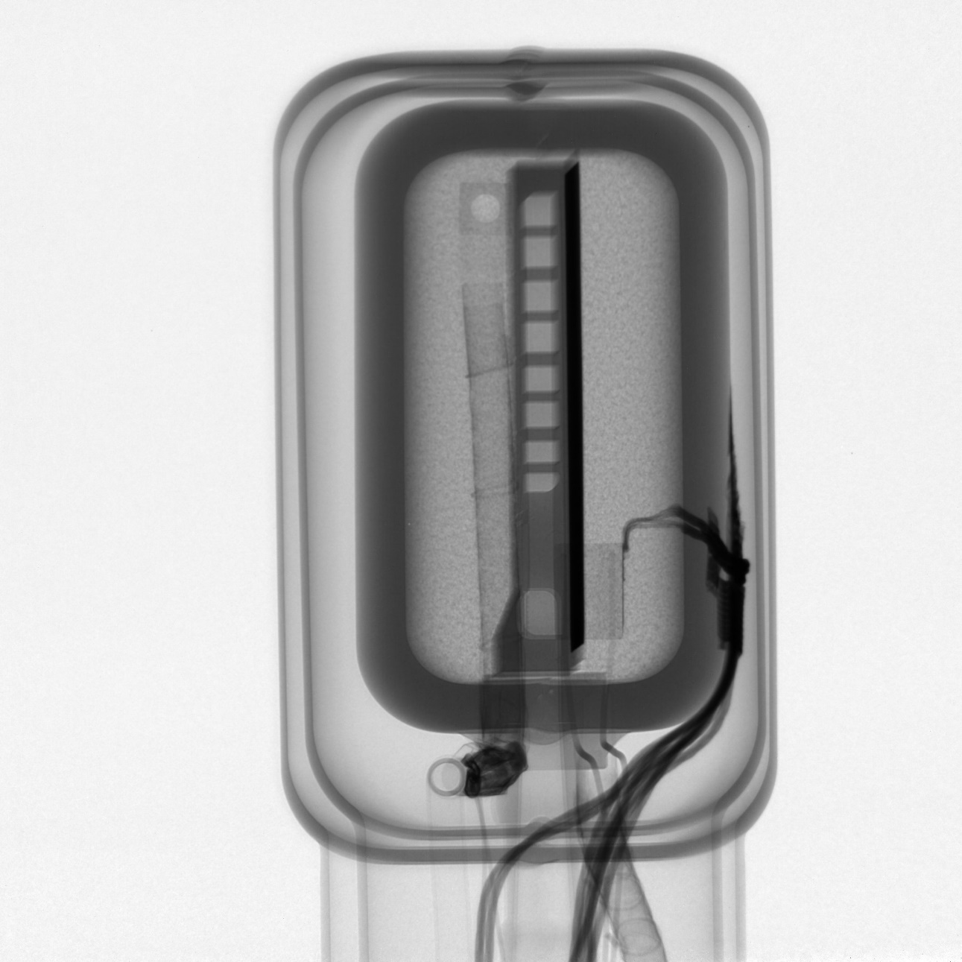

Neutron Imaging
DMOD 040
DMOD 041
DMOD 040
DMOD 041
Notes:
Part of our site acceptance testing. Imaging performed on the IMAT beamline at ISIS. Highlights the positioning of the foil within the moderator head, as well as confirming the separation of the moderator head from the vacuum shell.
Here we could see on DMOD 041 that the foil had slipped slightly within the head. This has prompted a slight design change to ensure it is held more securely.

Slide 12
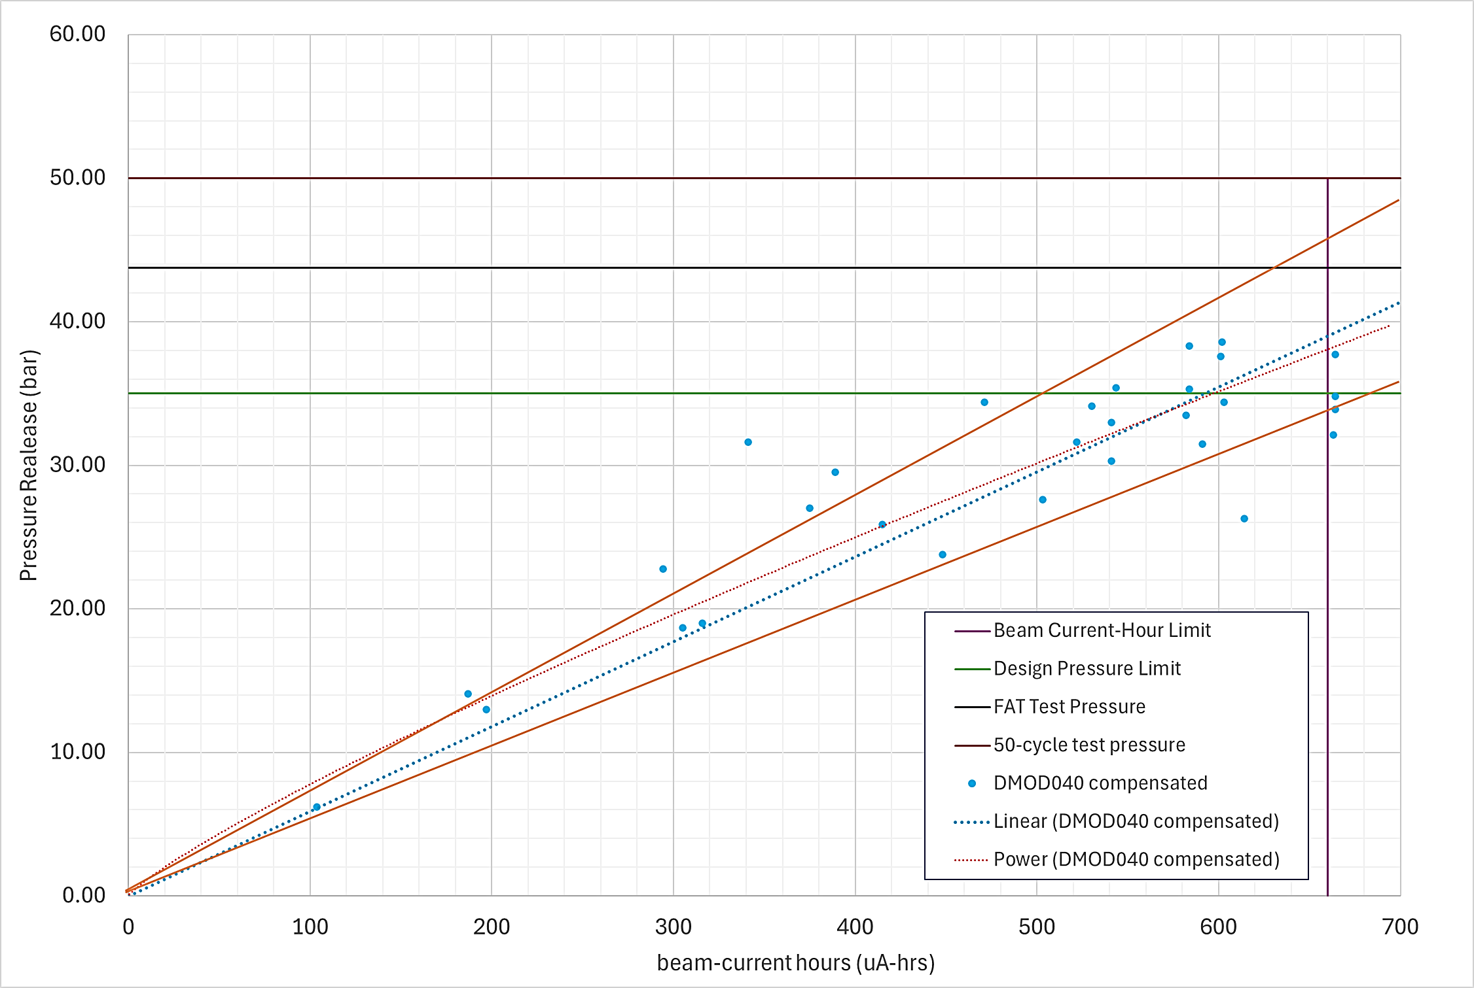
Charge Change Pressure Releases – DMOD 040
Incrementally increased charge run time
Scattered results
Hard to plot line of best fit
Upper and lower-bound limits
Can we trust the data?
Notes:
An important part of the moderator operation is ensuring it as able to run for 17-19 hours, or a cumulative beam current time value of 660uAh, before doing a charge change. The pressure release upon charge change is proportional to the amount of irradiation.
To do this safely and determine whether anything has changed because of the design changes, we incrementally increased the run time, starting at 100uAh. If the pressure recorded was low, then we moved on to the next step.
The results are somewhat scattered, partly because the strain gauges are only calibrated to about 20 bar and then an extrapolation curve allows us to read up to 400 bar. The strain increases with radiation, so this has to be accounted for.
We plot pressure release vs beam current hours for that charge, and plot a trend line to see what the next reading might be. Our design limit is 35 bar (green line), but we were already surpassing this at a run time of 540uAh. A test vessel was used to determine whether the shell and heat exchanger could survive a higher pressure. This allowed us to increase the run time to the normal 660uAh.

Slide 13
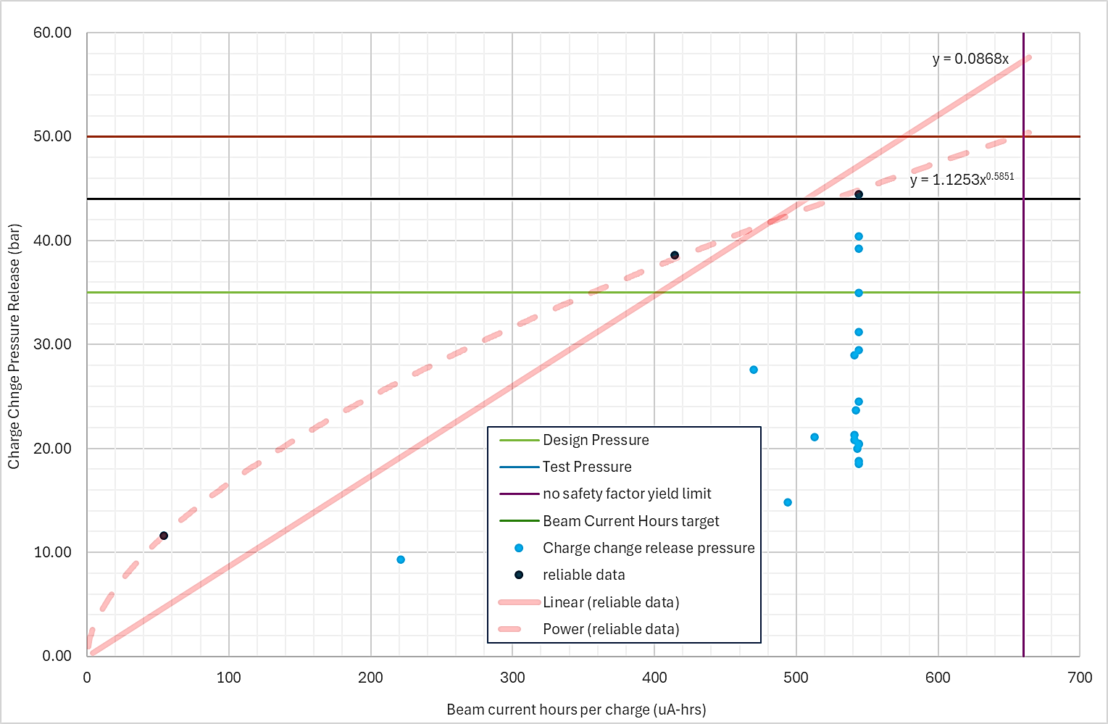
Charge Change Pressure Releases – DMOD 041
Strain gauges started to fail early – glue?
Use reliable readings to plot best fit
Which line to use?
Time limit stuck at 540uAh
Assessment on increasing run time to original limit
3
4
1
Notes:
We performed the same test on DMOD 041, but jumping to higher run times much earlier. Unfortunately, the strain gauge readings became unreliable quite early on, so we can only plot trend lines using the first 3 or 4 data points. The light blue markers show the pressure readings getting lower and lower for the same run times, later into the user cycle. We are having to perform another raised pressure test on a vessel to ensure we can get back up to the 660uAh run time.

Slide 14
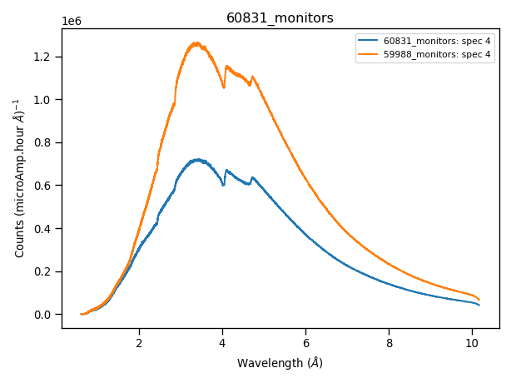
Poisoning Foil Impact
DMOD 039 - T_{He}=27 K; T_{mod} = 52.5 K
DMOD 040 - T_{He}=19 K; T_{mod} = 53.0 K
Initial findings
Peak in same position = same methane temperature
  But poisoned design required 8K colder helium!
Ratio between moderators 10% lower than Monte Carlo Simulation

Slide 15
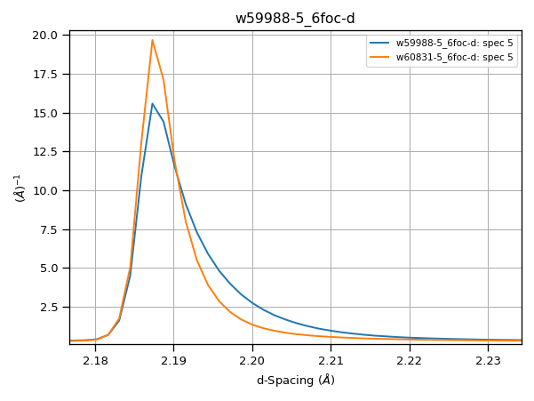
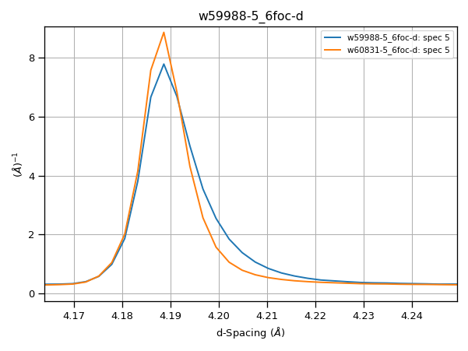
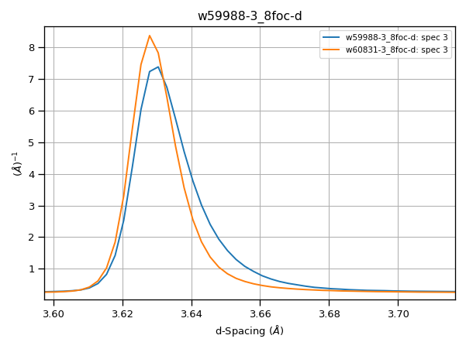
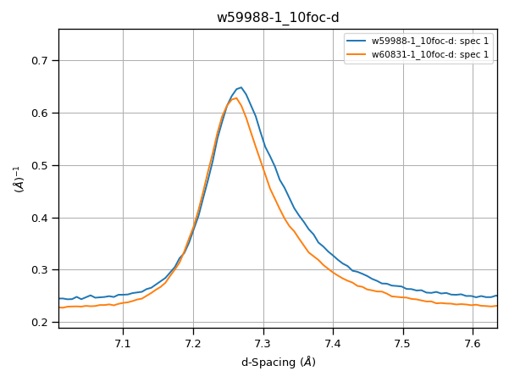
Poisoning Foil Impact
Blue: no-poisoning
Orange: Gd-poisoning
Reduction in long asymmetric tails
Good agreement with Monte Carlo simulations regarding peak shapes

Slide 16
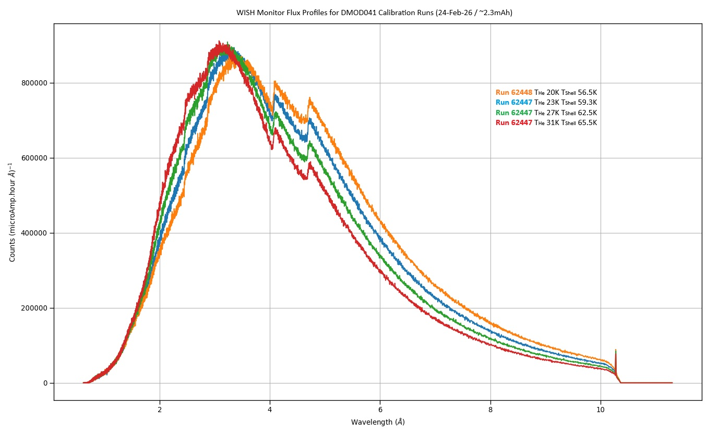
Shift in peak
DMOD 041 Calibration @ 2.3mAh
Increase in flux for < 4 Å
Notes:
When the moderator is new, we can plot the flux count versus wavelength profile for different helium temperatures. This can then be compared to the other designs. As can be seen from this test on DMOD 041, the peak count shifts to longer wavelengths at colder temperatures. And while there is some flux lost in the 1-3 angstrom range, a lot more flux is gained from 4-10 angstroms. This test was performed at an age of 2.3mAh, approximately 4 charges into the run.

Slide 17
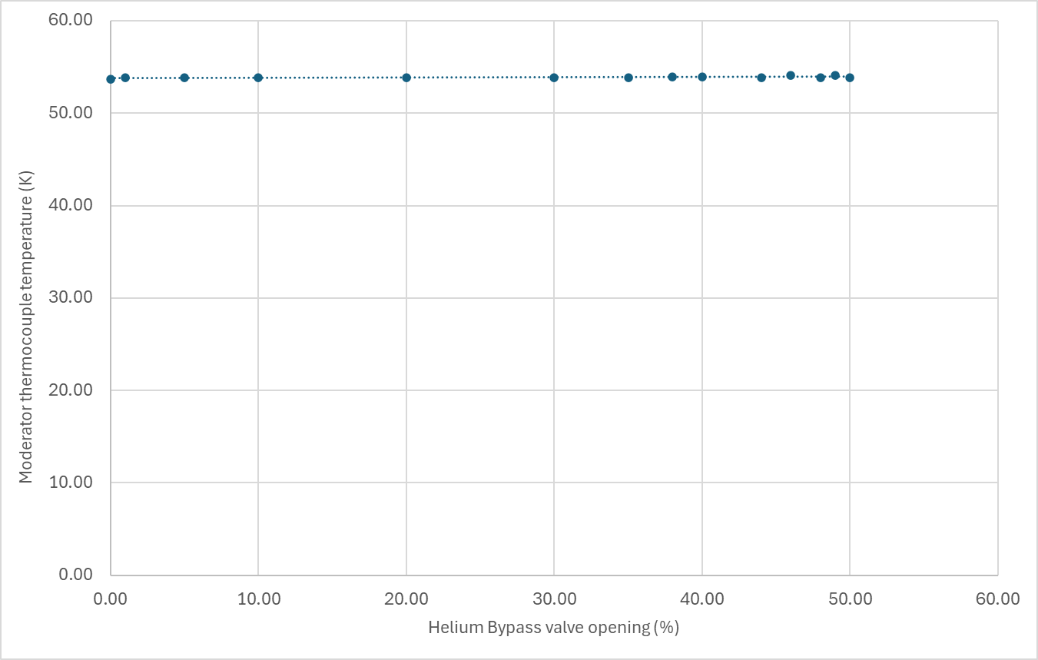
Coldbox optimisation
increased mass flow rate through heat exchanger
No impact on thermocouple temperature
No impact seen on WISH detectors
Why?
Direction of change
Notes:
The coldbox improvements to increase mass flow rate and reduce temperature did not yield the expected results. This graph shows that we closed the bypass from 50% open to 0% open, and this had no impact on the shell temperature. No impact was seen on WISH detectors either.
The same occurred when the inlet pressure to the turboexpander was increased but with the bypass open. This should also have increased the mass flow rate, but no impact was seen.
So why is this?

Slide 18
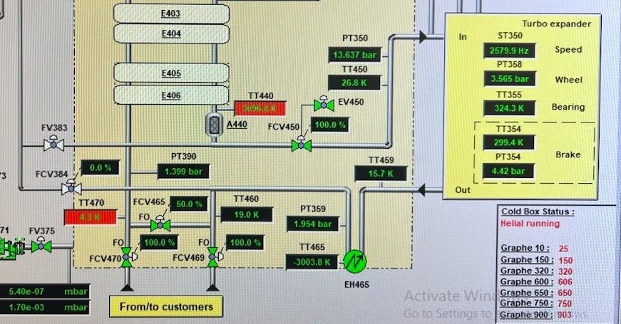

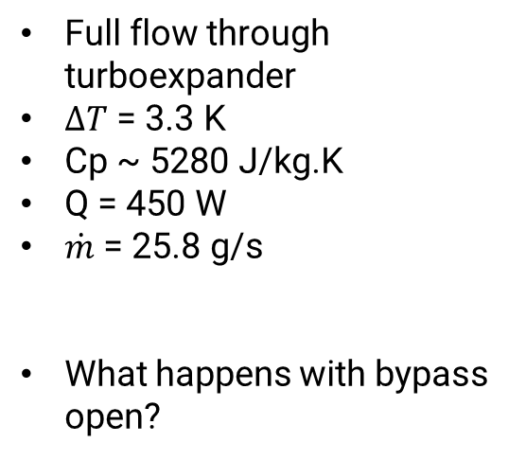
Real Mass flow rate?
$$\dot{Q}=\dot{m}C_{p}∆T$$
Full flow through turboexpander
$∆T$ = 3.3 K
Cp ~ 5280 J/kg.K
Q = 450 W
$\dot{m}$ = 25.8 g/s
What happens with bypass open?
T₂
T₁
To transfer line and moderator
Notes:
To determine the real mass flow rate through our system, we can use the temperatures either side of the heater on the helium circuit, and the power output of the heater. T_1 is the helium temperature on the outlet of the turboexpander, before the heater, and T_2 is the inlet to the moderator helium circuit, after the heater. With the inlet pressure to the turboexpander at maximum, therefore maximum flow rater, we obtained a value of 26 g/s, which matched our expectations.
The bypass is open, so some of this 26 g/s is diverted away from the moderator – but how much?

Slide 19
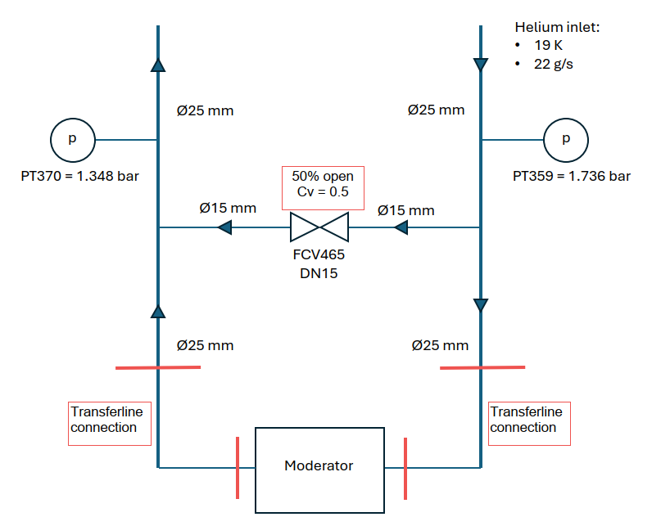
Deriving pressure drop and mass flow rates
PT 390
PT 359
Possible to calculate predicted pressure drop
50% open = 10% flow capacity!
Notes:
This is a simplification of the diagram you saw on the previous slide. The red dotted area encompasses the moderator and transfer line, of which we have details/ drawings; therefore, it is easier to predict the pressure drop vs mass flow rate trend.
Can only measure pressure drop across whole circuit.
This can then be compared to a data point we have for when the bypass was closed on DMOD 040. The pressure drop is taken from the difference between the two sensors either side of the circuit. This data point was recorded at a flow rate of 22 g/s.

Slide 20
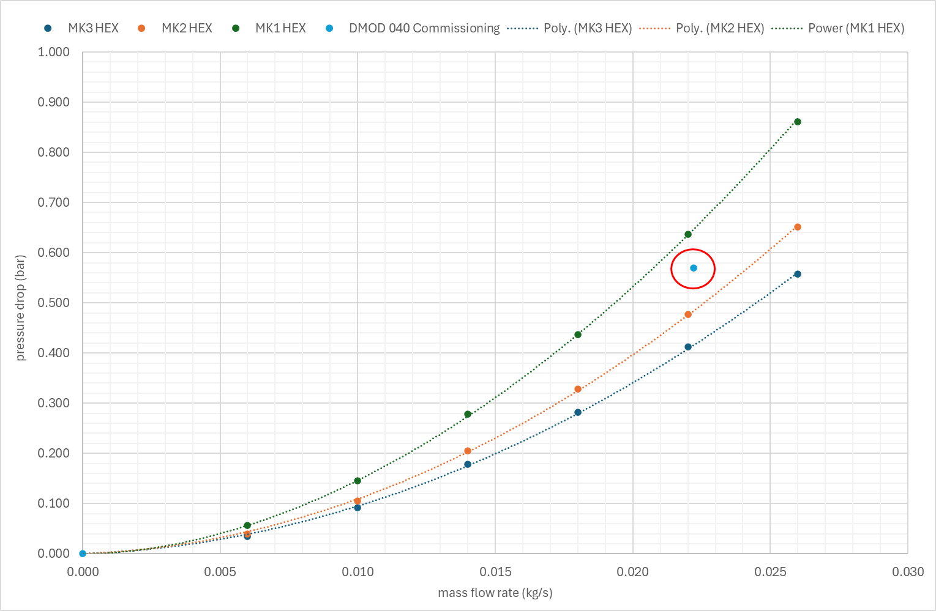
Pressure drop vs mass flow rate
Closing bypass on DMOD 040 gave a data point
Flow rate derived from heater output
Apply 16% error for future prediction
We are operating at higher flow rates than expected!
DMOD 040 (Mk2 HEX), bypass closed – 16% higher than predicted
Calculated trend plots from transfer line and moderator analysis
Notes:
The pressure drop vs mass flow rate trends were plotted for all 3 heat exchanger designs, with the transfer line pressure drop included.
Mk2 is the DMOD 040 design, and at ~22 g/s, my prediction is 16% lower than seen in commissioning. This could be accounted for some error in deriving flow rates using our instrumentation, plus some simplification in the calcs and non-inclusion of pipework within the coldbox. However, this does show that we are not operating in the 7-10 g/s range we expected, but more likely in the 18-22g/s region!
Applying the 16% error to my calculations on both Mk2 and Mk3 (or DMOD 040 and DMOD 041).
I can now use these plots to estimate mass flow rates based on circuit pressure drop

Slide 21
More CFD – temperature vs flow rate
MK2 vs MK3 with gap
MK2 vs MK3 no gap
Notes:
Analysis was reperformed for higher flow rates and showed that for both new designs, increasing the mass flow rate provides diminishing returns and that is mostly likely why we did not see a significant impact on performance.
The bottom two trends assume all parts are in perfect contact with each other. The top two trends assume a 0.5mm gap between the aluminium foam and heat exchanger.

Slide 22
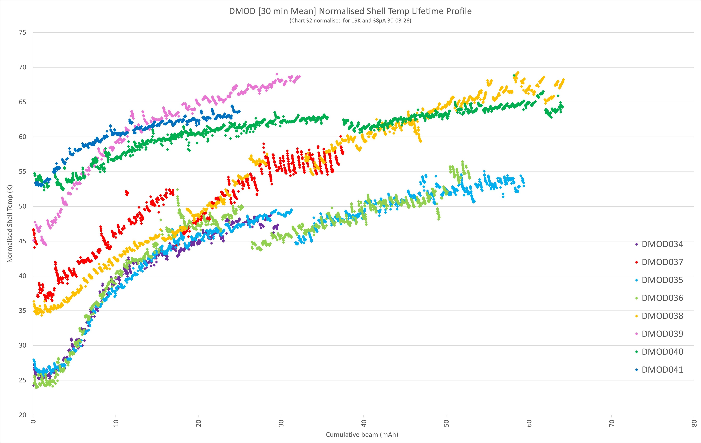
DMOD 040
DMOD 041
Notes:
Moving on to performance deterioration, this plot shows the thermocouple shell temperature for the last 8 moderators.
DMOD 040 and DMOD 041 and highlighted here, and all the other plots are moderators of the original design. The wide distribution in temperatures is a result of the inconsistencies seen in our thermocouple readings – they are not meant to be used at these temperatures, but they are stable within a radioactive environment. They are however good at monitoring deterioration (more on that in the next slides). The gradients for DMODs 040 and 041 are lower than that of the trends, and that is a good indication that the new designs deteriorate more slowly.
The wide range of thermocouple readings across moderators does make our life harder (and more colourful) when it comes to comparing moderators. So we can do this a different way…

Slide 23
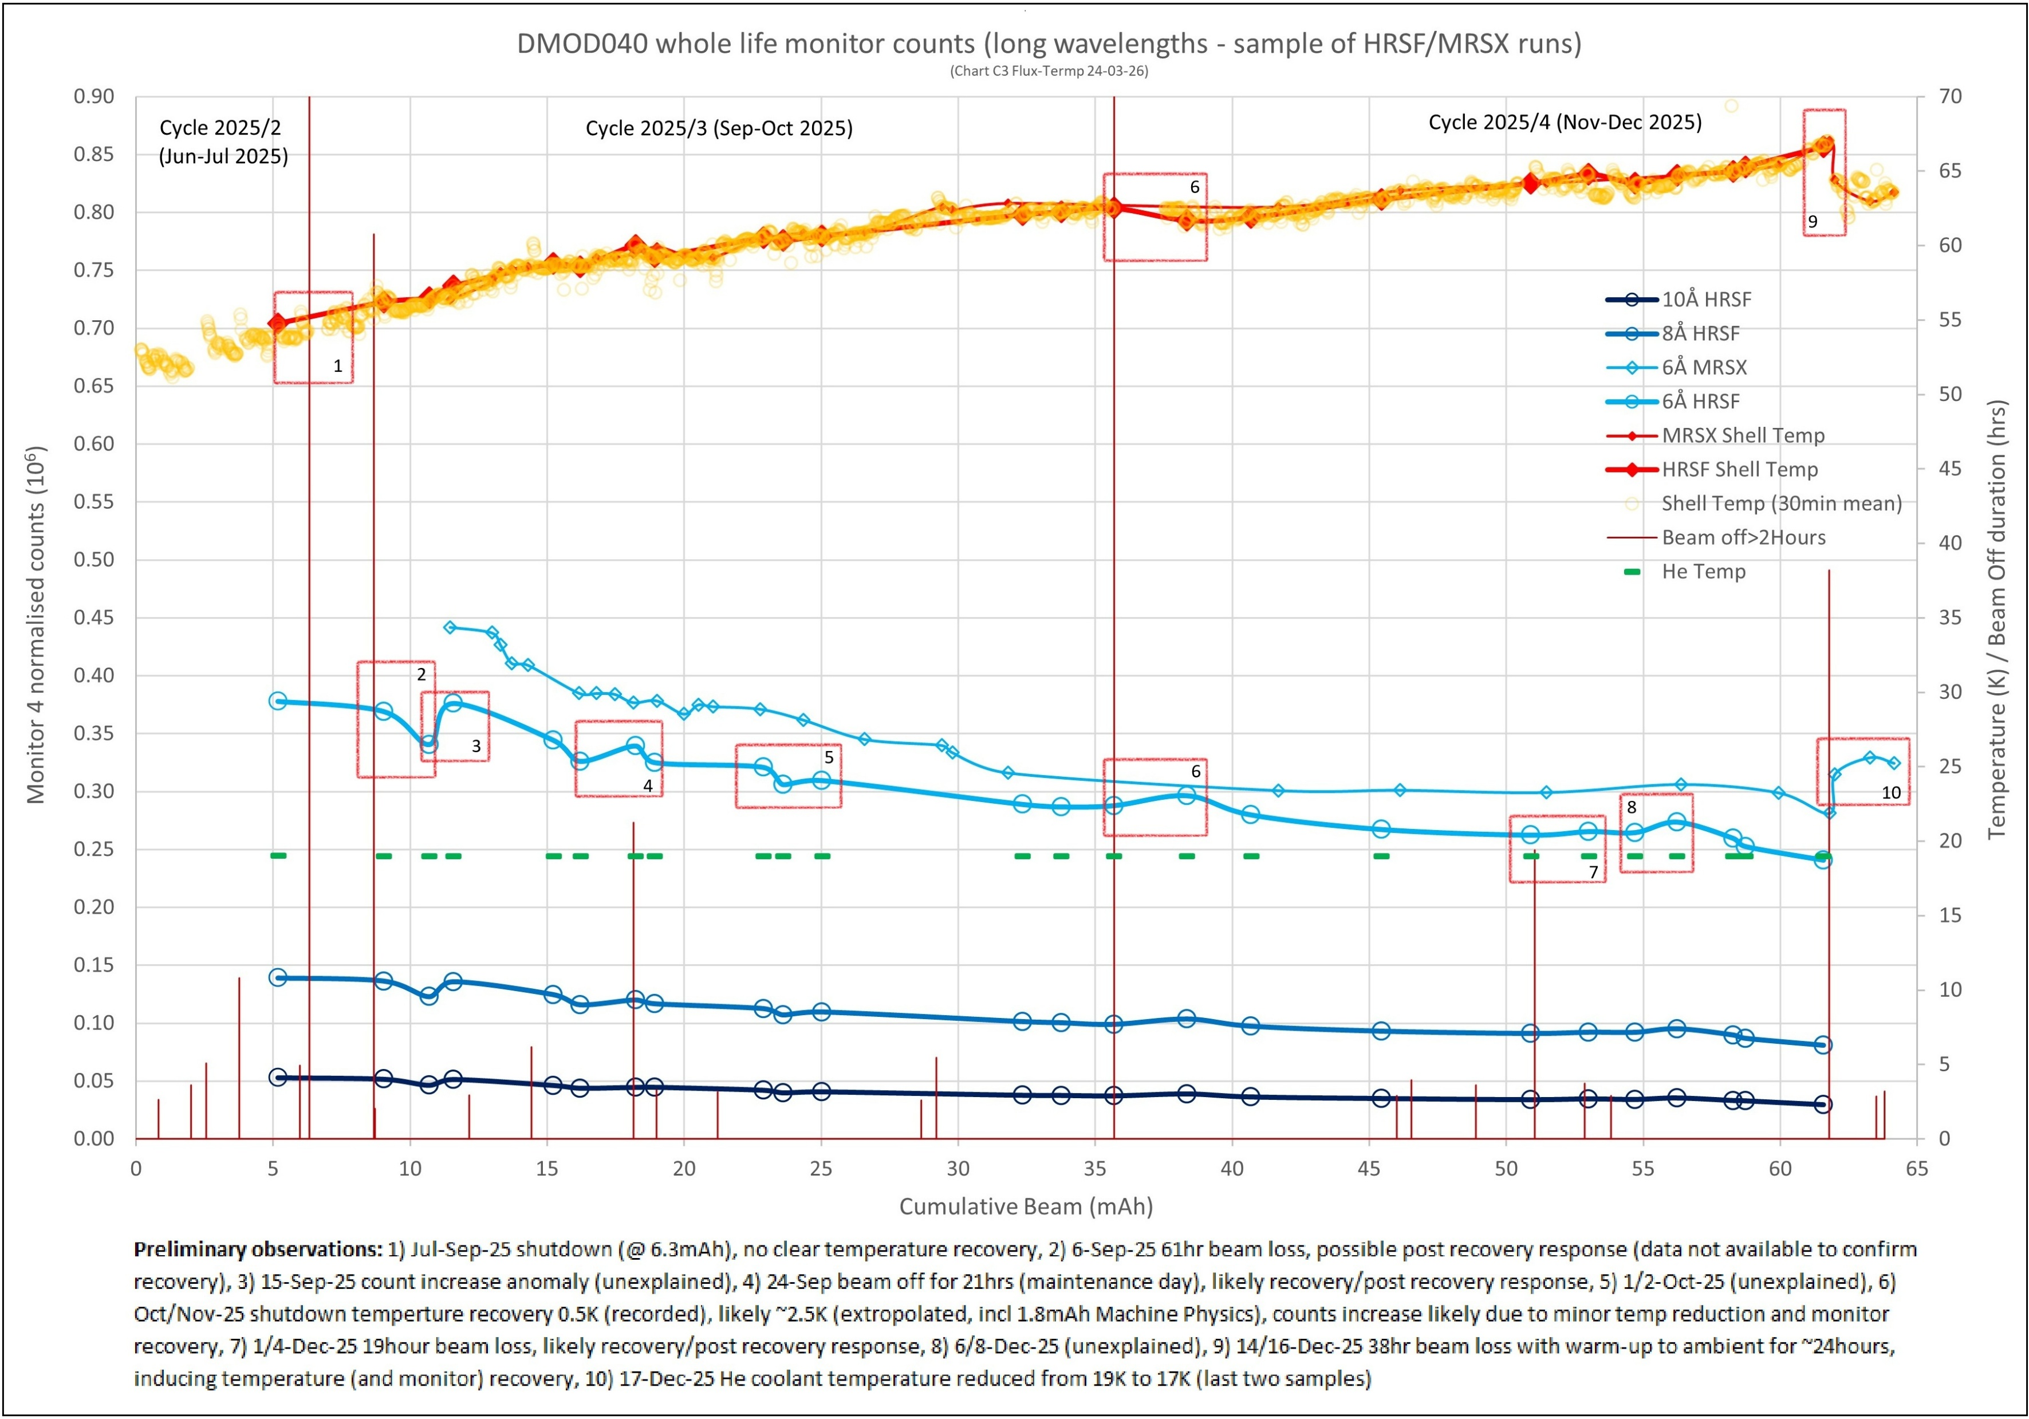
Plot flux count at different wavelengths over time
Compare with shell temperature tracking
Assess this against previous moderator design…
Notes:
We can look at how the flux count at different wavelengths changes over time. This graph is quite complicated, so I won’t go into too much detail, but the bottom blue lines are the flux counts at 6, 8, and 10 angstroms. We can monitor their change across the user to determine:
Does it match the thermocouple trend?
How does it compare with previous moderators?
Has anything unexpected happened?

Slide 24
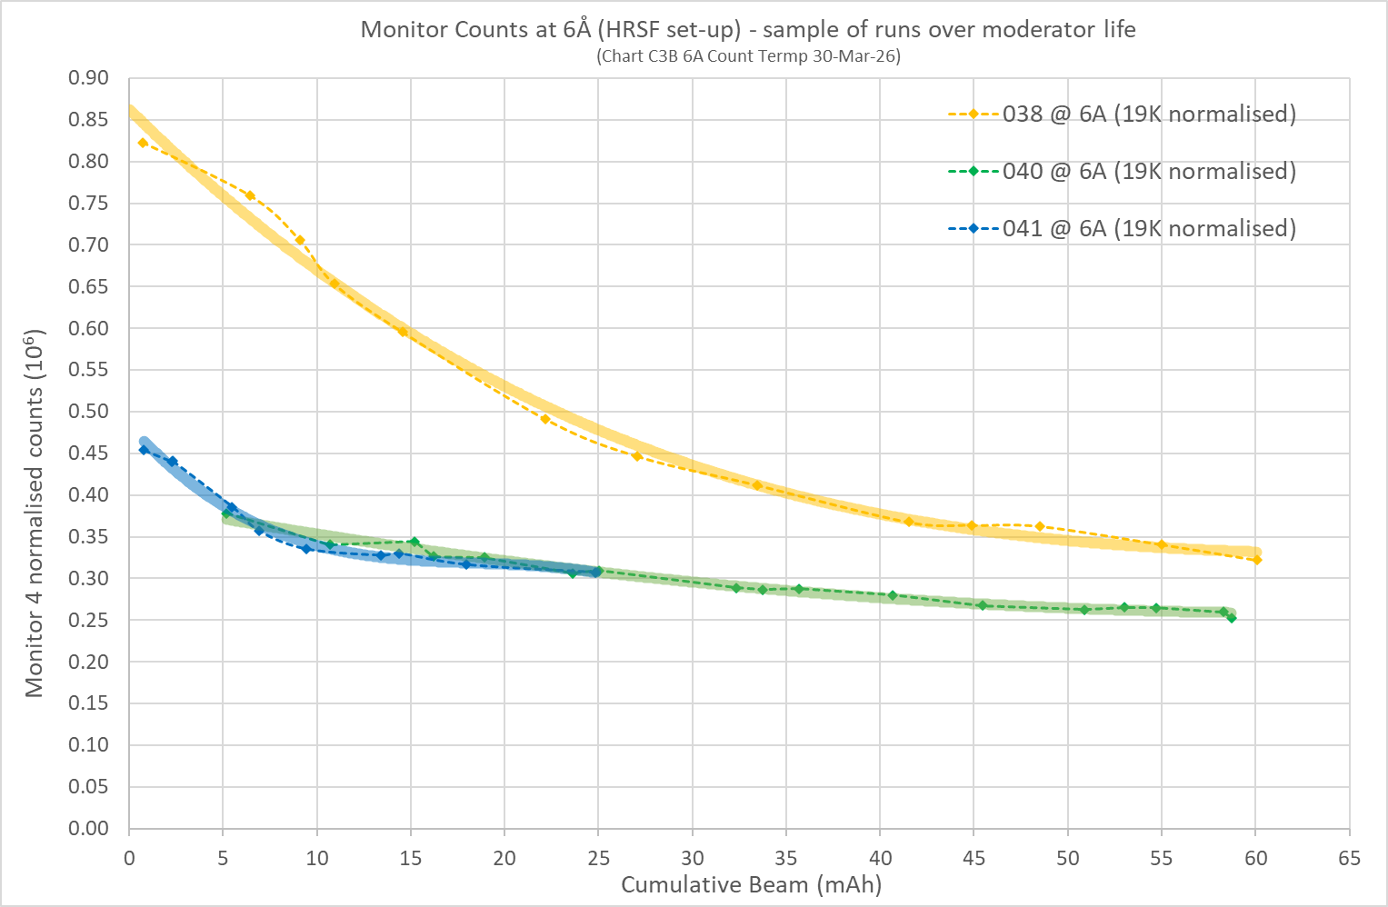
45%
Notes:
This graph looks at our 6 angstrom counts across DMODs 038, 040 and 041. We can see how the new design has reduced the flux count significantly, but this gap reduces over the moderator lifetime.
We can also see that DMOD 040 and 041 are performing quite similarly.

Slide 25
DMOD 041 commissioning problems
User-cycle was delayed – lost commissioning time and staffing issues!
  Coldbox settings not same as DMOD 040 – lower mass flow rate
Helium inlet temperature sensor failed at the start of the run – good fix put in place
Issues with charge changes
Thermocouple temperature high – very sure this is false
Accelerator issue halfway through cycle – another week off!
Performance similar to DMOD 040:
  Lower mass flow rate, does it make a significant difference?
  Why? Modelling errors?
  Helium temperature higher than sensor says?
Notes:
Several issues occurred throughout the commissioning of DMOD 041:
The user-cycle was delayed which meant we had a delayed and slightly hectic start to commissioning
The helium temperature sensor failed and needed a quick fix
We had issues with charge changes as a result of high thermocouple temperatures – we are sure these readings are not true
There was an accelerator issue which meant another week off
Performance like DMOD 040
most likely some modelling assumptions that could overestimate the improvements of the Mk3 heat exchanger
The fix of the helium sensor was good but think there is a small error – accounted for in previous plots.

Slide 26
Conclusions
Positives:
The poisoning foil was a success
Moderator ran for two user cycles
Deteriorated at a slower rate than the original brazed design
Provided insight into degradation mechanisms
More experience in operating cryogenic system
Results shows where to focus on for design development
Negatives:
The moderator is warmer than desired
Charge change pressure release higher anticipated
DMOD 041 coldbox settings not same as DMOD 040
Heat exchanger needs redesigning for higher flow rates
Helium cernox temperature sensor failed and now has a small error after fix

Slide 27
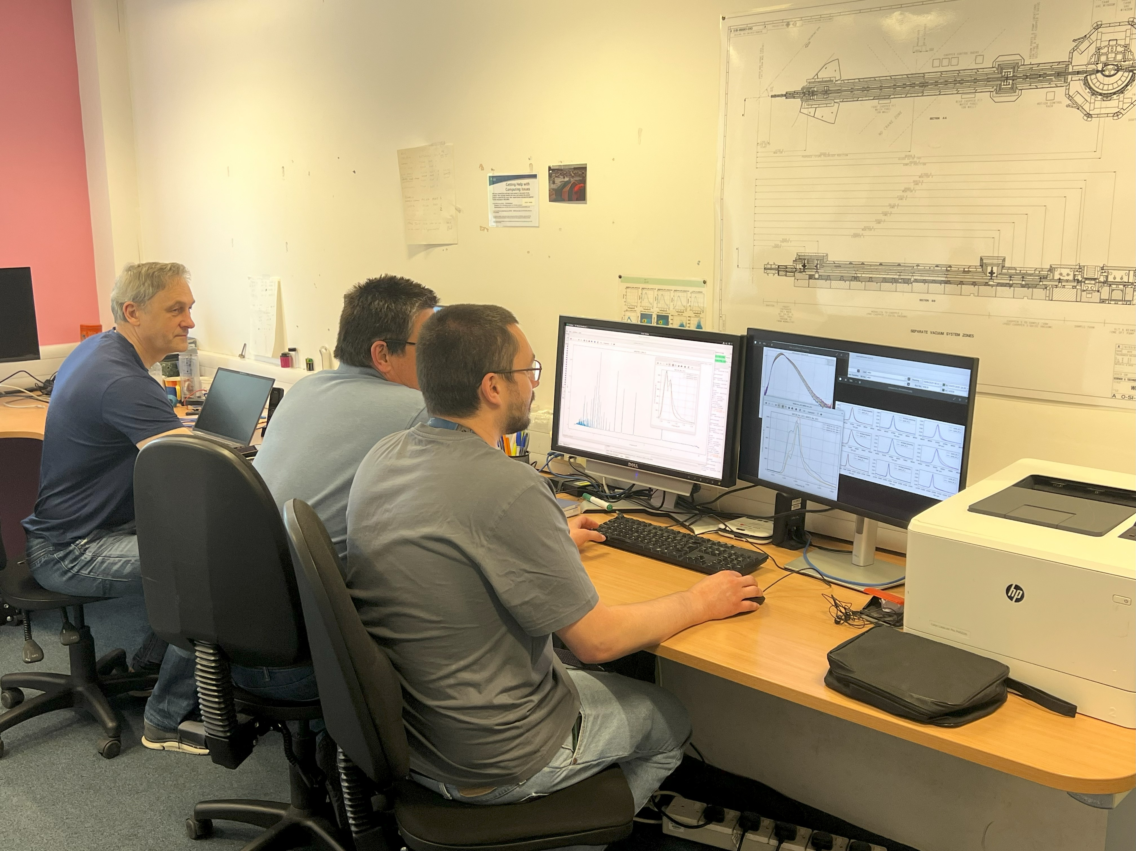
A big thank you
Target Design Group:
Paul Morgan
David Jenkins
Dan Coates
Ste Gallimore
ISIS Neutronics:
Goran Skoro
Rob Bewley
Steven Lilley
Target Operations:
Julius Bullock
Henry Russell
Graham Wallace
George Torrington
Jon Chapman
Jeremy Moor
Target Control Operations:
Rajesh Gupta
Alex Baker
WISH Instrument team – Pascal Manuel, Dmitry Khalyavin, Fabio Orlandi

Slide 28
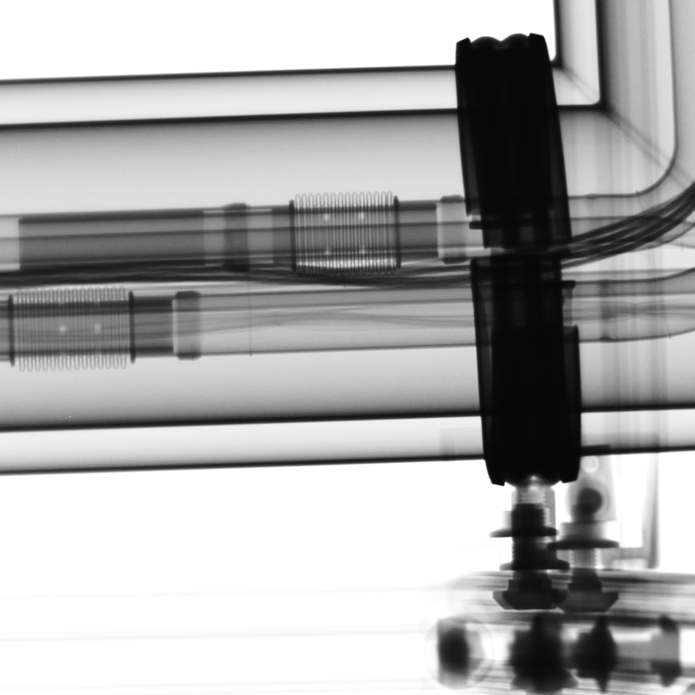
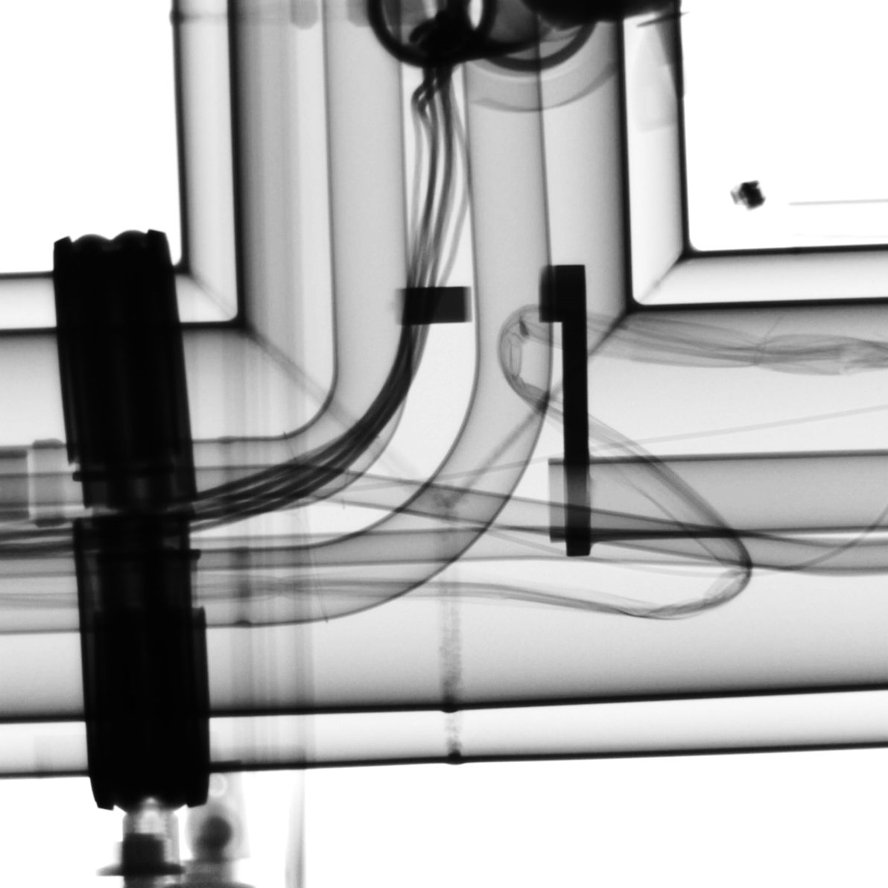
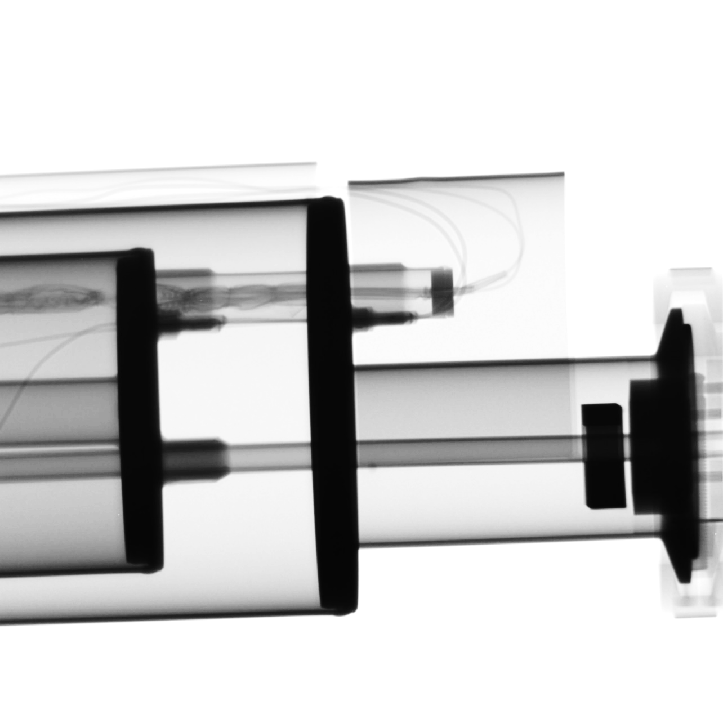
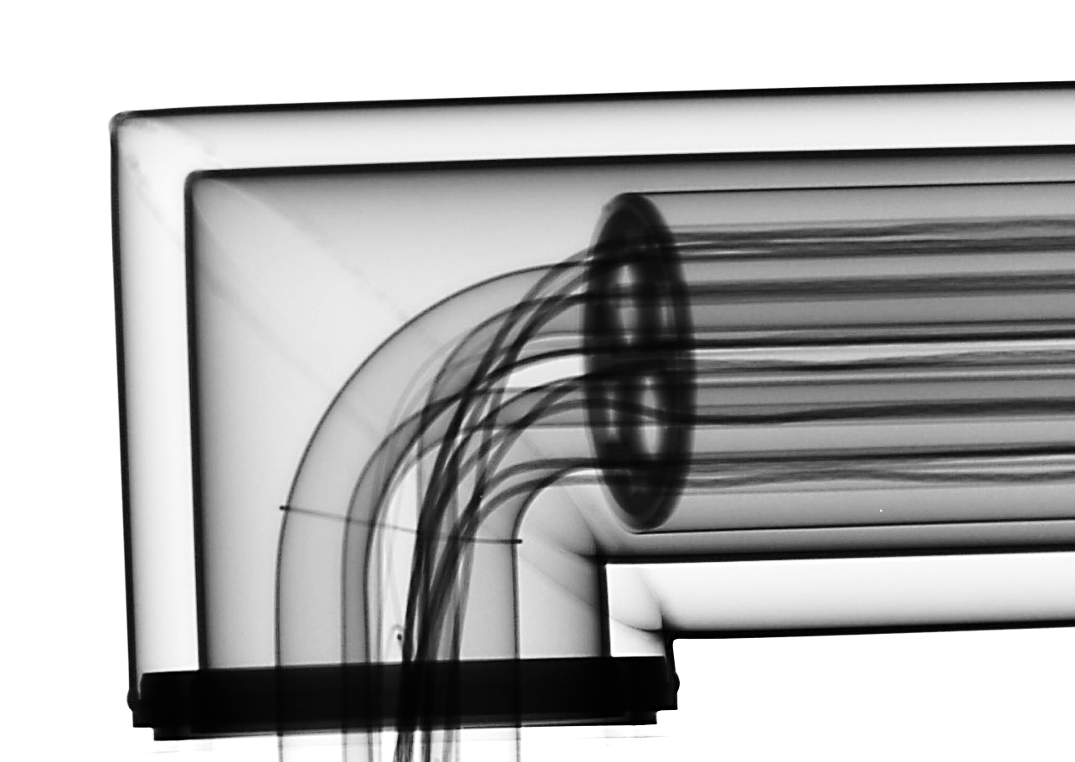
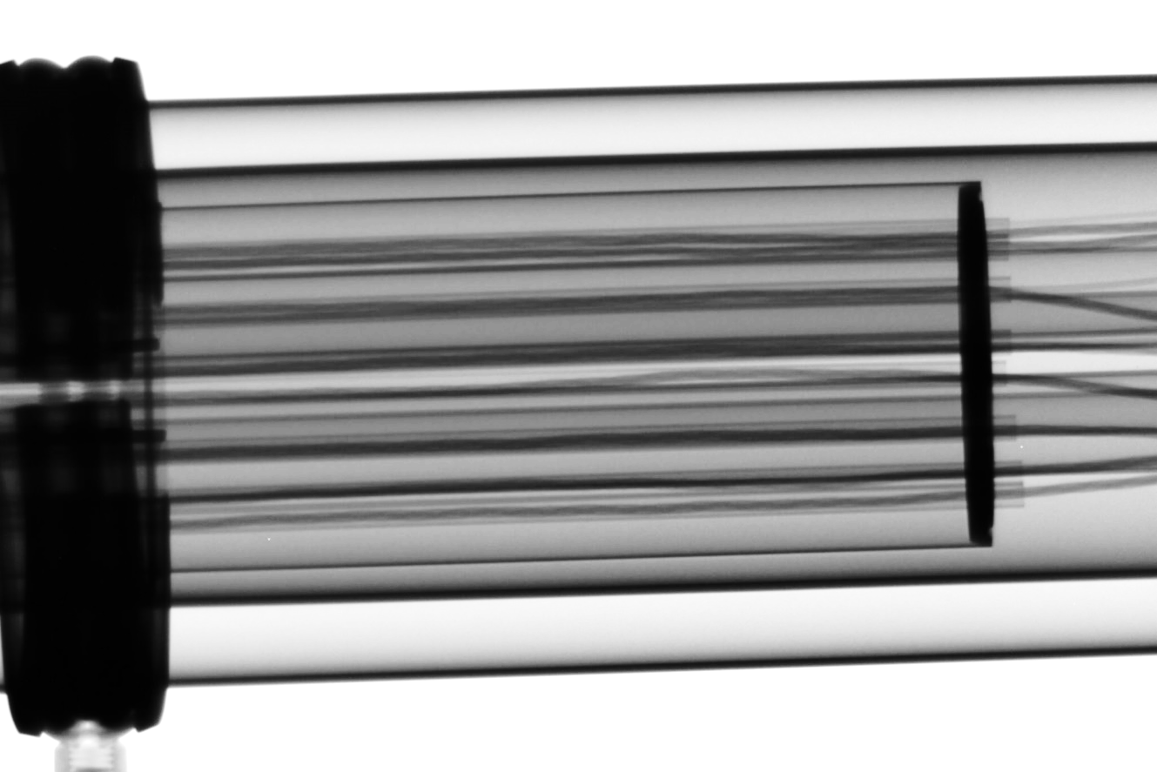
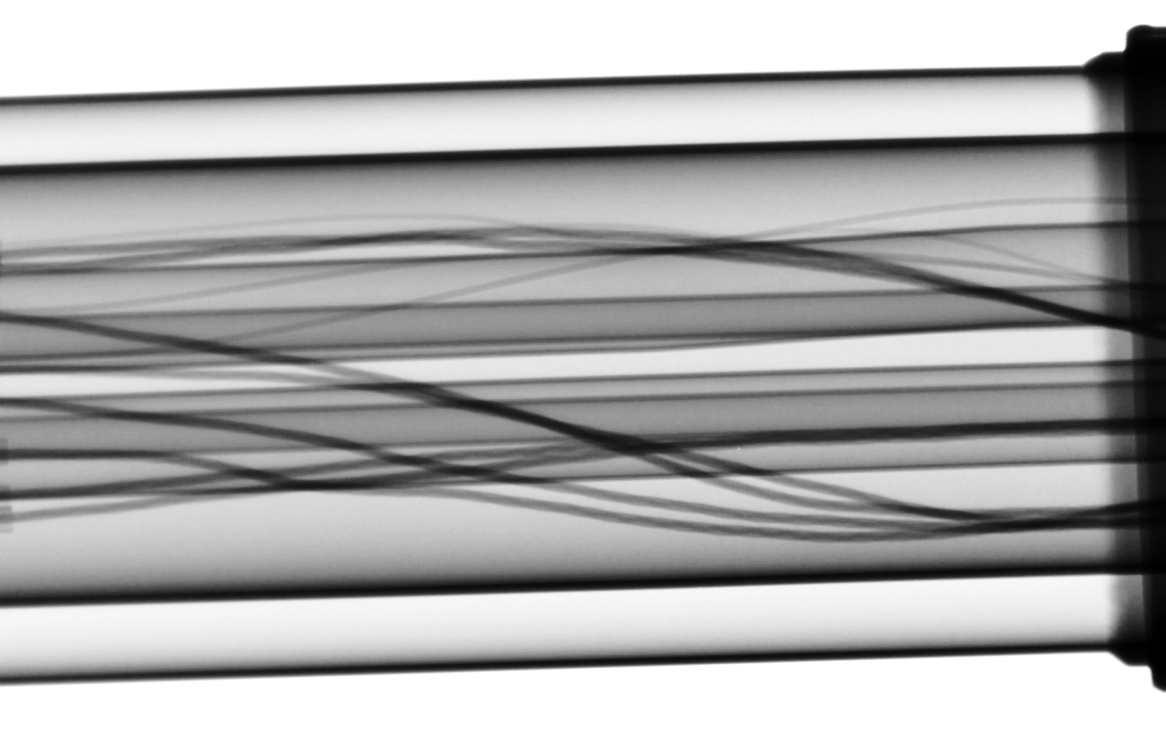
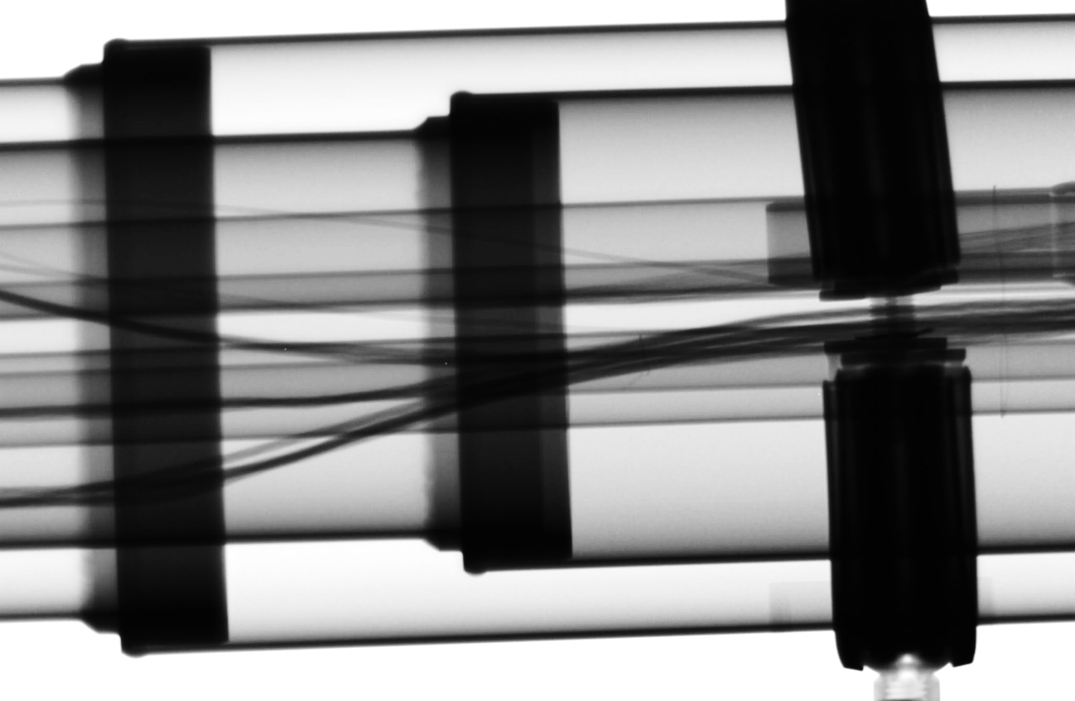
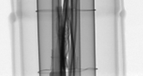
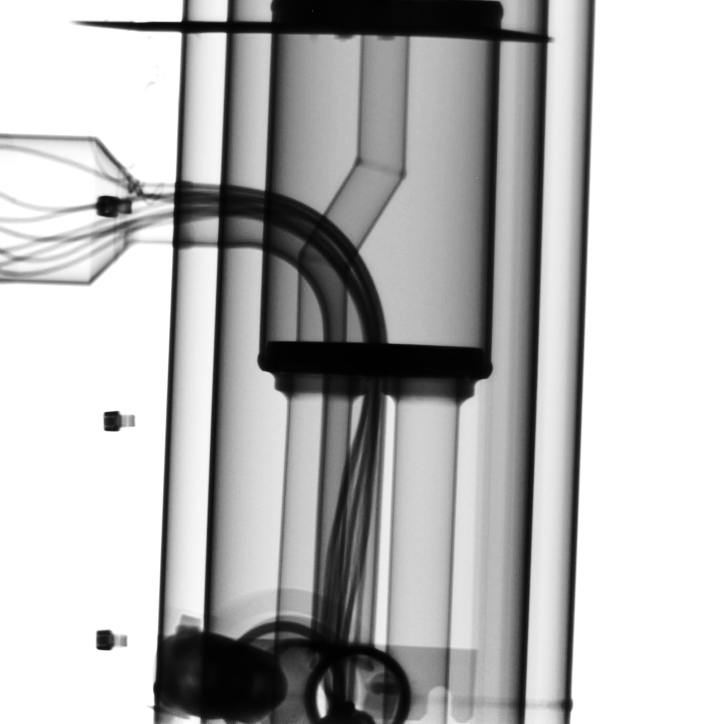

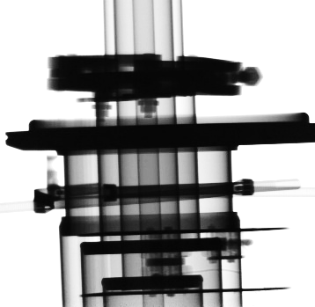
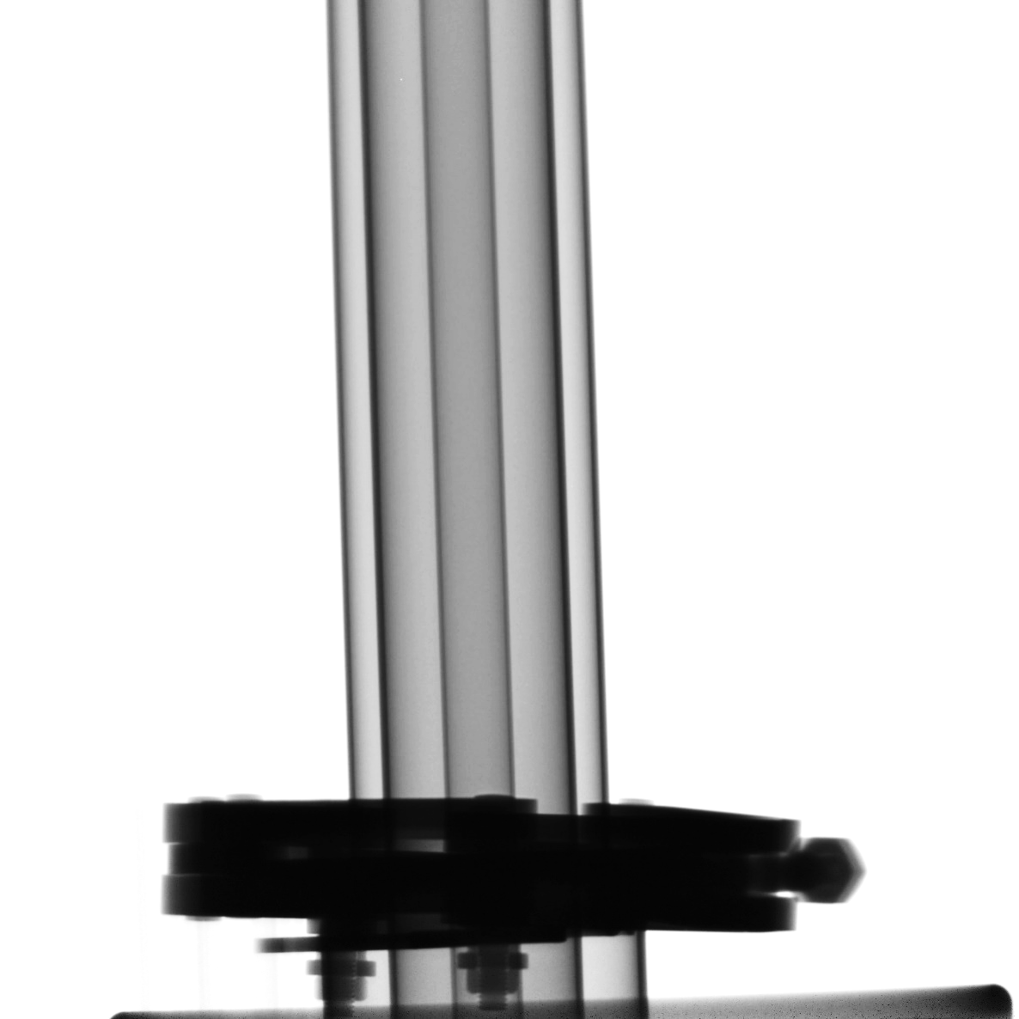
Questions?

Slide 29
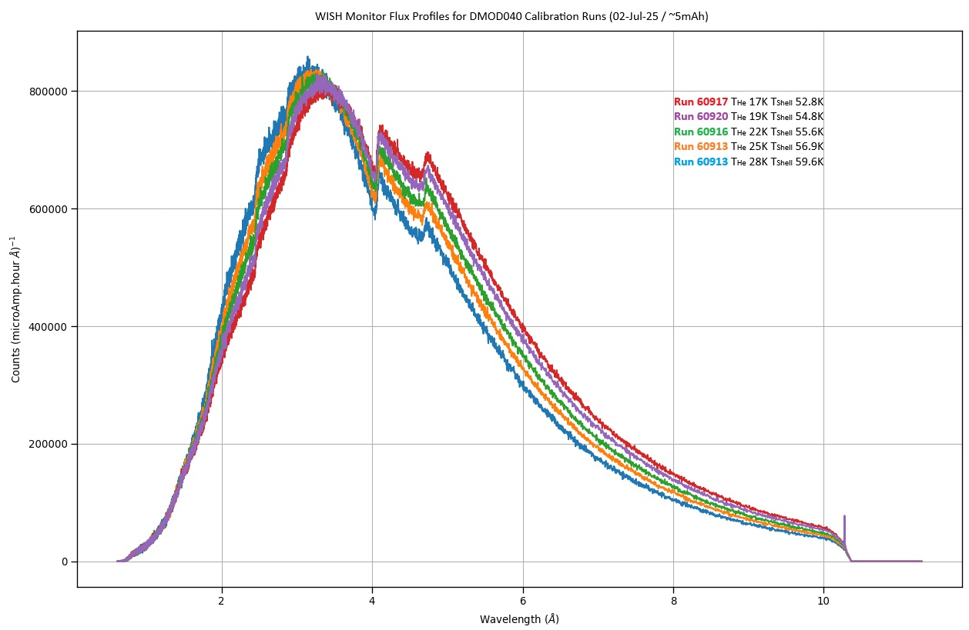
DMOD 040 Calibration @ 5mAh

Slide 30
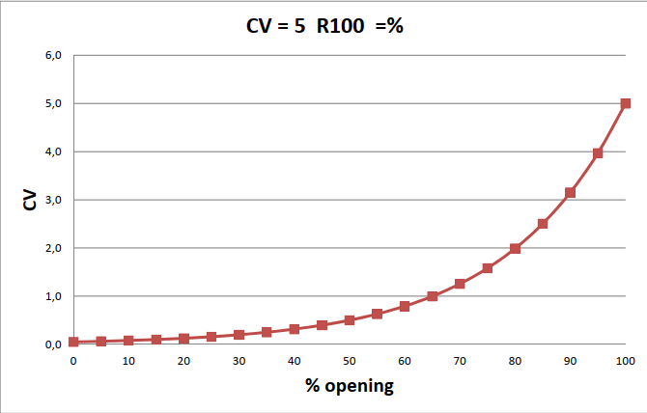
Bypass valve
50% open = 0.5 Cv
100% open = 5 Cv
So, 50% open means 10% flow capacity!
Notes:
We found out from the manufacturer of the bypass valve that 50% open does not mean 50% of the flow capacity, but actually 10%! So, we have been diverting a lot less flow than previously thought.

Slide 31
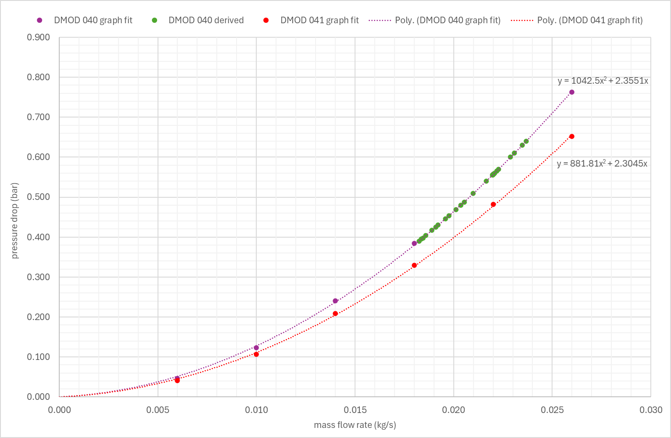
Pressure drop vs mass flow rate
Using new relationship, can estimate mass flow rate based on pressure drop in system
Notes:
Applying the 16% error to my calculations on both Mk2 and Mk3 (or DMOD 040 and DMOD 041), the green dots here show the data points from testing, and that we managed to increase the flow rate by 4 or 5g/s and saw no impact on temperature.
I can now use these plots to estimate mass flow rates based on circuit pressure drop

Slide 32
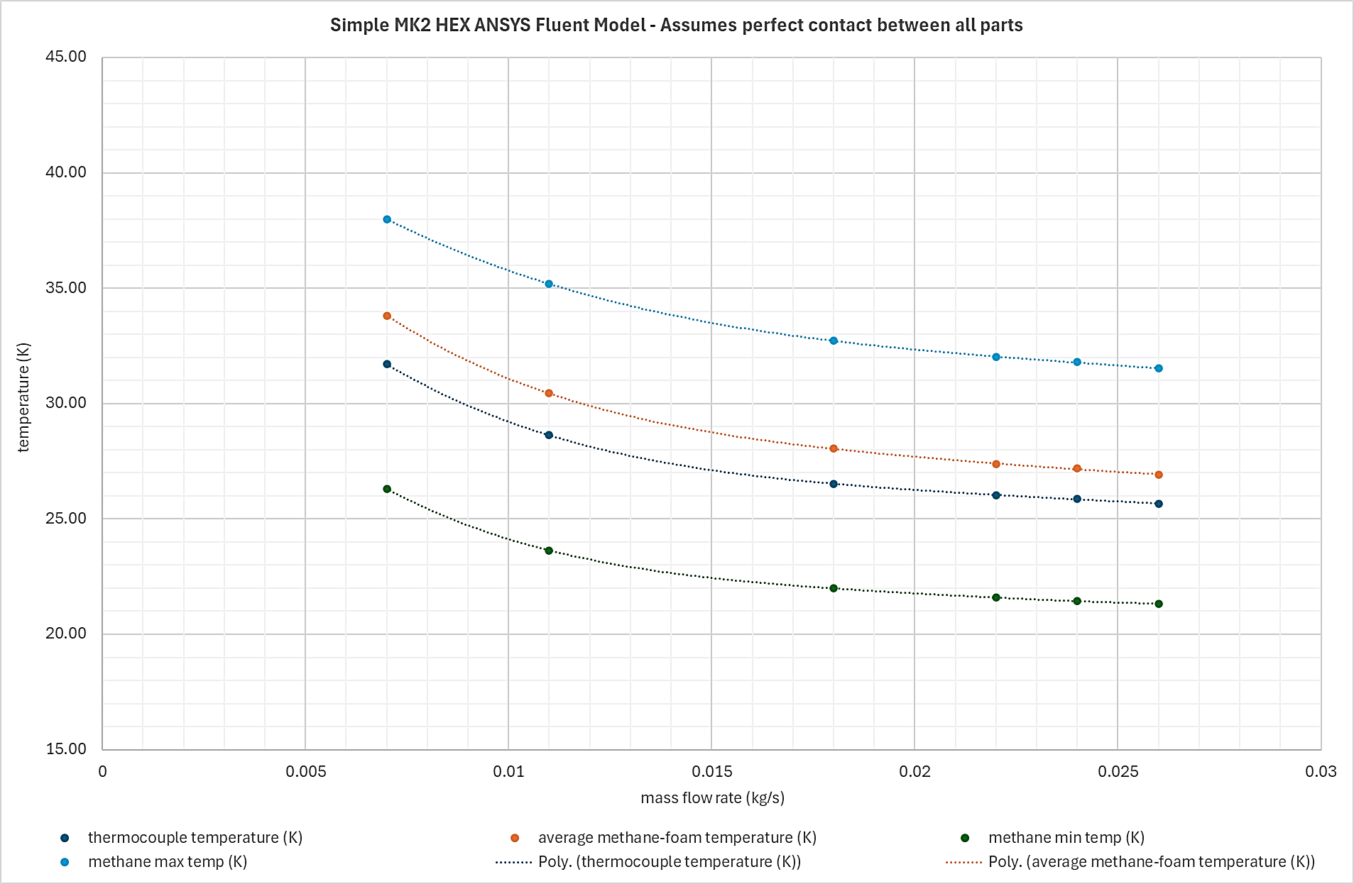
ΔT ~ 11K
ΔT ~ 10.4K
Notes:
Using the new simulation data, I could show what we might expect from DMOD 040 to DMOD 041.
This graph shows the temperature distribution in the methane as well as the difference in temperature between methane and thermocouple block. Across all flow rates, the difference between maximum and minimum methane temperature relatively constant at 10-11K.

Slide 33
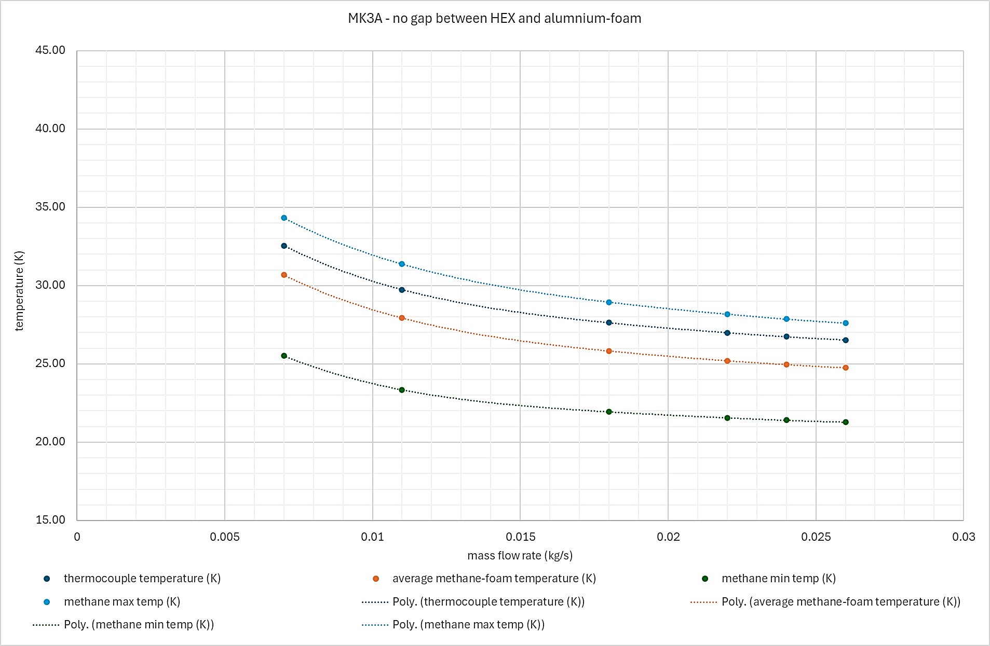
ΔT ~ 8.5K
ΔT ~ 6.6K
Notes:
However, for DMOD 041, it was expected to be less, somewhere between 8.5 and 6.6 K.
As seen in the previous slides, I also expected the average methane temperatures to be 2-3 degrees lower in DMOD 041.

Slide 34
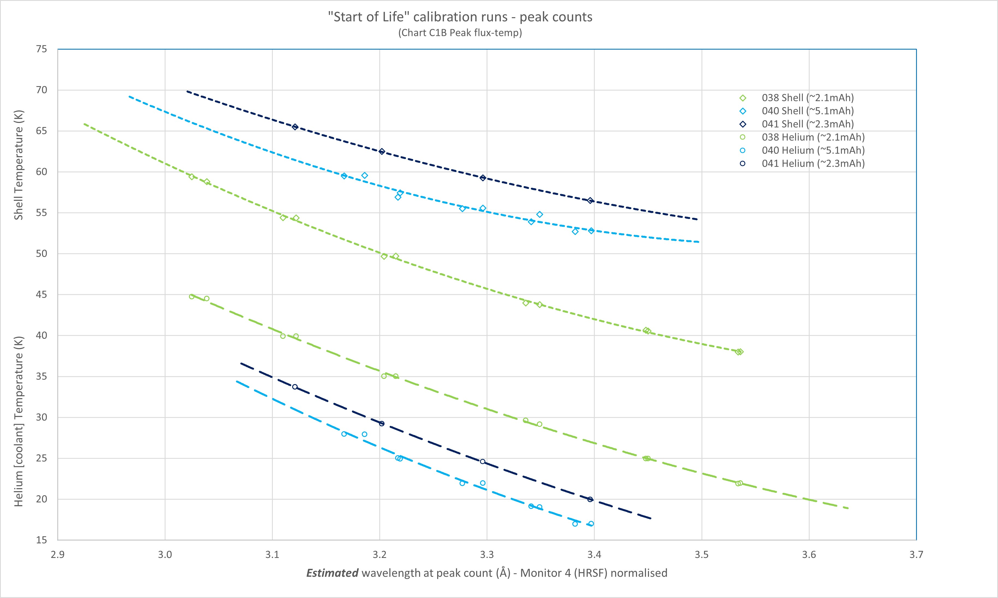
Similar ΔT for DMOD 040 and 041
DMOD 038 ΔT much lower

Slide 35
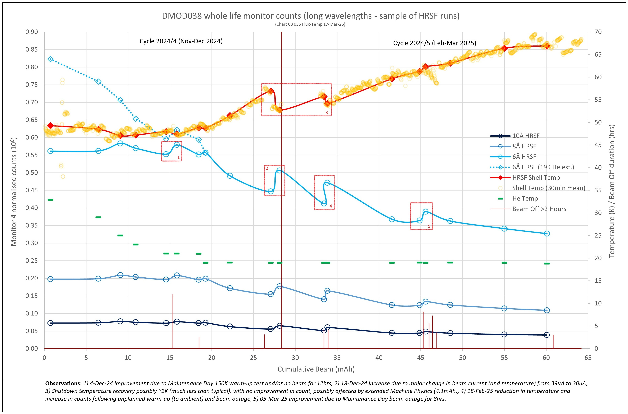

Slide 36
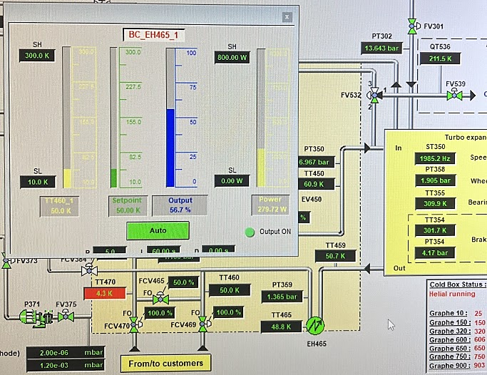
Temperature sensor issue…
Beam off setting
50.7 K, plus 280W heat, gives… 50K!!!
Use pressure drop and predicted flow rate vs pressure drop plot
Assume TT459 works!

Slide 37
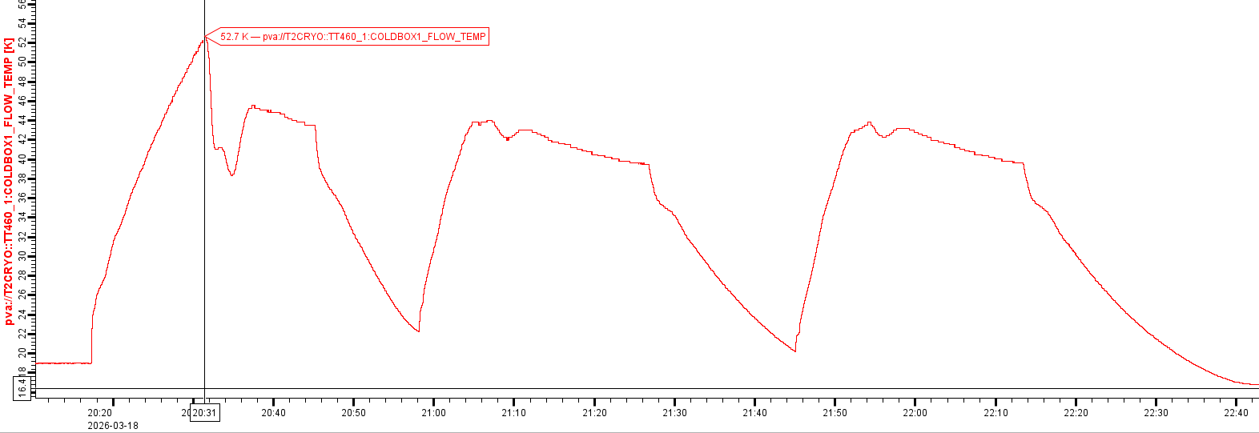
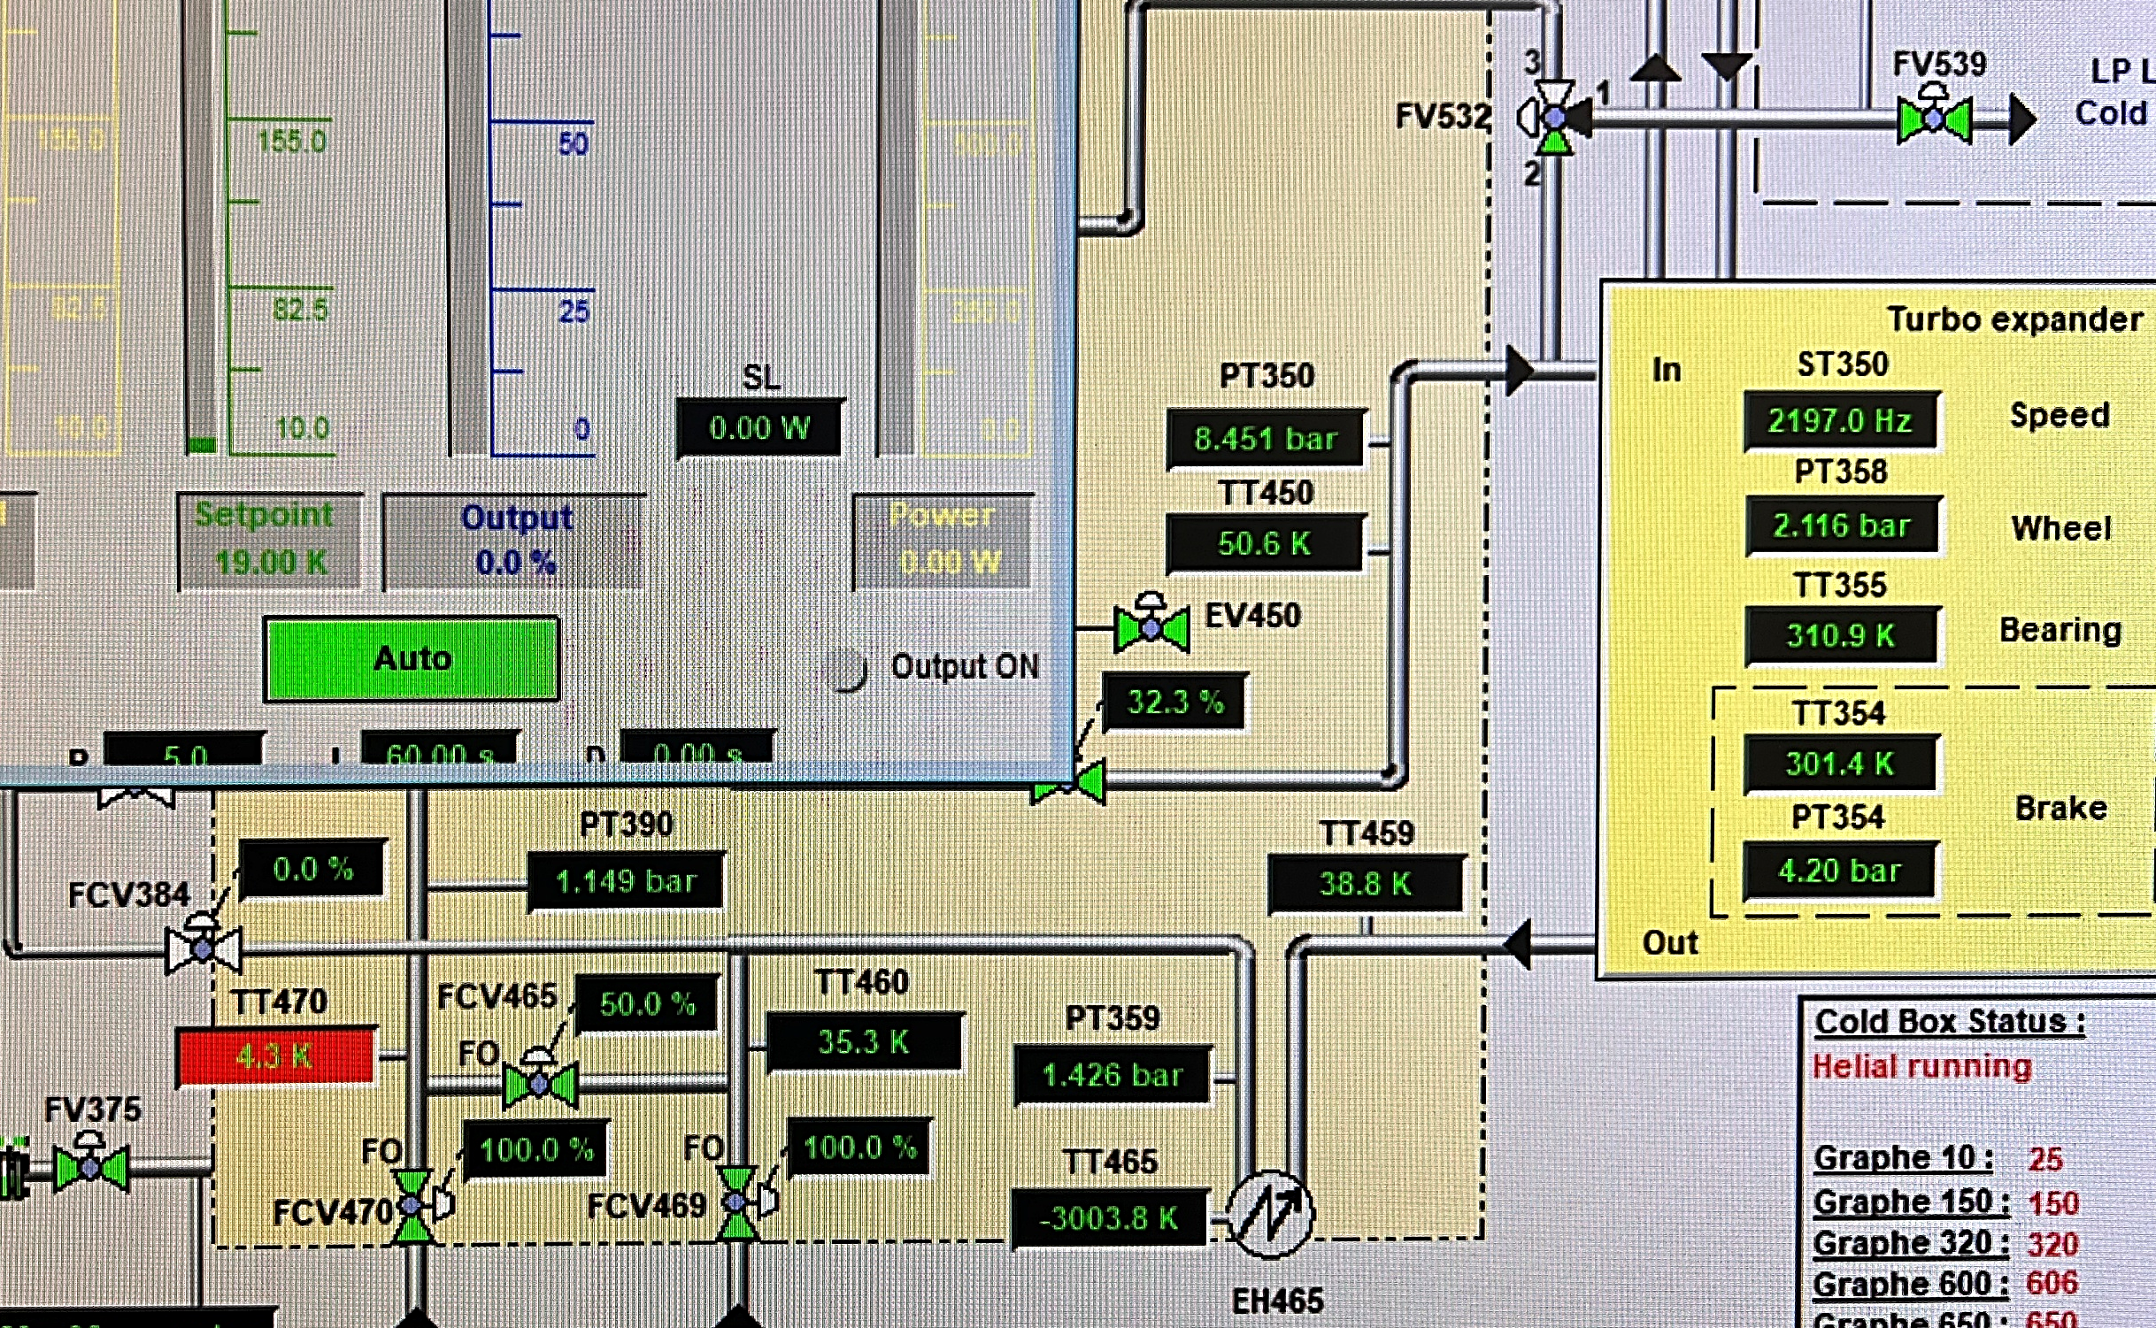
Temperature sensor issue…

