Slide 1
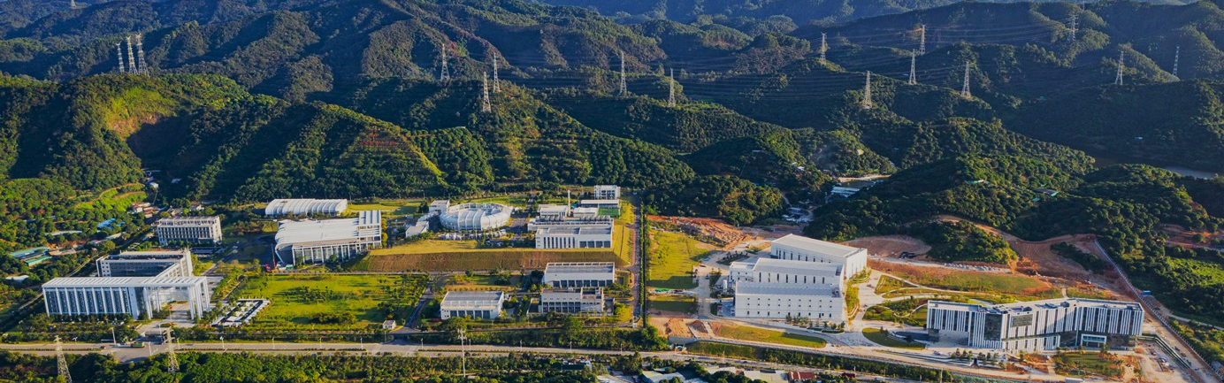


The 25th International Collaboration on Advanced Neutron Sources
Neutron Imaging Detectors @ CSNS
Zhijia Sun（zhjsun@ihep.ac.cn） Detector&Electronics Group
China Spallation Neutron Source, IHEP, CAS
April 16 2026，Malmö

Slide 2
I
Background
Contents
II
Resolution, FOV, Compact Neutron Imaging
III
Energy Resolved Neutron Imaging Based on Timepix4
Outline
IV
Summary and Outlook

Slide 3
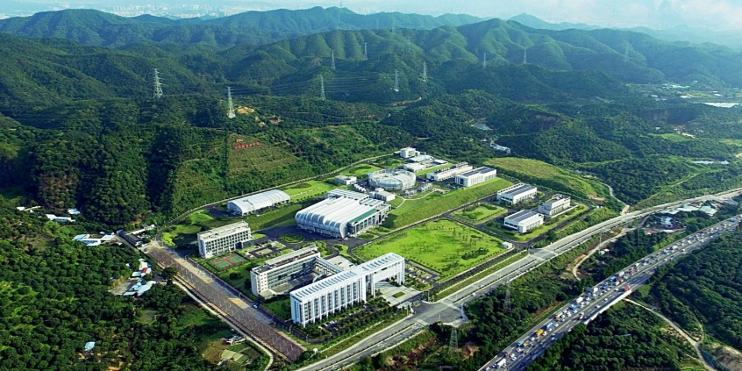
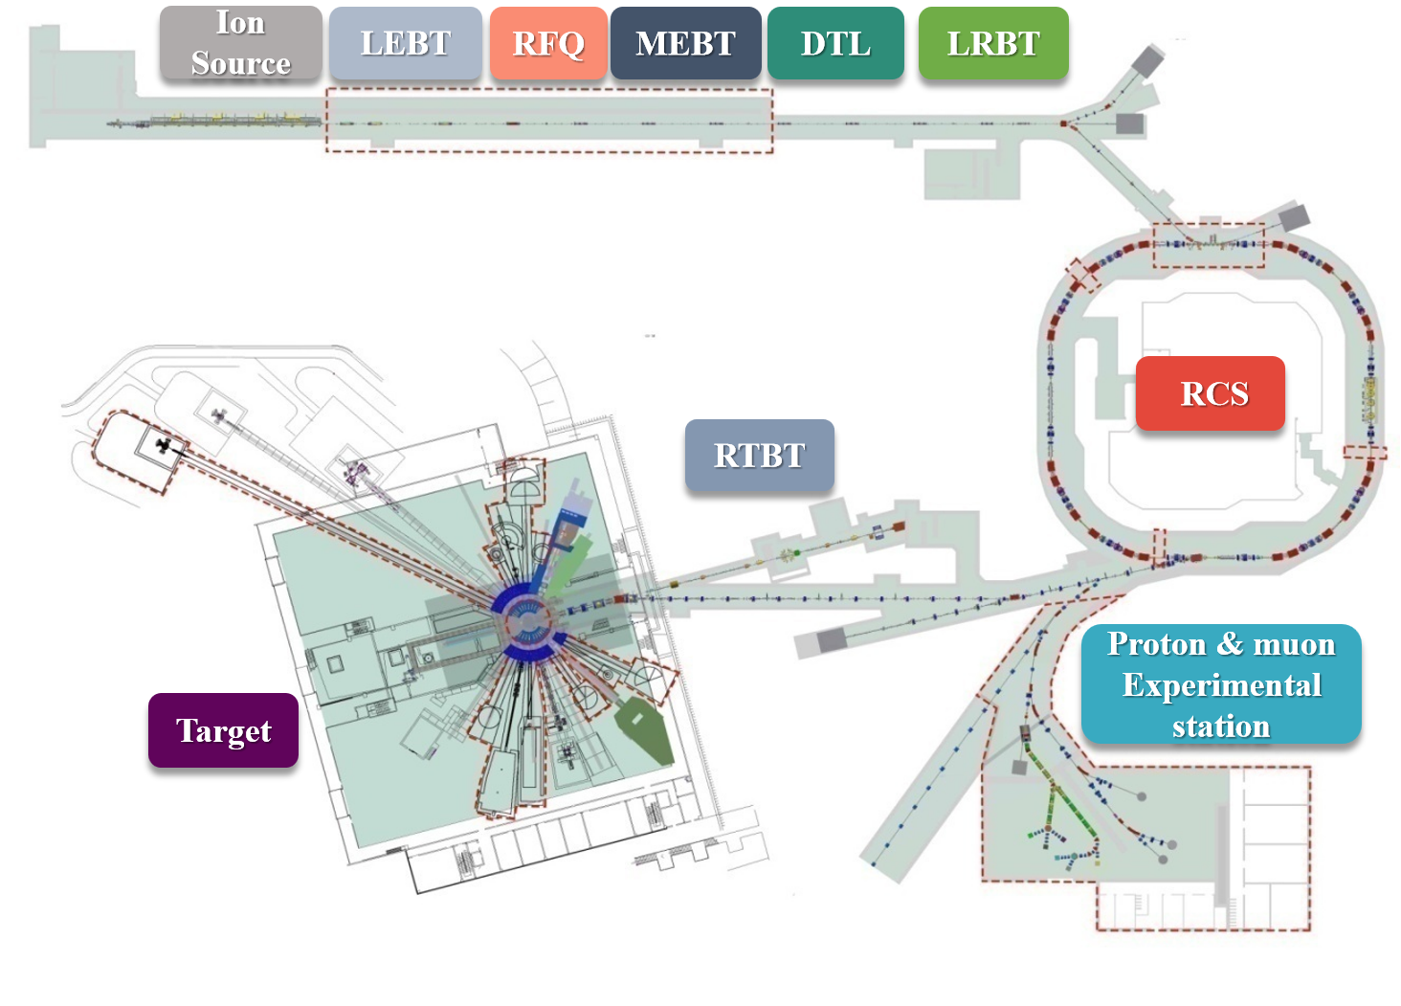
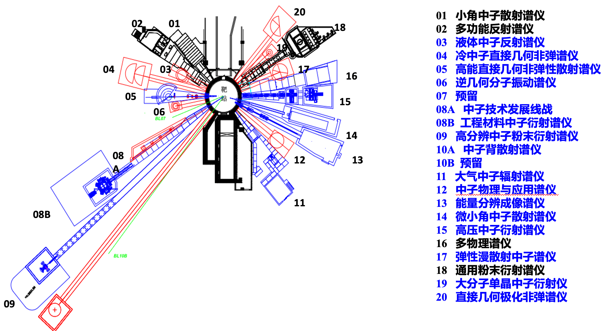
China Spallation Neutron Source(CSNS)
Aerial View of CSNS
Layout of CSNS
Properties of CSNS
 | Phase I | Phase II
Proton Beam Power (kW) | 100 | 500
Pulse Frequency (Hz) | 25 | 25
Mean Intensity of Proton Beam (μA) | 62.5 | 312.5
Energy of Protons (GeV) | 1.6 | 1.6
Proton Energy at Injected Port of RCS (MeV) | 80 | 300
Number of Instruments | 3 | 9
Instruments Layout
01 Small-Angle Neutron Scattering
02 Multi-Purpose Reflectometer
03 Liquid Reflectometer
04 Cold Neutron Inelastic Spectrometer
05 High-Energy Direct-Geometry Inelastic Spectrometer
06 Indirect-Geometry Molecular Vibrational Spectrometer
07 Reserved
08A Neutron Technology Development
08B Engineering Material Neutron Diffractometer
09 High-Resolution Neutron Diffractometer
10 Neutron Backscattering Spectrometer
11 Atmospheric Neutron Irradiation Spectrometer
12 Neutron Physics and Application Spectrometer
13 Energy-Resolved Neutron Imaging Instrument (ERNI)
14 Very Small-Angle Neutron Scattering
15 High-Pressure Neutron Diffractometer
16 Multi-Physics Instrument
17 Elastic Diffuse Scattering Neutron Diffractometer
18 General-Purpose Powder Diffractometer
19 Macromolecular Single-Crystal Neutron Diffractometer
20 Direct-Geometry Polarized Inelastic Spectrometer
3 phase-I instruments
8 cooperative neutron instruments
9 phase-II instruments
3

Slide 4
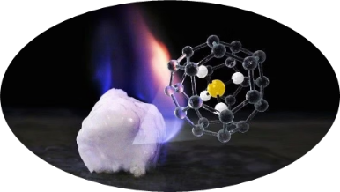
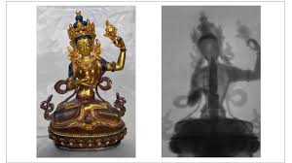
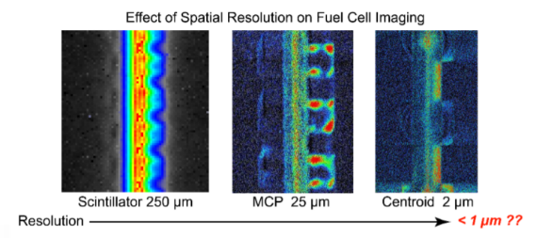

Road-map
Science
Neutron imaging physics,
instrument requirements
Renewable Energy
Archaeology and Cultural Heritage
Instruments
Materials Science,
Energy, Archaeology
Team
CSNS
Neutron Imaging Detectors
Detector & Electronics
Group, CSNS/IHEP
Technology
Scintillators, Timepix4,
in-house electronics
Environmental Science
Fuel cell

Slide 5
Neutorn Imaging Dtector Family
High spatial and Medium field detectors
Ceramic scintillator
Energy-resolved detector (Timepix3)
Imaging detectors commissioned at ERNI
Camera based on Timepix4
Ceramic scintillator thickness 20 μm spatial resolution 12 μm
2017
2023
2025
……
spatial resolution 18 μm achieved
Compact imaging detector
Neutron imaging microscope, spatial resolution 6.6 μm
Energy-resolved detector (Timepix4)
2018
2021
Large field detectors
2024
Neutron Imaging Detector family
High spatial resolution detector
GOS scintillator (powder, ceramic) and hBN scintillator
Spatial resolution <10 μm
Energy-resolved detector
High speed camera (Timepixe3，TimePixel4)
Max FOV ≥100mm × 100mm，spatial resolution <14 μm
Large field detector
Large area ⁶LiF/ZnS scintillator
Max FOV ≥200 mm × 200 mm
Compact detector
sCMOS camera, medium area ⁶LiF/ZnS scintillator
FOV 100 mm × 100 mm, spatial resolution 122 μm

Slide 6
I
Background and Motivation
Contents
II
Resolution, FOV, Compact Neutron Imaging
III
Energy Resolved Neutron Imaging Based on Timepix4
Outline
IV
Summary and Outlook

Slide 7
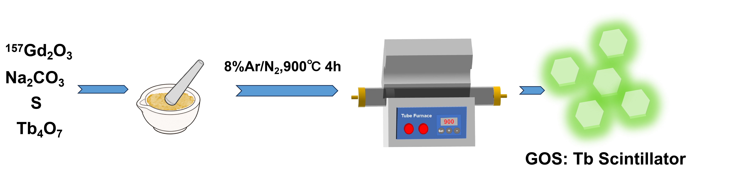
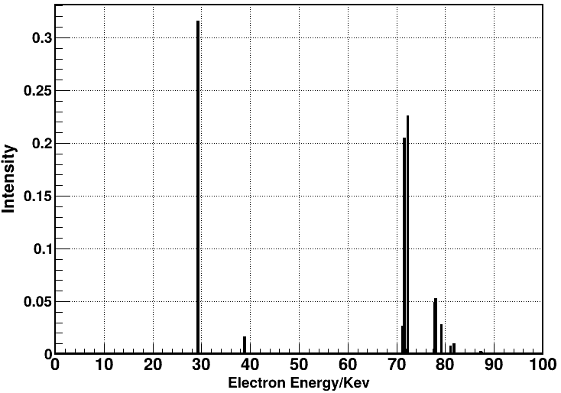
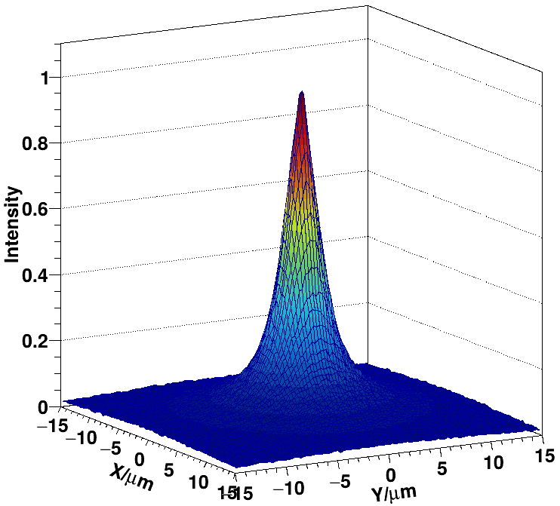
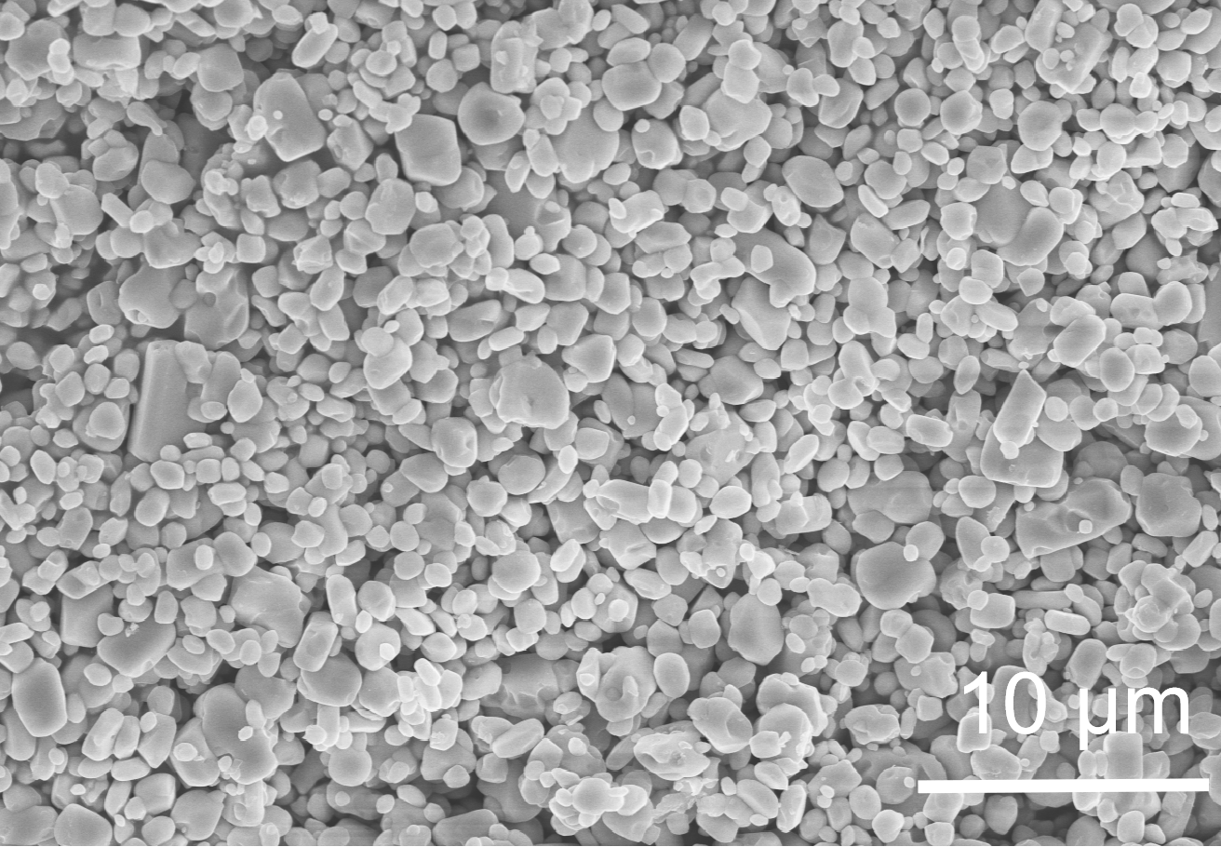
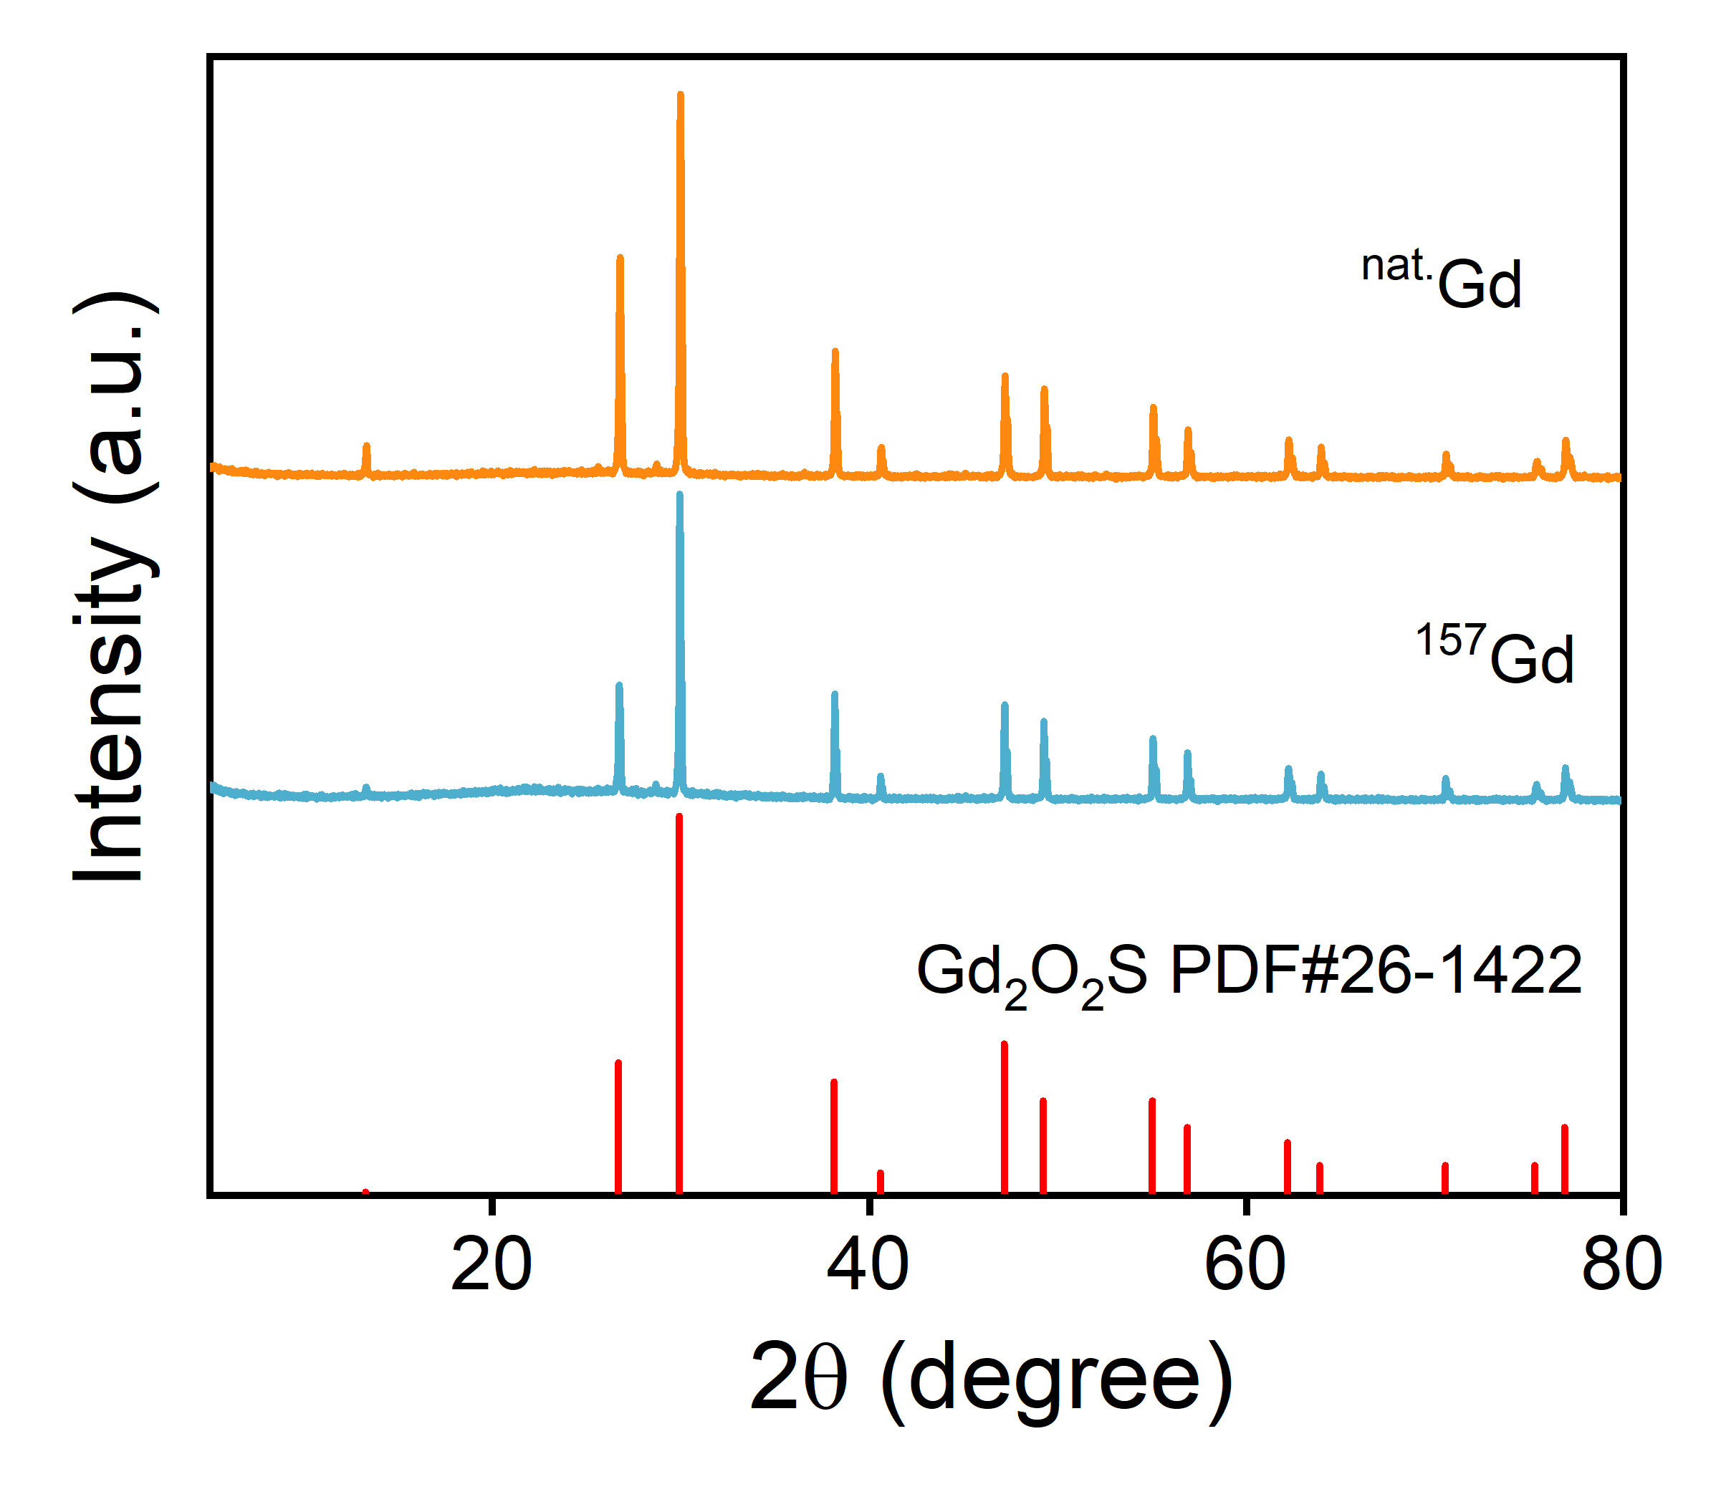
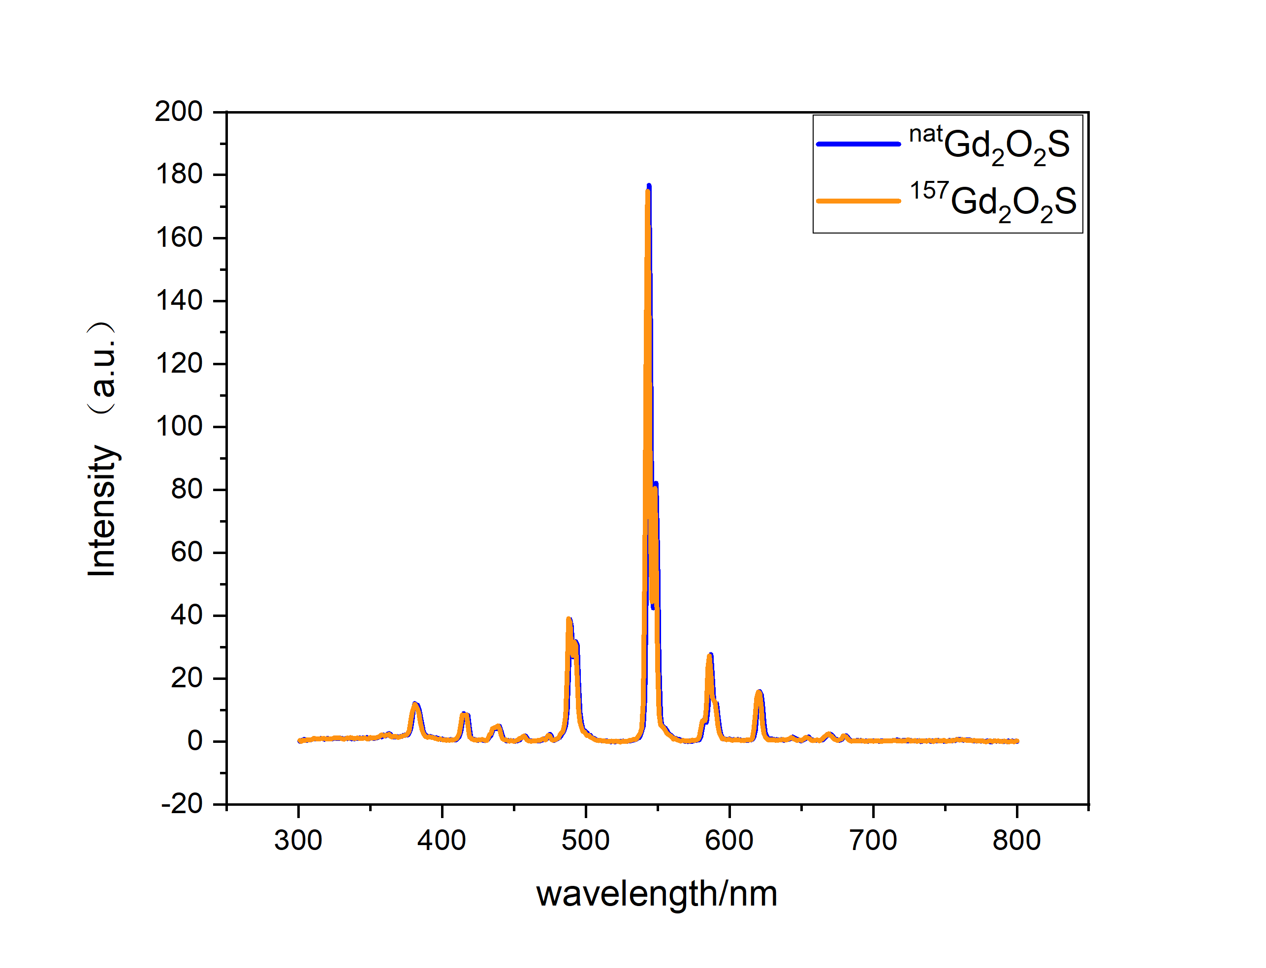
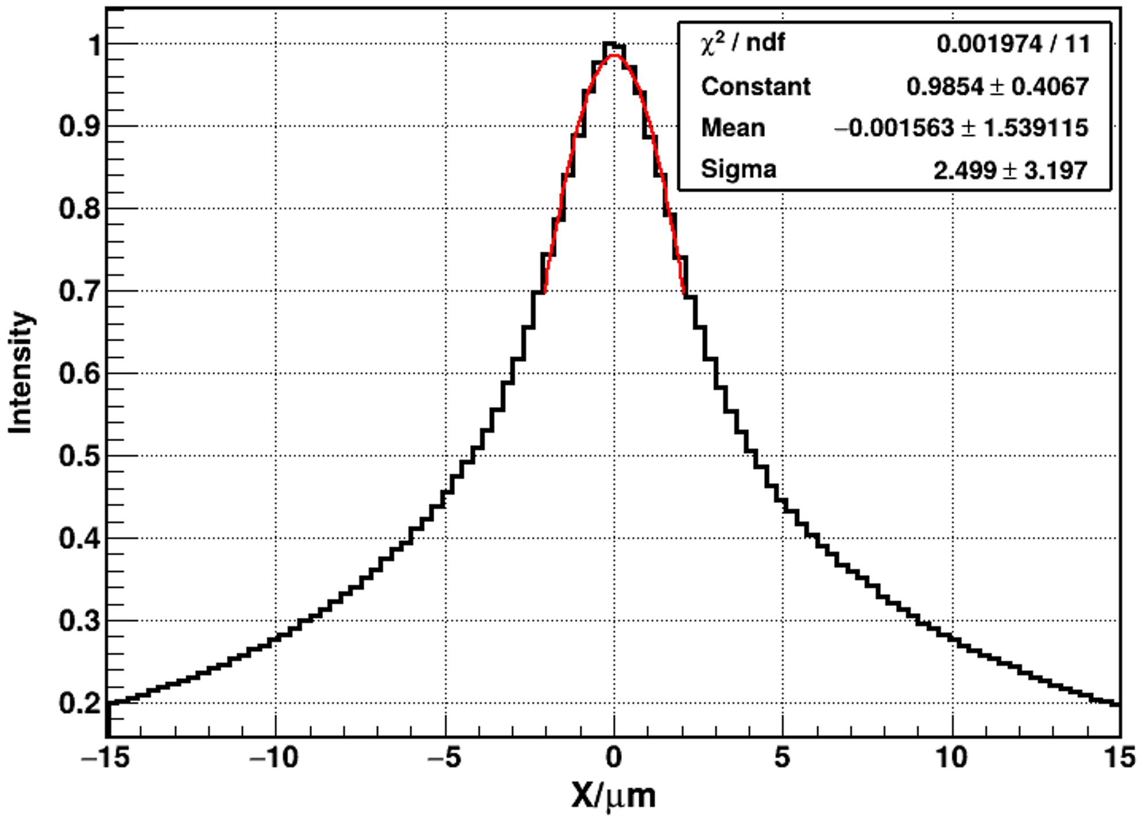
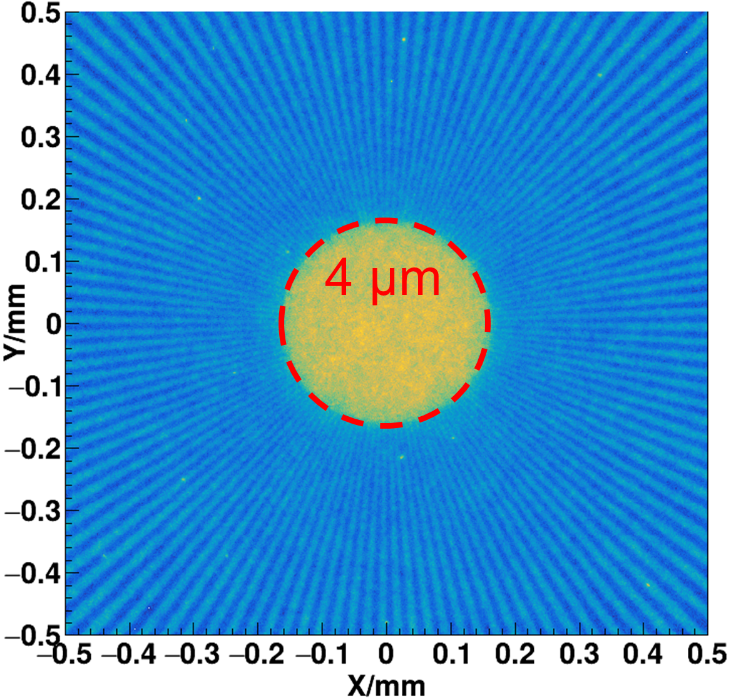
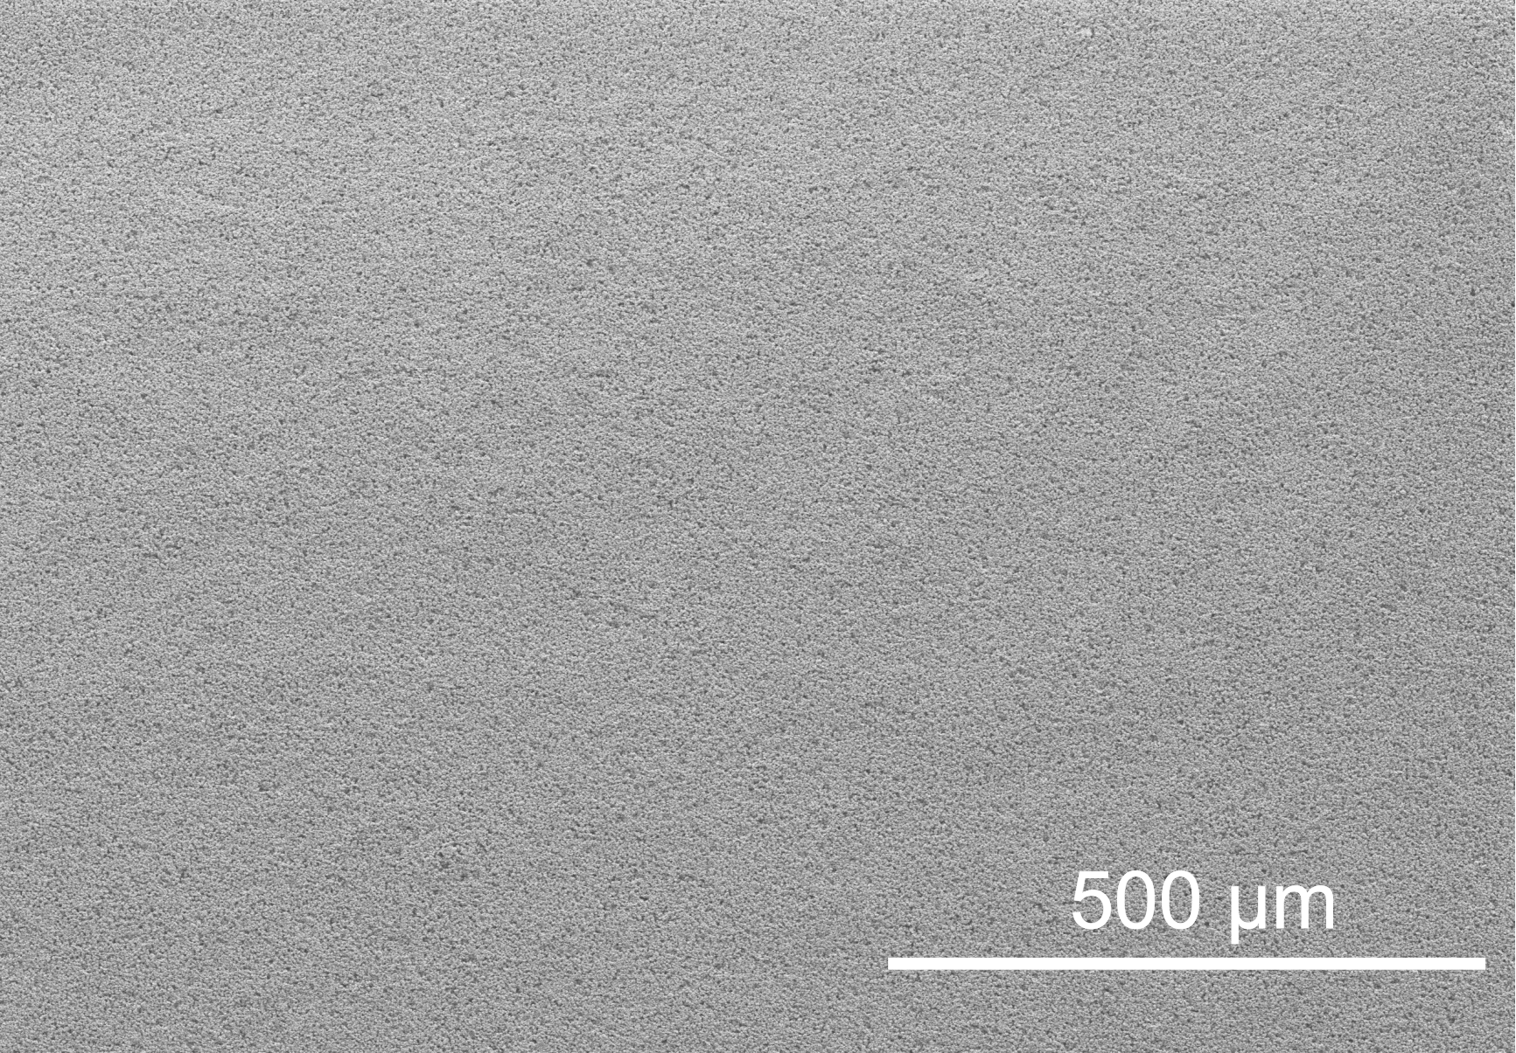
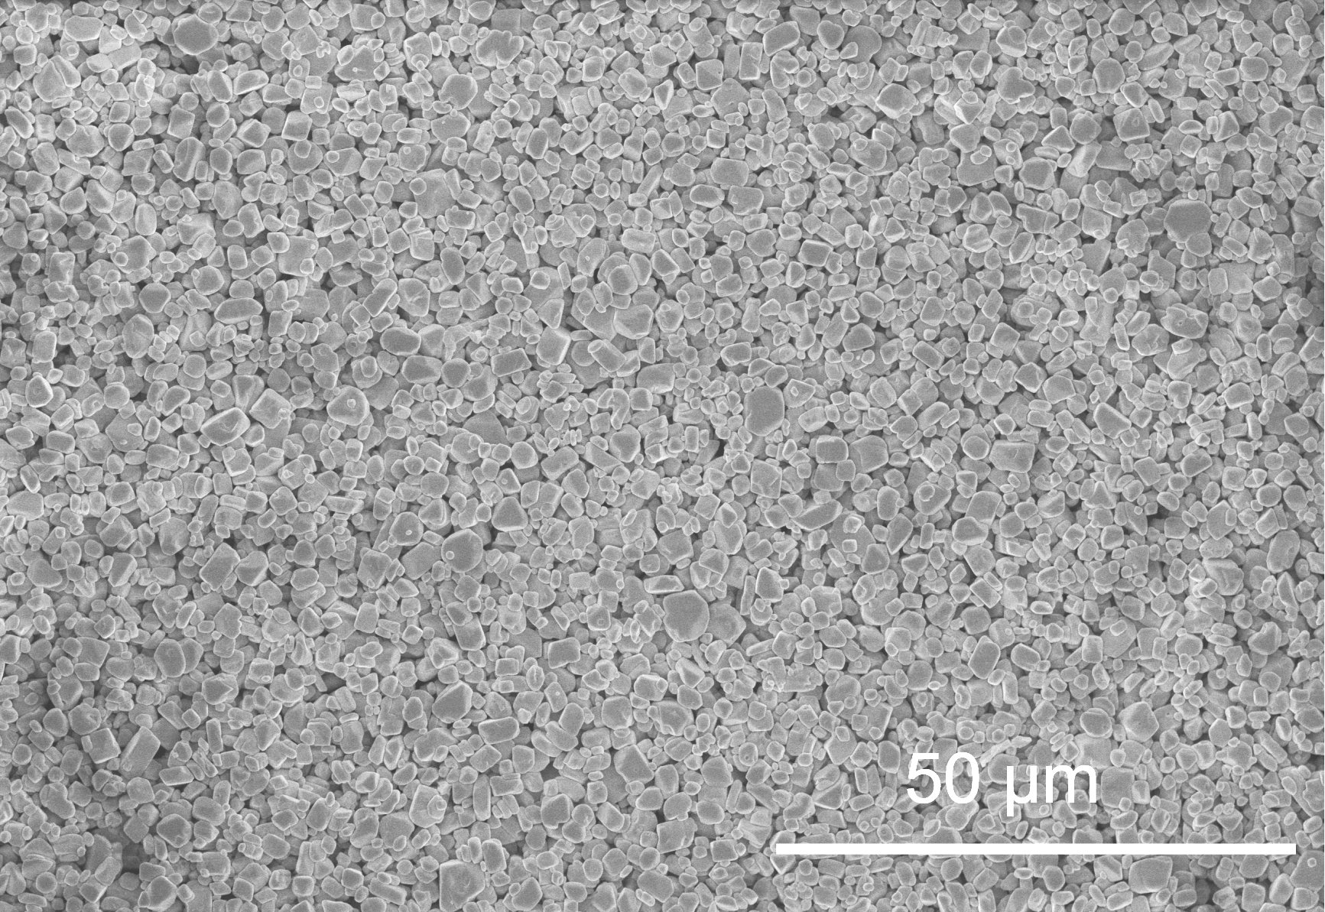
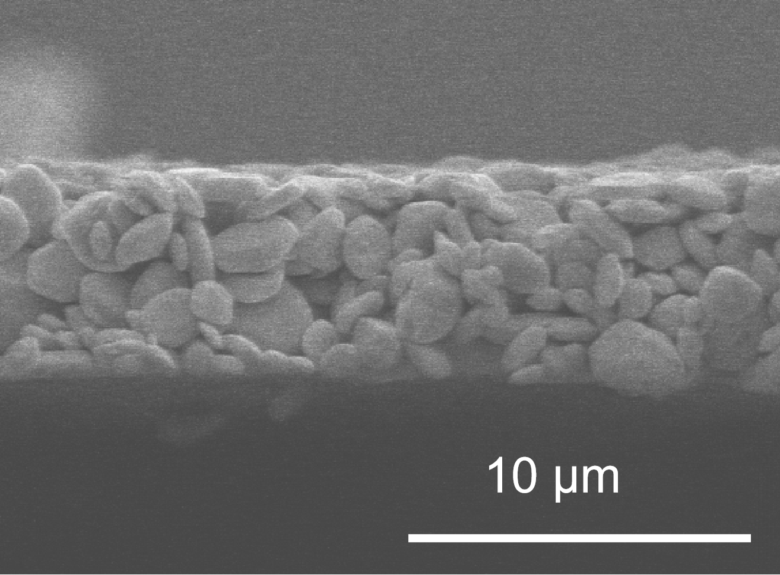
High Spatial Resolution Imaging Detector
Ultra-thin isotopically enriched gadolinium oxysulfide (¹⁵⁷Gd₂O₂S:Tb) scintillator
Thickness 5 μm , 88% abundance of ¹⁵⁷Gd, particle size ranges from several hundred nanometers to approximately 2 μm.
Scintillator simulation
Scintillator fabrication
Light Spot
GOS particles
XRD of Gd isotopes
Fluorescence spectrum
SEM ( low magnification）
SEM( high magnification）
SEM(cross-section）
FWHM 6μm
（Technical Institute of Physics and Chemistry，CAS）

Slide 8
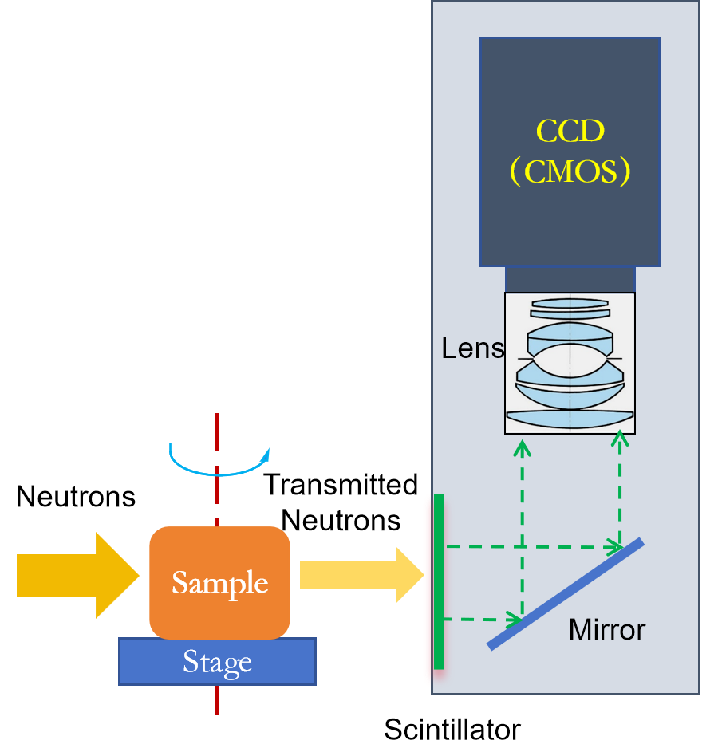
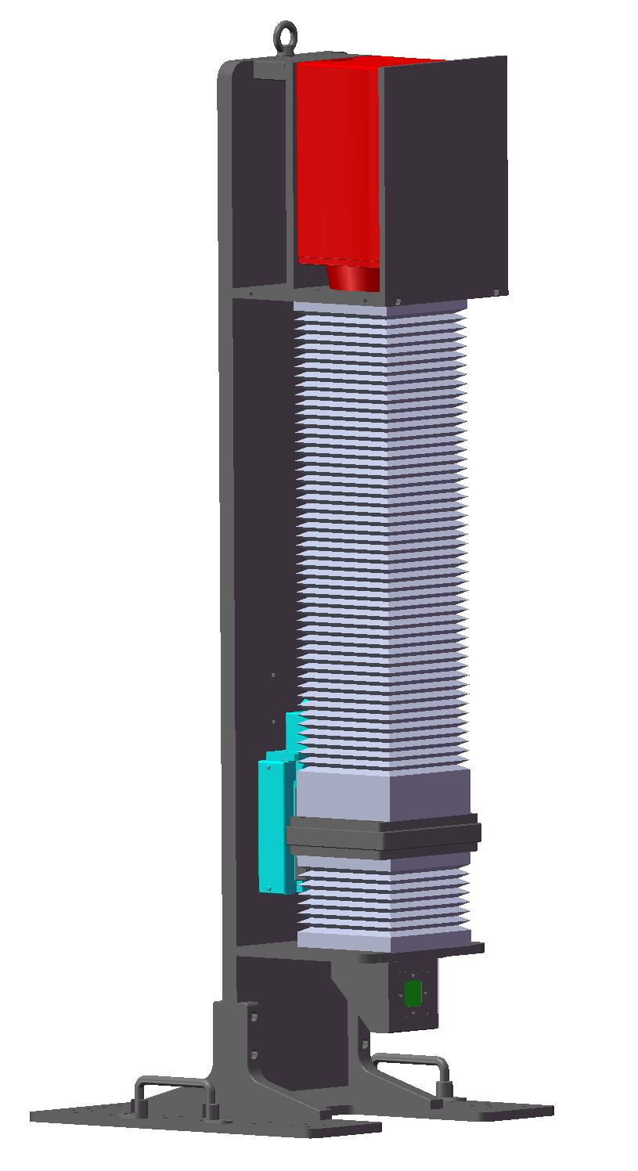
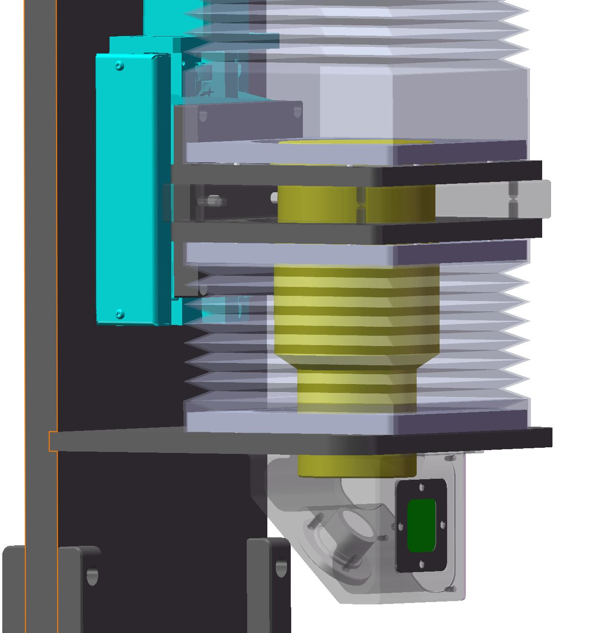
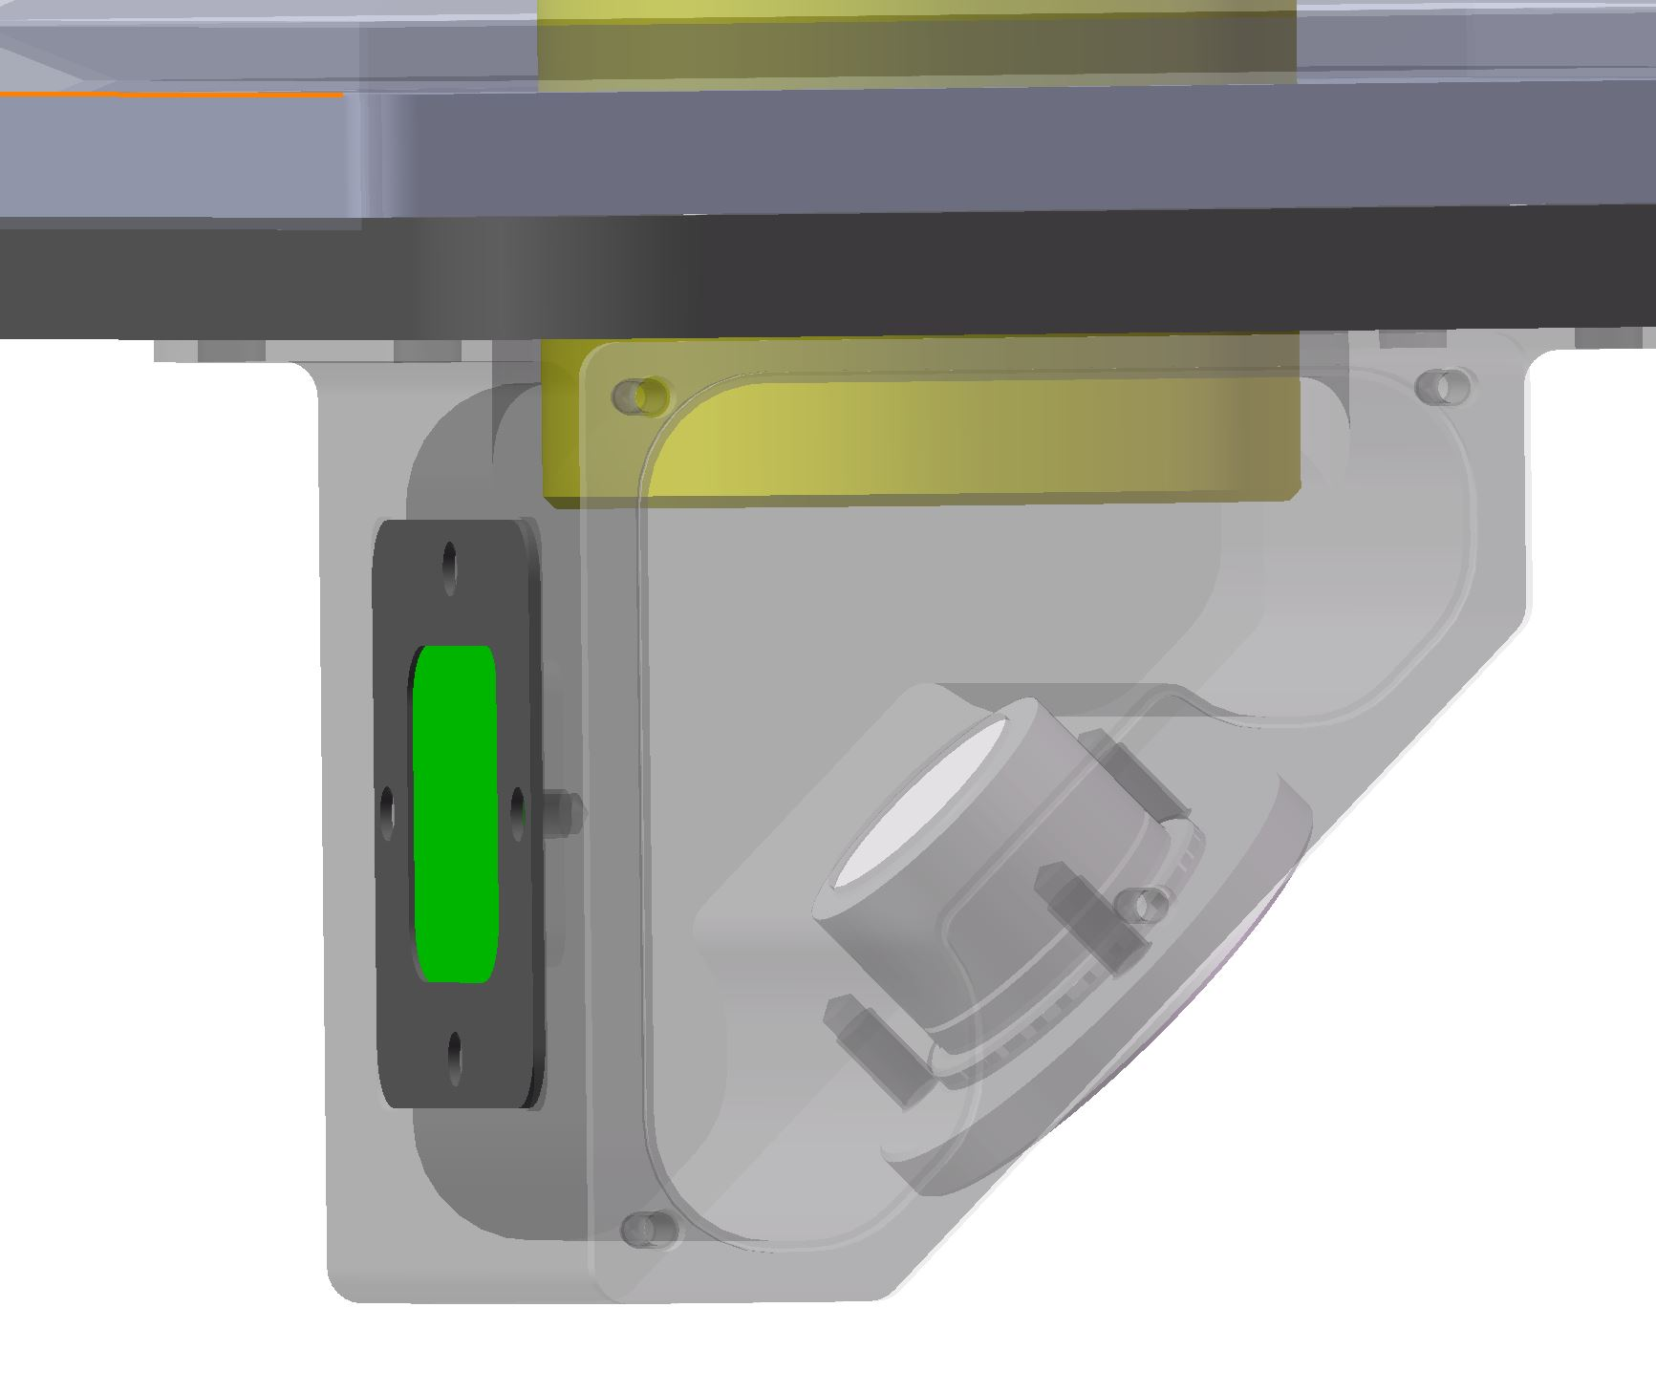
High Spatial Resolution Imaging Detector
The micron-level spatial-resolution neutron imaging detector
First ‘Neutron imaging microscope’ at CSNS, spatial resolution 6.6 μm，field of 6.4 mm×6.4 mm
Principle of the detector
Design of the detector
Experiment layout at ERNI
Spatial resolution performance

Slide 9
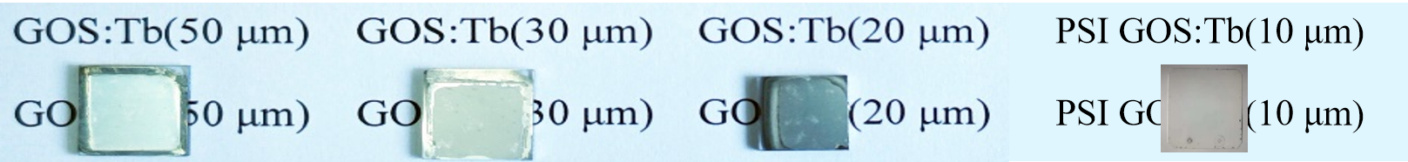
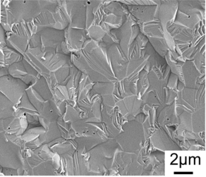
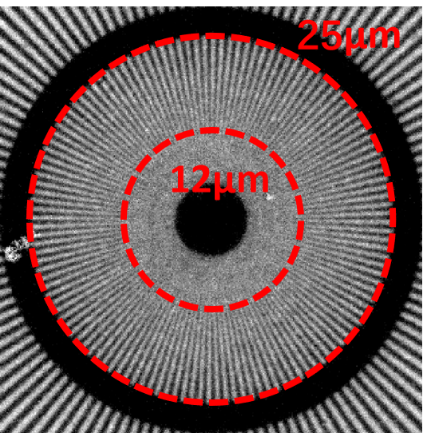
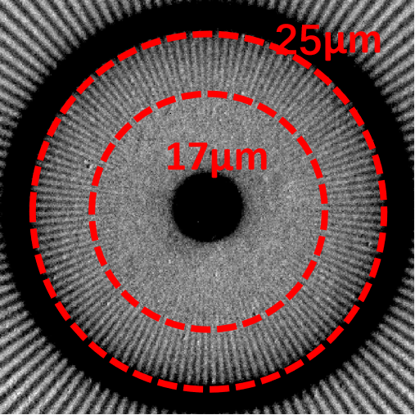
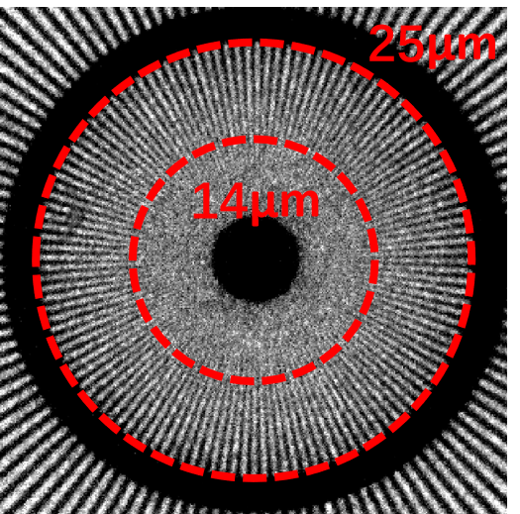
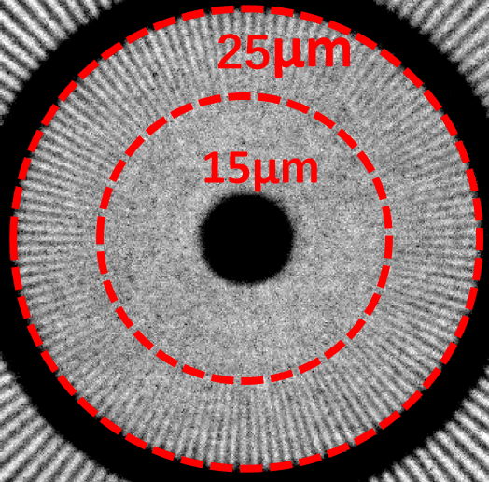
High Spatial Resolution Imaging Detector
Research on alternative scintillator for GOS powder scintillator
GOS ceramic scintillator：beset resolution 12 μm at 50 μm thickness
GOS Ceramic
12 μm
17 μm
14 μm
15 μm
Notes:
有疑问，问

Slide 10
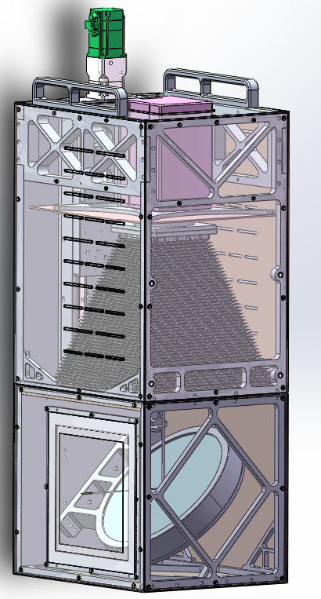
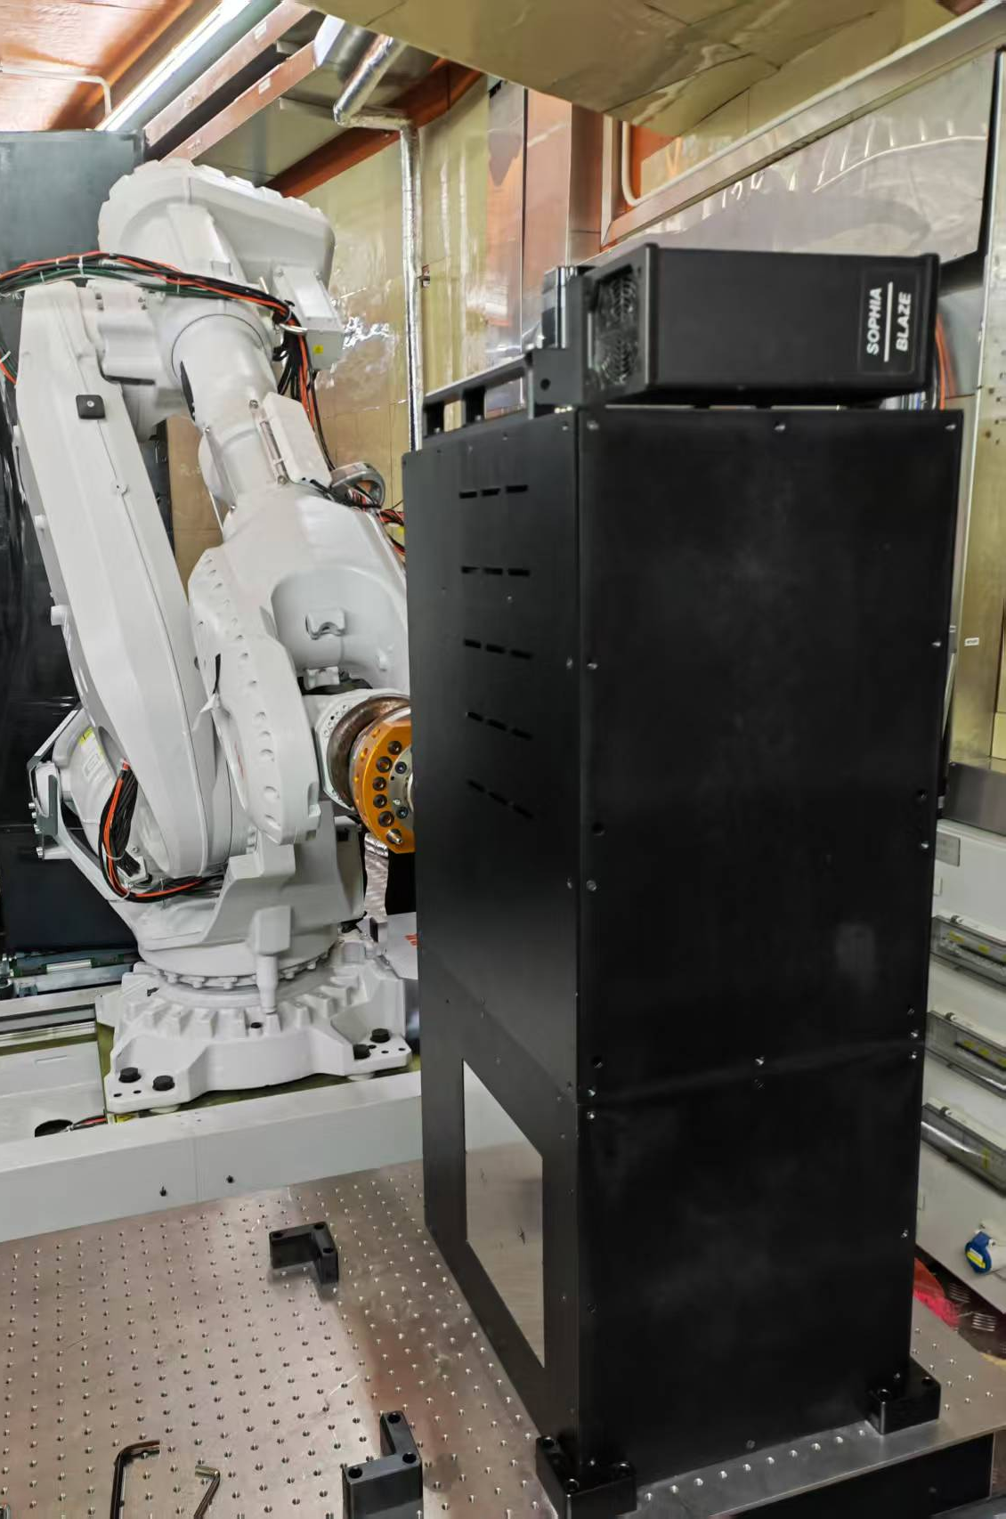
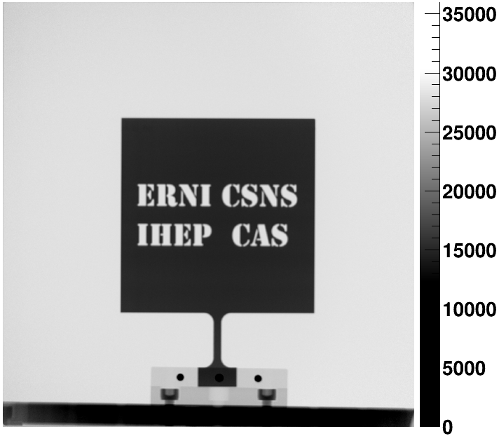
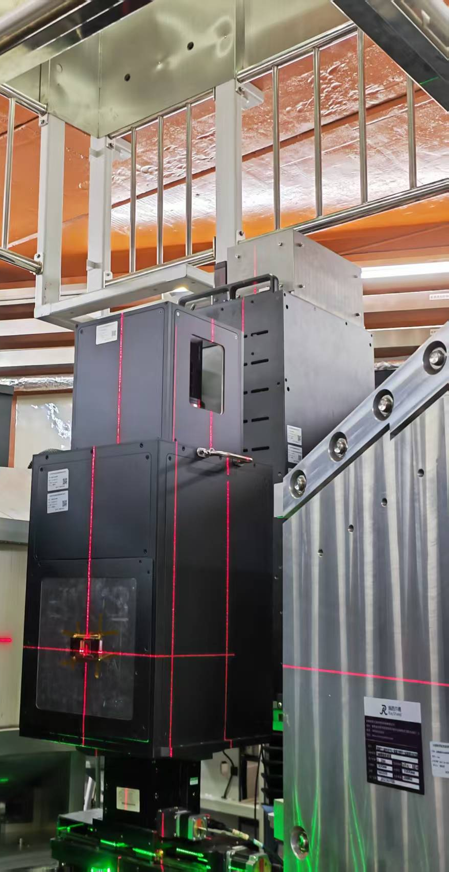
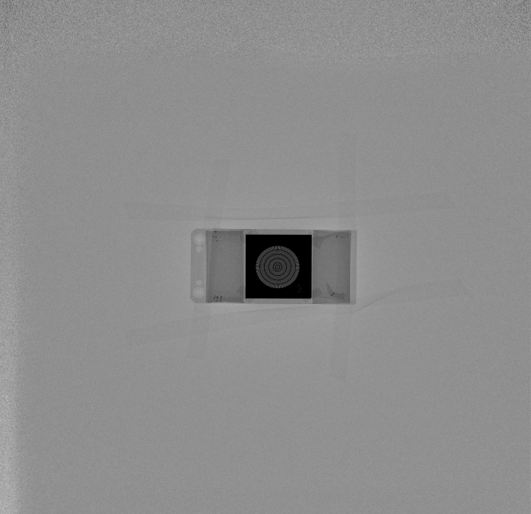
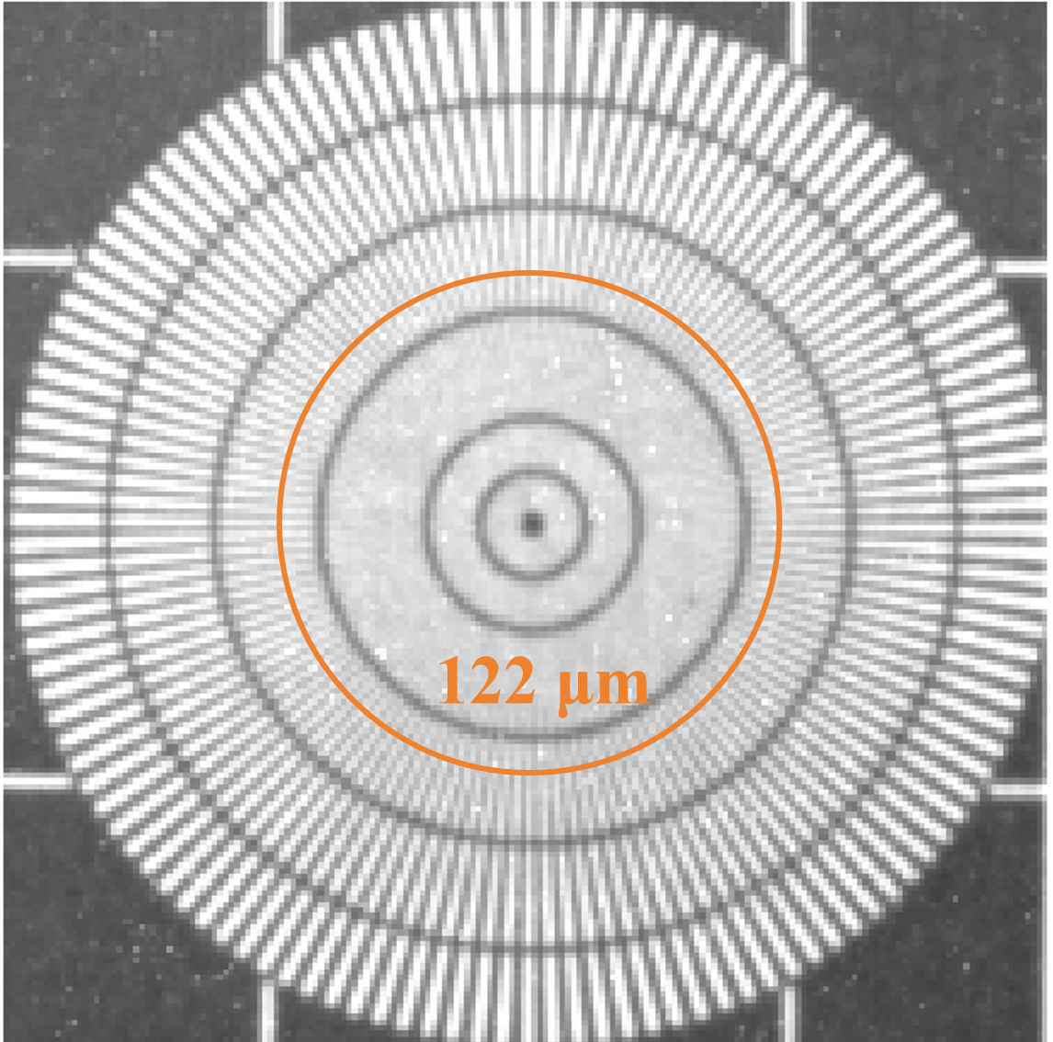
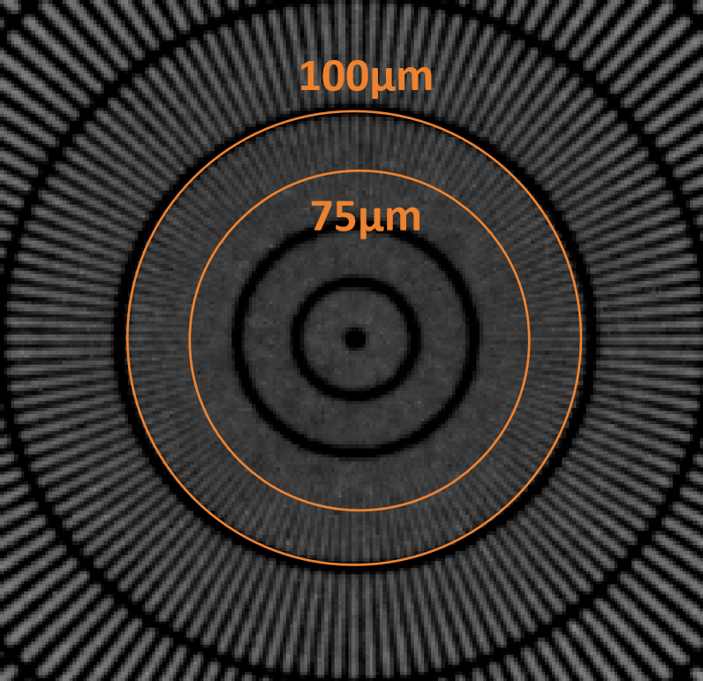
Large field imaging detector at ERNI
Large sensor CCD camera and large area ⁶LiF/ZnS scintillator,
FOV > 200 mm×200 mm, spatial resolution 75 μm.
Detector structure
Commissioned at ERNI
High resolution large FOV detector
FOV 220mm × 210mm
Resolution 120μm

Slide 11
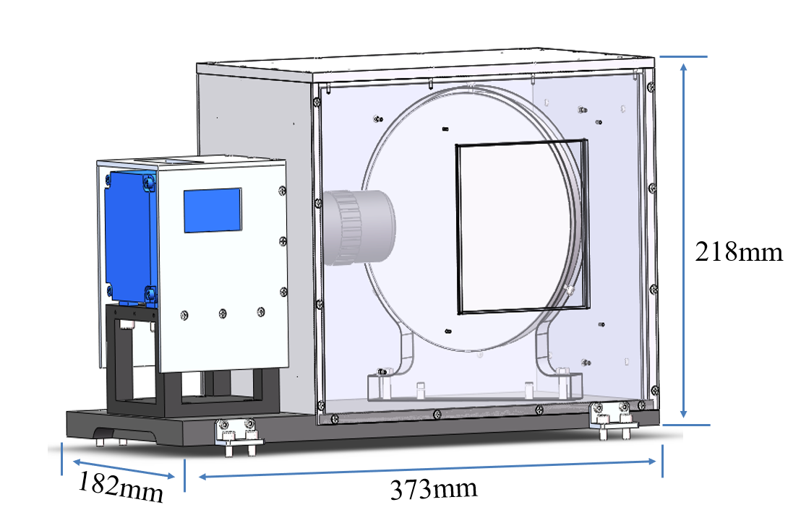
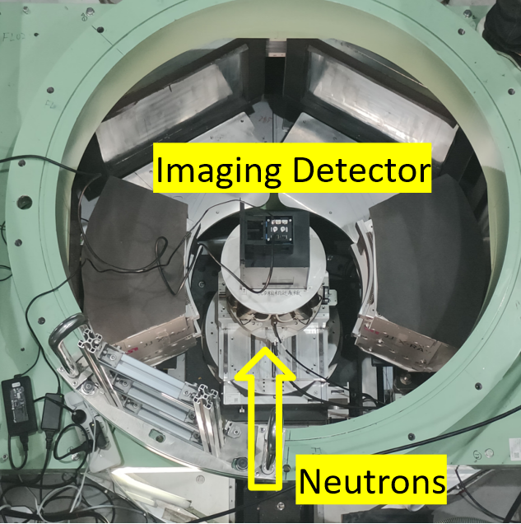
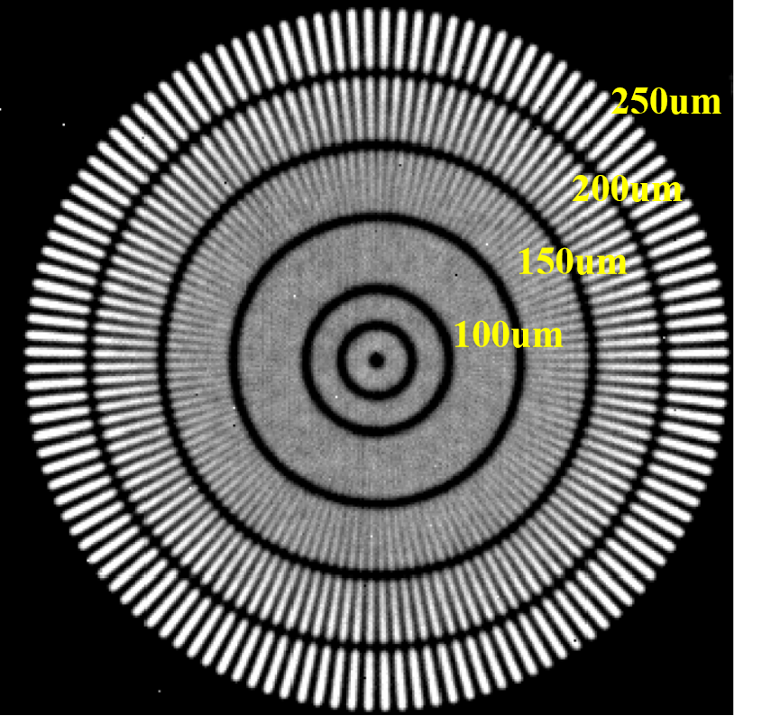
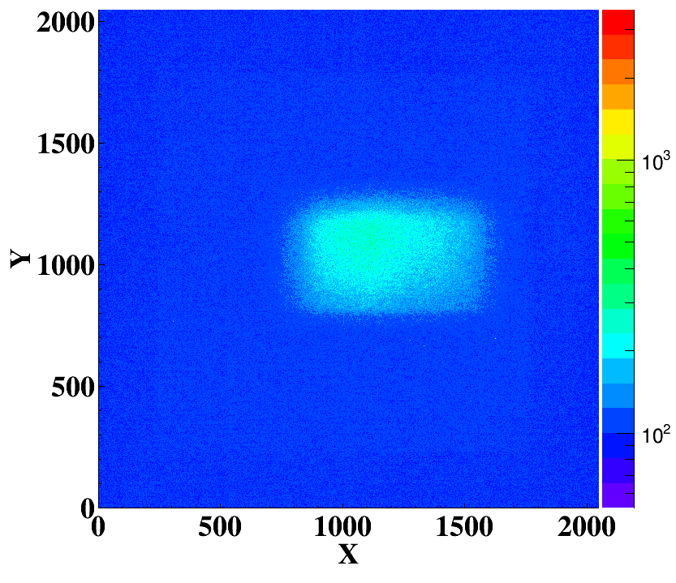
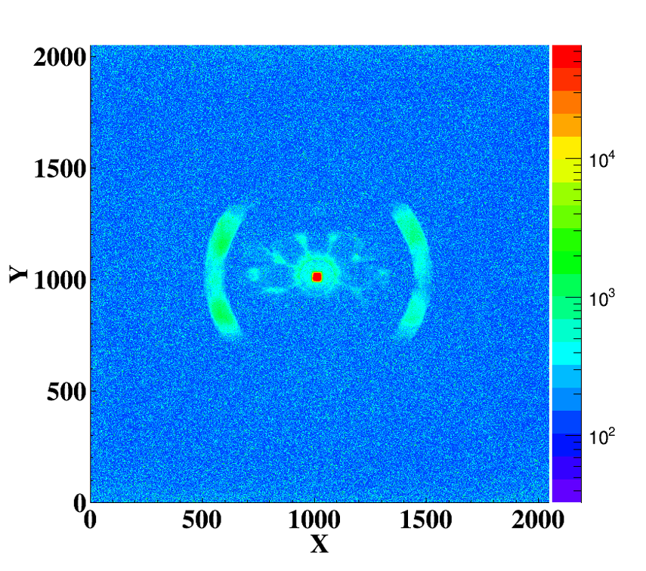
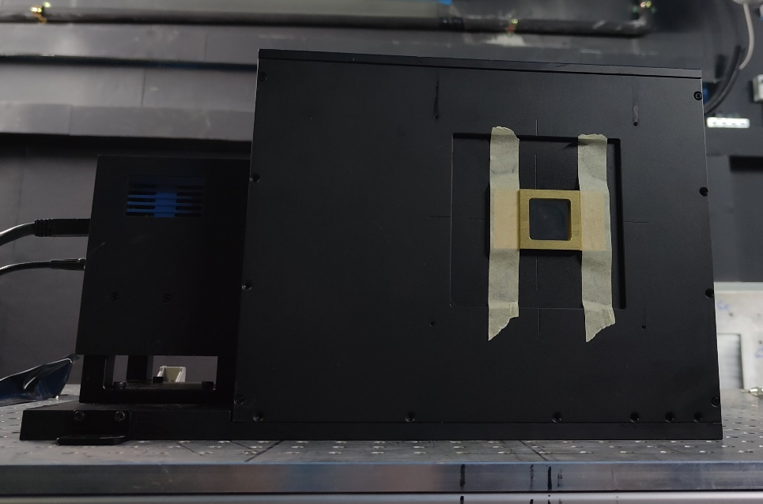
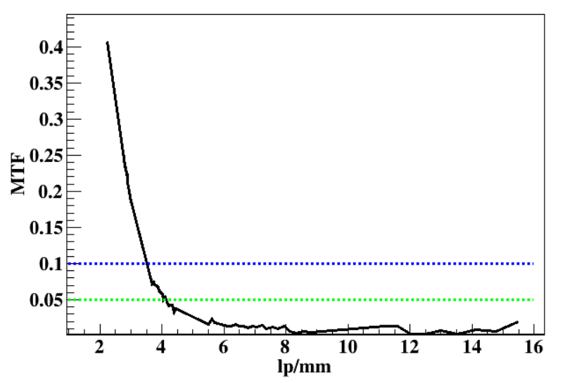
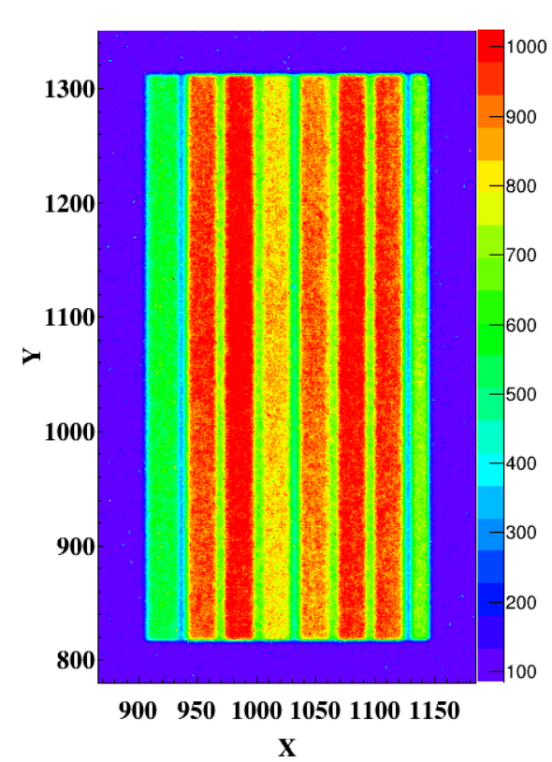
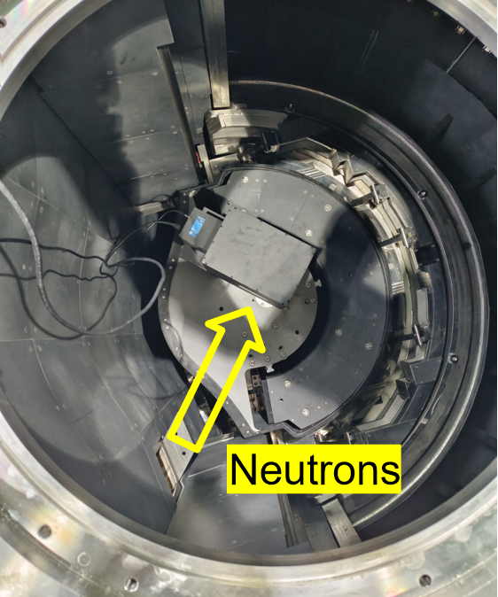
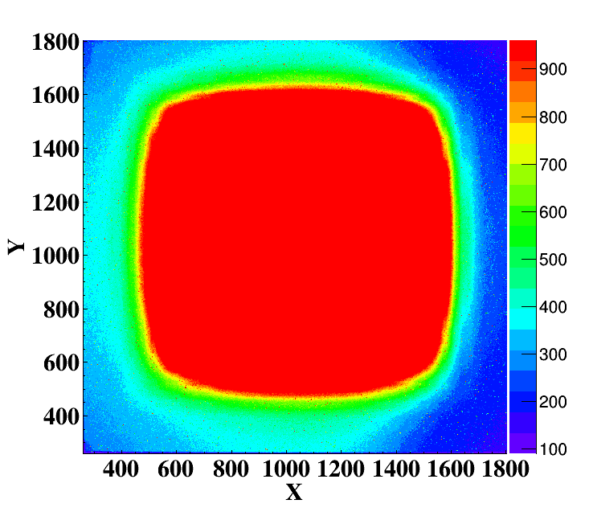
Compact imaging detector
Development of compact imaging detector for fast imaging
PCO sCMOS camera and medium area ⁶LiF/ZnS scintillator, FOV ~ 100 mm × 100 mm, spatial resolution 122 μm.
Detector structure
Detector parameters
GPPD, KB Lens Testing
HD, Neutron Beam Testing
VSANS, Slits Testing
122μm@5%MTF

Slide 12
I
Background and Motivation
Contents
II
Resolution, FOV, Compact Neutron Imaging
III
Energy Resolved Neutron Imaging Based on Timepix4
Outline
IV
Summary and Outlook

Slide 13
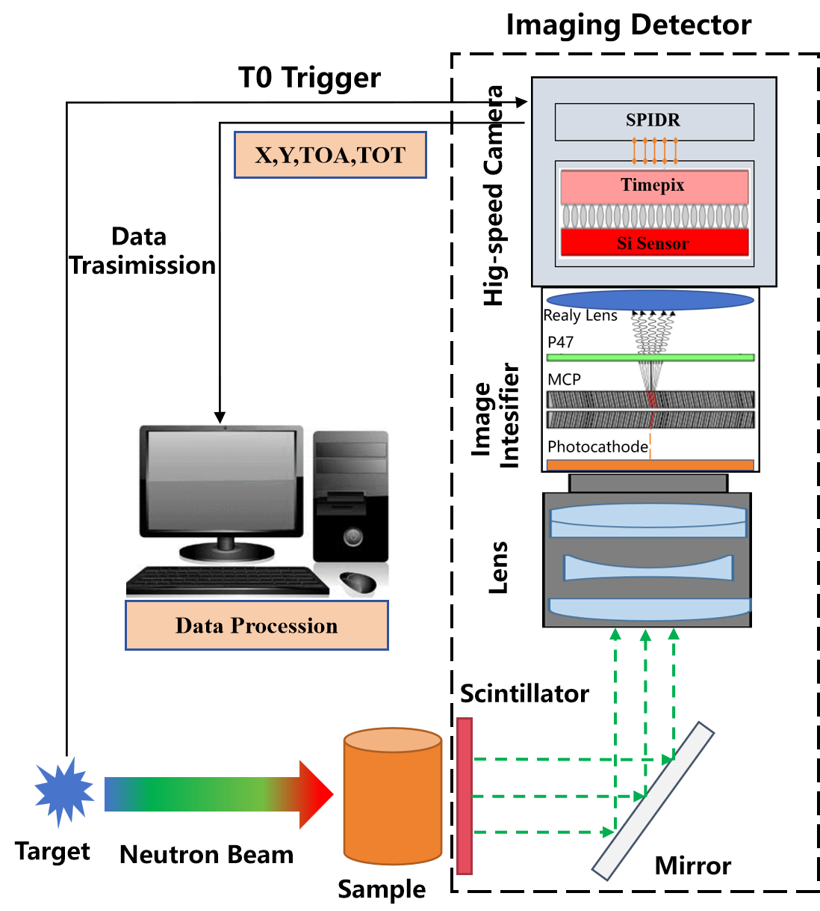
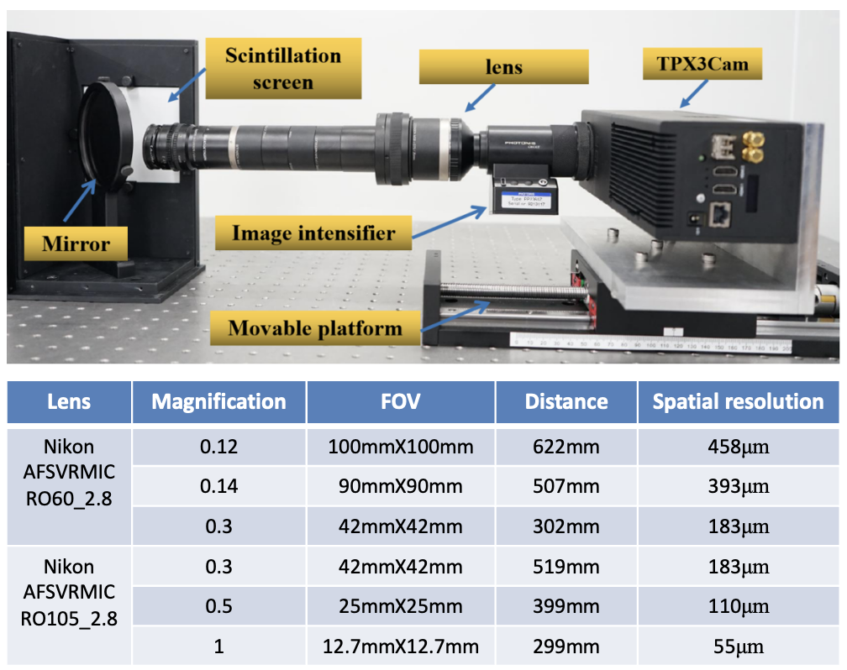
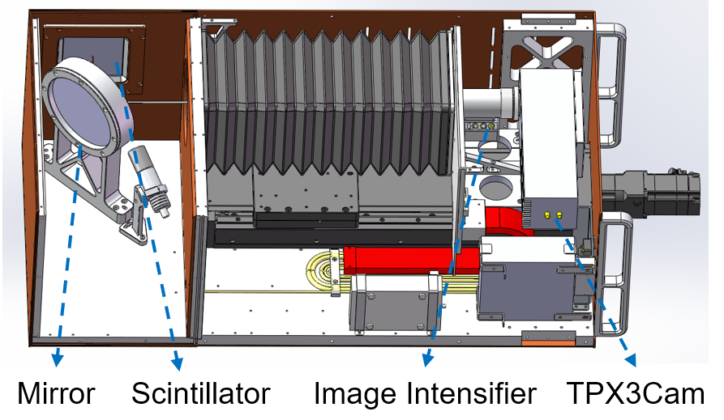
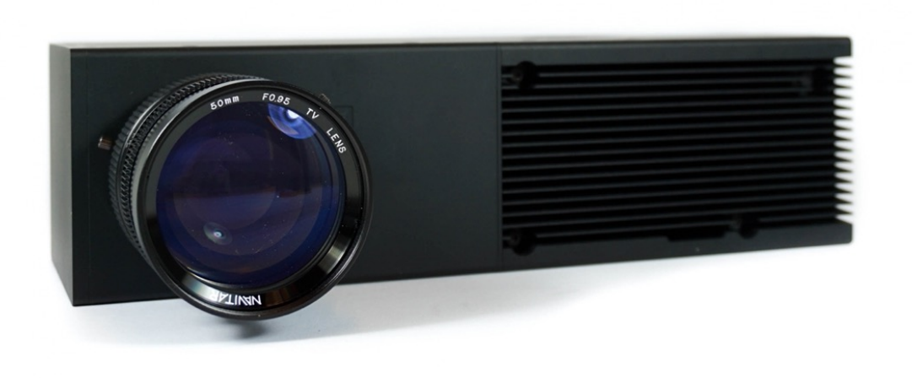
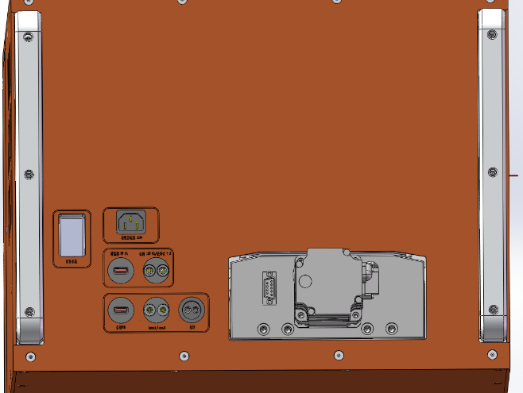
Energy-resolved imaging detector based on Timepix3
High spatial resolution and high time resolution imaging detector was developed based on Timepix3 chip
Neutron imaging and energy spectrum, Single event (X,Y,TOA,TOT), Variable field
Principle of the detector
Key components
Detector engineering design
Fast connection interface
pixels :256×256,55μm×55μm
time res.1.56 ns | 80 Mhits/s

Slide 14







Energy-resolved imaging detector based on Timepix3
ERNI（ Energy Resolution Neutron Imaging instrument ）
Field of view: 100mm×100mm, spatial resolution: 14 μm, relative wavelength resolution: 0.16% @2Å
Operated at ERNI instrument
Performance of the detector
304 steel Bragg edge
Time(wavelength) resolution
Mean 15.43ms
Sigma 0.024ms
Maximum field
Spatial resolution
The detector has been operating stably since 2023
GOS Powder, magnification 1.9X
GOS Ceramic, magnification 2.74X

Slide 15


Energy-resolved imaging detector based on Timepix4
Key Advances
Medipix4 Collaboration (since 2022)
CSNS joined the Medipix4 Collaboration (CERN), gaining access to the latest Timepix4 ASIC and collaborative R&D resources for next-generation pixel detectors
Timepix4 + In-house Electronics
Developed Timepix4-based detector with fully in-house designed readout electronics, achieving independent control of detector system and data acquisition chain
Real-time Data Pre-processing
In-house electronics enables real-time data pre-processing, replacing commercial ASI TPX3 camera with significantly reduced cost and improved flexibility
CSNS In-house Timepix4 System
✓ Timepix4 chip (512x448 pixels, 55 μm pitch)
✓ Fully in-house designed readout electronics
✓ Real-time on-board data pre-processing
✓ Member of Medipix4 Collaboration (CERN)
✓ Customizable firmware & DAQ pipeline
✓ Spatial resolution: 28 μm (GOS scintillator, 2.1x)

Slide 16







Energy-resolved imaging detector based Timepix4
Joined Medipix4 Collaboration in 2022
Welcome international collaborations on developments on Timepix4 based neutron imaging detectors!
Joined
Medipix4
Collaboration
(CERN)
Prototype
Development
System assembly & bench testing
Application
Exploration
Materials, energy, archaeology...
Oct 2022
2023
2024
2025
2026+
Circuit
Development
In-house readout electronics design
Neutron Beam
Experiments
TOF tests & calibration
Brazil LNLS detector team visit CSNS

Slide 17






Energy-resolved imaging detector
CSNS CTPX1 High-Speed Event-Driven Camera
Based on Timepix4
Full-speed readout of single module (16 x 5.12Gbps links)
Based on Xilinx Zynq Ultrascale+ ZU15EG FPGA
Multi-stage buffer, max count rate 1.2Gcps
Integrated HV generation/monitoring and semiconductor temperature control
80Gbps/ 1.25Gcps/32GB buffer
64Gbps/ 800Mcps/32GB buffer
32Gbps/400Mcps/1T buffer
PCIe Connection
Readout links
Timepix4 Chip Board and Readout Board
PCIe Readout Card

Slide 18




Energy-resolved imaging detector based on Timepix4
The detector structure
Testing by Laser
Top view of the detector
Image intensifier and camera
Isotope Light Source and USAF Test Pattern

Slide 19


Energy-resolved imaging detector based on Timepix4
neutron beam testing — TOF and counting rate
TOF
counting rate
Img. Int. Gain | Duration | File Size | Data Rate | Average Counting Rate | Maximum Counting Rate
Gain3400 | 5min | 4169MB | 13.9MB/s | 0.9 Mhits/s | 3.4M hits/s
Gain3600 | 5min | 13903MB | 46.3MB/s | 2.89 Mhits/s | 11.2M hits/s
Gain3800 | 5min | 29525MB | 98.4MB/s | 6.1 Mhits/s | 23.5M hits/s
Gain3900 | 5min | 37853MB | 126.2MB/s | 7.8 Mhits/s | 30.1M hits/s
Gain4000 | 5min | 44168MB | 147.2MB/s | 9.2 Mhits/s | 35.5M hits/s
Maximum event rate ：35.5M cps
Limited by flux of neutron beam
Neutron TOF spectrum from TPX4 camera is consistent with LND ³He PSD.

Slide 20










Energy-resolved imaging detector based on Timepix4
Spatial resolution ：28 μm
Measurement setup
Spatial resolution
Scintillator: GOS, Mag.: 2.1x
Scintillator: 6LiF/ZnS, Mag.: 1x
FOV Φ8mm
FOV Φ17mm
Scintillator: 6LiF/ZnS, Mag.: 0.348x
Scintillator: 6LiF/ZnS, Mag.: 0.1375x
FOV Φ48mm
FOV 100mm×100mm

Slide 21









Energy-resolved imaging detector based on Timepix4
Samples measurement
Bragg-edge Imaging
Energy-selected Imaging
Austenitic stainless steel
Co/Mo/W/Fe/Ni/Cu/Brass
W
Ni
W
Ni
Imaging result
Imaging result
W and Ni
The relative strength of W and Ni has reversed.

Slide 22
I
Background and Motivation
Contents
II
Resolution, FOV, Compact Neutron Imaging
III
Energy Resolved Neutron Imaging Based on Timepix4
Outline
IV
Summary and Outlook

Slide 23

Summary and Outlook
Summary
High Spatial Resolution
• Neutron imaging microscope: 6.6 μm
• GOS ceramic scintillator: 12 μm @ 50 μm
• ¹⁵⁷Gd₂O₂S:Tb, 5 μm, 88% enriched
Large Field Detector
• FOV: 200 mm × 200 mm
• Spatial resolution: 75 μm
• Commissioned at ERNI
Compact Detector
• FOV: 100 mm × 100 mm
• Spatial resolution: 122 μm
• with sCMOS camera
• Size: 18 x 37 cm x 22 cm
• Deployed at GPPD, HD, VSANS
Timepix4 Energy-Resolved
• Spatial resolution: 28 μm
• Max rate: 35.5M hits/s at CSNS
• Bragg-edge & energy-selected imaging
Outlook
Neutron Imaging Detector R&D
Continue pushing the performance frontier across high-resolution, large-FOV, compact, and energy-resolved neutron imaging detectors
International
Active member of Medipix4 Collaboration (CERN) since 2022; further Timepix4 application development and deeper participation in the global pixel detector community
Welcome Collaborations!
Warmly welcome interested teams worldwide to collaborate on neutron imaging detector R&D — in scintillators, electronics, imaging algorithms, and applications sunzj@ihep.ac.cn

Slide 24

Thanks for your attention！
Notes:
感谢CEAN合作团队，国内团队，funding

