Slide 1
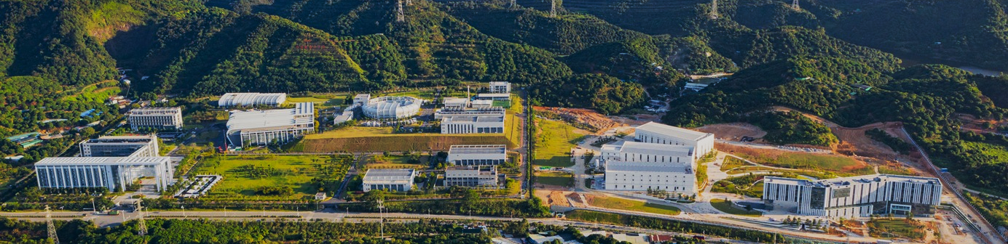


Progress of Scintillator Neutron Detectors at CSNS
Bin Tang (tangb@ihep.ac.cn), Detector&Electronics Group
China Spallation Neutron Source, IHEP, CAS
April 16 2026，ICANS XXV，Malmö

Slide 2
Outline
1
Motivation and detector demands at CSNS
Contents
2
Scintillator Detector Family at CSNS
3
SHiNE: a high-resolution detector for future instruments
4
Summary and outlook

Slide 3
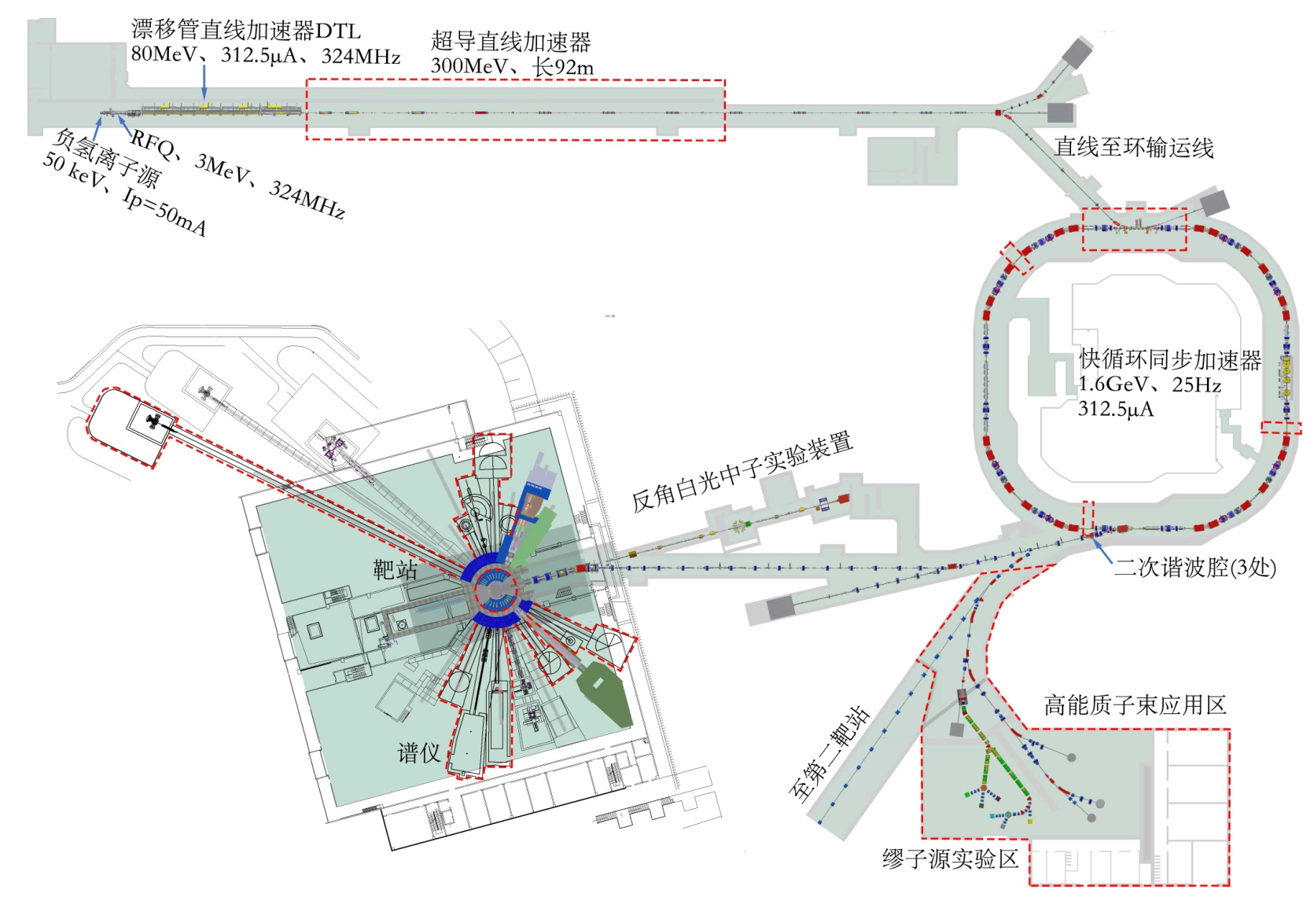
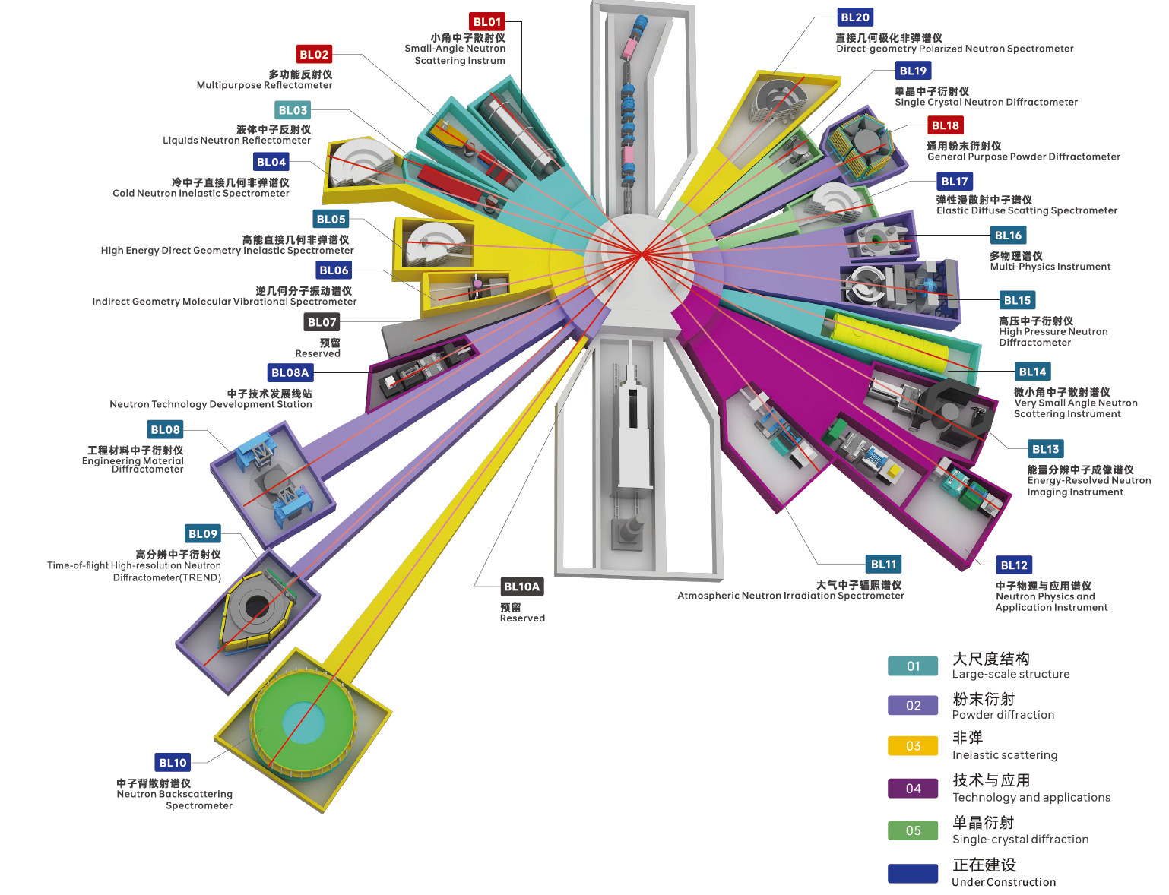
China Spallation Neutron Source
CSNS I（3 instruments ）
Cooperation（9 instruments ）
CSNS II（11 instruments ）
CSNS timeline
2011~2018
2018~2024
2024~2029
The energy of the superconducting linear accelerator will be increased to 300 MeV
Increase the beam power to 500kW
High-power target station upgrad
Total of 20 instruments need to be installed

Slide 4
Detector Requirements for CSNS Instruments
NO | Spectrometer | Detector type | Detector area | Main paremeters
1 | GPPD (BL18) | Scintillator detector | 6 m² | Efficiency≥40% @ 2Å, Spatial resolution ≤ 4mm×4mm
2 | SANS (BL01) | ³He Tube Array Detector | 1m² | Efficiency≥80% @ 2Å, Spatial resolution ≤ 8mm (FWHM)
3 | MR (BL02) | 3He_MWPC | 200mm×200mm | Efficiency≥60% @ 2Å, Spatial resolution ≤ 2mm×2mm
4 | MPI (BL16) | ³He Tube Array Detector | 3m² | Efficiency≥90 % @ 2Å, Spatial resolution≤8mm (FWHM)
5 | ANIS (BL11) | 3He Tube Array Detector | 3m² | Efficiency≥ 90% @ 2Å, Spatial resolution ≤8mm (FWHM)
6 | EMD (BL08) | Scintillator detector | 3m² | Efficiency≥60 % @ 2 Å, Spatial resolution ≤ 3mm×180mm
7 | ERNI (BL13) | Scintillator detector | 4 m² | Efficiency≥60 % @ 2 Å, Spatial resolution ≤ 3mm×50mm
8 | VSANS (BL14) | ³He Tube Array Detector | 3.6 m² | Efficiency≥ 90% @ 2Å, Spatial resolution ≤ 8mm (FWHM)
9 | HD (BL05) | ³He Tube Array Detector | 20 m² | Efficiency≥ 90% @ 2Å, Spatial resolution ≤ 25mm
10 | HPND (BL15) | 3He Tube Array Detector | 5.7 m² | Efficiency≥80 % @ 2Å, Spatial resolution ≤ 8mm (FWHM)
11 | HRD (BL09) | ³He Tube Array Detector | 8.8 m² | Efficiency≥70% @ 2Å, Spatial resolution ≤ 8mm (FWHM)
12 | NTDS (BL08A) | ³He Tube Array Detector | 32mm×300mm | Efficiency≥80% @ 2Å, Spatial resolution≤ 8mm (FWHM)
13 | NPAI (BL12) | 10B GEM | 50mm×50mm | Efficiency≥40% @ 6Å, Spatial resolution≤ 2mm (FWHM)
14 | IMVS (BL06) | ³He Tube Array Detector | 0.36 m² | Efficiency≥80% @ 1.8Å, Spatial resolution≤8mm (FWHM)
15 | NUBS (BL10) | ³He Tube Array Detector | 0.44 m² | Efficiency≥85% @ 6.3Å, Spatial resolution≤12.7mm (FWHM)
16 | EDS (BL17) | ³He Tube Array Detector | 7m² | 3He:Efficiency≥85% @ 1.8Å, Spatial resolution≤25.4mm (FWHM)
17 | CNIS (BL04) | ³He Tube Array Detector | 15.2 m² | 3He:Efficiency≥85% @ 1.8Å, Spatial resolution≤25.4mm (FWHM)
18 | PACS (BL20) | ³He Tube Array Detector | 12.2 m² | Efficiency≥85% @ 1.8Å, Spatial resolution≤25.4mm (FWHM)
19 | SCND (BL19) | Scintillator detector | 2.3 m² | Efficiency ≥ 50% @ 2Å, Spatial resolution ≤1mm×1mm
20 | LNR (BL03) | 3He_GEM | 600mm×1000mm | Efficiency≥70% @ 6Å, Spatial resolution 2mm×2mm
CSNS I
Cooperation
CSNS II
Notes:
Detector performance has been improving steadily .

Slide 5
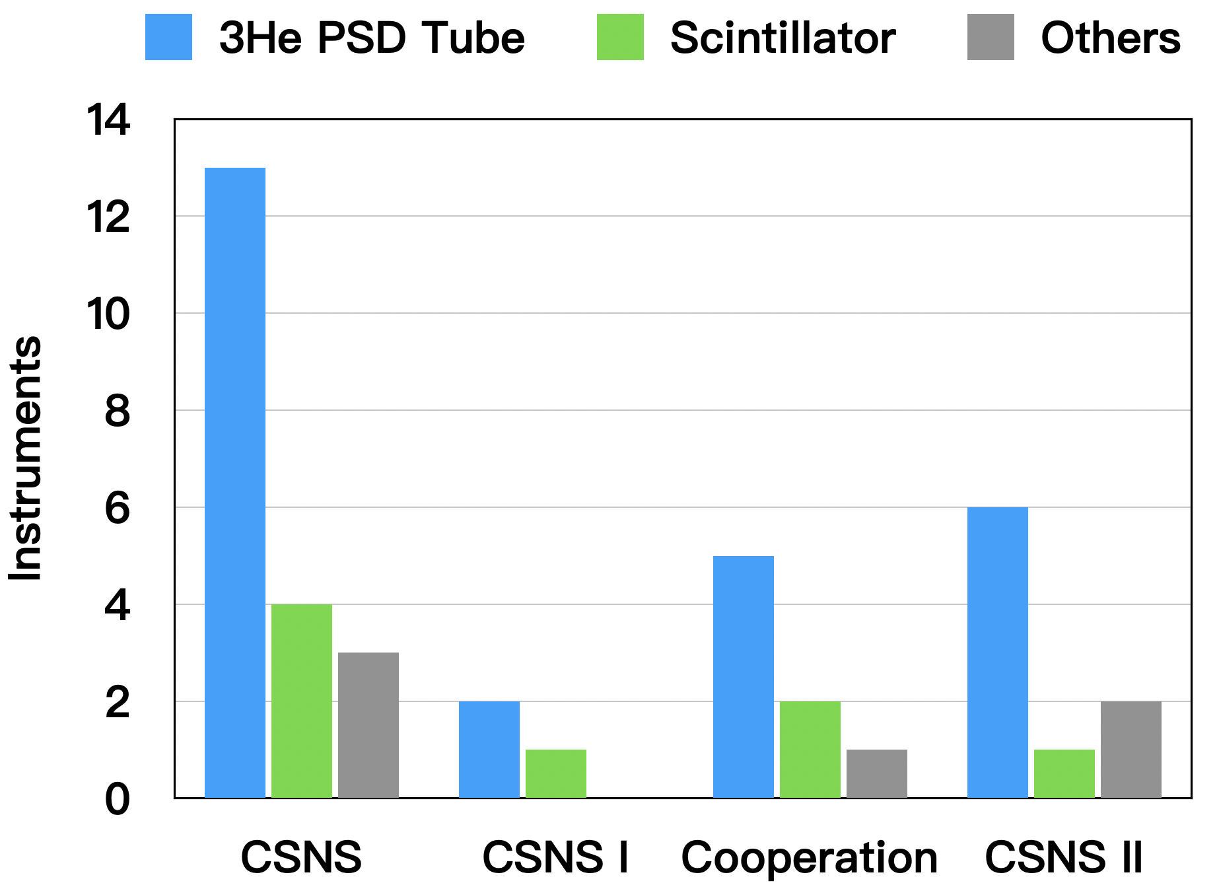
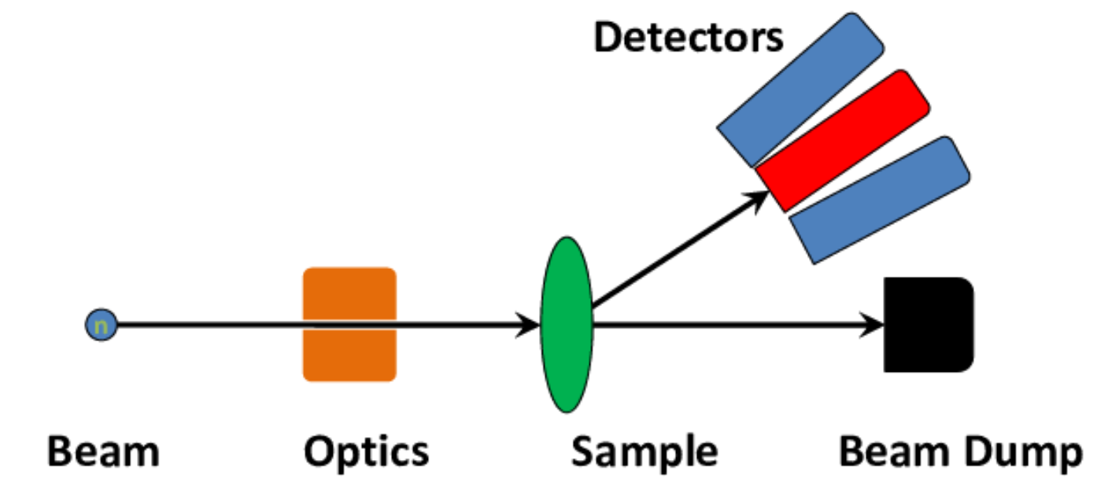

scintillator Detectors for CSNS Instruments
Requirements of the neutron scattering spectrometer
$$2dsinθ=λ$$
Large area coverage
High detection efficiency
Good spatial resolution
n/γ discrimination
Engineering scalability
Notes:
Why 4 instruments choose scintillator detectors as the main detector
Because it provide the most suitable balance for these specific applications.
our detector can fulfill these specific requirements.
Large area coverage for wide angular acceptance.
High detection efficiency for weak signals and time-resolved measurements.
Good spatial resolution to support instrument resolution.
n/γ discrimination for background suppression.
Engineering scalability is essential for multi-square-meter detector systems.

Slide 6
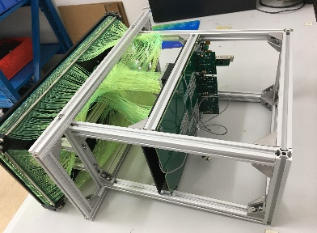
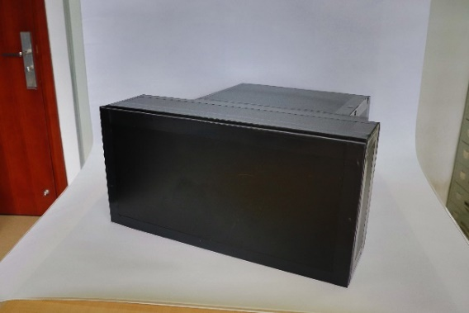
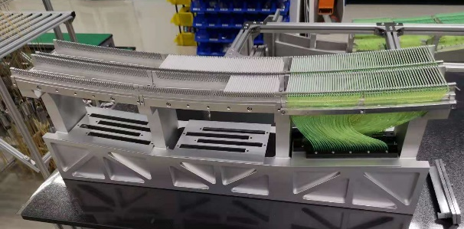
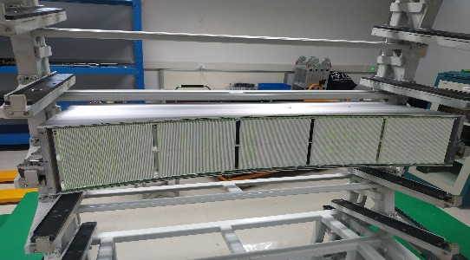
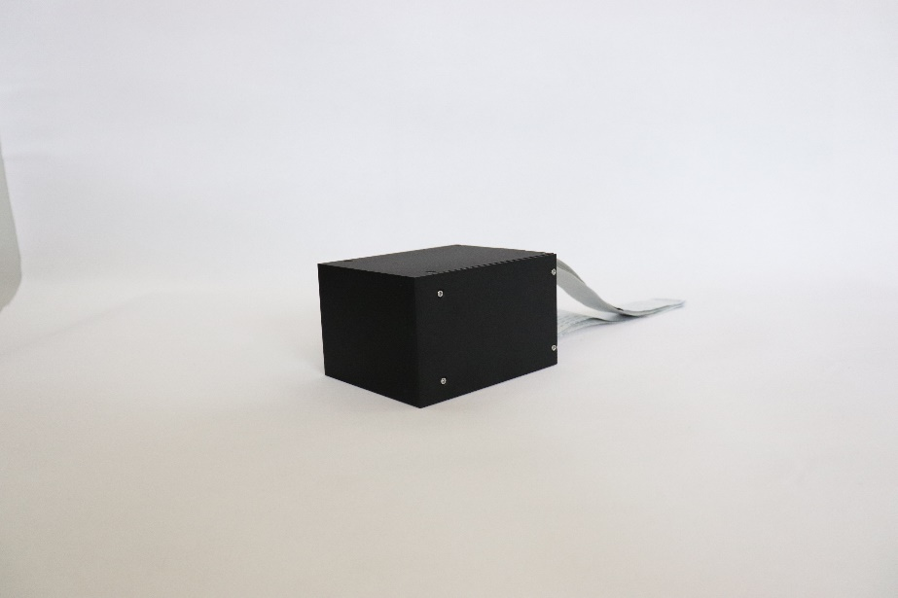
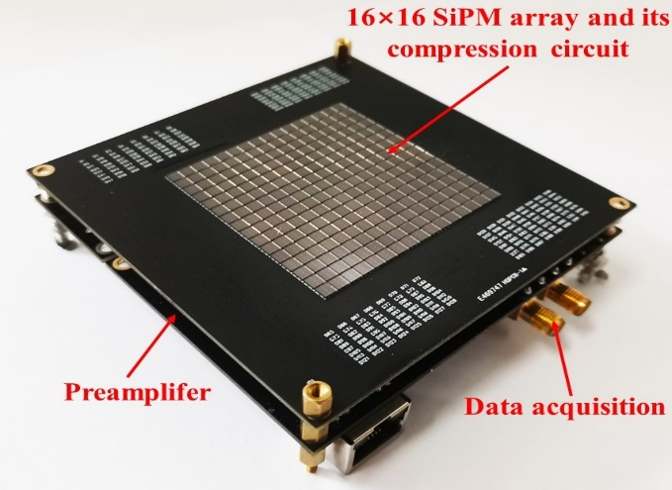
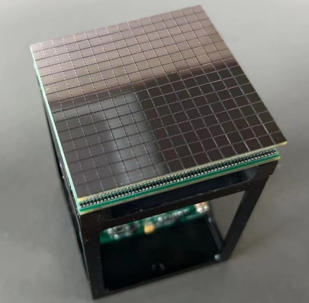
Scintillator Detector Family at CSNS
2010~2018 1st generation FiRST
61.2%
50.3%
43.6%
2018~2024 2nd generation LoGHT
0.35mm×0.35mm
18%
28%
3mm×50mm
2%
4mm×4mm
2×10⁵cps
2×10⁵cps
5×10⁵cps
2023~2029 3rd generation SHiNE
5×10⁵cps
10⁶cps
Notes:
Detector performance has been improving steadily

Slide 7
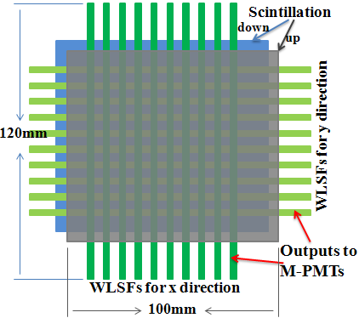
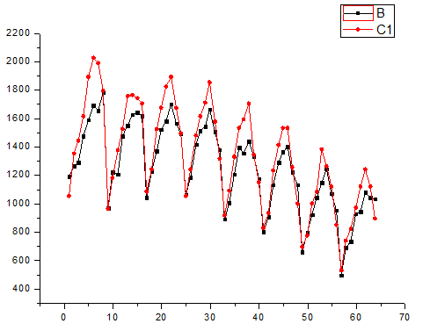
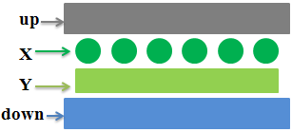
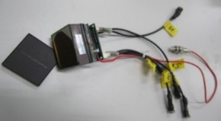
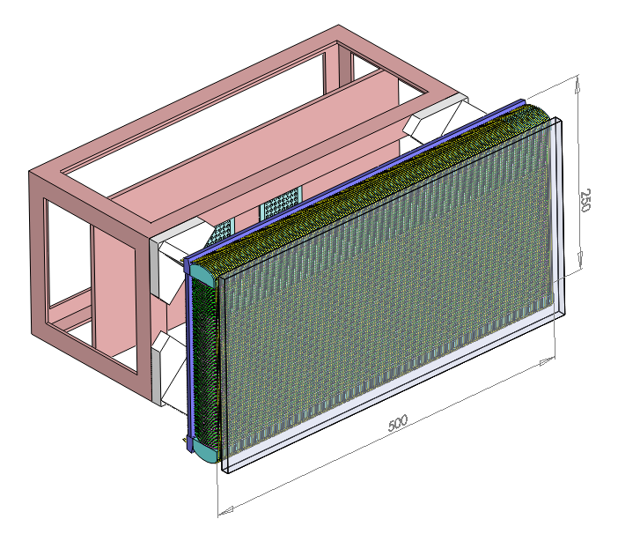
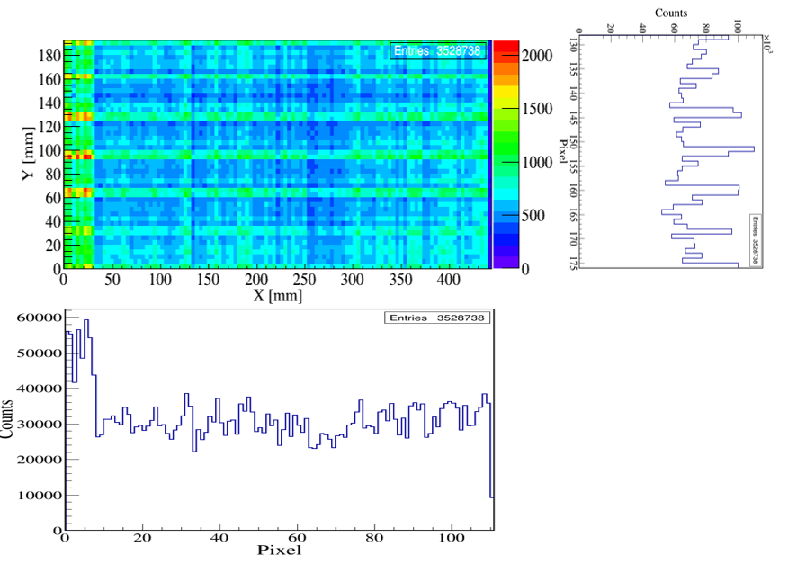
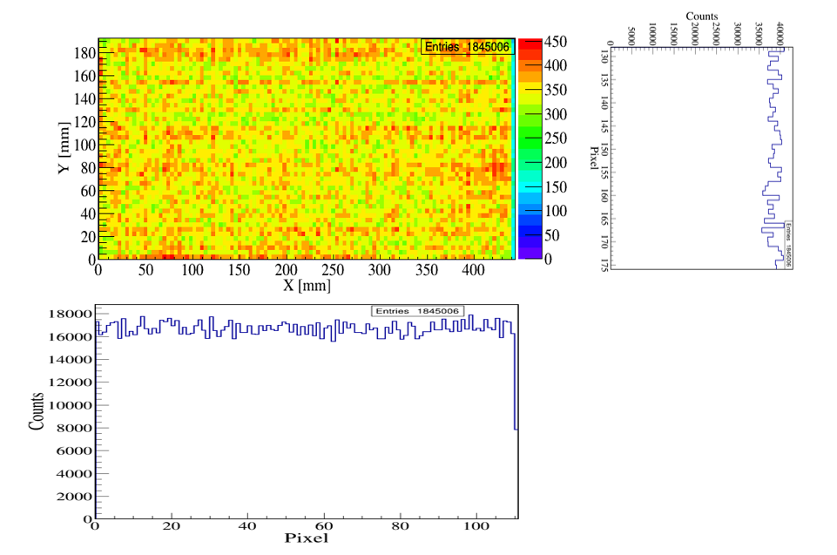
FiRST (Fiber-readout Scintillator Tracker)
Structure
Key technolgy
Ma-PMT Readout
Self-design ASIC chips
Neutrons
relative gain(a.u.)
Double layer ⁶LiF/ZnS:Ag Scintillator
MA-PMT
channel
Multi-channel
High gain
Matched to WLS fiber arrays
Compact integrated
Adjustable discrimination threshold for each channel
Improved neutron detection efficiency uniformity for each channel
Detection efficiency：43.6％ @ 2Å
Spatial Resolution： 4mm(H) × 4mm(V)
Max Count Rate：2×10⁵cps/moudle
before
after
Notes:
The gain difference between --- needs to be addressed.
compact

Slide 8
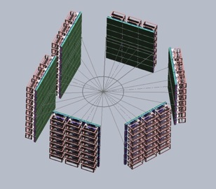
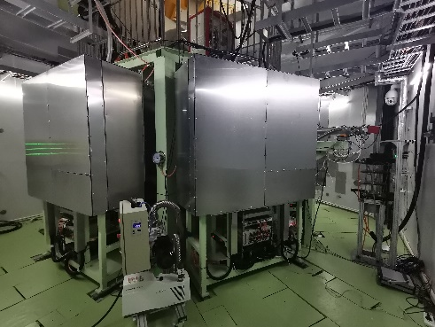
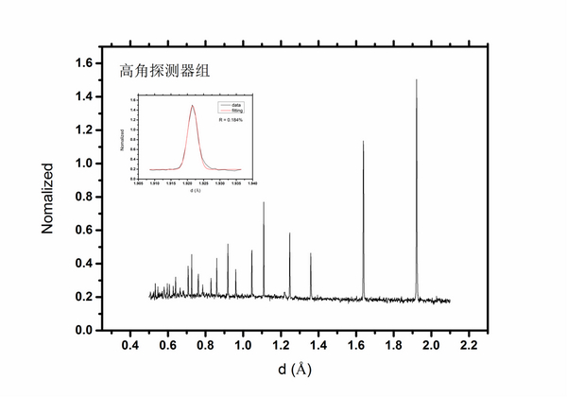
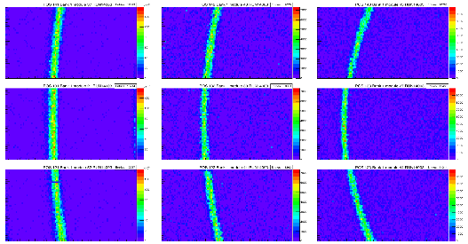
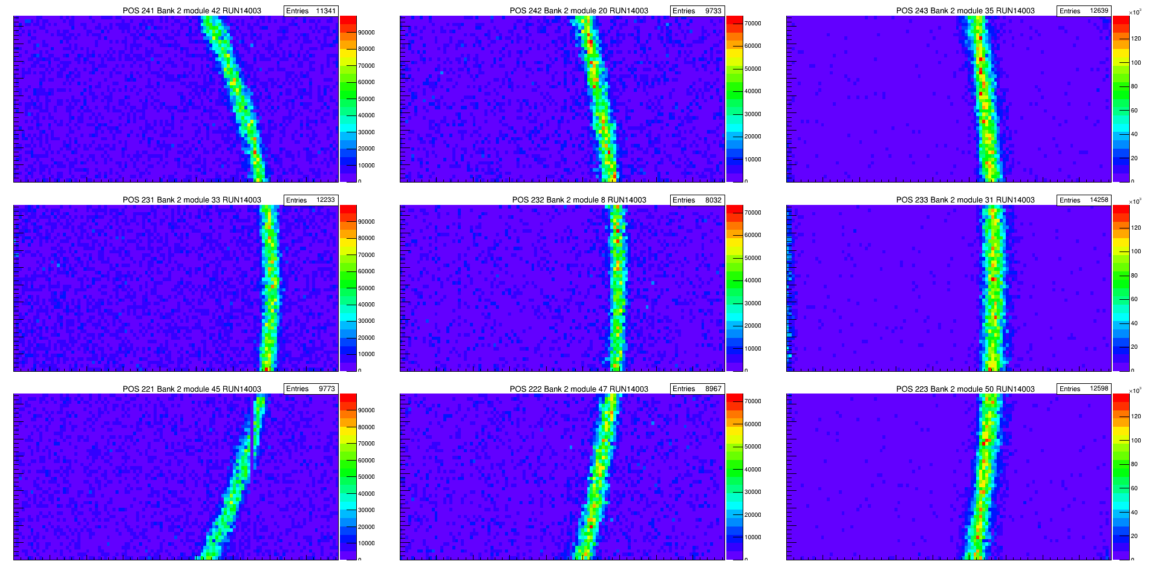
FiRST (Fiber-readout Scintillator Tracker)
Supports GPPD（General-Purpose Powder Diffractometer）good data quality measurements in 2018~2026
1.4752 Å wavelength
Simulation
Measurement
resolution
Resolution
Detector array in GPPD (6m²)
Angle ( ° )
Improved detection-efficiency uniformity gives a more uniform diffraction ring and improves the reliability of peak-intensity measurement.
The diffraction peaks of the Si powder sample

Slide 9
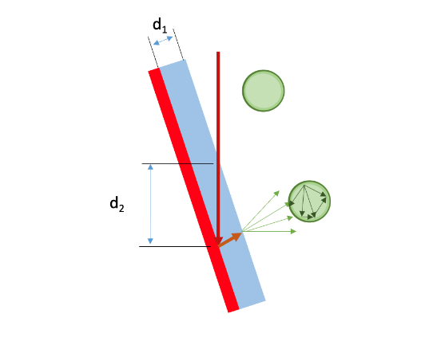
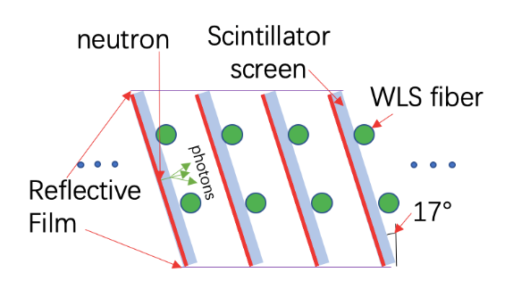
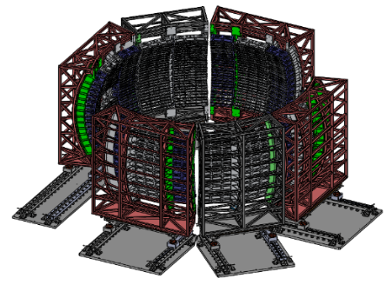
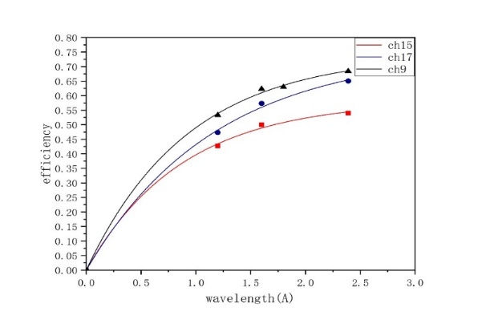
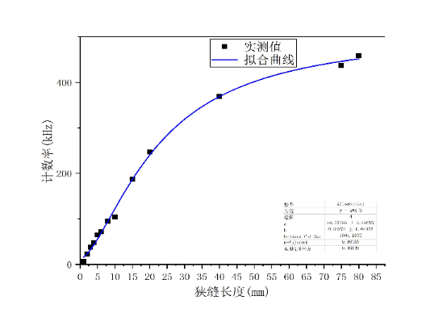
LoGHT（Louver Geometry High-efficiency Thermal-neutron Detector ）
Structure
Simulation results of detection efficiency for different tilt angle
Louver Geometry: increase the neutron incident length
Bank1
Bank2
Bank3
Detection efficency: 61.2% @2Å
Linear range for Single-channel: 10~2×10⁵cps
Bank6
Bank5
Cured detector shape: keeps the neutron incidence angle constant over the whole detector area
Beam test @CSNS BL20
Notes:
SiPM readout provides: compact size, low operating voltage
The key idea is the louver geometry. By tilting the scintillator screens, the neutron path length inside the converter is increased, so the detection efficiency can be significantly improved compared with the flat-panel configuration. As shown in the simulation, the efficiency increases with the tilt angle, and for our optimized geometry it reaches more than 60% at 2 angstrom.
The second important point is the curved detector shape. This keeps the neutron incidence angle nearly constant over the full detector area. This helps maintain a more uniform detector response across the bank.
LiGHT combines louver scintillator geometry, WLS-fiber light collection, SiPM readout, and customized ASIC-based electronics, so it is not only a high-efficiency concept, but also a detector architecture suitable for large-area instrument deployment.
Finally, the beam test at CSNS BL20 confirms the detector performance. We achieved more than 40% efficiency at 1 angstrom, more than 60% at 2 angstrom, and a single-channel linear count-rate range from about 10 to 2 × 10^5 cps.

Slide 10
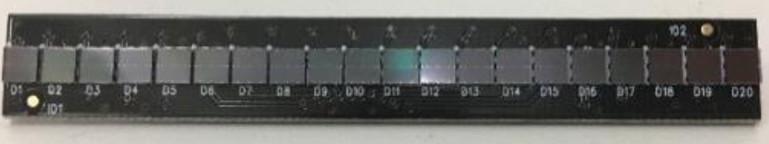
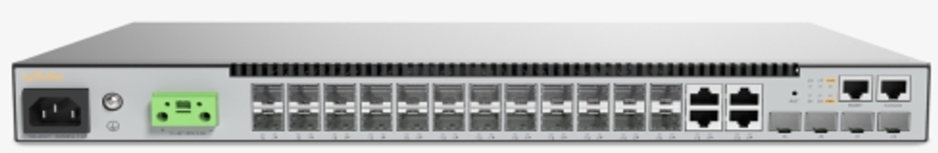
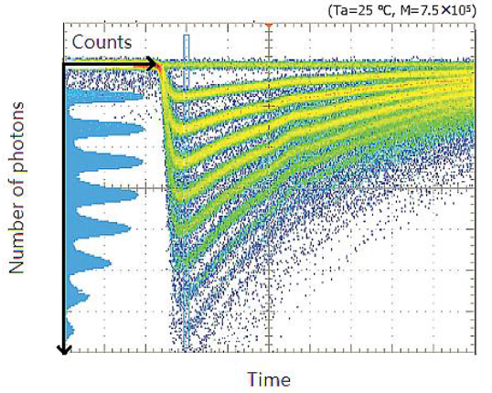
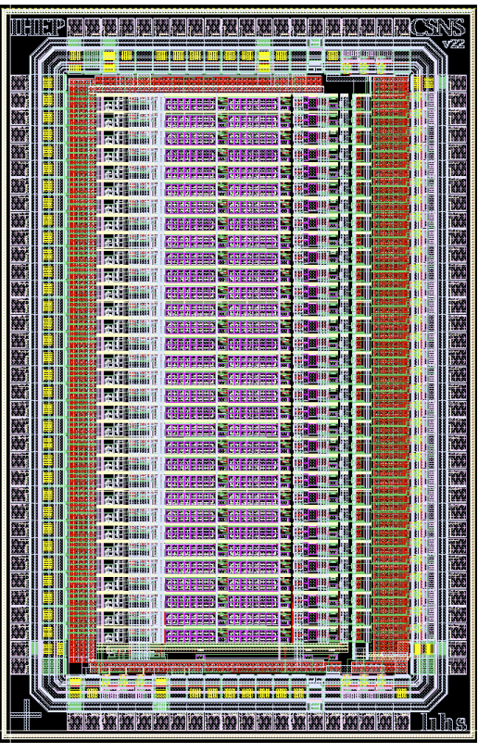
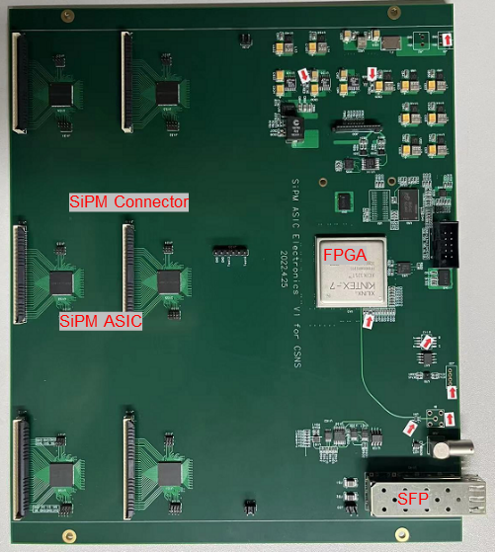
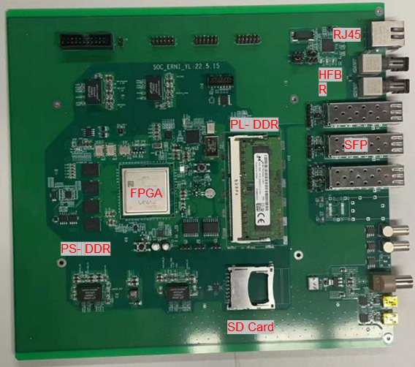
LoGHT（Louver Geometry High-efficiency Thermal-neutron Detector ）
Key technology: SiPM readout and customized ASIC electronics
SiPM: good gain uniformity, compact size, low operating voltage, temperature-drift compensation
ASIC chip: independent threshold adjustment, supports up to 2×10⁵ cps/pixel and 5×10⁵ cps/moudle
On-detector
Under detector crate
Off-detector
SiPM
PA
CMP
FPGA
SOC FPGA
Kafka DAQ Network
Amplifying & Discrimination
Data Processing
Data Aggregation
Customized ASIC
FE Readout Board
SOC Data Aggregator
Notes:
another key technology of LiGHT
Compared with conventional PMT-based solutions, SiPMs offer several advantages for instrument-scale deployment, including good gain uniformity, compact size, low operating voltage, and the possibility of temperature-drift compensation.
On the electronics side, we developed a customized ASIC-based readout chain. It supports signal amplification, discrimination, on-detector data processing, and data aggregation.
In particular, the threshold of each signal channel can be adjusted independently, which is very important for channel-by-channel optimization and uniform detector response.
With this readout architecture, LiGHT achieves both high integration and a single-pixel count-rate capability up to

Slide 11
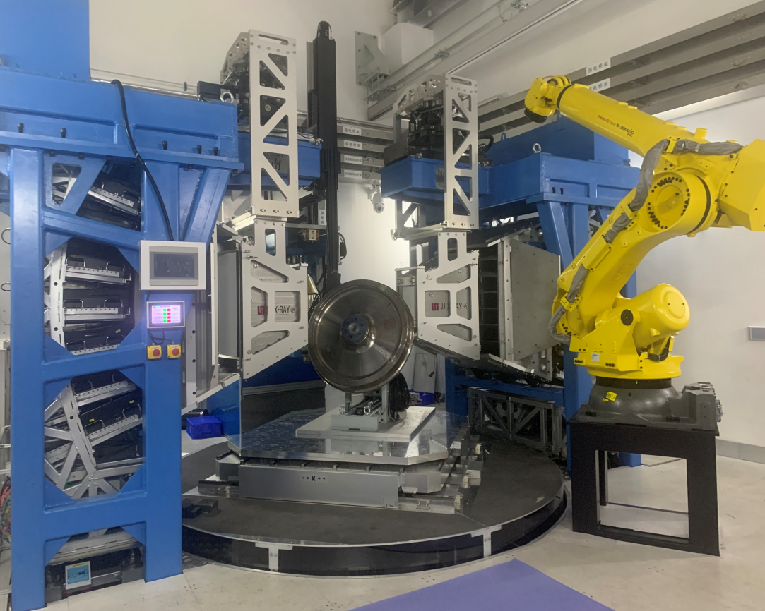
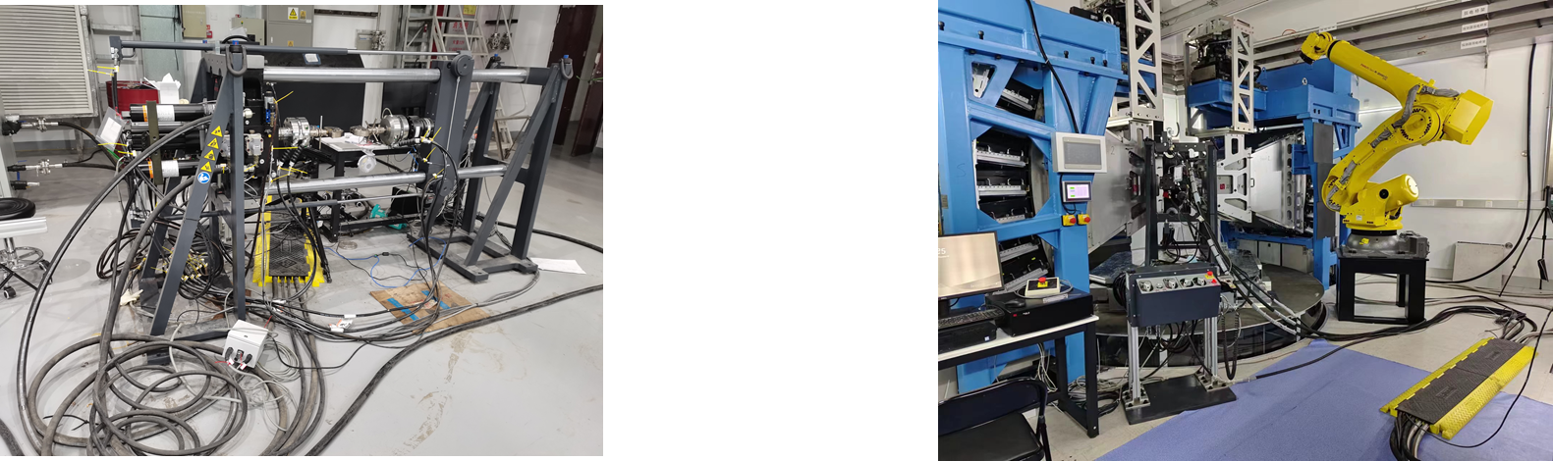
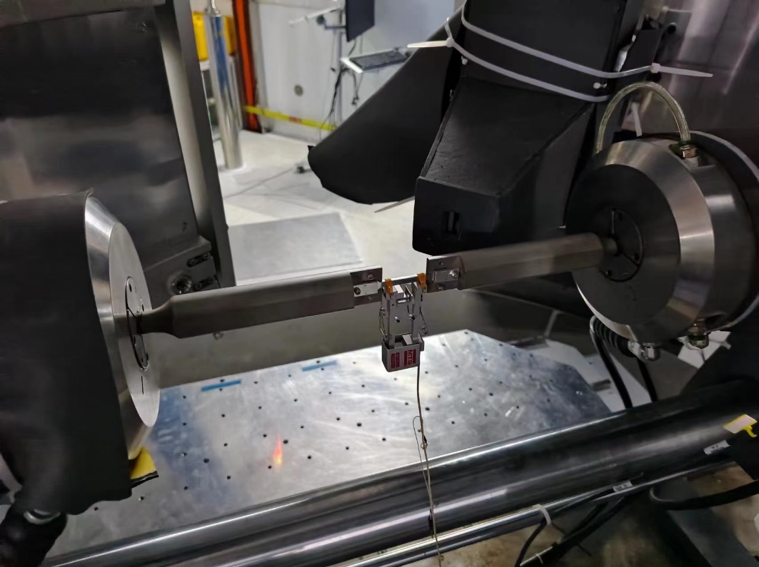
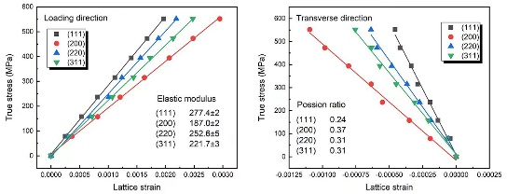
LoGHT（Louver Geometry High-efficiency Thermal-neutron Detector ）
Start operation from 2023~2026
The variation of the residual stress of the full-size high-speed train wheels along the depth direction obtained through EMD
EMD（Engineering Materials Neutron Diffractometer）
~3 m², 3 mm × 180 mm pixel
The uniaxial lattice stress-strain curve of the entropy alloy CrCoNi
Ti-2Al-2.5Zr biaxial lattice stress-strain curve
Notes:
LoGHT, has been deployed on EMD and ERNI.
EMD has been used to measure the residual-stress variation along the depth direction in full-size high-speed train wheels. It has also supported in-situ mechanical studies, such as the lattice stress–strain behavior of advanced alloys.

Slide 12
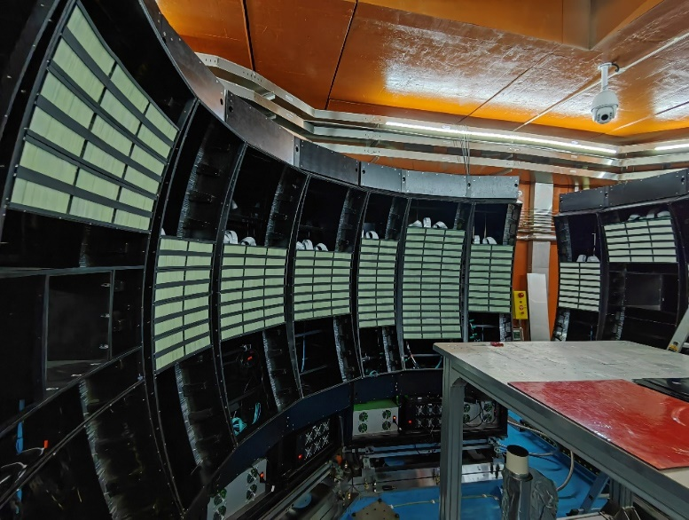
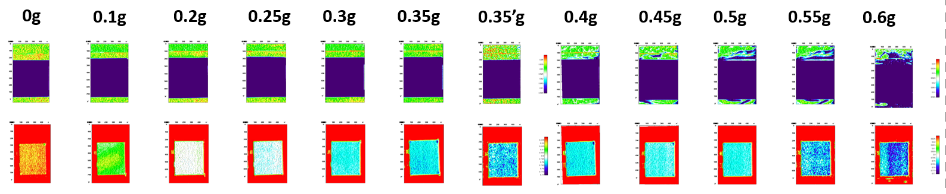
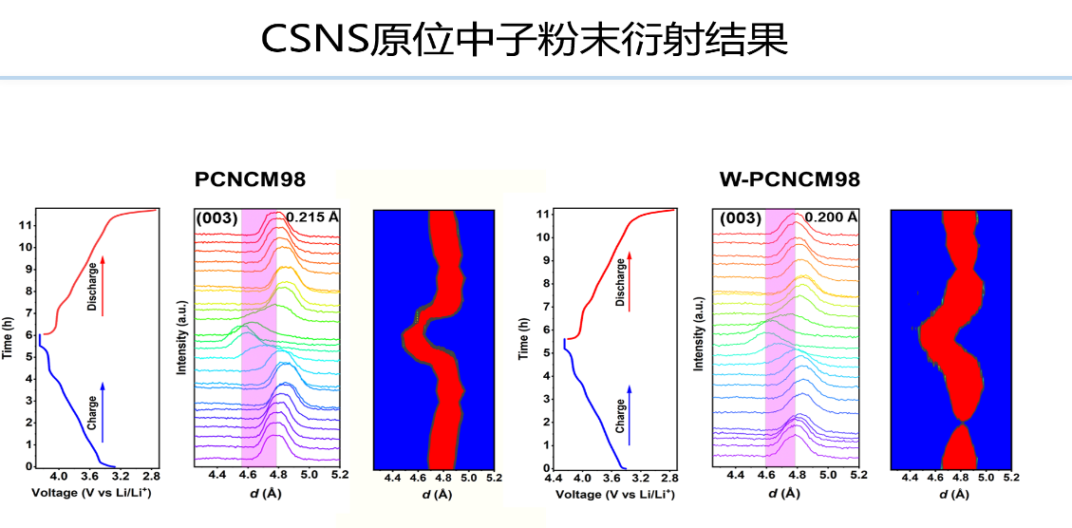
LoGHT（Louver Geometry High-efficiency Thermal-neutron Detector ）
Start operation from 2023~2026
ERNI (Energy Resolved Neutron Imaging Instrument)
Bank1
Bank2
Bank3
Bank6
Bank5
~4 m², 3 mm × 50 mm pixel
Research on Lithium Battery Performance (Imaging + Diffraction)
Notes:
and LiGHT serves as its diffraction detector system.
The total detector area is about 4 square meters, with a pixel size of 3 mm by 50 mm
the detector is already supporting real scientific applications. As shown here, ERNI can be used for lithium-battery studies, where imaging and diffraction information are combined to follow structural evolution during charge and discharge.

Slide 13
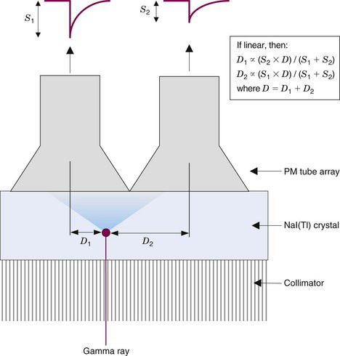
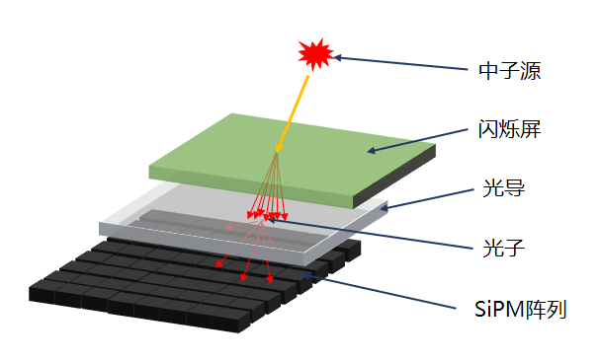
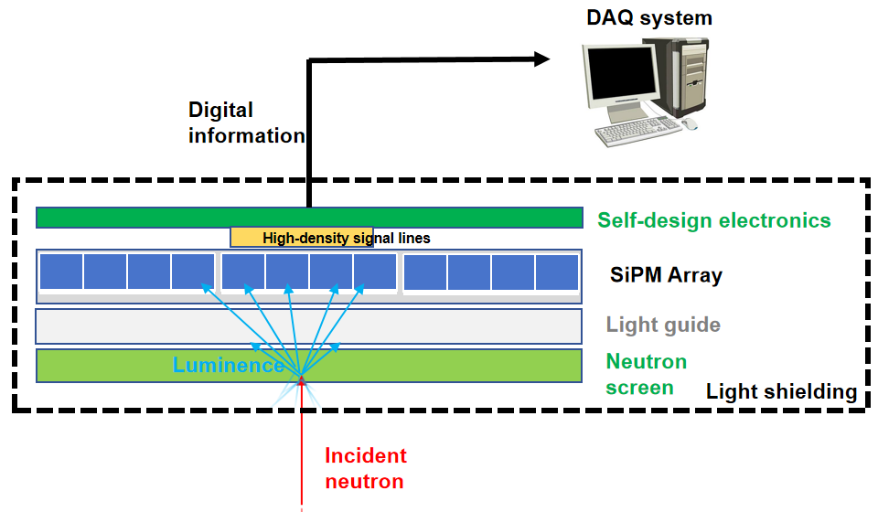
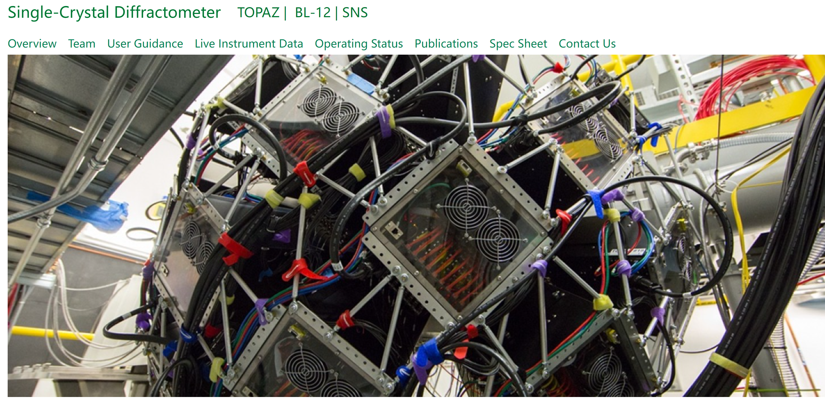
SHiNE ( SiPM-based High-resolution Neutron Detector)
SHiNE concept -- a kind of Anger Camera
Structure
neutron
Scintillator screen
optial guide
light
SiPMs Array
Tne Anger Camera in SNS-TOPAZ instrument
Notes:
•SHiNE stands for SiPM-based High-resolution Neutron Detector.
The basic idea is inspired by the Anger-camera concept, which has already been successfully applied on instruments such as TOPAZ at SNS for single-crystal neutron diffraction.
•Our detector uses a SiPM array instead of a conventional PMT-based solution, together with a scintillator screen, a light guide, and compact readout electronics.
From the detector structure shown on the right, a neutron is captured in the scintillator screen, the scintillation light spreads through the optical guide, and the light distribution is then sampled by the SiPM array. Based on that light-sharing information, the hit position can be reconstructed with high precision.
•The design is aimed at future single-crystal neutron instruments.

Slide 14
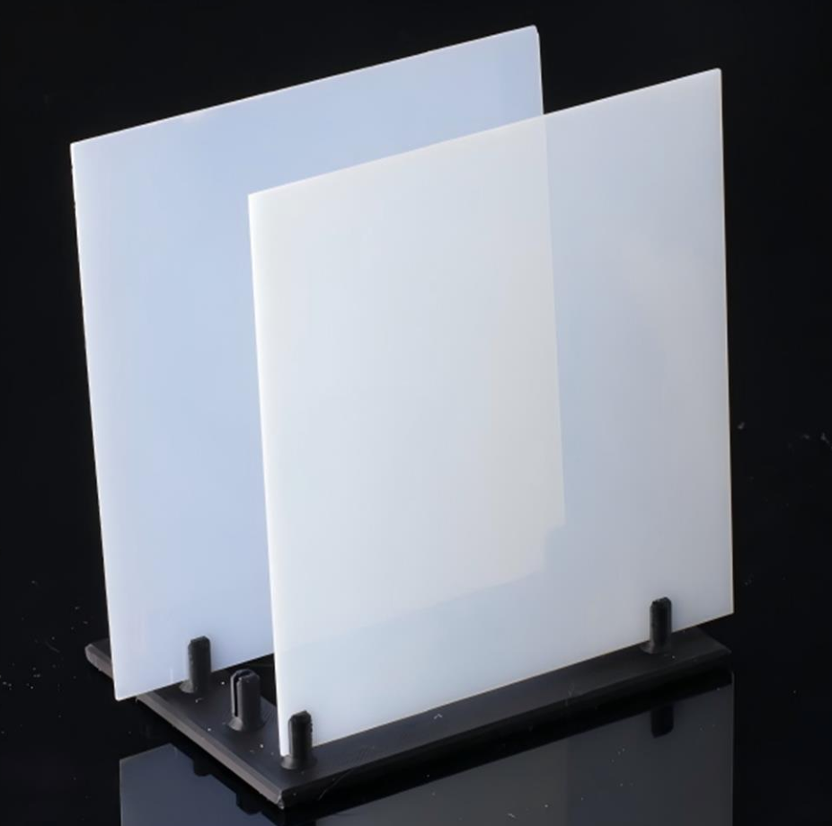
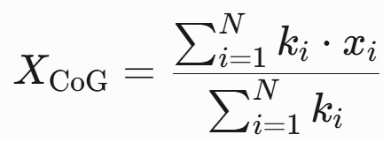
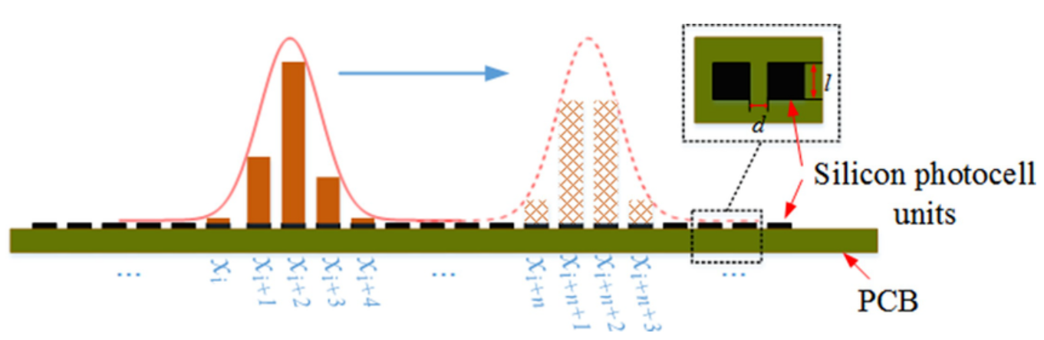




SHiNE ( SiPM-based High-resolution Neutron Detector)
Key technology
New Scintillator: high detection efficiency
Centroid Algorithm: sub-mm positon resolution
C D
neutron signal
Multi-channel Independent Readout Electronics
Detection mesurement result
Performance：
Pulse Timing​​: Rise time <50 ns, Fall time <500 ns；
​​Light Yield​​: Up to 4.7 times that of standard GS20 glass and 75% of commercial ZnS:Ag/LiF
Detect efficiency：50%>2Å
n/gamm rejection：~10⁻⁴
The threshold value, pulse width, and Time-of-Flight (ToF) are recorded
S. Lv, B. Tang, Z. Sun, S. Zhou et al, Nat. Commun. 15, 6746 (2024).
Degui Tu, Dazhao Wang, Xunpiao Liu, Shichao Lv, Bin Tang*, et al, Journal of the American Ceramic Society, 107, August 2024
Notes:
This slide shows the key technologies of SHiNE. channel-multiplexed readout electronics
The first is the centroid-based position reconstruction algorithm, which uses light sharing among multiple SiPM channels to achieve sub-millimeter spatial resolution.
The second is the new high-performance scintillator, which provides fast timing, high light yield, and promising neutron detection efficiency.
The third is the multi-channel independent-readout electronics, which records channel-level timing and ToT information for more accurate event reconstruction.
So SHiNE combines algorithm, material, and electronics optimization to achieve high-resolution neutron detection.

Slide 15







Stucture: Minimal dead-zone design
Large-area Optical-guide coupling scintillator together with a small gap below 0.1 mm
The SiPM array can be tiled over a large area with constant pixel gap across modules
neutron incident
Scintillator
Optial guide & Radiation shield
SiPM Array
Diffraction-peak obtained by detector
Cross-module event merging based on temporal and spatial clustering
Splitting and intensity distortion caused by module gaps
Integrity
Notes:
For tiled large-area detectors, the gap between adjacent modules is a critical issue because it can cause peak splitting, intensity distortion, and data loss near the module boundary.
To solve this problem, we use ultra-tight scintillator tiling with a stitching gap below 0.1 millimeter, large-area tiling of SiPM arrays with a uniform pixel pitch, and cross-module event merging based on temporal and spatial correlation.
In this way, the detector can be scaled to a larger area while preserving diffraction-peak integrity 衍射峰完整性
Ultra-tight scintillator tiling + tiled SiPM arrays + cross-module event reconstruction

Slide 16




Clustering-based position reconstruction algorithm
Two-step: temporal clustering followed by spatial clustering
Neutron Beam test
Temporal clustering：T0-based pre-segmentation of the signal stream
Spatial clustering：Position-window-based event selection
The spaical resolution is better than 0.35 mm (averaged FWHM )
Notes:
In this way, we can reconstruct neutron events more accurately from distributed SiPM signals. makes the reconstruction more efficient
The projected peaks are then fitted, giving an averaged FWHM of about 0.35 mm.
we first determine which signals are likely to belong to the same neutron event in time.
use position windows to identify which channels belong to the same physical event in space.

Slide 17





SHiNE @ SCND(Single Crystal Neutron Diffractometer)
Accurate Bragg-peak localization
Advantages of SHiNE for SCND
Sub-mm spatial resolution
Detector pixel Angle 0.0477°(0.5 mm )
High detection efficiency
Minimal-dead-zone
Large-area coverage
Bragg scattering:
Sharp & high intensity
Average structure of atoms in real space
Long-range order
Laue diffraction
Single crystal
Intensity
Multi-wavelength "white LoGHT"

Slide 18


Summary and outlook
CSNS Detector & Electronics Group
Scintillator detector family
01
Scintillator detector family at CSNS address instrument needs from large-area deployment to future high-resolution applications.
Key technologies developed
02
Novel scintillators, MA-PMT and SiPM readout, customized ASIC chips, and advanced position-reconstruction methods.
Future work
03
focus on higher efficiency, minimal dead zones, scalable large-area assembly, and real-time reconstruction.
Acknowledgements
04
International colleagues for valuable discussions and exchanges, domestic collaborators suport.
ISIS group for detailed technical discussions and constructive suggestions.
Notes:
The next-generation detector should also provide:
small dead zones
compact module structure
vacuum compatibility
scalable large-area assembly

Slide 19

Thanks
Welcome and Acknowledgements
Be curious and go deep into matter, like a neutron.
Be accelerated like a proton in a synchrotron.

