Slide 1
Neutron Beam Imaging on DICER Using a ⁶Li‑Glass Scintillator Read Out by a Large Area Picosecond Photodetector (LAPPD)
D. Kral¹, Th. Stamatopoulos¹, A. Couture¹, S. Chasapoglou, P. Koehler¹, B. DiGiovine², J. Ullmann¹
Physics Division, Los Alamos National Laboratory, NM 87545, USA
Weapons Engineering Verification & Validation Division, Los Alamos National Laboratory, NM, 87545, USA
ICANS XXV
13th – 17th April 2026
LA-UR-26-22894

Slide 2
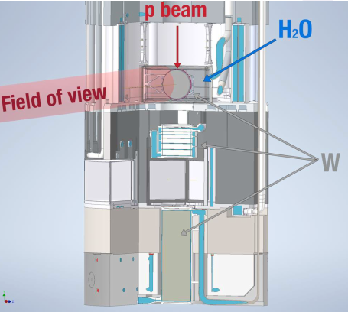
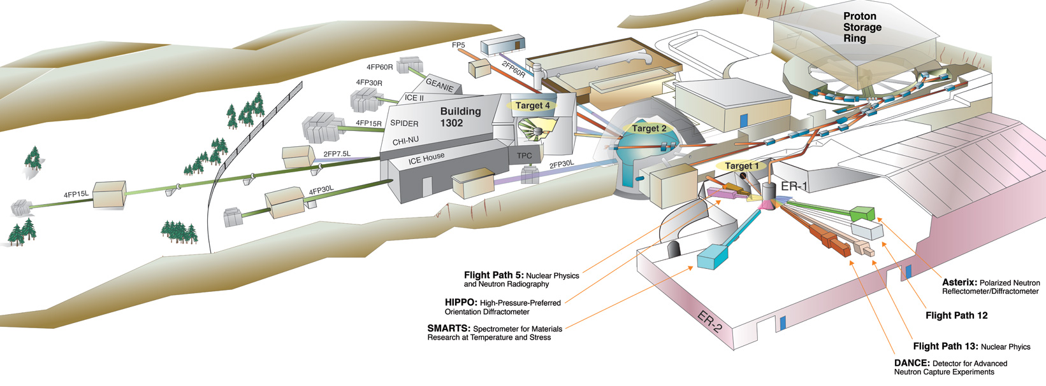
LANSCE Spallation Targets, DICER experiment
Target 1 (Lujan Center)
Combination of target-moderator-reflector-shield (TMRS)
Last design Mark-IV has been installed in 2022
TMRS is a shape of cylinder with about 60cm in diameter and height of 3m
DICER – Device for Indirect Capture Experiments on Radionuclides
resonance neutron transmission measurements important for nuclear physics, astrophysics as well as for applications (advanced reactors, nuclear criticality safety, radiochemical diagnostics) and isotope production.
Challenging with conventional methods (large γ background, small sample)
LiDAR scan

Slide 3
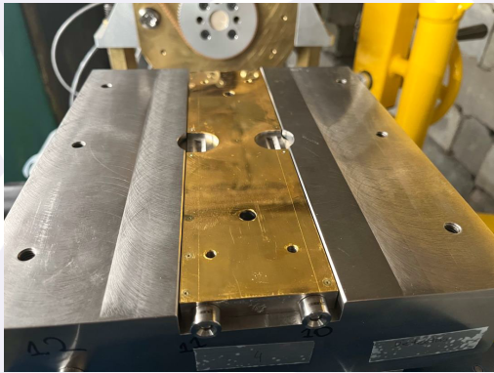
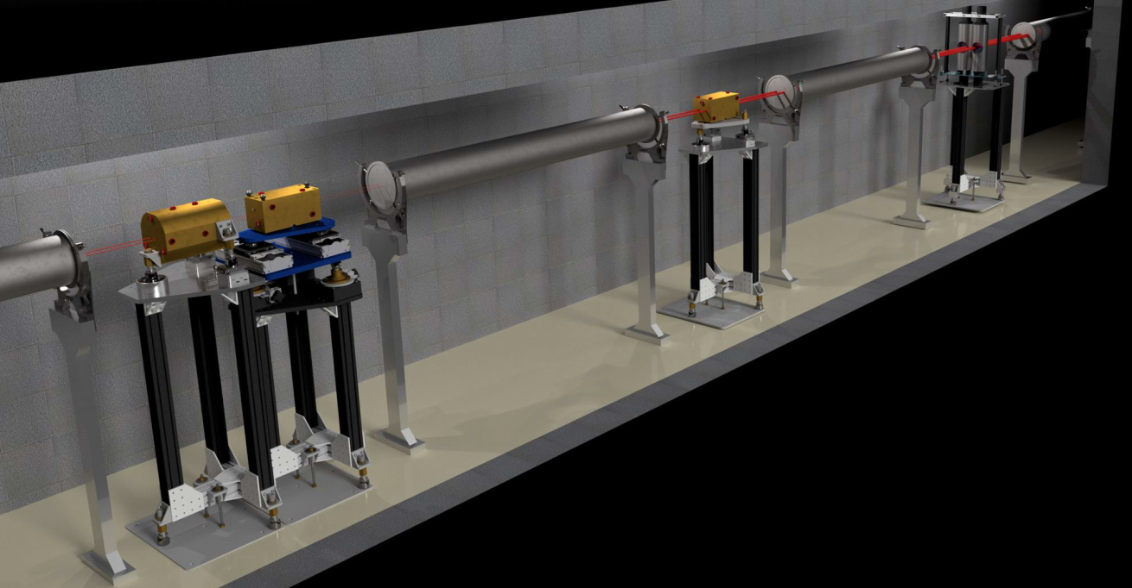
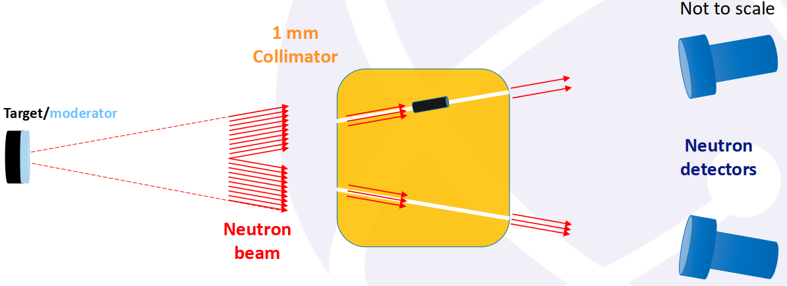
Closer look to DICER
A unique binocular collimation setup that allows continuous measurement without manipulating with sample
This allows work with very small radioactive samples compare to standard transmission measurements – no repositioning
Decrease beam time by 50% – simultaneous in/out
LiDAR scan
~15 m
~15 m

Slide 4
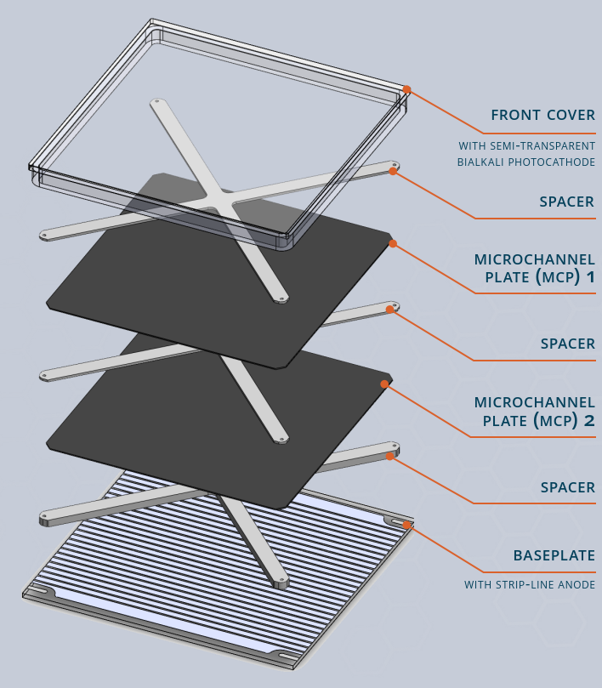
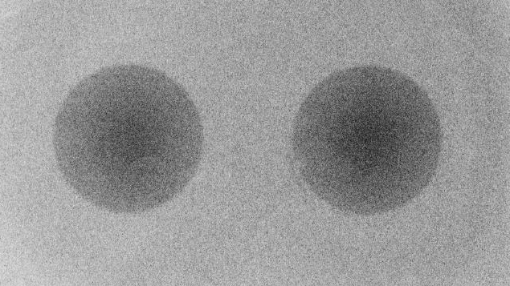
From image plates to event-by-event neutron imaging
Neutron beam profiling and position verification are part of the alignment process
  Field of View (FOV) changes after target upgrade
  Collimation changes/manipulations
  Position verification before run cycle
Improves the signal-to-noise ratio
Current approach – image plates: long exposure, limited feedback
Future approach – LAPPD multipixel detector coupled with ⁶Li scintillator
LiDAR scan
LAPPD – Large Area Picosecond Photodetector Gen II
Large-area MCP-PMT (20×20 cm²) with fast timing
8×8 external pad readout, 1″ pitch
High gain and low dark rate
Charge sharing enables sub-pixel resolution (mm-scale) despite large pads
Suitable for fast imaging applications (TOF, Cherenkov, neutron imaging)
Results from Phosphor loaded image plate (Gd doped)

Slide 5
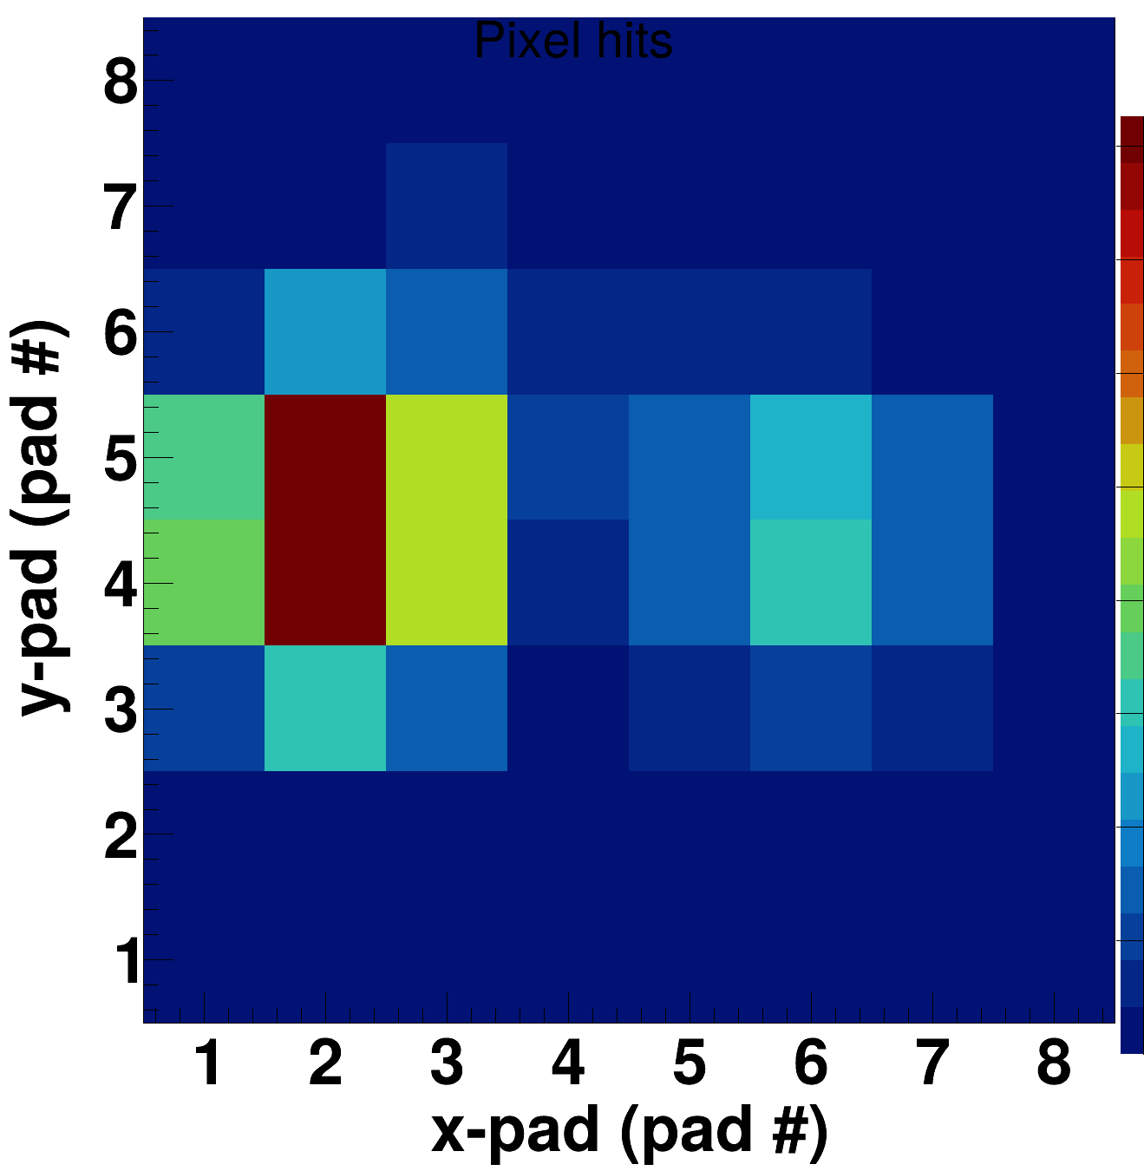
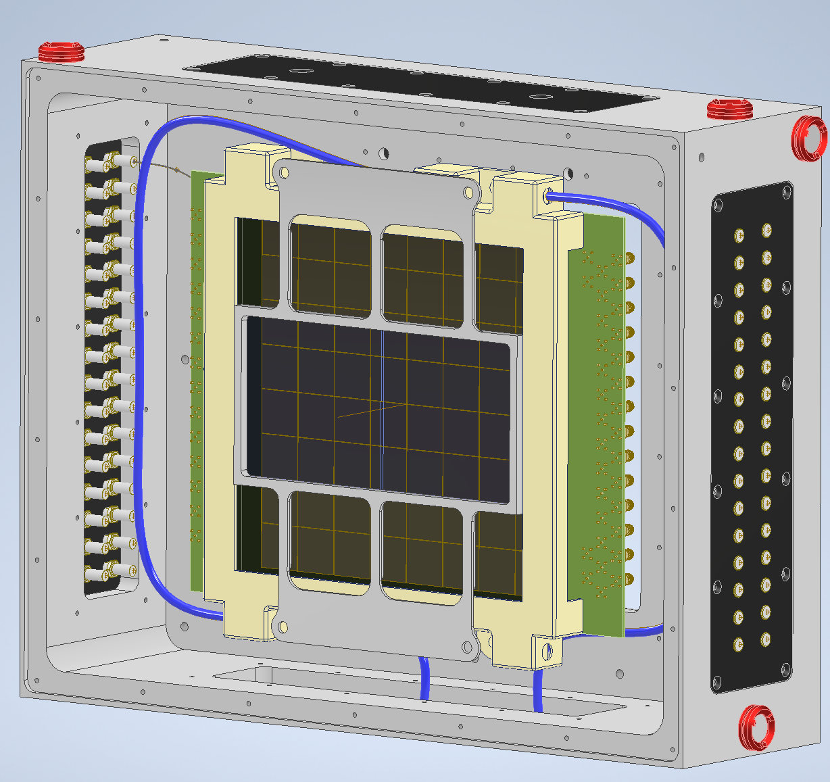
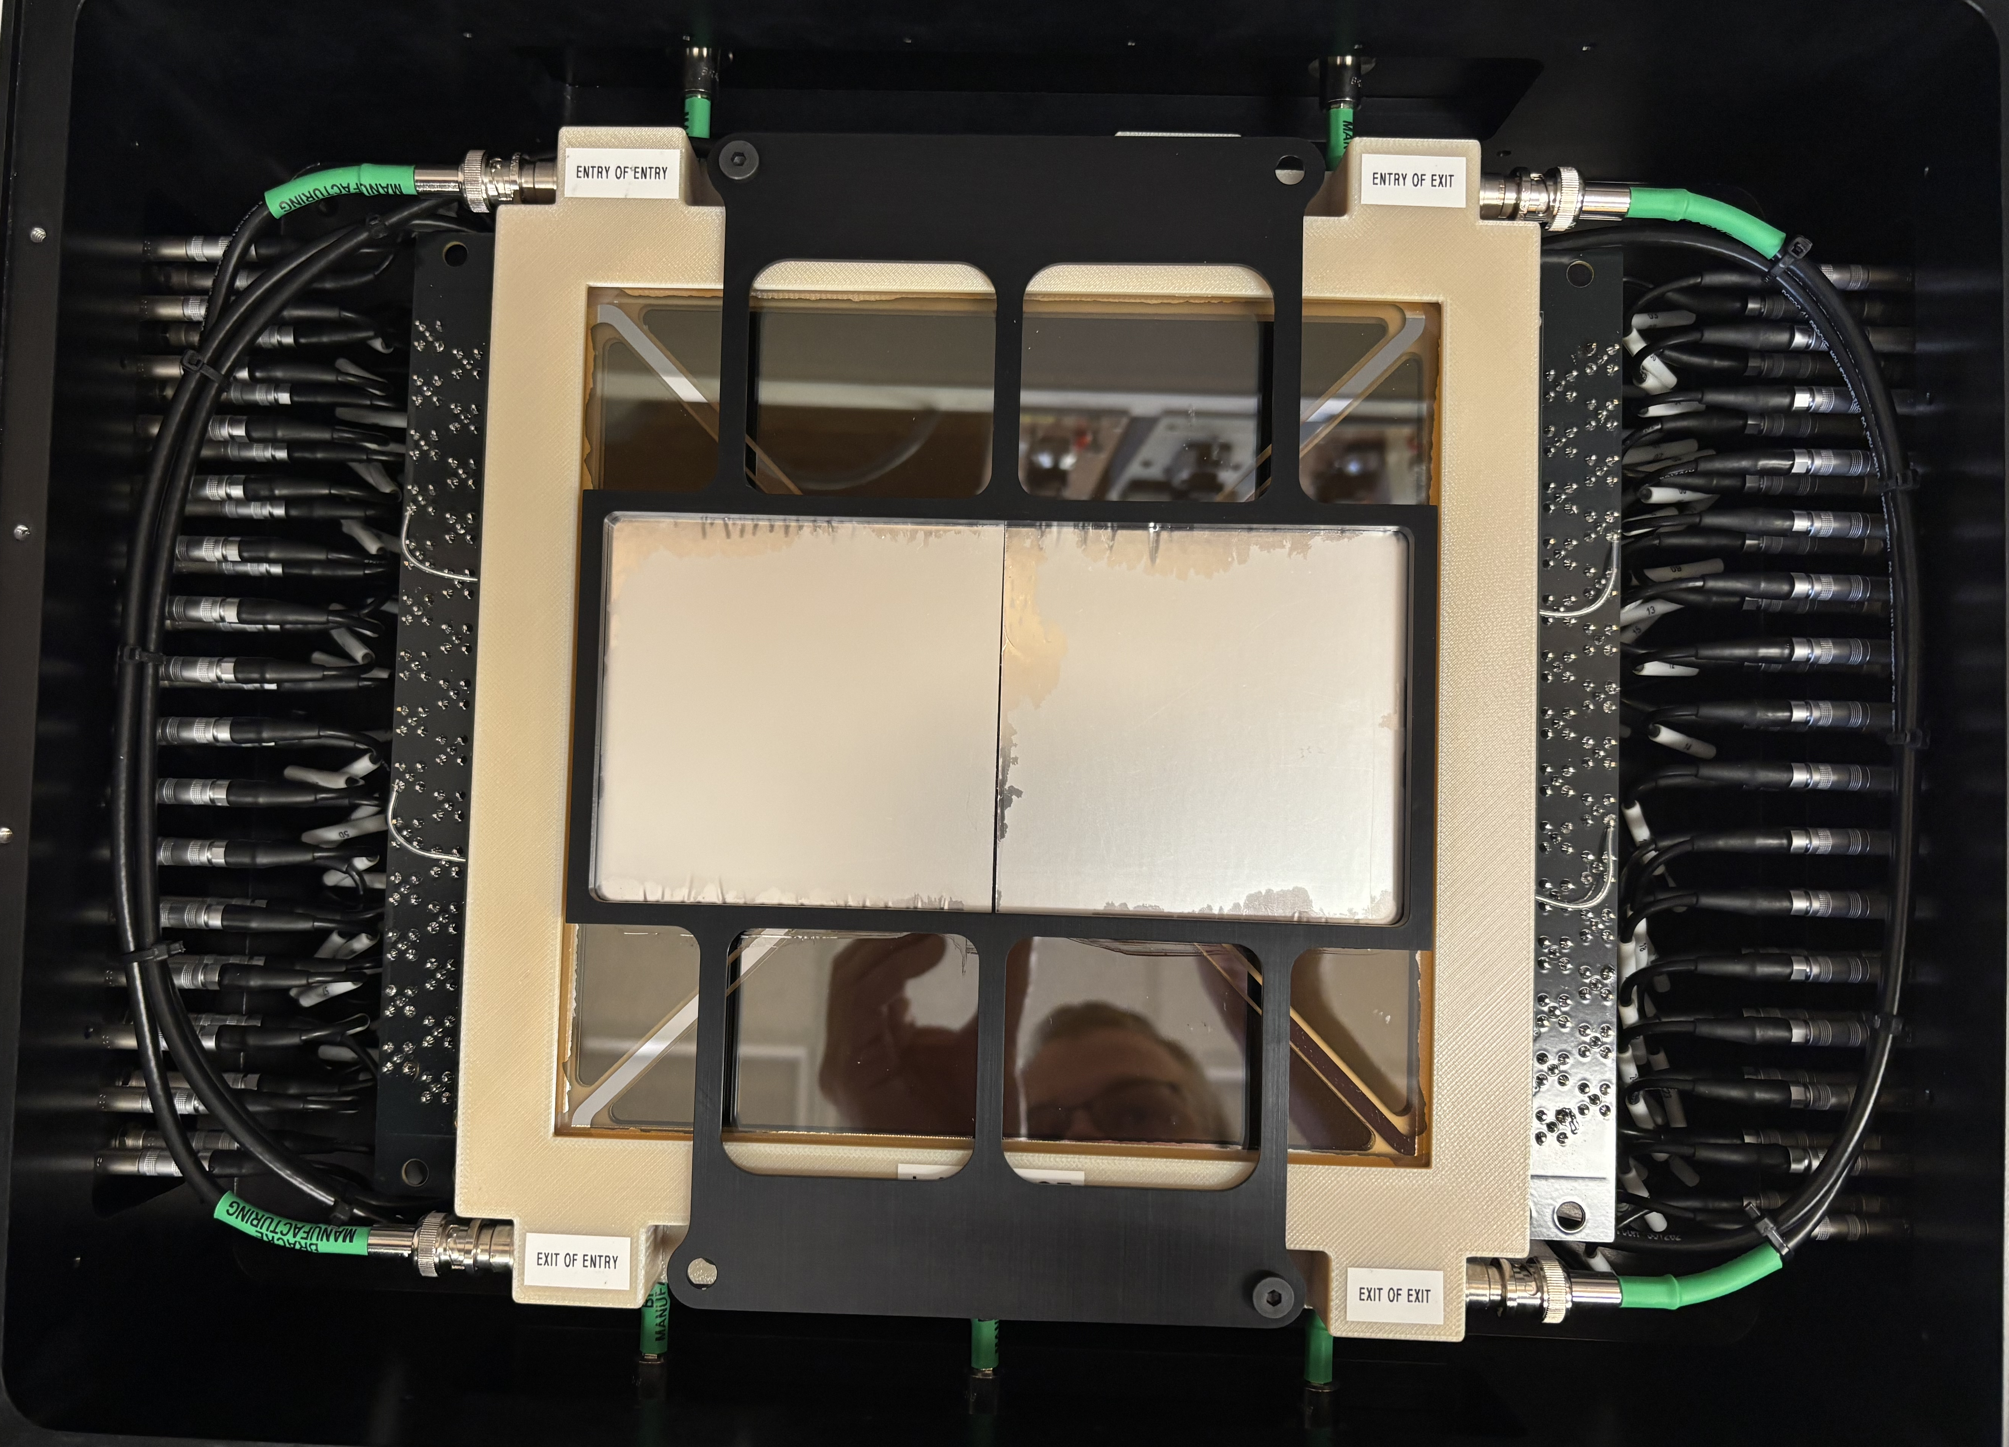
Gen-II LAPPD at DICER
The LAPPD was used in ¹⁴⁹Sm measurement (2021)
  Preliminary results showed good agreement between LAPPD and standard DICER detection system (ORELA detectors) → DOI: 10.1109/TNS.2023.3285068
  First beam image based on simple pad counts (left side – sample | right side – no sample)
  the LAPPD pulse height spectrum is compressed → PSD compressed → harder neutron-gamma discrimination
⁶Li glass
95×95×2 mm
LiDAR scan
Window + photocathode
HV inputs
Dark box
Pads readouts
LAPPD detector with coupled scintillator a) CAD model b) real setup

Slide 6
Dataset and coincidence-based reconstruction
How to reach a sub-pixel resolution (mm-scale)!? → lateral share of charge between pads → coincidence analysis
Coincidence search algorithm:
Data Loading & Filtering
  Load ROOT file (DICER tree)
  Apply experimental condition filters (paddle, beam blocker)
  Apply quality cuts (TOF, charge, pulse shape)
Data Preparation
  Separate Fission Monitor signals for normalization
  Group LAPPD events by beam pulse
Coincidence Detection (Parallel Processing)
  Time clustering: Find events within coincidence window
  Spatial analysis: Check pad adjacency using detector geometry
  Centroid calculation: Compute charge-weighted position (X, Y)
Output - Save processed data to HDF5 (compressed)
Visualization in external tool
7
6
5
4
3
2
1
0
X
Y
0
1
2
3
4
5
6
7

Slide 7
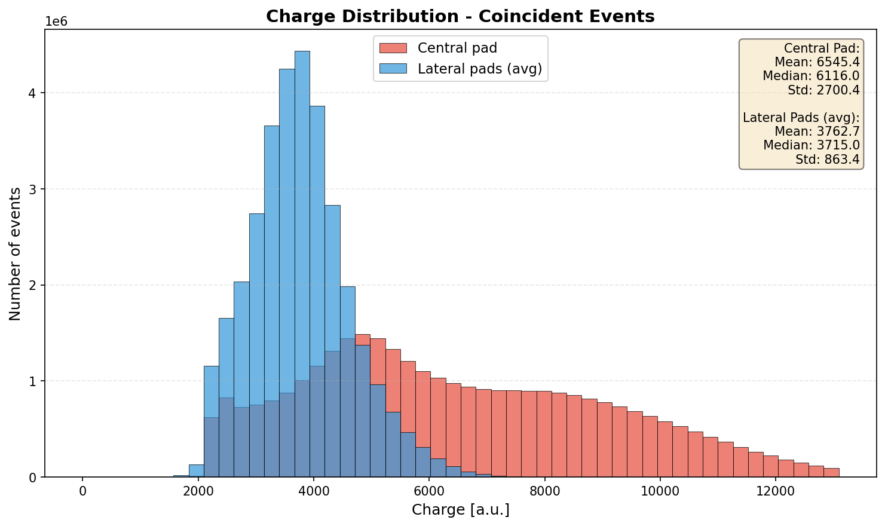
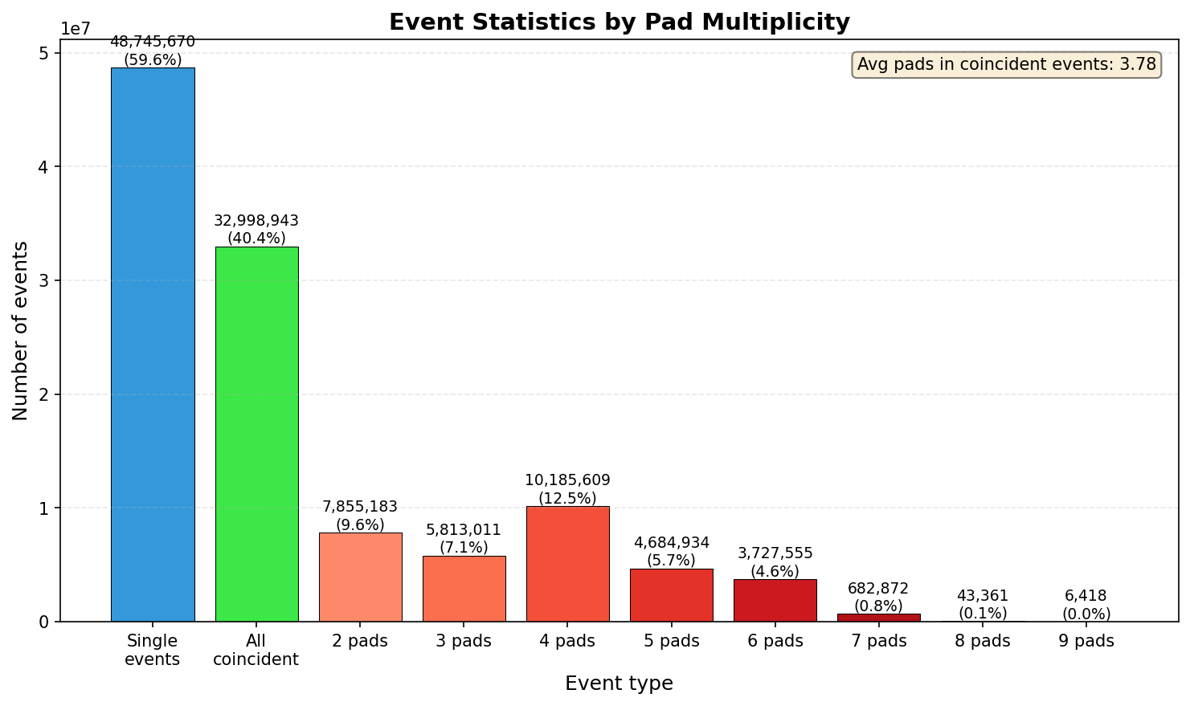
Sub-pixel resolution – Coincident events & Charge distribution
Charge distribution for central and lateral (avg.) pads
Coincident vs. single events for Cd + Both open

Slide 8
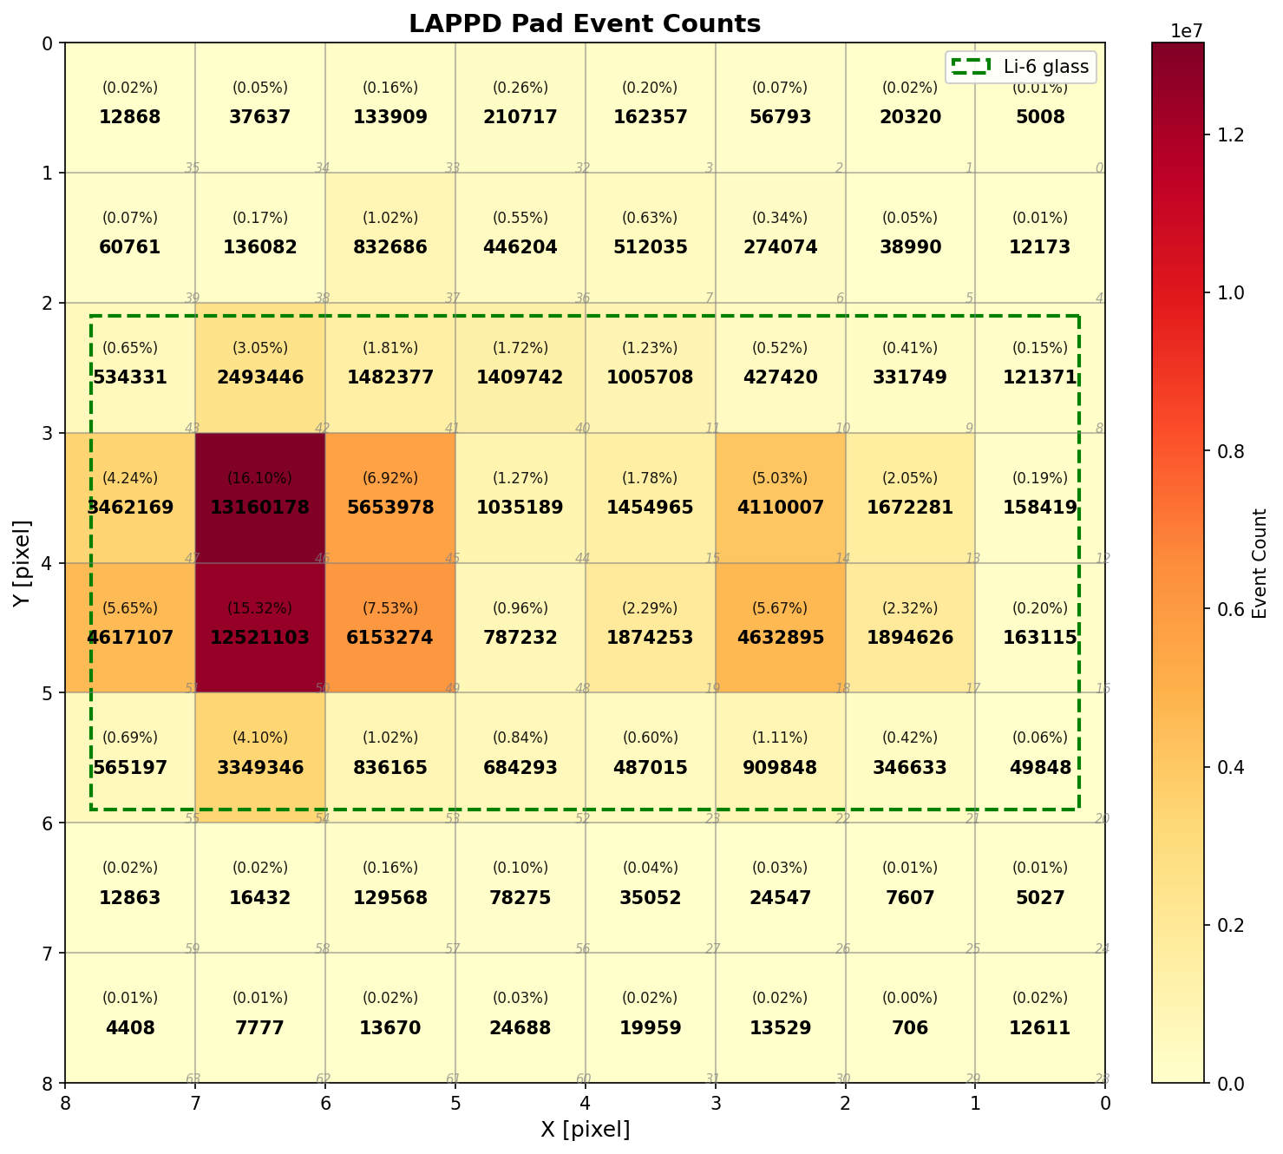
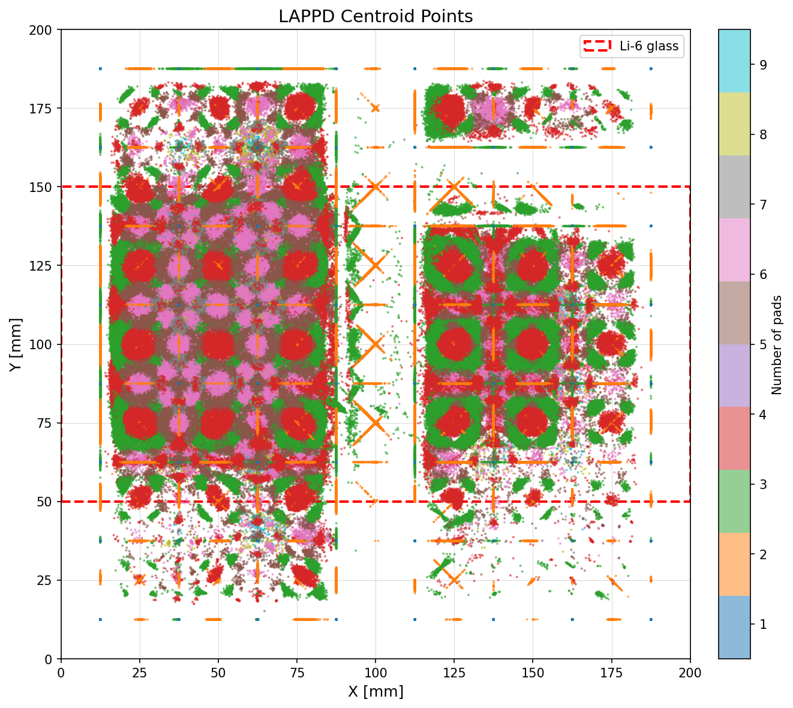
Sub-pixel resolution – Counts/Centroids distribution
Total counts in pads
Centroid-reconstructed positions

Slide 9
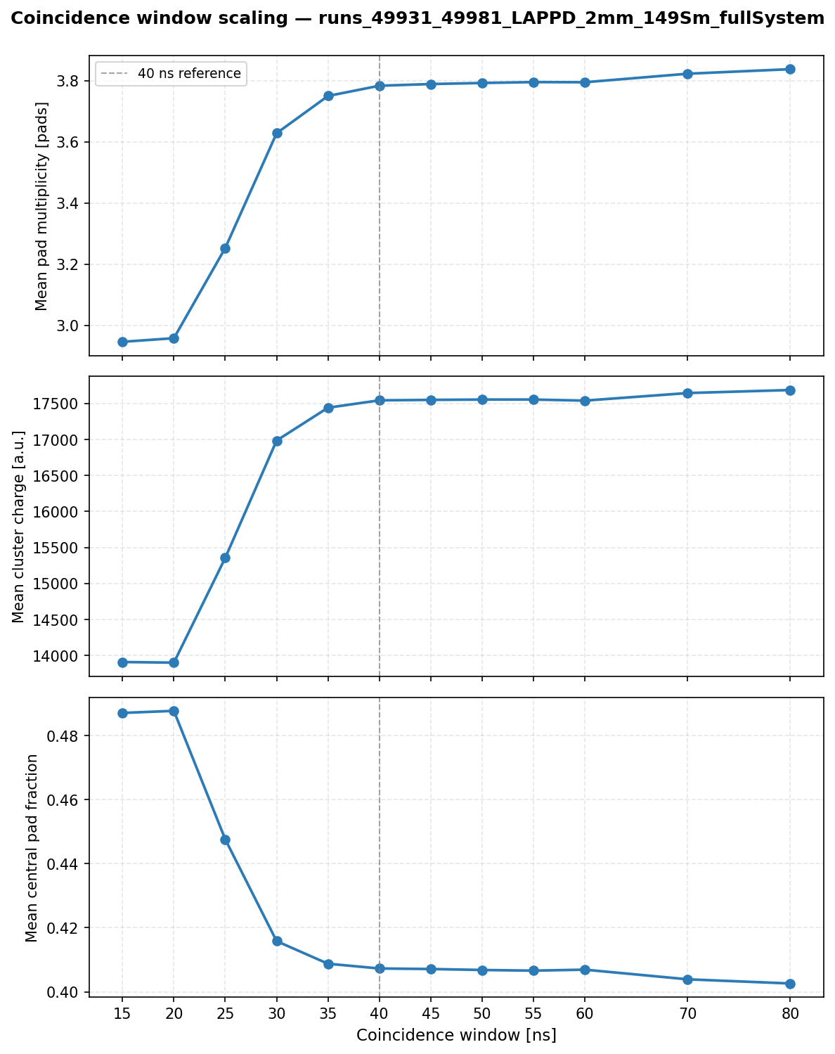
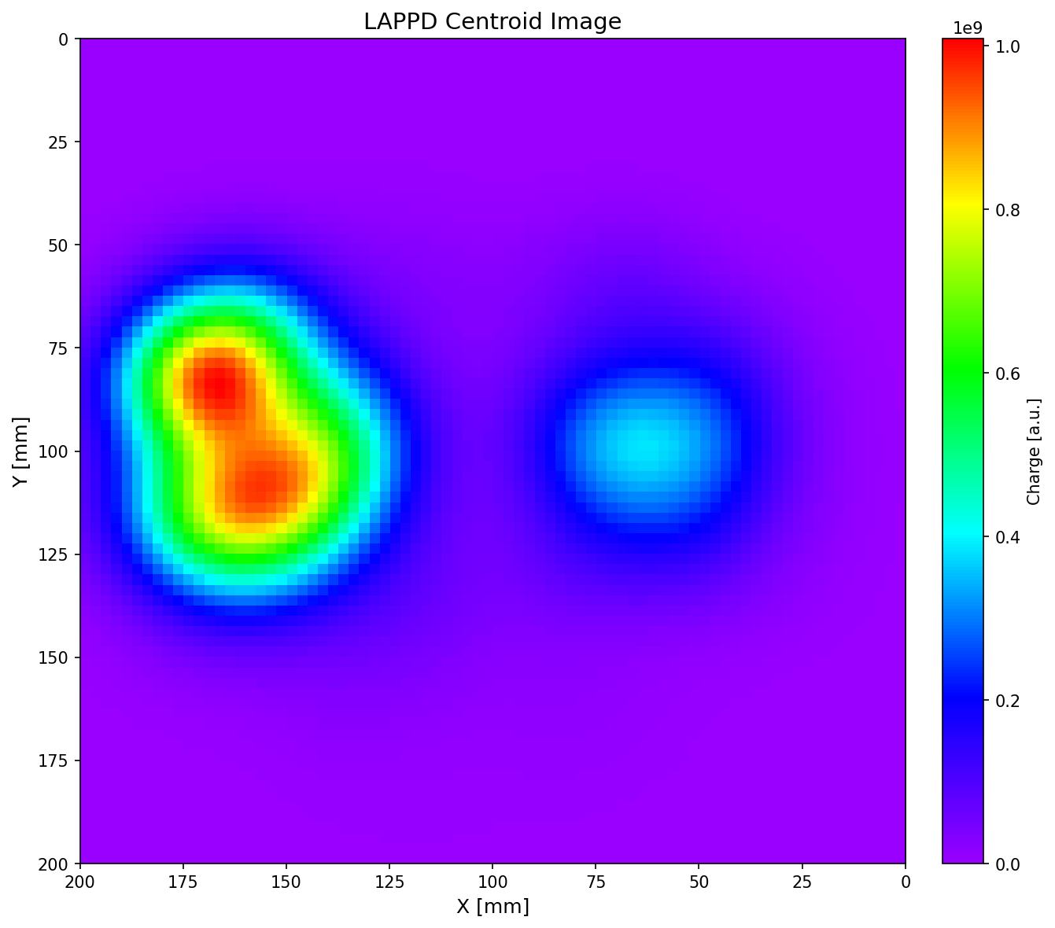
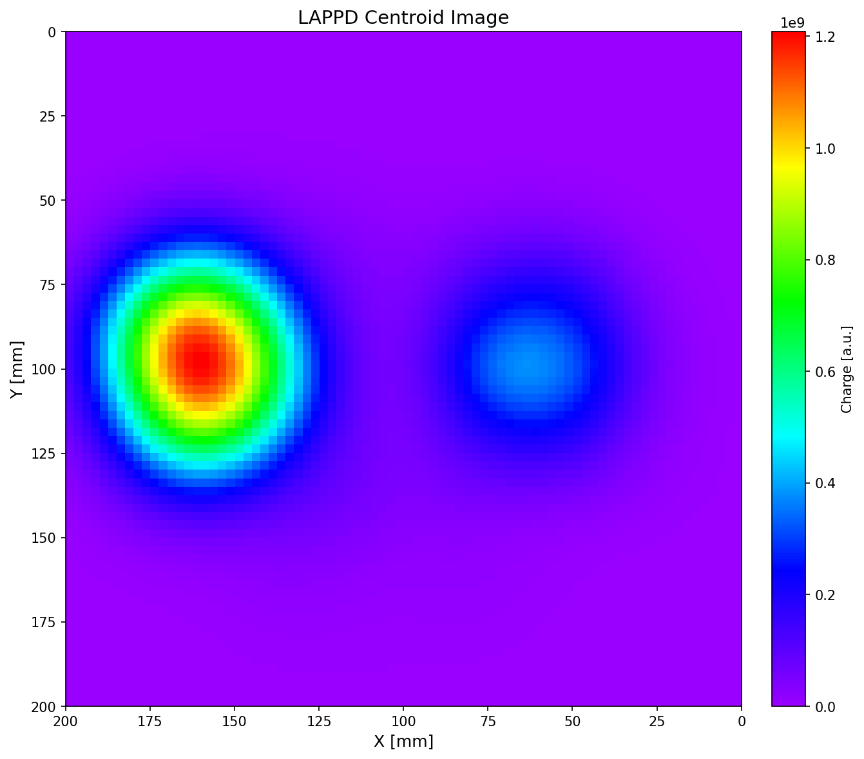
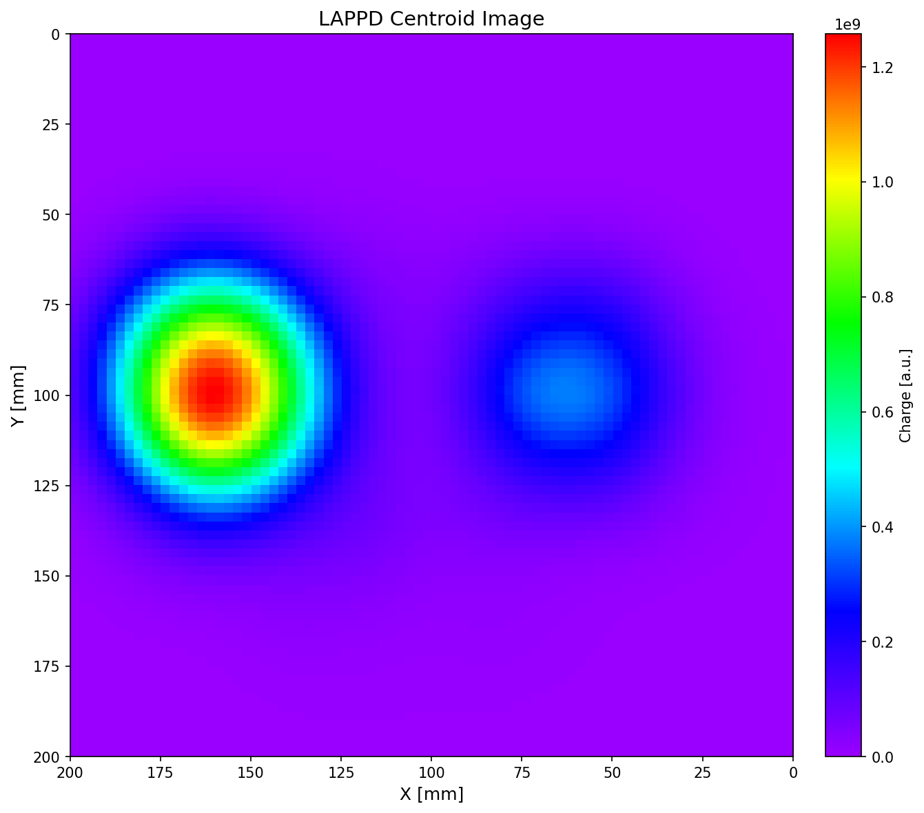

Sub-pixel resolution – Coincidence window study
t_{COI}=15 ns
t_{COI}=30 ns
t_{COI}=40 ns
t_{COI}=60 ns

Slide 10
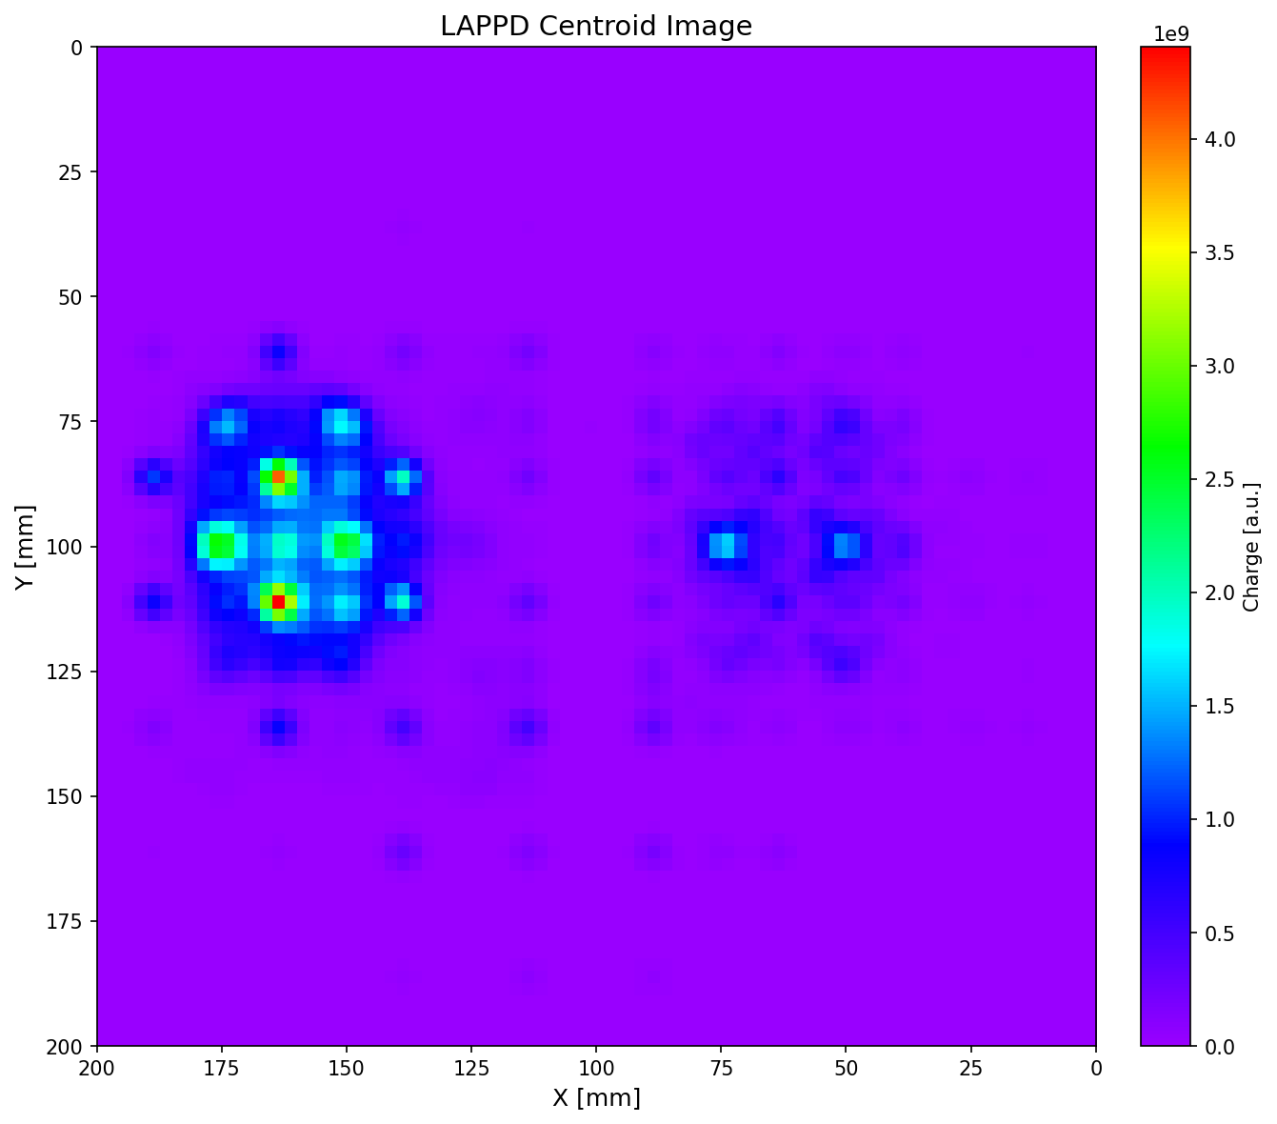
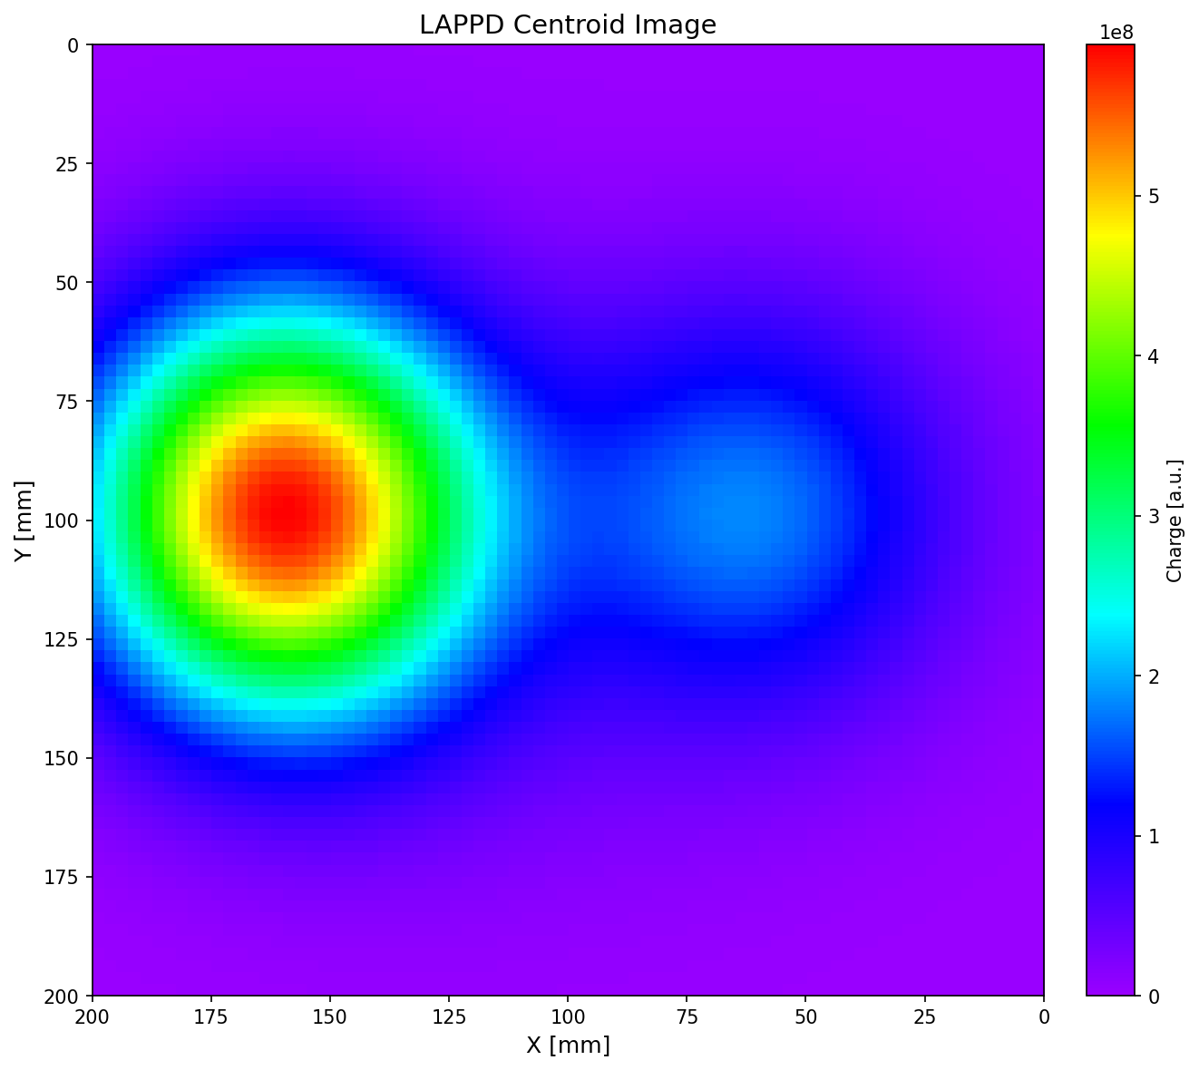
Gaussian smoothing: choosing a usable visualization scale
σ=2.5 mm
σ=12.5 mm
σ=25 mm

Slide 11
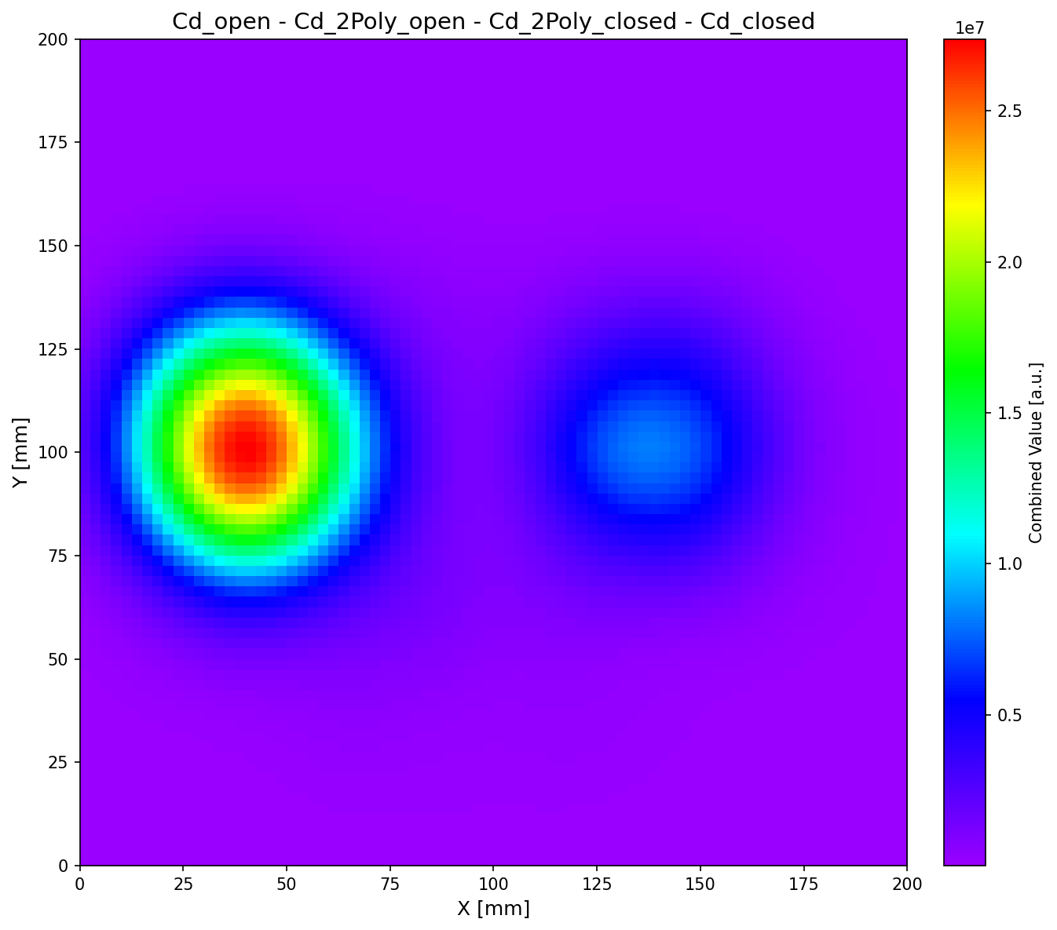
¹⁴⁹Sm sample data: preliminary neutron beam image
Simple pad counts
Coincidence-based image

Slide 12
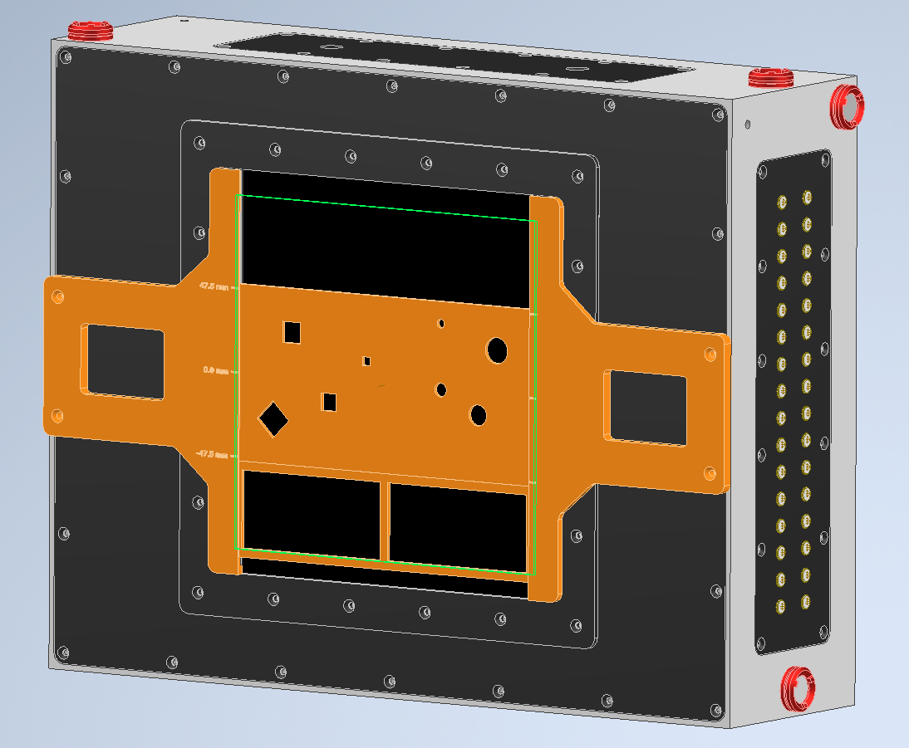
Summary and next steps
Coincidence analysis produces sub-pixel beam images from an 8×8 pad detector with beam spots in expected positions
Typical coincident clusters involve ~4 pads and support mm-scale localization
LAPPD brings ToF ability and faster response compared to image plates
Next steps:
Optimize cuts based on PSD
Validate with neutron source (PuBe / AmBe / Cf) and
mask measurements
Use in 2026 run cycle with ⁸⁸Y and 100 µm collimator

Slide 13
Thank you for your attention.
Dusan Kral
dkral@lanl.gov

