Slide 1
The Path to 2.0 MW and Beyond at the SNS
April 16, 2026
Nicholas Evans
ICANS XXV, Malmö, Sweden
Notes:
Image - 2021-P09584: Aerial overview of the Spallation Neutron Source, SNS, and the future location for the SNS Second Target Station, September 30, 2021. This image has been reviewed by an ORNL Releasing Official and is approved for public release, September 26, 2022.

Slide 2
Outline
The Proton Power Upgrade (PPU)
Commissioning PPU
Operation beyond 1.4 MW
Challenges
Preparing for Second Target Station operations

Slide 3
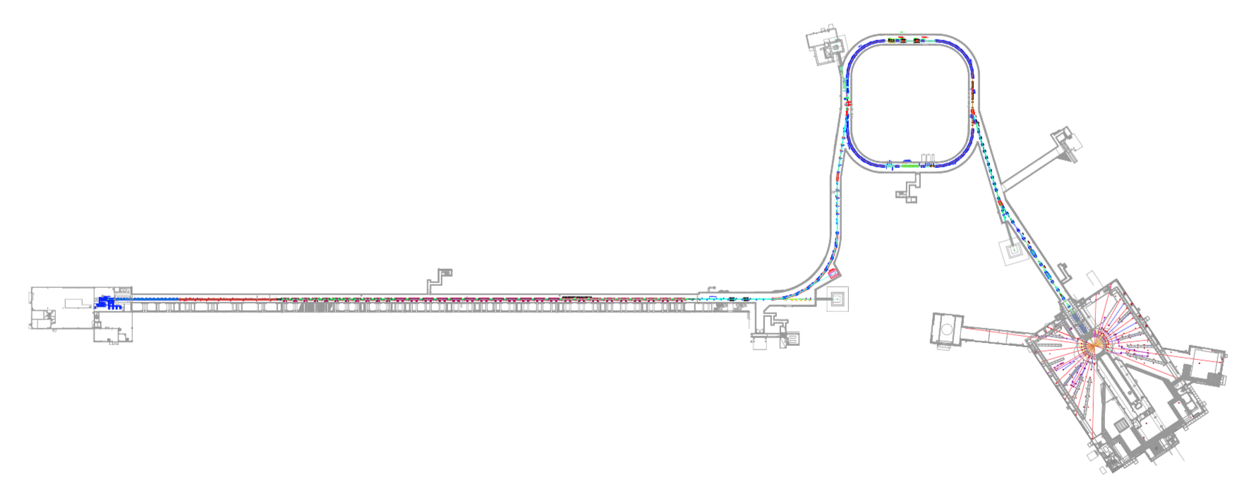
Spallation Neutron Source Today
Currently the highest power proton accelerator
1.4 MW 1.9 MW
Produce neutrons for materials science
research via spallation on a liquid mercury
target
Negative hydrogen (H-) ions stripped, resulting protons accumulated in the ring
increasing the intensity by a factor of ~1000
RFQ 2.5 MeV
CCL 186 MeV
SCL 387 MeV
SCL1000 MeV
After Upgrade
1300 MeV
DTL 87 MeV
Over 1 ms, 1000 pulses of negative hydrogen ions,
each 700 ns long are accelerated to 1.3 GeV or 0.91c
Accumulated 700 ns long pulse of 1.5 E14
protons is extracted to target 60 times a
second – roughly 32 kJ per pulse

Slide 4
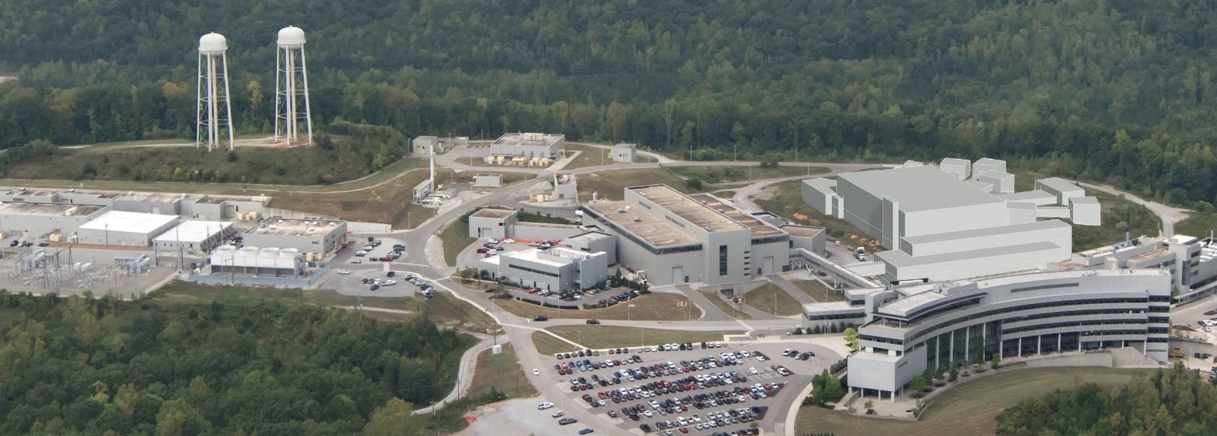
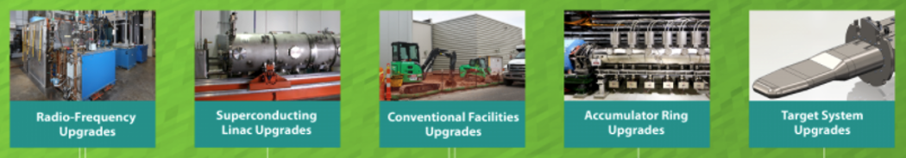
Proton Power Upgrade (PPU) Overview
PPU doubles Spallation Neutron Source (SNS) power capability from 1.4 MW to 2.8 MW
  30% beam energy increase, 50% beam current increase
2 MW to First Target Station
Accumulator Ring
Future Second Target Station (STS)
First Target Station (FTS)
Linac
PPU scope

Slide 5
PPU specifications & Key Performance Parameters
Major Specification | Original Spec. | Parameters Current Run | PPU full capability | PPU FTS operation
Beam power (MW) | 1.4 | 1.9 | 2.8 | 2.0
Beam energy (GeV) | 1.0 | 1.3 | 1.3 | 1.3
Beam current, macro-pulse average (mA) | 26 | 26 | 38 | 27
Macro-pulse length (ms) | 1 | 1 | 1 | 1
Energy per pulse (kJ) | 23.3 | 32 | 47 | 33
Repetition rate (Hz) | 60 | 60 | 60 | 60
Key Performance Parameter | Threshold | Objective
Beam power on target (MW) | 1.7 at 1.25 GeV | 2.0 at 1.3 GeV
Beam energy (GeV) | 1.25 | 1.3
Target operation without failure (hours) | 1250 at 1.7 MW | 1250 at 2.0 MW
Stored beam intensity in ring (protons per pulse, ppp) | 1.60 × 10¹⁴ at 1.25 GeV | 2.24 × 10¹⁴ at 1.3 GeV
All threshold values have been demonstrated
Energy objective complete

Slide 6
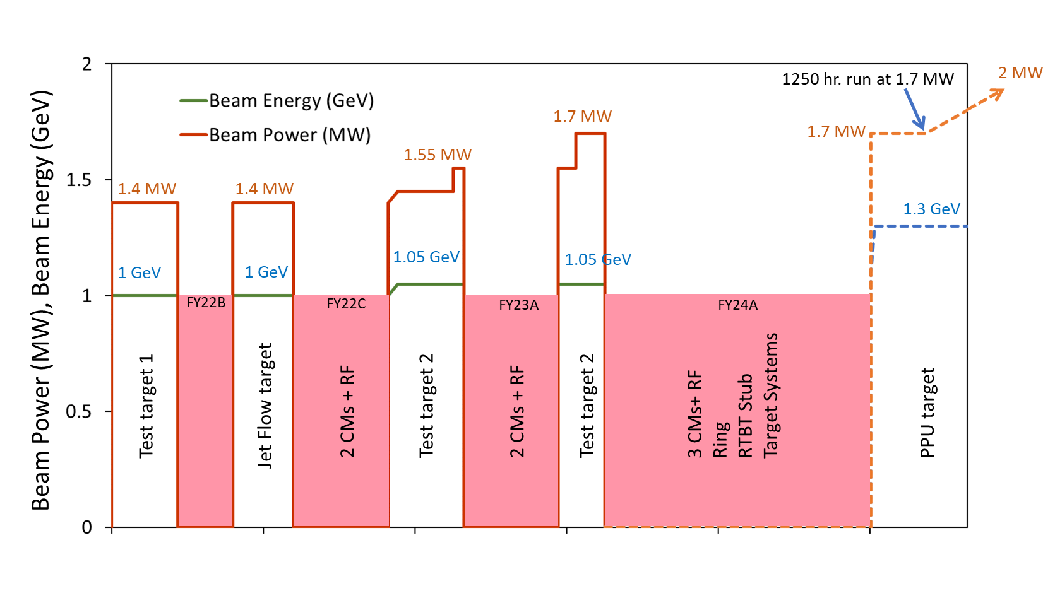
Phased Power Ramp-up: Philosophy and Execution
Increase neutron flux to users as quickly as possible
Push the power early to identify issues with new and existing equipment
2nd Phase
1st Phase
1250 Hours at
1.7 MW achieved Oct. 7th 2024
RID Window
1/1/2022
7/1/2022
1/1/2023
7/1/2023
1/1/2024
7/1/2024

Slide 7
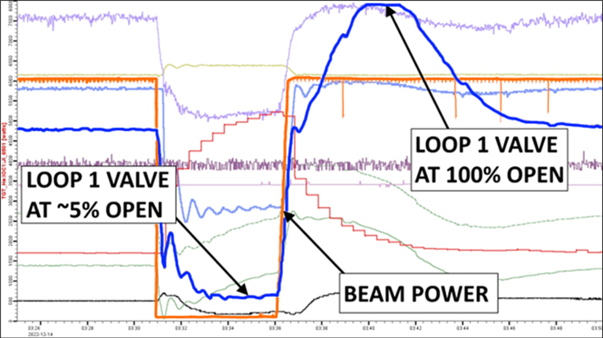
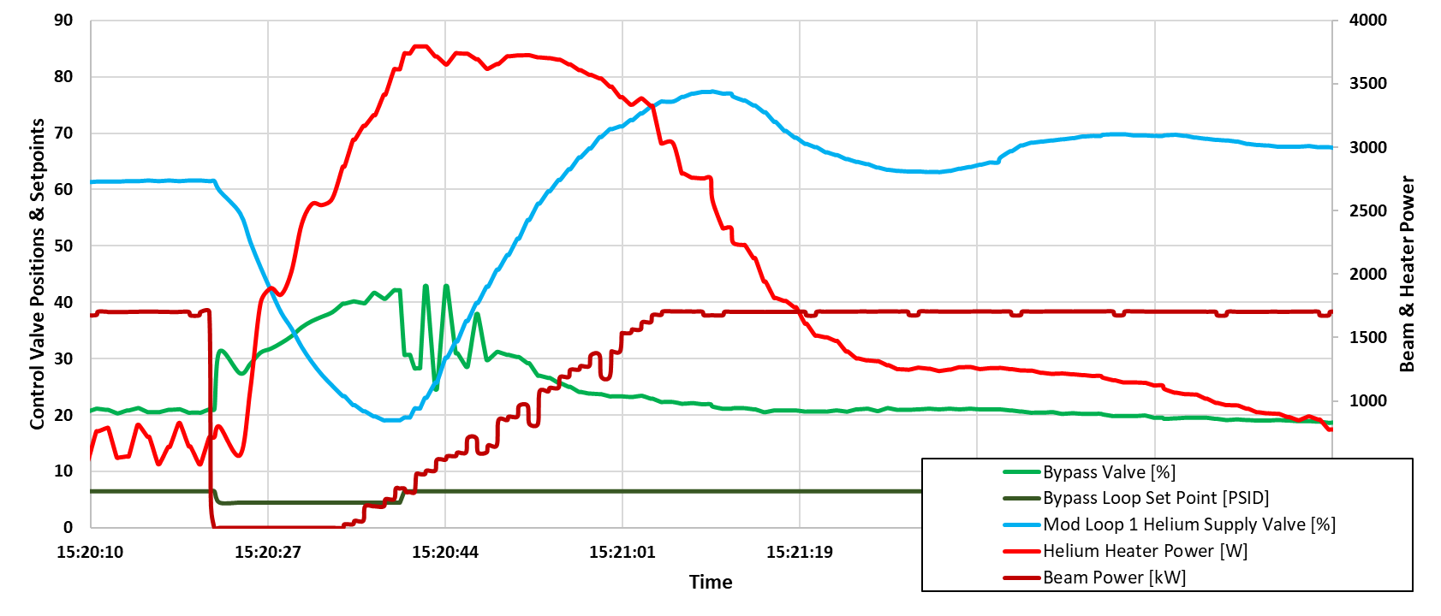
Power ramp-up – Phase 1
1.45 MW
Energy
  1.12 GeV linac output energy
  1.05 GeV for operation (limited by injection dump septum magnet)
Issue
  During beam power ramp-up beyond 1.4 MW, instability of
  Cryogenic Moderator System (CMS) process control in one of loops
  during beam on/off transient
  Beam power was limited at 1.45 MW
Resolution
  New controls implemented, providing feed forward
  control for helium return heater
  Later improvement for > 1.7 MW through better feedback to CMS
    Supported by modeling and machine learning
Power ramp-up to 1.55 MW by increasing beam current
CMS loop control at 1.45 MW as it was
Loop 1 valve stable
20 – 80 %
1.7 MW
CMS loop control at 1.7 MW after controls improvement
Notes:
The control valve that supplies cold helium to the He/H₂ heat exchanger
feed forward “kicking” of helium return heater

Slide 8
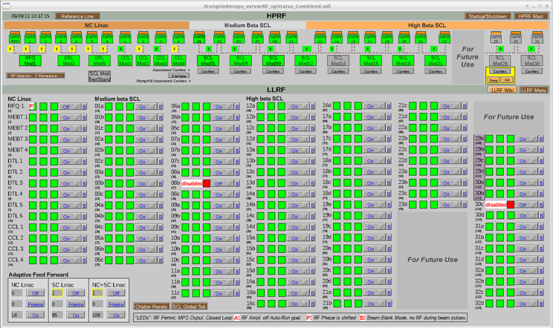
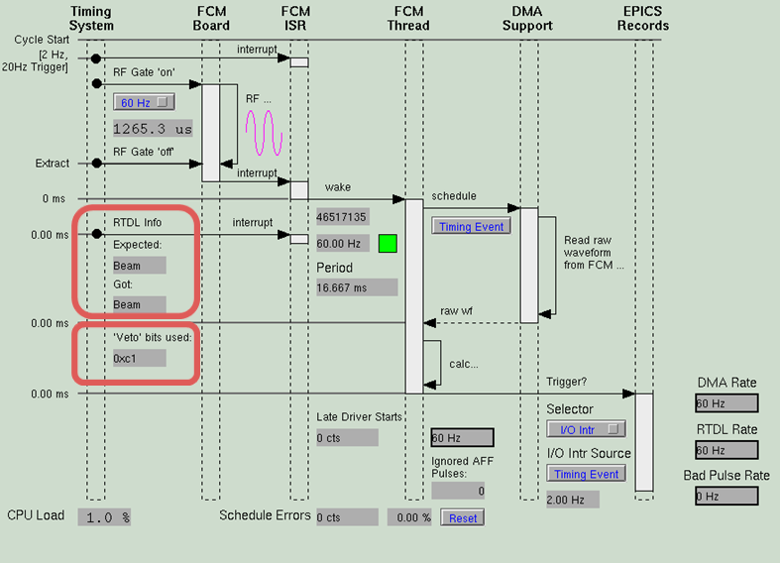
Power ramp-up – Phase 2
Energy
  1.18 GeV linac (reduced gradients for some existing high beta cavities for higher beam loading as planned, and with 2 cavities off)
  1.05 GeV for operation (limited by injection dump septum magnet)
Issue
  New LLRF not reliably receiving pulse-to-pulse beam information
    Adaptive feed forward (AFF) was not properly functioning at beam rep. rates except 60 Hz – lower rep rates were worse
    This was noticed occasionally during phase 1 but the addition of phase-2 cavities and attempt for higher beam-loading highlighted issue
Resolution
  Software update corrected the issue, and got reliable
  beam information for LLRF AFF
Power ramp-up to 1.7 MW by increasing beam current (charge per pulse equivalent to 2.1 MW at 1.3 GeV)
Phase 2
Phase 1

Slide 9
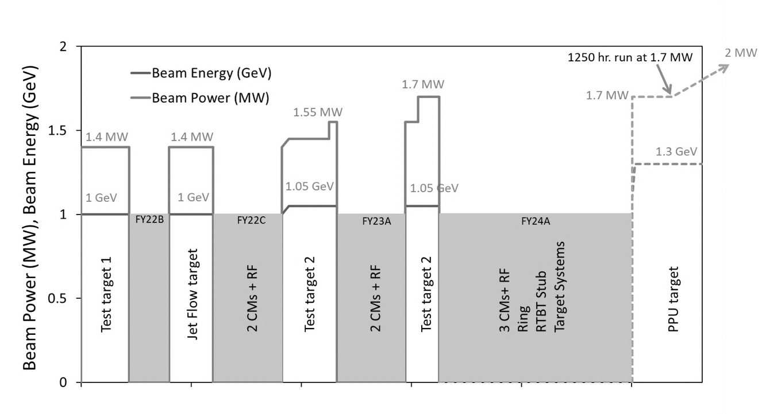
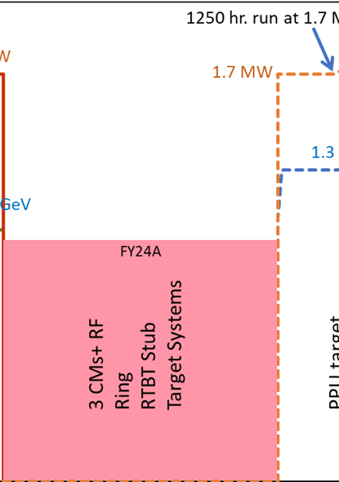
The Long Outage – All PPU Equipment is Installed
Aug. 2023 we shut down to install the final cryomodules, HPRF, upgrade the ring injection region, and make a penetration into the tunnel for the Second Target Station Stub
The rest of the talk will focus on the final push to 1.7MW at 1.3 GeV
1/1/2022
7/1/2022
1/1/2023
7/1/2023
1/1/2024
7/1/2024
1/1/2022
7/1/2022
1/1/2023
7/1/2023
1/1/2024
7/1/2024

Slide 10
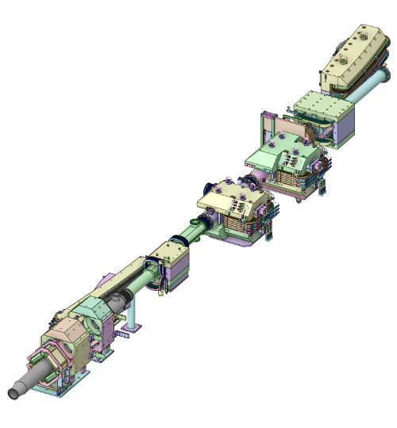
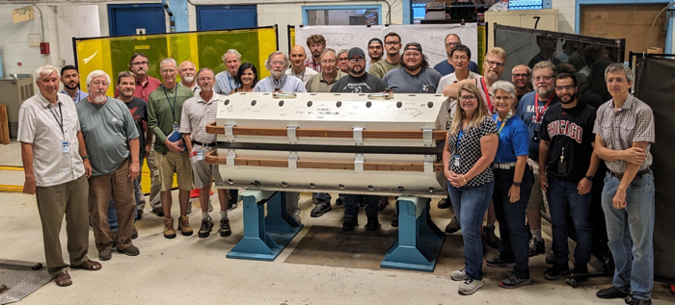
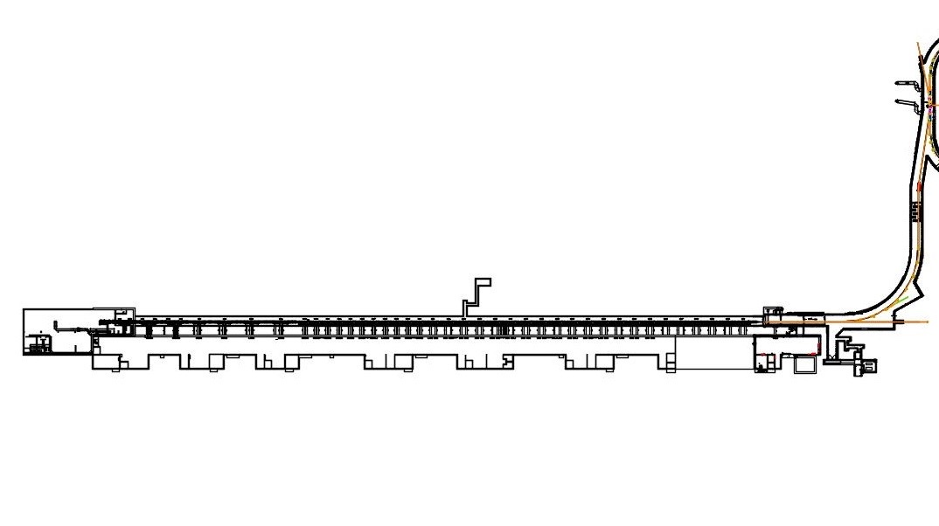
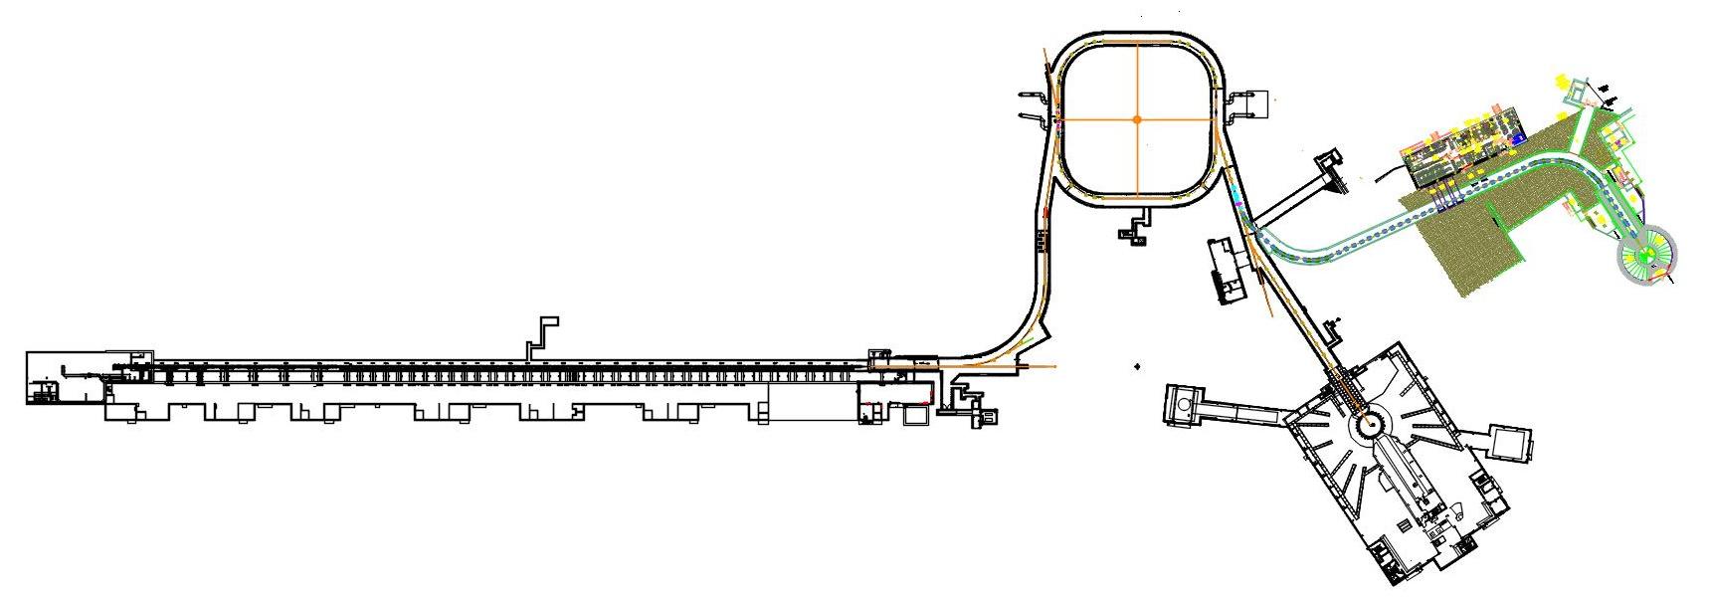
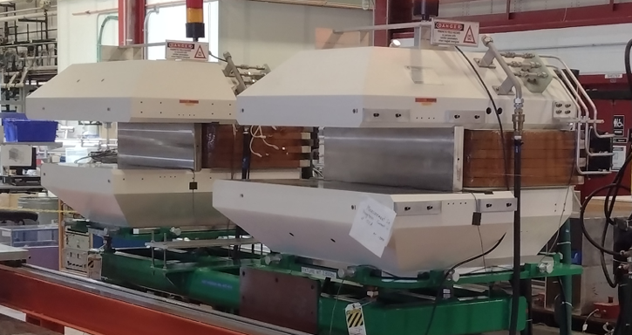
Injection Region Commissioning – New Magnets
Three new magnets designed and built at Fermilab to SNS specification to allow transport of 1.3 GeV beam through injection region of ring

Slide 11
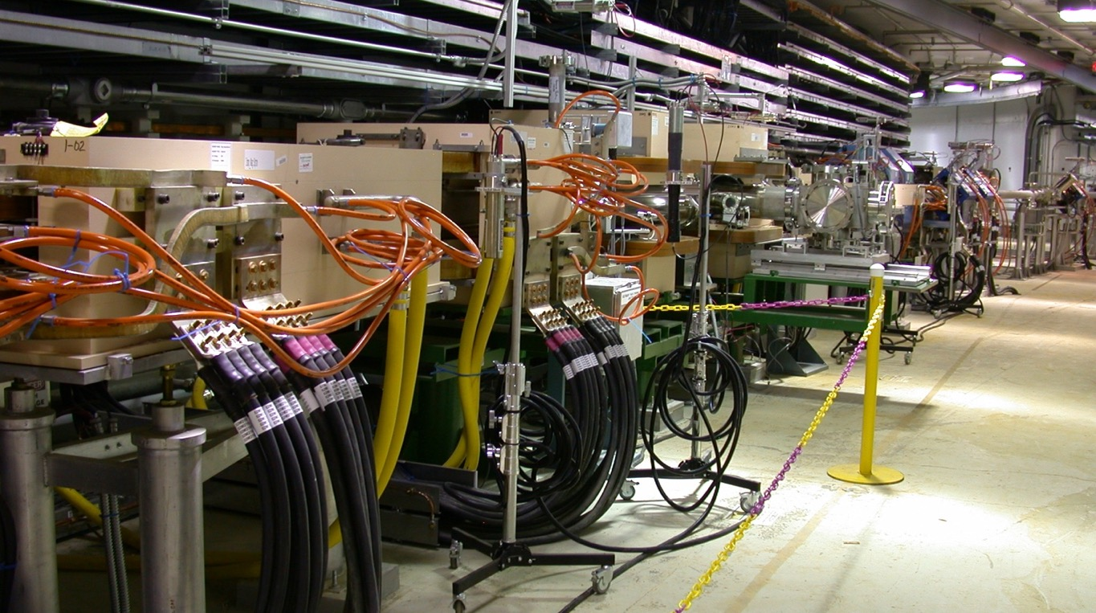
Ring Installation - Before
Dump Dipole
Chicane 3
Chicane 2

Slide 12
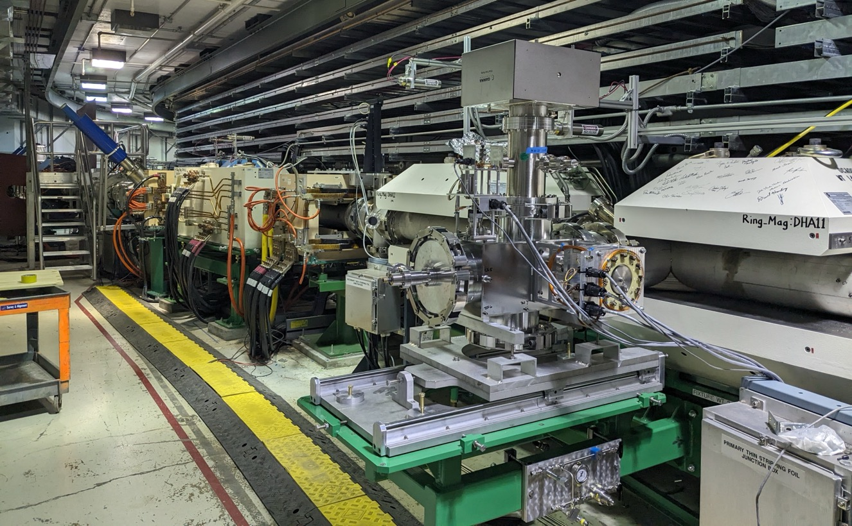
Ring Installation - After
Dump Dipole
Chicane 3
Chicane 2

Slide 13
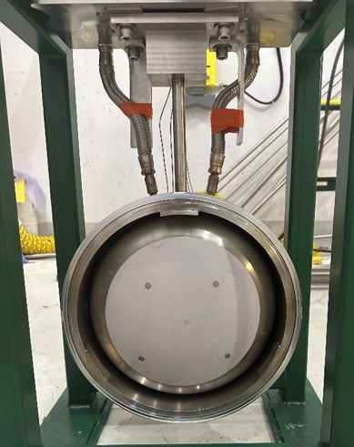
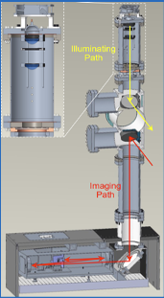
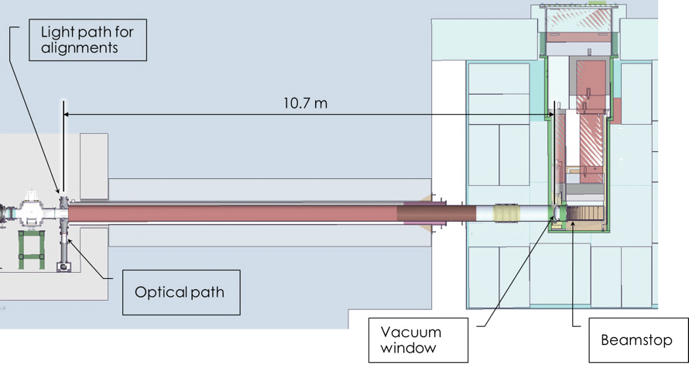
Ring Injection Dump Imaging System (RID-IS)
RID-IS is based on Target Imaging System - Optical system in the tunnel (left) images luminescent coating on dump vacuum window (right)
PPU-designed, installed system for tuning

Slide 14
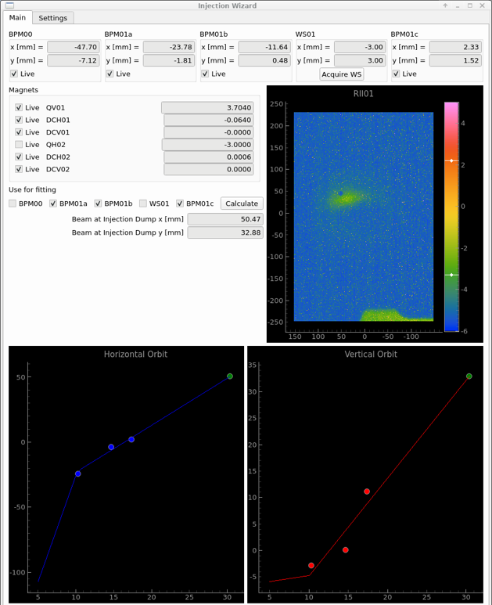
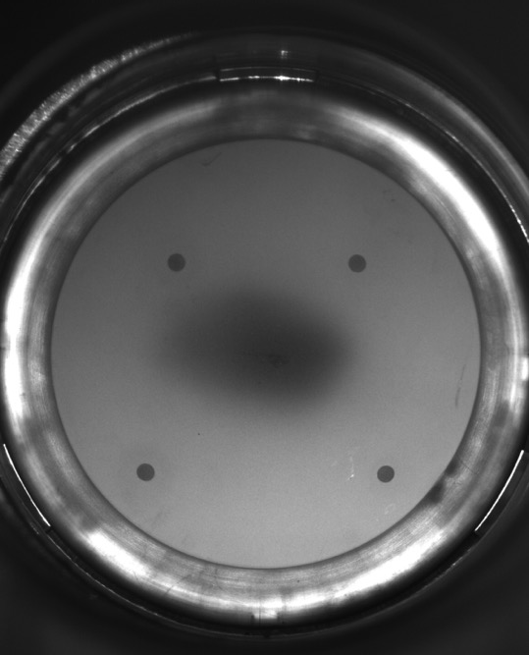
Injection Dump Imaging System – First Light
Image of window externally illuminated
Newly installed imaging system allowed for quick tune up of the injection dump
Application combines
information from RID-IS
and BPMs
Can’t use BPMs when
both waste beams are
present because
trajectories are very
different
BPM-only setup requires
‘simulating’ H0 trajectory
by changing magnet
currents, then verifying
wirescan that can see
both beams – time
consuming
Discoloration at the center of the window is from previous run. Almost no light from the center of the window
First image of beam on the dump

Slide 15
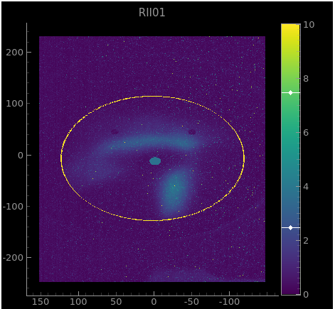
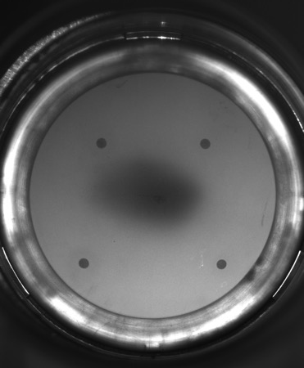
Ring Injection Dump Imaging System
“H naught” waste beam
Both waste beams on the dump face with
~0.1μC per pulse (6E11 particles) on the dump, about 200
turns (of 1000) in the ring
Uncoated area acts as fiducials
for image alignment
Dead spot in coating
“H minus” waste beam
Image of window externally illuminated
Boundary of coated area
ELOG: 12-JUN-2024 12:45 by Sarah Cousineau

Slide 16
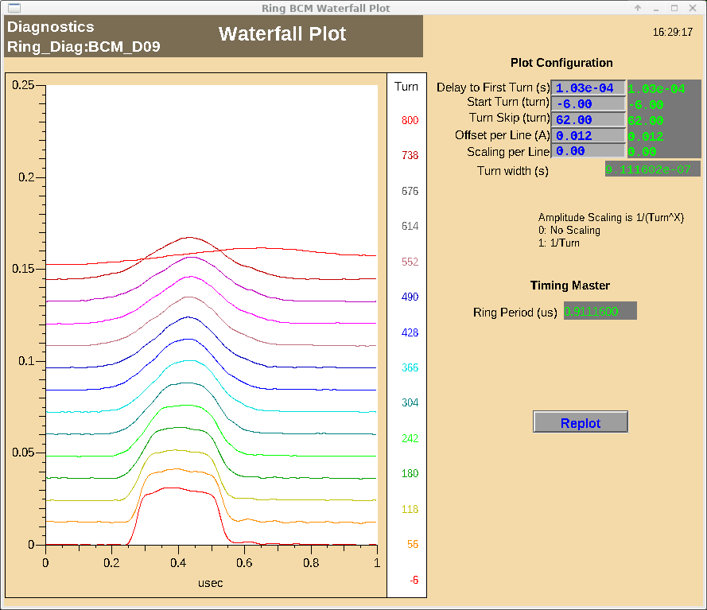
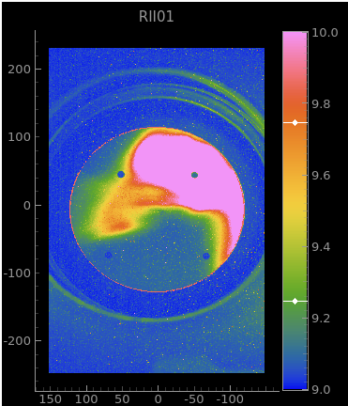
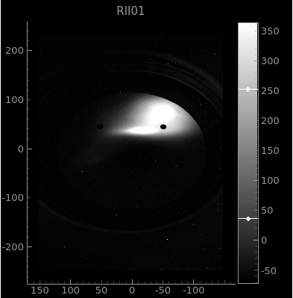
Injection Region Commissioning – Beam in Ring Highlights
BCM Signal showing first 1.3 GeV beam circulating in the ring for several hundred turns.
RID Imaging system showing full charge to the dump. Shadow of the foil can be seen – beam optics flips image of foil on window face.
Foil Shadow
With camera exposure adjusted two waste beams are clearly visible for 1.5 μC to the dump.

Slide 17
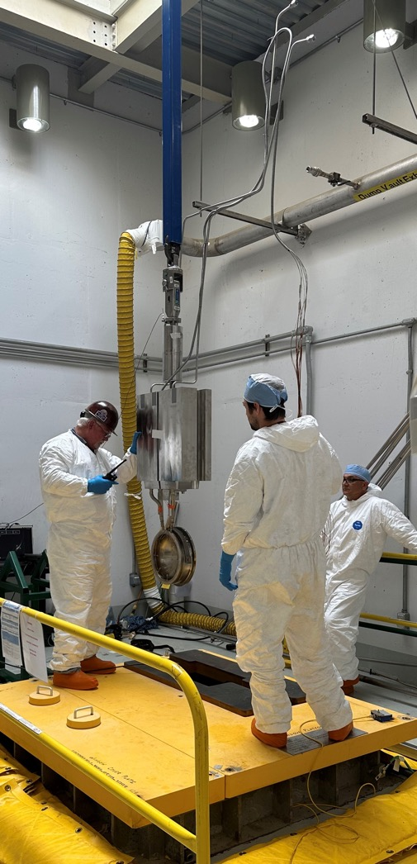
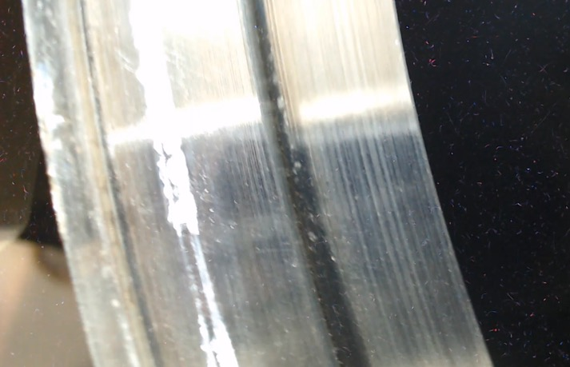
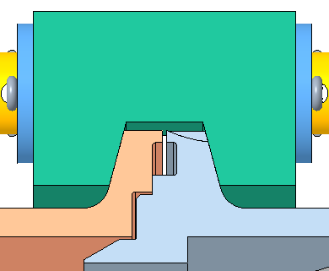
RID Issues Since Install/Commissioning
RID window was replaced with coated window in Spring 2023 – must be done remotely because of high radiation near dump
Sealing surface showed damage from original helicoflex seal
A new design was created in short order which worked initially, but since then we have a small leak
RID volume is backfilled with He which is leaking into the beamline causing issues with ion pumps – considering vacuum in RID, analysis is underway
Slowly getting worse
Sealing surface

Slide 18
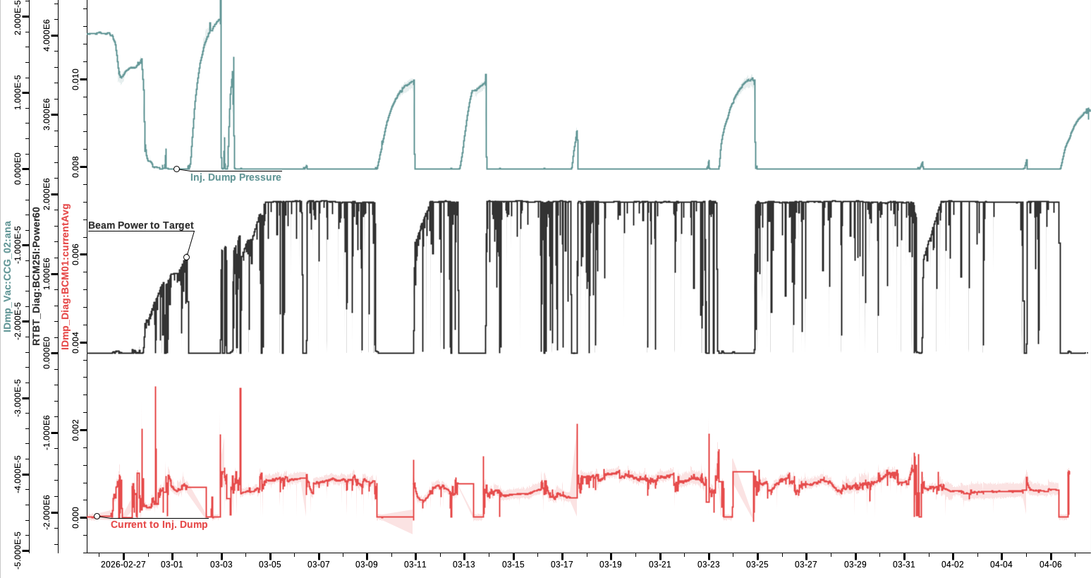
RID Issues – Operational Impact
Leak is temperature dependent not an issue when running at high power
When we turn beam off for maintenance vacuum pressure shoots up
A range of measures to deal with
issue:
  More turbo pumps
  Temperature set point of
  RID window cooling water
  increased when power is
  reduced
  Gate valve closed to
  isolate dump when off for
  long periods
Pressure rise when beam is off

Slide 19
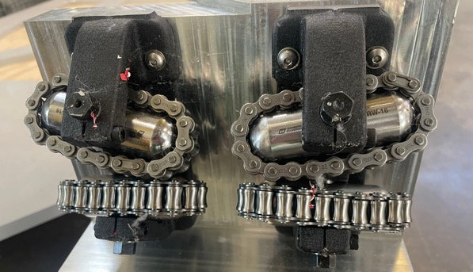
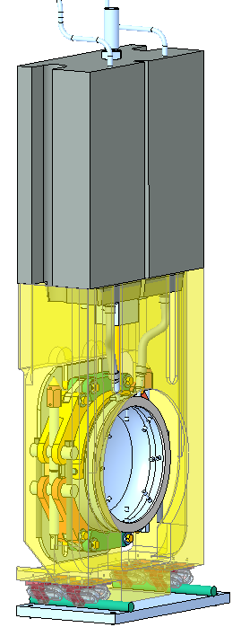
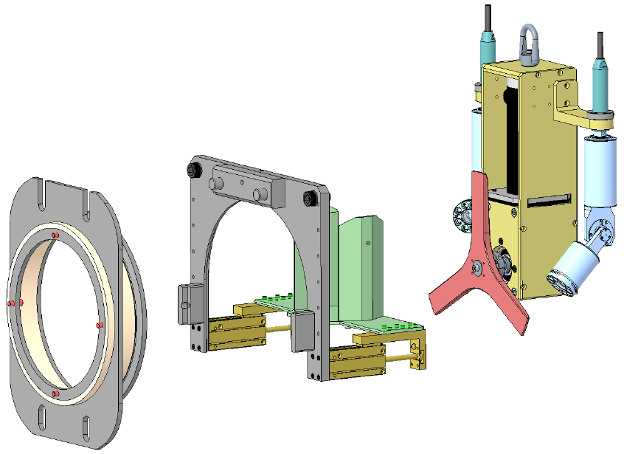
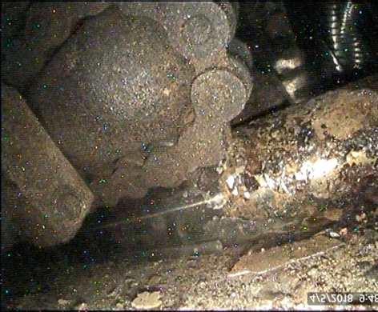
RID Issues – A More Permanent Fix
New rollers
Previous change out was very difficult due to damage from
moisture
Need a new design for:
  carriage and rollers – rails
  can’t be removed
  remote tooling to polish the sealing surface
  new clamp
Work is underway, replacement planned for FY27
Installed rollers
Polishing tool design
Window in cradle, with rollers and rails

Slide 20
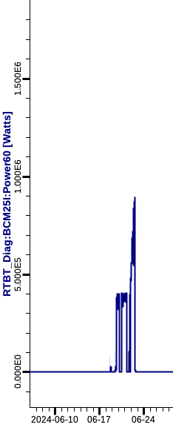

Ramp to High Power Operation
With a decent tune throughout, only minor tweaking was left to reduce losses
Ramp to 1.7 MW began on June 12th, 2024
Everything going well until ring
vacuum alarms started coming in
at 870 kW on June 22nd, 2024!
1.7E6 W
Beam Power (W)
870 kW

Slide 21
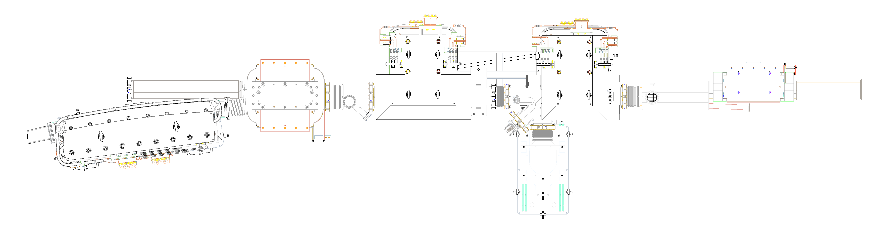
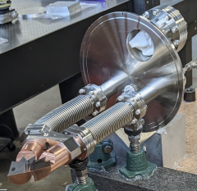
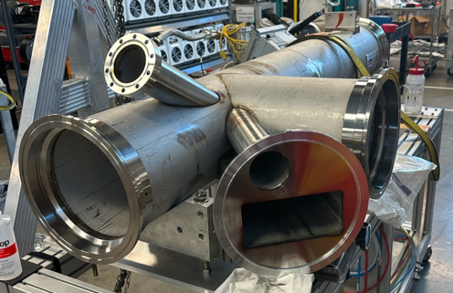
PPU Design
As part of PPU catcher was redesigned
Redesign of chicane 2 chamber and electron catcher allows easier replacement of –catcher
Catcher not brazed to chamber
Carbon-carbon geometry is identical to old catcher
Thermocouples were planned but not installed

Slide 22
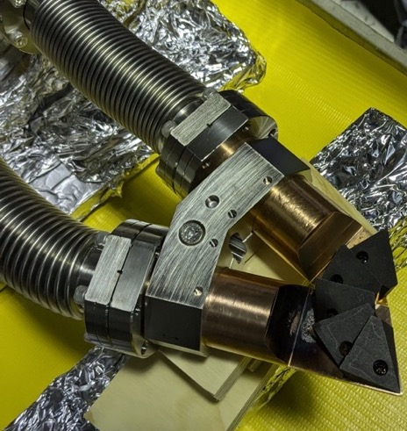
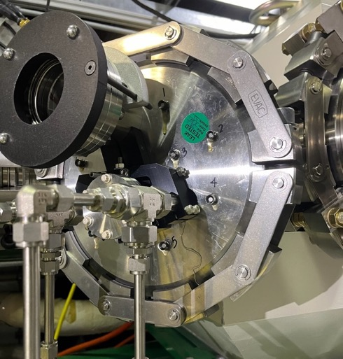
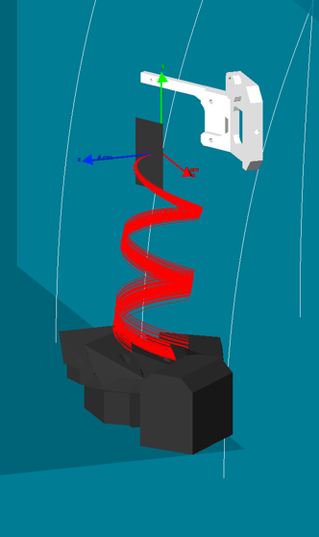
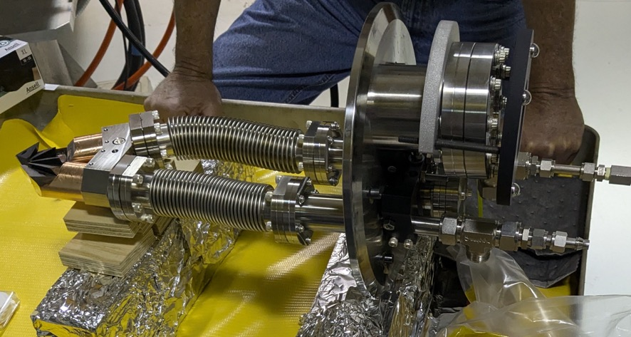
Vacuum Issues – What’s going on?
Vacuum group noticed water leaking from electron catcher - always a bad sign.
Cooling passage is in a vacuum-tight shroud.
How is water getting to vacuum?
Did we hit the copper and damage it?
Probably not this looks like sputtered carbon.
Leak check verified source of leak

Slide 23
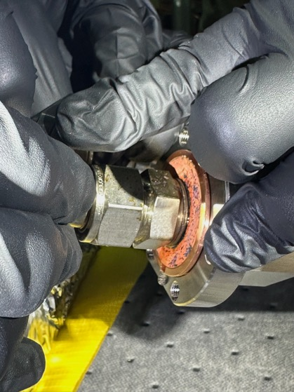
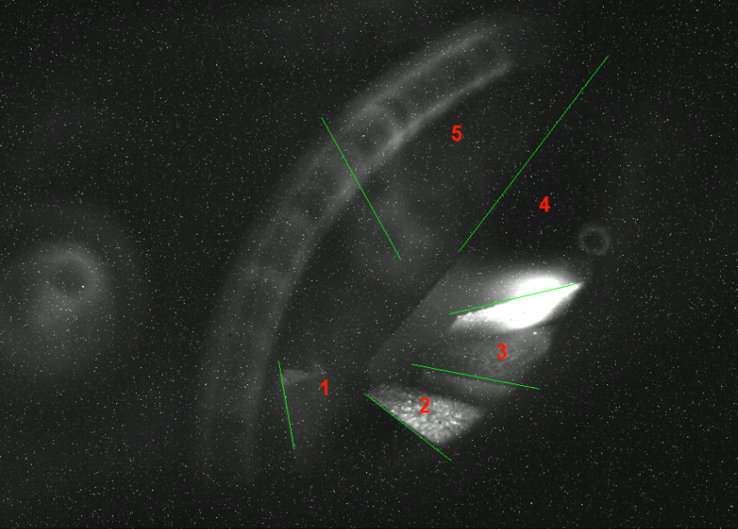
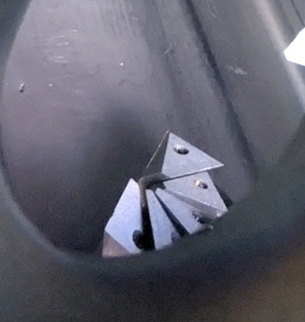
Electron Catcher – Leak Fixed
Leak was repaired, insufficient flow ID’ed as cause, flow increased
Imaging system quickly assembled and installed to view catcher during operation
No issues since
New design is underway
Illuminated view of electron catcher in-situ
Leaking joint identified
5
4
3
2
1
Imaging system view of catcher during operation after leak repair. Electrons are hitting the right spot.

Slide 24
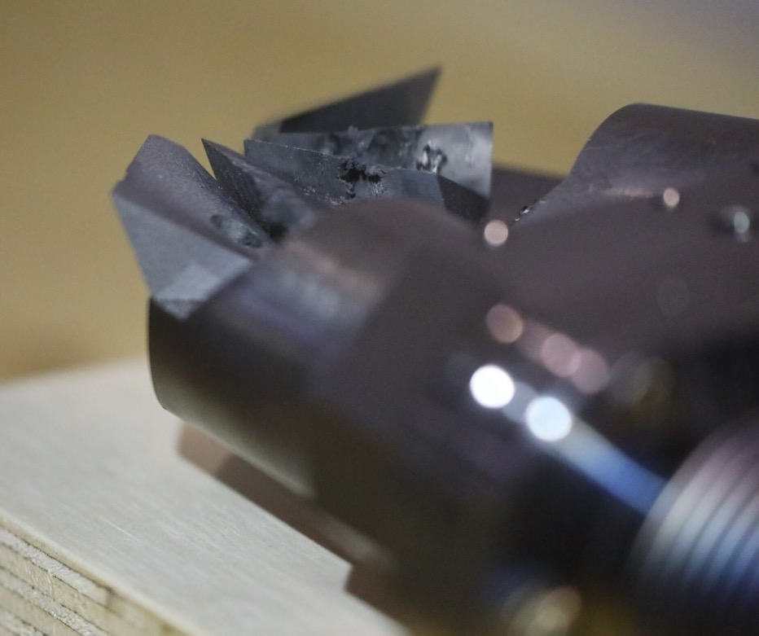
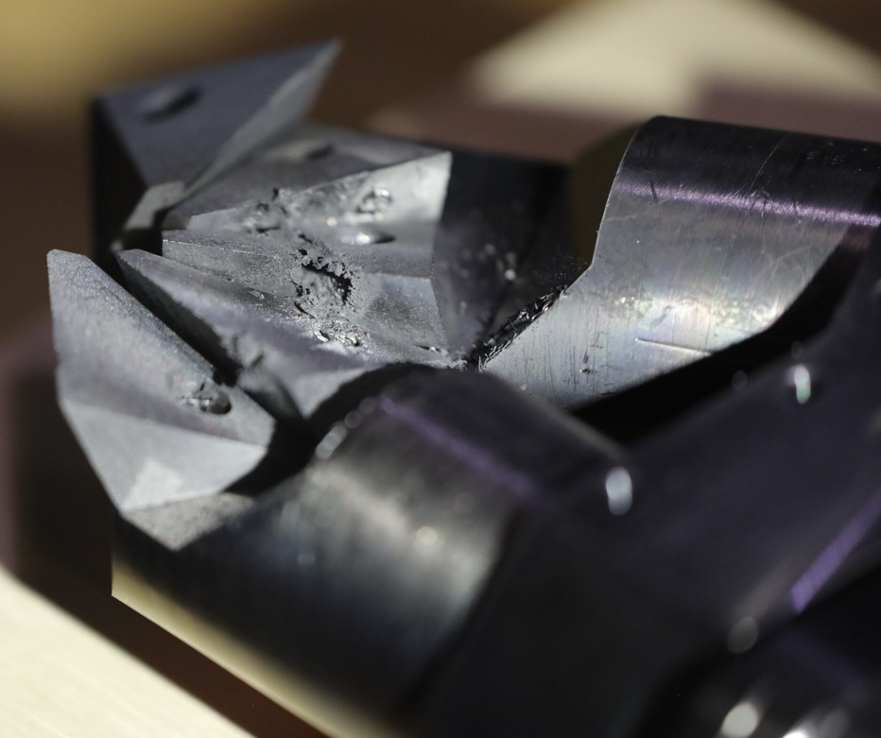
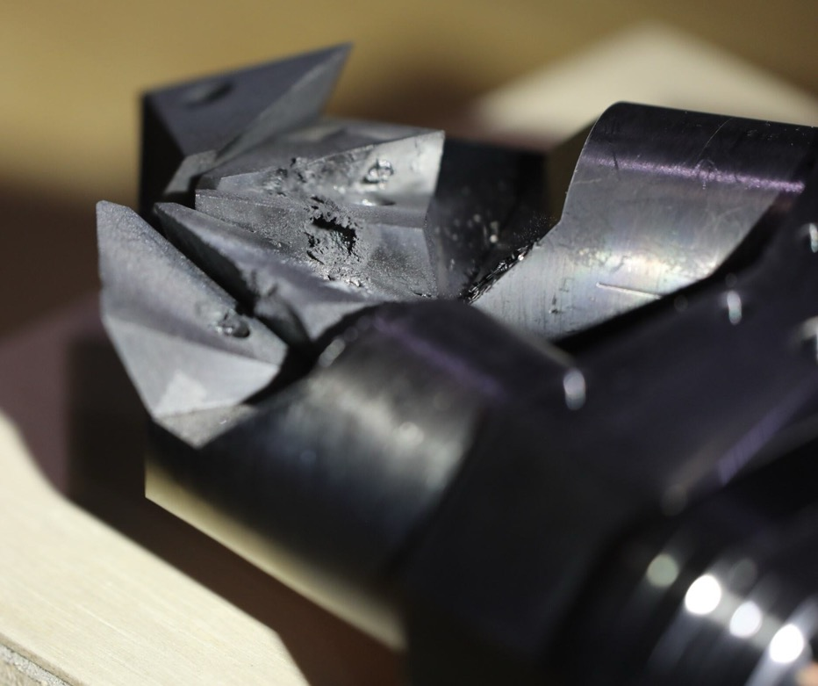
Catcher Damage 1 year later

Slide 25
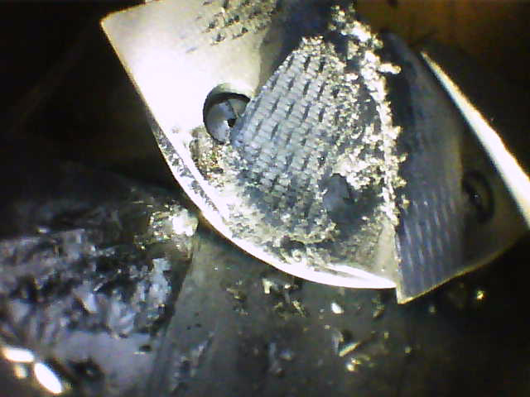
Original Catcher after 14 years for Comparison
In raking light you can see the channel dug by electrons

Slide 26



Damage to copper tells an interesting story
Damaged copper has been covered by more carbon – suggesting reflected electrons
might be under control after tunnel has been dug in carbon wedge
Compare to carbon etched away exposing copper in early operation (right)

Slide 27

Ramp to High Power
1250 Hrs at 1.7 MW, 1.3 GeV
Commissioning is ‘complete’
1.7E6 W
Time for loss tuning eaten by repairs
Target Gas Separation Issues
Full charge beam stored in ring
Beam Power (W)
Electron Catcher Repairs
Start of 1.3 GeV commissioning
Production Run Starts

Slide 28



SNS relies almost exclusively on high power pulsed klystrons for RF. Since 2019, there has been an increased volatility in the scientific klystron market, severely affecting the quality of the supply.
High Power RF – A Long-Term Problem
The SNS has three open klystron contracts, all starting in 2019:
5MW
3MW
700kW
Klystron Type | Usable Units | Refurbishment Status
5 MW | 0 / 3 | 1 under test at SNS
3 MW | 0 / 4 | 1 under refurbishment
700 kW | 4 / 28 removed | 3 under refurbishment

Slide 29



Recent Experience: Klystron Fabrication & Operational Challenges
5 MW Klystrons
3 MW Klystrons
700 kW Klystrons
Cathode micro-discharge: instantaneous 5A spike in beam current
Vacuum ion pump pressure vs. time — spike triggered DTL-3 removal (May 2024)
SCL-25 fault log: repeated Cathode 5 Over Current faults (Aug 2024)
High perveance → low peak output power
Persistent leaks → structural support redesign required
4 of 28 klystrons pulled from HV for repeated cathode arcing
All 3 klystrons: persistent cathode micro-discharge; prohibited operation on 2/3
Incorrect cathode radius → low perveance & low output power
3 of 4 removed units returned to vendor
Removed from CCL-1 (Aug 2024) after vacuum degradation; returned to vendor
Removed from DTL-3 (May 2024); returned to vendor
Stable operation elusive even at lower power levels

Slide 30

On the way to 2.0 MW
Since PPU commissioning we’ve been ramping power by 100kW per run
2.0 MW is expected in late April 2026
1250 Hrs at 1.7 MW, 1.3 GeV
July 2024 – PPU Commissioning
April 7, 2026

Slide 31

How are we doing two years later?
Electron catcher recovery impacted tune up– but we used operation to bring losses back in line with expectations. Except…
  ring activation is higher than expected (very localized spot ~1700 mrem/hr at a foot!)
Even at 1.9 MW accelerator is operating well with no major issues due to high power operation

Slide 32


A Plan for 2.8 MW – Preparing for the Second Target Station
We have a detailed plan toward a 2.0 MW, 45pps demonstration on the first target in June 2027
✅
✅

Slide 33




ORAI Investigates Potential Beyond 2.8 MW
The Oak Ridge Accelerator Institute (ORAI) led by Fulvia Pilat is developing:
a conceptual design to support new applications at the SNS
a prototype multi-purpose, low-power test station in an existing SNS dump beamline
Low-power (<7kW) target to be added to existing injection dump line
Potential siting options for a third (100 kW+) target

Slide 34
Summary
Spreading out installation and operation of new equipment proved a useful strategy to minimize the impact of new issues
Leaning on well-established machine settings wherever possible streamlined startup
Final commissioning push to 1.7 MW at 1.3 GeV was a huge success – one major hiccup with electron catcher, but recovery was quick
A lingering puzzle with injection losses
Dealing with a leak in the RID, a consumable electron catcher, and klystron sourcing issues
We’re inching closer to 2.0 MW, 60 Hz operation on the first target, and preparing for Second Target Station era with 2.0 MW, 45 pps on the First Target Station

Slide 35
Thanks
Thanks to the PPU team, and the dedicated SNS staff for an amazing, sustained effort throughout the project
Special thanks to accelerator physics, beam instrumentation and operations for commissioning effort
Special thanks to our partners at Fermi National Accelerator Lab and Jefferson Lab
Thanks to Sang-Ho Kim, John Moss, Melissa Harvey, Vasiliy Morozov, Fulvia Pilat, and Charles Peters for providing slides
Thanks to the organizers for inviting me

Slide 36
Backup Slides

Slide 37


1.7 MW at 1.05 GeV – equivalent to 2.1 MW at 1.3 GeV

Slide 38

Thin primary
stripping Foil
Thick secondary
stripping Foil
To Injection Dump
Foil stripping
H⁻ → p⁺ + 2e⁻
H⁻ beam
from Linac
2e⁻
H⁻
H⁰
p⁺
From the Ring
p⁺
To the Ring
H⁻ beam
From the Ring
p⁺
To the Ring
Notes:
This is more detailed scheme of ring injection area.
Right now we can do experiment over here for a small pencil beam.
The H- beam is injected from linac into the ring through the corner of the thin foil.

Slide 39










PPU commissioned 28 new complex RF systems in the high-beta portion of the superconducting Linac across three accelerator outage periods. The new systems ultimately power 28 new superconducting cavities.
Scope - RF
LLRF Control Systems x 28
Controls and Network
700kW 805MHz klystrons x 28
High-Voltage Convertor Modulators x 3
DI Water System for component cooling

Slide 40





Scope – Superconducting Linac
32 cavities and couplers procured and tested
  30 cavities field emission free
  2 cavities with limited field emission
  All cavities and couplers met specification
Eight cryomodules delivered from JLab to SNS
  All cryomodules met specification
  Seven are installed and operating with beam
  Cryomodule 8 is a spare
PPU01
PPU02
PPU03
PPU04
PPU05
PPU06
PPU07
Testing PPU CM in the SNS test cave
Unloading PPU07
PPU CMs from end of linac Slot 32
PPU07 – Slot 25 installation

Slide 41


Injection Region changes
New combined function dump dipole for waste beam transport
Waste Beams
New geometry meant injection region tuned from scratch
3 of 4 chicane magnets steer 2 waste beam trajectories, and recirculating beam – this drives injection region tuning
p Beam
H- Beam
Chicanes #2, #3
replaced
Move chicane #1
upstream ~30cm
Injection region after upgrade
p Beam

Slide 42
Commissioning Timeline

Slide 43

DTL, CCL and SCL Commissioning – Beam to Linac Dump
7 new high-beta cryomodules added to the end of the linac – 4 installed in previous outages, 3 new for 1.3 GeV operation
Commissioning of beam started Friday June, 7th
  Operation authorized to begin – 11:06
  Warm linac (DTL&CCL) tuning complete – 13:50
  Super conducting linac setup complete, 1.33 GeV beam
  to linac dump – 17:31
6 hours and 25 minutes to tune linac to a world record energy!
Machine setup from previous run provided a good starting point

Slide 44
Injection Region Commissioning – Beam to Injection Dump
Initial tuning was done at 1.05 GeV to leverage existing machine settings – transport line from linac to ring was identical to last run
All of the new magnets must be tuned up
from scratch

Slide 45

Injection Region Commissioning – Beam in Ring
1.05 GeV Ring Commissioning Begins Saturday June 8th
  First pulses in Injection Dump – 9:54
  First beam stored in the ring, send to extraction dump – function of newly installed magnets verified - 16:27
1.3 GeV Ring Commissioning Begins Tuesday June 11th
  First 1.3 GeV beam to extraction dump – 16:33
Full charge pulse stored in ring on Wednesday June 12th
  Accelerator ready for low-loss tuning and then beam to target
Took a break for several days to allow fault studies, and target strain measurements before resuming accelerator tune up

Slide 46
Injection Region Commissioning – Beam in Ring
Only remaining magnet to tune in the injection region was chicane #1 – we were quickly able to get beam circulating
With a good tune in the ring new magnets
were all set within 3% of design values.
Start of commissioning to full charge in ring:
~80 hrs in the control room (5 days, 16 hr/day)

Slide 47

Beam to Target
First beam on target June 18th, 2024
To reduce failure of components due to higher voltage at
1.3 GeV we now run all 14 at slightly lower voltage (instead of 13 + spare)
No issues were encountered with this new mode
Magnets in transport line to target scaled from existing
1.05 GeV machine settings with no issues

