Slide 1
Conceptual Design of Future Inner Reflector Plug at SNS
Malmö, Sweden Apr. 13-17, 2026
Wei Lu, Franz X. Gallmeier, & Douglas P. Armitage
Oak Ridge National Laboratory, Oak Ridge, TN USA
25th International Collaboration on Advanced Neutron Sources (ICANS XXV)

Slide 2
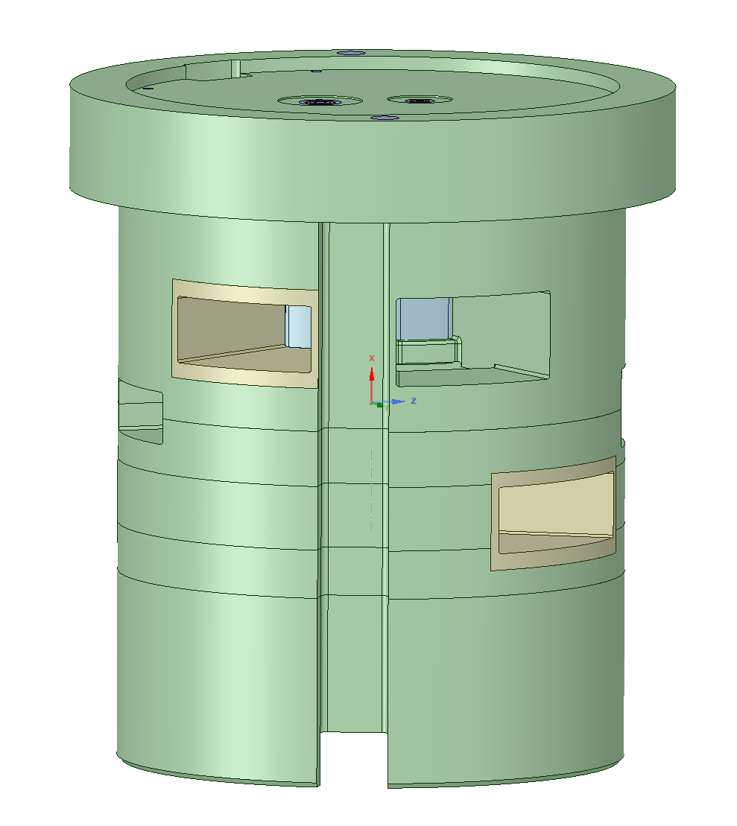
Outline
Inner reflector plugs (IRP) at SNS
Conceptual designs for IRP-V
Optimization of beryllium reflector
Lifetime improvement
Moderator performance
Summary

Slide 3
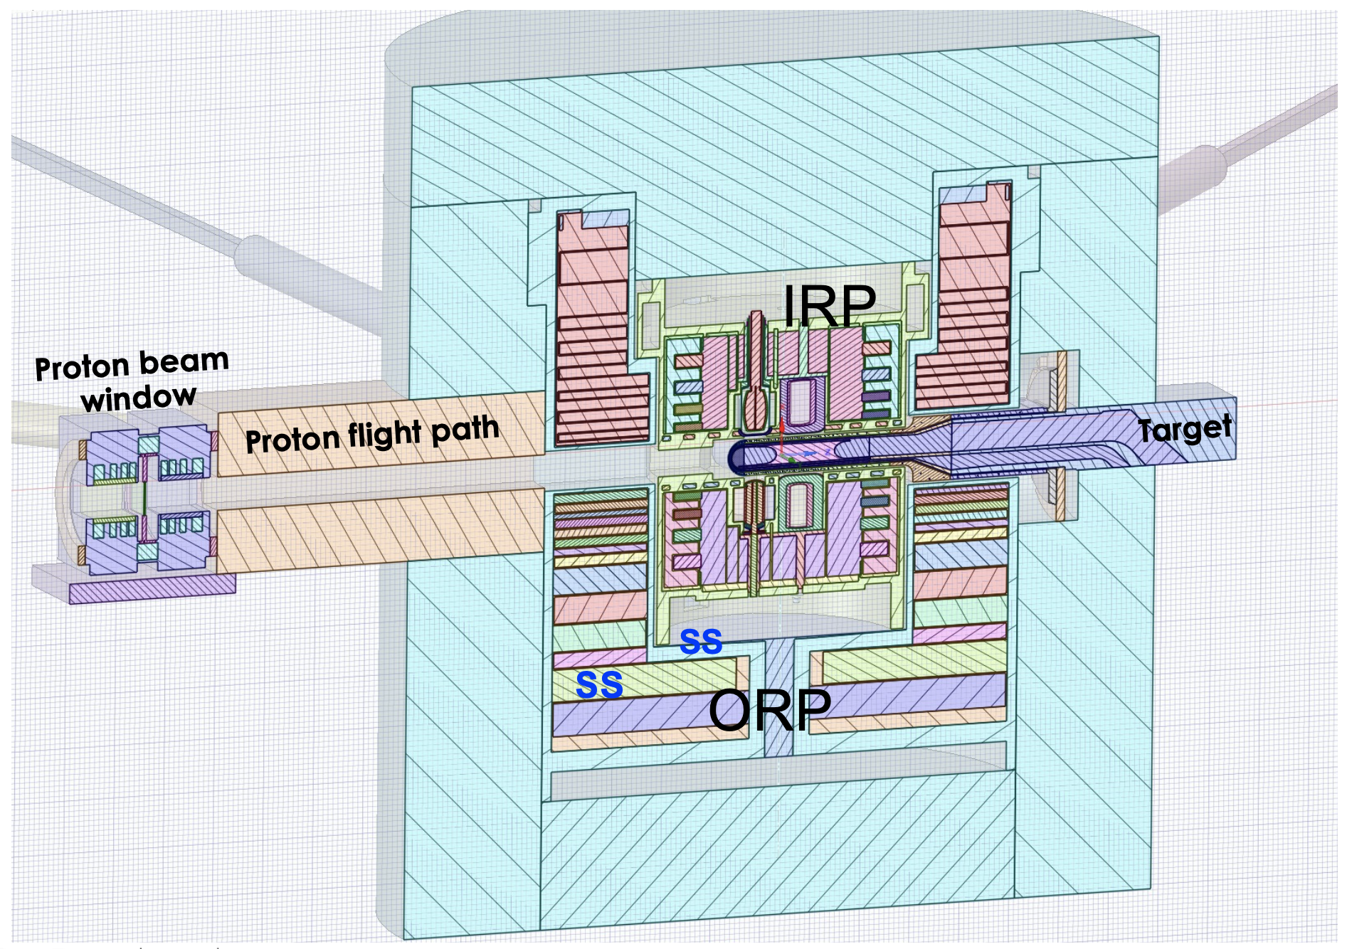
SNS Target-Moderator-Reflector System
Inner Reflector Plug (IRP), an essential component in delivering neutrons to the beamlines
IRP houses four moderators, Be reflector and stainless steel shielding.
Cooled by heavy water
IRP-I and IRP-II have served their lifetime
IRP-III was just installed early this year
IRP-IV is under manufacturing
Conceptual design for IRP-V was completed

Slide 4
Inner Reflector Plugs at SNS
Manufacturing of IRP is a complicated and lengthy process, so far with delays of delivery by a year over projection
IRP II & IV are a duplicate of IRP I & III, respectively, intended to serve as spare ones
Time window for the conceptual design of IRP V was short, the goal was to
improve operation stability and lifetime
reduce manufacturing difficulty
lower the cost
IRP I & II
IRP III
 | Duration | Operation lifetime | Designed lifetime
IRP I | 2006 - 2017 | ~40 GWhr | 32 GWhr
IRP II | 2018 - 2025 | ~43 GWhr | 28 GWhr
IRP III | 2026 - pre. |  | 38 GWhr

Slide 5

Conceptual Design of IRP V - reflector
Three reflector materials in the IRP
Beryllium, heavy water & stainless steel
Scattering:
SS304 Be > D₂O
Absorption:
SS304 >> Be > D₂O
Neutron production:
Be > D₂O > SS304
$$≳$$
Macro scattering cross section
IRP III top moderators
Macro absorption cross section
Macro (n, 2n) cross section

Slide 6
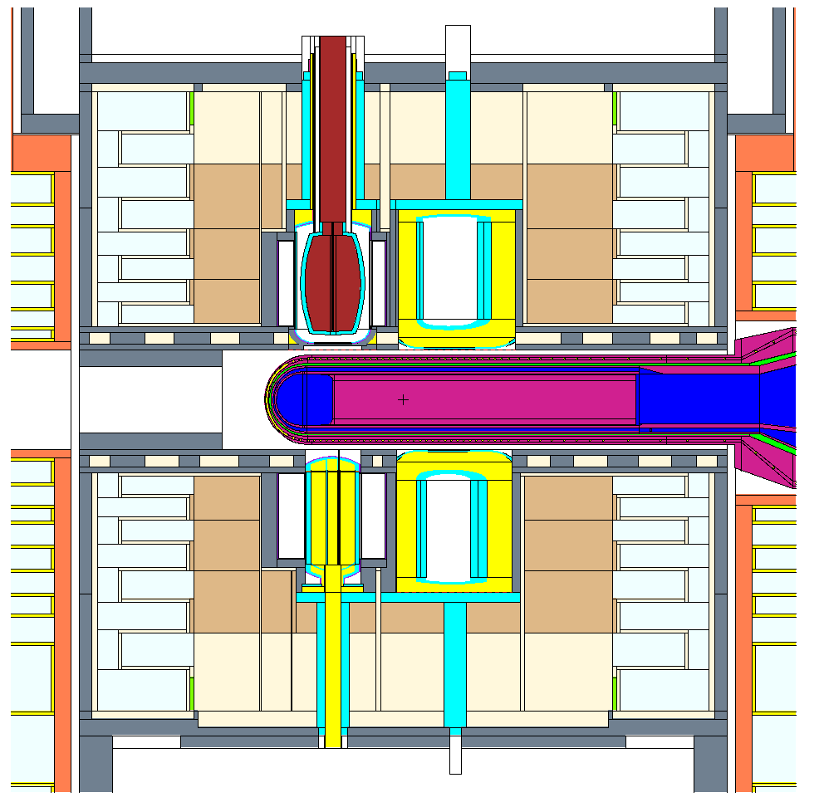
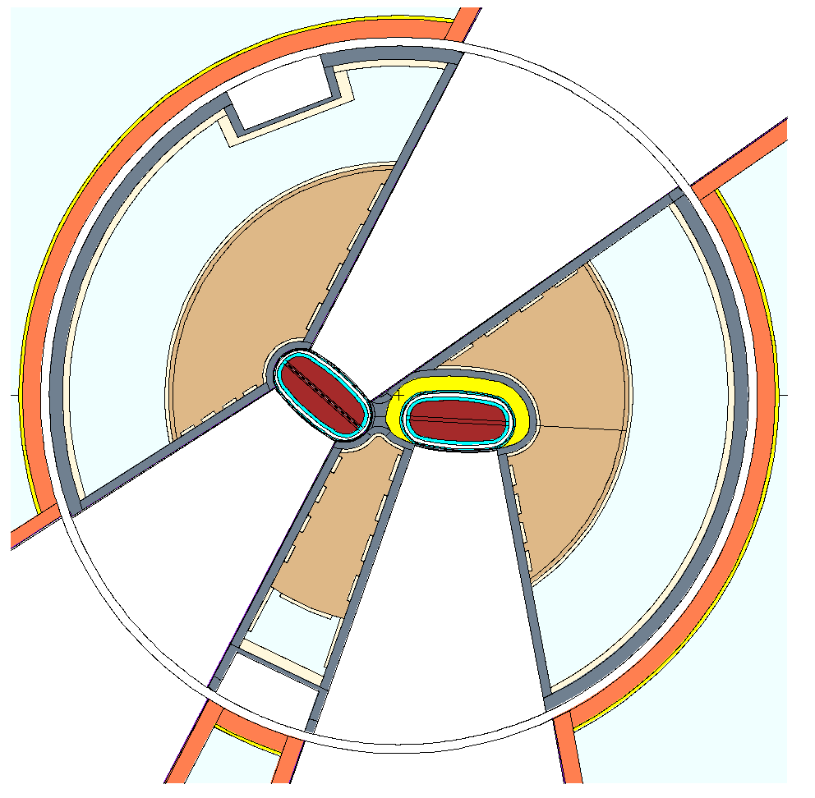
Conceptual Design of IRP V - reflector
D₂O
24.3 cm
Be
SS
Heavy water is generally a lighter version of beryllium; it results in moderator performance loss when replacing beryllium though it is still a good candidate for reflector
For coupled moderators, beryllium is the best material for reflector though steel offers a narrower pulse width and a shorter pulse tail
For decoupled moderators, the advantage of beryllium is less pronounced compared to steel especially in the decoupled water moderator
Combination of beryllium and heavy water trades off the moderator performance with cost
Combination of beryllium and steel may achieve a balance of moderator performance and manufacturing cost
SS
Be
R=32 cm
IRP III Be Reflector:
24.3 cm high, 32 cm in radius

Slide 7
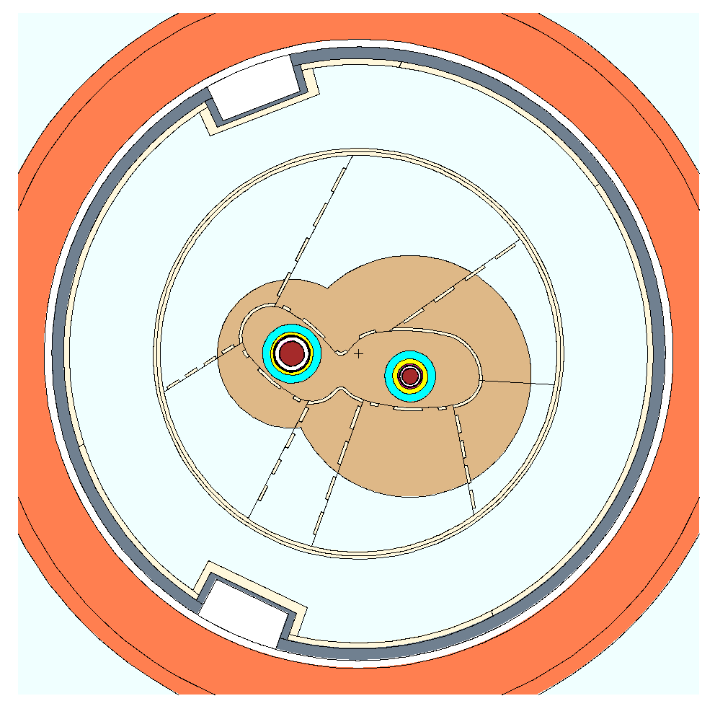
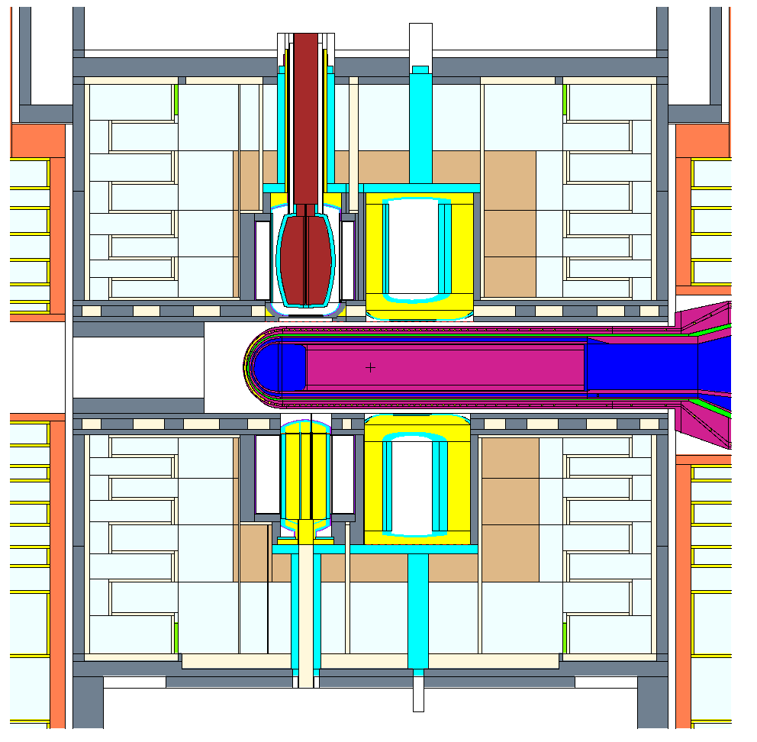
Conceptual Design of IRP V - reflector
Beryllium size could be reduced
Neutrons produced/scattered deep in beryllium are not or late reaching the moderators
Neutrons moderated to thermal are stopped at the decouplers
A fast reflector material is helpful
Beryllium + stainless steel
Decoupled and coupled moderators have different preference of reflector materials
Beryllium volume is reduced by ~60%, saving $ 0.75 M
Moderator performance is similar compared to IRP3
SS
Be
R=12 cm
R=19.5 cm
IRP V Reflector design:
same height compared to IRP3, heavy water on top is replaced with stainless steel
different radial sizes for decoupled and coupled moderator: R_{decp}=12 cm, R_{cp}=19.5 cm

Slide 8
Conceptual Design of IRP V - moderator performance
 | Time-integrated brightness | Peak pulse brightness | Pulse width in FWHM | Pulse time variance
Coupled hydrogen moderator | -2.0 % | + 5.0 % | -2.0 % | -25%
Decoupled hydrogen moderator | -1.25 % | 0.0 % | -1.0 % | -10%
Decoupled water moderator | +2.0 % | + 3.0 % | -1.0 % | -15%
Both types of moderators show significant reduction of pulse tail and slight reduction of pulse width
Both decoupled water and coupled hydrogen moderator see a slight increase of peak brightness, while that of the decoupled hydrogen moderator is kept same
Decoupled water moderator sees a slight increase of time-integrated brightness, while decoupled and coupled hydrogen moderators see a slight decrease

Slide 9
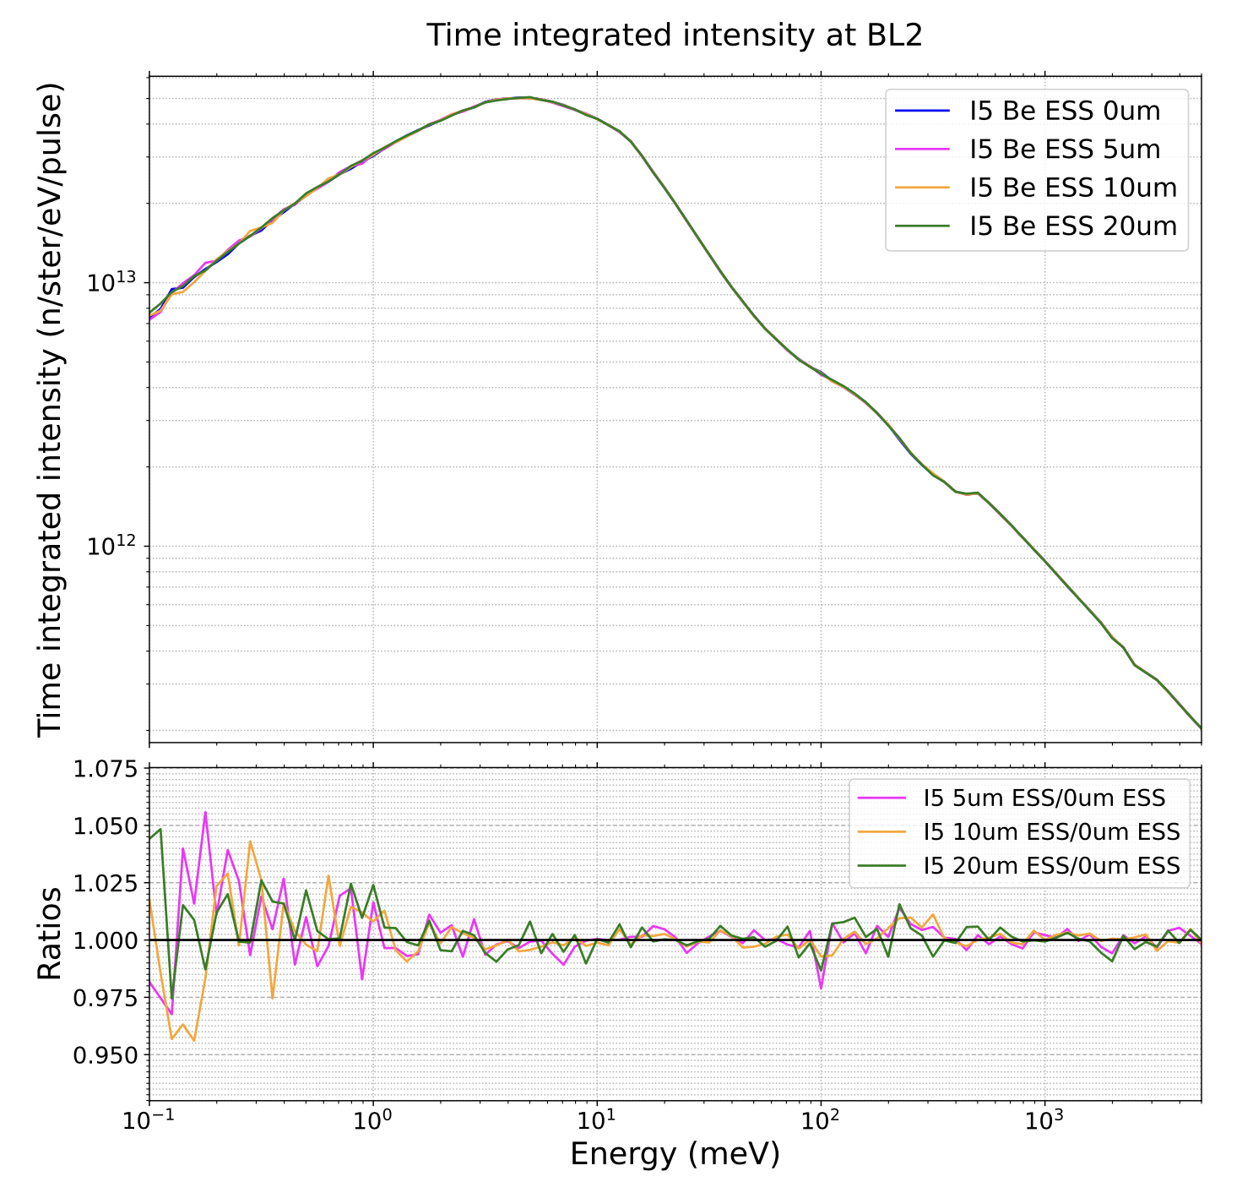
Extinction Effects of Beryllium
Crystallinity in various grades of beryllium metal leads to lower scattering cross sections. A larger grain size means a lower scattering cross section in thermal region
Be S-200-F is used at SNS with a requirement of < 15 um in grainsize
Scattering kernels were kindly provided by D. DiJulio at ESS
No significant impact on decoupled moderator

Slide 10
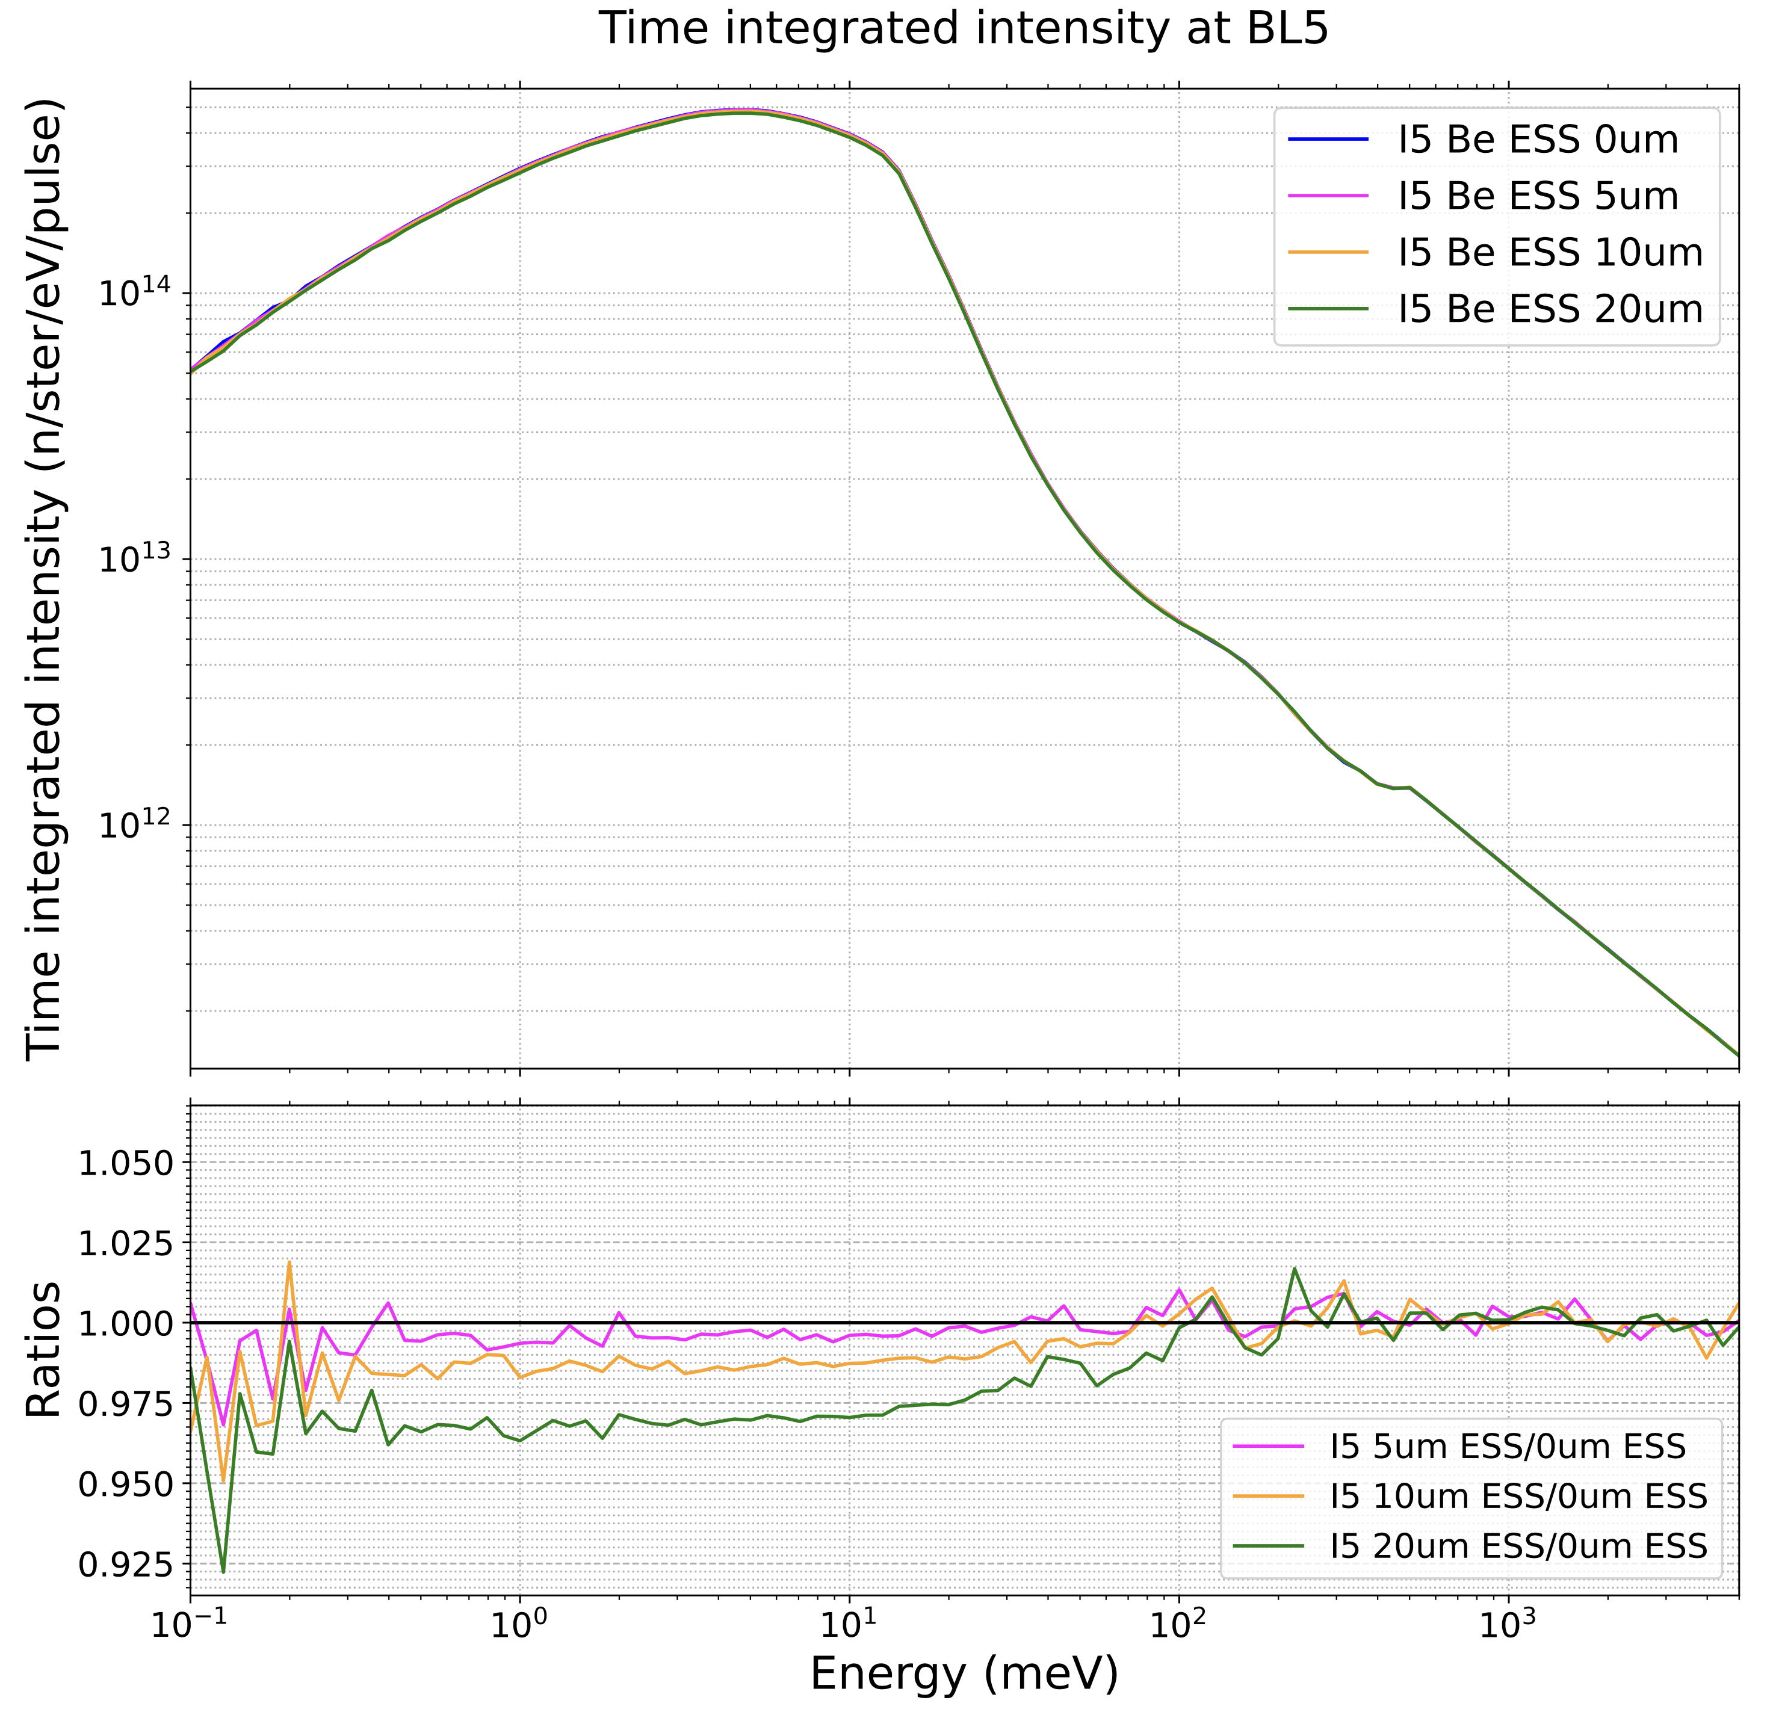
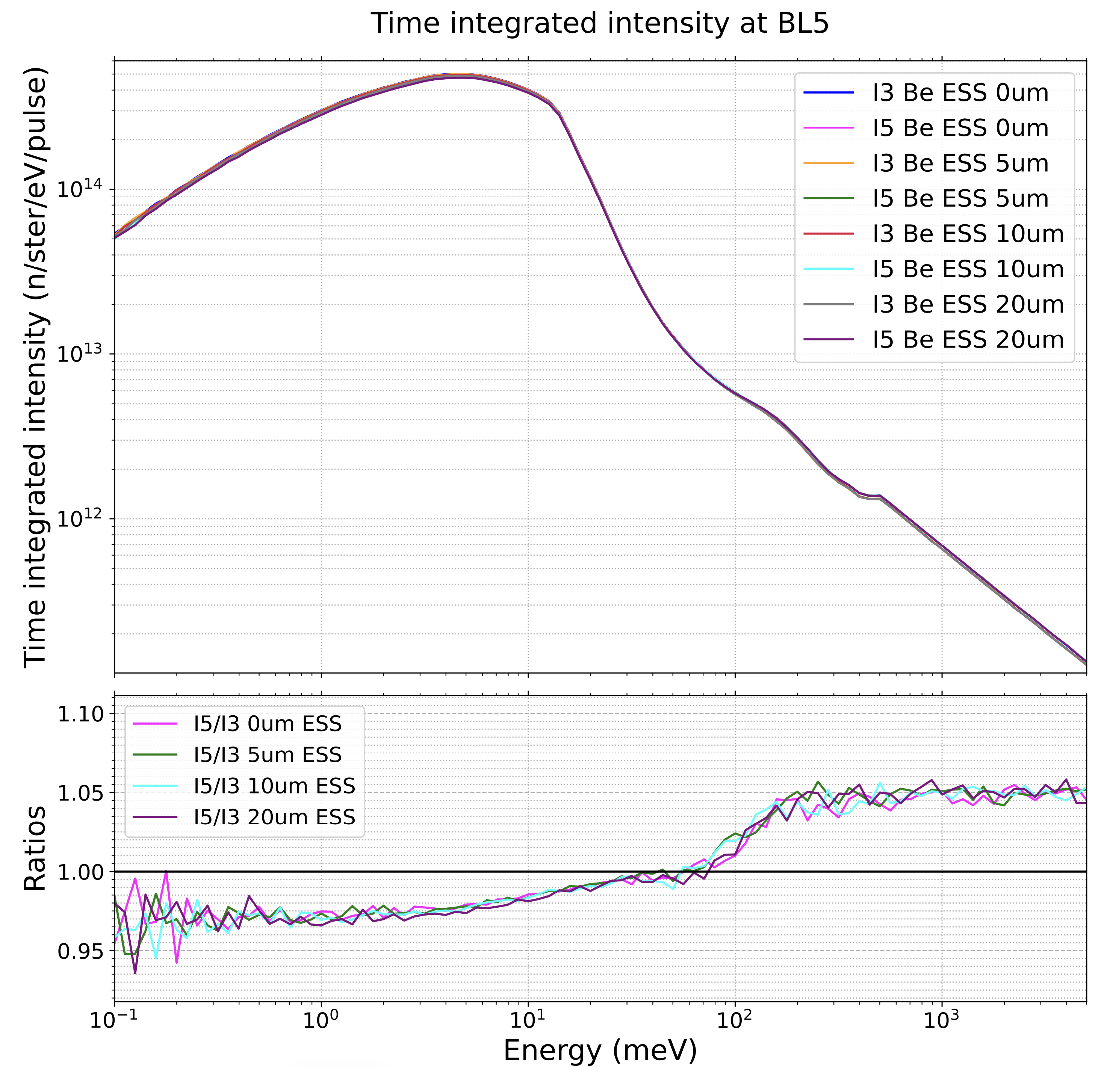
Extinction Effects of Beryllium
Similar impacts as observed at ESS on coupled moderators
~3% decrease at 20 um
However, no significant impact for the same grade of beryllium with the size reduction in IRP V

Slide 11
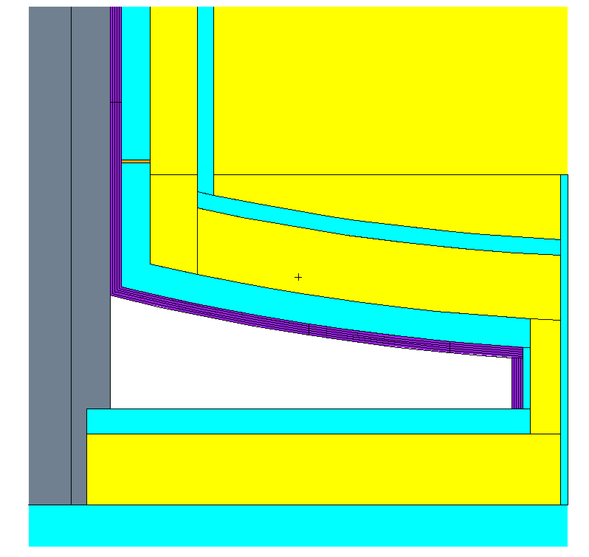
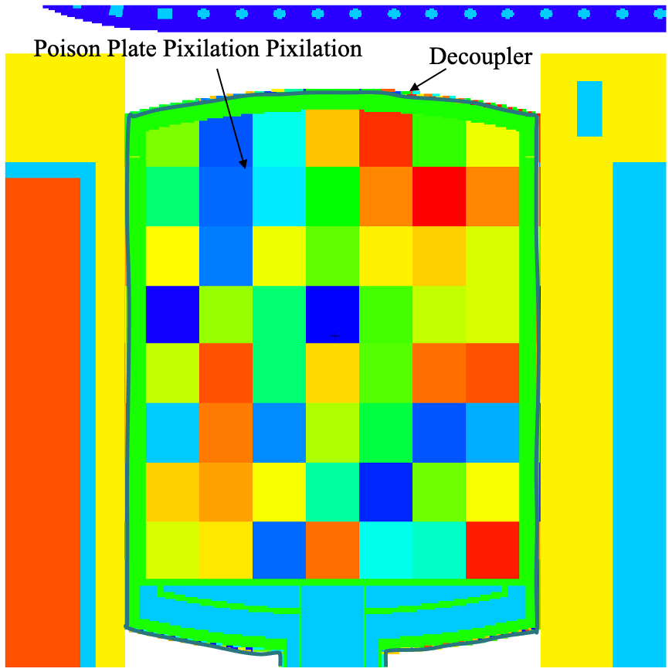
Conceptual Design of IRP V - poison and decoupler
IRP III has an estimated lifetime of 38 GWhr due to the burnup of the poison plates
Poison and decoupler layers were early found to be the lifetime limiting components as the Al-6061 radiation damage limit was estimated to be 50 GWhr
For IRP V we have the goal of extending the lifetime to 50 GWhr to match the poison/decoupler lifetime to that due to the radiation damage limit
A full coupled burnup calculation with segmented and sliced poison and decoupler layers was performed
The segmentation and slicing schemes is shown on the right
1100 um thick decoupler segmented in 64x5
1200 um thick poison plate segmented in 7x8x5
Decoupled hydrogen moderator
1100 um thick decoupler segmented in 56x5
1800 um thick poison plate segmented in 7x8x5
Decoupled water moderator

Slide 12
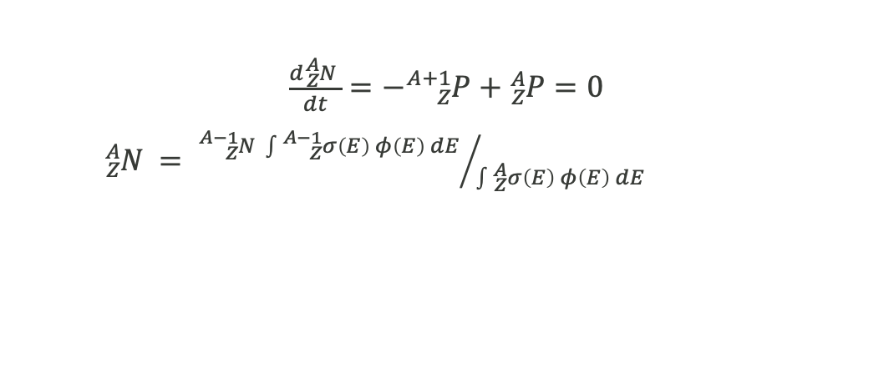
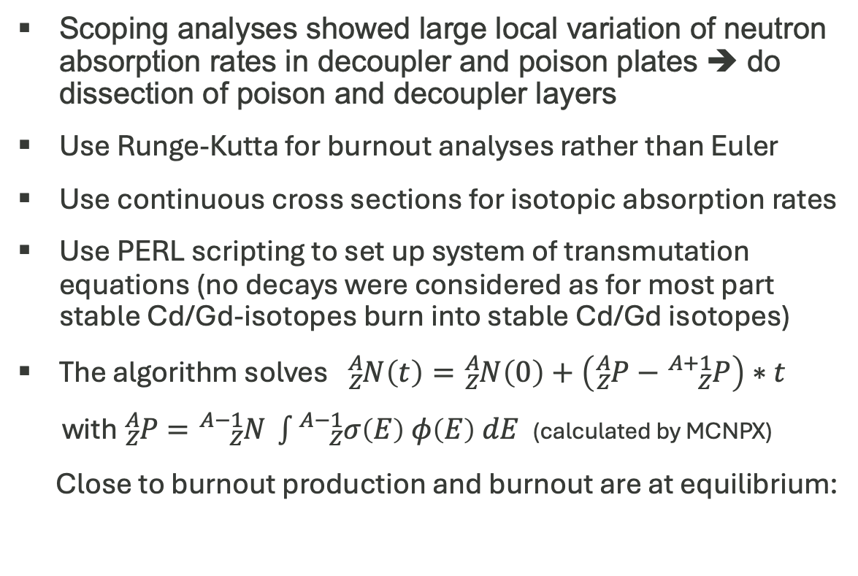
Burnup Calculation Method for Predicting Poison/Decoupler Lifetime
Scoping analyses showed large local variation of neutron absorption rates in decoupler and poison plates ➔ do dissection of poison and decoupler layers
Use Runge-Kutta for burnout analyses rather than Euler
Use continuous cross sections for isotopic absorption rates
Use PERL scripting to set up system of transmutation equations (no decays were considered as for most part stable Cd/Gd-isotopes burn into stable Cd/Gd isotopes)
The algorithm solves ${}_{Z}^{A}{N\left(t\right)=}{}_{Z}^{A}{N\left(0\right)}+\left({}_{Z}^{A}{P−{}_{Z}^{A+1}P}\right)∗t$
with ${}_{Z}^{A}P={}_{Z}^{A−1}{N }\int{{}_{Z}^{A−1}{σ\left(E\right) φ\left(E\right) dE }}$ (calculated by MCNPX)
Close to burnout production and burnout are at equilibrium:
MCNPX run BOS absorption rates
Calculate COS material compositions
MCNPX run COS absorption rates
Calculate EOS material compositions
EOS= BOS
loops of 0.8 GWh irradiation steps each ~100 MCNPX runs
BOS=begin of step
COS=center of step
EOS=end of step
$\frac{d{}_{Z}^{A}{N }}{dt}=−{}_{Z}^{A+1}{P+{}_{Z}^{A}{P=0}}$
${}_{Z}^{A}{N }= {{}_{Z}^{A−1}{N }\int{{}_{Z}^{A−1}{σ\left(E\right) φ\left(E\right) dE }}}/{\int{{}_{Z}^{A}{σ\left(E\right) φ\left(E\right) dE }}}$

Slide 13
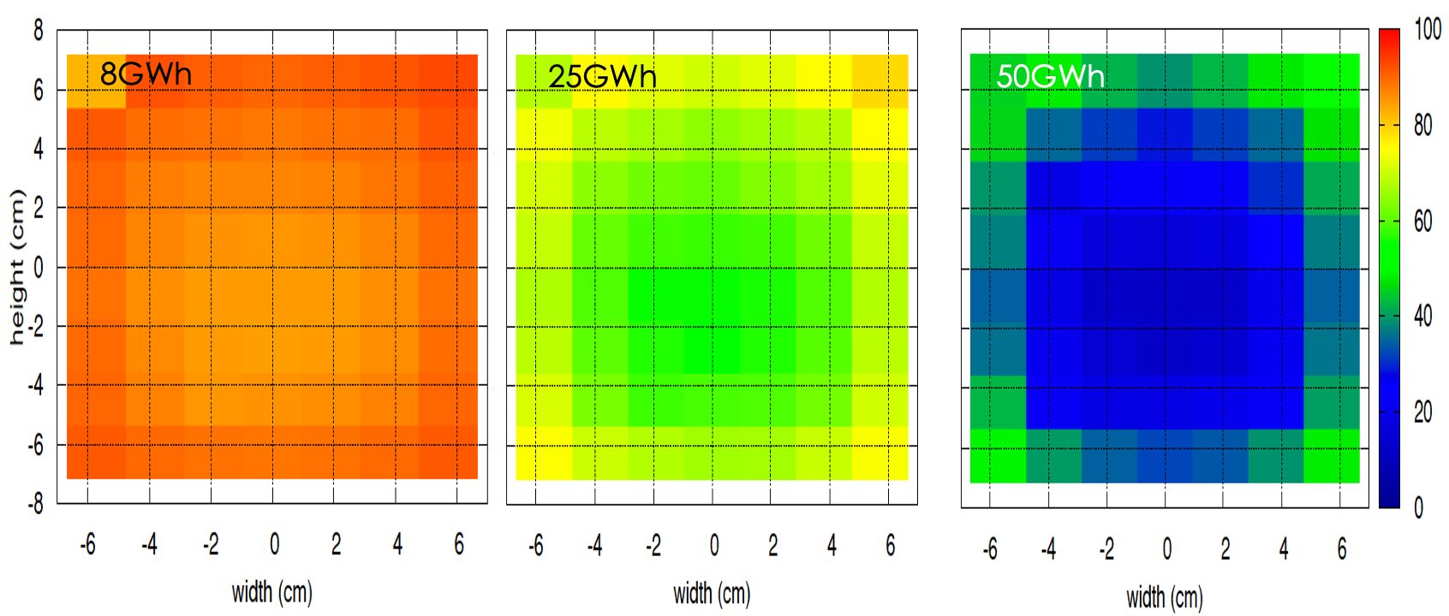
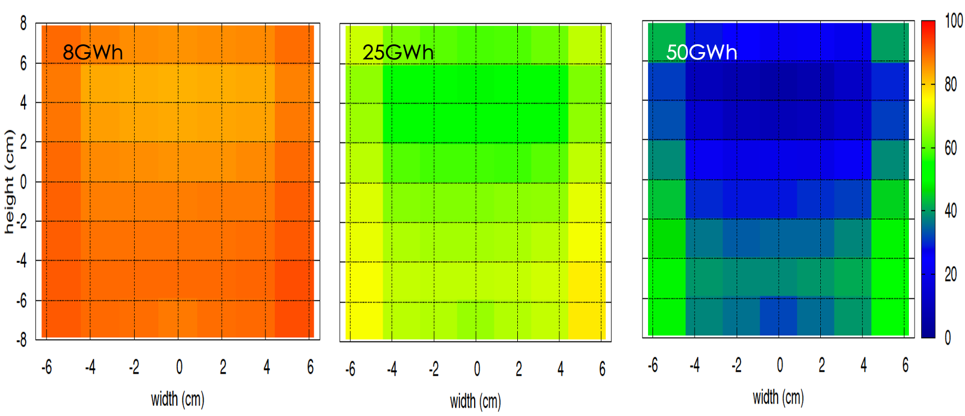
Poison and Decoupler Burnup
Decoupler
Poison
Decoupled hydrogen moderator
15
22
29
7
1
Decoupled water moderator
Local loading of ¹⁵⁵Gd+¹⁵⁷Gd in the poison plate of the water moderator in percent of initial loading

Slide 14
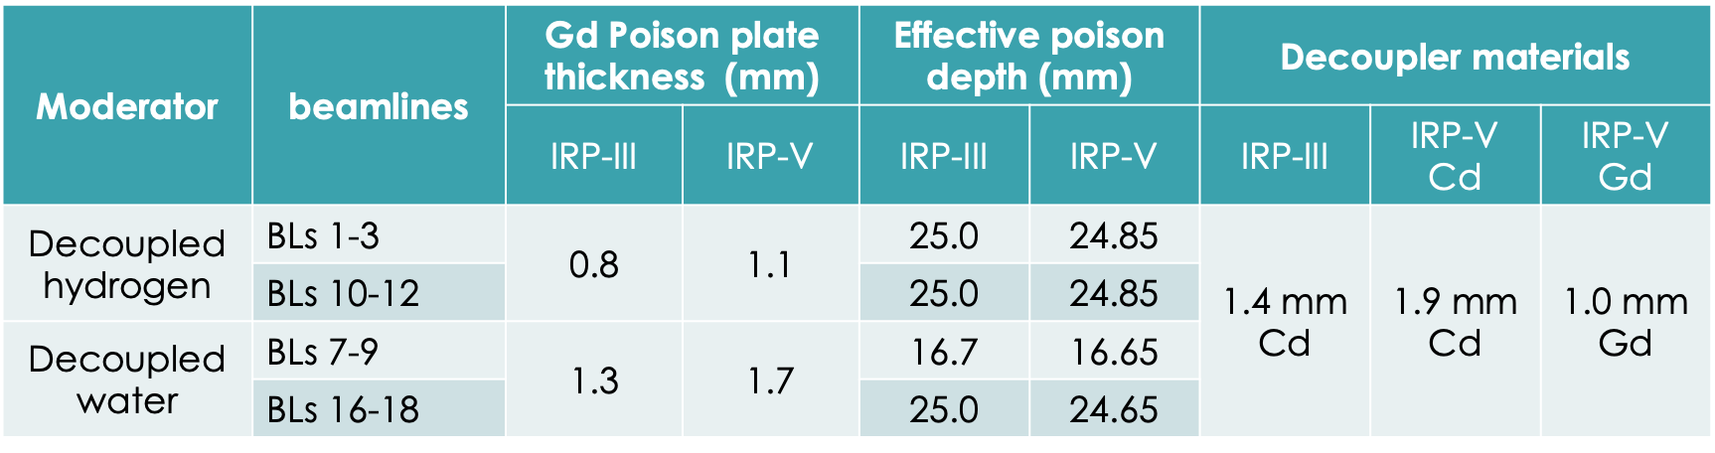
Conceptual Design of IRP V - poison and decoupler
The burnup calculations showed that to achieve a lifetime of 50 GWhr, both poison and decoupler have to be thickened
Gd poison plates:
0.8 to 1.1 mm for DHM
1.3 to 1.7 mm for DWM
Cd decoupler:
increased to 1.9 mm
Gd as a substitute was also studied then due to manufacturing challenge of Cd, but was discarded with the improved manufacturing method of Cd due to its larger impact on the moderator performance
Decoupled hydrogen moderator
Decoupled water moderator

Slide 15
Conceptual Design of IRP V - moderator performance
With thickened poison plates and decoupler, both types of moderators see slightly lower pulse widths and pulse time variances
For the time-integrated and peak brightness, an up to ~7% initial loss was observed in the decoupled moderator and ~2% initial loss in the coupled moderator
Combined with the design change of the reflector, the moderator performance of IRP V at its fresh start in comparison to that of IRP III
 | Time-integrated brightness | Peak pulse brightness | Pulse width in FWHM | Pulse time variance
Coupled hydrogen mod | -4.0 % | + 3.0 % | -2.0 % | -25%
Decoupled hydrogen mod | -8.2 % | -6.5 % | -1.0 % | -10%
Decoupled water mod | -4.0 % | - 2.0 % | -1.0 % | -15%

Slide 16
Summary
A conceptual design of IRP V at SNS, aiming for lowering manufacturing cost and difficulty and an improved lifetime of 50 GWhr, was completed
The volume of beryllium reflector was reduced by ~60% while achieving similar or slightly higher moderator performance
It was shown that the extinction effects of beryllium metal exhibits no significant impacts on a smaller sized beryllium reflector
A coupled full study of the burnup of the poison and decoupler was performed and concluded that both poison and decoupler need to be thickened significantly to achieve a lifetime of 50 GWhr for IRP V
The initial decoupled moderator performance might suffer to an up ~7% of loss. However, an ~30% increase of lifetime for IRP would save ~$ 3M over an operation of 5 years.

