Slide 1
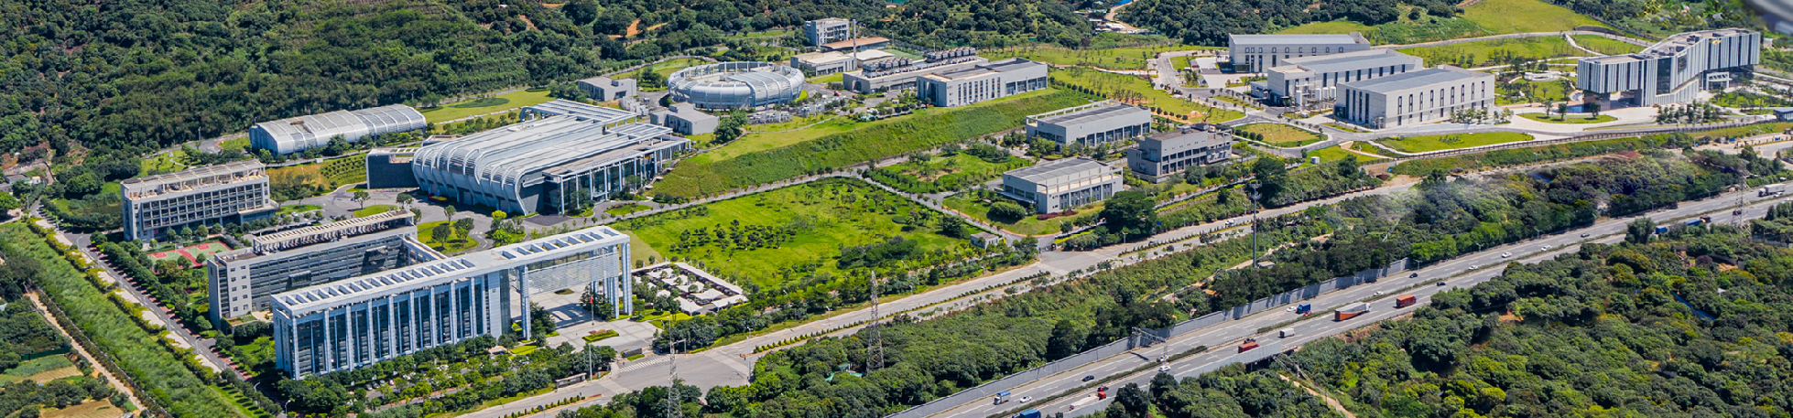



Report of Dongguan Branch
ICANS-XXV, Malmö, Sweden, 2026
Physical design and calculations of the CSNS-II target station
Bin Zhou
On behalf of neutronics group
Institute of High Energy Physics of Chinese Academy of Sciences

Slide 2

Outline
Target-Moderator-Reflector neutronic performance analysis
  Validations of the CSNS-I
  Calculations of the CSNS-II
Target heat transfer design and abnormal cases
Neutron Irradiation Project
Summary
2/22

Slide 3
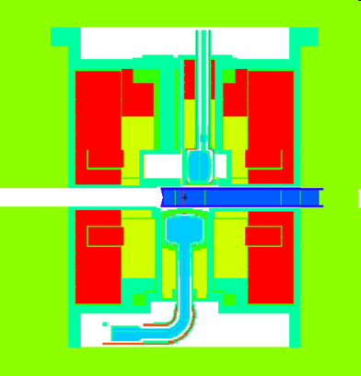
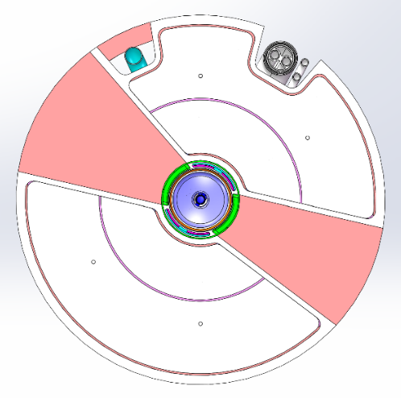
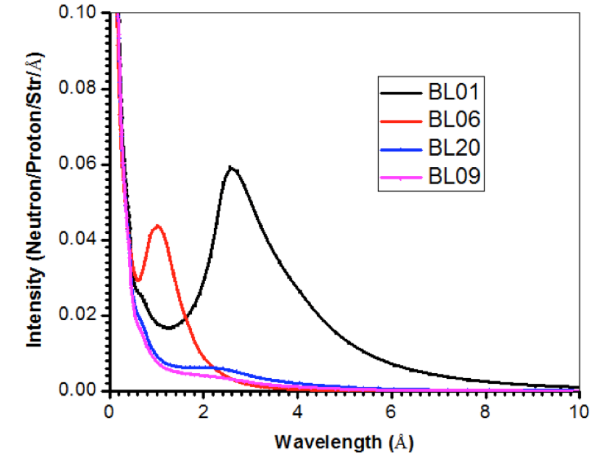
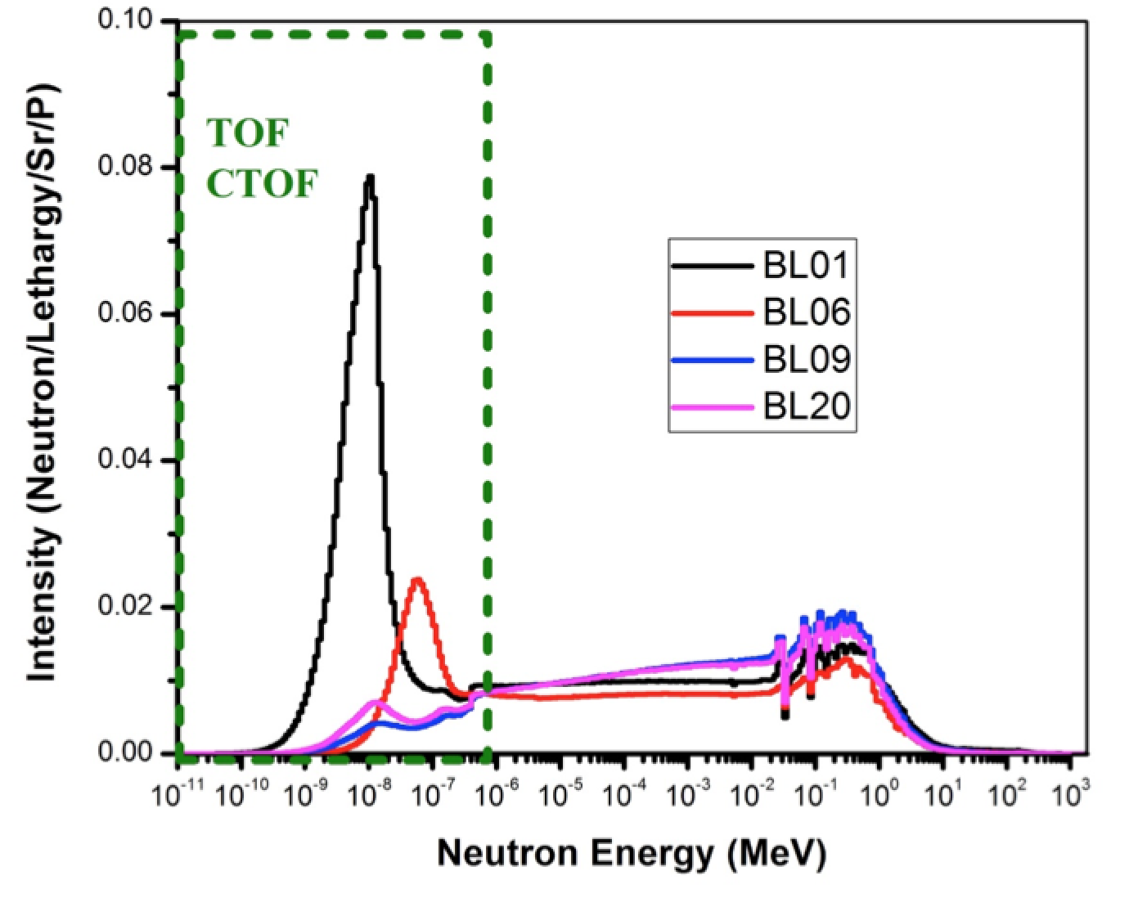
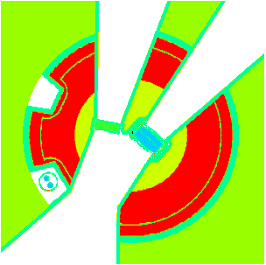
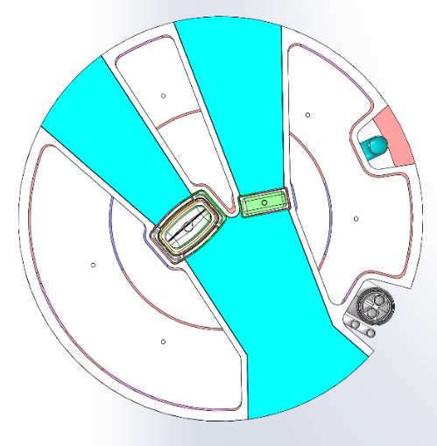
Neutronic performance simulations
A accurate TMR model based on engineering was established
Neutron wavelength spectra, pulse shape, heat deposition, radioactivity were calculated
Be/SS316
Be/SS316
CHM
CHM
proton
target
DWM
CHM
CHM
DWM
DPHM
DPHM
DWM
DWM
DPHM
DPHM
Be/SS316
Be/SS316
Calculation model
Engineering model
3/22

Slide 4
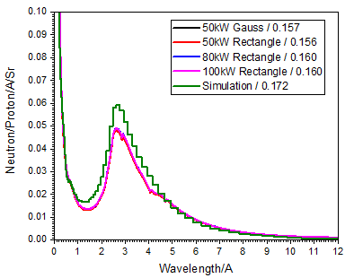
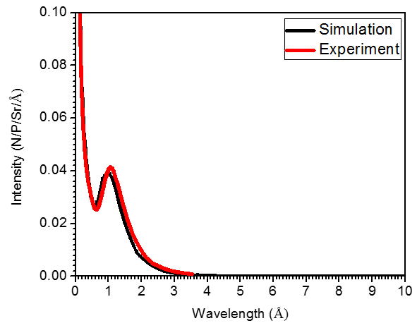
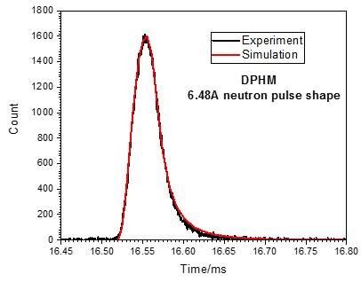
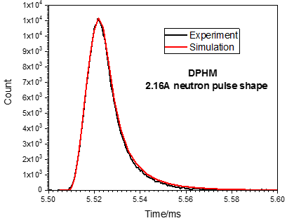
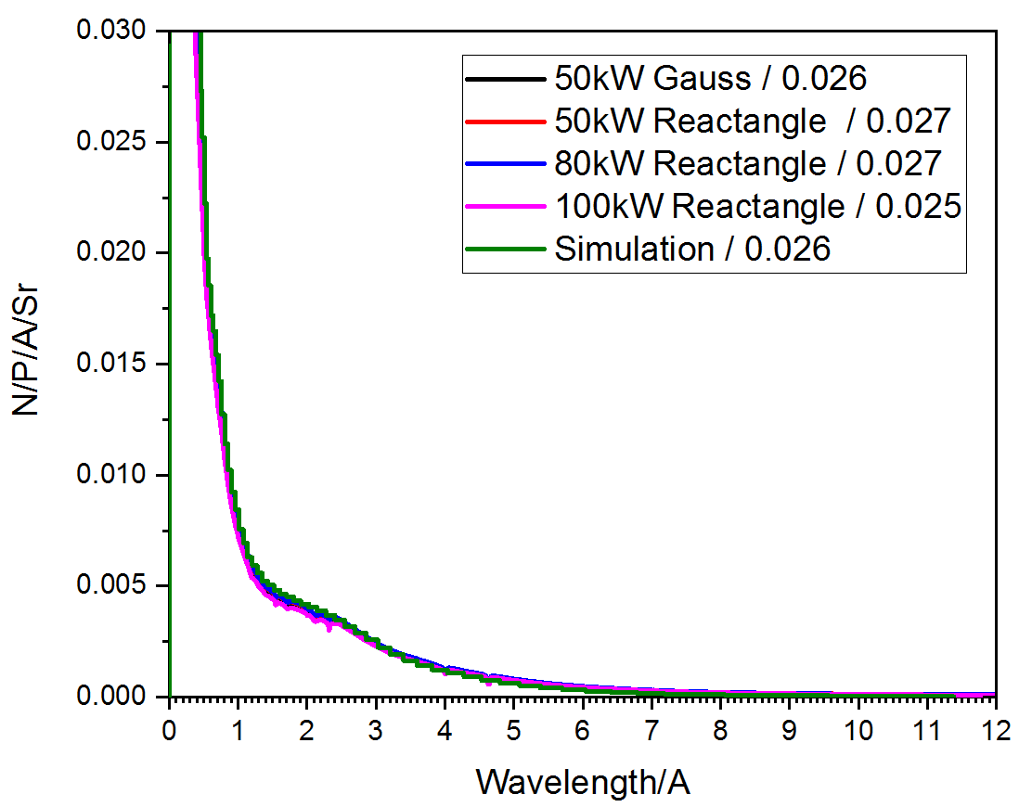
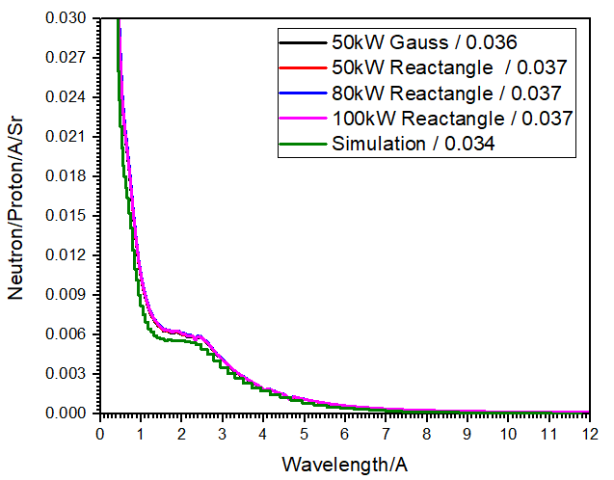
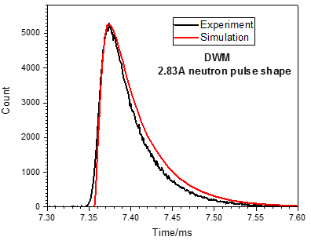
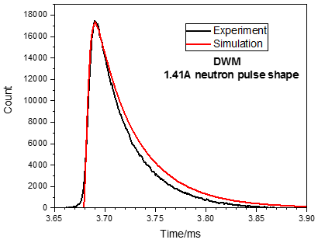
Neutronic performance measurements
A current-mode n-TOF spectrometer was developed to measure the neutron wavelength spectra.
A Ge monochromator was applied to measure the neutron pulse shape base on the TOF technique.
>0.286A Integral flux
BL01 CHM
BL06 DWM
SANS
BL09 DPHM
(narrow side)
BL20 DPHM
(wide side)
Comparisons of measurements and simulations
HS Chen, Nucl. Instrum. and Methods A 1078 (2025) 170431
4/22

Slide 5
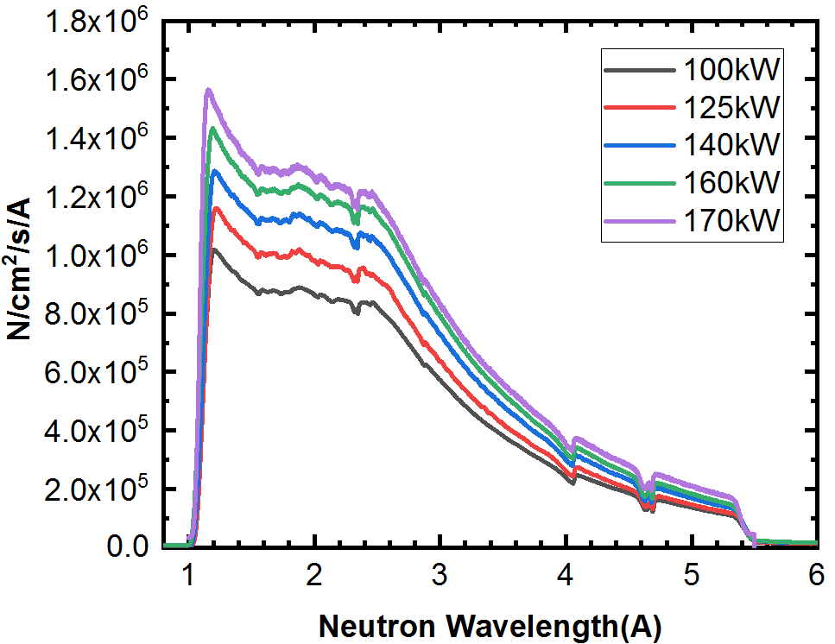
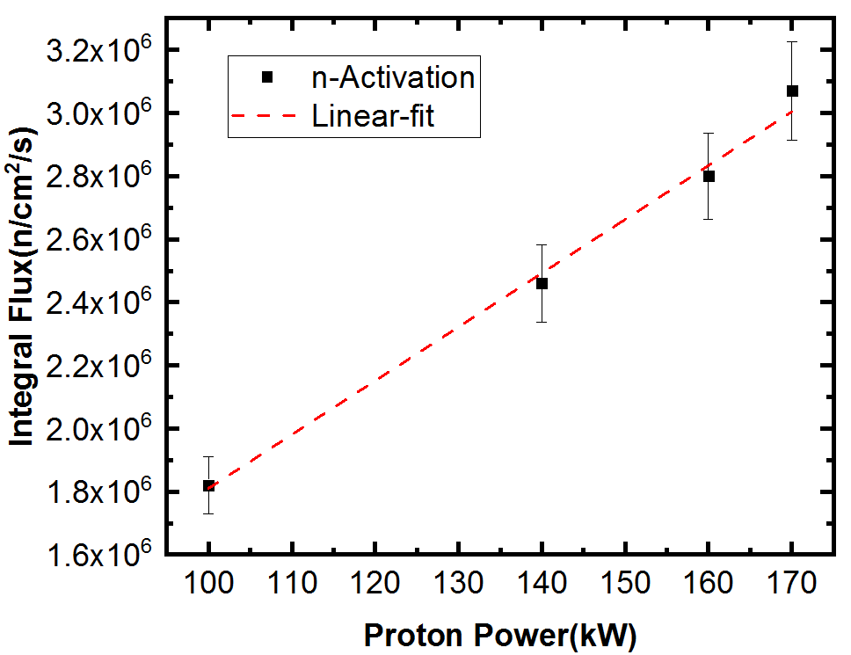
Neutronic performance measurements
Long term monitoring for the DPHM performance.
  Neutron wavelength spectra basically unchanged under different power conditions.
  The integrated neutron flux increases linearly with the beam power.
This year
5/22

Slide 6
Physical calculations of the CSNS-II
Main parameters of the CSNS-II TMR assembly
Target
6/22

Slide 7
Physical calculations of the CSNS-II
Comparison of the neutron brightness of the three moderators for CSNS-I (100kW) and CSNS-II (500kW).
The gain of the time-integrated and peak brightness of the CSNS-II will exceed 5 times.
n/s/Angstrom/Sr/cm²
Gain factors as a function of wavelength for the time-integrated (left) and peak (right) brightness
7/22

Slide 8
Physical calculations of the CSNS-II
Comparison of the neutron pulse shape of the three moderators for CSNS-I (100kW) and CSNS-II (500kW).
The width of the neutron pulses is basically unchanged, ensuring the resolution of the neutron instruments.
FWHM and Full Width at 0.01% Max ratio of the CSNS-II to CSNS-I as a function of wavelength
8/22

Slide 9
Physical calculations of the CSNS-II
Lifetime estimation for the components of the TMR
Component | Material | NRT-dpa (dpa/y) | H yield (appm/y) | He yield (appm/y) | Limited DPA | Limited He | Lifetime /year
Target | W | 8.0 | 5110 | 884
Target vessel | SS316 | 3.9 | 2180 | 334 | 12 |  | ~3.0
Moderator vessel | Al-6061 | 3.0 | 124 | 37 | 40 | 1500 | ~13
Reflector vessel | Al-6061 | 3.3 | 134 | 40 | 40 | 1500 | ~12
Be Reflector | Be | 0.5 | -- | -- | --
P-Beam Window | Al-5083 | 0.4 | 962 | 216 | 40 | 1500 | ~7.0
****LIFETIME (conservative) at full power: Target: 1 year; TMR plug & Proton beam window: 5 year;
9/22

Slide 10
Physical calculations of the CSNS-II
Heat deposition (500kW*1.2)
****TOTAL heat load: Target: 333kW; Reflector: 122kW; LH₂(CHM): 1396W; LH₂(DPHM): 1121W;
10/22

Slide 11
Outline
Target-Moderator-Reflector neutronic performance analysis
  Validations of the CSNS-I
  Calculations of the CSNS-II
Heat transfer design and abnormal cases considerations
Neutron Irradiation Project
Summary
11/22

Slide 12
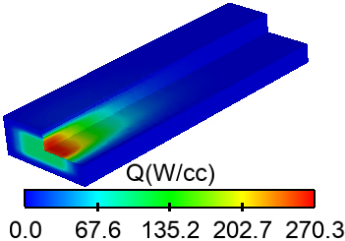
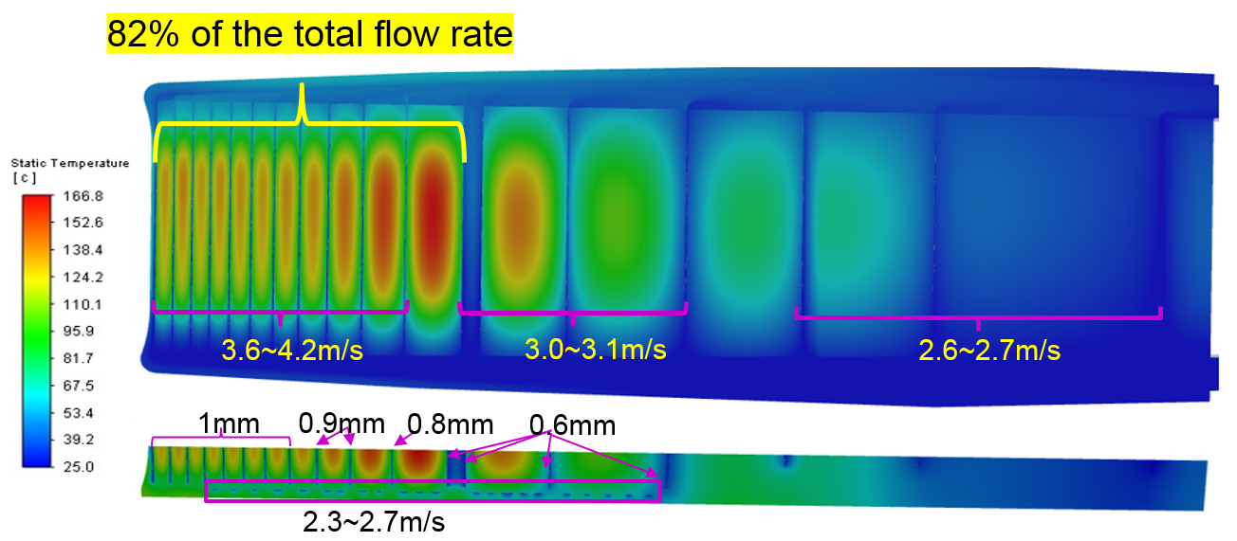
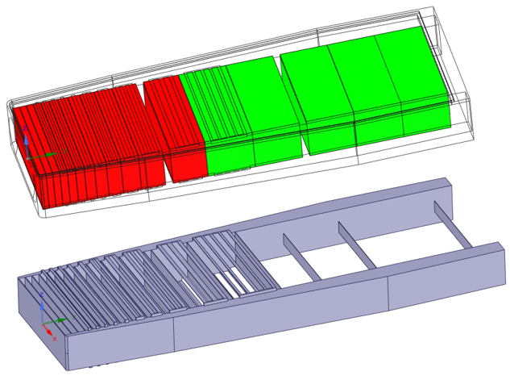
Heat transfer design: Target
Design parameters
Proton beam power: 500 kW (*1.2)
Pressure: 4 bar
Heavy Water inlet: 25℃, 200 L/min
Average flow velocity of gaps between targets: ≤4m/s
Coolant temperature on the target plate wall: ≤125℃
Heat deposition distribution in target
Target
Flow rate and velocity in the target
Target blocks: 17 pieces
The Min. thickness of target: [9.5(W)+1(Ta)] mm
The Max.t of solid wall in contact with water :104℃
The Max. t of target vessel: 108℃
The Max. t of target: 167℃
Water
Upper and lower flow channels
12/22

Slide 13
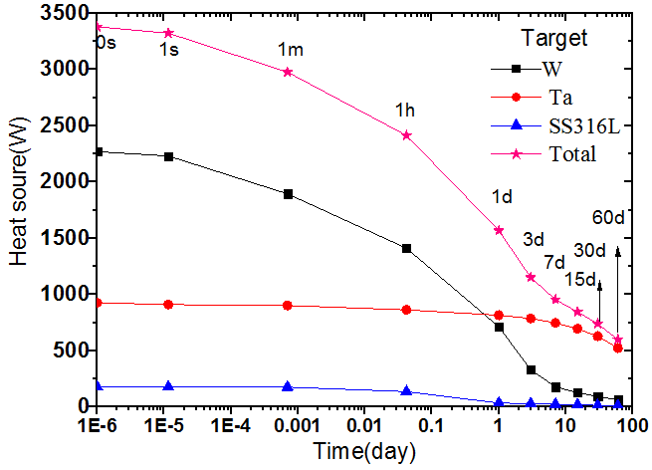
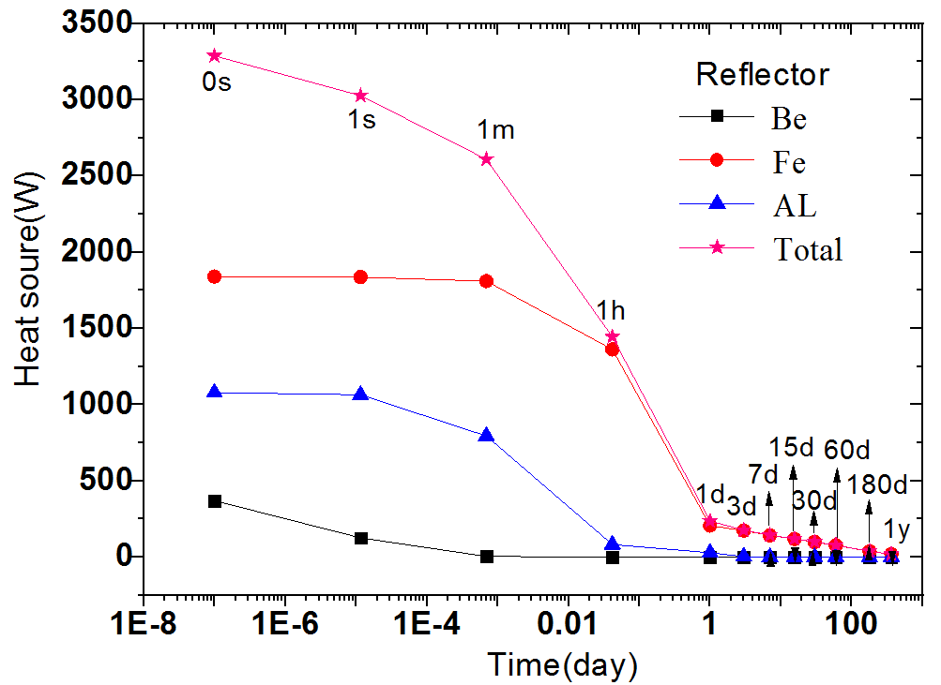
Abnormal cases consideration
Decay Heat
Stemming from the radioactive nuclides produced by interaction with the incident protons and secondary particles.
  Beam power, operation duration, materials,..
Heat power variation over time of each component
(Target: 1 year @ 500kW; Reflector: 5 years @ 500kW)
13/22

Slide 14
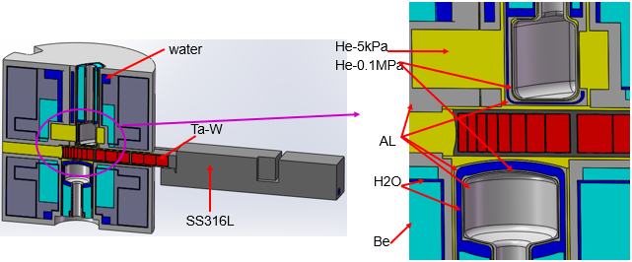
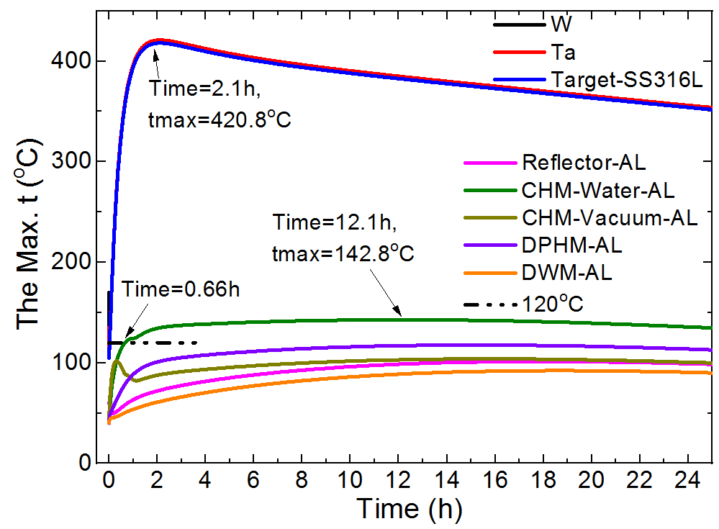
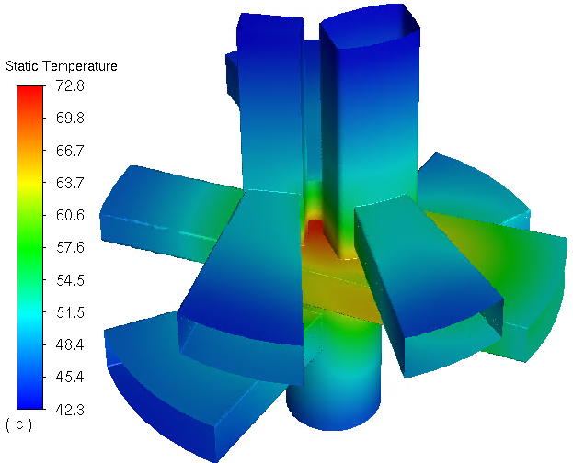
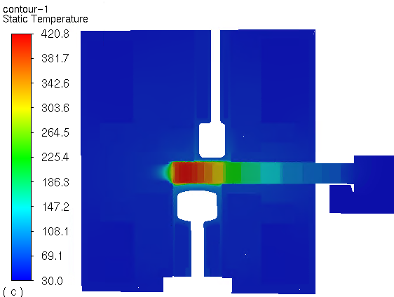
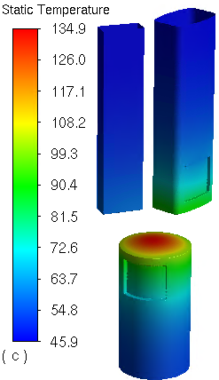
Abnormal cases consideration
Abnormal Cases: LOCA
Operation at 500kW for 1 year
Both TMR drain away water instantly
Initial heat: Target(3400W) + MR(3795W)
Outer surface: natural convection
h=10W/(m.K), ambient temperature: 30℃
Radiation heat transfer is considered.
Refilling medium in TMR cooling channel: Nitrogen
TMR temperature distribution at around 2.1h after the leakage happen
14/22
ZY Yang, Annals of Nuclear Energy 223 (2025) 111654

Slide 15
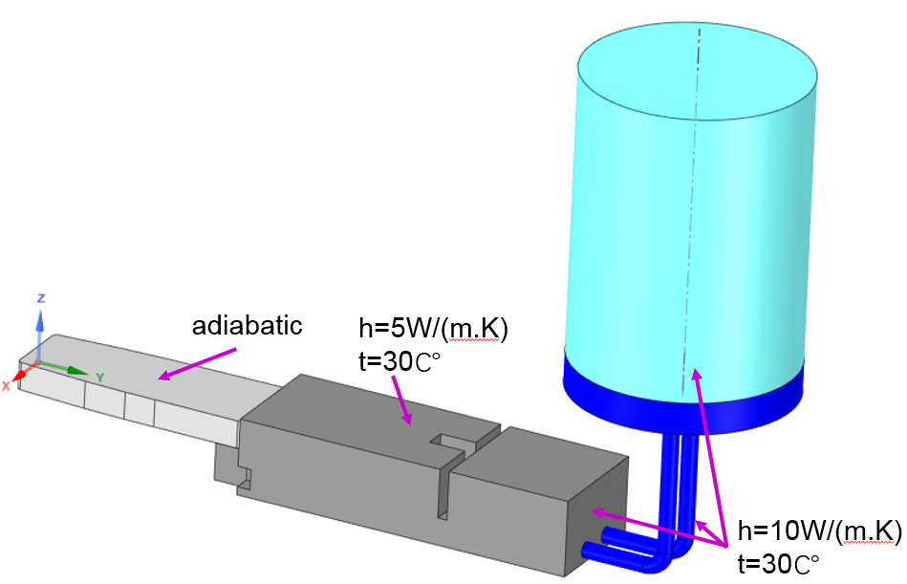
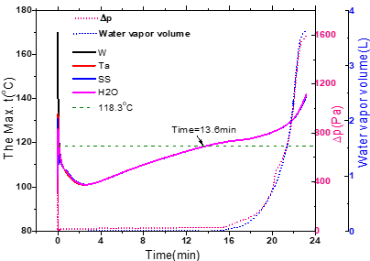
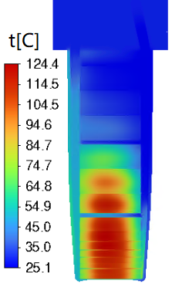
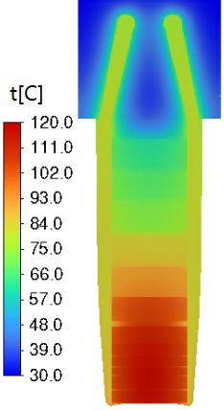
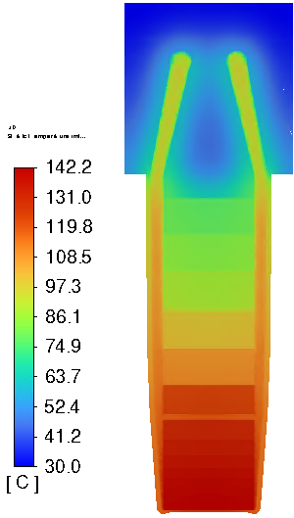
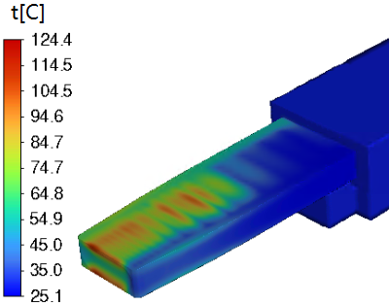
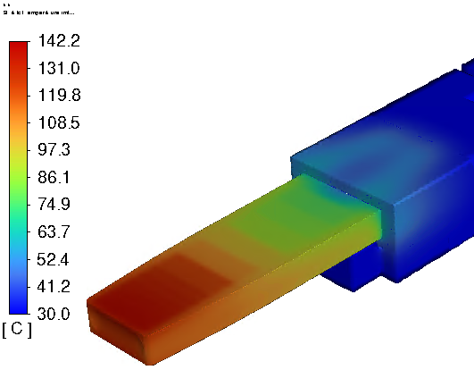
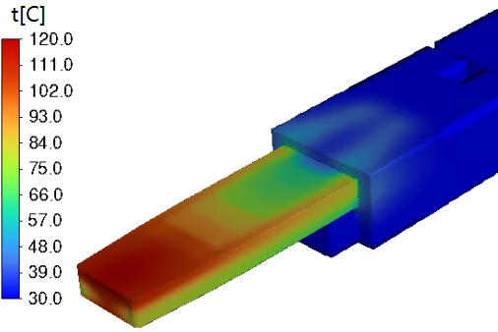
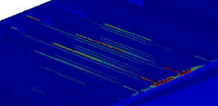
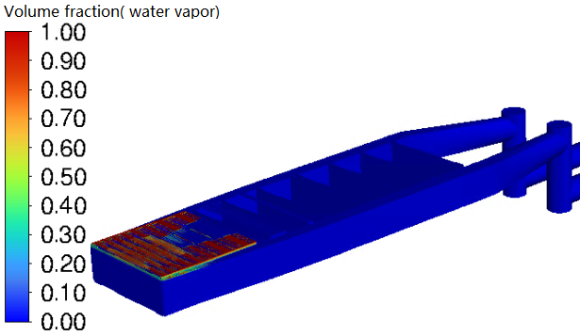
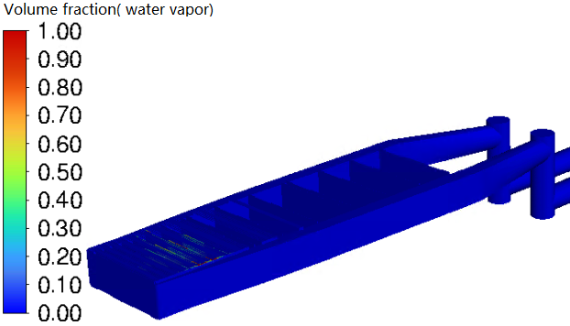
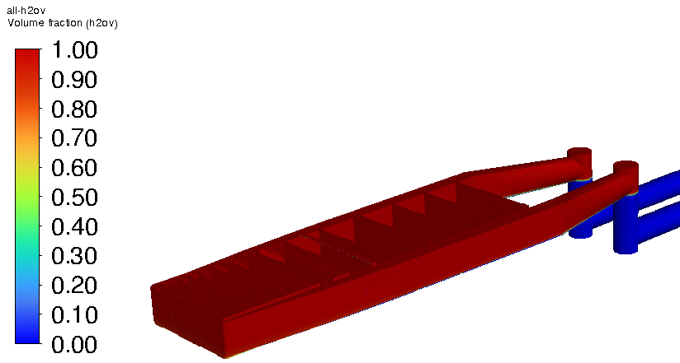
Abnormal cases consideration
Abnormal Cases: UPSA
Proton beam and the cooling water suspend at the same time.
  Target outer wall: adiabatic
  Target initial pressure: 0.087 MPa (ts =118.3℃)
  Initial temperature:
  Target: normal operation case
  Other components: 30℃
5.2s
15.2min
23.2min
5.2s
15.2min
23.2min
Temperature distribution of the target and SS316 vessel
5.2s
15.2min
23.2min
Vapor volume fraction distribution
15/22

Slide 16
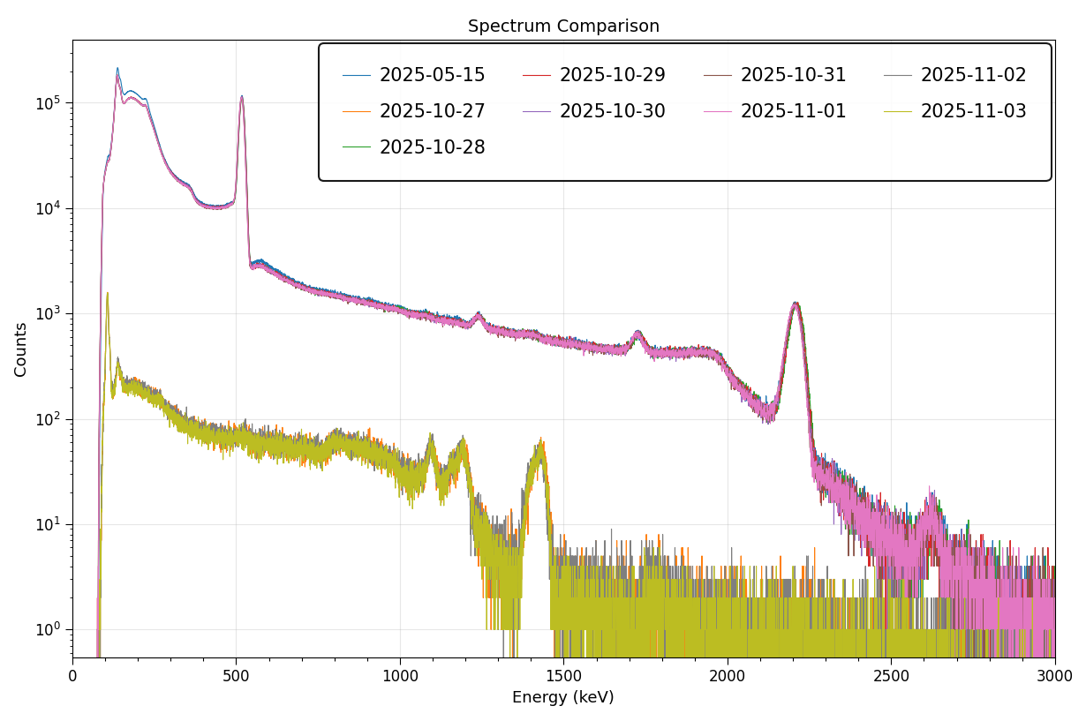
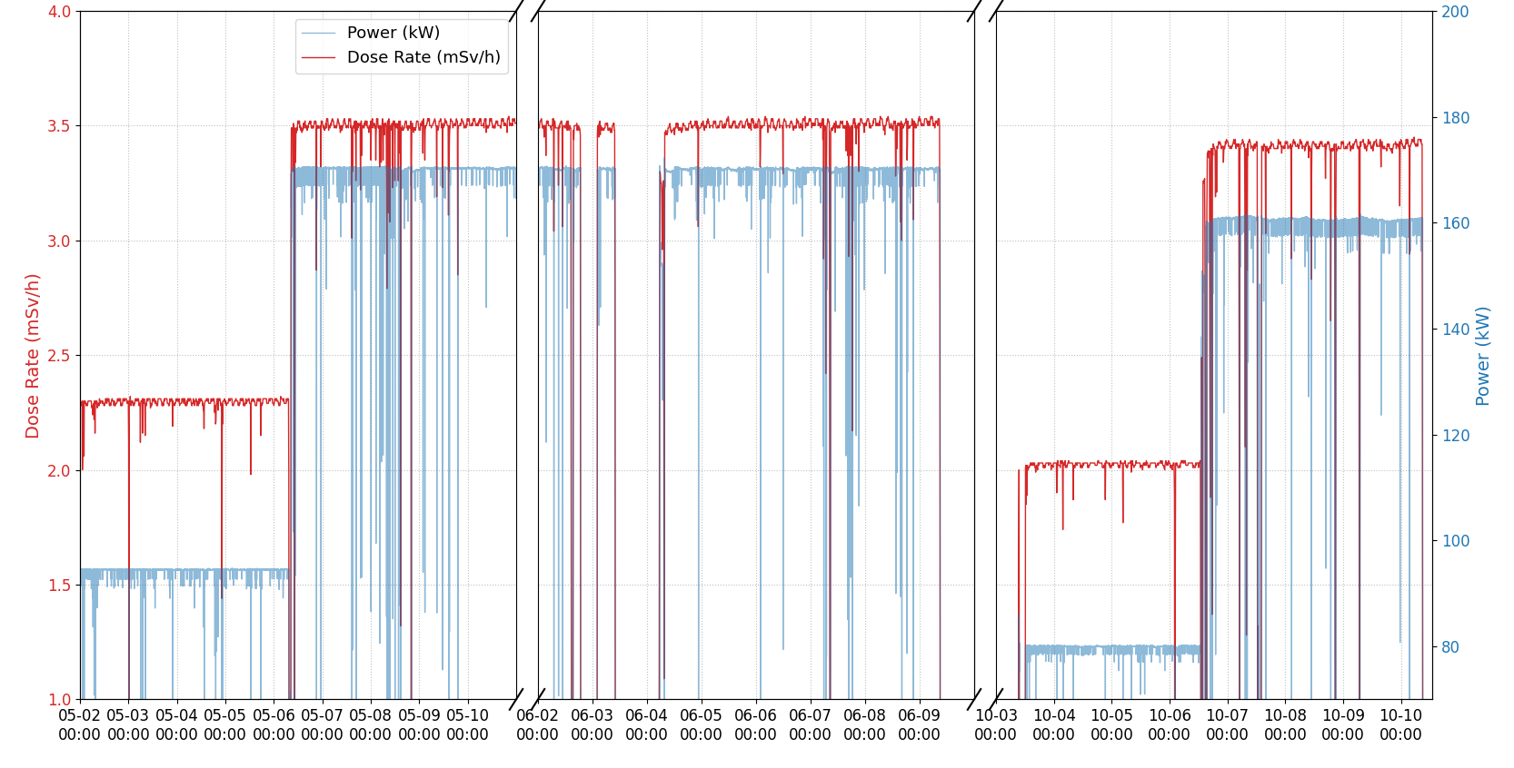
Abnormal cases consideration
Abnormal Cases: Ta/Zr Cladding failure
Accidents of Ta/Zr failure are expected to be monitoring by radiation dose and gamma spectroscopy techniques.
Several GM tubes and a LaBr₃ scintillator gamma spectrometer were installed along the target coolant pipes.
A long-term data monitoring and analysis are conducting, and no abnormal phenomenon has been observed.
170kW
170kW
160kW
Beam on
Beam off
Single Bunch mode
85kW
Single Bunch mode
80kW
Zr-95 half-life:64d γ:724&756 keV W-187 half-life: 23.8h γ:479&686 keV
16/22

Slide 17
Outline
Target-Moderator-Reflector neutronic performance analysis
  Validations of the CSNS-I
  Calculations of the CSNS-II
Heat transfer design and abnormal cases considerations
Neutron Irradiation Project
Summary
17/22

Slide 18
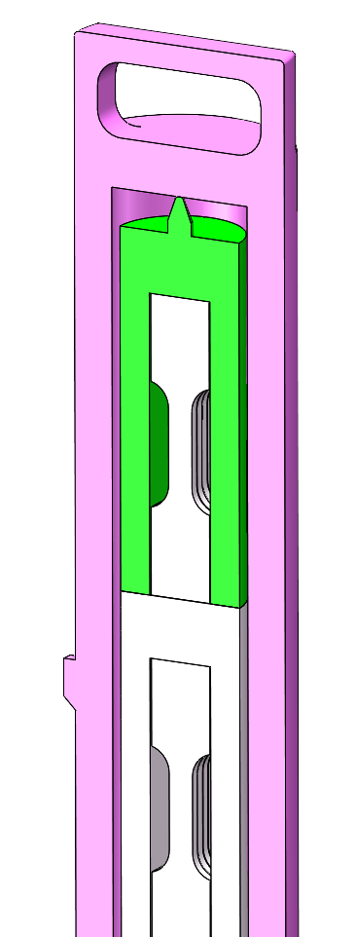
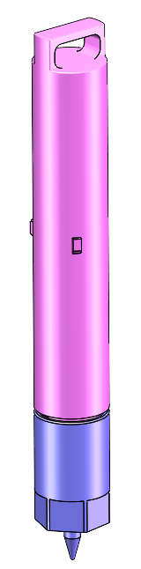
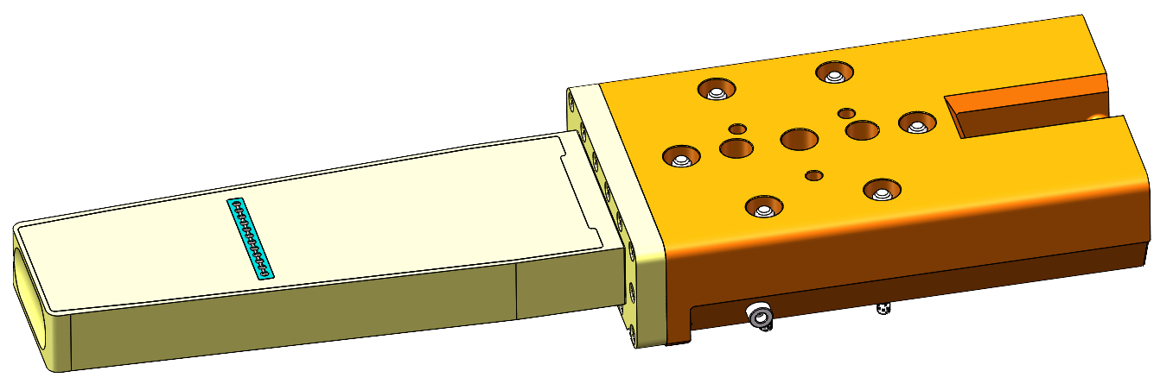
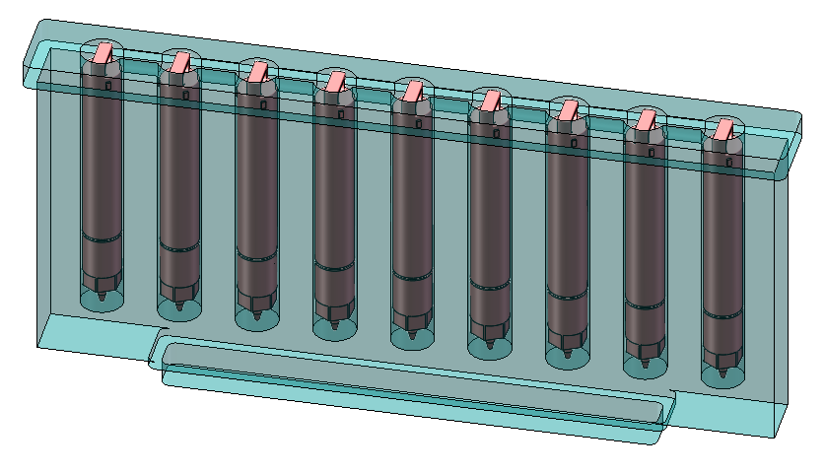
Neutron Irradiation Project
CSNS Neutron Irradiation Project （CNIP）
  GOAL: Material irradiation tests for the future high-power target stations.
  Features: High neutron fluence rate, a wide energy span.
Outer
container
Inner
container
The irradiation zones of
the 7th target in service
D: in the middle of connector
E: at the rear of the connector
sample
A: SS-316 fin plate
Zone | Size（mm） | Fluence rate (@200kW) | Est.Temp.（℃）
A | Ø10×68 | 4.6×10¹³ n/cm²/s | 50~450℃
D | D1=Ø45×114 D2=D3=Ø40×90 | 2.7×10¹¹ n/cm²/s | 20~70℃
E | 70×80×80 70×85×154 | 8.3×10¹⁰ n/cm²/s | 20~70℃
18/22

Slide 19
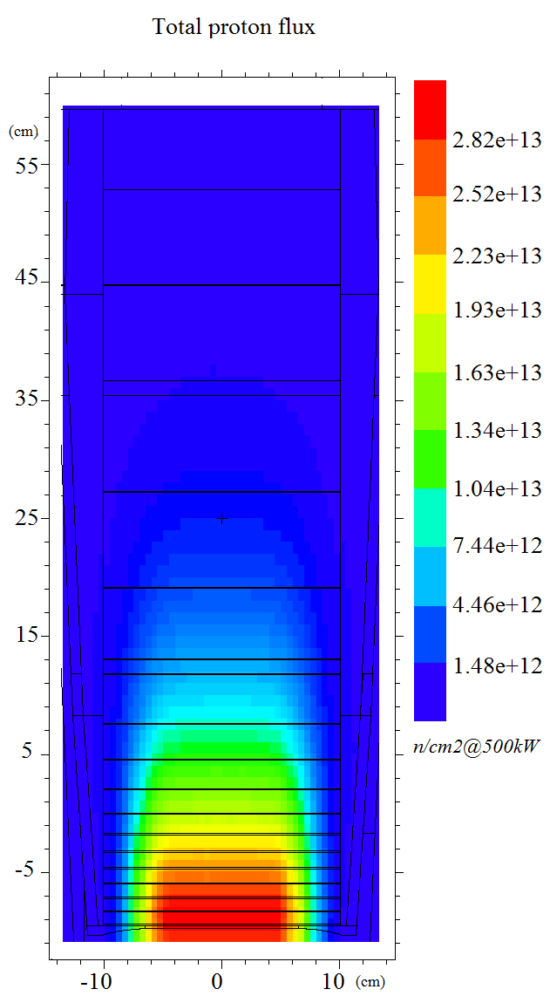
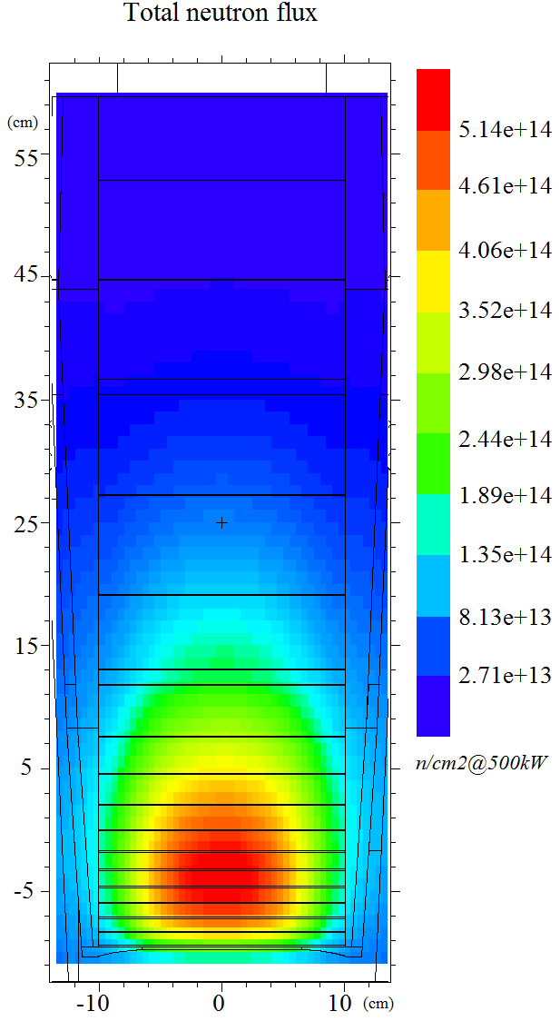
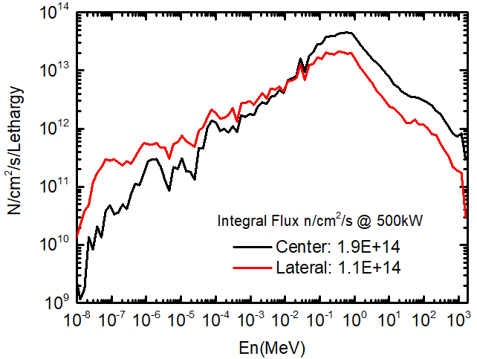
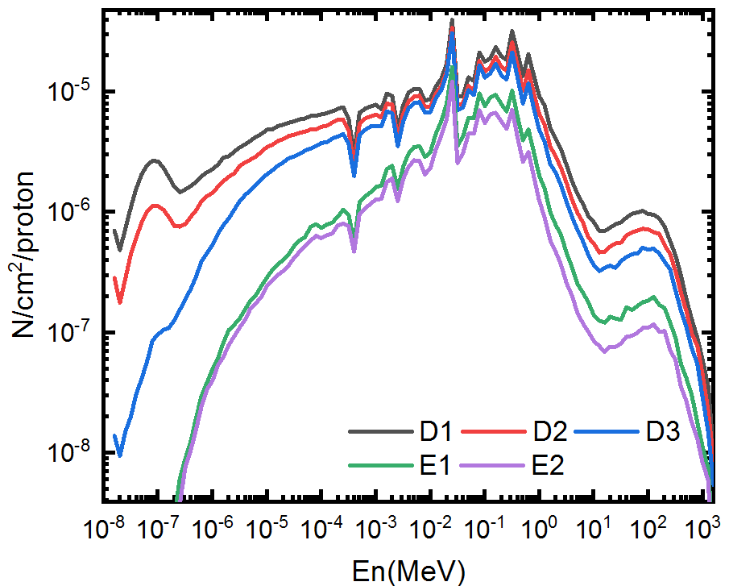
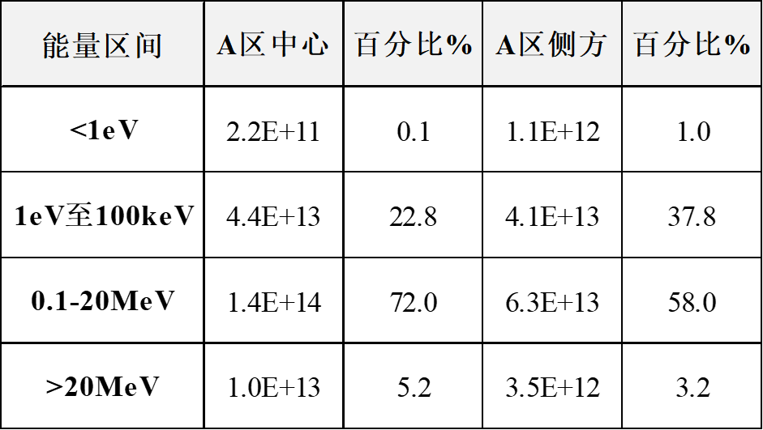
Neutron Irradiation Project
Neutron spectra and integral flux calculations
Proton and neutron flux distribution in the target
The most intensive area located at about 5 cm depth
A high proportion of evaporation neutrons with energy about 1 MeV
The maximum integral neutron flux in Zone A is about 2E+14 n/cm²/s
Zone A at SS316 fin
19/22

Slide 20





Neutron Irradiation Project
Irradiation conditions: DPA
Displacement damage cross-sections (E <10 GeV) from IAEA
DPA at the center of Zone A (@ 200kW & 5000h)
20/22

Slide 21

Neutron Irradiation Project
Irradiation conditions: H/He production
The H/He production cross section was calculated by Monte Carlo codes.
  For neutrons with E_{n}<20 MeV, MCNP+ENDF-VIII was applied.
  For neutrons with E_{n}>20 MeV and protons in full energy range, PHITS+ INCL4.6 was used
H/He at the center of Zone A (@ 200kW & 5000h)
21/22

Slide 22
Summary
The measurement results of the CSNS-I validated the reliability of the physical design and are now being applied to the CSNS-II development.
Simulations under normal/abnormal operating conditions confirm the reliability of the target heat exchange structure.
The neutron irradiation project is currently progressing smoothly and is expected to service for the CSNS future high-power target stations.
Thank you for your attention!
22/22

