Slide 1
The short- and long-lived method for water activation in spallation neutron systems
April 7, 2026
Ahmad M. Ibrahim, Franz X. Gallmeier, Tucker C. McClanahan, Don Montierth, Igor Remec

Slide 2
Outline
Shielding of water loop components outside of core vessel
Methods used
Comparing methods
  Radioisotope concentrations
  Decay source spectra and shielding requirements
  Experimental validation
Conclusion

Slide 3
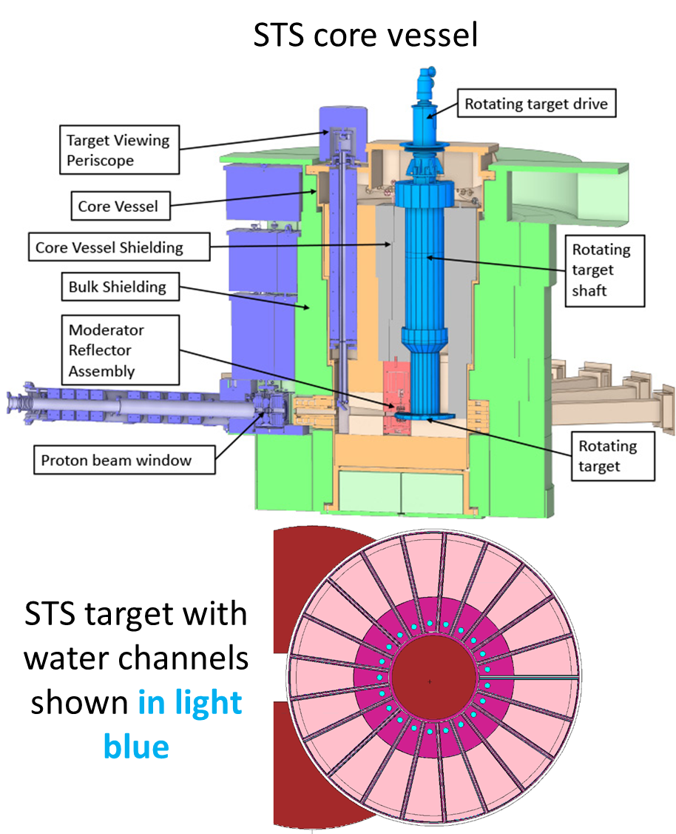
Cooling water activated inside core vessel
Primary components inside the core vessel:
  The STS target, the proton beam window (PBW), the moderators, the beryllium reflector surrounding each moderator, the target viewing periscope, the collimators, and the core vessel shielding.
Cooling water activated by primary irradiation from protons, neutrons, other particles
Unique challenges caused by spallation and high-energy interactions
Cooling water carries radioisotopes out of the well-shielded core vessel

Slide 4
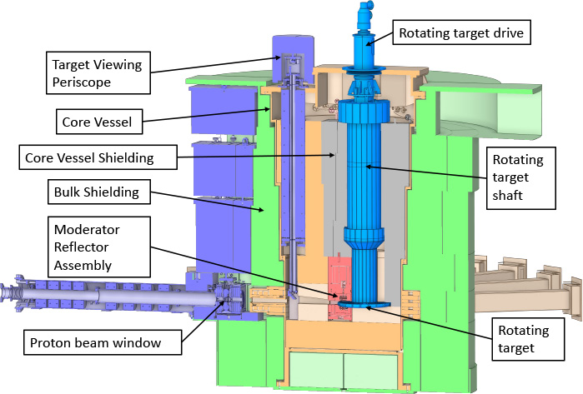
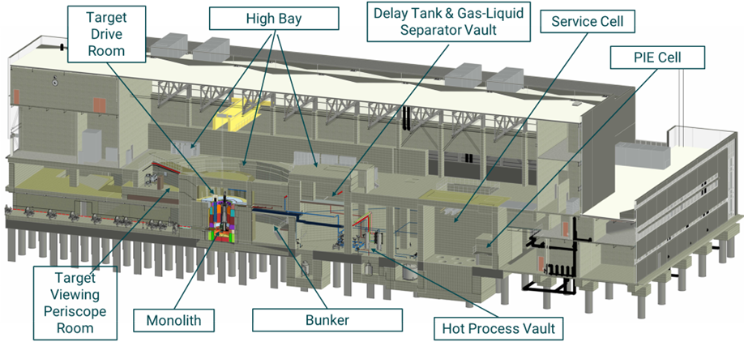
Water flow carries radioisotopes to regions not directly exposed to primary radiation
Core vessel
Secondary components outside of core vessel are not exposed to primary radiation:
  Pipes, tanks, filters, and pumps
Adjacent accessible areas must be adequately shielded
Goal: combine water activation with flow calculations to shield secondary components
ORNL SNS STS target systems and downstream utilities
High bay

Slide 5
Methods used
True calculation, dilution method, and short- and long-lived method

Slide 6
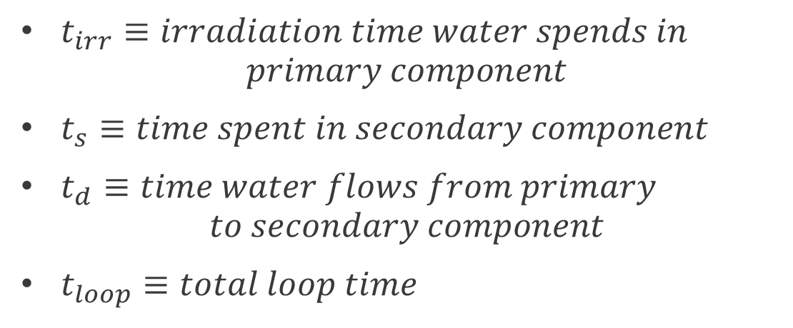
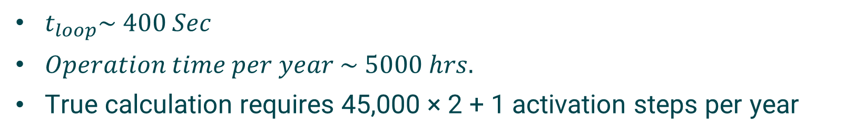
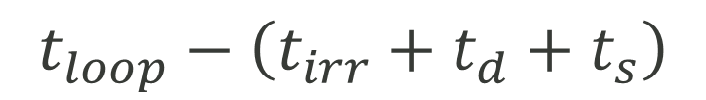



Fully detailed calculation has thousands of steps
Core vessel
Secondary comp.
Times to use in calculations
$t_{irr}≡irradiation time water spends in$
$$primary component$$
$t_{s}≡time spent in secondary component$
$t_{d}≡time water flows from primary$
$$to secondary component$$
$t_{loop}≡total loop time$
$$t_{irr}$$
$$t_{loop}−\left({t_{irr}+t_{d}+t}_{s}\right)$$
$$t_{d}$$
Typical values
$$t_{s}$$
$t_{loop}\sim 400 Sec$
$Operation time per year \sim 5000 hrs.$
True calculation requires 45,000 × 2 + 1 activation steps per year
Very difficult

Slide 7

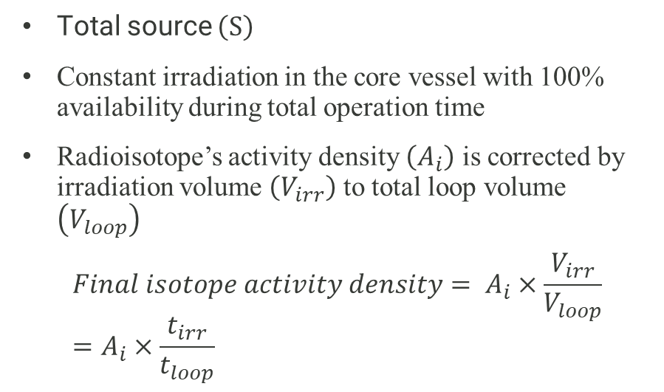




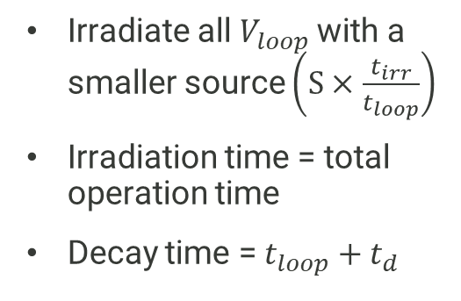

Dilution method and short- and long-lived method
Dilution method
Short- and long-lived method
Long-lived comp.
Short-lived comp.
Core vessel
Irradiate all $V_{loop}$ with a smaller source $\left(S×\frac{t_{irr}}{t_{loop}}\right)$
Irradiation time = total operation time
Decay time = $t_{loop}+t_{d}$
Total source $\left(S\right)$
One final irradiation step with $t_{irr}$ and decay step with $t_{d}$for only $V_{irr}$
Total operation time
$$t_{d}$$
Secondary comp.
Total source $\left(S\right)$
Constant irradiation in the core vessel with 100% availability during total operation time
Radioisotope’s activity density $\left(A_{i}\right)$ is corrected by irradiation volume $\left(V_{irr}\right)$ to total loop volume $\left(V_{loop}\right)$
$$Final isotope activity density= A_{i}×\frac{V_{irr}}{V_{loop}}=A_{i}×\frac{t_{irr}}{t_{loop}}$$
Core vessel
Loop volume irradiated with smaller source,
$$S×\frac{t_{irr}}{t_{loop}}$$
$$t_{irr}$$
$$t_{d}$$
Secondary comp.
Secondary comp.
$$Final activity density=long+short$$

Slide 8
Comparing the dilution and short- and long-lived methods
Isotopic concentrations and source spectra

Slide 9
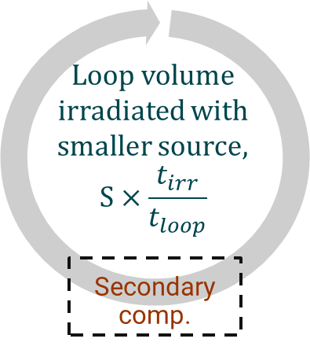
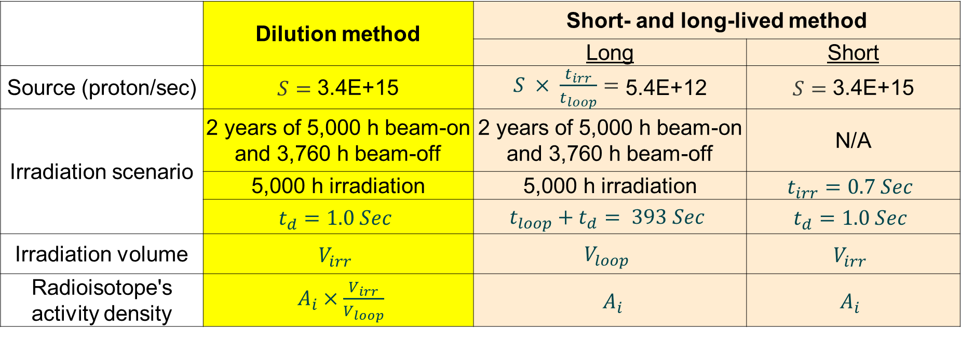



Source and irradiation scenario
 | Dilution method | Short- and long-lived method
 |  | Long | Short
Source (proton/sec) | $S=$ 3.4E+15 | $S × \frac{t_{irr}}{t_{loop}}=$ 5.4E+12 | $S=$ 3.4E+15
Irradiation scenario | 2 years of 5,000 h beam-on and 3,760 h beam-off | 2 years of 5,000 h beam-on and 3,760 h beam-off | N/A
 | 5,000 h irradiation | 5,000 h irradiation | $$t_{irr}=0.7 Sec$$
 | $$t_{d}=1.0 Sec$$ | $$t_{loop}+t_{d}= 393 Sec$$ | $$t_{d}=1.0 Sec$$
Irradiation volume | $$V_{irr}$$ | $$V_{loop}$$ | $$V_{irr}$$
Radioisotope's activity density | $A_{i}×\frac{V_{irr}}{V_{loop}}$ | $A_{i}$ | $A_{i}$
Core vessel
Core vessel
Total operation time
$$t_{irr}$$
$$t_{d}$$
$$t_{d}$$
Secondary comp.
Secondary comp.

Slide 10
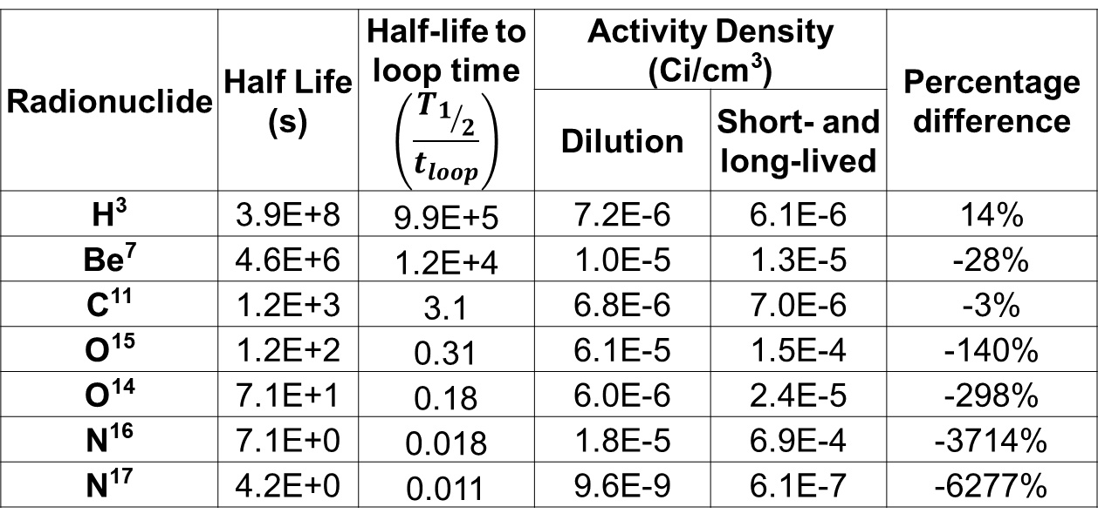
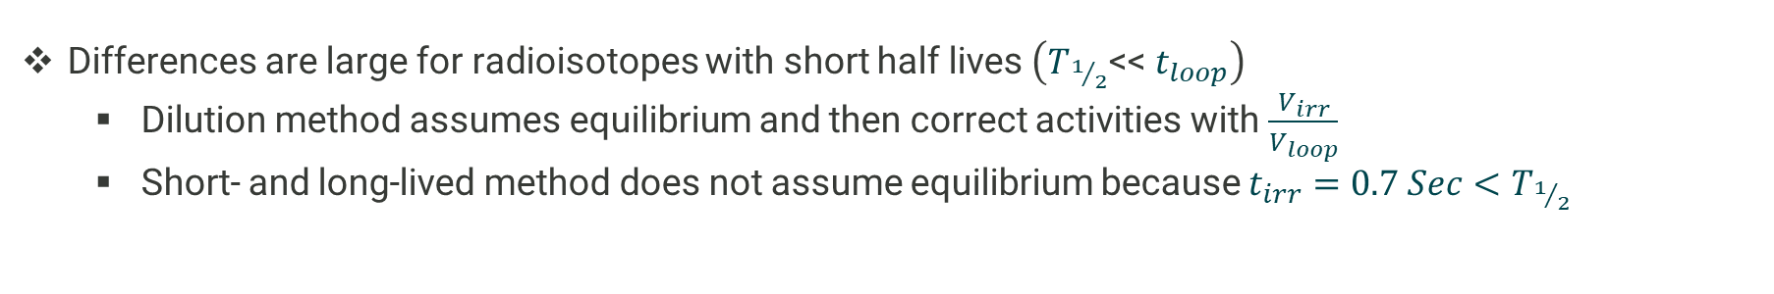
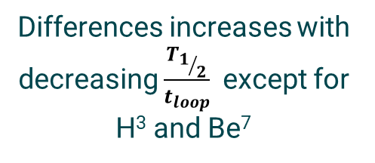
Comparing isotopic activity densities at 1 Sec
Radionuclide | Half Life (s) | Half-life to loop time $$\left(\frac{T_{1/2}}{t_{loop}}\right)$$ | Activity Density (Ci/cm³) |  | Percentage difference
 |  |  | Dilution | Short- and long-lived
H³ | 3.9E+8 | 9.9E+5 | 7.2E-6 | 6.1E-6 | 14%
Be⁷ | 4.6E+6 | 1.2E+4 | 1.0E-5 | 1.3E-5 | -28%
C¹¹ | 1.2E+3 | 3.1 | 6.8E-6 | 7.0E-6 | -3%
O¹⁵ | 1.2E+2 | 0.31 | 6.1E-5 | 1.5E-4 | -140%
O¹⁴ | 7.1E+1 | 0.18 | 6.0E-6 | 2.4E-5 | -298%
N¹⁶ | 7.1E+0 | 0.018 | 1.8E-5 | 6.9E-4 | -3714%
N¹⁷ | 4.2E+0 | 0.011 | 9.6E-9 | 6.1E-7 | -6277%
Differences increases with decreasing $\frac{T_{1/2}}{t_{loop}}$ except for H³ and Be⁷
Differences are large for radioisotopes with short half lives $\left(T_{1/2}\text{<<} t_{loop}\right)$
  Dilution method assumes equilibrium and then correct activities with $\frac{V_{irr}}{V_{loop}}$
  Short- and long-lived method does not assume equilibrium because $t_{irr}=0.7 Sec<T_{1/2}$

Slide 11
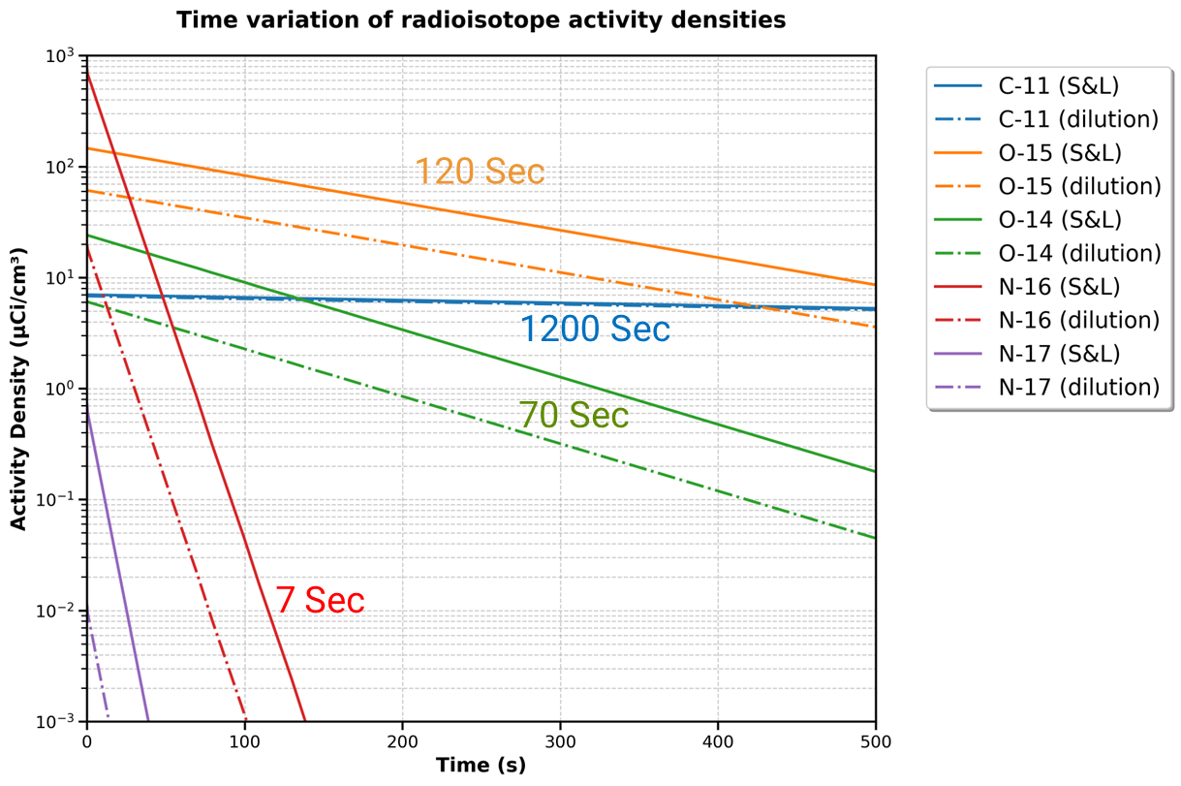
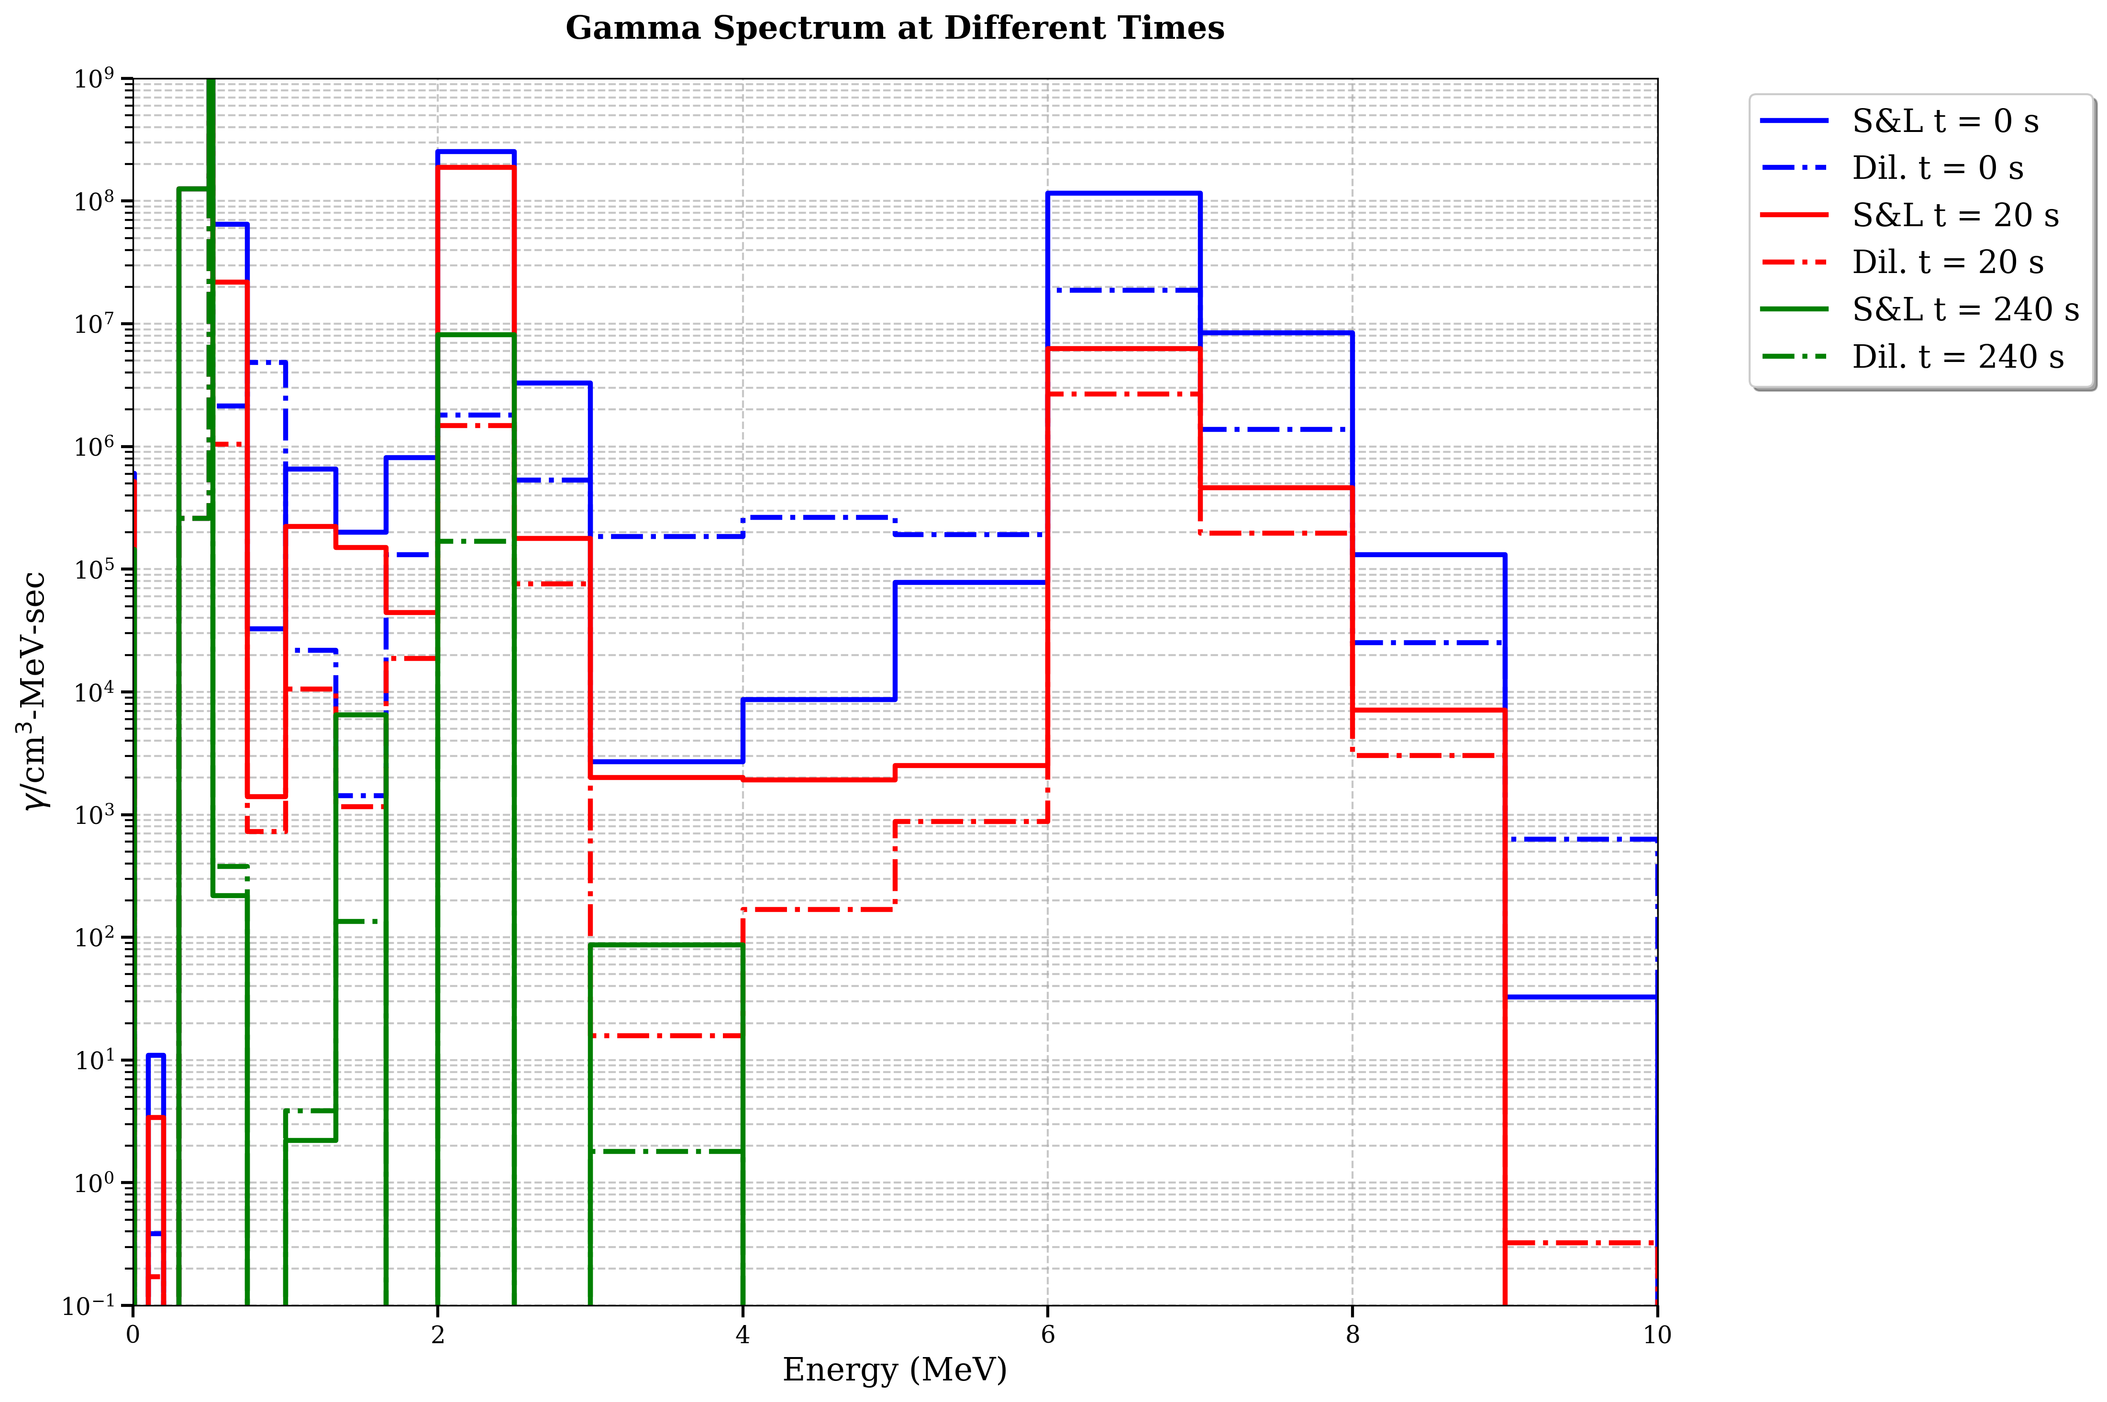
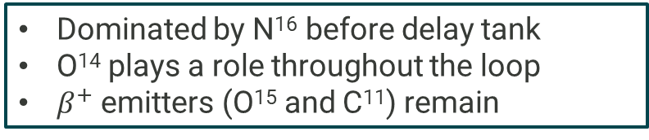
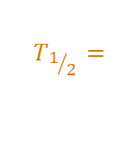
Comparing radioisotope concentration and decay spectra vs transit/decay time
$$T_{1/2}=$$
Dominated by N¹⁶ before delay tank
O¹⁴ plays a role throughout the loop
$β^{+}$ emitters (O¹⁵ and C¹¹) remain

Slide 12
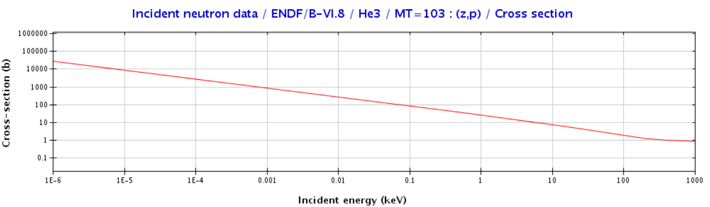
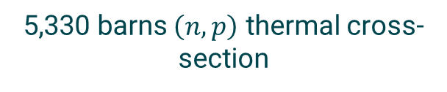
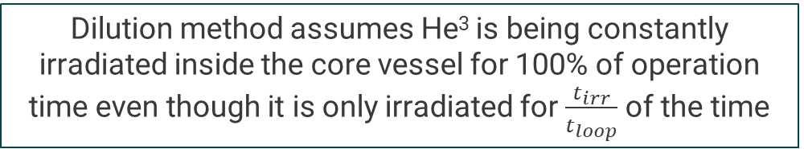
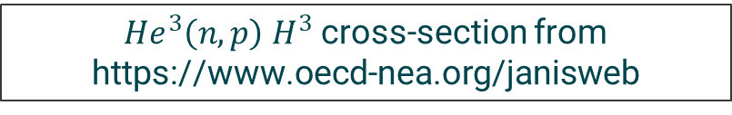
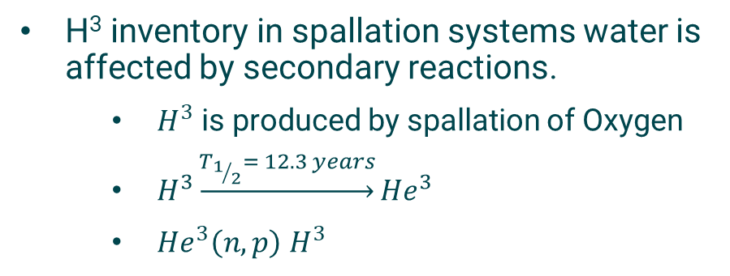
What causes differences in H³?
H³ activity densities calculated by Dilution and S&L-lived methods over 20 years of STS operation
H³ inventory in spallation systems water is affected by secondary reactions.
  $H^{3}$ is produced by spallation of Oxygen
  $H^{3}\underset{→}{T_{1/2}= 12.3 years}{He}^{3}$
  ${He}^{3}\left(n,p\right)$ $H^{3}$
${He}^{3}\left(n,p\right)$ $H^{3}$cross-section from https://www.oecd-nea.org/janisweb
5,330 barns $\left(n,p\right)$ thermal cross-section
Dilution method assumes He³ is being constantly irradiated inside the core vessel for 100% of operation time even though it is only irradiated for $\frac{t_{irr}}{t_{loop}}$ of the time
Notes:
Because of secondary reactions.
For Tritium, its inventory in spallation reactions is affected by two interactions, not one.
The first is the spallation reaction of Oxygen that creates tritium. This tritium decays to He-3. He-3 undergoes n,p reactions to regenerate the tritium again.
Method A overestimates the production of tritium by this secondary reaction.

Slide 13
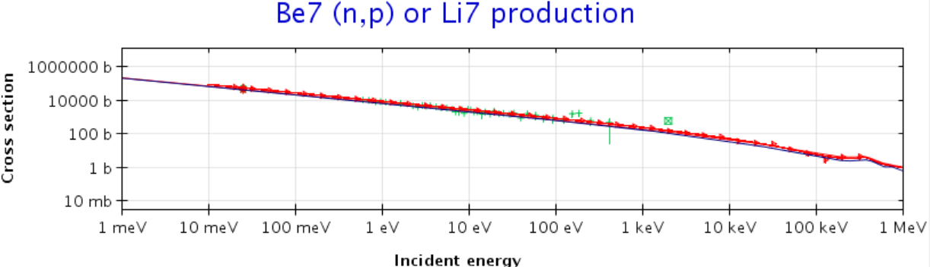
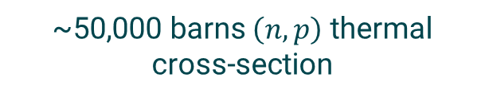
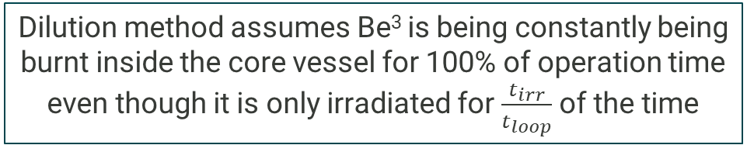
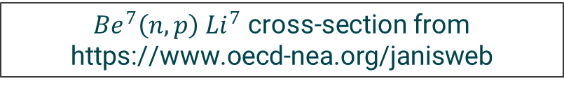
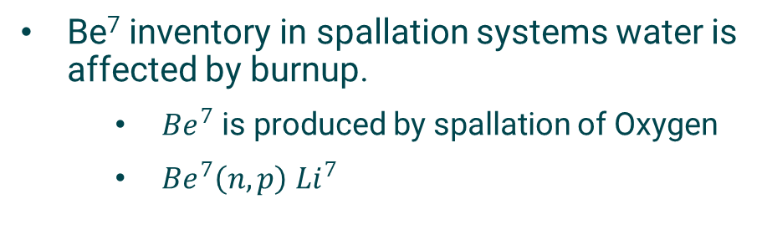
What causes differences in Be⁷?
Be⁷ activity densities calculated by Dilution and S&L-lived methods over 20 years of STS operation
Be⁷ inventory in spallation systems water is affected by burnup.
  ${Be}^{7}$ is produced by spallation of Oxygen
  ${Be}^{7}\left(n,p\right)$ ${Li}^{7}$
${Be}^{7}\left(n,p\right)$ ${Li}^{7}$ cross-section from https://www.oecd-nea.org/janisweb
~50,000 barns $\left(n,p\right)$ thermal cross-section
Dilution method assumes Be³ is being constantly being burnt inside the core vessel for 100% of operation time even though it is only irradiated for $\frac{t_{irr}}{t_{loop}}$ of the time
Notes:
The opposite happens to Be-7.
Be-7 is generated by the spallation reactions of Oxygen. However, because of its extremely high n,p cross-section, it gets burned as it stays in the irradiation region.
Method A assumes that it stays in the irradiation region more than it does, so it underestimate its inventory.

Slide 14
Comparing the dilution and short- and long-lived methods
Decay source spectra and shielding requirement

Slide 15
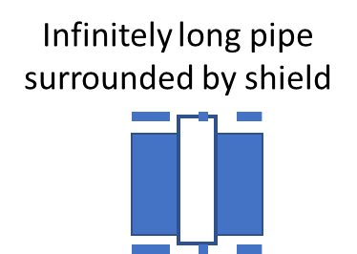
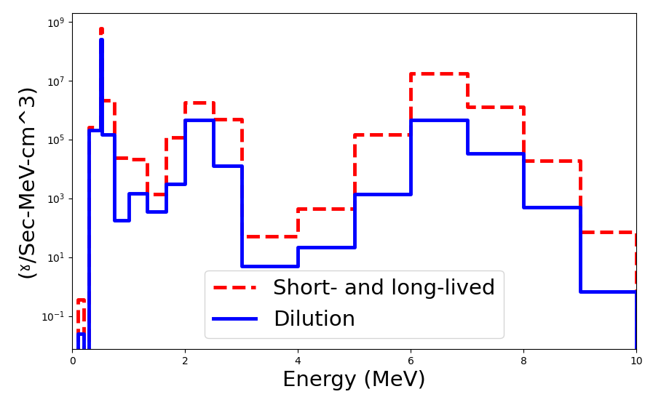
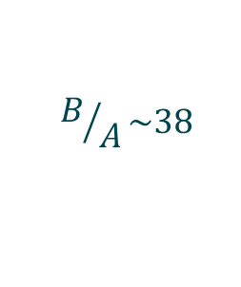
Source spectra and dose rates
Dose rate inside a concrete shield surrounding an infinite pipe
Decay photon spectra calculated using dilution and S&L-lived methods
$$B/A\sim 38$$
Dose rate is ~100% caused by N¹⁶ for short decay times
Differences in dose rates at these times is equivalent to N¹⁶ between the two methods
Notes:
Looking at the decay photon source spectrum and the decay dose rate, we can see that the most significant difference is around the 6 and 7 MeV, corresponding to the two gammas that the N-16 emits. In this case that we ran, the difference was a factor of 38.
We ran a simulation for an infinite pipe covered with regular concrete for shielding, and here are the dose rate profiles inside the concrete.
When I multiplied the dose rates calculated by Method A by the factor of 38, the two profiles agreed very well.

Slide 16
Comparing the dilution and short- and long-lived methods
Experimental validation

Slide 17
Well shielded Total Loss Monitor (TLM) near the proton beam window return pipe
TLM ~3 cm from the wall of a 1.5” pipe with 0.065” walls
Most reliable reading, not affected by interreferences
Notes:
We have many radiation monitors installed near components of the cooling water circuit at the SNS.
This is the monitor installed close to the proton beam window return pipe.

Slide 18
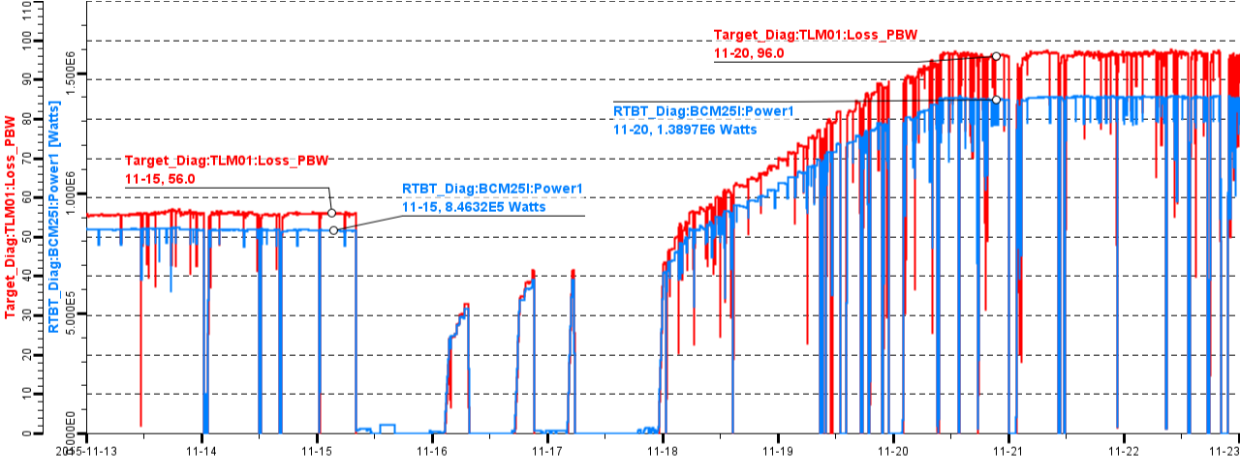
Control System Studio’s reading at SNS
From https://status.sns.ornl.gov/
~97 Rem.hr
1.4 MW power
At ~1.4 MW power, TLM reading ~97 Rem/hr
Notes:
We monitored the reading of this radiation monitor over several days. Its reading was about 97 rem/hr at 1.4 MW operation power of the SNS.

Slide 19
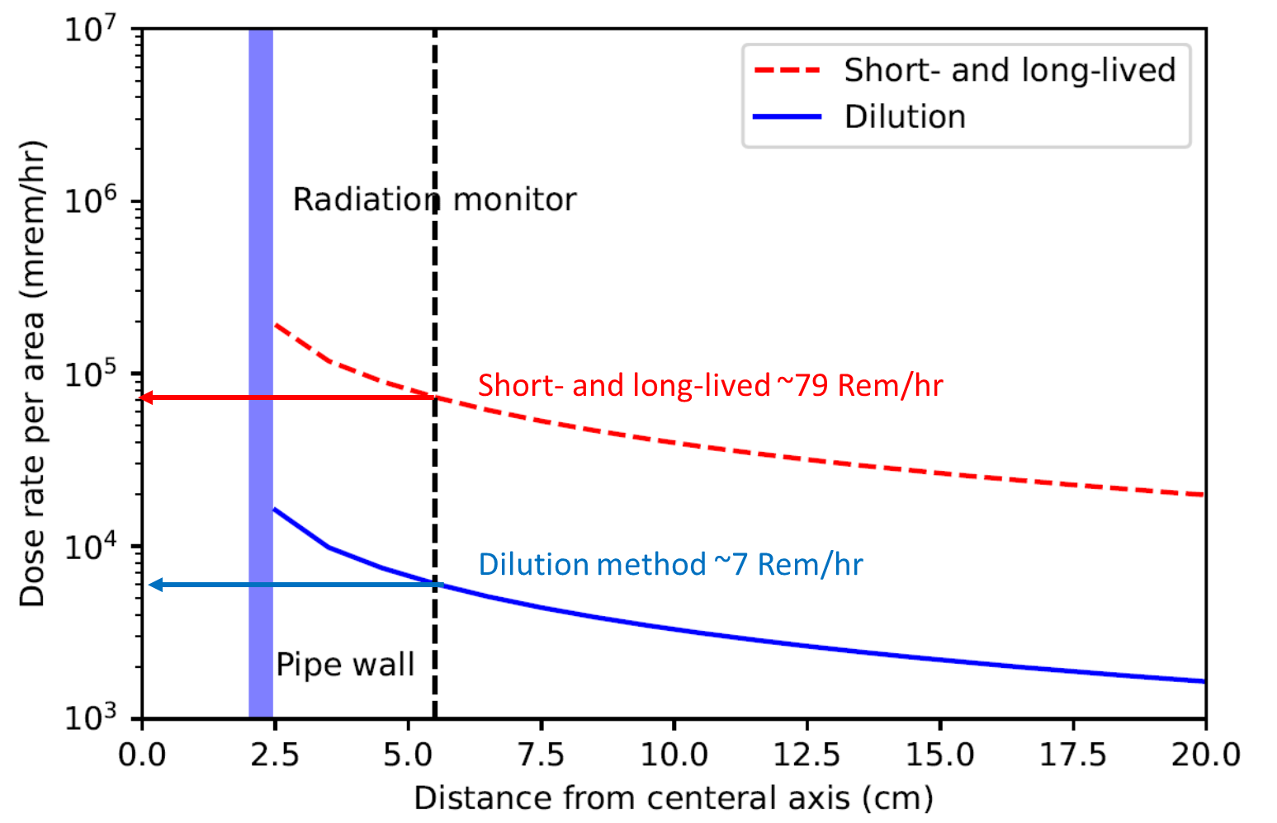
Dose rate calculated by Method A and Method B vs TLM measurement
At ~1.4 MW power, TLM reading ~97 Rem/hr
Calculation or measurement | Dose rate (Rem/h) | % difference with measurement
Measurement | 97 | 0%
Dilution | 7 | 92.8%
S&L-lived | 79 | 19.6%
Dose rate in the air surrounding PBW return pipe
S&L-lived calculates a much closer dose rate to measurement
Notes:
Method A calculated 7 Rem/hr. Method B calculated 79 Rem/hr.
This shows that Method B is much closer to measurements.

Slide 20
Conclusion
Coolant water transports radioactive nuclides from the irradiation regions inside the core vessel to secondary components that are not directly exposed to the primary radiation field.
We developed the short- and long-lived method to accurately model all radioisotopes regardless of whether their half-lives are short or long compared to the loop circulation time.
We recommend this method for shielding analysis of activated water loops in the design of the STS and similar spallation systems.

