Slide 1
ESS Light Shutter System - System design, simulation, testing and integration
Lennart Åström, Marc Kickulies, Jarich Koning, Markus Kristensson, Kristofer Jovanov, Hans Brommesson
European Spallation Source
PRESENTED BY Lennart Åström
lennart.astrom@ess.eu
lennart.astrom@fagerstrom.se
2026-04-16

Slide 2
Agenda
LSS-Environment and mechanical design
Dose rate assessment
Electrical System / Control System
Dynamic structural analysis
Data acquisition system and VHTS

Slide 3

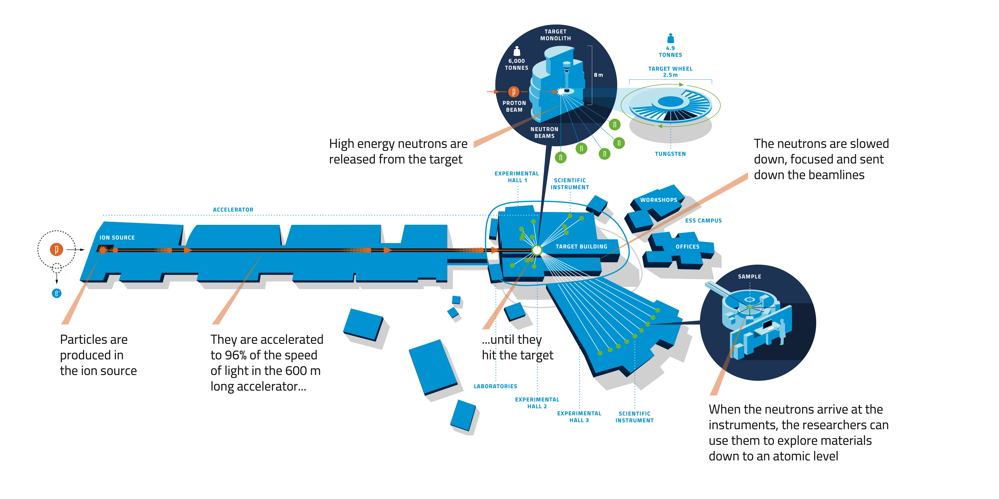
Light Shutter System
Location of the system
LSS
LSS

Slide 4
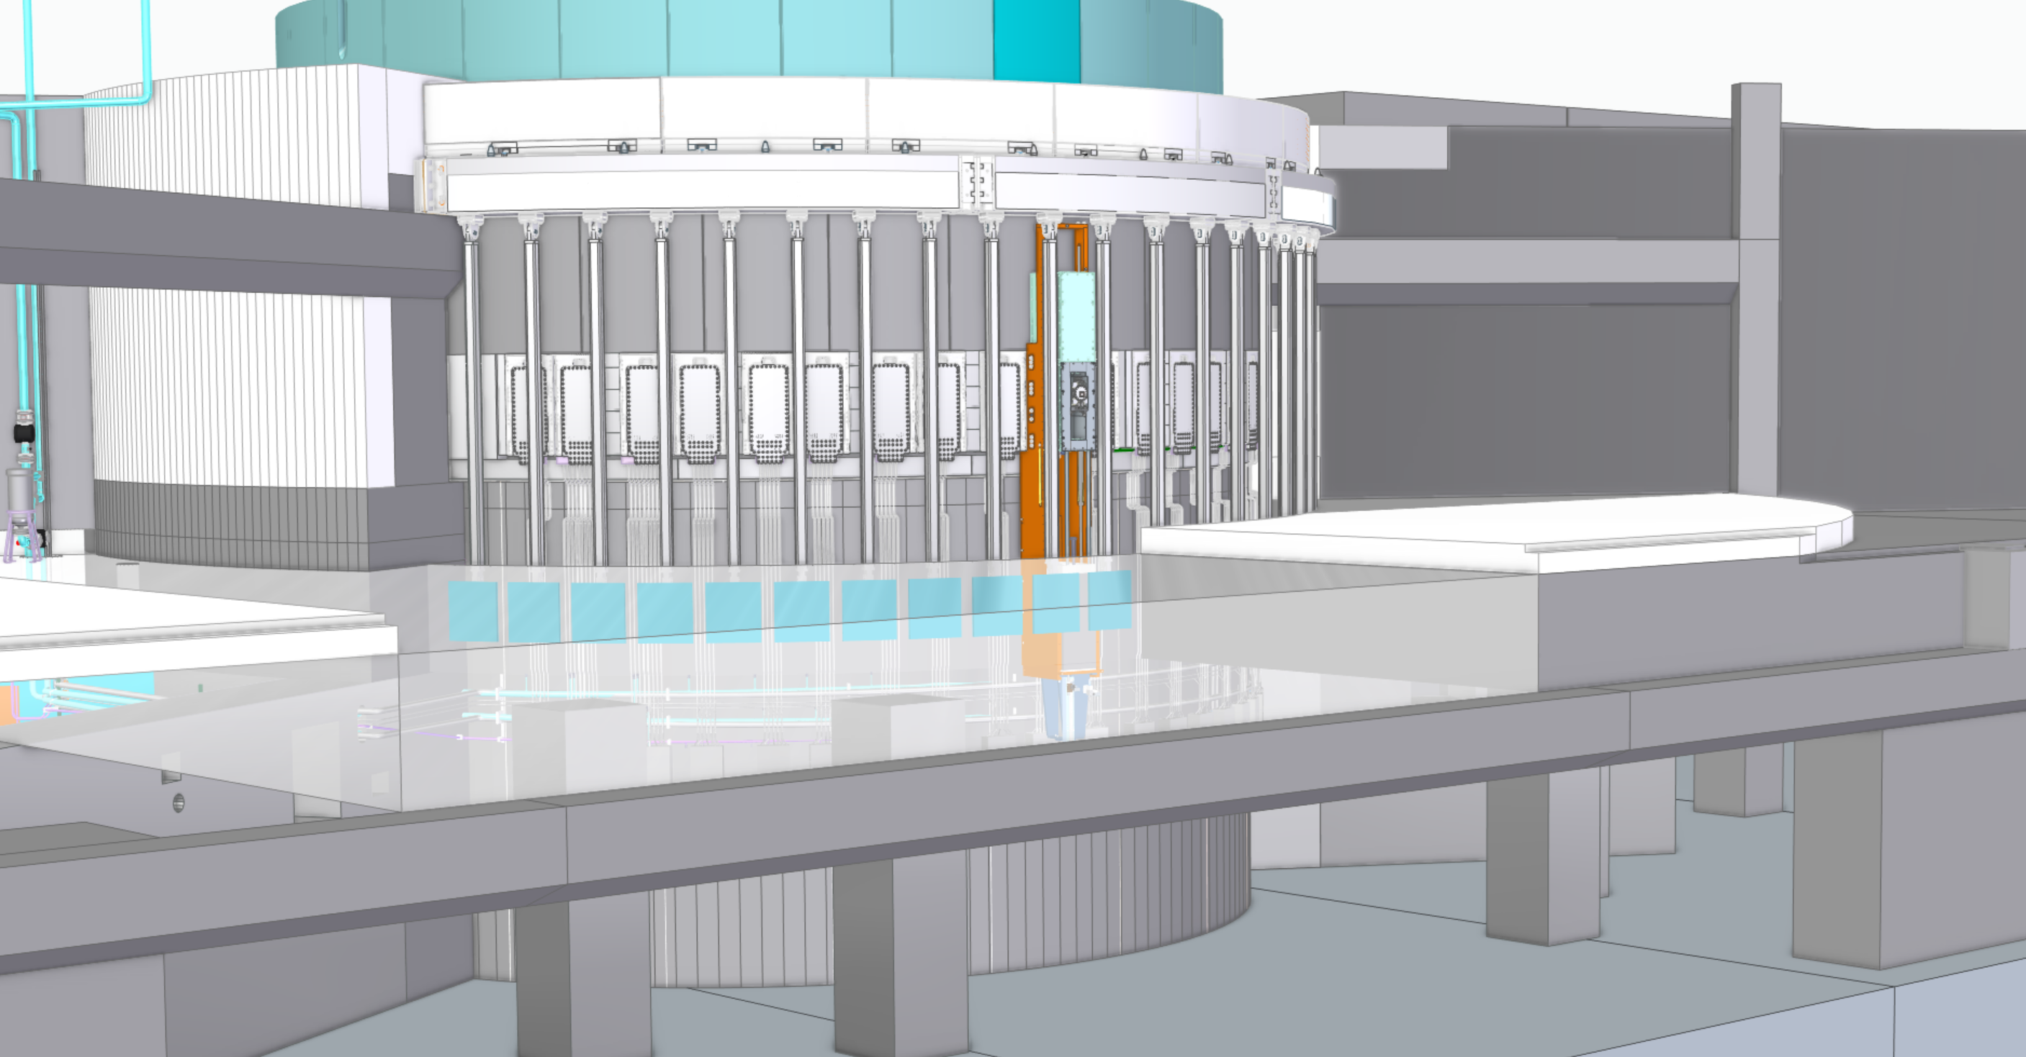
LSS Environment
Neutron Beam Window
Bunker floor
Light Shutter
Basement floor

Slide 5
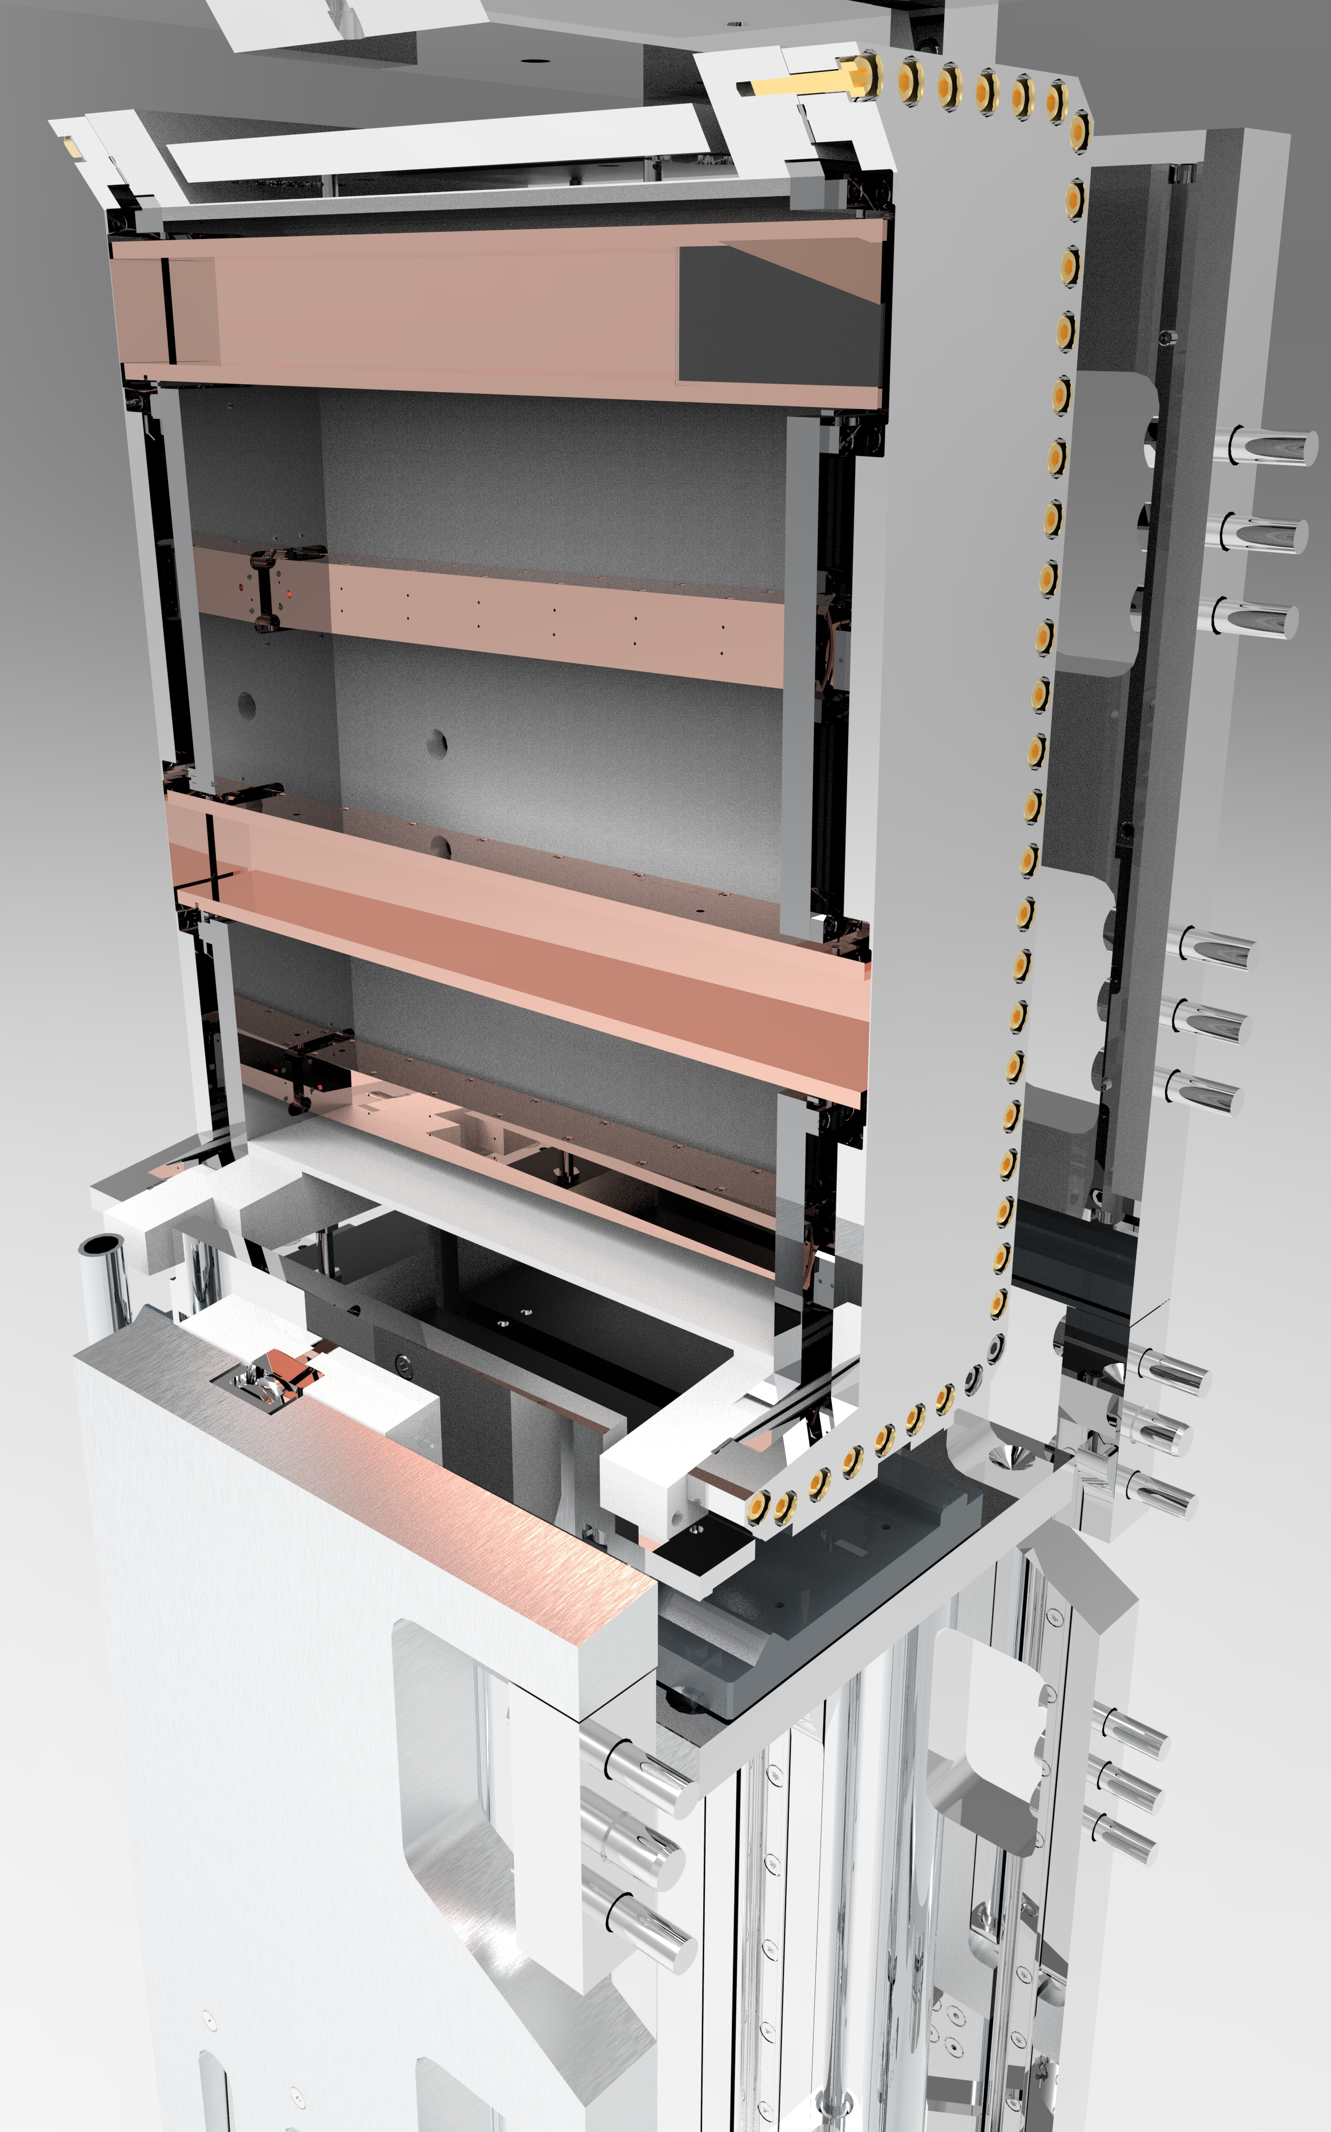
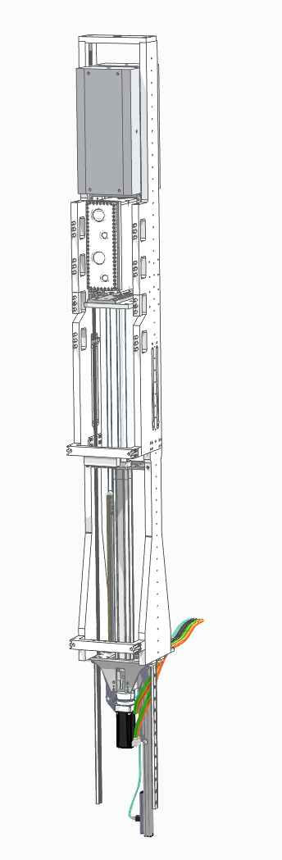
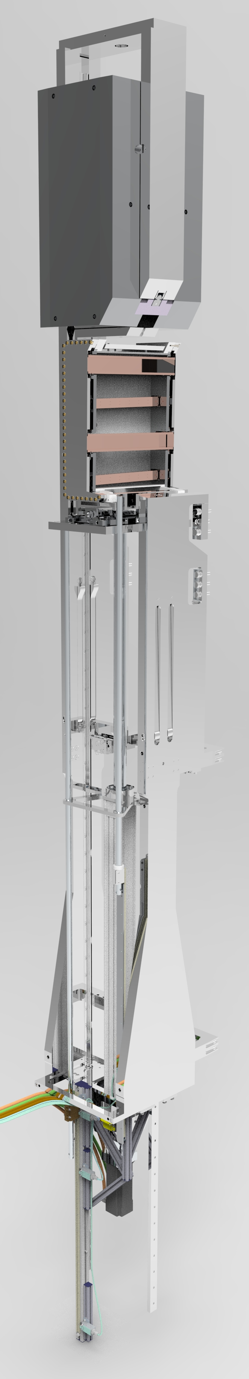
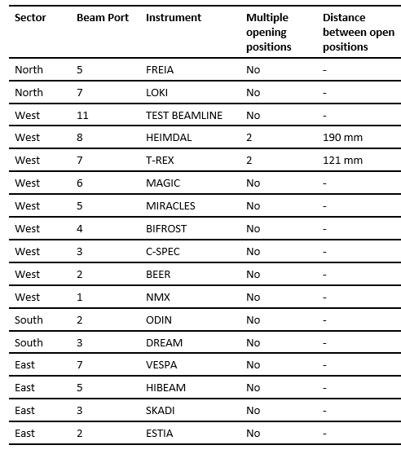
Light shutter
Main parts
Gamma Beam Shutter GBS
Allocation and configuration of instruments related to ports
17 instrumented ports of 42 possible.
Bridge Beam Guide Optical Assembly BBGOA
(Heimdal)
Bridge Beam Guide BBG
Levers
LSS Frame
Ball Screw Actuator
Actuator Assembly
Planetary gear
Servo Motor
Switch Bar

Slide 6
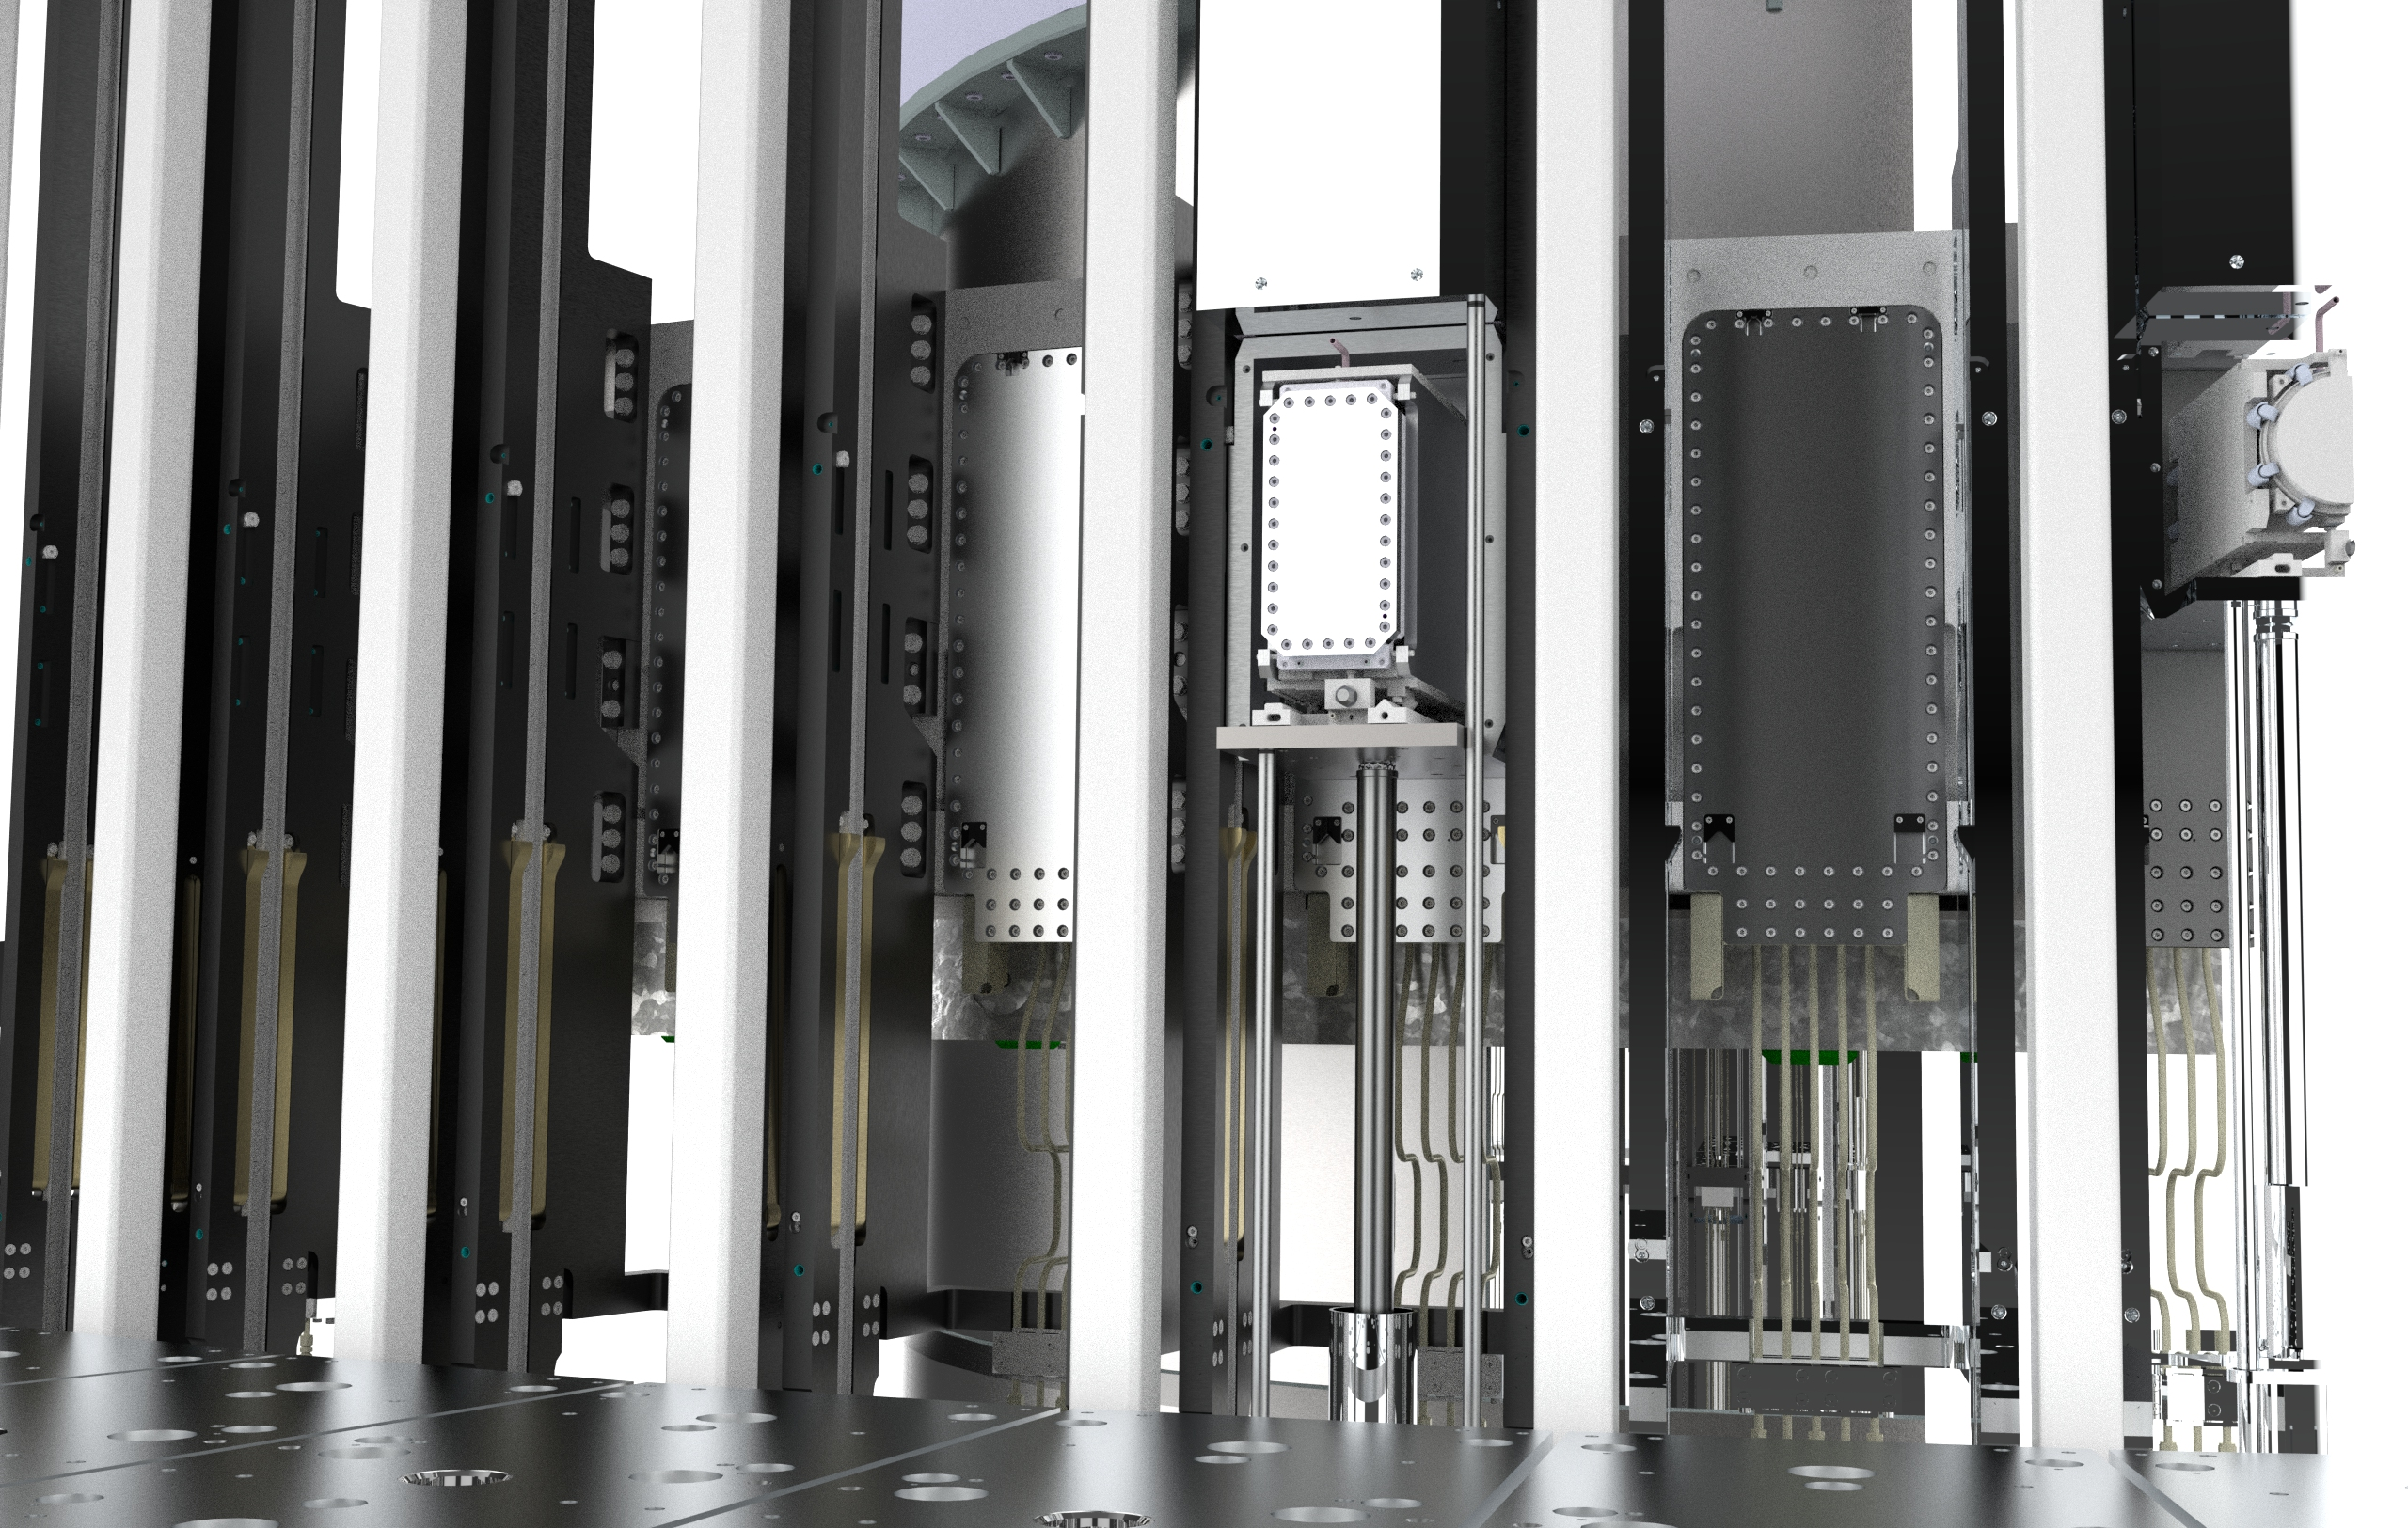
Light shutter system
Background and main functions
“A light shutter typically employed to provide personnel protection from residual gamma radiation from activation of upstream components, as the Target Wheel”
Background
One of the functions of the Target Station is to extract neutrons for the research instruments. The spallation process is performed by colliding high energy protons in the GeV range, from the linear accelerator, with the heavy tungsten target, shattering the latter into fast neutrons. Further, the moderator-reflector assembly surrounding the target, transforms the fast neutrons emitted, into useful beams of slow neutrons for delivery to and use at the neutron-scattering instruments facing the beam ports at different distances.
Main functions
The Light Shutter System shall provide shutter functionality for shielding of gamma radiation downstream instrumented neutron beam channels during manned access.
2. Shutters shall be able to open with an adequate precision towards the moderator during operation and shall carry a section of beam guide channel to facilitate neutron transport.
3. A subordinate function of the LSS is that the system shall enable maintenance of other NBEX components using the LSS space constraint, the LSS vault.

Slide 7
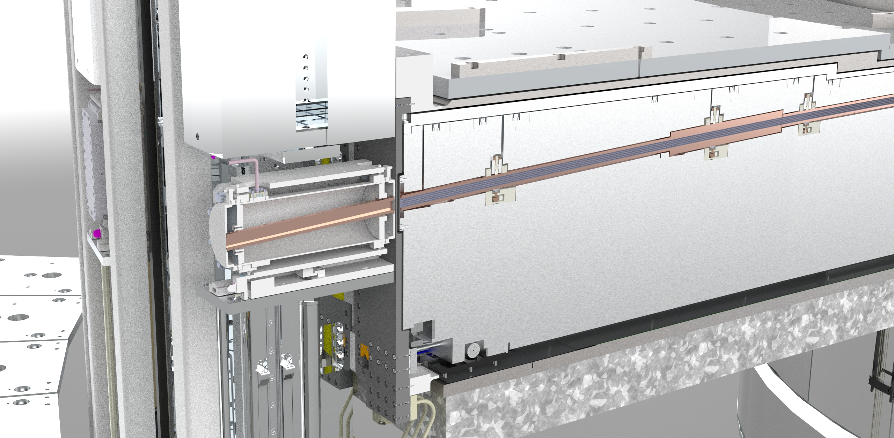
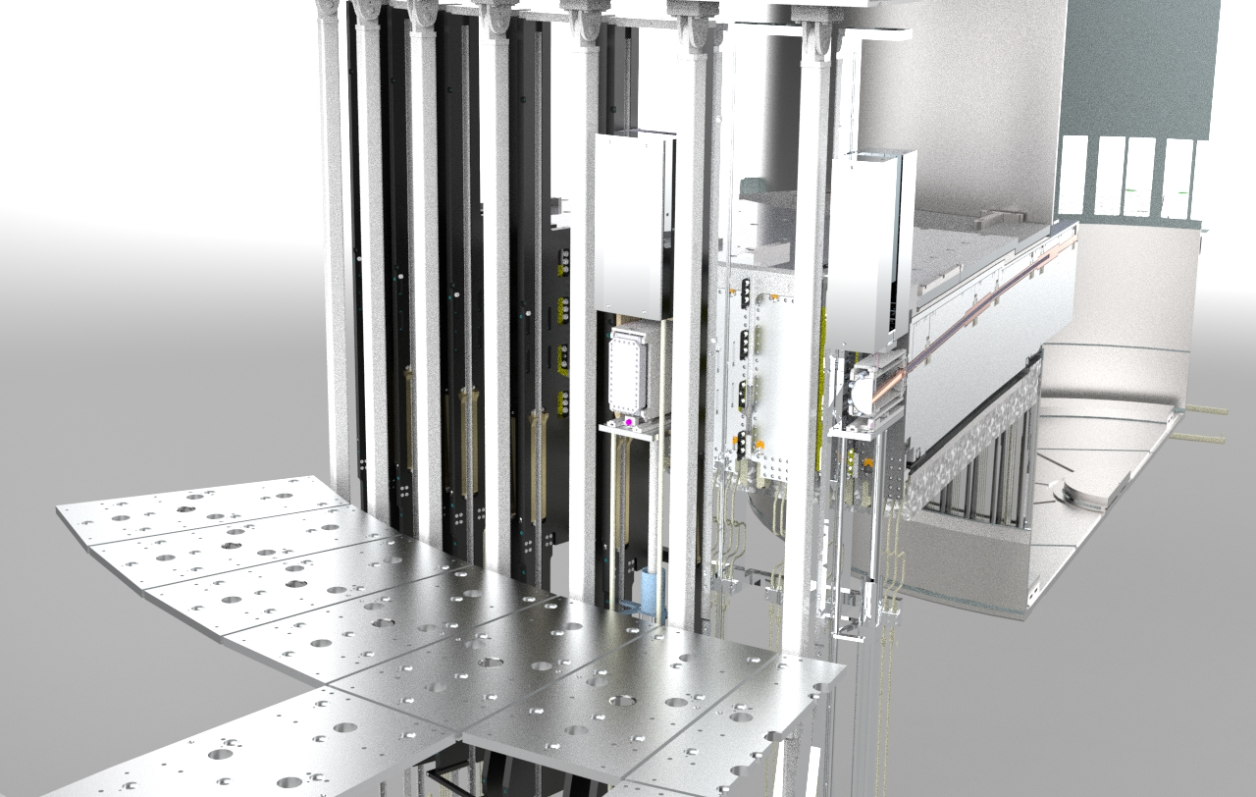
Light shutter system
Neutron extraction through Neutron Beam Insert and Bridge Beam Optical Assembly

Slide 8
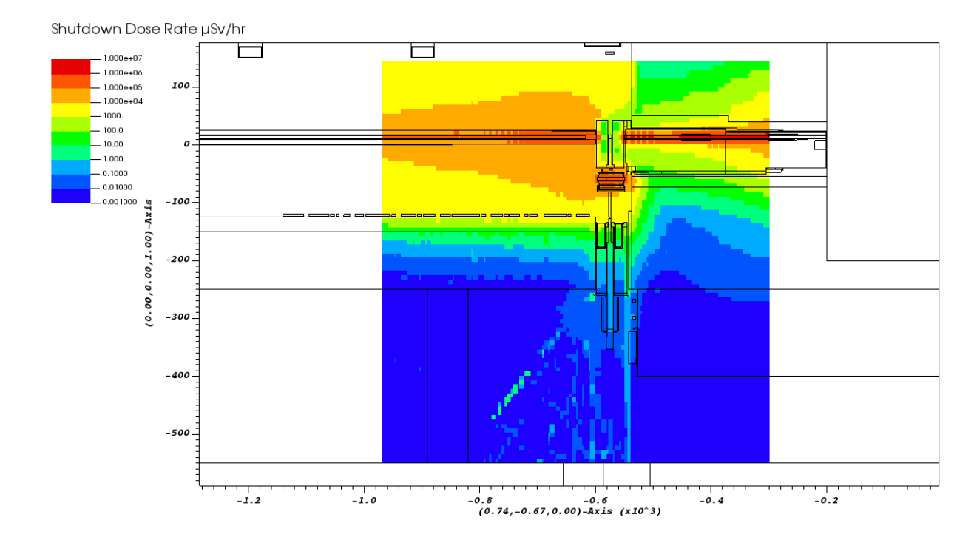
Light shutter System
Dose rate assessment
UKAEA ESS NEUTRON BUNKER ANALYSIS
The assessment of absorbed dose rates to components between the beamline and the basement floor was performed by15 MCNP simulations. The assessment determined the prompt and shutdown dose rates within the neutron bunker during the 40-year operational lifespan of the ESS facility.
For LSS a short summary of the comprehensive report reads:
“After 2 days cooling with the same safety factors applied, all reduce to below 10 μSv/hr and become accessible for human maintenance after this time”
Example of dose rate mapping

Slide 9
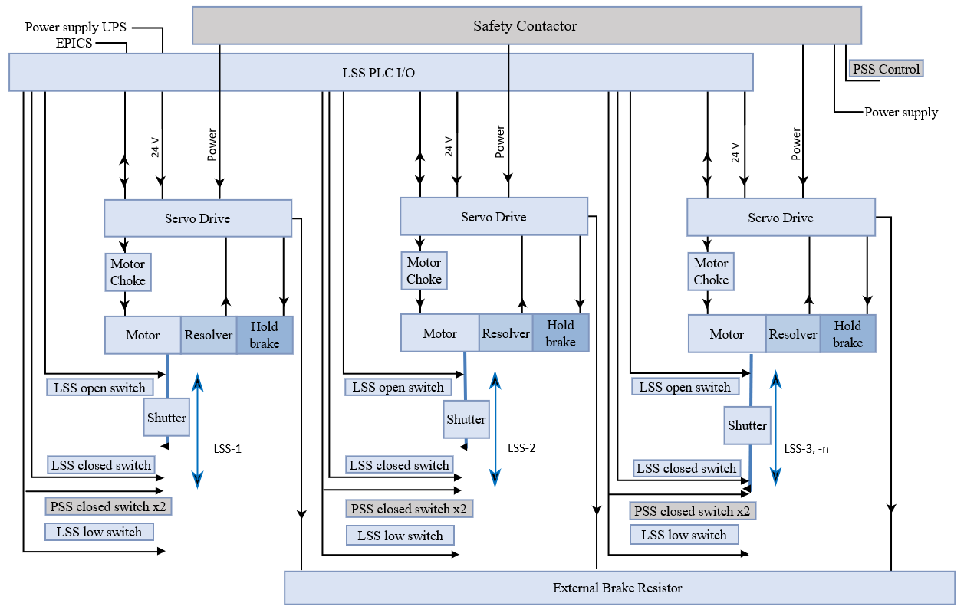
Light Shutter System
Electrical System - Overview

Slide 10
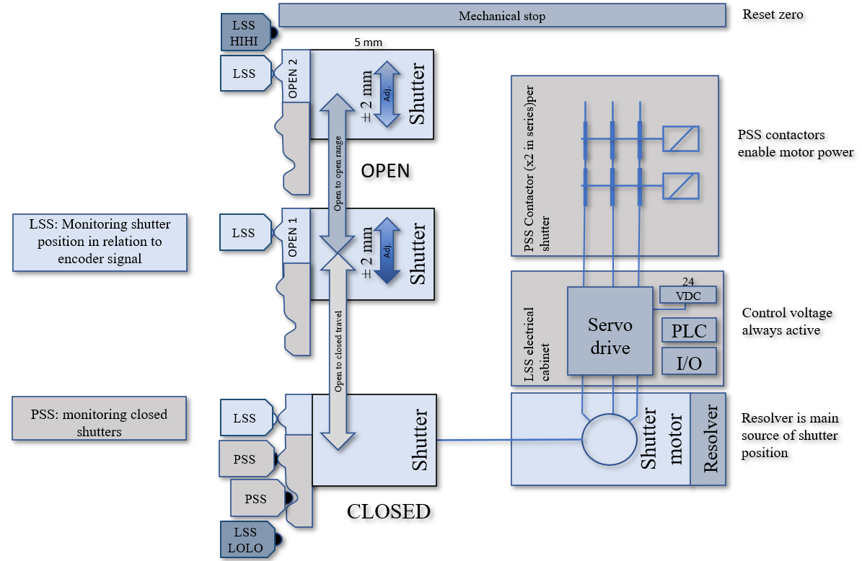
Light Shutter System
Limit switch configuration for two open positions and interface to Personnel protection system PSS

Slide 11
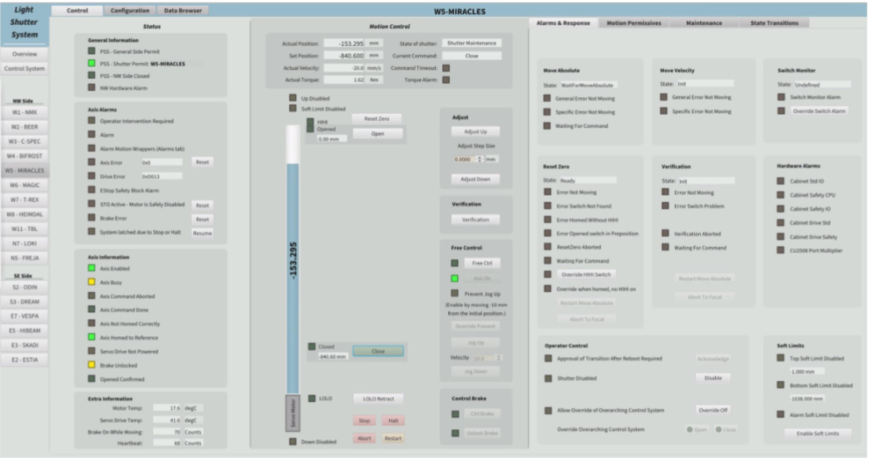
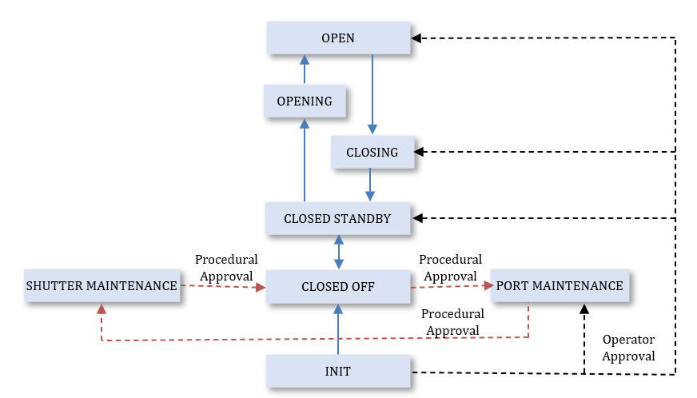
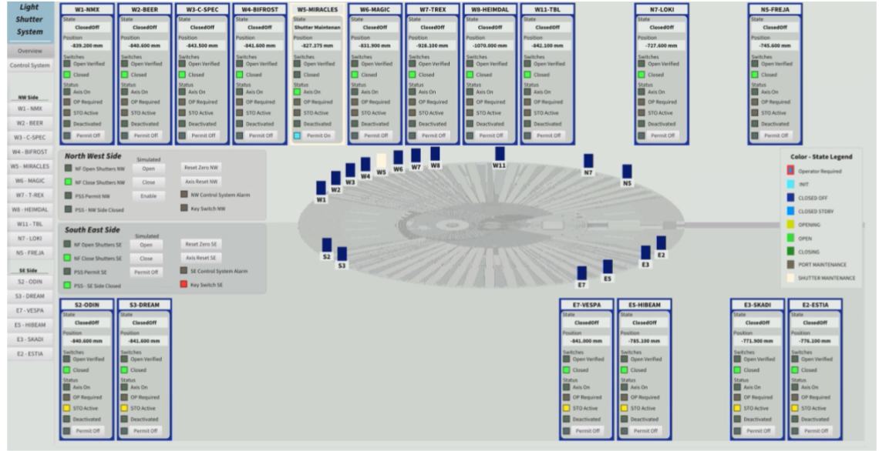
Light Shutter System
Control System, State Machine and OPI
The control system is developed by Integrated Control system division, ICS and consists of: PLC with digital I/O, Servo drives, EtherCAT junction, safety cards, power supplies, and SDD module.
The network architecture of LSSCS is incorporated into the Target Station control network infrastructure, more specifically the EPICS network. The purpose of the connection to the EPICS Network is to connect the control system to the EPICS tools and applications: EPICS, IOCs, OPIs, EPICS Archiver, EPICS Alarm Service.

Slide 12
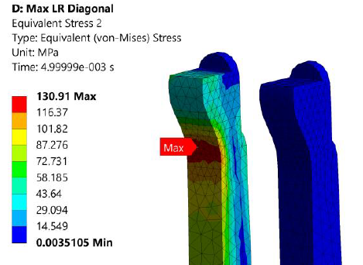
Light Shutter System
Dynamic structural analysis
In the event of a power loss the shutter is to be closed from its open position by gravity. The servo-brake will in that case be manually overridden, and the shutter will release its potential energy into back driving the ball-screw actuator, gears and servo drive. The servo will convert this motion to electrical energy, and as it will be connected to a brake resistor by default, that resistor will dissipate the electrical energy to heat. When this process starts, it results in reaching a ‘terminal velocity’ within a few mm of motion of the shutter.
The terminal velocity was determined in an experimental test. The velocity increased when the brake was disengaged, then plateaued at approximately 77mm/s

Slide 13
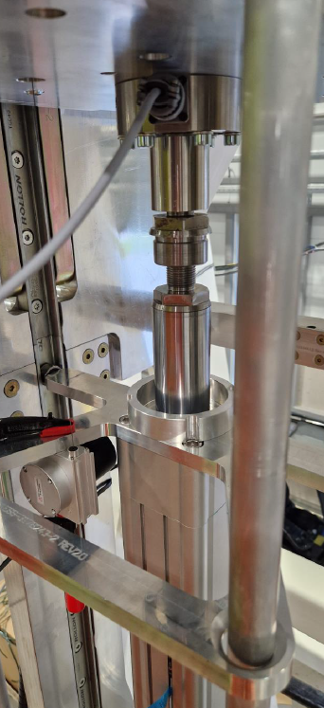
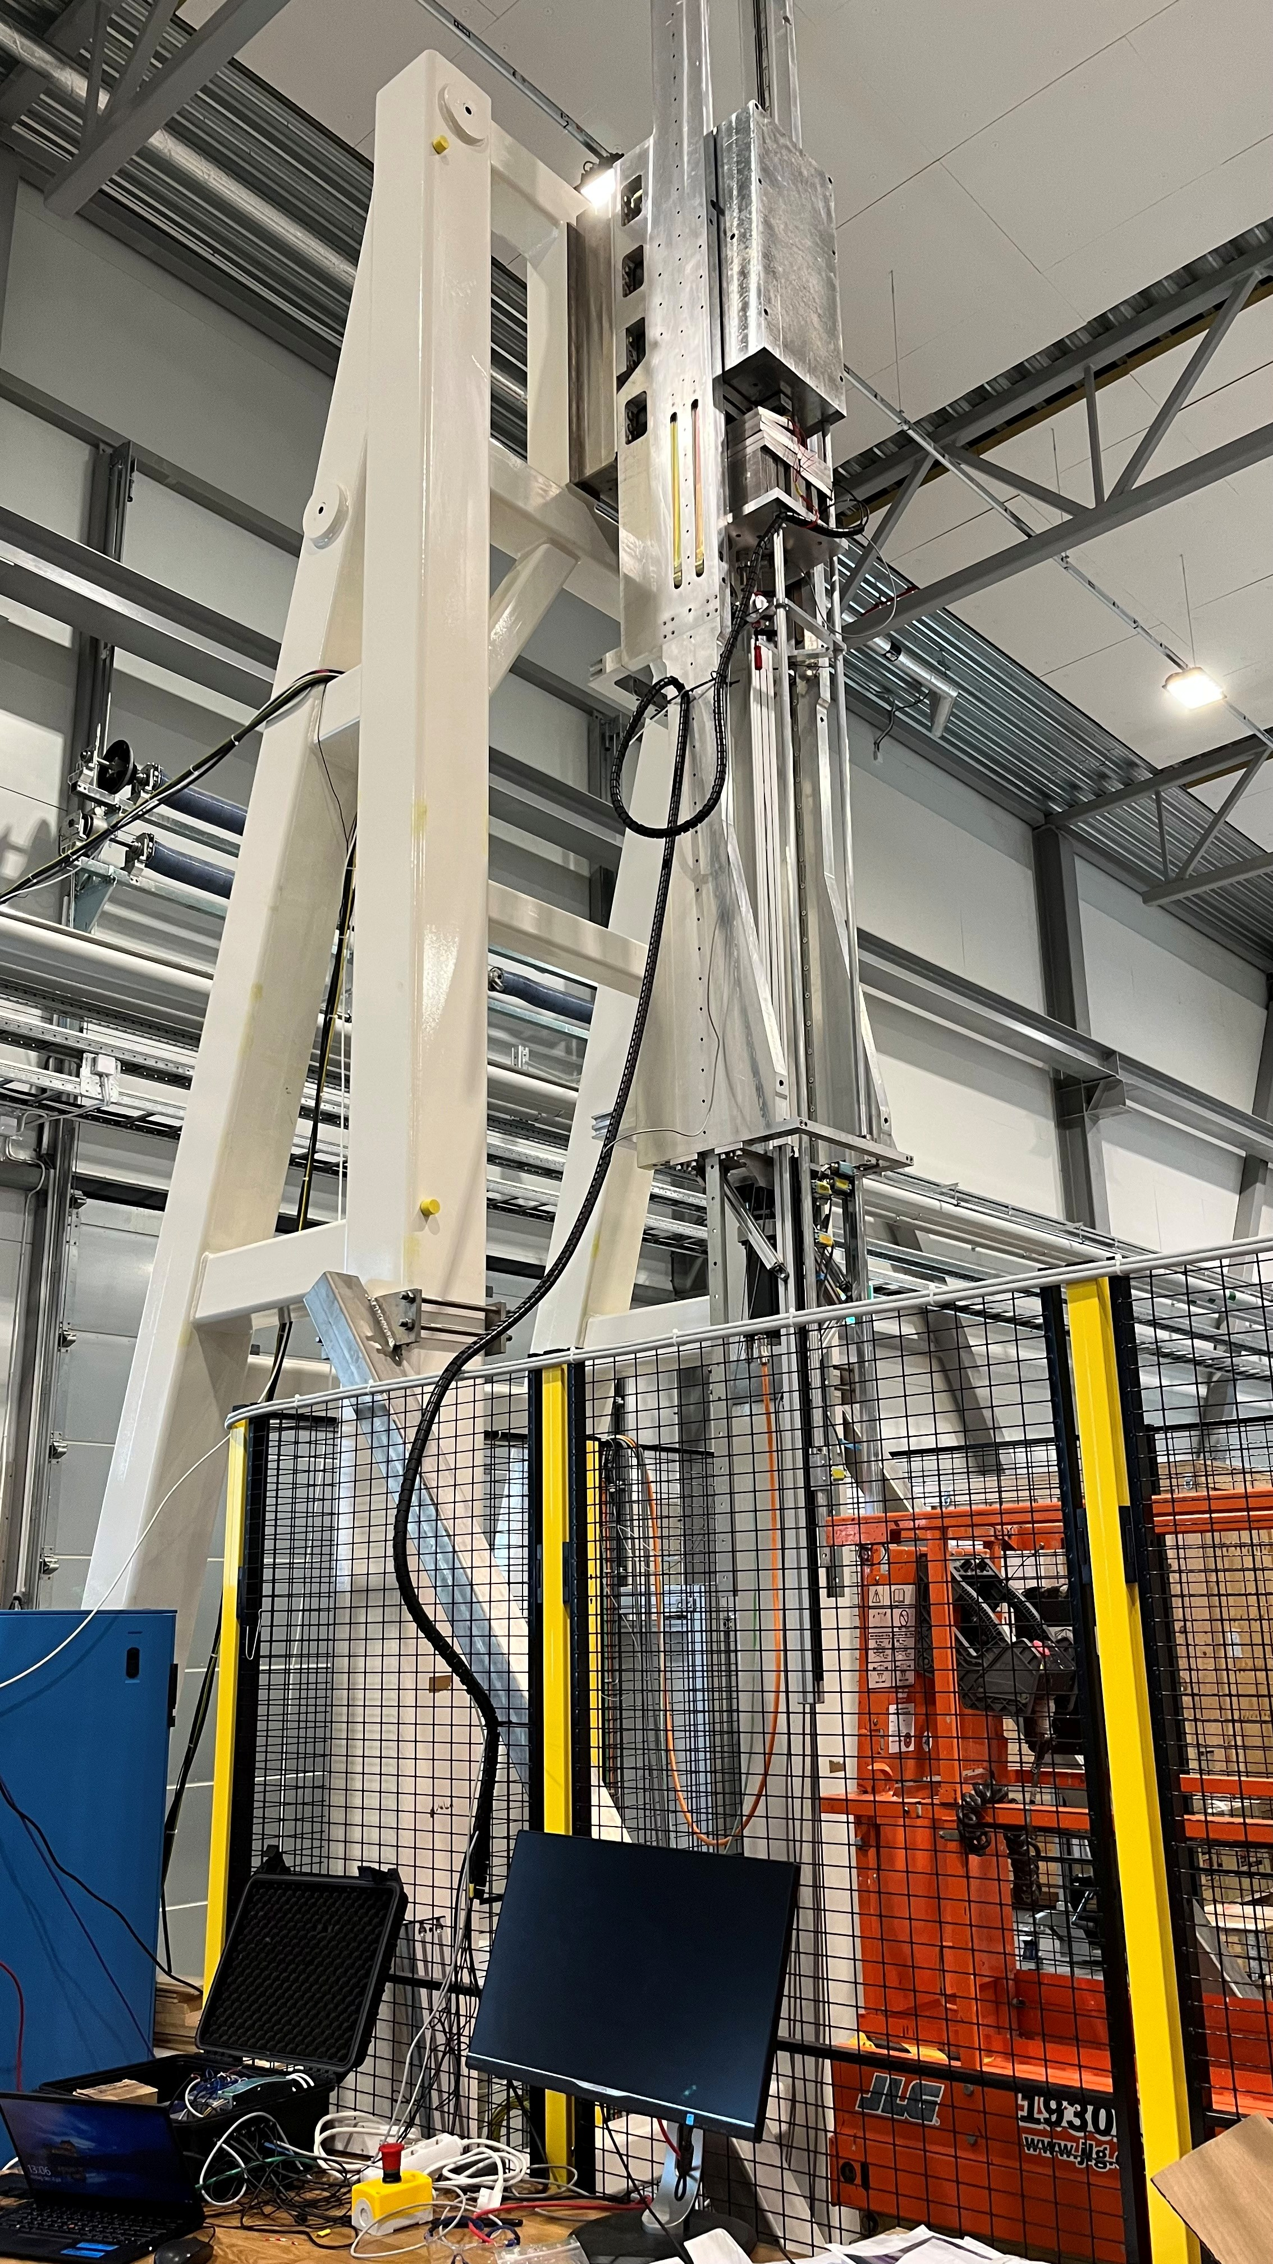
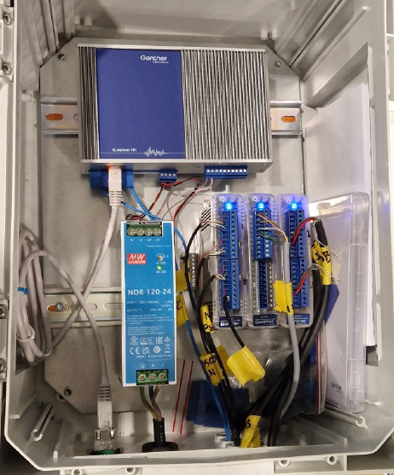
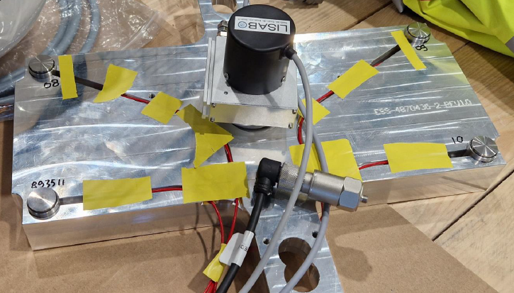
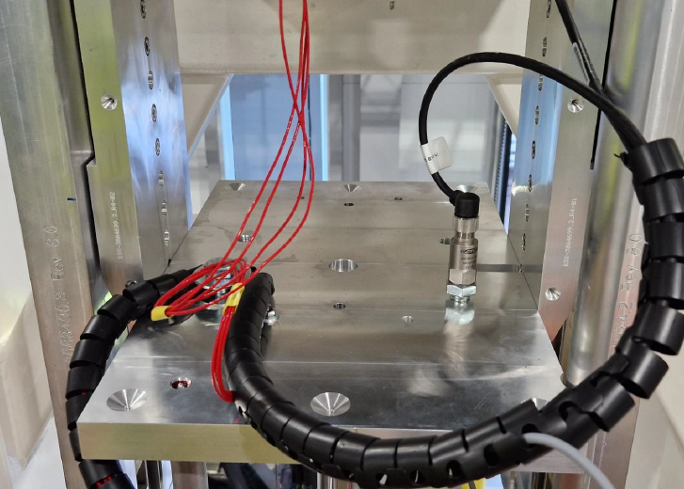
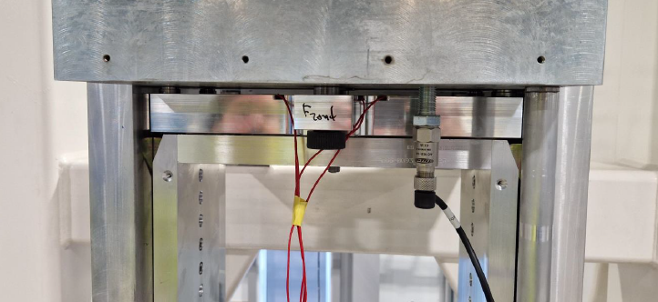
LSS Development
Data acquisition system and VHTS
The tests was executed with a Gantner Q.station 101 data acquisition system with several expansion modules (Q.bloxx A101, 2x A107). These allow to capture data in real-time, up to 20kHz, from a variety of sensors like force sensors, accelerometers, distance sensors etc.
Test system and LSS PLC is equipped with an interface for time synchronisation.

Slide 14
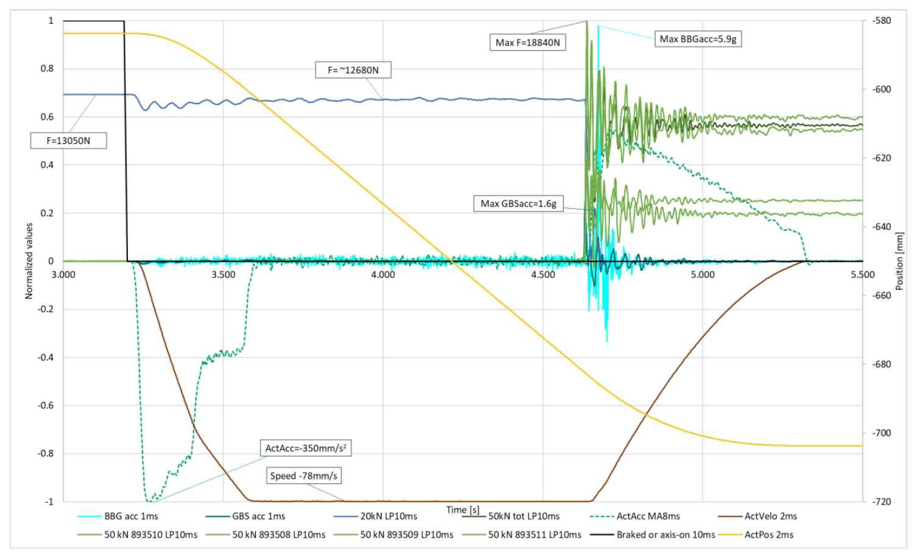
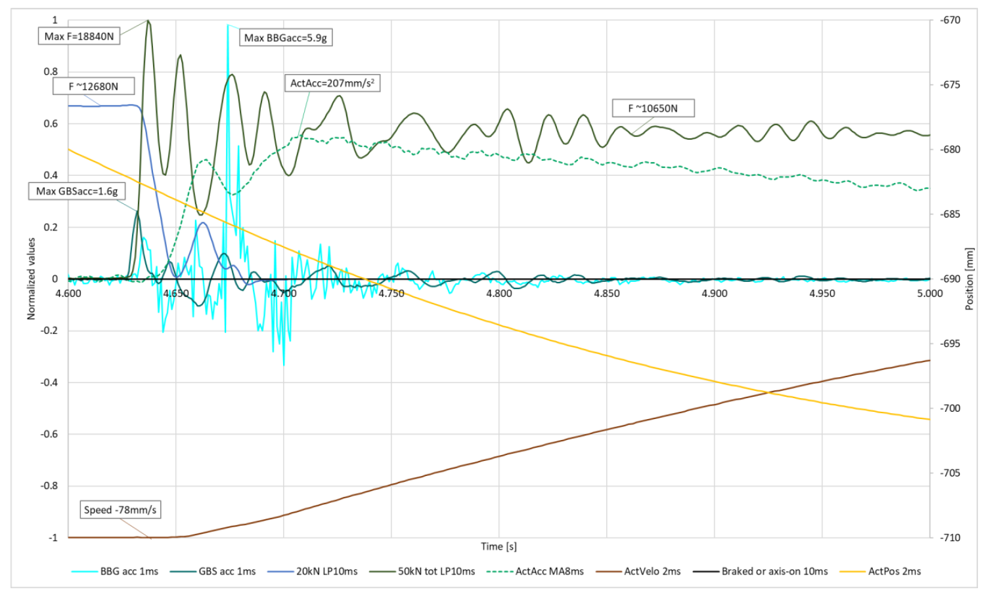
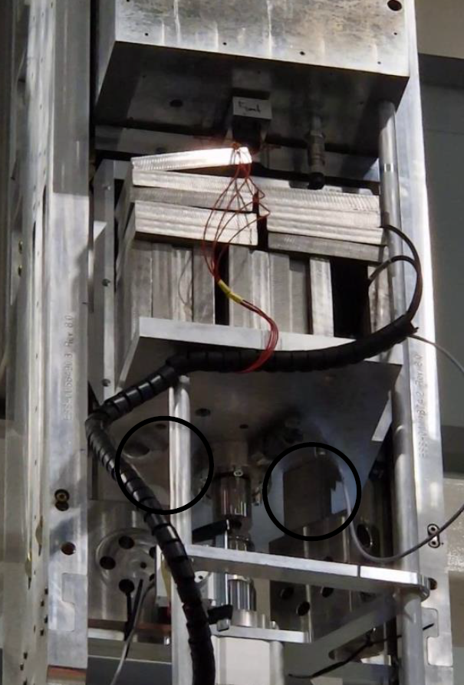
Light Shutter System
Falling load: GBS landing on levers
In all cases, the system can safely catch a falling load. Worst case shown: GBS landing on levers.
The very sharp and high peak of the BBG acceleration occurs only one time-step and is assumed to be a bounce of one of the 12 kg bricks right next to the sensor, as the rest of the amplitude of the BBG acceleration corresponds to the GBS values.
Detail

Slide 15
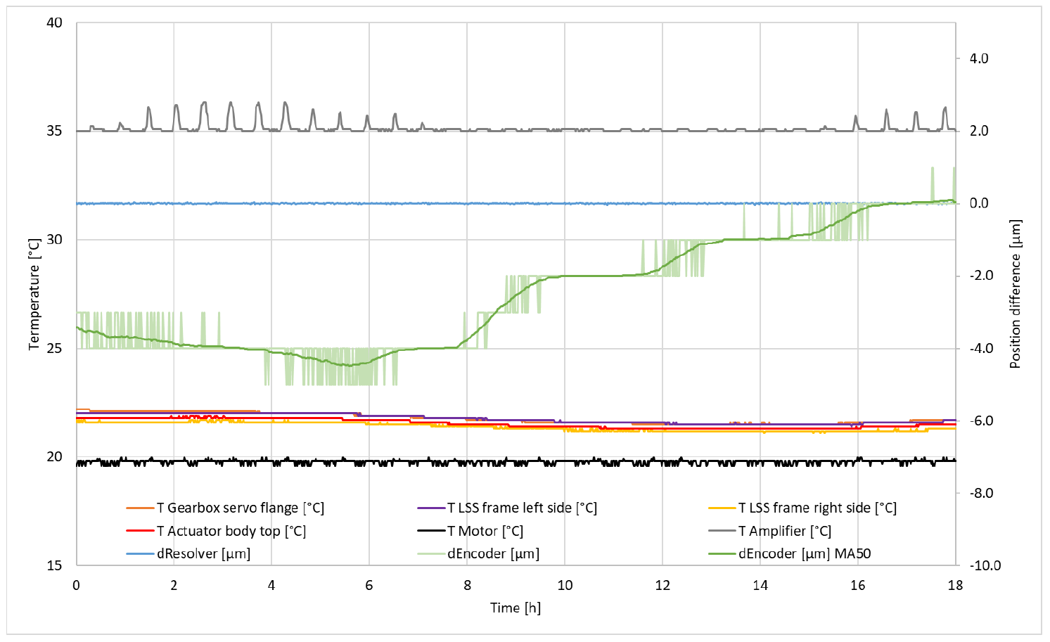
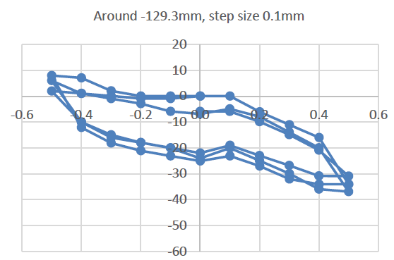
Light Shutter System
Accurate control over positioning and long-term stability
Accurate control over positioning (long-term stability).
Motor and servo temperatures are essentially flat. Figure shows the four external temperature sensors in detail. There, a ~-0.5°C temperature change coincides with ~4μm rise of the BBG (at open-HI position).
The Coefficient of Thermal Expansion, CTE is about -3 μm/(m·K).
µm
mm
Comparing the resolver reading with the external sensor:
The hysteresis, based on different tests can defined as approximately+5/-25μm,
One conclusion is that approaching an open position is done best with an around 0.5 mm upwards stroke.

Slide 16
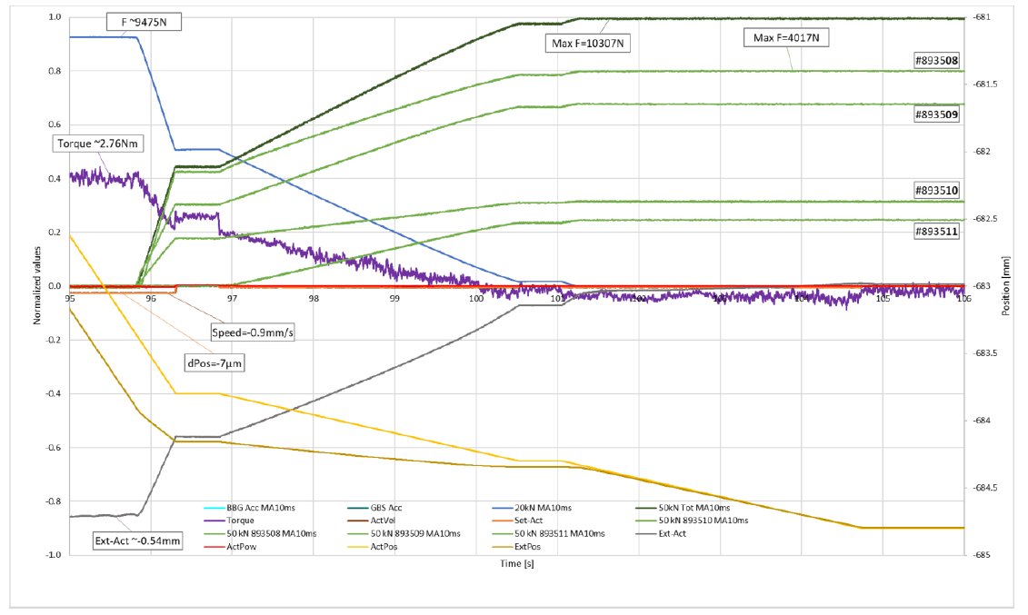
Light Shutter System
Smooth forces at load takeover - GBS to levers
First contact with levers
The closed position is at -685.3mm. A specific velocity profile is used to approach the levers, with some steps to let it settle (at 96.4s, and 100.5s). From about 96 s, the levers get in contact with the force sensor plate below the GBS, and some settlement between the four levers is visible when the flexibility of the plate catches the full GBS weight in the following 6s.
The 50kN sensors under the GBS tell that first the upstream levers engage, and the downstream left (looking downstream) lever. Only some 1 s later, the downstream-right lever (force sensor #893511) starts to engage. Both downstream levers end up taking some ~third of the load of the upstream levers.

Slide 17
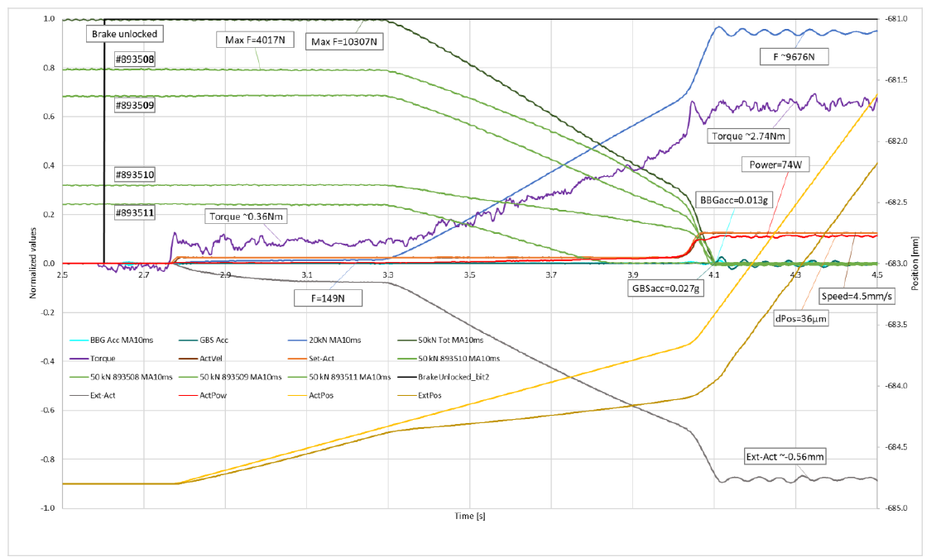
Light Shutter System
Smooth forces at load takeover - BBG to GBS when opening
First engagement with BGG
First contact between BGG and GBS
Picking up of BBG and GBS upwards.
First phase in opening is to engage to BBG at about 2.75 s and very close after at 3.3s, to GBS.

Slide 18
Light Shutter System
Summary
Repeatability under thermally stable conditions is ±0.02mm
Effective Coefficient of Thermal Expansion at open position -3 µm/K
Terminal velocity of the falling load with servo drive off, with default or maximum mass, is 77mm/s.
System hysteresis for longer strokes is ±0.06mm corresponding with linearity
LSS end stops, and BBG end stop surfaces, can take up to 10kN (‘tested’) / 12kN (analysed)

Slide 19
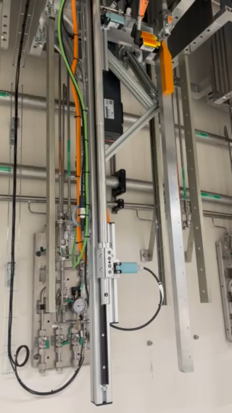
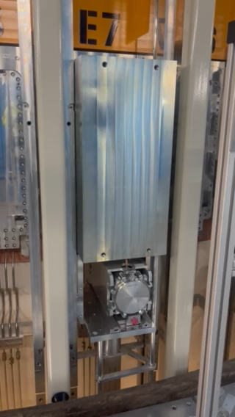
Light Shutter System
Opening sequence
Basement
Bunker

Slide 20
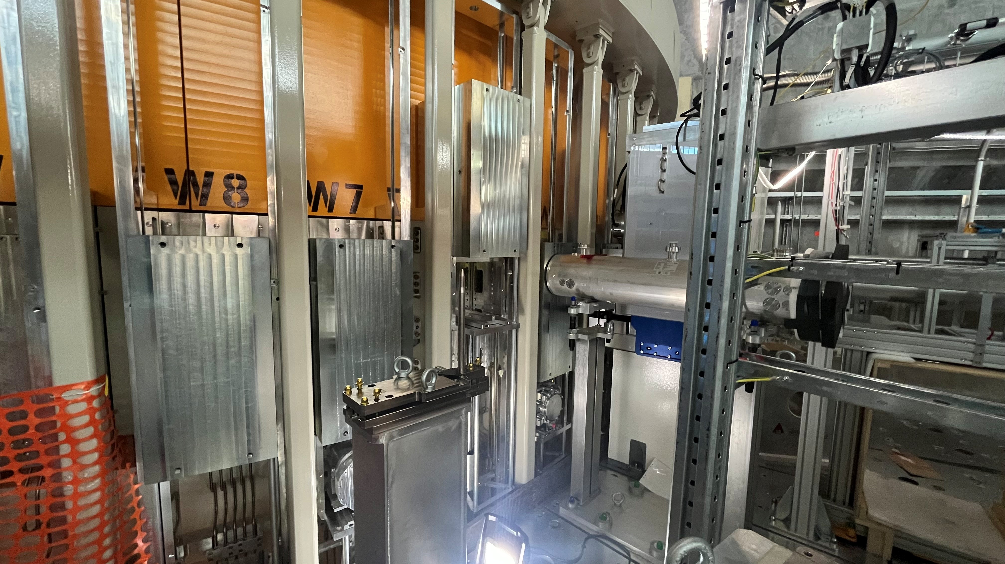
Light Shutter System
View from Bunker

Slide 21
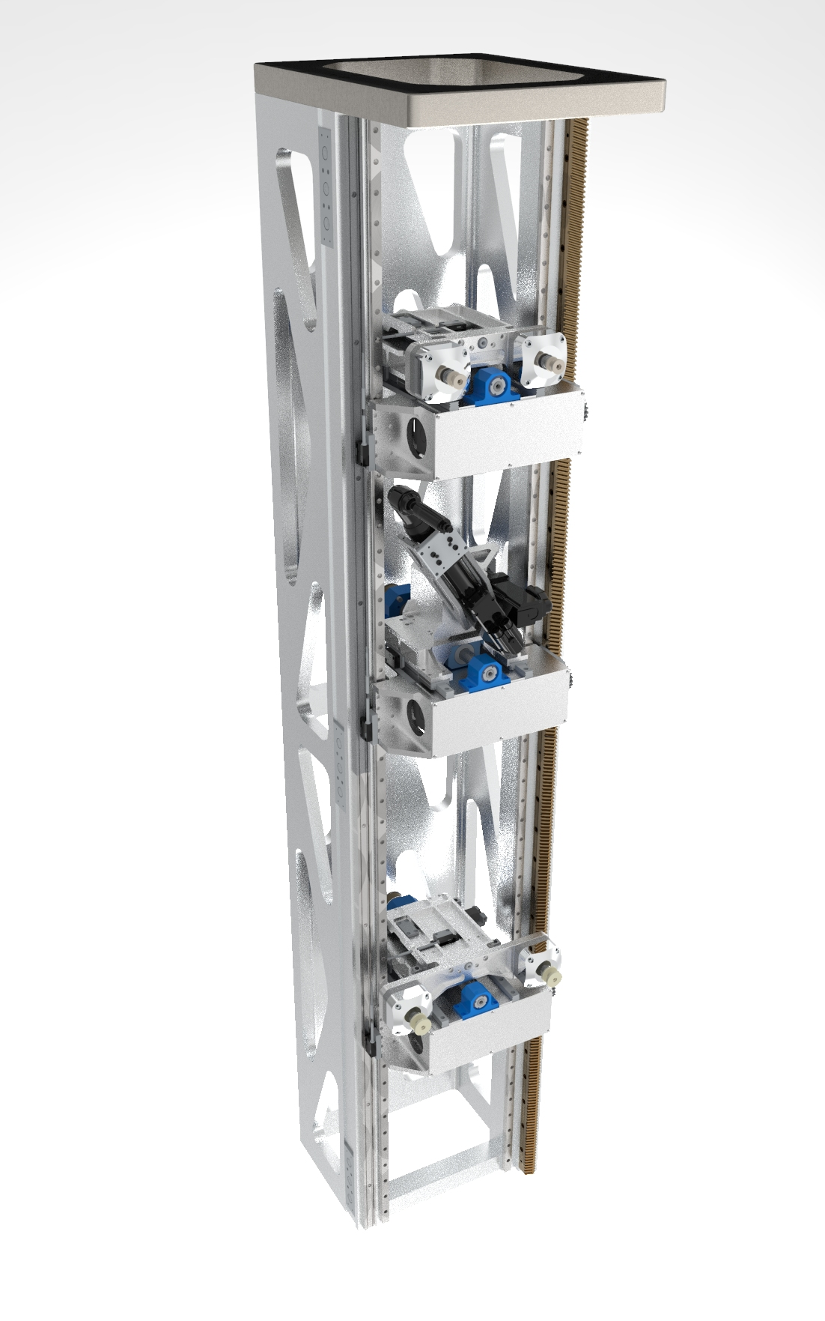
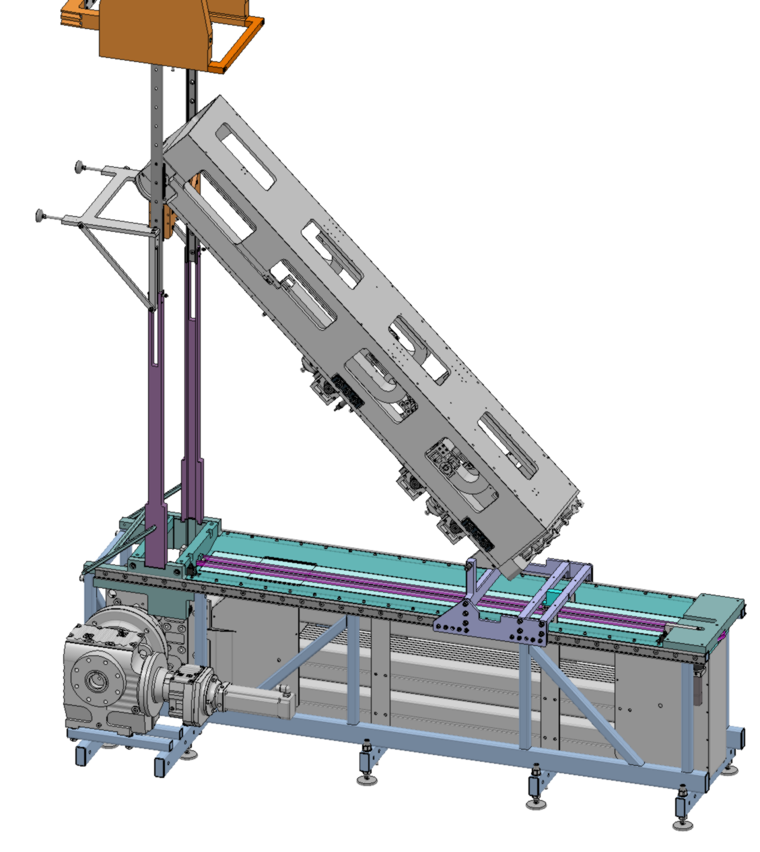
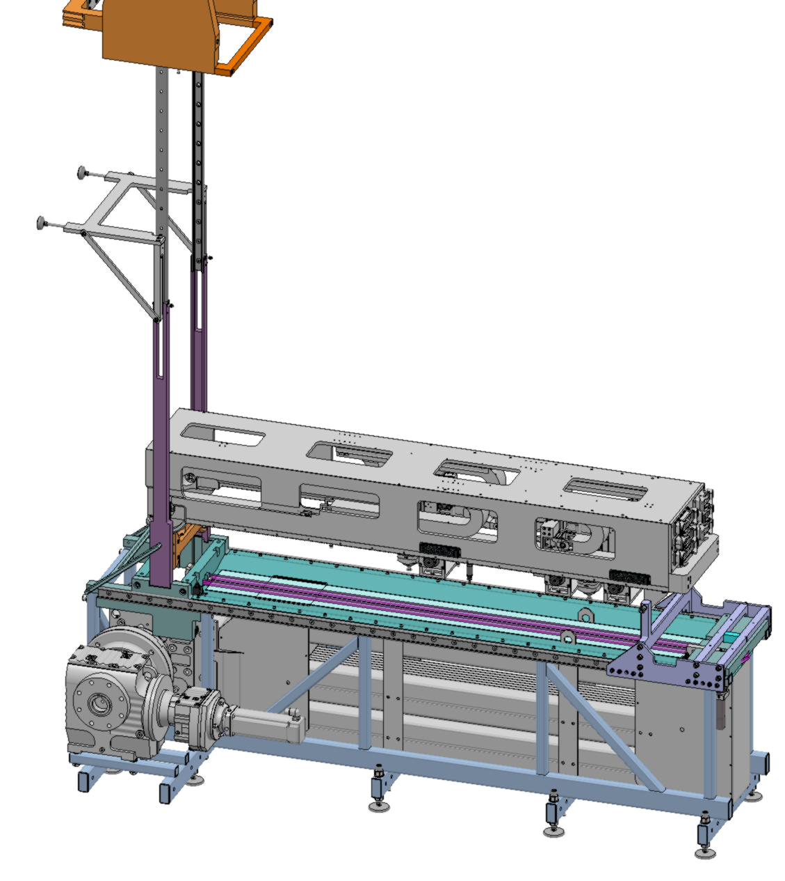
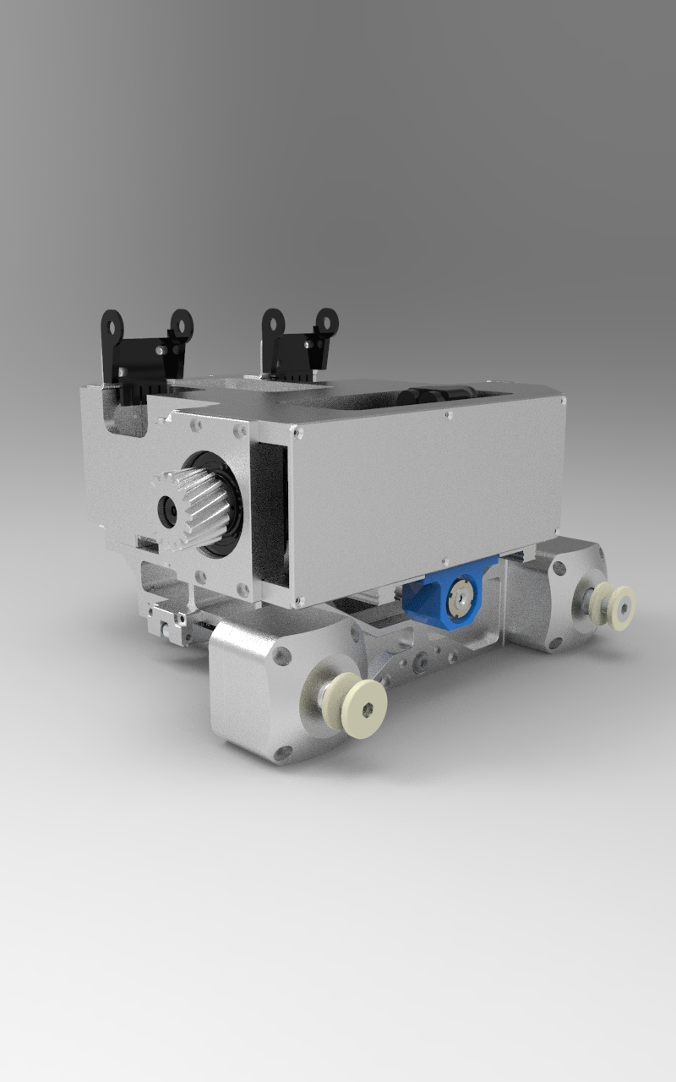
Hot Handling Tool
Neutron Beam Window

Slide 22
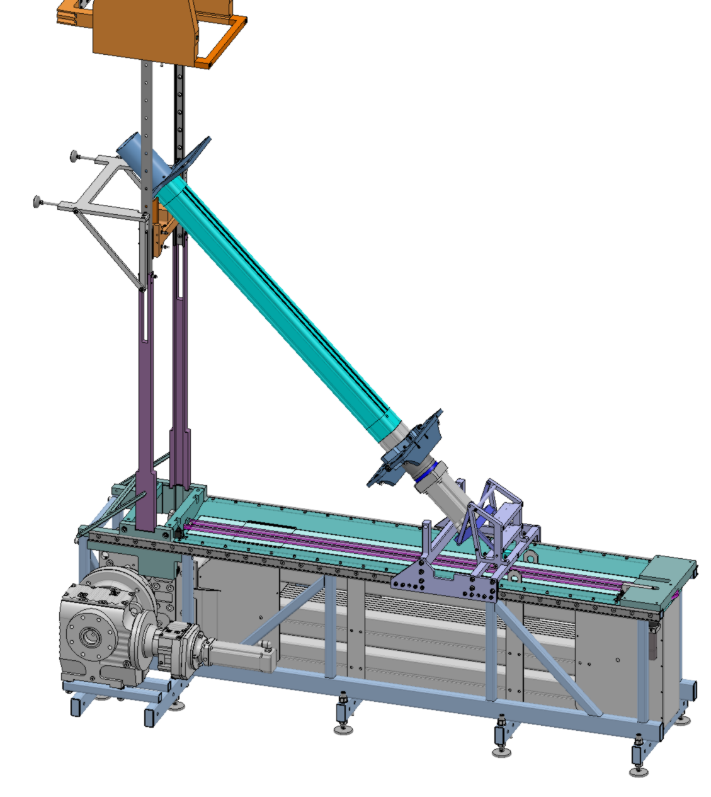
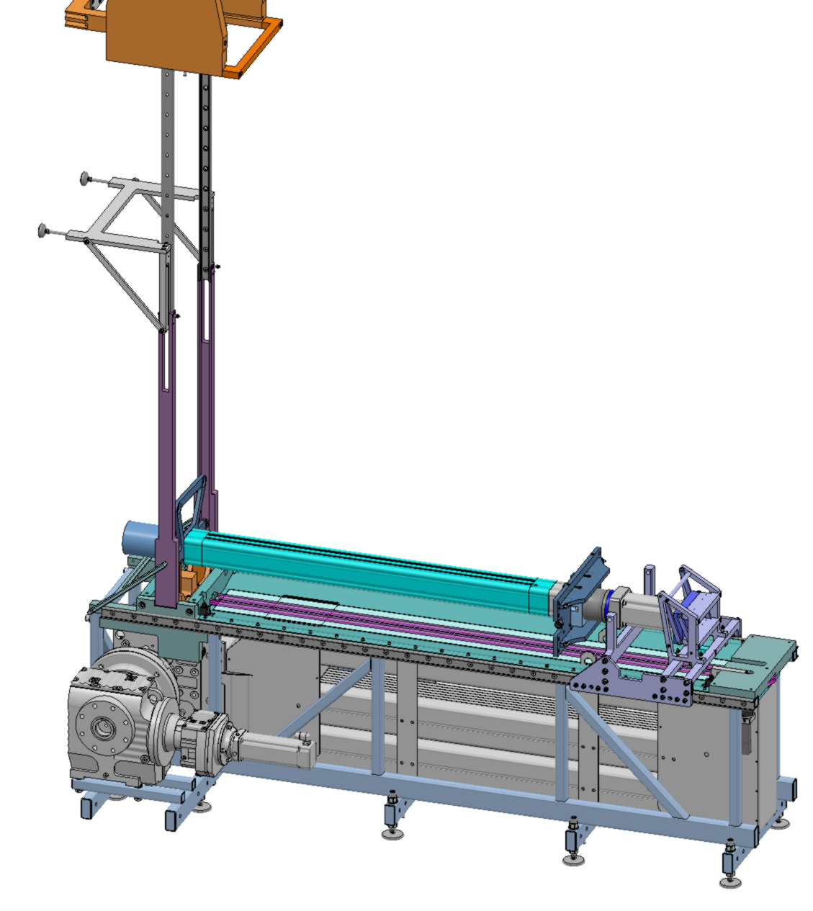
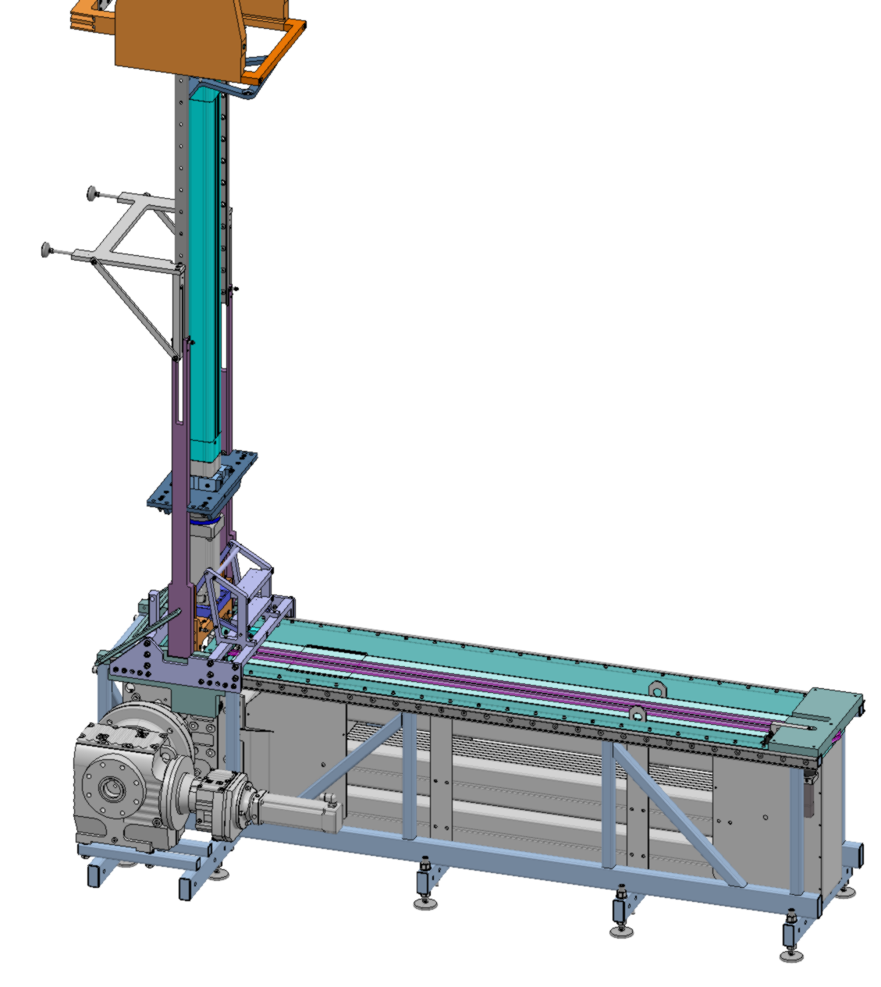
Hot Handling Tool
Vertical Actuator Assembly

Slide 23
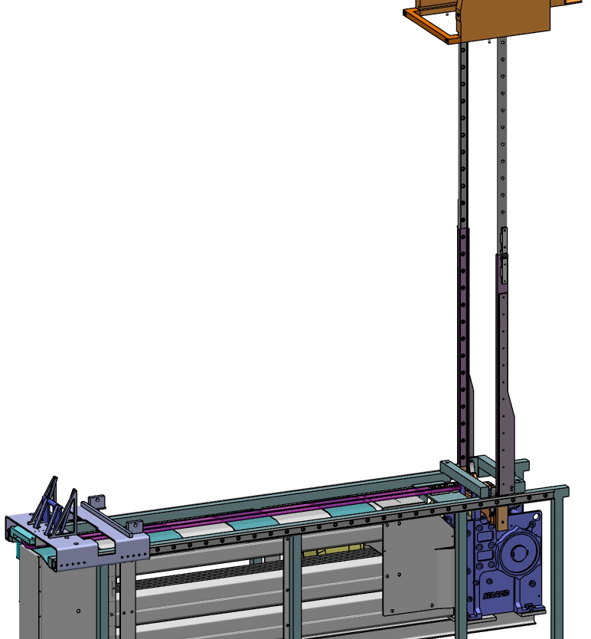
Hot Handling Tools
Neutron Beam Window

Slide 24
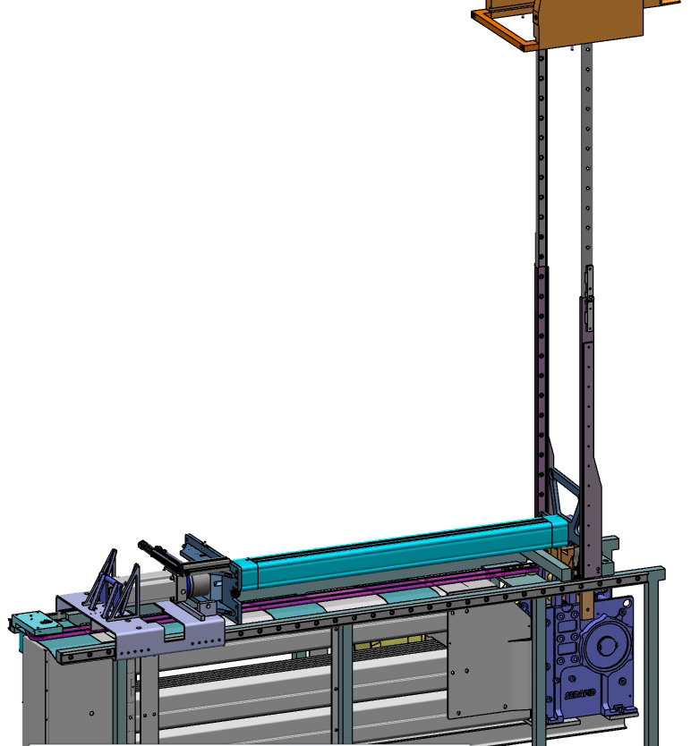
Hot Handling Tool
Animation

Slide 25
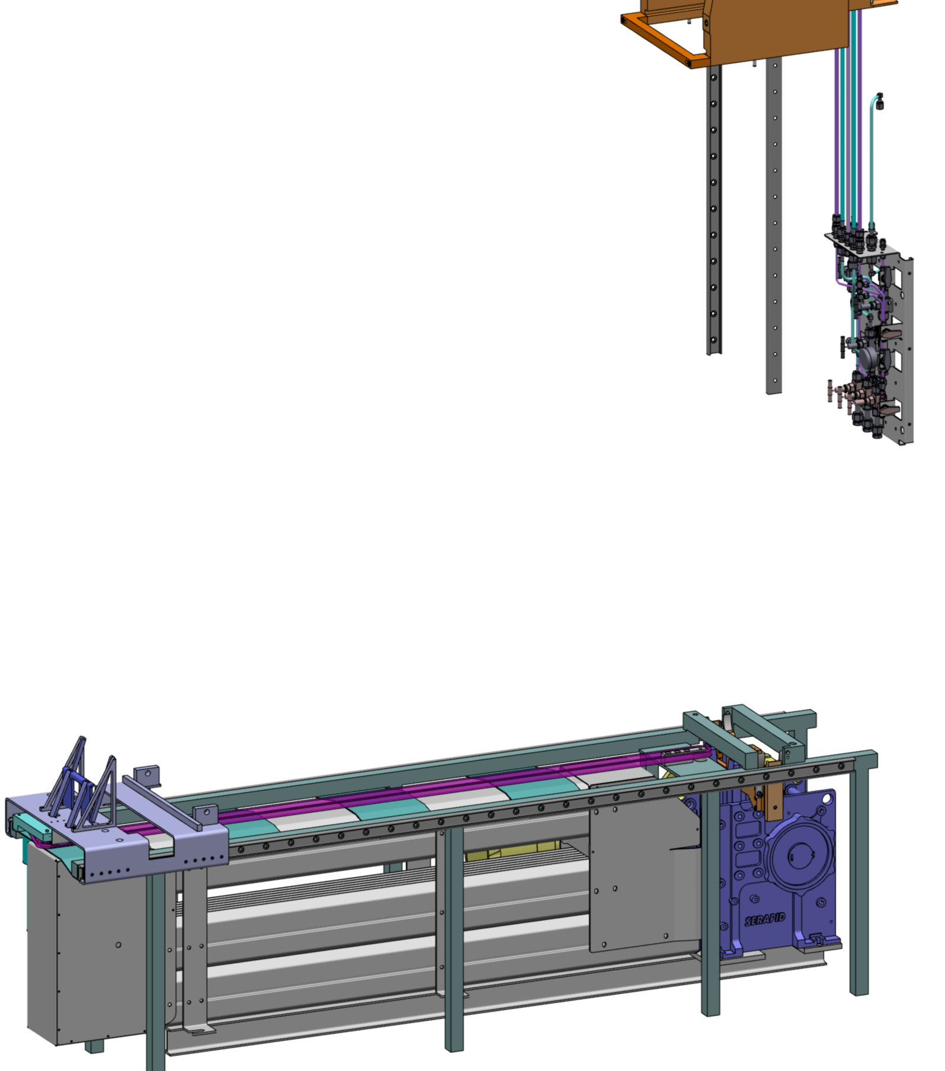
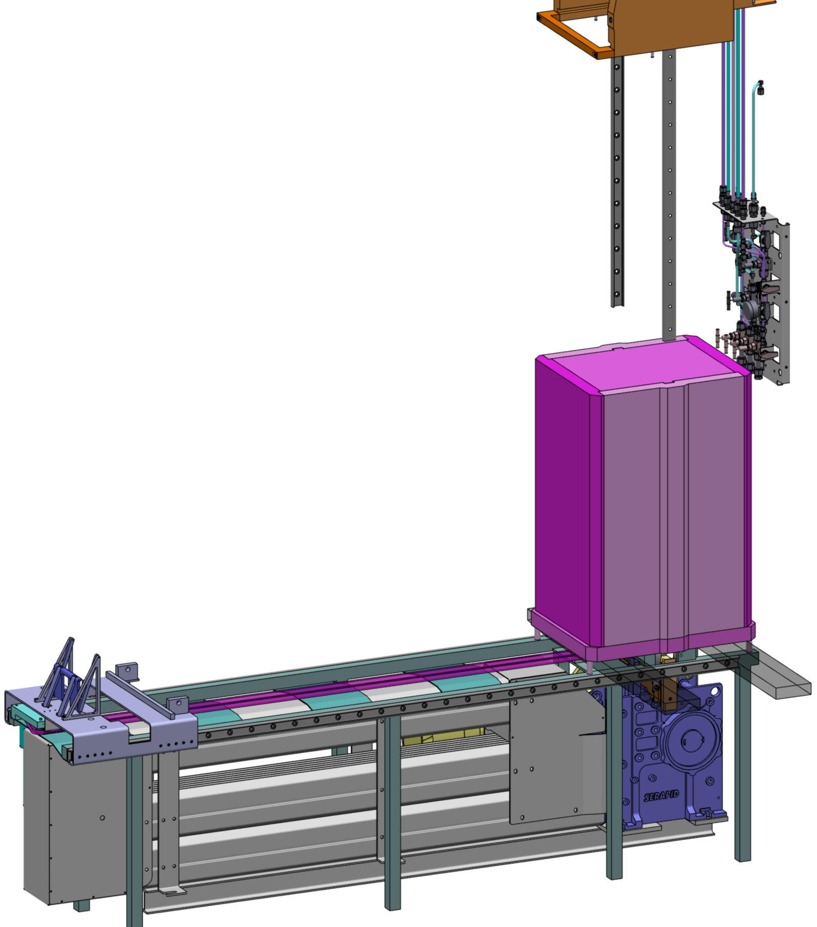
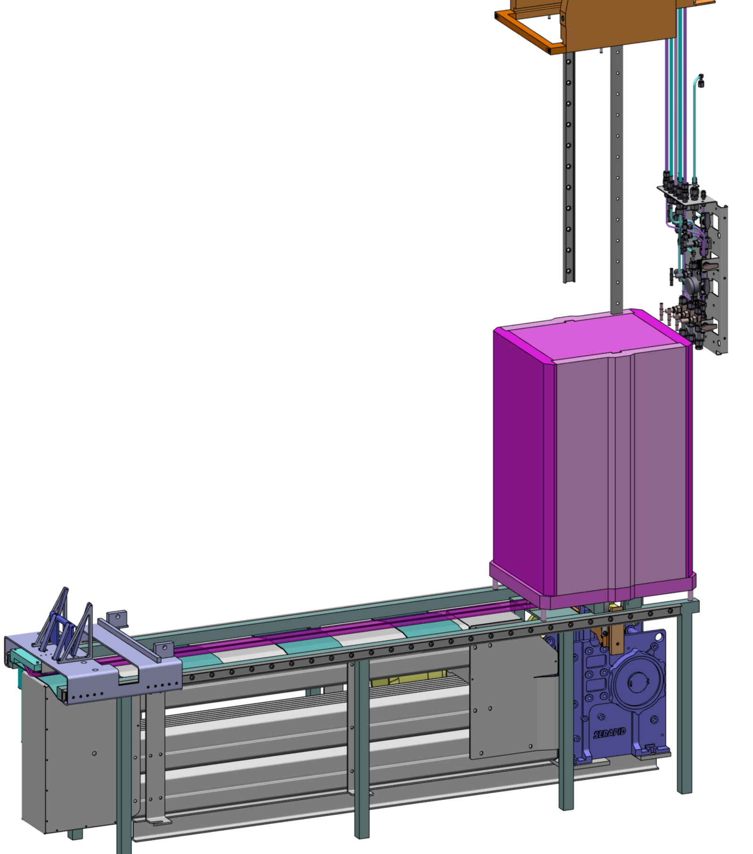


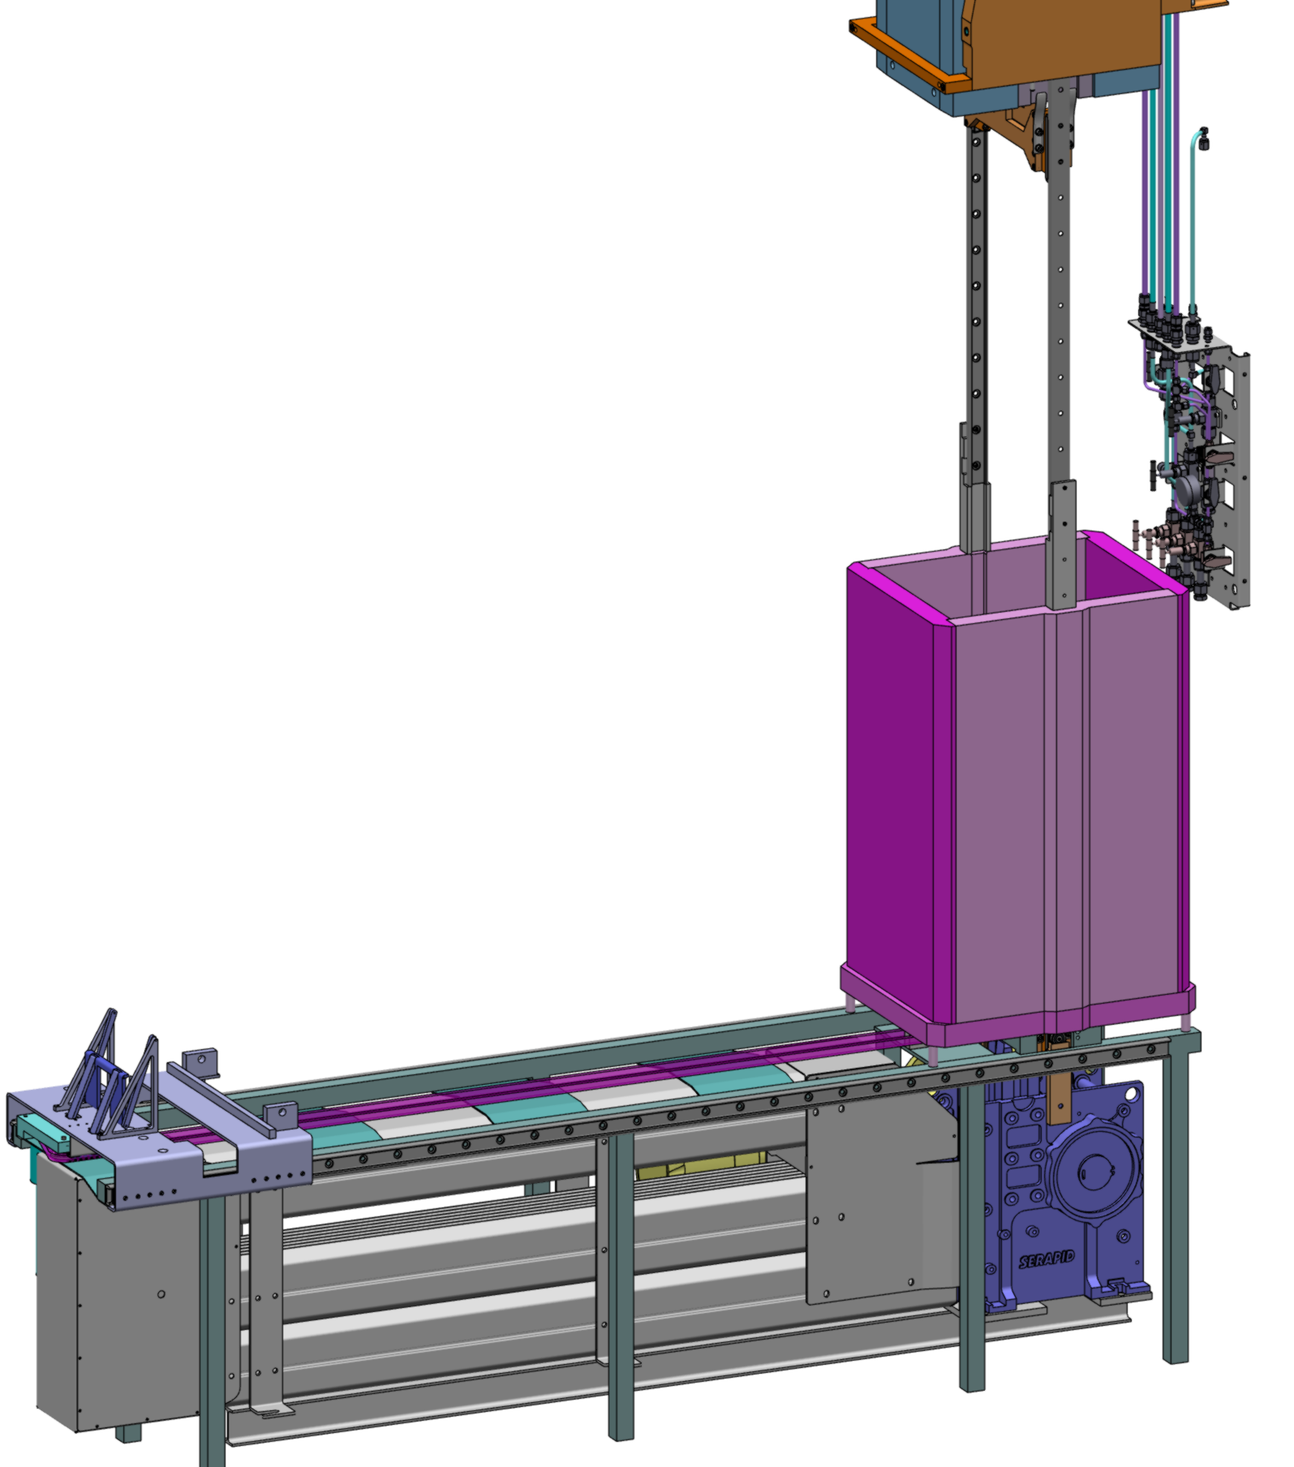
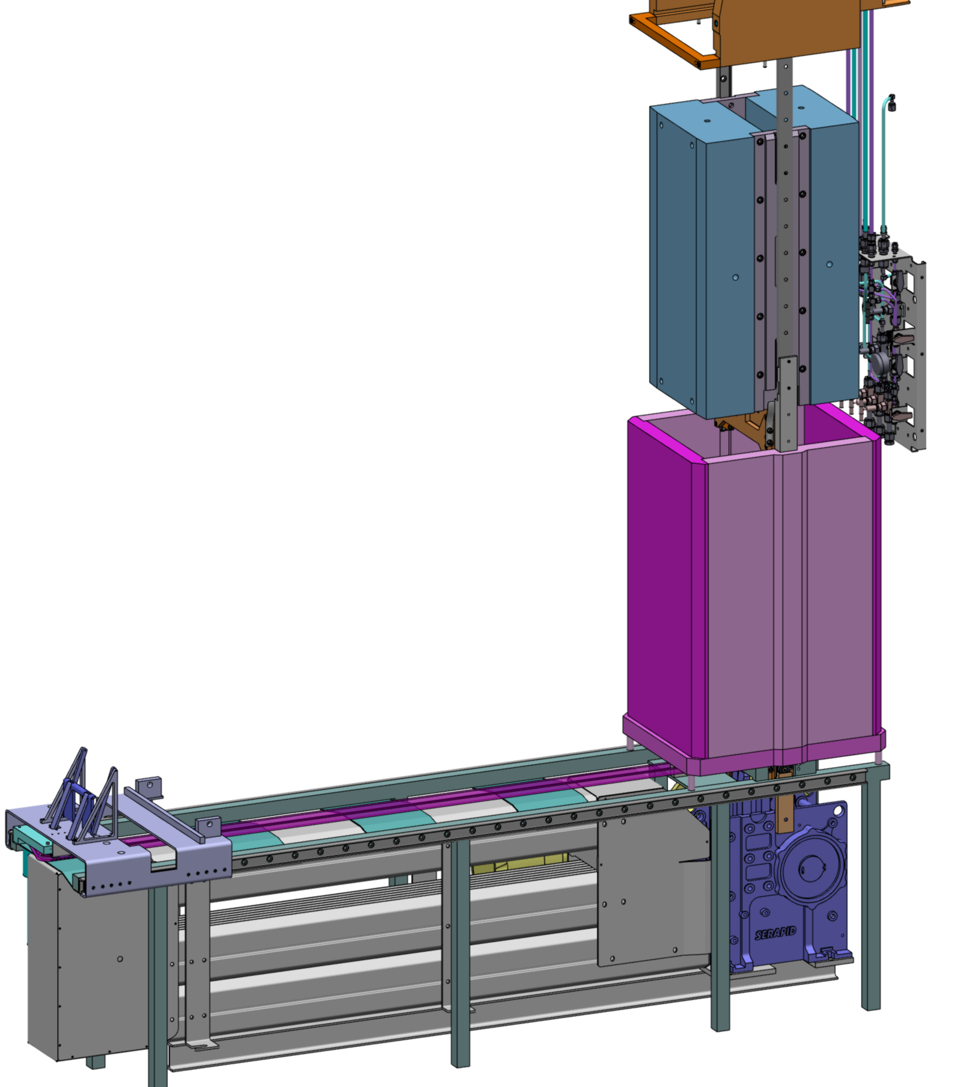
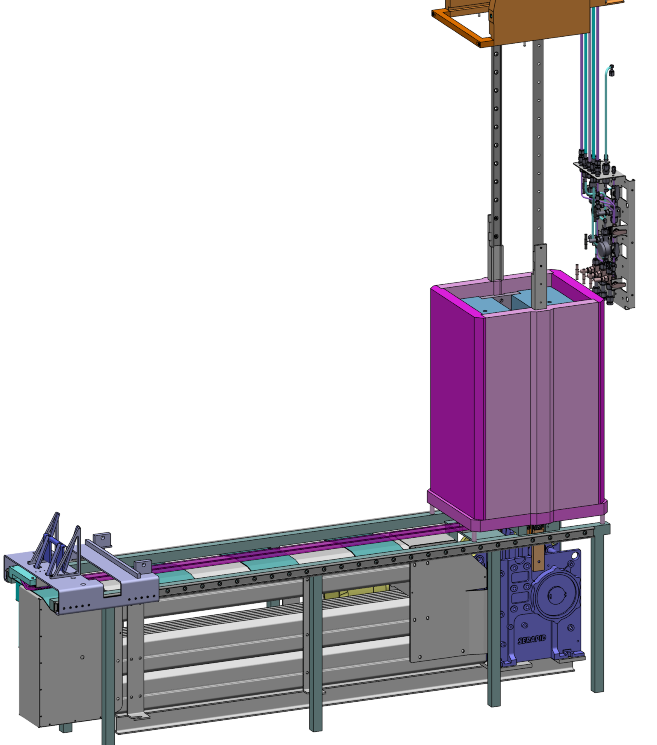

Shutter box
Sequence

Slide 26
Thank you

