Slide 2
ESS Proton Beam Window (PBW)
From manufacturing to site commissioning
PRESENTED BY sara Ghatnekar Nilsson
Anders Andersson, Stig Jörstad, Adrien Besson, Javier Garitaonandía, Fernando Sordo

Slide 3
Agenda
1 Why does ESS need a Proton Beam Window?
2 Introduction
3 Manufacturing
4 Beam diagnostics
5 Factory Acceptance Test, vacuum compatibility
6 Factory Acceptance Test, mechanical integration
7 Installation at ESS
8 Site Acceptance Test – vacuum tests after installation
9 The end

Slide 4
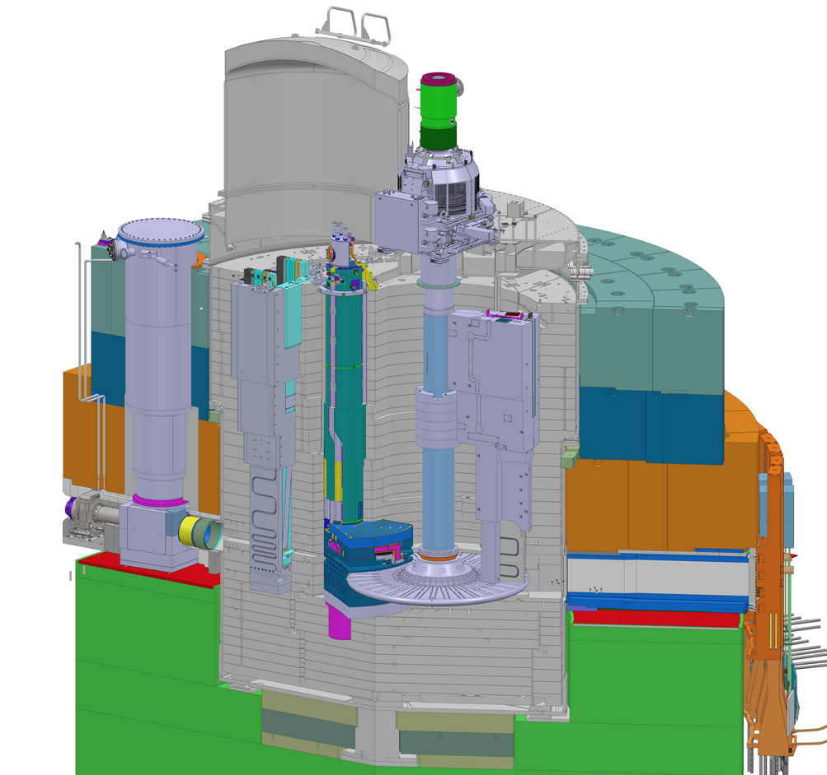
Why does ESS need a PBW?
The Proton Beam Window forms the mechanical boundary between the Accelerator and the Target environments.
The Accelerator side vacuum requirement is <10⁻⁴ mbar.
The Target side vacuum requirement is <1 mbar.
PBW Vessel
≈10⁻² mbar
So, what vacuum levels does ESS have today before Beam on Target?
Accelerator side
≈10⁻⁷ mbar
PBW
Monolith Vessel
≈10⁻⁵ mbar

Slide 5

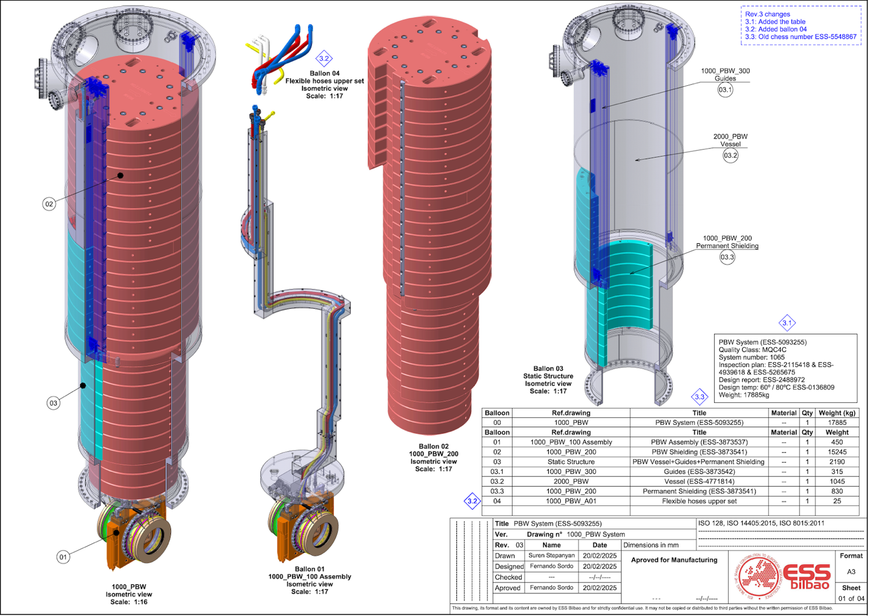


Introduction
The PBW is an In-kind delivery from ESS-Bilbao, Spain.
The design was done in collaboration between ESS-Bilbao and ESS since 2016.
The components to be presented today
Manufacturers:
Leading Metal Mechanic Solutions S.L.
Thune Eureka S.A.
Nortemecánica S.A.

Slide 6
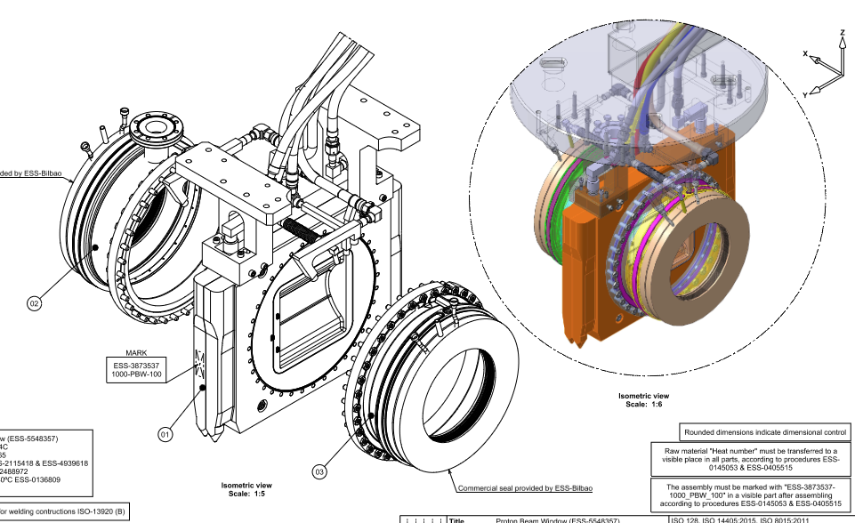
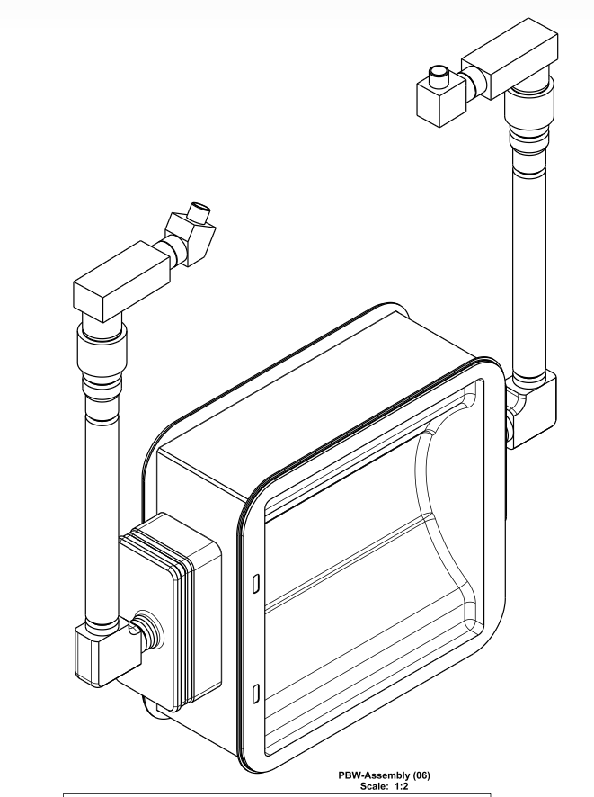
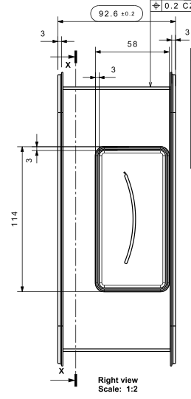
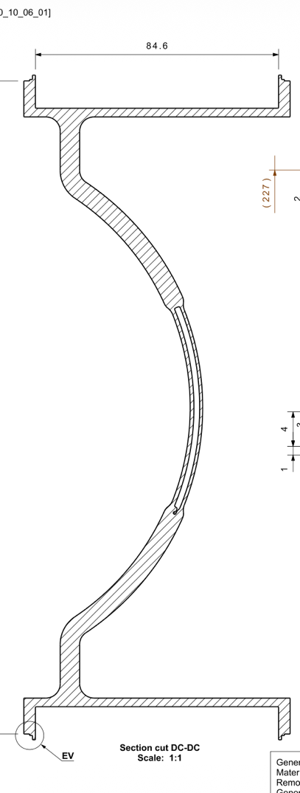
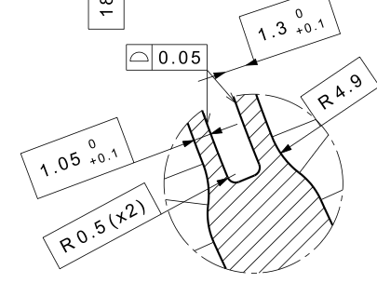
Manufacturing, PBW
PBW system = PBW+frame+flanges+pipes+inflatable seals
85 mm
Weight: 128 kg
Manufacturing started in 2023
165 mm
PBW milled out from Al T6061-T6 block. Cooling channel done by Electro Discharge Machining.

Slide 7
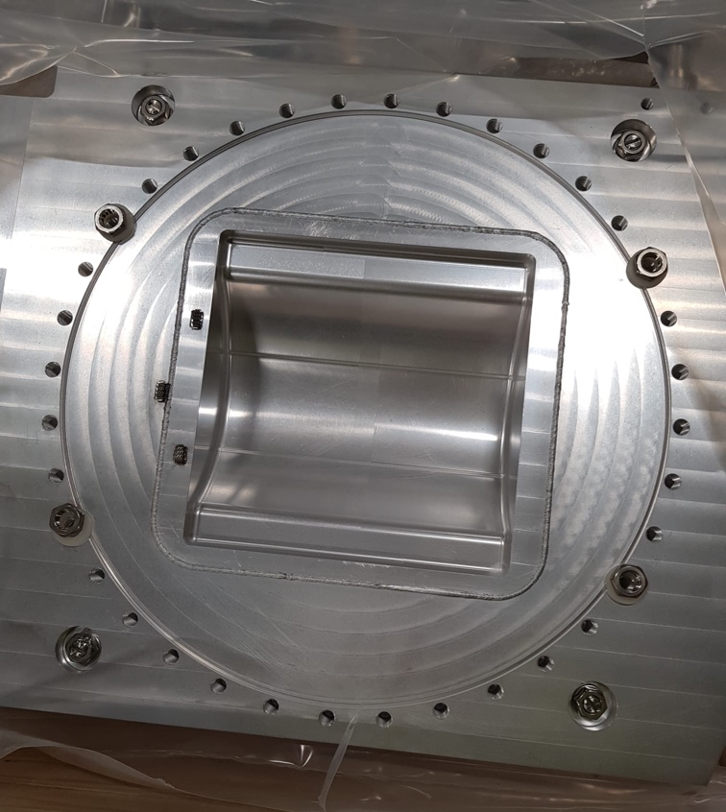
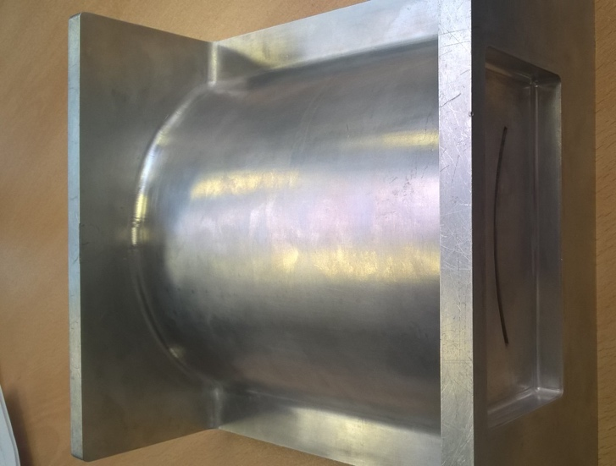
Manufacturing, PBW
View from Target side
2 mm water cooling channel
View from Acc side
3 fiducials made by FZ Jülich GmbH.
The PBW was E-beam welded to the frame by FZ Jülich.

Slide 8
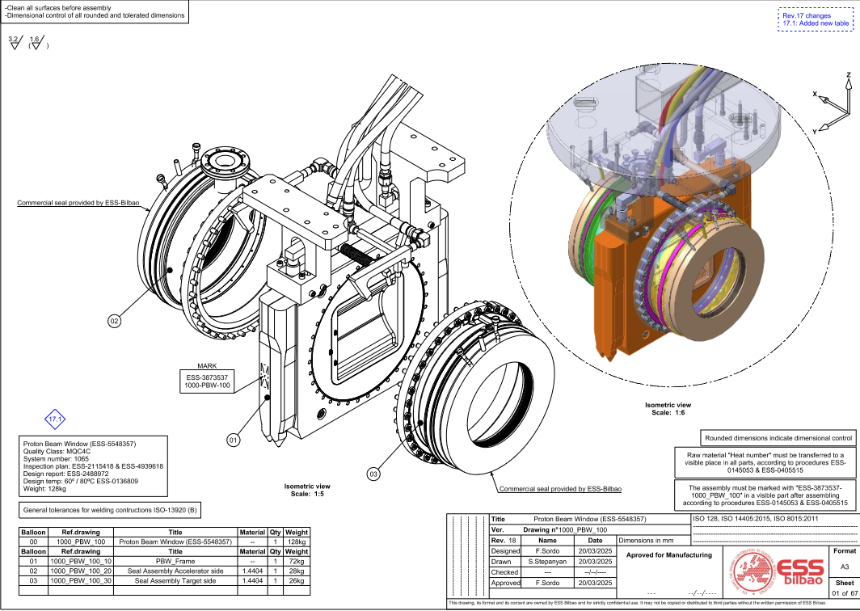
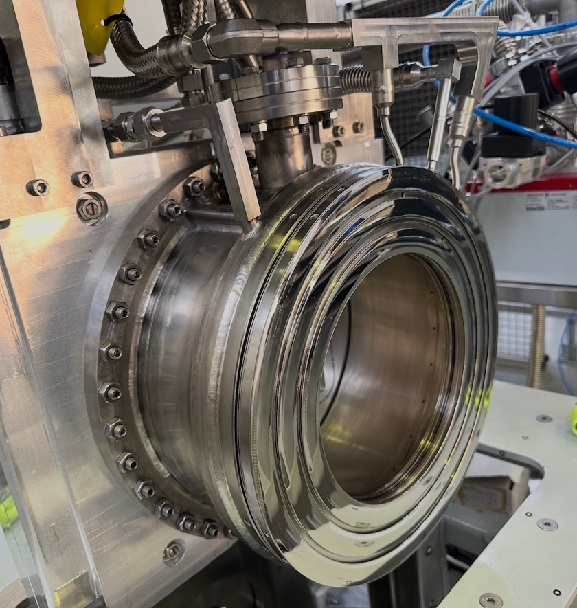
Manufacturing, PBW frame and flanges
Complete PBW system with inflatable seals on flanges, and hoses for vacuum, cooling water and instrument air.
Inflatable seals procured from Mewasa

Slide 9
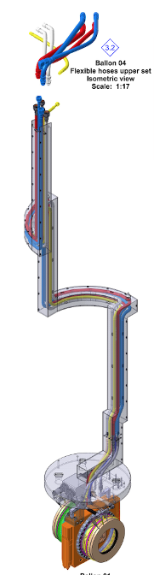
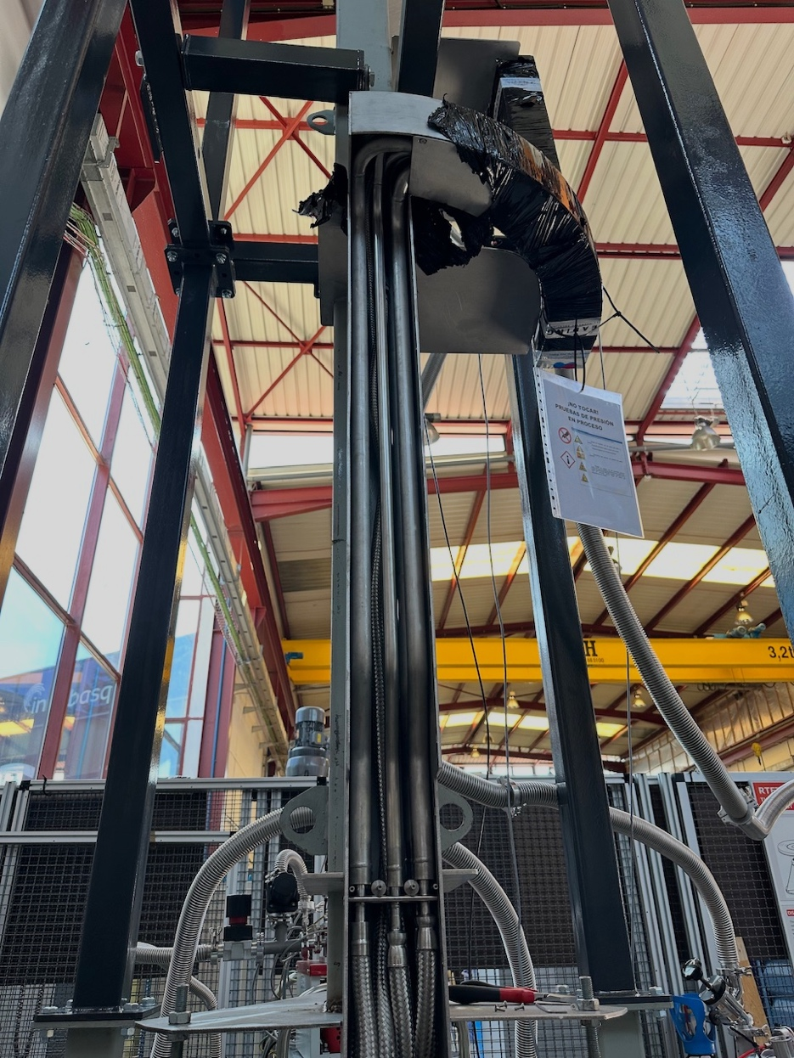
Manufacturing, Pipe box
Pipe box housing tubing for instrument air, water, vacuum and signal cables.
Total weight of PBW+Pipe box = 450 kg
4200 mm

Slide 10
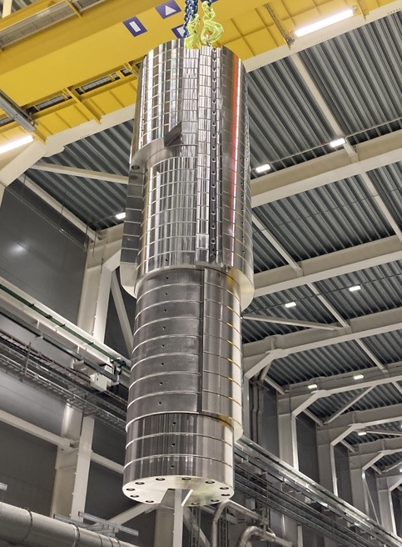
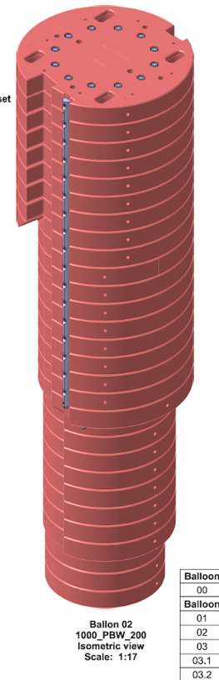
Manufacturing, Shielding plug
Shielding plug made of stainless steel with a weight of ≈15 tonnes.
⌀ 980 mm
Stainless steel plates put together by threaded rods.
3500 mm

Slide 11
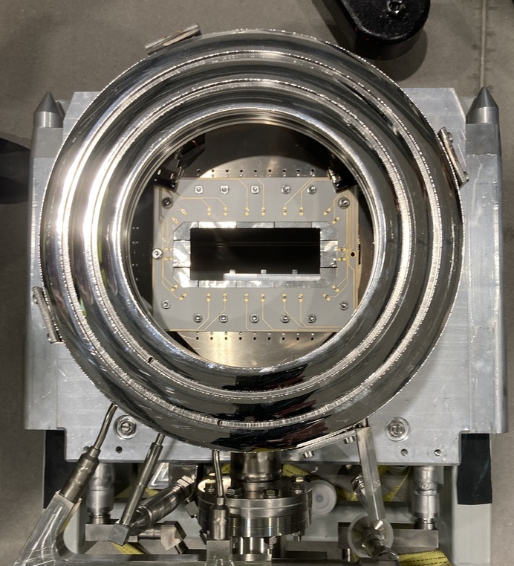
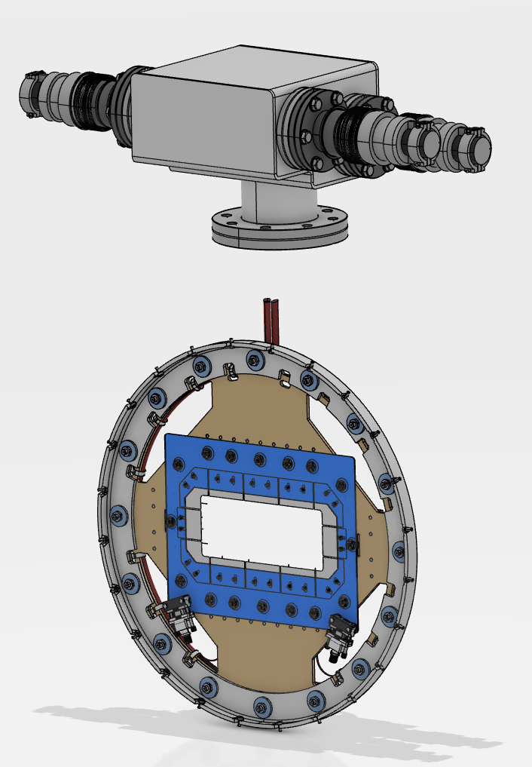
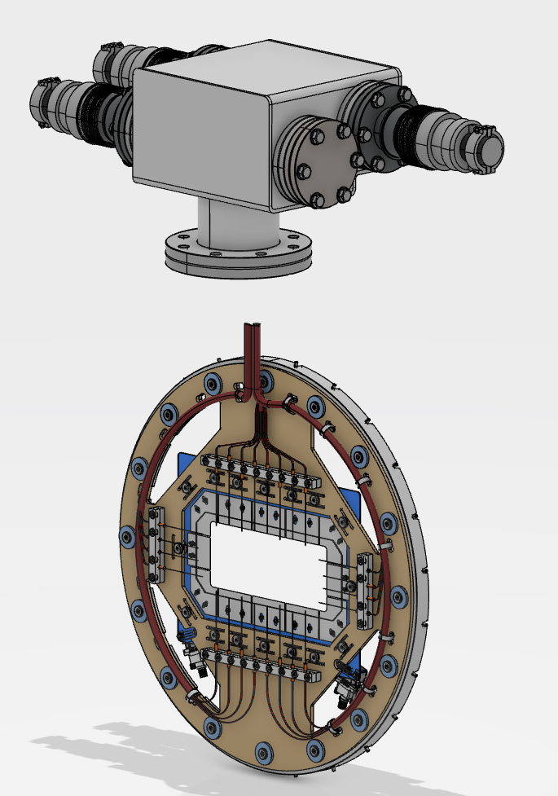
Beam diagnostics
Aperture Monitor (APTM)
The APTM monitors the fraction of the proton beam that is outside the intended envelope.
Connected to MPS.
View from Acc side
View from Acc side
View from Target side
128x52mm

Slide 12
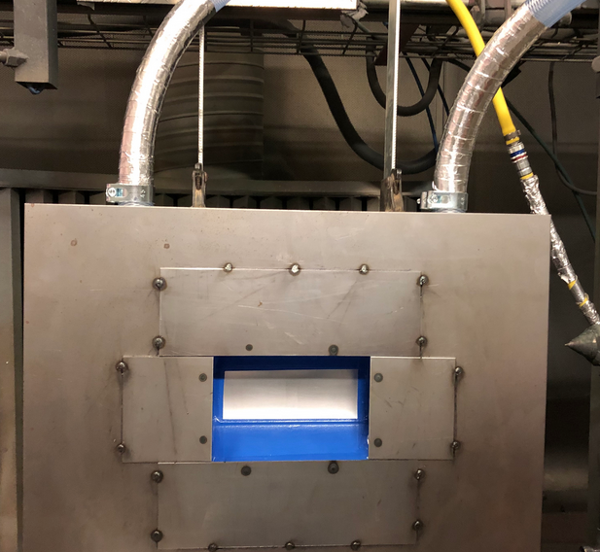
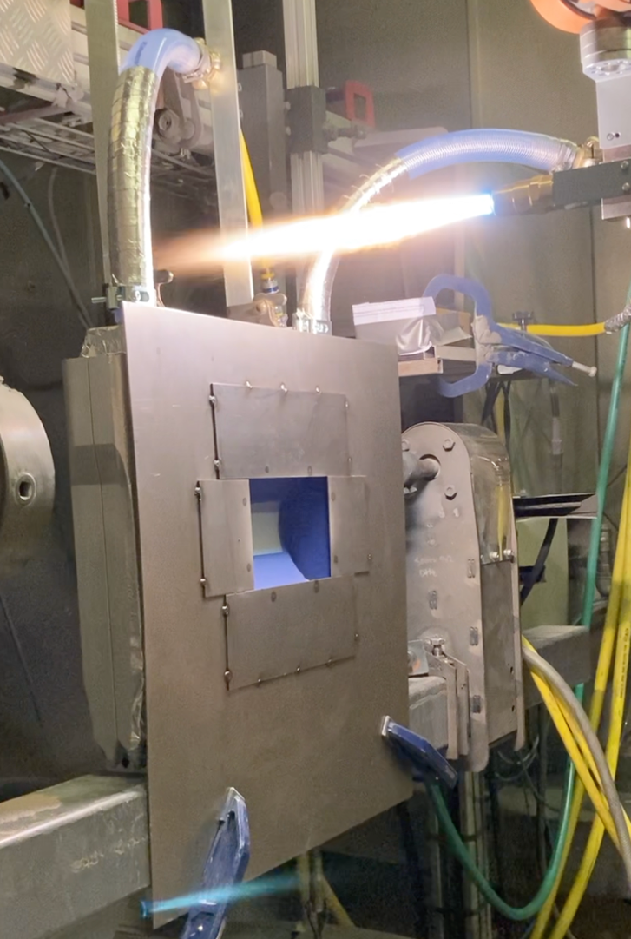
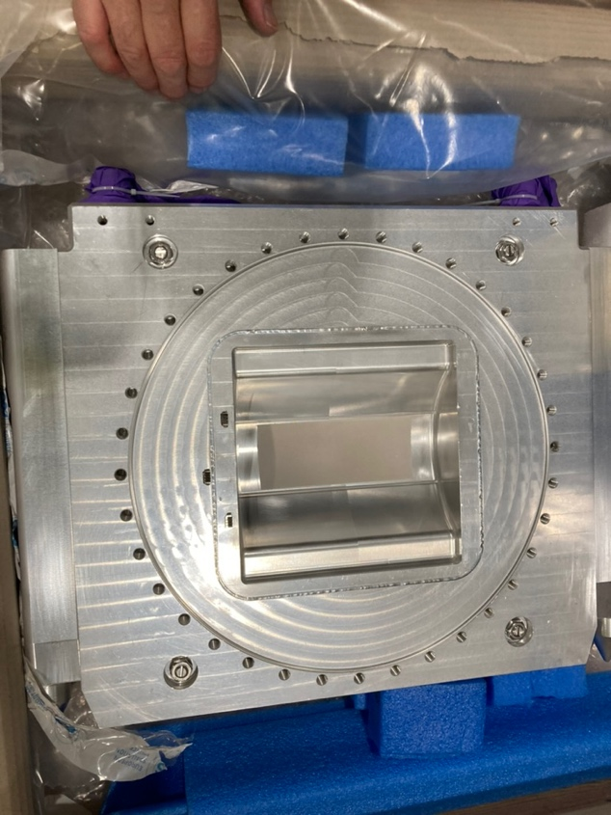
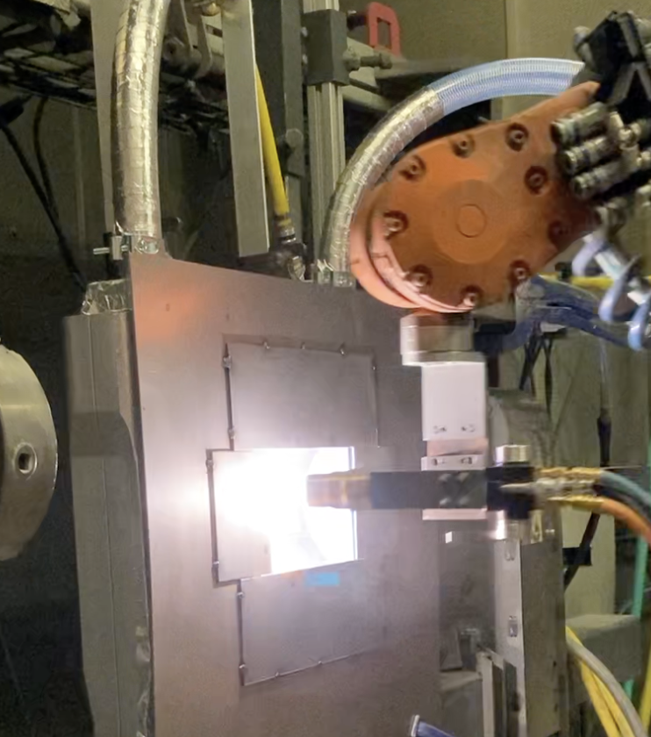
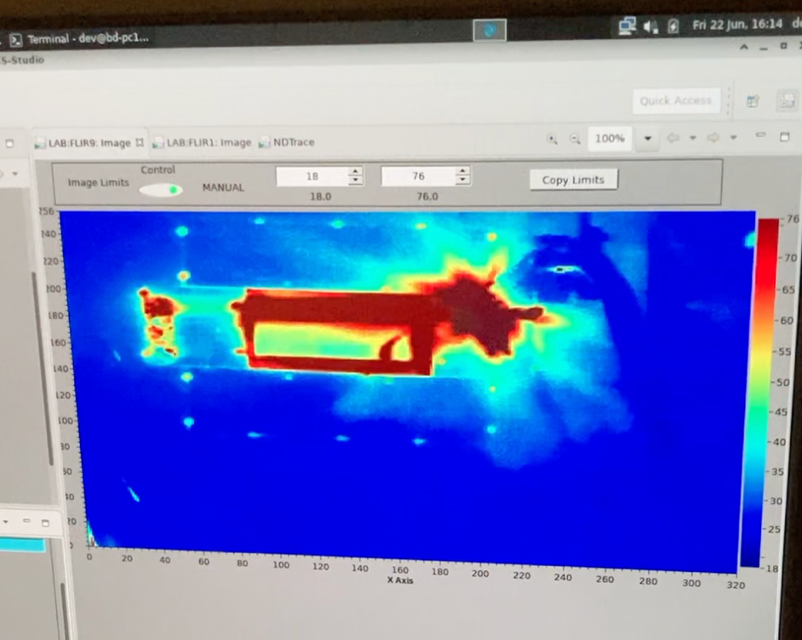
Beam diagnostics
Luminescence coating
The Target side of the PBW is coated with Al₂O₃ mixed with Cr₂O₃ by flame spraying.
The luminescence light is captured by mirrors inside the Monolith Vessel. Connected to MPS.
Pressure test (7 bar(g)) was done after coating to ensure the structural integrity of the PBW.
Coating thickness ≈180 μm
Un-coated
Coated

Slide 13
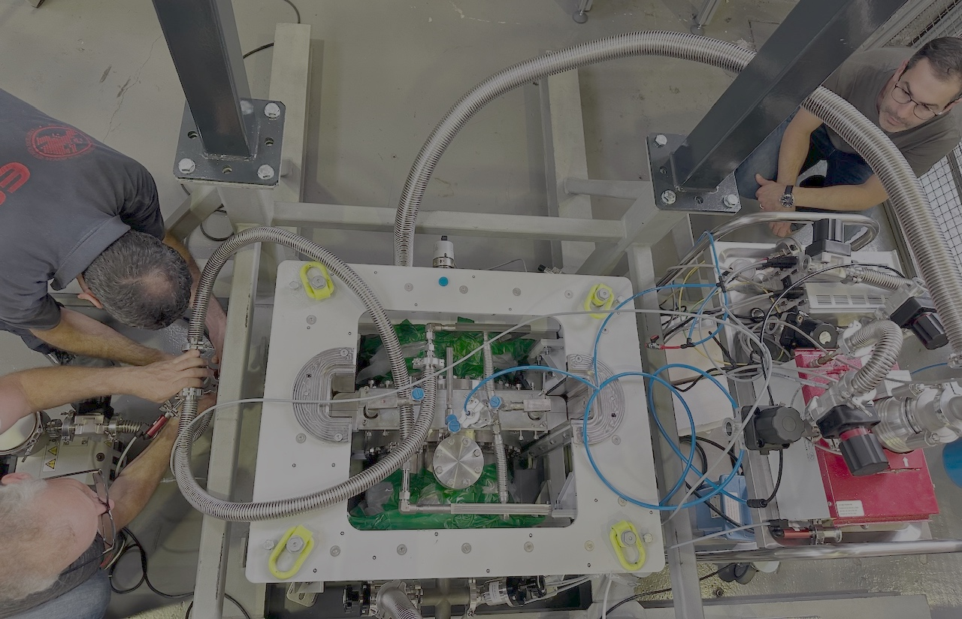
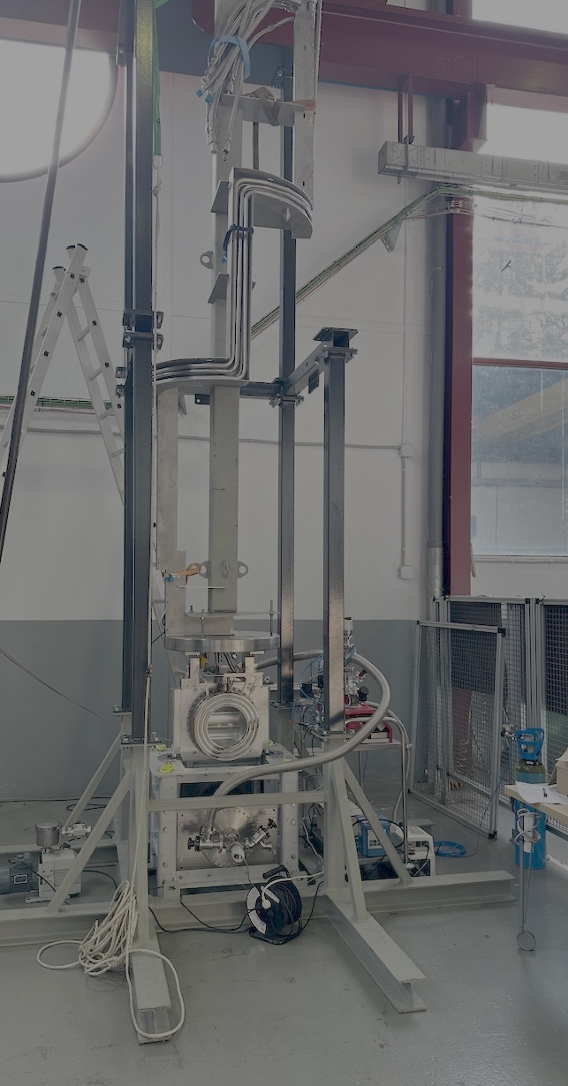
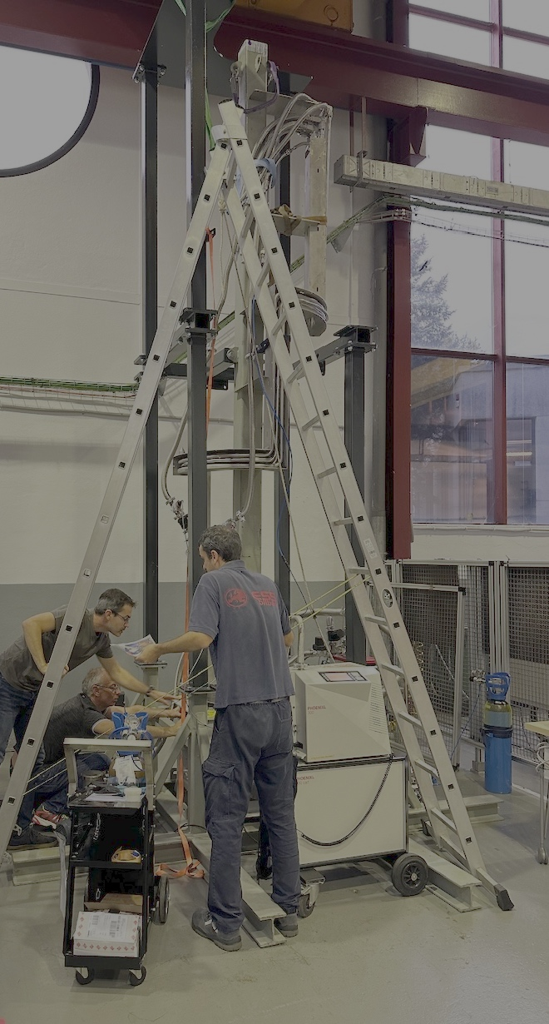
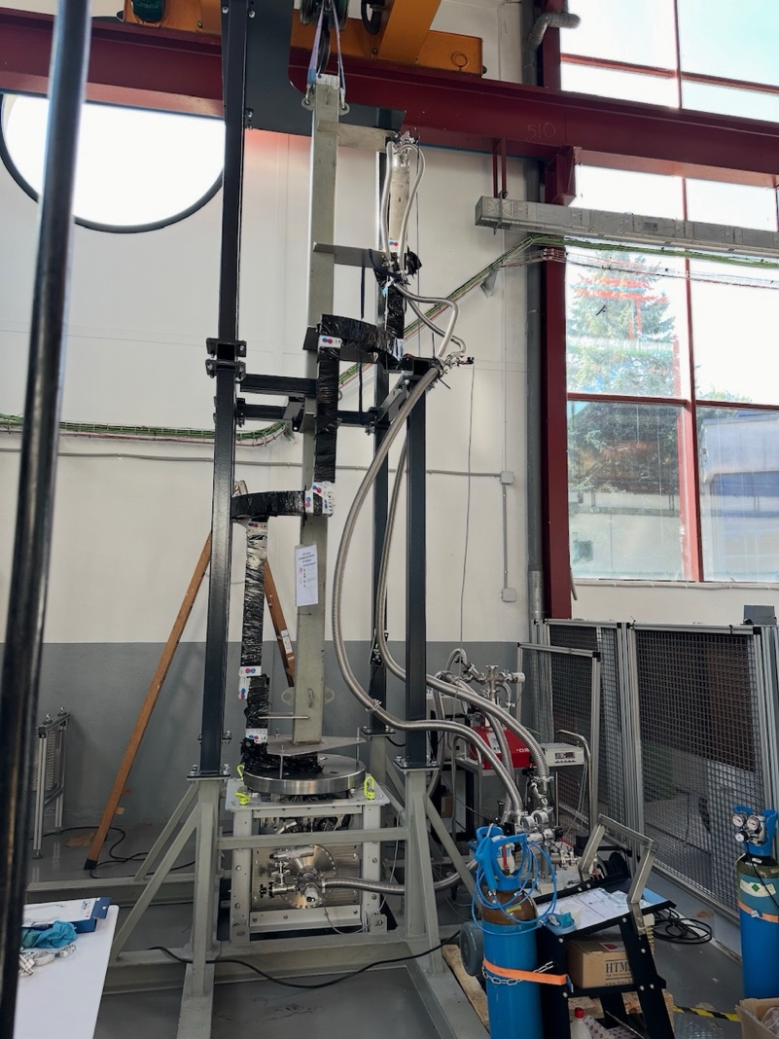
FAT, vacuum compatibility
Performed in Oct 2024 at Zamudio, Spain.
All media tubes and the inflatable seals were tested and approved.

Slide 14
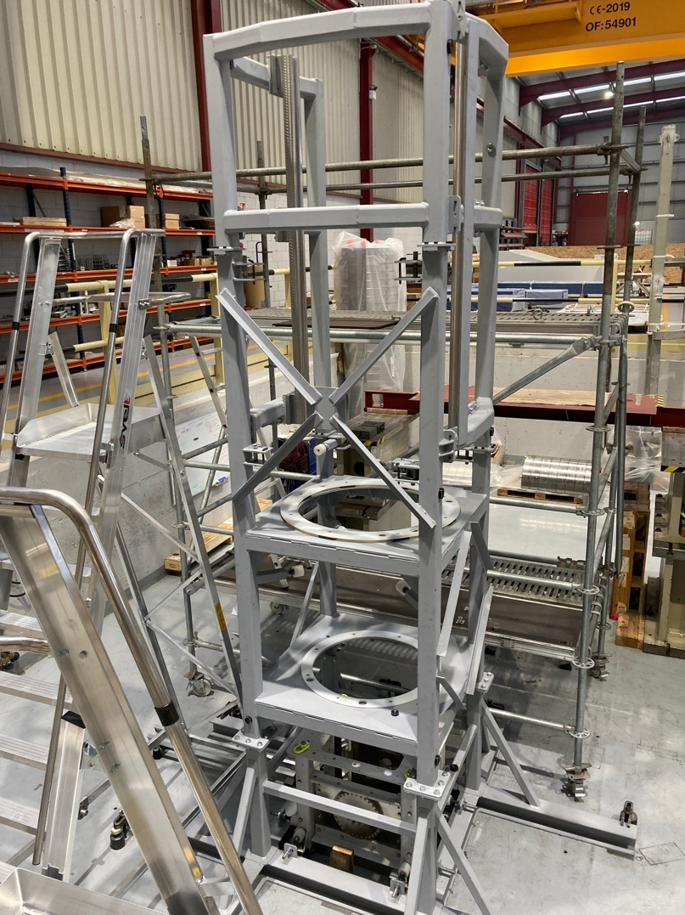
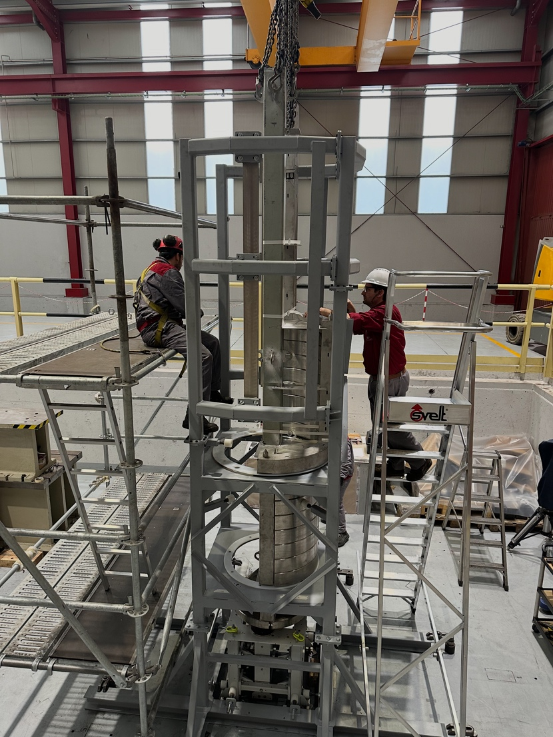
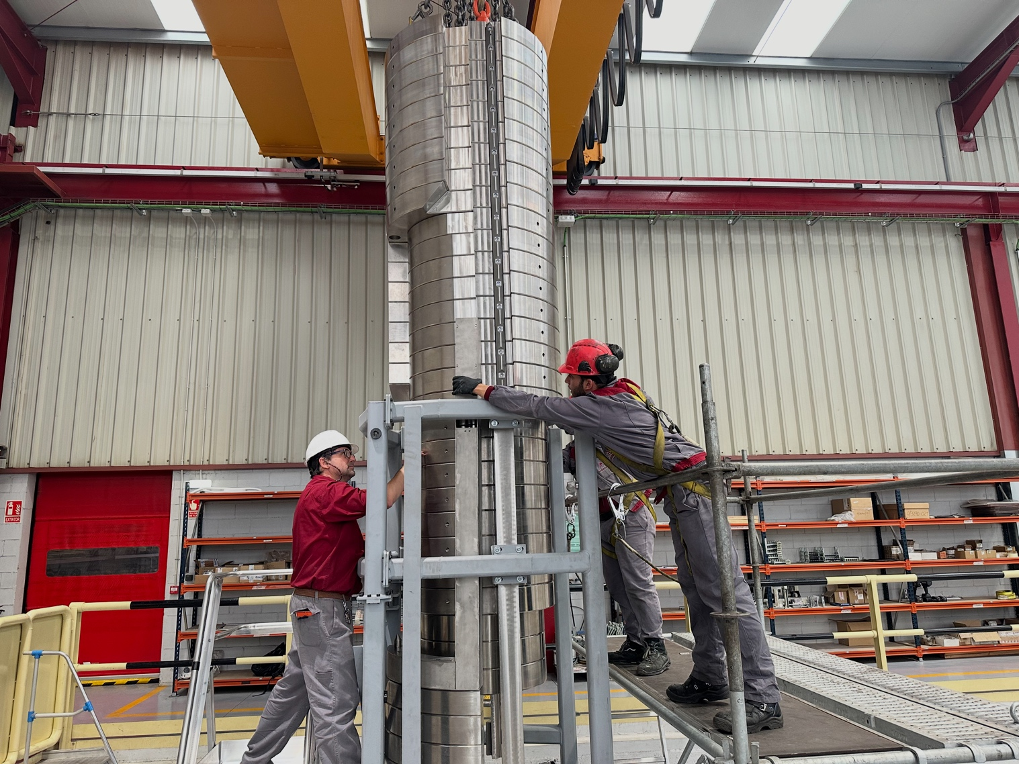
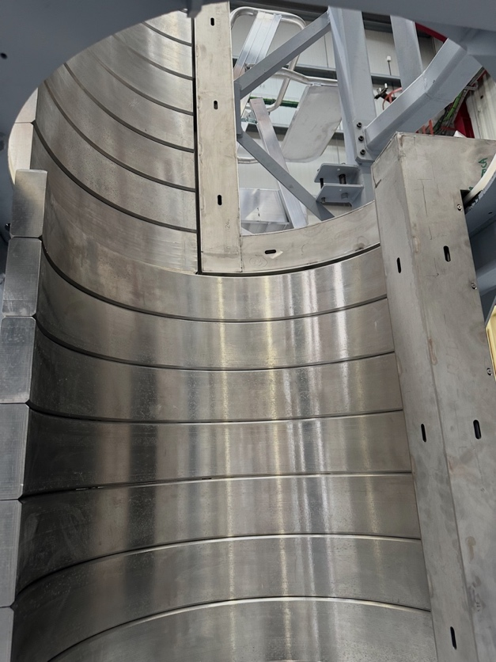
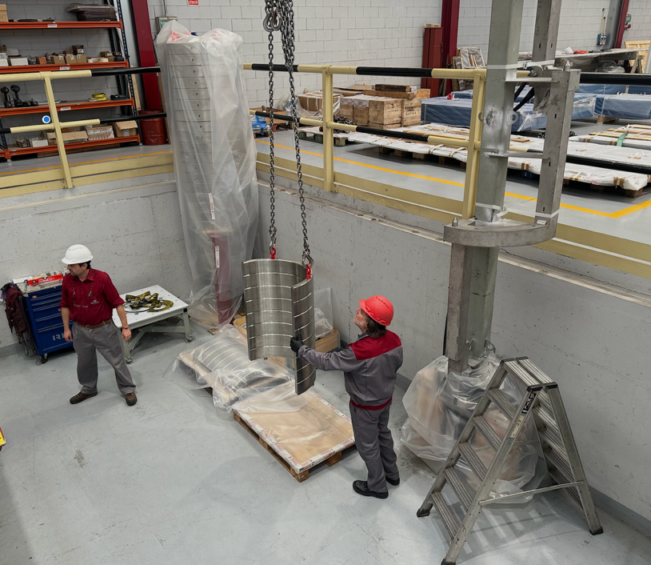
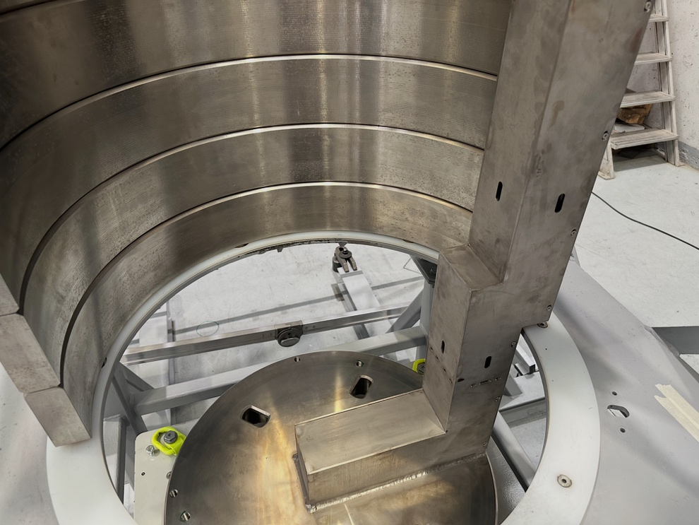
FAT, mechanical integration
Performed in Nov 2024 at Nortemecánica.
The components
The experience from the FAT was that the margins were too tight. Therefore the Shielding plug was optimised by machining some chamfers (Nortemecánica).

Slide 15
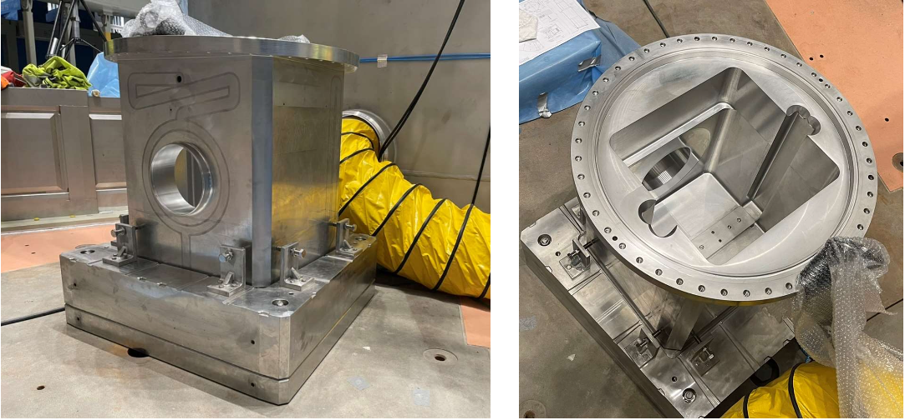
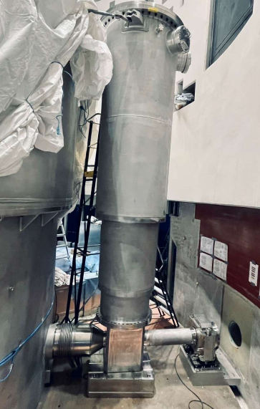
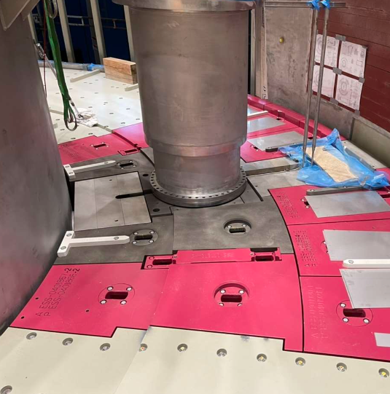
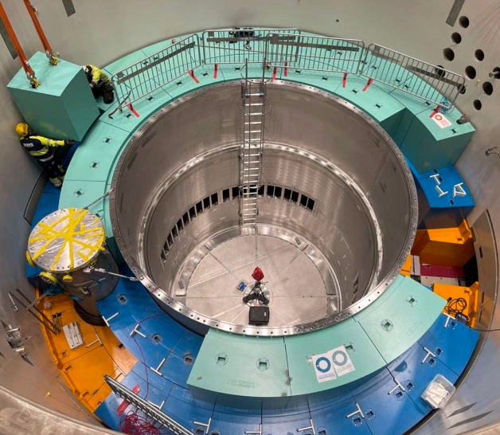
PBW Port Block and PBW Vessel
Installed at ESS in Feb 2022

Slide 16
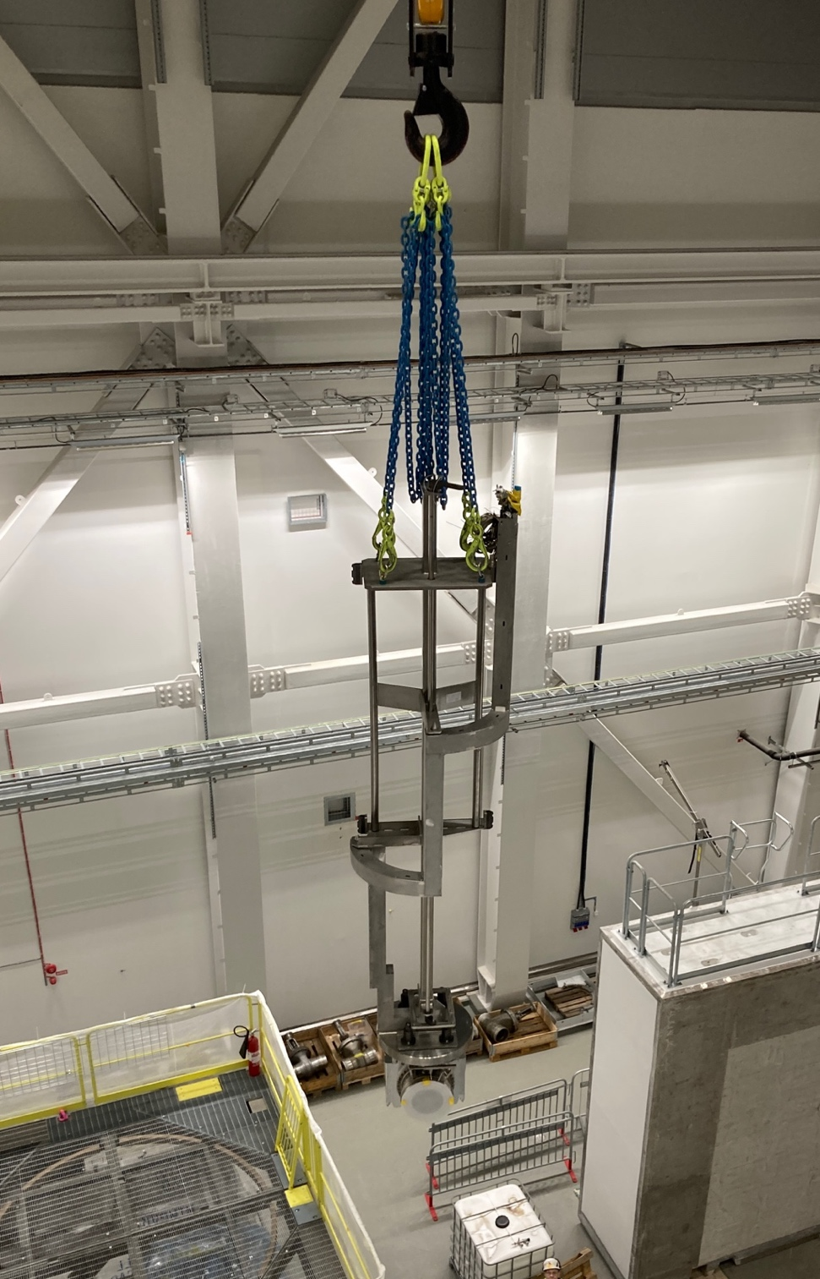
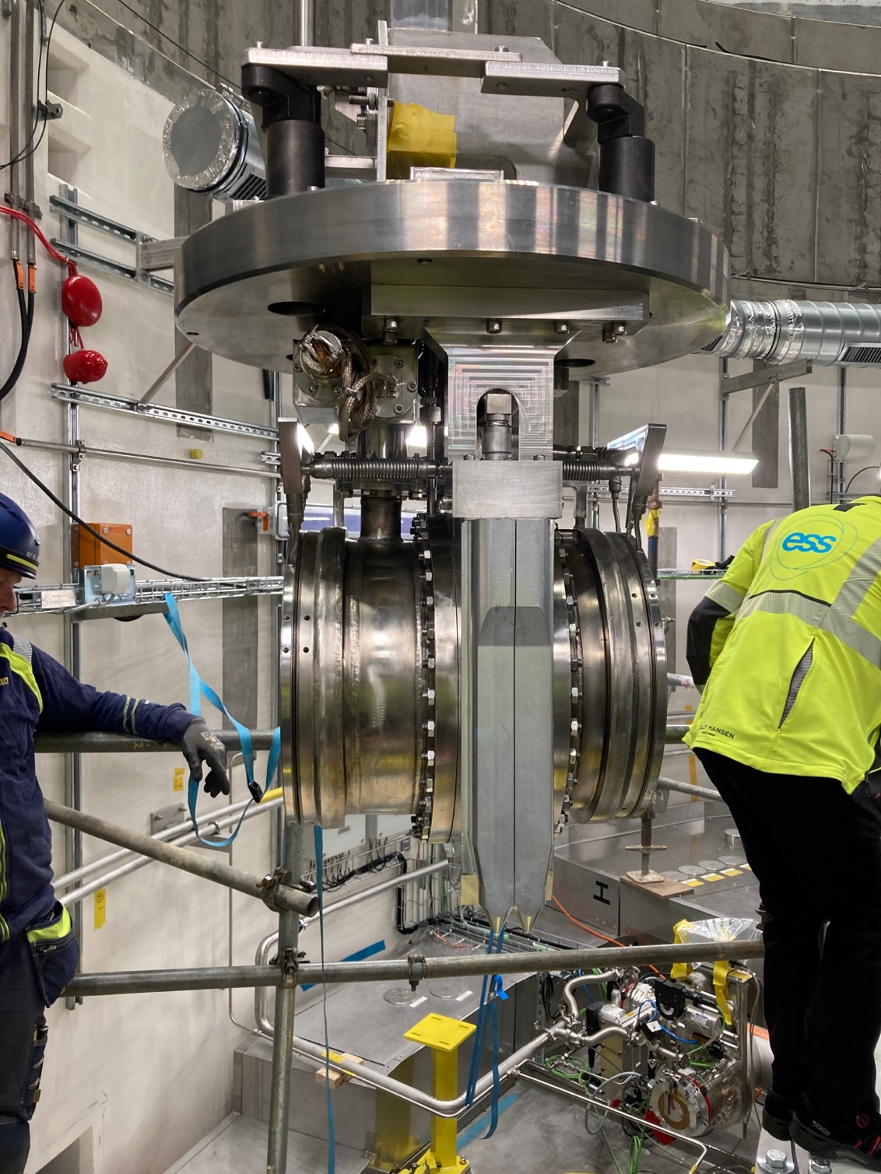
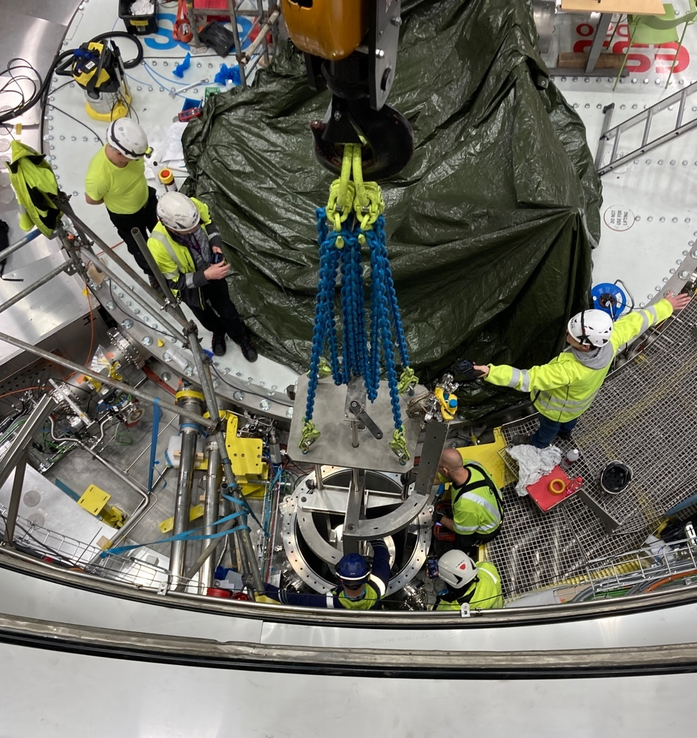
Installation of PBW at ESS
Installed in Feb 2025

Slide 17
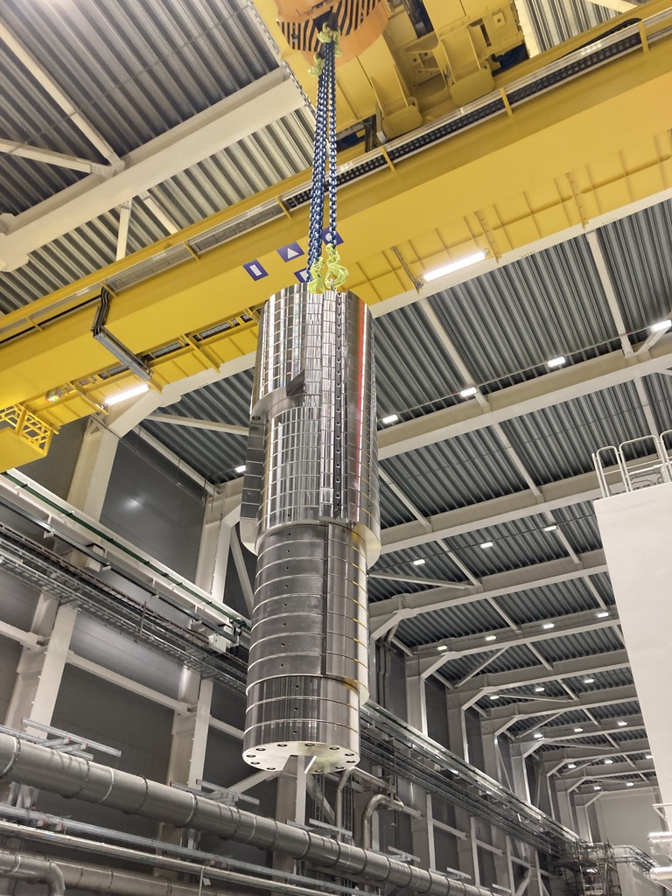
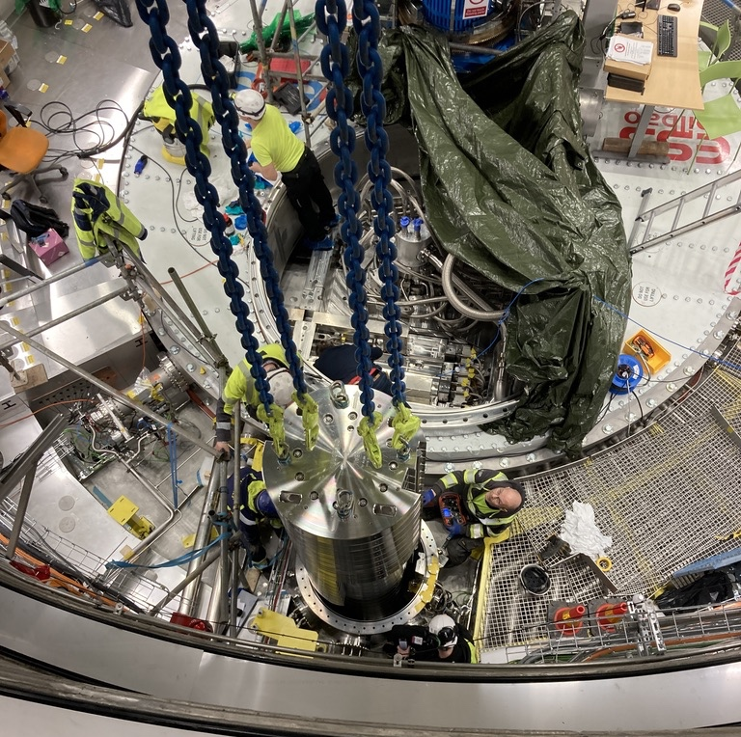
Installation of Shielding plug at ESS

Slide 18
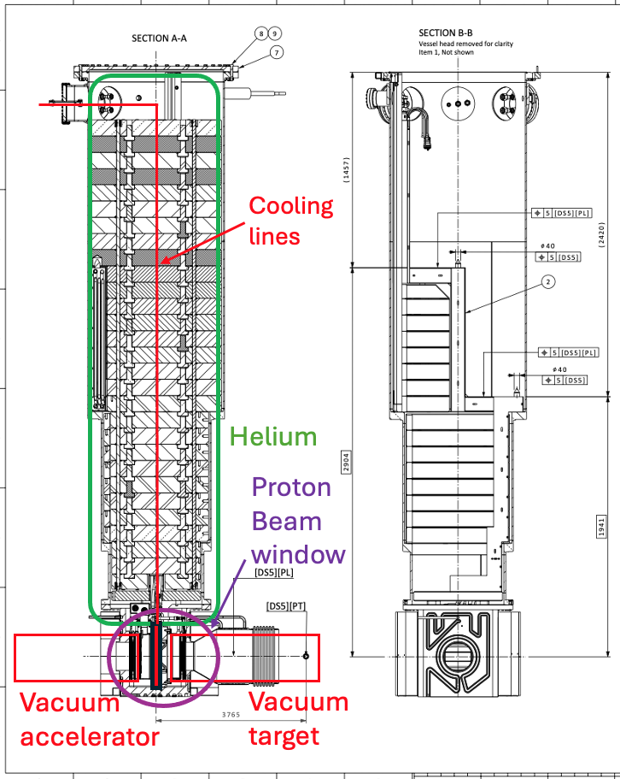
SAT - Vacuum test after installation
The inflatable seals were pressurised with 2 bar (g).
After installation, the PBW Vessel was evacuated and then filled with He.
Leak rates, both on the Acc side and the Target side, were measured and were approved.

Slide 19
The end

