Slide 2
Materials Engineering at ESS
From Material Verification to Post-Irradiation Examination (PIE)
Hossein Sina, Patric Lindqvist Reis, Günter Muhrer

Slide 3
Agenda
1 Introduction
2 Material Verification
3 Failure Analysis
4 PIE Activities

Slide 4
1
Introduction

Slide 5
Spallation Physics Group
Target Div.
Sci. Supp. Div.
4 Phys. Sci.
1 Chem. Sci.
1 Mat. Eng. Sci.
2 PhD St.
1 MSc St.
Chemistry
Group
Spallation Chemistry
Central Materials & Analytical Function to provide:
  Verified material data
  Technical support (e.g. inputs for neutronics, material selection, procurements, etc)
  Root cause understanding
  Irradiation & PIE

Slide 6
Background
ESS transitioning from construction → commissioning
Large fraction of components delivered as in-kind contributions
Limited direct control over delivered components
Challenges
- Incomplete or inconsistent material documentation
- Risk of material mismatch or unknown impurities on:
  Activation and shielding
  Mechanical performance
  Lifetime of critical components
  No specific workflow, complementary activities applied where needed

Slide 7
2
Material Verification

Slide 8
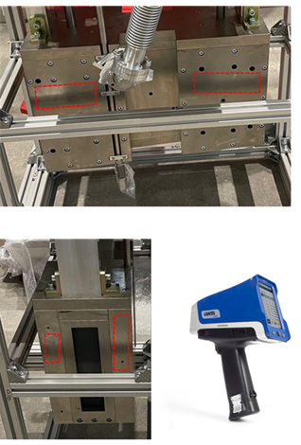
Material Verification
LOKI Heavy Shutter
Target: LOKI heavy shutter (S275JR mild steel with Ni-P plating) with protective Ni-P plating
Goal: Verify composition and quantify cobalt (Co) impurities for radiation safety
Methodology: Handheld XRF
Challenge: Signals represent a superimposed mixture of the plating and substrate
Thickness Calculation via X-ray Attenuation
Model: Beer-Lambert Law to calculate the iron (Fe) signal attenuation
Finding: Determined an average plating thickness of ∼20 μm
Results & Impact
Composition: Plating contains 92 % Ni, 7 % P, and 0.5 % Co.
Inventory: Total Co mass estimated at 0.7 ± 0.3 g.
Outcome: Provided vital input for neutronics and waste classification

Slide 9
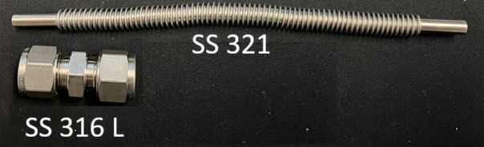
Material Verification
Trace Cobalt Analysis in Stainless Steel
Challenge: Cobalt Activation Hazard (59Co → 60Co); levels should ideally remain below 0.2 wt% in stainless steel
Limitation: XRF cannot resolve Co below ~0.2% due to spectral overlap between Co Kα and Fe Kβ lines
Requirement: High-sensitivity verification of components (e.g., Swagelok couplers/tubing) for high-radiation areas
Methodology: Overcoming Matrix Effects
Sample Prep: Complete acid dissolution of stainless steel (SS 316L & SS 321)
High Dilution Strategy: Utilized 10,000-fold to 100,000-fold dilutions to eliminate the iron-rich matrix effect that suppresses signal accuracy
Analytical Tool: ICP-OES (Inductively Coupled Plasma Optical Emission Spectroscopy)
Sensitivity: Calibration performed at sub-ppm levels (0.02- 1.00 ppm range) in the diluted aqueous solutions
Swagelok connections for Beam Monitor gas distribution system
High-Resolution Trace Detection
SS 316L (Coupler): 1070 ± 50 ppm Co
SS 321 (Tubing): 2140 ± 70 ppm Co

Slide 10
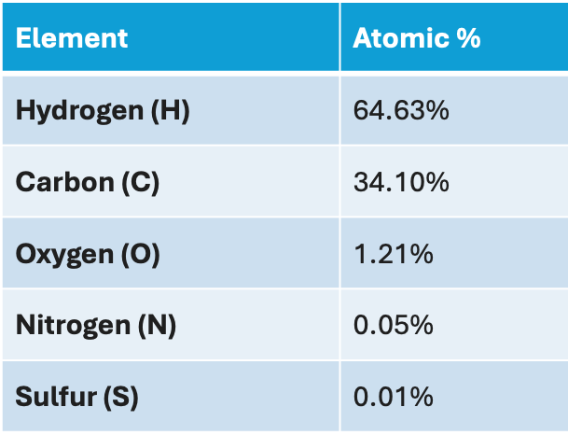
Material Verification
Analysis of Oil for He compressor
Context: Materials require precise elemental data for reliable nuclear activation simulations
Gap: Lubricant composition (Klüber Summit NGSH 68) is not declared by the manufacturer
Challenge: Quantify minor and trace elements (O, N, S) to ensure reliable risk assessment & high-fidelity neutronic modeling
Methodology: SDS Data Synthesis
Process: Integrated data from Swedish and German Safety Data Sheets (SDS) to identify 100% of weight-based ingredients
Component Identification: Characterized four primary chemical groups, including ester oils, synthetic hydrocarbons, and trace additives containing N and S
Modelling: Assigned molecular formulas to ester oils, hydrocarbons, and additives to calculate total elemental molarity
Results: Derived Atomic Profile

Slide 11
3
Failure Analysis

Slide 12
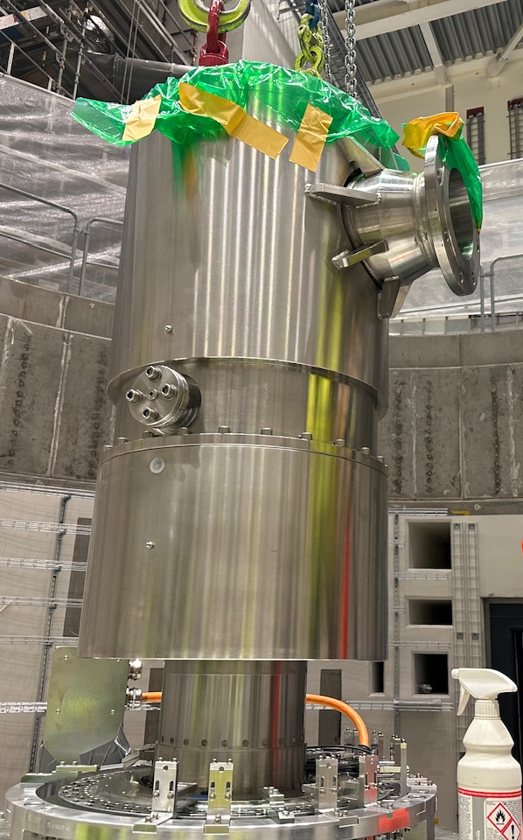
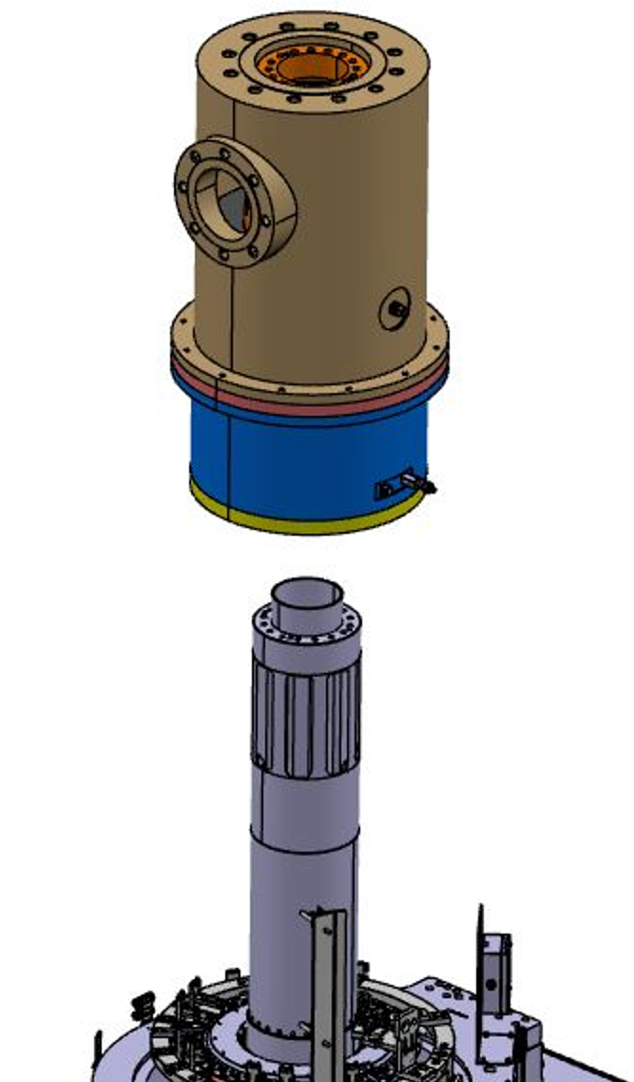
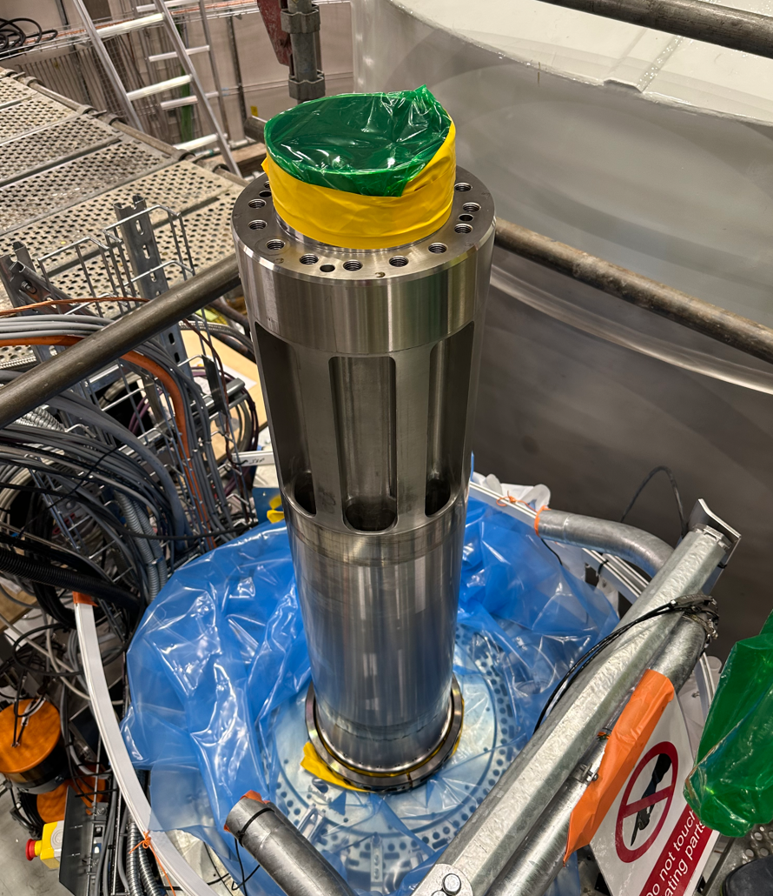
Failure Analysis
Helium Rotary Union (HRU)

Slide 13
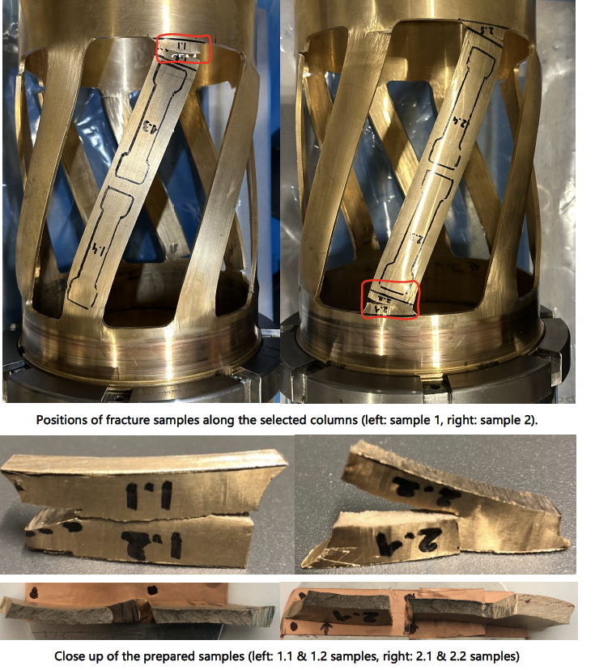
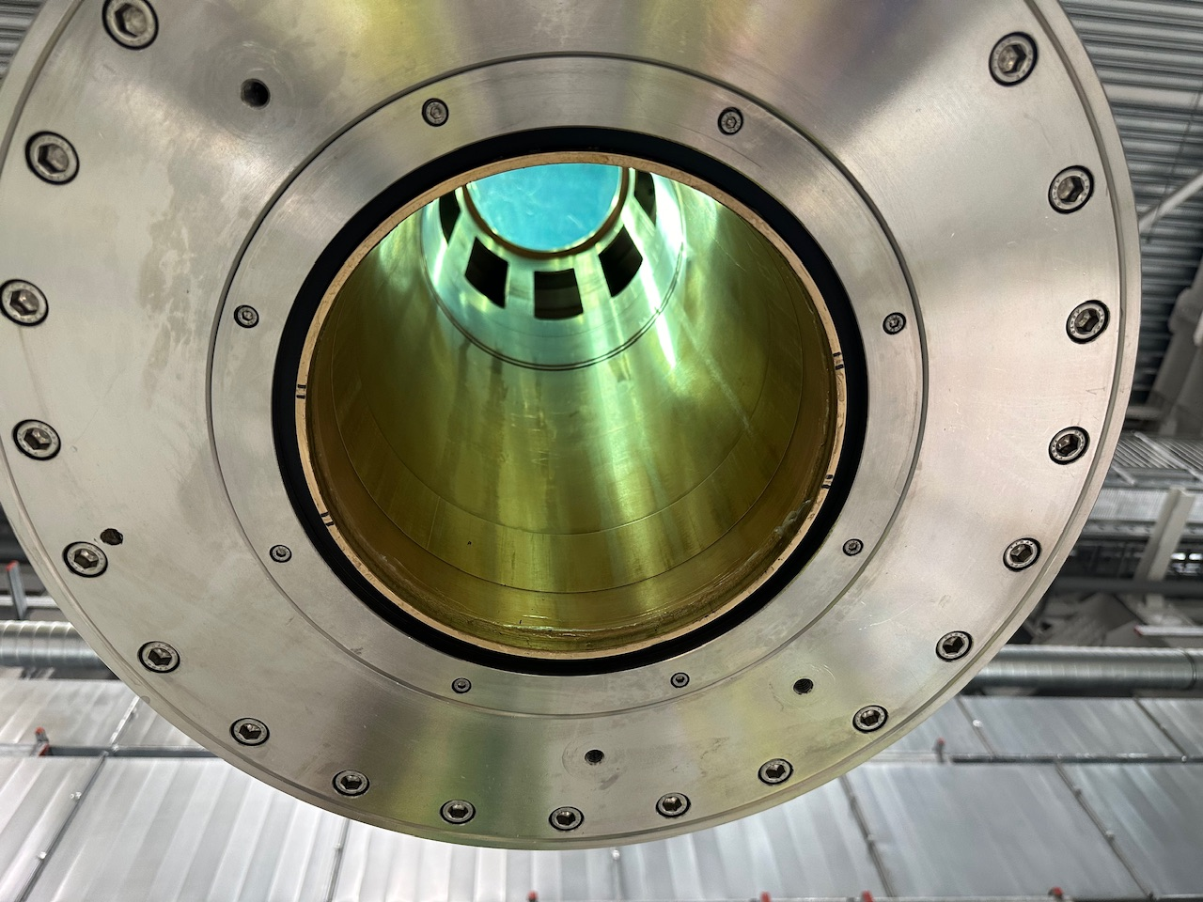
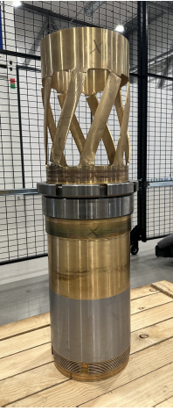
Failure Analysis
Helium Rotary Union (HRU)

Slide 14
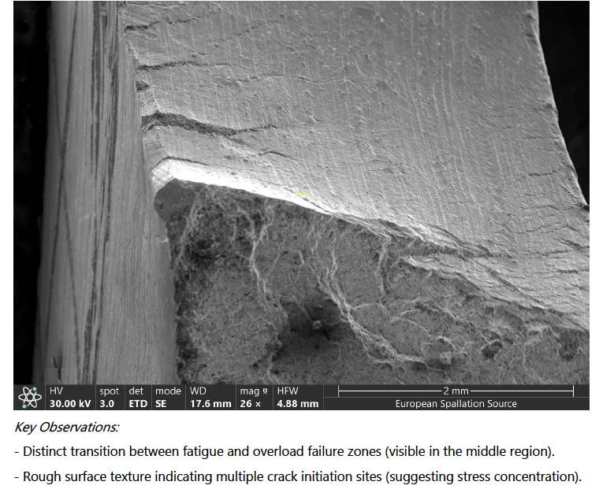
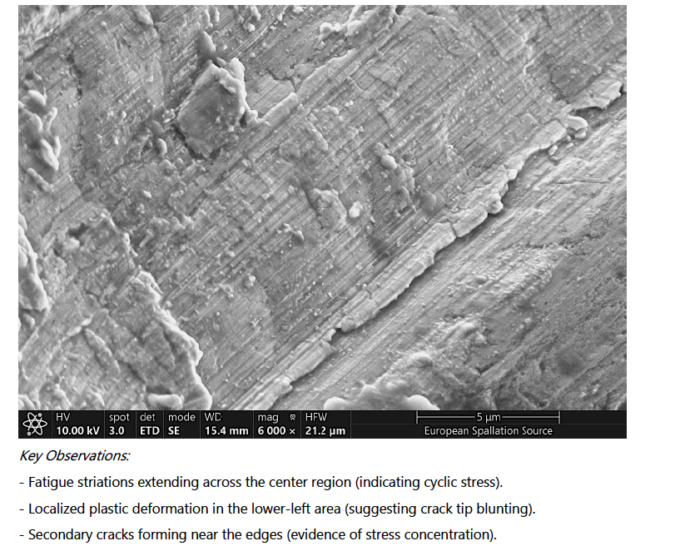
Failure Analysis
Fractography

Slide 15
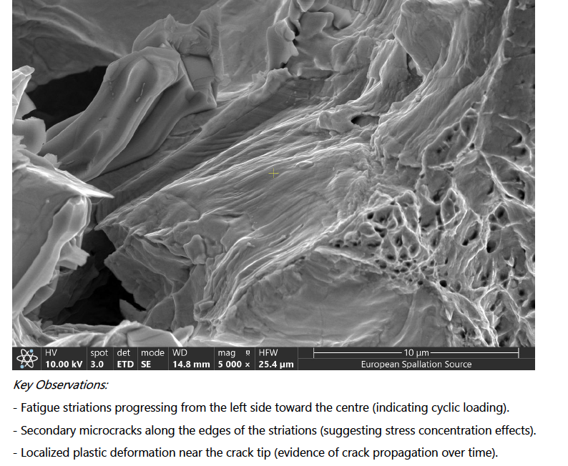
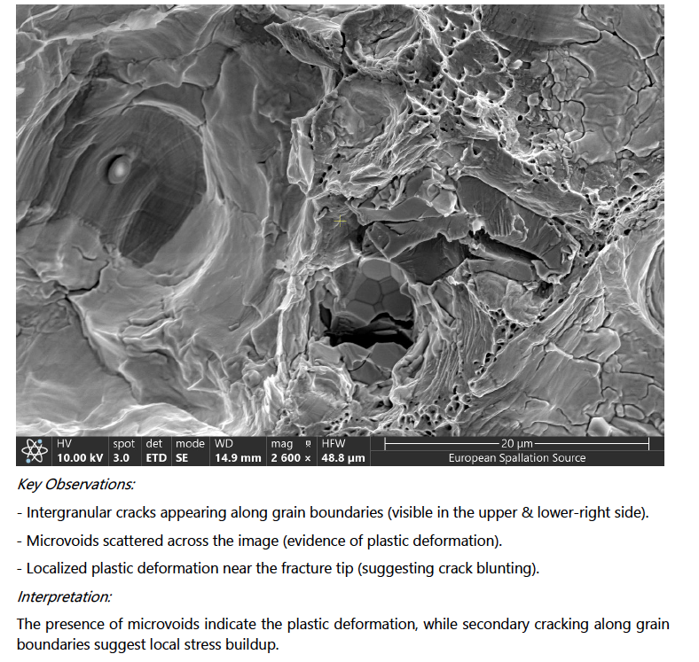
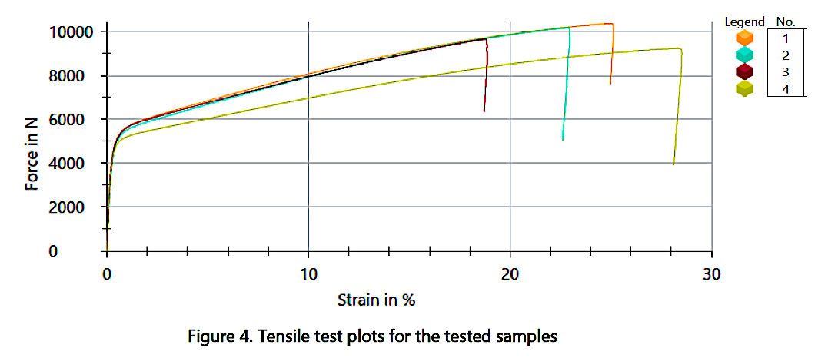
Failure Analysis
Fractography & Mechanical Testing
The material strength matched the design input for stress analysis

Slide 16
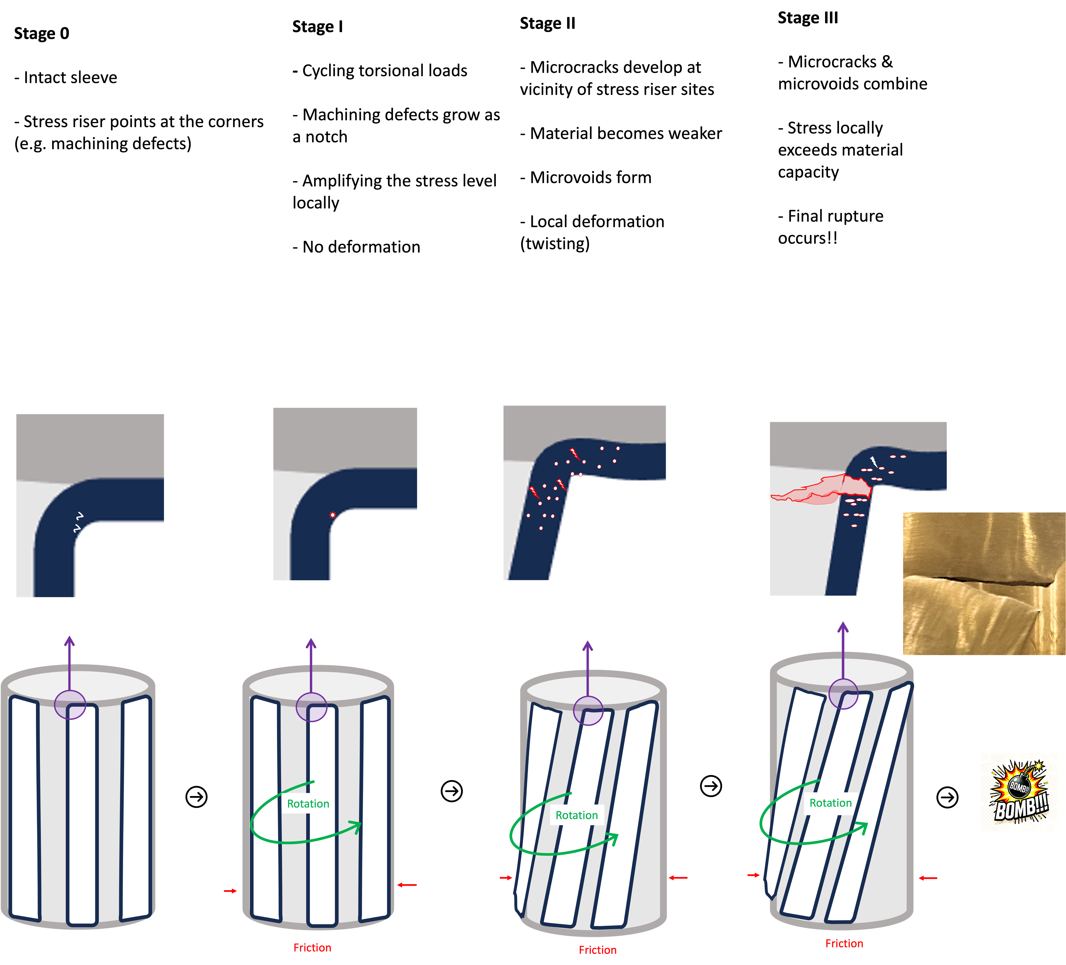

Failure Analysis
Helium Rotary Union (HRU)
Failure mechanism:
initiated by fatigue
accelerated by shear deformation
ultimately led to overload rupture
Mitigation:
Surface finish
Design
Material

Slide 17
4
Post Irradiation Examination (PIE)

Slide 18
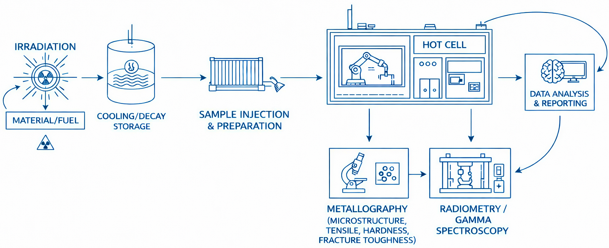
Post Irradiation Examination (PIE)
Impact
Reduced technical risks
Improved reliability
Extension of knowledge on material degradation under radiotion
Supporting lifetime extension
Focus: Target Station Key Components
Spallation Material (Tungsten)
Proton Beam Window (PBW)
Moderator-Reflector Plug (MRP)

Slide 19
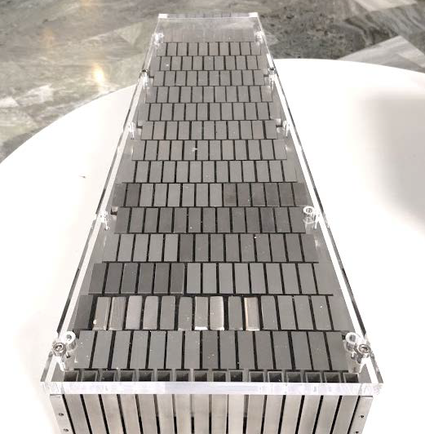
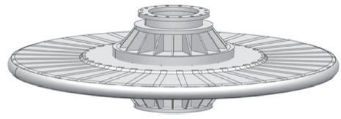
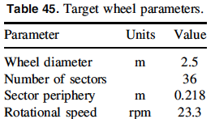
Post Irradiation Examination
Target Material: ESS+PSI Joint Project
ESS target wheel
One of the 36 segments of the target wheel with W bricks
Thermal diffusivity decrease => larger thermal stress
Knowledge of Radiation impact on thermal diffusivity of Tungsten is crucial to achieve a target with designed availability
Energy/Pulse kJ 357
Temp. rise/Pulse ∘C 100

Slide 20
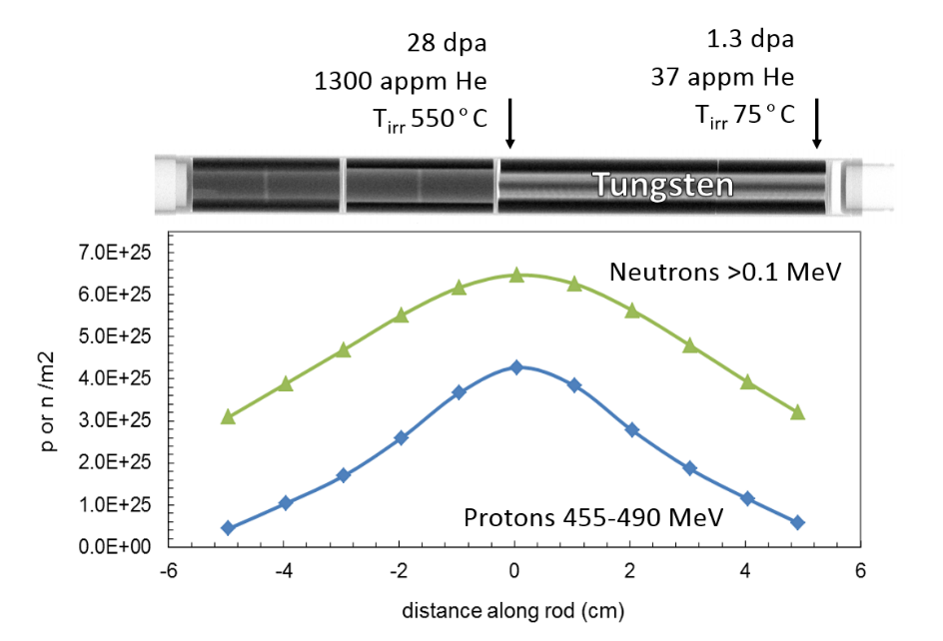
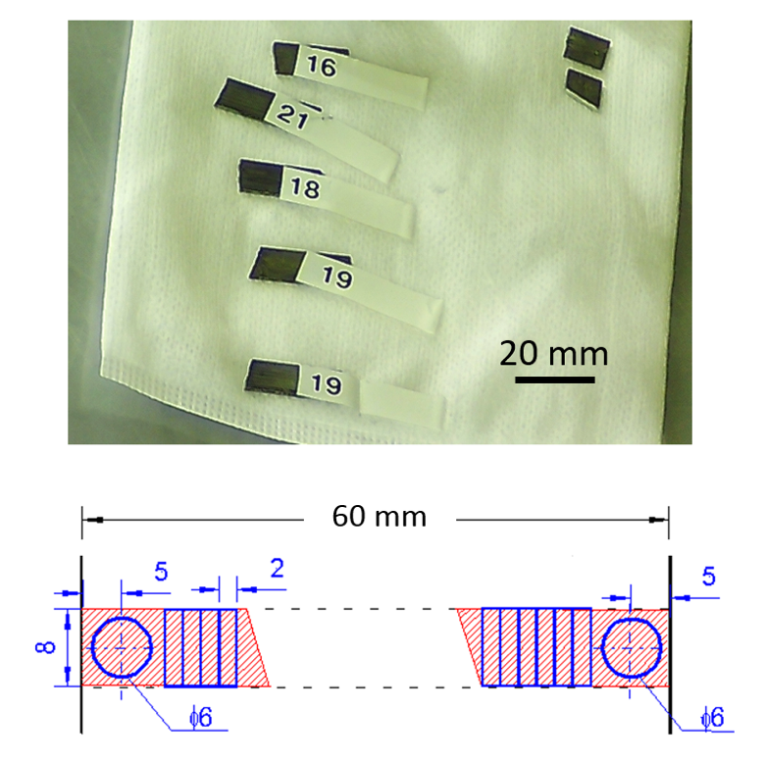
Post Irradiation Examination
Irradiated & samples preparation
As a part of STIP-V campaign, W plates (1×10×60 mm) were irradiated by high energy protons and secondary neutrons at Swiss Spallation Neutron Source (SINQ)-PSI
Samples with different doses were studied
6 mm disc were cut by EDM

Slide 21
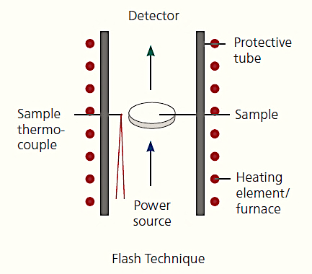
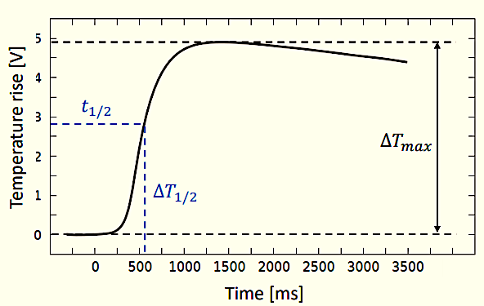
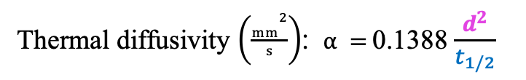
Post Irradiation Examination
Laser Flash Analysis (LFA)
Low dose* : with surface polishing & coating
High dose: without surface polishing & coating due to high dose (with EDM surface finish)
t₀ → T=T₀
t₁ → T=T_{max}
t_{1/2} =(t₁-t₀)/₂ (s)
Thermal diffusivity $\left(\frac{mm2}{s}\right)$: $α =$0.1388 $\frac{d^{2}}{t_{1/2}}$
_{t, T}
d (mm)
Heat flow
To measure the thickness (d) precisely, the sample surface is usually polished and then coated
* J. Habainy, Y. Dai, Y. Lee, S. Iyengar, Thermal diffusivity of tungsten irradiated with protons up to 5.8 dpa, JNM. 509 (2018) 152–157.

Slide 22
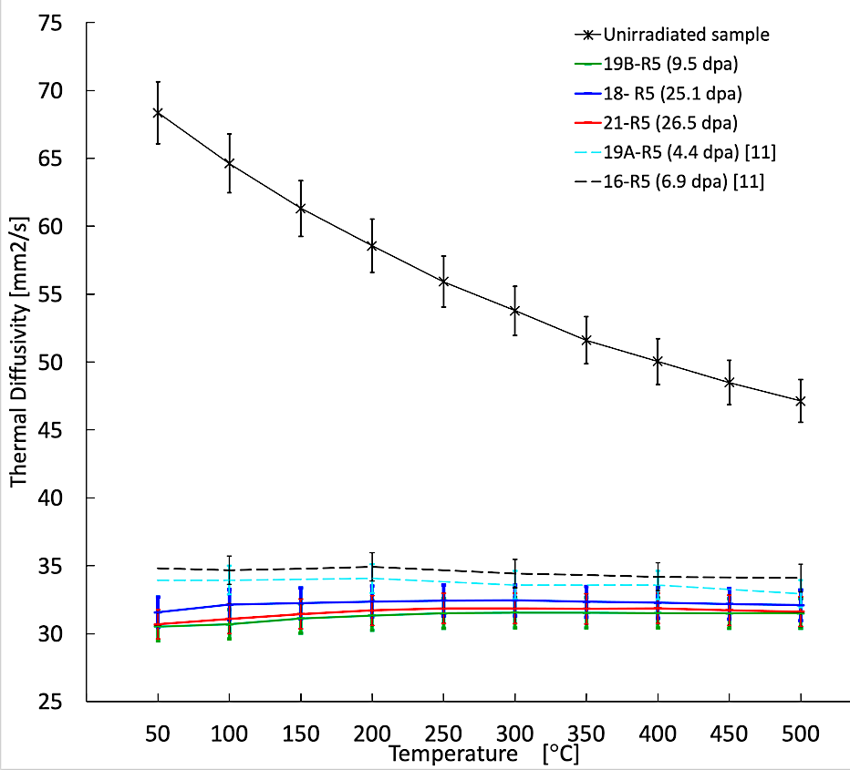
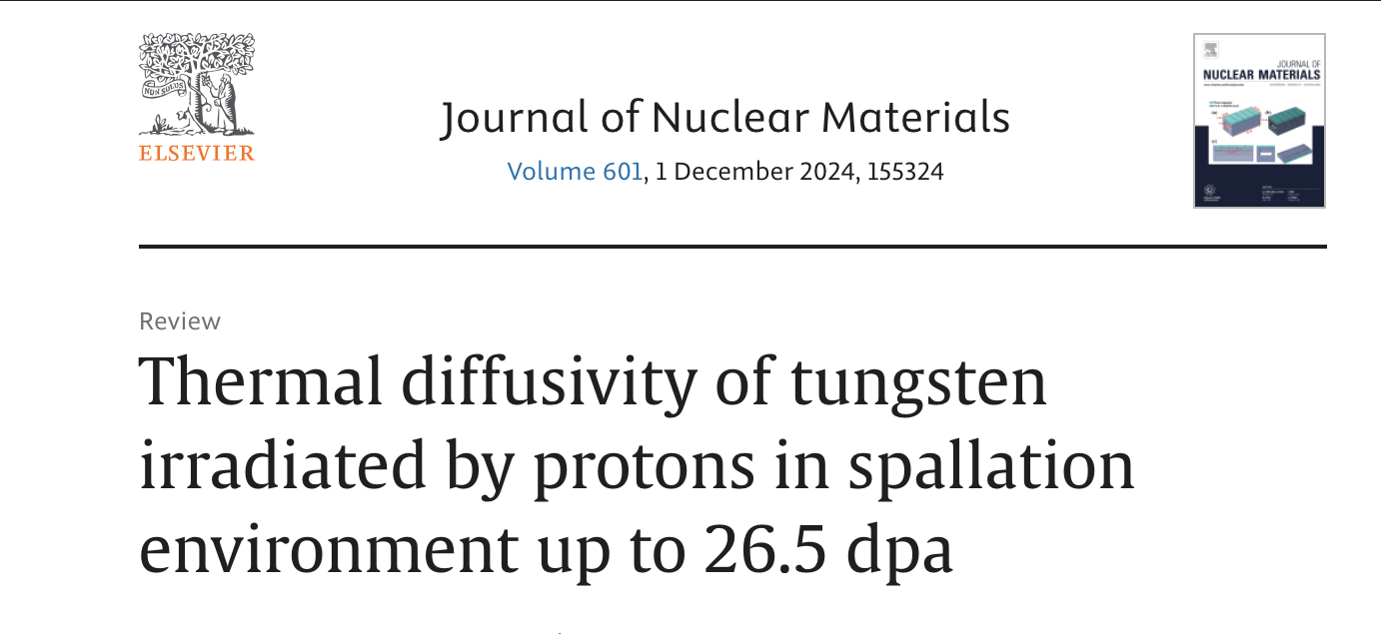
Data analysis
LFA results for irradiated samples after thickness calibration
Drastic reduction of the thermal diffusivity as a result of irradiation
Such a drop is attributed to Re formation and also displace damage
Thermal diffusivities of three high dose samples are almost overlapping, independent of the damage dose and test temperature
The threshold level for the high dose samples is marginally smaller than that for the low dose samples
Unirradiated
dpa
6.9
4.4
25.1
26.5
9.5

Slide 23
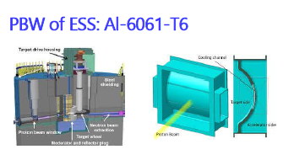
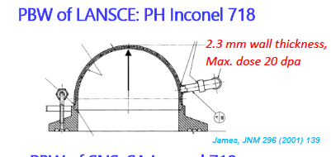
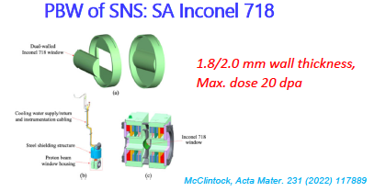
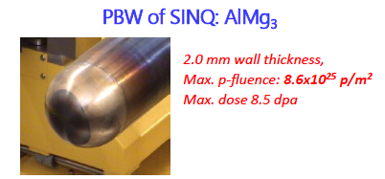
Post Irradiation Examination
Proton Beam Window (PBW): ESS+PSI Joint Project
Low scattering of proton beam (< 1%) => Low Z materials or thin wall structure with sufficient strength
High proton intensity => Excellent radiation tolerance
High energy intensity => Good thermal conductivity
ESS PBW: Al6061-T6 with 6-month service lifetime @ 5 MW beam
23

Slide 24
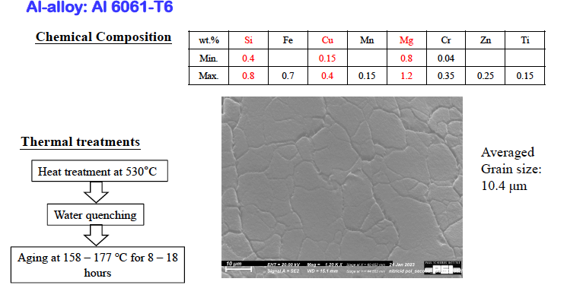
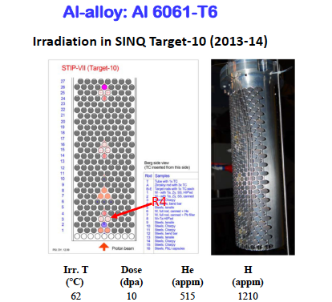
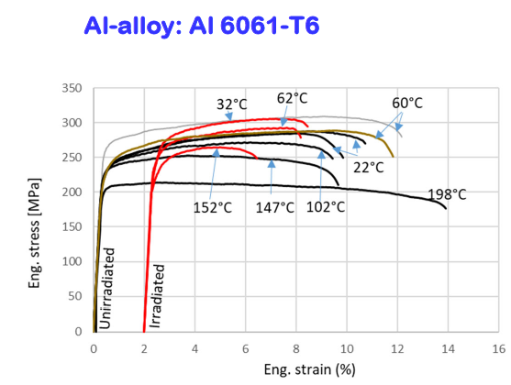
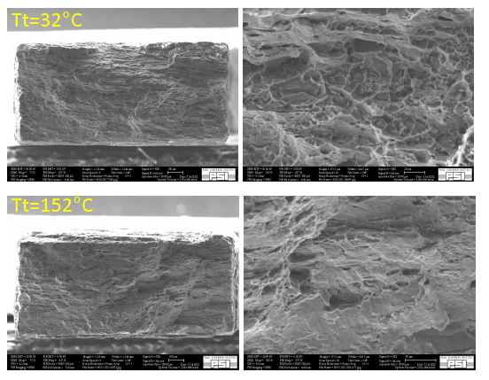
Post Irradiation Examination
Proton Beam Window (PBW)
PBW of ESS
Up to 11.1 dpa
@ 93 ℃
24

Slide 25
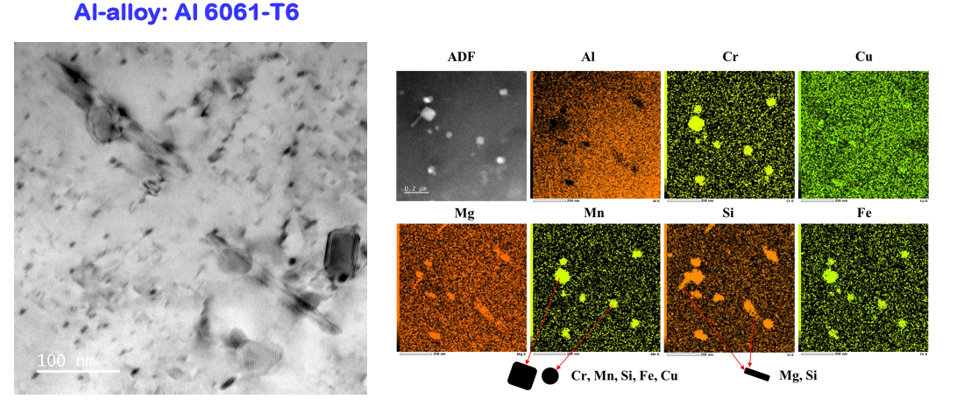
Post Irradiation Examination
Proton Beam Window (PBW)
Dissolution of needle-shaped β′′ phase precipitates detected after irradiation at 93°C
The dissolved needle-shaped precipitates largely recovered by annealing at 150°C for 1 hour
Ductility of Al6061-T6 decreased by ~50% after current irradiation, but remains at >5%.
25

Slide 26
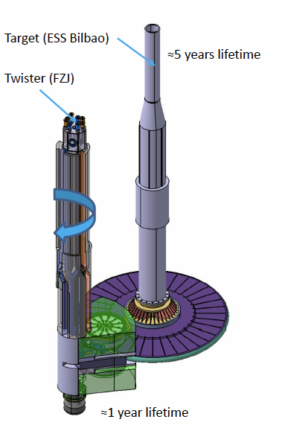
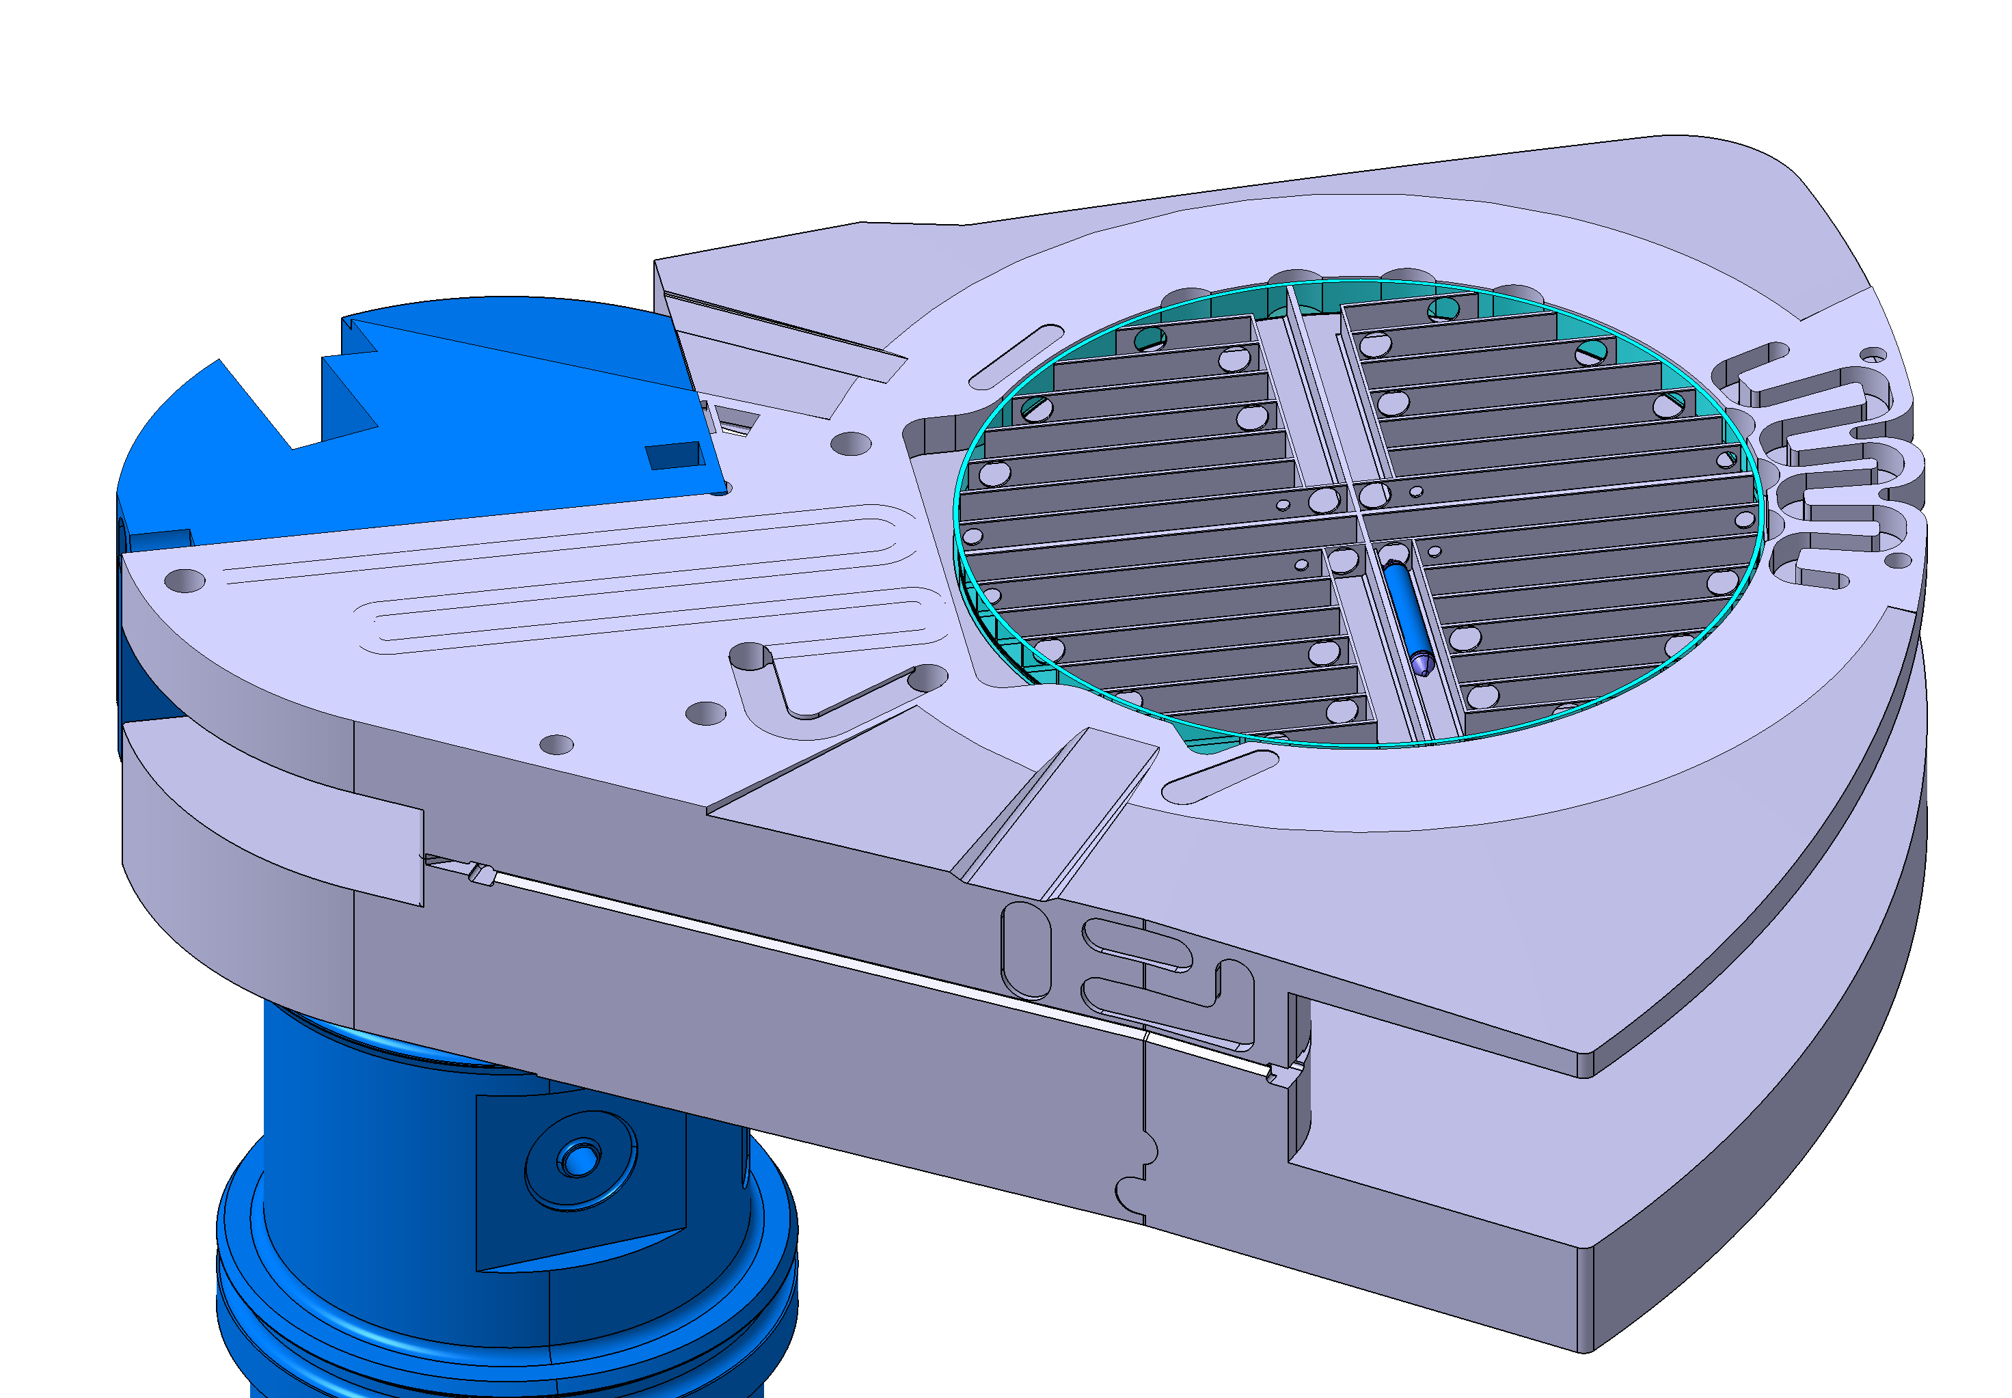
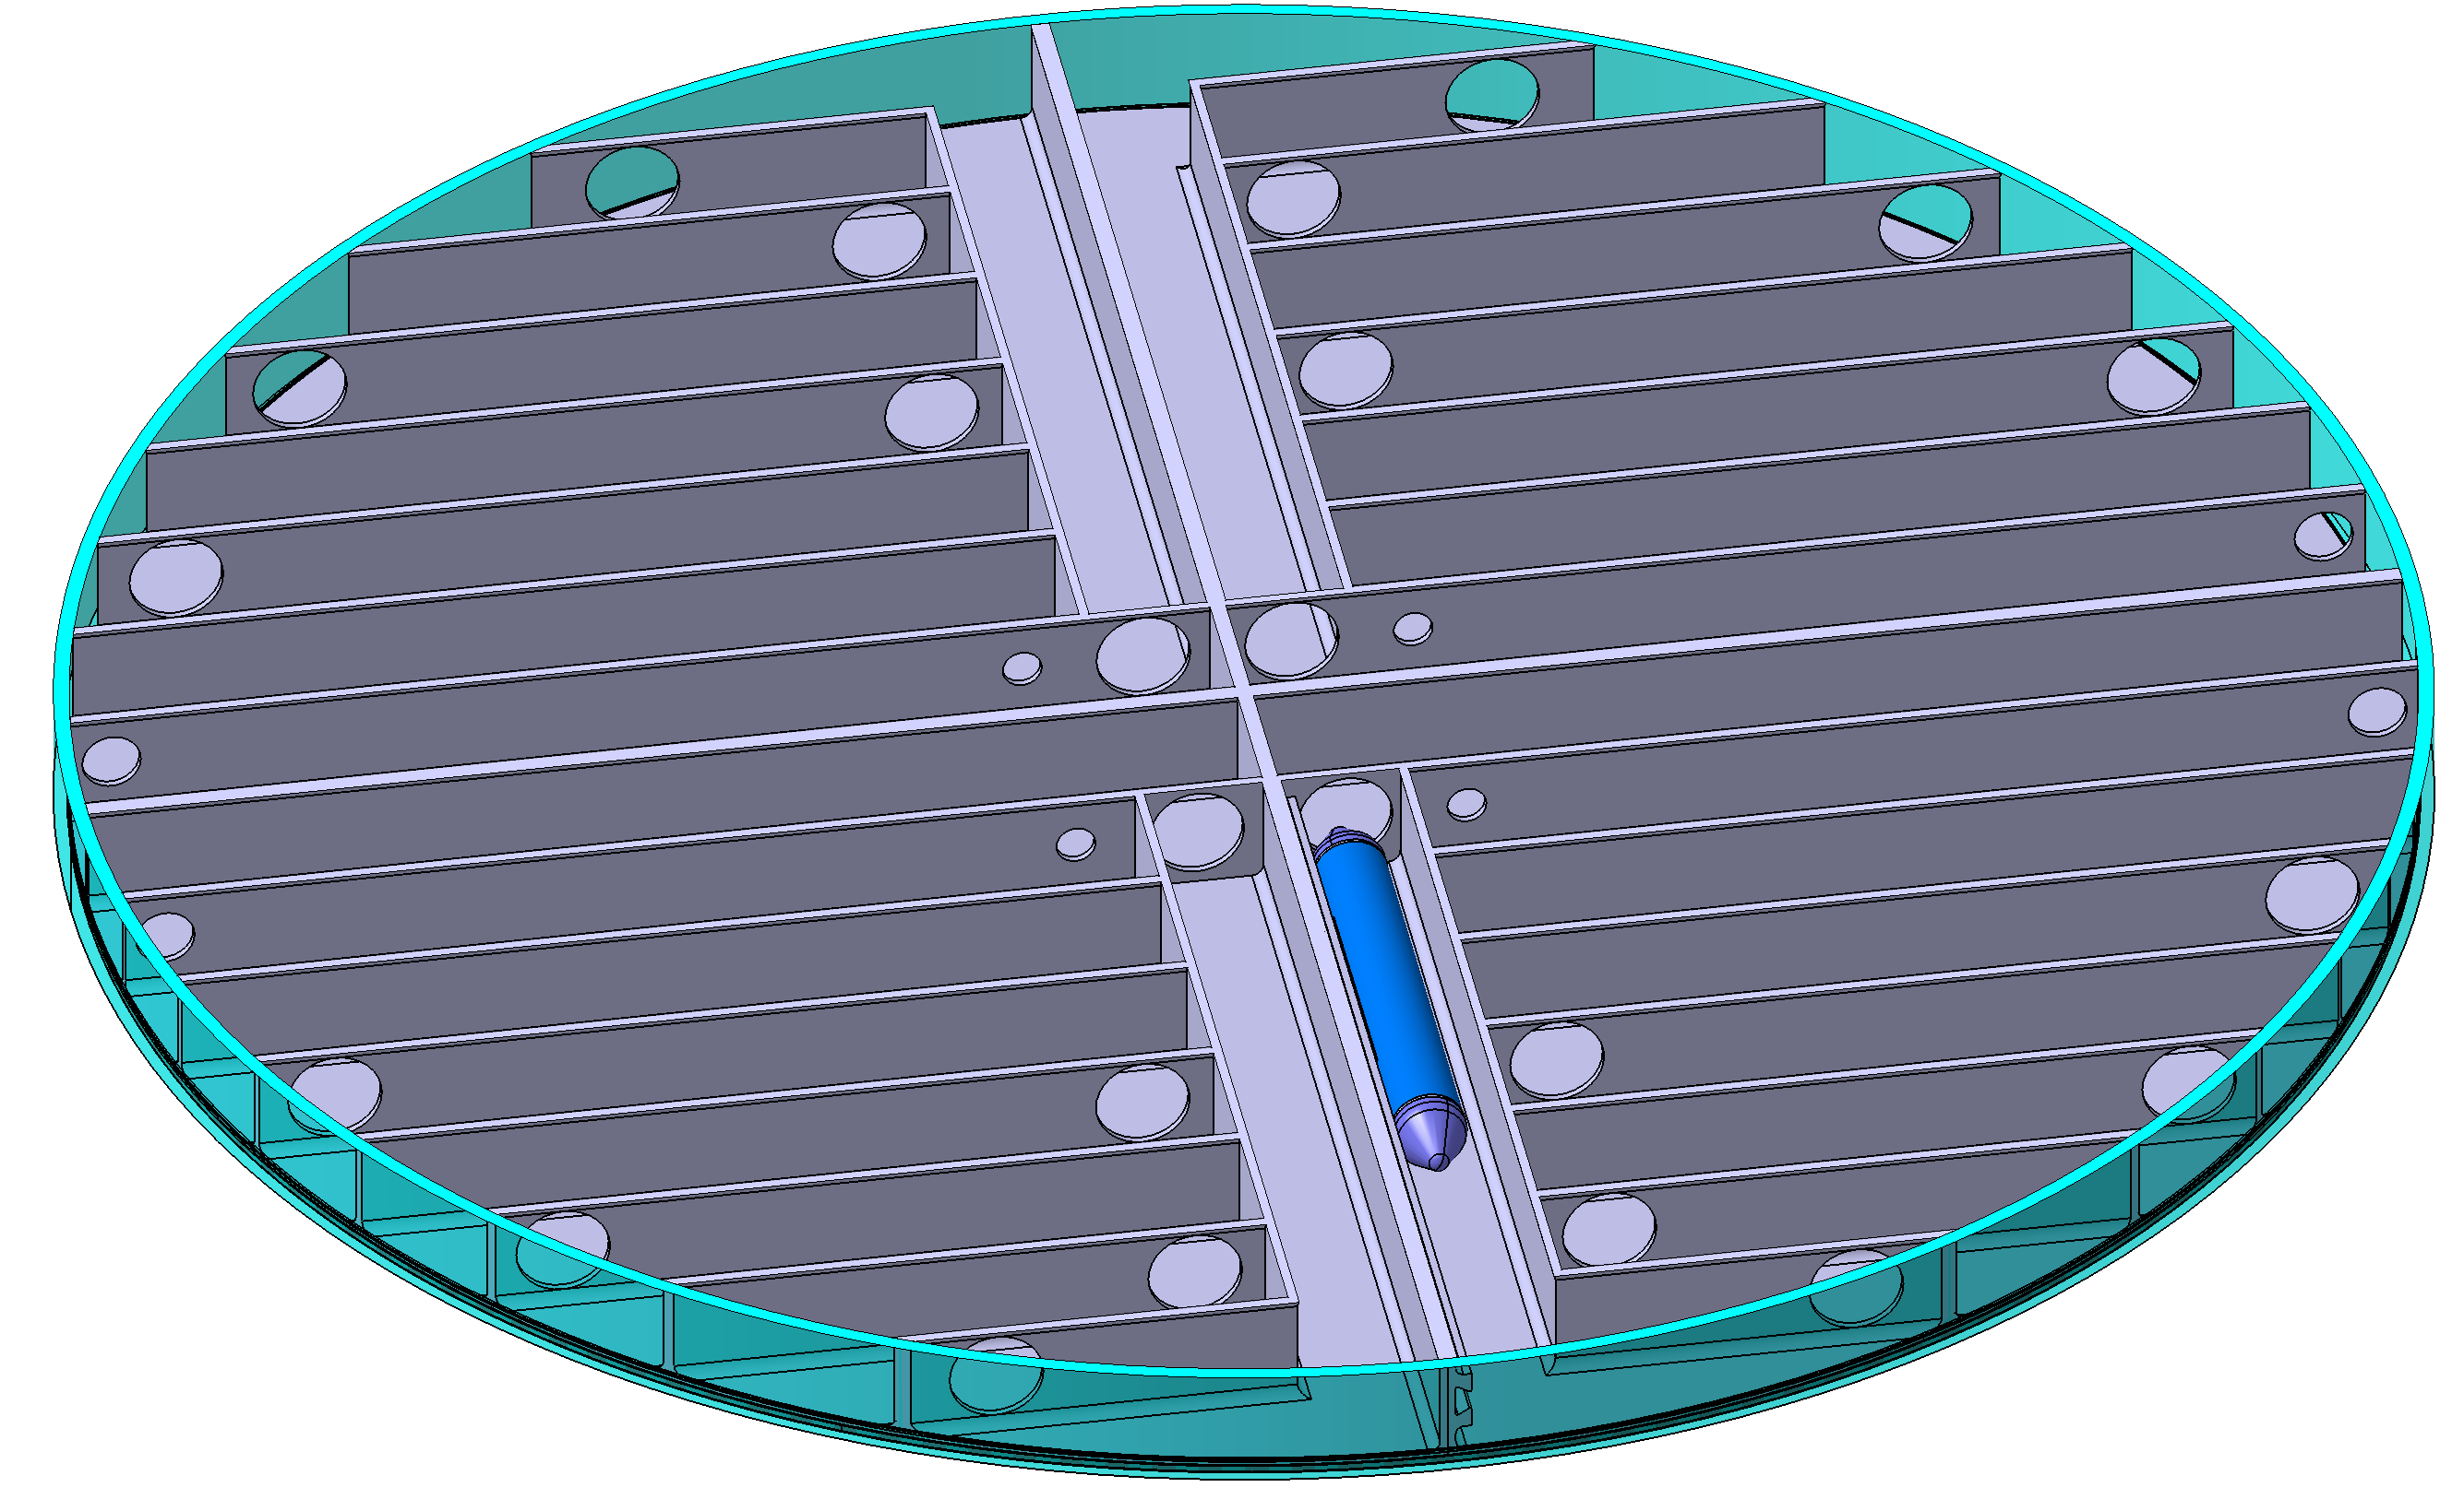
Post Irradiation Examination
Irradiation Module: ESS+...
Placed within the pre-moderator vessel
The irradiation time of 27000 MWh (5400 hours for 5 MW beam)
The calculated helium to dpa ratio is 15.6 (appm/dpa) while the dose varies between 3-7.5 dpa
Pre-moderator vessel
Proton beam
592 mm
Proton Beam
26

Slide 27
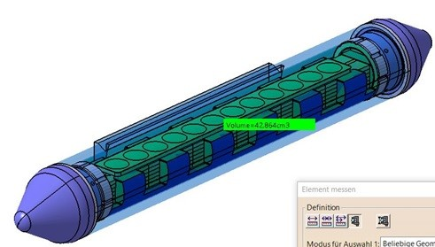
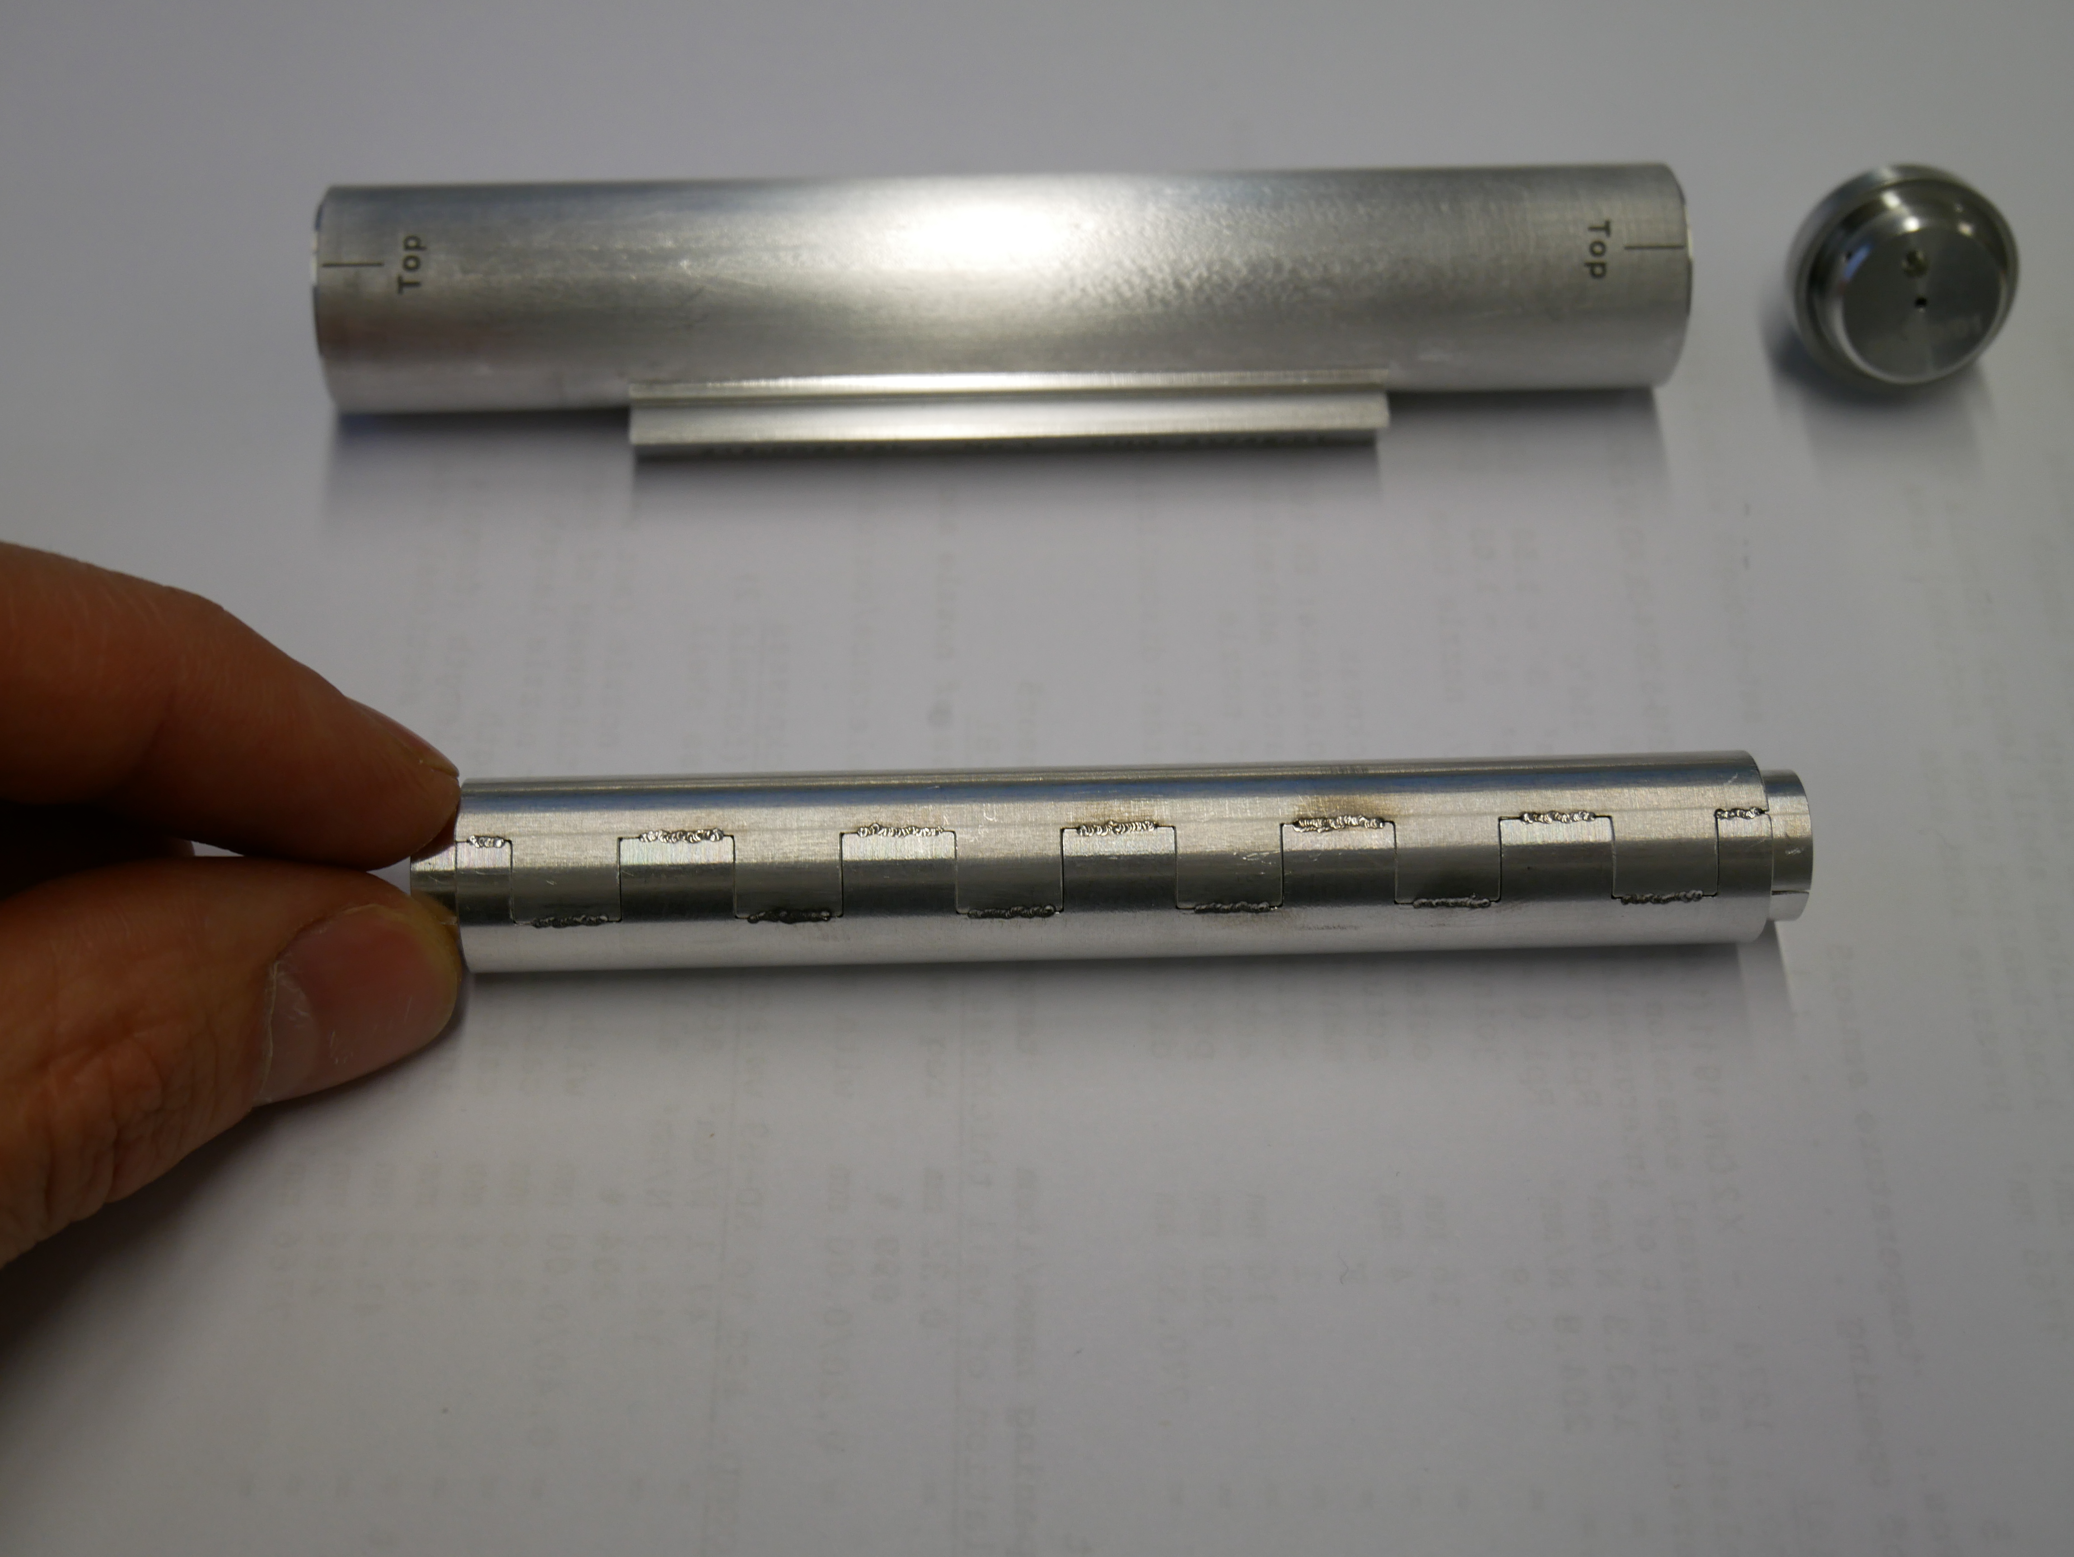
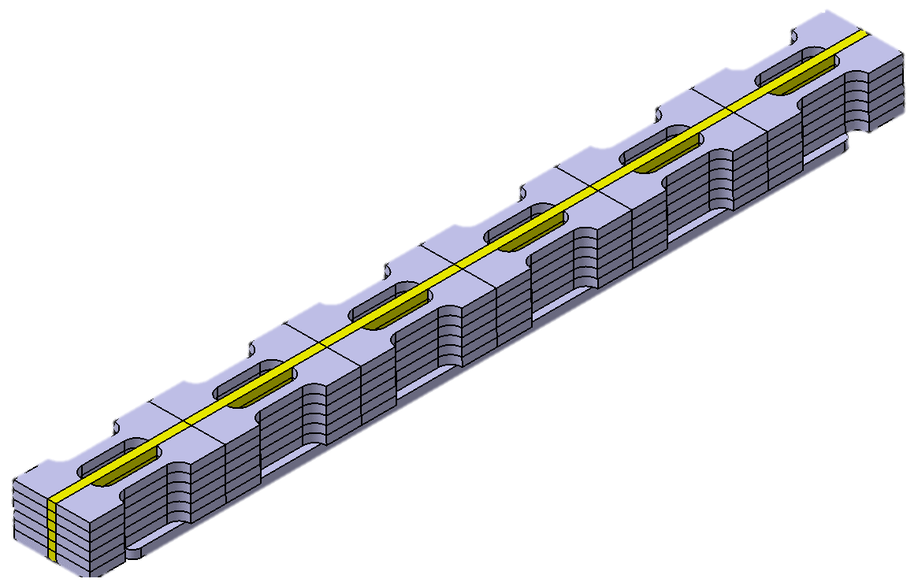
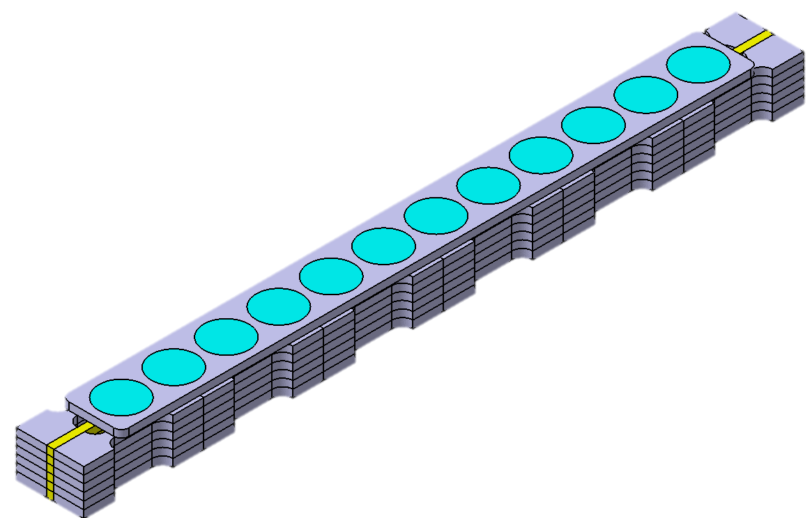
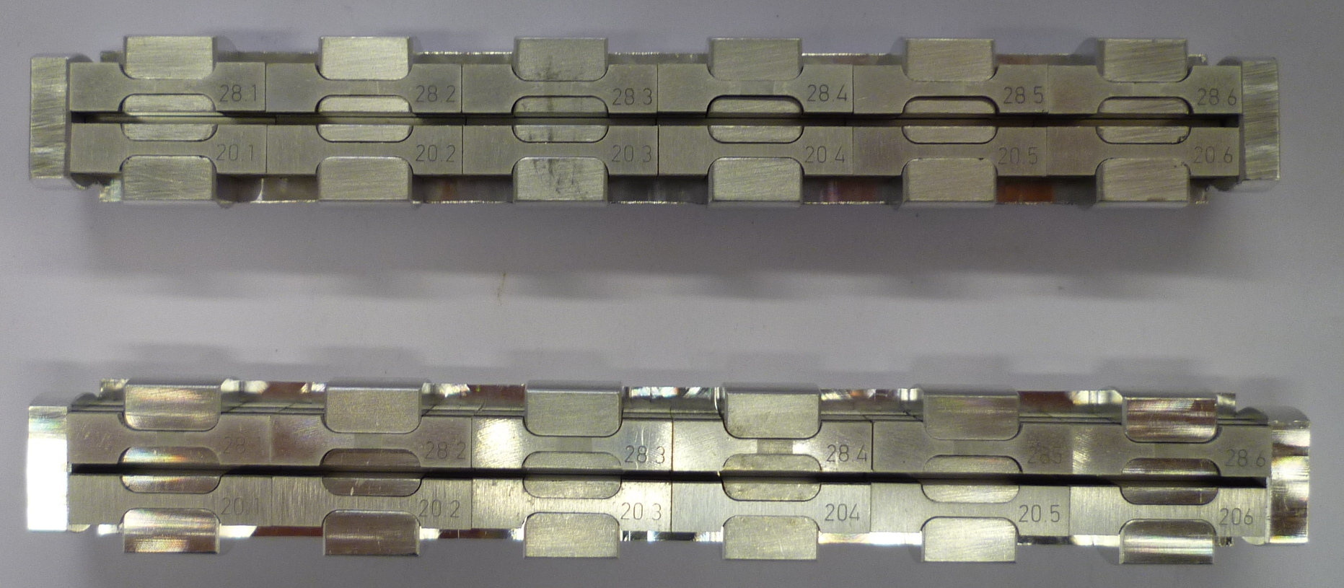
Post Irradiation Examination
Irradiation Module (Internal)
102.8 mm

Slide 28
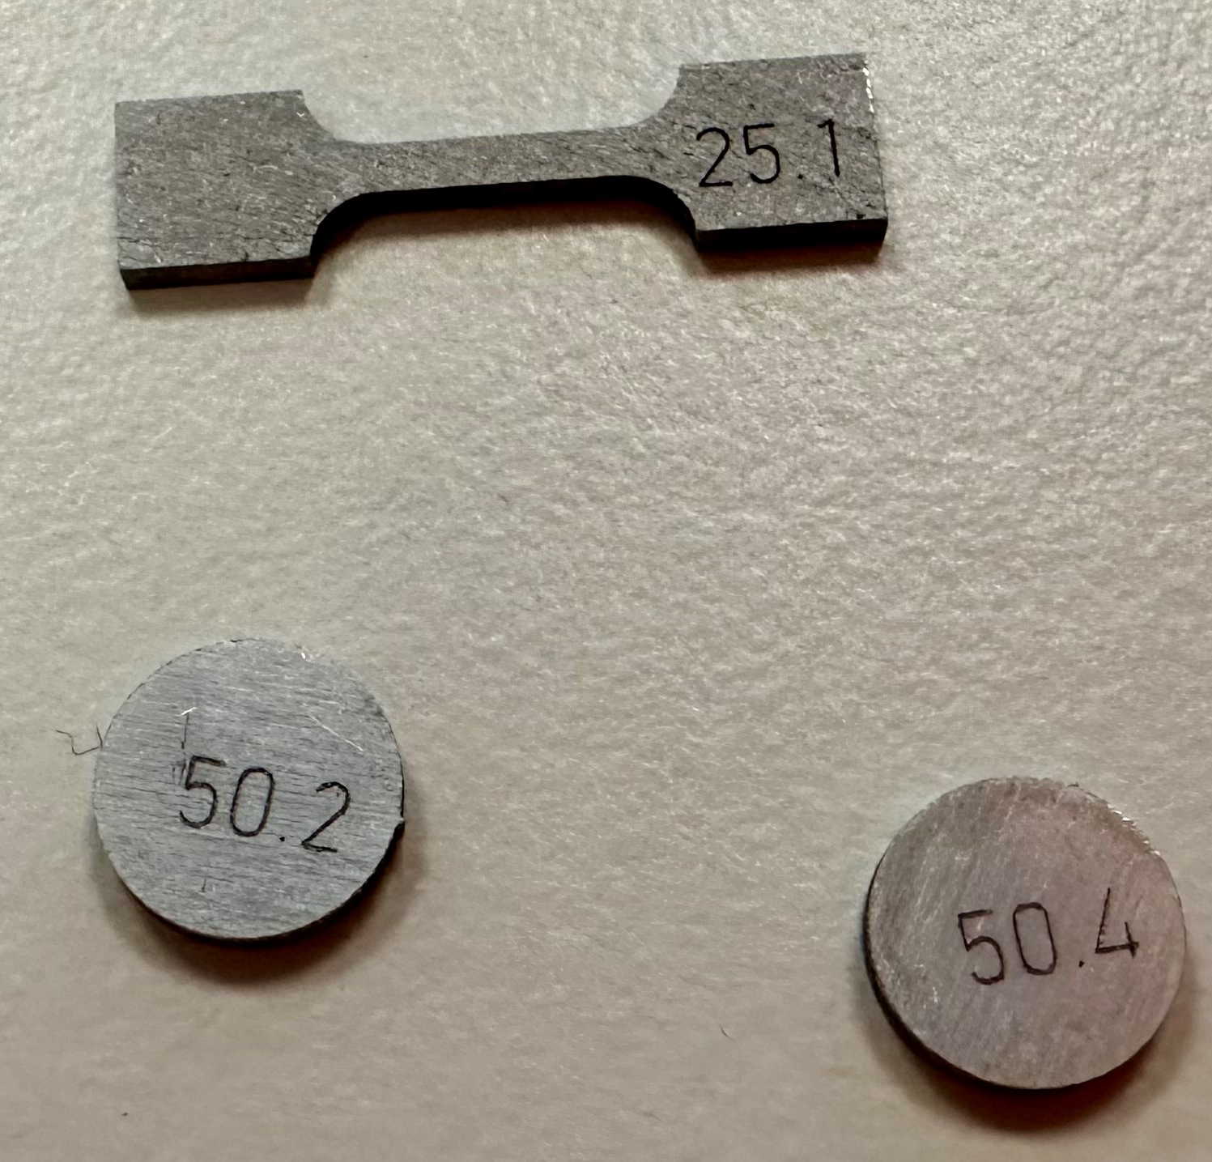
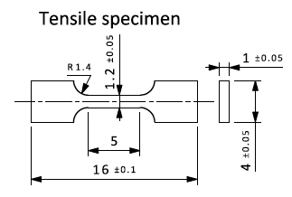
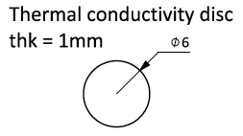
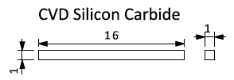
Post Irradiation Examination
Specimen list (IM-2)
Tensile test samples
LFA test samples
Electrical Conductivity (EC) samples

Slide 29
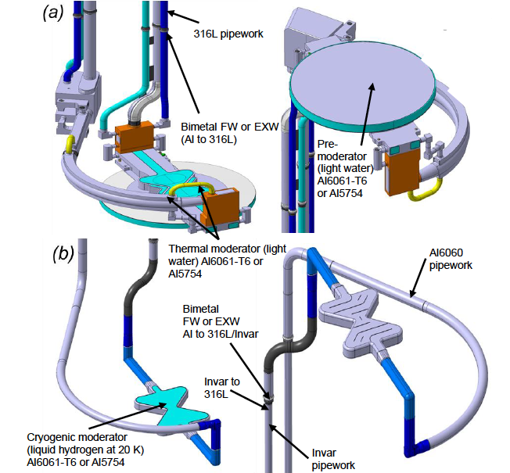
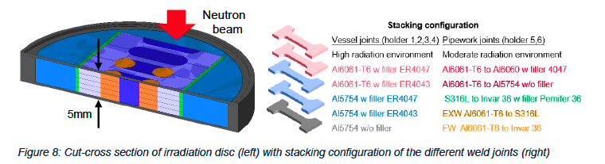
Post Irradiation Examination
Moderator-Reflector Plug (MRP)
Investigation of neutron irradiation effects on welded joints

Slide 30
Conclusion
Material verification is essential, particularly in in-kind delivery environments.
Establishing and developing in-house materials and analytical competence is critical to effectively support installation and commissioning activities.
Although often not prioritised during project completion due to time and budget constraints, PIE planning is essential for future upgrades, performance optimisation, and long-term development.

Slide 31
Thank You! ☺

