Slide 2
Radiolysis gas treatment for high-power neutron spallation source
System 1040
PRESENTED BY Larissa cunico

Slide 3

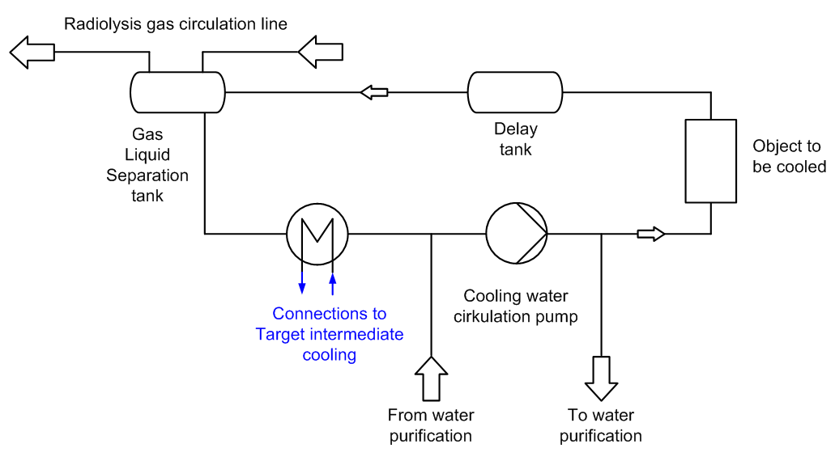
Primary Water Cooling Systems
Considerations
Water activation
Delay tank
Non-accessible rooms
Radiolysis
GLS tanks
Re-combiner system
300s
90s
Isotope | Half-life | Decay mode | Time step [0s] | Time step [90s]
³H | 12.3 y | β | 621.3 | 621.3
⁷Be | 53d | ECβ + γ[477keV ] | 445.1 | 445.1
¹¹C | 1223 s | β | 1473 | 1400
¹⁴O | 70.6 s | ECβ + γ[2.3MeV ] | 92.3 | 38.5
¹⁵O | 122 s | β | 4511 | 2723
¹⁶N | 7.1 s | β + γ[6.1MeV ] | 4462 | 0.8
Total |  |  | 12380 | 5657
Total activity in Curies, only isotopes contributing in excess of 10Cu at 60 s cooling are listed
(Esben Klinkby)
3

Slide 4
Radiolysis gas treatment system

Slide 5
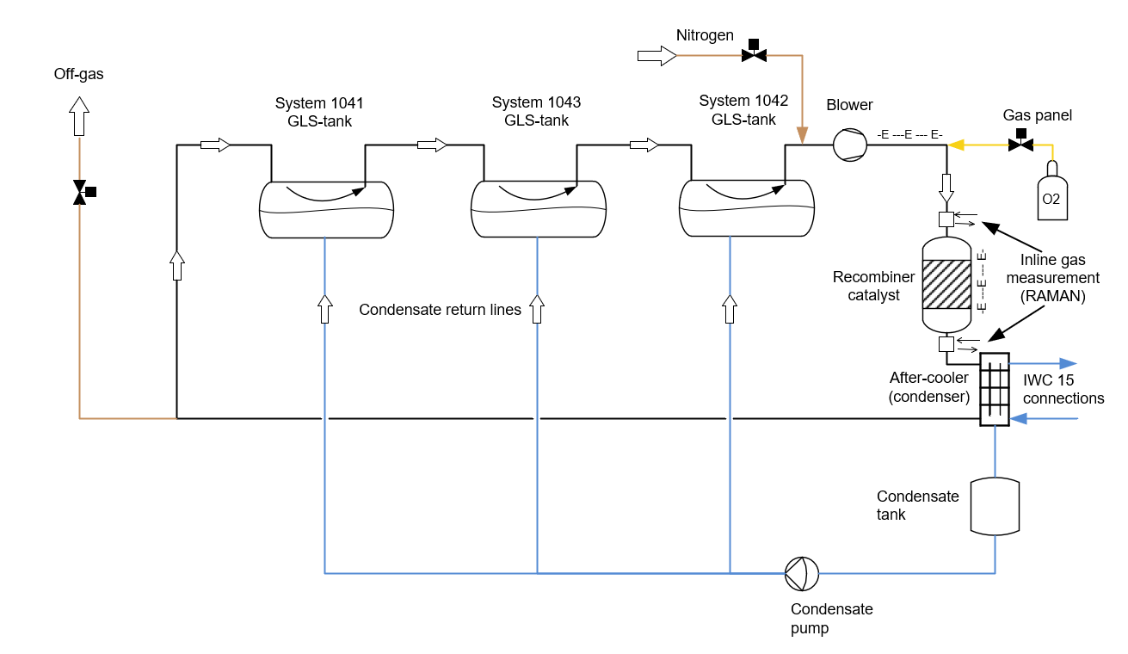
System Description
System 1040
Once in full operation, the main function of System 1040 is to control the accumulation of radiolysis and spallation gases generated in the Target Station cooling water.
Under irradiation, water radiolysis is the dominant process, producing hydrogen and oxygen, while additional gaseous species may arise from the spallation of water molecules and corrosion products.
Keep the non recombinable spallation gases contained until decay allows release to the atmosphere (160 minutes before it release)

Slide 6
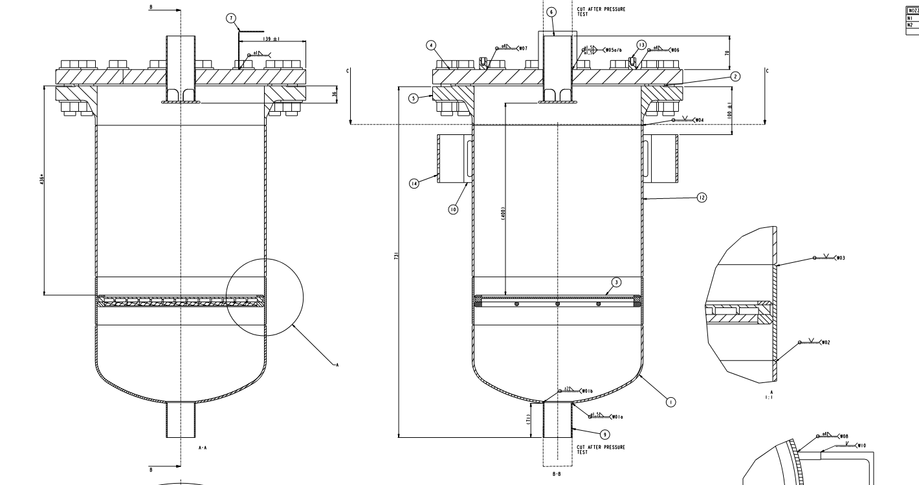
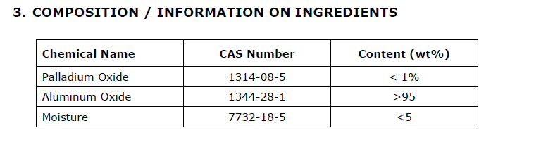
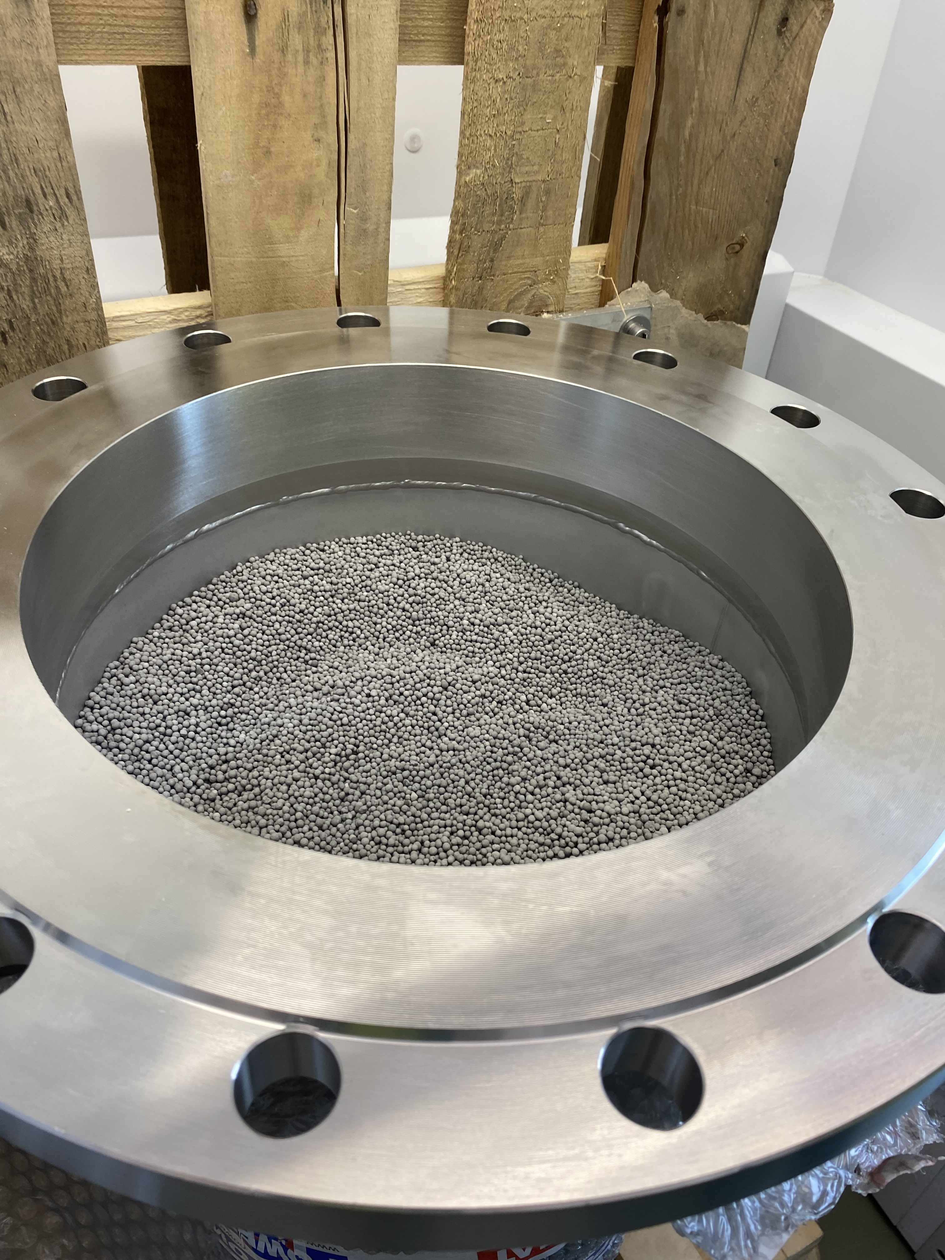
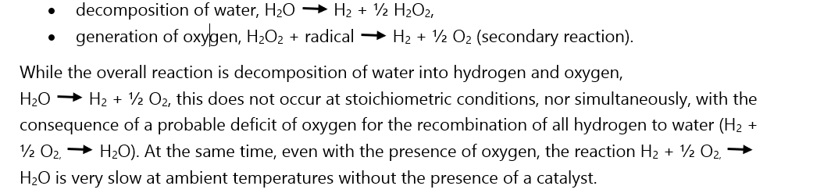
Catalyst OxiGone 130 Deoxo Catalyst from Research Catalysts Inc.
Catalyst reduces the activation energy required for hydrogen and oxygen to react and form water vapor. It reduces the downstream concentration of hydrogen to less than 10 ppm by volume. This reaction is highly exothermic.
Water does not decompose into hydrogen and oxygen directly, but rather into hydrogen, hydrogen peroxide, hydrogen radicals, and assorted oxygen compounds

Slide 7
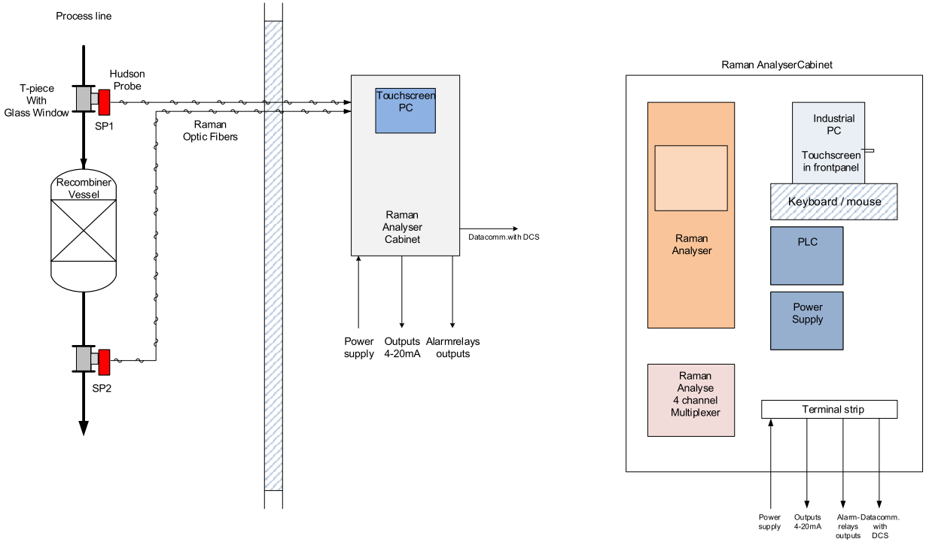
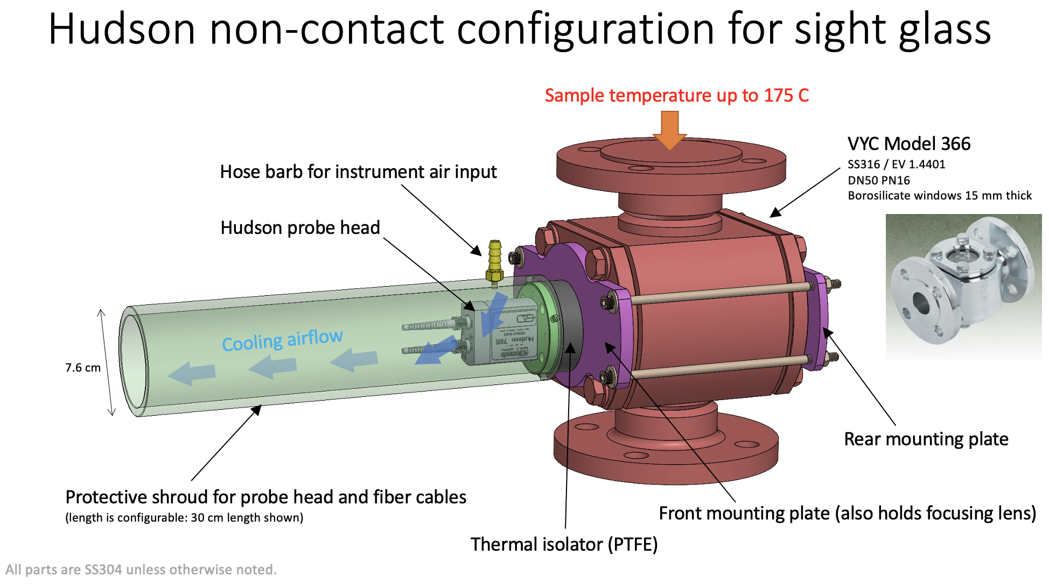
RAMAN gas analyser
The measurement of the gas concentrations is done with a RAMAN process analyser by supplier Aavos (Belgium):
Integration of signals obtained from the two measuring points with help of a multiplexor and a PC-based software program.
It has its own control cabinet together with a PLC for signal exchange with the main PLC for system 1040.
A third measuring point for instrument verification with sample gas is installed in the control cabinet for intermittent checks.

Slide 8
Test and comissioning

Slide 9
System test – Part 1
Inerting
Decrease the oxygen (from air) concentration in the gas loop to a level below 60% of the maximum allowed oxygen concentration, Maximum Allowed Oxygen Concentration (MAOC), (60% of MAOC = 3 % oxygen by volume) before transition to Running is allowed.
Replacing the loop gas (air or a mixture of air and nitrogen) with pure nitrogen until a pre-set oxygen concentration has been reached both upstream and downstream the recombiner (< 1.0 vol%)
As an example, starting at 21% oxygen (as in ambient air) will take approximately 2 h to reach an O2 level of 2% and 2 h and 30 minutes to reach an O2 level of 1% at a nitrogen flow of 3 g/s.

Slide 10
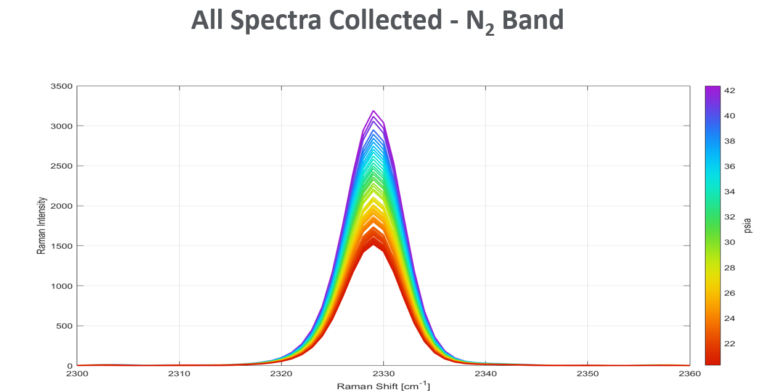
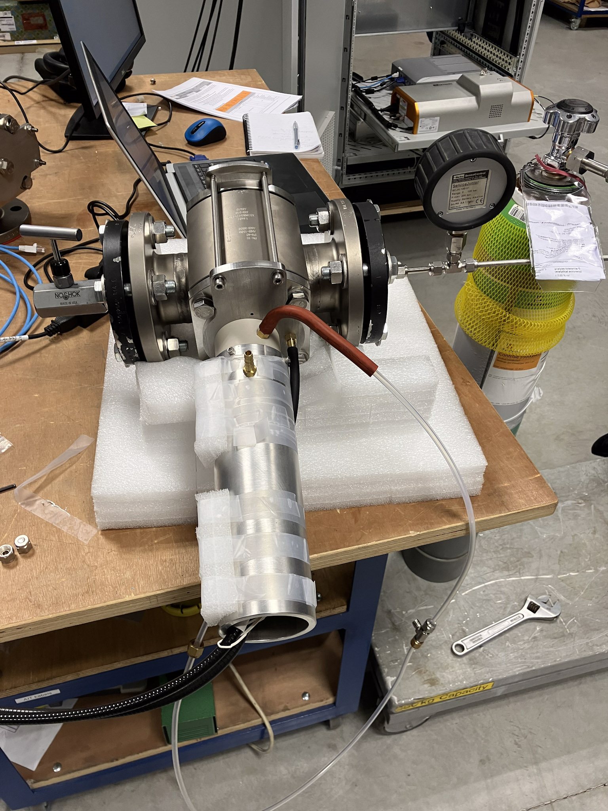
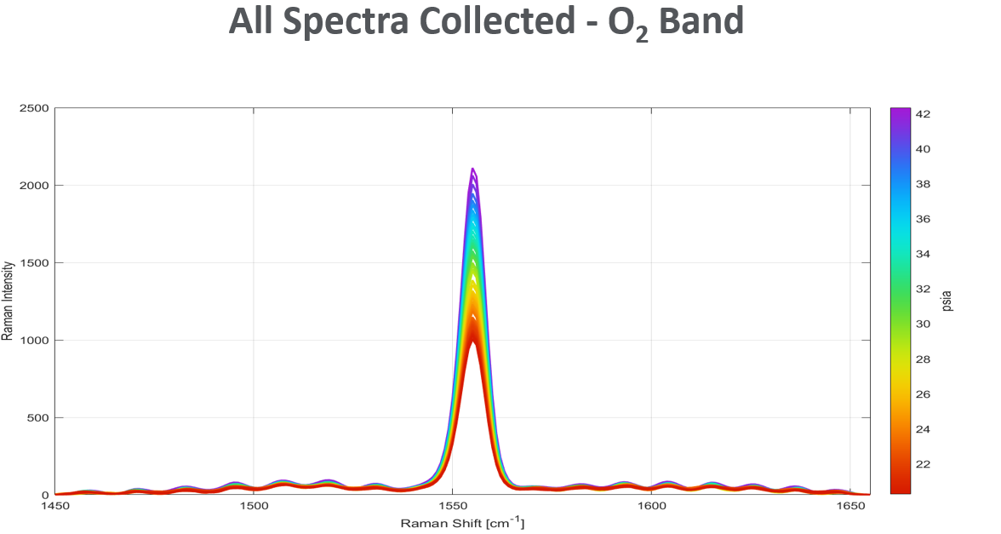
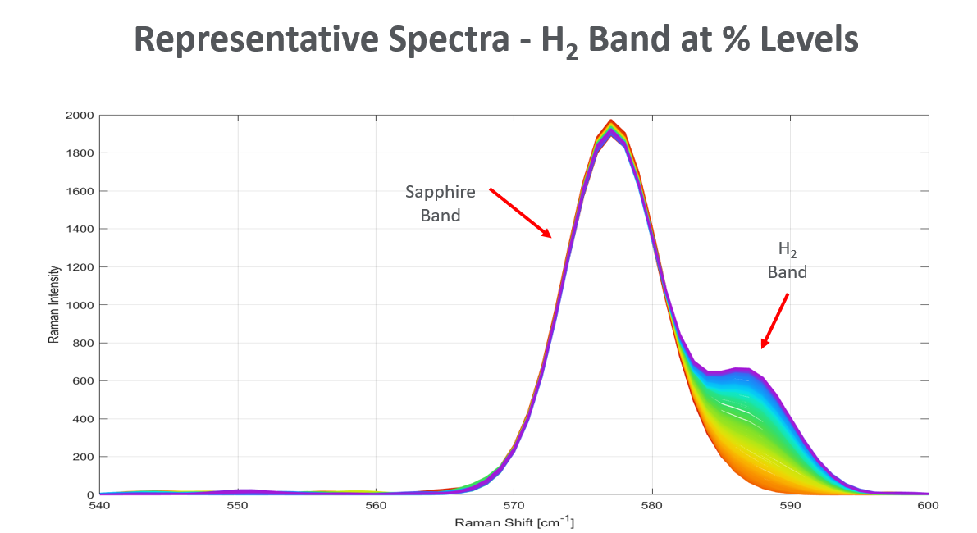
System test – Part 2
Test of RAMAN system and calibration
Use of Sampling gas:
Oxygen 2% mol in Nitrogen,
Hydrogen 2% mol in Nitrogen.

Slide 11
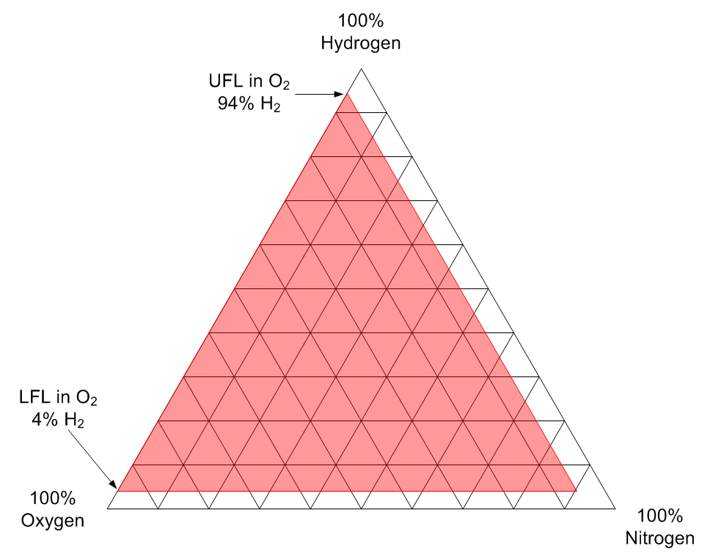
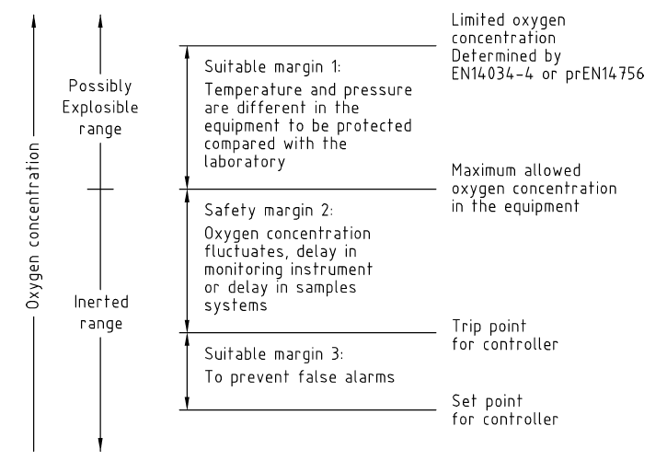
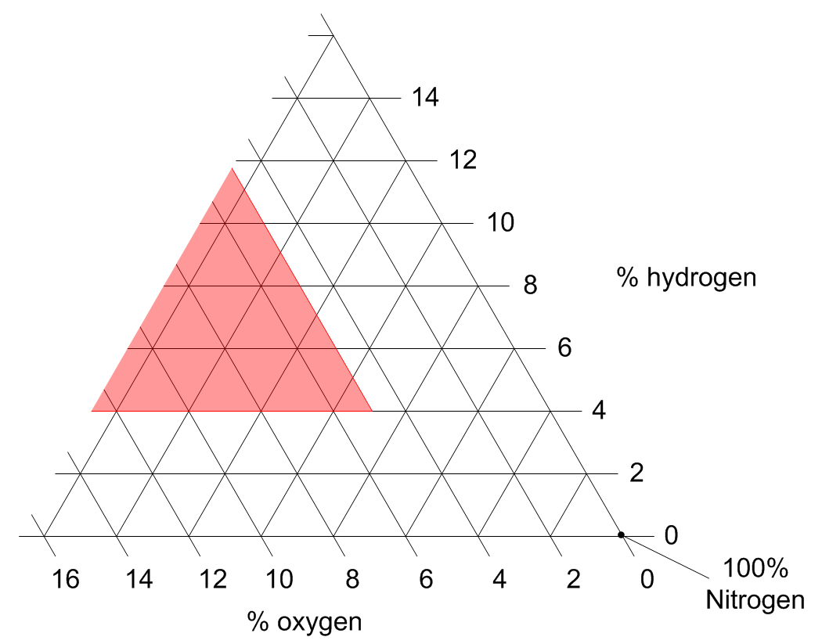
System test – Part 3
Final test with recombining function of the catalyst
Defined amounts of oxygen and hydrogen introduced in the circuit and measure with the Raman process analyser. Hydrogen in oxygen, the Lower Flammability Limit (LFL) is approximately 4%, while the Limiting Oxygen for Combustion (LOC) is approximately 5% at 1 atm and 21°C.
During operation, system 1040 is connected to machine protection system (MPS) that stops proton-beam – which stops water spallation.
H2 concentration 1 vol%, O2 concentration 2.5 vol% in gas loop after catalyst vessel.
Raman Gas Analyser not functional
No flow or no blowers running
Higher temperature after catalyst vessel than expected

Slide 12
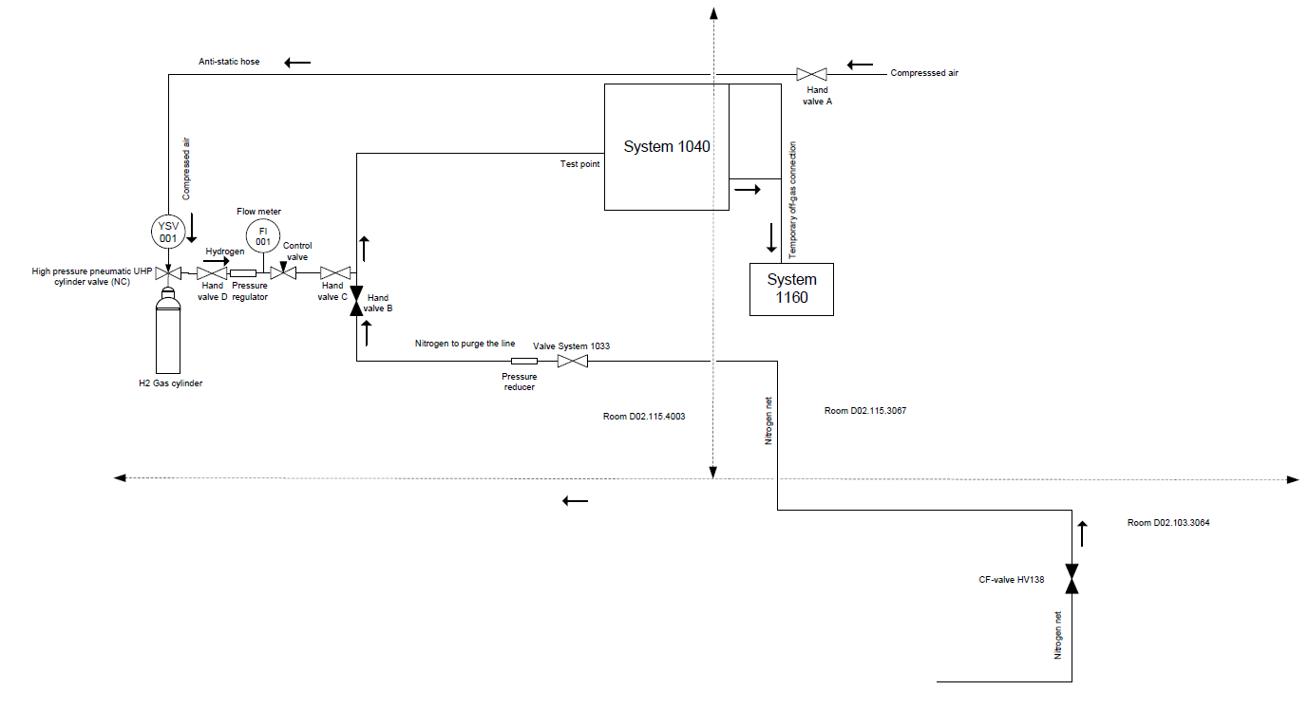
System test – Part 3
Injection of hydrogen
Fail-safe design: High-pressure pneumatic UHP valve, fail-safe closed; compressed air via Hand Valve A located in the side room.
Purging procedure: Hand Valve B used only for nitrogen purging before hydrogen introduction; nitrogen supply valve CF-HV-138 closed after N₂ addition.
Off-gas handling: Temporary connection to System 1160 used as Off-gas System 1140 was not operational at the time.
Safety & operations: Restricted activities in room during hydrogen use; threaded cylinder connections with supported piping/hoses.

Slide 13
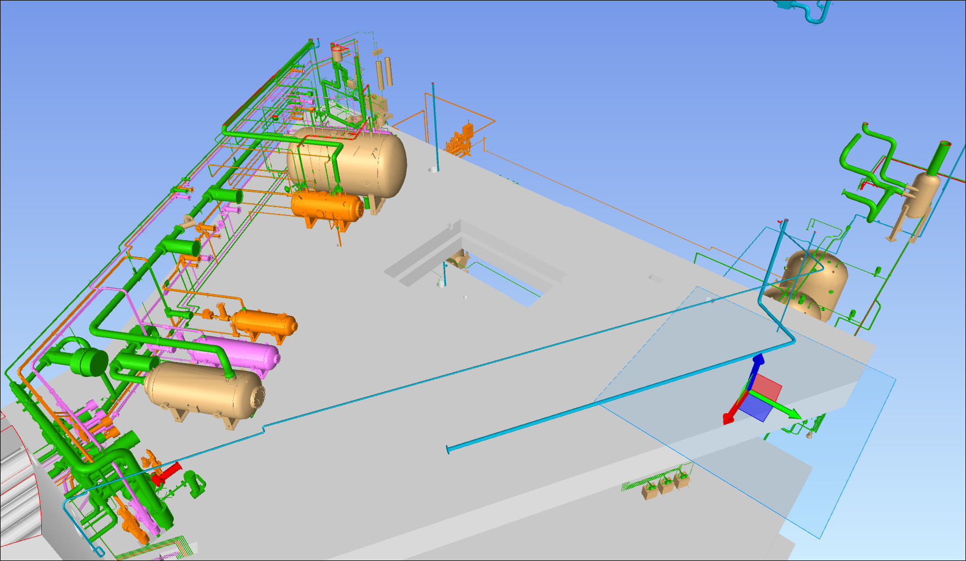
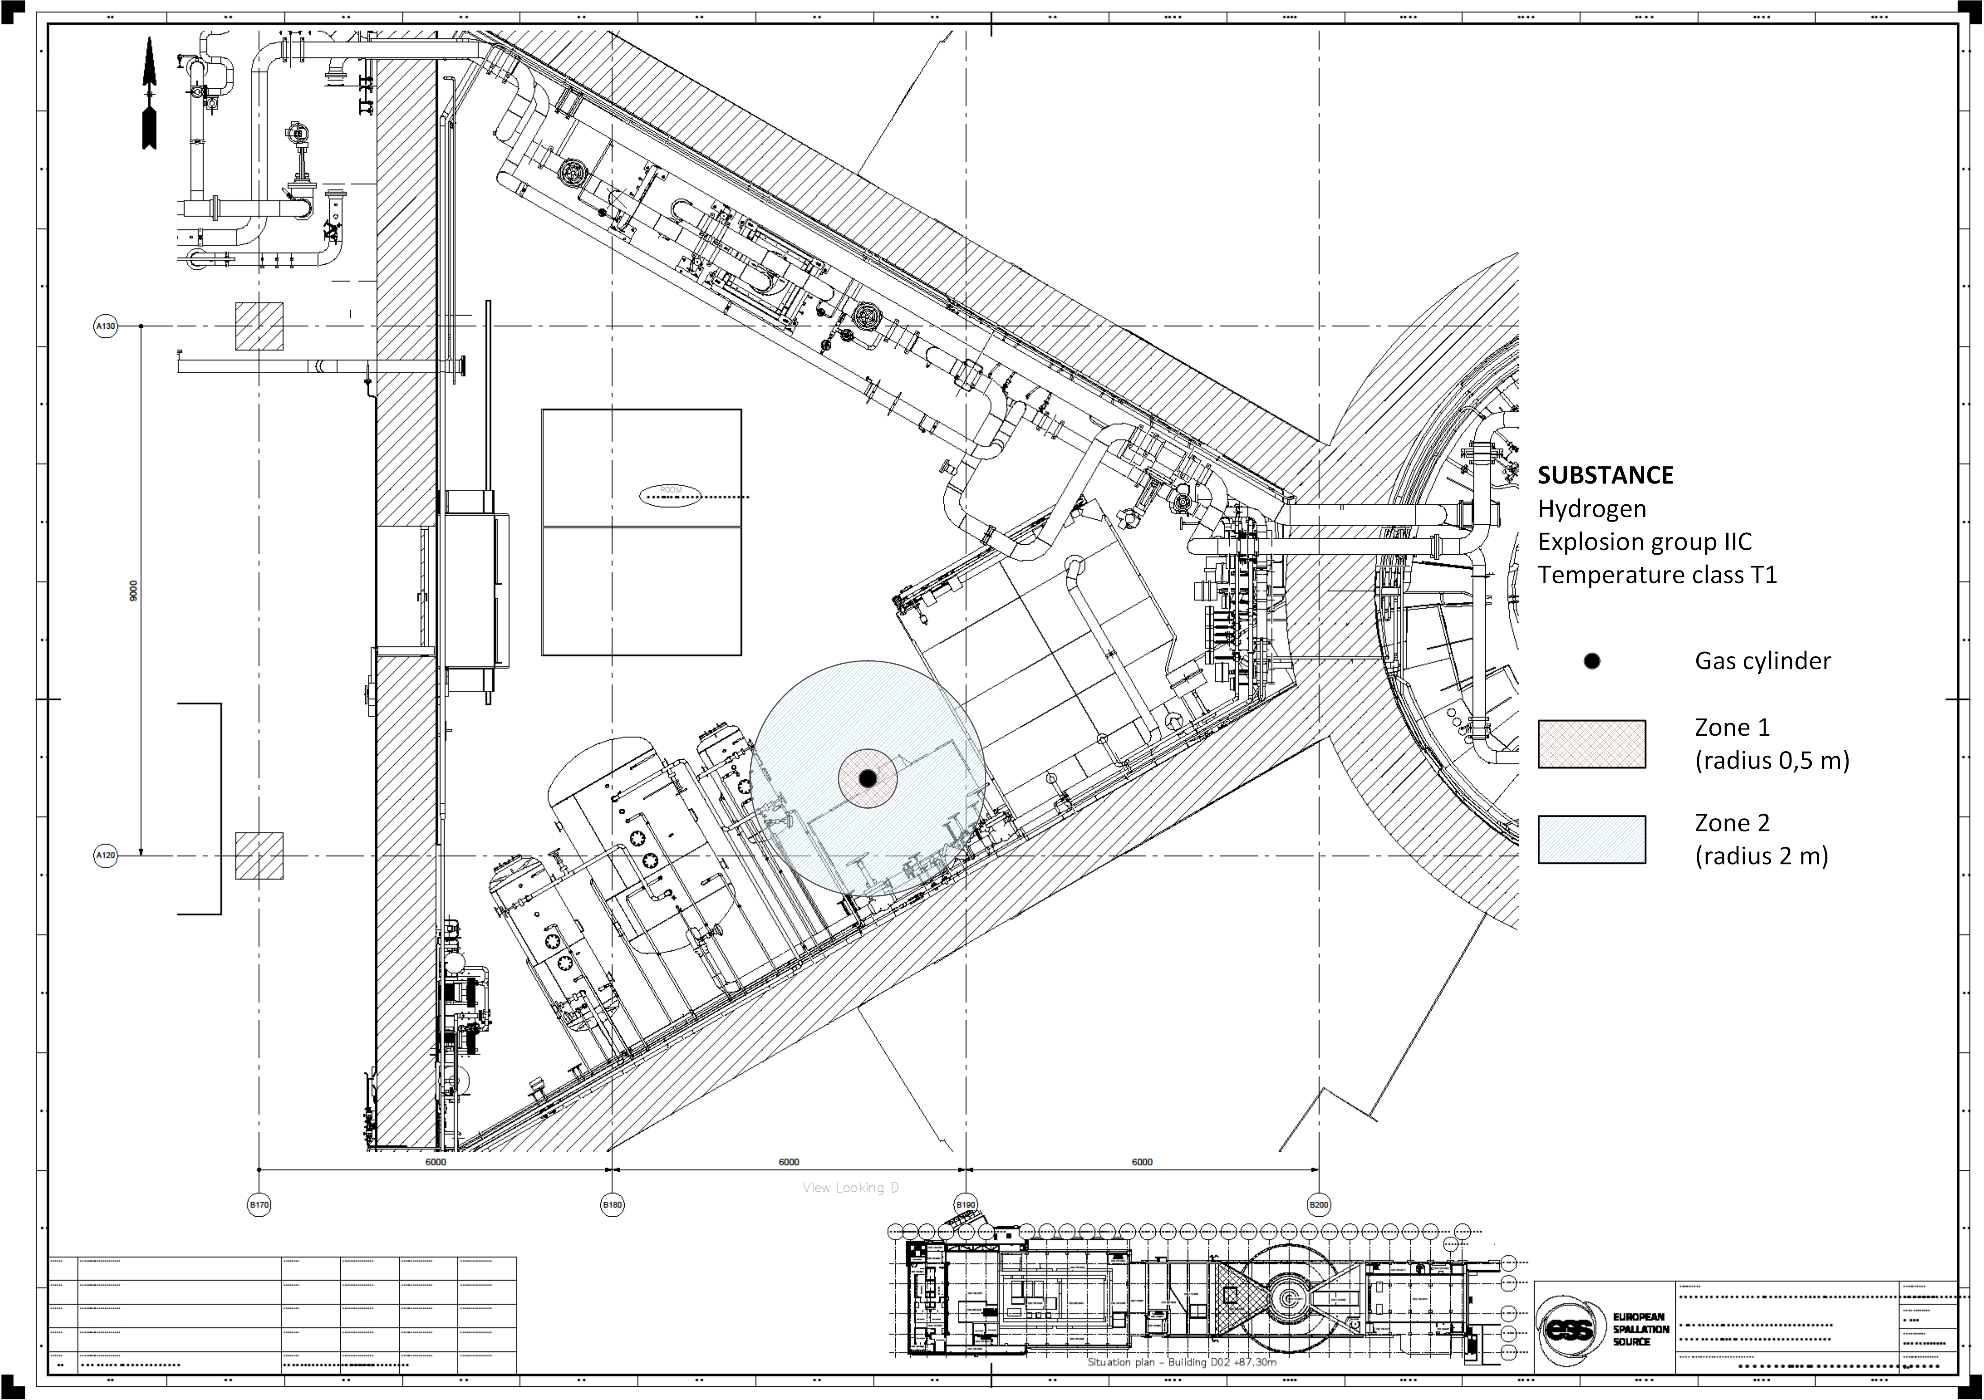
System test – Part 3 - continuation
Final test with recombining function of the catalyst
During the tests we will release air, nitrogen and traces of hydrogen will be vented using System 1160.
System 1040
Placement of O2 cylinder
Room D02.115.3067
System 1160
GLS Systems 1041, 1042, and 1043
Placement of H2 cylinder
Room D02.115.4003

Slide 14
System test – Part 3 - Results
Final test with recombining function of the catalyst
8:47
11:25
9:36
10:06
N2 purging started
Measurement accuracy for O2: ±0.5 vol%
Almost no variation in concentration H2 after catalyst observed until no O2 was available for the reaction

Slide 15
System test – Part 3 - Results
Temperature
Introducing H2
8:47
10:06
9:36
Bigger amount of H2
Less O2 to react
Heater in main loop to avoid condensate affects gas temperature before catalyst (35-65 °C)

Slide 16
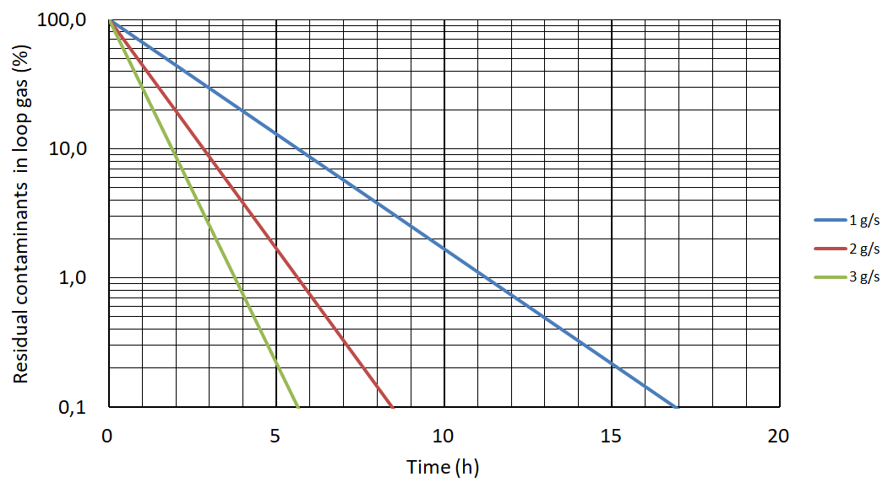
Maintenance
Flushing
Reduction of loop gas contaminates using Nitrogen purging in during Maintenance (used during Shut-down procedures if needed).
Reduction of contaminants f = (nitrogen purging time)

Slide 17
What’s next?
Group Tests: System was running together with other water systems 24/7. More tests will be performed until BoT (June and October).
Yearly maintenance: Supplier visit for inspection and calibration. Issues observed with optical fiber and multiplexer. Troubleshooting ongoing.
BoT: Production of first water radiolysis and spallation gases.

Slide 18
Thank you.

