Slide 1
Target HVAC system at the ESS research facility and its role in neutron production
PRESENTED by ANNA BIELIAIEVA
NUCLEAR VENTILATION ENGINEER
System owner target hvac and off-gas systems

Slide 2
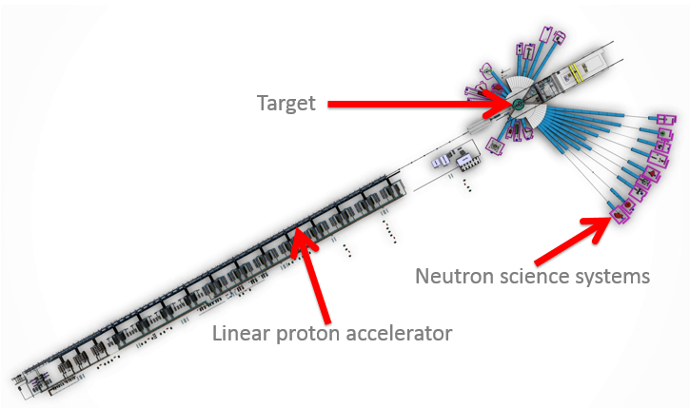
ESS overview

Slide 3
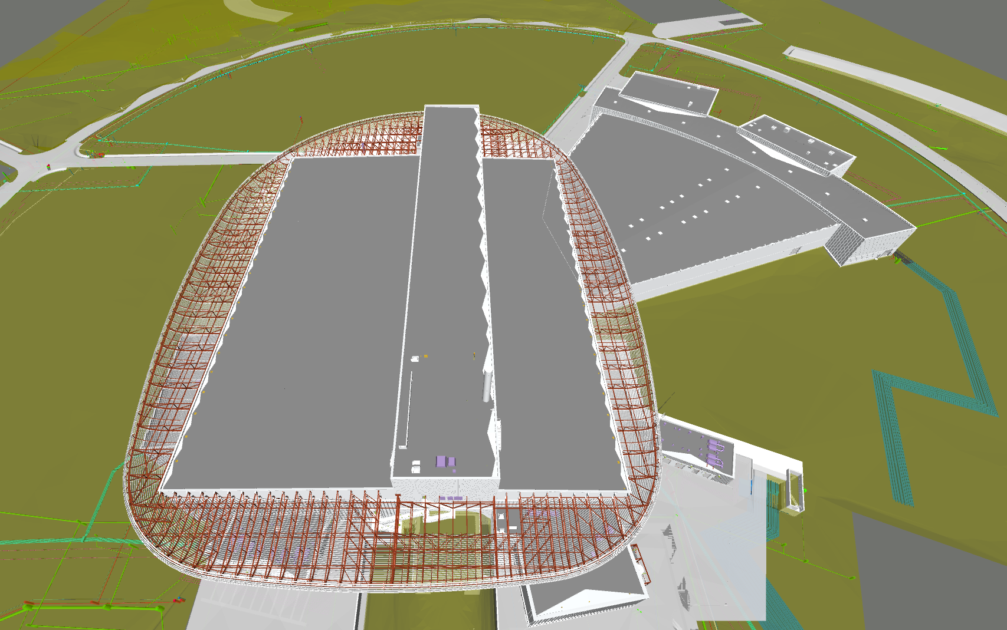
Target building (D02)

Slide 4
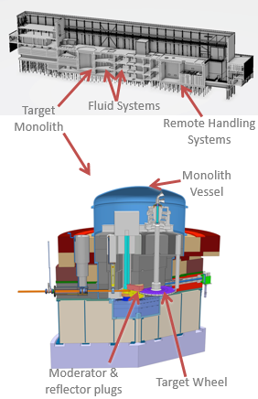
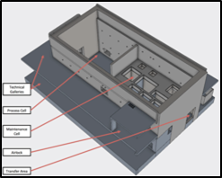
Target station overview
Target Station volume:≈75000 m3 (High Bay 45000 m3);
Number of rooms: ≈50;
Presence of airborne contamination/air activation (Active Cell, Utility Rooms, Connection Cell);
Presence of toxic (hypoxic) gases (Hydrogen room, Utility rooms, Connection Cell);
Presence of explosive gases (Hydrogen room).

Slide 5
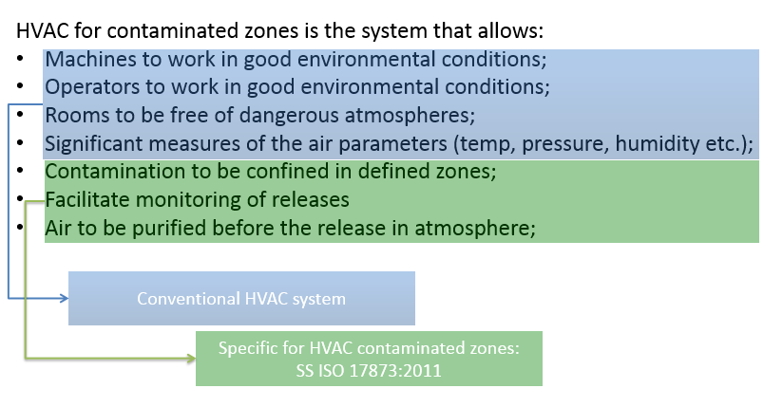
Target HVAC system function for neutron production

Slide 6
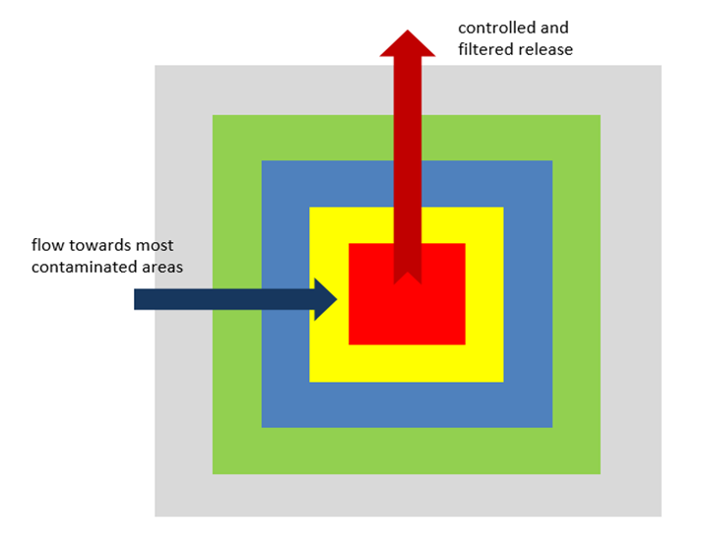
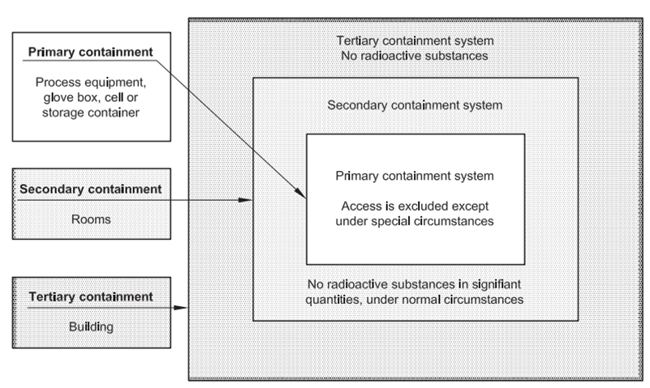
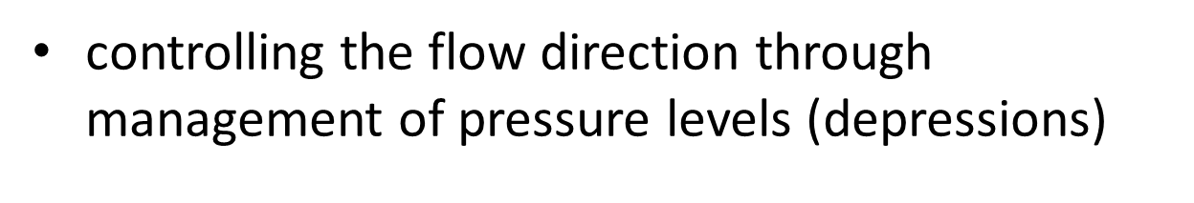
Contribution to confinement function

Slide 7
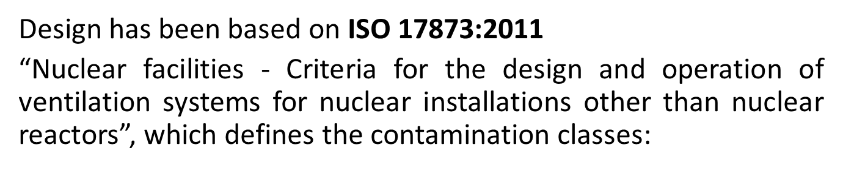
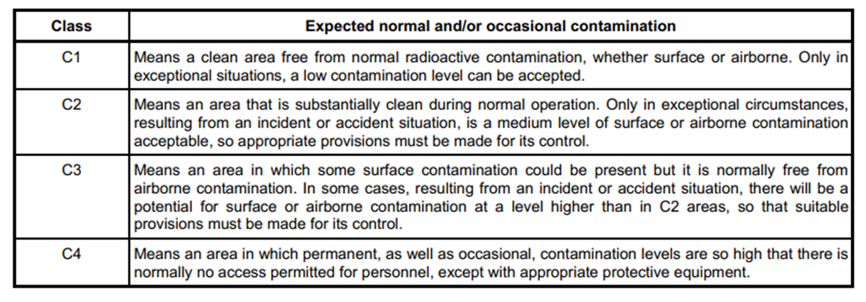
TS HVAC Design

Slide 8
TS HVAC subsystems
=ESS.TS.ISS.G01
Environment Monitoring System:
=ESS.TS.ISS.G01.B01 1130 Environment Monitoring System – pressure, temperature and humity
Ventilation systems:
=ESS.TS.ISS.G01.G01 1131 Air supply for zones C1, C2 and C3 (technical gallery)
=ESS.TS.ISS.G01.G02 1132 Air exhaust from zones C1, C2
=ESS.TS.ISS.G01.G03 1134 Outlet of exhaust gases (from Transport hall)
=ESS.TS.ISS.G01.G04 1135 Air supply for zones C3 (Utility)
=ESS.TS.ISS.G01.G05 1136 Air exhaust from zone C3
=ESS.TS.ISS.G01.G06 1137 Air exhaust from zone C4 (Active Cell)
Water circuits:
=ESS.TS.ISS.G01.W01 1138 Hydraulic system for TS HVAC - Hot water system feeding AHUs
=ESS.TS.ISS.G01.W02 1138 Hydraulic system for TS HVAC - Hot water system feeding FCs
=ESS.TS.ISS.G01.W03 1138 Hydraulic system for TS HVAC - Heat recovery system
=ESS.TS.ISS.G01.W04 1139 Hydraulic system for TS HVAC - Cooling water system feeding AHUs
=ESS.TS.ISS.G01.W05 1139 Hydraulic system for TS HVAC - Cooling water system feeding FCs

Slide 9
Ventilation systems (C1, C2 classes)
=ESS.TS.ISS.G01.G01 and =ESS.TS.ISS.G01.G02
dedicated to High Bay, Transport Hall, Personal Access Block, Technical Galleries and Active Cell Facility (only supply air)
two redundant air handling units control the temperature of the air supplied to the premises through galvanized steel air ducts
air heaters and coolers cover higher local loads
two reduntant exhaust fans extract air from the premises through the ductwork from painted carbon steel
single stage HEPA filter assemblies
discharge outside through the stack

Slide 10
Ventilation systems (C3, C4 classes)
=ESS.TS.ISS.G01.G04, =ESS.TS.ISS.G01.G05 and =ESS.TS.ISS.G01.G06
dedicated to Utility Block and Active Cell Facility (only exhaust air)
two redundant air handling units control the temperature of the air supplied to the premises through galvanized steel air ducts
air coolers distributed the Utility Block cover higher local loads
two reduntant exhaust fans extract air from the premises through the ductwork from painted carbon and stainless steel
two stages of HEPA filter assemblies
discharge outside through the stack

Slide 11
Main components
Target HVAC
4 air handling units (2 working and 2 redundant)
7 exhaust fans (4 working and 3 redundant)
13 HEPA filters stations (63 filter cassets in total)
over 100 dampers both motorized and manual
9 local air heating units, 3 electrical radiators
galvinized, carbon steel painted and stainless steel ductwork
heating and cooling water distribution pipework
propylene glycol heat recovery loop

Slide 12
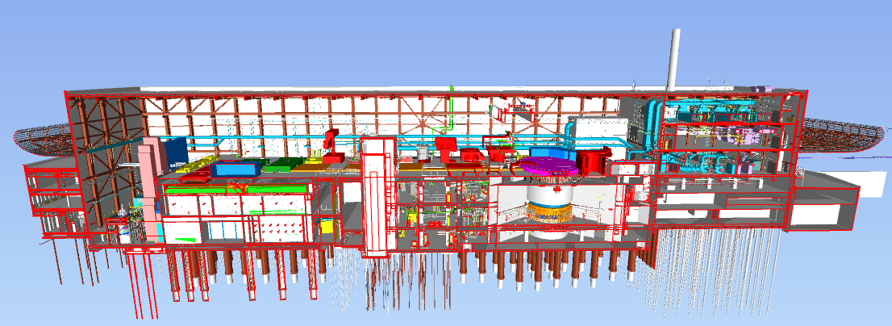
TS HVAC technical rooms
Accelerator to Target (A2T) area

Slide 13
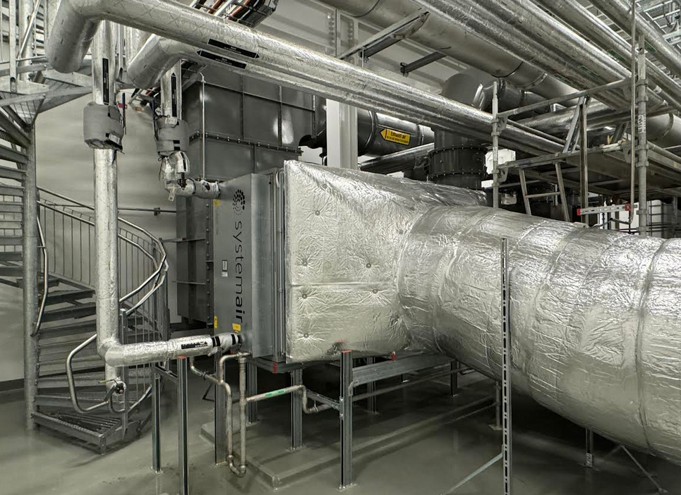
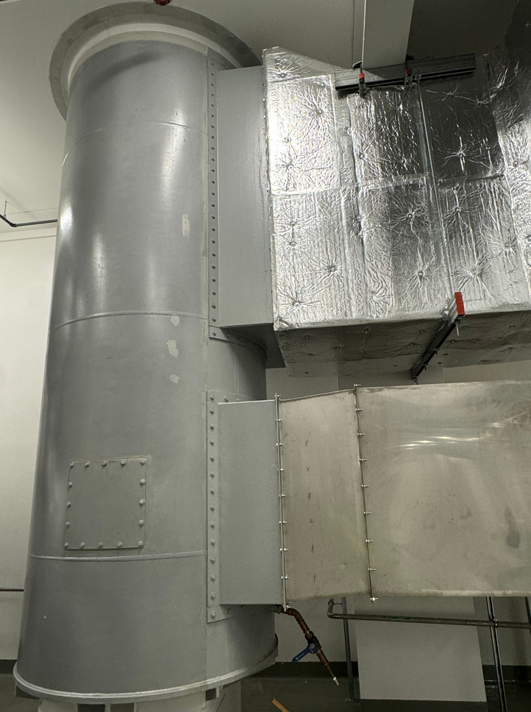
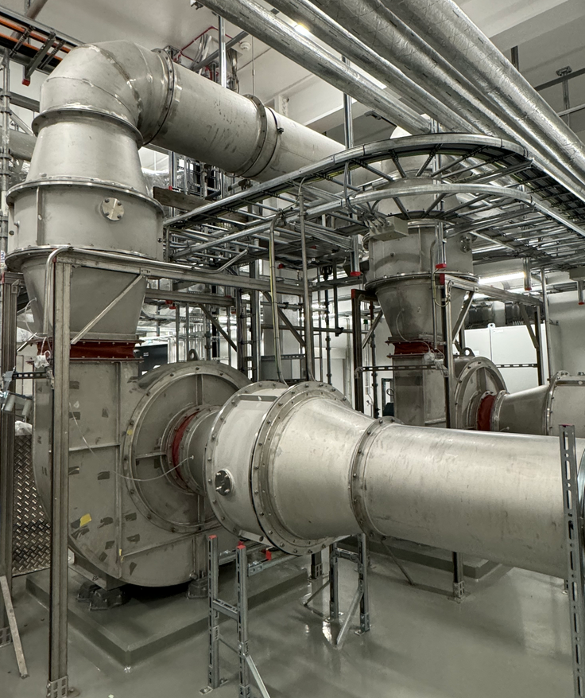
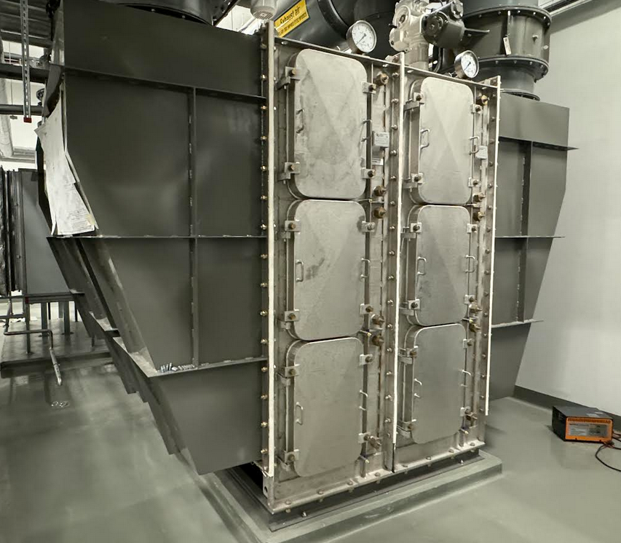
A2T level 125
HVAC Technical room D02.125.4014
exhaust fans
HEPA filter stations
heat exchanges
exhaust ductwork connection to the stack

Slide 14
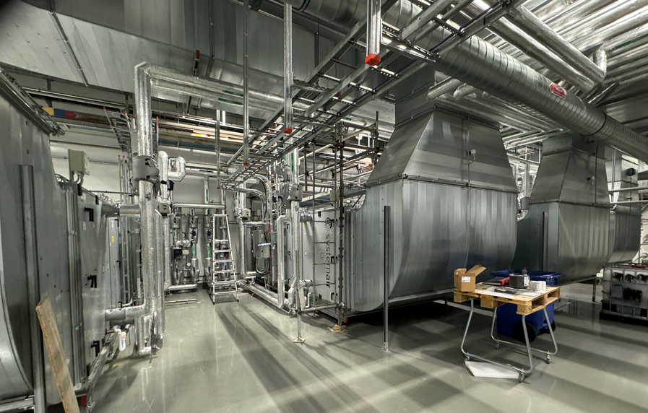
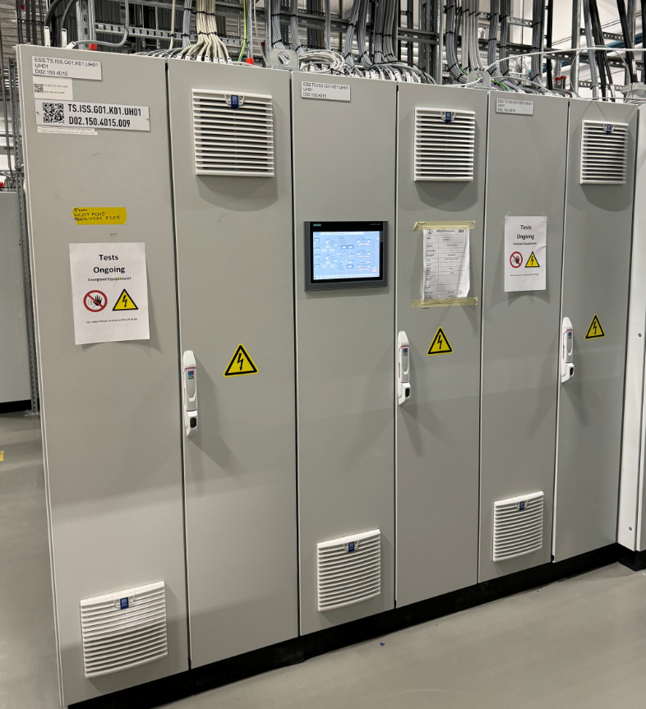
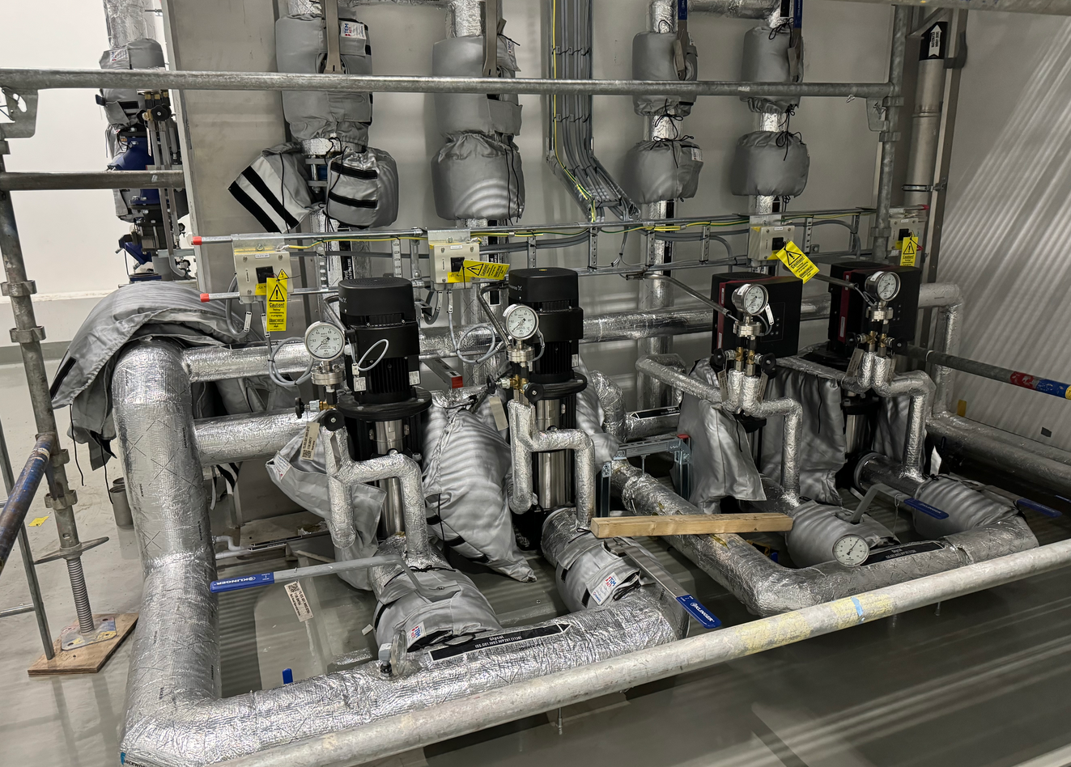
A2T level 150
HVAC technical room D02.150.4015
air handling units
pumps
control cabinets

Slide 15
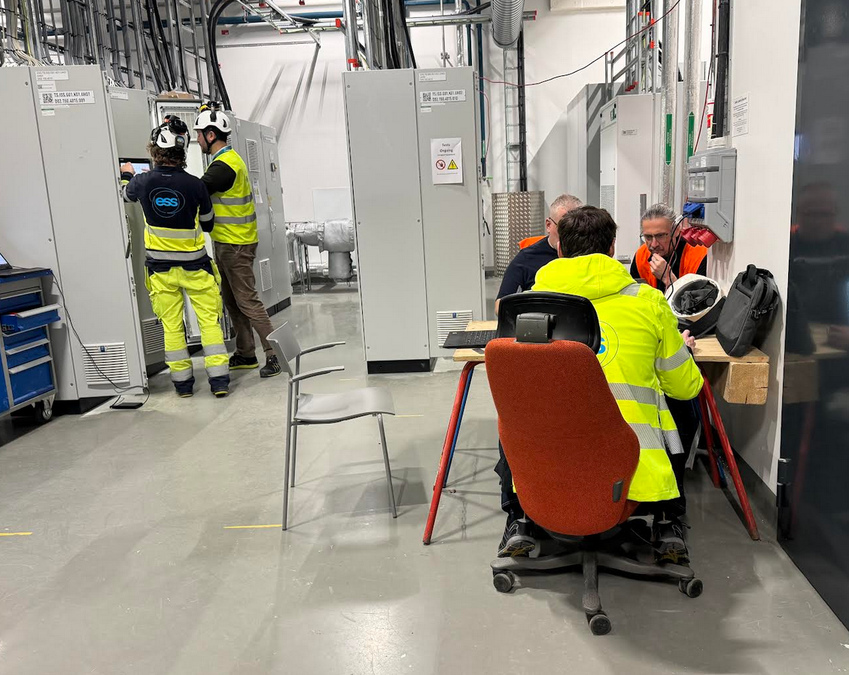
Commisioning status
Target HVAC system performance test is ongoing on the site at the moment with the participation of IK partner from Chezh Republic

Slide 16
System ballancing challenges
Working ”off-hours”
Performed measurements using Pitot static tube method according to SS-EN 16211:2015 Ventilation for buildings - Measurement of air flows on site –Methods
Accessibility of the premises
Working outside of normal hours

Slide 17
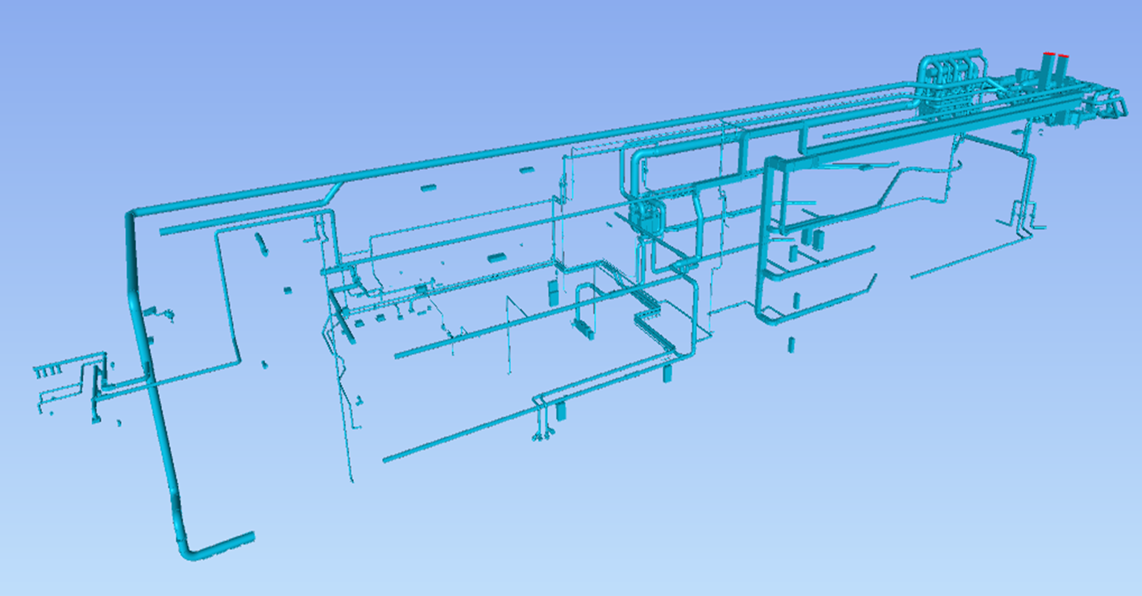
System balancing challenges
Many of systems to put to work simultaneously
6 ventilation systems

Slide 18
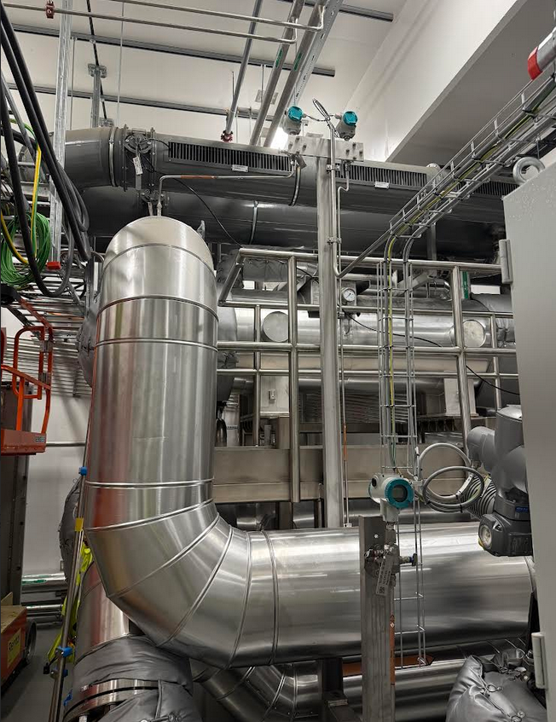
System ballancing challenges
Accessibility of the equipment
Blocked air ducts and balancing dampers by the installations from other systems

Slide 19
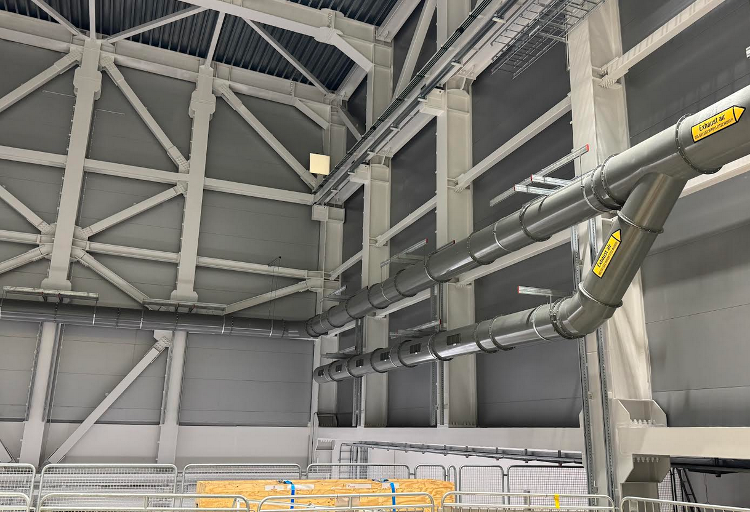
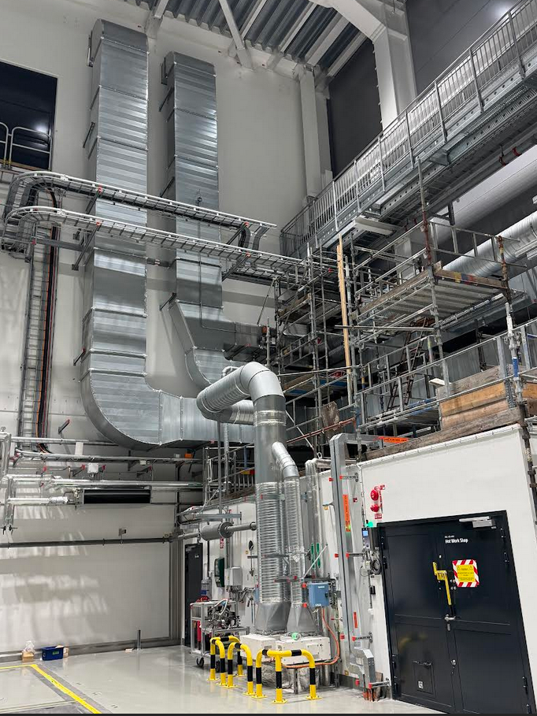
System balancing challenges
Heigh of air ducts placement
Air ducts are located on the height up to 12 m (it is planned to use a drone with camera to check the integrity of the air ducts during the operation)

Slide 20
End of presentation Thank you for your attention Questions?

