Slide 1
ICANS XXV Accelerator Subcommittee: Sessions Summary

Slide 2
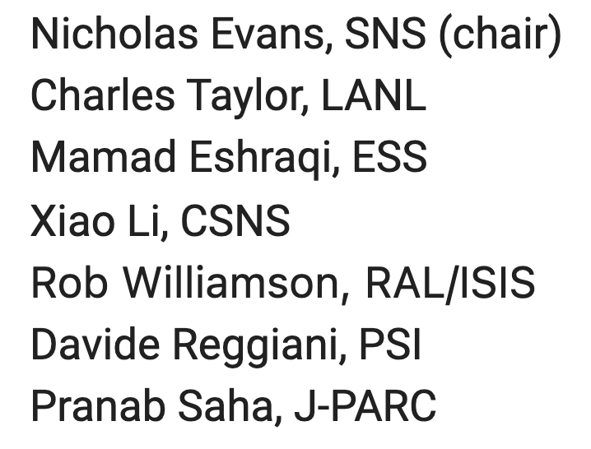
Accelerator Sub-committee
Three accelerator sessions, including HiCANS comprising 9 talks
Represented facilities (organizations):
LANSCE (Los Alamos National Lab)
Myrrha-Minerva (ESS Bilbao)
SNS (Oak Ridge National Lab)
J-PARC
ESS
ARGITU (ESS Bilbao)
HBS (Jülich)
ICONE (CEA, CNRS)
SORGENTINA (ENEA)
Program Subcommittee Members

Slide 3
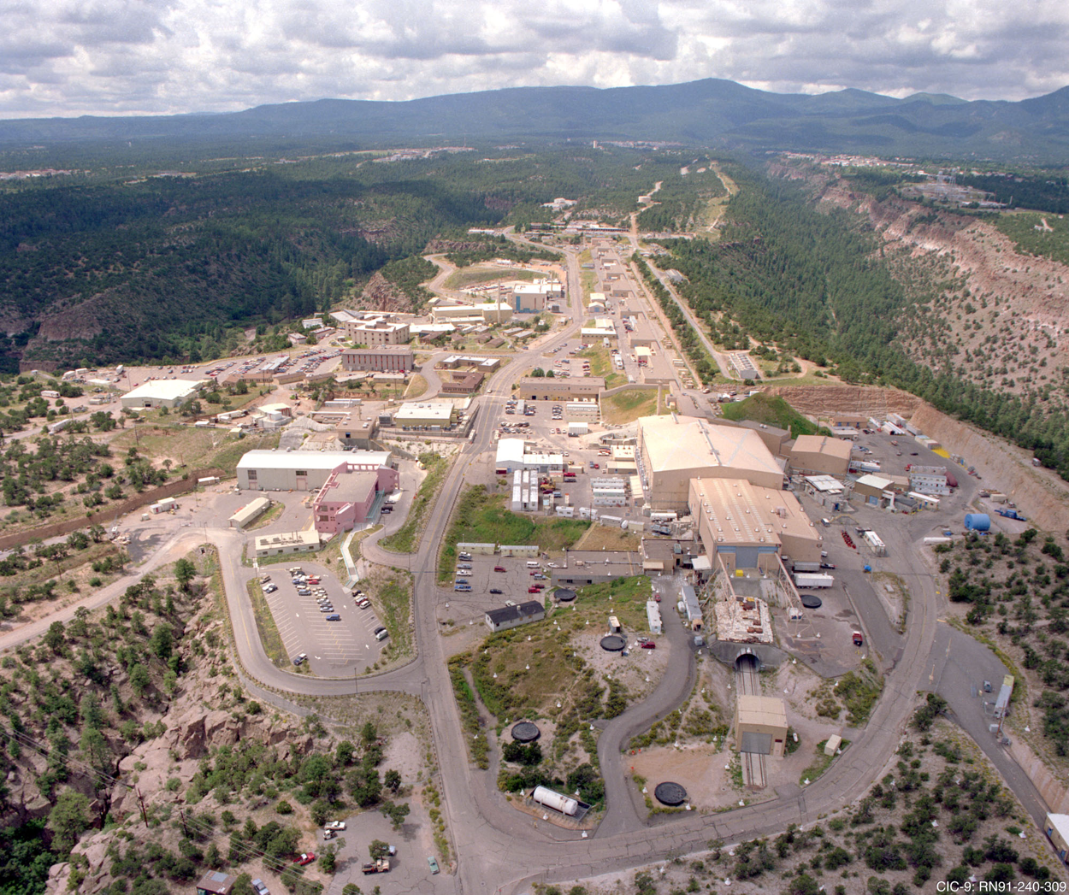

Building the Future of High-Power Accelerators: Opportunities at LANSCE
Presented by Charles Taylor (LANL)
Dual-species (H+,H-) 800 MeV linac at LANSCE provides beam with distinct parameters to five users simultaneously
LAMP and LANE upgrades will target the front end (source-DTL) and experimental areas respectively to keep LANSCE operational through 2050
LAMP will modernize ion sources, and result in first dual-species RFQ, and replace the existing DTL with a new design

Slide 4
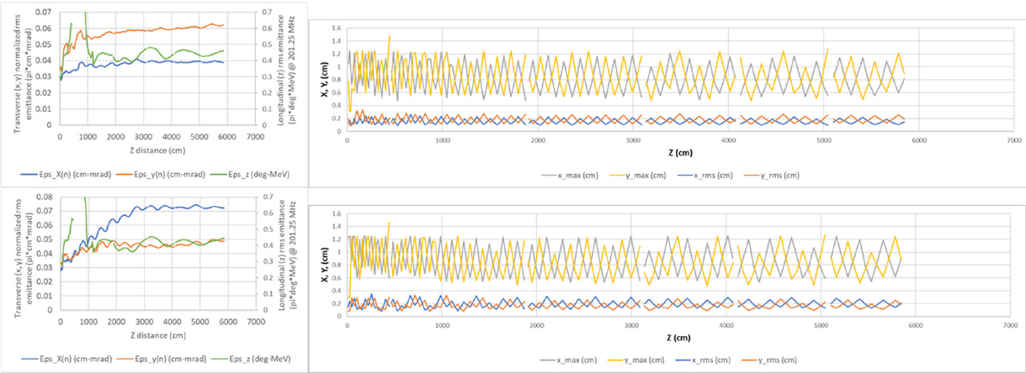
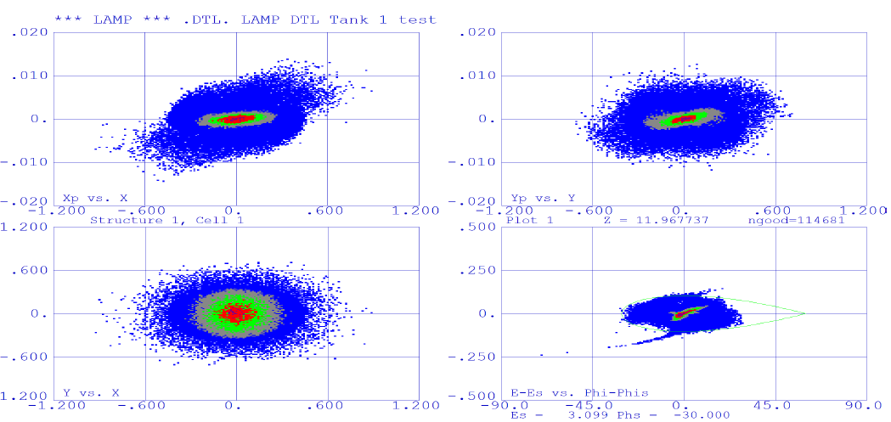
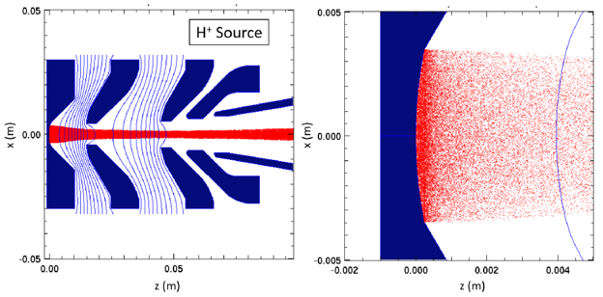
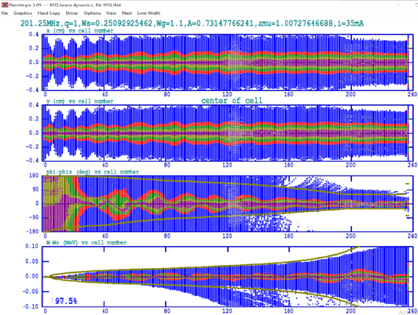
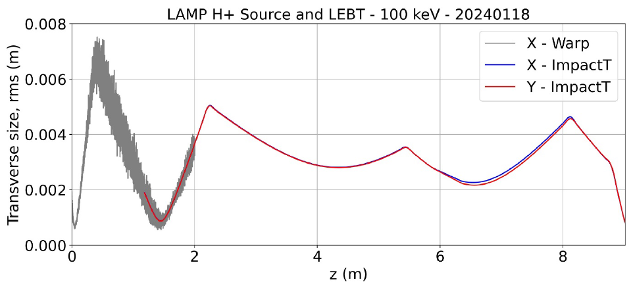
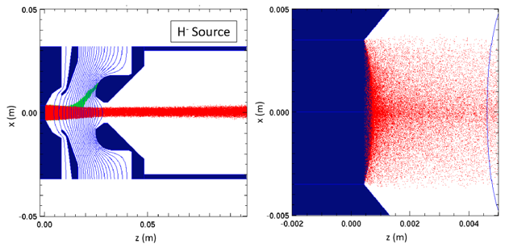
Building the Future of High-Power Accelerators: Opportunities at LANSCE
Presented by Charles Taylor (LANL)
Maintaining existing capability with a modern front-end presents unique challenges
Multi-code, start-to-end simulations show good transmission of all beams through well-developed preliminary design
DTL
MEBT
Source
LEBT
RFQ

Slide 5
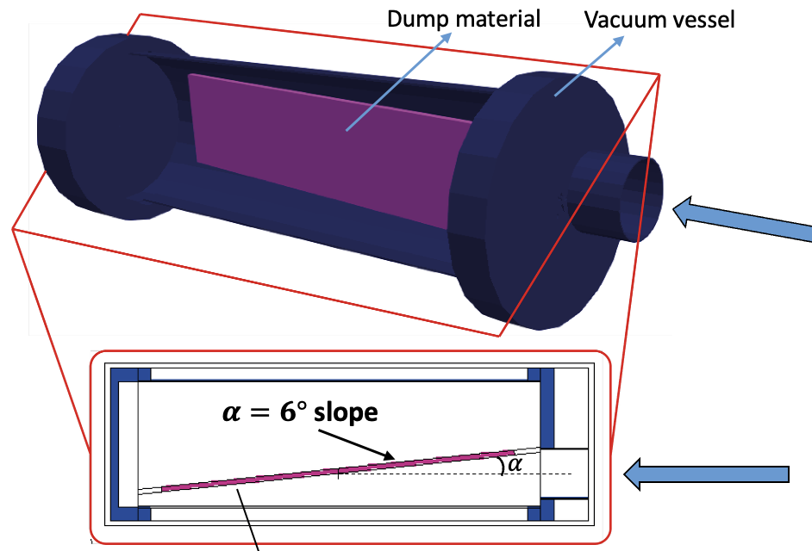
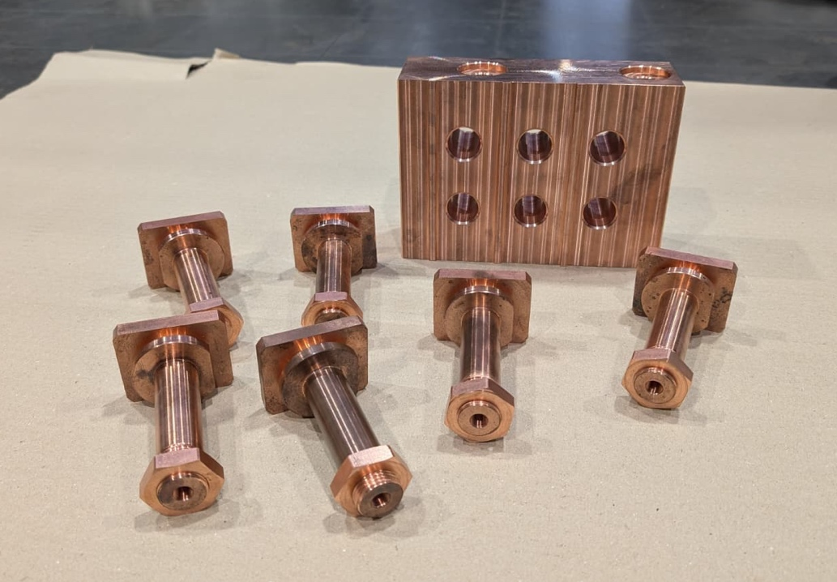

Development of the DUMP-OT for MYRRHA phase I accelerator
Presented by Jorge Garcia Tortosa (ESS Bilbao)
An innovative 3-4kW dump for 17 and 100 MeV proton beams at two beamline locations
Power density mitigated geometrically by tilted face
Based on tiled ‘mushroom’ bolts made of CuCrZr, and a simple to manufacture water-cooled block
Bolted-mushroom design approaches ideal as temperature rises and radial contact increases
Provisions for thermal instrumentation designed into each ‘mushroom’
Prototyping has begun

Slide 6

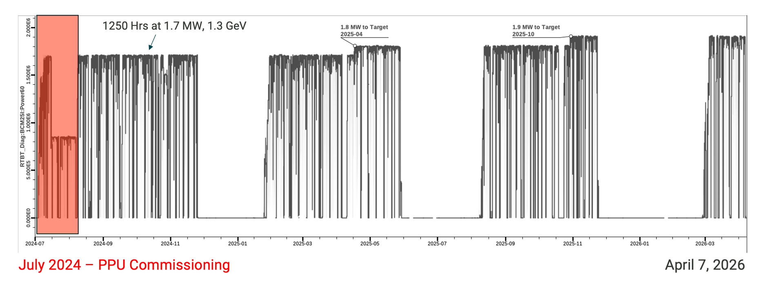
The path to 2.0 MW and beyond at the SNS
Presented by Nicholas Evans (ORNL)
After successful installation of Proton Power Upgrade equipment, SNS is running at 1.9 MW on target - approaching the goal of 2.0 MW operation for first target station
Challenges remain to reach reliable 2.8 MW for the Second Target era
A campaign is underway to demonstrate accelerator performance required for 2.8 MW operation by providing 45pps operation with 44 kJ/pulse

Slide 7
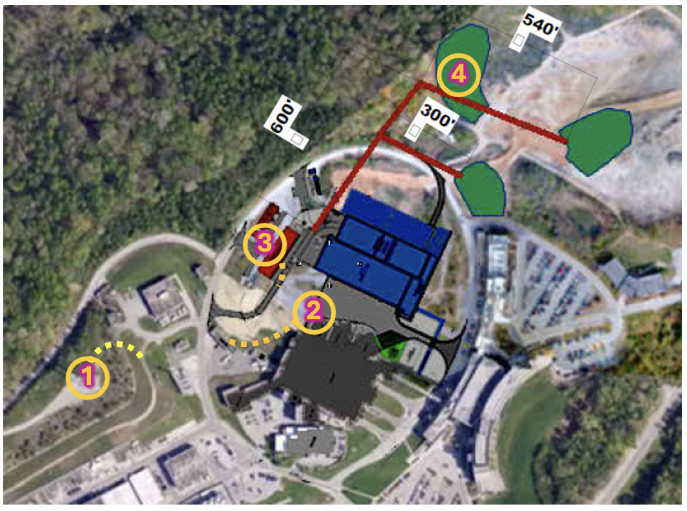
The path to 2.0 MW and beyond at the SNS
Presented by Nicholas Evans (ORNL)
Klystrons remain a long-term issue for reliable operation of high-power RF systems – Oak Ridge is dedicated to finding a solution in collaboration with other facilities
PPU left SNS with a few challenges:
a now ‘consumable’ electron catcher
a leaking Ring Injection Dump window
elevated ring losses solutions for each are in the works
The Oak Ridge Accelerator Institute (ORAI) is thinking even further ahead exploring the potential of a third target station for applications beyond neutron science at the SNS

Slide 8

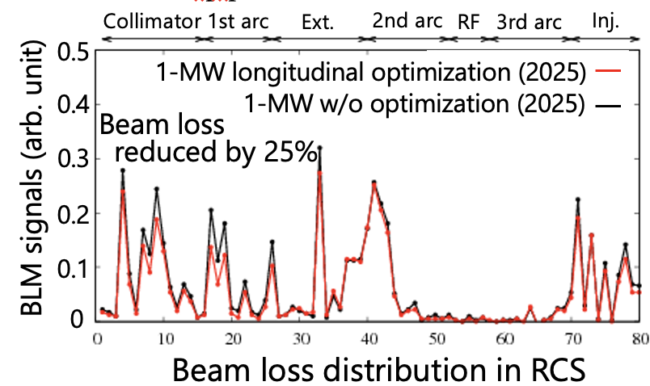
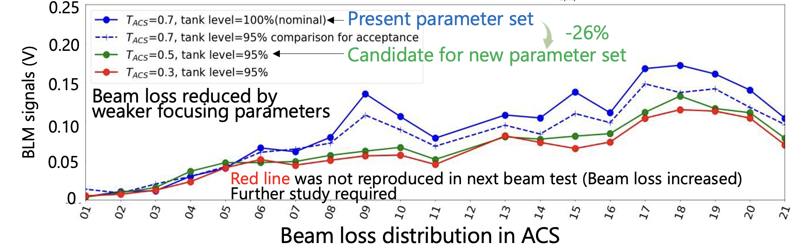
Operational status and recent upgrade studies of J-PARC accelerator facility for neutron and muon sources
Presented by Yuji Yamaguchi (J-PARC)
Throughout J-PARC, studies have been carried out to reduce beam losses, and increase accelerator reliability for 1 MW operation
Primary concerns are:
intrabeam stripping in the linac
space charge, foil scattering in the RCS

Slide 9
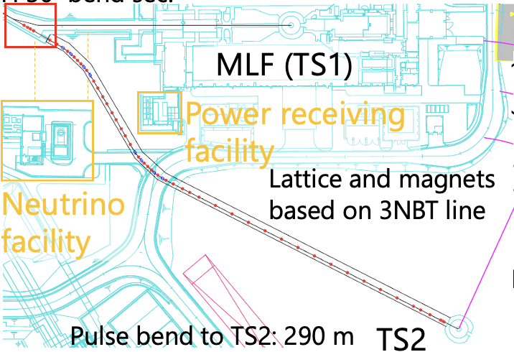
Operational status and recent upgrade studies of J-PARC accelerator facility for neutron and muon sources
Presented by Yuji Yamaguchi (J-PARC)
Upgrade studies are underway with a near-term goal of stable 1.5 MW operation
Linac optics reducing intrabeam stripping at 60 mA support upgrade plans
RCS parameters have been demonstrated at 1.5 MW equivalent charge with similar losses to 1 MW operation
Beamline design studies also show a viable solution for transport to a second target station

Slide 10

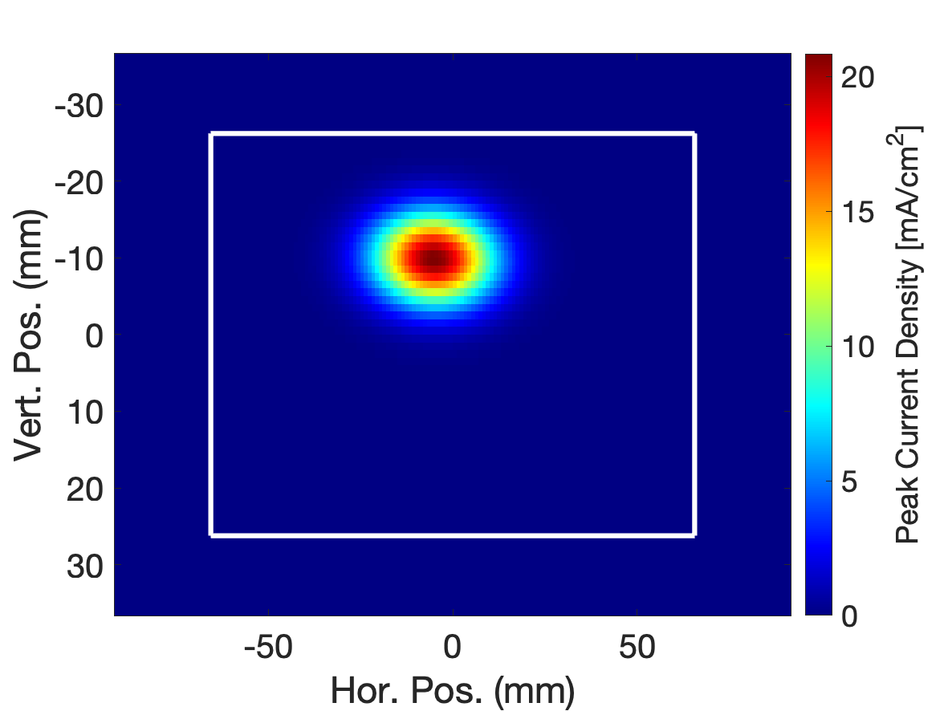
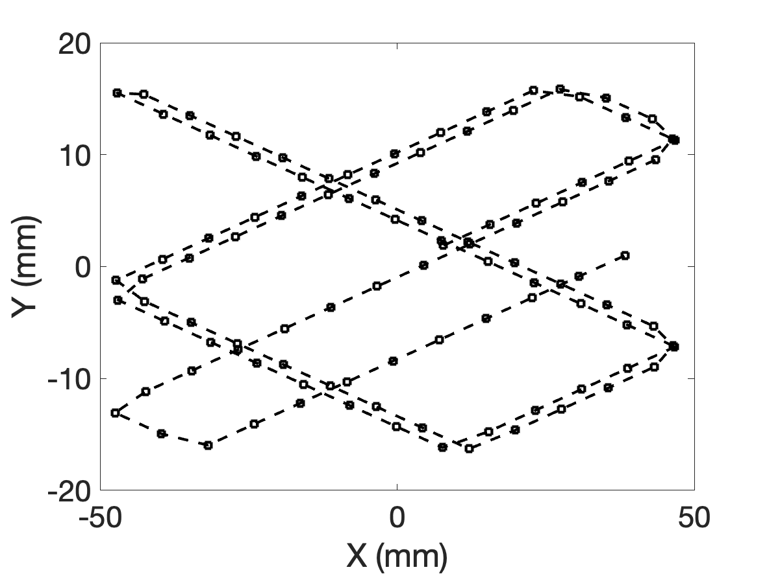
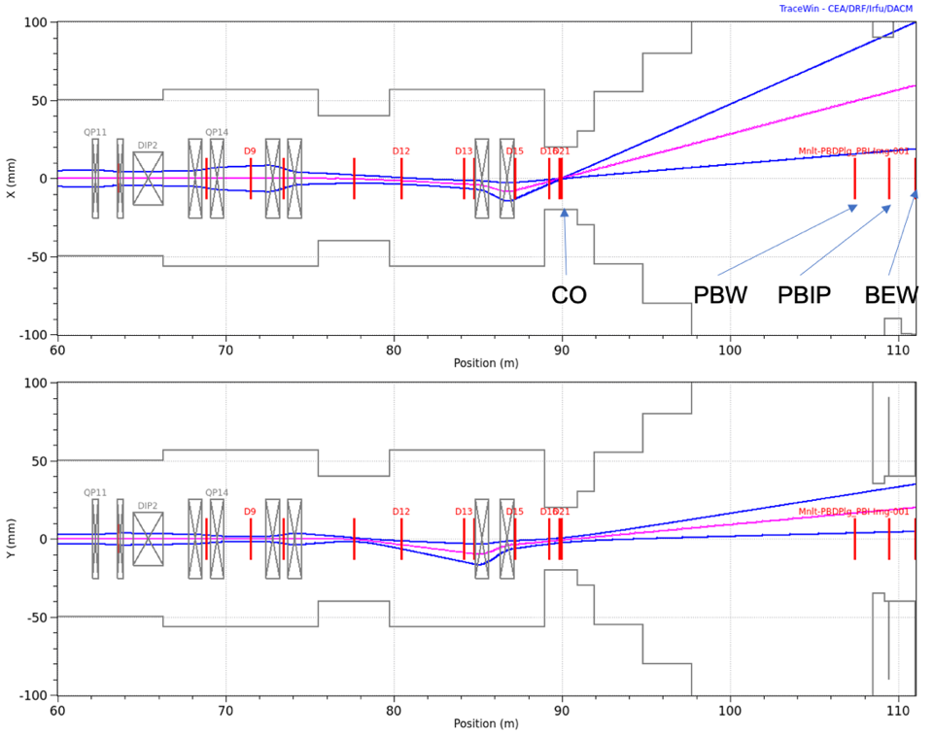
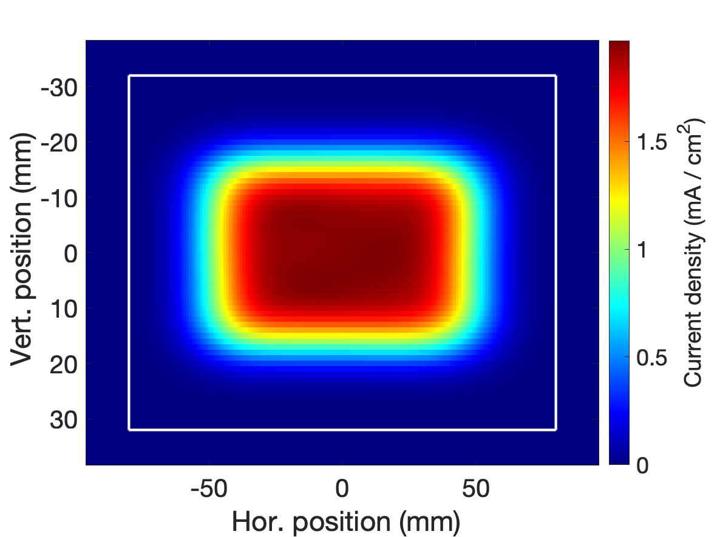
Beam-on-Target Instrumentation: Tuning, Monitoring, and Beyond
Presented by Cyrille Thomas (ESS)
Active rastering of high-power beam on target requires reliable, redundant, pulse-by-pulse on-line diagnostics for safe operation – and interlock within one beam pulse (71ms)
This talk focused on the target imaging (T-IMG) system, additional proton beam window imaging, and harp provide additional diagnostics

Slide 11
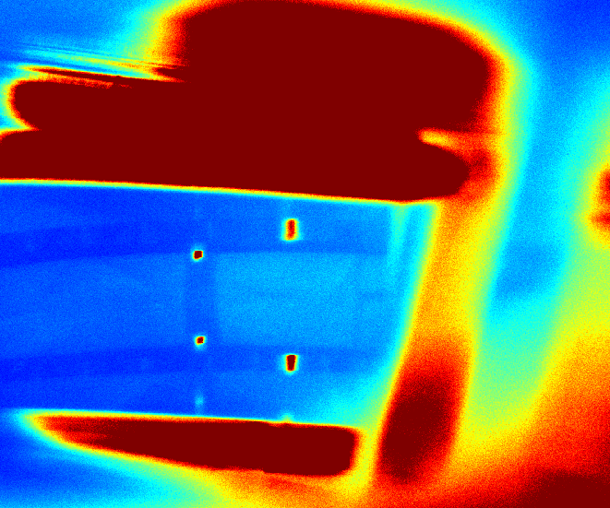
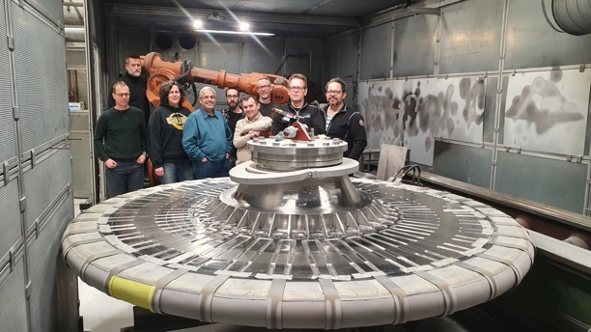
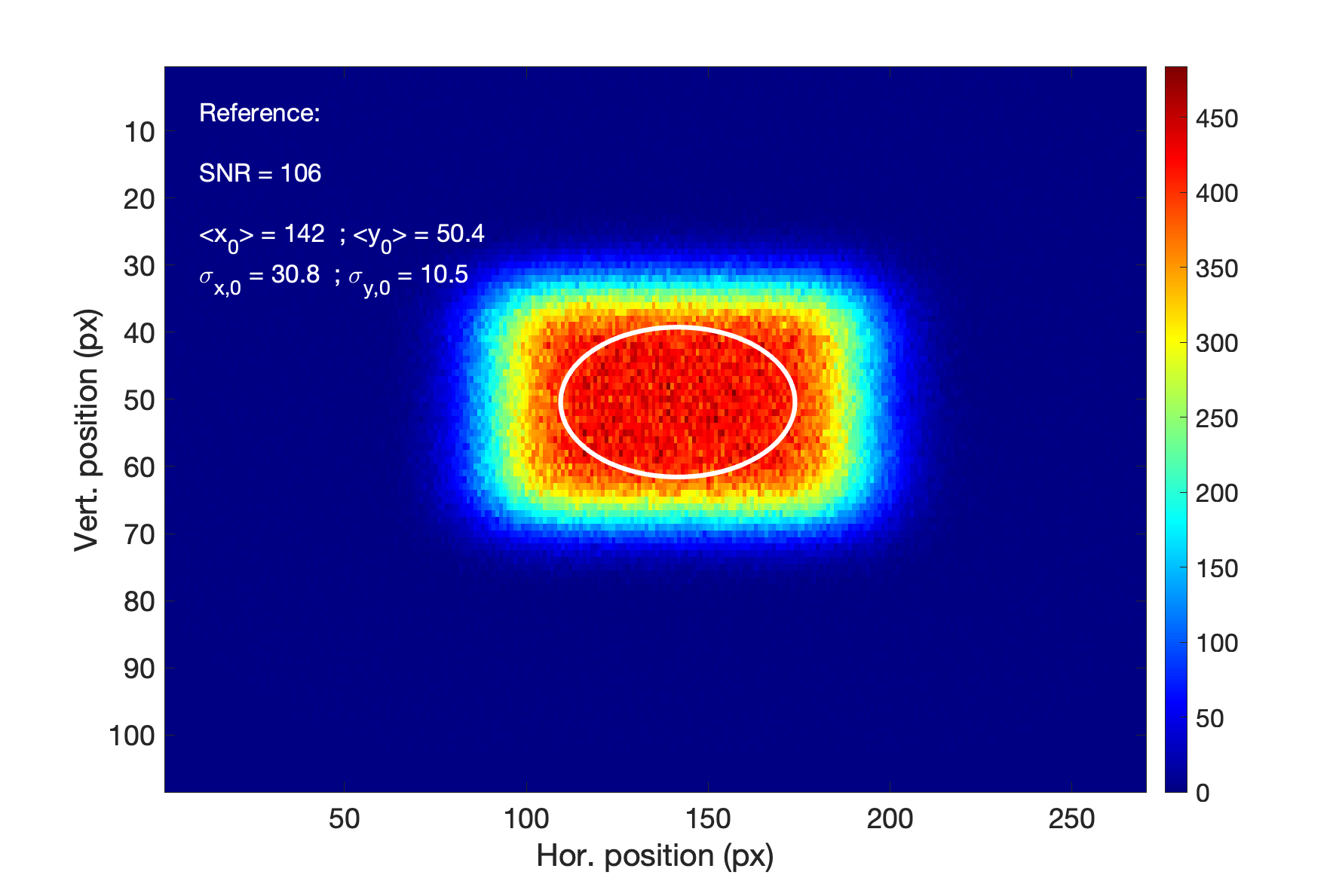
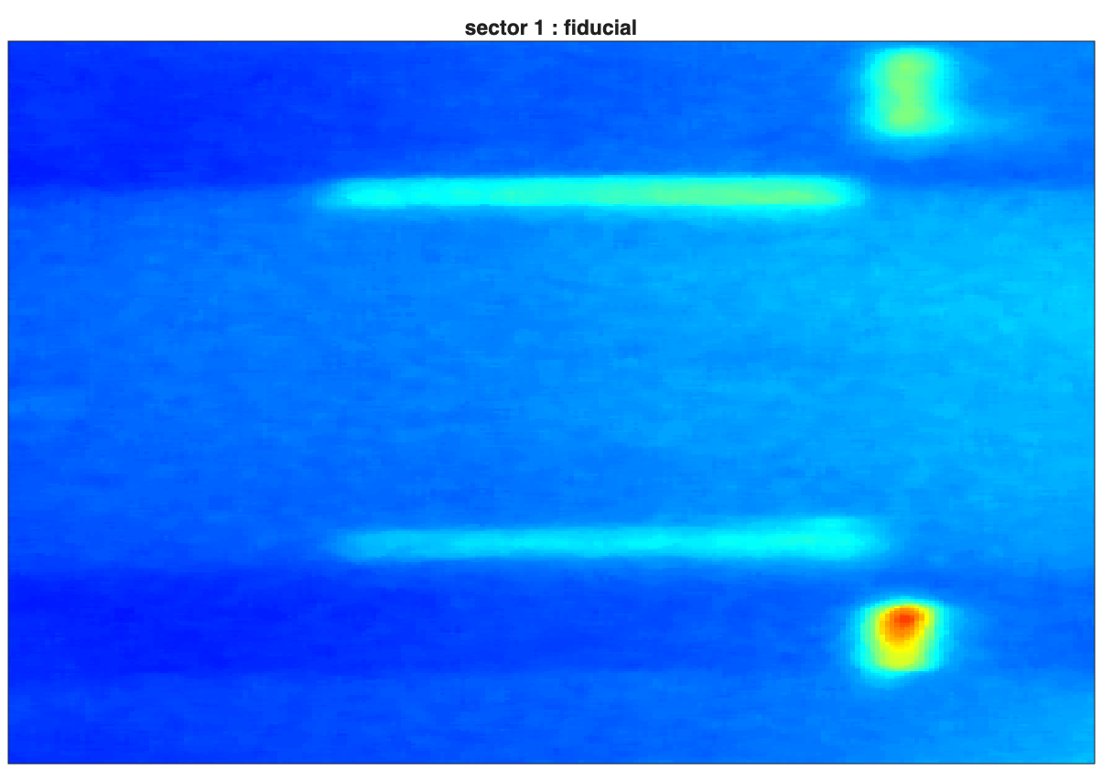
Beam-on-Target Instrumentation: Tuning, Monitoring, and Beyond
Presented by Cyrille Thomas (ESS)
Direct pulse-by-pulse imaging of the target with the T-IMG system provides feedback on raster performance – and unprecedented opportunity for eventual PIE analysis
Proper fiducialization requires design features integrated into the target wheel, and moderator, and integrated timing information
Such diagnostics are critical for tune-up, operation and machine protection
RR on moderator (missing)
Beam image
Fid. image

Slide 12
High-Current Accelerator Driven Neutron Sources (HiCANS) Going from Compact Accelerator based Neutron Sources (CANS) to High-Current Accelerator based Neutron Sources (HiCANS)

Slide 13
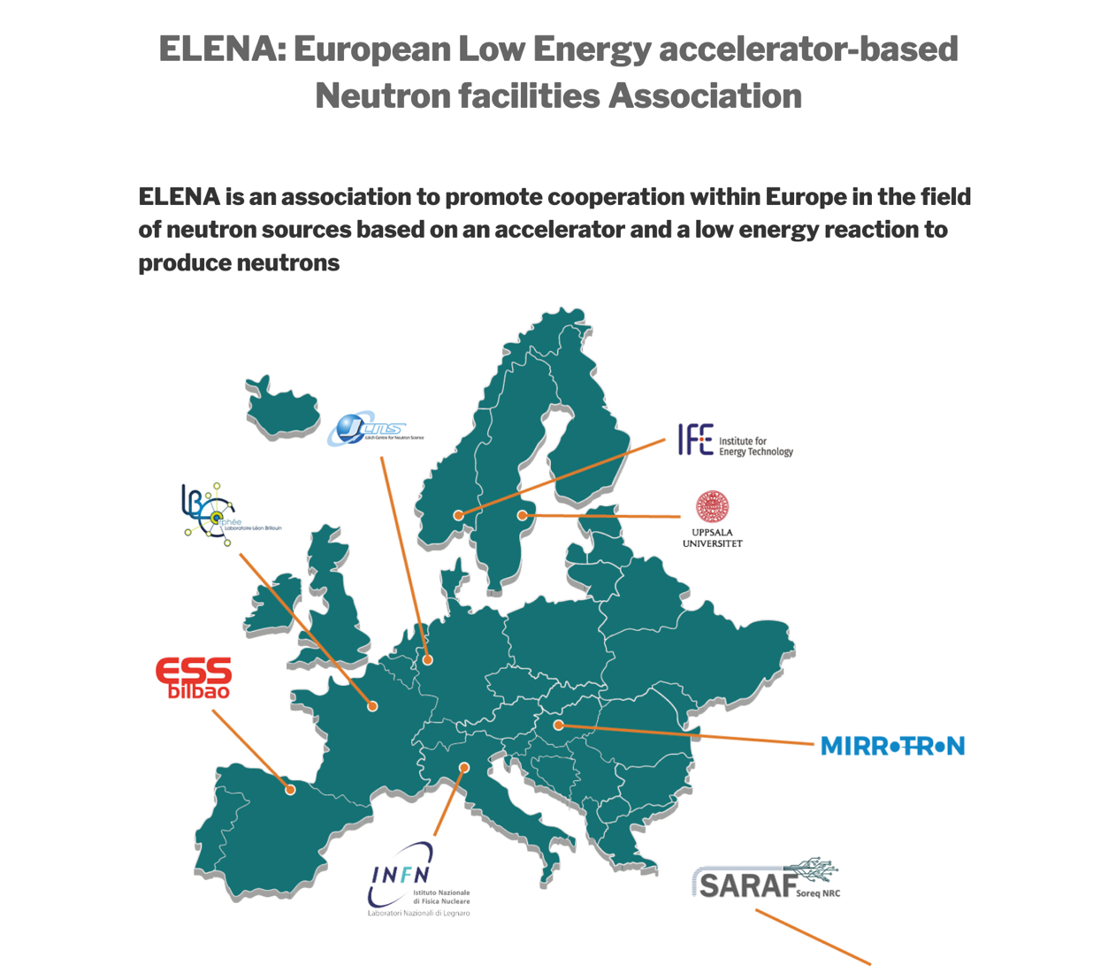
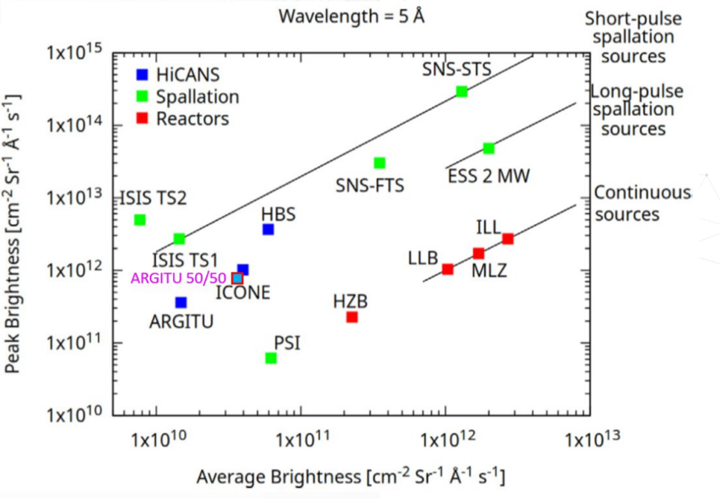
An Introduction to HiCANS
HiCANS represent a cost-efficient and scientifically attractive complement to fission reactors and spallation sources, combining brilliant neutron beams with low radiation background, a flexible pulse structure, multi-instrument capability, and straightforward user access.
HiCANS Projects:
HBS, JCNS (Germany)
ICONE, CEA LLB (France)
ARGITU, ESS Bilbao (Spain)
LENOS, INFN LNL (Italy)
SARAF, SOREQ (Israel)

Slide 14
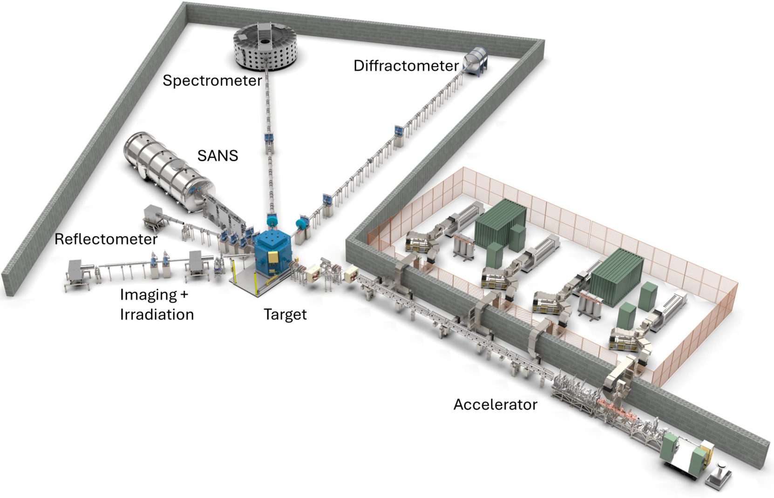
ARGITU, a Neutron Source based on the HiCANS Concept presented by Fernando Sordo
Goal: fill the gap in European neutron production left by the progressive shutdown of research reactors and establish a regional, accelerator-driven neutron facility in the Basque Country delivering ~10¹⁵ n/s.
Parameters: 50MeV protons, peak current 50mA, pulse length 1.5ms, rep rate of 30Hz, power of 112kW; supporting 5 instruments. Water cooled Berilium target.
Staged approach: focus is currently on ARGITU-Zero with 3MeV protons, peak current 30mA, pulse length 1.5ms, rep rate 30Hz. Lithium target.

Slide 15
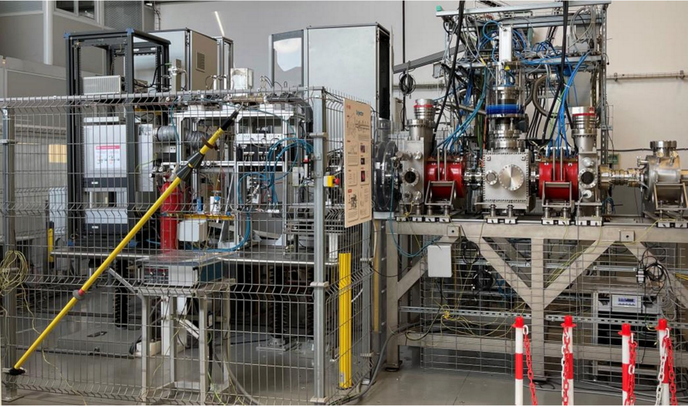
ARGITU: Status and Next Steps presented by Fernando Sordo
Status:
Budget of 100M€ over the next 5 years has been approved!
Ion Source and LEBT have been commissioned:
45keV protons
30mA
Pulse length up to 2ms
Rep rate up to 20Hz
RFQ has been assembled and is ready for further testing and validation
Power couplers v1.0 are tested at low and high power
Next steps:
High power RF conditioning
Continue the international collaboration with leading European R&D centers

Slide 16

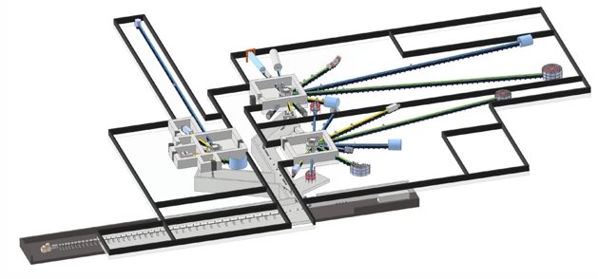
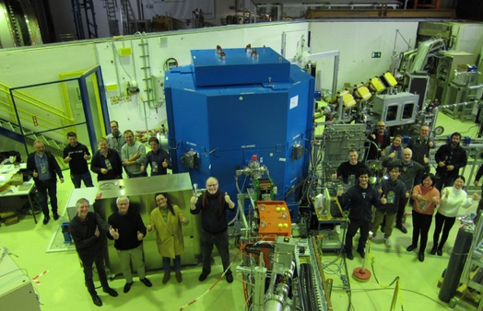
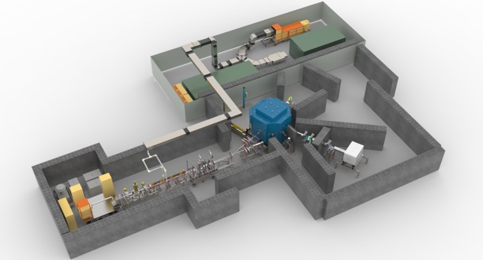
The High Brilliance Neutron Source (HBS) Project presented by Paul Zakalek
JULIC • HiCANS Platform • HBS-I • HBS – A modular, scalable approach to HiCANS
HBS
N-yield: 100% (10¹⁵ n/s)
Energy: 70 MeV
Time: only TDR
Place: -
JULIC Neutron Platform
N-yield: 0.001%
Energy: 45 MeV
Time: 2022 – 2023
Place: Big-Karl lab, IKP Jülich (Germany)
HiCANS Platform (with ESS Bilbao, LLB Saclay)
N-yield: 0.1%
Energy: 3 MeV
Time: 2027 – 2032
Place: Bilbao (Spain)
HBS-I
N-yield: 10%
Energy: 20 MeV
Time: 2034 – 20XX
Place: COSY-building, Jülich (Germany)

Slide 17
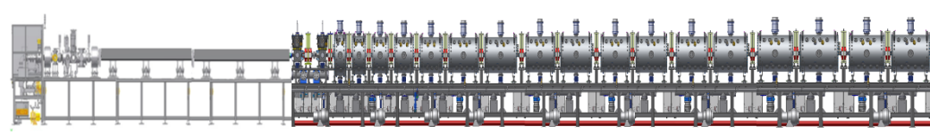
The HBS-I Accelerator – TDR Concept up to 20MeV presented by Paul Zakalek
Support for
5 instruments
as well as support for
Production of medical radioisotopes
HBS-I would be the first HiCANS user facility in Europe, and together with related projects in France and Spain would provide complementary capacity to shape and sustain the European user community.
100mA peak current, 20MeV pulsed proton linac, rep rate 20-200Hz
RFQ
RFQ
ECR ion source
CH cavity
CH cavity
LEBT
MEBT
>100mA
proton source
175MHz
(2-4m, 1.2 -> 2.5MeV)
normal conducting CH cavities and
quadrupole dublets
(~2.5m, 2.5 -> 20MeV)

Slide 18

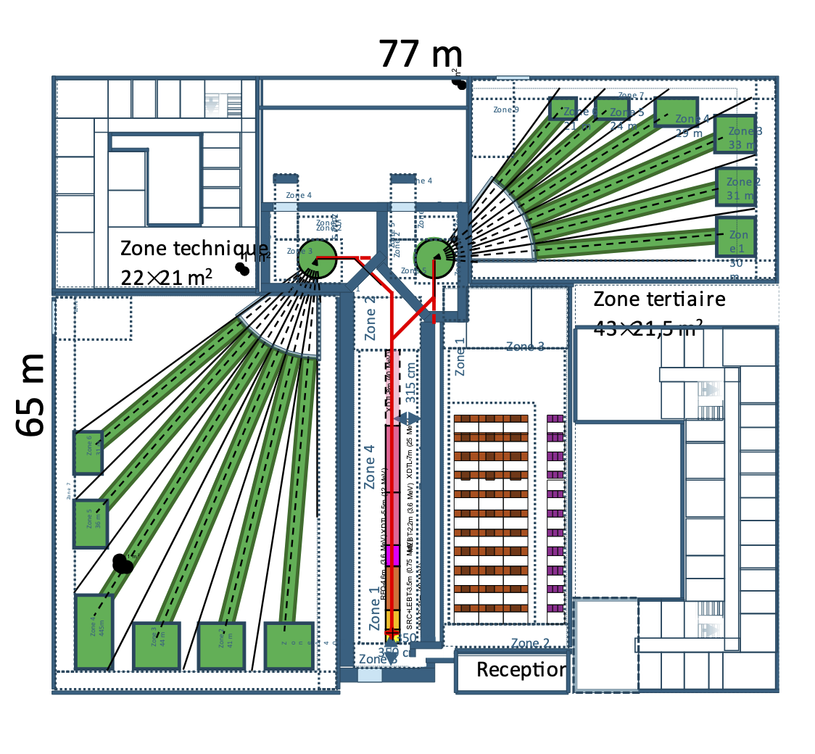
ICONE: The French HiCANS Source presented by Frederic Ott
Parameters:
25MeV protons
Peak current 80mA
2 Target stations:
long pulse: 2ms, DC 4%, power 80kW
short pulse: 400micsec, DC 4%, power 80kW
Supporting 12 instruments (6 per target)

Slide 19
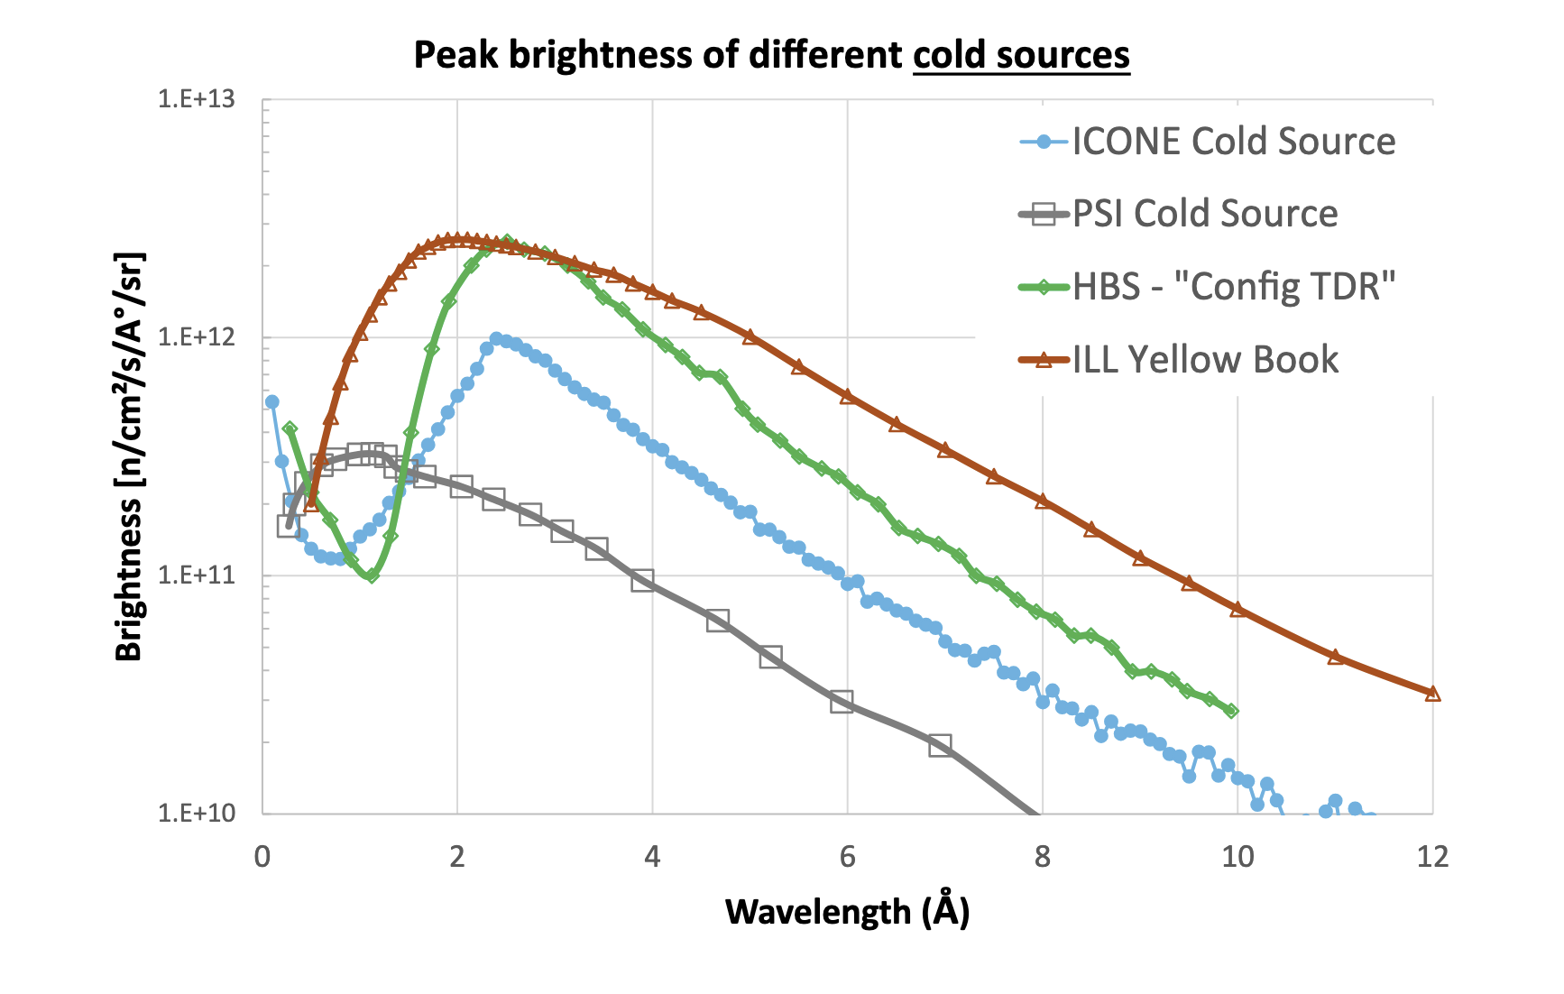
ICONE: The French HiCANS Source presented by Frederic Ott
Special emphasis has been put on providing cold neutrons and a practical TMR (Target – Moderator – Reflector) design has been proposed for the ICONE project.
The radiative heat load is expected to be
< 0.004kW – in comparison to ESS with ~4kW.
Also the radiation damage at ICONE will be negligible allowing for much simplified operational constraints.

Slide 20


SORGENTINA: A Multipurpose Accelerator Driven Fusion Neutron Source presented by Antonino Pietropaolo
Goal: develop an accelerator-driven fusion neutron source for applications in nuclear medicine, materials science, and fusion technology.
Parameters: mixed deuterium and tritium ion beam (300 keV), directed onto titanium-coated rotating targets, producing nearly monochromatic 14MeV neutrons. Neutron emission rate: 10¹⁴ n/s. 250kW power.
SORGENTINA is a first of a kind fusion neutron source. The project started in January 2020. Funding was approved for the thermomechanical demonstrator.

Slide 21
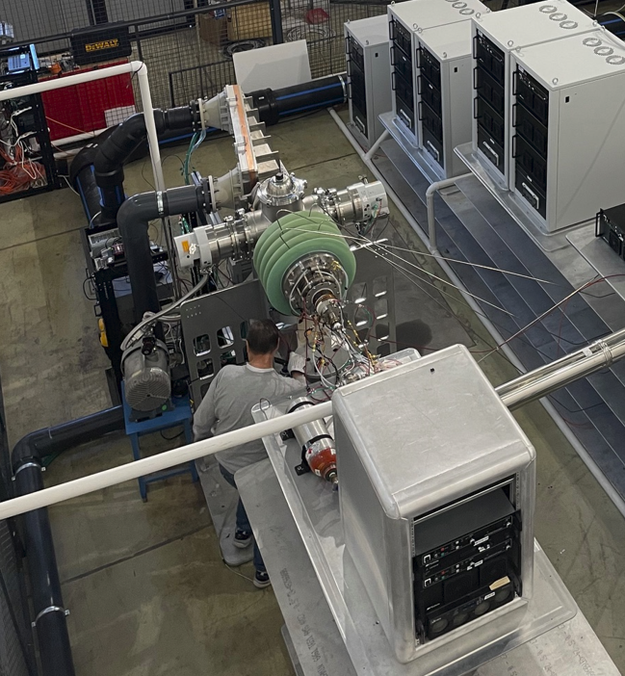
SORGENTINA: A Multipurpose Accelerator Driven Fusion Neutron Source presented by Antonino Pietropaolo
Vacuum, high voltage, control system tests were done at ENEA in Brasimone in February 2026.
Next Steps:
A full test with H⁺ at 250kW with beam dump at ENEA Brasimone is planned for May 2026.
Assessment of the primary cooling system using the inductor up 250kW power.
Study about rotating sealing systems.
Joining vacuum chamber hosting rotating target with ion source and accelerator.
Test the TI sputtering system to be hosted inside the vacuum chamber housing the rotating target.
Ion beam dump
Accelerator
Ion source
Ion source 300 kV deck

