Slide 1
Software
ICANS Close-out session
Thomas Holm Rod, ESS

Slide 2
Software presentations at ICANS
Simulation software for instrumentation
- 8 presentations in 3 sessions
Informal lightning-talk session on simulation software
Software mentioned in facility updates and other sessions
Analysis software
– 2 presentations

Slide 3
Presenter | Title
P. Willendrup (ESS / DTU) | An overview of Updates in McStas
Franz Gallmeier (ORNL) | Update the MCNP Guide Extension
Thomas Kittelmann (ESS) | Update on the NCrystal project for modelling thermal neutron interactions
Mads Bertelsen (ESS) | Multiple time sampling for Monte Carlo ray-tracing instrument simulations
Douglas Di Julio (ESS) | A liquids plugin for NCrystal
Nicolò Violini (FZJ) | Advances in Neutron Instrument Simulation with VITESS: Release 3.7 and 3.8
Gabriele Sala (JPARC) | Enhancing MLF Operations through a Digital Twin Framework for Neutron Scattering
Matthew Frost (ORNL) | Scattering Instrument Development and Design Workflows in Neutron Sciences at ORNL
Juping Xu (CSNS) | From Data to Structure in Neutron Total Scattering at the CSNS Multi-Physics Instrument
Shuqi Xu (ESS) | Quantitative data analysis for neutron scattering experiments using NCrystal
10 presentations from ESS, ORNL, FZJ, JPARC, CSNS
5/10 presentations from ESS

Slide 4
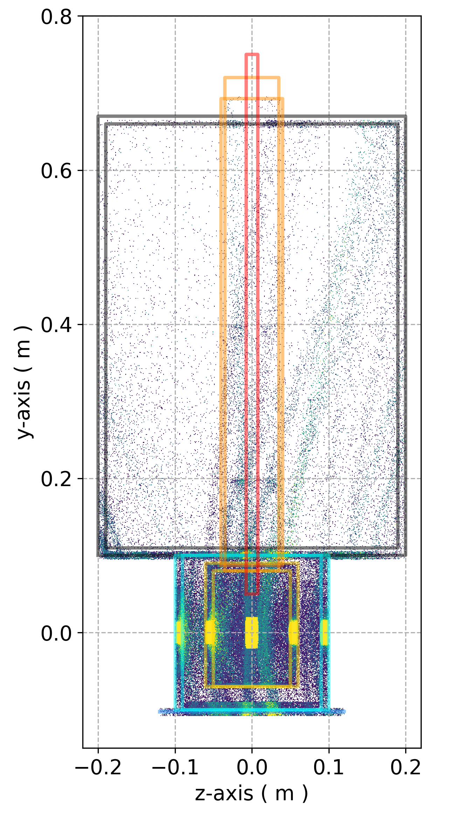
Simulation software strongly represented
Towards higher fidelity
Key takeaways
Expanded (physics) functionality
Support for Python
Support for GPU
Faster algorithms
Improved development workflows (CI)
Optimized instrumentation
Standardized design workflows
... and a bit of AI
Use case
Design of Instrumentation
(from moderator to detector)
Software
McStas
VITESS
MCNP
Ncrystal
(Gabriele Sala, JPARC)
Notes:
MCNP:
general-purpose transport of many particles including neutrons, photons, electrons, ions, and many other elementary particles, up to 1 TeV/nucleon

Slide 5
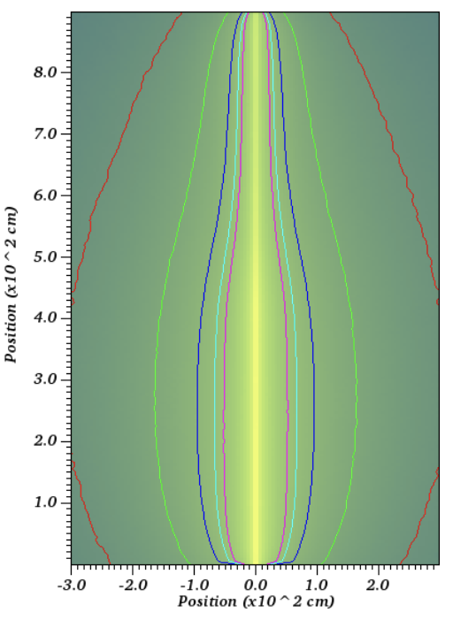
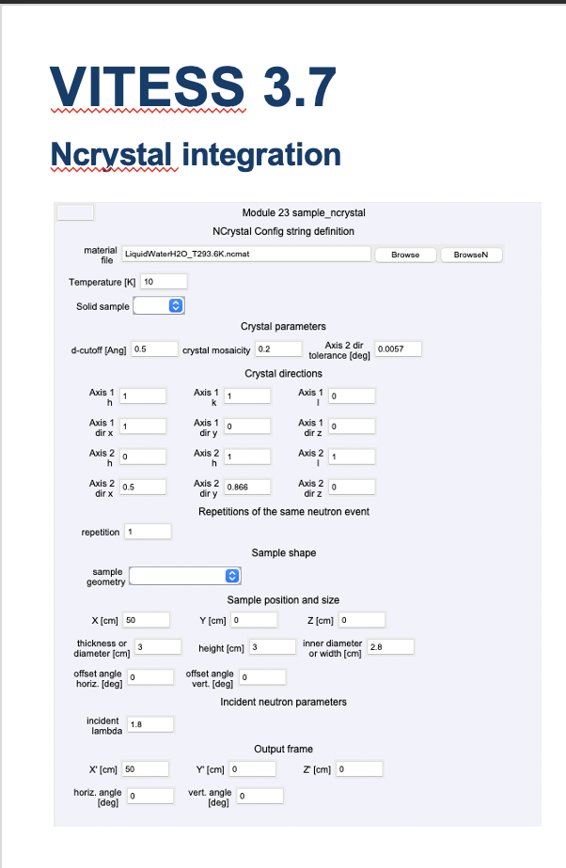
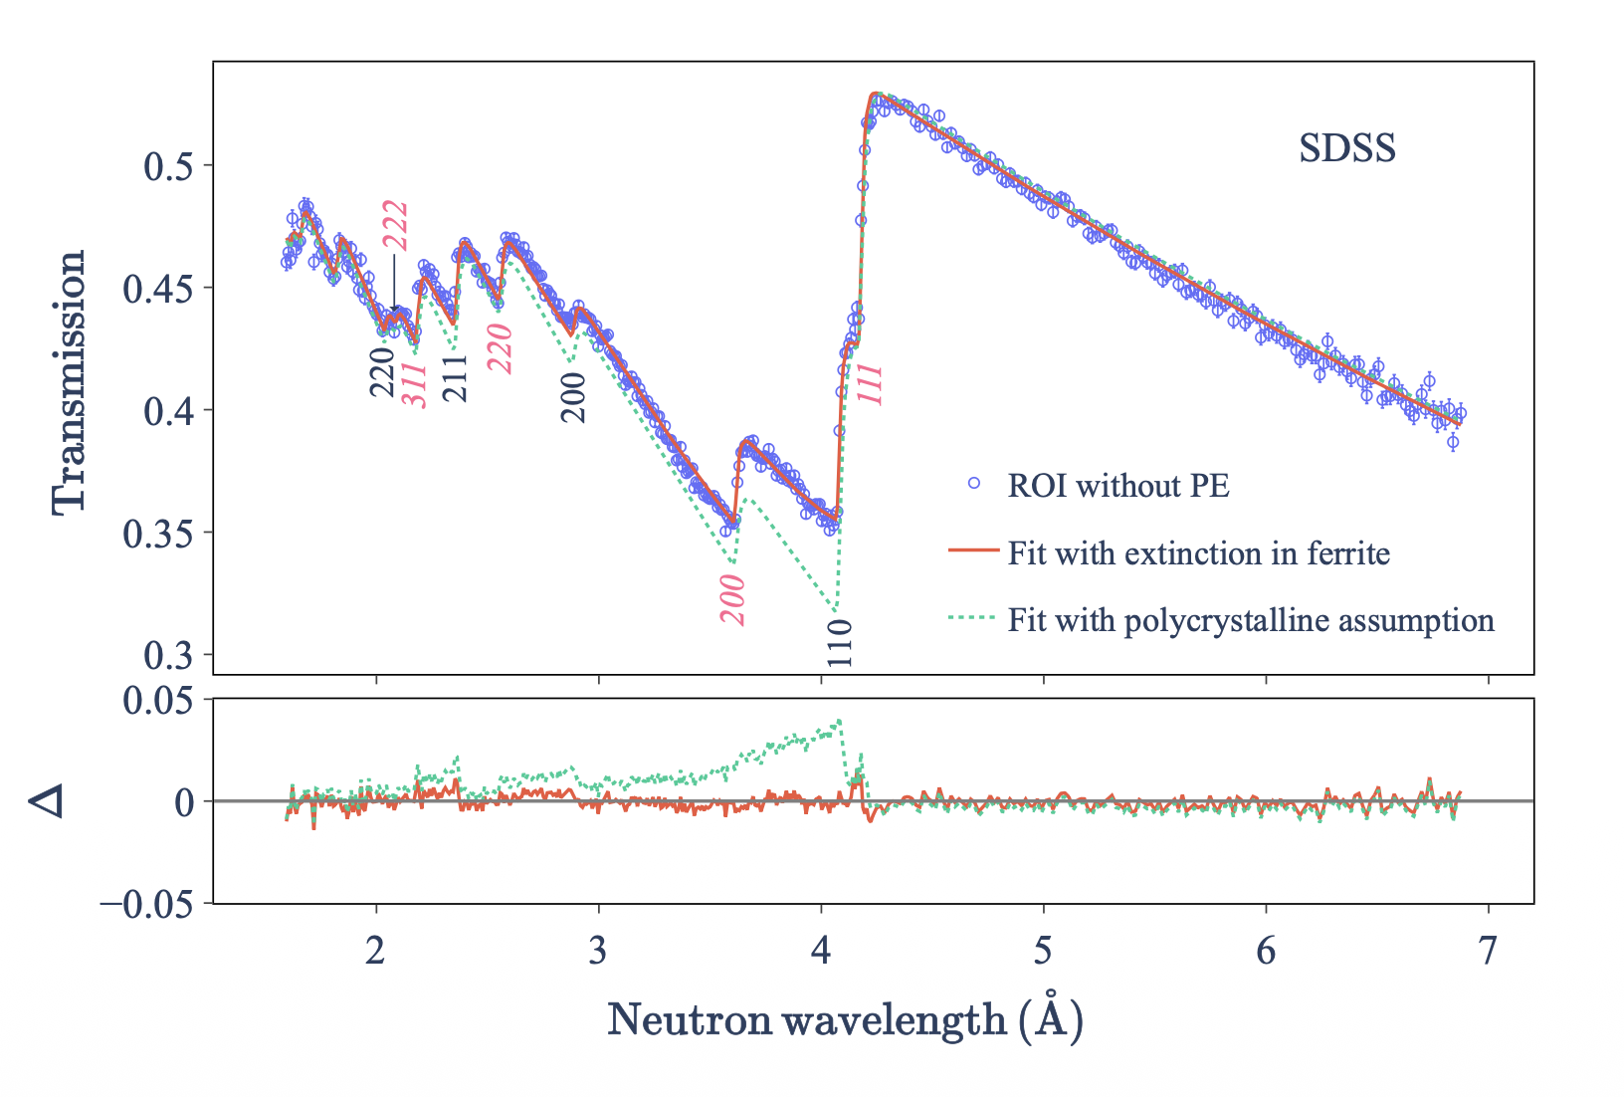
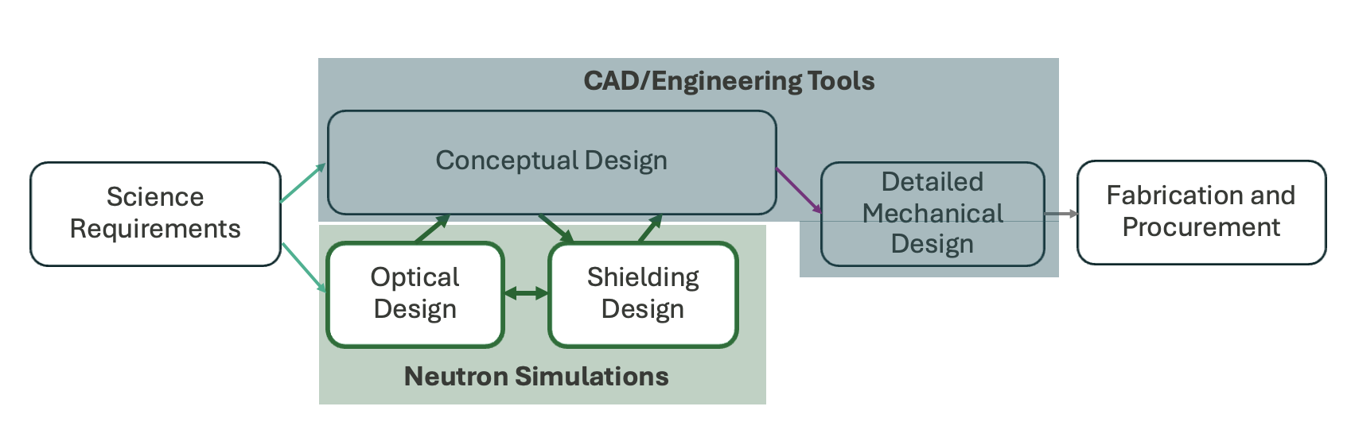
Examples of updates
Franz Gallmeier, ORNL
Shuqi Xi, ESS
Nicolò Violini, FZJ
Matthew Frost, ORNL

Slide 6
New physics modelling
Non-comprehensive list
MCNP: Improved simulation of gamma radiation from guides
NCrystal: Plugin for fluids, implementation of extinction (work in progress)
VITESS: Updated spin-polarization, Ncrystal integration
McStas:

Slide 7
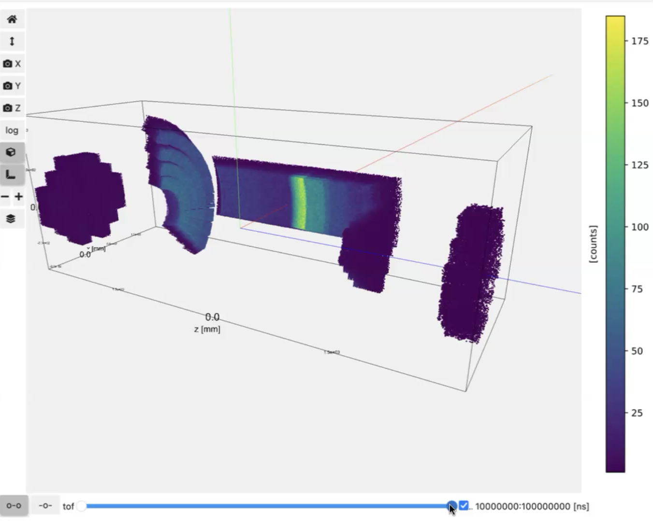
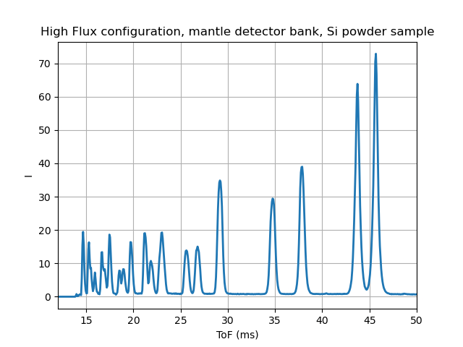
Another use case: Testing of data pipeline
At ESS, synthetic data are used for testing data pipeline
DREAM Detector
Data reduction
Credit: Céline Durniak
Notes:
Boron-10-carbide (B4C)

Slide 8
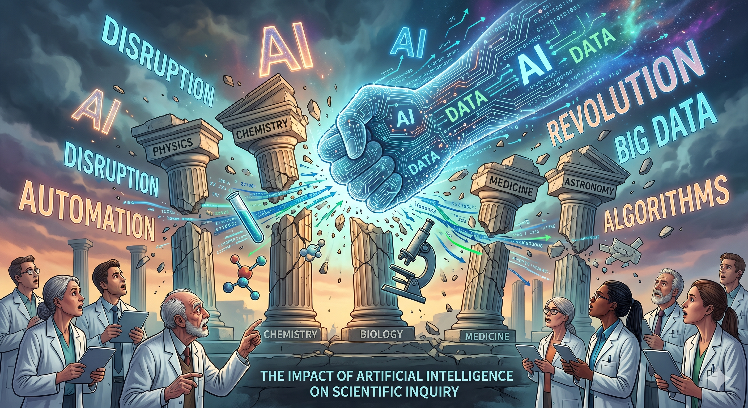

Slide 9

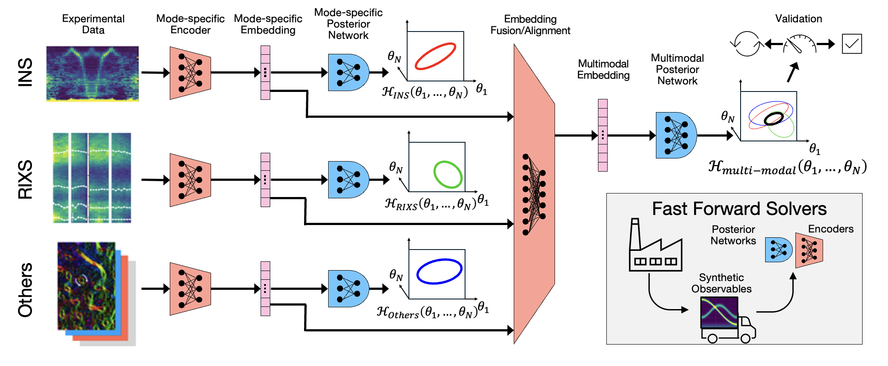
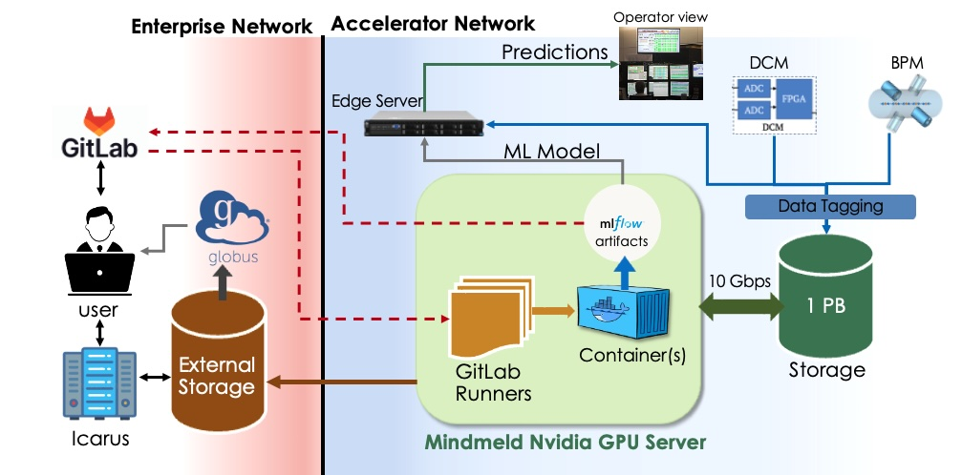
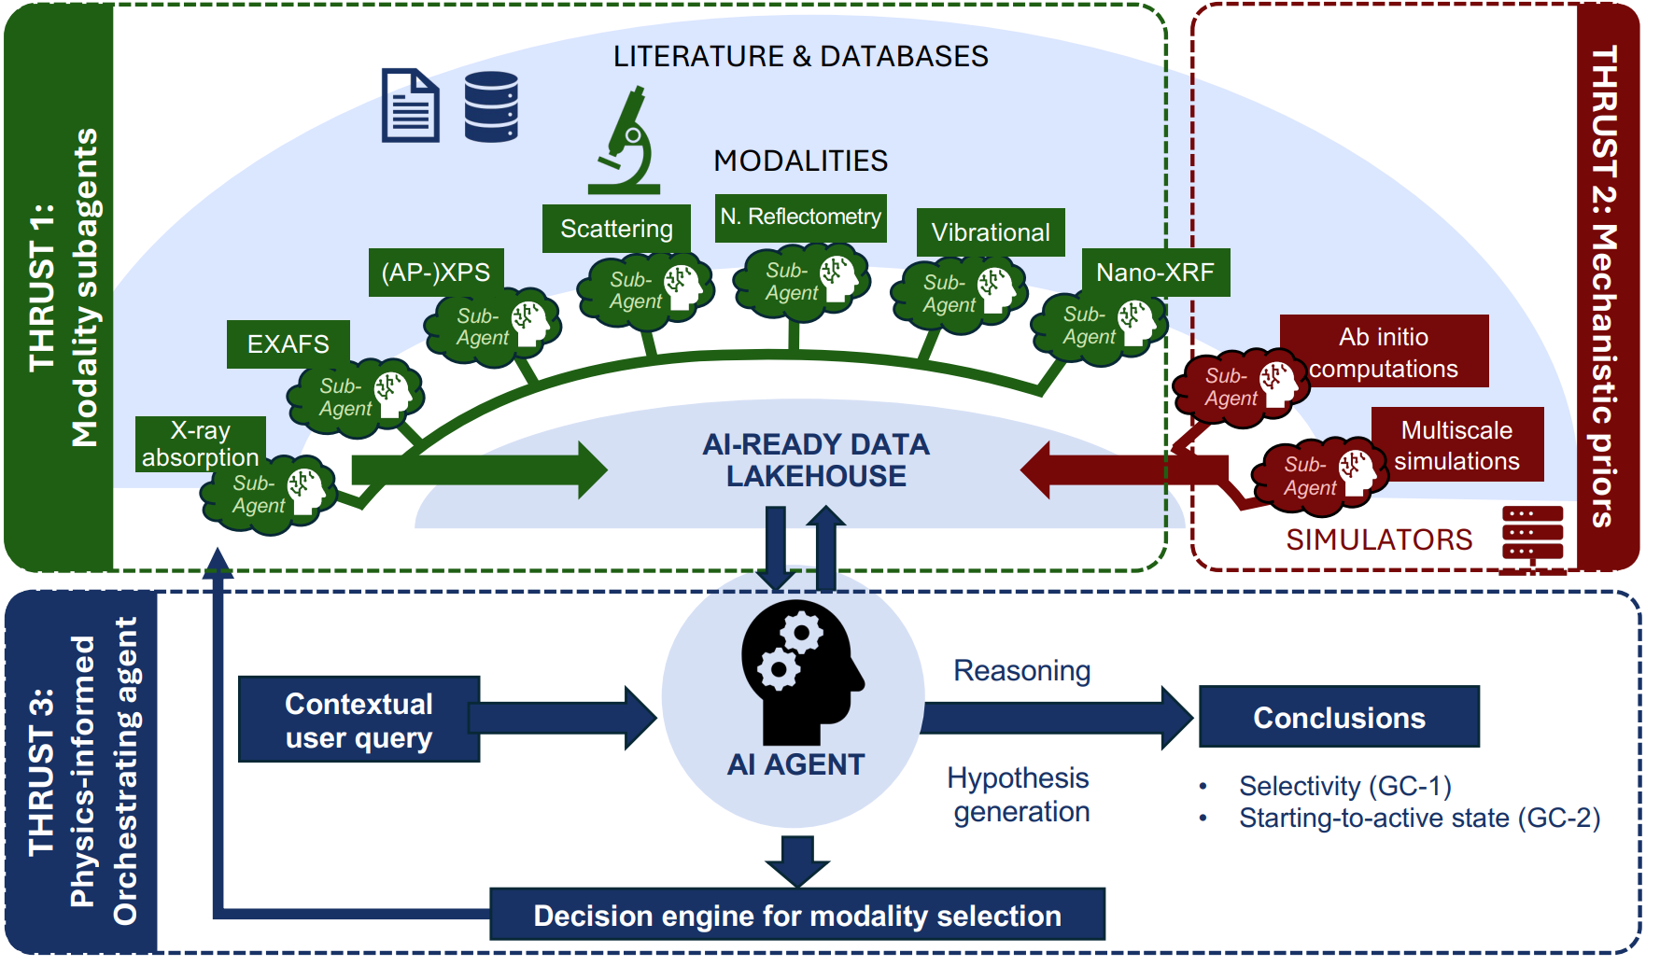
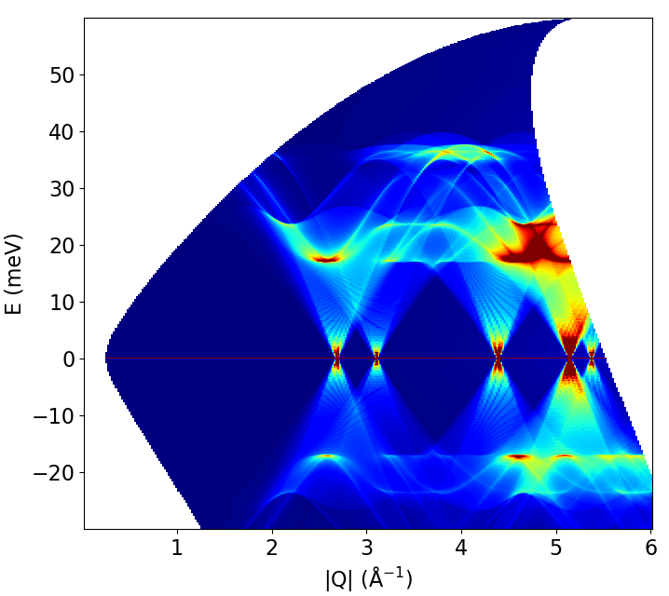
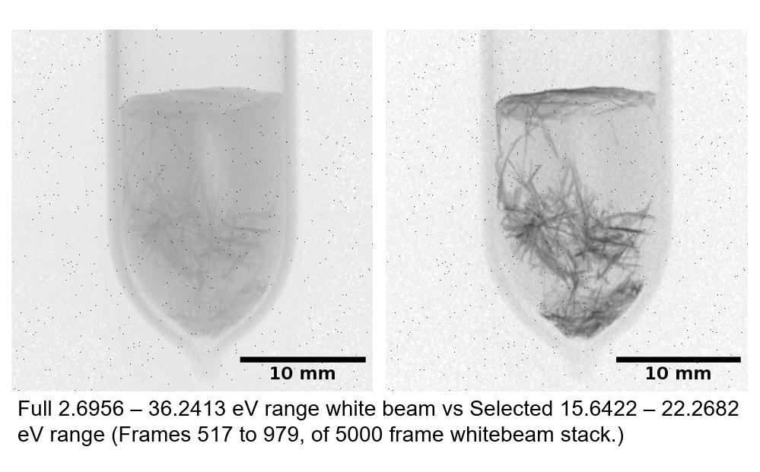
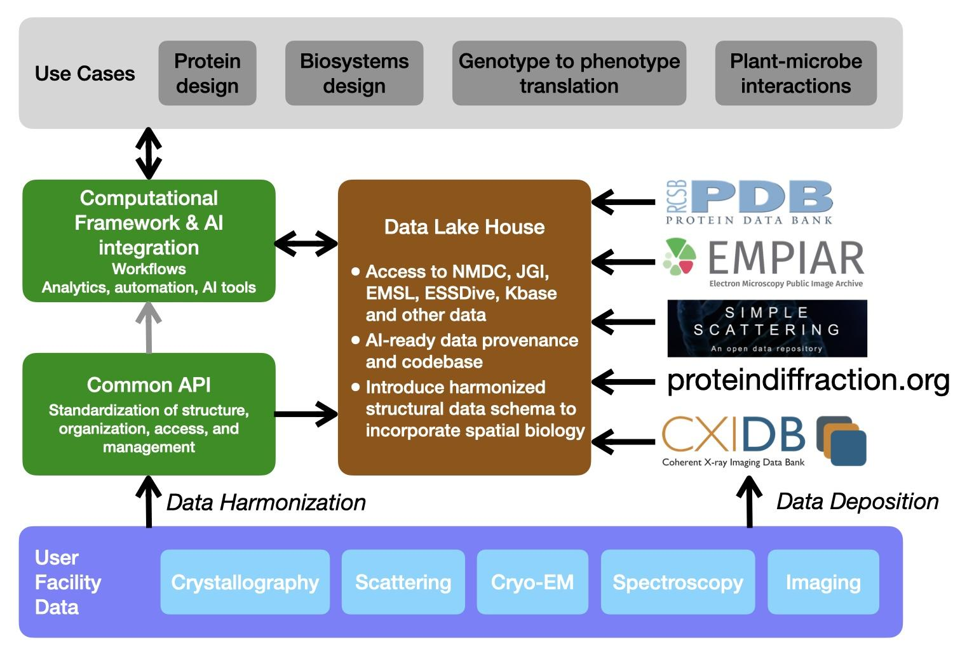
Genesis projects related to neutrons
… is a national initiative to build the world's most powerful scientific platform to accelerate discovery science, strengthen national security, and drive energy innovation.
Pathfinder projects
Other (non-Genesis) NSD activities
ASCR ModCon Projects
ILLUMINE is a DOE-funded project where we focus on diffraction.
AI methods for SANS data analysis and agentic workflows experiment execution.
Automated workflows for engineering diffraction and additive manufacturing.
MAIQMag
Multimodal AI for Hamiltonian inference
MOAT
Agentic system for accelerators
ISAAC
Agentic AI for catalysis
SiO₂
Te
MAIQMag
Super resolution and source separation for inelastic neutron scattering
WTe₂
LAMBDA
Lakehouse for biological small angle scattering
SYNAPS-I
Segmentation for imaging

Slide 10
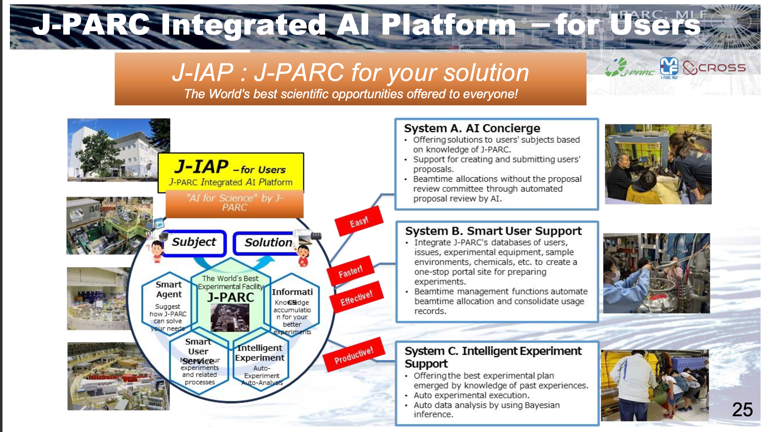
Image title

Slide 11
AI use cases presented at ICANS
Nicolò Violini: to ease the work of setting up multiple VITESS simulations
(demoed in satellite meeting)
Juping Xu: to automate analysis of total scattering data

Slide 12
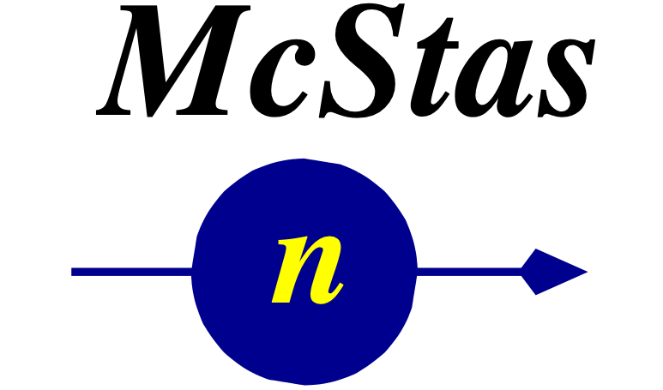





PaNRAID
PHOTONS AND NEUTRONS REALISTIC ARTIFICIAL INTELLIGENCE DATASETS
Dates: 21-25 September
Venue: Île d’Oléron, France
Objective:
The course will develop an integrated approach for generating synthetic data for supervised learning. This approach combines
multi-scale materials simulations (DFT, MD, XAS spectroscopy) with comprehensive digital twins of experimental X-ray and
neutron facilities, explicitly accounting for instrumental effects and experimental artefacts.
Intended audience:
Doctoral students
Postdoctoral researchers
Faculty and teaching-research staff
Researchers and research engineers
Further information and pre-registration: https://formation.pepr-diadem.fr/formation-panraid

Slide 13
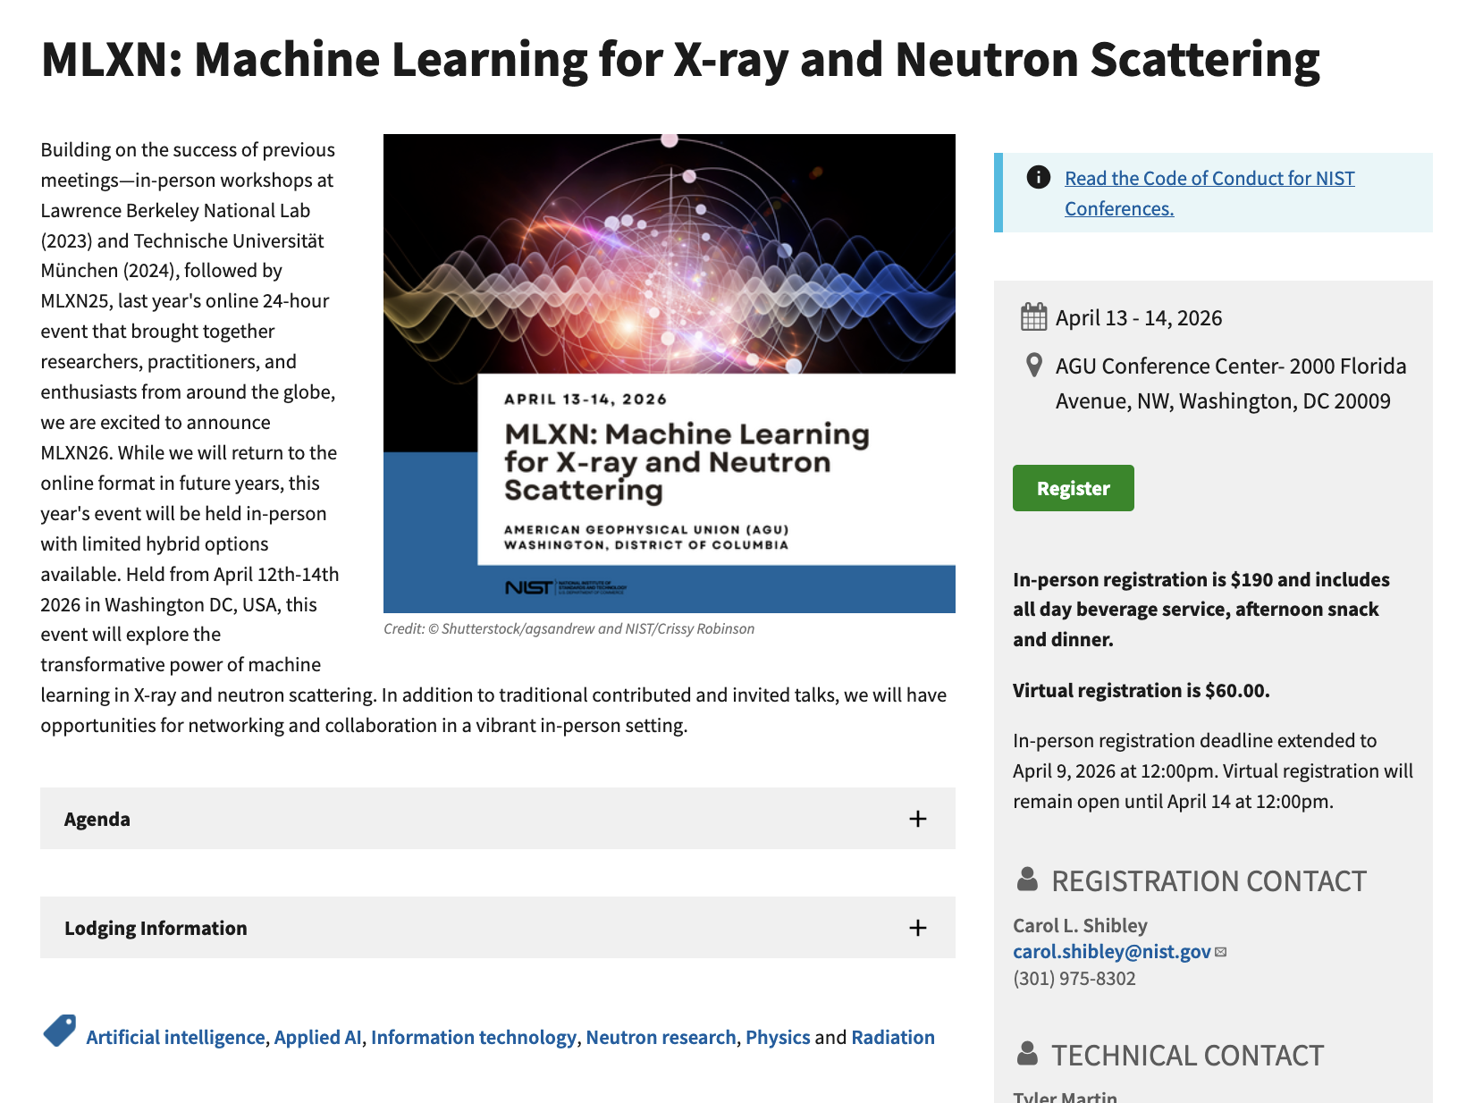
Other software events
International Conference on Accelerator and Large Experimental Physics Control Systems (ICALEPCS) – Japan in 2027

Slide 14
Concluding remarks
Good discussion between participants – promoted by satellite meeting
Simulations is a standard tool for instrumentation design and are becoming realistic
  Moving towards running simulations in parallel with experiments
Multiple facilities are looking into AI & ML for accelerating workflows, automation, and making things easier
Thank you!

Slide 15
Finish presentation

