Slide 2
Michael Wohlmuther
PRESENTED BY Jose ignacio Marquez Damian on behalf of Michael's colleagues at ESS
Notes:
In October last year Michael Wohlmuther passed away. He was a member of the local organizing committee of this ICANS meeting and well known by many in this community. For me, he was a colleague, a neighbor, a friend, and one of the most kind and selfless persons I ever met.
But Michael was also a great scientist. And from what matters most to this conference, he participated, and in many cases led, some of the experiments and developments that allowed the design and operation of megawatt-class spallation sources.

Slide 3
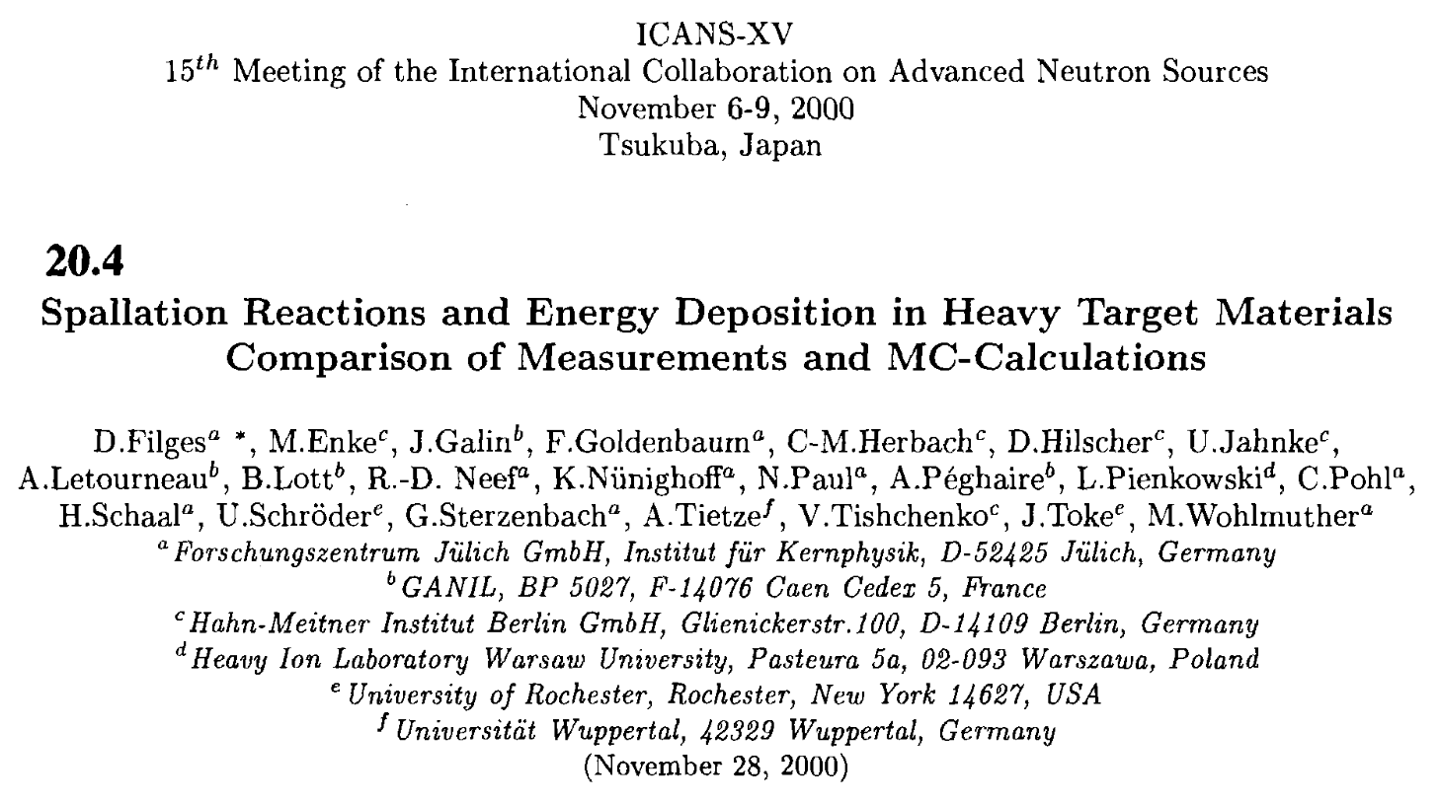
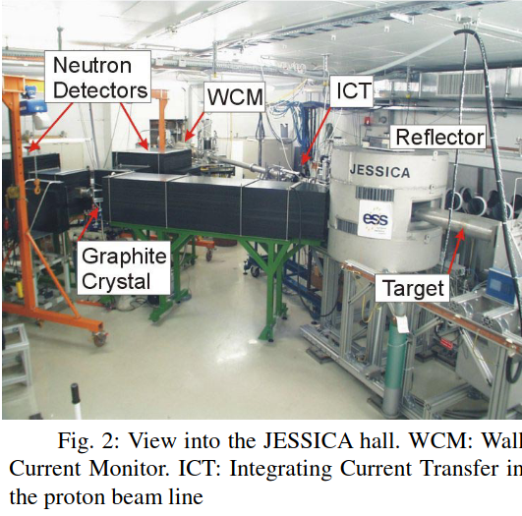
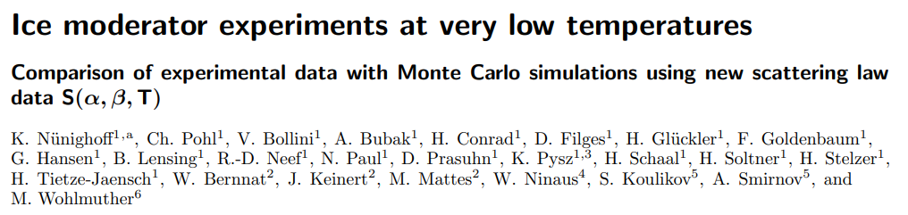
TU Graz and FZJ
Notes:
Michael studied at the Technical University of Graz in Austria and Forschungszentrum Jülich, working on intracascade simulations of spallation reactions being measured at the NESSI and JESSICA experiments at COSY which at the time were part of the original European Spallation Source project led by Günter Bauer.

Slide 4
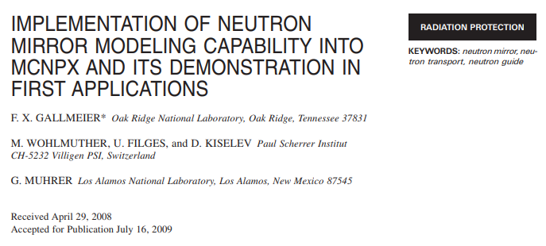
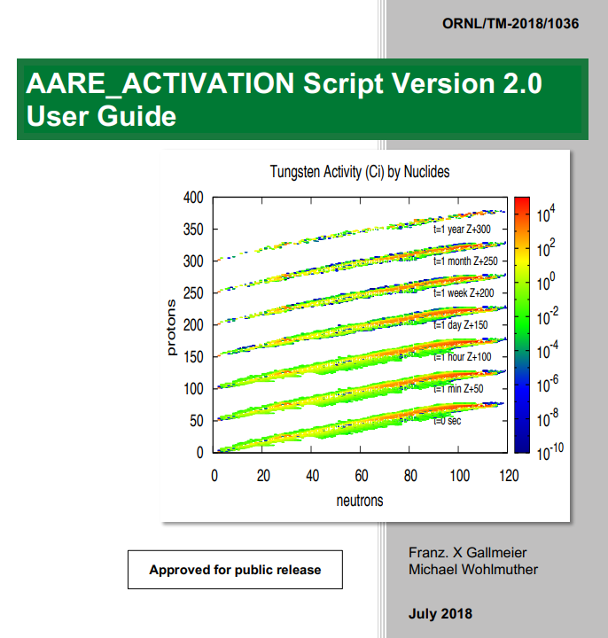
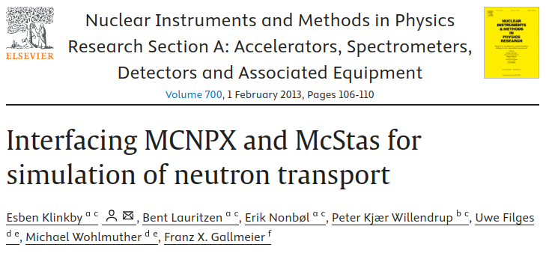
Paul Scherrer Institute
Notes:
He then transferred to Paul Scherrer Institut, where he held different positions until he became leader of the Radiation Transport and Multiphysics group. Here he collaborated with Franz Gallmeier and other scientists at SNS, ANL and Los Alamos in the development of modern tools for activation and neutron beam simulation calculations by coupling MCNPX with CINDER’90, FISPACT and McStas.

Slide 5
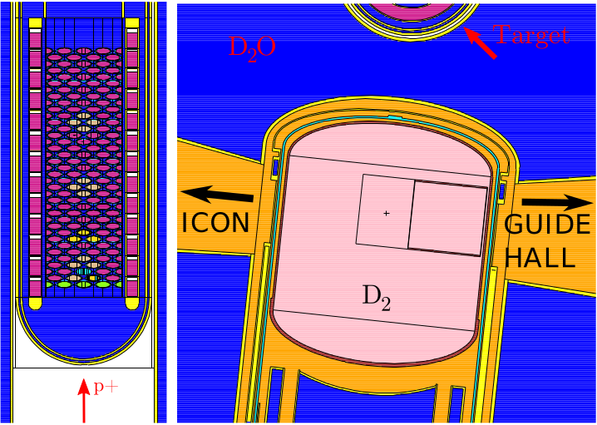
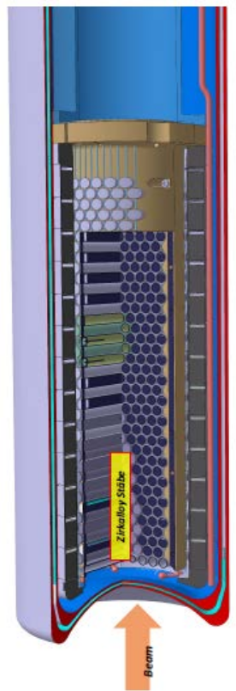
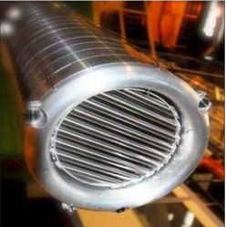
Paul Scherrer Institute
Notes:
At PSI he was responsible for the design of the spallation target for the UCN source, which Bertrand Blau presented on his talk this week, and of developments and improvements in the SINQ “cannelloni” target neutron production target as well as other facilities in the HIPA accelerator and the PROSCAN proton therapy center. I was talking with Nicola Rizzi this week, and a significant part of the SINQ++ design is based on work from Michael.

Slide 6
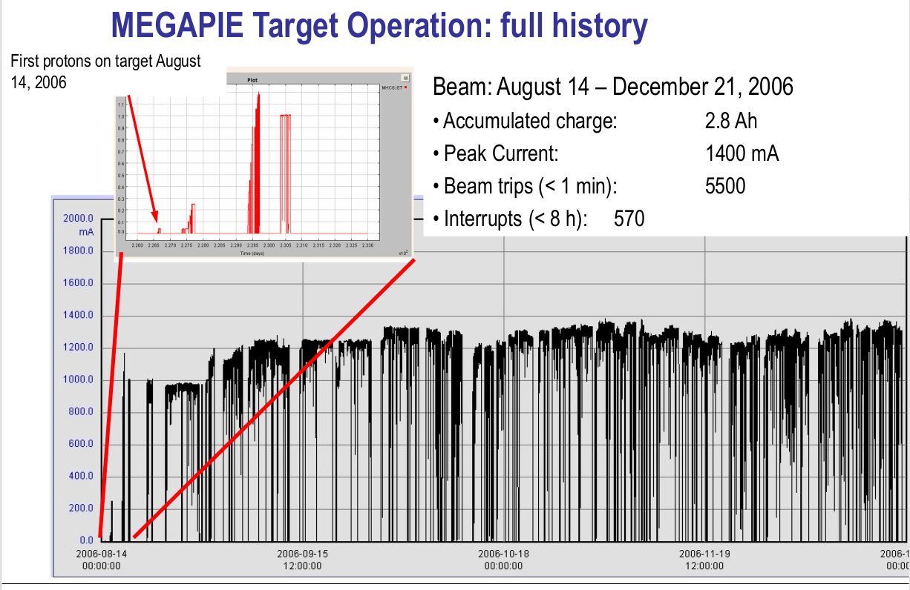
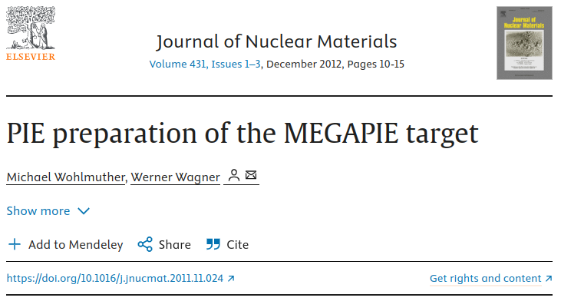
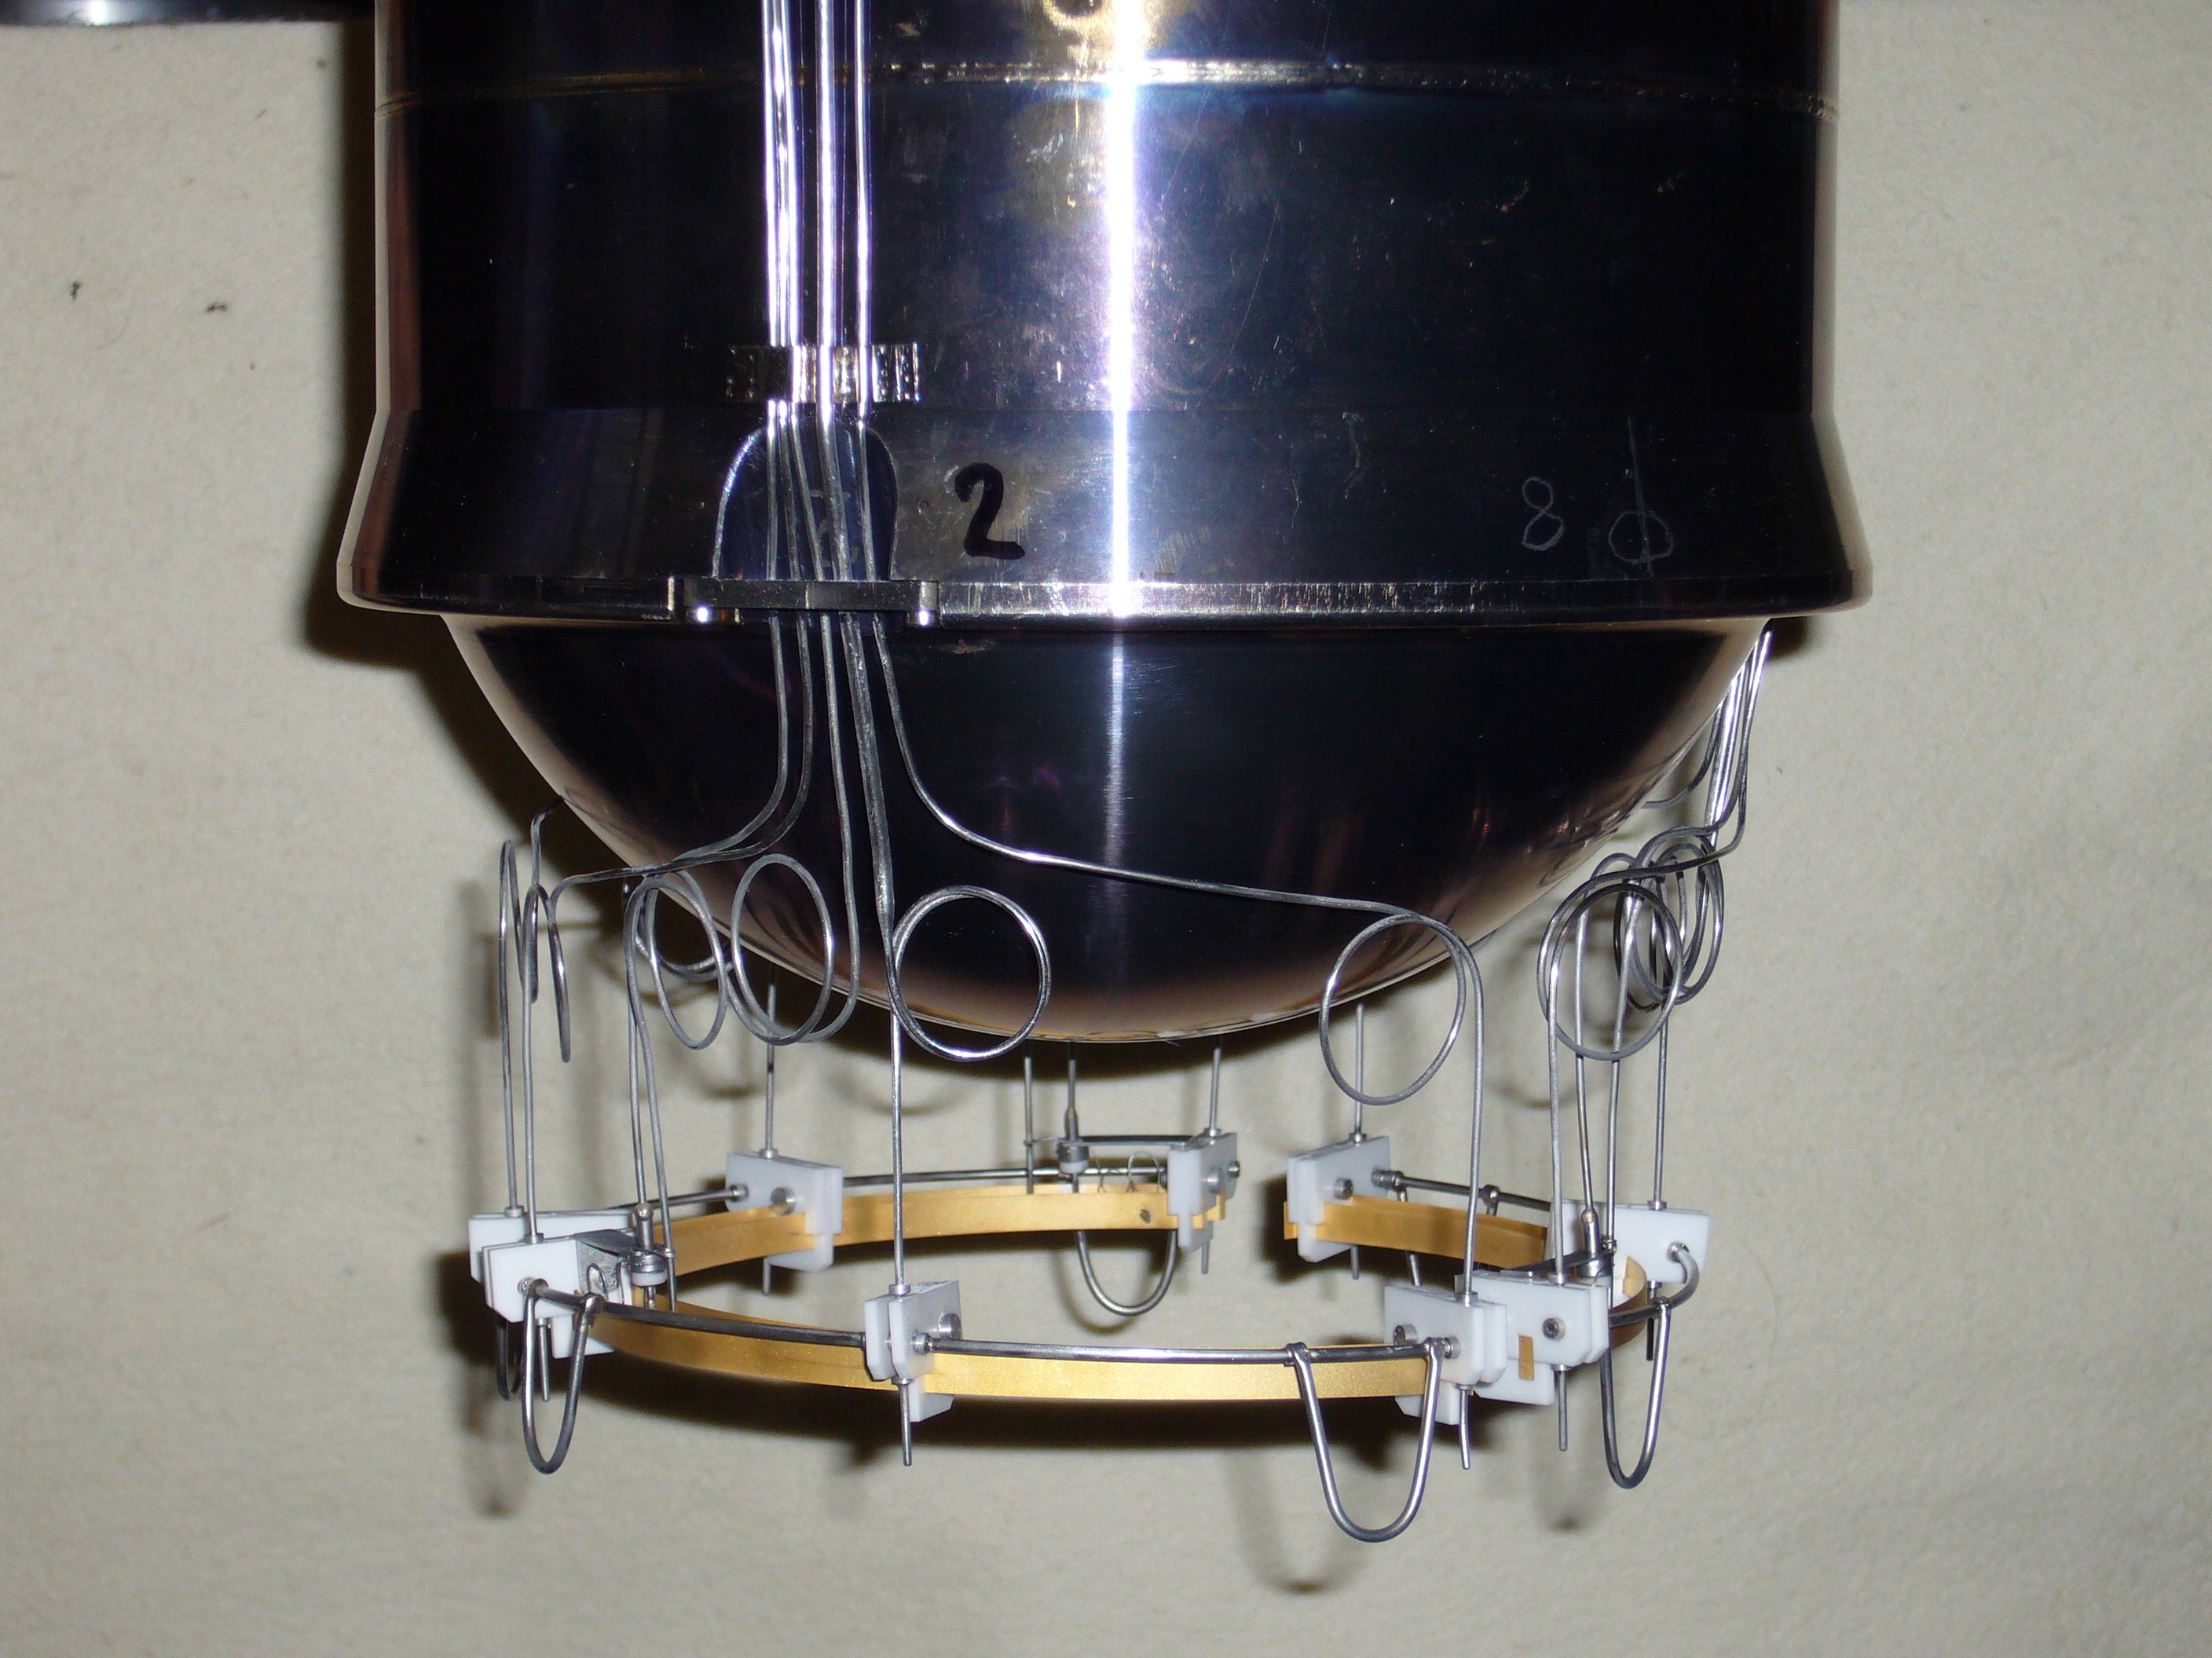
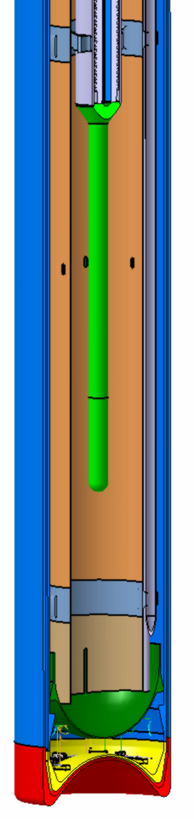
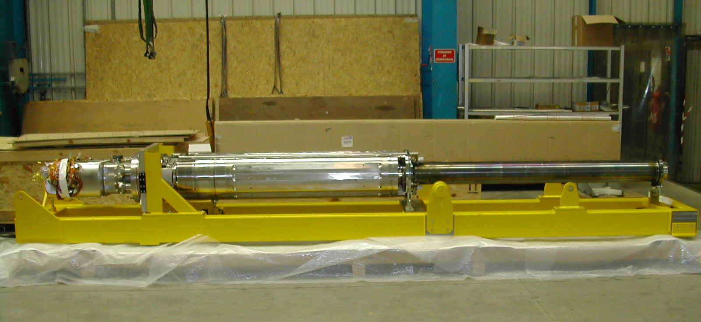
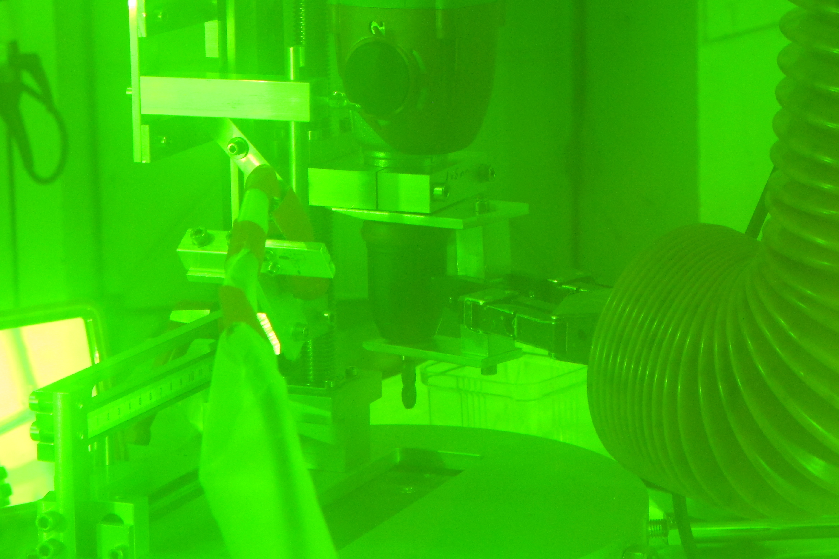
MegaPIE
Megawatt Pilot Experiment
Notes:
He was also technical director of the MEGAPIE project, a project for the whole life-cycle, from design to post irradiation investigation and disposal, of a lead-bismuth eutectic target in the megawatt regime, which was seen as an alternative for high intensity neutron source production and accelerator driven systems for nuclear waste transmutation.

Slide 7
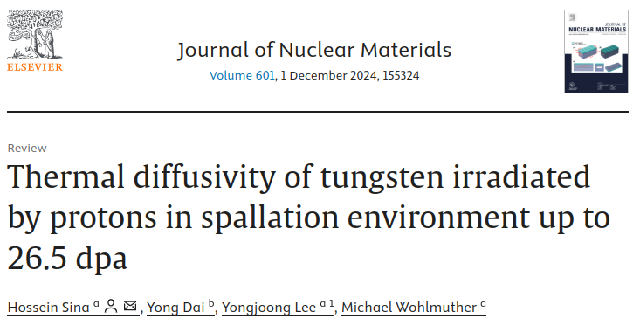
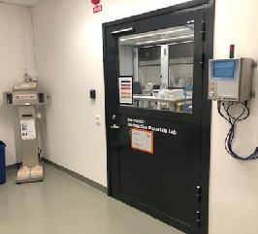
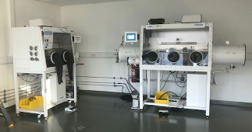
ESS
Post-irradiation examination
Radiological Materials Laboratory (RML)
Notes:
In March 2021 he joined the Spallation Physics Group at ESS where he contributed with radiation transport simulations, and irradiated material expertise in our preparation for operating with activated materials.

Slide 8
Advisory commitees
Member of the Scientific Advisory Board of HiRadMat (CERN)
Member of the Technical Advisory Committee of the Facility for Rare Ion Beams (FRIB)
Member of the ESS Technical Advisory Committee.
Member of International Organising Committee of the International Workshop on Spallation Materials Technology (IWSMT) and RaDIATE Collaboration meeting.
Notes:
Michael was a member of several technical advisory committees, including the HiRadMat facility at CERN, the Facility for Rare Isotope Beams in Michigan, the International Workshop on Spallation Materials Technology, and the RaDIATE collaboration. He was also a member of the ESS technical advisory committee, before he joined.

Slide 9
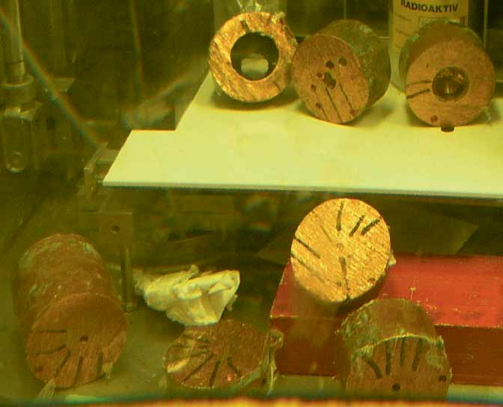
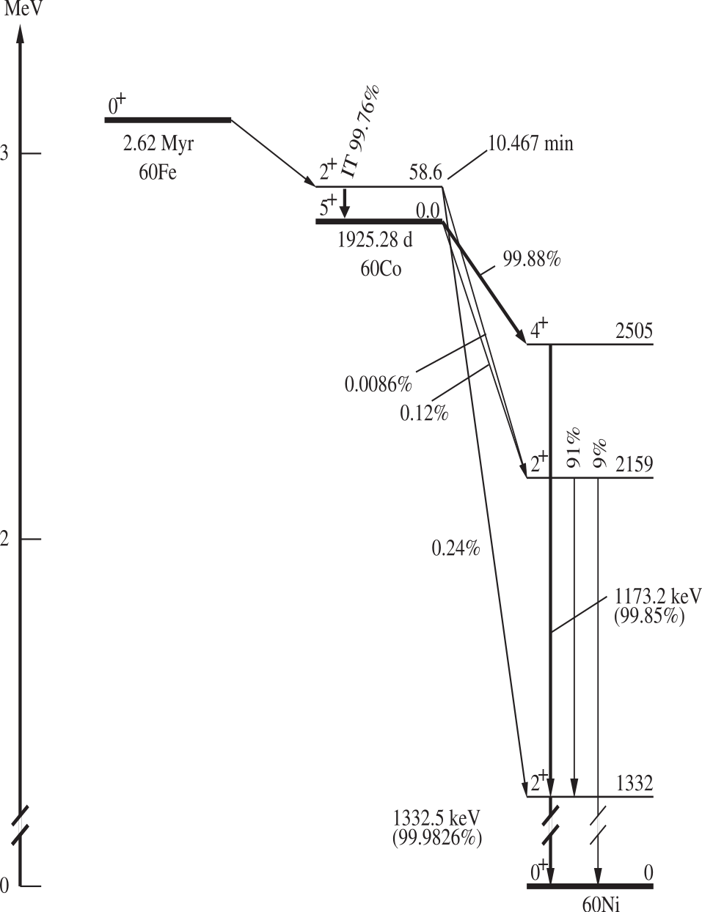
Extraction of ⁶⁰Fe from the HIPA beam dump
Notes:
One thing he was particularly proud of was the post irradiation analysis done on the copper beam dump that was used at the HIPA accelerator from 1980 to 1992. From this target they extracted a Fe-60 sample that was used to measure the half-life of this rare radioisotope, which is central for the interpretation of stellar processes and for the determination of timescales in the Solar System. He was always very humble, but this particular work was very important because it showed that something that in principle is a “waste” or a “problem” (like an irradiated beam dump that needs to be disposed of) can also be an invaluable source of information to understand the universe.

Slide 10
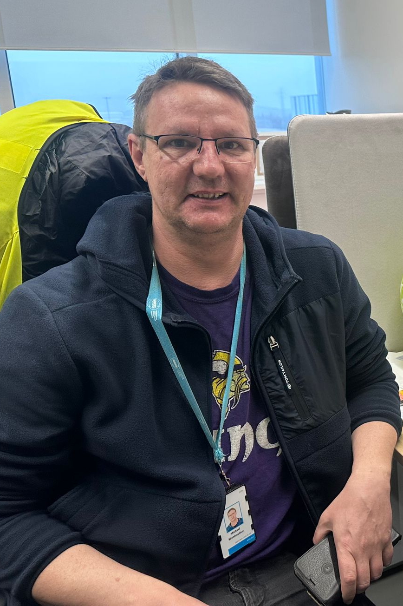
1975-†2025
Notes:
Michael was a great person and those who had the chance to meet him will remember him for that. But he was also left a legacy of developments in the field of advances neutron sources and we will also remember that.

Slide 11
The end

