Slide 1
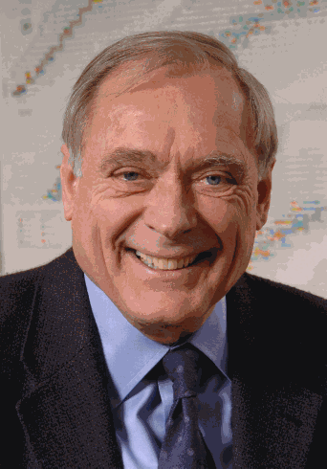
JOHN M. CARPENTER
20 JUNE 1935 – 10 MARCH 2020

Slide 2
John M. Carpenter was a Senior Physicist, retired, Emeritus Scientist, and Distinguished Fellow of Argonne National Laboratory, afterwards attached to the APS Engineering Services Division. Until 1975, he served for ten years as Professor of Nuclear Engineering at the University of Michigan. Then, until retiring in 2007, for 32 years he worked as a Senior Physicist at ANL, where he was known for developing accelerator-based pulsed spallation sources and as cofounder, with three others, in 1977, of the International Collaboration on Advanced Neutron Sources, ICANS.

Slide 3
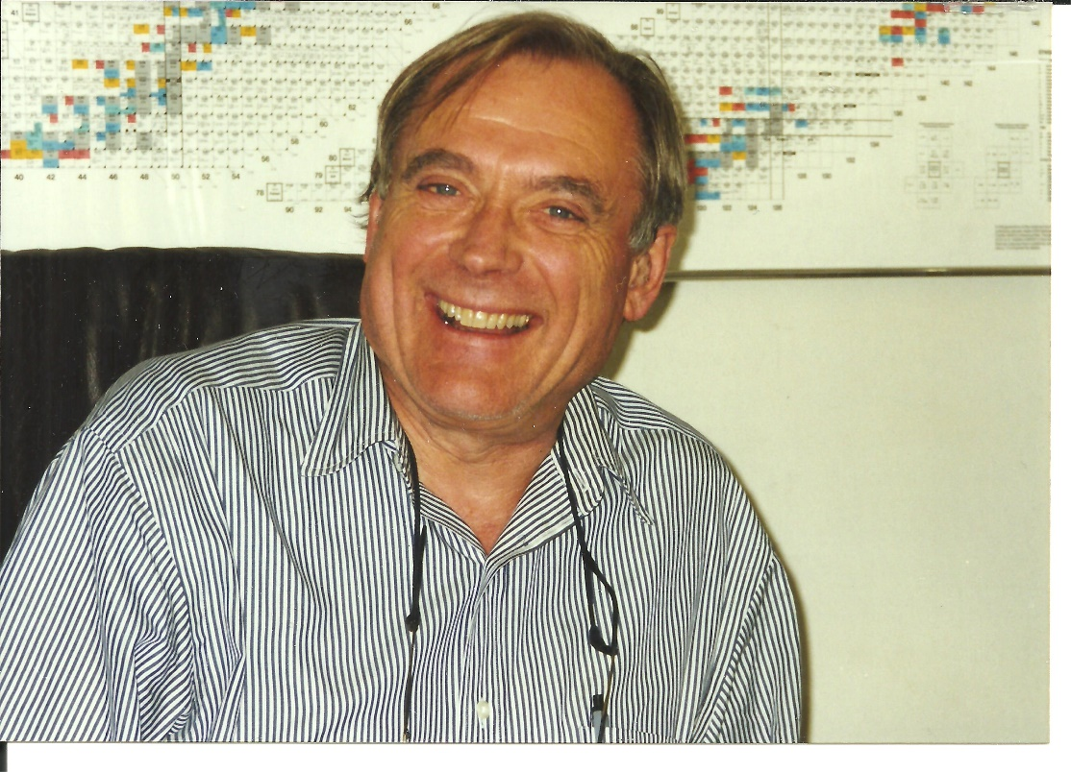
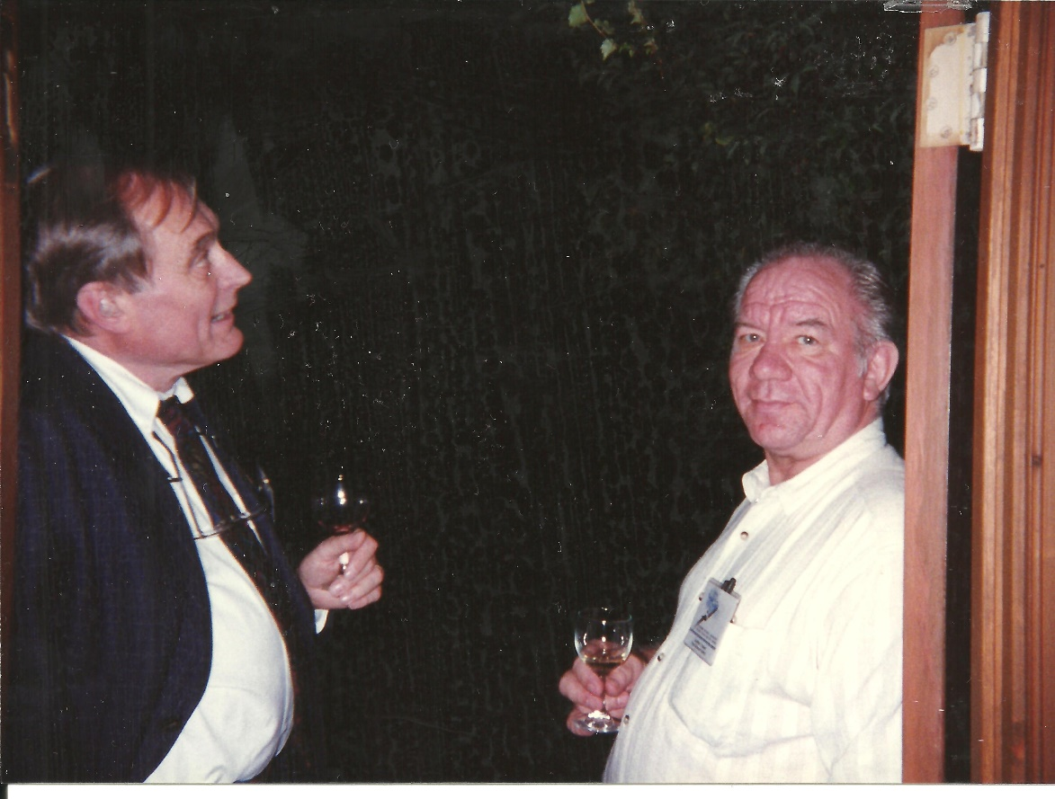

Slide 4
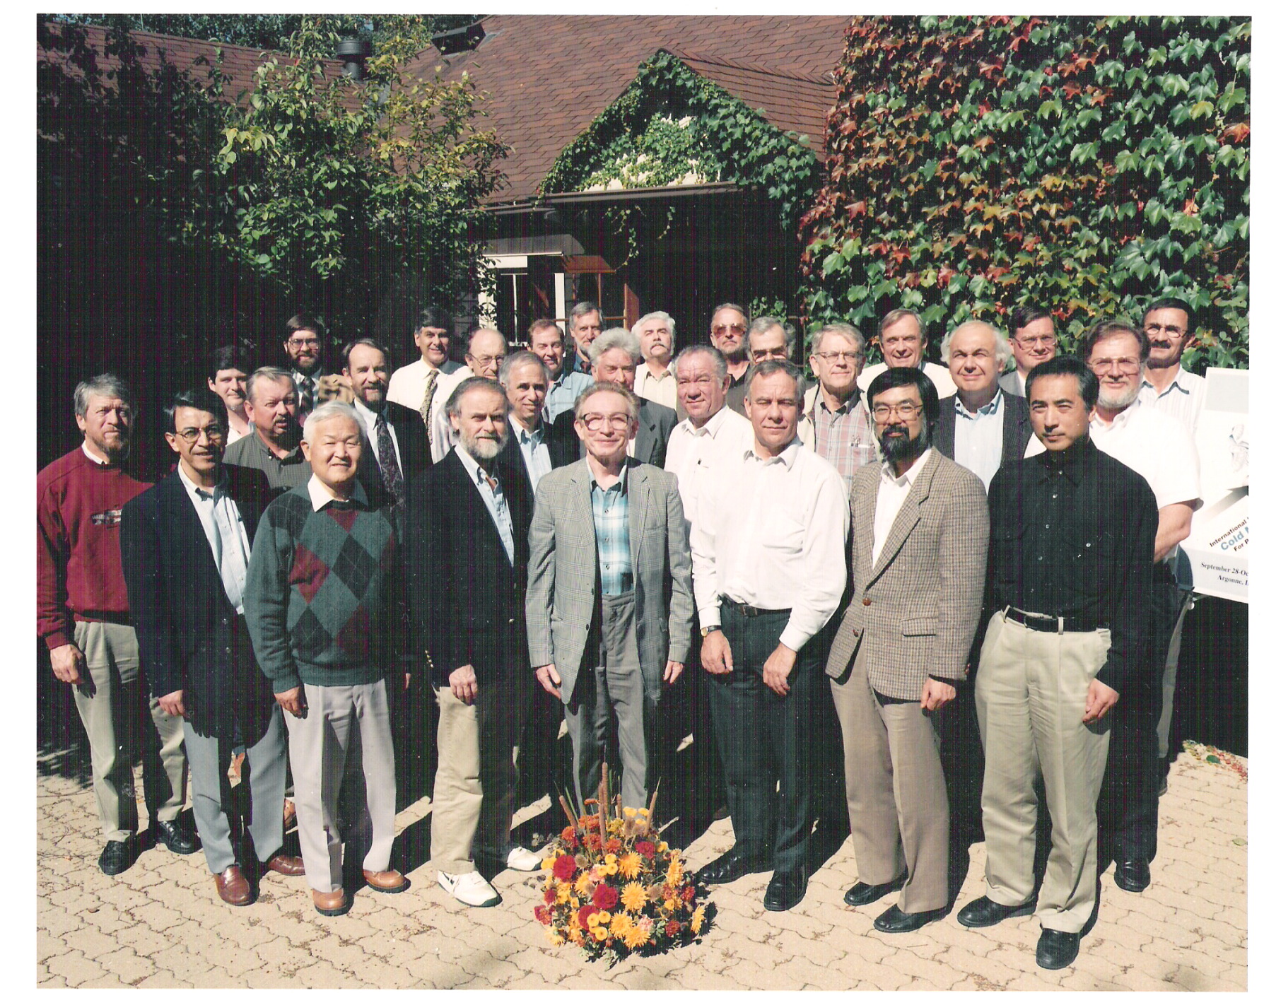
ARGONNE 1997….

Slide 5
ARGONNE 1997….
Ferguson Iverson Lucas Ludwig Russell Williams Cser Brun Carpenter Picton Spitzer
Stendal Scott MacFarlane Crawford Zemlyanov Bauer Broome Charlton Lanza Gabriel
Granada Watanabe Dorning Shabalin Jones Furusaka Kiyanagi

Slide 6
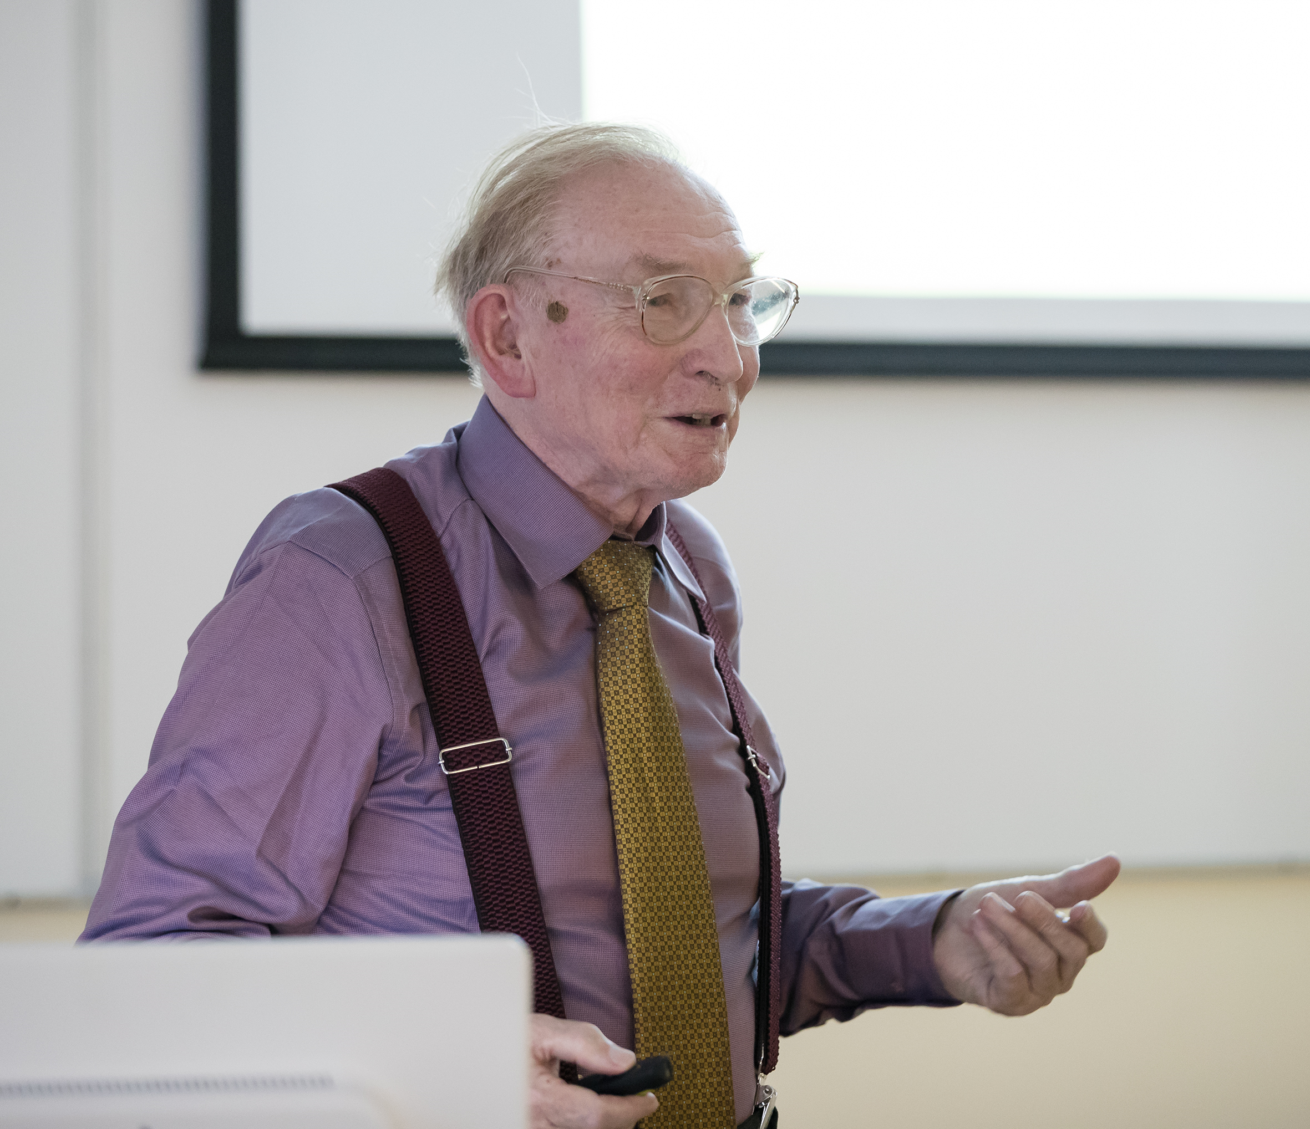

Dear Rolando,
I am glad to hear of you, and getting news about J. Carpenter prize foundation. He had been my warmest and closest foreing friend and colleague as well.
Among encloses , you'll find a file of English translation (sorry, by computer/, and it might be difficult to edit a text) of one chapter of my memoirs book 'On the ship of my dream' . Please, pay attention to pages devoted to Jack.
Eugene Shabalin

Slide 7
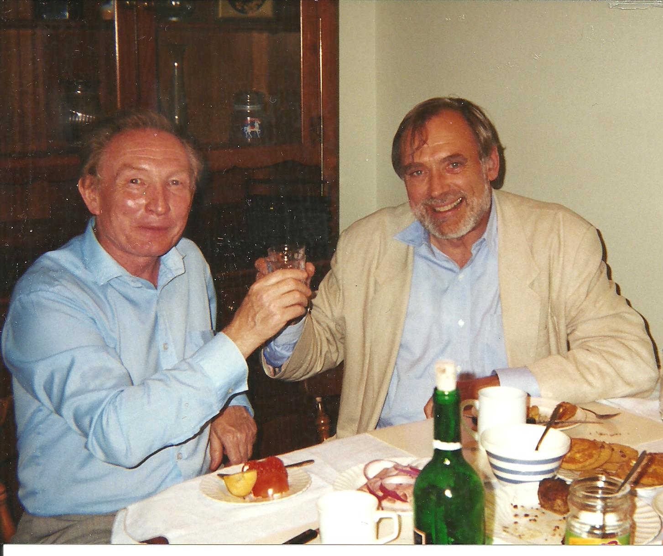
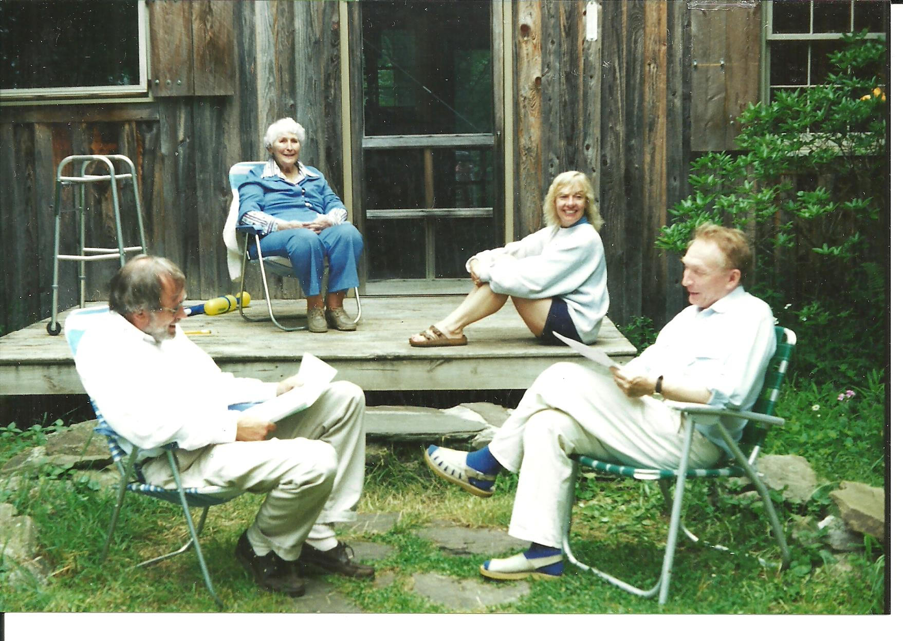
From foreign literature, I had heard of a man named J.M. Carpenter, who uses solid methane as a moderator at his neutron source in Chicago at Argonne National Laboratory. I wanted to learn firsthand about working with methane as a moderator. Carpenter responded quickly to my email and sent an invitation.
So, August 1990. A Boeing 747 carries me across Ireland, the Atlantic, and New York to Chicago, to John M. Carpenter, a world-renowned expert in neutron physics and neutron sources, the only person in the world working with cold neutron moderator on solid methane. I did not expect then that I was actually flying to the first meeting with one of my best friends of the second half of my life.

Slide 8
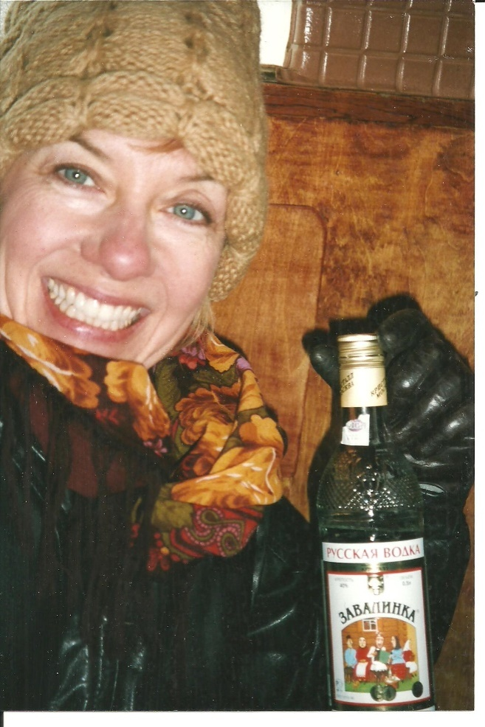
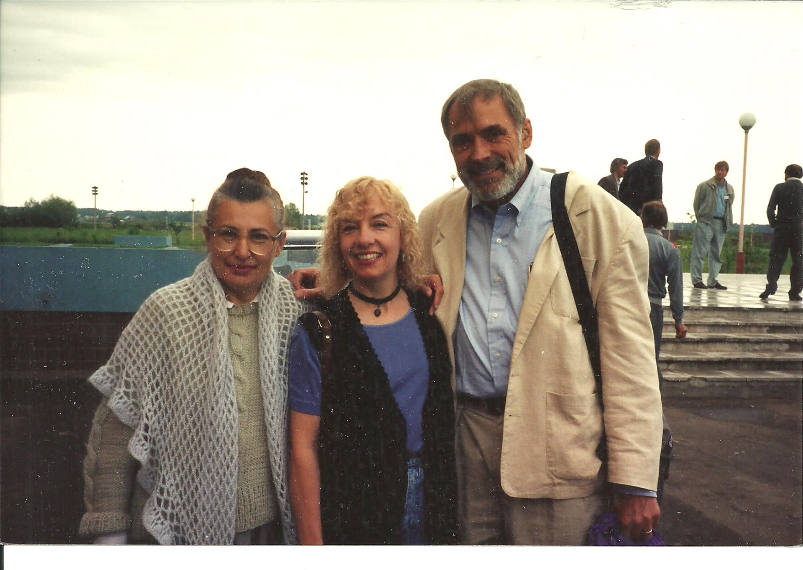
Thus, then, in 1990, having flown twice across the Atlantic Ocean, I gained something much more important than understanding thermal explosions in methane - I gained a friend, distant but reliable, not speaking Russian, but understanding me without words. When I mumbled something wrong and apologised, Jack would always say, "I'm the one who should apologise - I don't know Russian at all!
Carpenter made a good impression on me from the start. He was tall, thin, with a pleasant open face, attentive to his interlocutor. And later Jack, always remained with me as friendly and frank. After 3 years, he introduced me to his second wife, Rhonda, who became his inseparable companion until his last day. Never before or since have I met a couple more inseparable, more tender and attentive to each other.

Slide 9
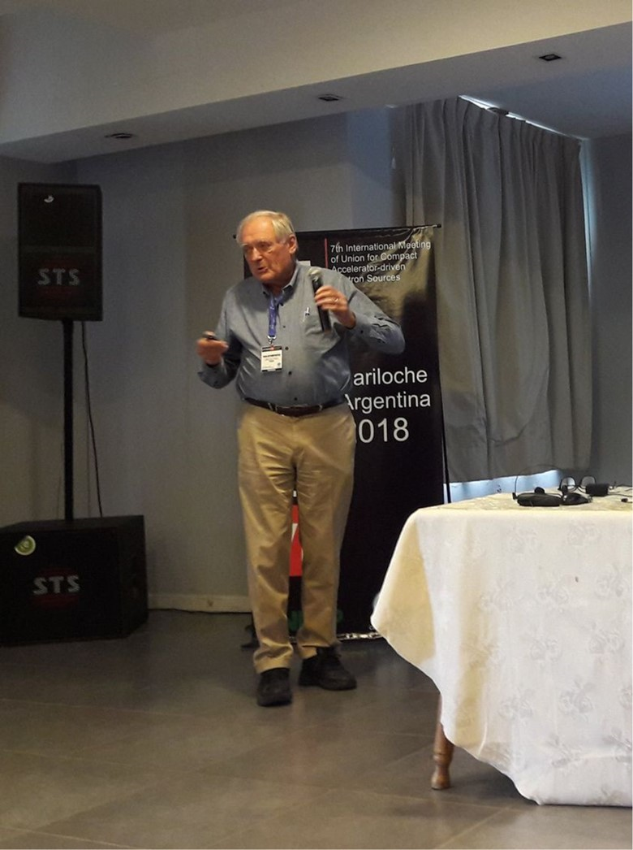
He was by far the leading man in the cohort of world scientists - experts in neutron physics who met 23 times over 55 years at the ICANS Collaboration on Advanced Neutron Sources. It was J.M. Carpenter who initiated this collaboration in 1977 and has always been the number one person wherever serious neutron physics is done.
And I will add that he was also
one of the founders of our
UCANS collaboration, in 2010.

Slide 10
DEVELOPMENT OF COMPACT NEUTRON SOURCES
UCANS-VIII
Eighth International Meeting of the Union for Compact
Accelerator-based Neutron Sources Paris, FRANCE
8-11 July, 2019
John M. Carpenter

Slide 11
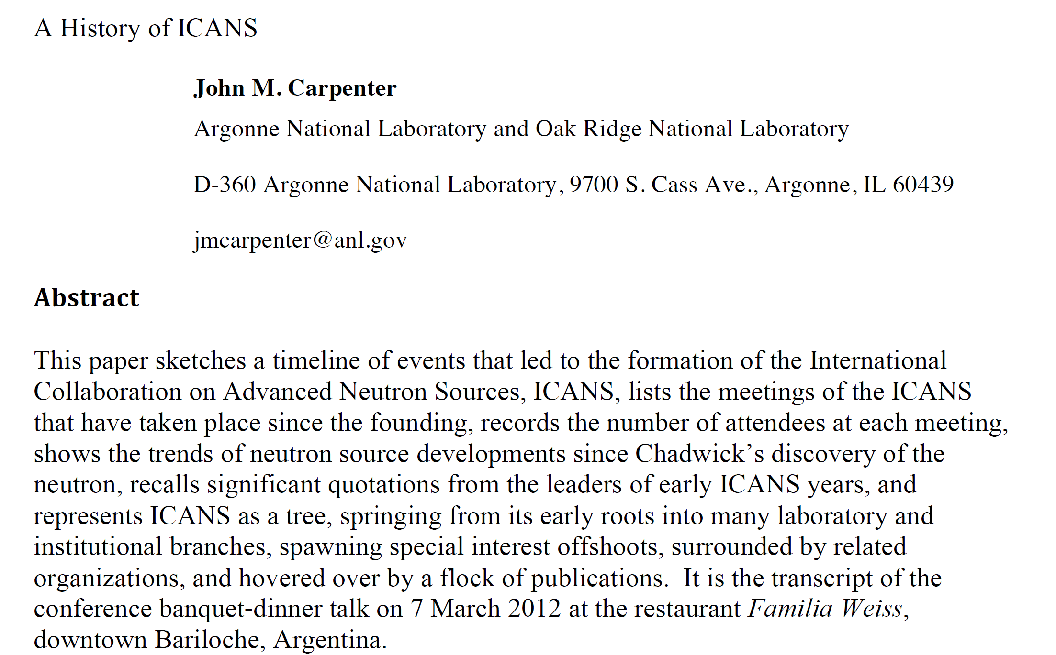

Slide 12
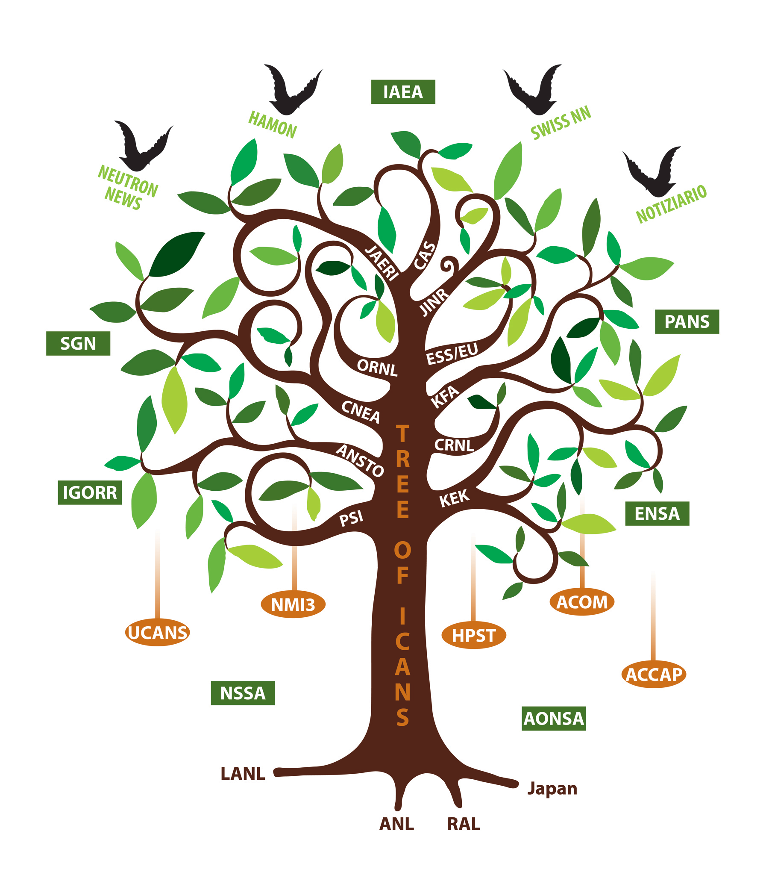
ICANS has grown from its roots in 1977 into a spreading tree with many branches, many fruits, many related organizations, and many hovering periodical-birds. The figure shows this as the TREE OF ICANS.
(ICANS XX, Bariloche, Argentina, 2012)

Slide 13
“It seems clear that ICANS will continue to serve the scientific community as the wellspring of collaboration on advanced neutron sources. It will be important to maintain the close sense of community, personal acquaintances, and cooperative efforts that have helped to advance neutron source technology and scientific applications.
Together, we have become the WeCANS.”
Jack Carpenter
(ICANS XX, Bariloche, Argentina, 2012)

Slide 14
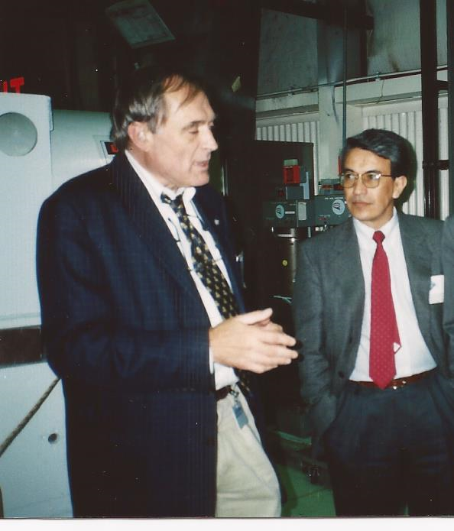
....for me he will always be in the front row of any meeting, smiling around, making remarks that help us to think a bit harder, a bit deeper.
It was a privilege of colleagues around the world to enjoy his friendship and warmth. his genius and his understanding...

Slide 15
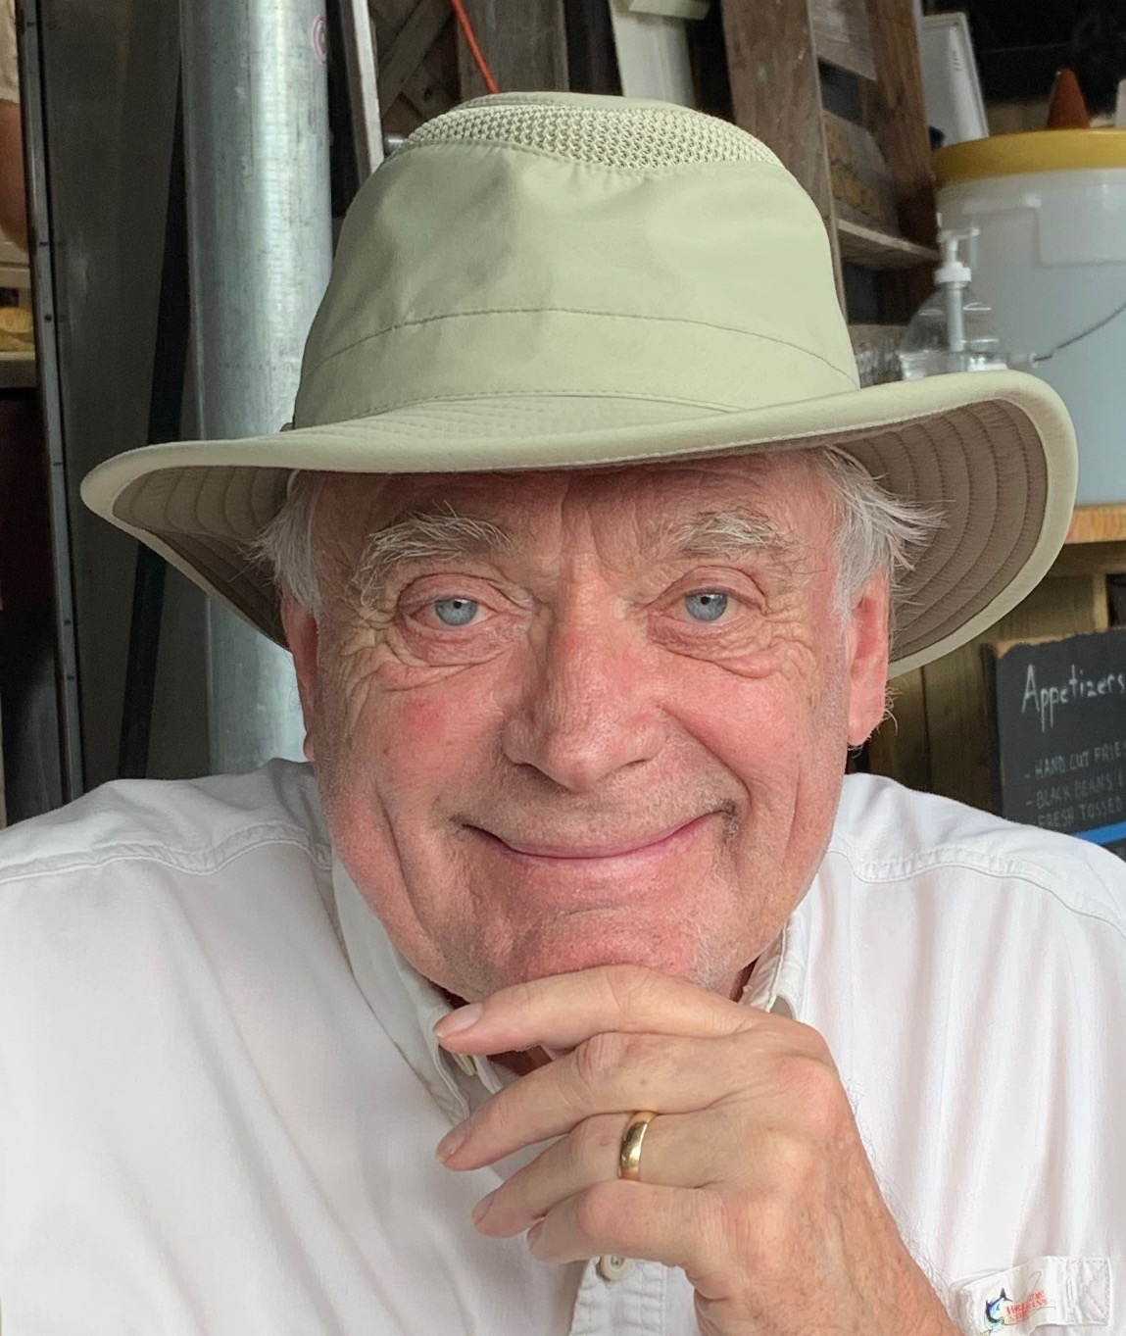
You will always be with us, Jack!

