Slide 1
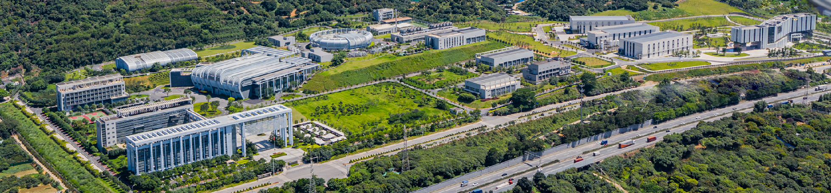



Report of Dongguan Branch
Progress on Manufacturing and Process R&D of the Moderator-Reflector Plug for CSNS-II
Chaoju Yu
On behalf of Moderator and Reflector System of CSNS
Institute of High Energy Physics, Chinese Academy of Sciences
ICANS XXV, Malmo

Slide 2

Outline
Current Operating Status of MR Plug at CSNS
Design Update of MR Plug-II
Manufacturing Progress of MR Plug-II
Process Technology R&D for MR Plug-II
Installation and Alignment Preparation
Summary&Challenges

Slide 3
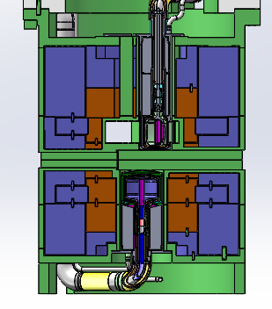
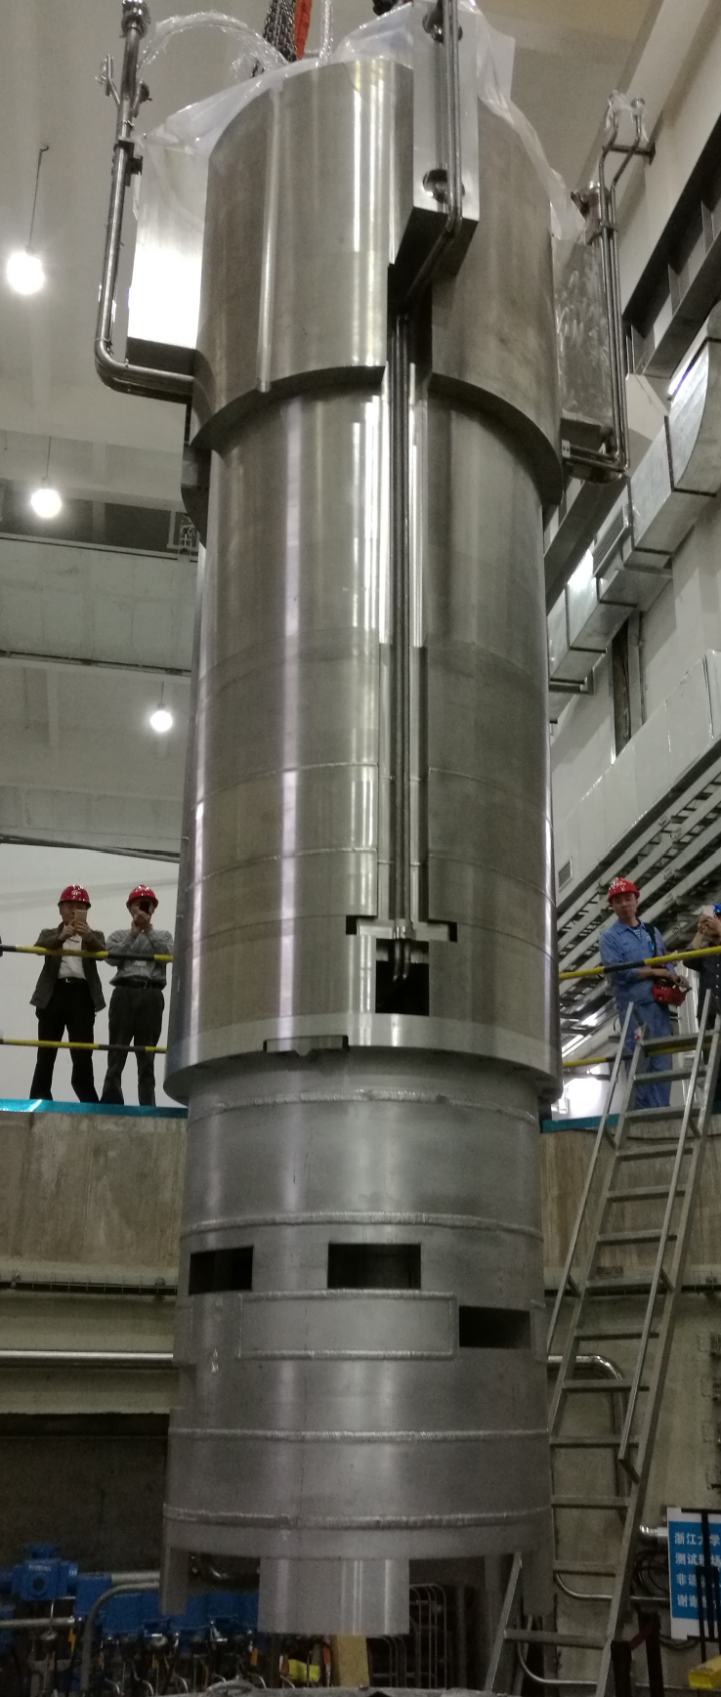
Current Operating Status of MR Plug at CSNS
  The moderator-reflector system of the CSNS target station has been operating stably for 8 years.
  The original design power of CSNS is 100KW, but currently the operating power had upgrade to 185KW, and temperature of the reflector aluminum vessel reaches 64 ℃, which is close to the service temperature limit of 65℃ for the 5083 aluminum alloy.
  According to estimates, the maximum proton power that the first CSNS MR Plug can accommodate will not exceed 200 kW. Therefore, the first MR Plug needs to be replaced in CSNS-II.
64℃@185KW
allowable temperature：65℃
MR Plug of CSNS

Slide 4
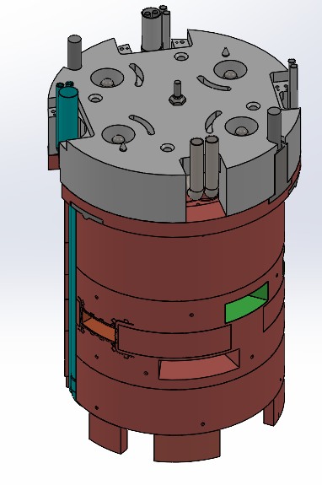
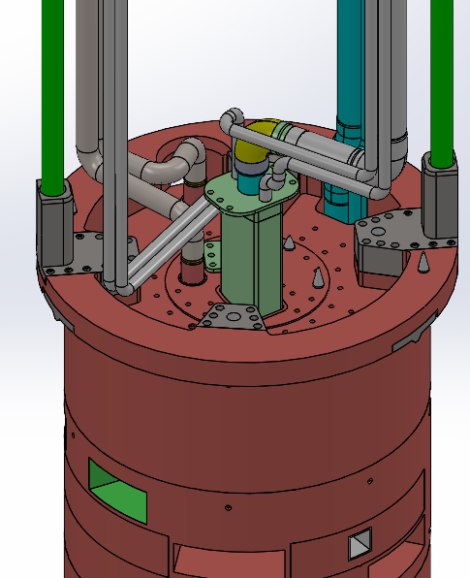
Design Update of MR Plug-II
More flexible replacement options
For the MR plug of CSNS, only full replacement is feasible.
The MR plug of CSNS-II features a more flexible design that supports both full replacement and separate moderator replacement.
Option Two：
Separate replacement of the moderators
Option one：
Full replacement
Two Replacement Options for the MR Plug of CSNS-II
Notes:
1、一期的原始设计，MR插件式整体维护，事实上寿命不同

Slide 5
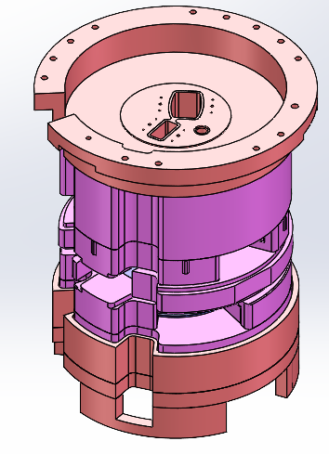
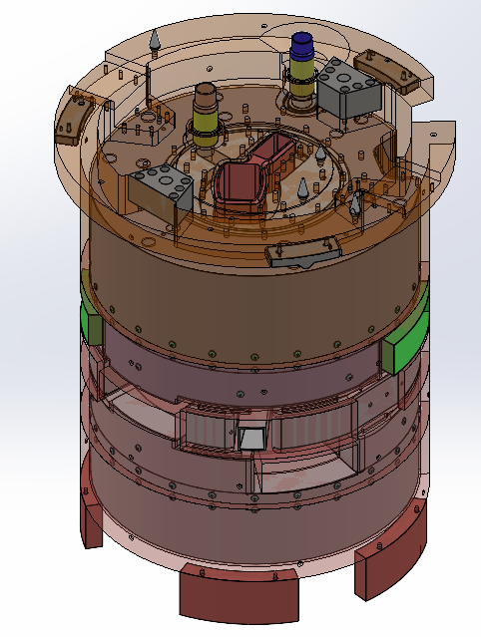
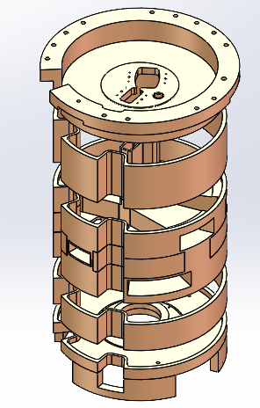
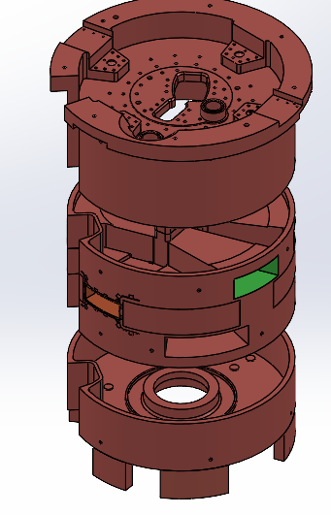
Design Update of MR Plug-II
Structure optimization for Better welding accuracy
The number of welds is reduced via structural optimization.
New structure design to prevent welding deformation.The expected welding deformation has been reduced from over 5mm in MR Plug-I to less than 1.5mm in Plug-II
Reflector vessel of MR Plug-I
Reflector vessel of MR Plug-II
Structure optimization to prevent welding deformation
Notes:
1、一期的原始设计，MR插件式整体维护，事实上寿命不同

Slide 6
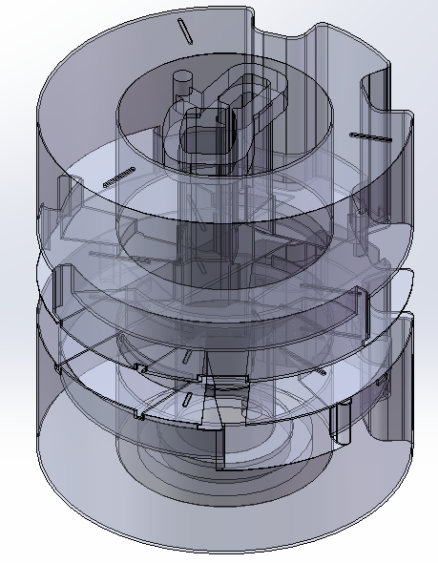
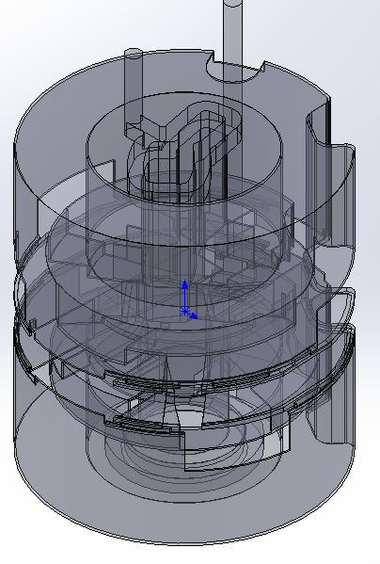
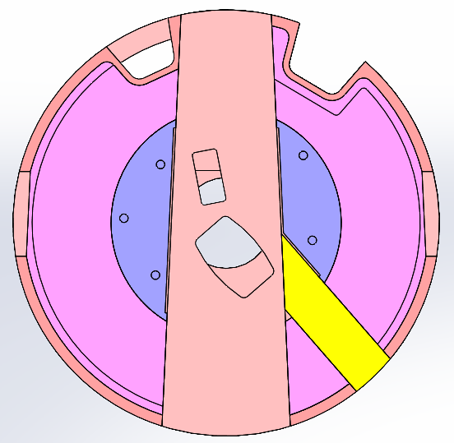
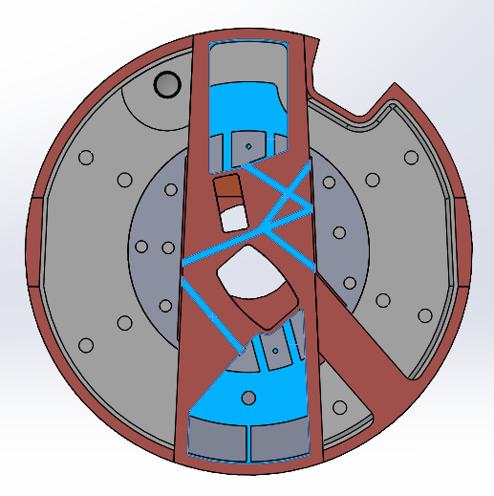
Design Update of MR Plug-II
Better heat transfer structure
More cooling channels to enhance heat dissipation
Meet the requirements of a proton beam power of 500 kW
More cooling channels in the middle area
More flow channels to facilitate heat removal
Notes:
1、一期的原始设计，MR插件式整体维护，事实上寿命不同

Slide 7
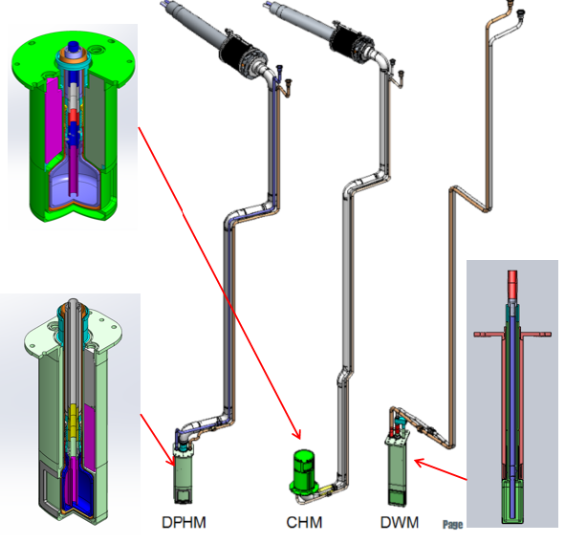
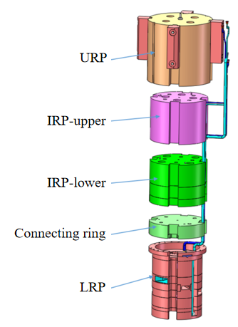
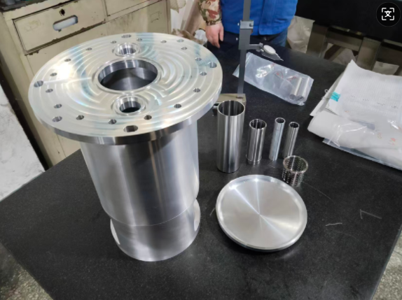
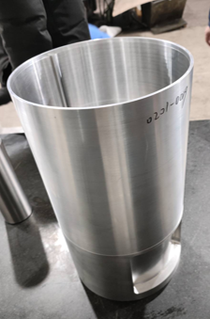
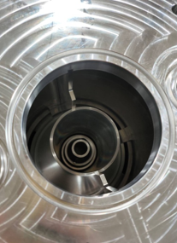
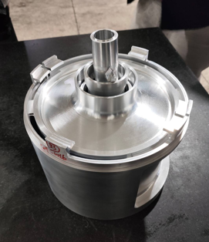
Manufacturing Progress of MR Plug-II
11/2024
07/2025
01/2026
03/2027
04/2028
Confirm manufacturer
Process review
Start Processing
Factory acceptance
Final installation
Three new moderators and Reflector for CSNS-II
First moderator body components

Slide 8
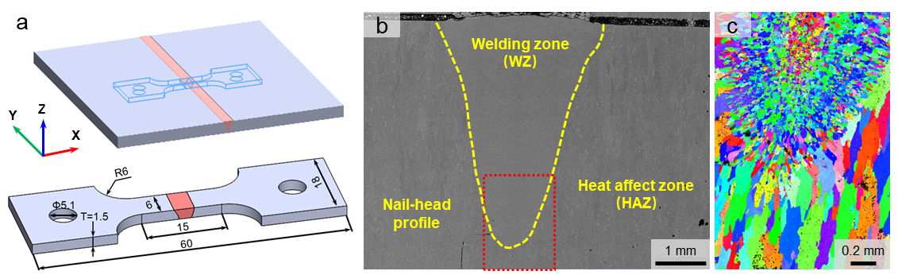
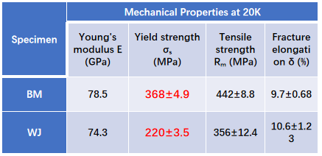
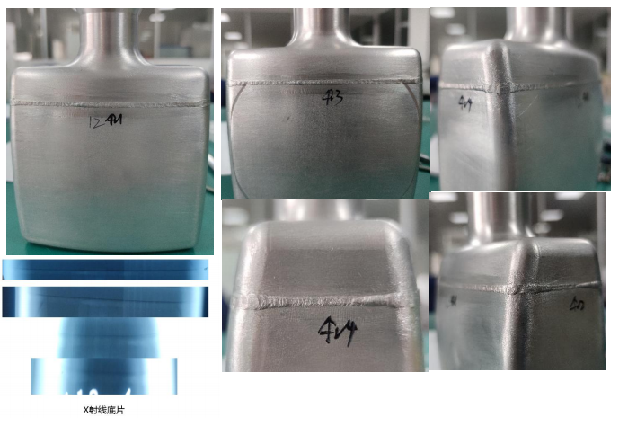
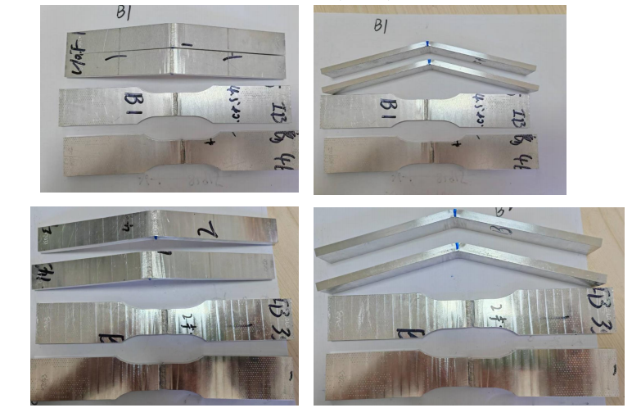
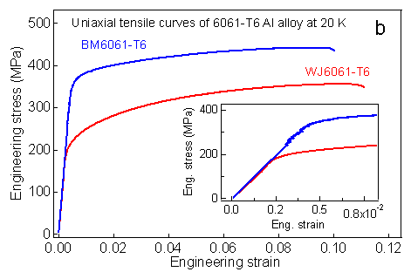
Process Technology R&D for MR Plug-II
  Al6061-T6 EB-Welding for moderators
  Optimized the welding process parameters to refine the grains in the weld zone and achieve a smaller heat-affected zone.
  Welded joint have excellent mechanical properties at cryogenic temperature of 20K.

Slide 9
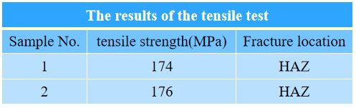
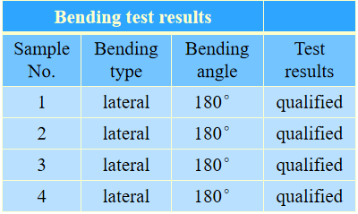
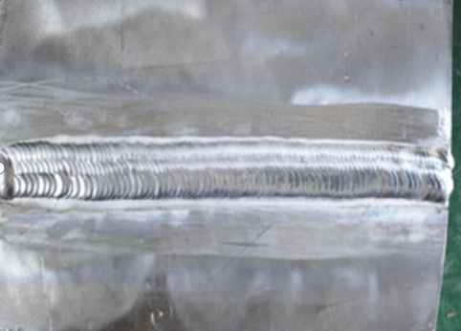
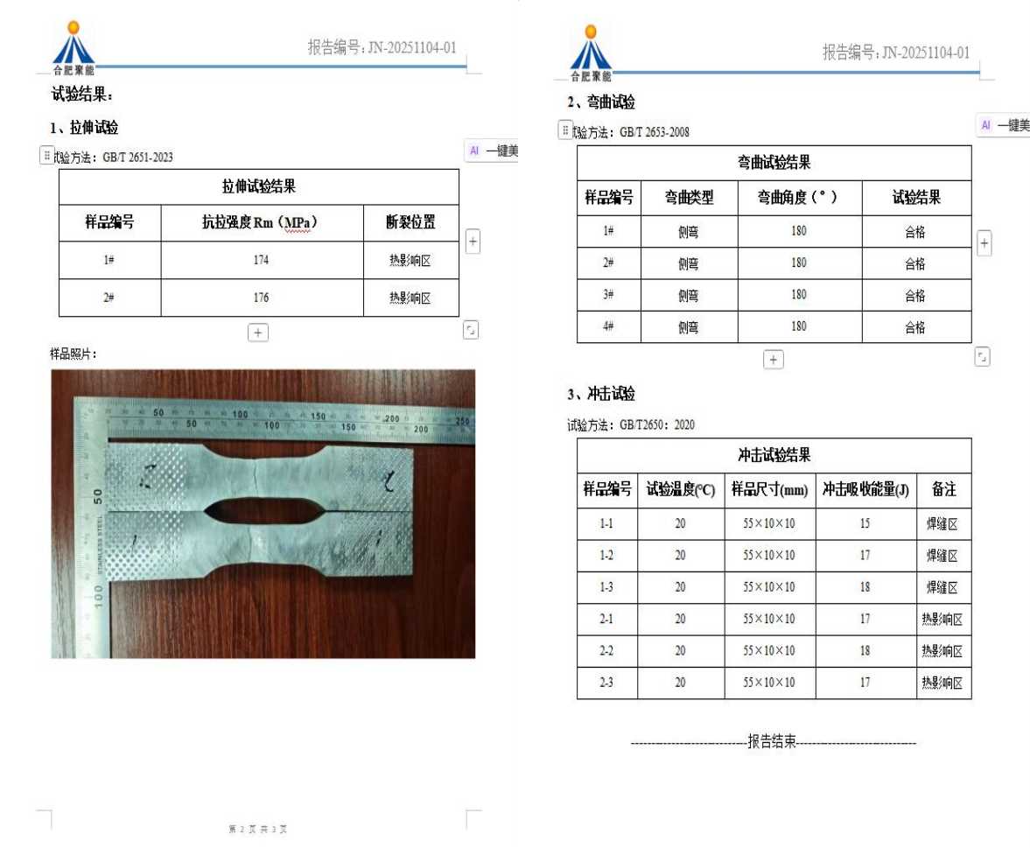
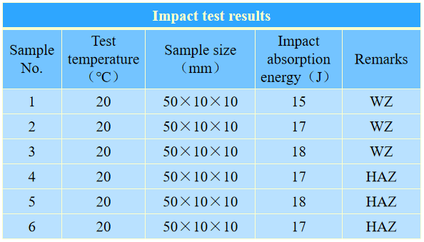
Process Technology R&D for MR Plug-II
  6061-T6 TIG welding for reflector vessel
Welding material: 6061-T6
Heating temperature: ~150℃
Welding current: 370A
Argon flow rate: 15-20L/min
Welding wire: ER4043
Interpass temperature: ~150℃

Slide 10
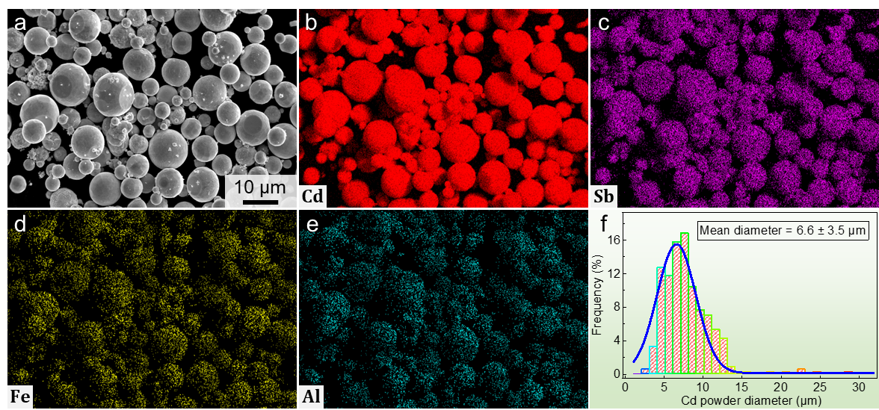
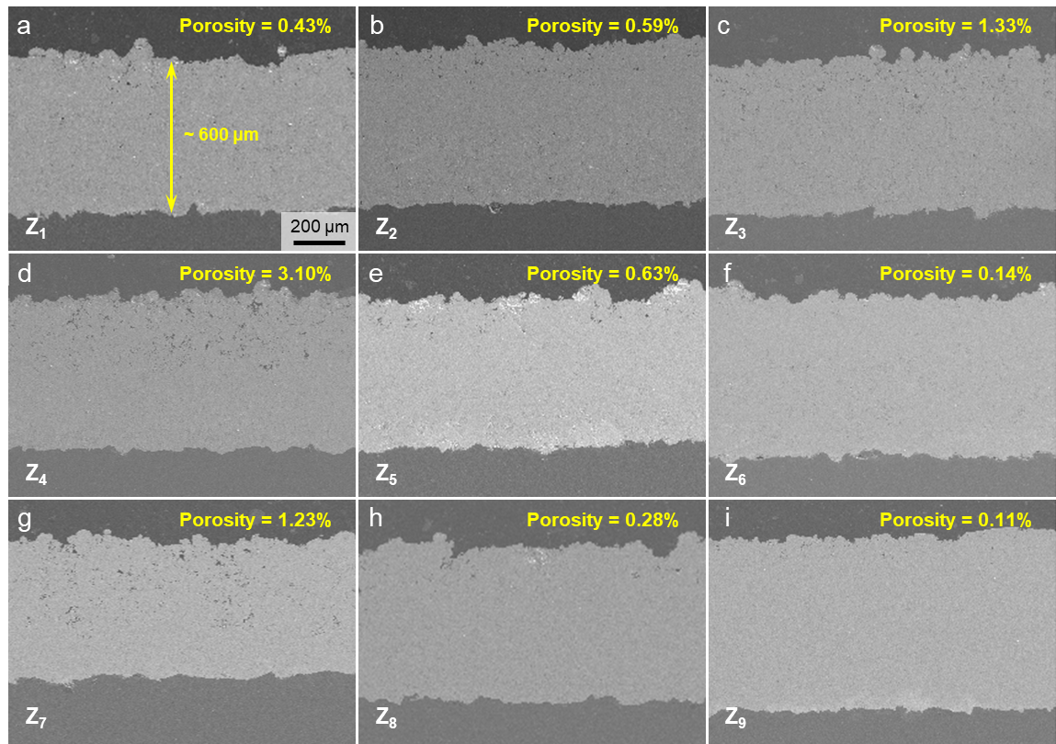
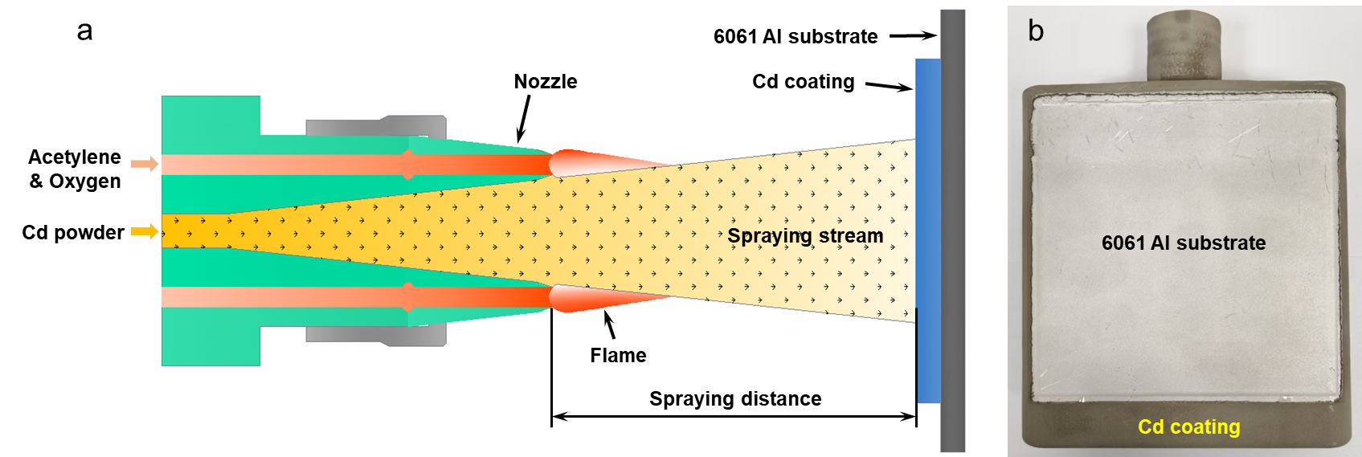
Process Technology R&D for MR Plug-II
Cd decoupling material Flame Spraying for moderator
composition mapping of Cd Powder
Cross-sectional morphology at Cd/6061Al Interface
Flame Spraying Process and Final Coating Product
A Cd coating was fabricated on 6061-T6 Al via flame spraying using the orthogonal experiments .
The average thickness of Cd coating is about 0.6 mm.
Bond strength of the Cd coating is ~35MPa

Slide 11
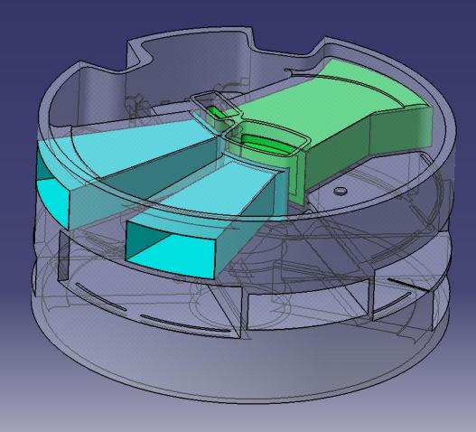
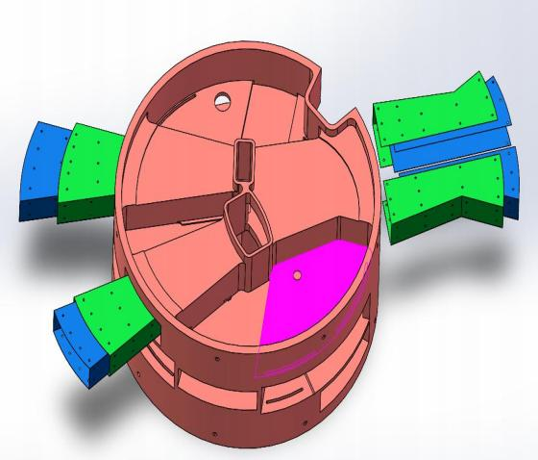

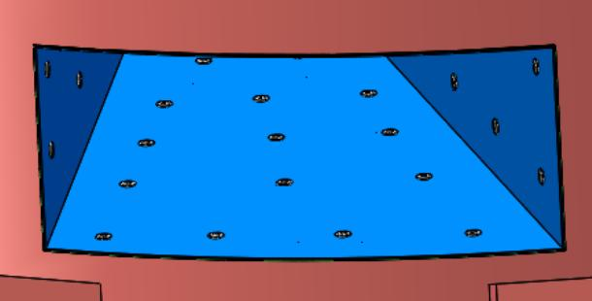
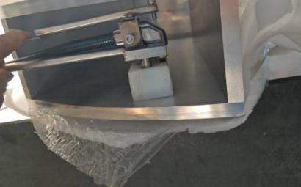
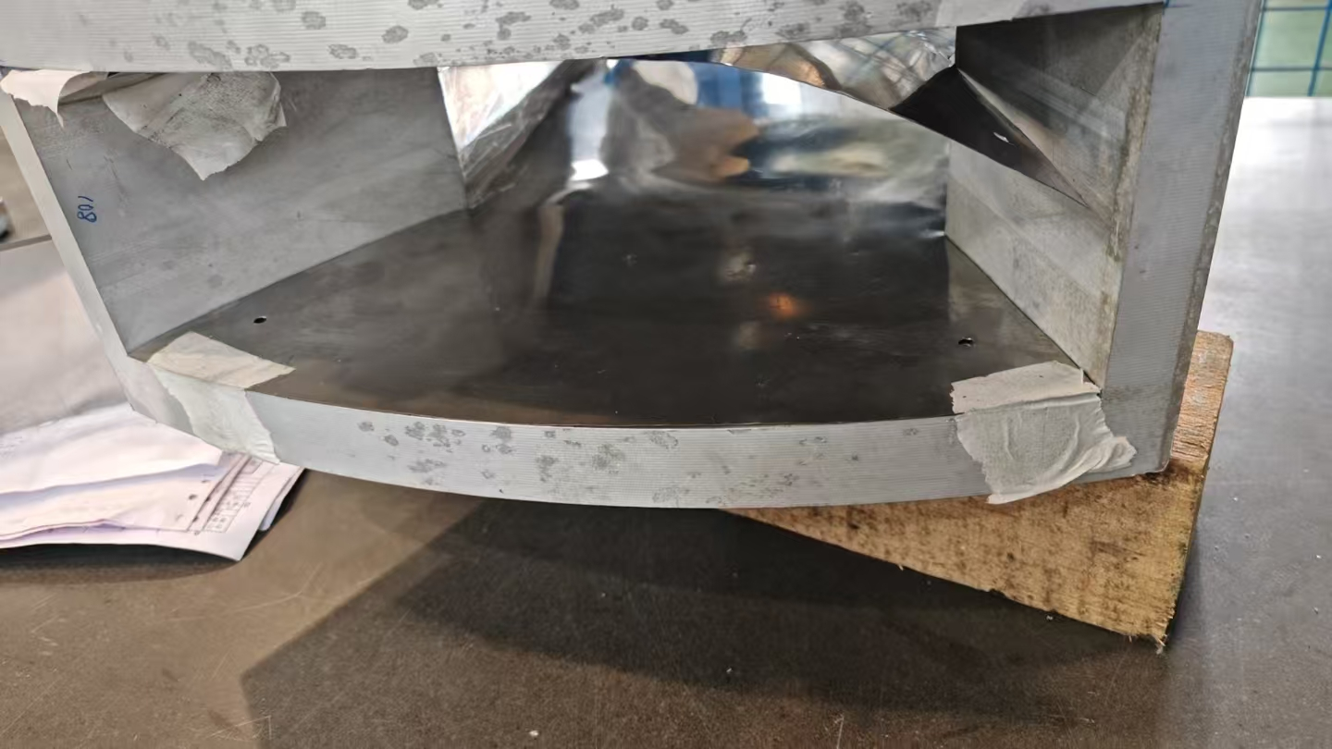
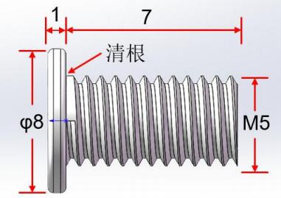
Process Technology R&D for MR Plug-II
  Cd decoupling sheet fixing for neutron channel
Manufacturing process: Cd sheet + stainless steel sheet, fixed to the aluminum container with screws
Technical difficulties: The neutron channel of the reflector has narrow space, making drilling difficult.
Solution: Develop a special tool for drilling.
Stainless steel frame
108
Cd sheet
Decoupling material for neutron channels of reflector containers
screws

Slide 12
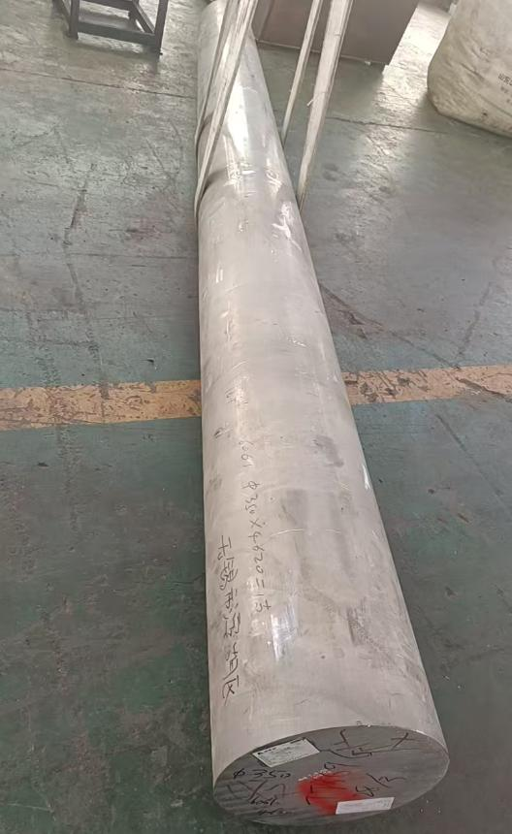
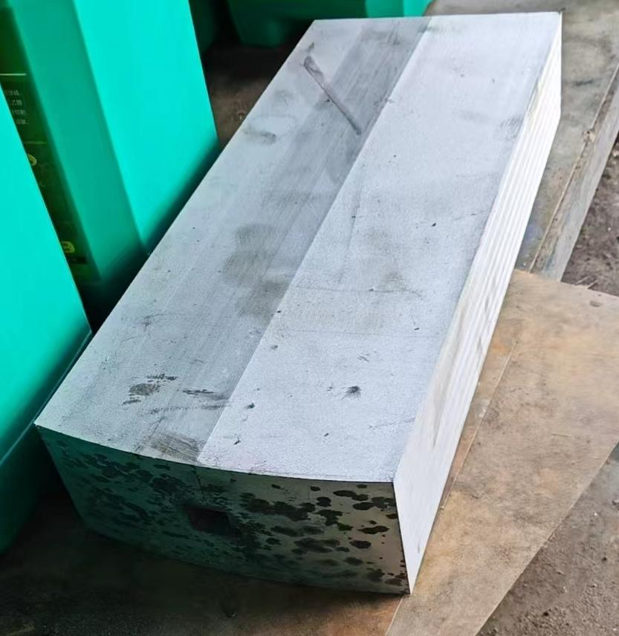
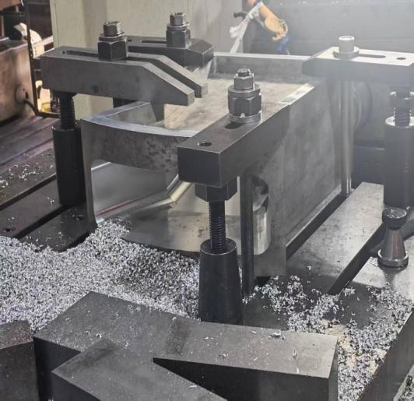
Process Technology R&D for MR Plug-II
  T6 heat treatment of large forgings of Al6061
In order to increase the service temperature of the reflector vessel, the vessel material has been upgraded from 5083 to 6061-T6.
Solution: firstly buy some O tempered Al6061, then make Al6061 forgings in the O temper; after rough machining, T6 treatment is conducted to achieve the mechanical properties.
O-temper rod
O-temper forging
After rough machining, T6 treatment is performed.
Mechanical properties of Al6061 after T6 treatment
 | Tensile Strength （MPa） | Yield Strength （MPa） | Elongation After Fracture（%） | Reduction of Area（%）
Requirements | ≥290 | ≥240 | ≥6 | /
Sample 1 | 327 | 281 | 12.5 | 27
Sample 2 | 328 | 283 | 15.0 | 30
Sample 3 | 327 | 282 | 12.5 | 29

Slide 13
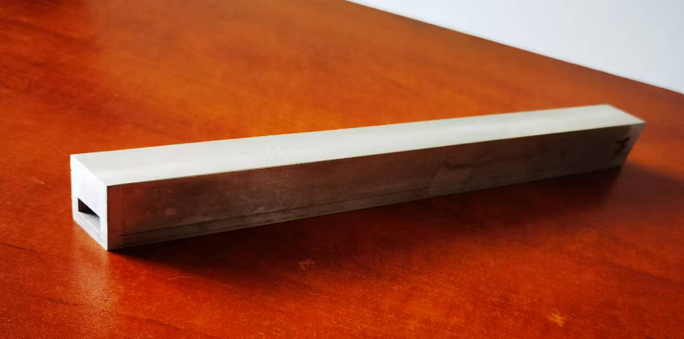
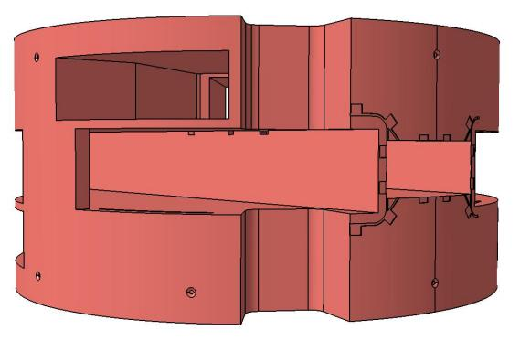
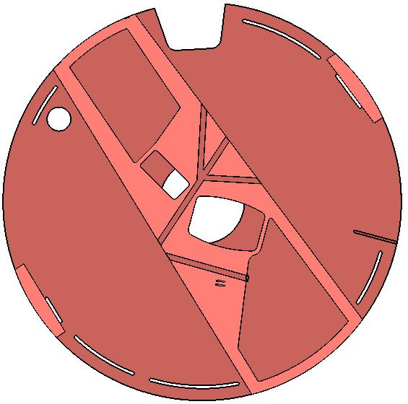
Process Technology R&D for MR Plug-II
  Deep hole machining for rectangular flow channels
Flow channel cross-sectional area: 4×20mm
Flow channel length: ~300mm
Process method: electrical discharge machining (EDM)
Machining accuracy: 0.2mm
350mm
EDM machine
Intermediate reflector container

Slide 14
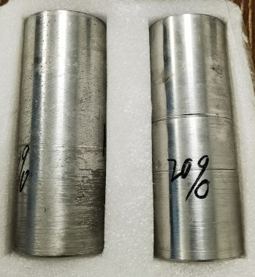
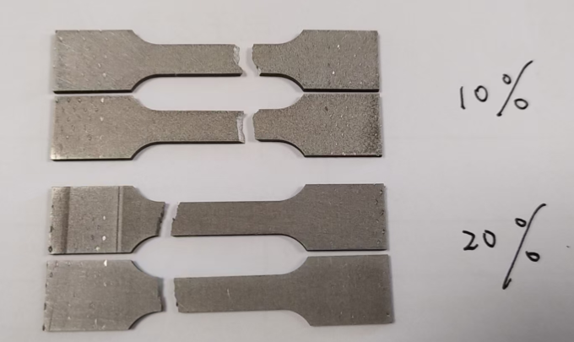
Process Technology R&D for MR Plug-II
  Composite decoupling material R&D
  Material composition：B4C+Gd2O3/Gd+Al6061
  Material properties: The thermal conductivity is similar to cadmium, while it has better strength.
  Decoupling energy: >1eV (by adjust ratio )

Slide 15
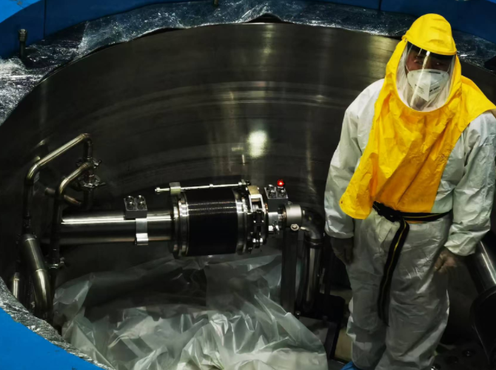
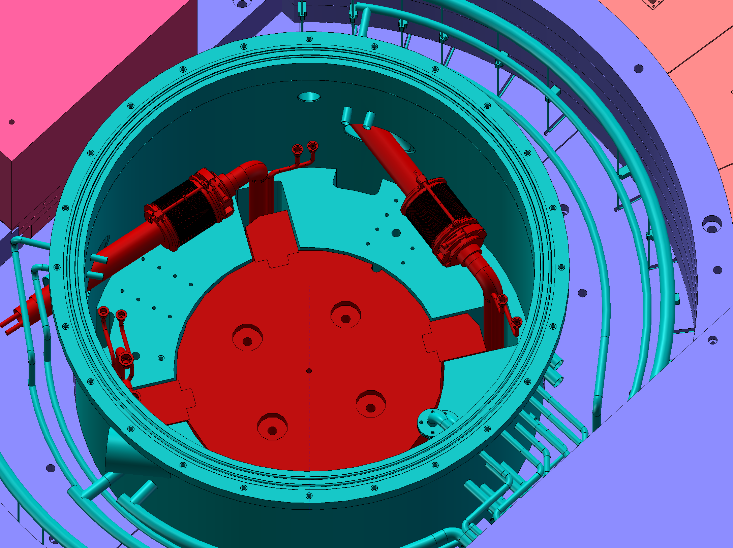
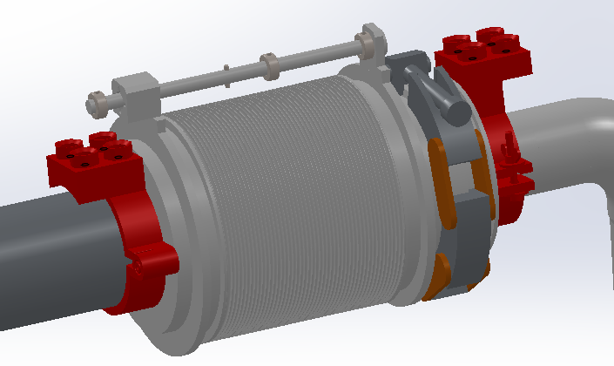
Installation and Alignment Preparation
  Position Measurement of Process Pipes
The position of the old cryogenic pipeline is measured to provide data for the manufacture of new moderators.
The old pipeline deviates from the theoretical design position by 7mm, which needs to be compensated during the manufacturing process of the new equipment.

Slide 16
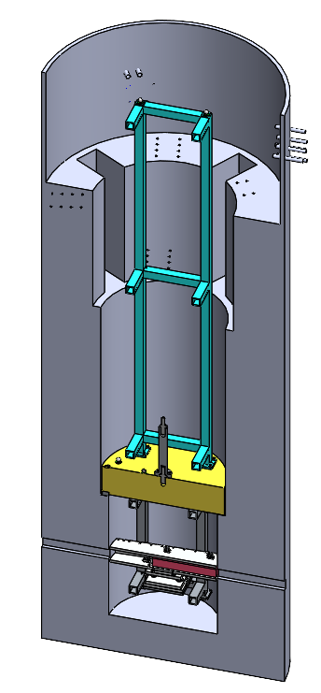





Installation and Alignment Preparation
  Measurement of the installation base of MR plug
Develop a dedicated tooling to indirectly measure the installation base of the MR plug.
The deformation of the measuring tooling itself is 0.09 mm, and the repeat positioning accuracy of simulating the installation of the MR plug is 0.15 mm.
7m
Schematic diagram of the positioning measurement tooling for MR insert installation base
Simulation experiment for collimation measurement of MR insert installation base

Slide 17
Summary&Challenges
  Design optimization can only be carried out on the basis of CSNS-I, leaving limited room for improvement.
  Many workers who manufactured the first MR Plug about 10 years ago have retired, requiring the manufacturer to develop key processes technology again.
  The overall construction schedule is relatively tight.

Slide 18
Thank you for your attention!
Notes:
I've finished my report. Thank you for your attention.

