Slide 1




ICONE
A future HiCANS Neutron Scattering Facility in France
https://www.icone-neutron.fr/
A. Desmedt, X. Fabrèges, A. Ferland, A. Menelle, F. Ott,
S. Petit, N. Pichoff, D. Uriot, T. Vassiliades,
14/04/2026 – ICANS

Slide 2
ICONE Project : main goals
Results discussed in the poster
Project requirements (end of 2023) :
→ Technical Design Report (2 years) 2024-2025 → Construction plan consolidation
Deliver a national facility for about ~300 experiments/year
→ 12 instruments : According to scientific case.
→ 2 neutron targets : High Flux (HF) : ~2 ms@20Hz (4% DC)
High Resolution (HR) : ~400 µs@50Hz (2% DC)
→ 1 proton accelerator : 25 MeV, Ipeak = 80 mA; @ 6% of Duty Cycle (DC)
If starting end of 2026 :
→ Phase 1 : First neutrons on TS1 & 6 instruments in 2033 (2034, for users)
→ Phase 2 : Full capability TS1 + TS2 (12 instruments) in 2037
2
14/04/2026 – ICANS Conference – ICONE, a HiCANS in France

Slide 3
Global view (→ 2037)
77 m
Zone 7
1 m²
Neutron Peak Brilliance :
  ~ 5 1011 /s/cm2/sr/Å @ 1 Å et 2.5 Å
  ~ 1011 /s/cm2/sr/Å @ 5 Å
5000 m² (~ a soccerfield)
Accelerator : 35m
Zone 4
29 m
Zone 5
24 m
Zone 6
21 m
Zone 9
Zone 3
33 m
Zone 4
Zone 2
31 m
Zone 5
Zone 5
Zone 5
Zone 2
Zone 5
Zone 5
Zone 4
Technical area
22×21 m²
Zone 2
Zone 3
Zone 1
30 m
1 m²
Zone 3
Zone 5
Zone 5
Zone 1
Zone 5
Zone 1
Office area
43×21,5 m²
Zone 7
- Target 1 : 2.0 ms@20 Hz (4% DC)
Zone 4
445m
Zone 5
36 m
Zone 6
31 m
Zone 9
65 m
- 6 instruments HF (<33 m)
1 m²
Zone 3
44 m
Zone 1
- Target 2 : 0.4 ms@50 Hz (2% DC)
Zone 3
Zone 1
Zone 4
Zone 2
- 6 instruments HR (<44 m)
Zone 2
41 m
RFQ-4.6m (3.6 MeV)
XDTL-5.5m (12 MeV)
XDTL-8m (40 MeV)
Zone 3
350 cm
Zone 2
315 cm
SRC+LEBT-3.5m (0.75 MeV)
XDTL-7m (25 MeV)
350 cm
MEBT-2.2m (3.6 MeV)
Zone 4
LINAC-31m (40 MeV)
Zone 1
40 m
- Staff buildings :
Technical area (~1000 m²)
Office area (~1500 m²)
Reception
5×5 m²
1:500
1 cm = 5 m
3
14/04/2026 – ICANS Conference – ICONE, a HiCANS in France

Slide 4
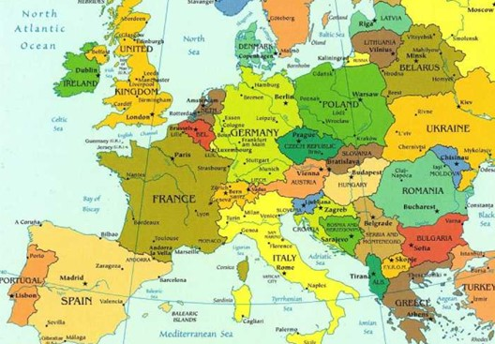
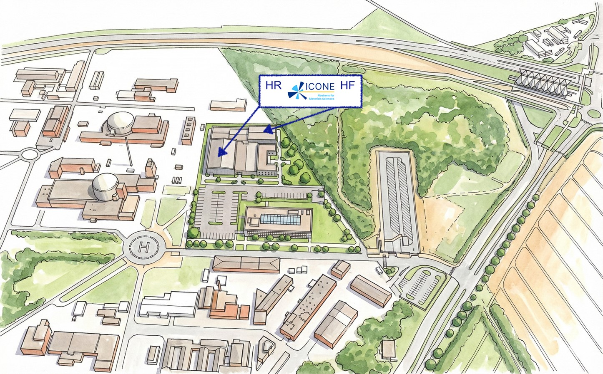
Location
Next to the New Metro Line 18 :
10 min from Massy Train Station
20 min from Orly Airport
Artist view :
Saclay CEA center
South west of Paris, France
4
14/04/2026 – ICANS Conference – ICONE, a HiCANS in France

Slide 5
See you at the poster station
5

