Slide 2
The ESS Spallation Target, design challenges resolved by support from In-Kind partners
PRESENTED BY Ulf odén

Slide 3
ESS Spallation Target
Presentation in summary
The presentation focuses on elaboration of the ESS Technical Design Report (TDR) concept design
Major changes to the concept design
Contributions from the In-Kind partners
In Kind partners challenges
Project working with “non-proven design”
Present status of installation, testing and ready for operation

Slide 4
ESS Spallation Target
ESS spallation Target Requirements
5 MW proton beam 14 Hz - 2GeV - 2.86ms
2.85kg/s helium gas heat load 3 MW Helium 240°c =>40°C
Contaminated helium including 10g/h of highly radioactive particles impact design and maintenance

Slide 5
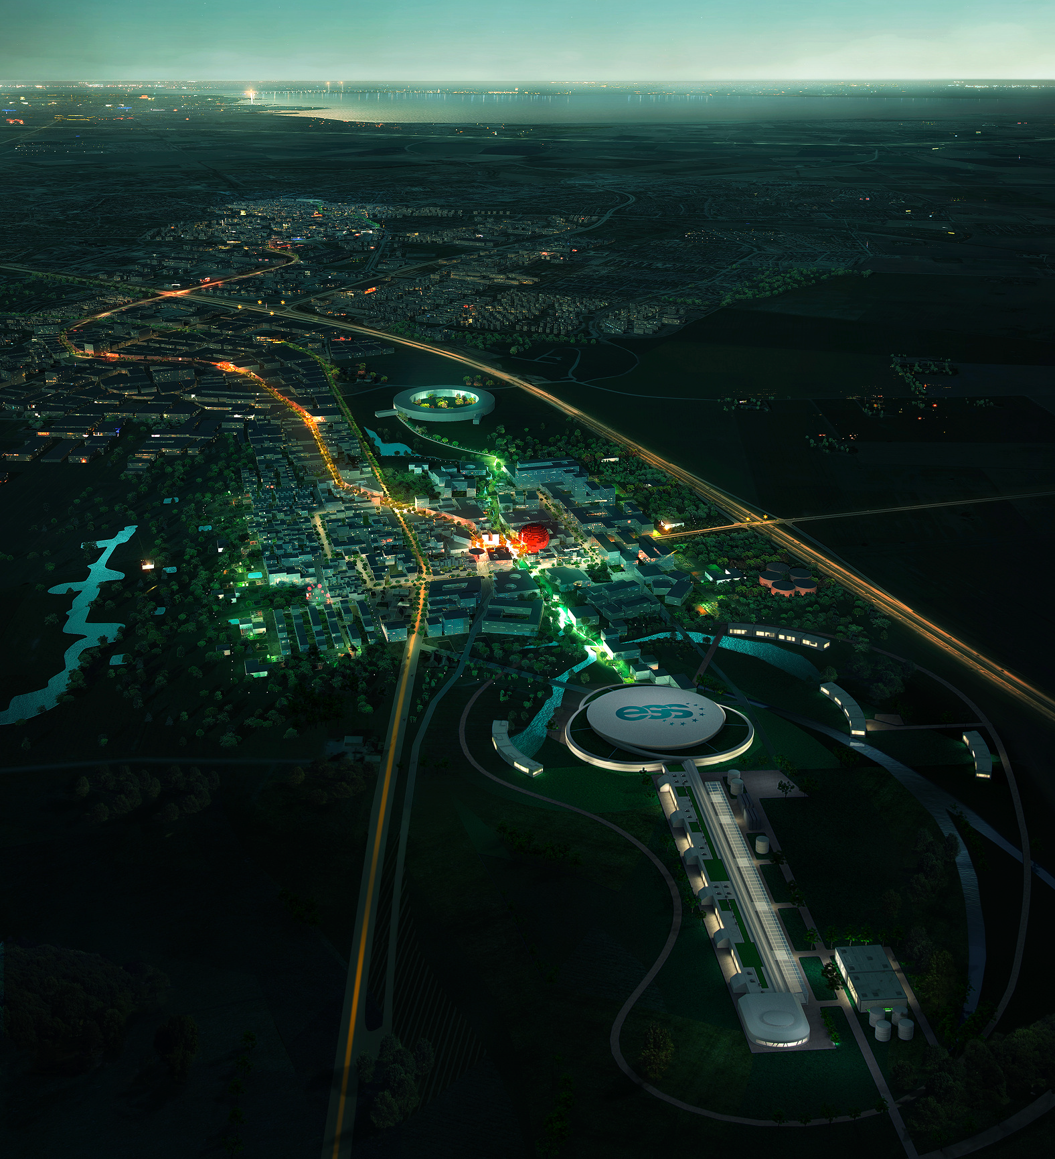
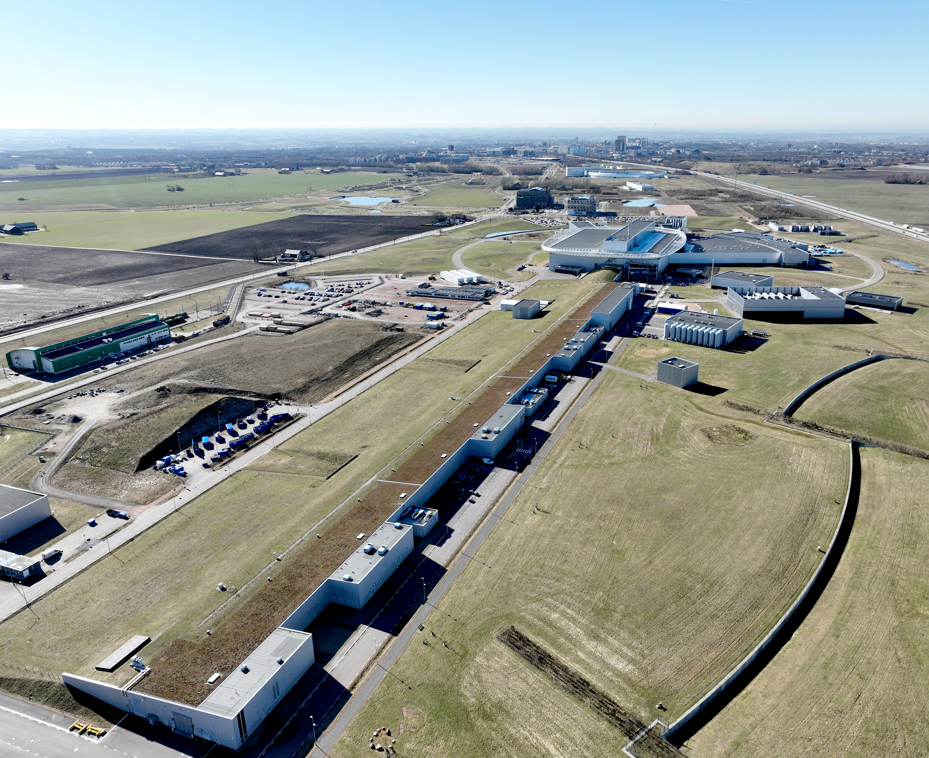
ESS Spallation Target
TDR concept design vs final design
TDR (Technical Design Report) 2013
Delivered

Slide 6
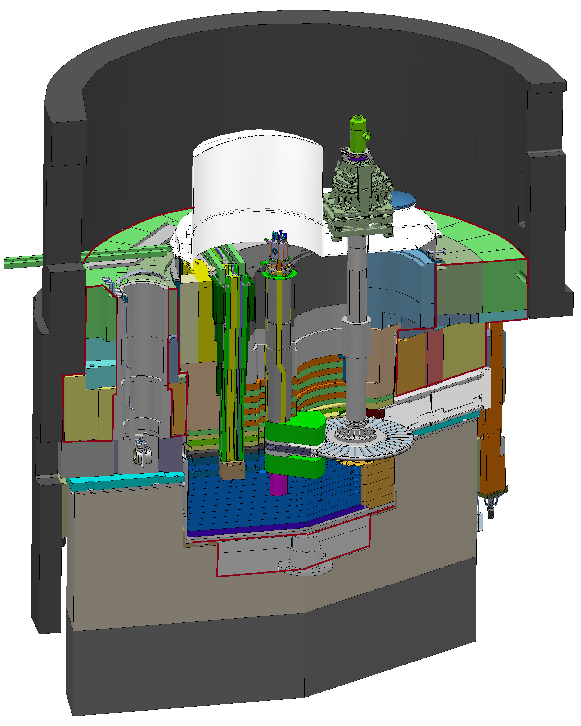
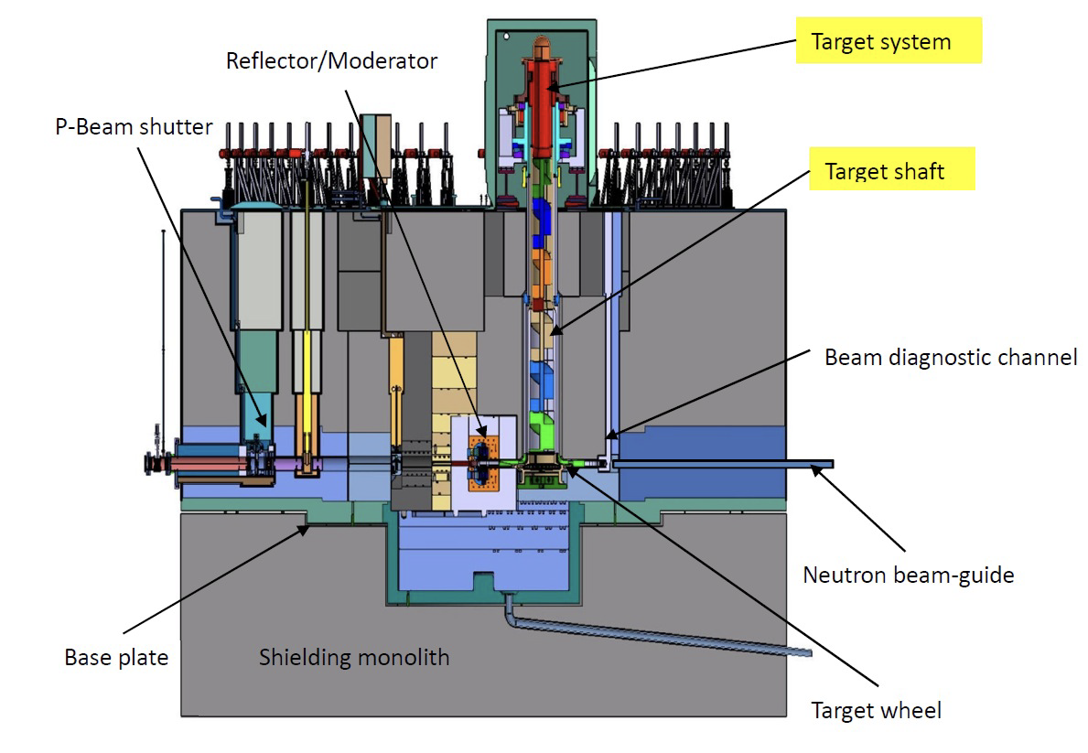
ESS Spallation Target
TDR concept design vs final design - Monolith
Helium to vacuum atmosphere – Target drive outside of the monolith
TDR 2013
Delivered

Slide 7

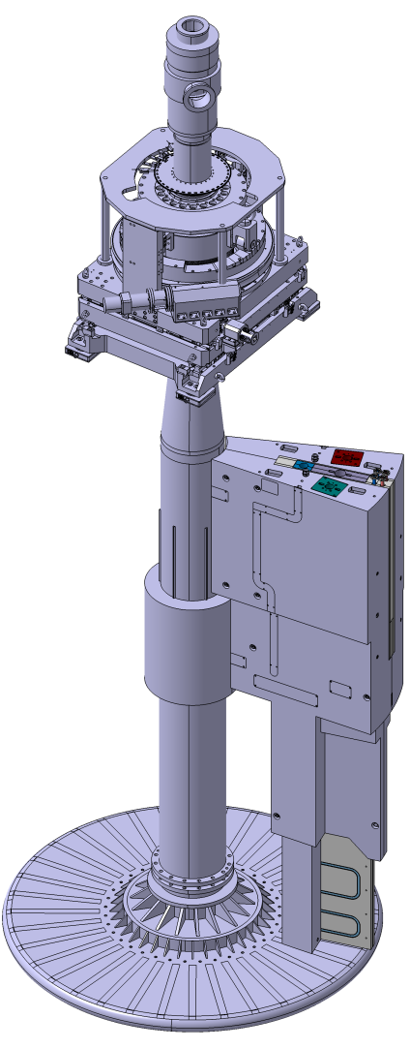
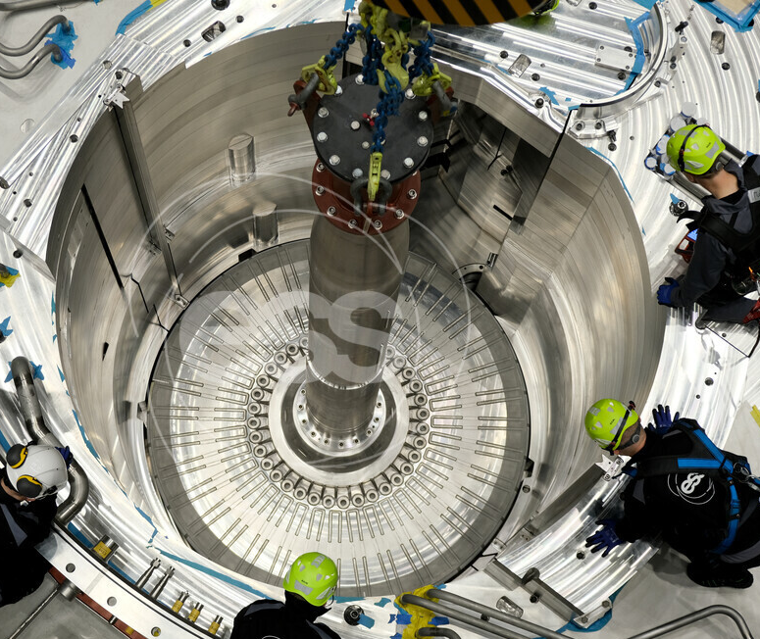
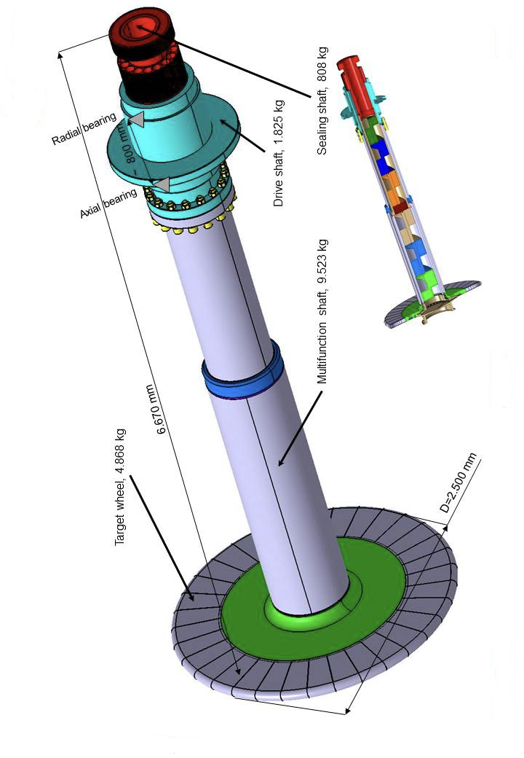
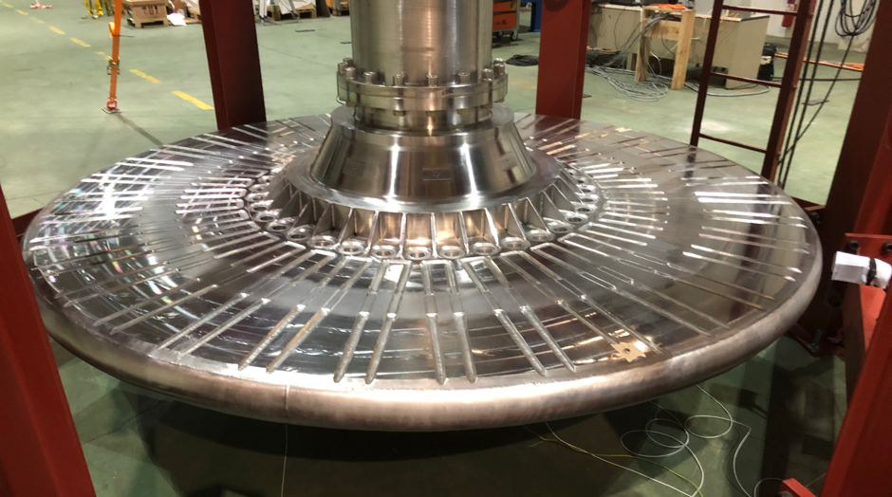
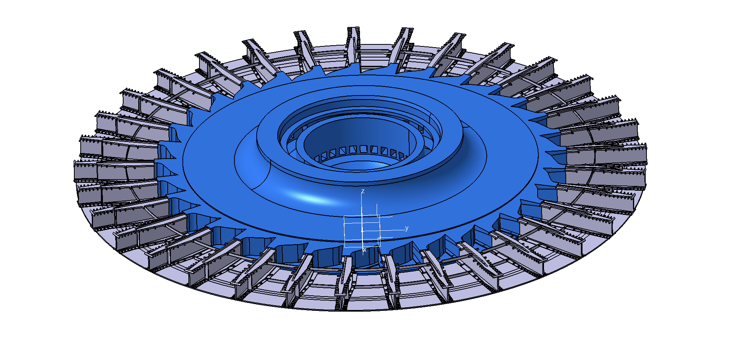
ESS Spallation Target
TDR concept design vs final design – Target
Manufacturing noticed to be challenging already at the concept design
3->11 bar helium pressure
TDR 2013
Delivered

Slide 8
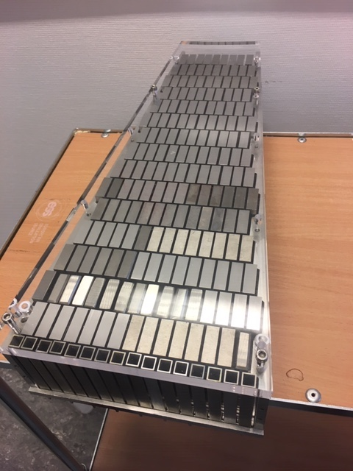
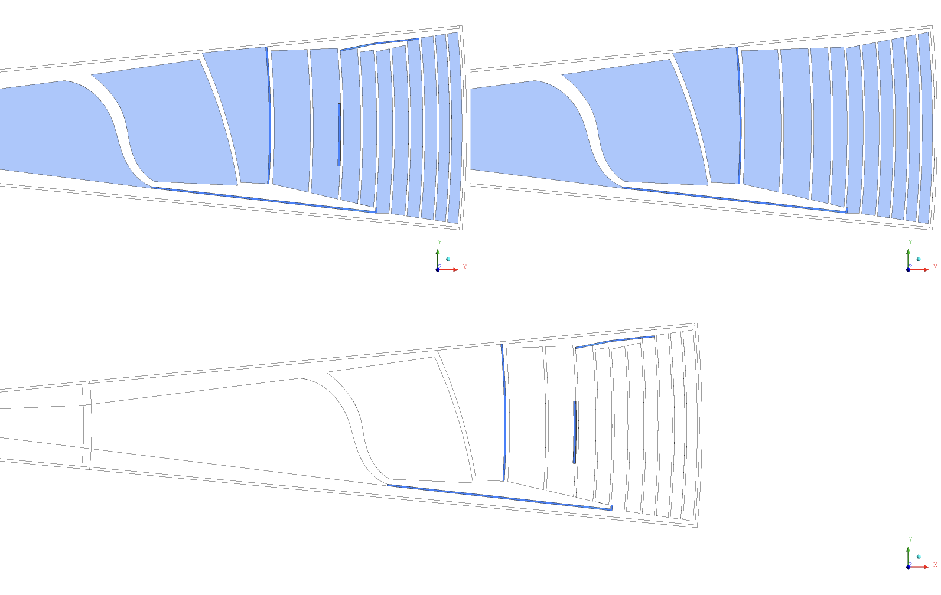
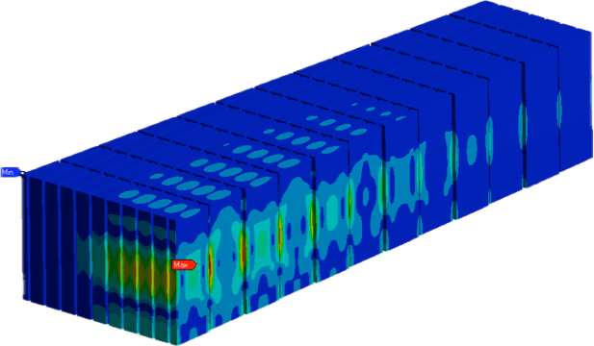
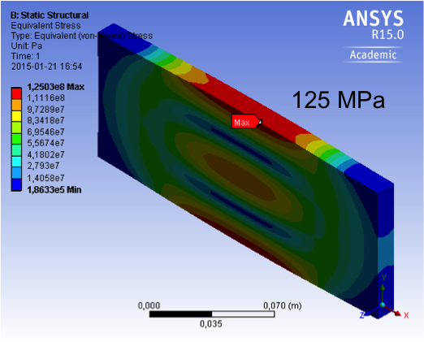
ESS Spallation Target
TDR concept design vs final design - Target
Redesigned tungsten structure and detailed calculations solved the max stress and temp. requirement.
Improved manufacturability.
Max stress 100MPa
TDR 2013
Delivered

Slide 9
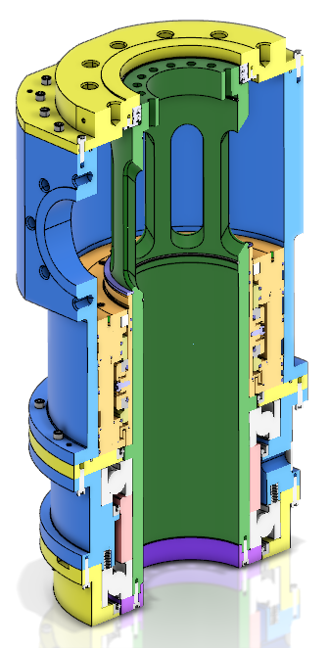
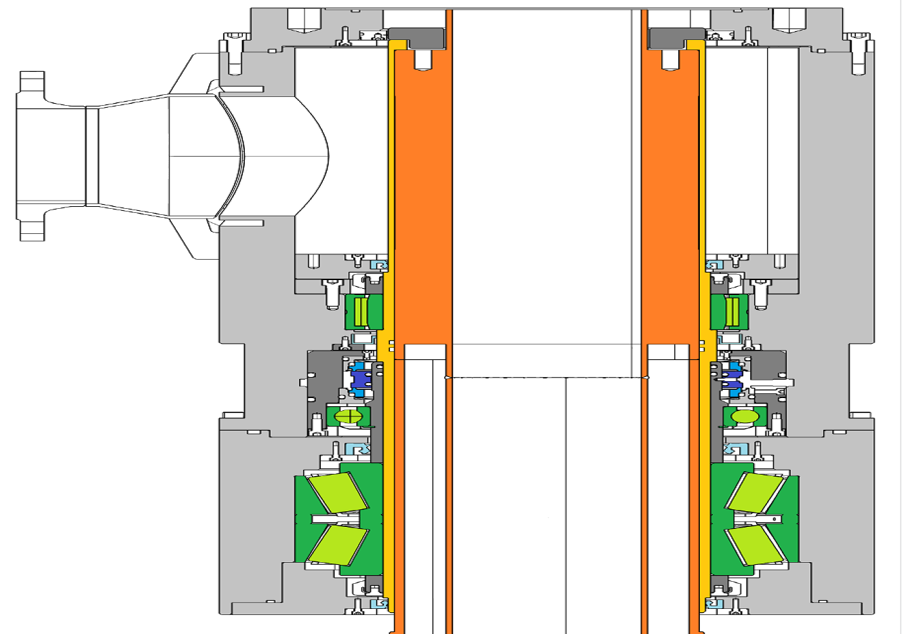
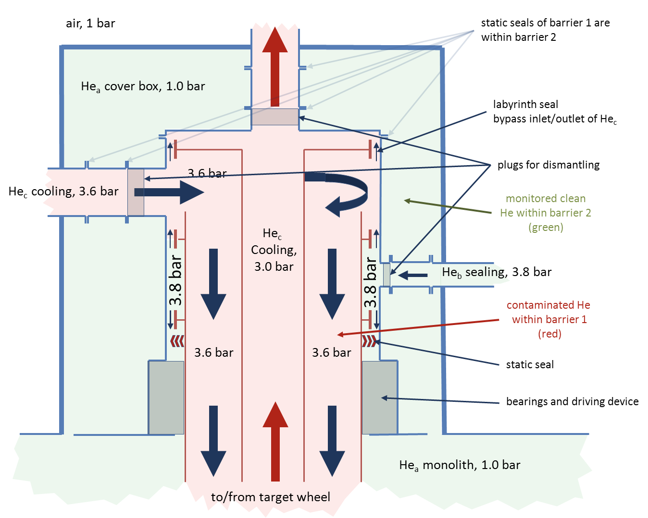
ESS Spallation Target
TDR concept design vs final design - Target connection to cooling system
The seal concept design was unsolved at TDR
Contaminated helium at 11 bar
TDR 2013
2025 HRU ver 2
2024 HRU ver 1
TDR 2013
Delivered
Next generation

Slide 10

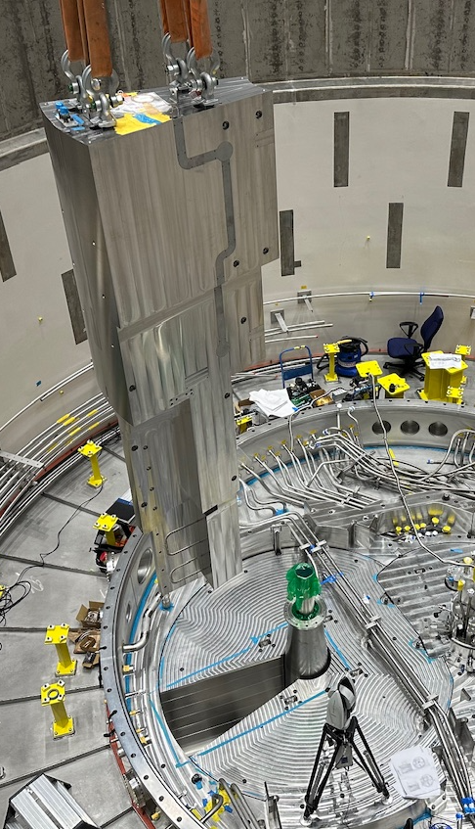
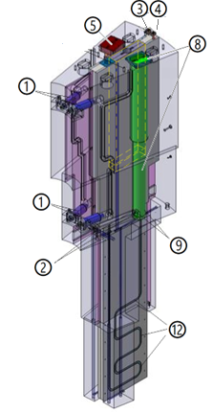
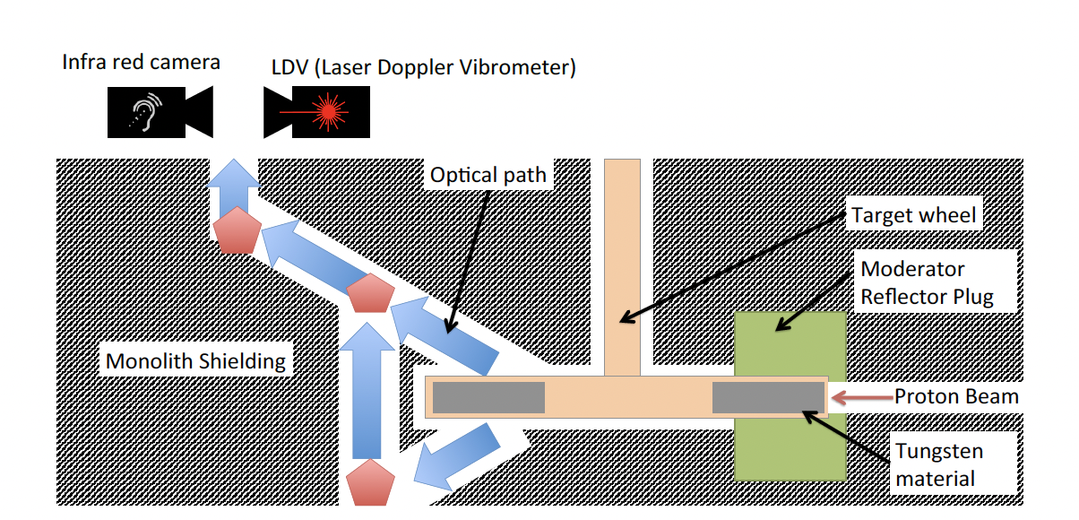
ESS Spallation Target
TDR concept design vs final design – Target monitoring
X, Y ,Z – temperature 1, temperature 2
Measurements on a high-radioactive component
Measurement on a component in rotation
TDR 2013
Delivered

Slide 11


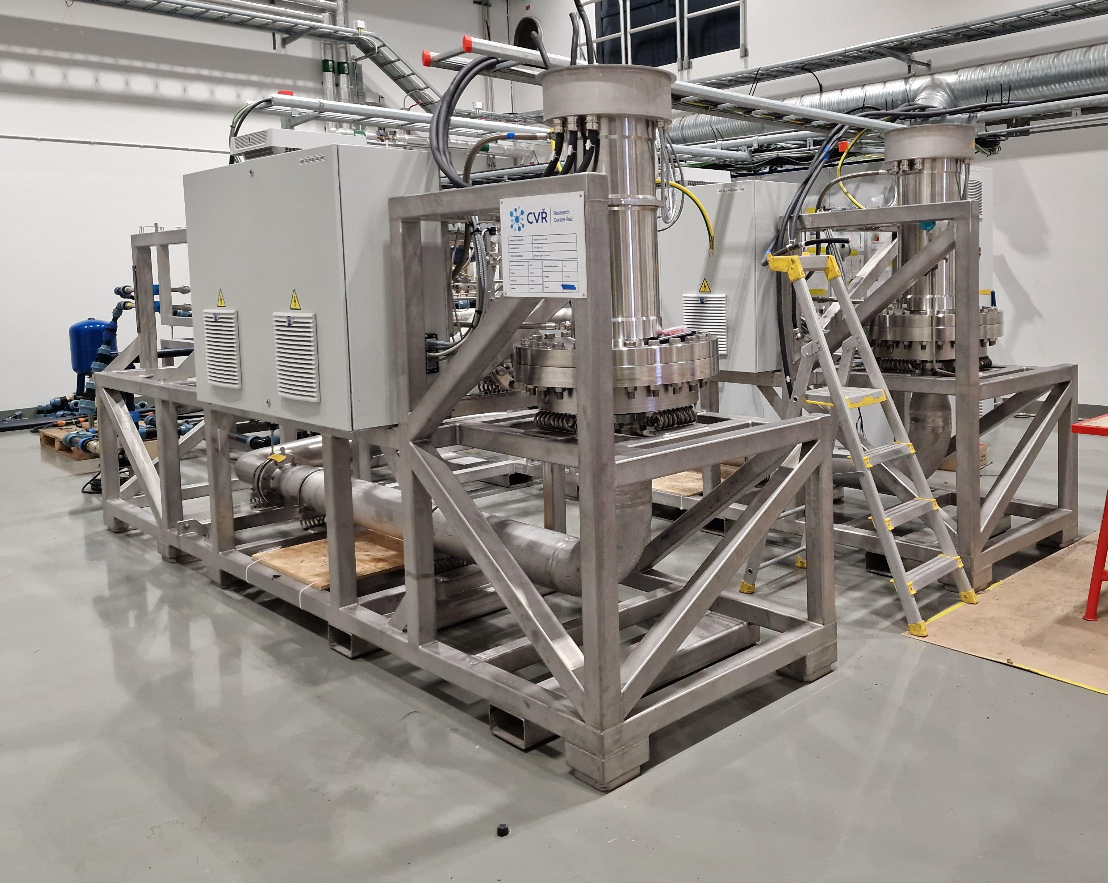
ESS Spallation Target
TDR concept design vs final design – Helium circulation
3 kg/s helium gas
a challenging requirement
Parameter | Value
System Pressure | 0.35 MPa
Helium Mass Flow | 3 kg/s
Pumping power | 800 kW
Parameter | Value
System Pressure | 1.1 MPa
Helium Mass Flow | 2.85 kg/s (2.2 kg/s)
Pumping power | 350 kW
TDR 2013
Delivered

Slide 12
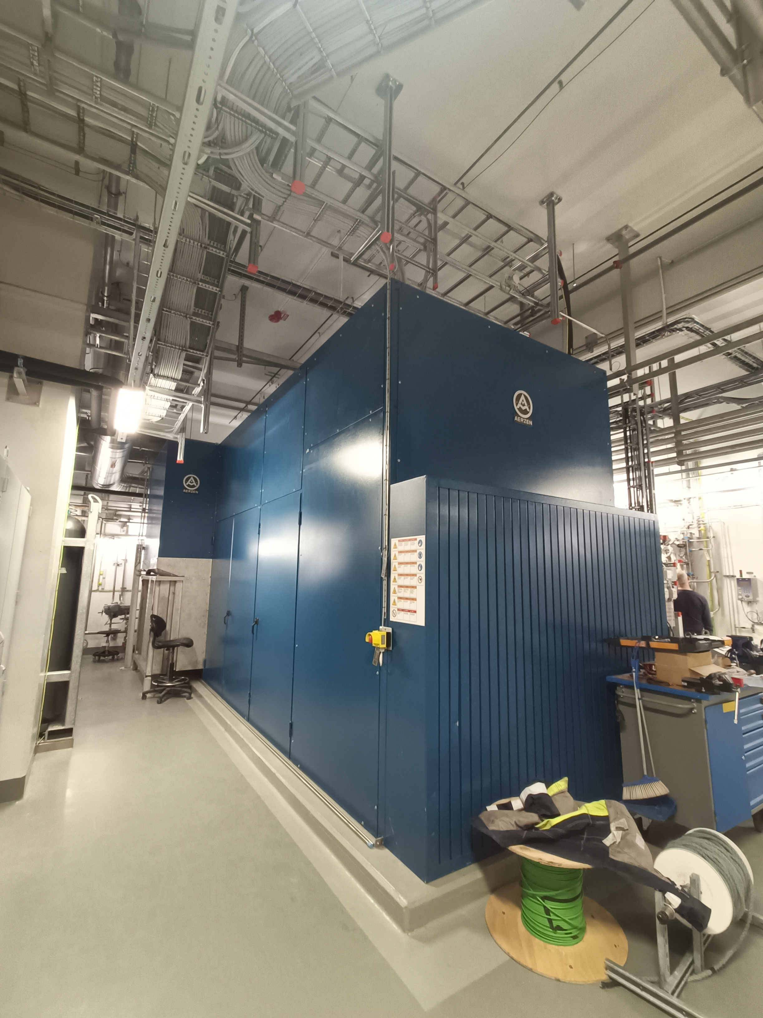
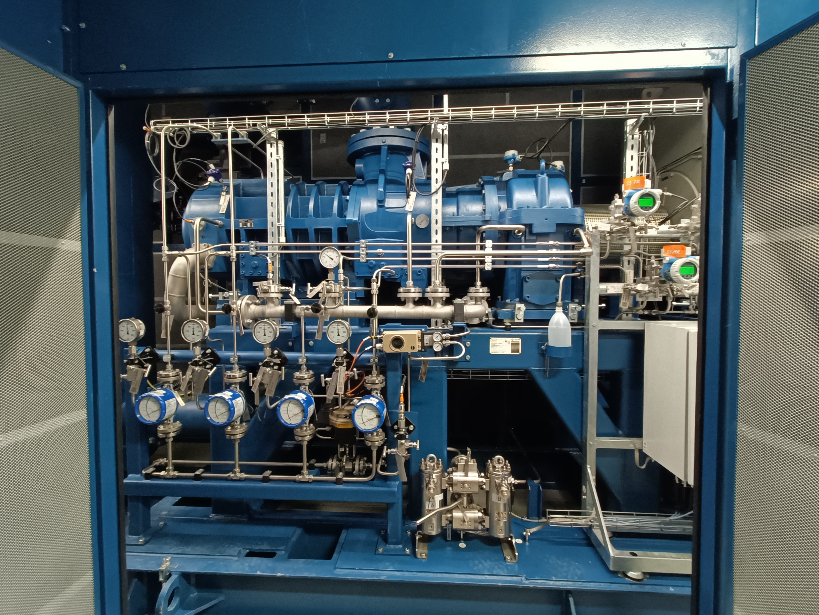
ESS Spallation Target
TDR concept design vs final design – Helium back-up circulation
Option B
Back-up circulator decided 2022
In addition to the TDR design
Parameter | Value
System Pressure | 0.35 MPa
Helium Mass Flow | 3 kg/s
Pumping power | 800 kW
Parameter | Value
System Pressure | 1.1 MPa
Helium Mass Flow | 2.85 kg/s
Pumping power | 1.000 kW
No backup circulator planned!
TDR 2013
Delivered

Slide 13
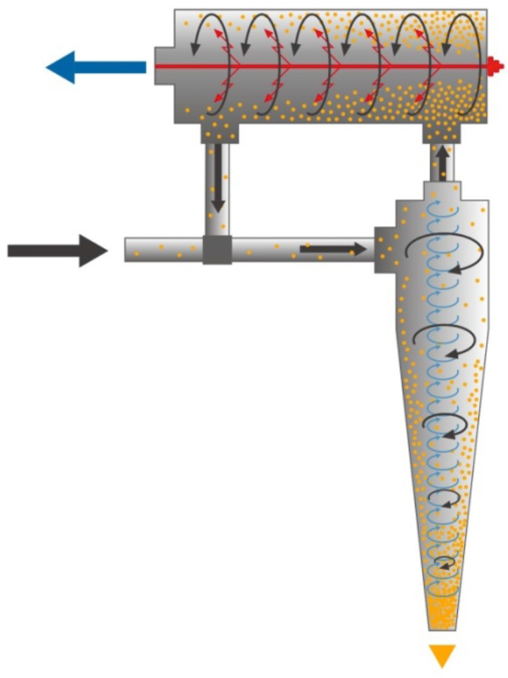
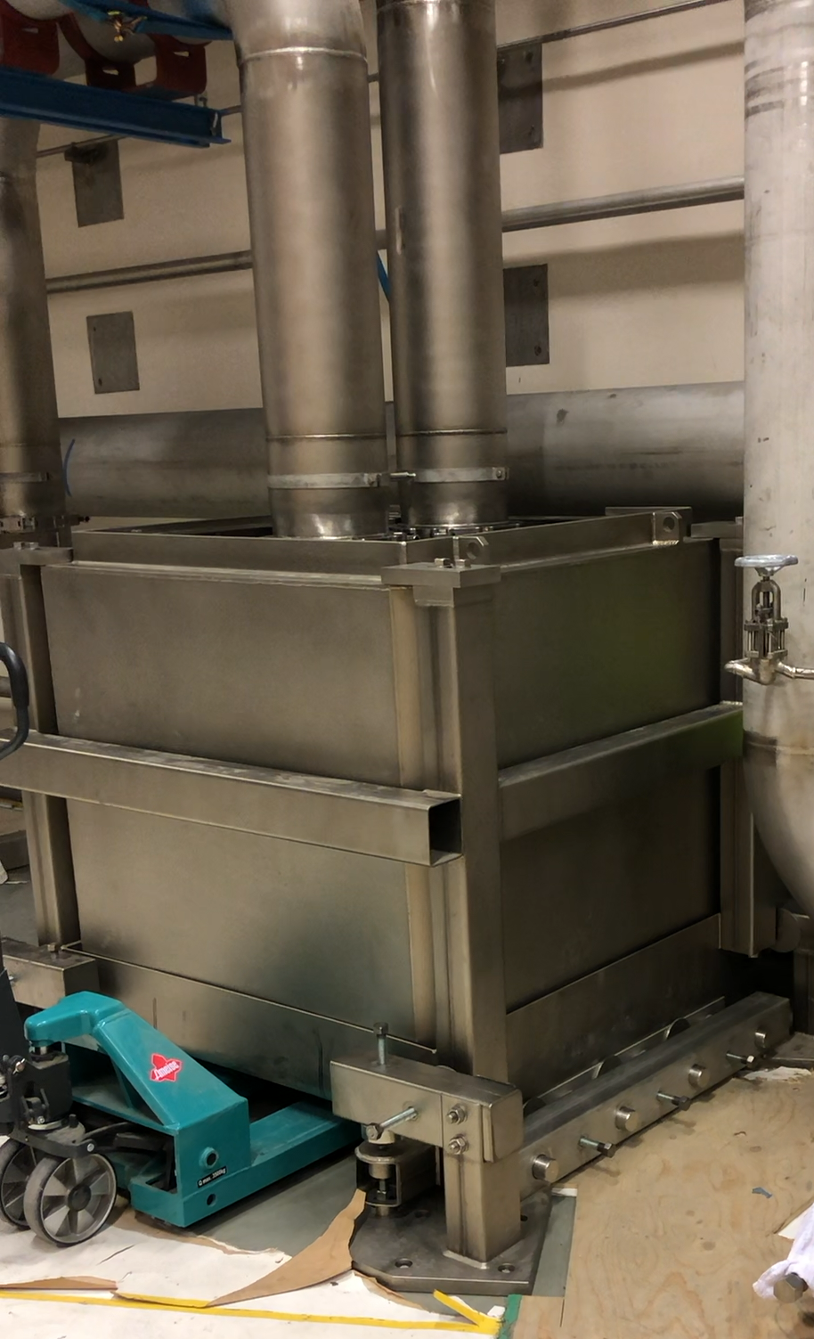
ESS Spallation Target
TDR concept design vs final design – Helium filter
Elaborated design don’t require remote handling of high radioactive filter components.
At operation filter is already placed in a shielded waste container.
TDR 2013
Delivered

Slide 14
ESS Spallation Target
ESS In Kind partnership
The strategy to kick-start the ESS project was to rely on the different In-Kind partners design capability, QA systems and supply chains.
The In-Kind partners developed the early TDR concept designs into solutions that are feasible to manufacture and operate.
The ESS spallation design involves the use of “non-proven design”. The project schedule limits the possibility to verify the design through extensive Engineering Development and Demonstration (EDD) activities.
During final testing, a few challenges were identified. This is expected in projects involving non-proven designs. Some issues were resolved with permanent solutions, while others were addressed with temporary solutions.

Slide 15
ESS Spallation Target
ESS In Kind partnership
Lessons learned from completed In-Kind collaboration contracts:
ESS has been realized based on In-Kind collaborations
Organize sufficient ESS support to the In-Kind partner (project management, technical experience, quality assurance, etc)
Acknowledge and adapt to the different In-Kind partners individual conditions
Have a mutual understanding with the In-Kind partner how to manage non-proven design projects
Fixed cost book value based on concept design is challenging
Identify and organize competences critical for development and long-term operation of the ESS

Slide 16
ESS Spallation Target
Target System status
Target System (Target Wheel Drive and Shaft) is installed and tested (without proton beam on target)
Target Helium Cooling System installed and tested, operated by the back up Helium Screw circulator.
Helium Turbo circulator tested in a test loop including full operational conditions. Installation of the Turbo circulator in the Target Helium Cooling system is ongoing.
Target System and Target Helium Cooling system operation data is verified.
Some of the components that are identified as possible to improve:
Rotating connection between target shaft and helium cooling system
Customized support systems to back up the helium screw compressor (oil and helium in the gear box)
Target residual heat cooling
Improved helium cooling system pressure drop regulation

Slide 17
ESS Spallation Target
Target System is ready for operation with beam on target
Target System future improvements
Increased helium turbo circulator performance (5 MW)
Target Wheel #2 (spare target)
Target Wheel #3 (next generation of target)
Helium Rotary Union ver 2
….

Slide 18
ESS Spallation Target
Target System
Proton Beam
Bring it on, we are ready

Slide 19
Finish presentation

