Slide 1
The European Spallation Source
Estia Early Science Workshop
PRESENTED BY Andrew Jackson
Head - Large scale structures division

Slide 2

How it works
The technology

Slide 3
High Power 5MW Proton Accelerator
Target
ISrc
LEBT
RFQ
MEBT
DTL
SPK
MBL
HBL
HEBT
Dump
75 keV
3.6 MeV
90 MeV
216 MeV
571 MeV
870 MeV
Target
The ESS accelerator was designed and is built by a collaboration of 23 institutes and universities in Europe
More then 50% of the total budget is delivered as In-kind with most systems being IK deliveries. The main exceptions are the cryo plants, the 704 MHz klystrons and modulators.
ESS accelerator division is responsible for functional requirements, coordination of work, installation including infrastructure, testing & commissioning and operation.
The linac shall in the full scope deliver 5 MW at 2 GeV, 14 Hz with 2.86 ms long pulses
For Beam on Dump and Ready for Beam on target the accelerator will operate at 572 MeV able to put 1.4 MW on the target with nominal duty-cycle. Planned with the medium beta elliptical section , but two high beta will be used to compensate for medium beta cavities needing reprocessing
For End-Of-Construction in 2027, an additional cryomodules will be installed and powered enabling operation at 2 MW, 870 MeV with nominal duty cycle
The remaining cryomodules will be installed in the tunnel during shutdowns but not powered with RF. Control and operation of e.g. tuners and cryogenics will be available for all cryomodules.

Slide 4
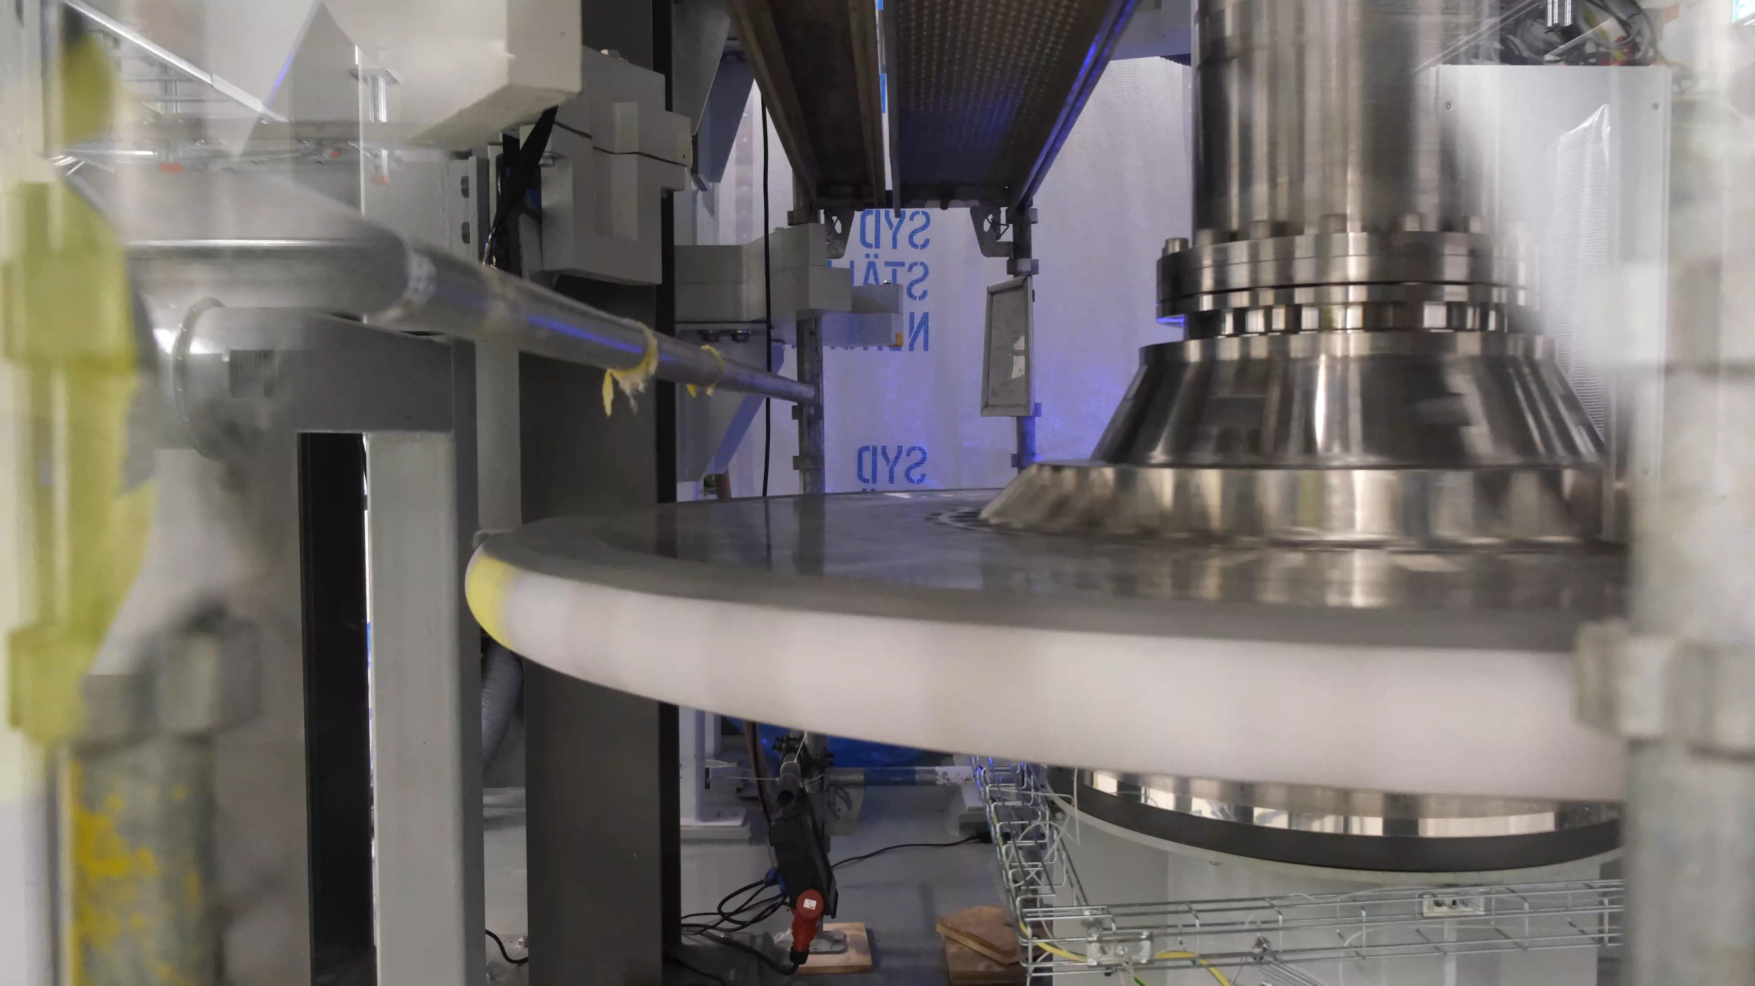
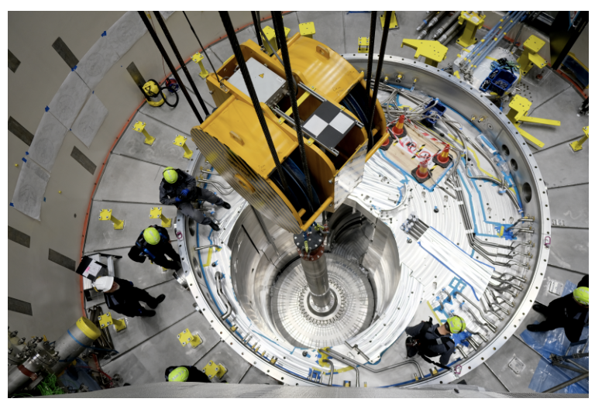
Target Wheel

Slide 5
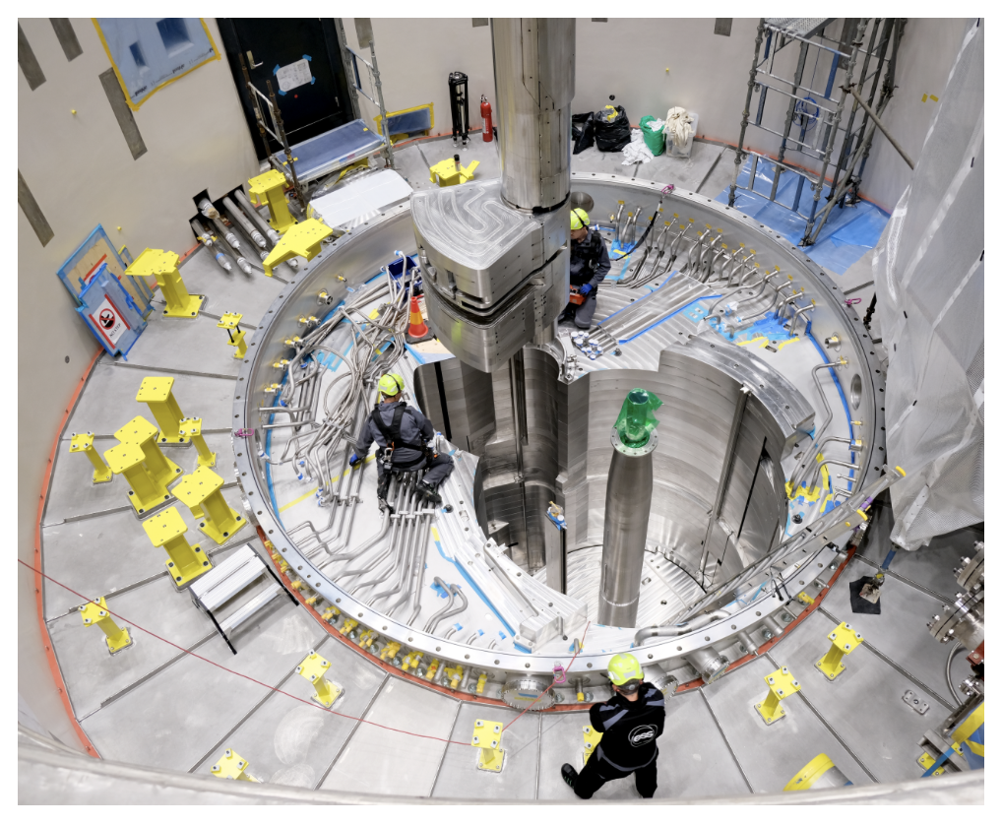
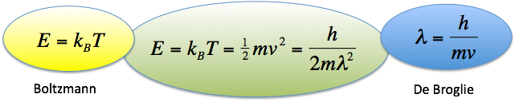
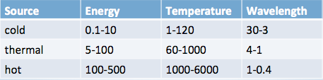
Getting the right energy
The neutrons generated must often be moderated to lower their energy (increase their wavelength) before they are used in scattering experiments
Moderation at reactor : water, liquid hydrogen or liquid deuterium
Moderation at spallation source : water, liquid hydrogen or solid methane
Proton’s-eye view
Reflector
Moderator
Target wheel
⨂
Proton beam in

Slide 6

Pulsed source time structures (λ=5Å)
short pulse
log(Intensity@λ=5Å)
ILL 57MW
1
0
100μs
ISIS-TS1 128kW
ISIS-TS2 32kW
1%
0.1
0.01
time (ms)
0 20 40 80 100 120

Slide 7
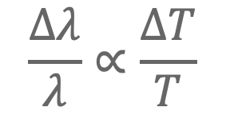
Long-pulse Performance and Flexibility
ESS 5MW
Possibilities of pulse shaping
λ = 5 Å
10
×10¹³
Brightness (n/cm²/s/sr/Å)
$$\frac{Δλ}{λ}∝\frac{ΔT}{T}$$
5
ESS 2MW
JPARC
1 MW
ESS duty cycle = 14 Hz * 0.00286 s ≈ 1/25
ESS Peak Brightness ≈ 25x ILL
ESS time-average flux ≈ ILL
SNS
2 MW
ISIS TS1
128 kW
ISIS TS2
32 kW
ILL 57 MW
0
time (ms)
1
2
3
4

Slide 8
Large Scale Structures Instruments
Small Angle Neutron Scattering, Neutron Reflectometry & Neutron Macromolecular Crystallography
Diffraction | DREAM, HEIMDAL, BEER, MAGiC, NMX
Imaging | ODIN, TBL
SANS | LoKI, SKADI
Reflectometry | Estia, FREIA
Spectroscopy | BIFROST, CSPEC, T-REX, MIRACLES, VESPA
NMX
LoKI
FREIA
 | SANS
 | Reflectometry
 | Macromolecular Crystallography
Estia
SKADI

Slide 9
Large Scale Structures Instruments
Small Angle Neutron Scattering, Neutron Reflectometry & Neutron Macromolecular Crystallography
Diffraction | DREAM, HEIMDAL, BEER, MAGiC, NMX
Imaging | ODIN, TBL
SANS | LoKI, SKADI
Reflectometry | Estia, FREIA
Spectroscopy | BIFROST, CSPEC, T-REX, MIRACLES, VESPA
 | SANS
 | Reflectometry
 | Macromolecular Crystallography
Estia

Slide 10
Towards the User Programme
Instrument Commissioning
Component Commissioning with Neutrons
Testing End-to-End Experimental Chain
Early Science with Expert Users
Standard Samples & Round Robin
Testing and Calibration
Instrument Enters User Programme
Potential Involvement
of
External Experts
Safety Readiness Review
Demonstrate that we can produce correct results
Demonstrate that we can perform full experiments
Demonstrate instrument capabilities with new science
System Acceptance Review
Cold Commissioning
Hot Commissioning
Early Science
User Programme
Estia Timeline
BOT +3 months ~June 2026
BOT+12 months ~April 2027
BOT+18 months ~December 2027

Slide 11
Post BOT Schedule
Start of user operation in the last quarter of 2027 at 800kW → 2MW in steady state operation
Beam on target
Start of user programme

Slide 12


ESS Ramp Up
Accelerator commissioning & TBL
Hot commissioning
Assuming BOT March 2026
First users
Beam parameters are indicative only, actual beam will depend on progress of commissioning
Shutdown
Users
2000
Typical beam
6 mA
5μS
1 Hz
> 570 MeV
12 weeks
Typical beam
6 mA
2860μS
14 Hz
> 570 MeV
140 kW
4 + 15 weeks
Typical beam
12 mA
2860μS
14 Hz
> 570 MeV
270 kW
17 weeks
Typical beam
25 mA
2860μS
14 Hz
> 570 MeV
570 kW
10 weeks
Typical beam
25 mA
2860μS
14 Hz
~800 MeV
570 - 800 kW
21 weeks
1800
1600
1400
1200
Source Power (KW)
1000
13+1 wk shutdown
10+1 wk shutdown
7+1 wk shutdown
55 days for UP
5.5 days/fortnight
55 days for HC
5.5 days per fortnight
800
4 weeks with
8 days for HC
2 days per week
40 days for HC
5 days per fortnight
44 days for HC
11 days (33 shifts)
per fortnight
28 days for HC
2 days per week
600
400
200
0
Mar 2026
Jun 2026
Sep 2026
Dec 2026
Mar 2027
Jun 2027
Sep 2027
Dec 2027
Mar 2028
Jun 2028
$$\frac{\text{570 }\text{kW} \text{at}\text{ 570 }\text{MeV}}{\text{2000 }\text{kW} \text{at}\text{ 870 }\text{MeV}}\text{→}\text{10 \% }\text{flux}$$
$$\frac{\text{800 }\text{kW} \text{at}\text{ 870 }\text{MeV}}{\text{2000 }\text{kW} \text{at}\text{ 870 }\text{MeV}}\text{→}\text{40 \% }\text{flux}$$
See ESS-0420218 “Early operations of ESS and prerequisites for first scientific results” for more details

Slide 13
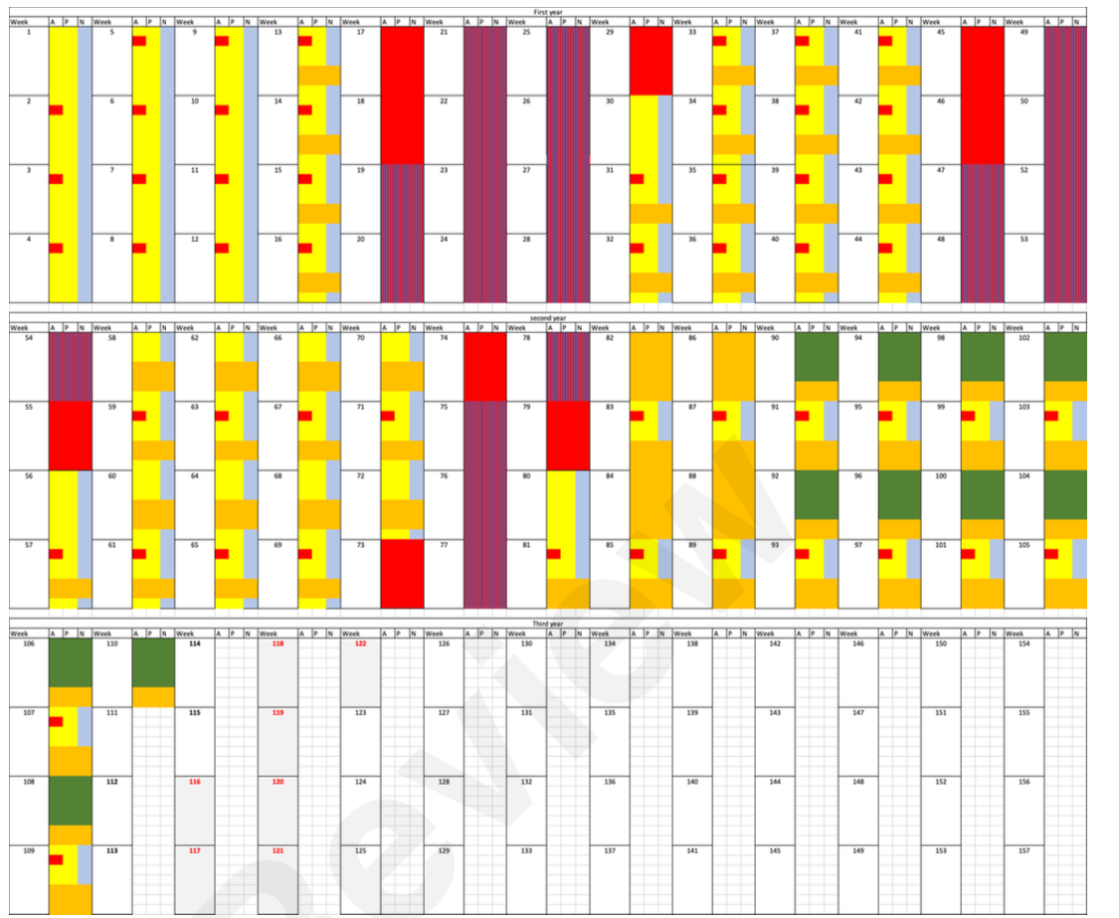
Detailed outline from ESS-0420218 “Early operations of ESS and prerequisites for first scientific results”
Tentative post-BOT weekly shift schedule indicating the distribution of shifts allocated to different
activities.
24/7 operation with 3 shifts/day is assumed.
Yellow indicates accelerator and target commissioning
Orange indicates dedicated beam for instrument hot commissioning
Green indicates user operation
Red indicates maintenance stop or shutdown.
Red with blue stripes (purple) indicates bunker open.

Slide 14
Commissioning phases
Phase | Main focus | Nominal Beam Power | Estia Neutron Flux (n/s/cm²)
Accelerator, Target & TBL (12 weeks) | First beam on target. Establish nominal (3ms) pulse length at low current (6mA or lower). Validation of moderator performance using TBL. (stable beam likely available overnight for instruments) | N/A | 1x10⁴ to 1x10⁶
Hot commissioning #1 | Power ramp up and availability improvements Target transient tests First dedicated neutron beam for instruments 2 days per week dedicated for instrument hot commissioninig | > 100 kW (570 MeV) | > 5x10⁶
Hot Commissioning #2 | Power ramp up and availability improvements Target transient tests 5 days per fortnight dedicated for instrument hot commissioninig | > 200 kW (570 MeV) | > 1x10⁷
Hot Commissioning #3 | Power ramp up and availability improvements 11 days per fortnight dedicated for instrument hot commissioninig | > 300 kW (570 MeV) | > 1.6x10⁷
First User Period | Power ramp up and availability improvements 11 days per fortnight above 500kW for instruments HC Half of the instrument time with users, rest for continued HC | > 500 kW (800 MeV) | > 4x10⁷
Power level for instruments will be agreed based on commissioning status to provide good availability and beam stability

Slide 15
Summary
Estia is expected to be ready for early science commissioning experiments in mid 2027 and user programme access in late 2027
Now is time to think about what experiments might be done and begin collaborations and sample preparation and characterisation
I look forward to hearing the ideas from today’s meeting!

