Slide 1
The Focussing Reflectometer ESTIA at the ESS
PRESENTED BY Jos Cooper

Slide 2
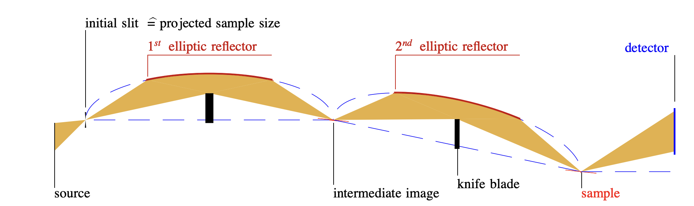





Selene Concept

Slide 3
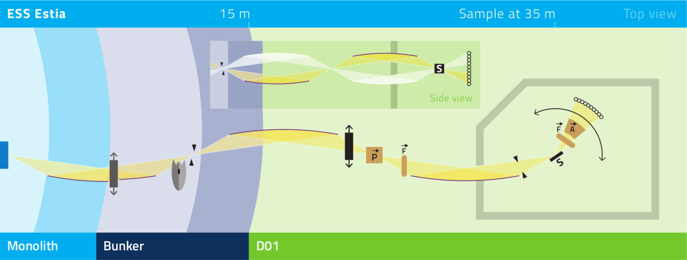
The ESTIA Instrument
At ESS

Slide 4
ESTIA as a reflectometer

Slide 5
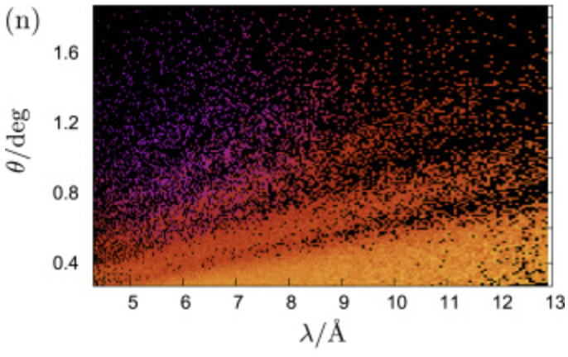
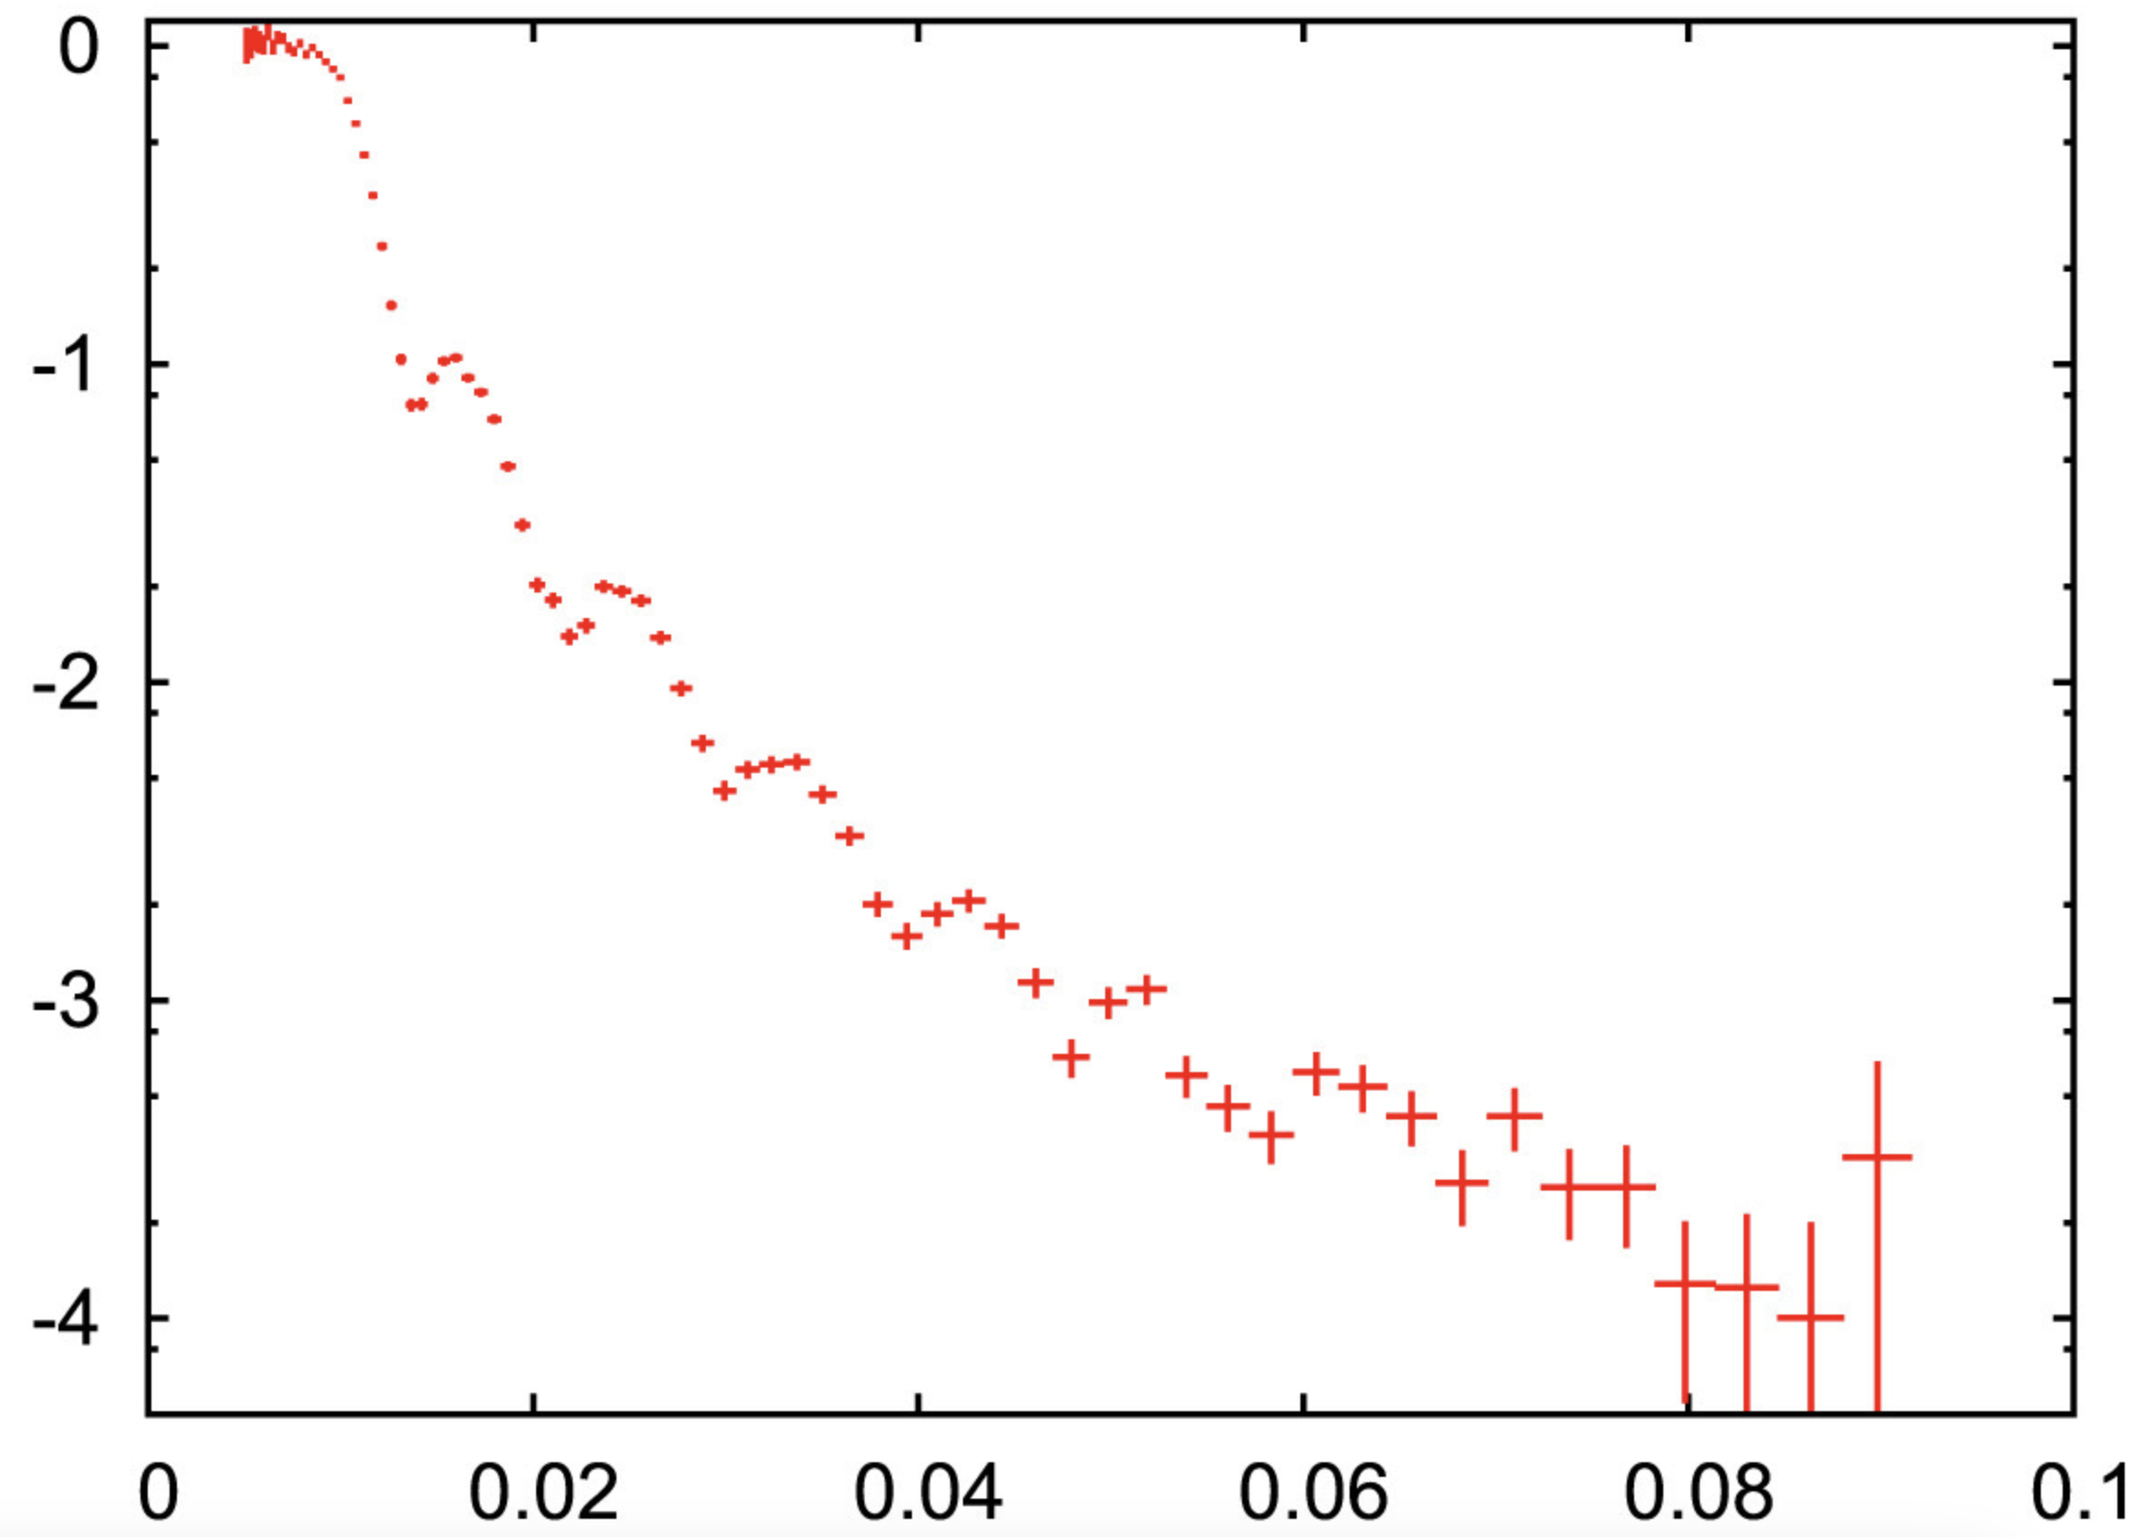
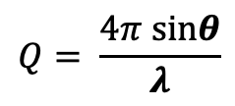
ESTIA Instrument
θ
Reflectometers explore Q using either ToF at a fixed angle, or multiple angles at a fixed wavelength
ESTIA uses a Selene guide with an extremely divergent beam, as well as ToF, to look at both simultaneously
$$Q= \frac{4π sinθ}{λ}$$
λ
θ
λ
https://doi.org/10.1016/j.nima.2016.03.007

Slide 6
Science Case

Slide 7
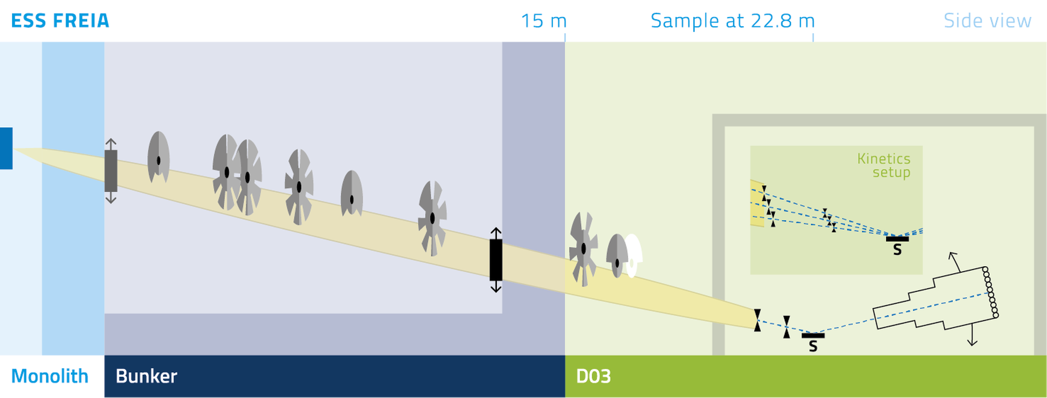
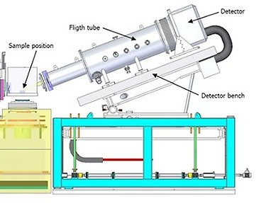
Reflectometry at ESS
FREIA
ESTIA’s sister instrument – FREIA (‘conventional’ reflectometer)
Horizontal sample - free liquid surfaces
Wavelength Frame Multiplication option – variable wavelength resolution
Very large guide, using slit position to define angle
Online 2027

Slide 8
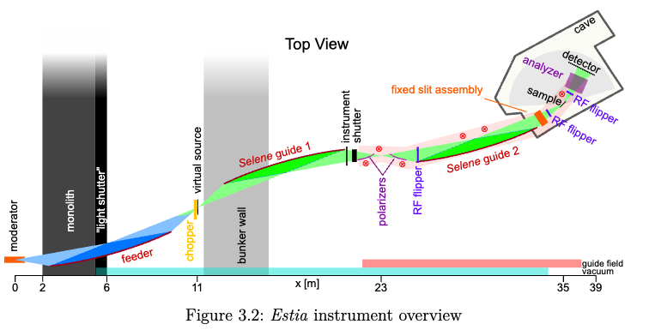
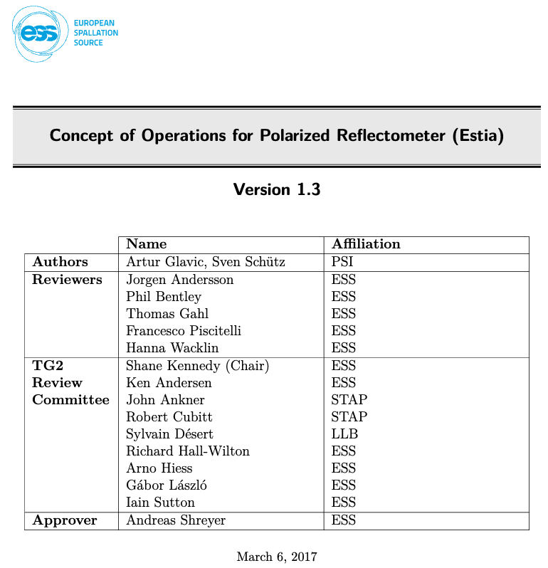
Science Case
Small samples
Magnetism, inhomogeneous films, devices,…
In operando measurements
High flux
High throughput measurements of e.g. biological samples
Low instruments background
A reflectometer generally wants most of these features but having Selene guides and polarisation built into its heart allows ESTIA to focus its abilities

Slide 9
Small Samples

Slide 10
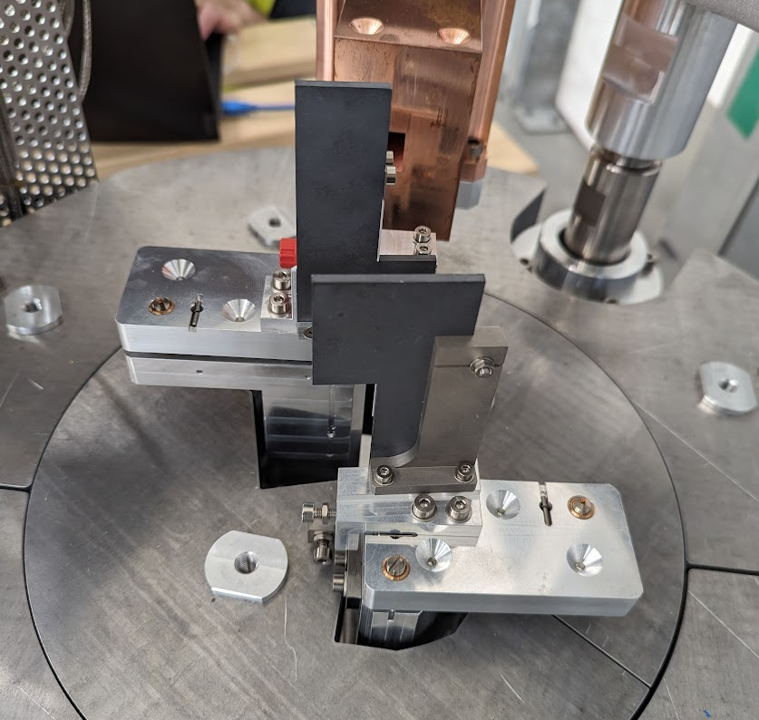
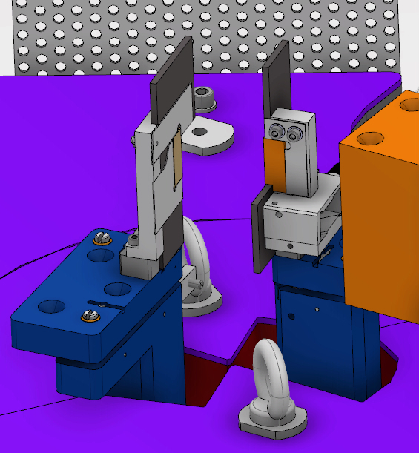
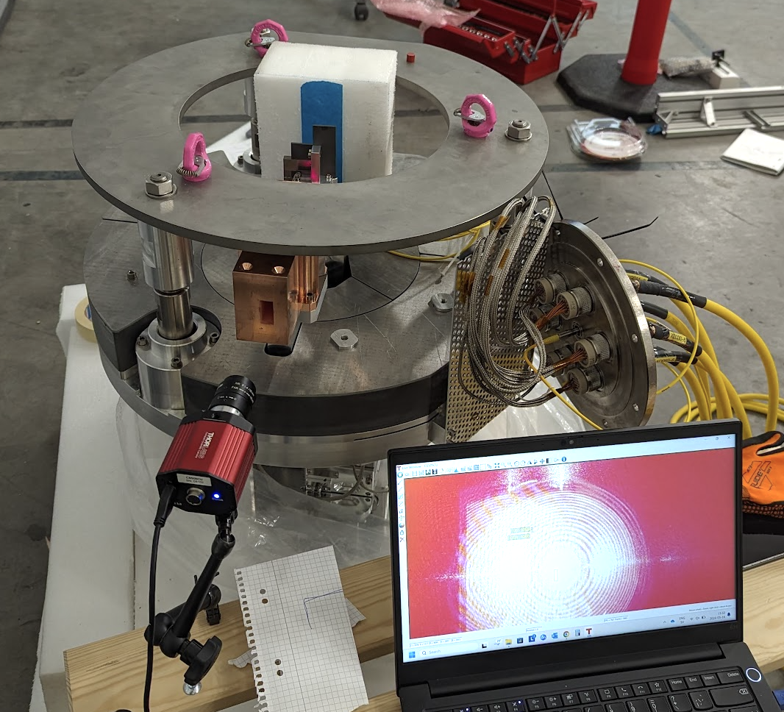
Small Samples
The only required collimation on ESTIA is done at the “virtual source” – the point where we decide what neutrons to bring to the sample point (almost 30m from detector)
Defines the projected beam size!

Slide 11
Virtual Source
The virtual source:
Low angle
VS. . . . . . Sample
VS. . . . . . Sample
Horizontal
Vertical

Slide 12
Virtual Source
The virtual source:
High angle
VS. . . . . . Sample
VS. . . . . . Sample
Horizontal
Vertical

Slide 13
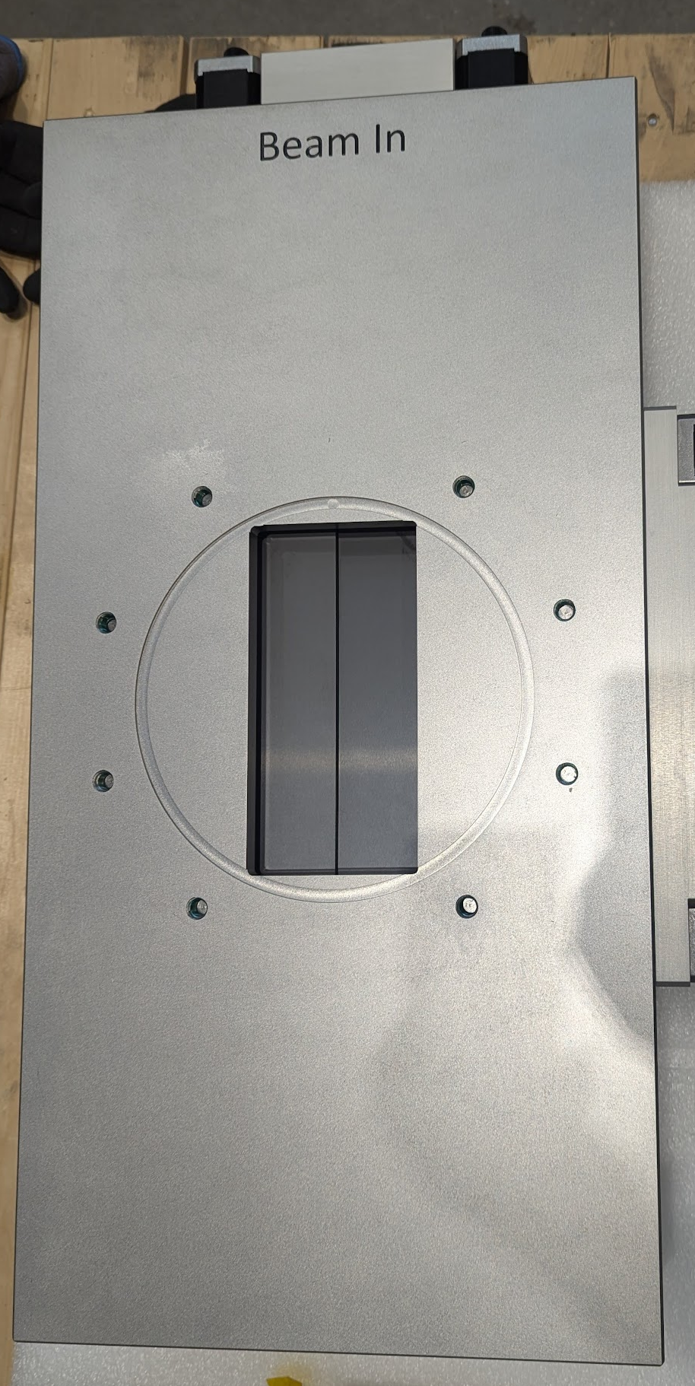
Footprint and Divergence
Virtual Source defines footprint of beam onto sample
Divergence is 1.5 degrees irrespective of footprint
‘Conventional’ slit set near sample point can limit divergence independent of footprint
Divergence range 1.5º → 0.005º
We can tune flux/divergence on a ToF source in seconds

Slide 14
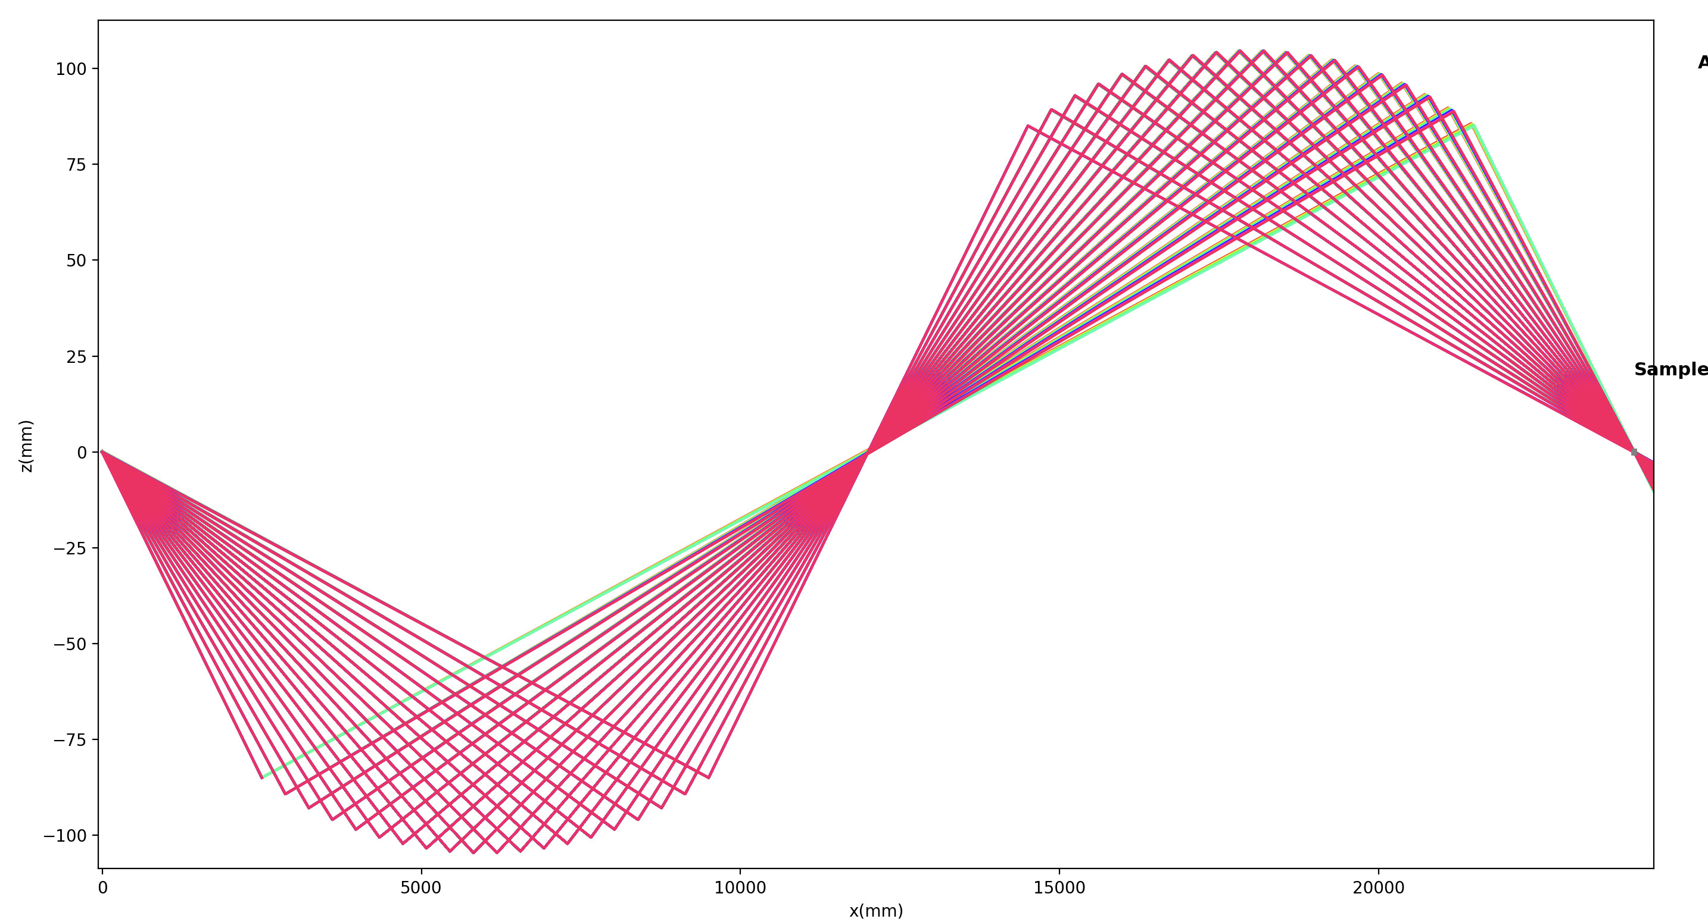
Footprint and Divergence

Slide 15
Footprint and Divergence

Slide 16
Shielding Concept

Slide 17
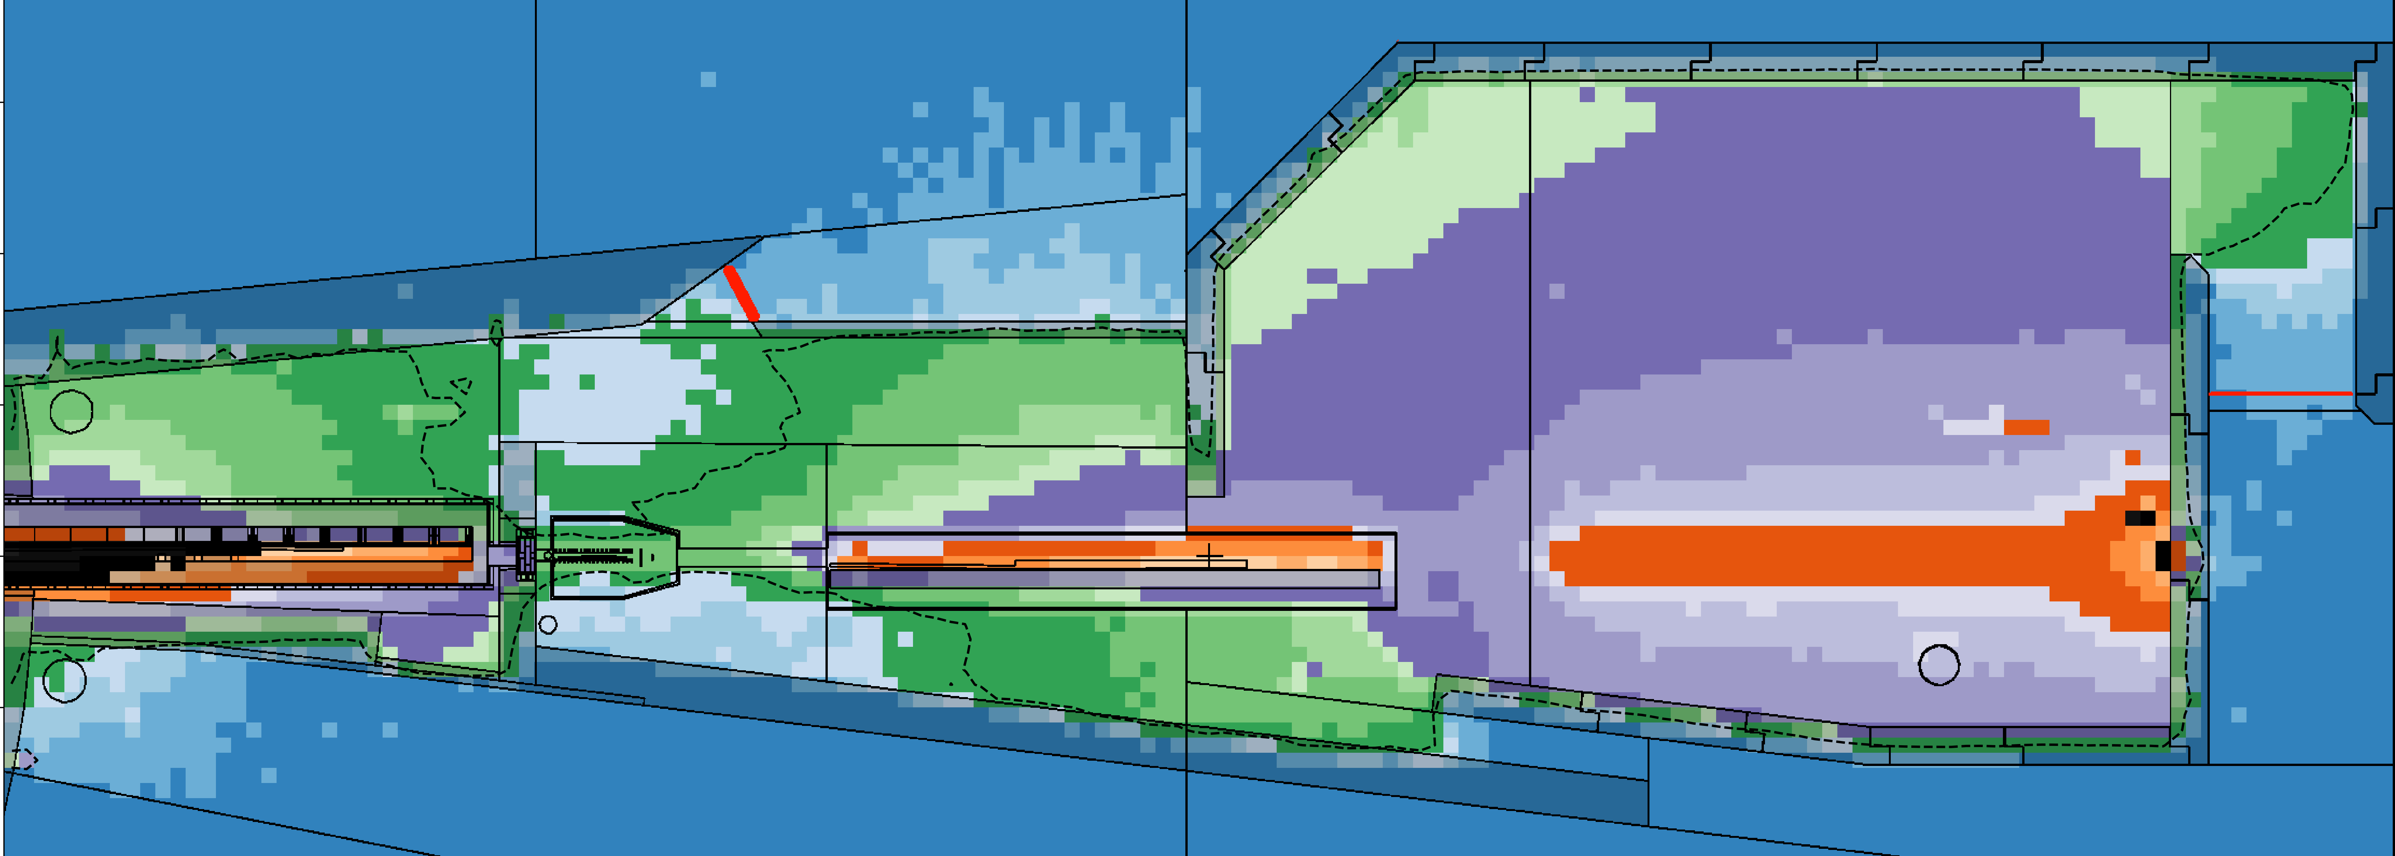
Shielding Concept
We know where the beam should be at all points on the beamline, so aggressively shield around it
Elliptical paths naturally eliminate line of sight three times
Lighter shielding everywhere to reduce secondary scattered beam
Predominantly use copper, borated aluminium, B4C and borofloat glass
Cave is slightly borated for good measure
You ‘could’ stand in the cave
with the beam on

Slide 18
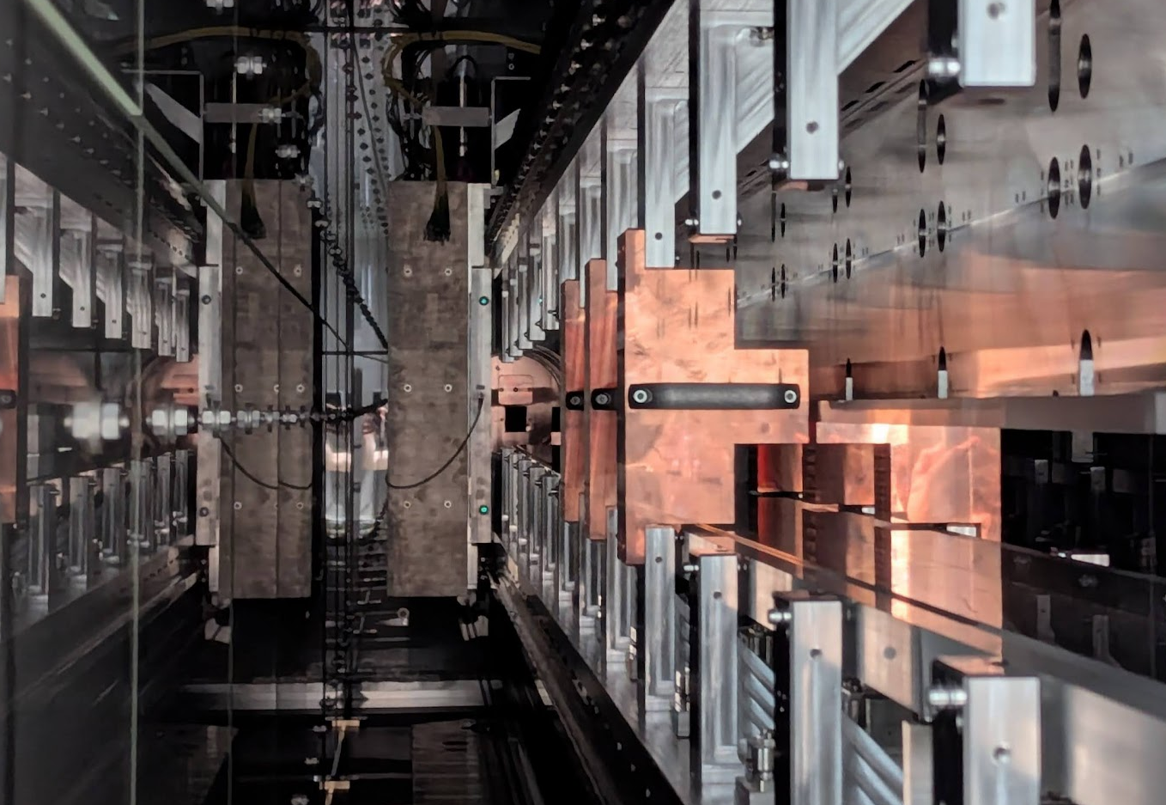
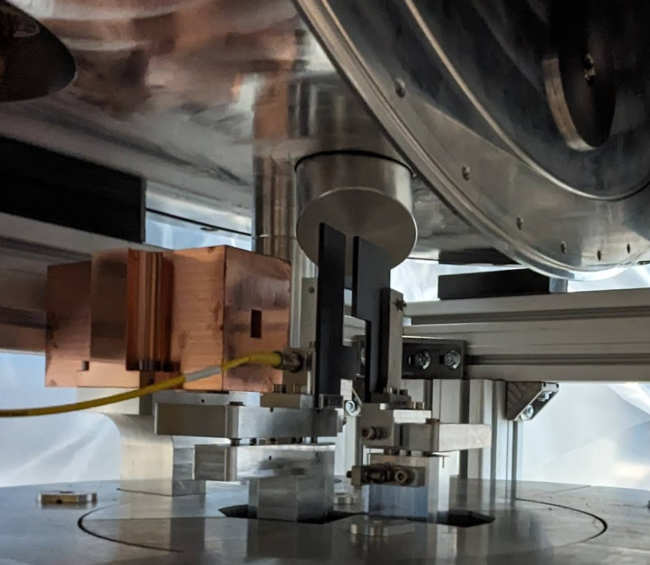
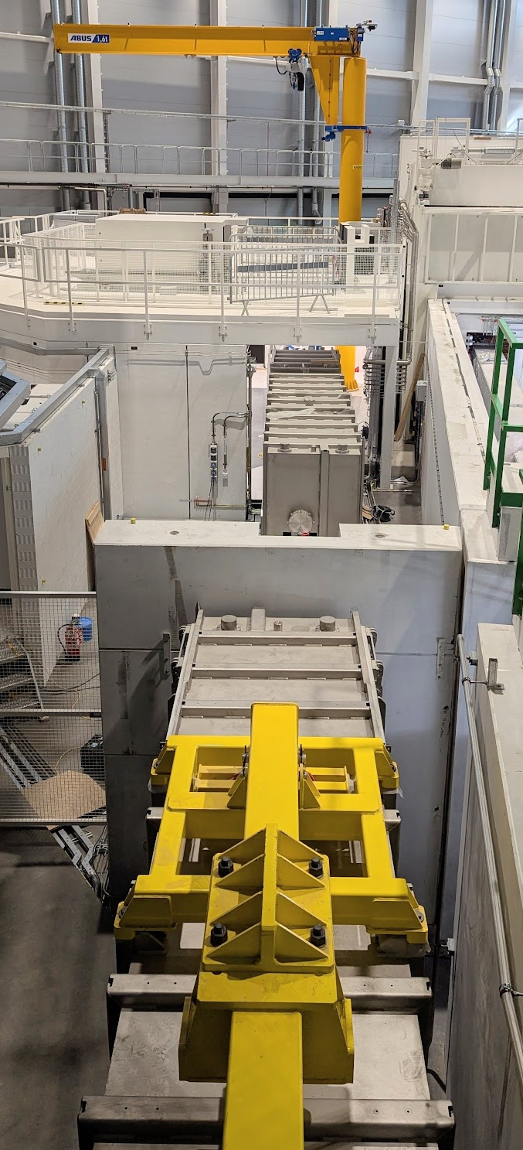
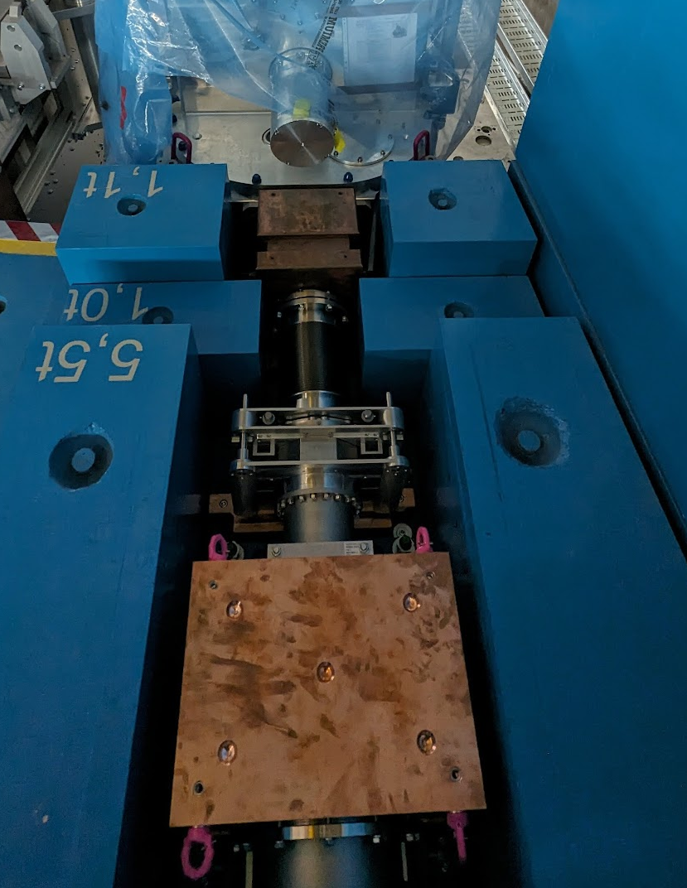
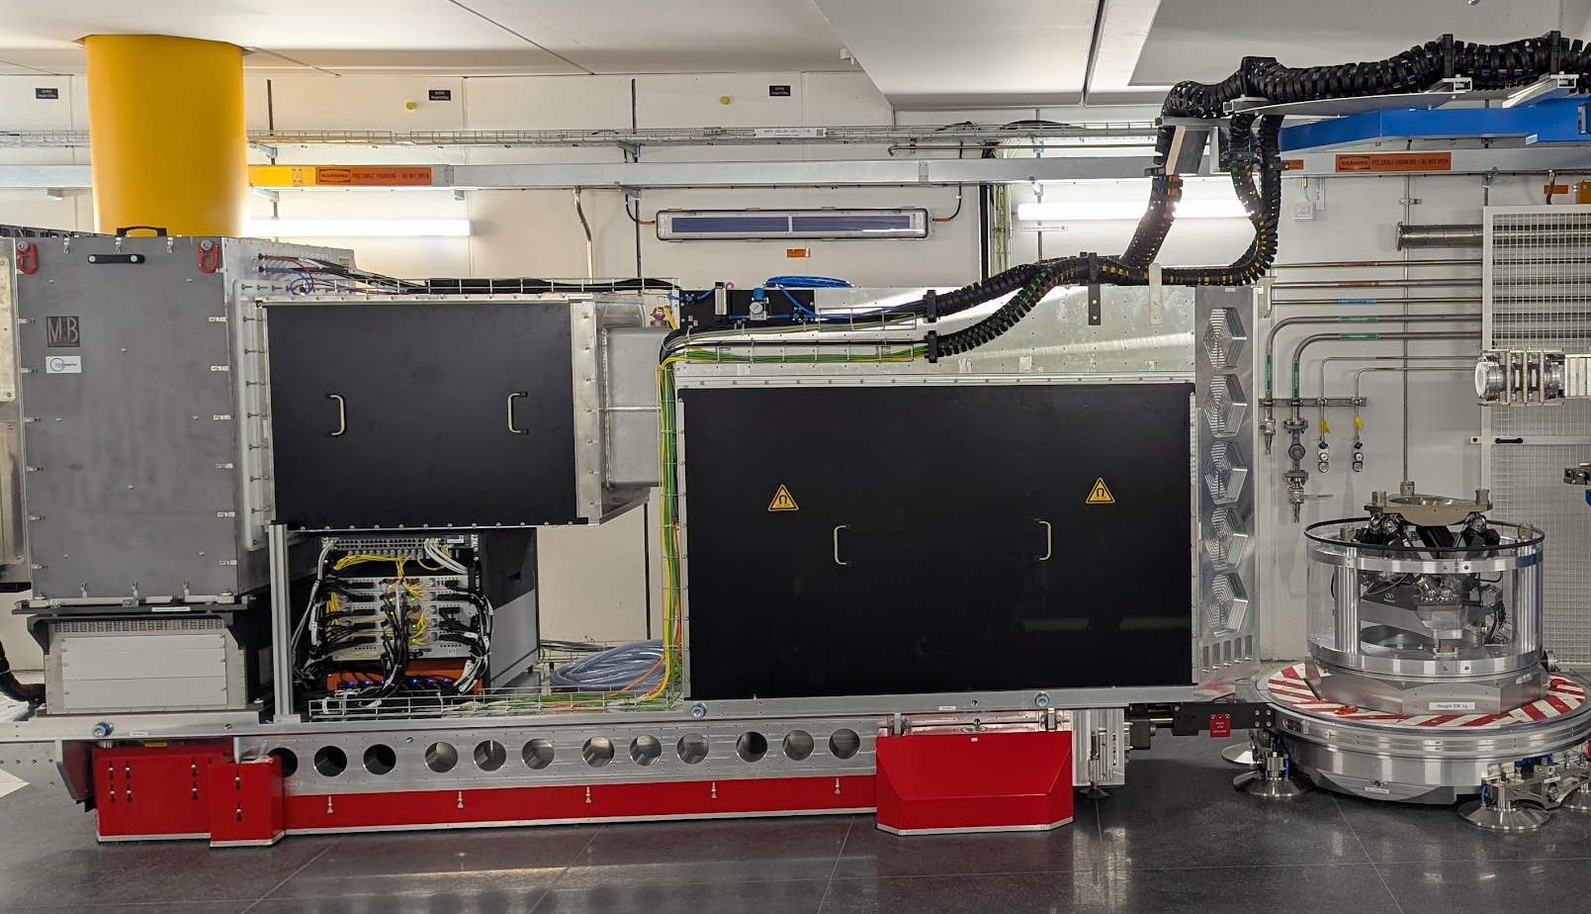
Shielding Concept

Slide 19
Polarisation

Slide 20
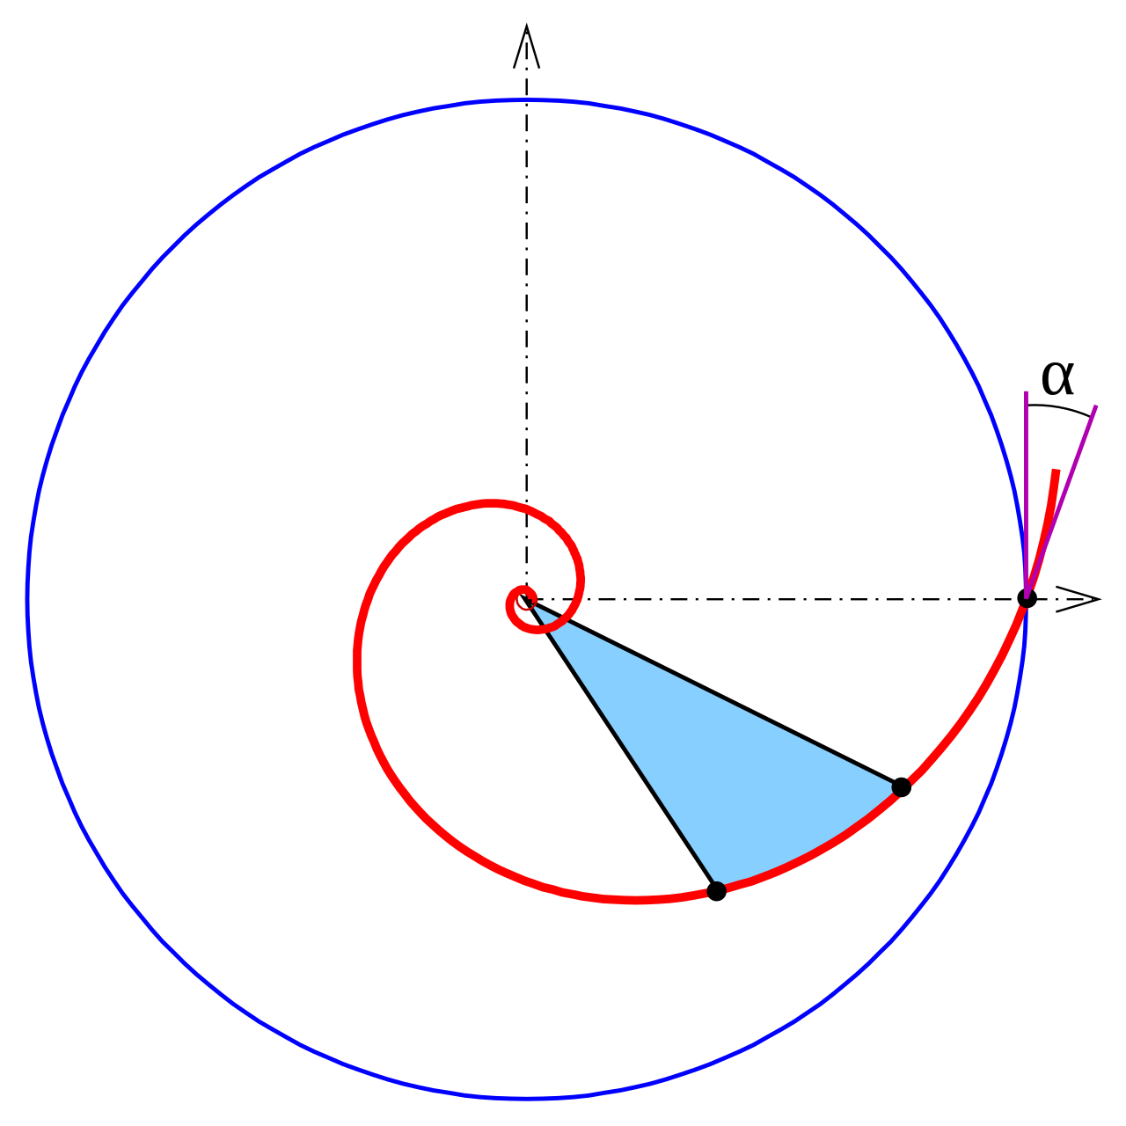
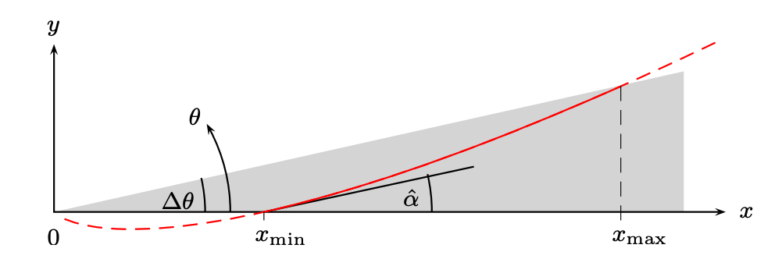
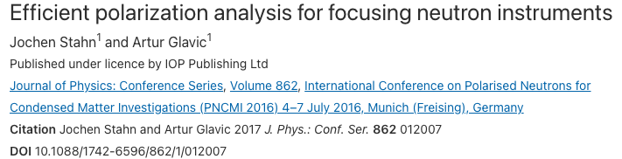

ESTIA
Polarisation
$$r=ae^{kφ}$$
https://commons.wikimedia.org/w/index.php?curid=81406863

Slide 21
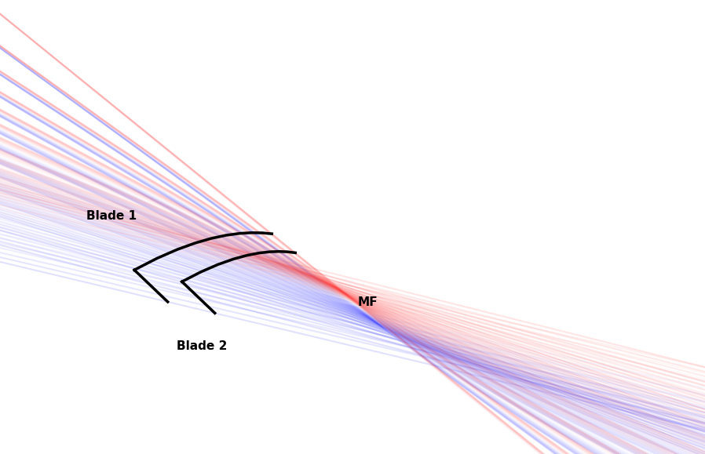
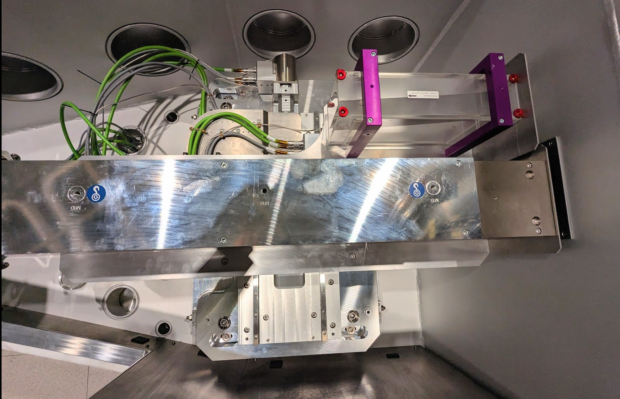
ESTIA
Polarisation
Two transmission polarisers in series
Improved polarisation
Part logarithmic spiral and part linear
Linear covers rays created by coma which are almost parallel
Pointing backwards to make device shorter
Both sides coated with m=5 Fe/Si
Device is almost 1m long

Slide 22

ESTIA
Requirements
Polarisation
Homogeneous polarisation across whole wavelength range
Small samples
Beam size on sample down to ~1x1mm²
Maximum size ~10x10mm²
High flux
ESS will provide huge number of neutrons
Divergent beam gives 10x flux
Low backgrounds
Only neutrons which will hit the sample get any where near the cave

Slide 23
Selene Guide Realised

Slide 24
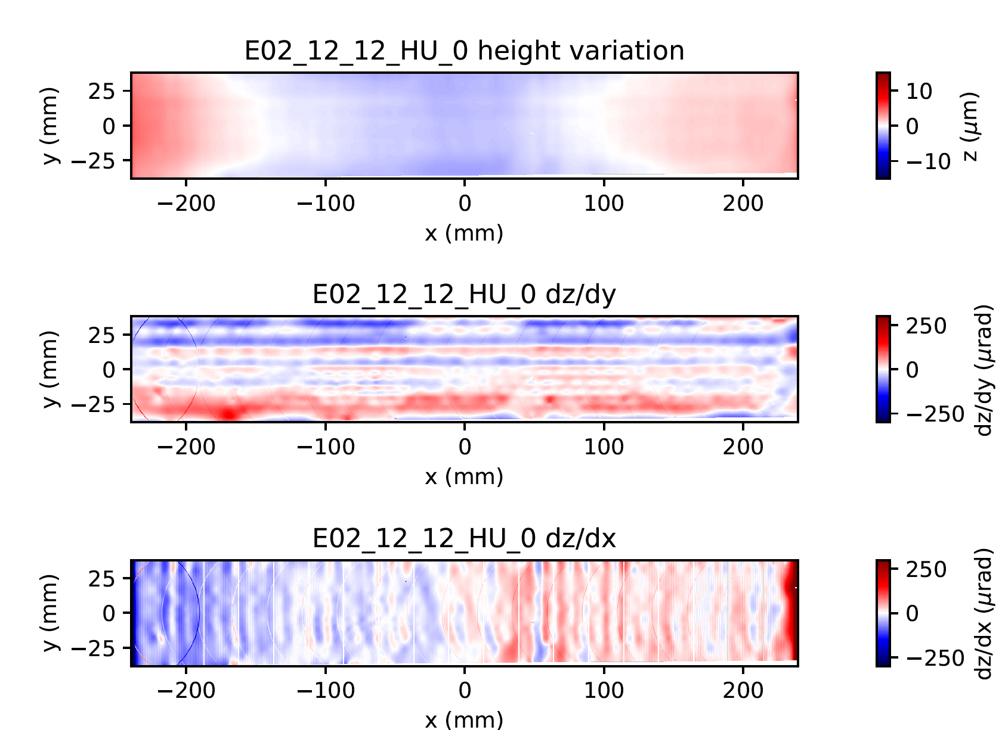
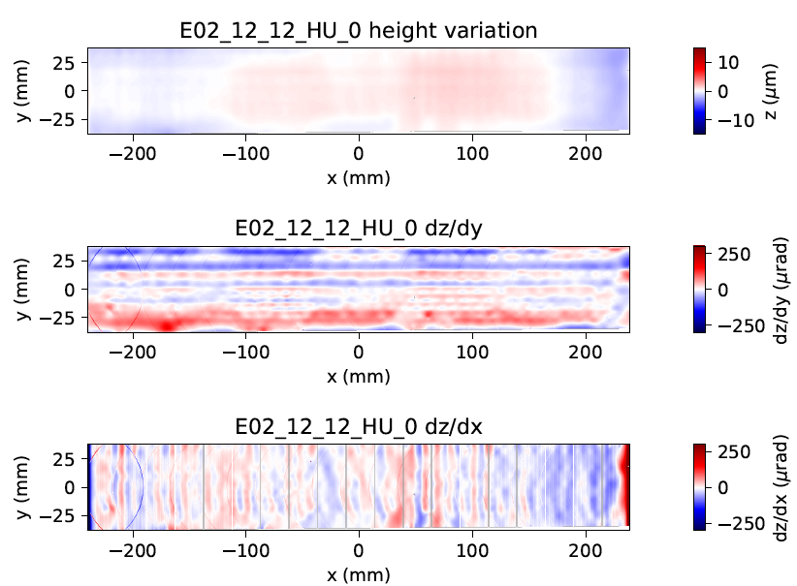
ESTIA
Selene Guides
Single elliptical section not possible so split up into 15 pieces ~0.45m long
Each piece has to be individually positioned to ~1um acuracy
How to hold in place?
How to position?
How to check?

Slide 25
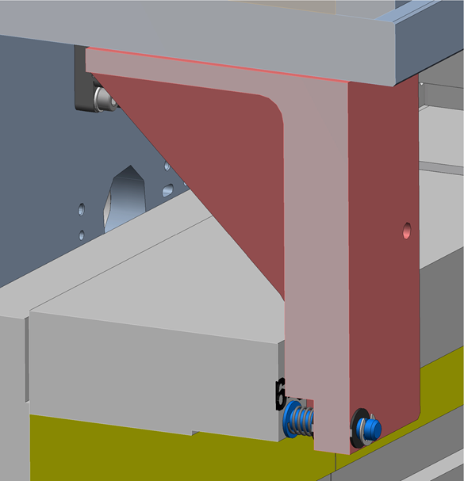
ESTIA
Selene Guide Mirror Holders
Back side hex-key adjuster
Horizontal segment mount
Mirror horizontal
Vertical segment Mount
Mirror vertical
Drop guard /coil Spring

Slide 26
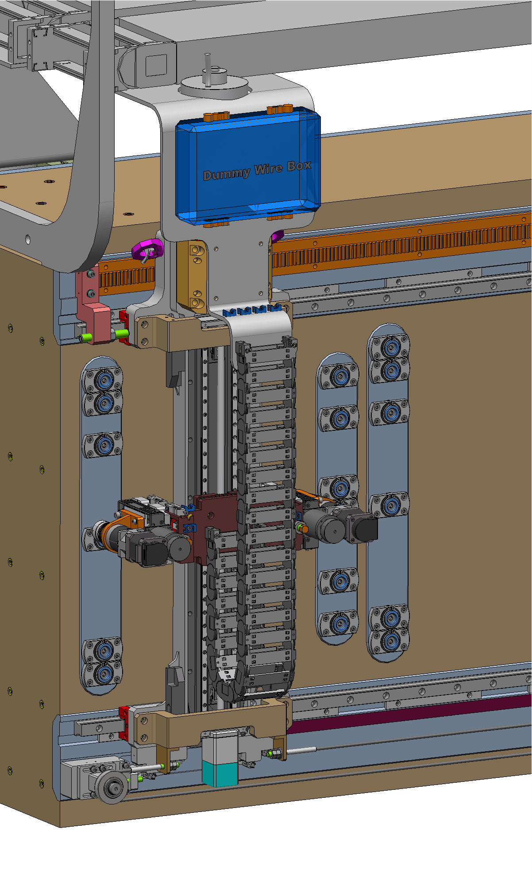
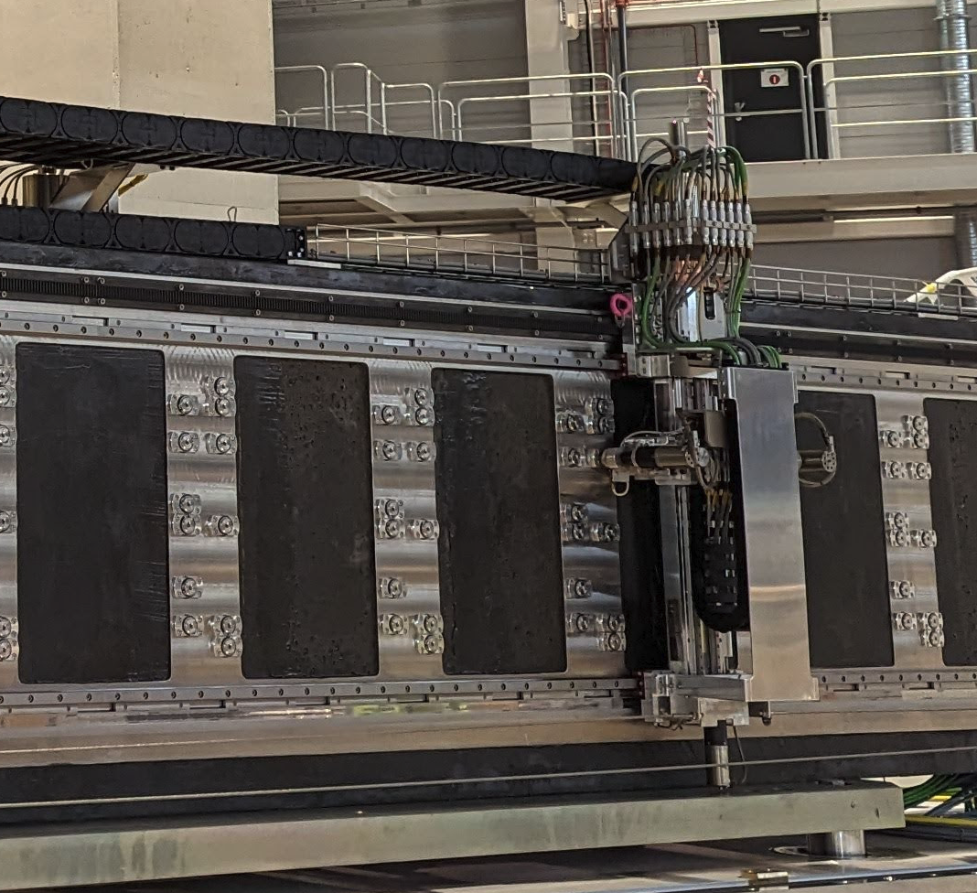
ESTIA
Selene Guide Robot
Patch Panel
Gear wheel drive
Hard Stop
X
Vertical Stage with linear encoder (from Newmark)
Y
Z
Hex-Key Screwer
End Switches
Linear encoder
Emergency wire

Slide 27
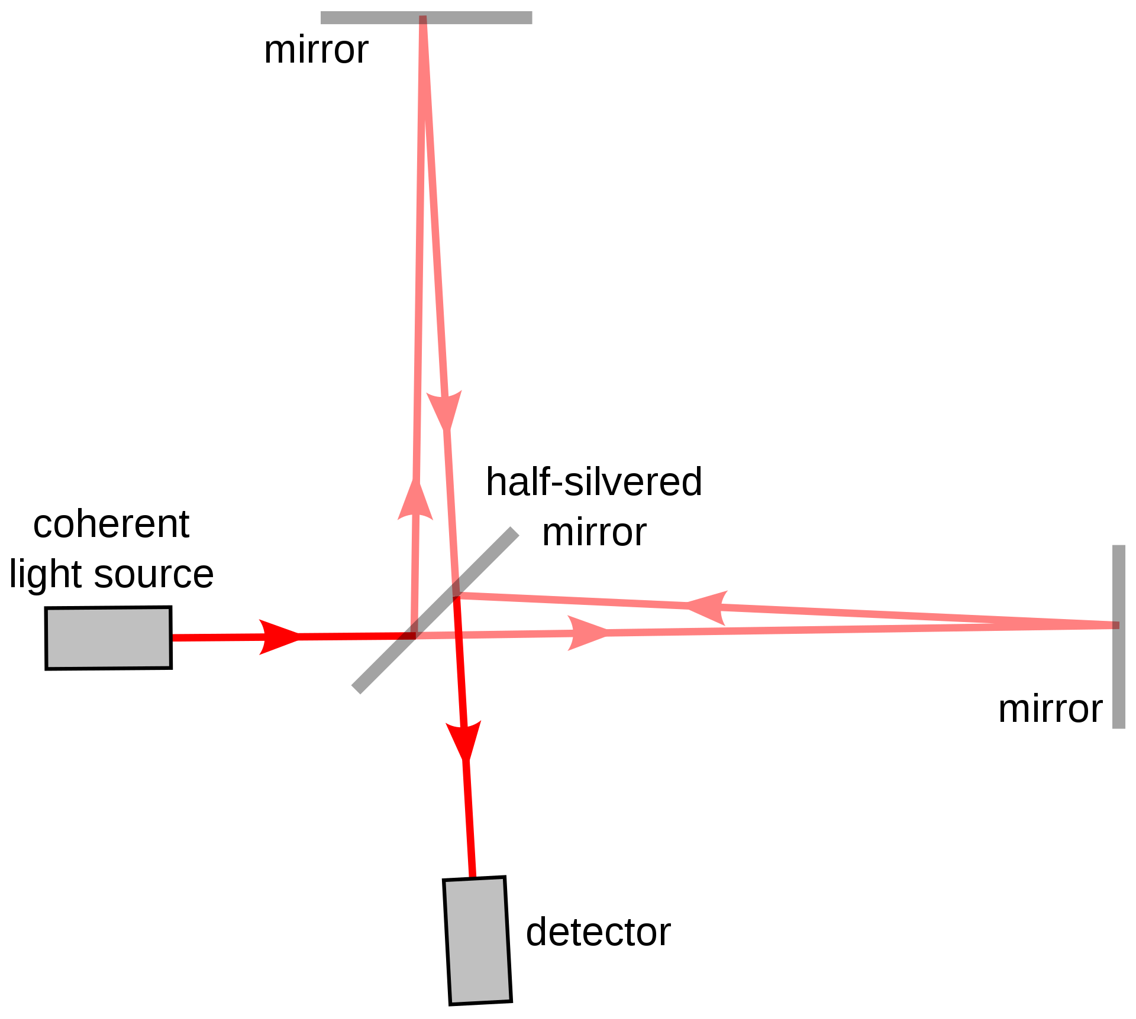
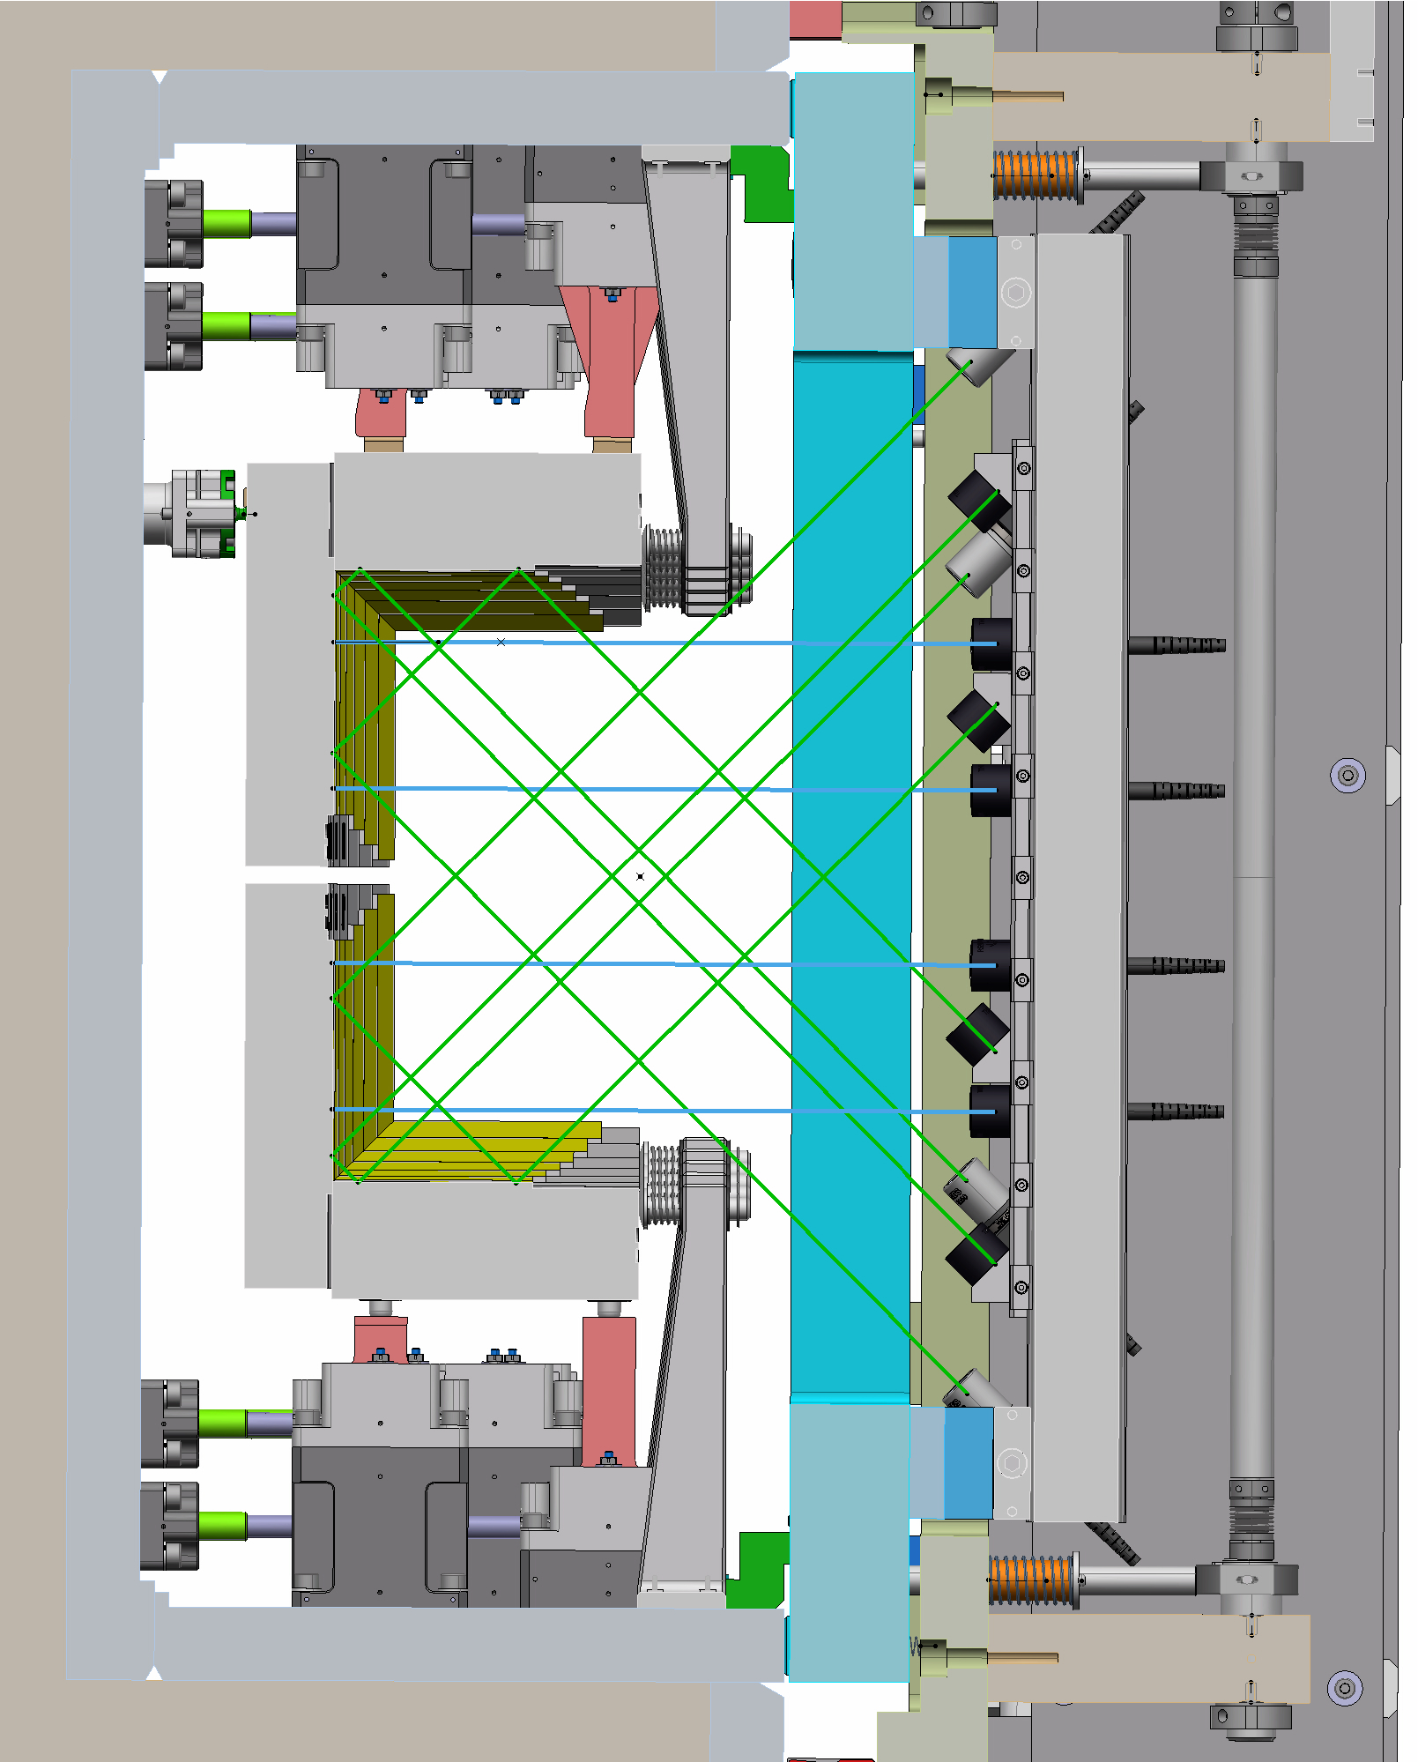
ESTIA
Selene Guide Interferometer
Reference plane
Collimator
Reflector
Metrology Rack
Reference plane
https://commons.wikimedia.org/w/index.php?curid=1728260

Slide 28
Detector

Slide 29
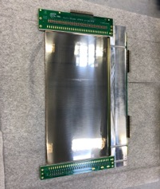
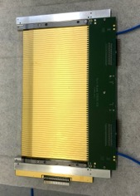
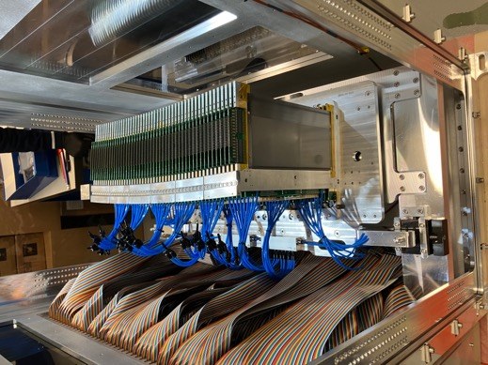
Detector
Multi-Blade
48 blades
Active area of 480 x 260 mm²
Set in a 4 m radius circle
Ar/CO₂ detector gas at a trickle over room pressure
Electronics convert signal to light within detector housing
Borated Al shielded with option for more
Expected max count rate ~10MHz
wires X
strips Y
neutrons
sample
The Multi-Blade Boron-10-based neutron detector for high intensity neutron reflectometry at ESS
Citation F. Piscitelli et al 2017 JINST 12 P03013
DOI 10.1088/1748-0221/12/03/P03013
Multi-Blade detector with VMM3a-ASIC-based readout: installation and commissioning at the reflectometer Amor at PSI
Citation F. Piscitelli et al 2024 JINST 19 P05010
DOI 10.1088/1748-0221/19/05/P05010

Slide 30
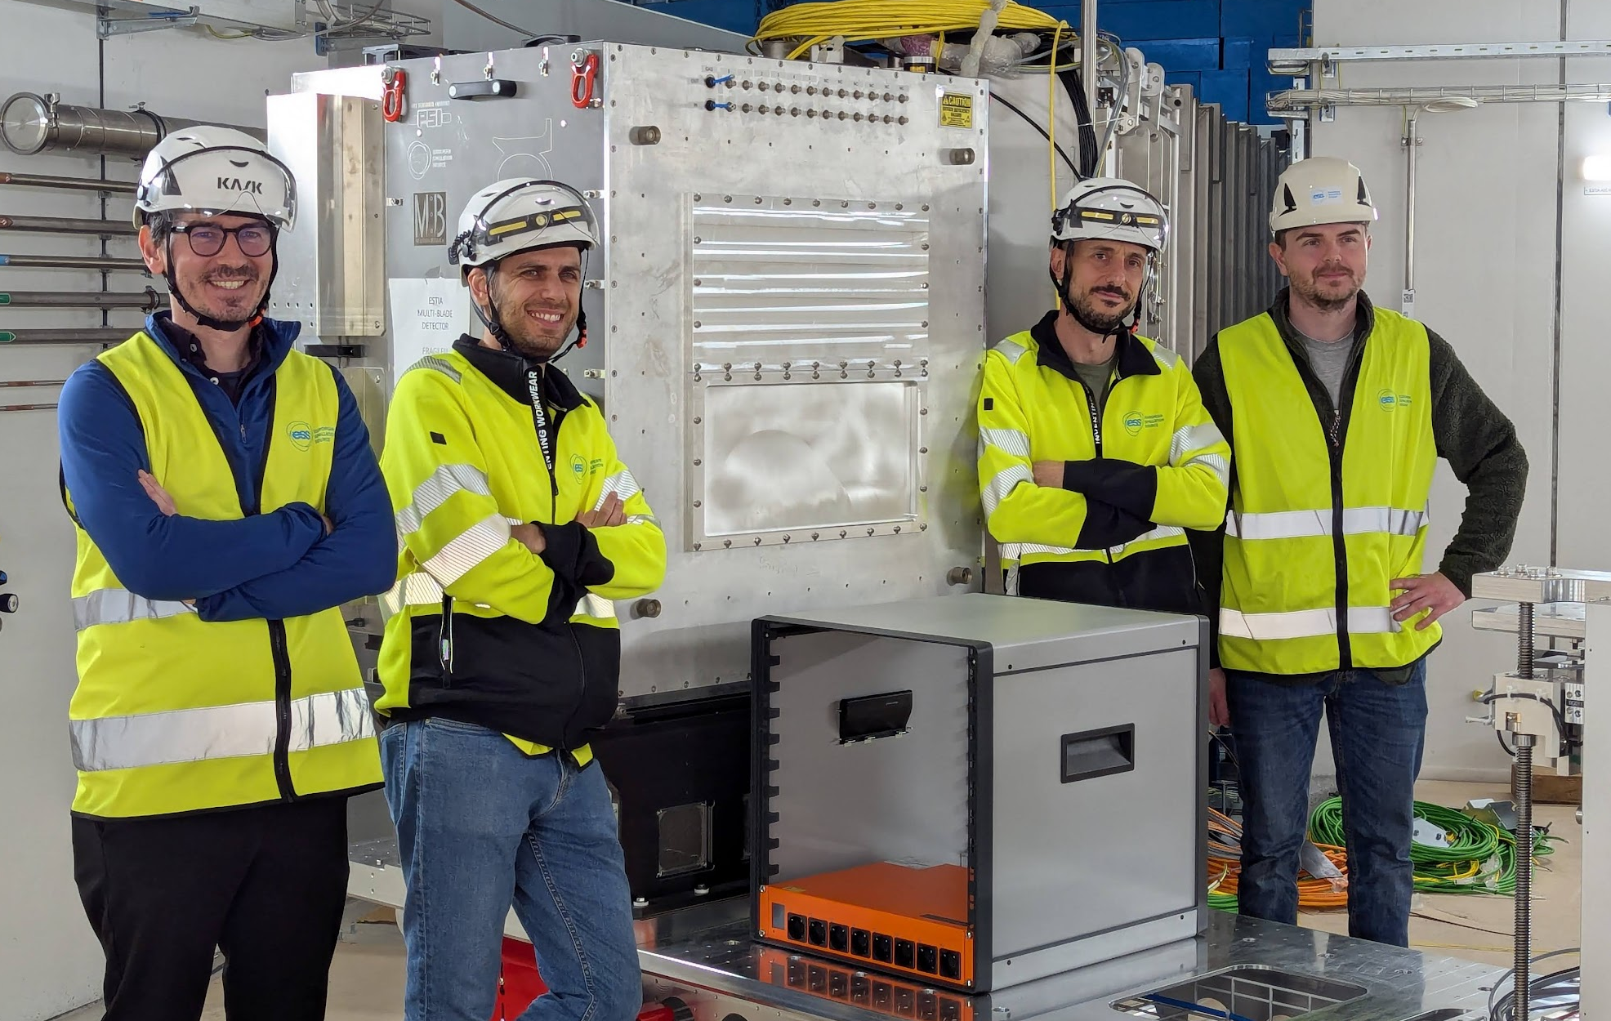
Detector
Multi-Blade

Slide 31
Conclusions

Slide 32
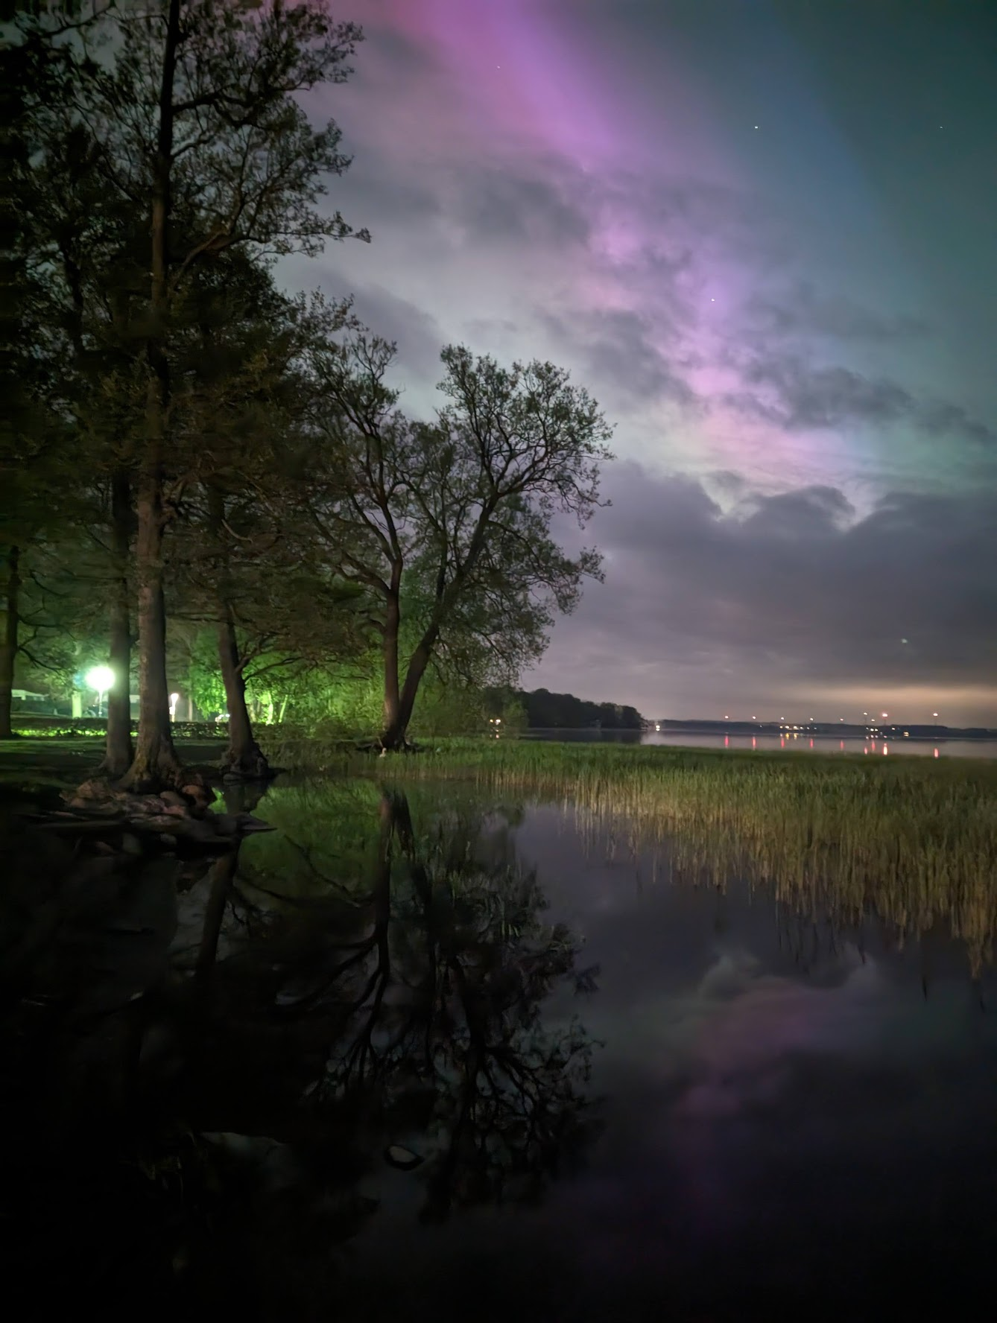
ESTIA
Getting ready for you!
At least 15 different work packages to be individually and jointly tested before we get neutrons
Most systems are in vacuum, have motion and need to be aligned to almost every other component of the beamline
Working with light until we have neutrons
Currently developing instrument control, data reduction and data analysis software
NICOS, scipp, and EasyReflectometry

Slide 33
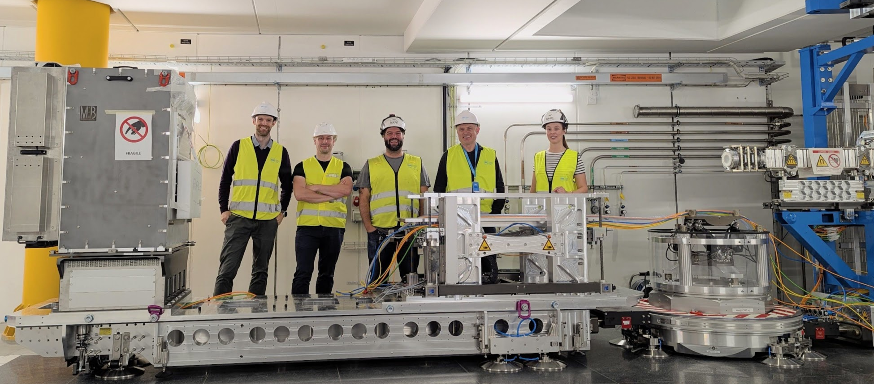
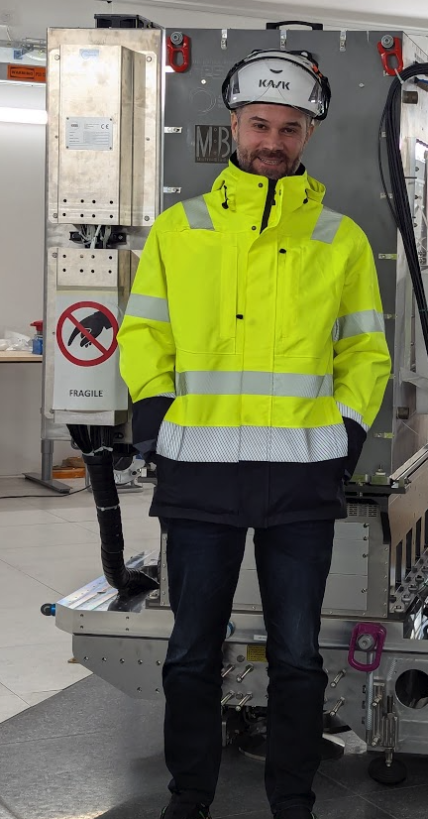
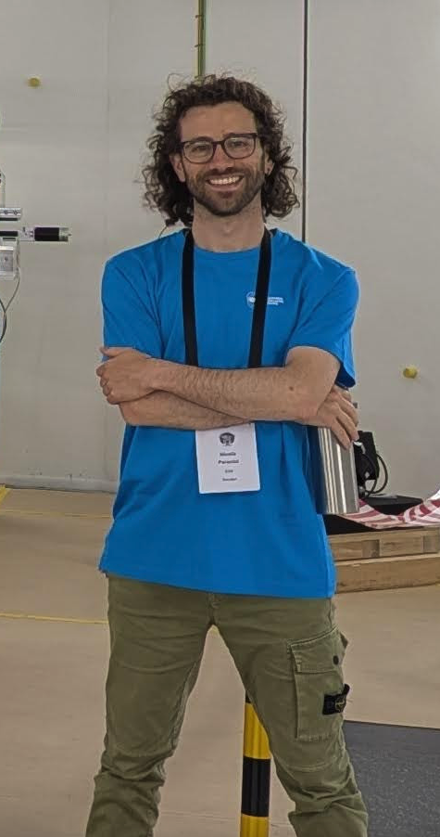
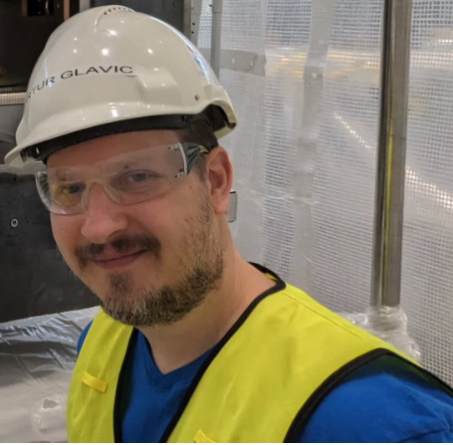
ESTIA Current Core Team
Nicolae Jos André Felipe Peter Grace Nicoló Artur

