Slide 1
ESS - DMSC
USER
COMMUNITY
Notes:
scope and planned role in supporting science users at ESS

Slide 2
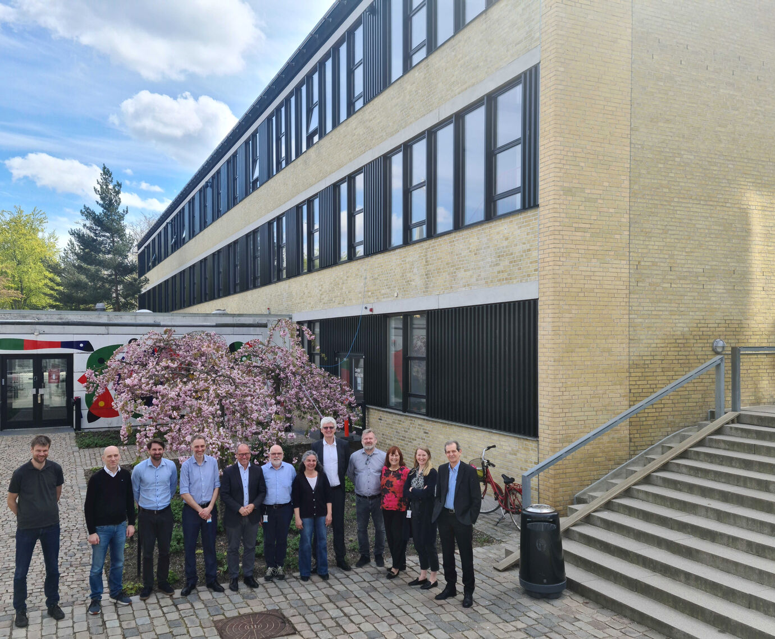
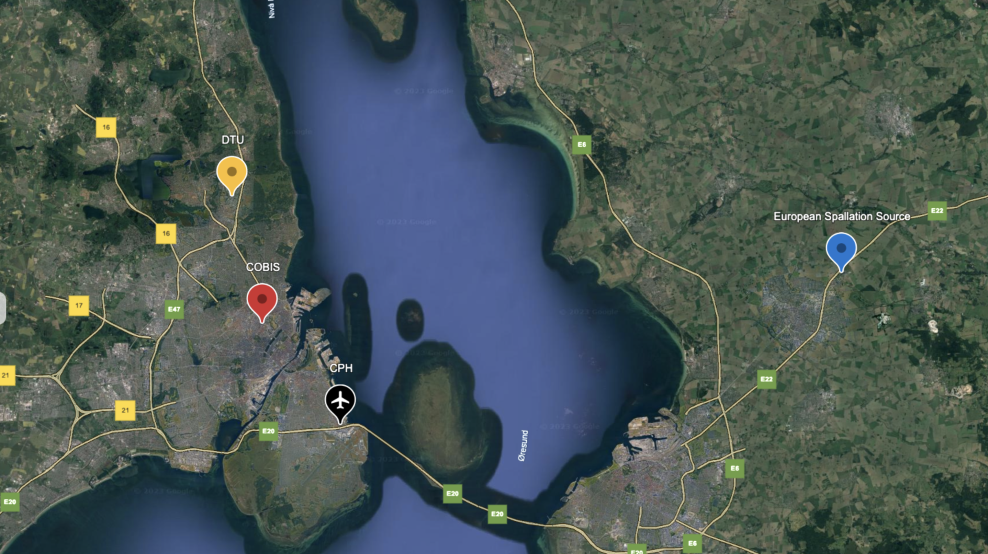
ESS – DMSC: a dual-site facility
Data Management and Scientific Computing
Notes:
ESS is a facility with two separate sites, with instruments and labs in Lund and the Data Management and Scientific Computing which is situated in Copenhagen, with offices in the DTU campus. There is quite a lot of travelling in between the two sites and everyone in Denmark visits regularly the site in Lund and the other way around as well but maybe a little less often for obvious reasons, they’re also more than 10 times our size. DMSC around 50 people

Slide 3
DMSC Anatomy
ESS
Quality & Compliance
Science
Operations & Machine
Project
Administration
ESH & Security
NSS
Large Scale Structures
Diffraction & Imaging
Spectroscopy
Science Support
Accelerator
Target
Integrated Control Sys.
Design & Engineering
Field Engineering & Site Support
IT
Project Control Manager
In Kind Management
Communication
Finance & Business Control
Human Resources
Supply, Procurement & Logistics
DMSC
Science Directorate
Giovanna Fragneto
Data Systems & Technologies
Jesper Selknaes
Scientific Information Management Systems
Fredrik Bolmsten
Data Reduction, Analysis, and Modelling
Torben Nielsen
DMSC
Thomas H. Rod
Administration & Project coordination
Petra Aulin
Instrument Data Scientists
IDS
SIMS
DRAM
DST
Notes:
This is where DMSC fits within the ESS structure, it sits under the science directorate which is headed by Giovanna Fragneto and DMSC itself is headed by Thomas Holm Rod. it is divided into 4 groups plus admin. I’ll say a few more words about what each group does in the course of this presentation. we are a mixture of scientists, software developers and engineers, simulation experts and technical staff.

Slide 4
DMSC supports the full user journey
From idea to publication with scientific computing tools / services
Notes:
Overall the scope of DMSC is to support the full user journey, so starting from before an experiment with access to computing resources for experiment simulations, to submitting proposals and registering for experiments through the user office. So DMSC provides all the software you will be using for visualising live data, reducing data and data analysis during your experiment as well as after the experiment is completed it takes over data management duties and continues with supporting in data treatment.

Slide 5






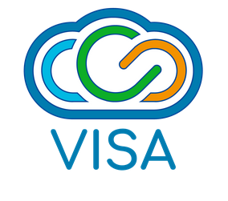
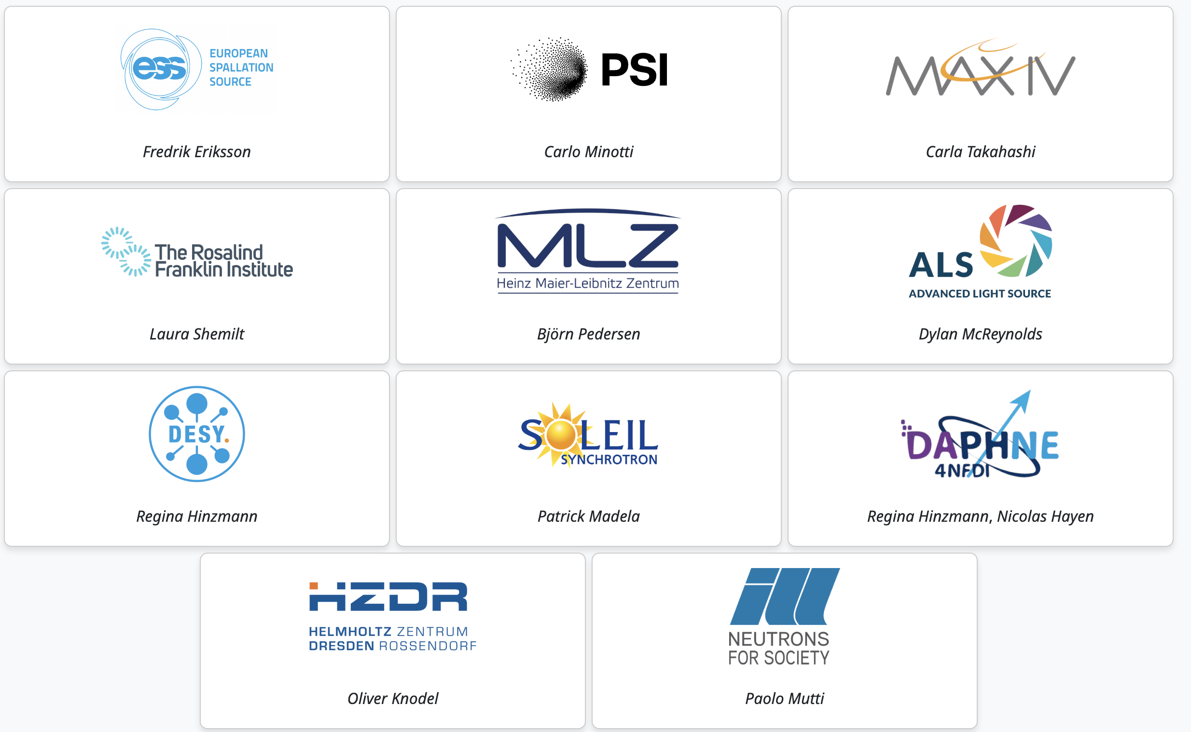

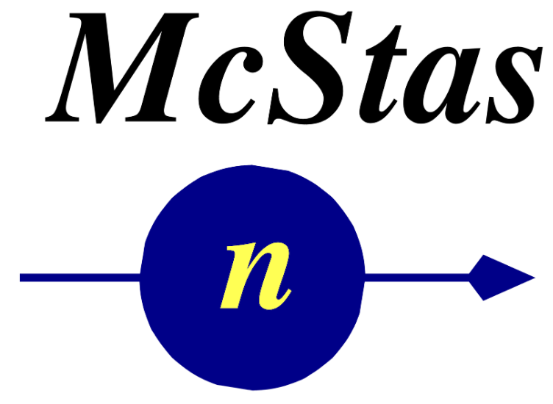
DMSC: who does what
Instrument control
Experiment Control and Data Curation
File structure
Data streaming
Data Systems & Technologies
Jesper Selknaes
Scientific Information Management Systems
Fredrik Bolmsten
Data Reduction, Analysis, and Modelling
Torben Nielsen
Instrument Data Scientists
Thomas H. Rod
Vincent Hardion
ECDC
DST
SIMS
DRAM
IDS
Hardware
Infrastructure
Cyber security
Computer cluster
User office software
Data Reduction and Live data view
Interface with instrument teams
Customization for instruments
Hands on support
U
O
S
Analysis
VISA
Data catalogue
Instrument modelling
Notes:
This is a busy slide with a very condensed break down of what each group looks after and how users will be interacting with the different parts of DMSC, you’ve got the four main groups I mentioned earlier plus up here the instrument control and data curation group which has members both based at ESS and at DMSC.
I just want to highlight some of the software packages that DMSC supports,
NICOS for instrument control, initially developped at MLZ
VISA for remote desktop and remote access to the instruments, currently in use at ILL
SciCat is the data catalogue which is led by Max Novelli here at ESS and it’s a cross-facility data catalogue platform and has partners at many other large-scale facilities.
Scipp is the core project for data reduction and the Scipp team has developed a wide range of software packages that integrate with Scipp for data reduction on the different instruments. All of the software is open source and on github which offers a platform for interaction and contributions from the user community as well as making data treatment transparent according to FAIR data principles
Easy Science comprises a suite of data analysis software for a range of techniques that are built on a common framework, a few more words on this in a minute
Finally McStas is the most widely used software for neutron and X-ray ray tracing for instrument simulations led by Peter Willendrup who works with us at DMSC
In all this the instrument data scientist, the fourth group here, has quite a horizontal role in interfacing DMSC with both the instrument team and the user community so we work quite closely with both ESS sites and plan to work closely with users too

Slide 6




DMSC: who does what
Experiment Control and Data Curation
Data Systems & Technologies
Jesper Selknaes
Scientific Information Management Systems
Fredrik Bolmsten
Data Reduction, Analysis, and Modelling
Torben Nielsen
Instrument Data Scientists
Thomas H. Rod
Vincent Hardion
ECDC
DST
SIMS
DRAM
IDS
Stream events & meta data
Data reduction & visualization
Data analysis
FAIR Data management
Experiment control
User office software
Notes:
So if you put it all together you get something like this where DMSC has a role along the whole user journey: before during and after your experiment

Slide 7
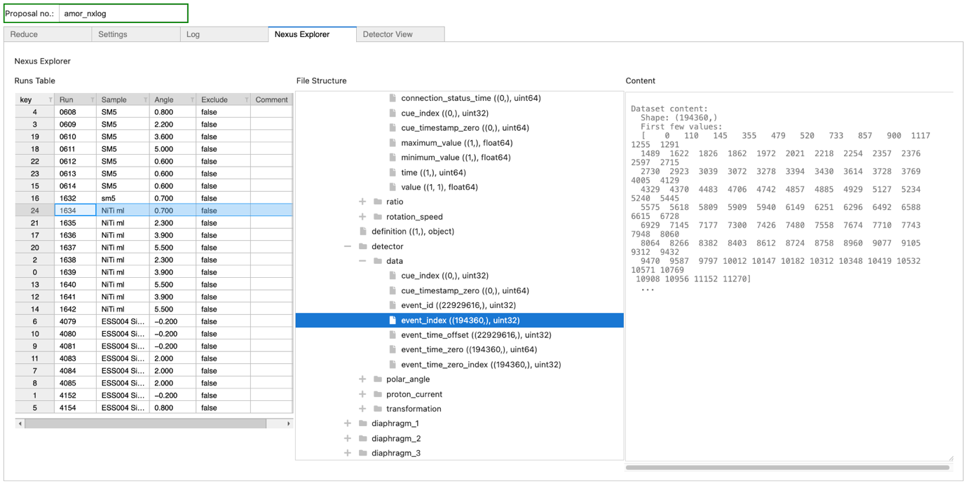
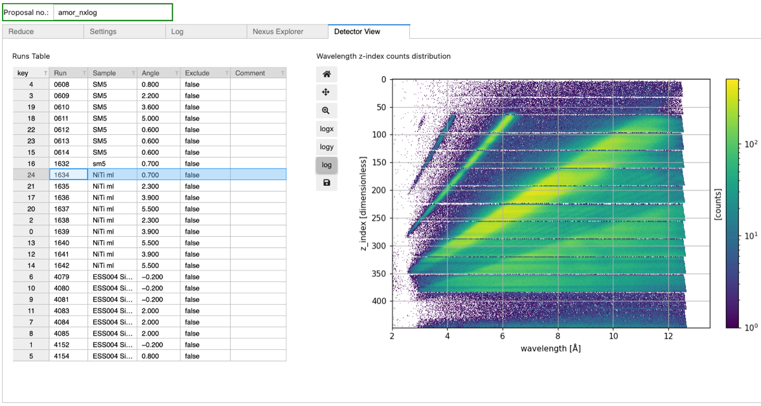
Reflectometry - Reduction
Scipp workflows available in jupyter notebooks and GUI
Tailored reduction workflows for specific reflectometry techniques
Available as jupyter notebooks as well as widget-based GUI
Notes:
For what concerns some more practical aspects, we are developing together with the Scipp team reduction workflows for reflectometry which are available both in form of jupyter notebooks as well as in a graphical user interface which is built on the same workflows but is displayed as a widget-based interface which depending on the user might be more accessible, maybe a little less flexible but these should cover the needs of the different user communities that use reflectometry

Slide 8
Analysis - EasyScience
A harmonized suite of analysis tools
Notes:
I also mentioned Easy science, this is the common framework which supports software for a range of different techniques including reflectometry, but also diffraction, imaging, QENS and more. The core modules are the foundations of the software which then branches into the domain specific project for the different techniques

Slide 9
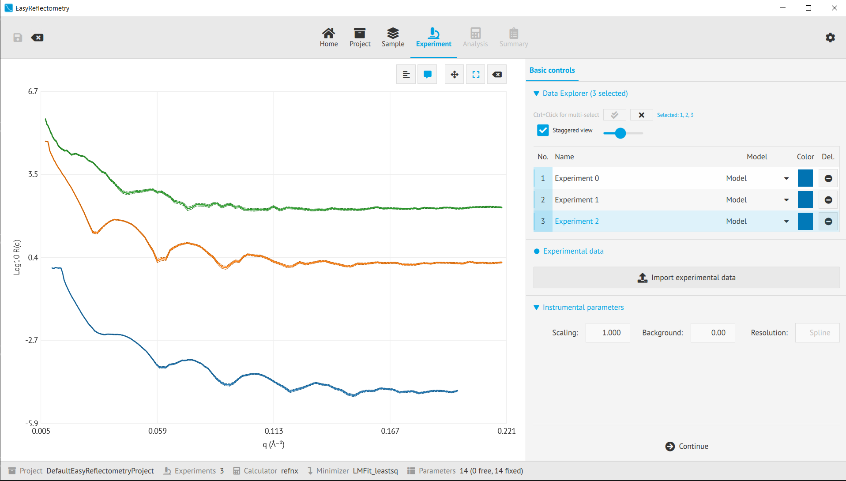
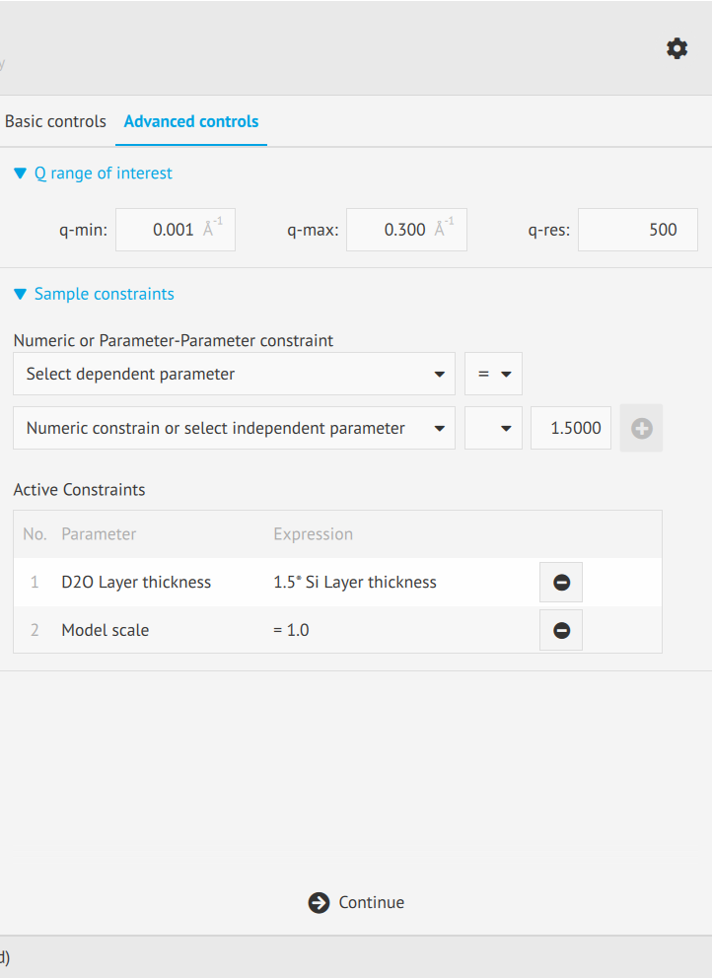
Reflectometry - Analysis
Easy Reflectometry available through jupyter notebooks and GUI
Easy Reflecotmetry Library: Jupyter notebooks
Easy Reflectometry App: GUI
Notes:
Here we also have the same approach where the software is accessible both via Jupyter notebooks as well as a graphical user interface depending on how much the user wants to interact with the code. Development is undergoing, the Easy science team is adding features to both the library and the GUI and we will soon get a long-awaited new developer to work on the project. Overall the goal here is to develop a software that is flexible and supported long term by DMSC, hence the approach of the Easy Science common framework which provides longer term maintainability. The interaction with the user community here will also of course be very important and like all the reduction software also the analysis software is open source and on github

Slide 10
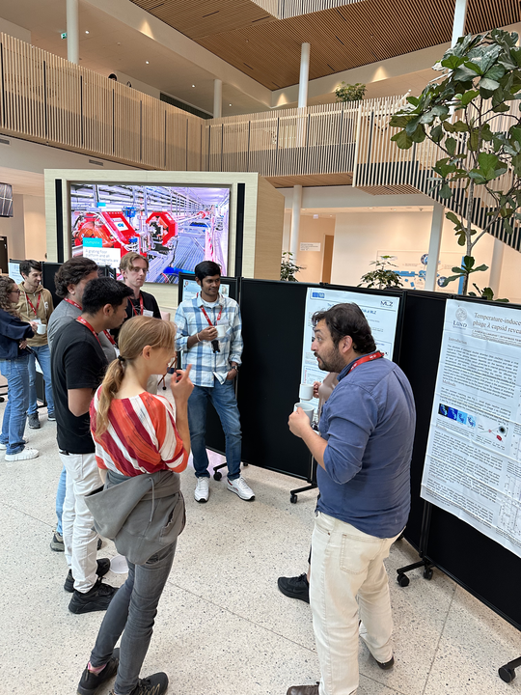
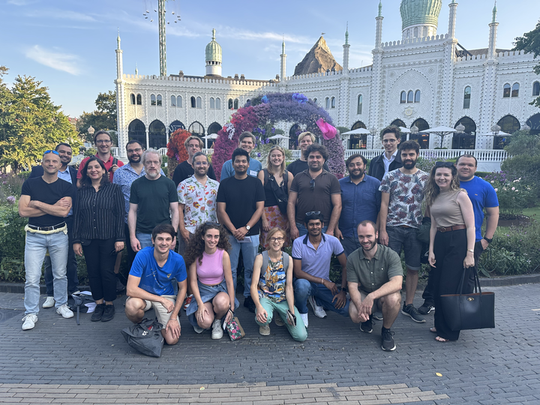
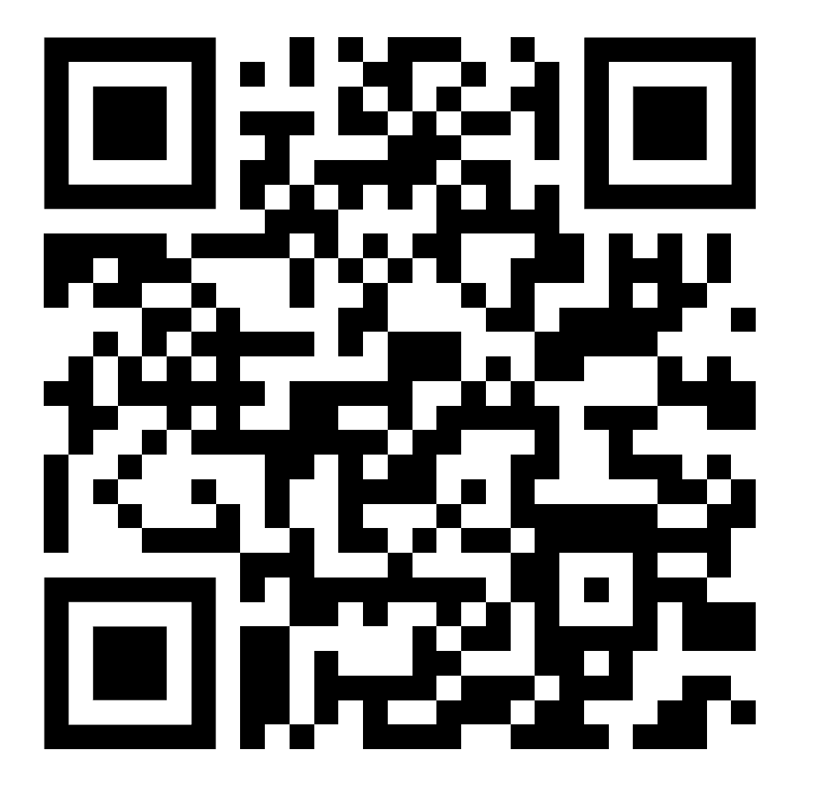




DMSC Summer School
3rd summer school in August 2025
Training of future users of ESS on FAIR & ESS software
Test of our solutions (e.g. full data pipeline)
Competence development of DMSC staff (organising, grant proposals, etc)
Summer School Material:
Sponsors:
Notes:
Finally I want to mention the DMSC summer school which offers training for future users of ESS
It’s a one week long hands-on school using ESS software with practical sessions on data processing, simulation, reduction and analysis
If you know people that might be interested, PhD, Postdocs but also Masters students, do encourage them to get in touch and apply for the school

Slide 11
Conclusion DMSC-ESS
Short and long term interactions with the user community
Short term
Long term
Early science support
DMSC commissioning
Full user journey support
User feedback
USER
COMMUNITY
Notes:
So that was a brief overview of what's going on at the DMSC

Slide 13
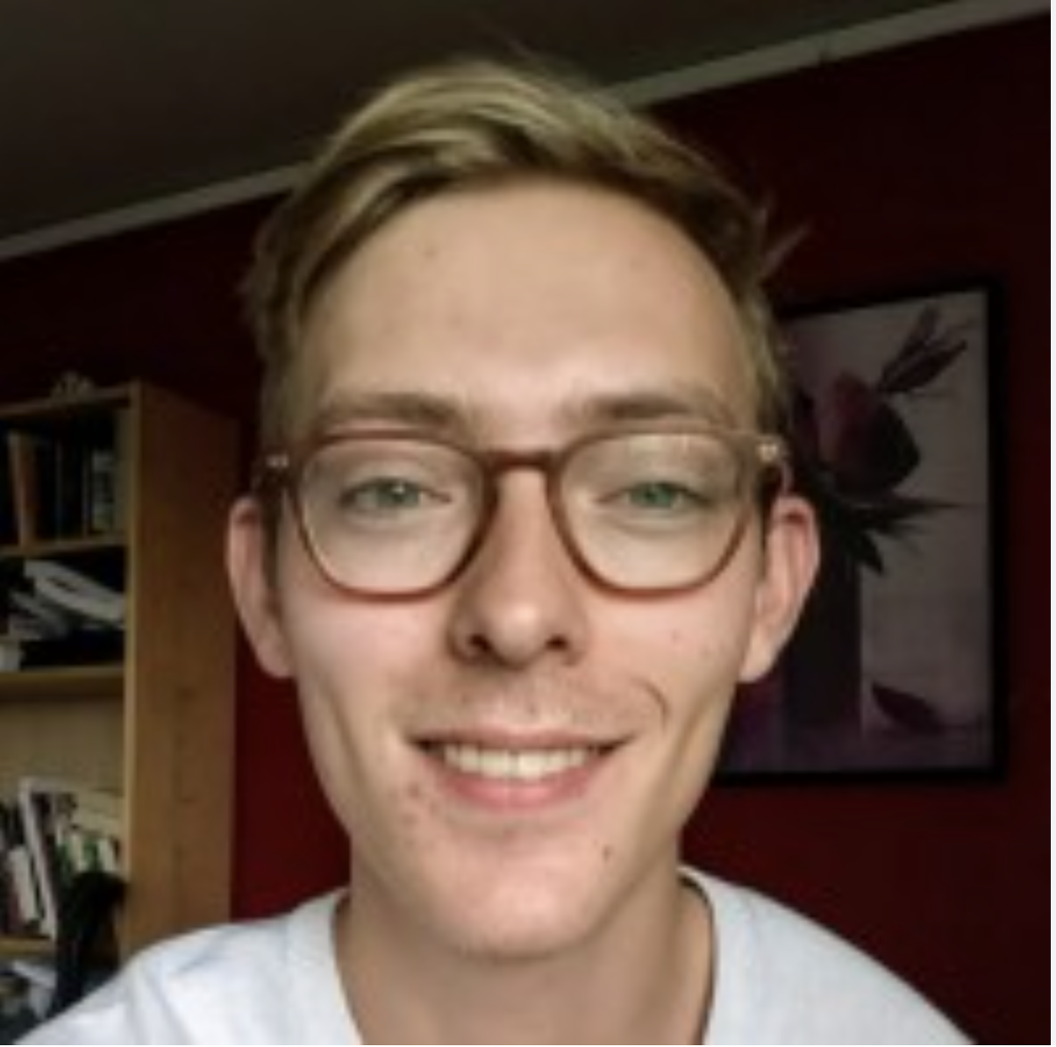
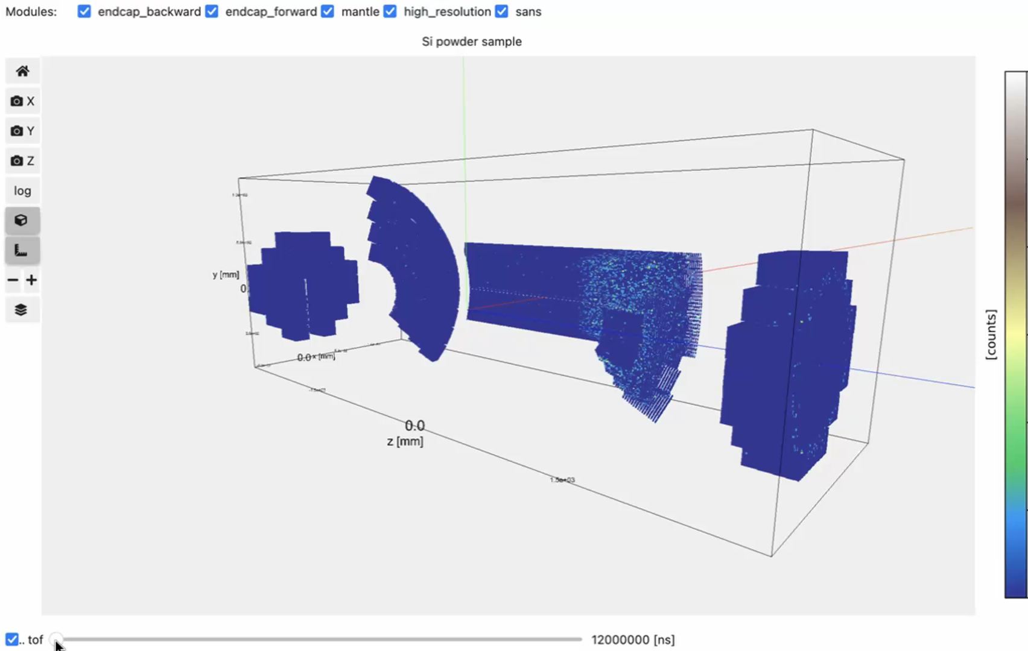
Data Reduction and Visualisation
Python tools to cover reduction and visualisation needs
Courtesy of Celine Durniak

Slide 14
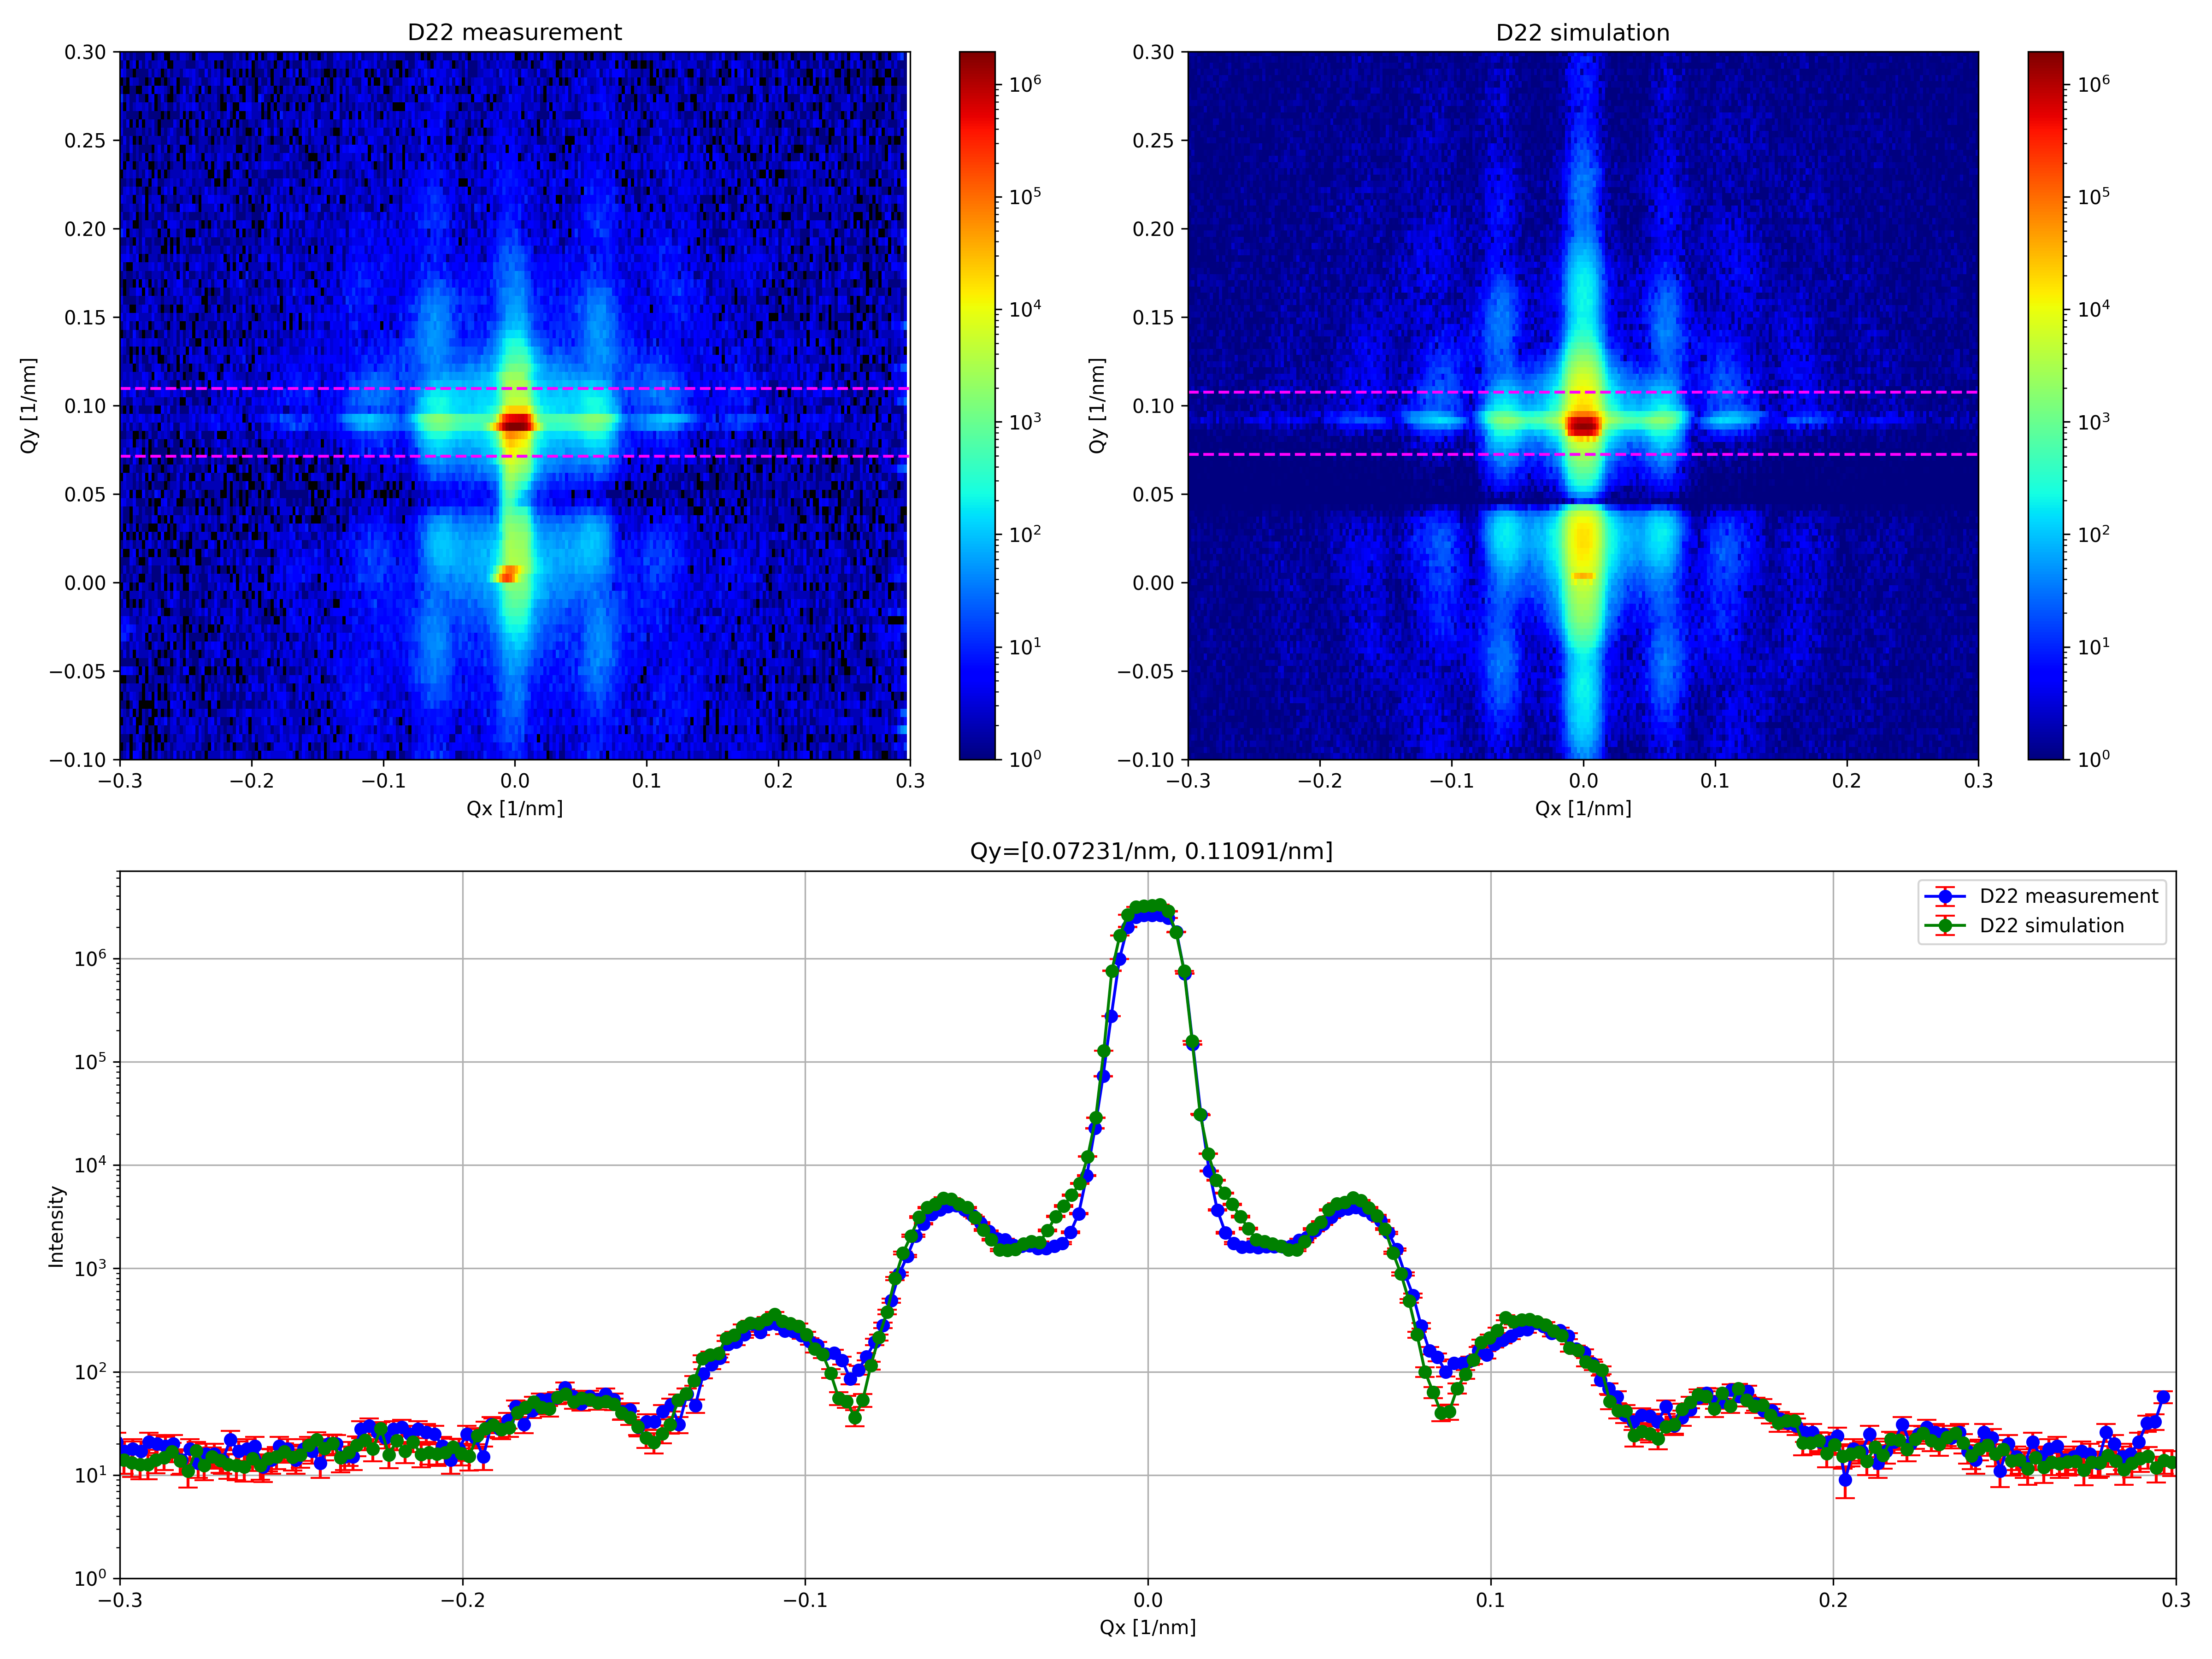

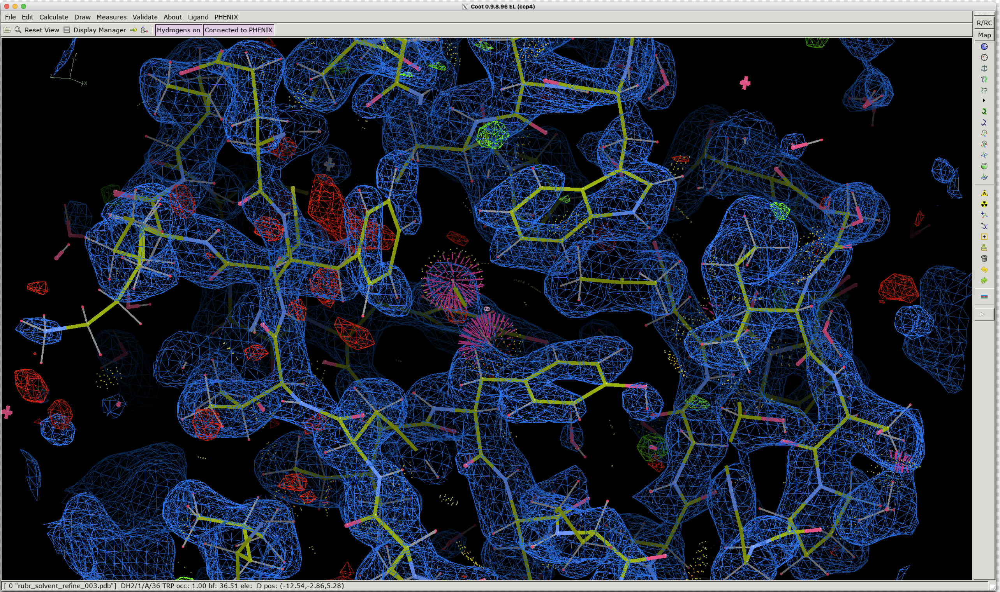
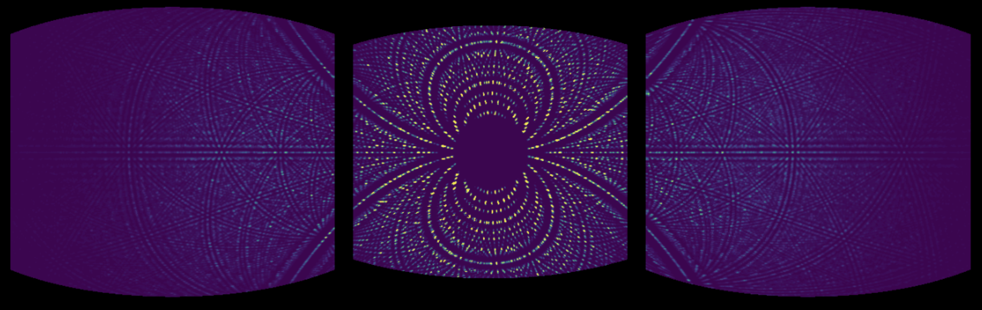

Modelling - McStas
Instrument simulations and ray tracing
Simulations of GISANS data combining McStas instrument (D22) and BornAgain sample definition and DWBA calculations
Benchmark with existing instruments performance to test current and future ESS instruments
Courtesy of Milan Klausz
McStas simulation of NMX and protein crystal
Reconstructed nuclear density map
Courtesy of Aaron Finke
Notes:
BornAgain simulations run separately for each neutron, calculating scattering vector (Q) values at the detector after propagating the array of outgoing rays to the detector surface

Slide 15
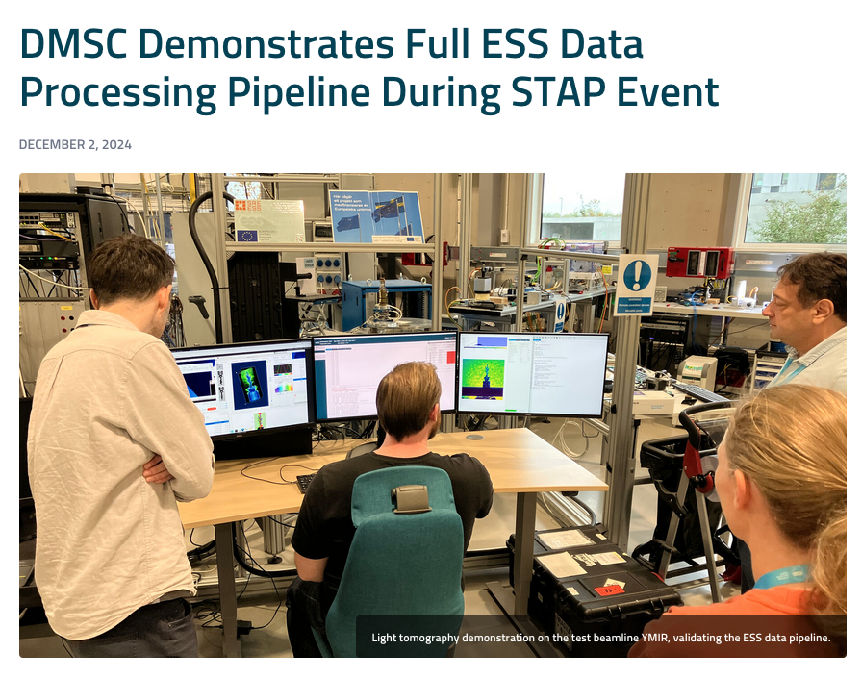
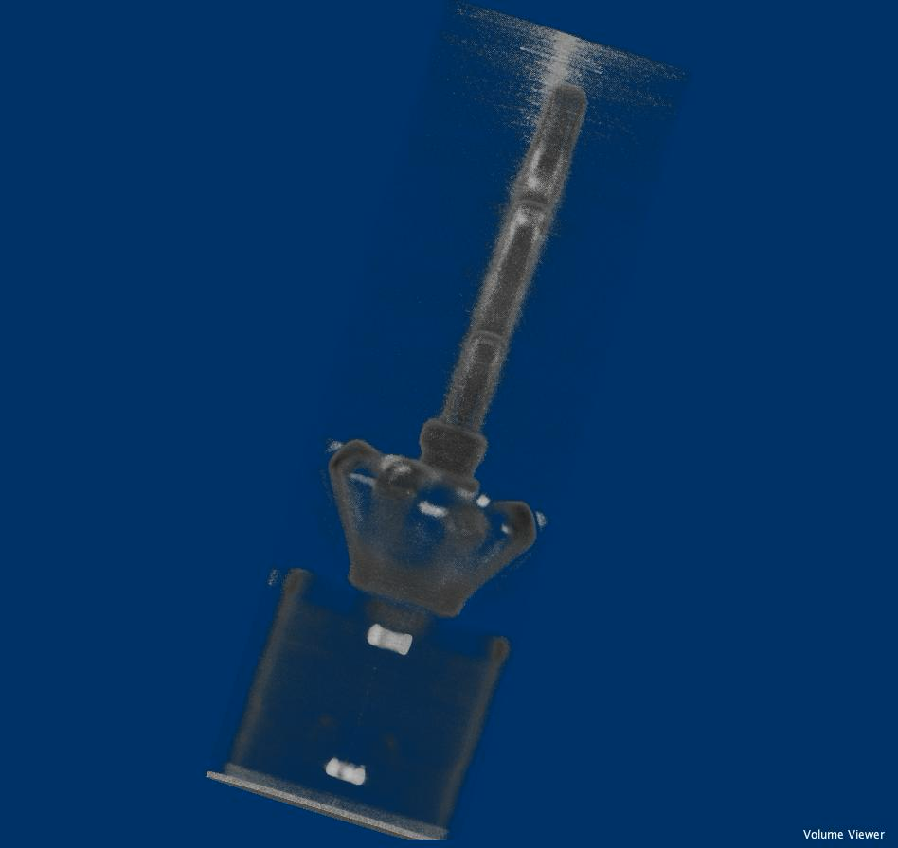
Live demos at Fall 2024 STAP meeting
Bringing all the bits and pieces together

Slide 16
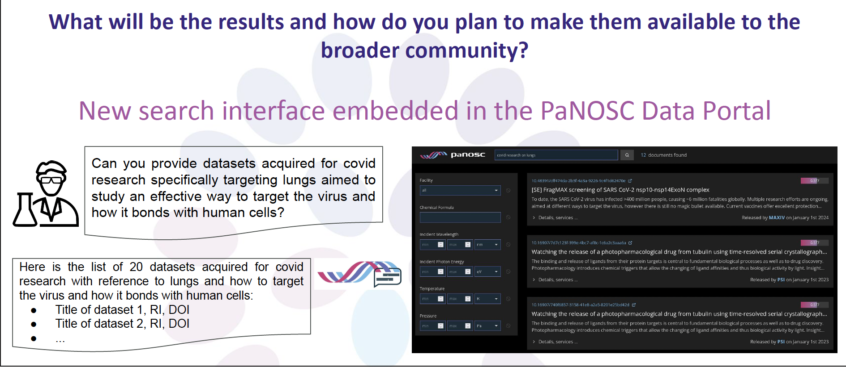
PaNOSC & EOSC
LLMs for cross-facility abstract search
Developing a new search interface embedded in the PaNOSC Data Portal
Find datasets on covid research, targetting the mechanisms of interaction between the virus and human lung cells
Here is a list of 20 datasets acquired on covid-related research referencing human cells interactions
Title of dataset 1, RI, DOI
Title of dataset 2, RI, DOI
…

Slide 17
DMSC objectives
Create compelling user experience
Lower entry barrier
Accelerate transition from experiments to results
Develop novel software-dirven epxerimtal approaches
Automate experiments
Education (DMSC summer school)
Support scientific
user program
FAIR data, facilitate use by the community
Integrate with community based data services (SciCat)
Integrate with the European Open Science Cloud (EOSC)
Increase value of acquired data
Optimize
beam time
Optimize experiments with planning
Improve statistical handling of data
Improve scheduling
Provide direct user support

Slide 18
DMSC objectives
Create compelling user experience
Lower entry barrier
Accelerate transition from experiments to results
Develop novel software-dirven experimtal approaches
Automate experiments
Education (DMSC summer school)
Support scientific
user program
FAIR data, facilitate use by the community
Integrate with community based data services (SciCat)
Integrate with the European Open Science Cloud (EOSC)
Increase value of acquired data
Optimize
beam time
Optimize experiments with planning
Improve statistical handling of data
Improve scheduling
Provide direct user support

Slide 19
DMSC objectives
Create compelling user experience
Lower entry barrier
Accelerate transition from experiments to results
Develop novel software-dirven experimtal approaches
Automate experiments
Education (DMSC summer school)
Support scientific
user program
FAIR data, facilitate use by the community
Integrate with community based data services (SciCat)
Integrate with the European Open Science Cloud (EOSC)
Increase value of acquired data
Optimize
beam time
Optimize experiments with planning
Improve statistical handling of data
Improve scheduling
Provide direct user support

Slide 20
DMSC objectives
Create compelling user experience
Lower entry barrier
Accelerate transition from experiments to results
Develop novel software-dirven experimtal approaches
Automate experiments
Education (DMSC summer school)
Support scientific
user program
FAIR data, facilitate use by the community
Integrate with community based data services (SciCat)
Integrate with the European Open Science Cloud (EOSC)
Increase value of acquired data
Optimize
beam time
Optimize experiments with planning
Improve statistical handling of data
Improve scheduling
Provide direct user support

Slide 21
DMSC objectives
Create compelling user experience
Lower entry barrier
Accelerate transition from experiments to results
Develop novel software-dirven experimtal approaches
Automate experiments
Education (DMSC summer school)
Support scientific
user program
FAIR data, facilitate use by the community
Integrate with community based data services (SciCat)
Integrate with the European Open Science Cloud (EOSC)
Increase value of acquired data
Optimize
beam time
Optimize experiments with planning
Improve statistical handling of data
Improve scheduling
Provide direct user support

Slide 22
Affiliations
Affiliations completed or in process
Whom | Department | University
Henrik Jacobsen | Niels Bohr Institute | UCPH
Nicolò Paracini | Pharmacy | UCPH
Aaron Finke | Molecular Biology and Genetics | AU
Søren Schmidt | Computer Science | DTU
Gregory Tucker | Physics | DTU
Oliver Hammond | Chemistry | KTH
Peter Willendrup, DTU-Physics seconded (in kind)
Three vacant positions for Instrument Data Scientists: Diffraction & Spectroscopy

Slide 23







DMSC supports the full user journey
From Idea to Publication with scientific computing tools / services
Post-experiment
Data reduction Data analysis, model-ling, simulations Data management
Planning
Modelling & simulations
Integrated data pipeline
Remote access services
Experiment
Live view Data reduction Data analysis, model-ling, simulations
Proposal
User portal
Notes:
After a proposal has been accepted, the proposal team gets access to VISA and SciChat. It will be possible to also give access duing the Ideation / preparation phase.
VISA gives the team access to the compute infrastructure, incl. Software for data reduction, analysis, modelling, simulations, etc. and High Performance computing. Staff can be added to a VISA instance.
SciChat provides a forum for the team where they can chat with each other and staff. During the experiment NiCOS will send messages to the room, such as "data collection start", "data collection stop", "Experiment values" and we can also send in real time data processing, plots etc
Lenghts of individual stepd can be adjusted, e.g. to better reflect the duration or effort of that step
Number of steps can be adjusted
Icons can be changed.

Slide 24
Relevant staff & activities
Relevant scientific staff @ESS
Oliver Hammond – SANS - KTH
Nicolò Paracini – Reflect. – UCPH
Aaron Finke – NMX – AU
Søren Schmidt – Img – DTU
Giovanna Fragneto
Thomas Arnold
Hanna Wacklin
Judith Houston
Andrew Jackson
Zoe Fischer
Simulations linked to experiments
PhD student with ILL / UAG (INS)
PhD student with Basque (INS)
PhD student with Chalmers (QENS)
Active in MDMC with Chalmers/STFC/UCPH (QENS)
Post Doc with Chalmers & STFC (SANS)
HALRIC project with LU (SANS)
----
SasView contributor (Piotr Rozyczko)
Neutron Instrument Simulation Team Peter Willendrup, Mads Bertelsen, Torben R. Nielsen, Thomas Kittelmann

