Slide 1
First science strategy @ BEER
PRESENTED BY Gergely németh

Slide 2
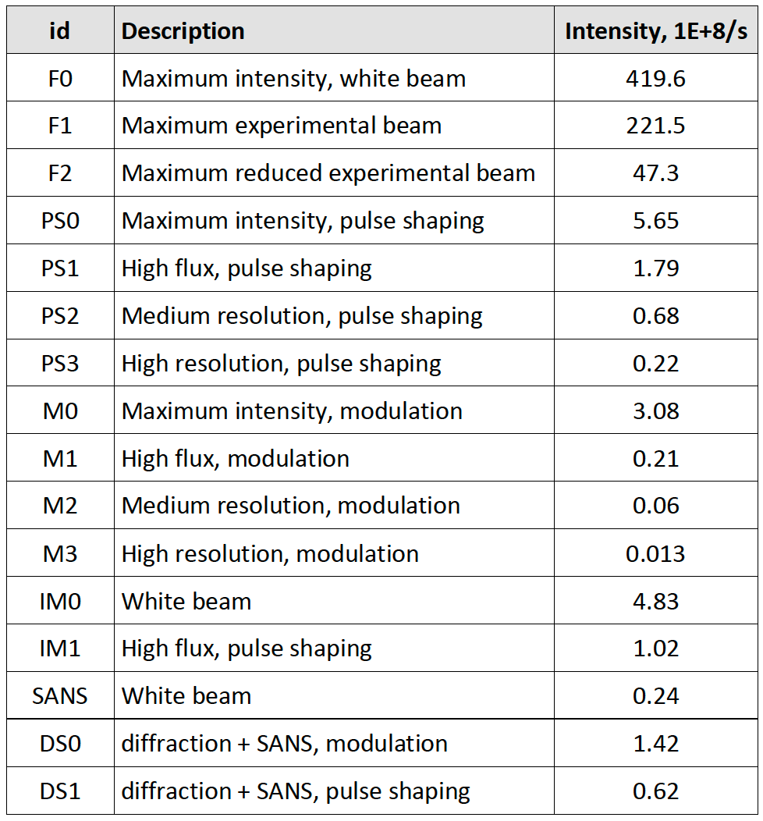

First-science strategy
Intensity $\sim$1E+7/s
Reduced power
Adapt the strategy
Desired ”fast experiments” will not be possible
Focus on experiments which emphasize other unique capabilities of BEER
Modulation Mode
Large samples
Sample environment capabilities (?)
Material technology, materials

Slide 3
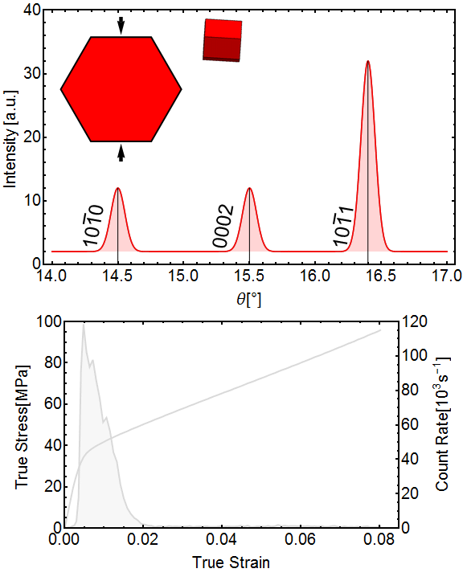
In-situ deformation testing with high spatiotemporal resolution
Neutron diffraction
In-situ investigation of microstructure development (dislocation structure, phase transformations etc.)
Internal strain analysis
Acoustic emission
Identification of the onset of deformation mechanism with ms resolution
Localization of the failure sites
Revealing the causality of deformation mechanisms by advanced statistical analysis (ASK) of AE signals
Expertise: @Charles University (Prof. Máthis)
Materials
Superalloys
High-Entropy Alloys
Materials prepared by AM

Slide 4
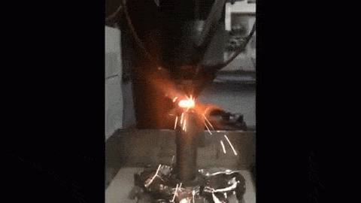
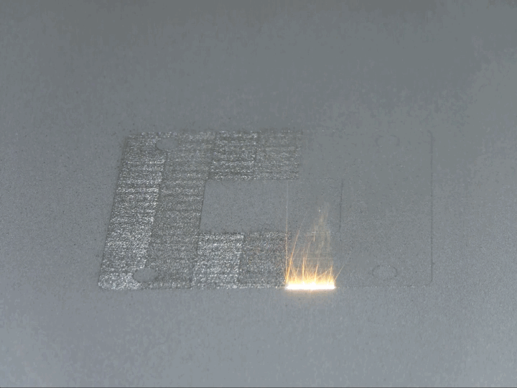
In-situ/operando investigation during Additive Manufacturing of materials
(Almost) Real time monitoring:
Residual stresses
Phase changes
Evolution of lattice defects (dislocation densities)
AM processes:
Direct Energy Deposition
Laser Powder Bed Fusion
Wire Arc Additive Manufacturing
Credit: 3Dprint.com
Credit: NIST

Slide 5
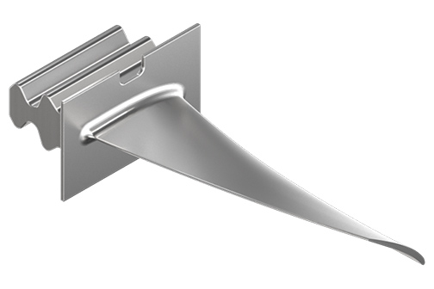
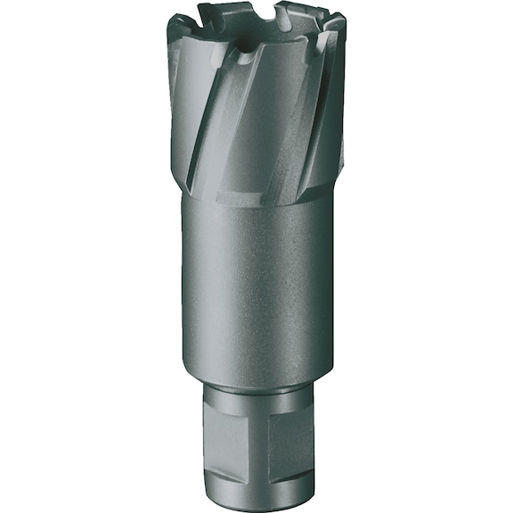
Ex-situ measurements
Credit: Tungaloy.com
Strain/stress mapping
Large/complex shaped samples:
turbine blades, drill heads
Texture measurements with robot
AM samples
Texture dependence on the process parameters
Credit: wuerth-industrie.com.com

