Slide 1
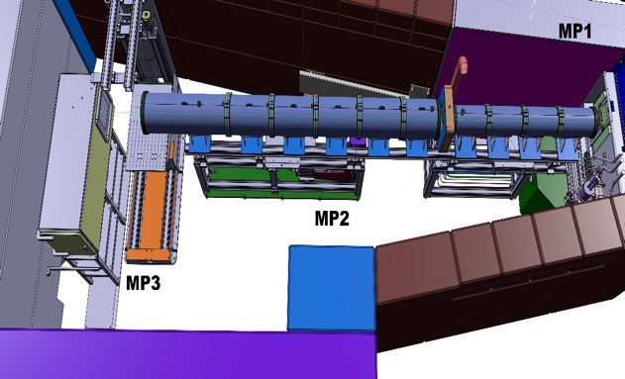
MAGNI – Microscopy, Advanced and Grating Neutron Imaging
Markus Strobl (PSI/DTU) Luise Theil Kuhn (DTU) Robin Woracek (ESS) et al.
MAGNI will be
A flexible short length instrument (~30m) with high flux,
high spatial resolution,
large field of view,
utilizing the divergence and relaxed wavelength resolution
Complementing ODIN’s capabilities (ODIN is expected to be heavily oversubscribed)
Offering flexibility for time-sensitive industrial users
Allowing novel sample environments requiring beamline reconfiguration (gratings, neutron microscope etc.)
Enabling studies where flux and spectral data are crucial
Possibly enabling epithermal neutron resonance imaging (with series of Fermi choppers) for element-specific analysis and precise cross-section measurements
MP1
MP2
MP3
Illustration: NEUTRA 2.0@PSI
25.09.2025

Slide 2
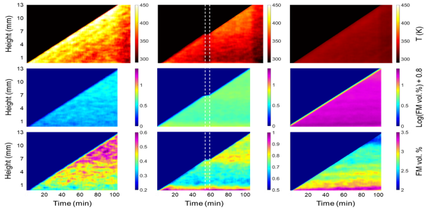
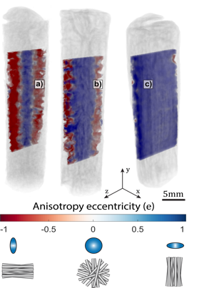
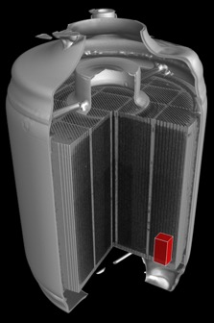
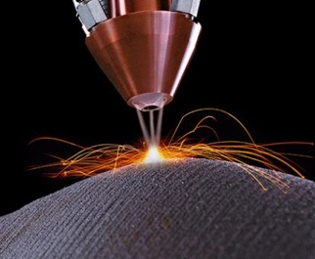
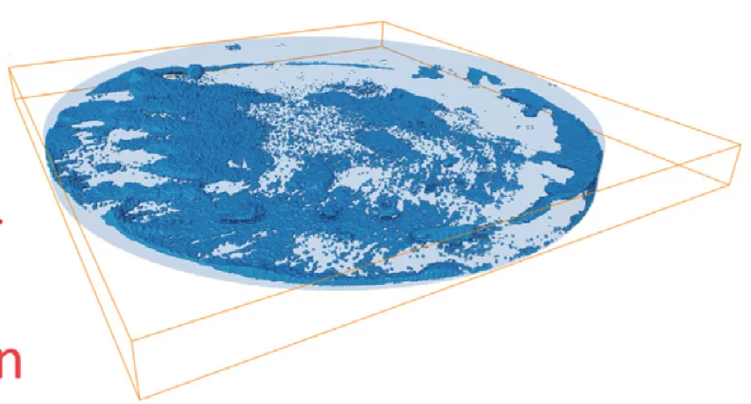
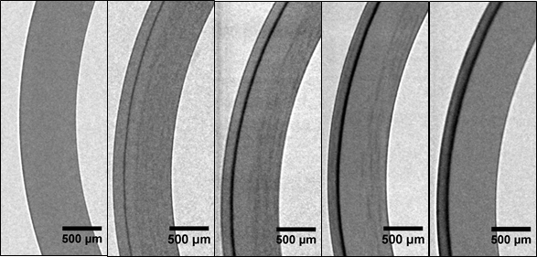
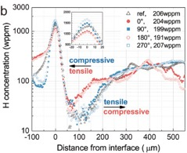
MAGNI – Microscopy, Advanced and Grating Neutron Imaging
Markus Strobl (PSI/DTU) Luise Theil Kuhn (DTU) Robin Woracek (ESS) et al.
Multi-scale mapping
Nanostructures in macroscopic context
MAGNI will enable neutron imaging studies of
Fast operando evolution of phases
large industrial
components
Revealing heterogeneous
dynamics in out of equilibrium
systems
40
50
60 wt.% CuCrZr
Operando phase mapping in multi-material laser powder bed fusion:
https://doi.org/10.1080/17452759.2024.2429132
Industrial processes
Hydrogen & hydrides in metal
Operando studies of novel battery materials
Quench. 100 C/h 30 C/h 10 C/h 0.3 C/h
Spectroscopic neutron imaging for resolving hydrogen dynamics changes in battery electrolytes: https://doi.org/10.1016/j.mtadv.2023.100405
Neutron imaging in 2D and 3D as a powerful tool to investigate electrolyte degradation and plating mechanisms in sodium-ion batteries: https://doi.org/10.1016/j.jpowsour.2025.237846
25.09.2025
Neutron radiography of detrimental hydrogen in nuclear fuel claddings

Slide 3
MAGNI – Microscopy, Advanced and Grating Neutron Imaging
Markus Strobl (PSI/DTU) Luise Theil Kuhn (DTU) Robin Woracek (ESS) et al.
MAGNI is different from ODIN:
Short: high flux
Fast operando measurements
Faster and better than ILL
Sufficient wavelength resolution for
dark field imaging and inelastic so
quantitative, 3D time resolved
Inelastic mapping
Gratings for phase mapping
Short: Large FoV, 40x40 cm²
Real-scale fabrication processes, components and devices
Short: high divergence
Neutron optics:
Wolter and/or
Fresnel zone plates and/or
compound refractive lenses
Neutron microscope with x100 flux and
50 μm resolution
Prototypes are pt. being developed through 2 projects 2xPhD + 1 postdoc and 2 high-tech spin-out companies
MAGNI – ESS STAP meeting
25.09.2025

Slide 4
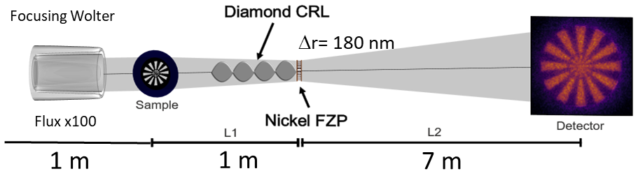
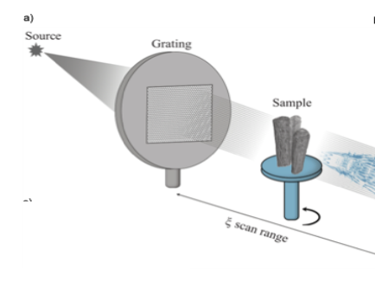
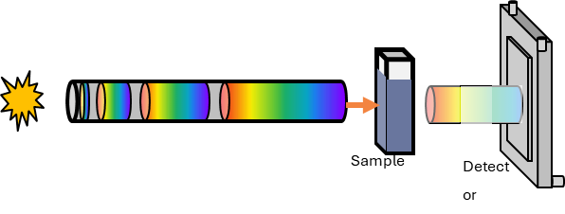
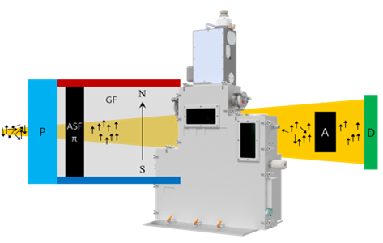
MAGNI – Microscopy, Advanced and Grating Neutron Imaging
Markus Strobl (PSI/DTU) Luise Theil Kuhn (DTU) Robin Woracek (ESS) et al.
MAGNI will exploit new neutron imaging methods
High resolution neutron imaging - a pioneering dedicated real neutron microscope exploiting the high divergence of short instrument
Dark-field contrast imaging – multiscale investigations,
macroscopic to nanometer, using versatile gratings
Advanced spectroscopic neutron imaging – leveraging low wavelength resolution for inelastic scattering
Large field-of-view and/or depolarization imaging –enabling studies of industrial-scale components and devices during fabrication/operation
short – high flux – high resolution - relaxed wavelength resolution - large field of view
25.09.2025

