Slide 1

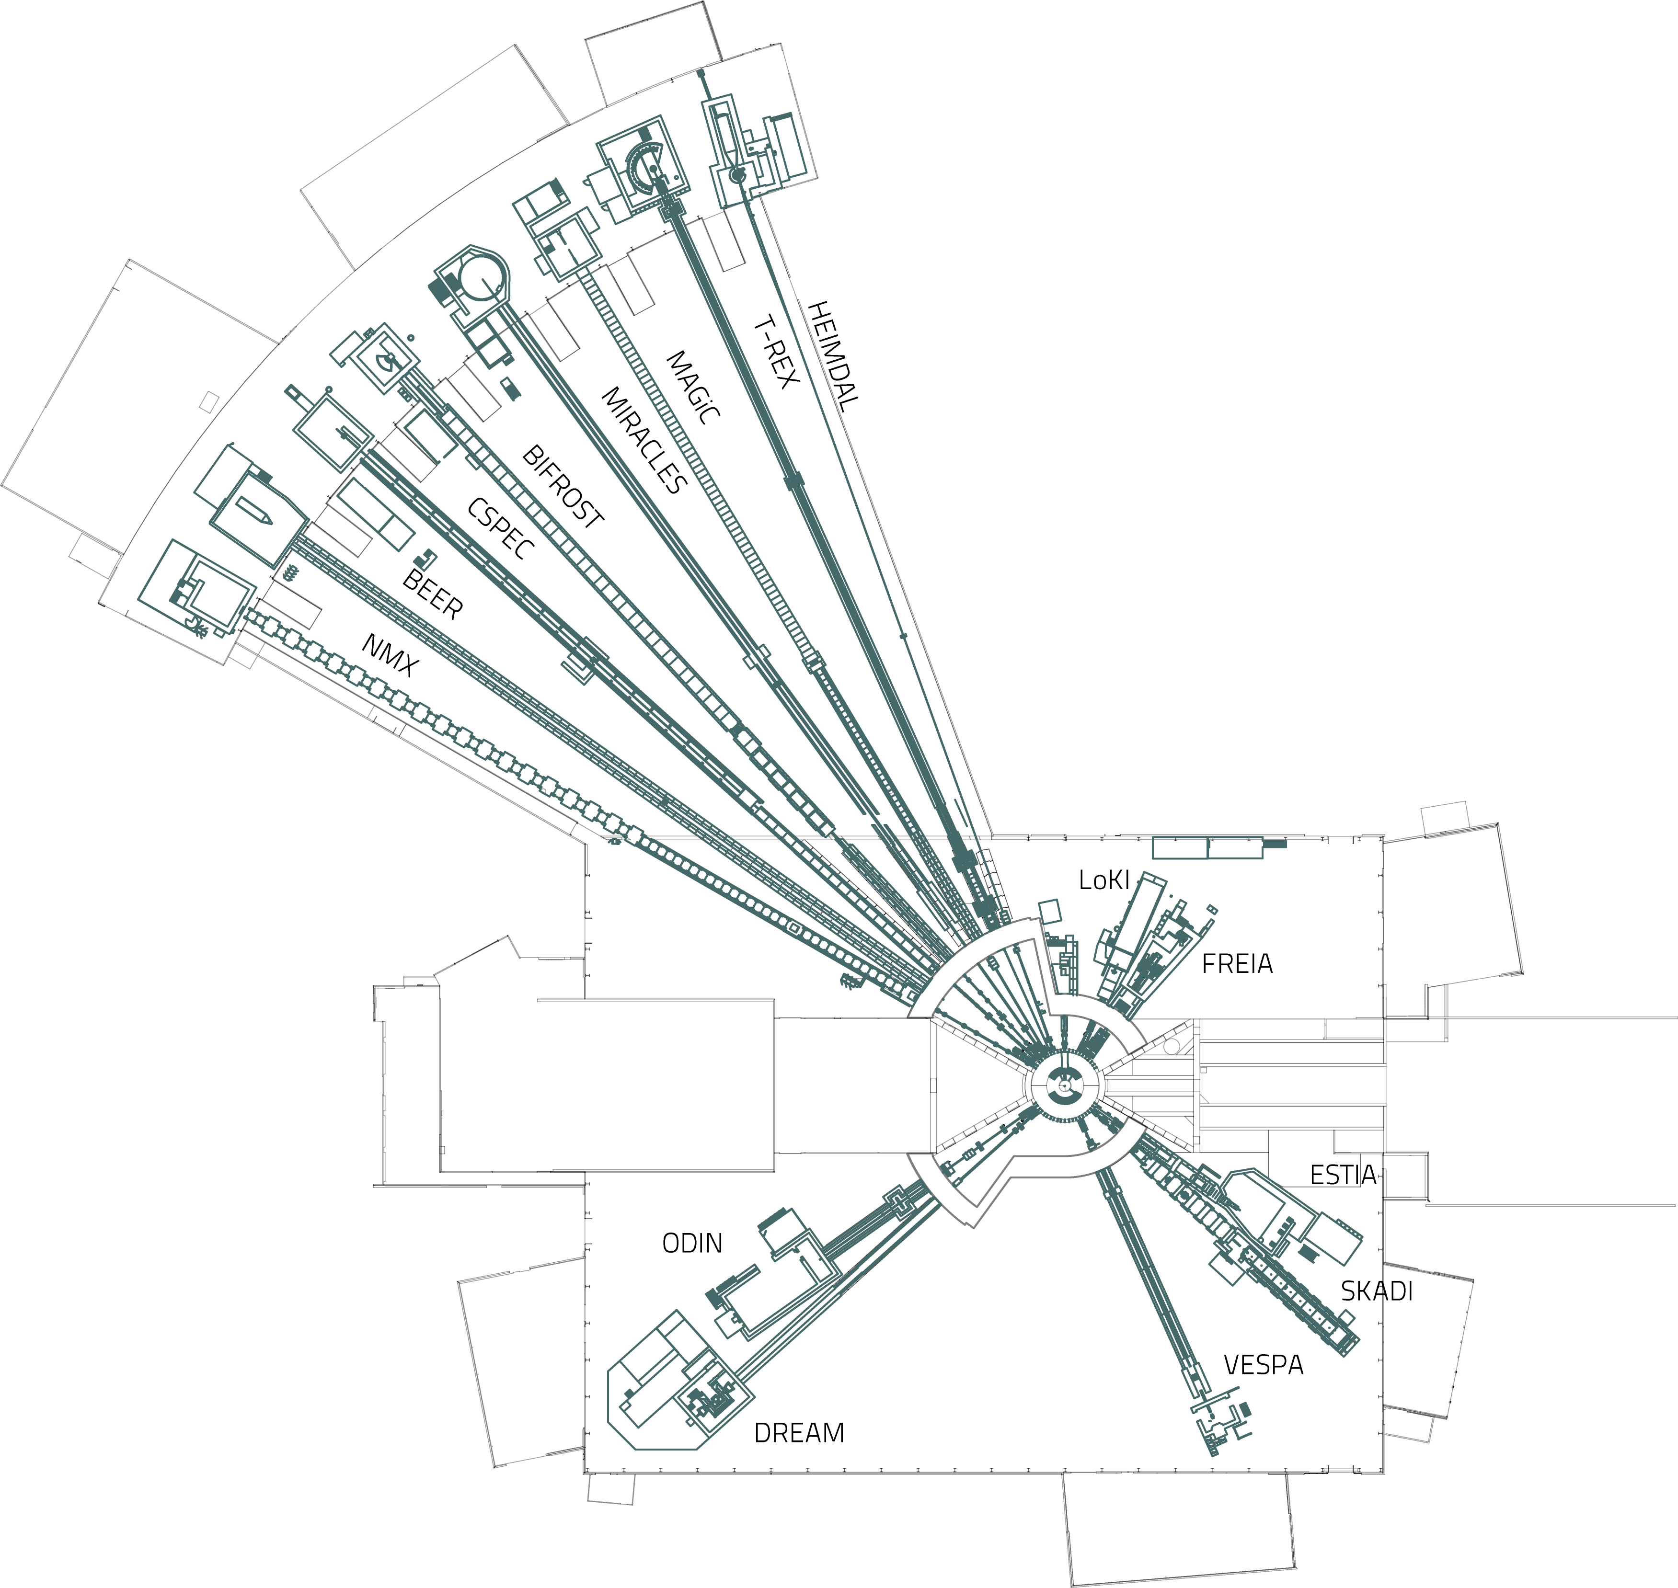
ESS Instrument Roadmap
Instrument pitch by
Sonja Holm-Dahlin
Instrument bundle
for high tough put
standard measurements
Engineering and Imaging STAP
Lund, September 25th 2025
IDUN

Slide 2
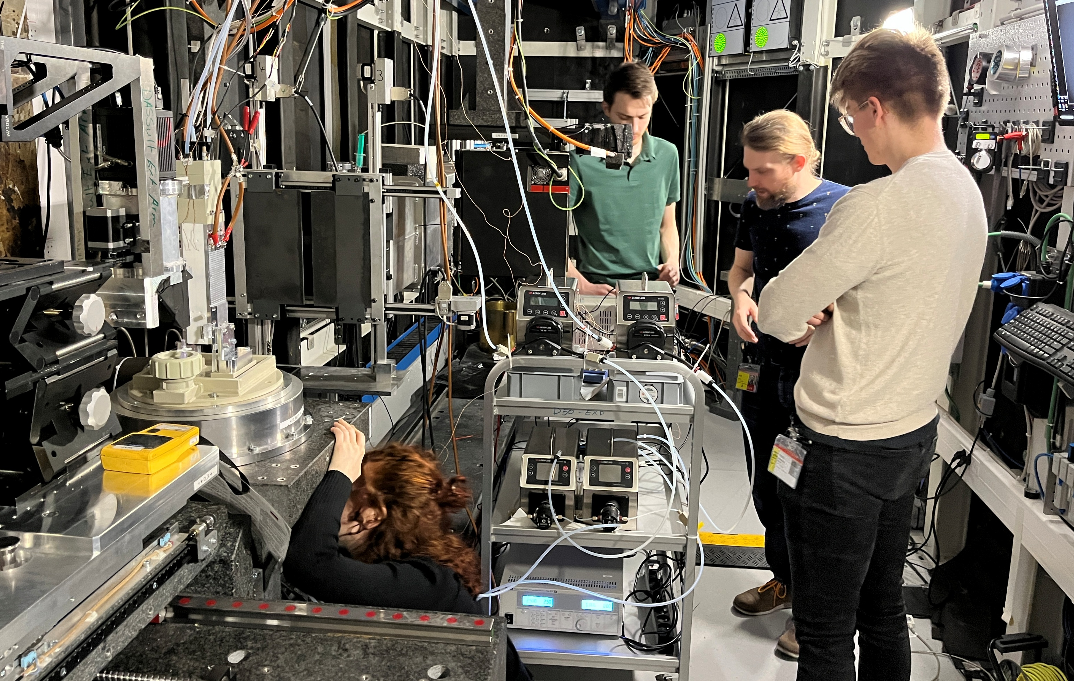

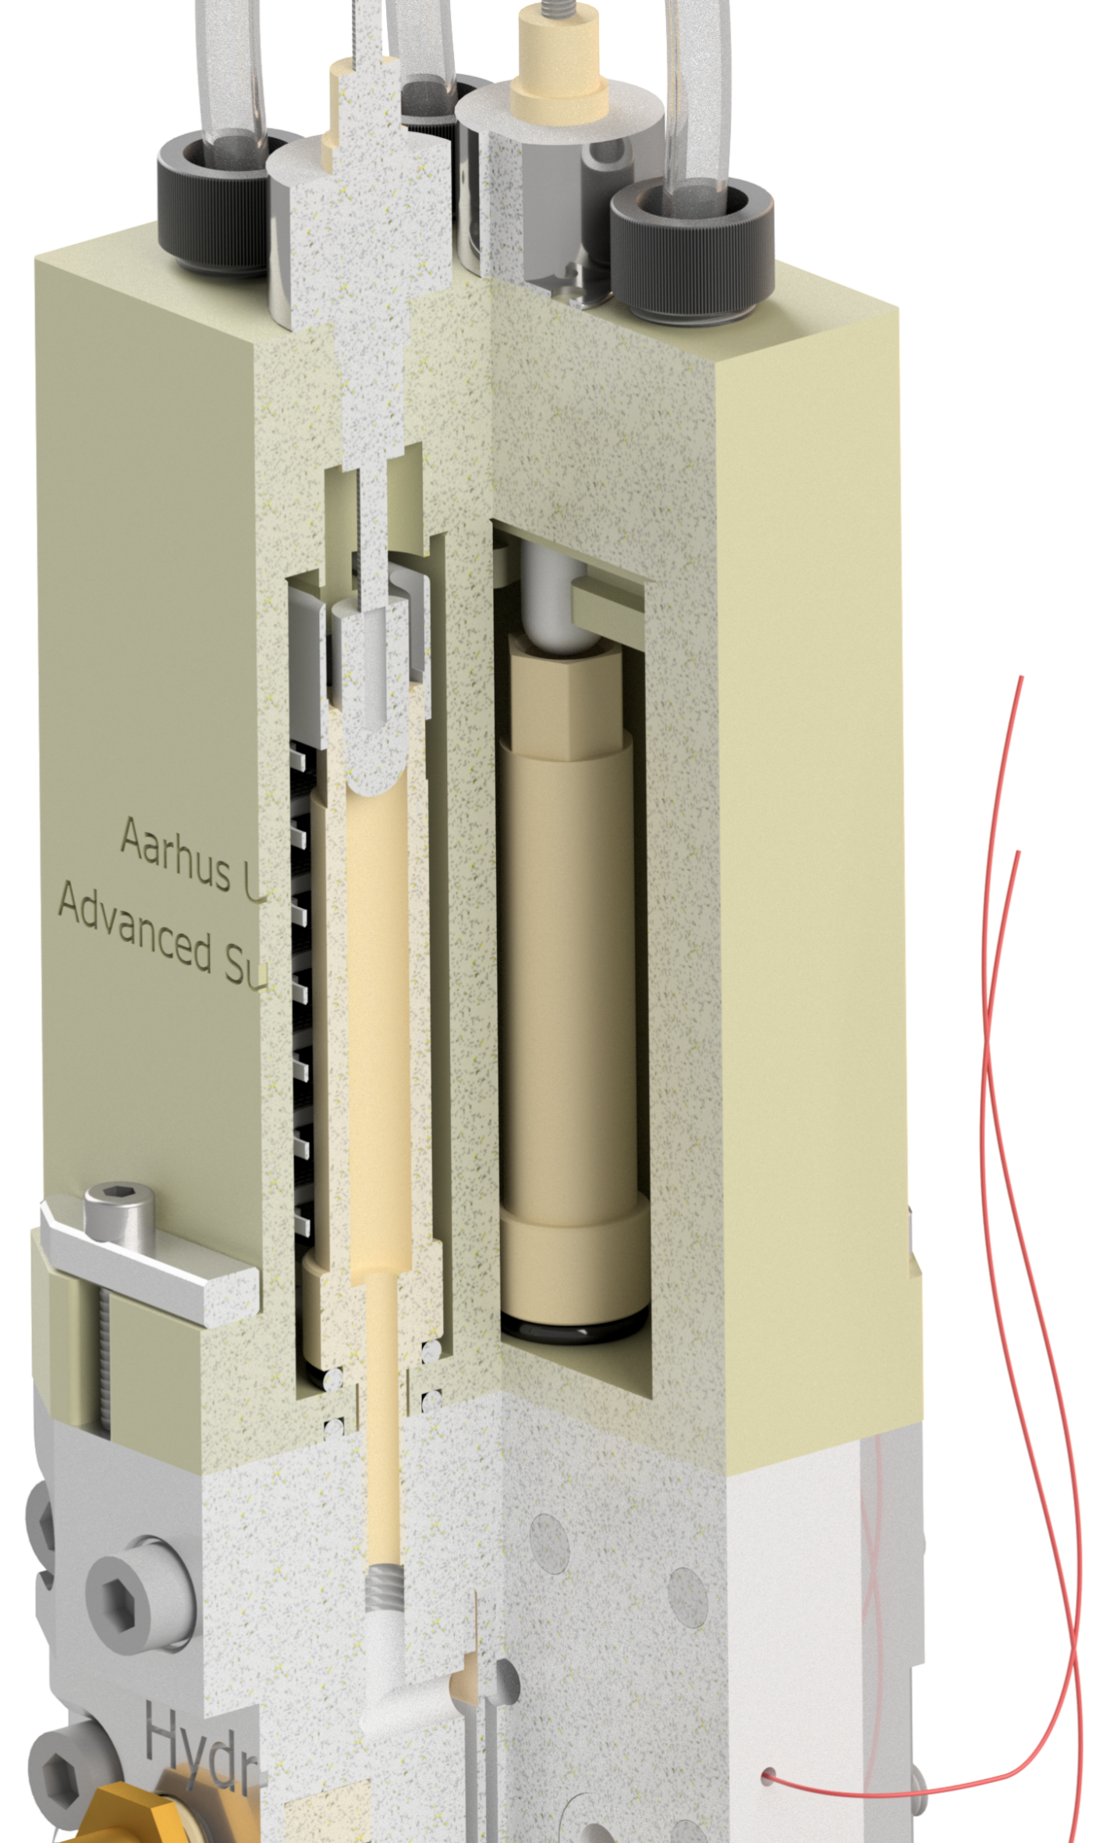
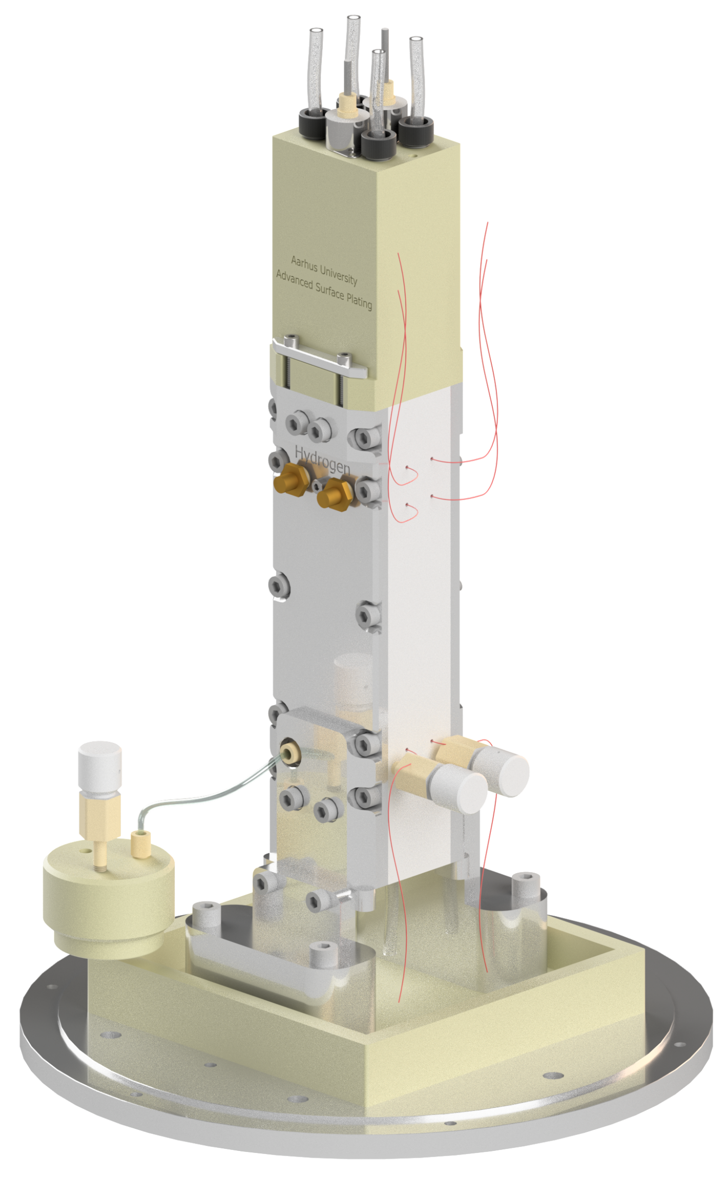
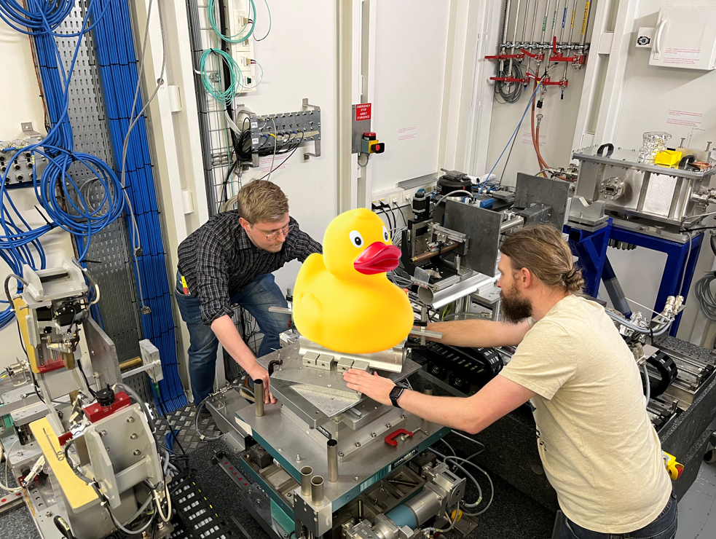
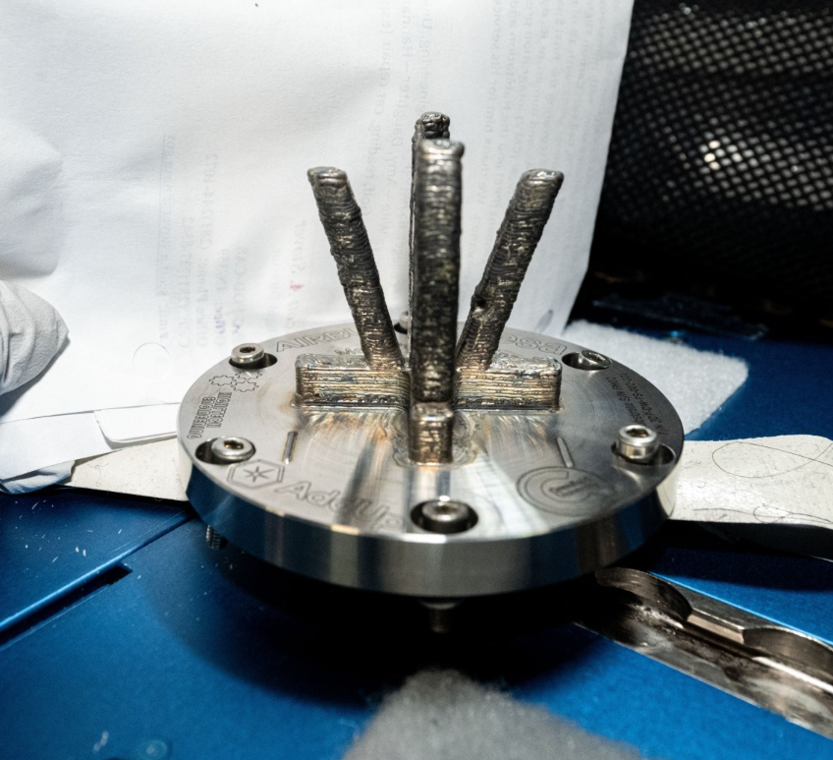
Inlets and outlets facing axis of rotation
Big Science Center
We provide full service for advanced measurements at large scale facilities
Gas separation placed directly above electrode compartments and 3D printed separation trays
Thermocouples, pulse free polymer-based gear pumps, remotely controlled valves, and conductivity sensor
Electrochemical monitoring

Slide 3
IDUN
Industrial & Utilitarian
Neutron Instruments
SANS
Imaging
Test beamline
Prompt gamma
Engineering diffraction
Easy access and fast turnover
AI assisted data analysis
Automated sample changer
Standard instrument settings
Mail-in measurements

Slide 4
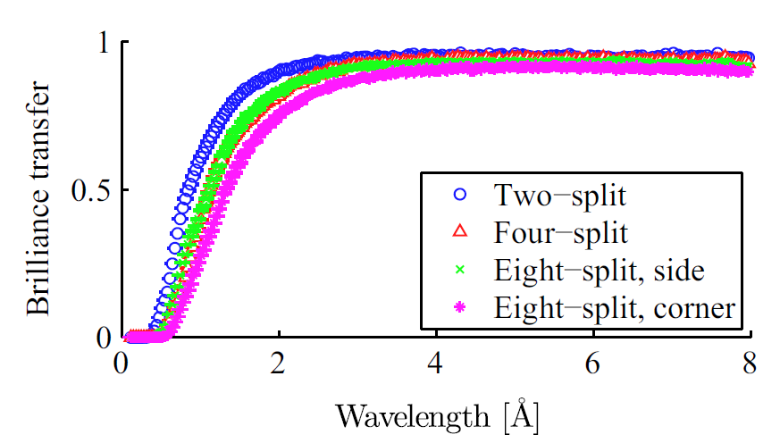
The guide split concept
ESS source
Primary guide
Second source
Secondary guides
Sample stations
4-split and
2-split
8-split (side)
2-split
4-split
8-split
Brilliance transfer
8-split (corner)
Wavelength [Å]

Slide 5
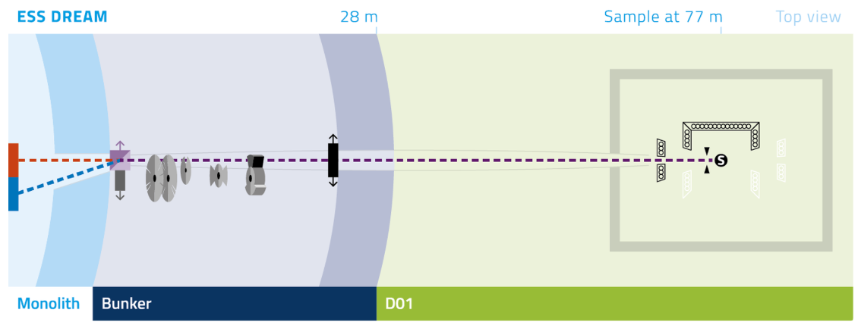
ESS source
Primary guide
Secondary guides
Top view

Slide 6
IDUN
The first set of
short instruments
IDUN
Top view
New guide hall

Slide 7
IDUN
Can be on top or below the second round of long instruments
The first set of
short instruments
Side view
New guide hall

Slide 8
IDUN
Industrial & Utilitarian
Neutron Instruments
SANS
8-split
Imaging
Test beamline
Prompt gamma
Engineering diffraction

Slide 9
Imaging
SANS
Prompt gamma
Engineering diffraction
Test beamline

Slide 10
The instrument cost per sample station is drastically reduced, as many of the expensive components are shared e.g.
Monolith insert
Primary shutter
Primary guide
Vacuum housing
Shielding
Pulse shaping choppers
Prompt pulse chopper
Monolith
Bunker
Shutter
T₀ chopper
Pulse shaping choppers

Slide 11
Easy access and fast turnover
AI assisted data analysis
Automated sample changer
Standard instrument settings
Mail-in measurements

Slide 13
ESS source
Primary guide
Second source
Secondary guides
Sample stations
Pulse shaping choppers
Band definition
choppers
Cold spectrum
Thermal spectrum
Distance
Distance
Time
Time

