Slide 2
DMSC
Fredrik Bolmsten
Group leader, Scientific Information Mamagement Systems (SIMS)

Slide 3
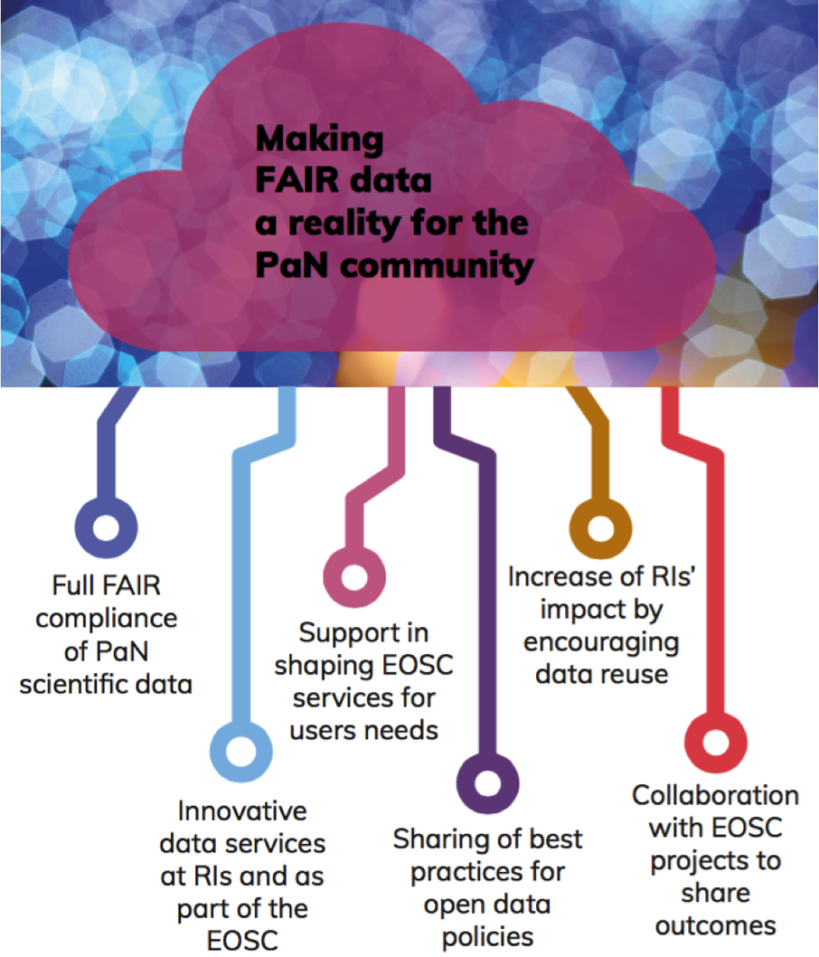
New ESS Data Policy
Main elements
ESS is the custodian of raw data and metadata from all instruments
High level metadata will be published as soon as possible, i.e. Title, Authors, Instrument, Abstract
Experimental team has sole access to the data during embargo period of 3 years
After embargo ESS will make the data “Open Access”
Access to the results of analysis performed on raw data and metadata is restricted to the team performing the analysis
Notes:
Purpose of this slide:
Is to point out how we enable FAIR data via our data policy, and that it is a collaboration between RI’s in Europe.
Created from the outcome of the PaNOSC project. This data policy is now implemented at all large photon and neutron RI’s in Europe. It balances the need for the researchers to be able to publish with the goal of the facility to make data open.
Approved by council and we can now make changes without the need for re-approval

Slide 4
The User Journey
Users notify ESS of team
User training
Experiment safety review
Travel and accommodation
Ship samples
Physical Access
Dosimetry
Feedback
Experiment report
Data curation
Expenses review
Publications
KPIs
Submit proposals
Technical review
Excellence review
Result notification
Registration
Proposal
Scheduling
Planning
Performing & Analysing
Wrap-up & Harvesting
Register
Personal Data
Digital Access
Experiments
Sample environments
Local contacts
User lab facilities
Experiment notification
Data directories in place
Permissions for files
Done
Ongoing
Not started
Notes:
Purpose of slide:
Provides a high-level overview of the current status of user journey support. Items marked in green are considered ready for first science, although they may require further development for steady-state operations. For example, a basic scheduling module has been implemented to manage the initial set of experiments, while more advanced functionality will be required during full operations.
From a DMSC perspective, most aspects of the user journey are ready. Ongoing work with various ESS stakeholders focuses on completing user training, safety reviews, and accommodation planning. A minimum viable product covering all key user journey steps is expected to be in place before the start of hot commissioning. The goal is to validate the user journey by having hot commissioning users follow the same process as future science users.
of start of hot commissioning. Our aim is to test the journey by having hot commissioning users go through the same steps as future science users.

Slide 5
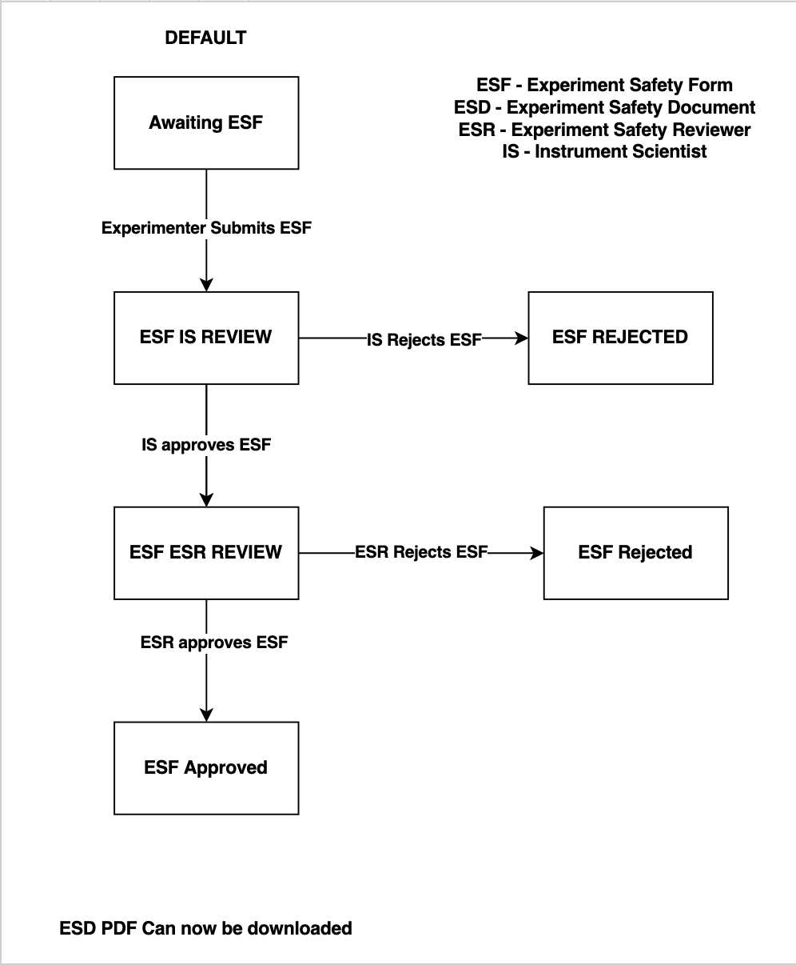
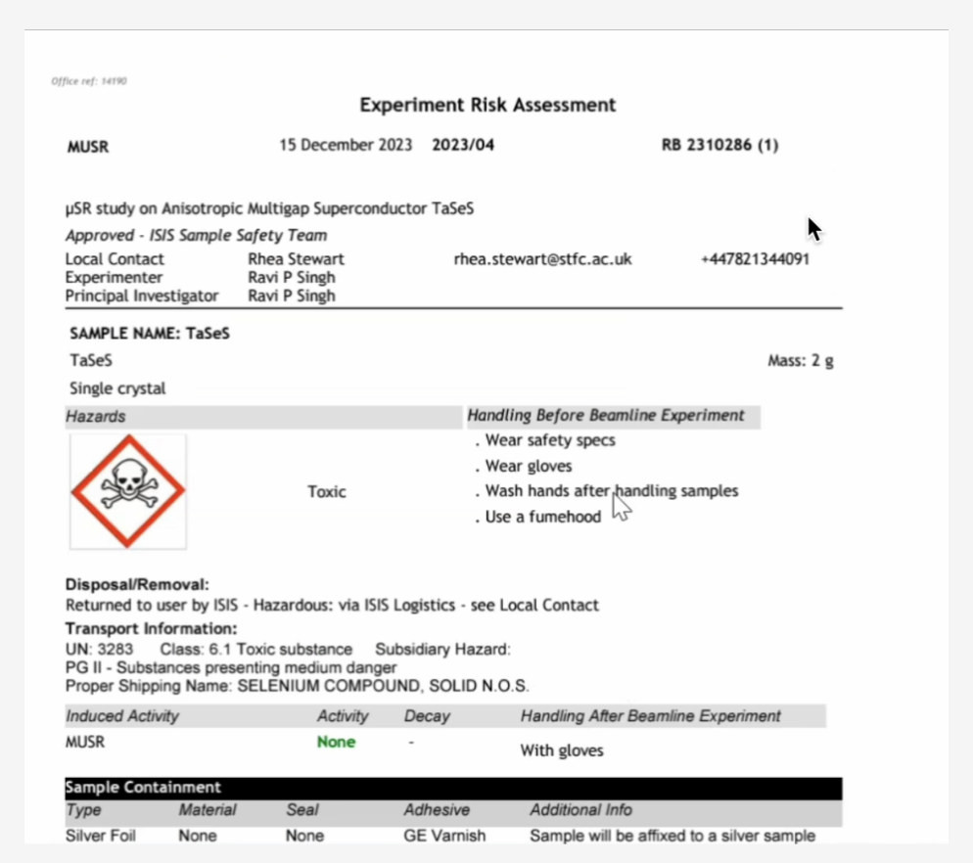
Experiment Safety Review
User Office
Notes:
Purpose of slide::
Demonstrate the progress made in creating a experiment safety review flow, which end with the Experiment risk assesment document shown on the right side.

Slide 6
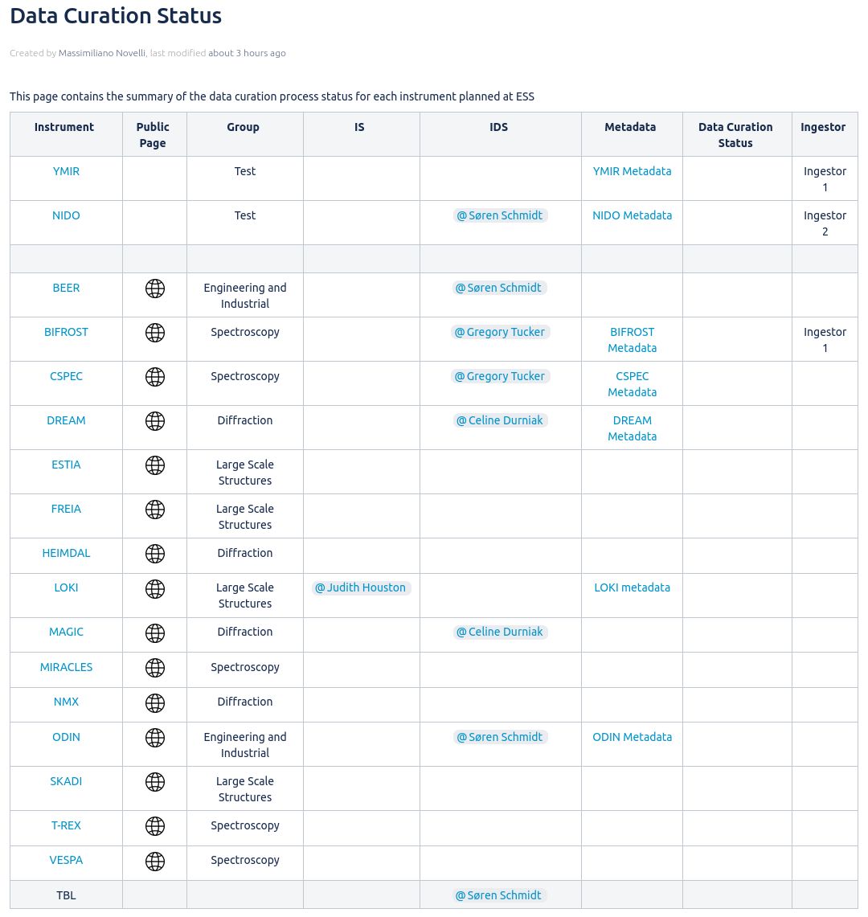

Data Curation
On-Going activities:
Documented individual instrument metadata
NiCOS integration for proposal and sample information
Instrument metadata acceptance from stakeholder
New dataset ingestor
Future milestones:
Technique specific dataset pages
Integration between VISA and SciCat
Technique widgets, HDF5 Viewer
Data acquisition
Data reduction
Analysis & modelling
User portal
FAIR
Community standards for processed data (e.g. CIF)

Slide 7
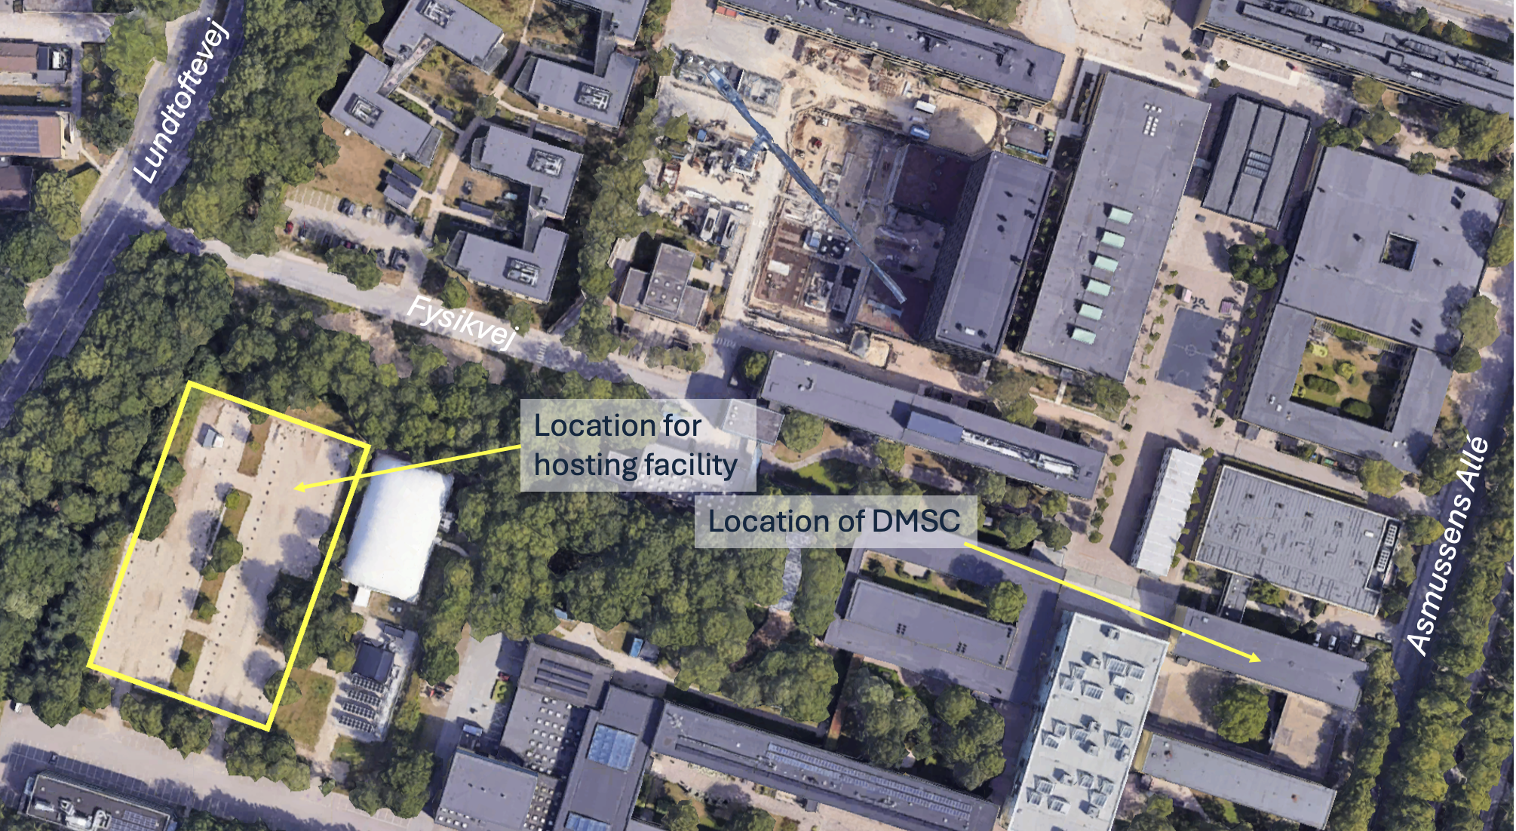
New server room
~250 m from DMSC offices

Slide 8
DMSC Datacenter (Lyngby)
Status, timeline and impact
Status:
Decision – ESS has decided to go with a Modular datacenter solution, located at DTU, Lyngby (DK) – pending approval by council
Current server-room – Lease in COBIS DC has been extended with BII until July 2027 to ensure continued operations
Tender awarded/contract signed
November, 2025
Construction started
January, 2026
BOT Spring 2026
DC ready (initial)
Start migration to new Data Center October, 2026
COBIS
end of lease July, 2027
DC ready (full)
March, 2027
SOUP Q1 2027
Impact on Hot Commissioning:
Capacity – existing and new datacenter will be sufficient to support HC activities and first science.
Resources – Compute/storage resources for Data Acquisition is unaffected (located in Lund)
Notes:
Purpose of slide:
Showing how we will be able to continue support the science directorate without affecting HC in the building of a new data center.

Slide 9
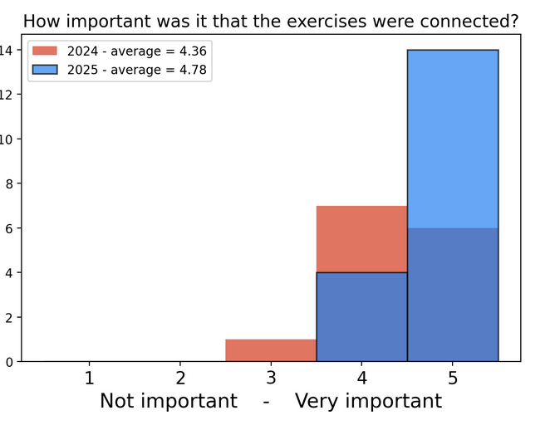
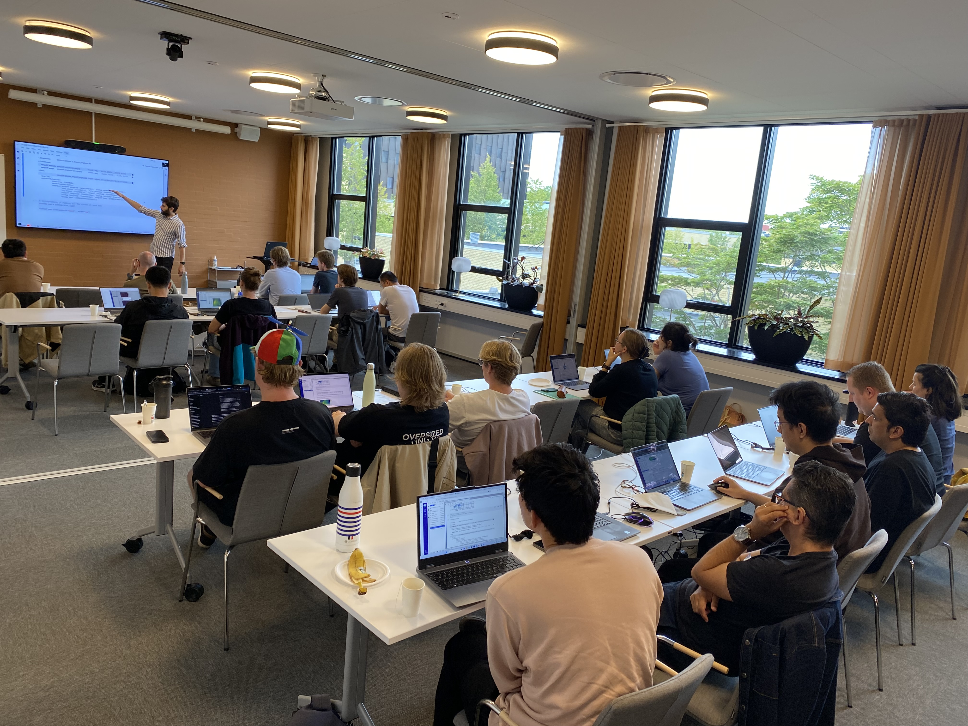



Training Schools
Summer school #3 finished
21 Participants
Next year planned
Winter school planned
ESS Staff only
Subjects include:
Using Python for scientific computing
Data Management and the role of data in the beamtime proposal
Simulating neutron scattering experiments
Modern reduction and analysis of data
The importance of scientific metadata and reproducibility
Notes:
Purpose of slide::
There are multiple purposes of the DMSC schools, one to train the future scientist but also to test our software. With the winter school we extend this to our internal staff. This will help us find issues while also showcasing the work that has been done.
Winter school with data reduction focus for HC

Slide 10
New instrument data scientists
Iurii Kibalin (Diffraction)
Christian Beck (Spectroscopy)
Bing Li (Spectroscopy)
Instrument Division | Employed
Large-scale-structures | Aaron, Nico, Oliver
Diffraction & Imaging | Céline, Søren, Iurii
Spectroscopy | Greg , Christian, Bing
New Instrument Data Scientists will focus on later instruments
Notes:
Purpose of slide:
With the plan to recruit an extra IDS for diffraction and imaging

Slide 11
Software status (for HC) - Simplified
Instrument | BIFROST | LoKI | ODIN | DREAM | NMX
McStas | Yes | Yes | Yes | Yes+GEANT4 | Yes
Reduction | Mostly complete | Mostly complete | Mostly complete | Mostly complete | Complete
Analysis | Mostly complete | Complete | Mostly complete | Mostly complete | Complete
VISA | Mostly complete | Complete | Mostly complete | Mostly complete | Mostly complete
SciCat | Complete | Complete | Complete | Complete | Complete
Notes:
Not started, Partial, Most complete, Complete
LOKI:
Has been tested with detector testing ISIS -
DREAM:
GEN4/McStas simulations, E2E, capable of writing to NeXus format for data analysis - Powder
BIFROST:
ODIN:
More detectors to be integrated. Complete for some of them.
NMX:
Most complete - - Aaron

Slide 12
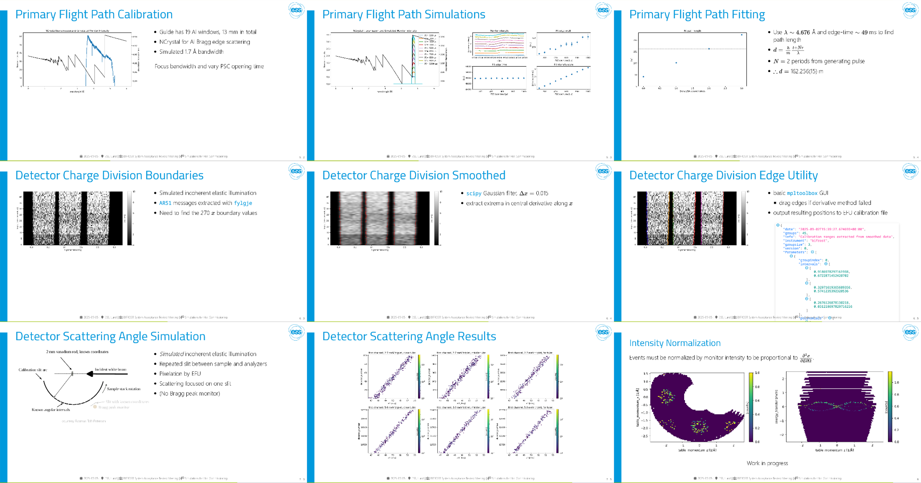
BIFROST
Topic |  | Details
Achievements | Simulations | Full instrument in McStas, ready for calibrated parameters
 | Pre hot commissioning | First tasks tested successfully
 | Data reduction | Workflows for BIFROST mostly complete
Remaining tasks | Pre hot commisioning | More simulations to test plans
 | Data reduction | Normalization and output to SQW
Bottlenecks & dependencies | 🔴 monitor data | In-file format not yet fully defined/implemented
Calibration tools | 🟢 scipp | Fully functioned and well received
 | 🟢 plopp | More than sufficient for HC plotting
 | 🟢 fylgje | Proven capable at extracting low-level data for HC
Data reduction tools | 🟠 ess.spectroscopy 🟢 ess.reduce 🟢 sciline 🟢 scippnexus 🟢tof | Good progress adding to workflows for normalization and SQW output
 | 🟠 Horace | Testing with BIFROST data needed
Analysis tools | 🟠 VISA | Many tools now available as loadable modules
System Acceptance Review | 🟢 SAR | Pre hot commissioning simulations presented at BIFROST SAR meeting
pre-HC task simulations
Notes:
A faithful digital representation of BIFROST has been developed using a McStas instrument model that interfaces with the EFU and Kafka to produce realistic NeXus data files, forming the basis for a digital shadow of the instrument. Several Hot Commissioning (HC) tasks have been successfully simulated
SAR Review has been done
Greg

Slide 13
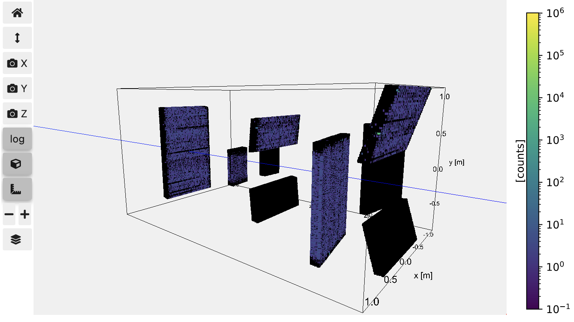
LoKI
Status– DMSC
“Ready” for neutrons?
Good progress through cold commissioning tasks and SAR
Neutron and instrumental data can be:
Saved to .nxs file with the correct proposal file structures
Inspected in VISA env
Reduced using Scipp/esssans
Analysed by the user off-line or on VISA (SasView, etc)
Topic | Description | Details / To-Do list | Priority
Achievements | Identify what has been achieved so far | CC testing completed. Minor re-tests to be performed. | Medium
Remaining tasks | What remains to be done | Mostly ECDC tasks: sample holder ‘macro’ in NICOS; integration of rheometer for first science. | High
Bottlenecks & dependencies | Identify bottlenecks, technical difficulties, or dependencies that are affecting progress | Integration of sample environment requirements and user-facing control software is somewhat dependent on ECDC and DST divisions. | Medium
Software | List calibration tools | Scipp (esssans, scippneutron, scippnexus) | -
Software | List data reduction tools | Scipp (esssans, scippneutron, scippnexus) | -
Software | List data analysis tools | SasView community package, including sasmodels, or homebrew code for specific requirements (SciPy, etc) | -
Software | Plans for deployment | Scipp (esssans, scippneutron, scippnexus) working well. Next steps: test full reduction workflow of different detector banks, and subsequent data merging etc, using simulated data (McStas). | -
SAR | Status on the System Acceptance Review process | SAR has been performed and iSRR scheduled. Only a few known issues highlighted by the panel. Minor NITs (NSS instrumentation tickets) being dealt with prior to SAR approval or pushed to TG6. Detector failure root cause potentially resolved. | High
Notes:
LoKI doing very well with a lot of key components successfully tested
Strong IDS involvement throughout cold commissioning testing phase
Used representative VISA environment throughout on a dedicated cold commissioning proposal (051657)
From measurement to viewing on SciCat test: 11 seconds!
In terms of the data pipeline, we are mostly there with a few details to finish up during HC (ie. stitching/merging of data from different panels)
SAR Review has been done
A proposal was set up through the user offoice software (proposal 051657), dedicated to all commissioning activities. NeXuS files were saved under this proposal as part of testing and opened for inspection with VISA.

Slide 14
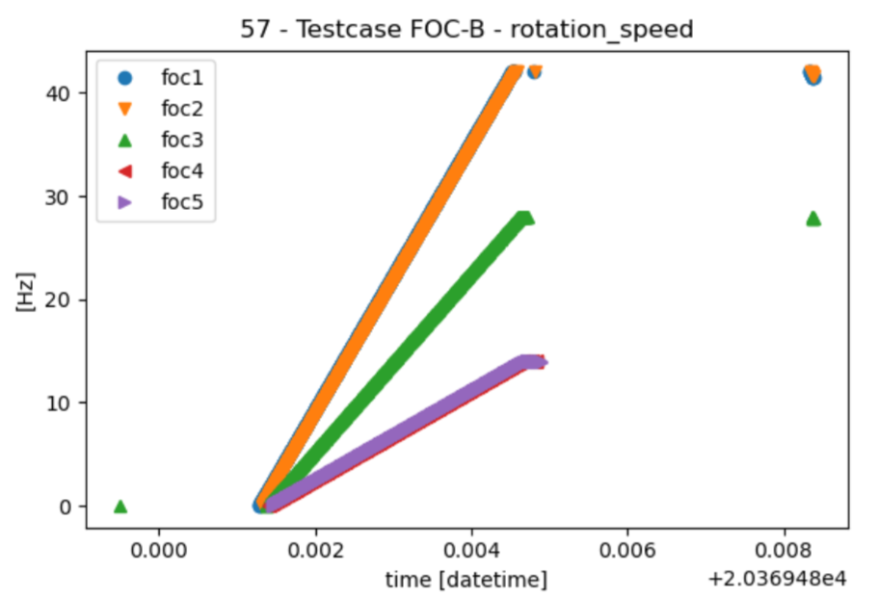
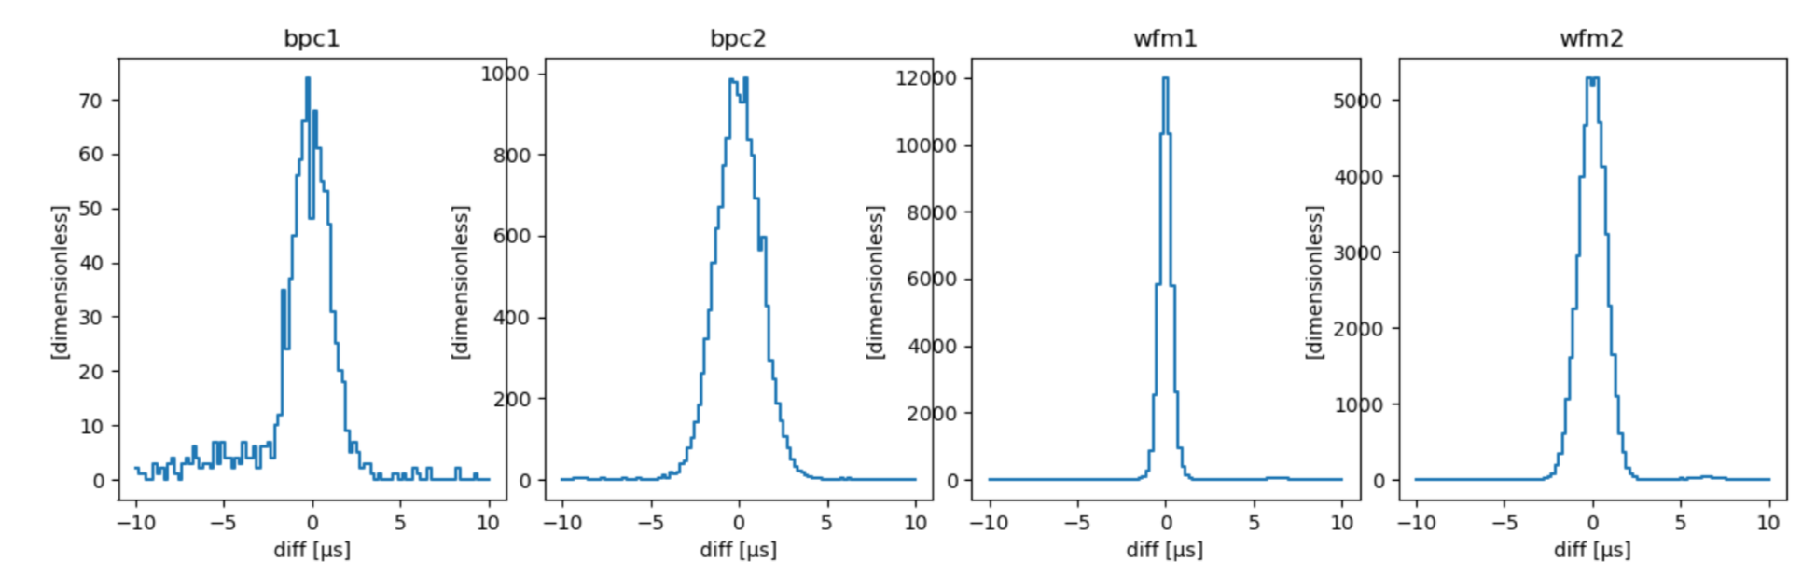
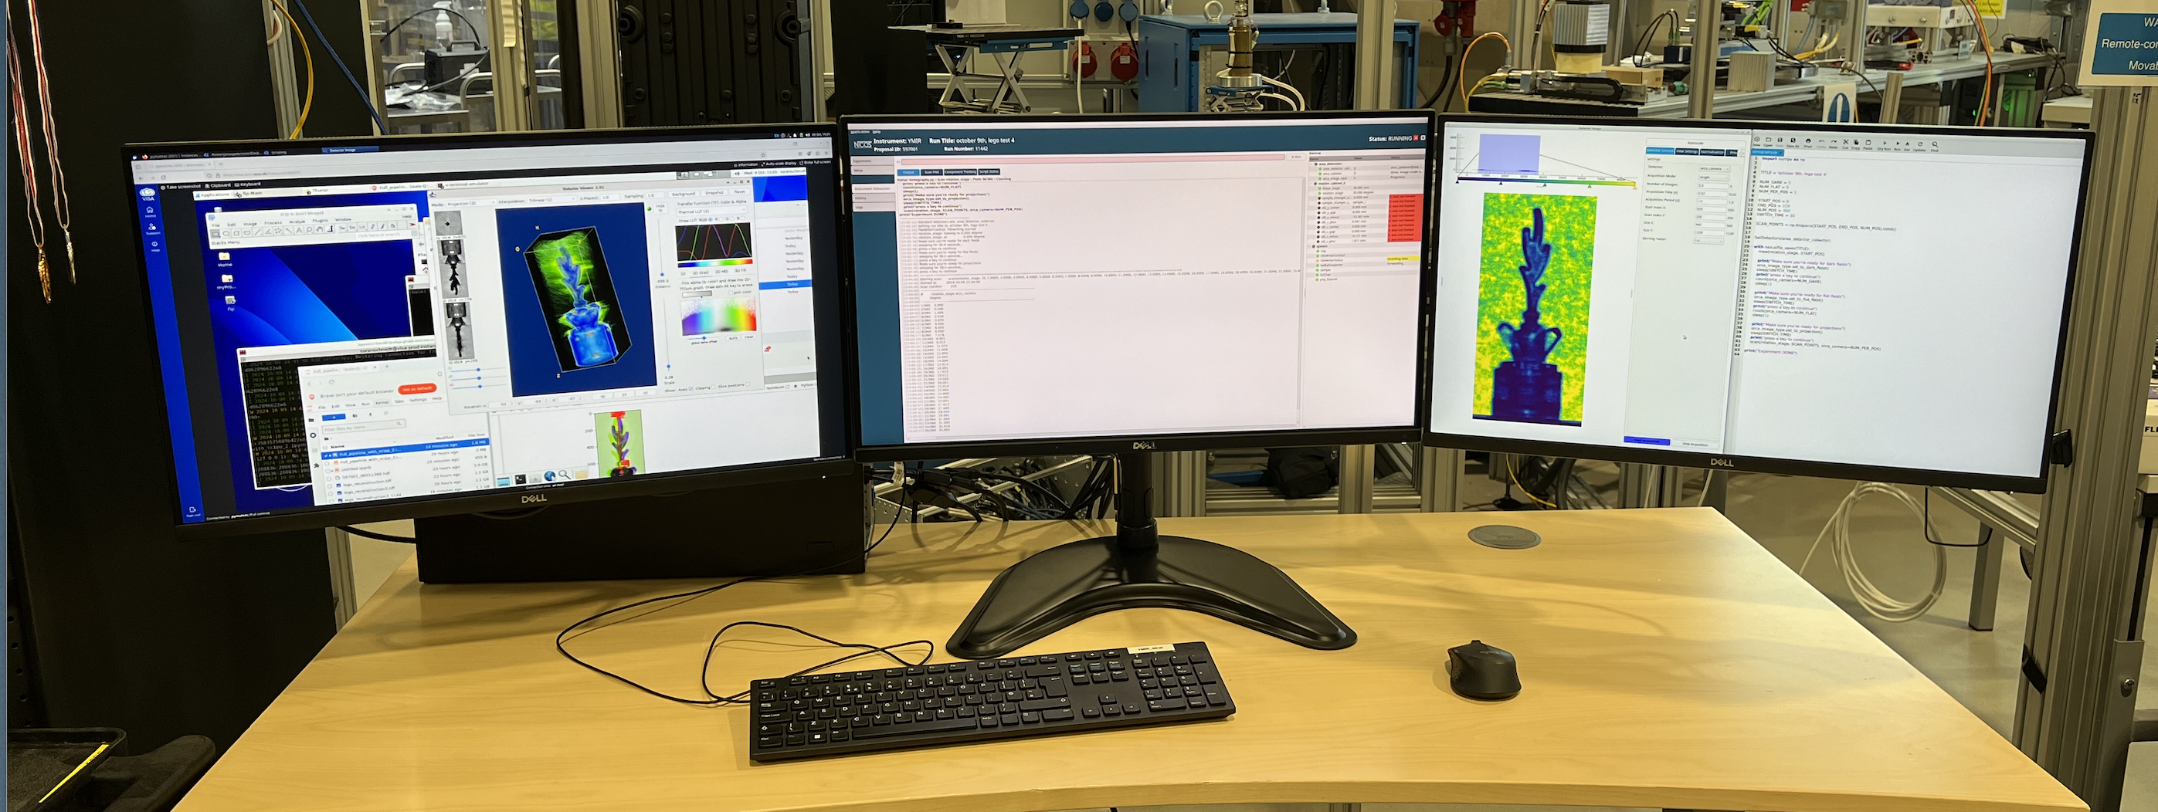
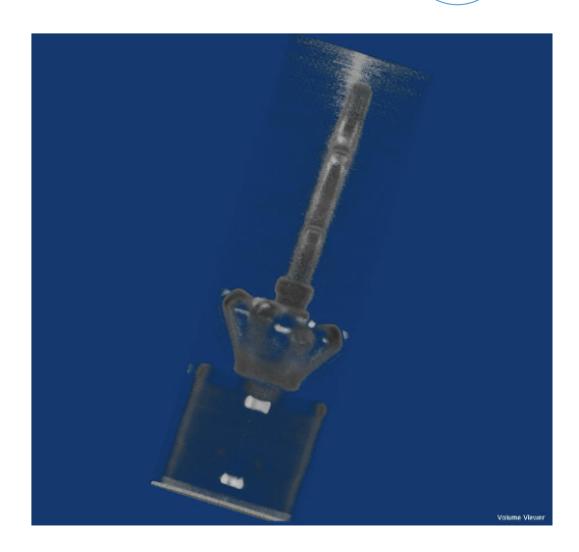
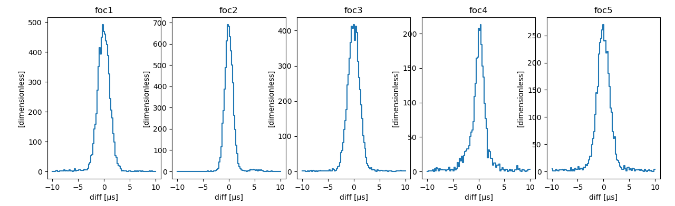
ODIN
Topic | Description
Achievements | Attenuation tomography demonstrated at YMIR last year Integrated tests for ODIN
Remaining tasks | Apply Bragg edge fitting engine on pixel-by-pixel basis Assortment of individual image operations used on a case-by-case principle Spectral tomography (exploratory) using Lumacam
Topic | Description
Calibration Tools | McStas model for ODIN Flight path calibration Determining detector resolution
Data reduction tools | Data reduction for ORCA (CMOS), including step-by-step and stroboscopic modes (acq. system runs as fast as possible) ORCA with fast gating device for obtaining coarse time-of –arrival profiles Data reduction for Lumacam (Timepix3) for both BPC alone (nat. res.) and WFM modes
Topic | Description
Data analysis tools | (py)Muhrec for tomography Core Imaging Library (CIL) for tomography Ncrystal and RITS/GUI-RITS for Bragg edge fitting DragonFly (segmentation and visualization)
Status of deployment | (py)Muhrec is deployed on VISA CIL is deployed on VISA. Awaiting access to GPU, scheduled before Dec. License keys for DragonFly received. Initial tests started on separate computer (not VISA). Awaiting deployment on VISA and access to GPU (before dec)
Topic | Description
ODIN Integrated tests | Lumacam, Choppers and ORCA tested
Light tomography at YMIR (ORCA)
Notes:
Integrations tests has been carried out during the past three weeks for Lumacam (time of arrival),ORCA (white beam camera) and ODIN chopper system.
YMIR used for testing
Example 1: Frame overlap coppers (FOC) observed over time, reaching final final rotation speed (frequency).
Example 2: Jitter in 9 choppers, fulfilling the requirements. (T0) choppper missing, will be installed at ODIN later.

Slide 15
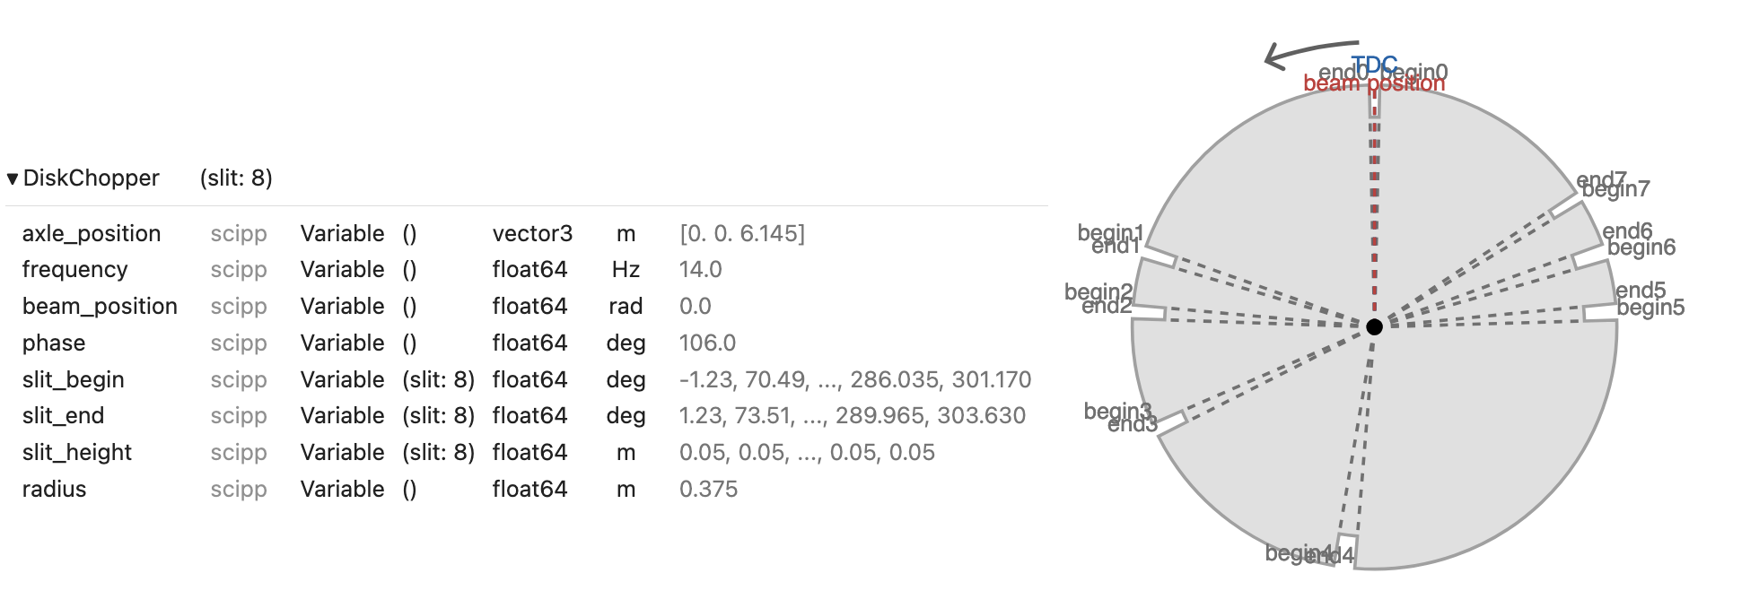
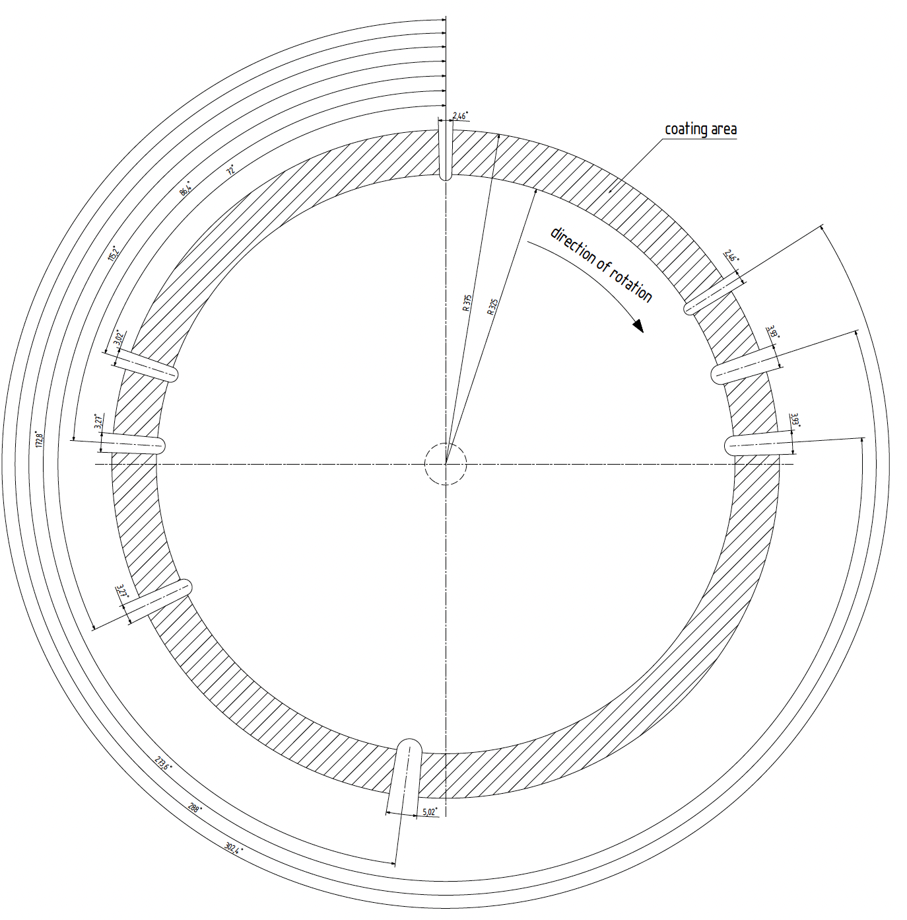
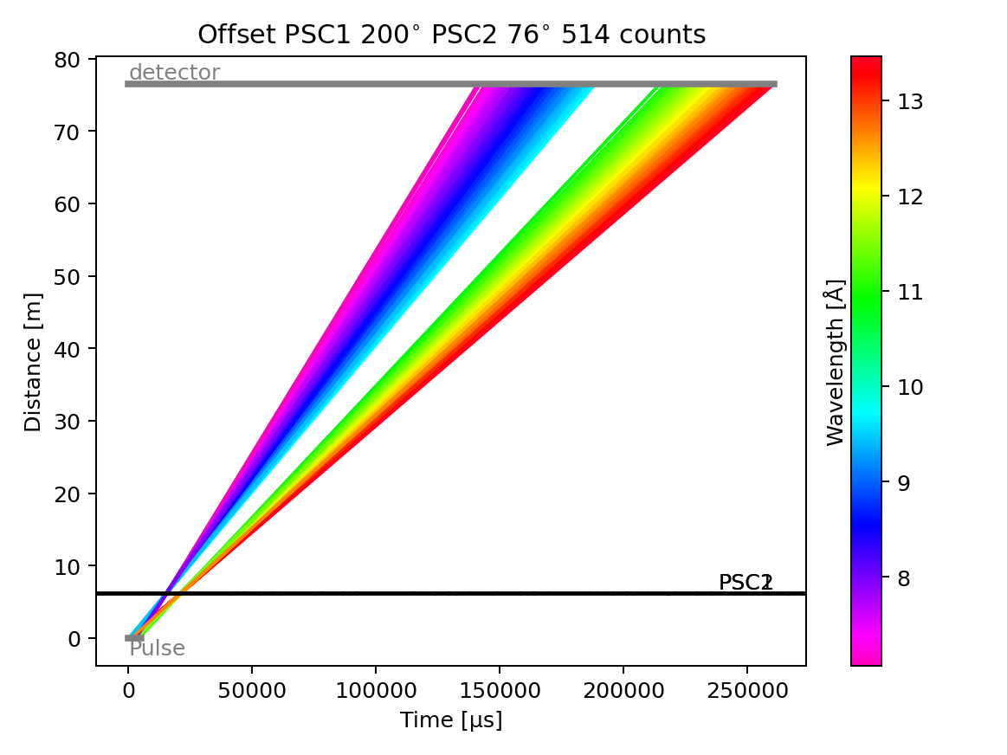
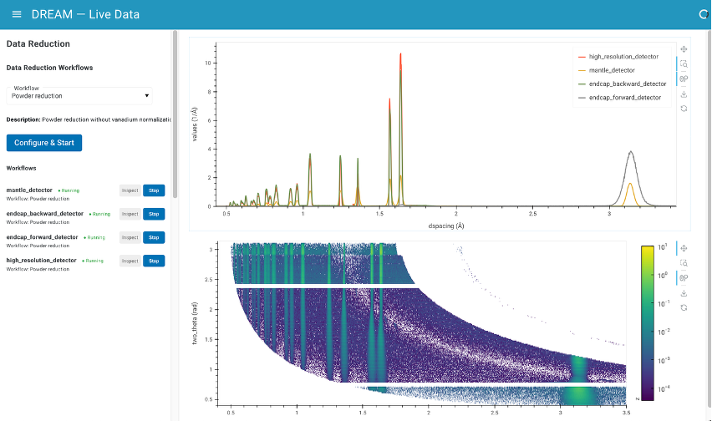
DREAM
Scipp
CAD
Updates from the last 6 months
Commissioning tools
Choppers:
WFM stitching, settings for High Flux, High Resolution, Medium Resolution
Detectors: calibration (WIP)
demo of Live data processing
More analysis software available on VISA
Reduction worflows for DREAM’s Science Cases
1D Powder Diffraction | Notebooks in Code Shelf & in online documentation
PDF | 60 % done
Polarisation | 10 % done
SANS | Just started Adapting workflow for LoKI
Notes:
Data processing pipeline from McStas/GEANT4 to Scicat demonstrated last year for Powder Diffraction. Other science cases in good progress together with commissioning tools (ESS live data, choppers settings)
The post-beamtime processing from McStas/GEANT4 simulation to storage on Scicat as well as the live data reduction have been demonstrated to the ESS Diffraction instrument scientists in May and October, respectively.
Not all is needed for day one

Slide 16






NMX
NMX Workflow complete, just waiting for equipment to arrive
Instrument simulation
Data catalogue
simulated detector data
Samples:
Rubredoxin
Data reduction
Data analysis
Reduced data files
Topic | Description | Details/To-do List
Achievements | Identify what has been Achieved so far | NMX data reduction pipeline Neutron MX simulations in McStas
Remaining Tasks |  | NMX analysis software on VISA (nearly done) Detector tests at other facilities: efficiency calculation, protein diffraction, identifying pitfalls and potential issues before BOT Geometry: how to interface NMX coordinate system with data reduction software
Bottlenecks |  | Robot/goniometer installation (in progress)
Data catalogue
Loading NeXus file
Grouping detector data
Binning TOF histogram
“nxs” format
Topic | Description | Details/To-do List
Software | Calibration Tools | ESSNMX (scipp) Grafana/DaqLite/ESS Live Viewer
Software | Data reduction Tools | ESSNMX (scipp) DIALS Daresbury Laue Suite (LSCALE)
Software | Data Analysis Tools | DIALS CCP4 Phenix
SAR Status |  | Cave, optics, guides- complete
Notes:
NMX- focus has been put on optimizing protein crystal diffraction in McStas. Data reduction workflow is complete and ready for HC.
The software suite for NMX data reduction is complete and a vision for an automated data reduction pipeline, NMX-workflow, was completed and shown to the NMX STAP at the beginning of 2025. We can now process protein crystallography data coming from NMX detectors.
great inroads in the simulation of NMX data in McStas. This was far from trivial, as single-crystal protein crystallographic simulations required a great deal of computational power, modeling of neutron-solvent interactions, and updating of specific McStas components. This work will be submitted for publication in the near future.
Aaron

Slide 17



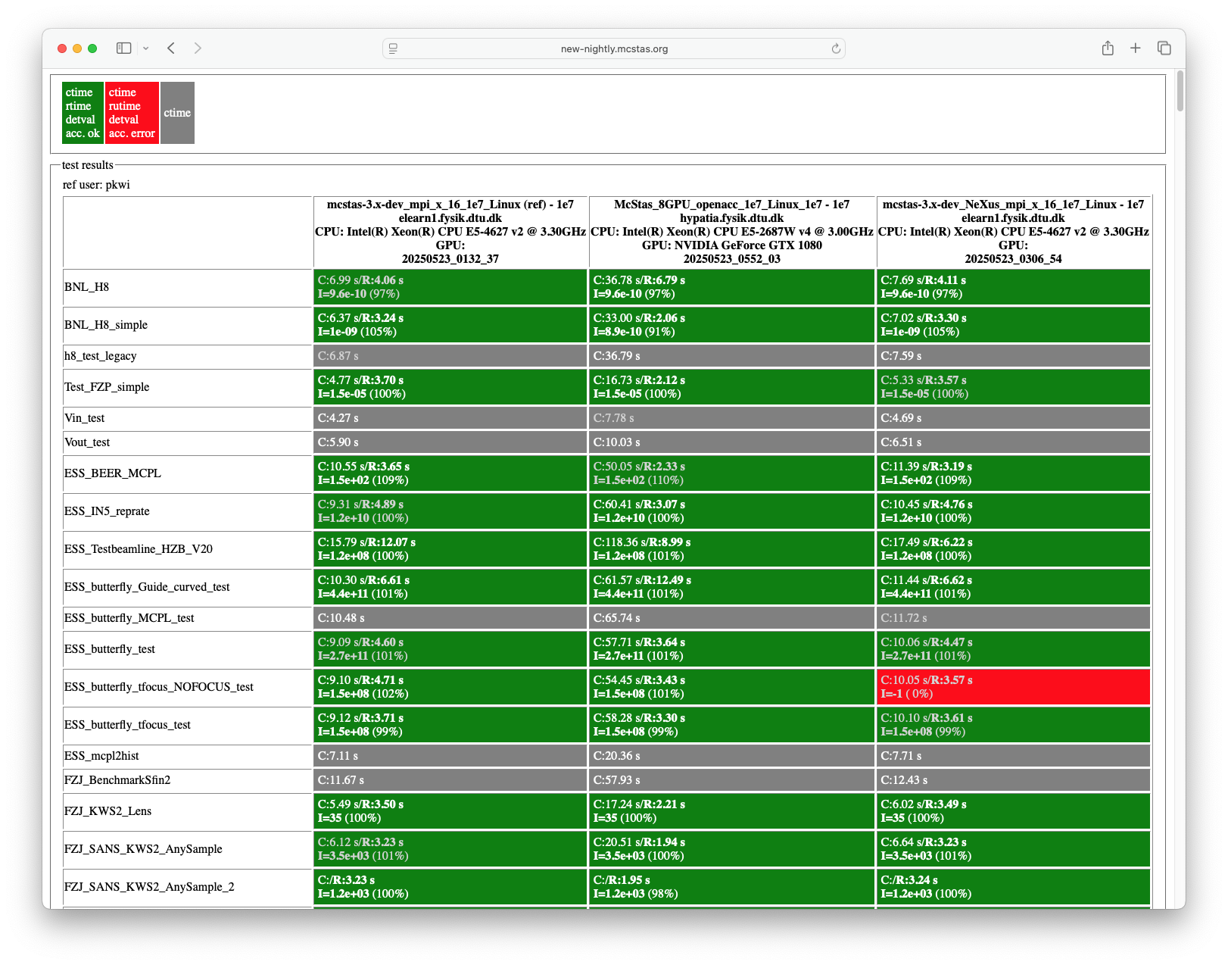
Modelling subgroup
McStas
Improving foundation
Platform support
MCPL / NCrystal now on windows
McStas / NCrystal / MCPL now supports Linux, Windows and Mac
All distributed through conda-forge
Improving continuous integration
Improvements on testing
Pull request templates for code contributions
McStasToX package
Reads McStas NeXus, can output scipp object
Will add more output to more formats
Notes:
Thomas Kittelmanns projects
NCrystal: Library for calculation of cross section and performing scattering, used in many packages for example McStas
MCPL: Monte Carlo Particle List, standardized format to exchange beam states between different simulation tools
The work on primary extinction looks at effects from the crystal grain sizes and directly impacts the probability to scatter, most visible in transmission as on imaging.
Thomas has compared several models, some quite old, and fixed numerical issues caused partly by limited computing resources when these were made.
The graph shows early work of different grain sizes, still under development.
McStas is installed using conda, and now the nightly testing is also using that system.
Since McStas sees contributions from a large community, improvements to pull requests is important as a lot of time is spent by the main developer Peter Willendrup on ensuring these contributions are healthy.
McStasToX is a play on Power-To-X and is intended to export McStas data to scipp and other formats in the future.

Slide 18
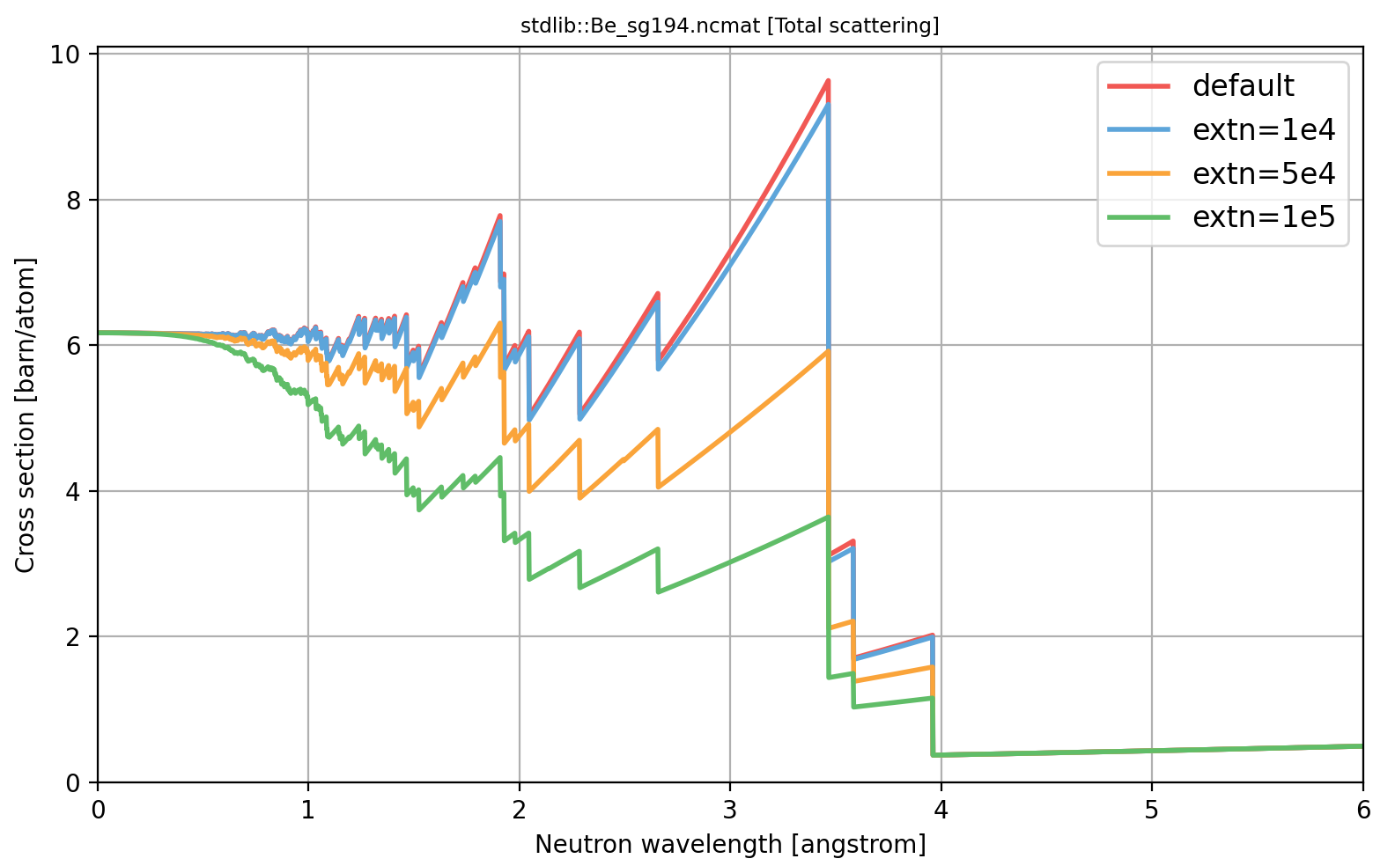
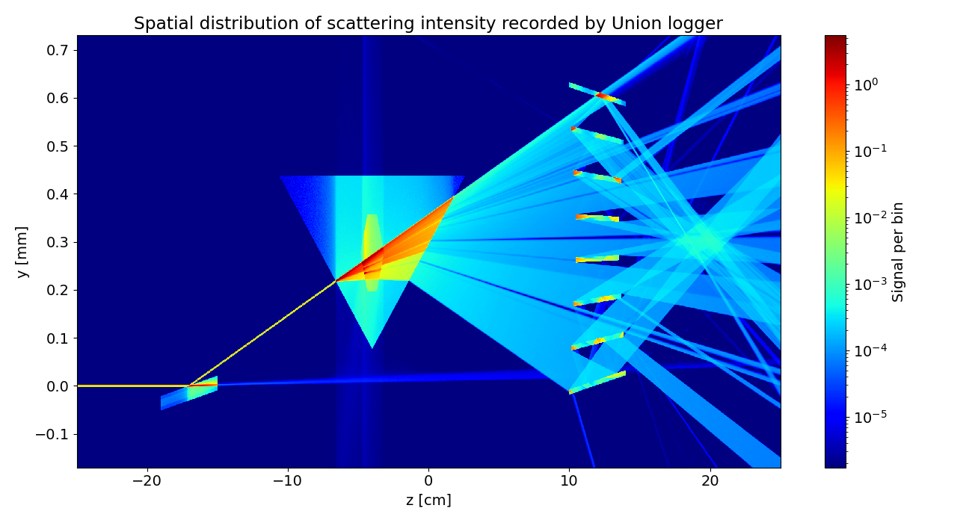
Modelling subgroup
McStas
Adding capabilities
Be_sg194.ncmat [Total scattering]
MCPL got metadata on ray statistics in origin simulation
NCrystal incorporating primary extinction
Requsted to handle Bragg edge analysis
Several models updated and compared
On-going work
McStas Union components getting surface effects
Refraction / Reflection allow for lenses
Reflectivity on surfaces allow supermirror optics
Both can be intergrated in sample environments
Continued user contributions to McStas & NCrystal
Cross section [barn/atom]
Neutron wavelength [Å]
y [mm]
z [cm]
Notes:
Thomas Kittelmanns projects
NCrystal: Library for calculation of cross section and performing scattering, used in many packages for example McStas
MCPL: Monte Carlo Particle List, standardized format to exchange beam states between different simulation tools
The work on primary extinction looks at effects from the crystal grain sizes and directly impacts the probability to scatter, most visible in transmission as on imaging.
Thomas has compared several models, some quite old, and fixed numerical issues caused partly by limited computing resources when these were made.
The graph shows early work of different grain sizes, still under development.
Surface effects in Union components:
Union components are a way to model complex regions of the instrument, such as sample environment
Now reflection/refraction can be modelled within that system as well as for example super mirrors
Development by Mads Bertelsen
Figure for surface
Demonstration of surface effects in complex setup.
Beam with wide range of energies enters from left.
Beam hits supermirror and most energies are reflected, though some are refracted and continues almost straight.
The reflected beam then hits a prism that cause different energies to be deflected different amounts.
The center of the prism has a single crystal sample that scatters at certain energies, those are removed from the ongoing beam, causing small gaps.
After the prism there is a nested mirror optic that attempts to focus the beam.
New components are contributed, for example a new model of scattering from mirrors by Artur Glavic.

Slide 19
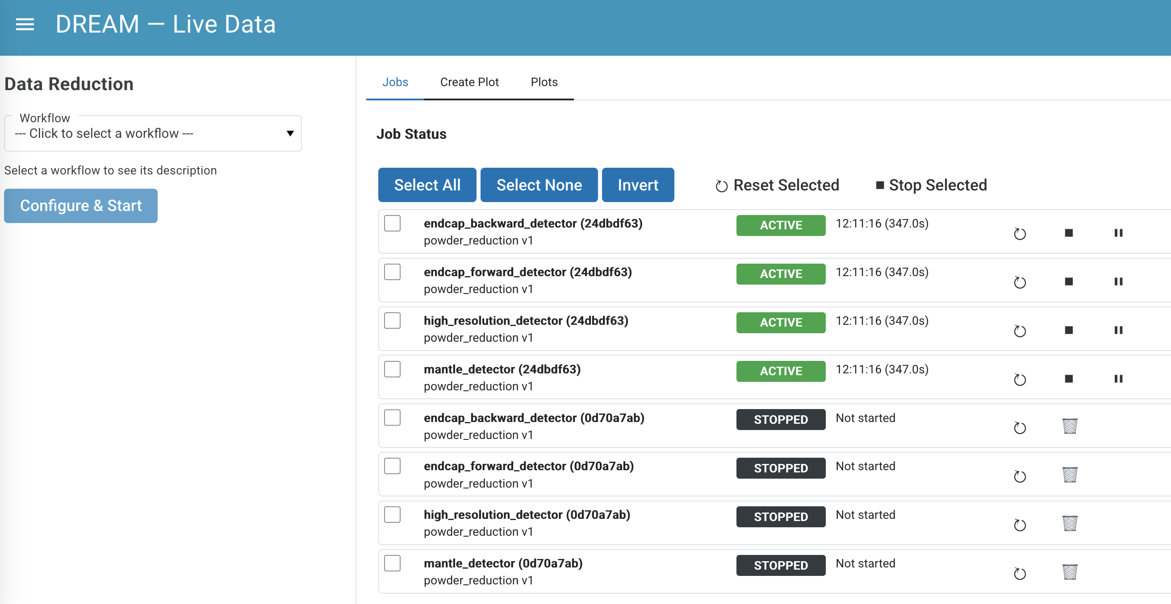
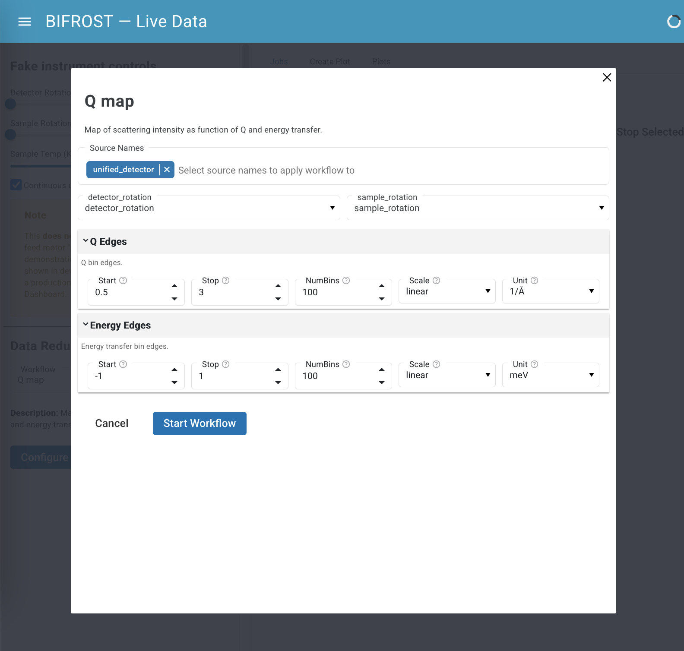
Live Data Processing & Dashboard
Getting ESSlivedata (formerly Beamlime) production-ready
Development direction informed by output of DMSC Live Data Working Group
Scalable and extensible architecture
Integrated with ECDC infrastructure (Kafka, Graylog)
Deployed using DST puppet configuration management
Strong uptake in interest and demonstration of progress by instrument teams
Demonstrated to BIFROST and diffraction teams
Successfully tested with TBL, BIFROST, DREAM, BEER, ODIN
Successfully interfaced with NICOS for displaying reduced data but mainly focusing development on web-based dashboard.
Dashboard: Launch workflows, monitor job status, plot results
Workflow config dialogs generated from Pydantic Models
Notes:
Over the last 3 months one of the most used and demo-ed data reduction software has been esslivedata (previously known as beamlime) as the instrument team have a high interest in the capabilities for live data processing and reduction. We have already run through various tests and demos of live data reduction with TBL, BIFROST, DREAM, BEER and ODIN teams.

Slide 20
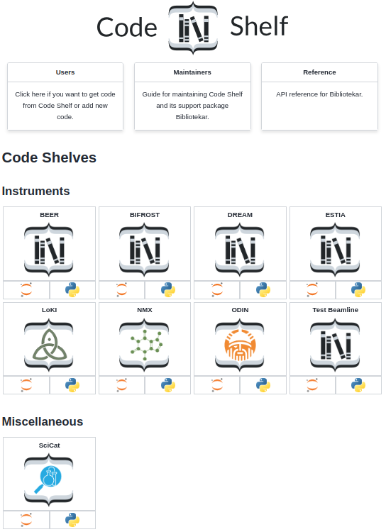
Code Shelf and VISA
Introducing repositories for user code
Curated, continuously tested notebooks for common reduction tasks
Deployed on VISA with re-producible Conda environments
Tracking metadata allows for tracing a user’s notebook back to origin
facilitate support & debugging
Notes:
We have also started developing and collecting notebooks/scripts which are and will be used for common data reduction tasks, these notebooks are deployed on VISA and can be downloaded by users to run locally. We also use these notebooks during the various instrument SARs and integrated tests. These notebooks will be the starting point for science users for data reduction where they can load in the data from their experiments

Slide 21
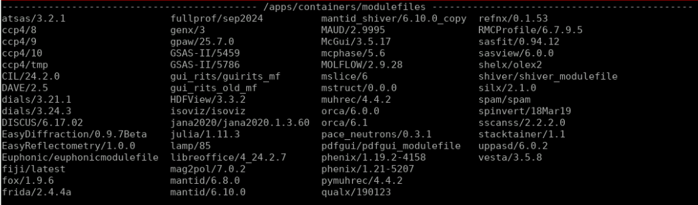
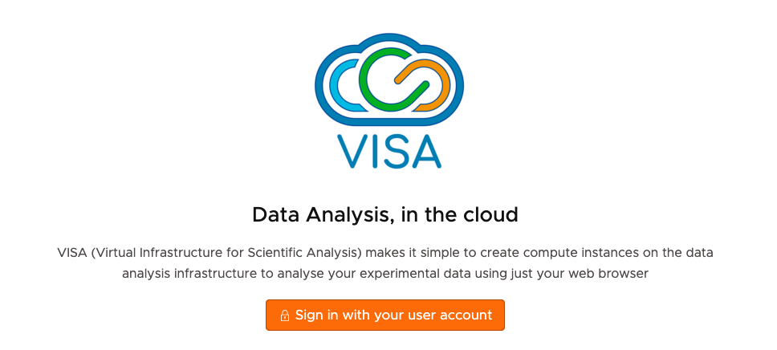
Data analysis software
Different paths to analysis software
Data analysis software by DMSC:
In-house developed: EasyDiffraction, EasyReflectoemtry, etc.
Joint developed: SasView, (Py)MuhRec, etc.
Deployed 3rd party developed code base: (py)SpinW, Pace, Dials, etc.
Suite of analysis tool based on input from IDS’s
Deployed by DST and available on VISA

Slide 22
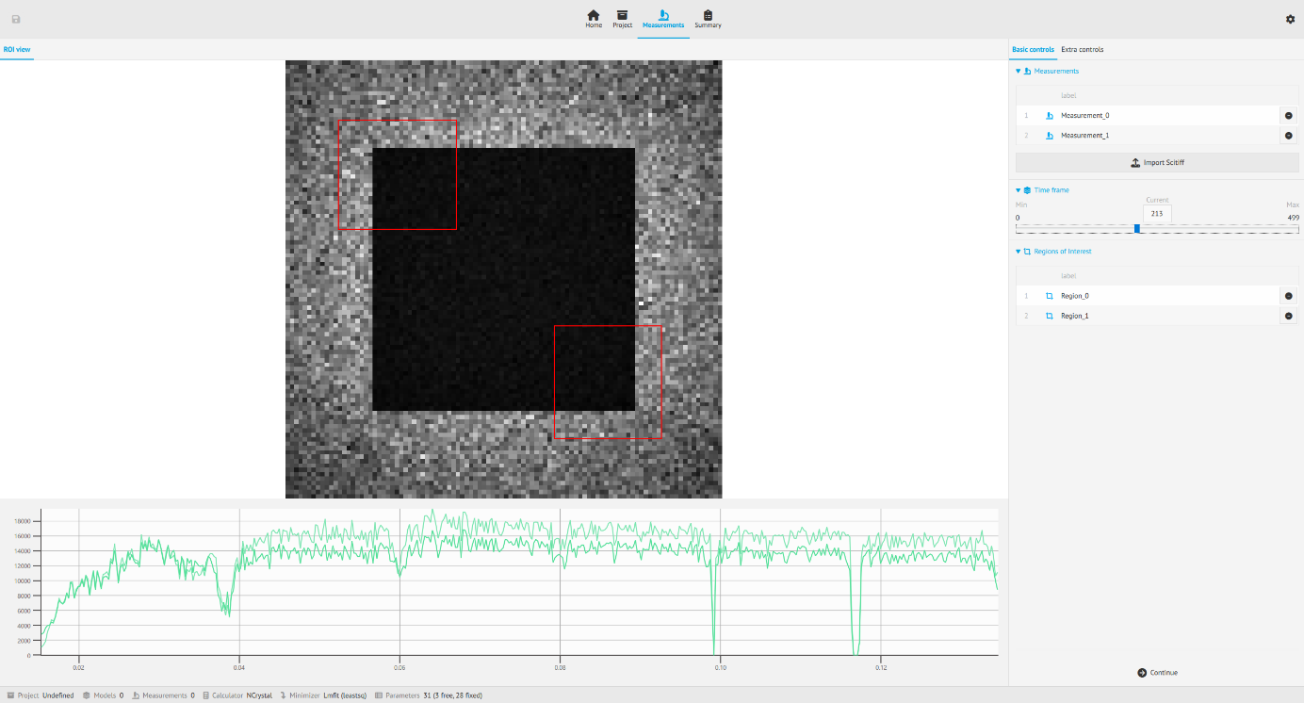
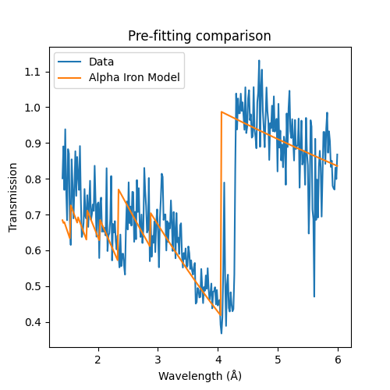
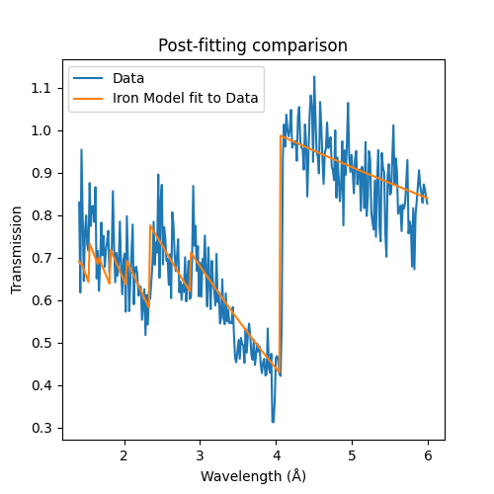
Imaging
In-house developed: EasyImaging
Recent development:
A prototype EasyImaging GUI with the measurement page has been completed, enabling data loading, display, and region of interest (ROI) selection.
Proof-of-concept Jupyter Notebooks for phase fraction and strain fitting with real or simulated data by ROI selection, as well as flight path calibration, have been created.
The Measurement page showing an image with two regions of interest highlighted in red. The green curves at the bottom shows the intensity in the two regions of interest.
Calibrating the flight path using EasyImaging. Left figure shows the fit before the calibration, right shows the fit after calibration
Notes:
For Bragg-edge imaging analysis, EasyImaging is being developed as part of the EasyScience framework, consisting of EasyImagingApp

Slide 23
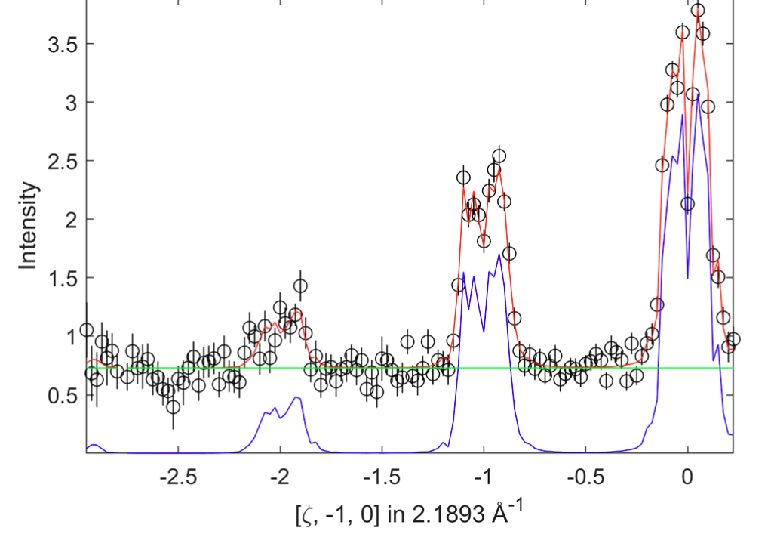
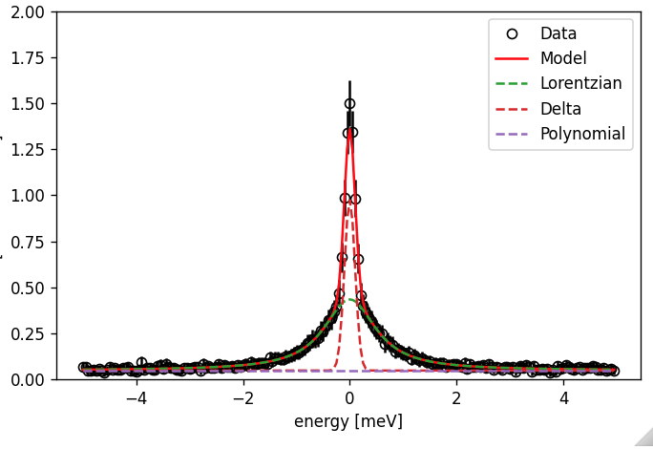
Spectroscopy
In-house developed: EasyDynamics
BIFROST single crystal data analysis : PACE neutrons (developed by ISIS). It is now available on VISA (via the Python interface).
Powder spectroscopy analysis: EasyDynamics, covering mostly quasielastic (QENS) and inelastic scattering.
Plans for the next period involve building the graphical interface for EasyDynamics.
Fitting a spin wave model to simulated data using pace_neutrons on VISA.
Example of EasyDynamicsLib using simulated data. 16 cuts of intensity as a function of energy are fitted simultaneously to a Brownian diffusion model, while each cut has its own resolution, background and elastic scattering
Notes:
Powder spectroscopy analysis is being addressed through EasyDynamics,

Slide 24
Conclusion
DMSC is well prepared for supporting first instrument
Plans for a new data center is underway and is not foreseen to impact HC
Using simulated data and data from similar instruments for extensive end-to-end testing
Proposal submission → data reduction → data analysis → data management
Majority of the user journey is completed
Proposal submission
Review
Scheduling
Site-access
Notes:
Purpose of slide::
Data policy
Server room
IDS
Good track for first instruments, work starting for later instruments
And cross instrument projects like the user journey is progressing
Working on real instruments have been beneficial, including

Slide 25
Questions?

