Slide 1
Status & updates from the accelerator models
nick.gazis@esss.se
www.europeanspallationsource.se
September 2015

Slide 2
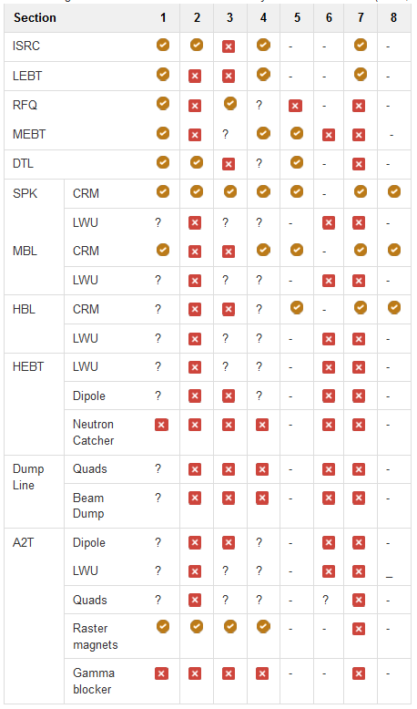
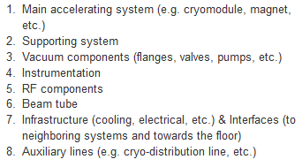
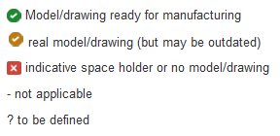

On-going work with the CAD Inventory
The inventory of the CAD model for the accelerator is now summarized under a link:
https://ess-ics.atlassian.net/wiki/display/DIG/Inventory+of+integration+models+and+drawings+for+the+ACCSYS+components
Each tunnel section contains sub-systems:
Inventory is reported per tunnel section with one of the following statuses:
Current goal is to reach for all tunnel sections the level of:
Your feedback on the inventory status will be appreciated.

Slide 3
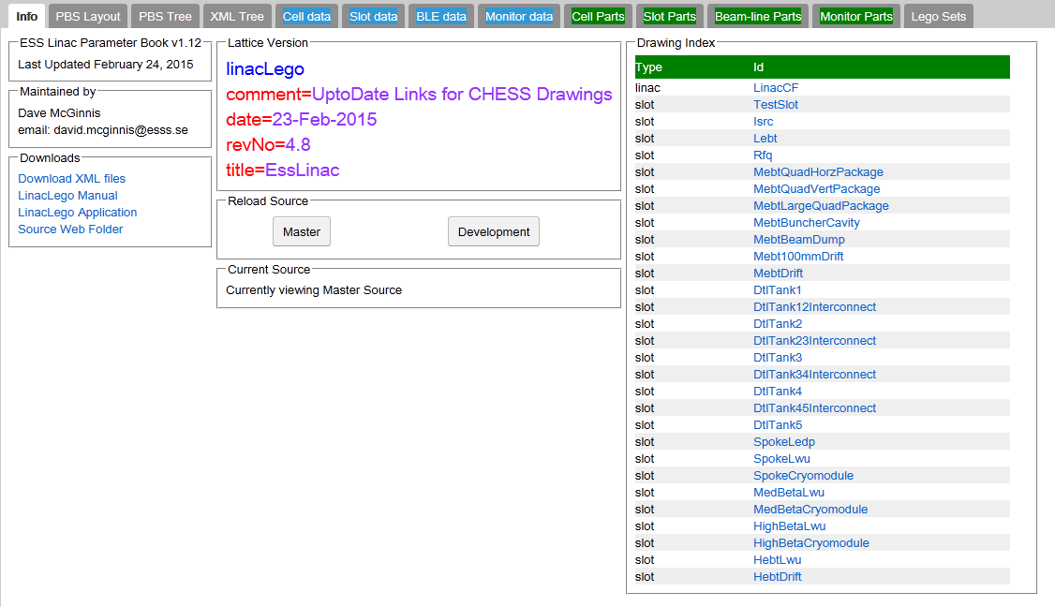
Kind Reminder
LinacLego summarizes the links to the CHESS documents for the relevant component design (slot)
please use & update the dedicated CHESS references

Slide 4


Lattice hierarchy in LinacLego
FOR REFERENCE
SECTION
ISRC
LEBT
RFQ
DTL
SPK
MBL
etc…
CELL
SPK-01
SPK-02
SPK-03
…
SPK-13
SLOT
SPK-02-LWU
BEAMLINE ELEMENTS
SPK-02-LWU-QH01,
SPK-02-LWU-QH02, …
Level of exchange for the CAD files between IKC-ESS
SPK-02-CM

Slide 5
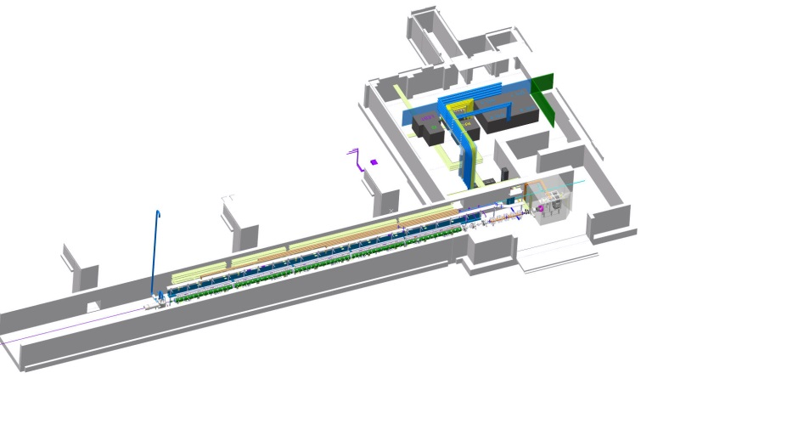
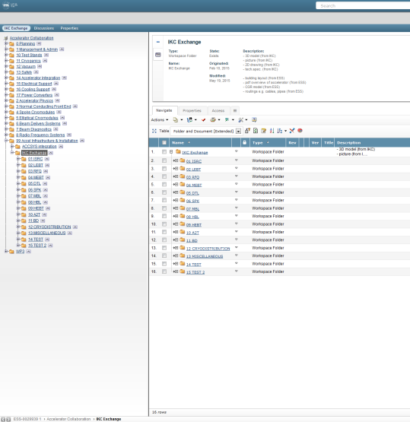
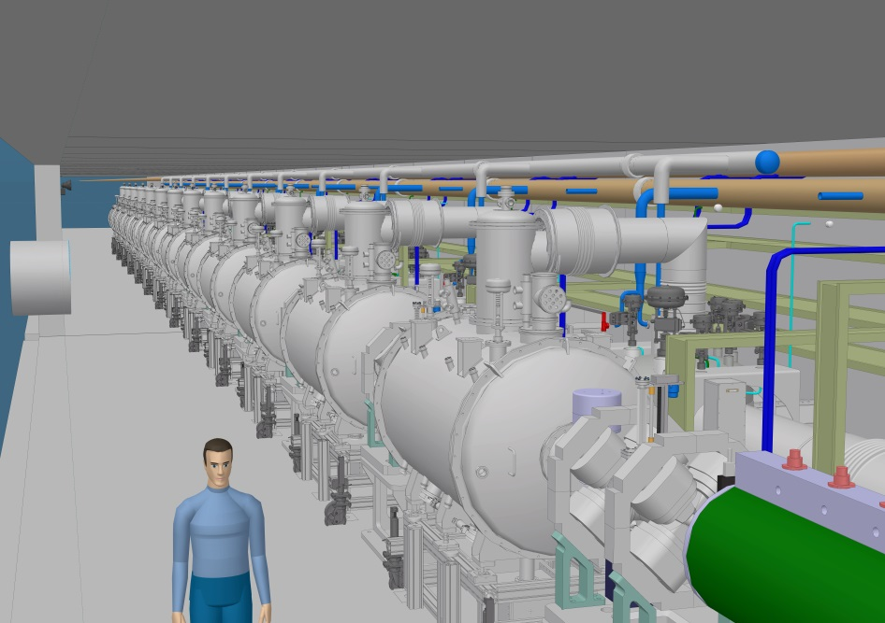
IKC exchange folder https://chess.esss.lu.se/enovia/tvc-action/showObject/Workspace%20Vault/IKC%20Exchange/0000003411
e.g.1:
ACCSYS warm linac export
e.g.2:
SPK tunnel section export
The output from the accelerator integration is also available under the exchange folder:

Slide 6
End
Thank you for your updated contributions,
looking forward for more!
  *Users of IKCs have been receiving CHESS login’s and Confluence login’s:
  for more please send e-mail and affiliation to nick.gazis@esss.se

Slide 7

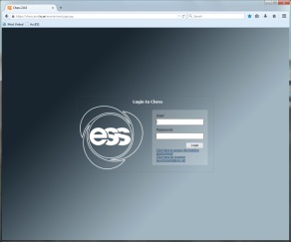
Integration Drawing Exchange Solution
FOR REFERENCE
Login CHESS
Collaboration area in CHESS
Exchange folders
Parent folder
History bar

