Slide 1
Status of In-Kind Contributions to the ESS Accelerator
Håkan Danared
Deputy Head Accelerator Division
www.europeanspallationsource.se
23 September 2015

Slide 2
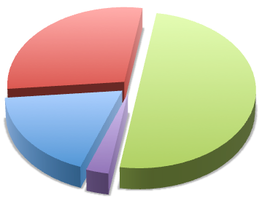
In-Kind to Accelerator
Since the launch of Expressions of Interest in spring 2013, discussions on in-kind are going on with 27 organizations.
Possible partners to Accelerator have been identified in Denmark, Estonia, France, Germany, Hungary, Italy, Norway, Poland, Spain, Sweden, Switzerland, and UK.
Value of items discussed with in-kind partners represents 48.8% of the accelerator budget (49.5% according to P6).
Host countries cannot formally give in-kind contributions, contracts represent 3.1% of budget.
Another 16.1% (17.8% in P6) possible as in-kind.
Important for ESS budget to find partners also for the ”possible”.
Not IKC, 32%
Planned IKC, 49%
Possible IKC, 16%
SE,DK, 3%

Slide 3
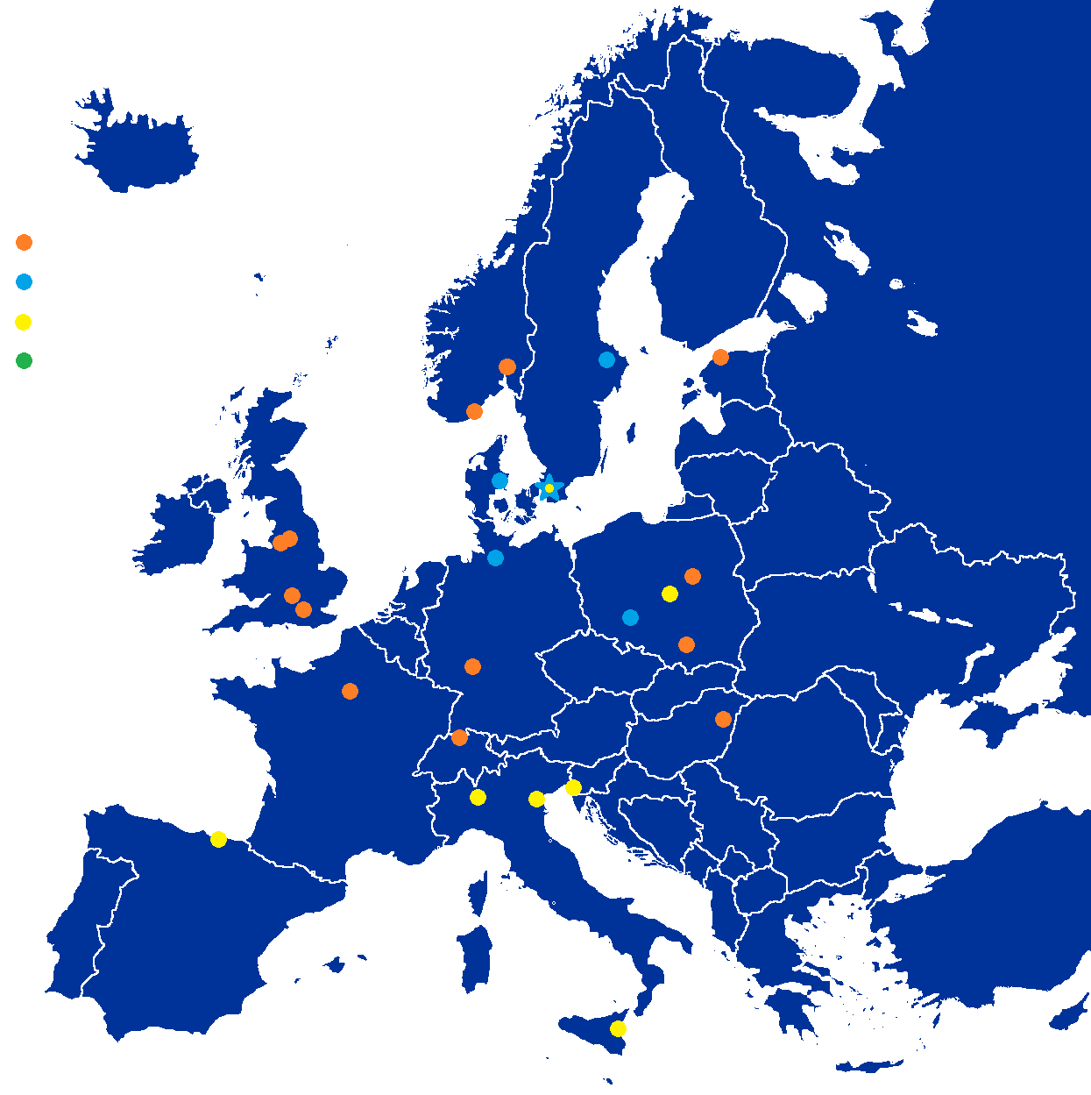
Partner Institutions
In-kind (main contributions)
Univ Agder (Ion source expert)
ATOMKI (RF-LPS)
CEA (RFQ, SRF, Diagn)
CNRS (SRF, Cryo)
Cockcroft Inst (Diagn)
Daresbury Lab (SRF, Vacuum)
Elettra (RF, Magn, PS, Diagn)
ESS-Bilbao (MEBT, RF)
GSI (Diagn, Vacuum, Cryo)
Huddersfield Univ (RF distrib)
IFJ PAN (Installations)
INFN Catania (Source, LEBT)
INFN Legnaro (DTL)
INFN Milan (SRF)
NCBJ (LLRF)
RAL (Diagn)
RHUL (Diagn)
Tallinn UT (RF)
TU Lodz (LLRF)
Univ Oslo (Diagn)
Warsaw UT (LLRF)
Wroclaw UT (Cryo)
Not yet signed
Contract
HoA
IKC
Paid contracts
Aarhus Univ (Beam del)
DESY (Diagn)
Lund Univ (LLRF, RF)
PSI (Diagn)
Uppsala Univ (Tests)

Slide 4
Contract Structure
IKC Agreement with 3 4 sections
1. Agreement (General Terms and Conditions)
2. Framework for handling in-kind contributions
Schedule N
STC
approved
Legal and commercial terms and conditions
Definitions
Work programmes
Obligations
Organization
…
Etc.
Schedule 2
Schedule 1
Deliverables
Time schedule and delivery of project
Reporting
Excluded background
1 Agreement (General Terms and Conditions)
Signed only once with each partner
IKRC
reviewed
3. Schedule (Technical Annex)
1 Agreement (General Terms and Conditions)
Added separately for each WP/WU
ACC
approved
Framework for handling In-Kind Contributions
4. Statements of Work
1 Agreement (General Terms and Conditions)
Added optionally for each WU/deliverable

Slide 5
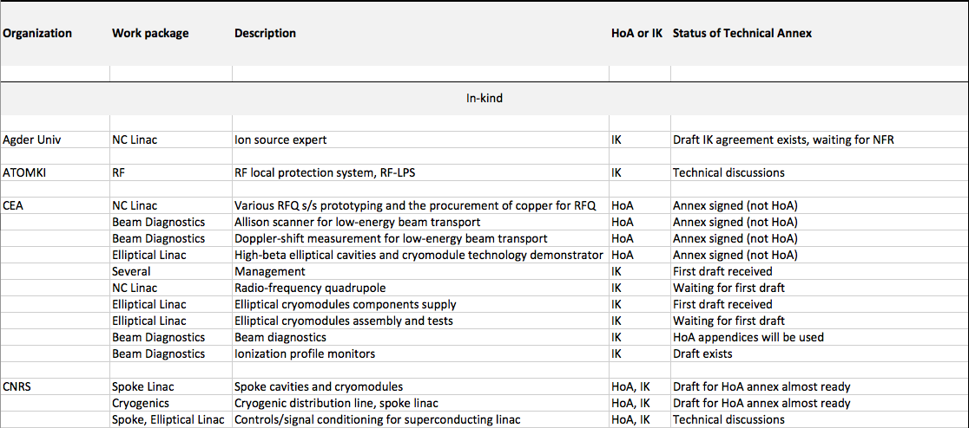
Planned In-Kind Contributions

Slide 6
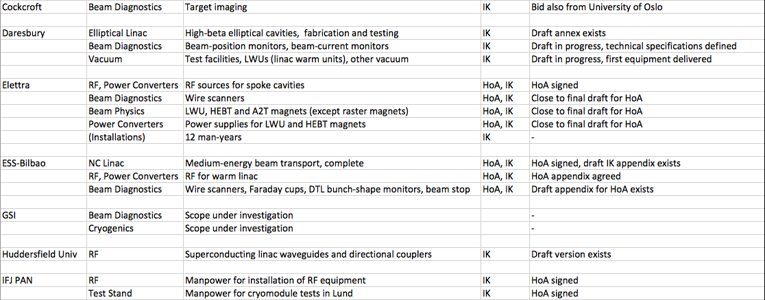
Planned In-Kind Contributions

Slide 7
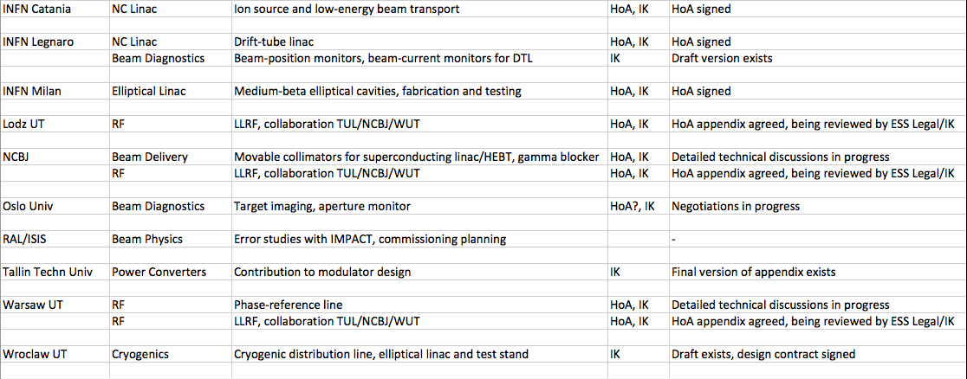
Planned In-Kind Contributions

Slide 8
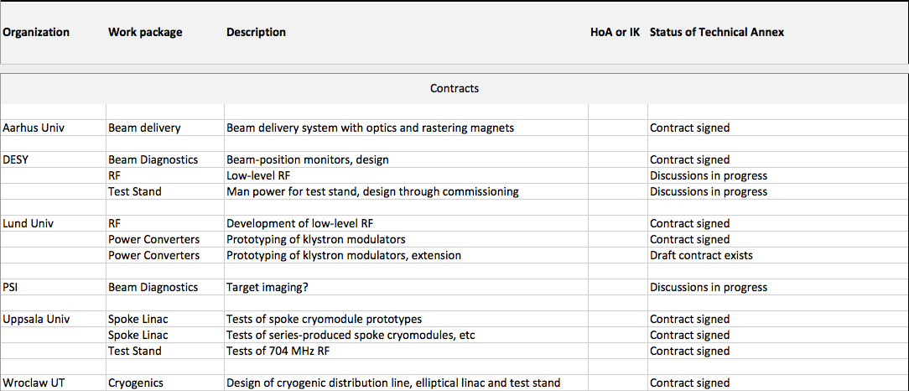
Contracts

Slide 9
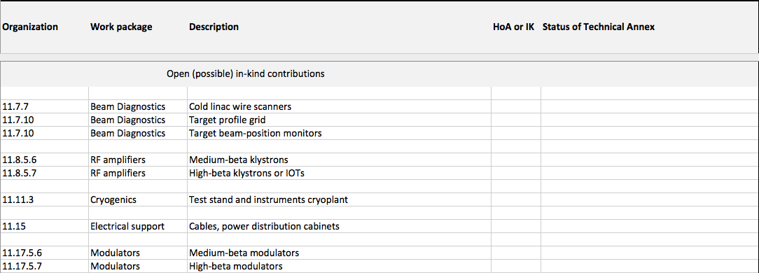
Open (Possible) In-Kind Contributions

Slide 10
In-Kind Target for Accelerator
In order for member states to have an approximately 70% in-kind and 30% cash, accelerator needs to have approximately 75% of its 510 M€ budget as in-kind.
We are at present in detailed discussions with in-kind partners for 249.0 M€ or 48.8% of the budget (49.5% tagged as planned in P6).
Signed contracts, tagged as cash in P6, represent 15.6 M€ or 3.1% of the budget.
There are open in-kind contributions for 81.9 M€ or 16.1% of the budget (17.7% tagged as possible in P6).
Items that have been procured in the past, which could have been in-kind if we had had partners, represent 28.3 M€ or 5.6% of the budget.
The four categories sum up to 374.8 M€ or 73.5% of the accele-rator budget. These are thus items obtained from institutions in the member states or through public procurements where compenies in any member state can take part.

Slide 11
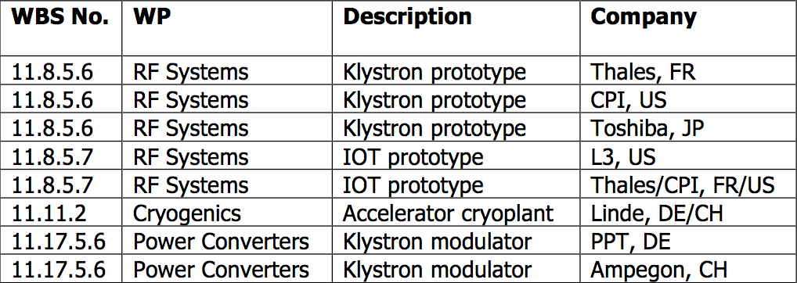
Major Past Procurements

Slide 12
In-Kind Target for Accelerator
One can possibly claim that Accelerator is close to achieving a reformulated target of spending 75% of the budget outside of ESS in Lund.
But unless the remaining open contributions are not taken by the member states, ESS will still have a cash problem.
Please consider to take on any of the still open in-kind contributions!
Thank you.

Slide 13
High-Level Schedule

