Slide 1
Accelerator Project
TB Meeting September 2015
Mats Lindroos
Head of Accelerator
www.europeanspallationsource.se
September 23, 2015

Slide 2
Accelerator overview
The ESS accelerator project is making progress according to plan (5 MW, 14 Hz, 2.86 ms)
26 In-kind partners have started detailed contract negotiations for >50% of the project value.
  Head of Agreement permits work to start at IK partners while contract negotiations are being completed
  Remaining possible in-kind consist of commercial procurement of components for the accelerator
The accelerator division has 61 staff members. An additional 10 engineers and 40 technicians is to be hired up to 2019 (plus 15 operators)
  A new organisation has just been approved by ESS management
  A major task for the division is to coordinate, integrate and install the accelerator which to a large part will be delivered as in-kind or by industry
ESS AB is becoming the EESS ERIC 2nd October 2015
EPG has become ETB – Technical management meeting
  TCM to address specific technical issues
Integration test launched at ESS

Slide 3
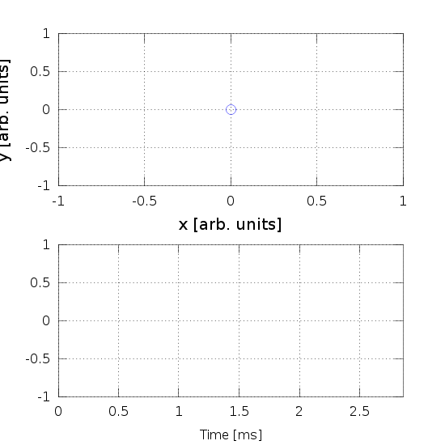
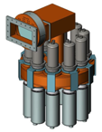
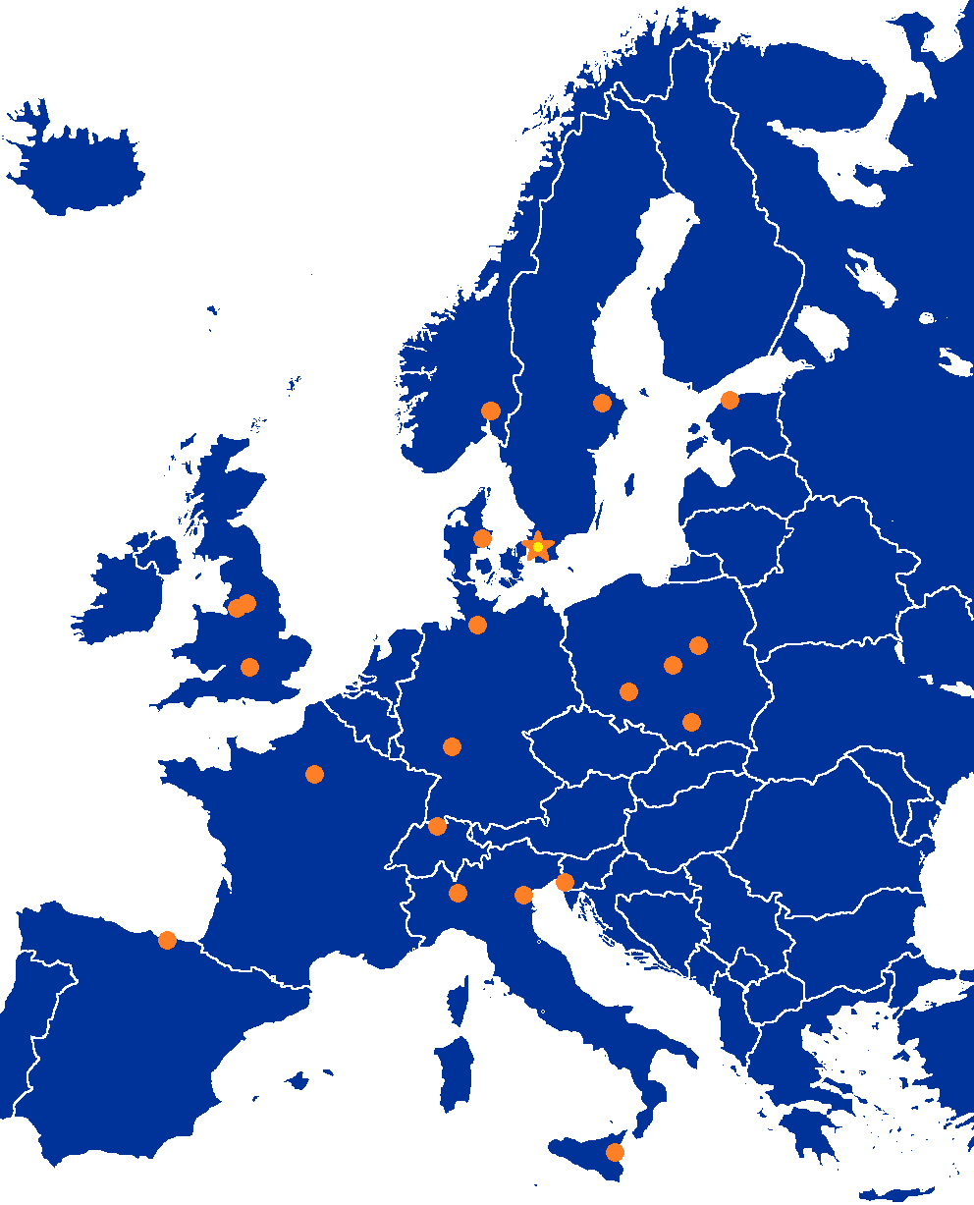
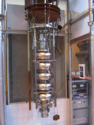
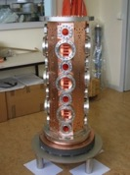

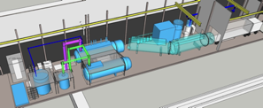

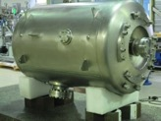
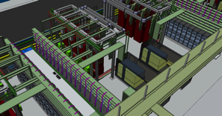
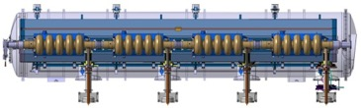
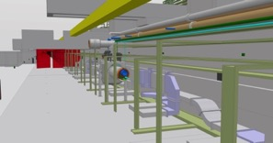


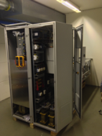
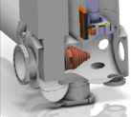


Accelerator Selected technologies
PARTNERS
ESS AD
Notes:
Explain in-kind and bilateral agreements for pre-construction phase which now are being transformed into in-kind contracts for construction

Slide 4


Partner Institutions
In-kind (main contributions)
Univ Agder (Ion source expert)
ATOMKI (RF-LPS)
CEA (RFQ, SRF, Diagn)
CNRS (SRF, Cryo)
Cockcroft Inst (Diagn)
Daresbury Lab (SRF, Vacuum)
Elettra (RF, Magn, PS, Diagn)
ESS-Bilbao (MEBT, RF)
GSI (Diagn, Vacuum, Cryo)
Huddersfield Univ (RF distrib)
IFJ PAN (Installations)
INFN Catania (Source, LEBT)
INFN Legnaro (DTL)
INFN Milan (SRF)
NCBJ (LLRF)
RAL (Diagn)
RHUL (Diagn)
Tallinn UT (RF)
TU Lodz (LLRF)
Univ Oslo (Diagn)
Warsaw UT (LLRF)
Wroclaw UT (Cryo)
Nothing signed
Contract
HoA
IKC
Not IKC, 32%
Planned IKC, 49%
Possible IKC, 16%
Paid contracts
Aarhus Univ (Beam del)
DESY (Diagn)
Lund Univ (LLRF, RF)
PSI (Diagn)
Uppsala Univ (Tests)
SE,DK, 3%

Slide 5
Objectives of re-org
The annual review recommended a re-org to:
Further align line and project
Strengthen the safety organization
Strengthen the role of all WPs in the line organization
Furthermore, I also think it is essential:
To bring together lead engineers, liaison person and deputy WP leaders
Establish clear line authority for the accelerator systems and the Work Packages
Clarity regarding the responsibility for the development of interface requirements

Slide 6
Accelerator Project organization 2015
WP# | WP TITLE | WP LEADER | EXT. WP? | DEPUTY WP LEADERs FOR EXTERNAL WPs
WP01 | MANAGEMENT | J.G. WEISEND II | NO
WP02 | ACCELERATOR PHYSICS | M. ESHRAQI | NO
WP03 | NORMAL CONDUCTING FRONT END | S. GAMMINO | YES | W. WITTMER
WP04 | SPOKE CRYOMODULES | S. BOUSSON | YES | C. DARVE
WP05 | ELLIPTICAL CRYOMODULES | P. BOSLAND | YES | C. DARVE
WP06 | BEAM DELIVERY SYSTEMS | S. MØLLER | YES | I. ALONSO
WP07 | BEAM DIAGNOSTICS | A. JANSSON | NO
WP08 | RF SYSTEMS | A. SUNESSON | MIX | A. SUNESSON
WP99 | ACCEL INFRASTRUCTURE & INSTALLATION | D. MCGINNIS | NO
WP10 | TEST STANDS | W. HEES | MIX | W. HEES
WP11 | CRYOGENICS | P. ARNOLD | NO
WP12 | VACUUM | M. JUNI-FERRERA | NO
WP13 | SAFETY | L. TCHELIDZE | NO
WP14 | ACCELERATOR INTEGRATION | S. MOLLOY | NO
WP15 | ELECTRICAL SUPPORT | F. JENSEN | NO
WP16 | COOLING SUPPORT | A. LUNDMARK | NO
WP17 | POWER CONVERTERS | C. MARTINS | NO
Collaboration Board:
ESS Technical Director
Project leader
Representatives of all contracted institutes (one elected as chair)
Technical Board (quarterly):
Extended ESS project management team
All WP leaders and deputies
Representatives of all contracted institutes if not already a WP leader
Accelerator Project management team (weekly):
Mats Lindroos, Project leader
John Weisend, Deputy project leader and STS
David McGinnis, Senior Accelerator systems expert and engineering resources
Håkan Danared, In-kind manager and LINAC systems
Lali Tchelidze, Safety including radiation safety
Anders Sunesson, RF systems
Luisella Lari, Head planner
Andreas Jansson, Beams and operation
Matthew Conlon, QA/QC
Section leaders are part of the Project management and can be called to participate in the weekly meetings.

Slide 7
New AD – Groups, sections and WP from 2 October 2015
ACCELERATOR DIVISION
WP 1
Mats Lindroos
Beam Physics, Operation & Beam Diagnostics
WP 2,7
Andreas Jansson
Engineering Resources
WP 99
David McGinnis
LINAC
WP 3,4,5,6,14
Håkan Danared
Radio Frequency
WP 8,17
Anders Sunesson
Admin & QA
Safety
WP 13
Lali Tchelidze
Specialized Technical Services
WP 10,11,12,15,16
John Weisend
Beam Physics
WP 2
M. Eshraqi
Beam Diagnostics
WP 7
Vacant
Low Energy L.
WP 3
Vacant
High Energy L.
WP 4,5,6
S. Molloy
Power Converters
WP 17
C. Martins
RF Sources
WP 8
M. Jensen
Cryogenics
WP 11
P. Arnold
Vacuum
WP 12
M. Ferreira
Planning

Slide 8
Control Change Boards (CCB) & control flow for ACCSYS
ESS governance
ESS Council
CCB-A
1-2/year
Collaboration board
CEO / ETB/ ESS CCB
CCB-B
Quarterly
ACCSYS TB
reports
ACCSYS Mngt Team
delegates, approves
CCB-C’
weekly
minutes, actions & ACCSYS Control Log

Slide 9
High Level Master Schedule
There are many “close critical path” in the project, notably RFQ, DTL, Cryomodules and RF systems

Slide 10
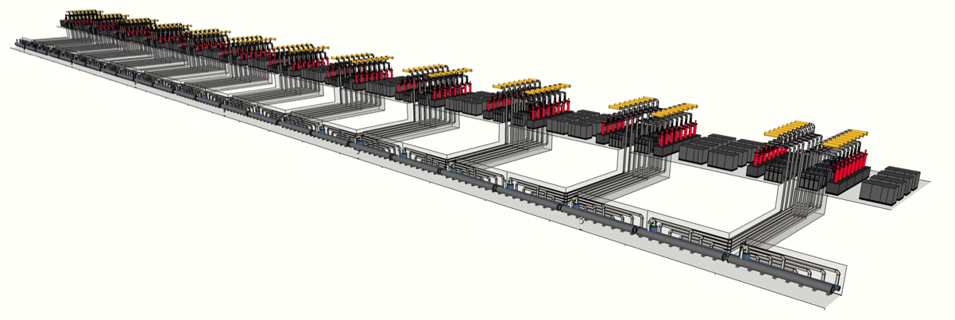
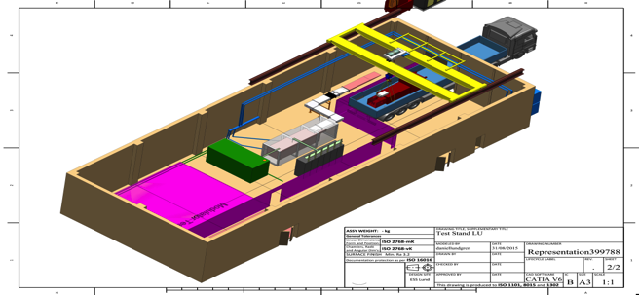
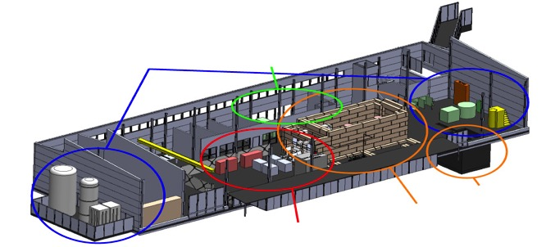
ESS Linac RF System
Integration test at LTH
In-kind RF:
Sweden, Uppsala University (FREIA) and Lund University
Polen, tri-uni
Italy, Elettre
Spain, ESS Bilbao
Hungary, Atomki
Estonia, Tallin U
cryogenics
- liquid helium
- liquid nitrogen
control room
- equipment controls
- data acquisition
FREIA in Uppsala
3 bunkers
with test stands
horizontal cryostat
vertical cryostat
RF power sources

Slide 11
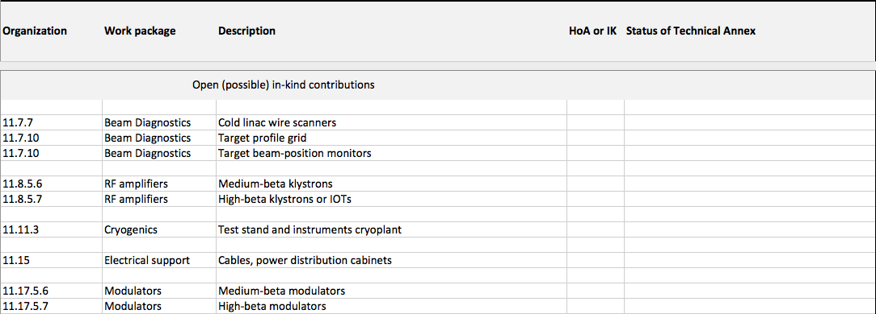
Open (Possible) In-Kind Contributions

Slide 12
WP17 Modulators medium beta
Two strategies
  A: SML – Stacked Multi-Level modulator topology 660 kVA
    This gives scalable, compact, and cost effective solutions
    New development by ESS
    Industrialization (build to print concept) tender for 9 units 2016
  B: Commercial topology 330 kVA
    Two contracts: Ampegon and DTI launched by ESS and CEA
Baseline is strategy A with order of 9 units in fall 2016 – Possible IK

Slide 13
WP 17 Modulator decision chart (to medium β)
Strategy | Ready/Delivery | Validated | Decision point | Outcome
A - SML | Nov 2015 | Dec 2015 | If A: SML fully validated, Q1 2016 If B: Sept 2016 | Strategy A: Launch call for tender for nine 660 kVA units medium beta
B:1- Ampegon | Q2 2016 | Fall 2016
 |  |  |  | Strategy B: Launch call for tender for eighteen 330 kVA units for medium beta
B:2 - DTI | Q1 2016 | Mid 2016

Slide 14
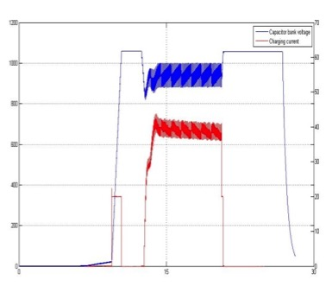
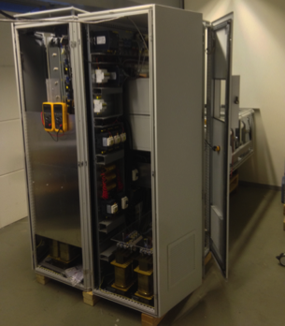
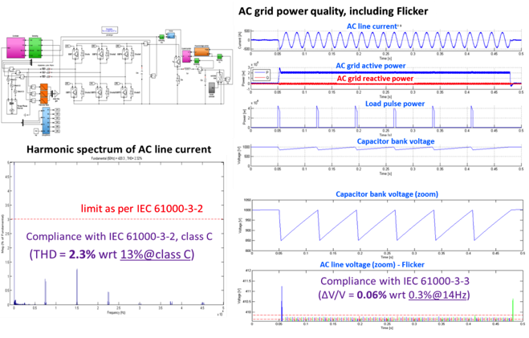
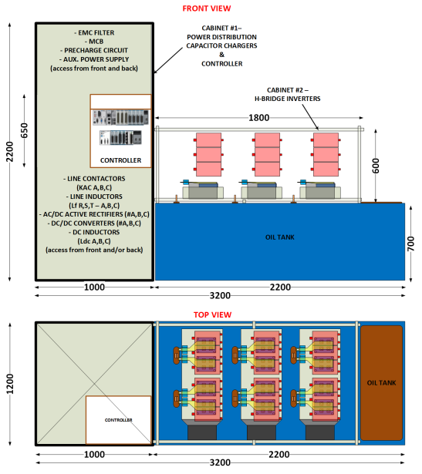
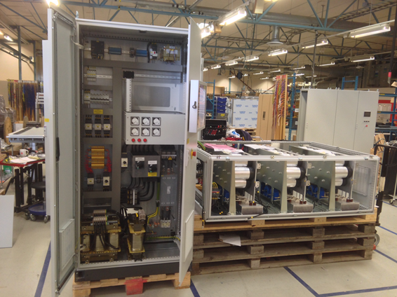
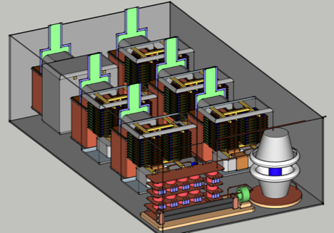
From a conceptual design to reality…
The Stacked Multi-Level (SML) modulator:
– Development roadmap
Construction and testing of High Voltage Oil tank assembly
Feb’15 to Sept’15
Jun ’13
Experimental results, low voltage stage
Sept ’13 – May ’14
Jan ’15
Apr ’14
May ’14
Aug ’14
14

Slide 15
WP 17 Modulators Strategy B
ESS has launched an Invitation To Tender for the design and construction of one 330kVA modulator
  Contract awarded to Ampegon on June 2014
  Technical Design Report reviewed in April 2015
  Delivery foreseen for May 2016
  Soak testing in Uppsala RF test stand, from June to Sept (?) 2016
CEA / Saclay has launched an Invitation To Tender for the design and construction of another 330kVA modulator for their RFQ test stand. It can also serve as a technology demonstrator for ESS
  Contract awarded to DTI on Oct 2014
  Delivery foreseen for Jan 2016
  Soak testing at CEA/Saclay RFQ test stand from January to April(?) 2016

Slide 16
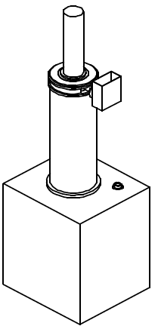
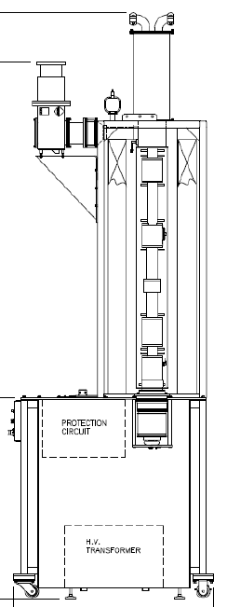
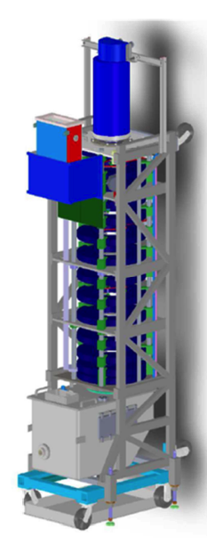
WP 8 Medium beta klystrons
3 prototypes ordered
Delivery Q2-Q3 2016
36 tubes needed for medium beta
Tender in the end of 2016 for 36 tubes - possible In-kind
Toshiba
E37504
CPI
Thales
TH 2180

Slide 17
WP 8 RF components
Hardware such as waveguides, circulators, loads, directional couplers, arc detectors, support stands, etc. for spoke, medium, and high beta linac to be integrated into ESS RF distribution (procurement + IK)
  RF distribution systems for 62 cavities (stage 1) and 84 cavities (stage 2)
Hardware for Low-Level RF electronics for integration into ESS LLRF system (procurement + IK)
Hardware for RF interlock system for integration into ESS interlock system (procurement + IK)

Slide 18
Overview cryogenics
Est. Contract Date | Unit | Description and possible contracts
Dec 2015 | TICP | Lot 1: small cryogenic plant incl. coldbox, compressor system, filling station, 5000 l LHe Dewar
 |  | Lot 2: helium recovery system incl. high pressure compressors, storage, gas bag, valve panel
 |  | Lot 3: stand-alone helium purifier
Q1 2016 | TMCP (Target, WP3) | Large cryoplant incl. coldbox, compression and oil system
Q1 2016 | Piping | Warm interconnecting piping for helium and cooling water between subunits in several buildings, valve panels and installation
Q2 2016 | PHS | Warm pure helium storage tanks
Q3 2016 | LHe tank (ACCP) | 20’000 l liquid helium storage tank, can be ordered as option of the ACCP contract
Q3 2016 | Molecules | Helium and nitrogen supply including rent LN2 tanks – long term supply contract

Slide 19
Status cryogenics
Unit | Current Status | Possible suppliers
TICP | RFQ published in June 2015, tenders due date 2015-09-18, several evaluation meetings planned, contract(s) award expected in CW46, 2015 | Tenders from France, Switzerland, Germany and China for different lots
TMCP (Target, WP3) | RFQ published in September 2015, tenders due date 2015-12-01, contract award expected in January 2016 | Tenders from France and Switzerland Planned in-kind supply from FZJ, Germany
Piping | Technical specification in early draft state, RFQ to be published till end of 2015, goal for contract award till March 2016 | Unknown, budgetary proposal from Sweden
PHS | Technical specification in almost final state, RFQ to be published early 2016, goal for contract award till April 2016 | Unknown, budgetary proposals from Turkey, Germany and China
LHe tank (ACCP) | Part of ACCP (Option 2), can be ordered directly or new RFQ | Switzerland with sub-supplier from UK or directly UK for new RFQ (higher risk for ESS)
Molecules | Very early stage, contact with suppliers established, ESS needs specified | Swedish branches of big gas companies from France, Germany, USA

Slide 20

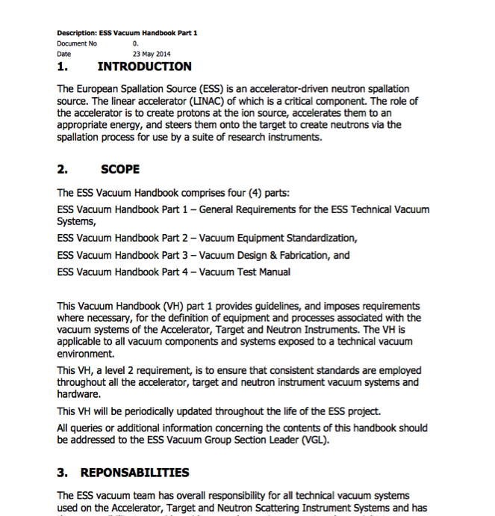
Vacuum Standardization, an Integrated Approach
Working closely with our partners across the project one of our primary goals was to promote the use of common vacuum equipment and standards. As a result a Vacuum Standardization meeting was held in February 2014 where equipment suitable for Standardization was agreed and reflected in the ESS Vacuum Handbook.
An important element of this Standardization is the Procurement Policy applied for the procurement of all “major” vacuum equipment. The primary objective of the program is to develop a list of standard vacuum equipment for use project wide to minimize project costs, reduce spares holdings, training and achieve other benefits of standardization.
http://europeanspallationsource.se/accelerator-documents

Slide 21
List of components and Quantities 2015/2016 schedule
Equipment | Source+LEBT | RFQ
Gauges Controller
 | 2 | 2
 | 1
Turbo pump Controller
 | 4 | 12
Gass Mass Flow Controller
 | 4
Residual Gas Analyzer
 | 2 | 1
Gauges
 | 6 | 4
 | 2 | 4
 | 1
Turbo pumps
 | 4 | 12
Primary pumps
 | 2 | 3
Valves
 | 2 | 1
 | 6 | 16
 | 1 | 1
 | 3 | 2
 | 2 | 1
Total numbers | 42 | 58
2015/216
Some major specifications and correspondent frame work agreement with the in-kind are “ on going” process:
Vacuum gauges,
Turbo pumps and backing pumps,
Mass flow meters,
Residual Gas Analyzers,
Valves.
Aprox. 100 units

Slide 22
Accelerator Summary
The accelerator is built by a collaboration and the management model must reflect that
  CB and TB important tools
  IK contributions already represents 50% of the project volume
The accelerator project is in a phase of intense prototyping and reviewing and will soon see most major systems in construction
  Large part of prototyping and design done by in-kind partners
  Essential to get in-kind contracts agreed and signed in 2015 to permit construction of all systems to start in earnest
  Work on (parts of the) RF design, modulators, beam instrumentation and cryogenic design done in Lund
Coordination, integration and verification represent a major part of the work done today by the accelerator division at ESS in Lund
  A large number of Accelerator items will be installed in a very short time much faster than other similar projects – the integration test is very important to prepare for this
The goal is to build and train the accelerator division so that it can assume full responsibility for operation and maintenance of the accelerator systems in 2019
  The work at the Integration test in the M-building at LTH is an essential part of achieving this and was recommended by Annual Review

Slide 23
Extra slides

Slide 24
WP 17 Modulators Strategy A
ESS internal development of a new topology (SML – Stacked Multi-Level)
Construction and validation of a Reduced Scale prototype rated for 120 kVA (115kV / 20A, 3.5ms / 14Hz) in collaboration with Lund University (LTH). Can power one 704MHz 1.2MWpk klystron
Project has started in June 2013. Completion and demonstration of technology are foreseen for end 2015
Upgrade to the full scale system 660kVA (115kV / 100A, 3.5ms / 14Hz) is a matter of thermal re-design and selection of higher current components. The full scale modulator is able to power 4x 704MHz 1.2MWpk klystrons in parallel. Straightforward approach with low risks

Slide 25
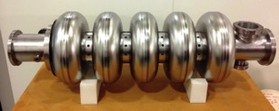
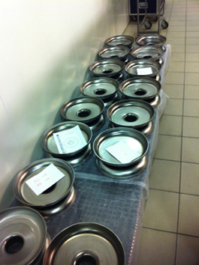
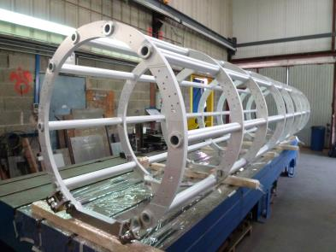
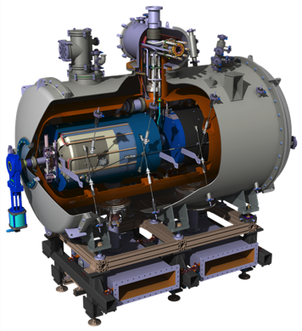
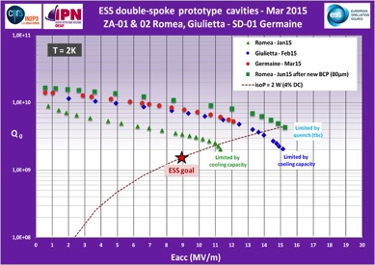
SRF developments
France, IRFU-CEA: 6 medium beta prototype cavities under fabrication at Zanon
  All 30 dumbbells have been e beam welded
  First complete bare cavity to CEA in October
France, IPN-CNRS: Experimental results obtained so far on the 3 prototype spoke cavities.
  Notice the recovery and even the gain on the performance of Romea after additional chemistry to recover from the “bad baking”.

Slide 26
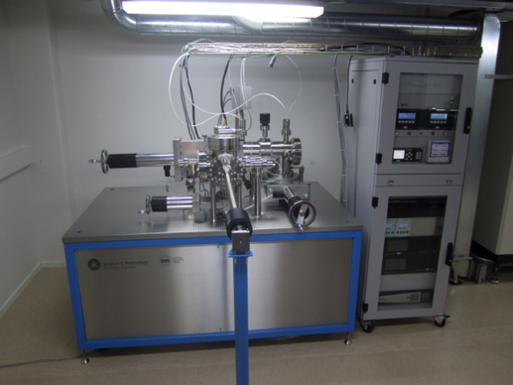
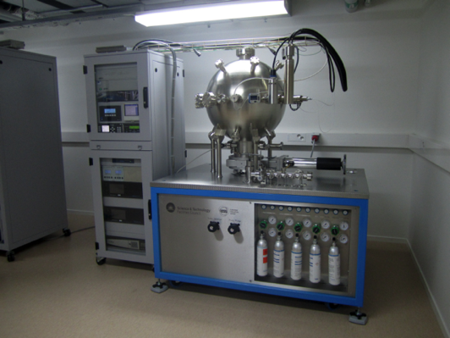
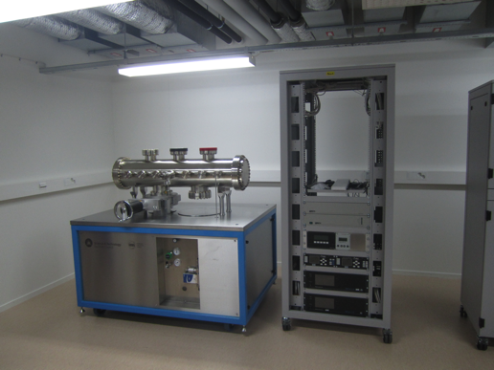
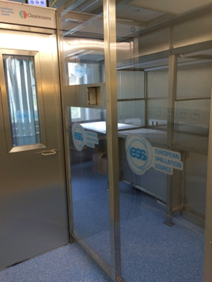
Vacuum lab at ESS, IK from UK-STFC-Daresbury
Material test facility
Calibration facility
Integration test facility
Clean room

Slide 27
From a conceptual design to reality…
The Stacked Multi-Level (SML) modulator:
– Development roadmap
Construction and testing of High Voltage Oil tank assembly
Feb’15 to Sept’15
Jun ’13
Experimental results, low voltage stage
Sept ’13 – May ’14
Jan ’15
Apr ’14
May ’14
Aug ’14
27

