Slide 1
Project Planning Update
14th Technical Board Meeting
Luisella Lari
Head planner for Accelerator & Senior Scientist
www.europeanspallationsource.se
September 23rd, 2015

Slide 2
Outline
Budget per WPs + escalation budget.
Annual review top ten actions
  → An update for ACCSYS planning.
P6 WP standardization for procurement.
Next steps/Conclusions.

Slide 3
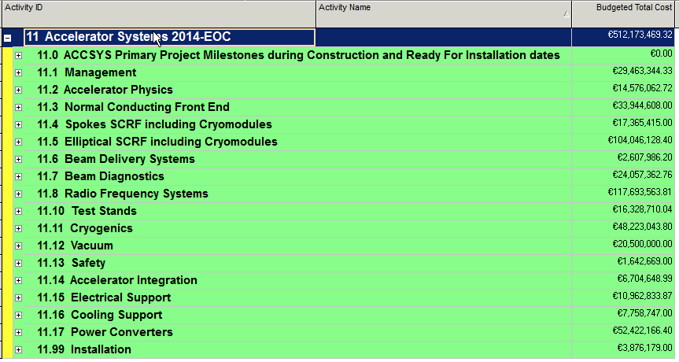
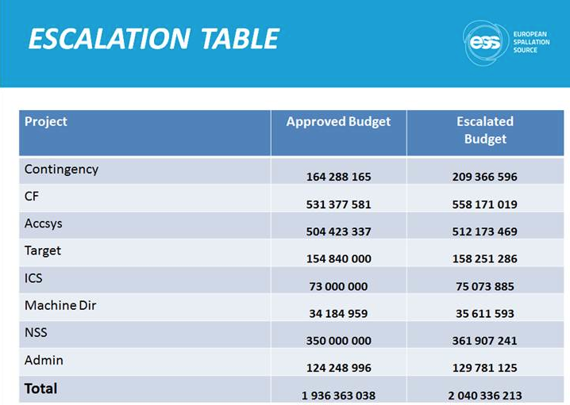
Budget per WP (1/4)
….Presented by M. Jakobsson/J. Brisfors

Slide 4
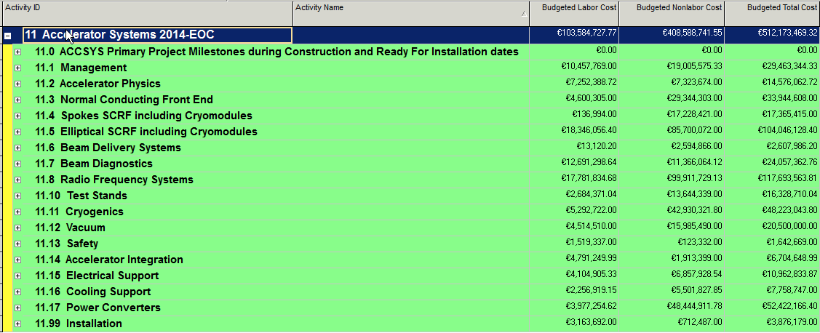
Budget per WP (2/4)
~20%
~80%

Slide 5
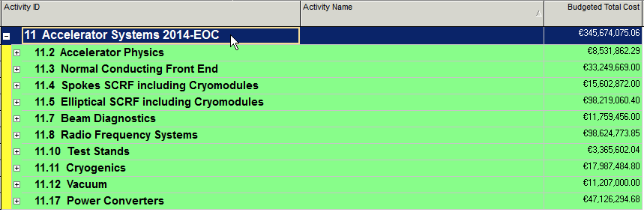
Budget per WP (3/4)
Planned + Possible IKC ~68%

Slide 6
Budget per WP (4/4)
Saved cost from AcCp
Wrong actual tag for IK
Budget escalation
Change of scope
Installation moved in WPs
Cables/Racks
/cable
trays

Slide 7
Annual Review 2015 (1/6)
1st of Top Ten actions:
Schedule: identify milestones with better visibility: i.e. Module-0, Production Readiness Review, anchor them clearer to the Installation….

Slide 8
Annual Review 2015 (2/6)
identify MS with better visibility
Added RFI for GSA and A2T
LEVEL 1B
PDR/CDR/TRR LEVEL 3
….Presented at the TB in May

Slide 9
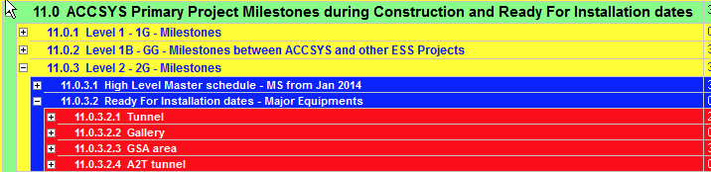
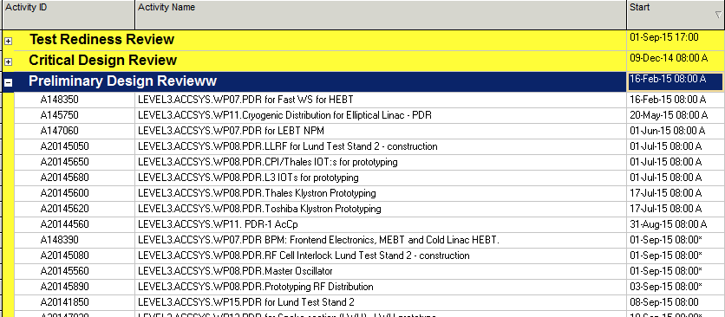
Annual Review 2015 (3/6)
identify MS with better visibility & Reviews

Slide 10
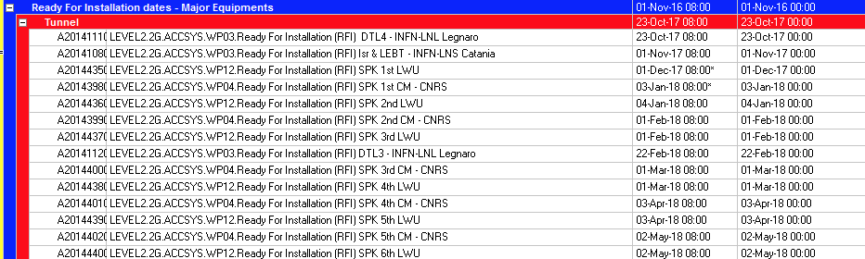
Annual Review 2015 (4/6)
identify MS with better visibility & monitoring
RFI Committed/Reference dates
RFI Resulting from planning
Reporting on LEVEL 2 MS floating
Reference dates monitored for LEVEL 3 MS (i.e. Review dates)

Slide 11
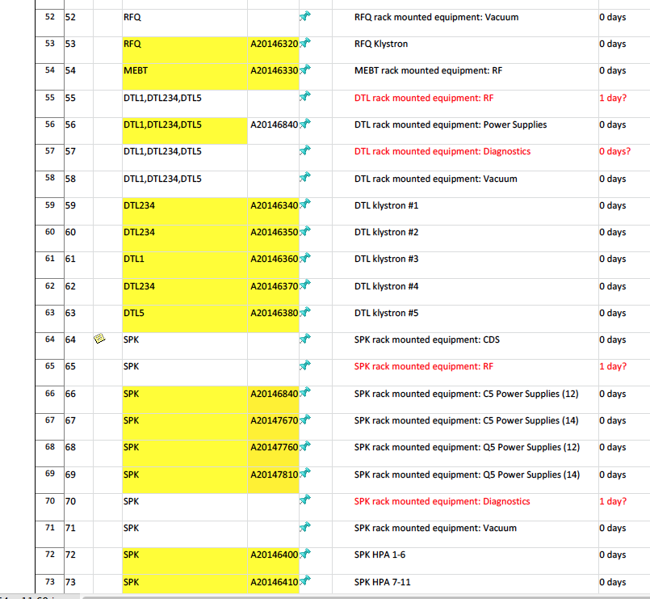
Annual Review 2015 (5/6)
identify MS with better visibility & anchor them to installation
RFI MS is growing up from Annual Review 2015
→ the goal is to have as resulting of planning all the RFI used by Eugene as input for the installation sequence.
Today 70 % of RFI are in P6 with respect to Eugene list, excluding the BI
Courtesy of Eugene

Slide 12
Annual Review 2015 (6/6)
identify MS with better visibility & anchor them to installation
Steps to go trough in order to have
a mature installation plan
(working in close collaboration
with the Integration Team):
Match all the RFI used in Eugene installation sequence, as resulting of planning.
Move to the Project 11I in P6 to allocated resources.

Slide 13
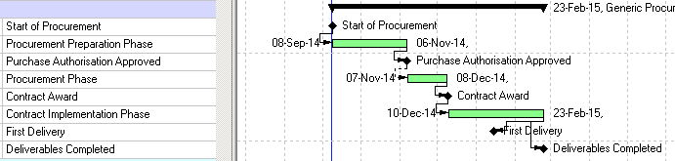

P6 WP standardization for procurement
ID for Procurement missing
Procurement support phase
Scope: fine-tuning of technical specifications, preparation and finalization of tender documents,
publication, evaluation, award decision, contract signature
Duration: <50K EUR = 4 weeks (min)
50K > 207K EUR = 8 weeks (min)
> 207K EUR = 20 weeks (min)
Done for WP16, work in progress for WP08, WP10, WP15

Slide 14

Budget for 2016
First draft end of June/last version October the 4^{th.}
Working in progress to review the TBC amount for procurement (in particular WP16 (fixed), WP07, WP12 and WP15 in progress).
2016 Budget for cash flow is saved

Slide 15

Next steps/Conclusions
Moving into to a stable baseline resource loaded schedule for Accelerator (but still to be aligned to the new organization).
Moving into a more formal change control for AD (CHESS doc available in few days).
Moving into the first draft resource loaded installation schedule.

Slide 16
Thanks for your attention!
In particular I would like to thank L. Gunnarson

Slide 17
In-kind in P6

