Slide 1
ESS-0012700 ACCSYS Project CCB Change Log
Changes to ESS Project Plan
(change control) Classes D and above originating in ACCSYS project
Change Log, Sheet 1: Change Requests (CR) PMO (Primavera P6)– activities, time schedule, costs
Log nr | CR-ID | Class - Approver/Reviewer | WBS | Summary of Change Request (proposed change)
024 | 11.00024.1 | A - ESS AB Board | 11.2. 11.3, 11.7, 11.8, 11.17, 11.99 | RFQ testing
025 | 11.00025.1 | C - Project Ldr /Project CCB | 11,8 | Change of procurement strategy for Klystron prototype.
026 | 11.00026.1 | B - CEO/ESS CCB | 11,11 | Accelerator Cryoplant cost savings
027 | 11.00027.1 | C - Project Ldr /Project CCB | 11,17 | Replanning of Elettra In-Kind distribution and revision of delivery dates.
028 | TBA | C - Project Ldr /Project CCB | 11 | Accelerator Installation Plan
ATB 14_150922_CCB page 1(4)

Slide 2
Project-Level CCB: Decisions for ATB 14
23 September 2015
Changes to Project Plan (P6):
024: For info only: changes re. RFQ Testing. ESS Council decision.
025: For decision: to agree a changed procurement strategy for Klystrons
026: For info only: cost savings for Accelerator Cryo-Cooling Plant
027: For decision: to agree re-planning for IKC – partner Ellettra
028: For decision: to confirm Baseline Installation Schedule, that is, to agree with or to modify or to reject the installation sequence as presented today by E. Tanke, and as documented in ESS-0032966. If approved, this shall be used as a guiding sequence for the activities and milestones in a resource-loaded P6 plan for installation and commissioning.
ATB 14_150922_CCB page 2(4)

Slide 3
ESS-0012700 ACCSYS Project CCB Change Log
Changes to Scope/Configuration for Technical Systems
(change control) Classes C and above originating in ACCSYS project
Change Log, Sheet 2: Change Requests (CR) for Technical scope, PBS, design engineering configuration
Log nr | CR-ID | Class - Approver/Reviewer | WBS | Summary of Change Request (proposed change)
T-007 | N/A | C-Project CCB | 11 | new PBS L2 Requirements - Fiducials
T-008 | N/A | C-Project CCB | 11 | Baseline lattice update
T-007:
For decision: To agree, modify or reject four (4) new L2 requirement on alignment as outlined in (DOORs or CHESS reference) and operationally accepted at the ACCSYS Management Team Meeting on Sept 7, 2015. See next slide.
T-008:
For decision: to confirm the Baseline lattice update. That is to agree with or to modify or to reject the lattice design as presented today by M. Eshraqi, and to be documented in design report ESS-0039518. If approved, this updated lattice design shall be:
used to confirm or change the location and configuration data for linac systems in Linac Lego
propagated as new or changed requirements in DOORS and for IKC agreements and procurement contracts
propagated as changes to Master 3D model for Accelerator
ATB 14_150922_CCB page 3(4)

Slide 4
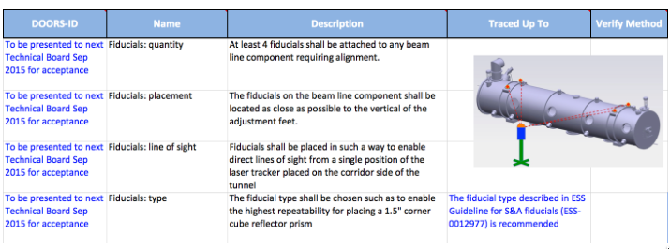
Change Log T-007:
4 x L2 Requirements - Fiducials
ATB 14_150922_CCB page 4(4)

